Slide 1

教会有什么好看的？
课程介绍
Dr. Rick Griffith •新加坡神学院 • BibleStudyDownloads.org

Slide 2

自我介绍!
名称
国家
家庭背景
教会
事奉目标
Name
Country
Programme
Family
Church
Ministry Goal
$20 each for Notes

Slide 3

我们的3个儿子

Slide 4
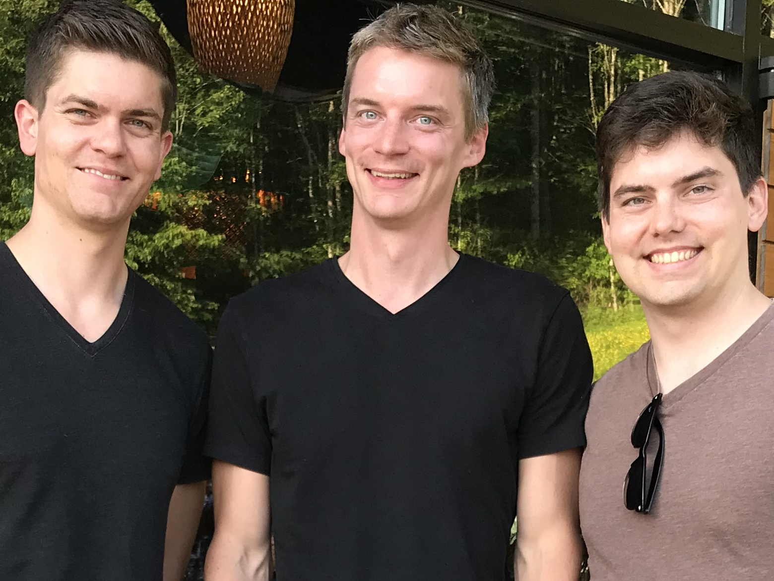
我们的3个儿子

Slide 5

The Griffiths
31 May 2019
2019
力克和苏珊
约翰
(26)
克尔和 卡拉
(31)
史帝文
和卡蒂 杰西(29)

Slide 6
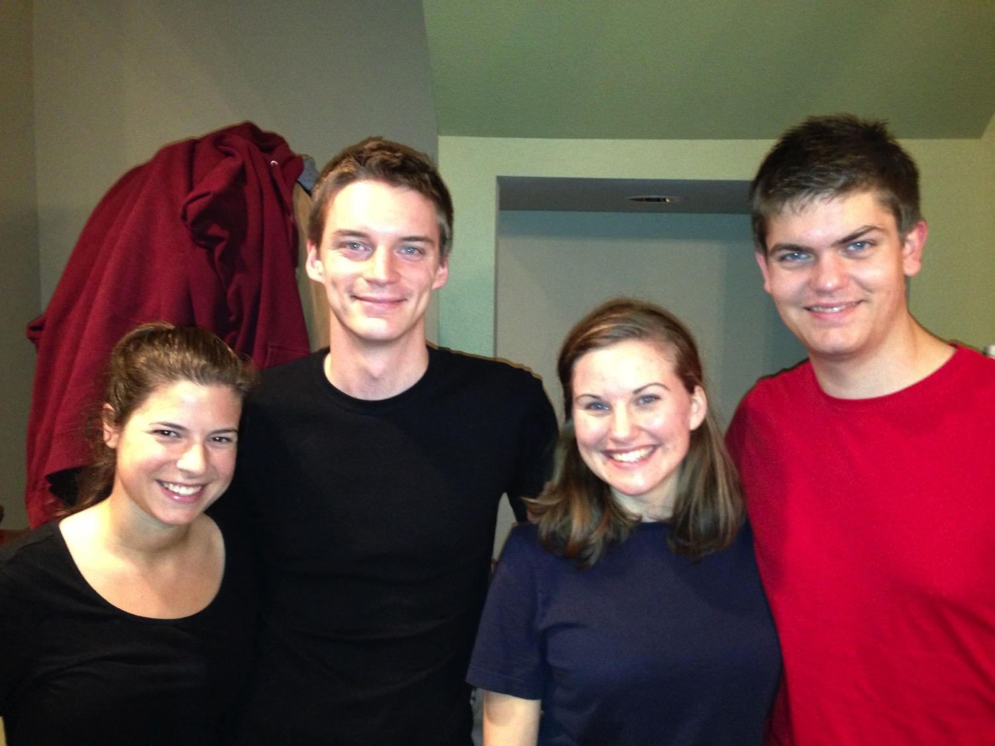
克尔和卡拉 史帝文和卡蒂
8

Slide 7
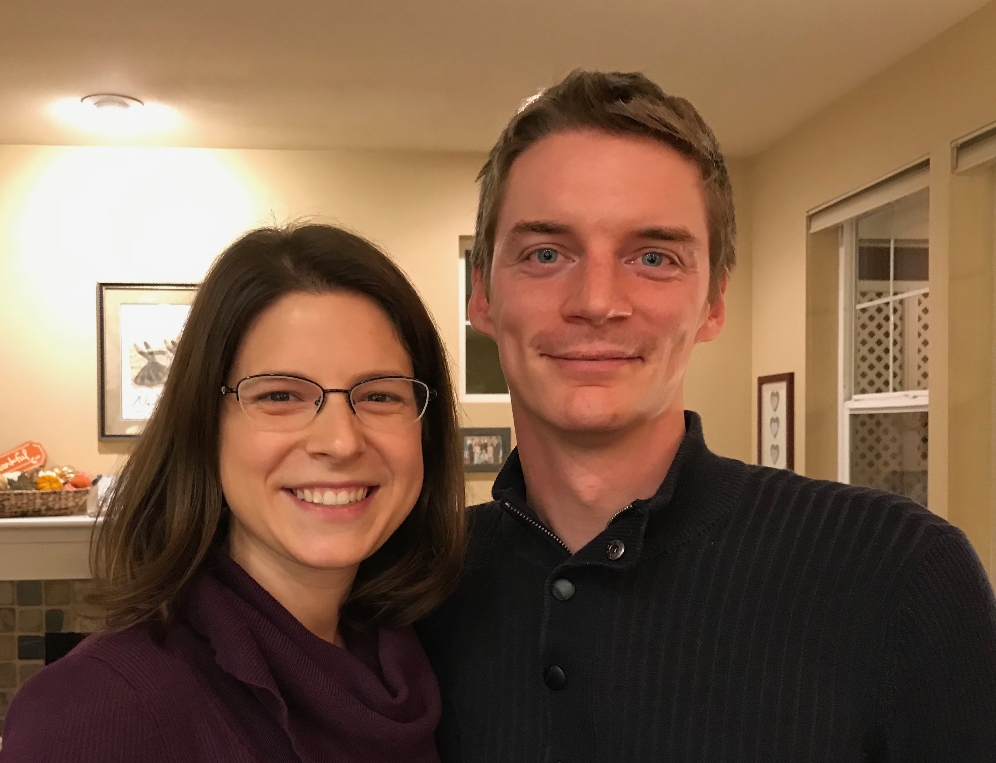
克尔是一位 信息技术人员
Notes:
Kurt and his wife Cara are in Seattle

Slide 8
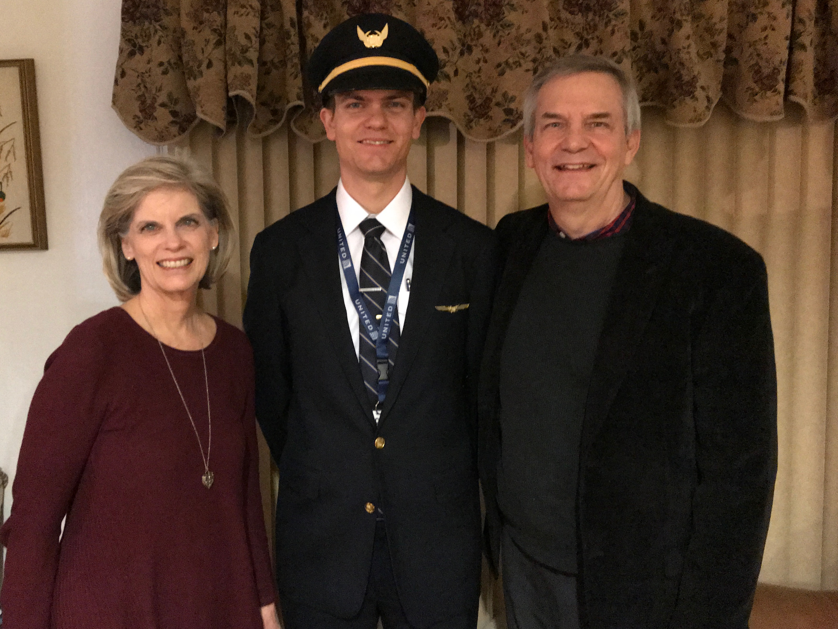
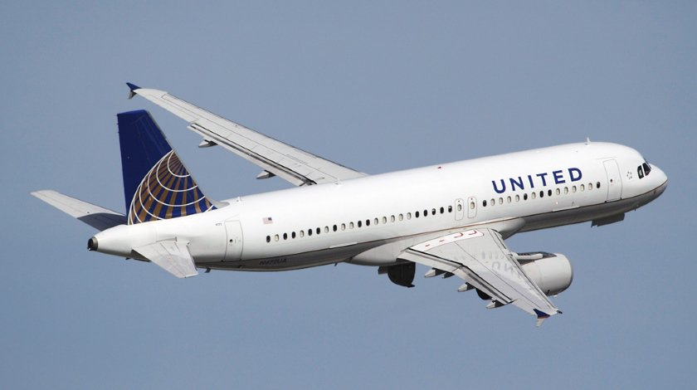
史帝文是一位
United航空公司
机师
6
Notes:
Stephen and his wife Katie in Boise

Slide 9
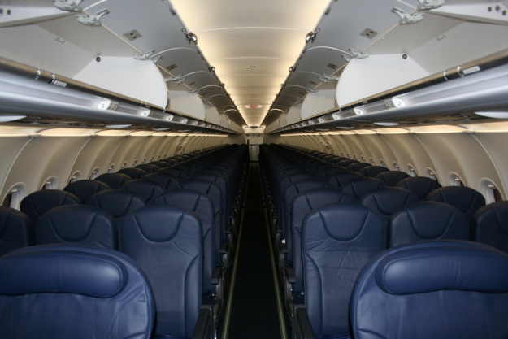
史帝文驾机搭载 170+ 旅客
8

Slide 10
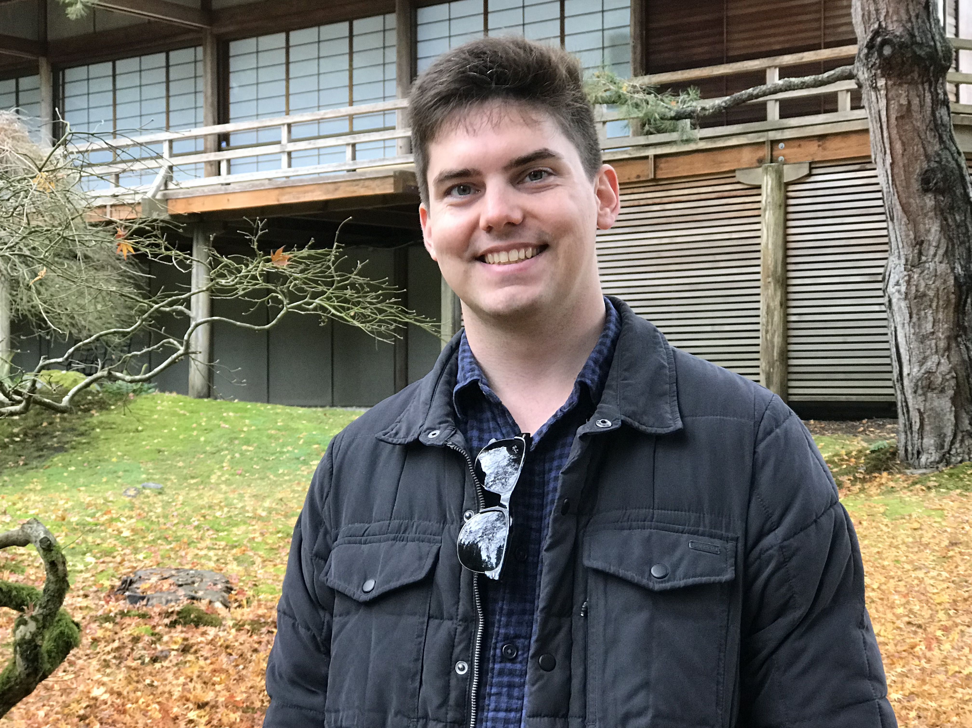

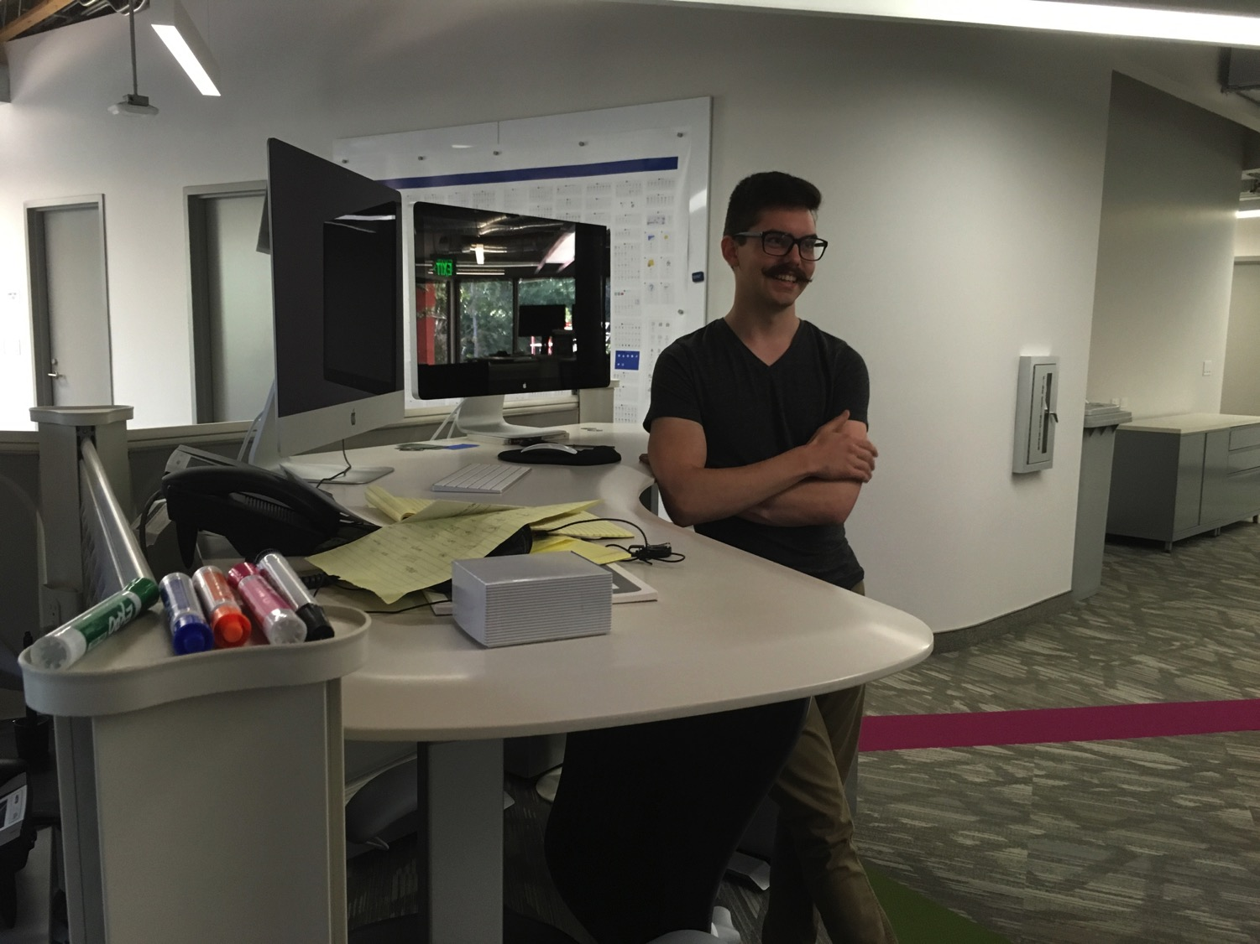
我们的小儿子，约翰(23)是 加利福尼亚的一个图形艺术家
8
Notes:
John just graduated from Biola and works for ESRI

Slide 11


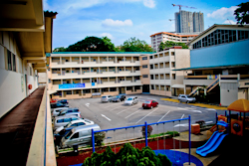


ICS 现在有480个学生!
瑞典
英国
韩国
瑞士
日本
意大利
美国
泰国
印度
墨西哥
ICS
委内瑞拉
印尼
巴西
南非
澳大利亚
Notes:
With nearly 500 students

Slide 12


宣教机构…

Slide 13

我们的愿景
爱列国
爱教会
爱神
Notes:
Repentance will bring restoration in a church: God wants our church to really trust him.
We still don’t see our need for him as we don’t see our need to pray.
We also need to be involved in his work: missions, teaching, accountability groups, finances, etc.
_______________
OS-29-Joel-128
NS-13-1 Thess-111

Slide 14


Crossroads教会会友2015年7月
意大利
法国
日本
荷兰
香港
韩国
黎巴嫩
台湾
中国
缅甸
印度
美国
菲律宾
津巴布韦
马来西亚
新加坡
CIC
新西兰
印尼
Notes:
我们2015年3月的源自世界上12个不同的国家。

Slide 15

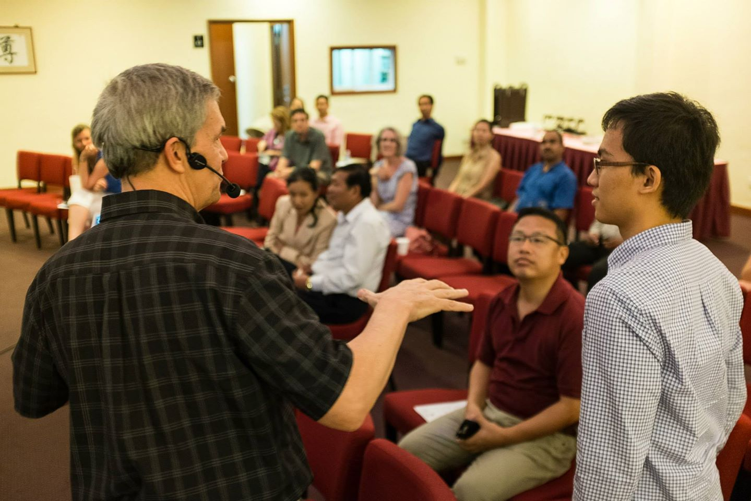
Our People
2015:来自13个国家的50名会友
Notes:
We also helped start Crossroads International Church in 2006 where I serve as the pastor-teacher.

Slide 16

Our People
用经文讲道
Notes:
RICK: Yes, we helped start Crossroads International Church in 2006 and I serve as the pastor-teacher.

Slide 17

Our People
新加坡神学院学生在教会事奉
Notes:
One special joy is mentoring my students who serve with us at church and led ministries to youth, children, home groups, and the worship team.

Slide 18

Our People
苏珊教导教会的妇女
Notes:
I also lead the woman's Precept Bible study at our church

Slide 19

妇女查经班在研读列王记上下
美国•印度•新加坡•新西兰•津巴布韦•荷兰

Slide 20

泰国•蒙古•缅甸•印度尼西亚
Notes:
INTERVIEWER: And Susan, what ministries has the Lord granted you?
SUSAN: I have been teaching the wives of leaders at SBC. These 5 women come from 5 different nations!
SUSAN: I also lead the woman's Bible study at our church

Slide 21
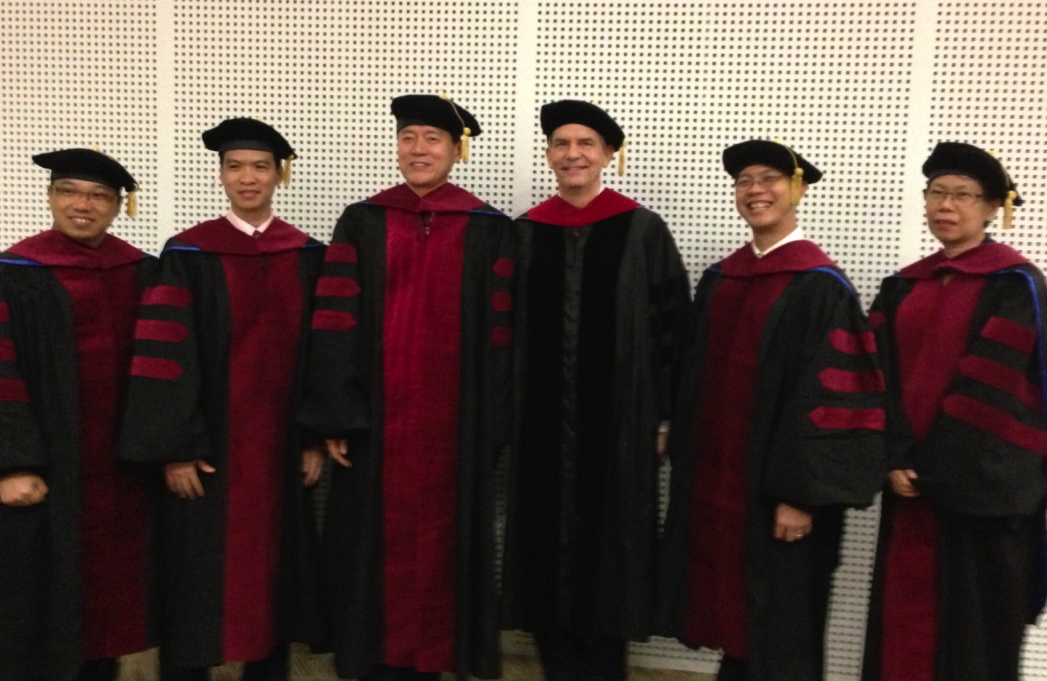
我负责指导新神博士研究生（DMin）
Notes:
I'm also the director of the doctoral program at SBC that trains about 80 seminary professors and pastors throughout Asia in English and Chinese. Generallly each year about 5 of them received their Doctor of Ministry degree.

Slide 22

Two Saturdays, 24 & 31 August
9 am-1 pm at SBC

Slide 23

新加坡神学院
Notes:
I've served as a seminary professor with 30 other faculty at Singapore's largest training school: Singapore Bible College

Slide 24

新神 课程 网上教学
(英文 • 印尼文 • 中文)
基础 旧约 新约
背景 旧约的世界 新约的世界
神学 教会 灵命 未来
讲道 讲道研习（上） 讲道研习(下）
Notes:
I get to teach these leaders every book of the Bible in survey courses, plus backgrounds to both the OT and NT, three areas of theology, and how to preach.

Slide 25



让我们也来教导其他人如何讲道!
门徒训练
"又应当把你在许多见证人面前从我这里听见的，交托给那些又忠心又能够教导别人的人。"
(提后 2:2 新译本).
忠心可靠的人
保罗
提摩太
其它人

Slide 26
教导事工 1997-2018
红色 = 我曾经在这些国家教授过这课程
蒙古
约旦
韩国
中国
尼泊尔
缅甸
印度
泰国
越南
马来西亚
斯里兰卡
新加坡
印度尼西亚
26
Notes:
From 1997-2018 God has seen fit to grant me the privilege to train pastors in 12 other countries on 65 trips. I have taught Homiletics in 8 of these countries.

Slide 27

分配文件系统

Slide 28

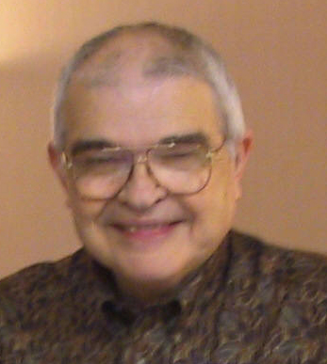
Dr John Fryman
约翰·弗莱曼博士
得克萨斯州沃思堡, 基督教国际公司呈献
www.biblebasically.com
©2004 TBBMI
8.0.01.
04

Slide 29

英语

Slide 30

Burmese
缅甸文
Lai S
iangtho…Abulpi
A Presentation of The Bible…Basically Ministries International Inc. Fort Worth, Texas
www.biblebasically.com
©2004 TBBMI
8.0.01.
04

Slide 31


French
法文
LA BIBLE…
EN BASE
Une Présentation du Ministère Internationale de La Bible… En Base Inc. Fort Worth, Texas
www.biblebasically.com
©2006 TBBMI
8.0.01.
04
©2004 TBBMI
9.6.01.

Slide 32

Japanese
日文
バイブル ベイシックミニストリーズ
インスティチュート
A Presentation of The Bible…Basically Ministries International Inc. Fort Worth, Texas
www.biblebasically.com
©2004 TBBMI
8.0.01.
04
Notes:
Japanese title slide

Slide 33

Khmer (Cambodian)
柬埔寨文
mUldæanRKwH>>>
énRBHKm<IIr
karbgðaj[sÁal;nUvRBHKm<Ir>>> EdlCamUldæanRKw³ kñúg B½n§kic©shKmnGnþrCati GayGinsIu.
Fort Worth, Texas
www.biblebasically.com
©2004 TBBMI
8.0.01.
04

Slide 34

Korean
朝鲜文
성경은 …
기본적으로
A Presentation of The Bible…Basically Ministries International Inc. Fort Worth, Texas
www.biblebasically.com
7.5.01.
©2003 TBBMI
04

Slide 35

Malay
马来文
Alkitab…
Dasar
Presentasi dari The Bible…Basically Ministries International Inc. Fort Worth, Texas
www.biblebasically.com
©2004 TBBMI
8.0.01.
04

Slide 36

Mao (India)
Bible…
Amolo Leino
印度文
Bible…Ngashankakhuina Ministries International Inc. pashina semkashok Fort Worth, Texas
www.biblebasically.com
©2004 TBBMI
8.0.01.
04

Slide 37

Malayalam (India)
Æß èÌÌßZ
çÌØßAÜß
马拉雅拉姆文
¥ÕÄøßMßAáKÄí Æß èÌÌßZ çÌØßAÜß… ÎßÈßØíd¿àØí §aVÈÞ×ÃW çËÞVGíÕVJí, æ¿µíØÞØí
©2004 TBBMI
8.0.01.
04

Slide 38

Mongolian
蒙古文
Библи…
Үндсэндээ
A Presentation of The Bible…Basically Ministries International Inc. Fort Worth, Texas
www.biblebasically.com
©2004 TBBMI
8.0.01.
04

Slide 39

Nepali
尼泊尔文
afOan======
cfwf/e[\t
A Presentation of The Bible…Basically Ministries International Inc. Fort Worth, Texas
www.biblebasically.com
8.0.01.
©2004 TBBMI
04

Slide 40

Swahili (Kenya)
斯瓦希里文(肯尼亚)
biblia kwa ujumla
A Presentation of The Bible…Basically Ministries International Inc. Fort Worth, Texas
www.biblebasically.com
8.0.01.
©2003 TBBMI
04

Slide 41

Tagalog (Philippines)
塔加路族文(菲律宾）
Ang Biblia . . . Pinasimple
A Presentation of The Bible…Basically Ministries International Inc. Fort Worth, Texas
www.biblebasically.com
©2004 TBBMI
8.0.01.
04
Notes:
PLEASE PUT THE TITLE AND SUBTITLES INTO YOUR NATIONAL LANGUAGE AND LEAVE THE WEBSITE UNCHANGED

Slide 42

Tangkhul (India)
Bible…
Ngashankakhui
唐胡尔文(印度)
Bible…Ngashankakhuina Ministries International Inc. pashina semkashok Fort Worth, Texas
www.biblebasically.com
©2004 TBBMI
8.0.01.
04

Slide 43

Tamil (Sri Lanka/India)
泰米尔文(斯里兰卡/印度）
jpUkiwapd;…
mbg;gil
泰米尔语（斯里兰卡/印度）
A Presentation of The Bible…Basically Ministries International Inc. Fort Worth, Texas
www.biblebasically.com
©2004 TBBMI
8.0.01.
04

Slide 44

Vietnamese
越南文
Kinh thánh…
Cơ bản là
A Presentation of The Bible…Basically Ministries International Inc. Fort Worth, Texas
www.biblebasically.com
©2004 TBBMI
8.0.01.
04

Slide 45


Bahasa Indonesia
印尼文
Presentasi dari The Bible…Basically Ministries International Inc. Fort Worth, Texas
www.biblebasically.com
7.5.01.
©2003 TBBMI
04

Slide 46
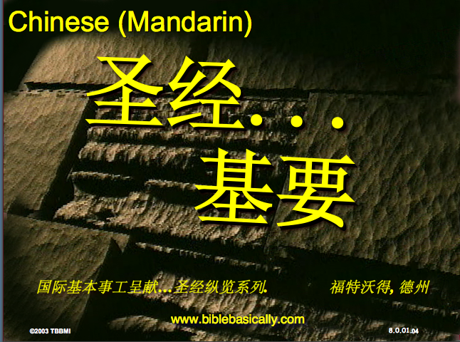
Chinese (Mandarin)
中文
圣经...
基要
国际基本事工呈献…圣经纵览系列. 福特沃得, 德州
www.biblebasically.com
8.0.01.
©2003 TBBMI
04

Slide 47
PowerPoint (945幻灯片)
学生作业簿（100页)
教师课文（400页）
TBB 教材
已被翻译成
英文•中文•印地文•印度尼西亚文•韩文•马来文•蒙古文•俄文•西班牙文
A Presentation of The Bible…Basically Ministries International Inc. Fort Worth, Texas
www.biblebasically.com
©2004 TBBMI
8.0.01.
04

Slide 48

7
造
您的圣经
档案
默
主
学生手册第8-14页
37

Slide 49
7
1
2
3
造
4
5
6
7
8
默
9
10
主
学生手册第8-14页
39

Slide 50
打开
“您的圣经档案”
7
造 默主
造 默主
造 默主
造 默主
7
7
学生手册第8-14页
4
40

Slide 51
打开
“您的圣经档案”
7
7
= 4+3
学生手册第8-14页
2
41

Slide 52
7
打开
“您的圣经档案”
造 4 3 默 主
造 4 3 默 主
学生手册第8-14页
1
42

Slide 53
五个关键字和词组:
7
造 = 创造
4 = 人物
3
= 时期
默 = 静默
主
= 主耶稣
学生手册第8-14页
5
43

Slide 54
五个关键字和词组:
7
造 = 创造
4 = 人物
3
= 时期
默 = 静默
主
= 主耶稣
学生手册第8-14页
6
44

Slide 55
五个关键字和词组:
7
造 = 创造
4 = 人物
3
= 时期
默 = 静默
主
= 主耶稣
学生手册第8-14页
45

Slide 56
4 个人 物 就 是:
7
亚伯拉罕
约瑟
摩西
约书亚
学生手册第8-14页
5
46

Slide 57
7
亚 伯拉罕
的约
摩 西
的 书 !
学生手册第8-14页
47

Slide 58
4 个人 物 就 是:
7
约瑟
亚伯拉罕
亚伯拉罕
摩西
的约
约书亚
摩西
的书
学生手册第8-14页
8
48

Slide 59
7
创造
亚伯拉罕
约瑟
摩西
约书亚
学生手册第8-14页
5
49

Slide 60
五个关键字和词组:
7
造 = 创造
4 = 人物
3
= 时期
默 = 静默
主
= 主耶稣
学生手册第8-14页
50

Slide 61
7
无 王 掳
学生手册第8-14页
2
51

Slide 62
3 个时期就是:
7
无 王
王 朝
被 掳
学生手册第8-14页
6
52

Slide 63
OT Review
7
天地被创造
亚伯拉罕
约瑟夫
摩西
约书亚
无政府状态的国民
被君王统治的国民
被俘虏的国民
Handbook pg. 8-14
55
Notes:
Now we add the 3 SOCIETIES group to the others, and we have:
CREATION
ABRAHAM
JOSEPH
MOSES
JOSHUA
ANARCHY
ROYALTY
CAPTIVITY

Slide 64
To Review…
7
让我们来重复..
C 7 S J
C 4 3 S J
Handbook pg. 8-14
3
56
Notes:
To review the entire sequence so far…
Beginning with the single number
//// 7....
leading to…
//// C 7 S J...
which becomes...
//// C 4 3 S J.
These numbers and letters are then used to develop a mental list of TEN WORDS that will form a dependable mental outline of the entirety of Scripture.

Slide 65
5关键词或短语：
7
C=天地被创造
4 = 人物
3 = 群体
S = 沉默
J = 耶稣
Handbook pg. 8-14
5
45
Notes:
Now, based on C 4 3 S J, we enlarge that idea into five key words or phrases. They will become the foundation of your mental Bible File. Here they are…say them aloud…
//// C = CREATION
//// 4 = 4 PEOPLE
//// 3 = 3 SOCIETIES
//// S = SILENCE
//// J = JESUS.
And that's an organizational plan for the entire Bible! Those five words and phrases create an abbreviated outline map of the entire Bible's basic design.

Slide 66
OT Review
天地被创造
亚伯拉罕
约瑟夫
摩西
约书亚
无政府状态的国民
被君王统治的国民
被俘虏的国民
沉默
耶稣
7
Handbook pg. 8-14
55
Notes:
Now we add the 3 SOCIETIES group to the others, and we have:
CREATION
ABRAHAM
JOSEPH
MOSES
JOSHUA
ANARCHY
ROYALTY
CAPTIVITY

Slide 67
你要牢记的圣经文件
CREATION
CREATION
ABRAHAM
ABRAHAM
ABRAHAM
ABRAHAM
JOSEPH
ABRAHAM
MOSES
JOSEPH
JOSHUA
ANARCHY
MOSES
ROYALTY
CAPTIVITY
JOSHUA
SILENCE
JESUS
ANARCHY
ROYALTY
CAPTIVITY
SILENCE
JESUS
Handbook pg. 8-14
59
11
Notes:
Now it's time mentally to apply those ten words as labels to ten mental folders in your new Bible File –
//// right up there in your head. That mental picture might look something like this. And there they are...
//// CREATION//// ABRAHAM//// JOSEPH//// MOSES//// JOSHUA//// ANARCHY//// ROYALTY//// CAPTIVITY//// SILENCE…and…//// JESUS.
Now it's organized in a neat and orderly package in your mind --- ready for recall and use as you need it. Now just a few more
examples to drive home the point...

Slide 68
Membuka
“Arsip Alkitab Anda”
7
7
7
7
7
7
C S Y
C S Y
C S Y
C S Y
Buku Panduan hlm. 8-14
40
4

Slide 69
Membuka
“Arsip Alkitab Anda”
7
7
= 4+3
Buku Panduan hlm. 8-14
41
2

Slide 70
Membuka
“Arsip Alkitab Anda”
7
C 4 3 S Y
C 4 3 S Y
Buku Panduan hlm. 8-14
42
1

Slide 71
5 Kata Kunci atau Ungkapan:
7
C = CIPTAAN
4 = TOKOH
3 = KOMUNITAS
S = SENYAP
Y = YESUS
Buku Panduan hlm. 8-14
43
5

Slide 72
5 Kata Kunci atau Ungkapan:
7
C = CIPTAAN
4 = TOKOH
3 = KOMUNITAS
S = SENYAP
Y = YESUS
Buku Panduan hlm. 8-14
45

Slide 73
4 TOKOH tsb adalah:
7
A BRAHAM
Y USUF
M USA
Y OSUA
Buku Panduan hlm. 8-14
46
5

Slide 74
AYMY
7
ANUGERAH
YANG
MENAKJUBKAN
YA !
Buku Panduan hlm. 8-14
47

Slide 75
5 Kata Kunci atau Ungkapan:
7
C = CIPTAAN
4 = ORANG
3 = KOMUNITAS
S = SENYAP
Y = YESUS
Buku Panduan hlm. 8-14
50

Slide 76

KAKAP
7
K
A
K
A
P
Buku Panduan hlm. 8-14
53
2
Notes:
Alat pengingat yang lainnya adalah …
//// Ini ikan apa?
//// Benar, ikan “KAKAP”
//// Kita lihat disini ada 2 huruf K, kita mau buang 1 huruf K-nya
//// Huruf A juga ada 2, kita buang lagi huruf A yang double
//// Sekarang yang tersisa adalah A-K-P
//// Ikan KAKAP-nya tidak dibutuhkan lagi, kita kembali ke laut saja..
Sisa tiga huruf ini A-K-P, huruf-huruf ini akan membantu anda mengingatkan huruf pertama pada tiga 3 MACAM KOMUNITAS.

Slide 77
KE 3 KOMUNITAS ADALAH:
7
A NARKI
K ERAJAAN
P EMBUANGAN
Buku Panduan hlm. 8-14
52
6

Slide 78
Two Saturdays, 24 & 31 August
9 am-1 pm at SBC

Slide 79
新加坡神学院
Notes:
I've served as a seminary professor with 30 other faculty at Singapore's largest training school: Singapore Bible College

Slide 80
新神 课程 网上教学
(英文 • 印尼文 • 中文)
基础 旧约 新约
背景 旧约的世界 新约的世界
神学 教会 灵命 未来
讲道 讲道研习（上） 讲道研习(下）
Notes:
I get to teach these leaders every book of the Bible in survey courses, plus backgrounds to both the OT and NT, three areas of theology, and how to preach.

Slide 81

“in the beginning”
Gen. 1:1
An Introduction to Genesis

Slide 82

“pada mulanya”
Gen. 1:1
Pengenalan kitab Kejadian

Slide 83
“起初”
Gen. 1:1
创世记导论

Slide 84

Days of Creation
33
Void
Formless
Forming
Filling
Day 4: Sun, moon & stars arranged
Day 1: Light
Day 2: Water & air separated
Day 5: Fish & fowl
Day 3: Land & sea separated
Day 6: Animals & man
Genesis 1:3-31

Slide 85
Days of Creation in Bahasa Indonesian
Hari-hari penciptaan
64
Kosong
Tidak berbentuk
Dibentuk
Diisi
Hari 4: Matahari, bulan & bintang diatur
Hari 1: Terang
Hari 2: Air & udara dipisahkan
Day 5: Ikan & unggas
Day 3: Darat & laut dipisahkan
Day 6: Binatang & manusia
Kejadian 1:3-31

Slide 86
六天的创造
空虚
64
充满
混沌
形成
第四天: 太阳，月亮与众星摆列在天
第一天: 光
第二天:
水与空气分开
第五天: 鱼与雀鸟
第三天:
旱地与海分开
第六天: 动物与人
创世记 1:3-31

Slide 87


圣经基本链接地址 BibleStudyDownloads.org
免费获得该讲解!
圣经学习下载
Notes:
The explanation for free!
The Bible…Basically link address

Slide 88
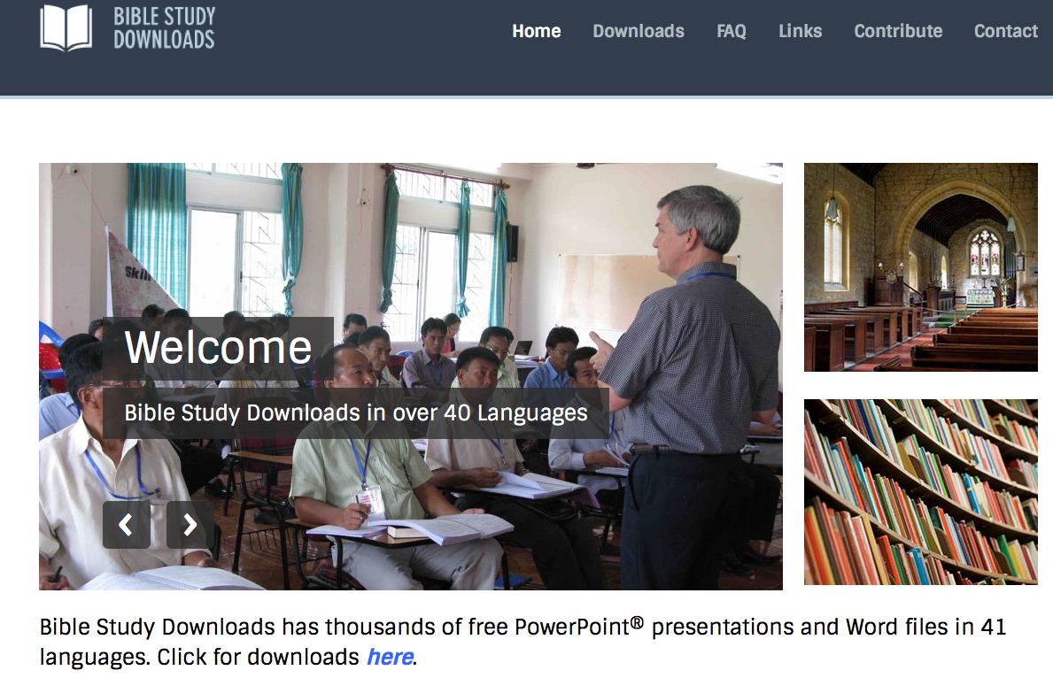
BibleStudyDownloads.org
7
Notes:
This has resulted in Bible teaching and study materials—mostly PowerPoint—in 42 languages! All a teacher needs to do is to click on a file and it downloads for free to teach any book of the Bible and many other subjects.

Slide 89
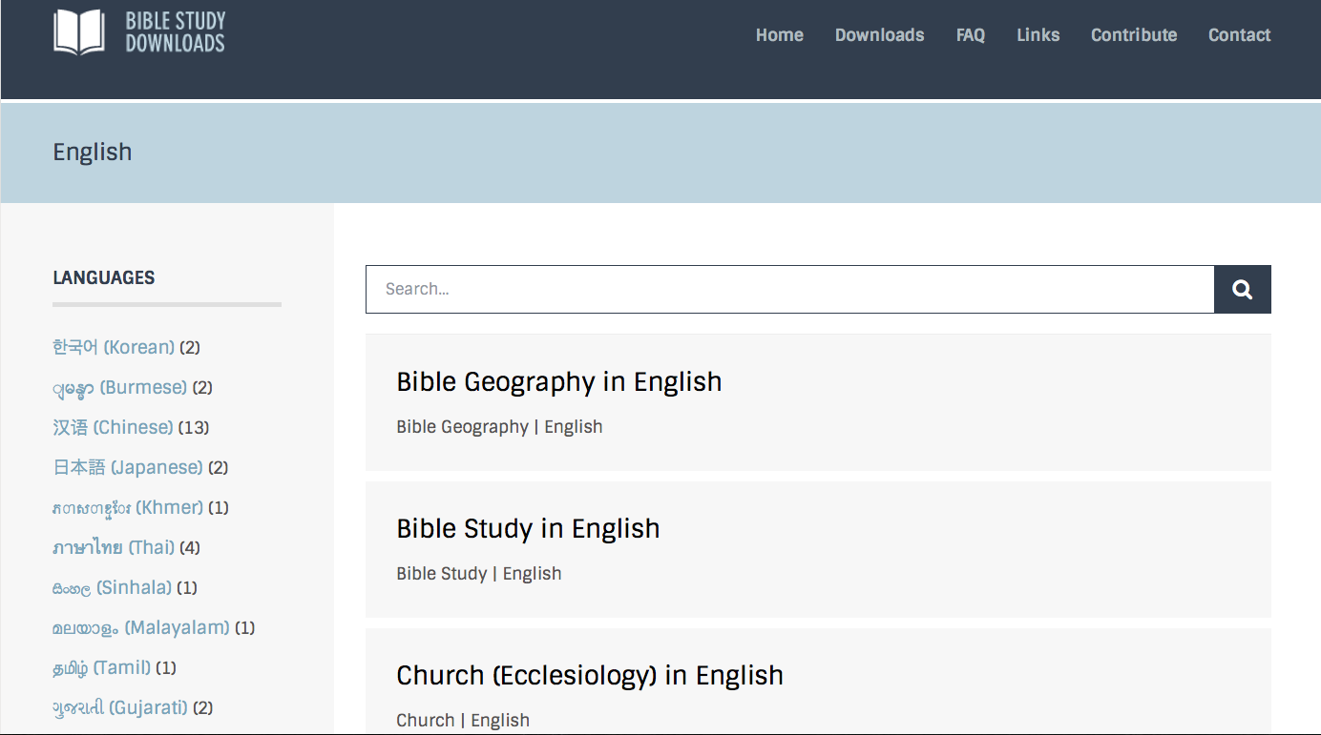
BibleStudyDownloads.org
7
Notes:
This has resulted in Bible teaching and study materials—mostly PowerPoint—in 42 languages! All a teacher needs to do is to click on a file and it downloads for free to teach any book of the Bible and many other subjects.

Slide 90
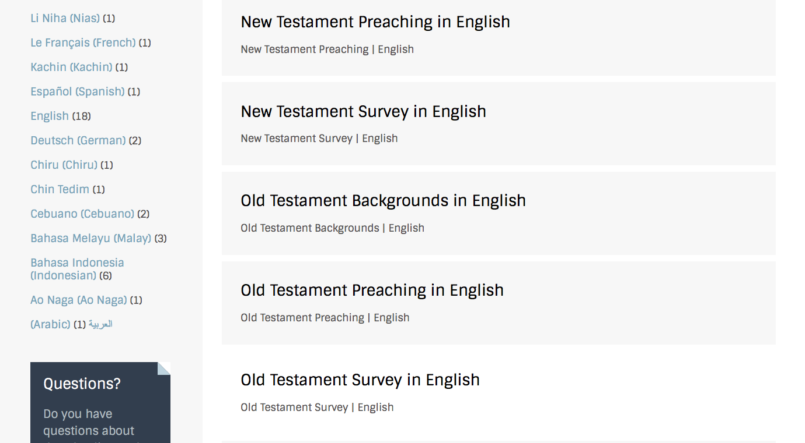
BibleStudyDownloads.org
7
Notes:
This has resulted in Bible teaching and study materials—mostly PowerPoint—in 42 languages! All a teacher needs to do is to click on a file and it downloads for free to teach any book of the Bible and many other subjects.

Slide 91
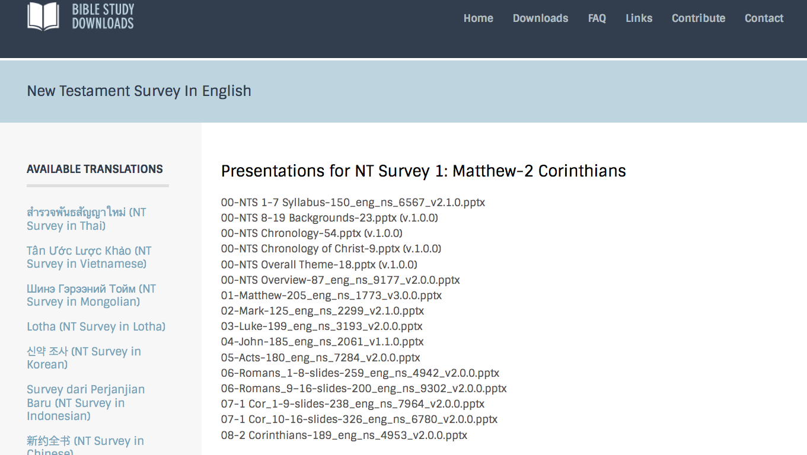
BibleStudyDownloads.org
7
Notes:
This has resulted in Bible teaching and study materials—mostly PowerPoint—in 42 languages! All a teacher needs to do is to click on a file and it downloads for free to teach any book of the Bible and many other subjects.

Slide 92
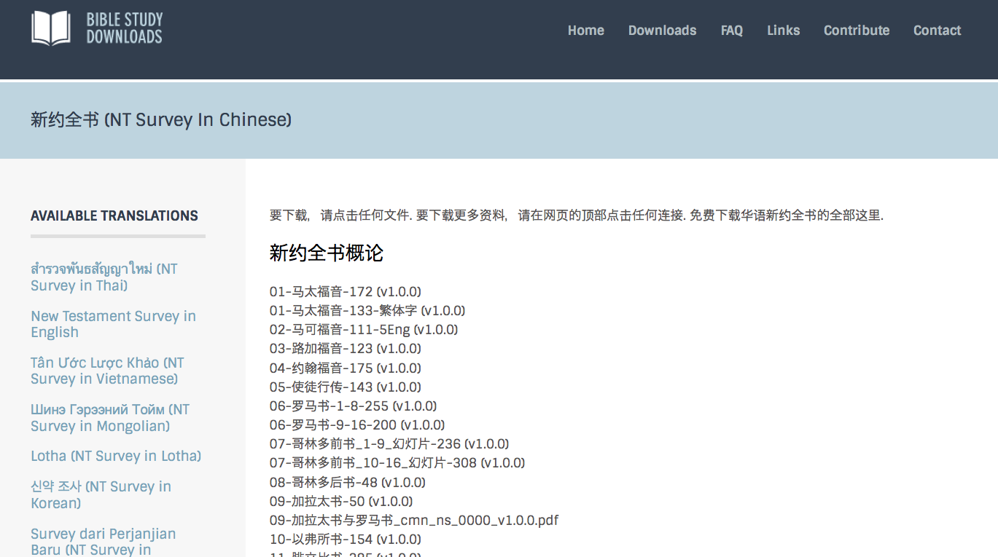
BibleStudyDownloads.org
7
Notes:
This has resulted in Bible teaching and study materials—mostly PowerPoint—in 42 languages! All a teacher needs to do is to click on a file and it downloads for free to teach any book of the Bible and many other subjects.

Slide 93
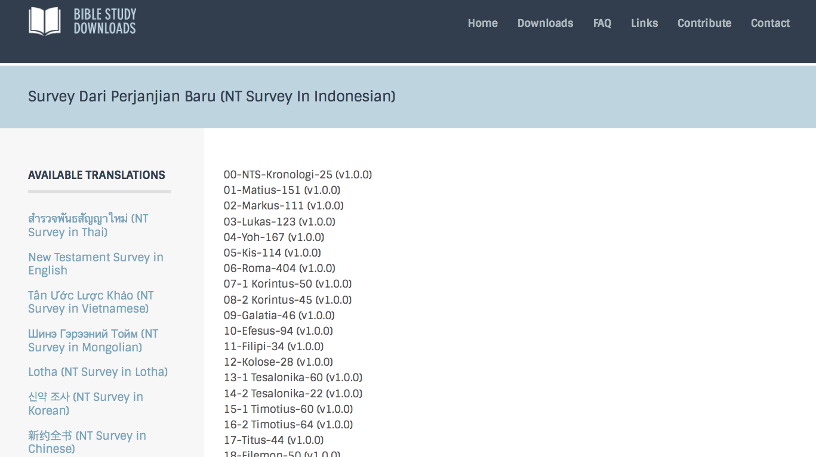
BibleStudyDownloads.org
7
Notes:
This has resulted in Bible teaching and study materials—mostly PowerPoint—in 42 languages! All a teacher needs to do is to click on a file and it downloads for free to teach any book of the Bible and many other subjects.

Slide 94
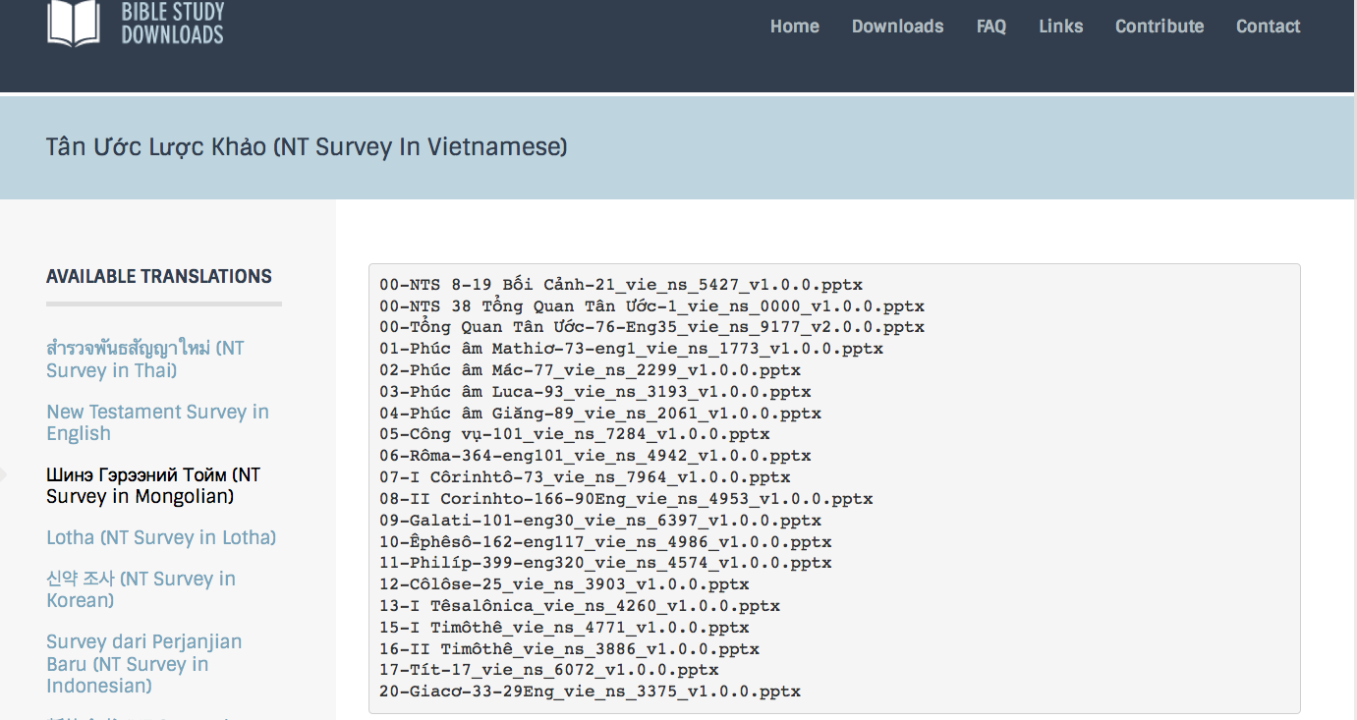
BibleStudyDownloads.org
7
Notes:
This has resulted in Bible teaching and study materials—mostly PowerPoint—in 42 languages! All a teacher needs to do is to click on a file and it downloads for free to teach any book of the Bible and many other subjects.

Slide 95
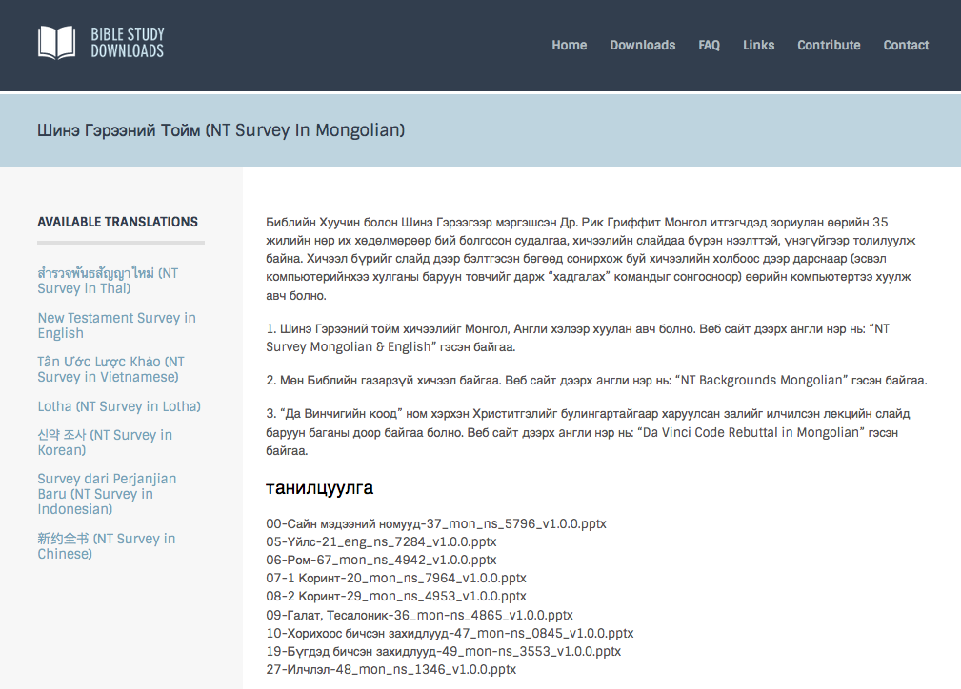
BibleStudyDownloads.org
7
Notes:
This has resulted in Bible teaching and study materials—mostly PowerPoint—in 42 languages! All a teacher needs to do is to click on a file and it downloads for free to teach any book of the Bible and many other subjects.

Slide 96
BibleStudyDownloads.org
7
Notes:
This has resulted in Bible teaching and study materials—mostly PowerPoint—in 42 languages! All a teacher needs to do is to click on a file and it downloads for free to teach any book of the Bible and many other subjects.

Slide 97
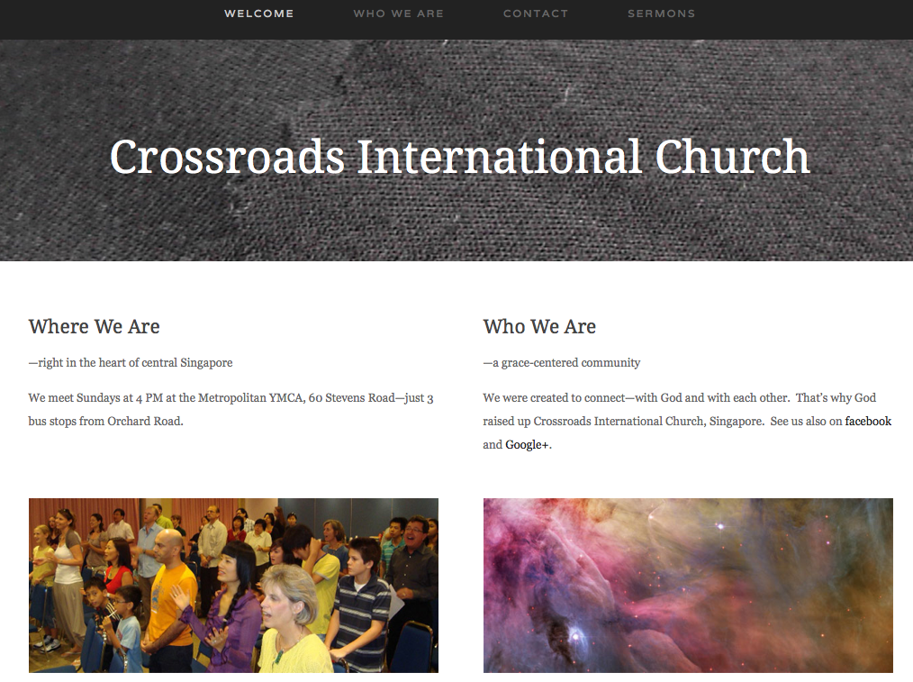
www.cicfamily.com

Slide 98
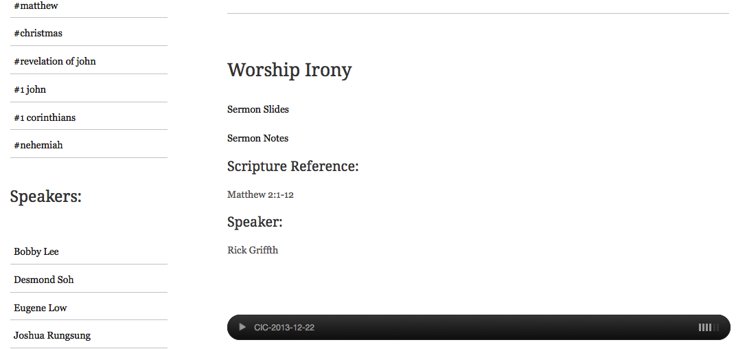
www.cicfamily.com

Slide 99
上帝给我们的事工
世界探索事工 新加坡工场领袖
新加坡神学院 圣经和讲道教授
新加坡神学院 事工博士学位负责人
兼职教授 在12个国家任教
圣经基础事工 翻译负责人
Biblestudydownloads.com圣经学习下载网站 网站负责人
十字路口国际教会 牧师-教师

Slide 100

Course Description
1
This course addresses the nature, purpose, multiplication, leadership, discipline, ordinances, unity, and body life of the local church. Students see a variety of opinions on each of these subjects but should support their own conviction from Scripture.

Slide 101

Objectives
1
By the end of the course the student should be able to …
Articulate the biblical nature of the local church (define what the church is).
Articulate the biblical purpose of the local church (show what the church is supposed to do) so as to develop priorities for change in his own ministry.

Slide 102
Objectives
1
By the end of the course the student should be able to …
Apply the distinction between function and form along with the roles of Scripture, history, and culture to bring relevance to local church issues.
Know how church multiplication (evangelism and growth) can be accomplished in his ministry.

Slide 103
Objectives
1
By the end of the course the student should be able to …
Explain from Scripture the proper means of church discipline in order to restore sinning believers in his local church.
Implement the most important NT principles of leadership.

Slide 104
Objectives
1
By the end of the course the student should be able to …
Discern the NT pattern for church leadership selection in order to evaluate the student’s own leadership style and the offices in his assembly.
Defend what the student considers the most biblical church government structure after studying various alternate views.

Slide 105
Objectives
1
By the end of the course the student should be able to …
Prove from Scripture one’s own view on the ordinances (baptism and the Lord’s Supper) to make these celebrations more meaningful.
Implement biblical principles of body life to meet edification needs in his church

Slide 106
Objectives
1
By the end of the course the student should be able to …
Know the importance of and process towards unity in the student’s local body and with other churches.
Implement his own biblically-based philosophy of ministry that shows the steps his church will follow to train a new believer to become a spiritual leader who is mature in Christ.

Slide 107

Schedule
4
14 Jan: Nature
21 Jan: Leadership
4 Feb: Discipline
11 Feb: Baptism
18 Feb: Lord's Supper, Multiplication, Edification, & Implementing Change
25 Feb: Unity & The Role of Women

Slide 108

Course Requirements
1-3
Readings (50%)
Quizzes (50%)

Slide 109

通过互联网学习的优势
7
兴趣
更好的学习
装备/训练信徒
节省时间

Slide 110
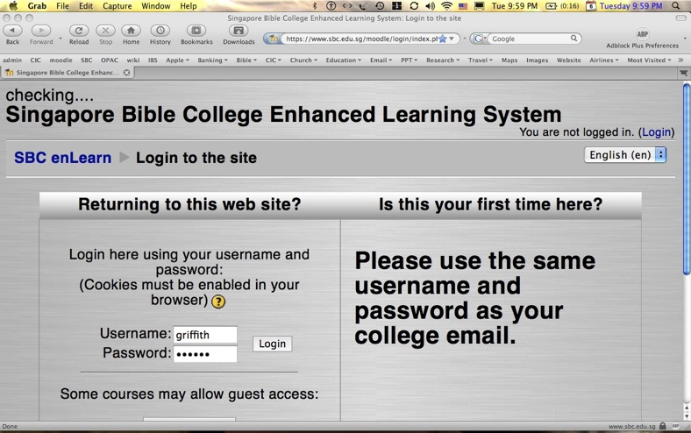

我们的 2个网站
SBC Moodle
(Quizzes)
BibleStudyDownloads.org
(Downloads)

Slide 111
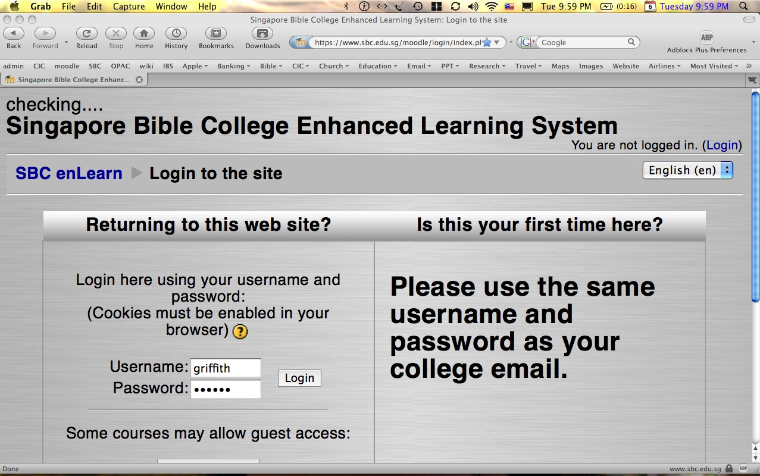
如何使用 moodle…
1
上网到sbc.edu.sg/moodle/login/index.php
键入您的正常SBC用户名和SBC密码
点击OT课程（或CCTE OT CCTE课程）
开始进行测验或发布信息

Slide 112


测验，中期和 期末考试都
不可参考书本！

Slide 113
Black

Slide 114
教会论链接地址 BibleStudyDownloads.org
免费获得该讲解!
圣经学习下载
Notes:
CH Church (Ecclesiology)

