Slide 1
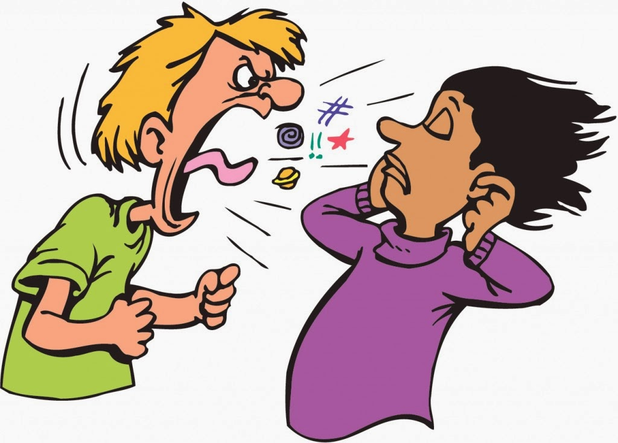
CONFLICT MANAGEMENT AND RECONCILIATION
Designed by Dr. Scott Wooddell Uploaded by Dr. Rick Griffith • Singapore Bible College All files in many languages for free download at BibleStudyDownloads.org

Slide 2
1. ACCOMODATING
Definition: The attempt to make everyone happy without any true effort to solve the problem.
Underlying Value: Winning is not important, relating is.
Advantage: Effective when the leader doesn’t need to care how the problem is resolved and wants to empower others who do.

Slide 3
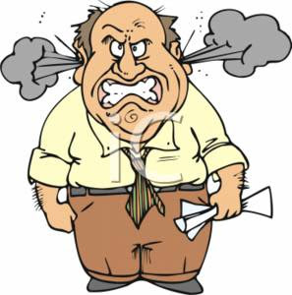
1. ACCOMODATING
Problem: It usually doesn’t work because nothing gets resolved and everyone remains dissatisfied.
Underlying Drives: Positive – to release power to others who don’t usually have it.
Negative – fear to offend others while trying to look like one who cares for others.

Slide 4
2. COMPETITION
Definition: The leader’s effort to control the outcome of the conflict, often while trying to look like he is inviting others to participate in the solution.
Underlying Value: Win/lose. Leaders win, followers lose and this is the way life should be.

Slide 5
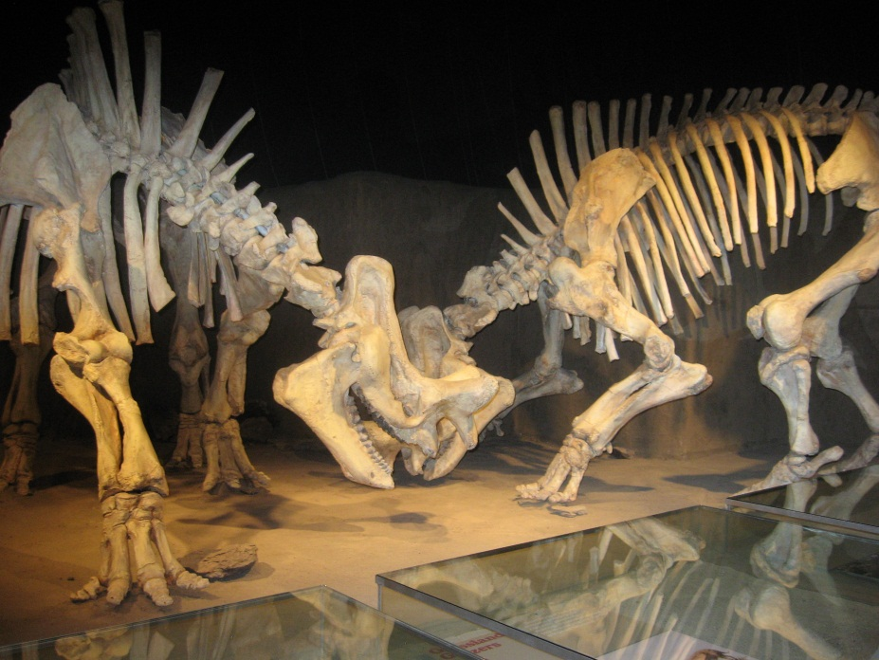
2. COMPETITION
Advantage: Solves problems quickly if not cleanly, thus saving time and tension when time and tension are more important than all other considerations.
Problem: It generates resentment in the followers and leads to power moves on their part.

Slide 6
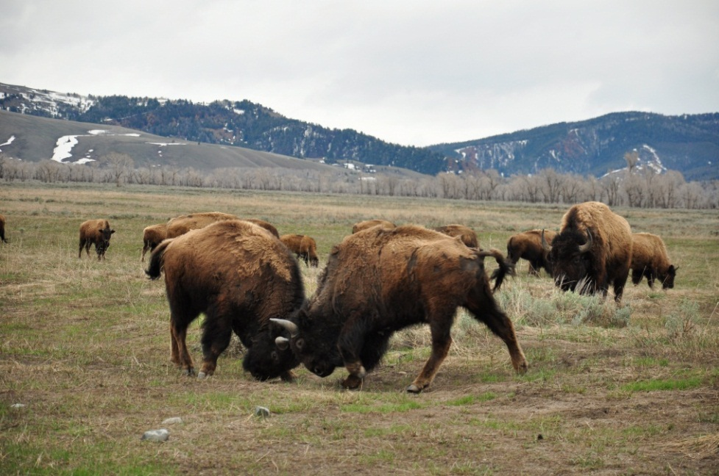
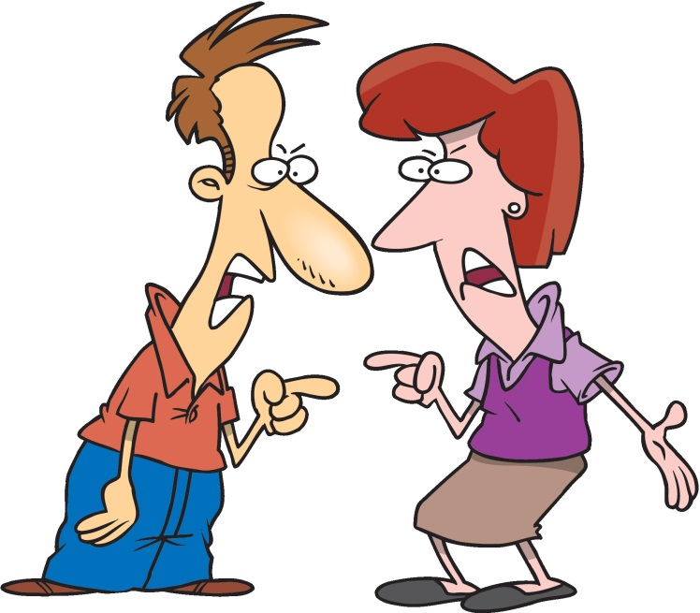
2. COMPETITION
Underlying Drives: Positive – to serve followers by helping them solve problems they don’t know how to solve.
Negative – to satisfy the leader’s personal need for power and control.

Slide 7
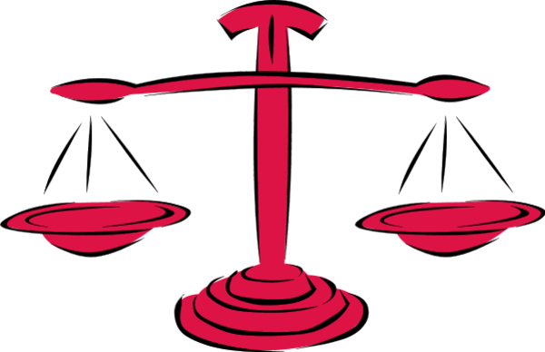
3. COMPROMISING
Definition: The effort to give all involved something they want in order to satisfy everyone.

Slide 8
3. COMPROMISING
Underlying Value: Happiness for all because one bite of pie is better than no pie at all.
Advantage: It helps to resolve differences and relieve tension so all interests are represented in some way by the solution.

Slide 9
3. COMPROMISING
Problem: People focus on what they didn’t get rather than what they got, resulting in renewed and frequently accelerating conflict because all of the pie is better than only one piece of the pie.
Underlying Drives:
Positive – wisdom is more important than winning.
Negative – relationship is more important than principle.

Slide 10
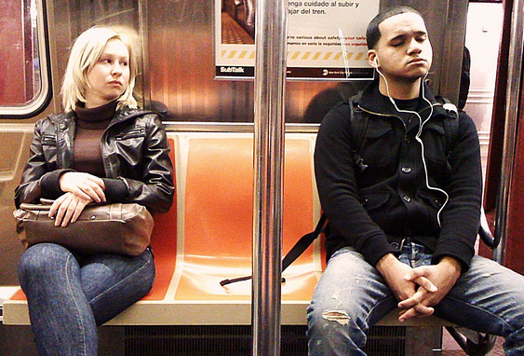
4. AVOIDING
Definition: The decision not to get involved in the conflict with the hope it will go away.
Underlying Value: Peace at any price, even at the loss of principle and respect.

Slide 11
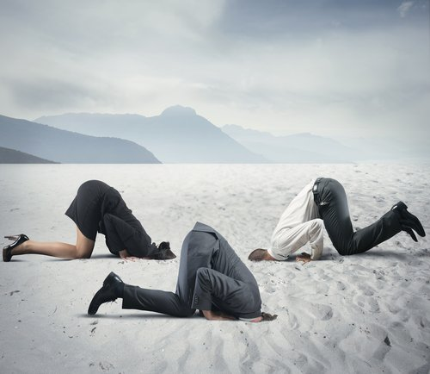
4. AVOIDING
Advantage: Keeps the leader out of the battle, thus enabling the leader to serve as the last court of appeal when this is appropriate.
Problem: Conflict avoided means conflict accelerated.

Slide 12
4. AVOIDING
Underlying Drives:
Positive – he who fights and runs away lives to fight another day, if he chooses the right time to run.
Negative – peace is more important than principle, no matter what it costs.

Slide 13
5. COLLABORATING
Definition: The decision to focus on a process for resolving the tension rather than seeking to resolve it before the people involved are ready to do so.
Underlying Value: Everyone can and should win because everyone’s needs and concerns can and should be met.

Slide 14
5. COLLABORATING
Advantage: It achieves a win/win result by involving all in the outcome, so all are satisfied because they get what they want, even if the solution is not what they thought they wanted at the beginning of the process.
Problem: It takes more time than may be available.
Underlying Drives:
Positive – nothing beats a win for all
Negative – none of the time and process is right.

Slide 15
Black

Slide 16
Church Dynamics link at BibleStudyDownloads.org
Get this presentation for free!
Notes:
Church Dynamics (cd)

