Slide 1

十大领袖者素质
TOP TEN LEADER QUALITIES
Designed by Dr. Scott Wooddell
Uploaded by Dr. Rick Griffith • Singapore Bible College
All files in many languages for free download at BibleStudyDownloads.org

Slide 2

定义领导力
DEFINING LEADERSHIP
领导力
领导力是指在实现追随者成为有效领导者的同时，影响他人实现商定愿景的行为
Leadership is the act of influencing others toward the accomplishment of an agreed upon vision while at the same time forming followers into effective leaders.

Slide 3

定义领导力
DEFINING LEADERSHIP
1.基督教领袖必须追求神对事工和有关个人的议程
Christian Leadership must pursue God’s agenda for the ministry and the individuals involved.
2.真正的领导力有两个结果：
- 愿景的实现
- 未来领导者的形成
True Leadership has two results:
- The accomplishment of a vision
- The formation of future leaders`

Slide 4
DEFINING LEADERSHIP
3.领导和管理是同一事物的两个方面
-领导应对变化和新事
-管理层应对正在发生的事
Leadership and management are two sides of the same coin.
- Leadership copes with change and the new
- Management copes with complexity and the ongoing
4.牧者和管理层同等重要
Leadership and management are equally important.
领导和管理对于健康教会的成长都必不可少
不断变化的教会将被烧尽
不断受到管理的教会会窒息而死
Both leadership and management are necessary for a healthy church to grow.
Churches constantly changing will burn out.
Churches constantly under management will suffocate.

Slide 5
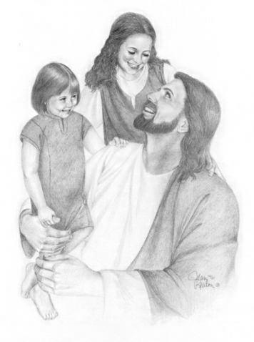
十大领袖者素质
TOP TEN LEADERSHIP QUALITIES
1.爱–以奉献自我为标志的爱。 爱是决定寻求他人最大利益的决定
LOVE – Love that is marked by sacrificial self-giving. Love is a decision to look out for the best interest of others.
服侍
Serving
带领
Leading
造型
Modeling
爱愿意卷入他人生活中的混乱局面。
Love is willing to get involved in the messes that others make of their lives.

Slide 6

十大领袖者素质
TOP TEN LEADERSHIP QUALITIES
2. 完整性–完整性既是外部的，也是基础的。
完整性–完整性既是外部的，也是基础的。 诚信是我们认为的基本诚实； 遵守我们的诺言，挣我们的薪水，做一个诚实的工作，证明可靠性并有效交付。
INTEGRITY – Integrity that is both external and foundational. Integrity is what we think of as basic honesty; keeping our word, earning our pay, doing an honest days work, demonstrating reliability and delivering effectively.
所见即所得
What you see
is what you get

Slide 7
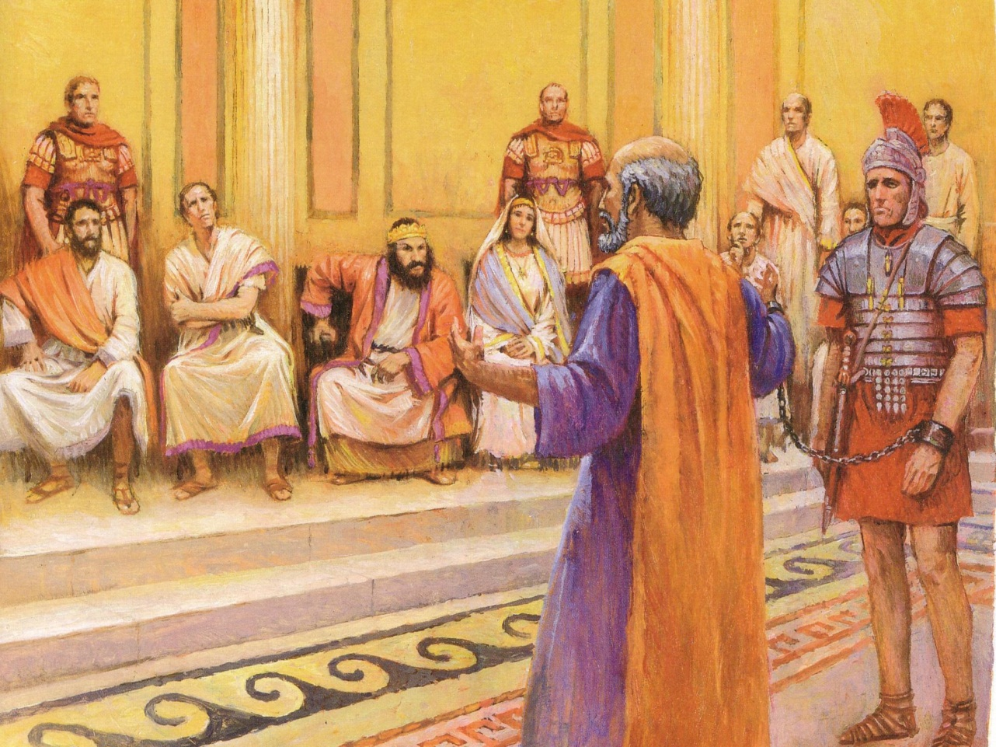
十大领袖者素质
TOP TEN LEADERSHIP QUALITIES
3.保证 -基于与基督的关系的安全感，
与领导者可能面对的任何事件无关
SECURITY - Security that is based on one’s relationship with Christ, independent of any events the leader may face.
保证是免于获得他人认可的自由，因此人们可以对他人进行公正和客观的判断
Security is freedom from needing the approval of others and thus one can exercise fair and objective judgments concerning others.

Slide 8

十大领袖者素质
TOP TEN LEADERSHIP QUALITIES
4. 谦卑–谦卑使领导者意识到自己的局限性，并能以适当的方式表达自己的技能和成就。 谦卑是指准确地看到自己的弱点和优点的能力.
HUMILITY – Humility that makes the leader aware of his/her limitations and comfortable expressing his/her skill and achievements in appropriate ways. Humility is the ability to see one’s weaknesses and strengths accurately.

Slide 9

十大领袖者素质
TOP TEN LEADERSHIP QUALITIES
5. 勇气–勇于面对问题，问题，困难情况和人员的勇气，要谨慎，温和，坚定
COURAGE – Courage that is willing to face issues, problems, difficult situations and people carefully, gently, and firmly.
勇气是代表原则和价值观的力量
Courage is the strength to stand for principles and values.

Slide 10
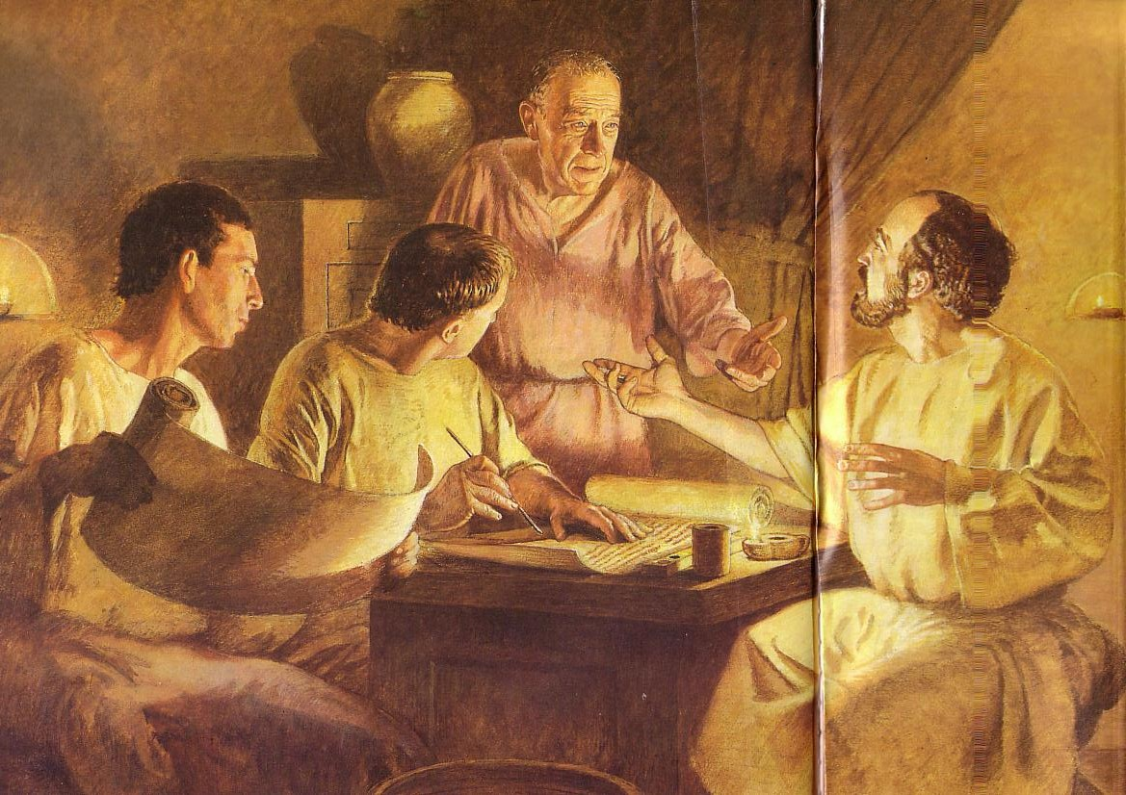
十大领袖者素质
TOP TEN LEADERSHIP QUALITIES
6.纪律–自我控制和勤奋表达的纪律，并酌情以灵活性为标志。
DISCIPLINE – Discipline that is expressed by self-control and diligence and marked by flexibility as appropriate.

Slide 11
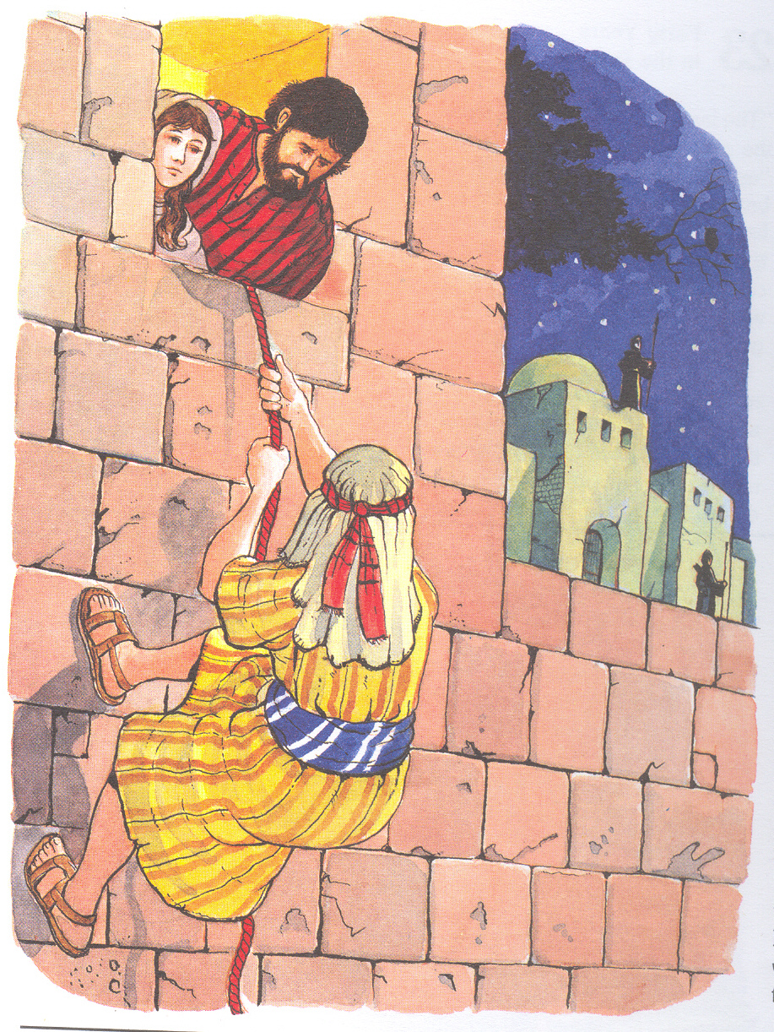
十大领袖者素质
TOP TEN LEADERSHIP QUALITIES
7.忠诚度-忠诚度体现在忠诚关系中，以极大的个人代价支持他人。
忠诚是对领导者的承诺
LOYALTY – Loyalty as expressed in faithfulness in relationships that supports others at great personal cost. Loyalty is a commitment to the people one leads

Slide 12
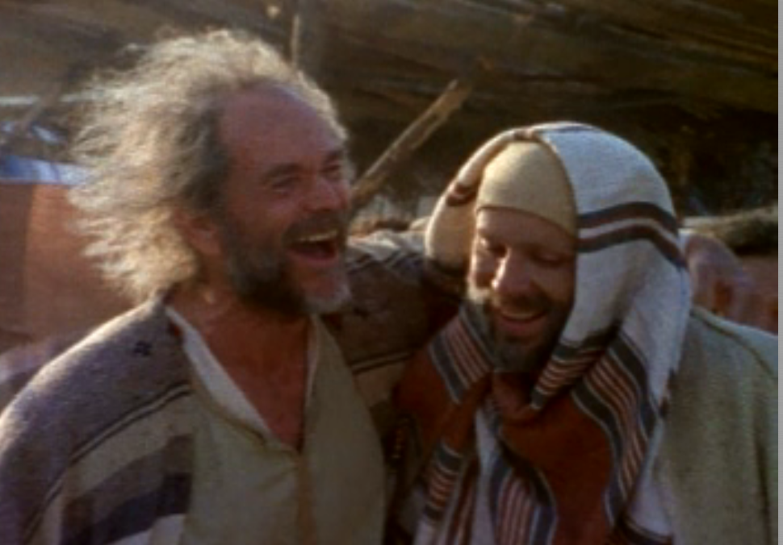
十大领袖者素质
TOP TEN LEADERSHIP QUALITIES
8.脆弱性/完整性–脆弱性/亲密关系使领导者处于牺牲地位
VULNERABILITY/INTIMACY – Vulnerability/intimacy that puts the leader in a sacrificial position.
脆弱性/亲密性是愿意以适当的方式进行披露和自我牺牲。
Vulnerability/intimacy is a willingness to disclose and give oneself in appropriate ways.

Slide 13
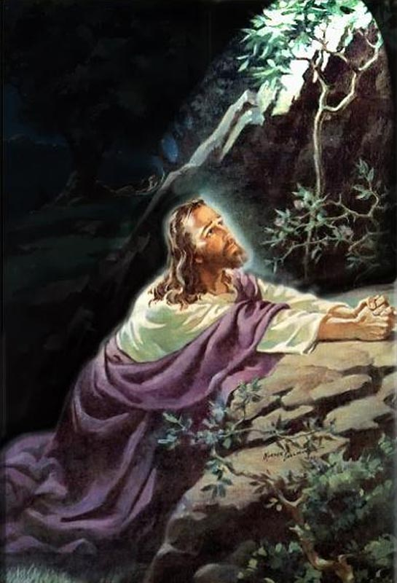
十大领袖者素质
TOP TEN LEADERSHIP QUALITIES
9.承诺–以奉献为标志的承诺。 承诺是通过将自己所需要的全部工作交给自己来完成事业的强烈愿望。
COMMITMENT – Commitment that is marked by dedication. Commitment is the strong desire to accomplish the cause by giving all he/she has to the tasks at hand.

Slide 14

十大领袖者素质
TOP TEN LEADERSHIP QUALITIES
10.信心–愿景激发了信心，并鼓励所有寻求实现愿景的人。 信心是愿景中的坚定保证
CONFIDENCE – Confidence that is motivated by the vision and encouraging to all who are seeking to accomplish it. Confidence is a firm assurance in the vision.

Slide 15
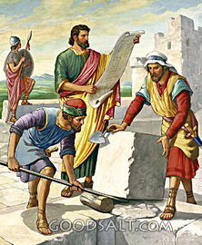
十大领袖者素质
1. .给跟随者树立基督化的榜样，激励他们以同样的方式生活
Model Christ-likeness to your followers to inspire them to live in the same manner.
2. .呼召跟随者对基督有更深的承诺
Call your followers to a deeper commitment to Christ.
3.与跟随者一起探索改变，以保持教会为基督前进
Navigate change with your followers to keep the church moving forward for Christ.

Slide 16
十大领袖者素质
4.倾听您的追随者，以表达对他们的尊重和谦卑。 向他们学习，让他们知道您没有所有答案或必须做出所有决定。
Listen to your followers to demonstrate respect and humility toward them. Learn from them so they know you don’t have all the answers or have to make all the decisions.
5. 向追随者传达方向和您对愿景的关注，以使他们的承诺保持新鲜感并按目标努力
Communicate direction and your visions concerns to your followers in order to keep their commitment fresh and their efforts on target.

Slide 17
十大领袖者素质
C
6.训练并释放您的追随者，使他们获得个人成长的回报，并为事工的远景做出持续的贡献
Disciple and release your followers so they gain the reward of personal growth and a sense of on-going contribution to the ministry vision.
C
C
C
7. 通过认可和奖励他们的积极贡献来鼓励您的关注者
Disciple and release your followers so they gain the reward of personal growth and a sense of on-going contribution to the ministry vision.
8. 评估并跟进您的追随者，以对愿景的实现负责，因此所有人都朝着一致的方向前进
Encourage your followers by recognizing and rewarding their positive contributions.

Slide 18
十大领袖者素质
9.解决冲突并在您的追随者之间实现和解，以便他们可以将精力投入到愿景中，而不是破坏性的竞争中
Resolve conflict and bring about reconciliation among your followers so they can invest their energies in the vision and not in destructive competition.

Slide 19
十大领袖者素质
10.首先，通过培养成群结队的追随者来表现出您对卓越关怀的承诺，其次通过衡量其活动的结果，始终记住，帮助追随者取得成果是您可以做的最关怀的事情之一
Show your commitment to caring excellence first by building your followers as men and women and second by measuring the results of their activities, always remembering that helping your followers achieve results is one of the most caring things you can do.

Slide 20
Black

Slide 21


教会动力学 • BibleStudyDownloads.org
免费获得此演示文稿
Notes:
Church Dynamics (cd)

