Slide 1
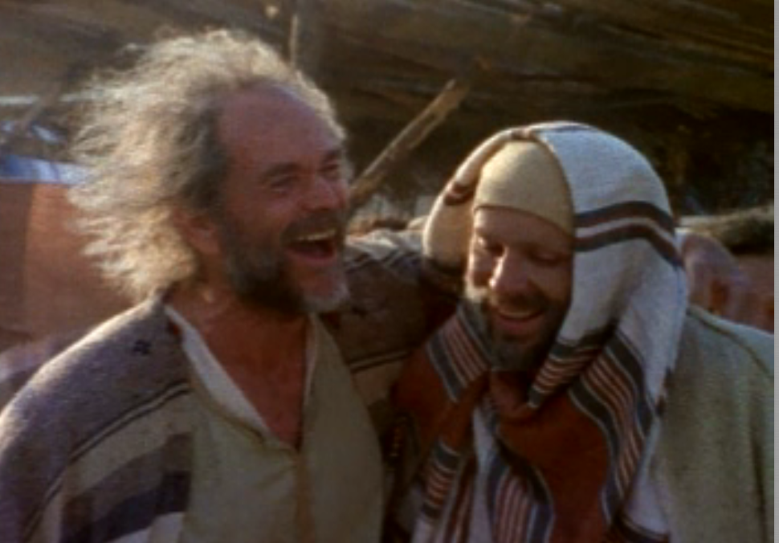
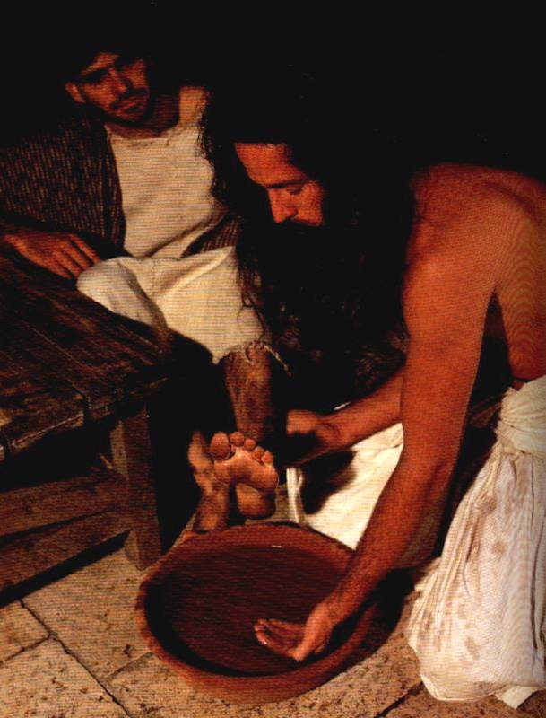
领袖培训过程
THE LEADERSHIP TRAINING PROCESS
Designed by Dr. Scott Wooddell
Uploaded by Dr. Rick Griffith • Singapore Bible College
All files in many languages for free download at BibleStudyDownloads.org

Slide 2
领袖培训过程
THE LEADERSHIP TRAINING PROCESS
从新信徒到有经验的领导者
FROM NEW CONVERT TO EXPERIENCED LEADER

Slide 3
从新信徒到有经验的领导者
FROM NEW CONVERT TO EXPERIENCED LEADER
第一阶段– 从新信徒 STAGE ONE – NEW CONVERT
第二阶段-门徒 STAGE TWO – DISCIPLE
第三阶段–装备 STAGE THREE – EQUIPPER
第四阶段-部委领袖 STAGE FOUR – MINISTRY LEADER

Slide 4
1-2-3-4-5过程
THE 1-2-3-4-5 PROCESS
第一步–您做到，演示
STEP ONE – YOU DO IT
第二步–执行未来的领袖者观察
STEP TWO – YOU DO IT WHILE FUTURE LEADER WATCHES
第三步 - 未来的领袖者执行 您观察
STEP THREE – FUTURE LEADER DOES IT WHILE YOU WATCH
第四步-未来的领袖者独自完成
STEP FOUR – FUTURE LEADER DOES IT ALONE
第五步–未来领袖以另一种潜力完成它 未来的领导者
STEP FIVE – FUTURE LEADER DOES IT WITH ANOTHER FUTURE LEADER

Slide 5
Black

Slide 6


教会动力学 • BibleStudyDownloads.org
免费获得此演示文稿
Notes:
Church Dynamics (cd)

