Slide 1
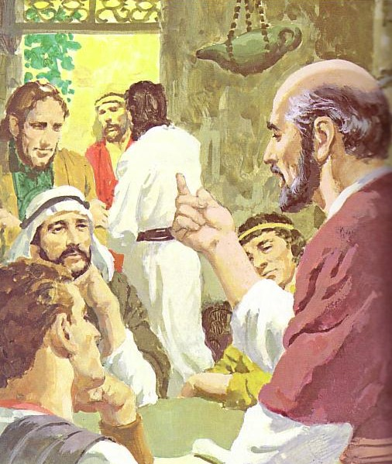
培育教会领袖 DEVELOPING LEADERS
训练基督般的领袖
Discipling
Christ-like
leaders
Designed by Dr. Scott Wooddell Uploaded by Dr. Rick Griffith • Singapore Bible College All files in many languages for free download at BibleStudyDownloads.org

Slide 2
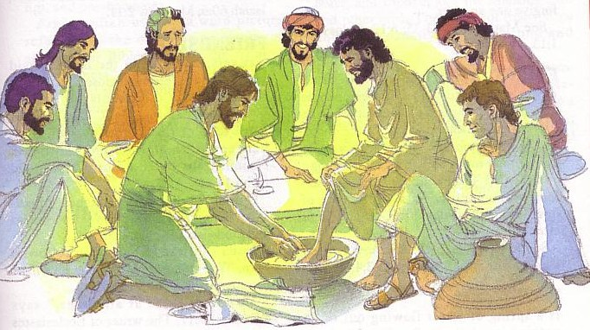
培养愿意的教会领袖 DEVELOP LEADERS WHO:
1.与基督的思想思考 Think with the mind of Christ (Philippians 2:5-11)
2. 与基督的手服侍Serve with the hands of Christ (John 13:1-17)
3. 与基督的心关怀 Care with the heart of Christ (Matthew 11:28-30)

Slide 3
Black

Slide 4
教会动力学 • BibleStudyDownloads.org
免费获得此演示文稿
Notes:
Church Dynamics (cd)

