Slide 1
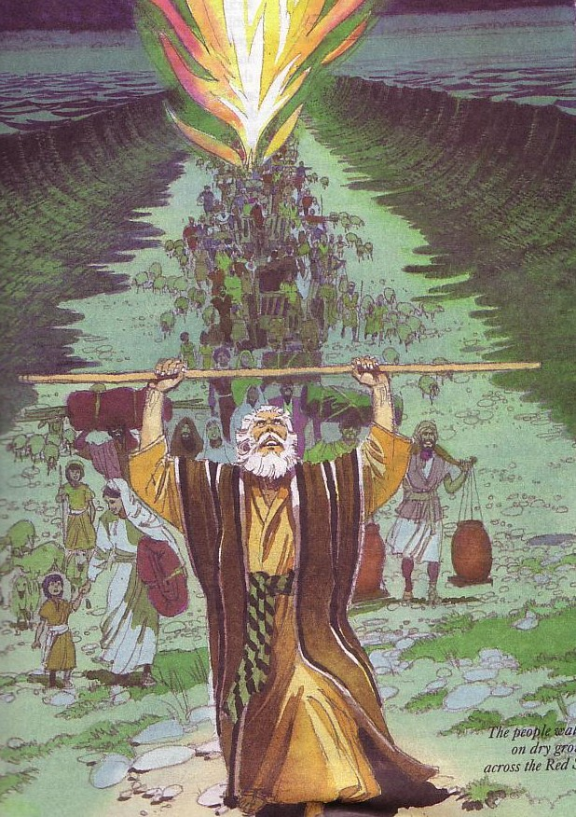
领袖 者如何领导 HOW LEADERS LEAD
Designed by Dr. Scott Wooddell Uploaded by Dr. Rick Griffith • Singapore Bible College All files in many languages for free download at BibleStudyDownloads.org

Slide 2
领袖 者如何领导 HOW LEADERS LEAD

Slide 3
领袖 者 为教会提供教会愿景
LEADERS LEAD BY PROVIDING VISION FOR THE CHURCH
领袖 者 的首要任务是保持愿景
The leaders primary task is to be the keeper of the vision.
领导者的主要责任是阐明愿景并协助所有团队成员在实现愿景方面保持目标
The leaders primary responsibility is to articulate the vision and assist all team members to stay on target in the accomplishment of the vision.

Slide 4
2.领导者通过促进乐观态度来领导
LEADERS LEAD BY PROMOTING AN OPTIMISTIC ATTITUDE
领导者必须采取行动发展团队合作精神, 并在必要时进行干预以保持团结
Leaders must act to develop teamwork, intervening as necessary to maintain unity.
领导者必须让每个人都充分了解团队事件，因为这是积极态度的关键之一
Leaders must keep everyone fully informed concerning team events as this is one of the keys to a positive attitude.

Slide 5
3.领导者尊重教会成员
LEADERS LEAD BY SHOWING RESPECT FOR CHURCH MEMBERS
领导者尊重教会成员
Leaders appreciate the gifts others bring to the church.
领导者赞扬他人的成就
Leaders praise the accomplishments of others
领导者建立在自身优势之上，
而不是专注于自身劣势
Leaders build on their strengths, not focusing on their weaknesses.

Slide 6
4.领导者要敏锐地教会成员
LEADERS LEAD BY BEING SENSITIVE TO CHURCH MEMBERS
领导者必须能够容忍个性差异，并采取行动帮助具有不同观点的人们良好地合作
Leaders must be able to tolerate personality differences and act to help people of differing outlooks work well together.
领导者必须设法使所有人的参与达到最高水平
Leaders must seek to raise the participation of all to their highest level of ability.
领导者必须灵活应变，愿意听取新想法并持不同观点
Leaders must be flexible, willing to listen to new ideas and open to differing perspectives.

Slide 7
5. 领袖者通过建模基督 领导
LEADERS LEAD BY MODELING CHRISTLINENESS
你们应该效法我，好像我效法基督一样。
“Be imitators of me, as I am of Christ.”
1 Corinthians 11:1

Slide 8
Black

Slide 9
教会动力学 • BibleStudyDownloads.org
免费获得此演示文稿
Notes:
Church Dynamics (cd)

