Slide 1
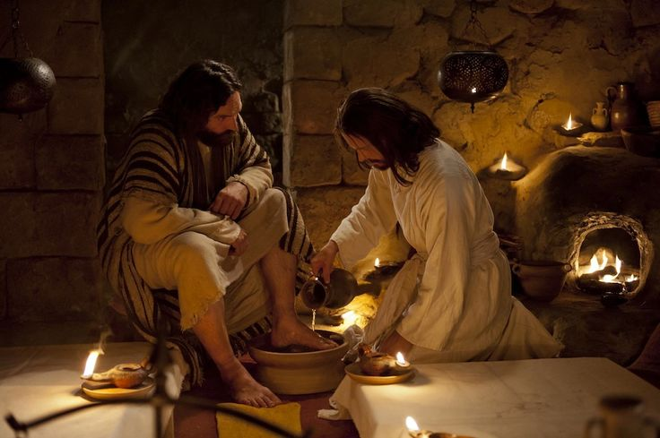
仆人领导 SERVANT LEADERSHIP
Designed by Dr. Scott Wooddell Uploaded by Dr. Rick Griffith • Singapore Bible College All files in many languages for free download at BibleStudyDownloads.org

Slide 2
仆人领导 SERVANT LEADERSHIP

Slide 3
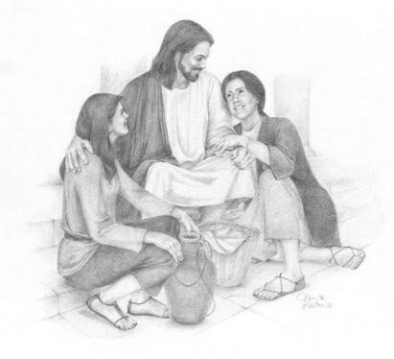
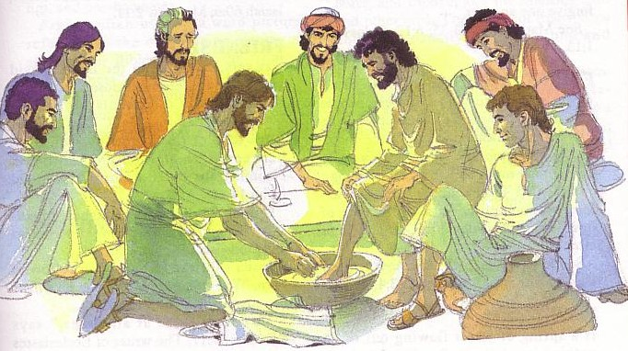
仆人领导
SERVANT LEADERSHIP
1 仆人领袖爱人 Servant Leaders Love (John 13:1-2)
仆人领袖无条件地爱每个人They love everyone unconditionally.
仆人领袖完全爱大家 They love everyone fully.

Slide 4
仆人领导
SERVANT LEADERSHIP
2. 仆人领袖式的服务 Servant Leaders Serve (John 13:3-5)
仆人生命的保障来自与基督的关系 Their security comes from their relationship with Christ.
牧者生命的保障来自相信上帝的主权 Their security comes from believing in God’s sovereignty.

Slide 5
仆人领导
SERVANT LEADERSHIP
3.仆人领袖面对面的问题 Servant Leaders Confront (John 13:6-8)
仆人领袖以爱面对问题 They confront with love.
仆人领袖以谦卑面对问题 They confront with humility.

Slide 6
仆人领导
SERVANT LEADERSHIP
4.仆人领袖纠正 Servant Leaders Correct (John 13:9-11)
仆人领袖以权威纠正 They correct with authority.
仆人领袖有目的地纠正 They correct with purpose.

Slide 7
仆人领导
SERVANT LEADERSHIP
5.仆人领袖的榜样 Servant Leaders Model (John 13:12-17)
仆人领袖知道自己在基督里的定位 They know who they are in Christ.
仆人领袖呼吁其他人效法他们的领导 They call on others to follow their lead.
仆人领袖站在前线为他人洗脚 They stand first in line to wash the feet of others.

Slide 8
仆人领导
SERVANT LEADERSHIP
6.仆人领袖认识他们的追随
Servant Leaders Know Their Followers (John 13:18-19)
7.仆人领袖接纳所有人, 就像基督接纳我们
Servant Leaders Accept Everyone as Christ Accepts us (John 13:20)

Slide 9
Black

Slide 10
教会动力学 • BibleStudyDownloads.org
免费获得此演示文稿
Notes:
Church Dynamics (cd)

