Slide 1
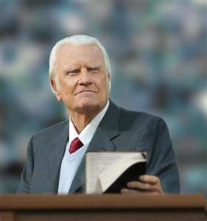
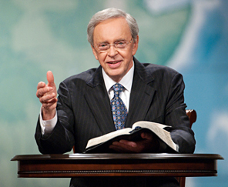
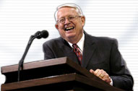
牧师的角色和责任 ROLES AND RESPONSIBILITIES OF THE PASTOR
Designed by Dr. Scott Wooddell Uploaded by Dr. Rick Griffith • Singapore Bible College All files in many languages for free download at BibleStudyDownloads.org

Slide 2
牧师的角色和责任 ROLES AND RESPONSIBILITIES OF THE PASTOR
使徒保罗指示提摩太担任牧师的角色和职责
The Apostle Paul instructed Timothy in the roles and responsibilities of a Pastor.

Slide 3
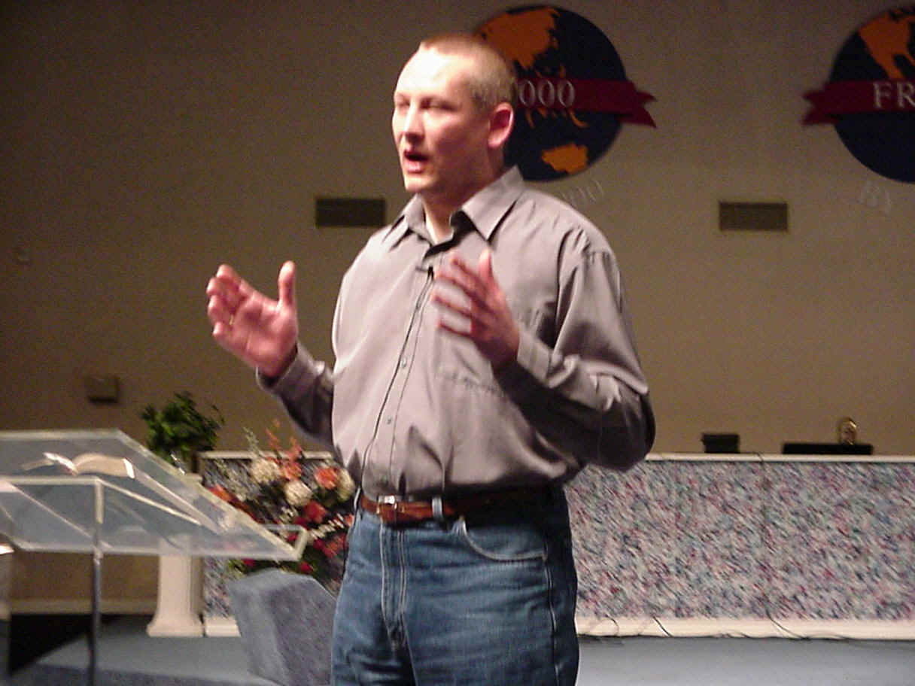
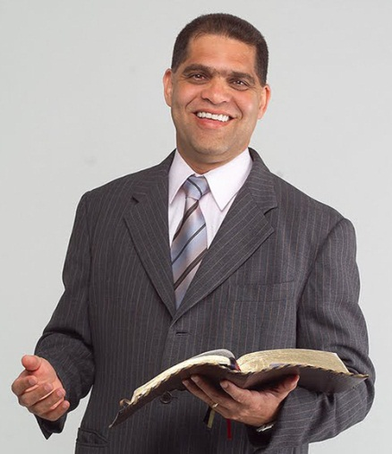
牧师的角色和责任 ROLES AND RESPONSIBILITIES OF THE PASTOR
1. 老师
TEACHER
(1 Timothy 1:3; 4:1-11; 5:7; 6:3-30; 6:17-19; 6:20-21)
2.牧师
PASTOR
(1 Timothy 2:1-8; 2:9-15)
使徒保罗指示提摩太担任牧师的角色和职责
The Apostle Paul instructed Timothy in the roles and responsibilities of a Pastor.

Slide 4
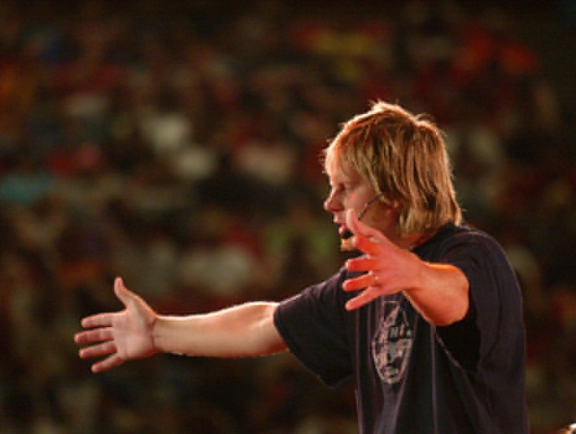
牧师的角色和责任 ROLES AND RESPONSIBILITIES OF THE PASTOR
3.领导
LEADER
(1 Timothy 3:1-13; 5:3-6; 6:1-2)
4. 榜样
ROLE MODEL
(1 Timothy 3:1-7; Titus 1:5-9)
使徒保罗指示提摩太担任牧师的角色和职责
The Apostle Paul instructed Timothy in the roles and responsibilities of a Pastor.

Slide 5
Black

Slide 6
教会动力学 • BibleStudyDownloads.org
免费获得此演示文稿
Notes:
Church Dynamics (cd)

