Slide 1
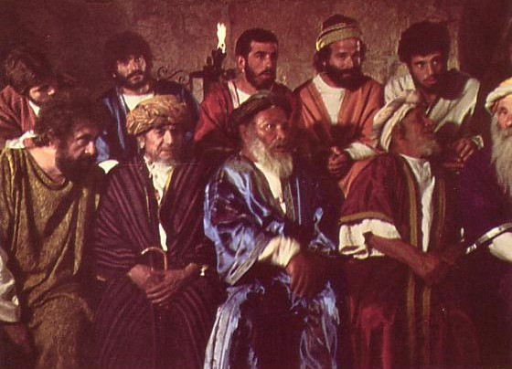
教会领袖的责任 RESPONSIBILITIES OF CHURCH LEADERS
Designed by Dr. Scott Wooddell Uploaded by Dr. Rick Griffith • Singapore Bible College All files in many languages for free download at BibleStudyDownloads.org

Slide 2
教会领袖的责任 RESPONSIBILITIES OF CHURCH LEADERS
教会领袖有许多角色和责任
Church leaders have many roles and responsibilities

Slide 3
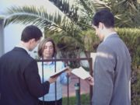
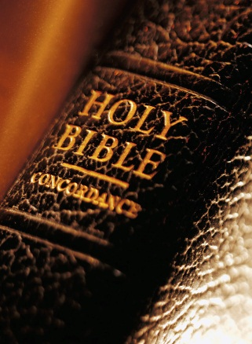
1.愿景
Vision
长老带领教会完成其宗旨 （马太福音28：19-20）
ELDERS LEAD THE CHURCH IN ACCOMPLISHING ITS PURPOSE (Matthew 28:19-20)
长老带领教会传福音给失丧者
Elders lead the church in evangelizing the lost.
2. 长老带领教会的门徒训练
Elders lead the church in disciplining the saints.
“使万民作门徒”
“Make disciples of all nations”

Slide 4
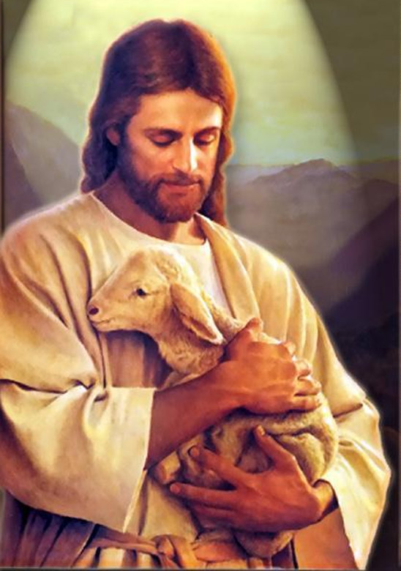
2. 规定
Provision
长老领导教会通过牧养主的羊
ELDERS LEAD THE CHURCH BY FEEDING CHRIST’S SHEEP (約翰John 21:15-17)
长老根据他们的恩赐担任老师(教师)
Elders serve as teachers according to their gifts.
2.长老根据自己的恩赐担任顾问/辅导员
Elders serve as counselors according to their gifts.
3.长老根据自己的恩赐担任门徒造就者
Elders serve as disciplers according to their gifts.

Slide 5
3.行政
Administration
长老通过结构设计来满足人们的需要
ELDERS LEAD THE CHURCH BY STRUCTURING TO MEET THE NEEDS OF THE PEOPLE (使 徒Acts 6:1-7)
教会中未满足的需求意味着教会中的紧张气氛。 （使徒行传 Acts 6:1-7）
Unmet need in the church means tension in the church.
2.当教会出现紧张局势时，领导者必须领导, 以便追随者跟随
When tensions are triggered in the church, leaders must lead so followers will follow.

Slide 6
4. . 保护
Protection
长老领导教会并牧养主的羊
ELDERS LEAD THE CHURCH BY GUARDING GOD’S FLOCK (使 徒 Acts 20:28-31)
1.长老必须意识到对上帝羊群的危险
Elders must be aware of the dangers to God’s flock.
2. 长老必须能够抵挡 对上帝羊群的危害
Elders must be able to defend against the dangers to God’s flock

Slide 7
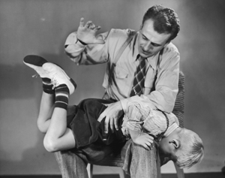
5.成为圣洁
Purification
长老带领教会的门徒训练
ELDERS LEAD THE CHURCH BY DISCIPLINING SINNING SAINTS (哥林多前 1 Corinthians 5:1-13)
1.教会的圣洁性是首要的
The purity of the church is a top priority.
2. 长老必须以适当的方式维护圣洁
Elders must protect purity in a proper way.

Slide 8
6.资格
Qualification
教会领导者通过展示属神的性情来领导教会
提前 4:5 提多 1:5-9
CHURCH LEADERS LEAD THE CHURCH BY MODELING GODLY CHARACTER (1 Timothy 3:1-7; Titus 1:5-9)
领导的主要责任是作模范
The primary responsibility of leadership is modeling.
2. 领导者没有作模范 ,根本没有领导
Leaders who do not lead by modeling, don’t lead at all.
使徒保罗
“你们应该效法我，好像我效法基督一样”- 使徒保罗 (哥林多前11:1)
“Follow my example as I follow the example of Christ.”
The Apostle Paul
(1 Corinthians 11:1)

Slide 9
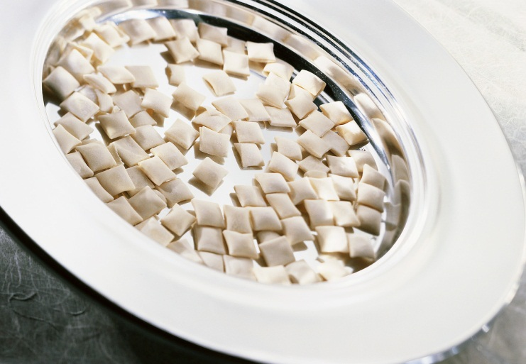
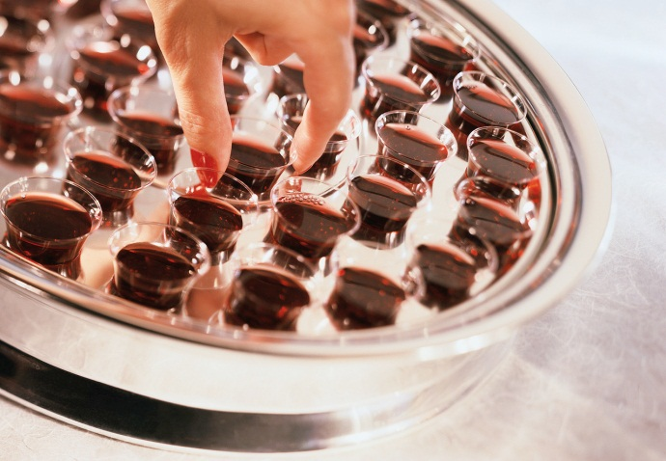
7.怜悯
Compassion
成为牧养群羊的长老(雅各5:14）
ELDERS LEAD THE CHURCH BY CARING FOR THE FLOCK (James 5:14)
长老通过照顾羊群来带领教会
Elders lead the church by caring for the flock (James 5:14)
长老热爱照顾羊群的灵命和身体需要
Elders lovingly care for the spiritual and physical needs of the sheep

Slide 10
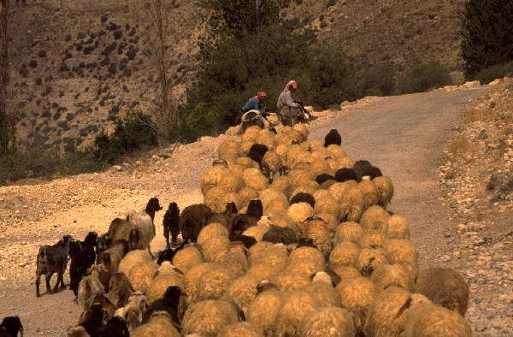
8.动机
Motivation
长老牧养 羊群引领教会
ELDERS LEAD THE CHURCH BY SHEPHERDING GOD’S FLOCK (彼得前 1 Peter 5:1-5)
1.长老通过监督来牧养神的羊群
Elders shepherd God’s flock through the exercise of oversight.
2.牧养神羊群的长老将得到奖赏
Elders who shepherd God’s flock will be rewarded.
3.牧养神羊群的长老必须付上代价带领别人
Elders who shepherd God’s flock must be worthy of being followed.

Slide 11
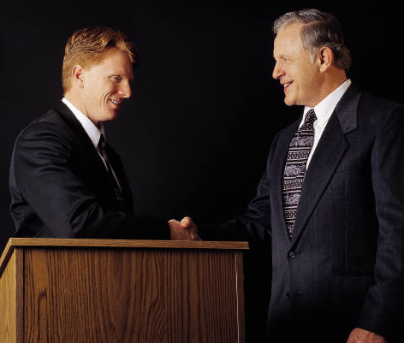
9.决议
Resolution
长老解决羊群中的教义和人际冲突 （徒15：1-2; 6; 19-22）
ELDERS LEAD THE CHURCH BY RESOLVING DOCTRINAL AND PERSONAL CONFLICTS IN THE FLOCK (Acts 15:1-2; 6; 19-22)

Slide 12
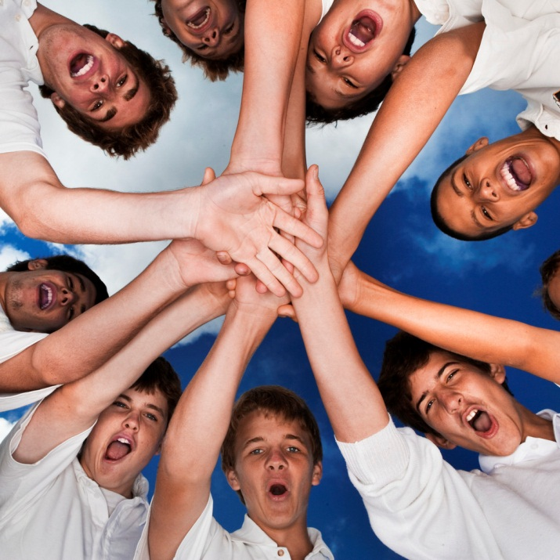
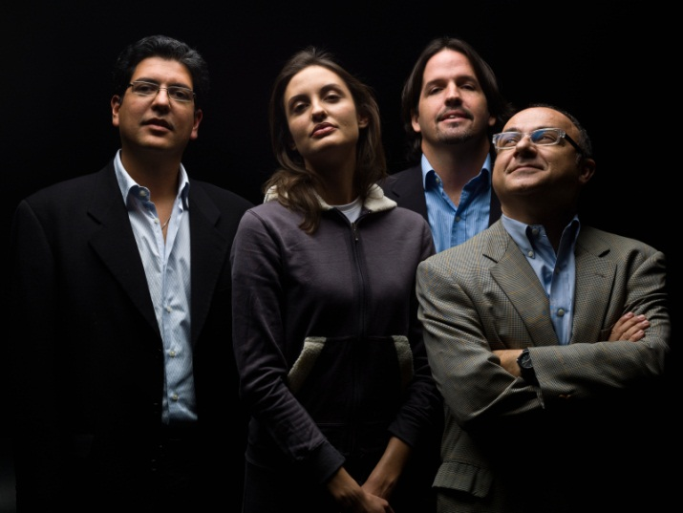
健康教会的执行者/管理者
A HEALTHY CHURCH BOARD
他们一起团队事奉
They work together as a team
2. 他们有勇气的表现
They display courage
3. 他们互相信任和尊重
They show trust and respect
4. 他们很好地处理分歧
They deal well with disagreements

Slide 13
Black

Slide 14
教会动力学 • BibleStudyDownloads.org
免费获得此演示文稿
Notes:
Church Dynamics (cd)

