Slide 1
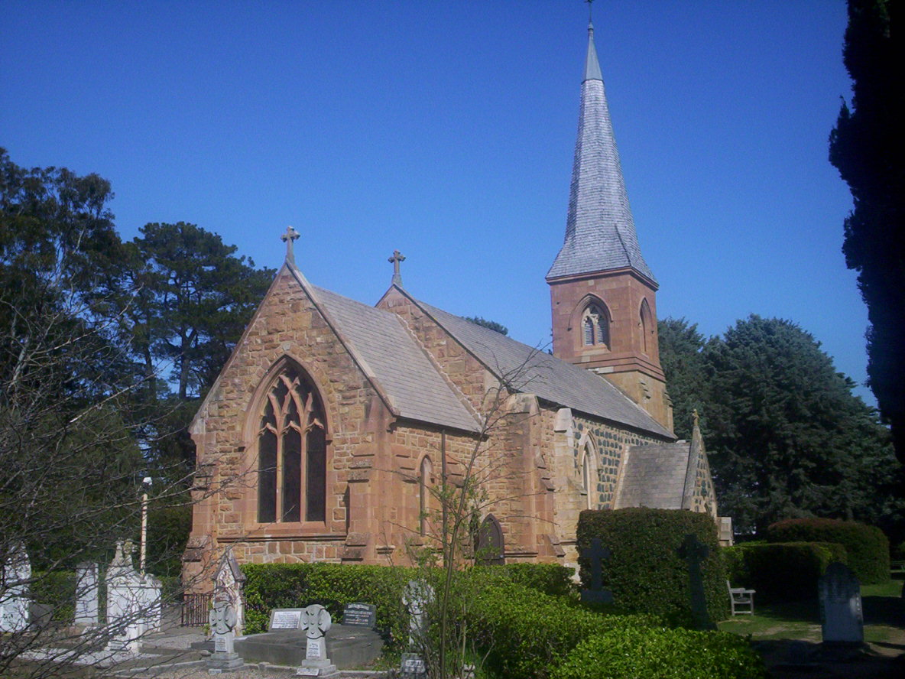
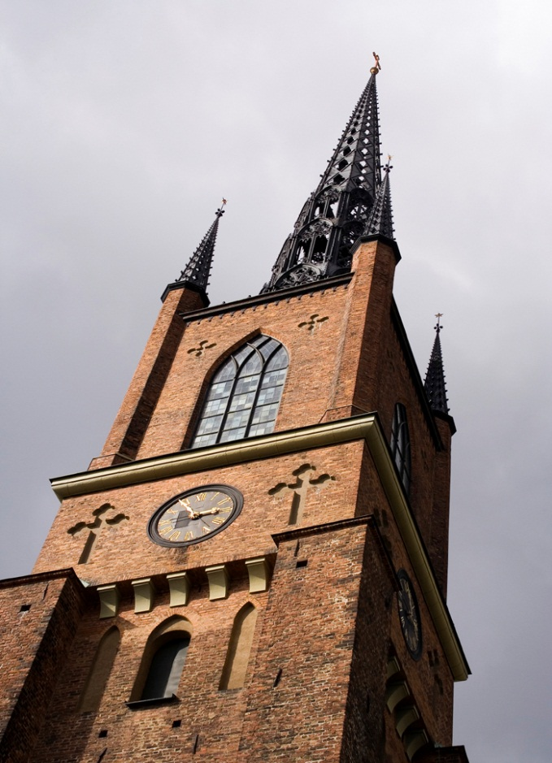
教会动力学 CHURCH DYNAMICS
Designed by Dr. Scott Wooddell Uploaded by Dr. Rick Griffith • Singapore Bible College All files in many languages for free download at BibleStudyDownloads.org

Slide 2
教会动力学 CHURCH DYNAMICS
主耶稣说,
“我会建立我的教会，死亡的权势不能胜过他 馬太” 16:18
Jesus said, “I will build my church and the gates of hades will not overpower it.”
(Matthew 16:18)

Slide 3
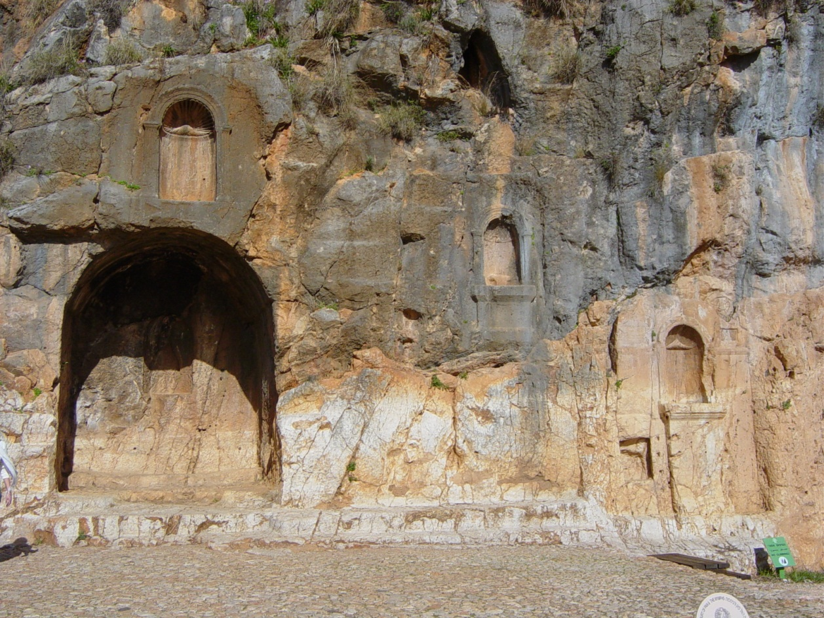
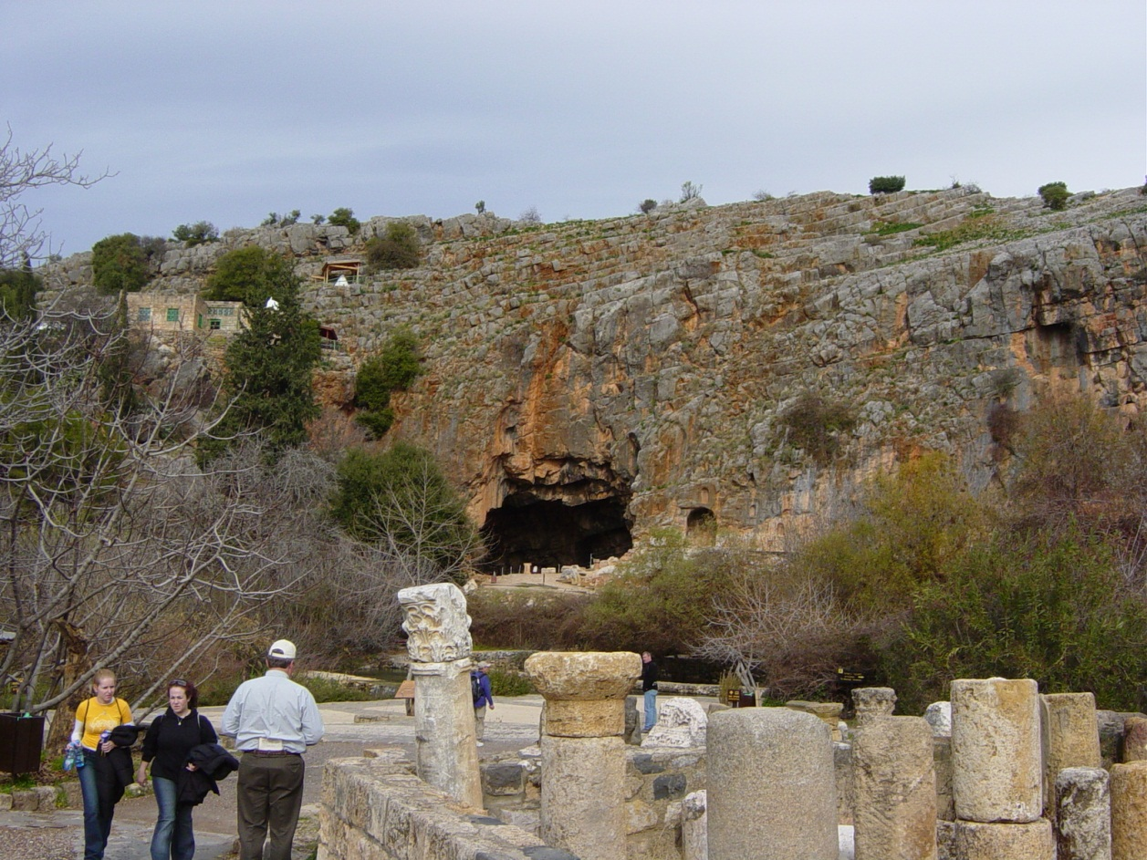
教会动力学 CHURCH DYNAMICS
主耶稣说,
” 我会建立我的教会，死亡的权势不能胜过他”
Jesus said, “I will build my church and the gates of hades will not overpower it.” (Matthew 16:18)

Slide 4
教会动力学 CHURCH DYNAMICS
教会的目的是什么？ What is the purpose of the church?
教会应该如何组织？ How should it be organized?
谁来领导教会？ Who should lead it?
教会该有哪些活动与事工？ What kind of activities and ministries should it have?

Slide 5
理解教会的性质和目的 UNDERSTANDING THE NATURE AND PURPOSE OF THE CHURCH
在新约中翻译的“教堂”一词是希腊语的“ Ekklesia”
The word translated “church” in the New Testament is the Greek word “Ekklesia.”
非基督徒使用（使徒19:32,41）Non-Christian usage (Acts 19: 32, 41)
基督徒使用(使徒 13: 1) Christian usage (Acts 13:1)

Slide 6
理解教会的性质和目的 UNDERSTANDING THE NATURE AND PURPOSE OF THE CHURCH
EKKLESIA
非基督教徒
NON
CHRISTIAN
Acts 19:32
地方教会
LOCAL
CHURCH
Acts 13:1
普世教会
UNIVERSAL
CHURCH
Ephesians 5:25

Slide 7
教会的目的 THE PURPOSE OF THE CHURCH
“所以，你们要去使万民作我的门徒，奉父子圣灵的名，给他们施洗.
我吩咐你们的一切，都要教导他们遵守”
“Therefore, go and make disciples of all nations, baptizing them in the name of the Father and of the Son and of the Holy Spirit and teaching them to obey everything I have commanded you” (馬太 Matthew 28:19-20)
宣传福音
EVANGELIZE THE LOST
培育门徒
DISCIPLE THE SAINTS

Slide 8
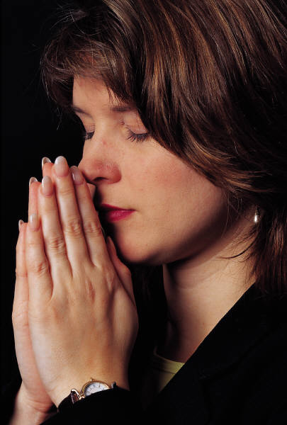
教会的比喻 THE METAPHORS OF THE CHURCH
基督的身体
THE BODY OF CHRIST
基督的新娘
THE BRIDE OF CHRIST
上帝的圣殿
THE TEMPLE OF GOD
上帝的祭司
THE PRIESTHOOD OF GOD
上帝的羊群
THE FLOCK OF GOD

Slide 9
教会的定义 A DEFINITION OF THE CHURCH
教会是信仰基督的群体在地上的生活，共同团结合一的实现四个目标：敬拜、教导、传福音和团契。
The church is the living community of people who trust in Christ Jesus, organized and serving in unity to fulfill corporately a four-fold purpose: worship, edification, evangelism and fellowship.

Slide 10
Black

Slide 11
教会动力学 • BibleStudyDownloads.org
免费获得此演示文稿
Notes:
Church Dynamics (cd)

