Slide 1
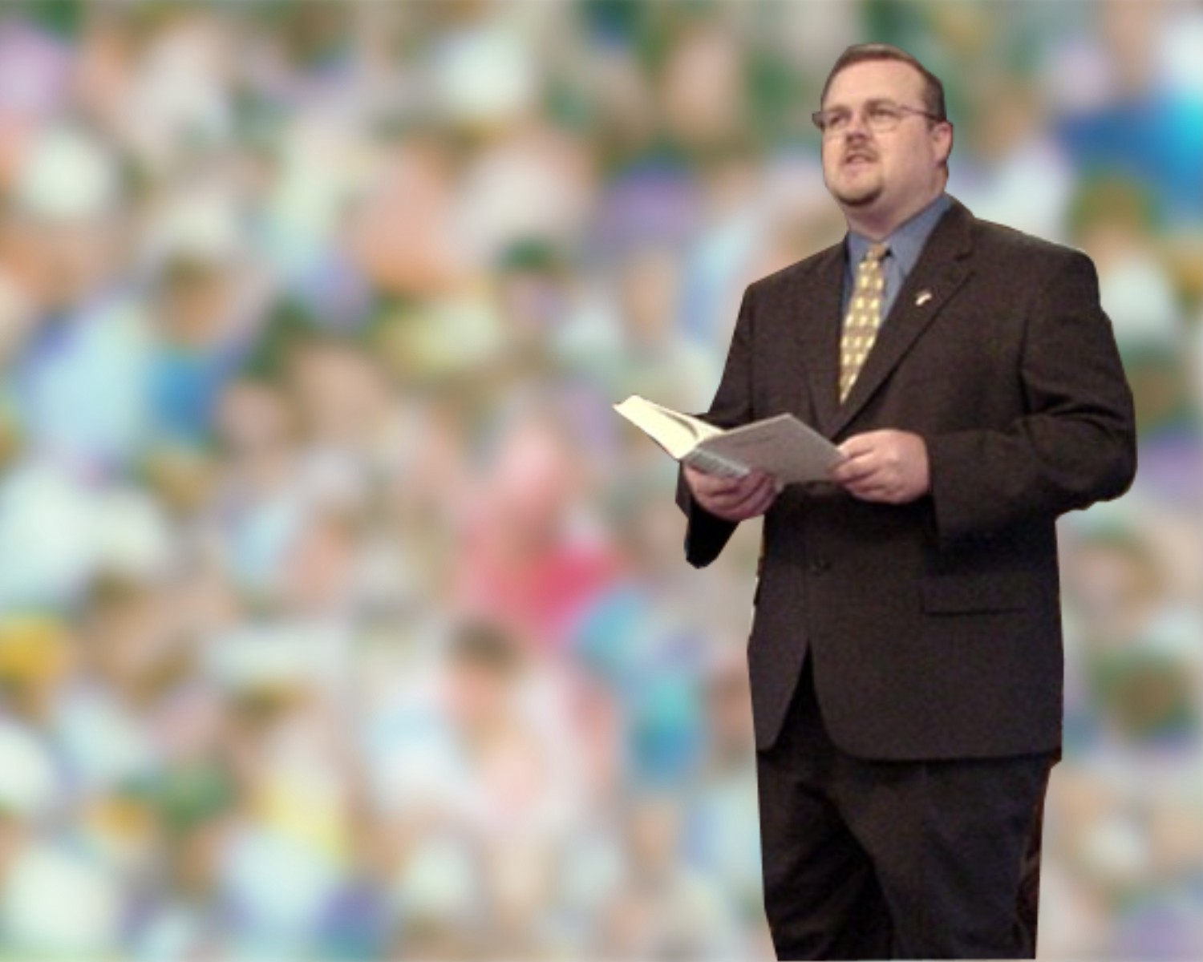
应用经文
神的话语显示在现实生活中
顾力凯博士 新加坡神学院
www.biblestudydownloads.com

Slide 2
准备解经的过程 The Preparing Expository Sermons
27-28, 251
Based on Ramesh Richard's text, Preparing Expository Sermons
经文
讲道
5 理想的听众回应
头脑
4 三个发展性的问题
目的的骄梁
应用
3.2 解经的概念
CPT
心
CPS
6 讲道的概念
解经
7 讲道的概述
8 明晰
9 开场白/结论
3.1 解经的概述
结构
骨骼
结构
2 分析经文
研究
肉体
讲道
10 MSS &
讲道
观察
1 选择经文
白色的字体显示10个步骤 － 改编 于 Haddon Robinson, Biblical Preaching (notes, 105)

Slide 3
Restore People in Sin
把人从罪恶中挽回过来
72
“弟 兄 们 ， 若 有 人 偶 然 被 过 犯 所 胜 ， 你 们 属 灵 的 人 就 当 用 温 柔 的 心 把 他 挽 回 过 来 ； 又 当 自 己 小 心 ， 恐 怕 也 被 引 诱 。.”
加拉太书 6:1

Slide 4
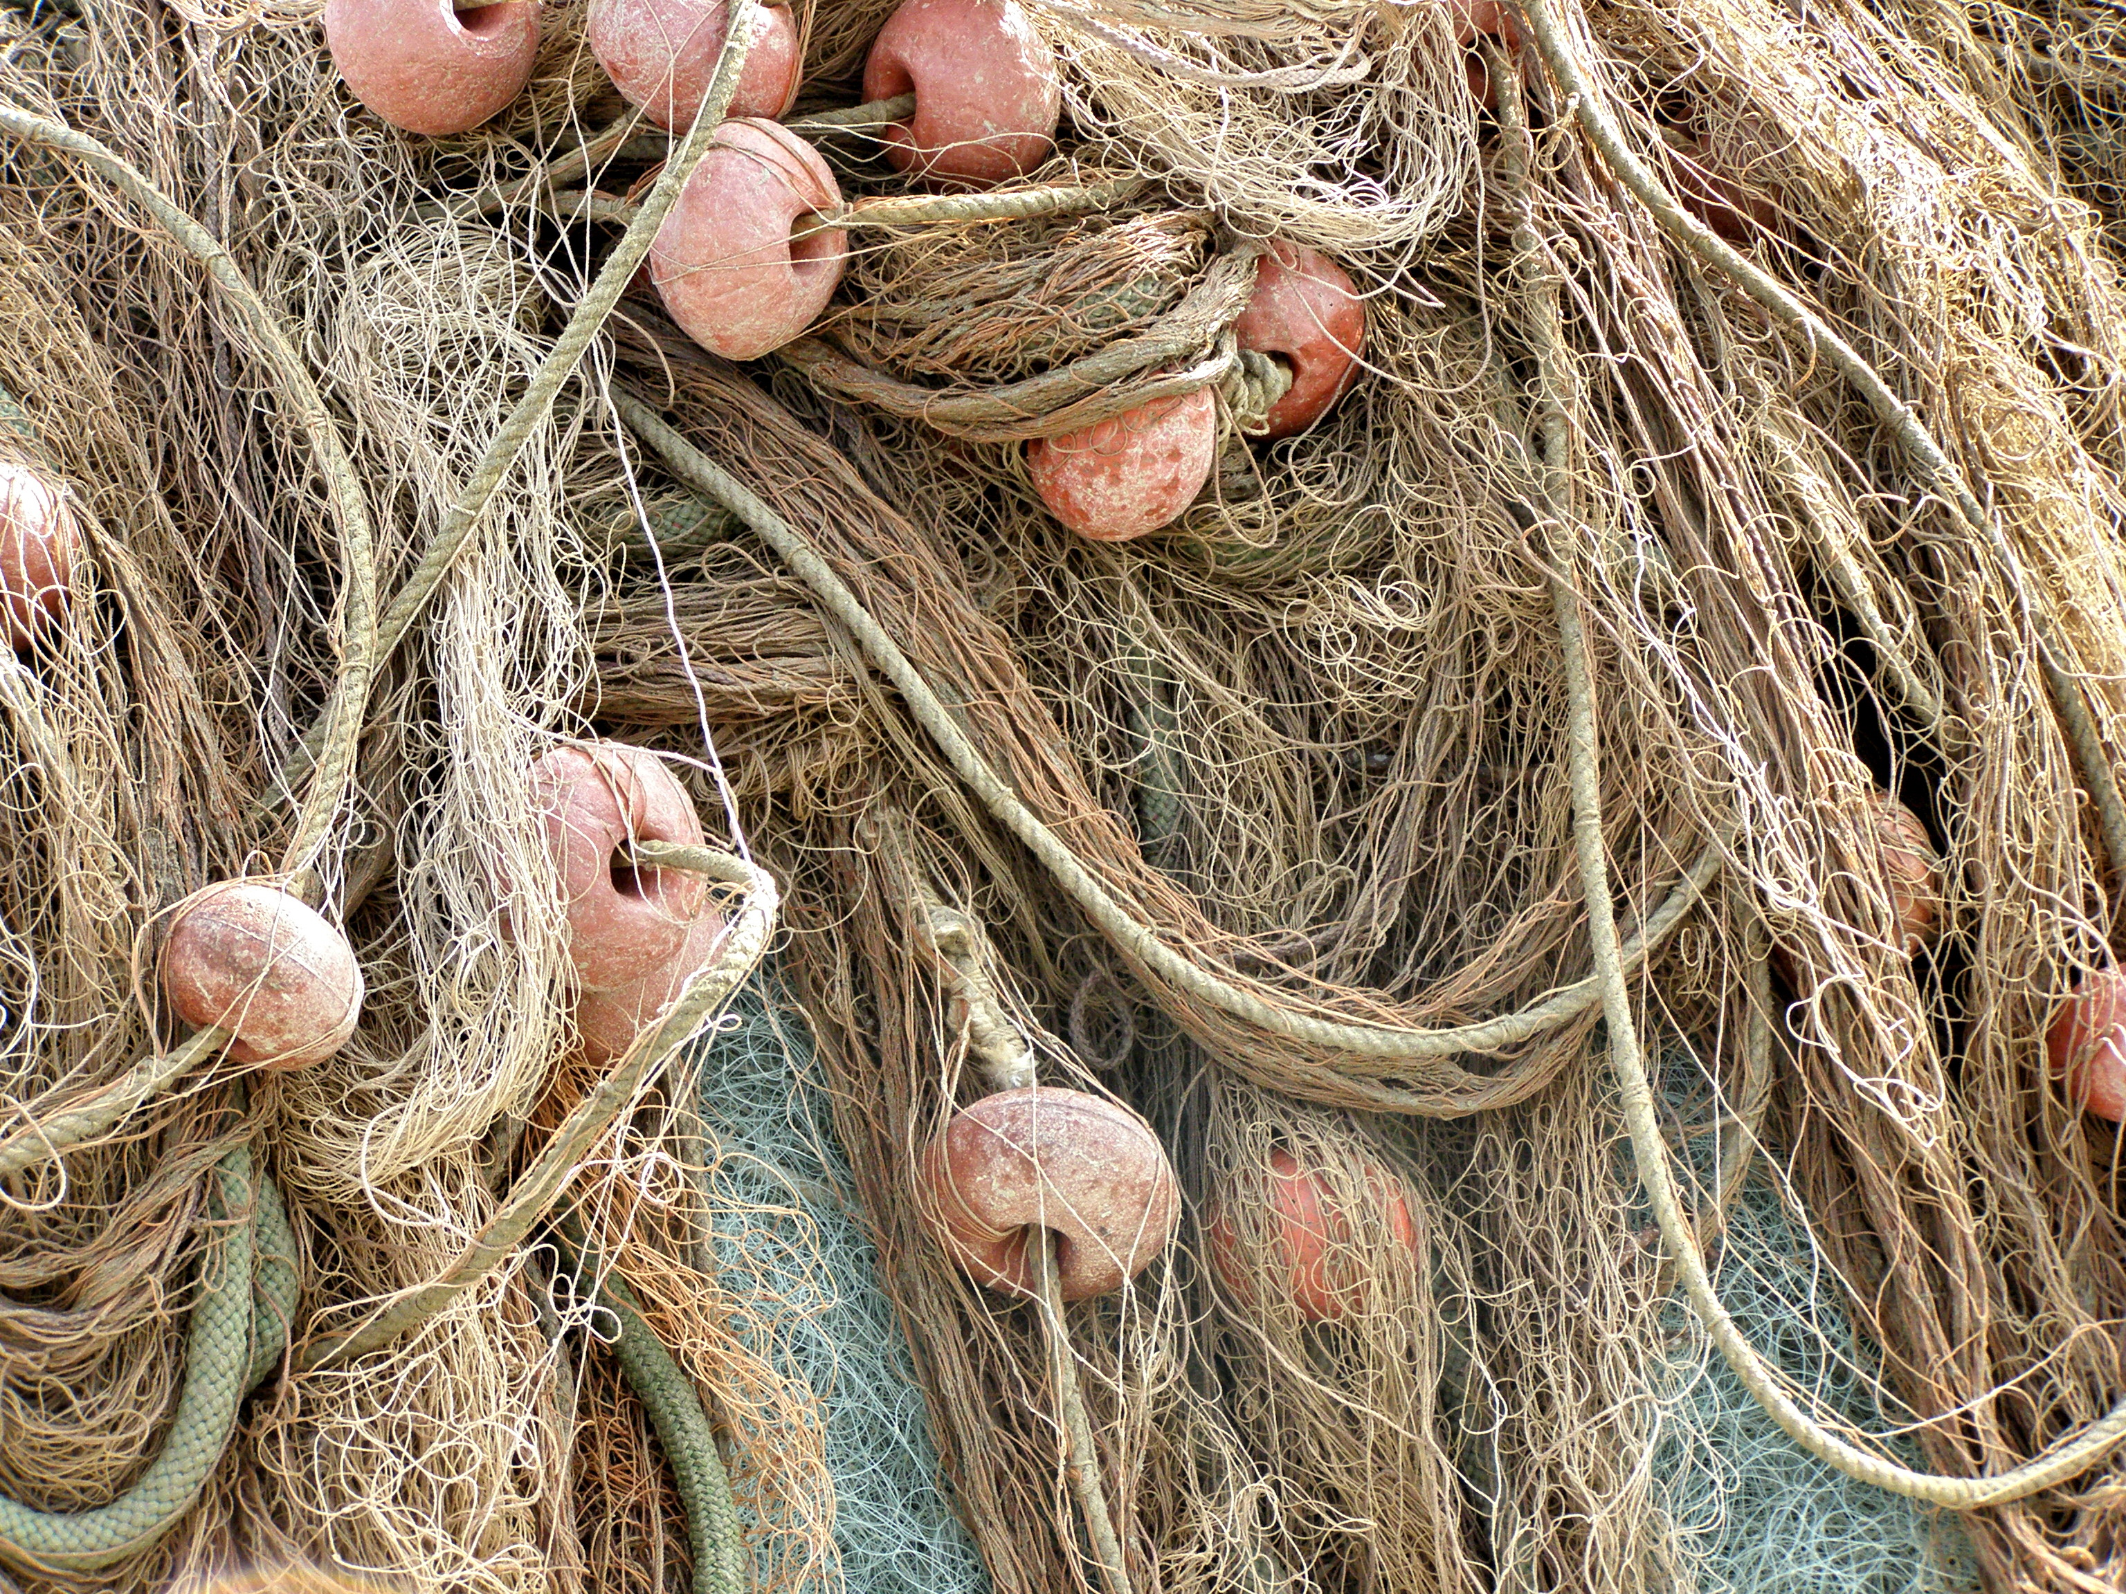
A. 有些图解说明只能说明一种概念，因他们来自一个无关的生活领域。
72
修补渔网

Slide 5
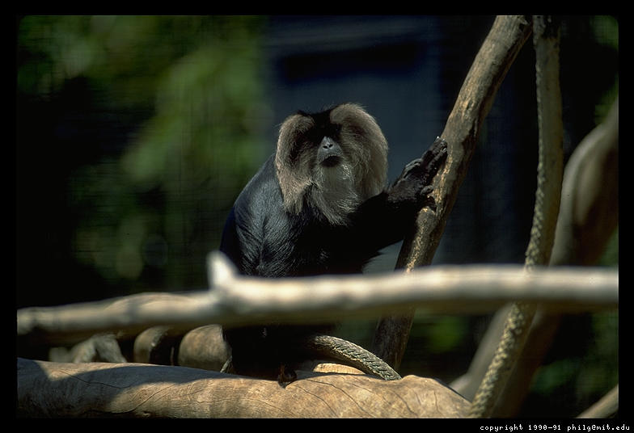
A. 有些图解说明只能说明一种概念，因他们来自一个无关的生活领域.
72
“贪 财 是 万 恶 之 根 …” (提 摩 太 前 書 6:10)
猴子与金属丝
The monkey & tinsel
“不要贪财”
Notes:
Monkeys put their hands in hollowed out logs to grab the tinsel ball inside. However, their clenched hands over the tinsel becomes too large to withdraw from the log. Since they are unwilling to let go of the tinsel, hunters easily club them to death. This illustration has been used to show the perils of wealth--but all it teaches us is how stupid monkeys are! It helps very little to illustrate the point of greed so the sermon time taken is better invested in sharing how a human has gotten trapped due to greed.

Slide 6
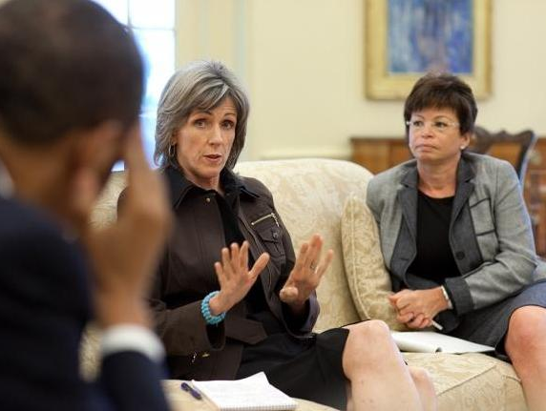
B. 更好的图解说明应用一种概念， 因它与生活系系相关。
72
修补渔网
恢复人的关系
Notes:
Instead of restoring nets, share about a genuine reconciliation between people.

Slide 7
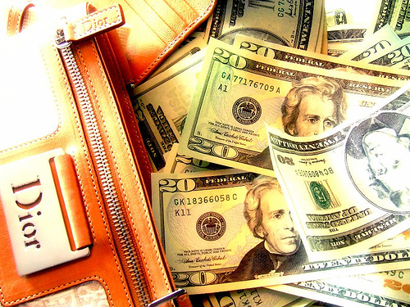
B. 更好的图解说明应用一种概念， 因它与生活系系相关.
72
“贪财是万恶之根。。。（提摩太书 6:10)
The monkey & tinsel
牧师被引诱
“不要贪财
Notes:
Instead of the monkey and tinsel story, to illustrate greed, share about a person who gave up ministry simply for better pay.

Slide 8
Law of Application: Model
51
Resource
Method
Result
“All Scripture is inspired by God and profitable for teaching, for reproof, for correction, for training in righteousness; so that the man of God may be adequate, equipped for every good work (2 Tim. 3:16-17 NAU)
D
Doctrine
Belief
C
Correction
I
Instruction
Behavior
R
Reproof
Source: Bruce Wilkinson, 7 Laws of the Learner (Walk Thru The Bible)

Slide 9
Application Maxims
51
Maxim 1: Application is the central reason for God's revelation.
Maxim 2: Application is the responsibility of the teacher.
Maxim 3: Application and information should be balanced.
Maxim 4: Application focuses Scripture on students' needs.
Maxim 5: Application has the maximum influence when the student sees its biblical basis
Maxim 6: Application that has impacted the teacher tends to impact the student
Maxim 7: Application must ultimately lead the student from studying the Bible to obeying the Lord.
Source: Bruce Wilkinson, 7 Laws of the Learner (Walk Thru The Bible)

Slide 10
Application Method
54
Explain
Distill
Personalize
Persuade
Evaluate
Source: Bruce Wilkinson, 7 Laws of the Learner (Walk Thru The Bible)

Slide 11
Application Maximizers
54
Maximizer 1: Ask God to develop in you an applier's heart.
Maximizer 2: Prepare applications in relation to your students' needs.
Maximizer 3: Plan all parts of the lesson to contribute to the application.
Maximizer 4: Lead your student beyond general applications to specific steps of obedience.
Maximizer 5: Illustrate the application with Scripture, history, personal experience and imagination.
Maximizer 6: Employ an appropriate style when calling for commitment.
Maximizer 7: Strengthen application with student accountability.
Source: Bruce Wilkinson, 7 Laws of the Learner (Walk Thru The Bible)

Slide 12
圣经学习链接地址 biblestudydownloads.com
免费获得该讲解!
圣经学习 下载
圣经研读材料链接地址 biblestudydownloads.com
Notes:
The explanation for free!
Bible Study materials link address (top) translated by Michele Ang 15 Jan 2015
Bible study (bottom)

Slide 13
Black

