Slide 1
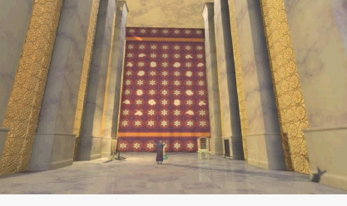
喻象语言
One key to interpreting properly…
Evocative language for effect
Dr. Rick Griffith, Singapore Bible College
www.biblestudydownloads.com

Slide 2
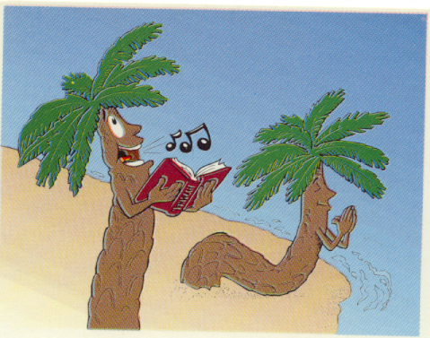
Title Slide
棕榈
诗篇

Slide 3
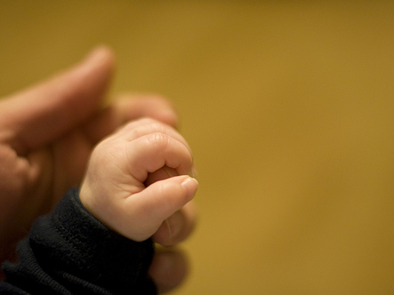
What is Poetry?
In the next 30 seconds define poetry to the person next to you

Slide 4

文学结构 Structure
388c
P 13
韵步
离合体
平行体

Slide 5

The Key:
Hebrew Parallelism
388c
P 13

Slide 6
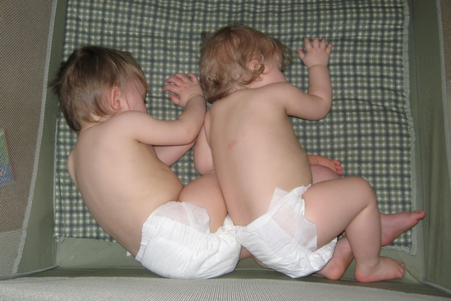
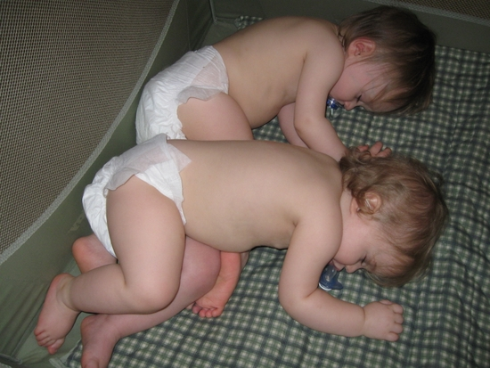
What is Parallelism?
388c
P 13

Slide 7
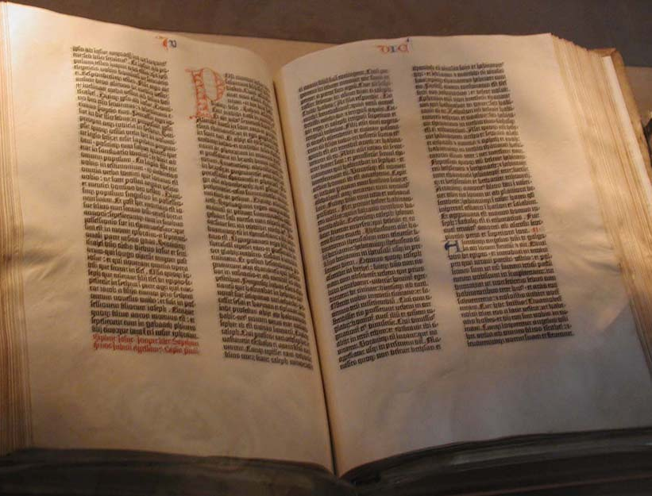
一 同义平行 Synonymous
1）最基本的平行句
第二行重複第一行的意思， 在思想上沒有任何增減。
詩十九2
這日到那日發出言語。
這夜到那夜傳出知識。

Slide 8
390
P 13
Synonymous: 2nd line restates the 1st in the same or similar form
Psalm 2:3 “Let us break their chains,” they say, “and throw off their fetters.”

Slide 9
390
P 13
Synonymous: 2nd line restates the 1st in the same or similar form
Psalm 2:3 “Let us break their chains,” they say, “and throw off their fetters.”

Slide 10
390
P 13
Synonymous: 2nd line restates the 1st in the same or similar form
Psalm 2:3 “Let us break their chains,” they say, “and throw off their fetters.”
Psalm 10:1 Why, O LORD, do you stand far off? Why do you hide yourself in times of trouble?

Slide 11
390
P 13
Synonymous: 2nd line restates the 1st in the same or similar form
Psalm 2:3 “Let us break their chains,” they say, “and throw off their fetters.”
Psalm 10:1 Why, O LORD, do you stand far off? Why do you hide yourself in times of trouble?

Slide 12

390
P 13
Psalm 19:2 Day after day they pour forth speech; night after night they display knowledge.

Slide 13

390
P 13
Psalm 19:2 Day after day they pour forth speech; night after night they display knowledge.

Slide 14
390
P 13
Psalm 19:2 Day after day they pour forth speech; night after night they display knowledge.
Psalm 27:1 The LORD is my light and my salvation—whom shall I fear? The LORD is the stronghold of my life— of whom shall I be afraid?

Slide 15
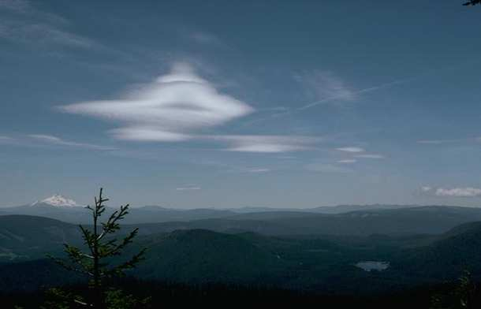
390
P 13
Psalm 19:2 Day after day they pour forth speech; night after night they display knowledge.
Psalm 27:1 The LORD is my light and my salvation—whom shall I fear? The LORD is the stronghold of my life— of whom shall I be afraid?

Slide 16
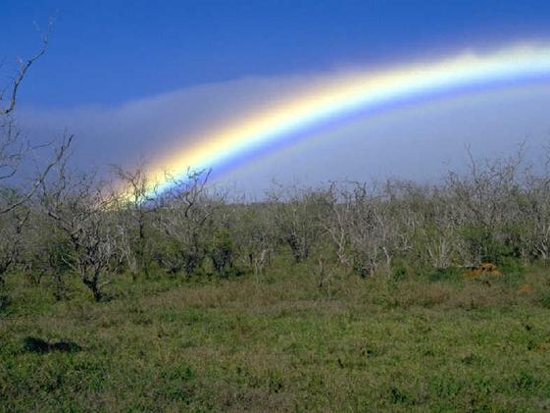
390
P 13
Psalm 19:2 Day after day they pour forth speech; night after night they display knowledge.
Psalm 27:1 The LORD is my light and my salvation—whom shall I fear? The LORD is the stronghold of my life— of whom shall I be afraid?

Slide 17

390
P 13
Psalm 19:2 Day after day they pour forth speech; night after night they display knowledge.
Psalm 27:1 The LORD is my light and my salvation—whom shall I fear? The LORD is the stronghold of my life— of whom shall I be afraid?

Slide 18
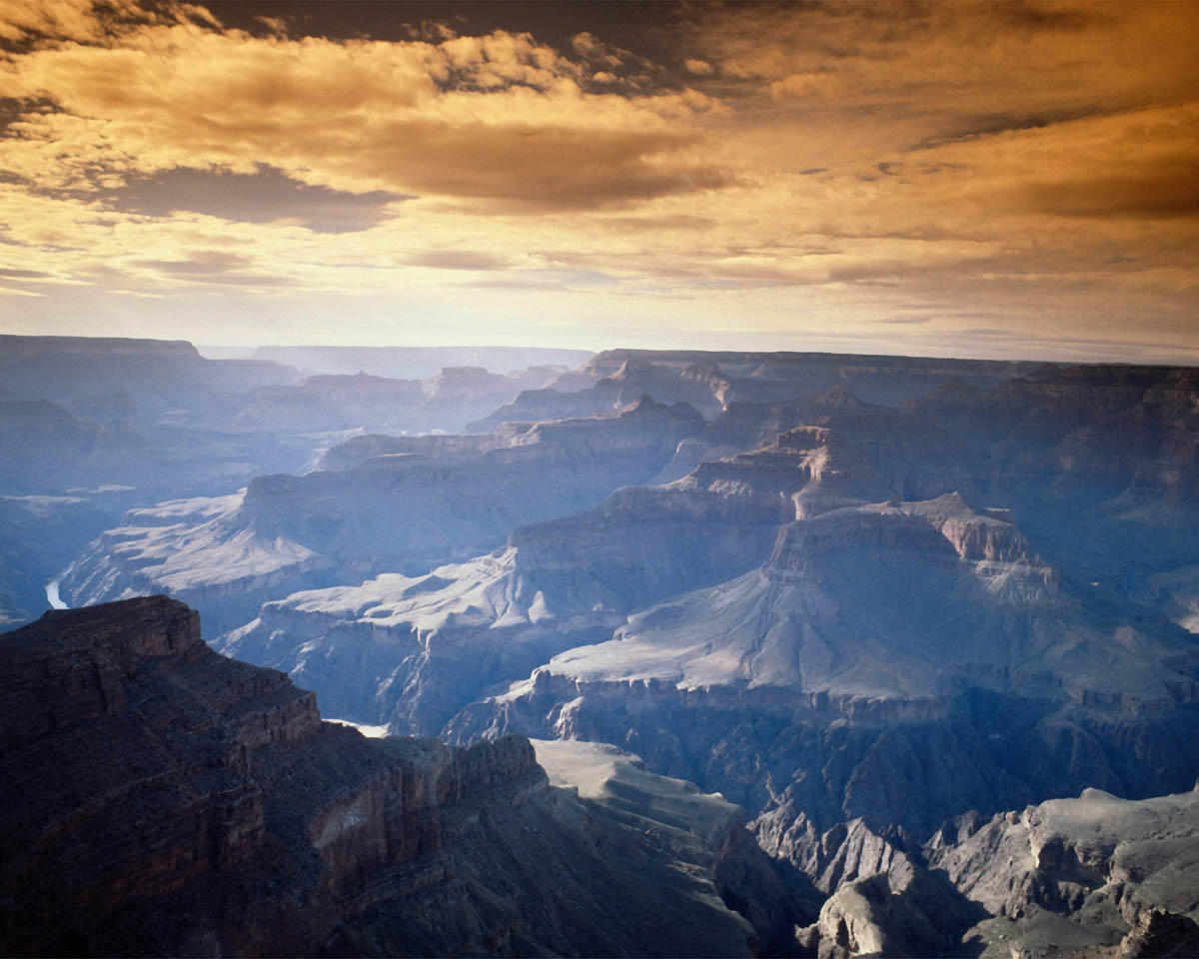
390
P 13
Psalm 34:1 Glorify the LORD with me; let us exalt his name together.

Slide 19
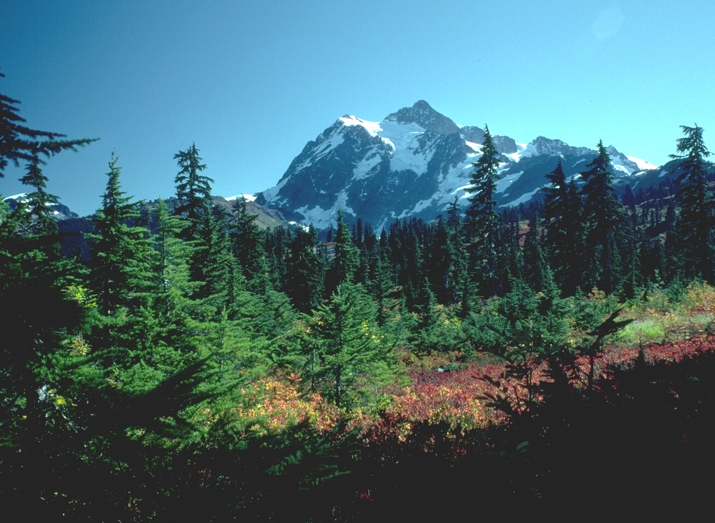
390
P 13
Psalm 34:1 Glorify the LORD with me; let us exalt his name together.

Slide 20
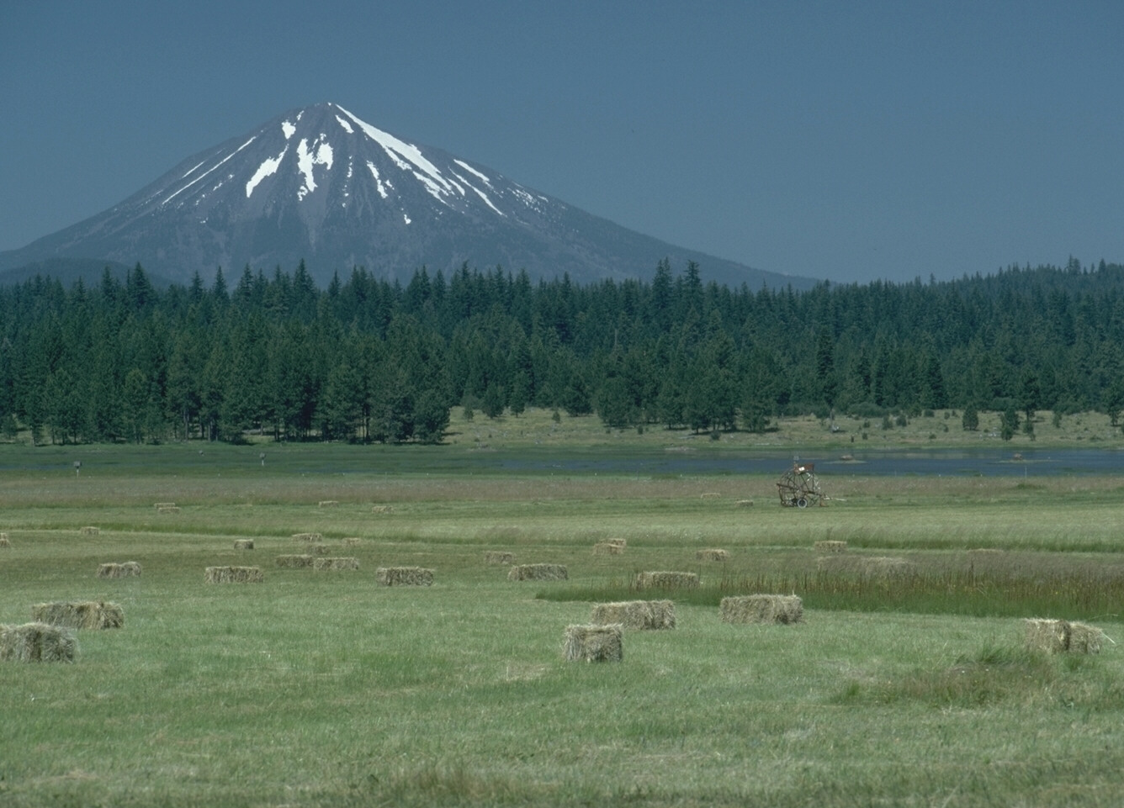
390
P 13
Psalm 34:1 Glorify the LORD with me; let us exalt his name together.

Slide 21

390
P 13
Psalm 34:1 Glorify the LORD with me; let us exalt his name together.

Slide 22
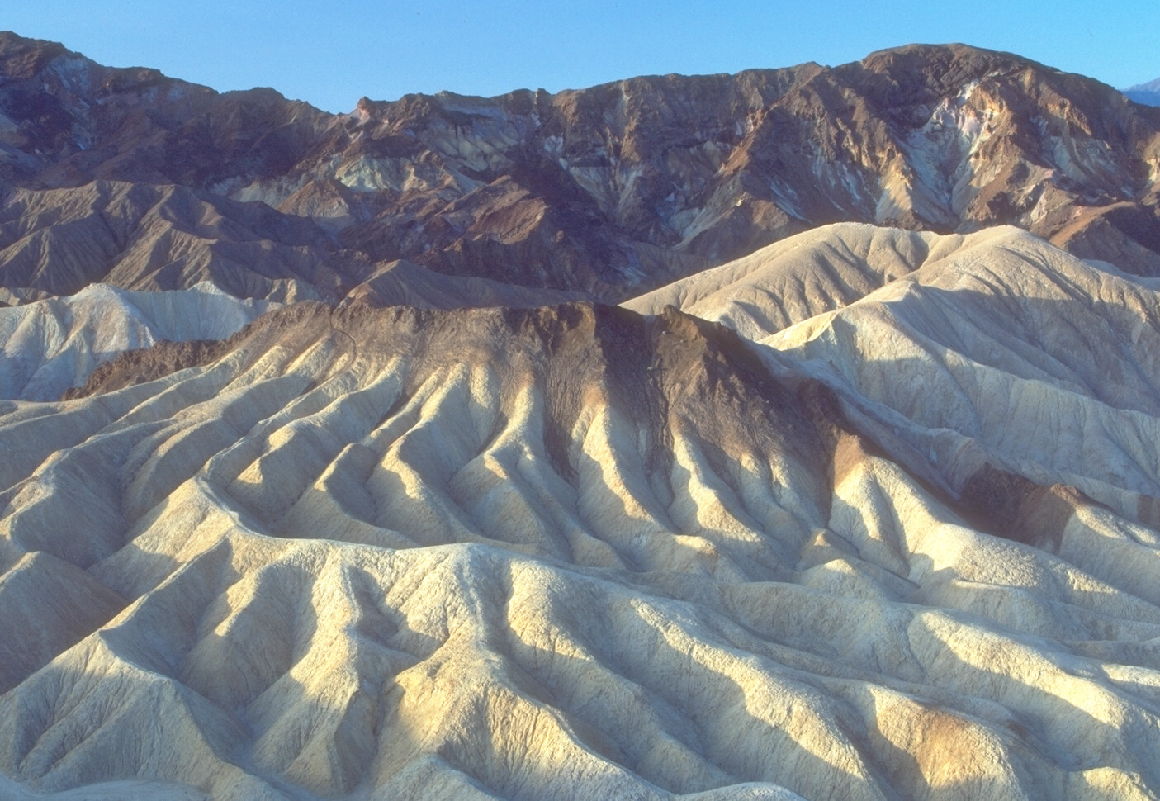
391
P 14
Antithetic: 2nd line offers a contrast of thought to the 1st
Psalm 1:6 For the LORD watches over the way of the righteous,
but the way of the wicked will perish.

Slide 23
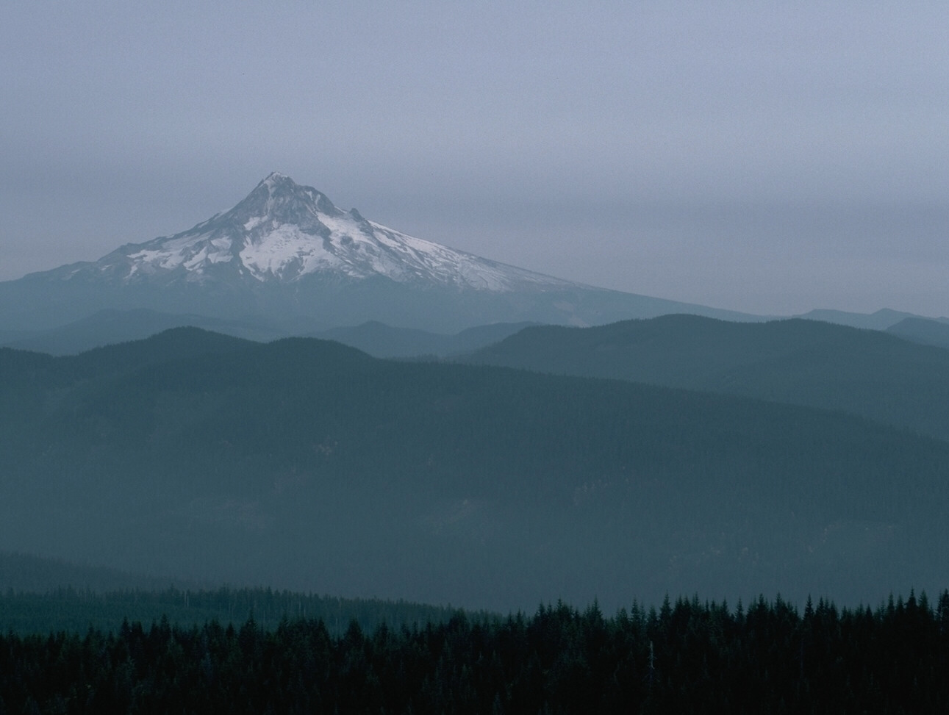
391
P 14
Antithetic: 2nd line offers a contrast of thought to the 1st
Psalm 1:6 For the LORD watches over the way of the righteous, but the way of the wicked will perish.

Slide 24

391
P 14
Antithetic: 2nd line offers a contrast of thought to the 1st
Psalm 1:6 For the LORD watches over the way of the righteous, but the way of the wicked will perish.

Slide 25
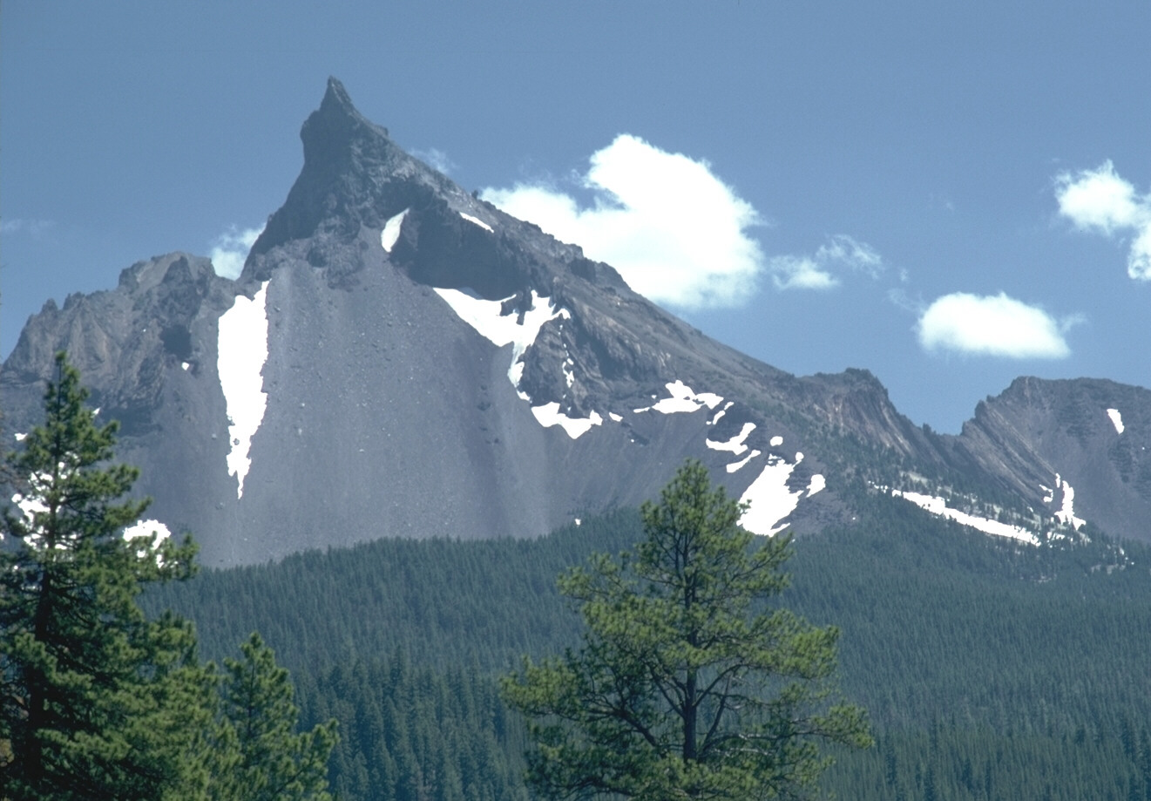
391
P 14
Antithetic: 2nd line offers a contrast of thought to the 1st
Psalm 1:6 For the LORD watches over the way of the righteous, but the way of the wicked will perish.

Slide 26
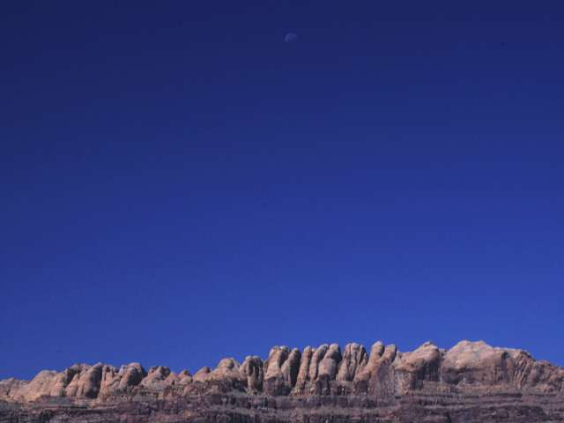
391
P 14
Antithetic: 2nd line offers a contrast of thought to the 1st
Psalm 37:9 For evil men will be cut off, but those who hope in the LORD will inherit the land.

Slide 27
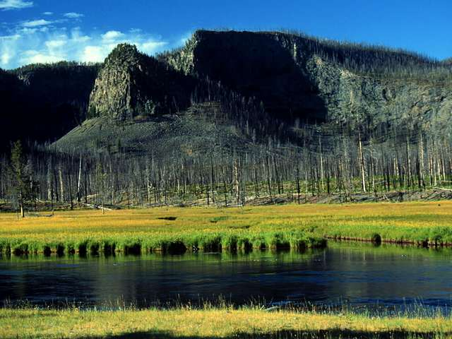
391
P 14
Antithetic: 2nd line offers a contrast of thought to the 1st
Psalm 37:9 For evil men will be cut off, but those who hope in the LORD will inherit the land.

Slide 28
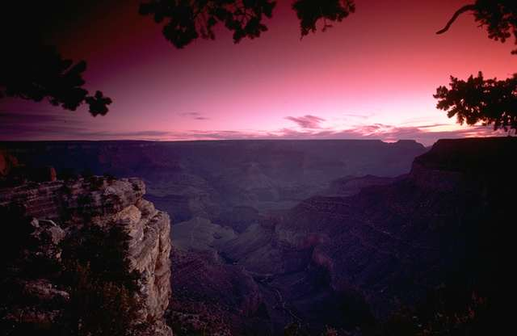
391
P 14
Antithetic: 2nd line offers a contrast of thought to the 1st
Psalm 37:9 For evil men will be cut off, but those who hope in the LORD will inherit the land.

Slide 29
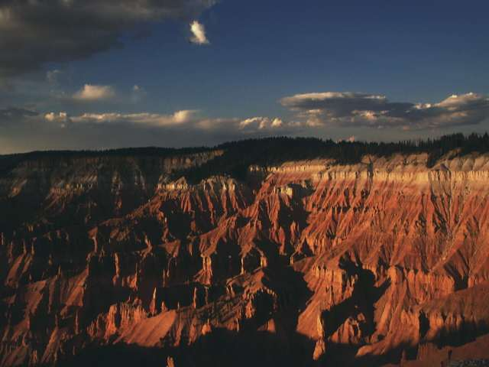
391
P 14
Antithetic: 2nd line offers a contrast of thought to the 1st
Psalm 37:9 For evil men will be cut off, but those who hope in the LORD will inherit the land.

Slide 30
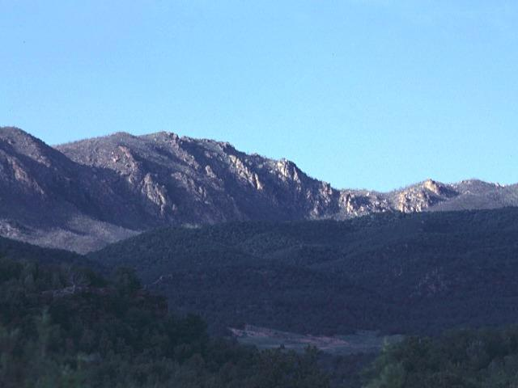
391
P 14
Emblematic: 2nd line reproduces the 1st line by metaphorical comparison
Psalm 1:4 Not so the wicked! They are like chaff that the wind blows away.

Slide 31
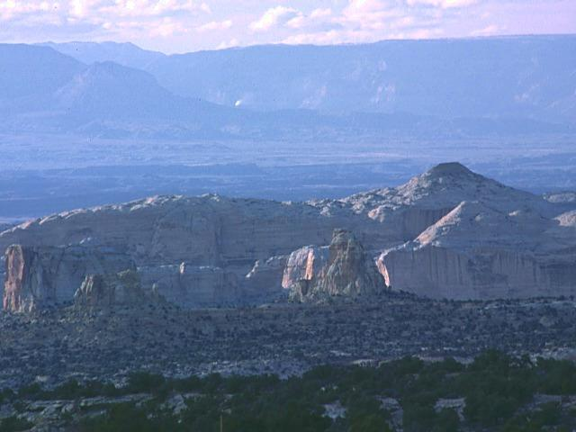
391
Synthetic (Incomplete with Compensation): 2nd line develops the thought of the 1st line
P 14
Psalm 95:3 For the LORD is the great God, the great King above all gods.

Slide 32
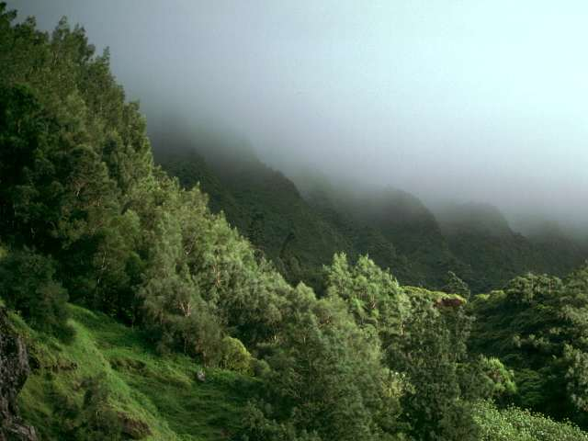
391
Synthetic Climatic: 2nd line repeats the first, but omits the last term
P 14
Psalm 29:1-2
Ascribe to the LORD, O mighty ones, ascribe to the LORD glory and strength.
Ascribe to the LORD the glory due his name; worship the LORD in the splendor of his holiness.

Slide 33
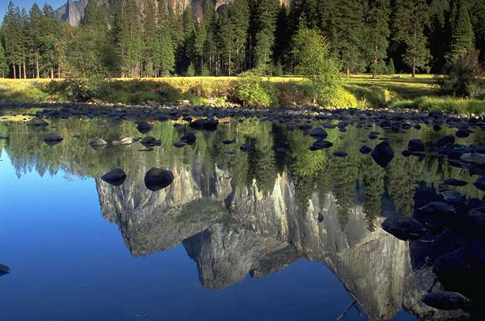
391
P 14
Synthetic (Incomplete without Compensation): lines of different length with only some terms parallel
Psalm 6:1
“O LORD, do not rebuke me in Your anger
or discipline me in Your wrath.”

Slide 34
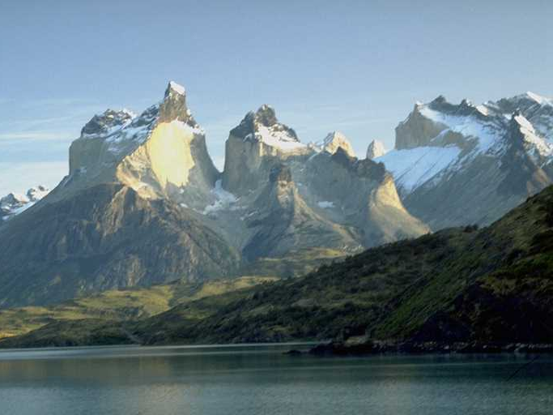
391
P 14
Synthetic Formal: 2nd line develops the thought of the 1st line
Psalm 2:6 “I have installed my King on Zion, my holy hill.”

Slide 35
对句法
388c
那是，他要在他的怒中责备他们
在烈怒中惊吓他们。
（诗 2:5）
文字上的平行：
责备与惊吓
怒与烈怒 在意思上平行。
文法上的平行：
动词 -- 宾语 -- 介词短语
介词短语 -- 动词 – 宾语
Similarities & Differences
Two categories of Parallelism :
Grammatical Parallelism (syntax)
Semantic Parallelism (meaning of words)

Slide 36

解开喻象语言
392
P 15

Slide 37
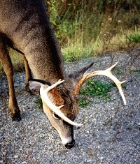

明喻 Simile
甲象乙/甲如同乙
神 啊 ， 我 的 心 切 慕 你 ，
如 鹿 切 慕 溪 水 。诗篇42：1

Slide 38
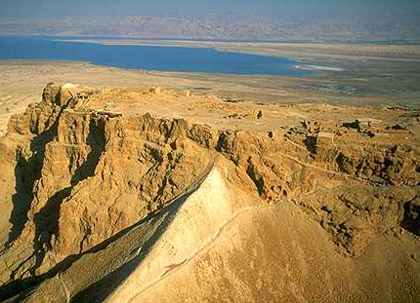
暗喻、隐喻 Metaphor
甲是乙
耶 和 华 是 我 的 岩 石 ， 我 的 山 寨 ， 我 的 救 主 ， 我 的 神 ， 我 的 磐 石 ， 我 所 投 靠 的 。诗篇18：2

Slide 39
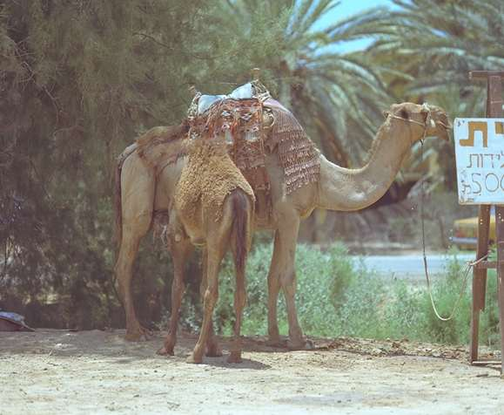
夸张法 Hyperbole
故意夸大、言过其实
以达到强调的目的
诗119：136
我的眼泪下流成河

Slide 40

拟人法 Personification
将人的特征、行为
加于固定物或动物之上
赛55：12
大山小山必在你们面前发声歌唱，田野的树木也都拍掌

Slide 41


神格拟人法
392
P 15
用人的特征、行为、情感来形容神
诗8：3
我 观 看 你 指 头 所 造 的 天 ，
并 你 所 陈 设 的 月 亮 星 宿 ，

Slide 42
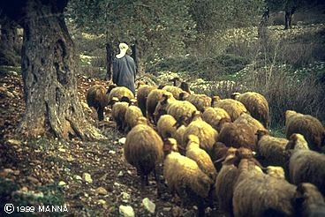
意象
388c
耶和华是我的牧者；
我并不至缺乏。
（诗 23:1）
意象藉由相比来达成文字绘图

Slide 43
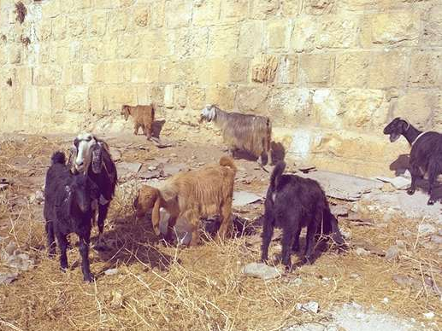
你属于哪一种动物?

Slide 44

诗篇 23 篇
¹ 耶和华是我的牧者，我必不致缺乏。 ² 他使我躺卧在青草地上，领我在可安歇的水边。³ 他使我的灵魂苏醒，为自己的名引导我走义路。⁴ 我虽然行过死荫的幽谷，也不怕遭害，因为你与我同在；你的杖，你的竿，都安慰我。⁵ 在我敌人面前，你为我摆设筵席；你用油膏了我的头，使我的福杯满溢。⁶ 我一生一世必有恩惠慈爱随着我；我且要住在耶和华的殿中，直到永远。

Slide 45
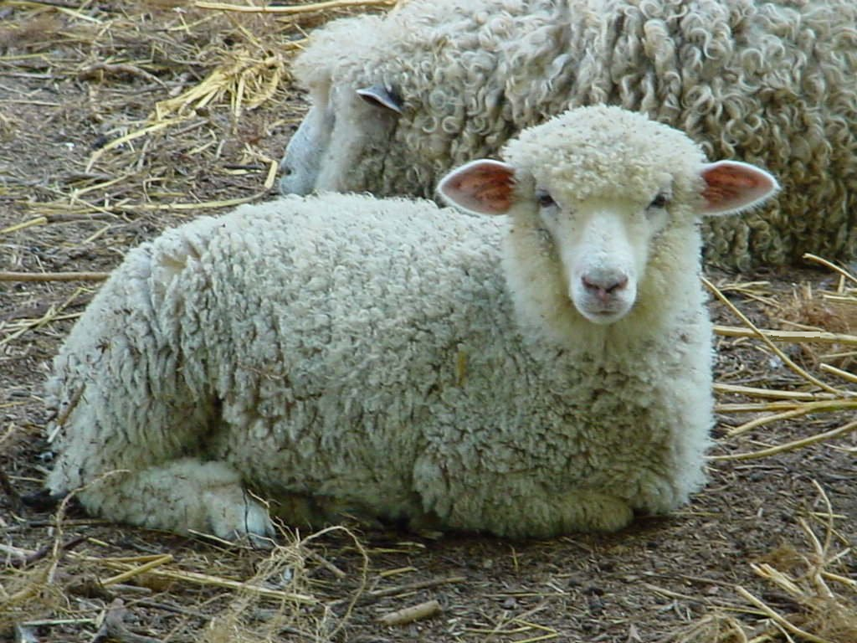
你是一只羊

Slide 46
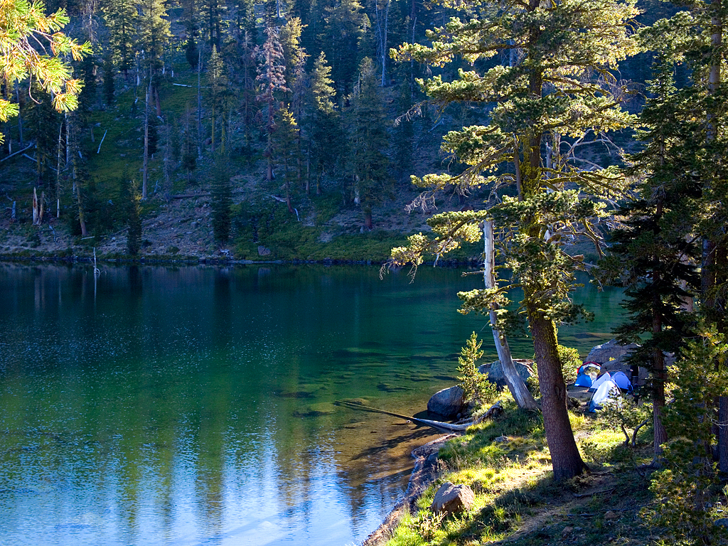
祂领我在可安息的水边

Slide 47
诗篇 23 篇
¹ 耶和华是我的牧者，我必不致缺乏。 ² 他使我躺卧在青草地上，领我在可安歇的水边。³ 他使我的灵魂苏醒，为自己的名引导我走义路。⁴ 我虽然行过死荫的幽谷，也不怕遭害，因为你与我同在；你的杖，你的竿，都安慰我。⁵ 在我敌人面前，你为我摆设筵席；你用油膏了我的头，使我的福杯满溢。⁶ 我一生一世必有恩惠慈爱随着我；我且要住在耶和华的殿中，直到永远。

Slide 48
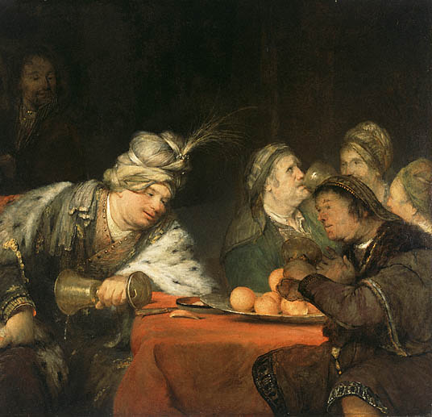
“在我敌人面前，你为我摆设筵席” (第5节)
或
?
羊
得胜筵席

Slide 49


“在我敌人面前，你为我摆设筵席” (第5节)
或
?
绿草地上的“筵席”
字面上的筵席

Slide 50
诗篇 23 篇
¹ 耶和华是我的牧者，我必不致缺乏。 ² 他使我躺卧在青草地上，领我在可安歇的水边。³ 他使我的灵魂苏醒，为自己的名引导我走义路。⁴ 我虽然行过死荫的幽谷，也不怕遭害，因为你与我同在；你的杖，你的竿，都安慰我。⁵ 在我敌人面前，你为我摆设筵席；你用油膏了我的头，使我的福杯满溢。⁶ 我一生一世必有恩惠慈爱随着我；我且要住在耶和华的殿中，直到永远。

Slide 51
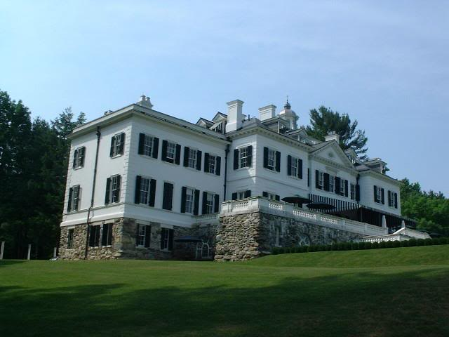
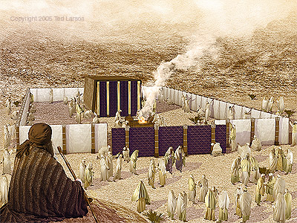
有什么永远住在
“主的殿里”?
或
?
住在天堂般的房子里
圣殿敬拜

Slide 52
Colossians 4:6 EO & HO
Let your speech always
be with grace,
as though seasoned with salt,
so that you will know
how you should respond
to each person

Slide 53
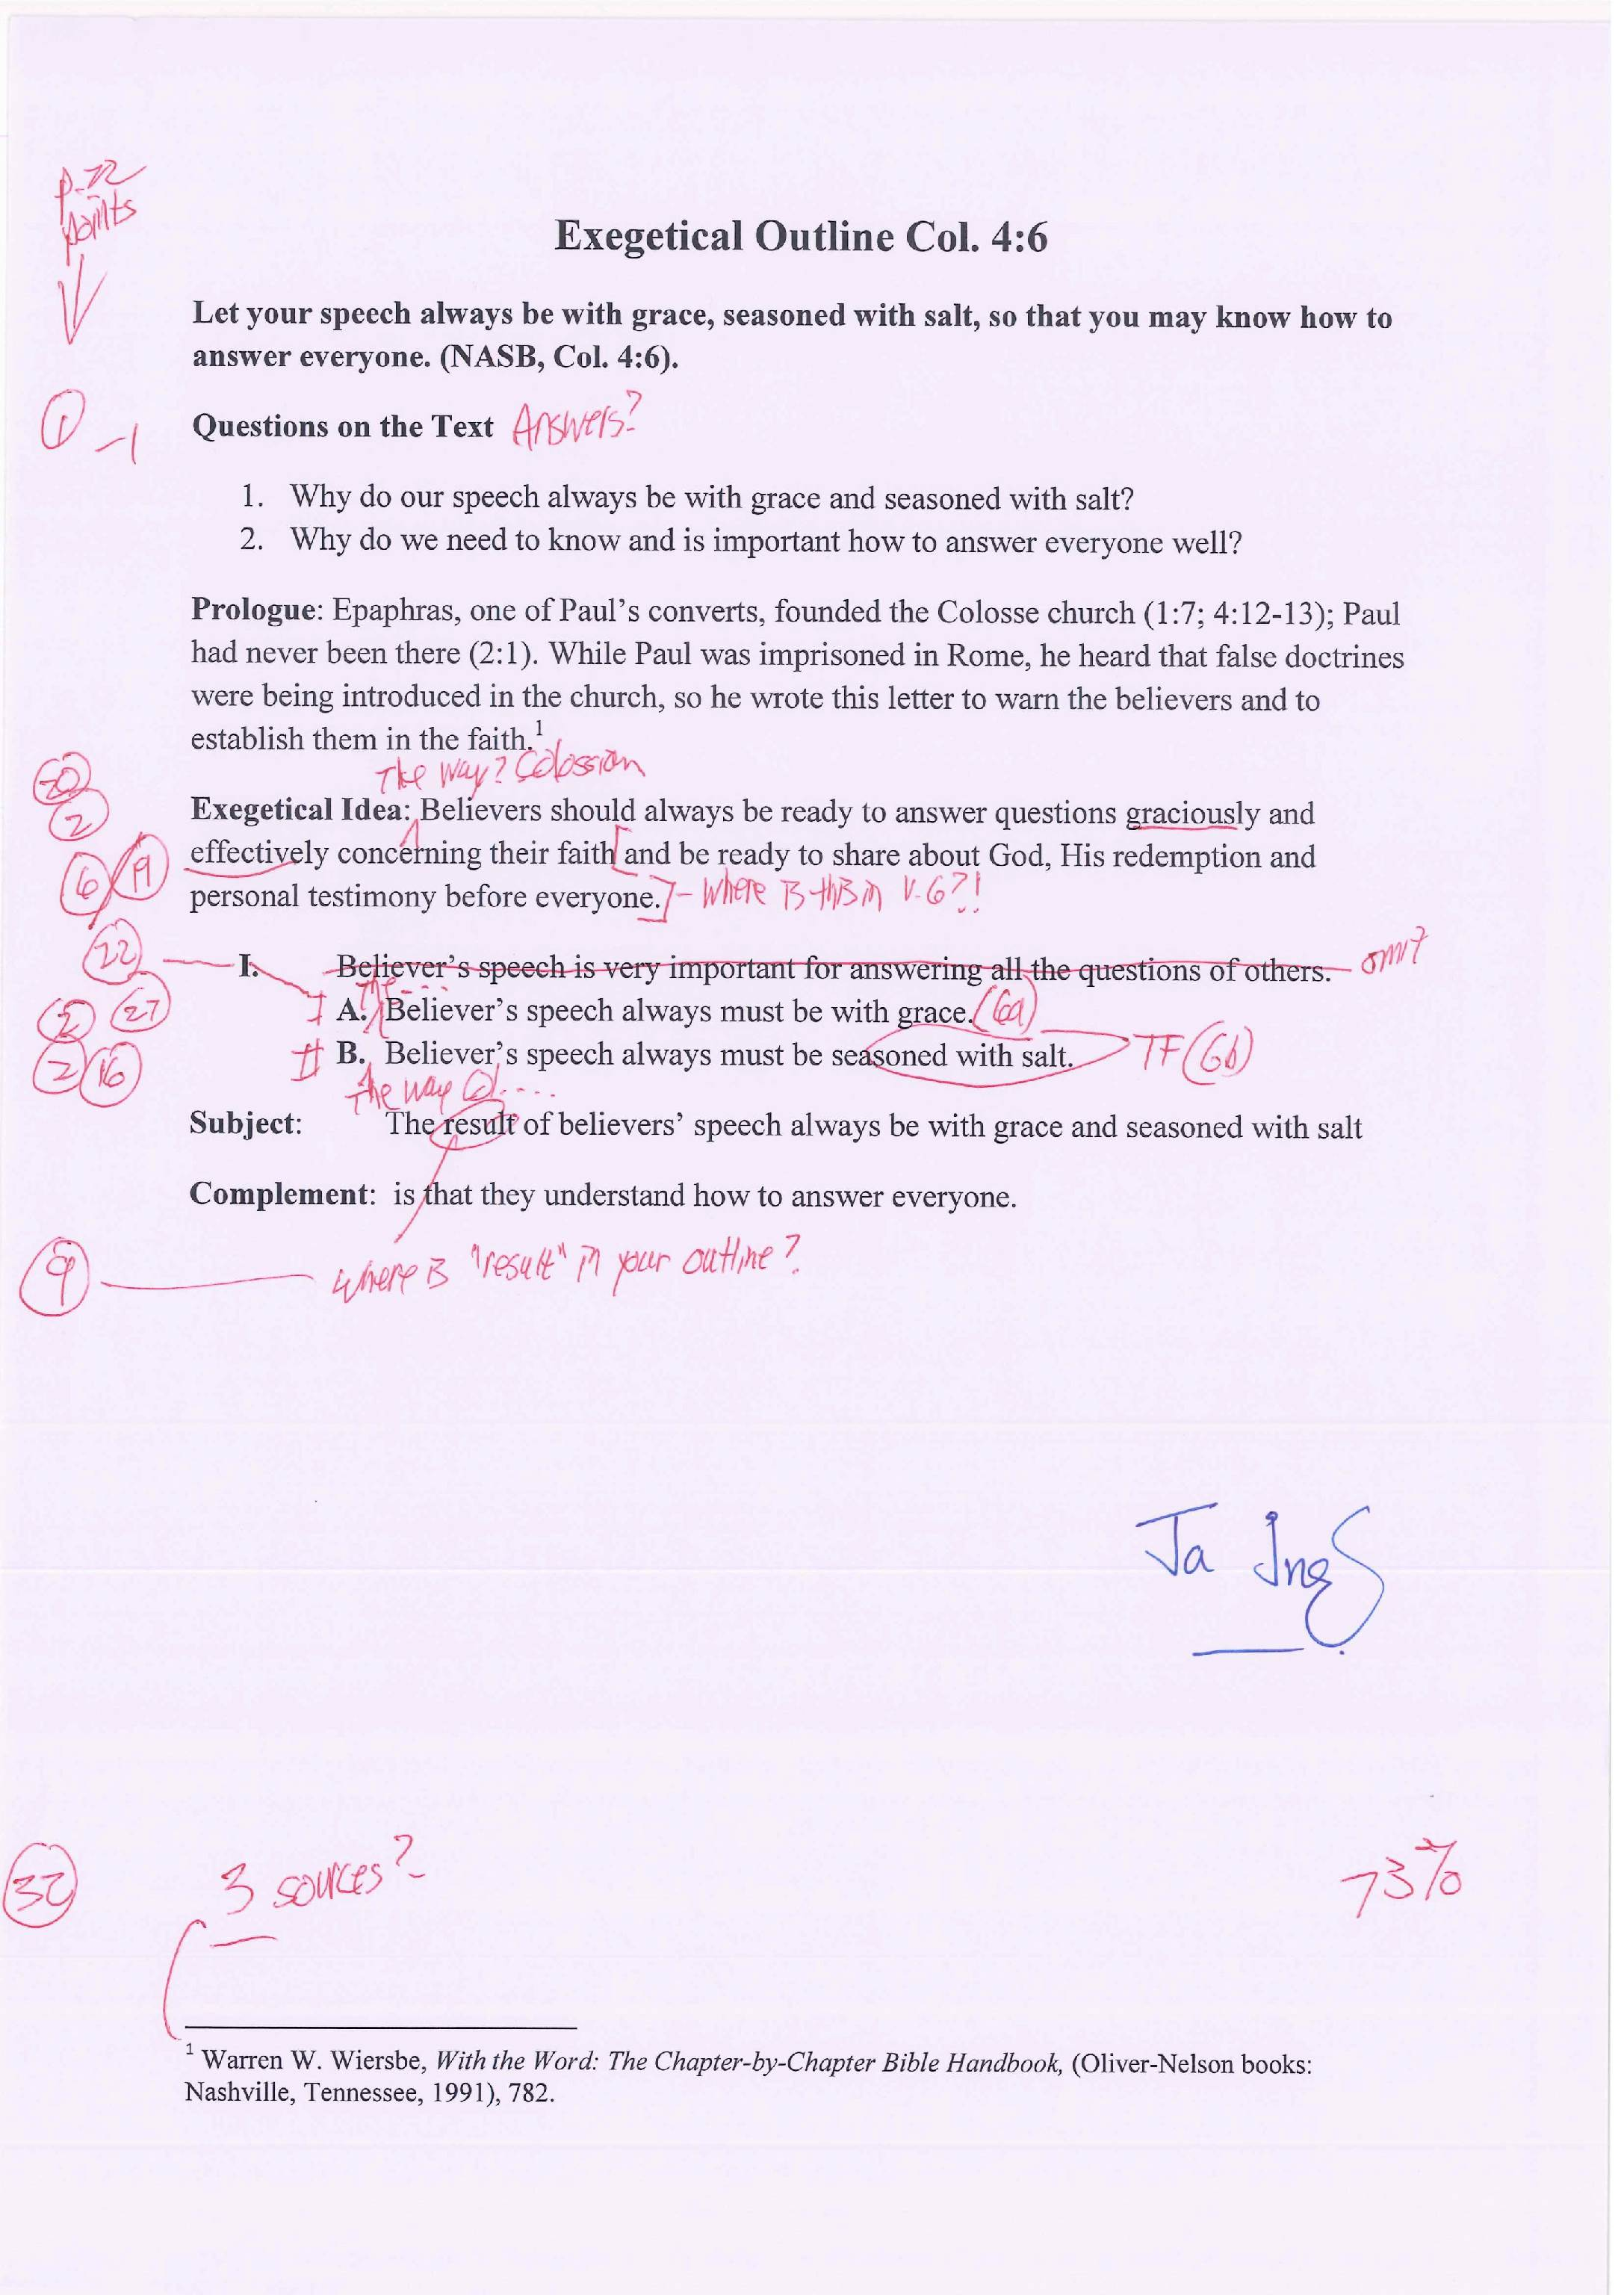
我如何给西4:6 EO (作业 #4) 打分
22
确保你对照了第22页清单中的每个项目
1. 如果讲道中有提到1-2节，是否有把文本中的问题和答案以及章节本身写出来?
2. 释经思想 (EI) 和重点 (MPs) 都以正确 Z1+X+Z2+Y 方式呈现?
20. 重点是否是在受助者的过去（不是现在)（写“歌罗西的方式应该…”而不是“我们应该…”） 并使用了自动词 （非被动）词？
EI和大纲训诂正确的勾画出作者的愿意? (AI = 评估作者的意图)?
19. SP (或 MP)回避了不在文章中的想法 (例，引用自其他材料）? (“NP” = 不在原文中)?
是否在MP中最少有一个Z1符合其中的 EI?
22. 每个点是否都有另个协调点 (“I” 有 “II”, “A” 有 “B”; 第61页 [II.A.1.] 和 第55页)?
2. 释经思想 (EI) 和重点 (MPs) 都以正确 Z1+X+Z2+Y 方式呈现?
27. 每个句子是否有正确的勾画相关的章节或部分章节 (1a, 1b, 1c, 等)?
16. 陈述是否有翻译的修辞，而不是实用文本的话？ (“TF”)
Notes:
HOM 12.2
HSB 22.53

Slide 55

圣经学习链接地址 biblestudydownloads.com
免费获得该讲解!
圣经学习
下载
Notes:
The explanation for free!
Bible Study link address

