Slide 1
解释新约中的文学类型
顾理克博士
新加坡神学院
Biblestudydownloads.com

Slide 2
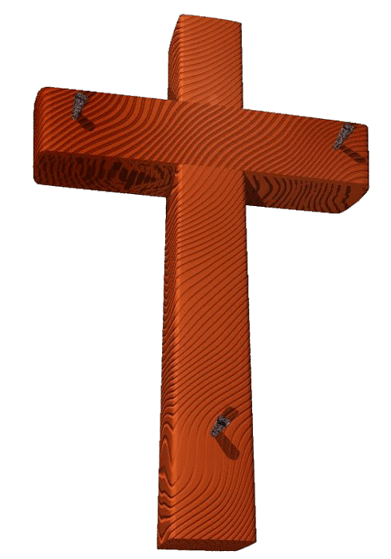
解释 福音书 & 使徒行传
123
13
2
Notes:
Using Study Help #21, through this large picture frame…
we're going to create a graphic representation called
//// A FINISHED PORTRAIT OF THE LORD JESUS CHRIST… but…
//// …we're going to compose that portrait through four different literary lenses as the completed image develops.

Slide 3
每一位福音书作者都有:
• 他特定的 听众
• 他对耶稣基督独特的 表达
• 他写福音书基本的 目的
• 他写作的日期
14
4
Notes:
From each Gospel writer…
//// …we’ll discover the specific audience for his writings…
//// …with his unique presentation of the person of Jesus Christ…
//// …suggesting a foundational purpose communicated through the text of his Gospel…
//// …followed by the scholars’ estimate of the date of each writing.

Slide 4
四个个别的素描 …
52
1
2
3
4
15
Notes:
Now, please…in your imagination…insert four smaller picture frames into the larger one. In each frame install four lines. As we fill them in we’ll have some specific information about the purpose and function of each of the four Gospels. The individual “sub-frames” are designated 1 through 4.

Slide 5
构成四福音…
52
1
马太
2
马可
3
路加
4
约翰
16
3
Notes:
Each of the frames now gets its name... MATTHEW in the first...
//// MARK, second...
//// LUKE, third...and finally, the fourth…
//// JOHN, the names of the Gospels in the order of their appearance in the New Testament canon...the official collection of Biblical writings.

Slide 6
四福音的听众…
52
1
马太
2
马可
对象:
犹太人
对象:
罗马人
3
路加
4
约翰
对象:
希腊人
对象:
教会
17
4
Notes:
Now comes an idea endorsed by Biblical scholars around the world…having to do with the audiences TO WHICH each Gospel was written.
For instance…
//// MATTHEW penned his work specifically toward his brothers and sisters in the Jewish audience. He makes repeated references to a regnant Jesus, seeing him as the Messiah and the King of the Chosen People.
//// For MARK, his work is widely regarded as directed toward the Romans, then occupying his native land and into the farther parts of the ancient world. MARK is brief, to the point. And, in fact, repeatedly he uses such term as "straightway" in early translations…all in a get-the-job-done mentality, which characterized the Roman way of thinking and doing things.
//// While LUKE, the physician, is the highly intellectual Greek who accompanied Paul on his tours. For LUKE, his Gospel audience was the Greeks, and in other words, to the Gentile world in general.
Also as the author of The Acts, Luke set down for all time a detailed account of the development of the early church and its wide-spread missionary ministries, to which he was a witness.
//// Finally, we come to the gospel of JOHN, whose audience differs markedly from the first three. John is written directly to UNBELIEVERS, AND REACHING THEM THROUGH THE COMMUNICATION CHANNEL OF THAT NEW ORGANISM, THE CHURCH. In fact, when you read John's gospel, you are struck with the fact that his work carries with it a somewhat mystical quality, certainly not the quick, even terse recounting of facts as we find in Mark’s Gospel. John's audience –– the Church itself, the members of the new Organism, bathed in the redemptive love of Christ –– receives his brilliant articulation of the impact of the coming of the Holy Spirit, now –after the Day of Pentecost -- having taken up permanent residence in the heart of each new believer.
So there are four individual audiences to which the Gospels were specifically directed at the time of their writing. That one insight, alone, gives a new way to categorize and individualize the Gospel writings.

Slide 7
…对耶稣的描述…
52
2
1
2
1
马太
马可
对象:
犹太人
对象:
罗马人
基督是:
君王
基督是:
仆人
4
3
4
3
JOHN
路加
约翰
希腊人
教会
对象:
对象:
CHURCH
TO:
TO:
基督是:
神子/人子
基督是:
神
18
4
Notes:
Another question: How does each Gospel portray The Lord as a Man and as Immanuel, “God With Us?”
//// For MATTHEW...Christ is seen as King of the Jews. Repeatedly Matthew describes how Jesus is the fulfillment of Old Testament Scripture. Matthew makes wide use of Jewish terminology of royalty.
//// For MARK...He is seen as the Servant of all...some say the Suffering Servant, and traditionally associated with an audience in Rome and among the widespread Roman world.
//// LUKE sees Christ as the God-Man -- truly God and truly Man. Luke shows the Gentiles that Christ is the perfect man to which they aspired.
//// Finally, John’s Gospel. Clearly and above all else...JOHN portrays Christ as God Himself. JOHN uses his pen to communicate the mystery and the power of the Messiah. Why? Because John experienced a particular closeness to the Master, one that was apparently unique among the disciples. Remember too that this was this same JOHN who was destined to see and write down the great End-Times vision we know as The Revelation.

Slide 8
耶稣基督的信息…
52
1
马太
2
马可
对象:
犹太人
对象:
罗马人
基督是:
君王
基督是:
仆人
基督:
所讲
基督:
所做
3
路加
4
约翰
对象:
希腊人
对象:
教会
基督是:
神子/人子
基督是:
神
基督:
所感受
基督:
所认为
19
5
Notes:
Here is a last set of interesting ideas, with thanks to some anonymous believer who developed them years ago.
//// Call it “the message in a nutshell.” Question: what is the one single word that might characterize the message of each Gospel?
//// For MATTHEW...that book tells us what Jesus Christ SAID.
//// MARK tells us what He DID.
//// LUKE shows us clearly what the Messiah FELT.
//// And JOHN, with enormous clarity, tells us what Christ MEANT!
What he SAID...what He DID...what He FELT...and what He MEANT!
These single-word ideas help us to tightly focus on the remarkable differences that exist among the Gospel writings. For many Bible readers, such distinctives are unfamiliar territory.

Slide 9
奇怪的形容词…
52
对观福音书:
1
马太
2
马可
对象:
犹太人
对象:
罗马人
基督是:
君王
基督是:
仆人
所讲
所做
基督:
基督:
对观:
“共同参考”
3
路加
对象:
希腊人
神子/人子
“共同参考”
基督是:
所感受
基督:
20
3
Notes:
Now comes that word that’s a strange one to many...
//// SYNOPTIC…meaning…
//// … “TO SEE TOGETHER”…add these words to that triangle shape on your study help.
//// It is a term from Greek roots that means seeing a group of things together... from the same general perspective. One word that, again, helps organize and categorize the enormous factual base that makes up our Bible.

Slide 10
对观福音书: “共同参考”
52
1
马太
2
马可
对象:
犹太人
对象:
罗马人
基督是:
君王
基督是:
仆人
所讲
所做
基督:
基督 :
∑
3
路加
4
约翰
对象:
希腊人
教会
对象:
基督是:
神子/人子
基督是:
神
所感受
所认为
基督:
基督:
21
1
Notes:
Follow the arrows as they link together the gospels of MATTHEW, MARK and LUKE. Again…you’ll notice that JOHN is not among them. Those three are the so-called SYNOPTIC Gospels...THEY ARE SEEN TOGETHER...in that these works take on that ground-level view of the human history of Jesus Christ just as he walked about Palestine in the days of his ministry. The Man…and his Mission among his People.
//// On the other hand…the Gospel of John –– seen here with the familiar mathematical SUMMA sign –– represents the summation of all that Jesus Christ MEANT –– the sum of all that he preached and demonstrated –– both publicly and privately. Seeing the Lord clearly as God Himself, John raises our spiritual horizon in ways that the first three gospels do not.

Slide 11
…写作日期呢？
1
马 太 福 音
2
马 可 福 音
主后 40年左右
罗马人
犹太人
主后 64-68年
对象:
对象:
形象:
王
形象:
仆人
强调:
言
强调:
行
4
3
路 加 福 音
4
约 翰 福 音
JOHN
希腊人
主后 69 年 在符类福音 之后
教会
主后 57-59年
CHURCH
对象:
对象:
TO:
TO:
形象:
神/人
形象:
神
强调:
感受
强调:
深意
©2006 TBBMI
27
4

Slide 12
独特的题材…
52
1
马太
2
马可
7% 独有!
洗礼 圣餐
出生 族谱
喂饱5000人热心
3
路加
4
约翰
92% 独有!
16
Notes:
Each of the Gospels say things that the others don’t...
//// MATTHEW was believed by the early church to have written first...
//// MARK shares a lot of material with Matthew, such as Christ’s baptism and supper...
//// LUKE also has much overlap with Matthew and Mark, such as Christ’s baptism and supper—but only Matthew and Luke record Christ’s birth and genealogy. However, the fourth…
//// JOHN, stands alone in terms of its material. Only 8% of it repeats stories from the others—such as the feeding of the 5000, and, of course, His death and resurrection.
//// But the remaining 91% of JOHN you will find only in JOHN.

Slide 13
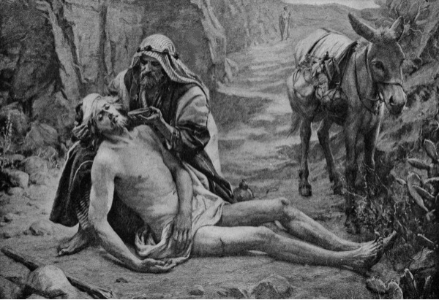
好 撒 玛 利 亚 人

Slide 14
奥古斯丁的寓言解释该好撒玛利亚人的比喻（路加福音15）
文本 解读
“某人” ... ... ... ... ... ... 亚当
盗贼 ... ... ... ... ... ... ... 魔鬼和恶魔
剥去他 ... ... ... ... ... ... 把他的不朽
打他 ... ... ... ... ... ... ... 引诱他犯罪
祭司和利未人 ... ... ... ... ... 旧约的职事它什么也
不做的亚当
好撒玛利亚人 ... ... ... ... ... 基督
结合创面用油和酒 ... ... ... ... 抑制了罪了希望和告诫
与合作热切精神
客栈 ... ... ... ... ... ... ... 教会
客栈老板 ... ... ... ... ... ... 使徒保罗
真的吗?!

Slide 15
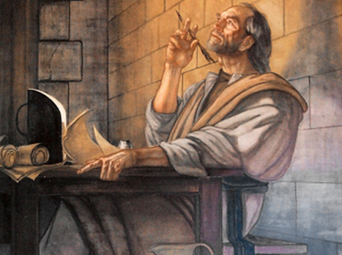
解释 书信
125

Slide 16
新约综览(书卷＋关键字)
38 124 39-41
“直 到 地 极” (使 徒 行 传 1:8)
使 徒 9 13 14 15 16 18 21 27 28
四月 48- 九月 49
1 加 拉 太
四月 50- 九月 52
2 爱琴海
春季 53- 五月 57
3 亚洲
五月 57- 八月 59
试验
二月 60- 三月 62
1 罗马
春季 62- 秋季 67
4 西班牙
秋季 67- 春季 68
2 罗马
35-37
大 马 色 安 提 阿
秋季 49
理事会
春季68
教会扩长
35 48 49 50 52 53 57 60 62 67 68 95
马太
天国
路加
主权1
使徒行传
主权2
马可
门徒
约翰
相 信
以弗所
合一
提前
秩序
提后
教 义
犹大
歌前
伪装者
加拉太
帖前
成圣
因信称义
被提
雅各
行为
帖后
大患难
歌后
使 徒
歌罗西
神性
提多
行事为人
希伯来
优秀
约 1
爱
彼 前
受苦
约 2
罗马
饶恕
极限
称义
腓利门
福音书以及使徒行传
腓利比
态度
彼后
知识
约 3
传教士
保罗书信
启示录
胜利
普通书信
书卷＋关键字

Slide 17
Black

Slide 18
Bible Study link at biblestudydownloads.com
免费获取此讲解!
免费获得该讲解!
圣经学习 下载
圣经学习链接地址 biblestudydownloads.com

