Slide 1

解经
103
基本原则
顾理克博士
新加坡神学院
Biblestudydownloads.com

Slide 2
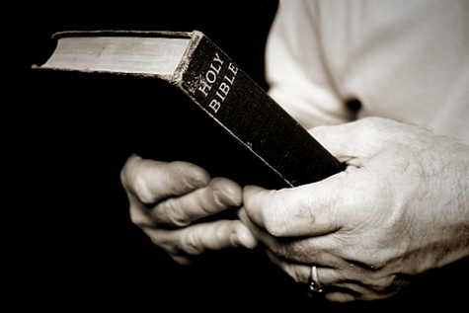
解释全经的基要
109
问作者上帝
从头开始

Slide 3


TBB
圣经
基要
上帝的话语向所有的神的百姓显明

Slide 4

TBB Vision
圣经
基要
让上帝的话语活起来, 从而帮助改变人的生命, 遍及世界各地.

Slide 5

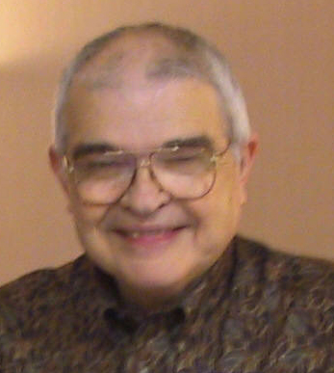
Dr John Fryman
弗约翰博士
圣经基要10小时研讨会的作者
德克萨斯州, 沃思堡
www.biblebasically.org
©2004 TBBMI
8.0.01.
04

Slide 6

English

Slide 7

Burmese
Lai S
iangtho…Abulpi
A Presentation of The Bible…Basically Ministries International Inc. Fort Worth, Texas
www.biblebasically.com
©2004 TBBMI
8.0.01.
04

Slide 8

French
LA BIBLE…
EN BASE
Une Présentation du Ministère Internationale de La Bible… En Base Inc. Fort Worth, Texas
www.biblebasically.com
©2006 TBBMI
8.0.01.
04
©2004 TBBMI
9.6.01.

Slide 9

Japanese
バイブル ベイシックミニストリーズ
インスティチュート
A Presentation of The Bible…Basically Ministries International Inc. Fort Worth, Texas
www.biblebasically.com
©2004 TBBMI
8.0.01.
04
Notes:
Japanese title slide

Slide 10

Khmer (Cambodian)
mUldæanRKwH>>>
énRBHKm<IIr
karbgðaj[sÁal;nUvRBHKm<Ir>>> EdlCamUldæanRKw³ kñúg B½n§kic©shKmnGnþrCati GayGinsIu.
Fort Worth, Texas
www.biblebasically.com
©2004 TBBMI
8.0.01.
04

Slide 11

Korean
성경은 …
기본적으로
A Presentation of The Bible…Basically Ministries International Inc. Fort Worth, Texas
www.biblebasically.com
7.5.01.
©2003 TBBMI
04

Slide 12

Malay
Alkitab…
Dasar
Presentasi dari The Bible…Basically Ministries International Inc. Fort Worth, Texas
www.biblebasically.com
©2004 TBBMI
8.0.01.
04

Slide 13

Mao (India)
Bible…
Amolo Leino
Bible…Ngashankakhuina Ministries International Inc. pashina semkashok Fort Worth, Texas
www.biblebasically.com
©2004 TBBMI
8.0.01.
04

Slide 14
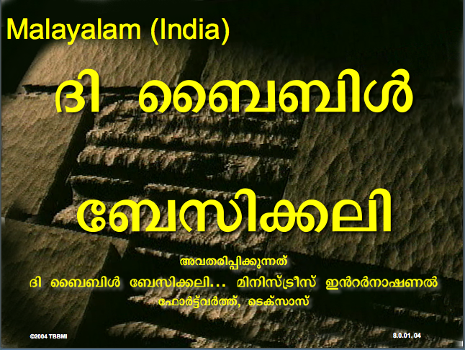
Malayalam (India)
Æß èÌÌßZ
çÌØßAÜß
¥ÕÄøßMßAáKÄí Æß èÌÌßZ çÌØßAÜß… ÎßÈßØíd¿àØí §aVÈÞ×ÃW çËÞVGíÕVJí, æ¿µíØÞØí
©2004 TBBMI
8.0.01.
04

Slide 15
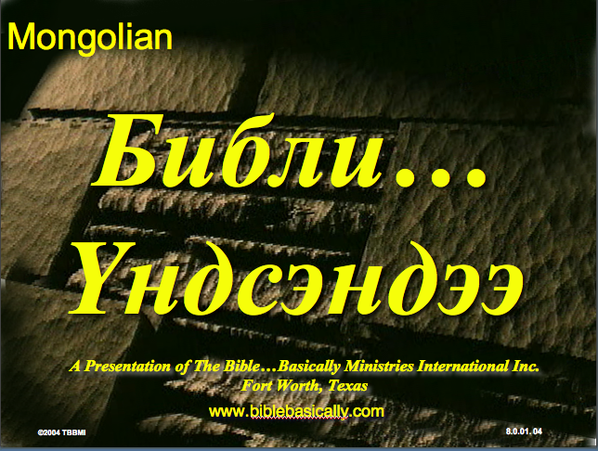
Mongolian
Библи…
Үндсэндээ
A Presentation of The Bible…Basically Ministries International Inc. Fort Worth, Texas
www.biblebasically.com
©2004 TBBMI
8.0.01.
04

Slide 16

Nepali
afOan======
cfwf/e[\t
A Presentation of The Bible…Basically Ministries International Inc. Fort Worth, Texas
www.biblebasically.com
8.0.01.
©2004 TBBMI
04

Slide 17

Swahili (Kenya)
biblia kwa ujumla
A Presentation of The Bible…Basically Ministries International Inc. Fort Worth, Texas
www.biblebasically.com
8.0.01.
©2003 TBBMI
04

Slide 18

Tagalog (Philippines)
Ang Biblia . . . Pinasimple
A Presentation of The Bible…Basically Ministries International Inc. Fort Worth, Texas
www.biblebasically.com
©2004 TBBMI
8.0.01.
04
Notes:
PLEASE PUT THE TITLE AND SUBTITLES INTO YOUR NATIONAL LANGUAGE AND LEAVE THE WEBSITE UNCHANGED

Slide 19

Tangkhul (India)
Bible…
Ngashankakhui
Bible…Ngashankakhuina Ministries International Inc. pashina semkashok Fort Worth, Texas
www.biblebasically.com
©2004 TBBMI
8.0.01.
04

Slide 20

Tamil (Sri Lanka/India)
jpUkiwapd;…
mbg;gil
A Presentation of The Bible…Basically Ministries International Inc. Fort Worth, Texas
www.biblebasically.com
©2004 TBBMI
8.0.01.
04

Slide 21
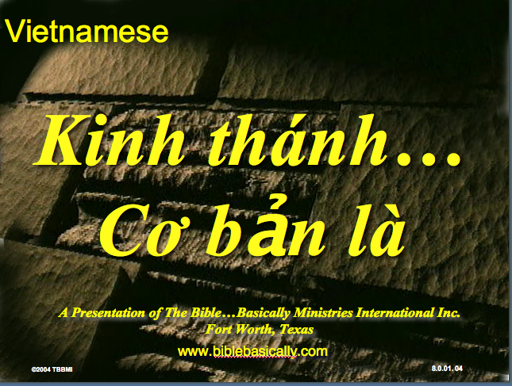
Vietnamese
Kinh thánh…
Cơ bản là
A Presentation of The Bible…Basically Ministries International Inc. Fort Worth, Texas
www.biblebasically.com
©2004 TBBMI
8.0.01.
04

Slide 22


Bahasa Indonesia
Presentasi dari The Bible…Basically Ministries International Inc. Fort Worth, Texas
www.biblebasically.com
7.5.01.
©2003 TBBMI
04

Slide 23
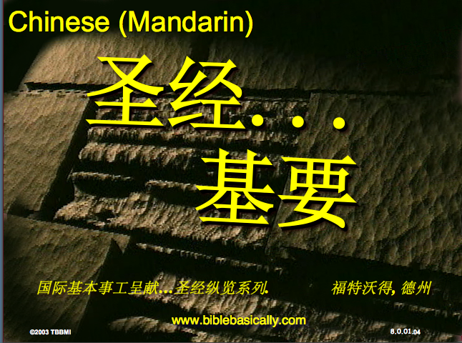
Chinese (Mandarin)
圣经...
基要
国际基本事工呈献…圣经纵览系列. 福特沃得, 德州
www.biblebasically.com
8.0.01.
©2003 TBBMI
04

Slide 24
PowerPoint (945 片)
学生工作簿 (100 页)
教师脚本 (400 页)
圣经基要材料
已完成
英语 • 印尼语 • 中文 • 韩语 • 马来语 • 蒙古语
由 圣经基要国际事工 呈现
德克萨斯州, 沃思堡
www.biblebasically.com
©2004 TBBMI
8.0.01.
04

Slide 25

7
造
您的圣经
档案
默
主
学生手册第8-14页
37

Slide 26
7
1
2
3
造
4
5
6
7
8
默
9
10
主
学生手册第8-14页
39

Slide 27
打开
“您的圣经档案”
7
造 默主
造 默主
造 默主
造 默主
7
7
学生手册第8-14页
4
40

Slide 28
打开
“您的圣经档案”
7
7
= 4+3
学生手册第8-14页
2
41

Slide 29
7
打开
“您的圣经档案”
造 4 3 默 主
造 4 3 默 主
学生手册第8-14页
1
42

Slide 30
五个关键字和词组:
7
造 = 创造
4 = 人物
3
= 时期
默 = 静默
主
= 主耶稣
学生手册第8-14页
5
43

Slide 31
五个关键字和词组:
7
造 = 创造
4 = 人物
3
= 时期
默 = 静默
主
= 主耶稣
学生手册第8-14页
6
44

Slide 32
五个关键字和词组:
7
造 = 创造
4 = 人物
3
= 时期
默 = 静默
主
= 主耶稣
学生手册第8-14页
45

Slide 33
4 个人 物 就 是:
7
亚伯拉罕
约瑟
摩西
约书亚
学生手册第8-14页
5
46

Slide 34
7
亚 伯拉罕
的约
摩 西
的 书 !
学生手册第8-14页
47

Slide 35
4 个人 物 就 是:
7
约瑟
亚伯拉罕
亚伯拉罕
摩西
的约
约书亚
摩西
的书
学生手册第8-14页
8
48

Slide 36
7
创造
亚伯拉罕
约瑟
摩西
约书亚
学生手册第8-14页
5
49

Slide 37
五个关键字和词组:
7
造 = 创造
4 = 人物
3
= 时期
默 = 静默
主
= 主耶稣
学生手册第8-14页
50

Slide 38
7
无 王 掳
学生手册第8-14页
2
51

Slide 39
3 个时期就是:
7
无 王
王 朝
被 掳
学生手册第8-14页
6
52

Slide 40
创造
亚伯拉罕
约瑟
摩西
约书亚
无王
王朝
被掳
7
学生手册第8-14页
53

Slide 41
7
7
复习一下...
造 7 默 主
造 4 3 默 主
学生手册第8-14页
3
54

Slide 42
创造
4个人物
3 个时期
静默
主耶稣
7
学生手册第8-14页
55

Slide 43
7
创造
亚伯拉罕
约瑟
摩西
约书亚
无王
王朝
被掳
静默
主耶稣
学生手册第8-14页
2
56

Slide 44
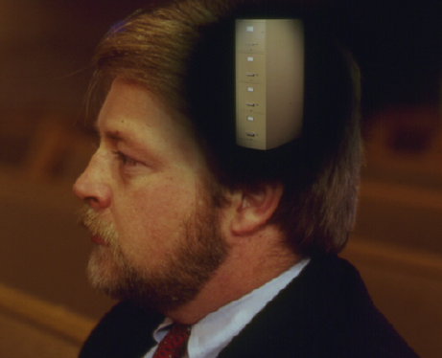
您脑海中新的“圣经档案”
创造
创造
ABRAHAM
亚伯拉罕
ABRAHAM
约瑟
亚伯拉罕
ABRAHAM
摩西
约瑟
约书亚
无王
王朝
摩西
被掳
静默
约书亚
主耶稣
无王
王朝
被掳
静默
主耶稣
学生手册第8-14页
11
57

Slide 45
English

Slide 46
Opening Up
"Your Bible File"
7
7
7
7
7
7
7
7
C
7
J
C
S
J
C
S
J
C
S
J
S
Handbook pg. 8-14
4
42
Notes:
We begin right here...with the single number…. 7.
That's our mental anchor point. Simply the number 7 with that all-important dash through the stem.
//// Next step...surround that number with three alphabet letters. Set them firmly in place in your mind:
C 7 S J
Repeat the letter group aloud several times as you embed it in your mind... Because this is the very core of the Bible's organization and time-line flow:
//// "C 7 S J....
//// C 7 S J....
//// C 7 S J...etc."

Slide 47
Opening Up
"Your Bible File"
7
7
= 4+3
Handbook pg. 8-14
2
43
Notes:
Now...about that European style '7'.
//// You'll remember that it has a dash through its stem... That's an important reminder — a mind clue. Keep it mentally handy. That small dash divides the length of the 7's stem into two parts. So, ask yourself the question: "What two numbers does 7 easily split into?"
//// One possible answer…and the right one…is: 4 and 3.

Slide 48
C 4 3 S J
7
Opening Up
"Your Bible File"
C 4 3 S J
C 4 3 S J
Handbook pg. 8-14
1
44
Notes:
So, in the C 7 S J formula, by changing the 7 to a 4 and a 3, we have
C 4 3 S J.
As before, repeat that changed sequence aloud several times to help it hold tightly in your mind for easy recall.
//// C 4 3 S J.

Slide 49
5 Key Words or Phrases:
7
C = CREATION
4 = PEOPLE
3 = SOCIETIES
S = SILENCE
J = JESUS
Handbook pg. 8-14
5
45
Notes:
Now, based on C 4 3 S J, we enlarge that idea into five key words or phrases. They will become the foundation of your mental Bible File. Here they are…say them aloud…
//// C = CREATION
//// 4 = 4 PEOPLE
//// 3 = 3 SOCIETIES
//// S = SILENCE
//// J = JESUS.
And that's an organizational plan for the entire Bible! Those five words and phrases create an abbreviated outline map of the entire Bible's basic design.

Slide 50
5 Key Words or Phrases:
7
C = CREATION
4 = PEOPLE
3 = SOCIETIES
S = SILENCE
J = JESUS
Handbook pg. 8-14
6
46
Notes:
Once again...aloud…
//// C = CREATION
//// 4 = 4 PEOPLE
//// 3 = 3 SOCIETIES
//// S = SILENCE
//// J = JESUS.
We will now go back through the phrases, expanding them still farther.
//// CREATION,
of course, remains at the top of the list naturally…because the Bible story itself begins right there.

Slide 51
5 Key Words or Phrases:
7
C = CREATION
4 = PEOPLE
3 = SOCIETIES
S = SILENCE
J = JESUS
Handbook pg. 8-14
47
Notes:
We then take the next phrase from the list:
4 PEOPLE.

Slide 52
THE 4 PEOPLE ARE:
7
ABRAHAM
JOSEPH
MOSES
JOSHUA
Handbook pg. 8-14
5
48
Notes:
Let's break apart "4 PEOPLE" into 4 specific people, in this order:
//// ABRAHAM
//// JOSEPH
//// MOSES
//// JOSHUA
It's helpful to remember the word order by repeating several times the first-letter order of the words:
//// "A-J-M-J ... A-J-M-J ... etc."

Slide 53
A Judge Must Judge
7
A
JUDGE
MUST
JUDGE!
Handbook pg. 8-14
49
Notes:
How can you remember the order of those letters and the names?
This simple sentence..."A JUDGE MUST JUDGE." The first letters of each word: AJMJ and then you have it.

Slide 54
THE 4 PEOPLE ARE:
7
A BRAHAM
A
J OSEPH
JUDGE
M OSES
MUST
J OSHUA
JUDGE
Handbook pg. 8-14
8
50
Notes:
Just remember to repeat the four names aloud to yourself several times until you feel the rhythm of the words:
//// "ABRAHAM,
//// JOSEPH,
//// MOSES and
//// JOSHUA."
And here again is that mental tool…
//// A
//// JUDGE
//// MUST
//// JUDGE.

Slide 55
Creation to Joshua
7
CREATION
ABRAHAM
JOSEPH
MOSES
JOSHUA
Handbook pg. 8-14
5
51
Notes:
So, from the top of the list we now can say:
//// CREATION
//// ABRAHAM
//// JOSEPH
//// MOSES
//// JOSHUA
This step completes the main FOUR PEOPLE of your new Bible File. Of course, there are dozens of other Biblical characters, but these are the only ones we are using to build the Bible File right now. Repeat the four names aloud several times until they are firmly set mentally.

Slide 56
5 Key Words or Phrases:
7
C = CREATION
4 = PEOPLE
3 = SOCIETIES
S = SILENCE
J = JESUS
Handbook pg. 8-14
52
Notes:
The next phrase of that beginning list is:
3 SOCIETIES.

Slide 57
A R C
7
Handbook pg. 8-14
2
53
Notes:
Another memory tool now…what do you call
//// that red section of the perimeter of a circle?
//// It's called an "arc," spelled A-R-C. Those letters, then, remind you of the first letters of 3 KINDS OF SOCIETIES.

Slide 58
THE 3 SOCIETIES ARE:
7
ANARCHY
ROYALTY
CAPTIVITY
Handbook pg. 8-14
6
54
Notes:
The three societies are…
//// ANARCHY
//// ROYALTY
//// CAPTIVITY.
As before, please repeat that word order several times.
ANARCHY, ROYALTY, CAPTIVITY...
ANARCHY, ROYALTY, CAPTIVITY.
And the mental tool here:
//// A
//// R
//// C.

Slide 59
OT Review
7
CREATION
ABRAHAM
JOSEPH
MOSES
JOSHUA
ANARCHY
ROYALTY
CAPTIVITY
Handbook pg. 8-14
55
Notes:
Now we add the 3 SOCIETIES group to the others, and we have:
CREATION
ABRAHAM
JOSEPH
MOSES
JOSHUA
ANARCHY
ROYALTY
CAPTIVITY

Slide 60
To Review…
7
7
TO REVIEW...
C 7 S J
C 4 3 S J
Handbook pg. 8-14
3
56
Notes:
To review the entire sequence so far…
Beginning with the single number
//// 7....
leading to…
//// C 7 S J...
which becomes...
//// C 4 3 S J.
These numbers and letters are then used to develop a mental list of TEN WORDS that will form a dependable mental outline of the entirety of Scripture.

Slide 61
The Basics
7
CREATION
4 PEOPLE
3 SOCIETIES
SILENCE
JESUS
Handbook pg. 8-14
57
Notes:
C 4 3 S J is then expanded into:
CREATION
4 PEOPLE
3 SOCIETIES
SILENCE
JESUS.

Slide 62
The Last Two Folders
7
CREATION
ABRAHAM
JOSEPH
MOSES
JOSHUA
ANARCHY
ROYALTY
CAPTIVITY
SILENCE
JESUS
Handbook pg. 8-14
2
58
Notes:
Then further expanded into:
CREATION
ABRAHAM
JOSEPH
MOSES
JOSHUA
ANARCHY
ROYALTY
CAPTIVITY.
Finally, now, we add: //// SILENCEand//// JESUS.

Slide 63
Your New Mental "Bible File”
CREATION
CREATION
ABRAHAM
ABRAHAM
ABRAHAM
ABRAHAM
JOSEPH
ABRAHAM
MOSES
JOSEPH
JOSHUA
ANARCHY
MOSES
ROYALTY
CAPTIVITY
JOSHUA
SILENCE
JESUS
ANARCHY
ROYALTY
CAPTIVITY
SILENCE
JESUS
Handbook pg. 8-14
59
11
Notes:
Now it's time mentally to apply those ten words as labels to ten mental folders in your new Bible File –
//// right up there in your head. That mental picture might look something like this. And there they are...
//// CREATION//// ABRAHAM//// JOSEPH//// MOSES//// JOSHUA//// ANARCHY//// ROYALTY//// CAPTIVITY//// SILENCE…and…//// JESUS.
Now it's organized in a neat and orderly package in your mind --- ready for recall and use as you need it. Now just a few more
examples to drive home the point...

Slide 64
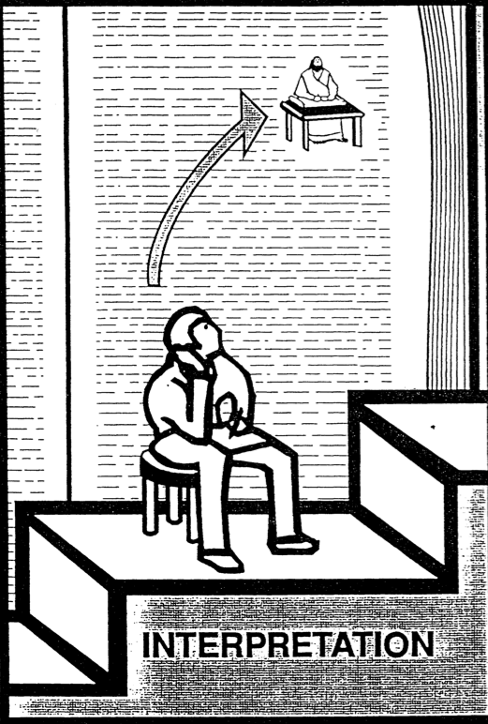
解经
41
现在我们准备好了可以来 问某经文是什么意思!

Slide 65

圣经学习链接地址 biblestudydownloads.com
免费获得该讲解!
圣经学习
下载

