Slide 1
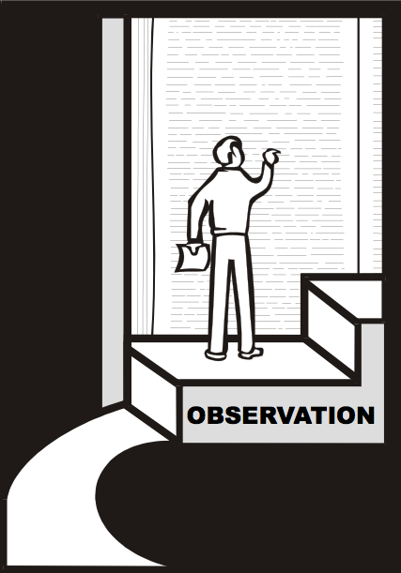
观察
释经前必须观察
18
Dr Rick Griffith
新加坡神学院
Biblestudydownloads.com

Slide 2
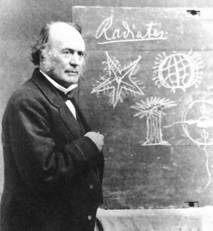
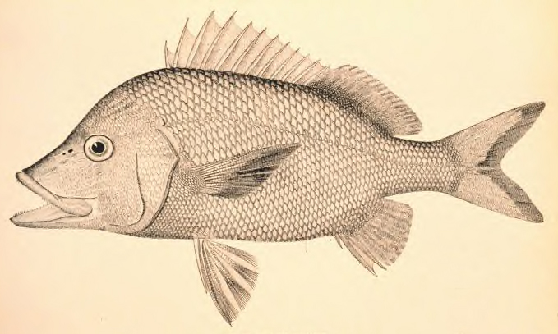
学生, 雨, & Agassiz
23-25
请把故事的重点告诉你旁边的人
"我们将失去很多祝福， 若没有好好地观察!"

Slide 3
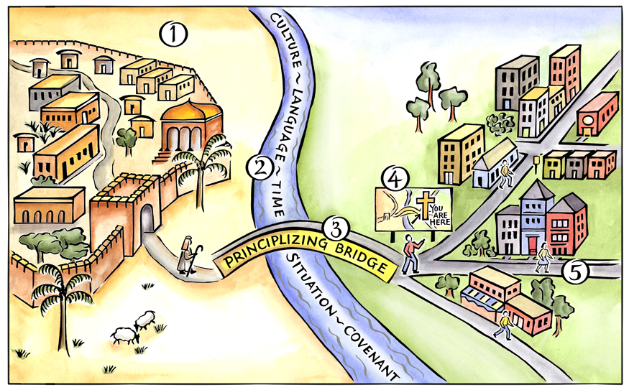
基本步骤
当时城镇
现今城镇
咨询圣经总原则
测量要跨过的长度
原则化的“桥”
Duvall & Hays, 《抓准神的话》
Notes:
Above is a pictorial representation of our consistent approach to biblical interpretation. We call it the Interpretative Journey. There are 5 steps on this journey:
Grasping the Text in Their Town
Measuring the Width of the River to Cross
Crossing the Principlizing Bridge
Consult the Biblical Map
Grasping the Text in Our Town
By embarking on this journey we commit to the goal of grasping the meaning of text. We do not create meaning out of a text; rather, we seek to find the meaning that is already there.

Slide 4
归纳法读经
20
 | 书 (综合性)
观察 (我看到什么?) | 经文 或 细节 (分析) | 解释所观察的 (有什么意思能?)
 | 题目 (题目化)

Slide 5
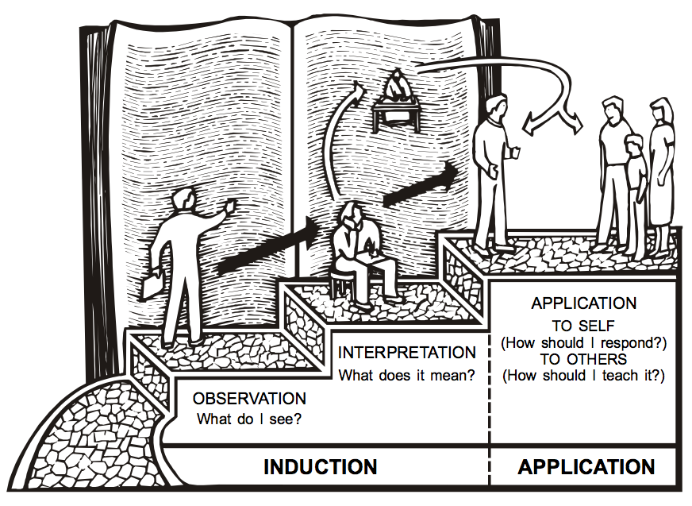
三段法
20
运用
自己
解释
(我应该怎么回应?)
有什么意思呢?
其他人
观察
(我应该怎么教?)
我看到什么?
归纳法
运用

Slide 6
基本步骤
观察
运用
当时城镇
现今城镇
解释
咨询圣经总原则
测量要跨过的长度
原则化的“桥”
Duvall & Hays, 《抓准神的话》
Notes:
Above is a pictorial representation of our consistent approach to biblical interpretation. We call it the Interpretative Journey. There are 5 steps on this journey:
Grasping the Text in Their Town
Measuring the Width of the River to Cross
Crossing the Principlizing Bridge
Consult the Biblical Map
Grasping the Text in Our Town
By embarking on this journey we commit to the goal of grasping the meaning of text. We do not create meaning out of a text; rather, we seek to find the meaning that is already there.

Slide 7
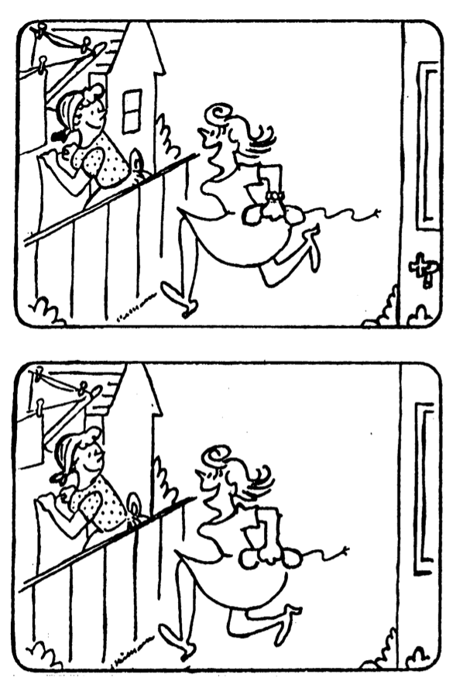
找出俩图中六处不同点。
19

Slide 8
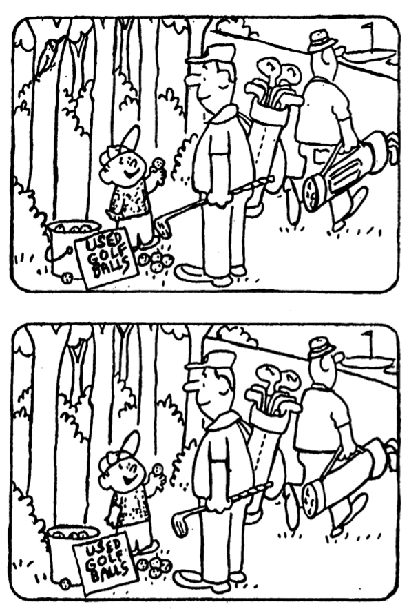
找出俩图中六处不同点。
19

Slide 9
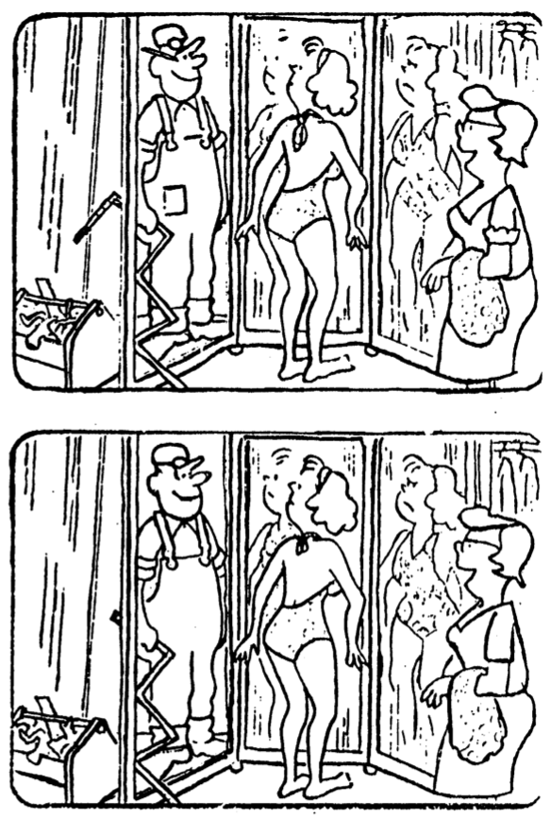
找出俩图中六处不同点。
19

Slide 11
圣经学习链接地址 biblestudydownloads.com
免费获得该讲解!
圣经学习 下载
圣经研读材料链接地址 biblestudydownloads.com
Notes:
The explanation for free!
Bible Study materials link address (top) translated by Michele Ang 15 Jan 2015
Bible study (bottom)

