Slide 1
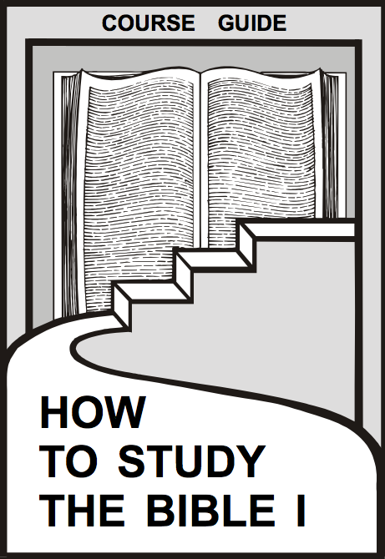
总看 3个步骤的方法
课程指导
研读先于释经!
Dr Rick Griffith
新加坡神学院
Biblestudydownloads.com

Slide 2
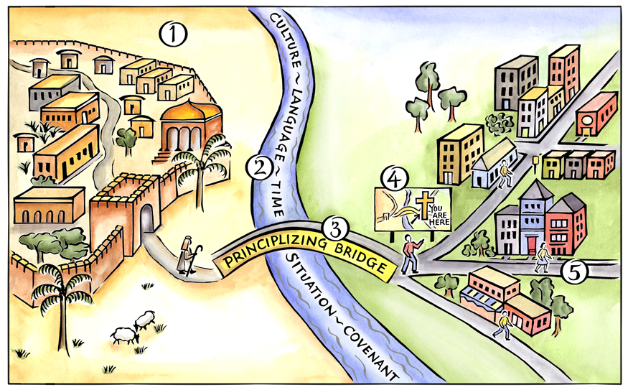
基本步骤
Duvall & Hays, 《抓准神的话》
Notes:
Above is a pictorial representation of our consistent approach to biblical interpretation. We call it the Interpretative Journey. There are 5 steps on this journey:
Grasping the Text in Their Town
Measuring the Width of the River to Cross
Crossing the Principlizing Bridge
Consult the Biblical Map
Grasping the Text in Our Town
By embarking on this journey we commit to the goal of grasping the meaning of text. We do not create meaning out of a text; rather, we seek to find the meaning that is already there.
Duvall, J. Scott, and J. Daniel Hays. Grasping God's Word: A Hands-on Approach to Reading, Interpreting, and Applying the Bible. Third Edition. Grand Rapids: Zondervan, 2012.

Slide 3
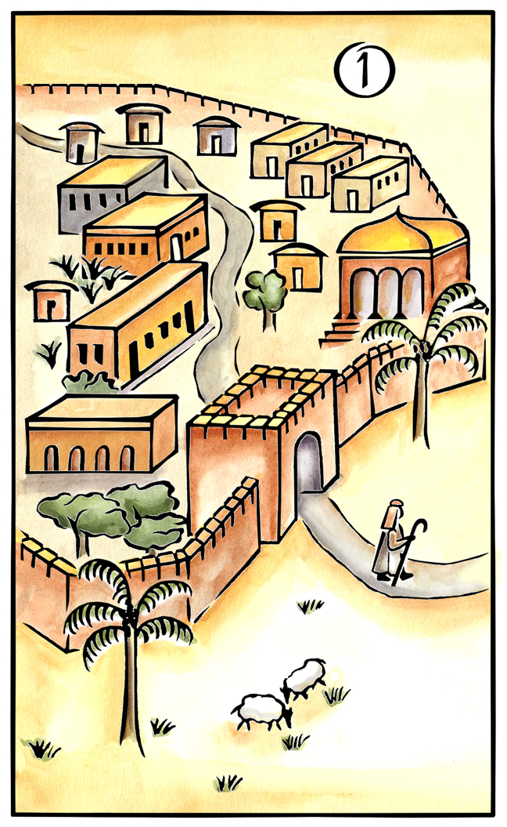
第一步：抓住经文在当时城镇的意义。
基本步骤
问：经文对当时读者说什么？
Duvall & Hays, 《抓准神的话》

Slide 4
基本步骤
第一步:
读，观察.
研读历史及文学.
聚成原义
Duvall & Hays, 《抓准神的话》
Notes:
The synthesis statement should use past tense verbs and refer to the biblical audience.

Slide 5
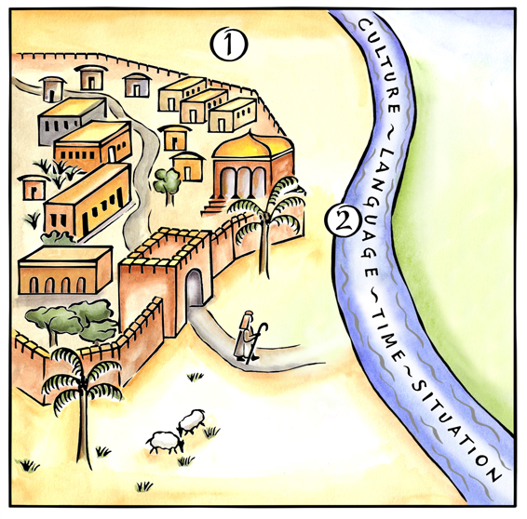
基本步骤
第二步：测量要跨过的长度
问： 不同处？
Duvall & Hays, 《抓准神的话》

Slide 6
基本步骤
第三步：跨过原则化的“桥”共同处.
不同处.
若你在读旧约的经文，你要说明耶稣基督的生命与服侍.
Duvall & Hays, 《抓准神的话》
Notes:
Students often get bogged down in the common differences that possibly have little impact on the interpretation of a passage. It is important for them to realize that to take the Interpretative Journey means that we must account for the unique set of differences that we find in any given text.

Slide 7
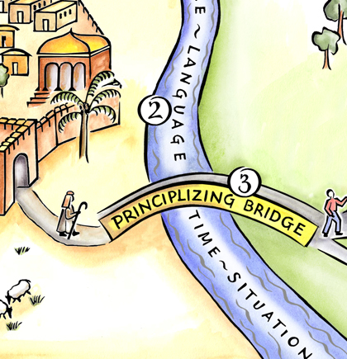
基本步骤
第三步：跨过原则化的“桥”共同处.
问：神学原则？
Duvall & Hays, 《抓准神的话》
Notes:
This theological principle is connected to the meaning that was discovered in Step 1.

Slide 8
基本步骤
第三步：跨过原则化的“桥”共同处.
神学原则（主题）
Duvall & Hays, 《抓准神的话》

Slide 9
神学原则（主题）应当是：
基本步骤
基于经文：创4：1-15
跨时间
跨空间
相关
和谐
Duvall & Hays, 《抓准神的话》
Notes:
Above is a list of 5 criteria that describe a good theological principle.

Slide 10
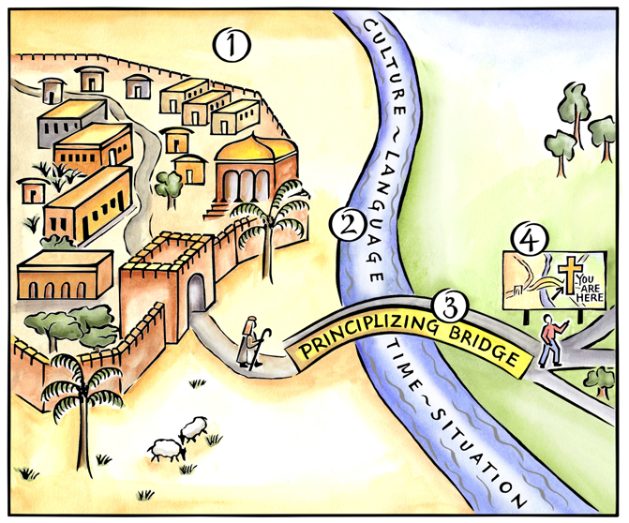
基本步骤
第四步：咨询圣经总原则
问题：我们的神学原则如何与正本神经符合?
Duvall & Hays, 《抓准神的话》

Slide 11
基本步骤
第四步：咨询圣经总原则
和谐
旧约转入新约
Duvall & Hays, 《抓准神的话》
Notes:
Point 1 describes the parts-whole spiral.
Point 2 forces us to ask if the New Testament adds to or modifies our principle.

Slide 12
基本步骤
第五步：抓住经文在现今城镇的意义
问题:每个基督徒应该如何活出神学原则能?
Duvall & Hays, 《抓准神的话》
Notes:
This step moves an abstract principle to concrete application.

Slide 13
基本步骤
当时城镇
现今城镇
咨询圣经总原则
测量要跨过的长度
原则化的“桥”
Duvall & Hays, 《抓准神的话》
Notes:
Above is a pictorial representation of our consistent approach to biblical interpretation. We call it the Interpretative Journey. There are 5 steps on this journey:
Grasping the Text in Their Town
Measuring the Width of the River to Cross
Crossing the Principlizing Bridge
Consult the Biblical Map
Grasping the Text in Our Town
By embarking on this journey we commit to the goal of grasping the meaning of text. We do not create meaning out of a text; rather, we seek to find the meaning that is already there.

Slide 14
归纳法读经
20
 | 书 (综合性)
观察 (我看到什么?) | 经文 或 细节 (分析) | 解释所观察的 (有什么意思能?)
 | 题目 (题目化)

Slide 15
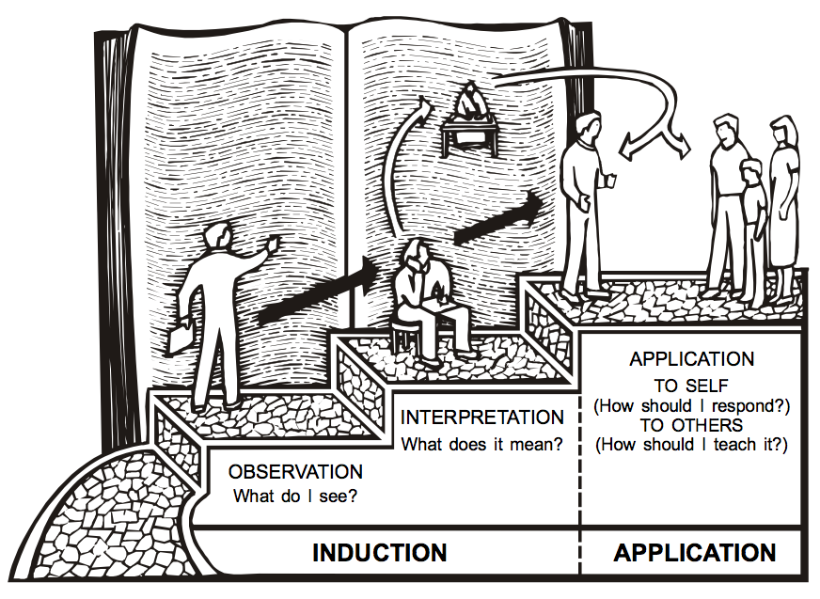
三段法
20
运用
自己
解释
(我应该怎么回应?)
有什么意思呢?
其他人
观察
(我应该怎么教?)
我看到什么?
归纳法
运用

Slide 16
基本步骤
观察
运用
当时城镇
现今城镇
解释
咨询圣经总原则
测量要跨过的长度
原则化的“桥”
Duvall & Hays, 《抓准神的话》
Notes:
Above is a pictorial representation of our consistent approach to biblical interpretation. We call it the Interpretative Journey. There are 5 steps on this journey:
Grasping the Text in Their Town
Measuring the Width of the River to Cross
Crossing the Principlizing Bridge
Consult the Biblical Map
Grasping the Text in Our Town
By embarking on this journey we commit to the goal of grasping the meaning of text. We do not create meaning out of a text; rather, we seek to find the meaning that is already there.

Slide 17
圣经学习链接地址 biblestudydownloads.com
免费获得该讲解!
圣经学习 下载
圣经研读材料链接地址 biblestudydownloads.com
Notes:
The explanation for free!
Bible Study materials link address (top) translated by Michele Ang 15 Jan 2015
Bible study (bottom)

