Slide 1

研經法
Dr Rick Griffith
新加坡神学院
Biblestudydownloads.com

Slide 2
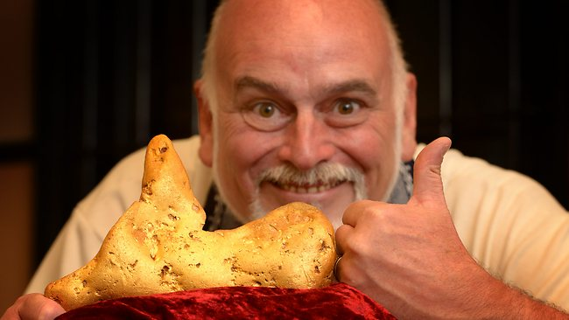
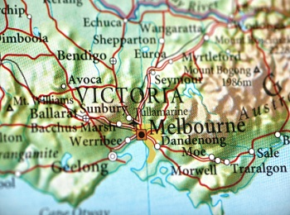
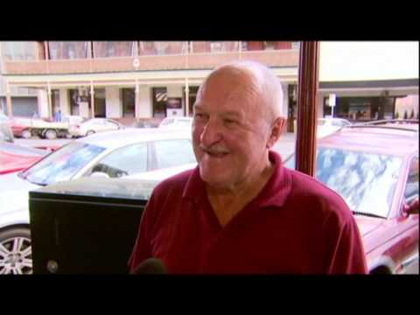
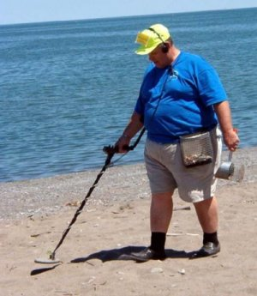
澳洲的黄金
Notes:
"TIME TO BUY A METAL DETECTOR
11 pound gold nugget found in Australia by guy with metal detector
January 17, 2013, 11:58 AM
Pack your bags, gold bugs! An Australian prospector using a state-of-the-art metal detector has discovered a gold “nugget” that weighs as much as some small dogs, the BBC reports.The 5.5 kg (11 pound) nugget was found about 2 feet below the surface of the ground near the town of Ballarat, in Victoria, according to the report. (See map below.)The gold in the nugget is worth more than $300,000 at current prices. But the size of the sample likely makes it worth even more. Gold was first discovered in the area more than 160 years ago."
http://www.theburningplatform.com/?tag=gold-nugget accessed 24 Jan 2013

Slide 3

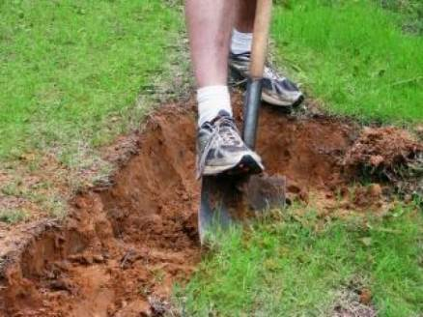
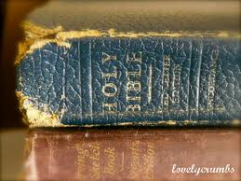
经文的黄金
你口中的律法对我有益， 胜过千千万万的金银。 (诗篇119:72 CNV)."
Notes:
"Application:
You may not have access to an ultra powerful metal detector, but God has made His Spirit available to all. And the Holy Spirit is all you need to probe deeper into the depths of God's Word and grasp truths that the casual reader will pass by without knowing the true value of what he is missing.
Beyond the realm of what can be seen, heard, or touched are treasures of eternal worth, just waiting to be discovered. And when you discover them, you give others hope that the riches of God's Word can be theirs, as well.
"Let the word of Christ dwell in you richly as you teach and admonish one another with all wisdom, and as you sing psalms, hymns and spiritual songs with gratitude in your hearts to God" (Colossians 3:16).
"Your laws are my treasure; they are my heart's delight" (Psalm 119:111, NLT)."
Illustration Exchange 24 Jan 2013

Slide 4
经文的黄金
因此我爱你的命令， 胜过金子， 甚至胜过精金。 (诗篇119:127 CNV)."
Notes:
"Application:
You may not have access to an ultra powerful metal detector, but God has made His Spirit available to all. And the Holy Spirit is all you need to probe deeper into the depths of God's Word and grasp truths that the casual reader will pass by without knowing the true value of what he is missing.
Beyond the realm of what can be seen, heard, or touched are treasures of eternal worth, just waiting to be discovered. And when you discover them, you give others hope that the riches of God's Word can be theirs, as well.
"Let the word of Christ dwell in you richly as you teach and admonish one another with all wisdom, and as you sing psalms, hymns and spiritual songs with gratitude in your hearts to God" (Colossians 3:16).
"Your laws are my treasure; they are my heart's delight" (Psalm 119:111, NLT)."
Illustration Exchange 24 Jan 2013

Slide 5
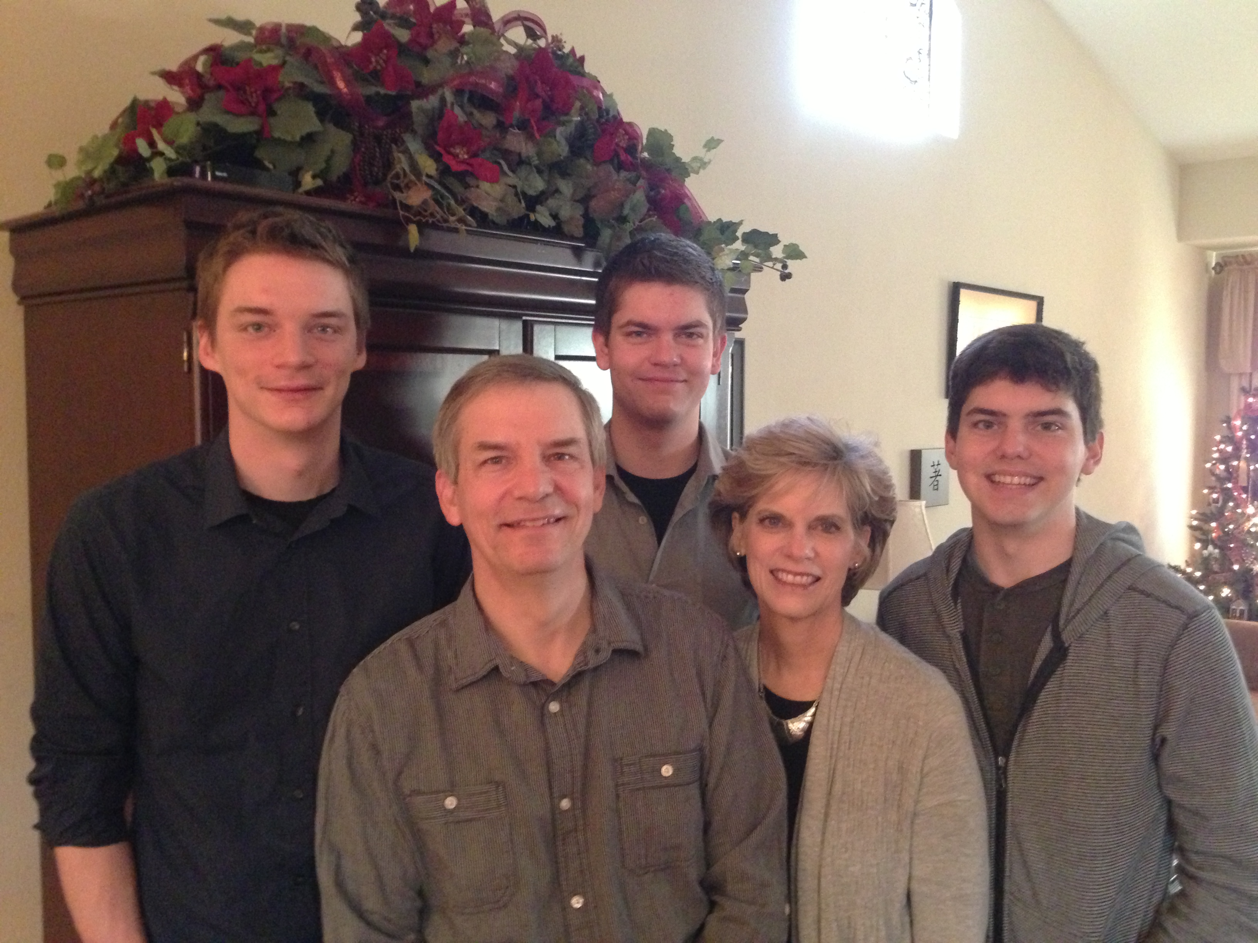
Griffith博士的家庭
2012年12月
Kurt
26
Stephen
23
John
20
6
Rick
Susan
Notes:
SUSAN: God continues working in our family as we see Him work in our three sons. Our two older ones work in Seattle and our youngest (John) is in his first year at Biola University in Southern CA. We lived in the USA his first semester, pretending that he needed us until we returned to Singapore on January 5.

Slide 6

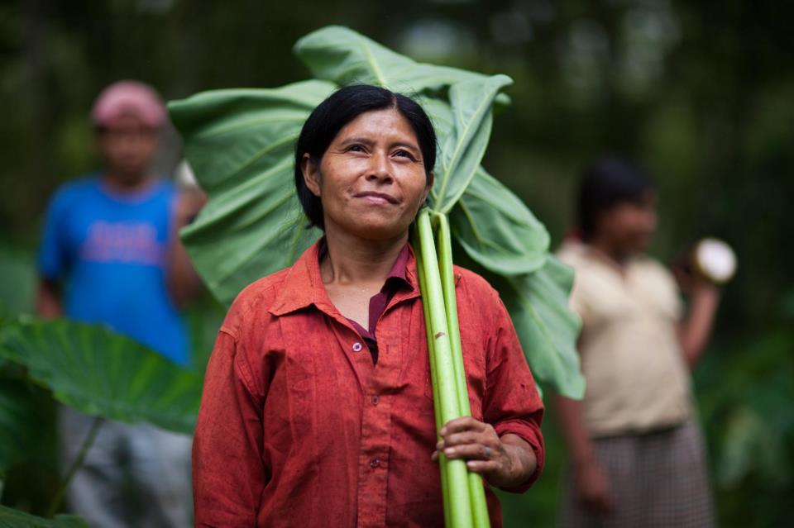
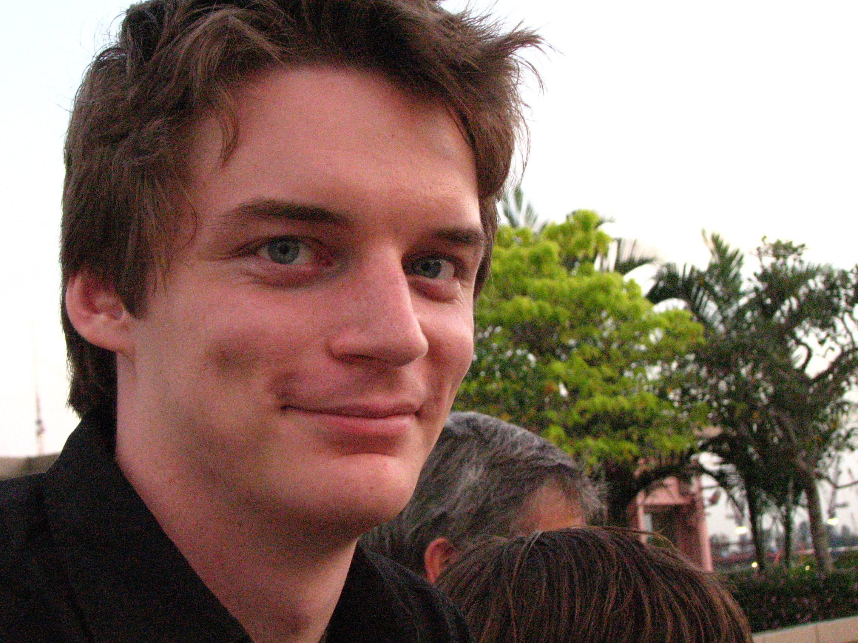

Kurt 在市场营销与资信科技领域工作

Slide 7
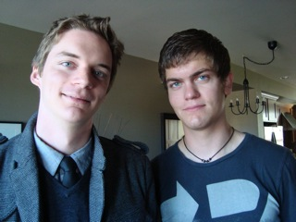
Kurt & Stephen

Slide 8

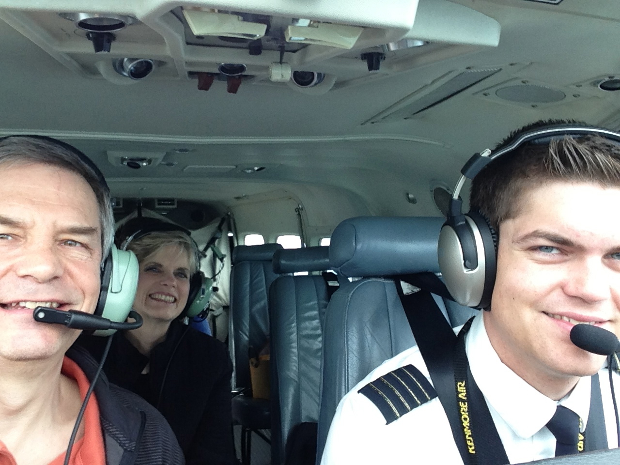

Slide 9
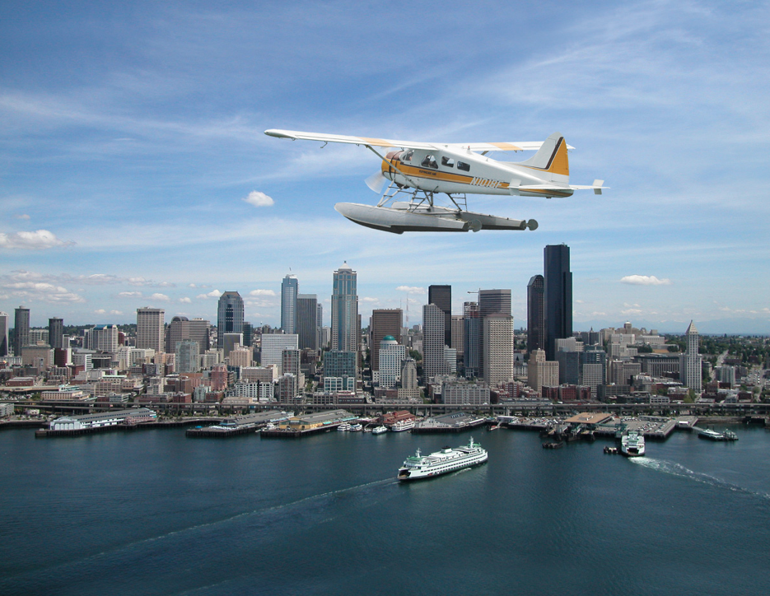
Stephen the Pilot

Slide 10
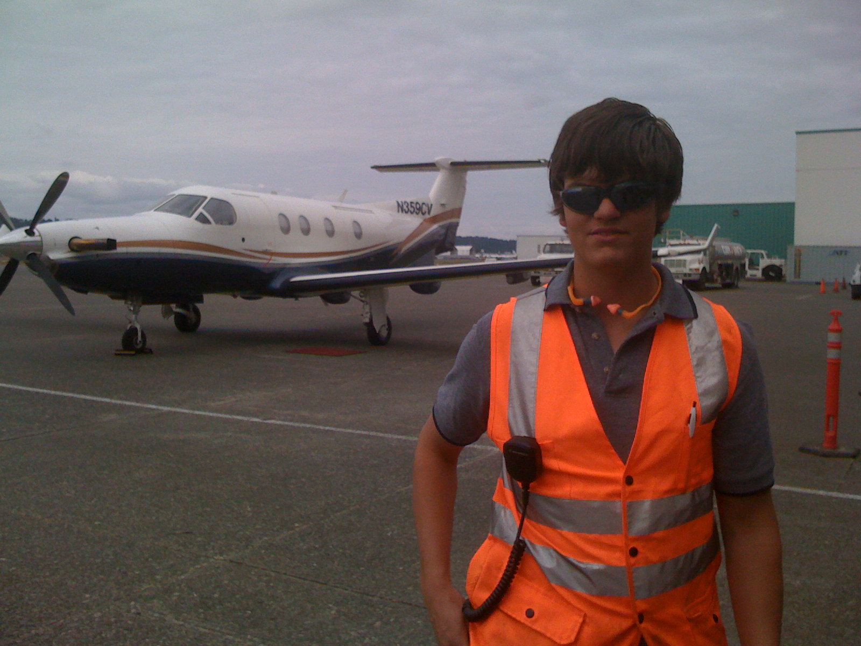
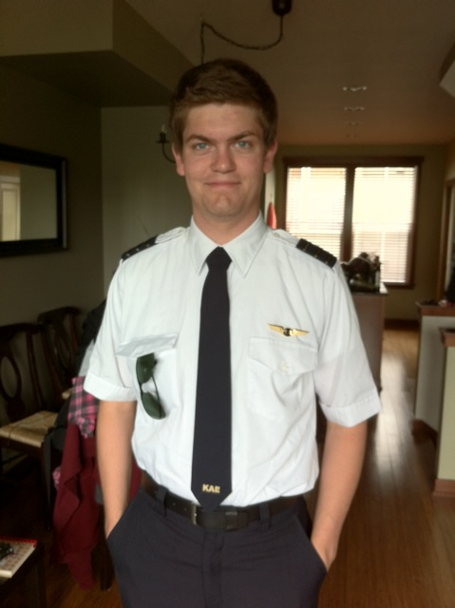
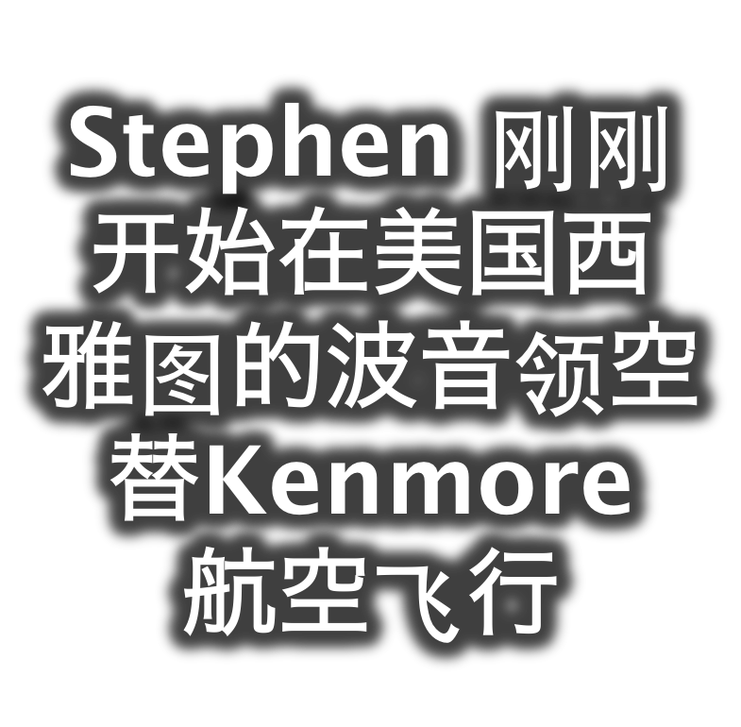

Slide 11
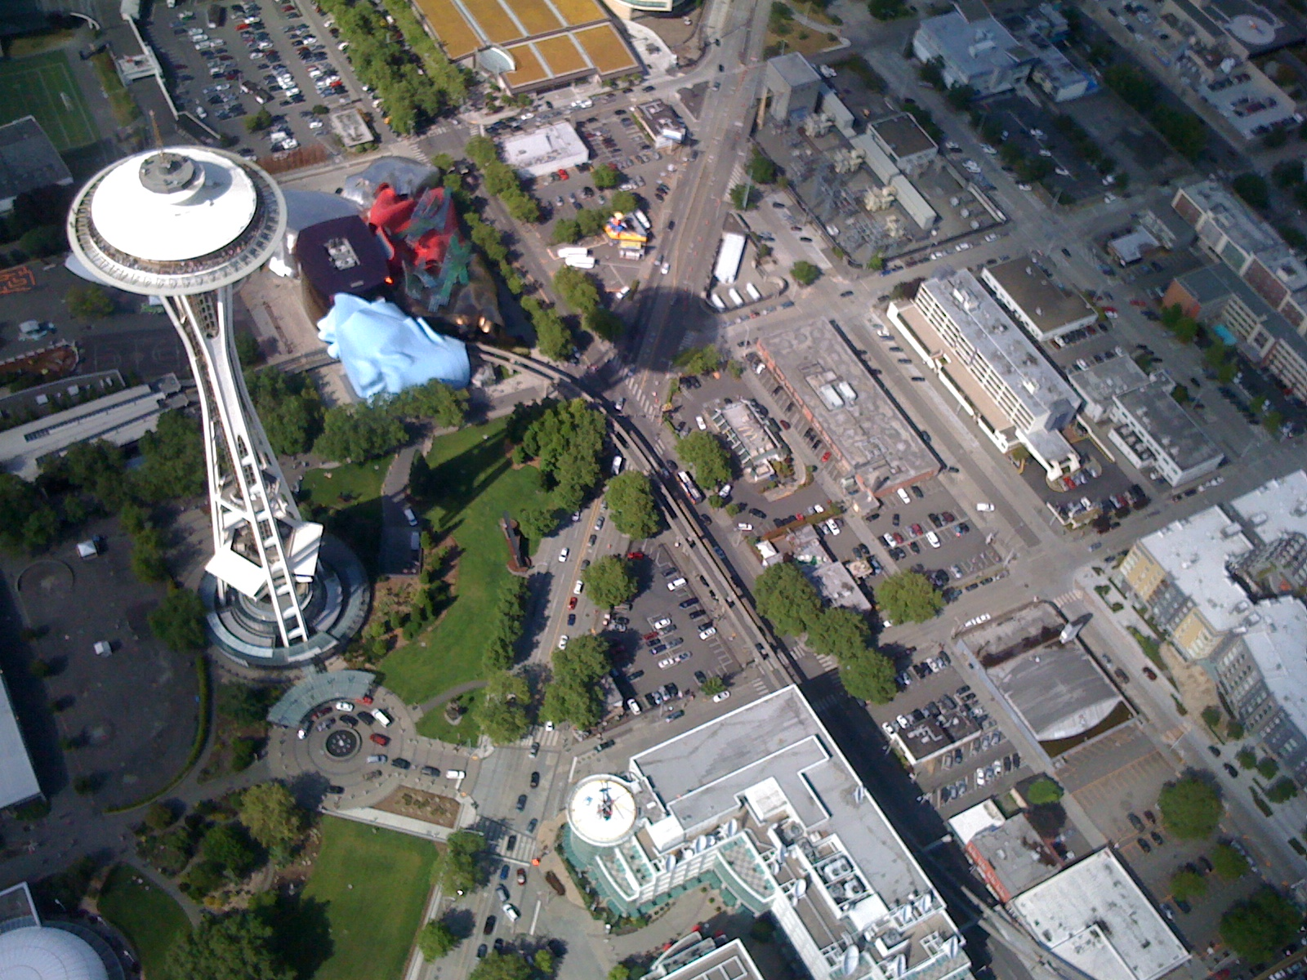
鸟瞰西雅图

Slide 12
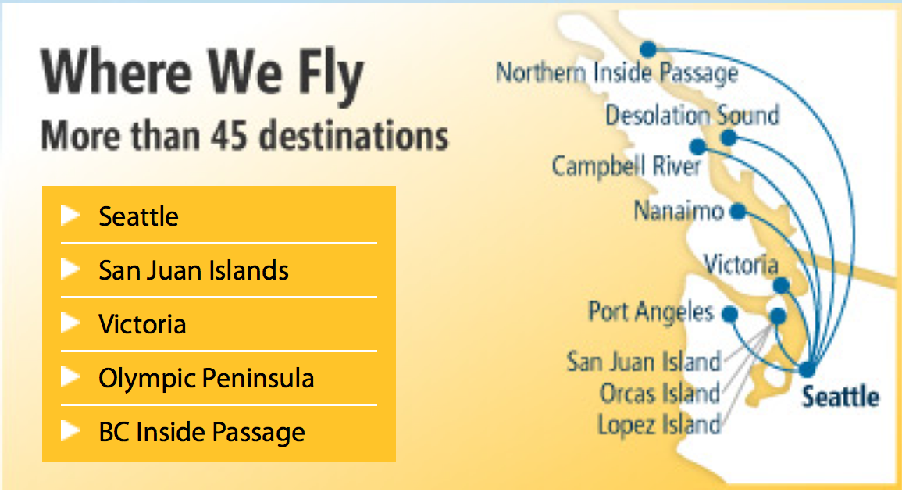
Stephen 负责 Kenmore 航空飞往 San Juan岛的航路

Slide 13
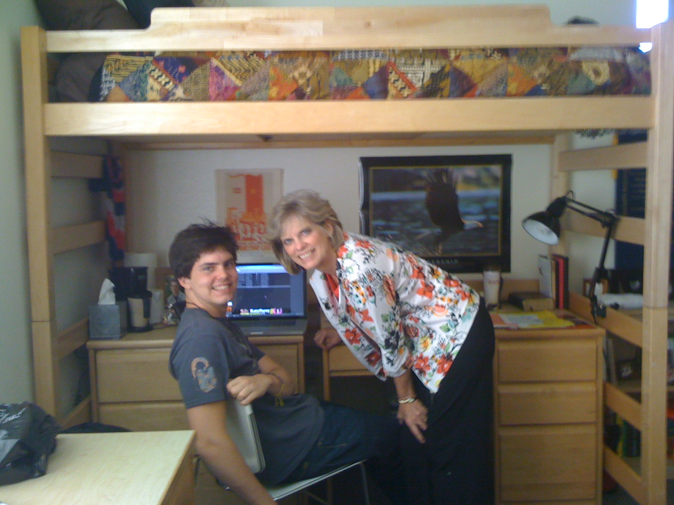


Slide 14
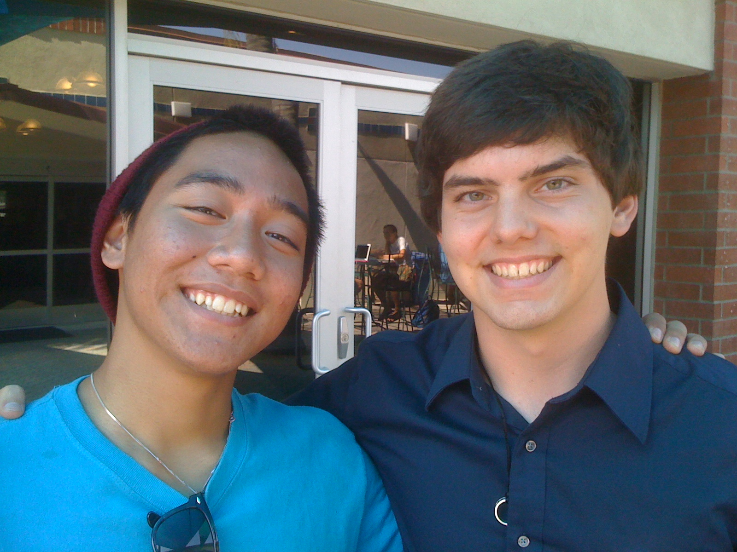
John at Biola University

Slide 15


宣教机构…

Slide 16
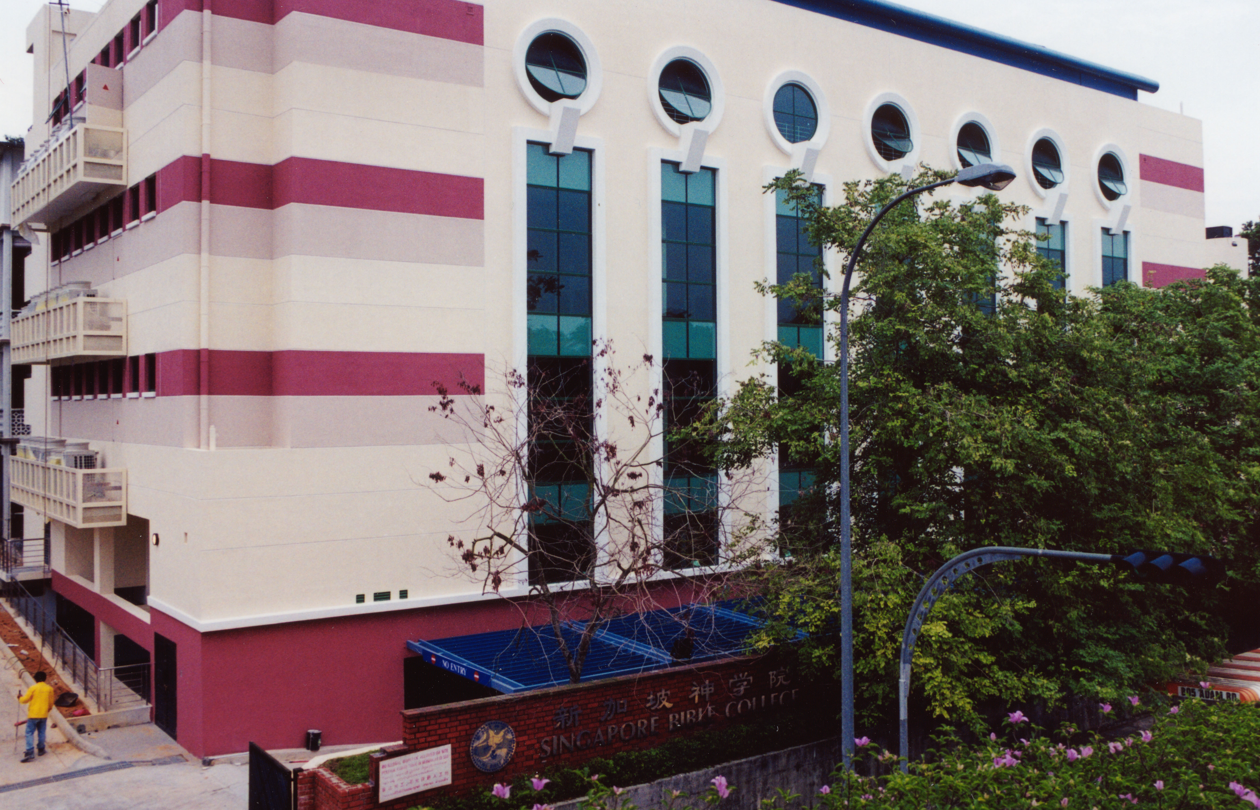
新加坡神学院
Notes:
I've served as a seminary professor with 30 other faculty at Singapore's largest training school: Singapore Bible College

Slide 17
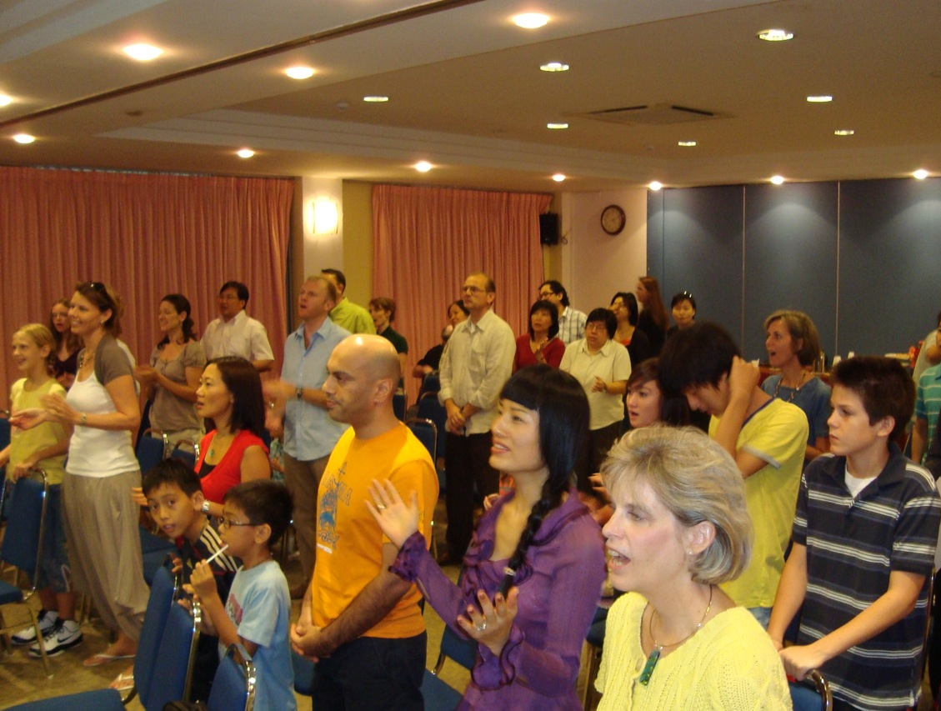

Our People
来自8个国家的37个人

Slide 18
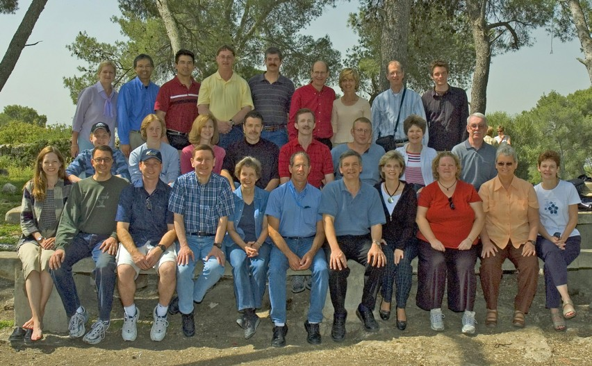
WorldVenture 神学院的讲师在以色列

Slide 19
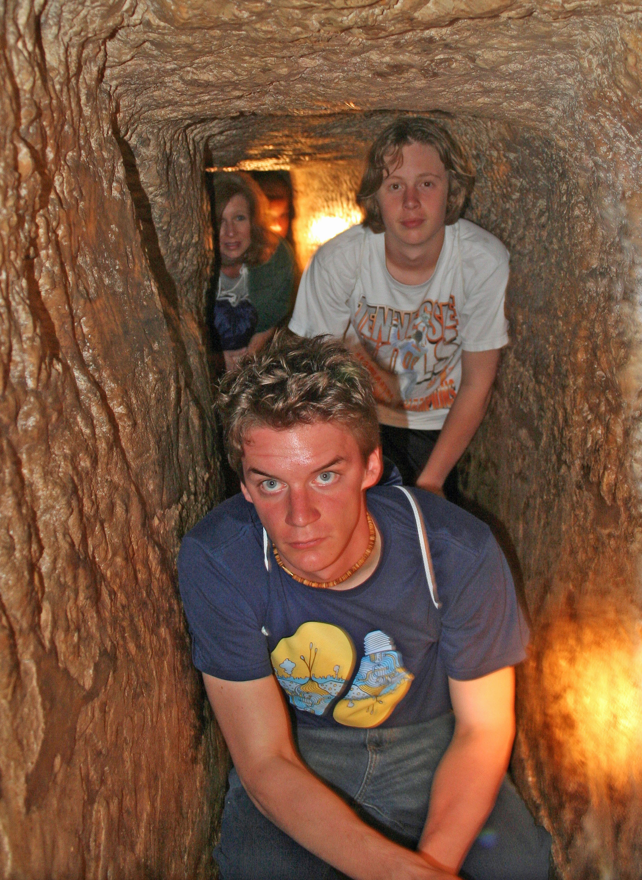
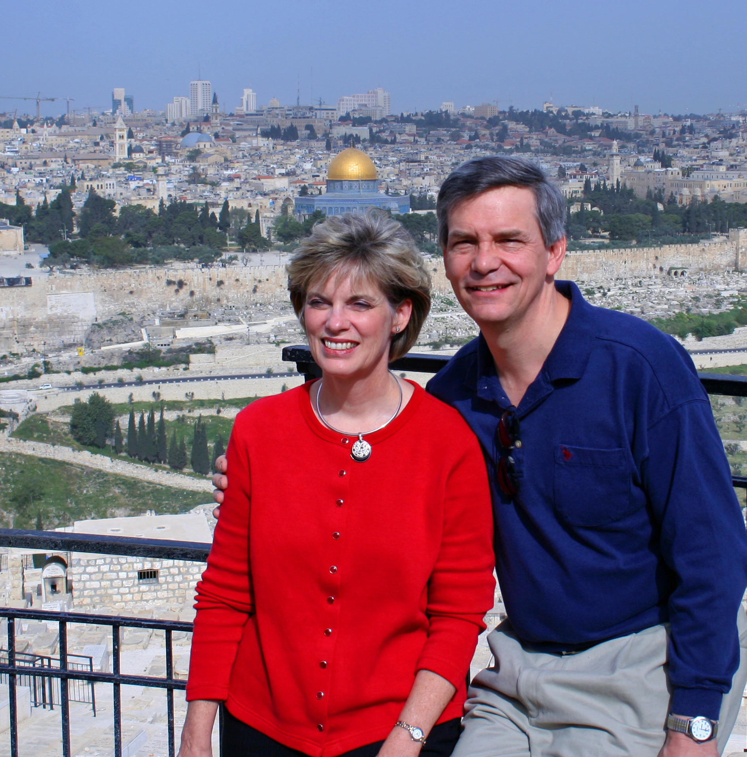
Susan 和 Rick 在
橄榄山
Kurt 在
希西家的地下道

Slide 20
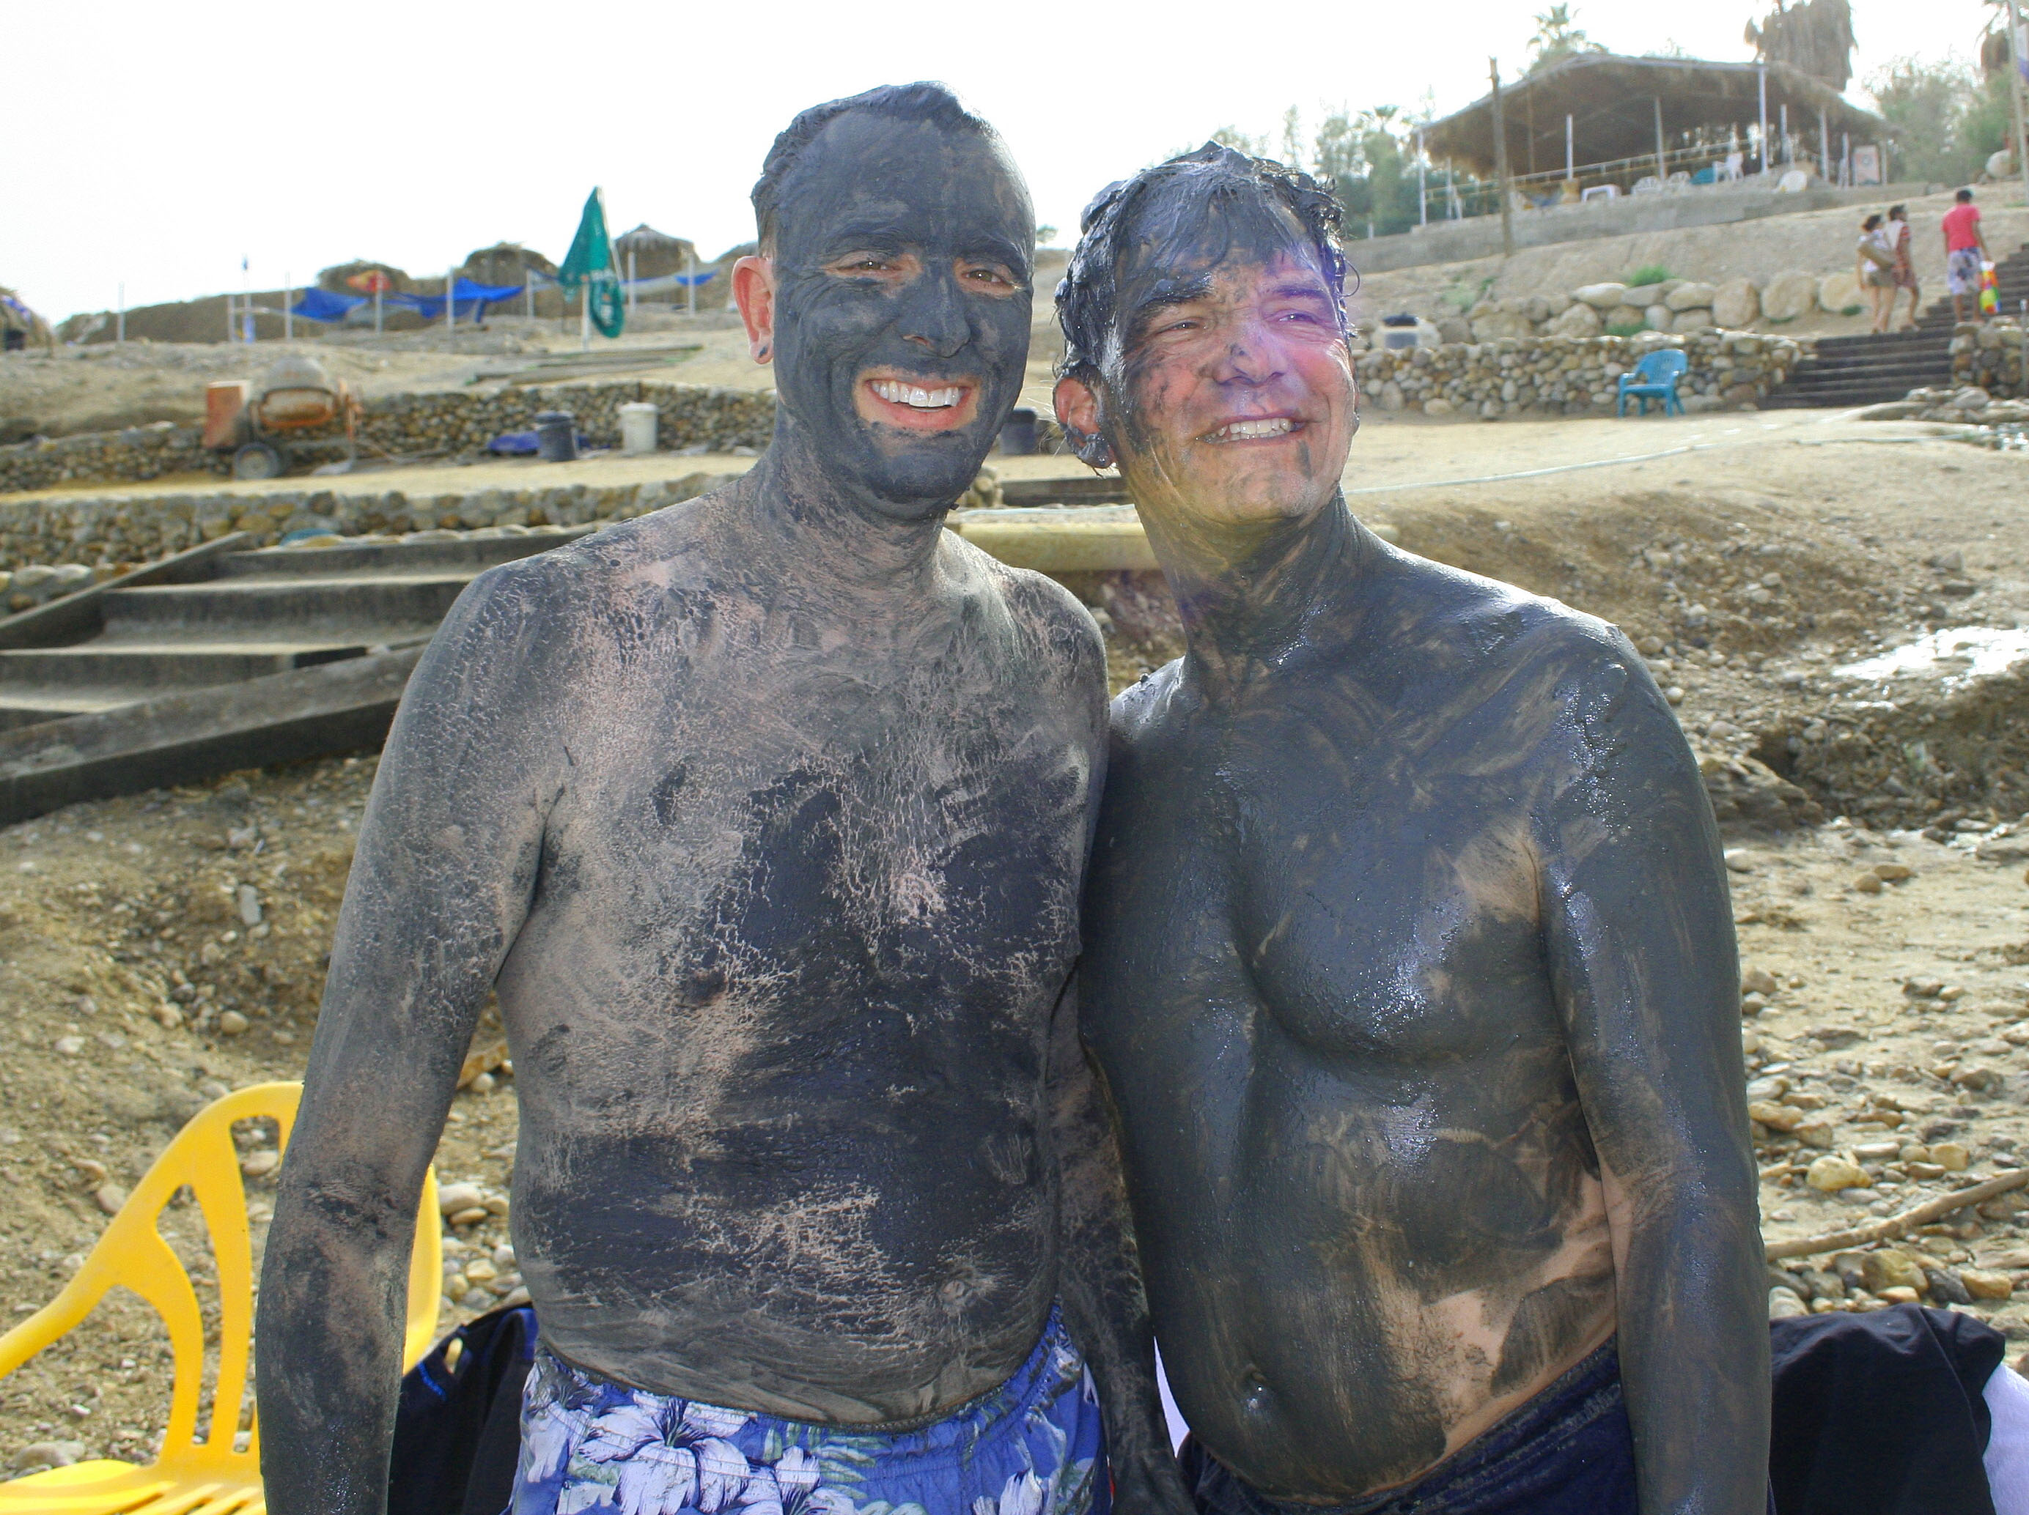
Dead Sea Mud

Slide 21
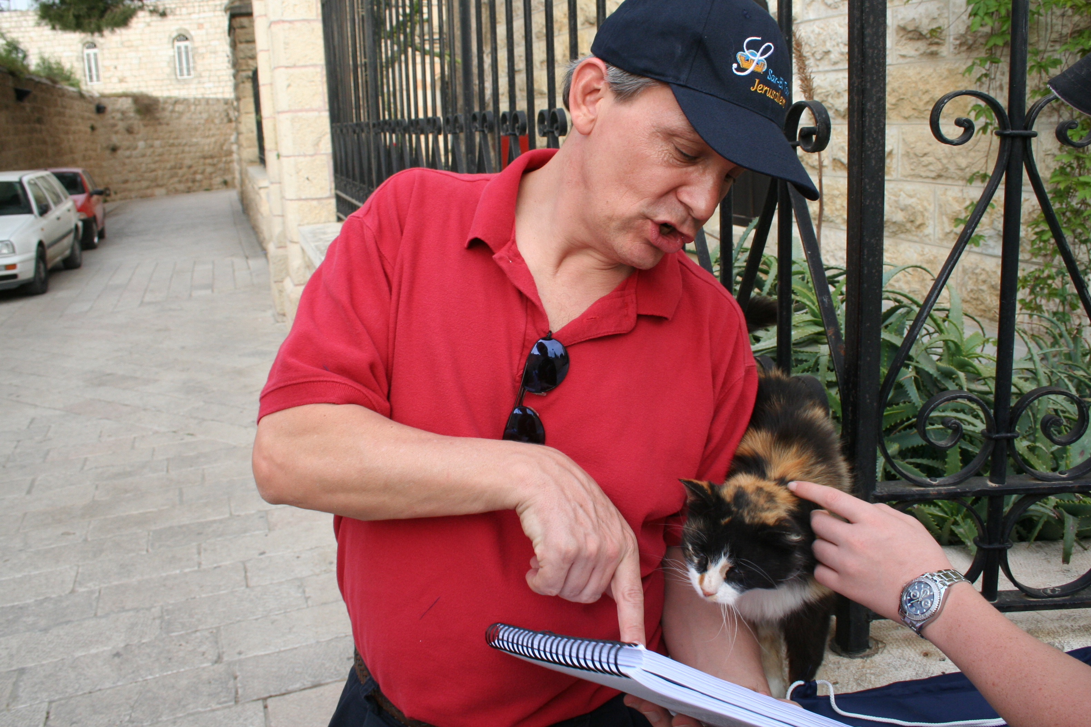
“向所有的人传福音” (马可福音 16:15)

Slide 22
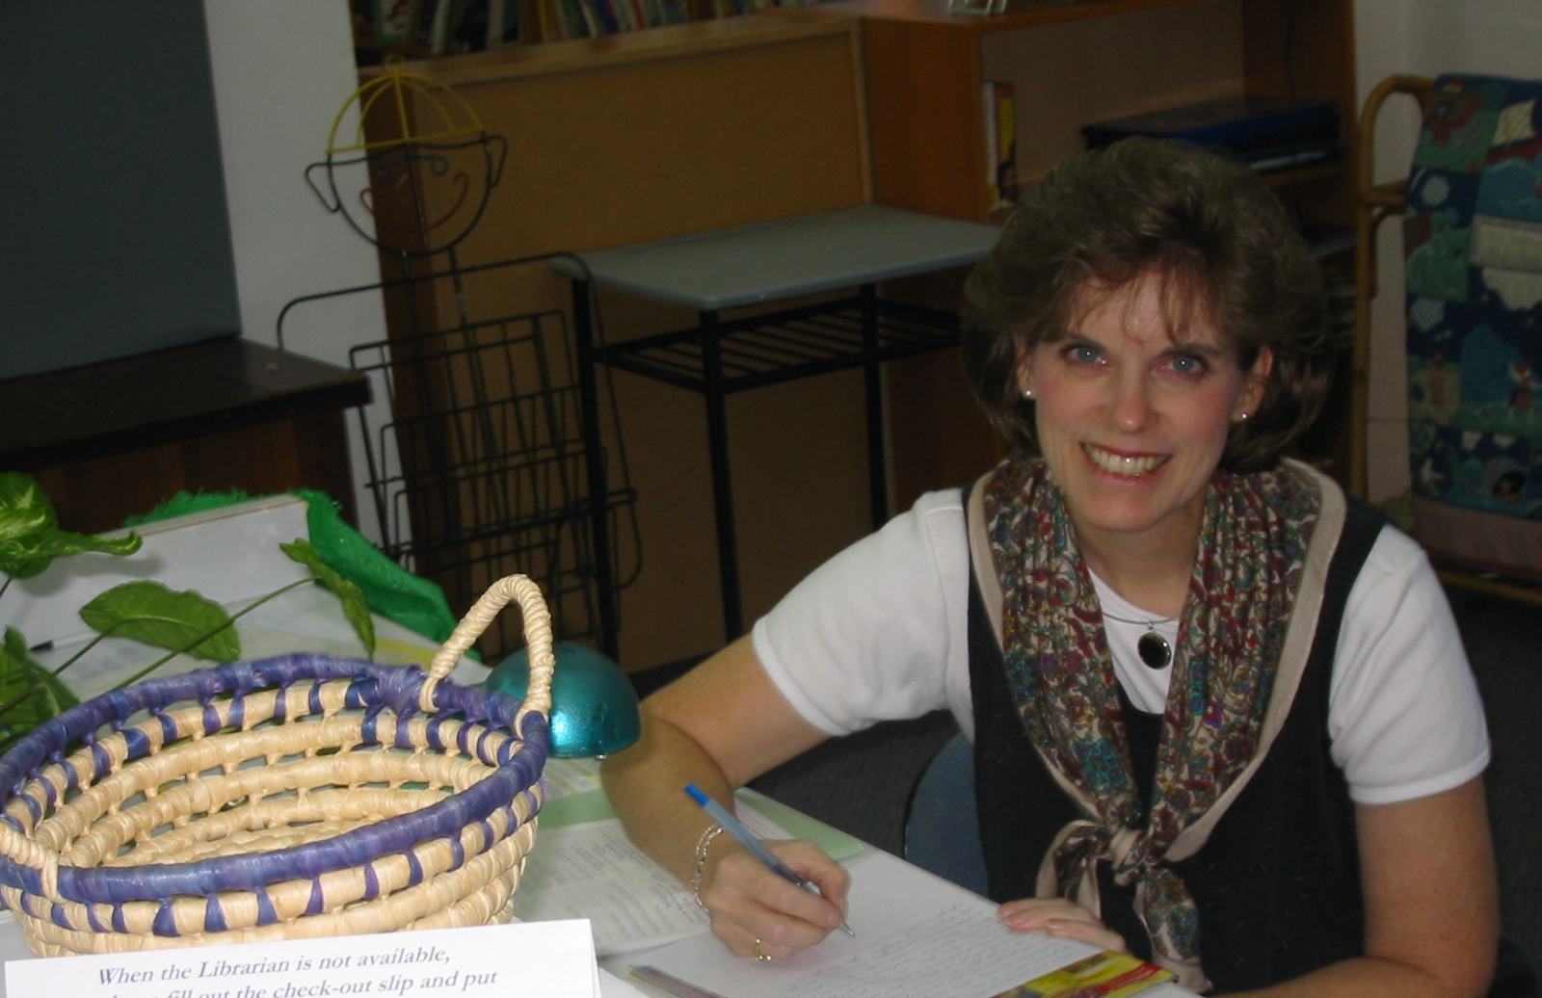
Susan 曾经在
International Community School, 新加坡，当图书馆管理员与董事会员

Slide 23
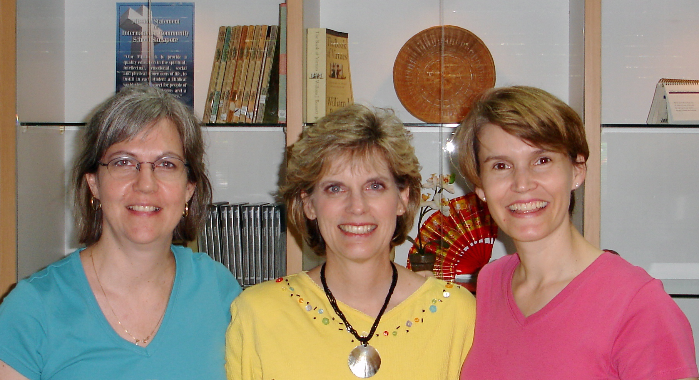
Susan 领导了其它的ICS图书馆管理员八年

Slide 24

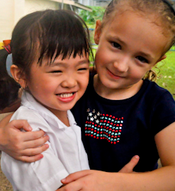
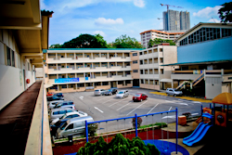
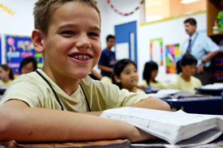

ICS 至今有 470 学生!
瑞典
欧美
韩国
瑞士
日本
意大利
美国
泰国
印度
墨西哥
ICS
委內瑞拉
印尼
巴西
南非
澳洲

Slide 25
课程描述
1
这个课程提供实践多过与哲理性的学习。通过研读许多的经文教导学生如何适当的运用圣经。
它跟着圣经归内法的方式来观察经文，一致的使用释经学的原则来解经。再把经文运用在学生的生命里，也能在教导或讲道的事功上使用。

Slide 26
课程目标
1
在课程结束以前，学生能。。。
掌握基础以致考察圣经得到生命改变.
观察 经文不漏掉 重要部份.
解释 经文来理解神所说的.
应用 经文让自己和其他人有生命改变.

Slide 27

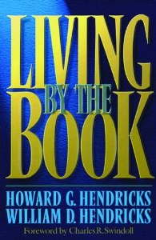
课程要求
2
阅读 (10%)
课业 (90%)

Slide 28
其他事项
18
抄写课堂笔记
联络我
在新神 信箱 L19 或 办公电话 (6559-1513)
住址是 2座-门牌302
手机电话: 9113-7090
我办公时间在早会过后 (星期四和五)
电邮: griffith@sbc.edu.sg
让我们一起吃午饭吧!

Slide 29

圣经学习链接地址 biblestudydownloads.com
免费获得该讲解!
圣经学习
下载
圣经研读材料链接地址 biblestudydownloads.com
Notes:
The explanation for free!
Bible Study materials link address (top) translated by Michele Ang 15 Jan 2015
Bible study (bottom)

Slide 30
Black
1
4
2
5
3
6

