Slide 1
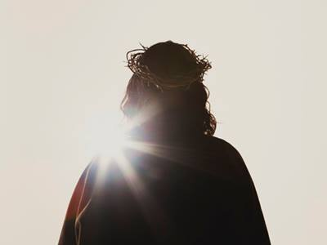
要有知识
彼得后书
Rick Griffith 博士 • Crossroads International Church Singapore
BibleStudyDownloads.org

Slide 2
关键字
284
知识
彼得后书

Slide 3
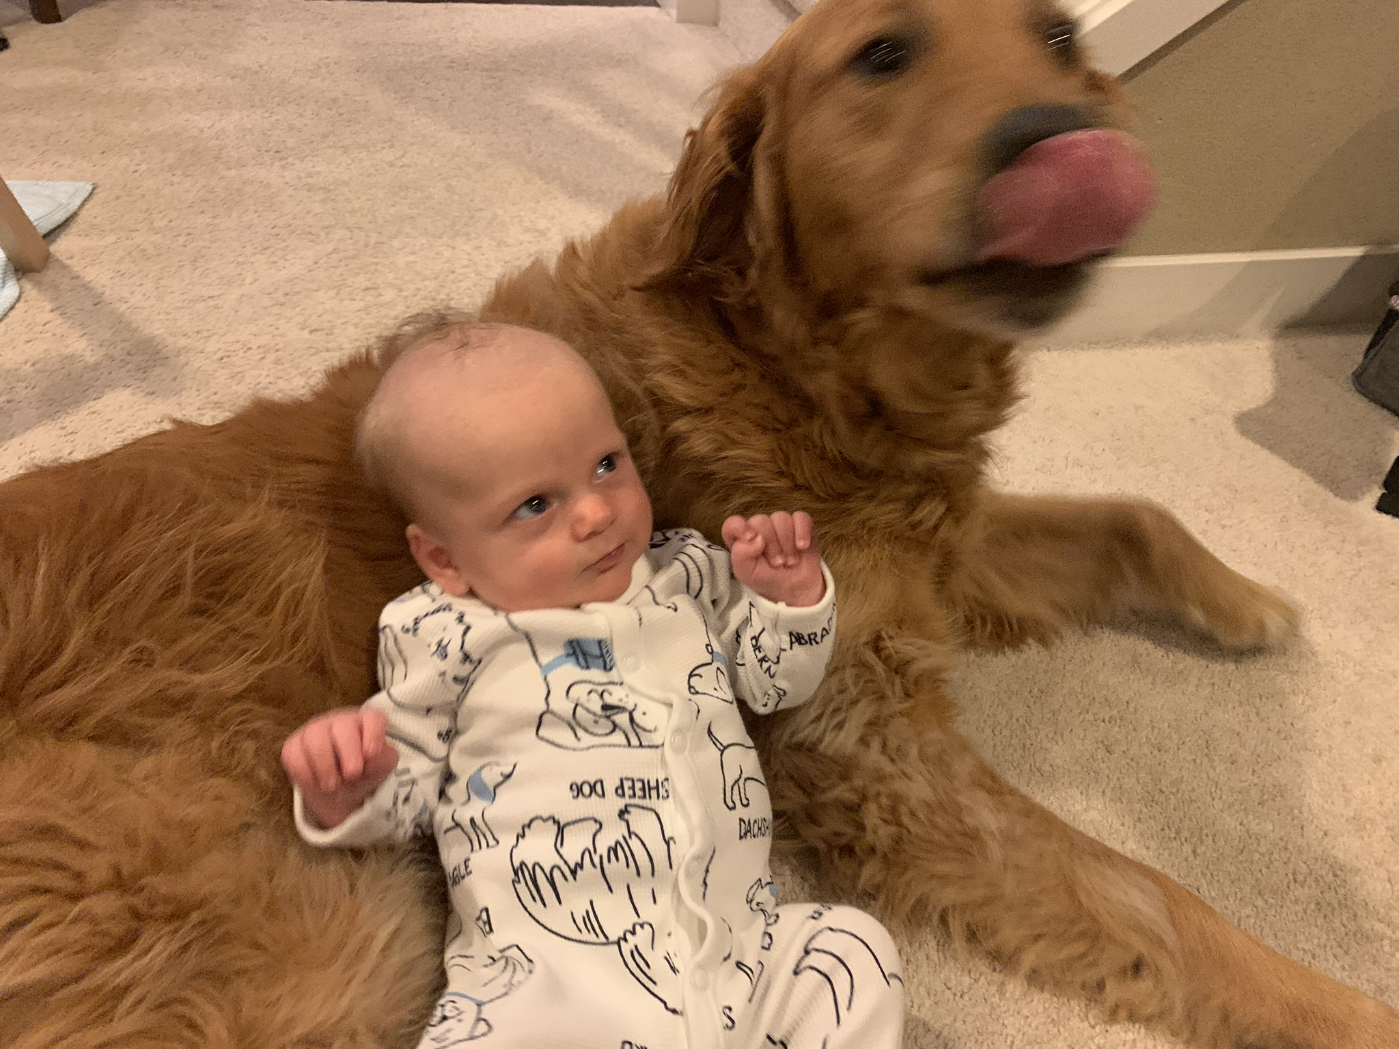
We know about family…
Notes:
Of course, we all want knowledge about our family.
当然，我们都希望了解关于自己家庭的情况。

Slide 4
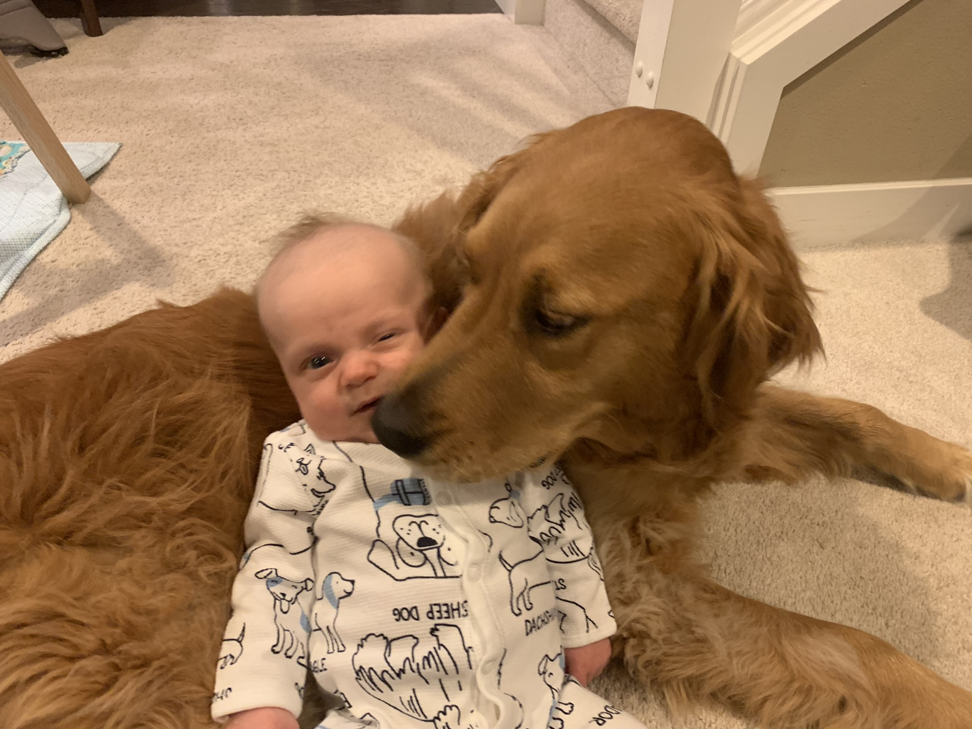
We know about family…
Notes:
I want to know how my grandson is getting along with the dog.
我想知道我的孙子和那只狗相处得怎么样。

Slide 5
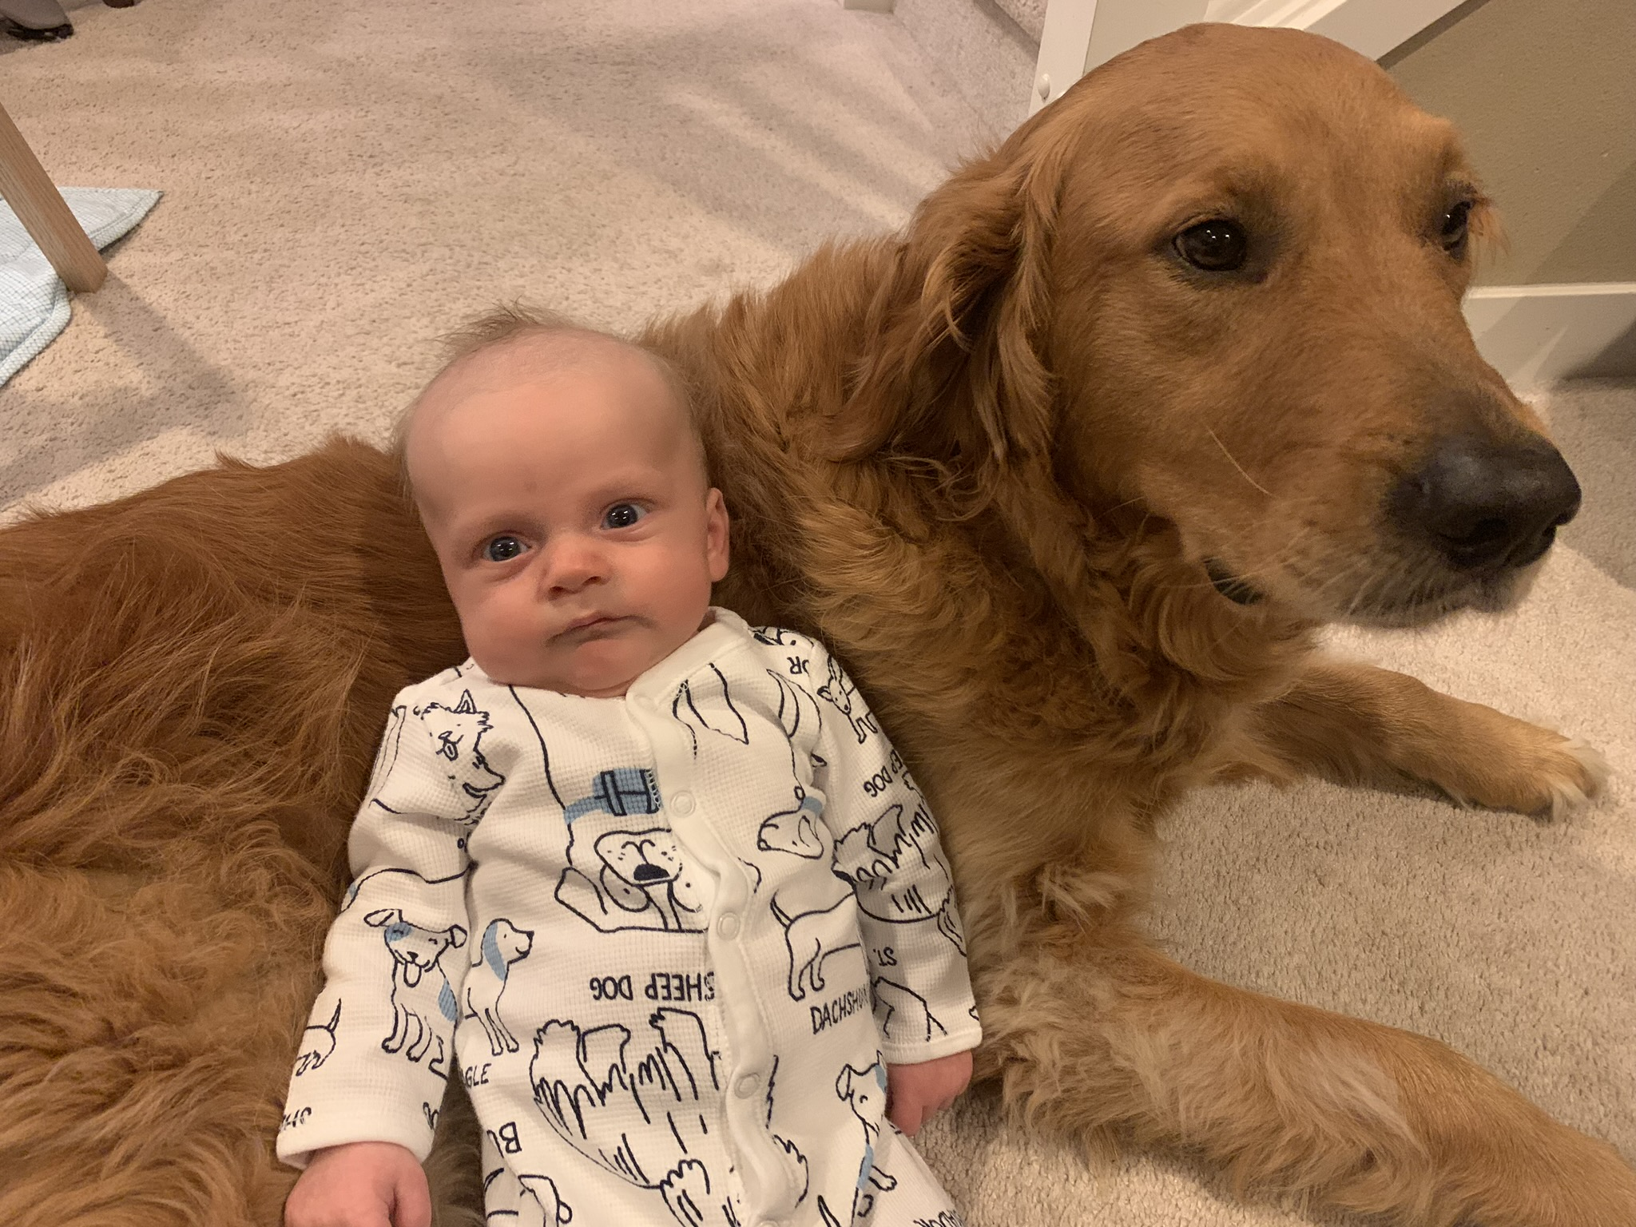
We know about family…
Notes:
Looks like he has some knowledge to gain about dog kisses!
看起来他还需要学习一些关于狗狗亲吻的知识！

Slide 6

我们好像有非常多…
与信仰无关的知识…
彼得后书

Slide 7
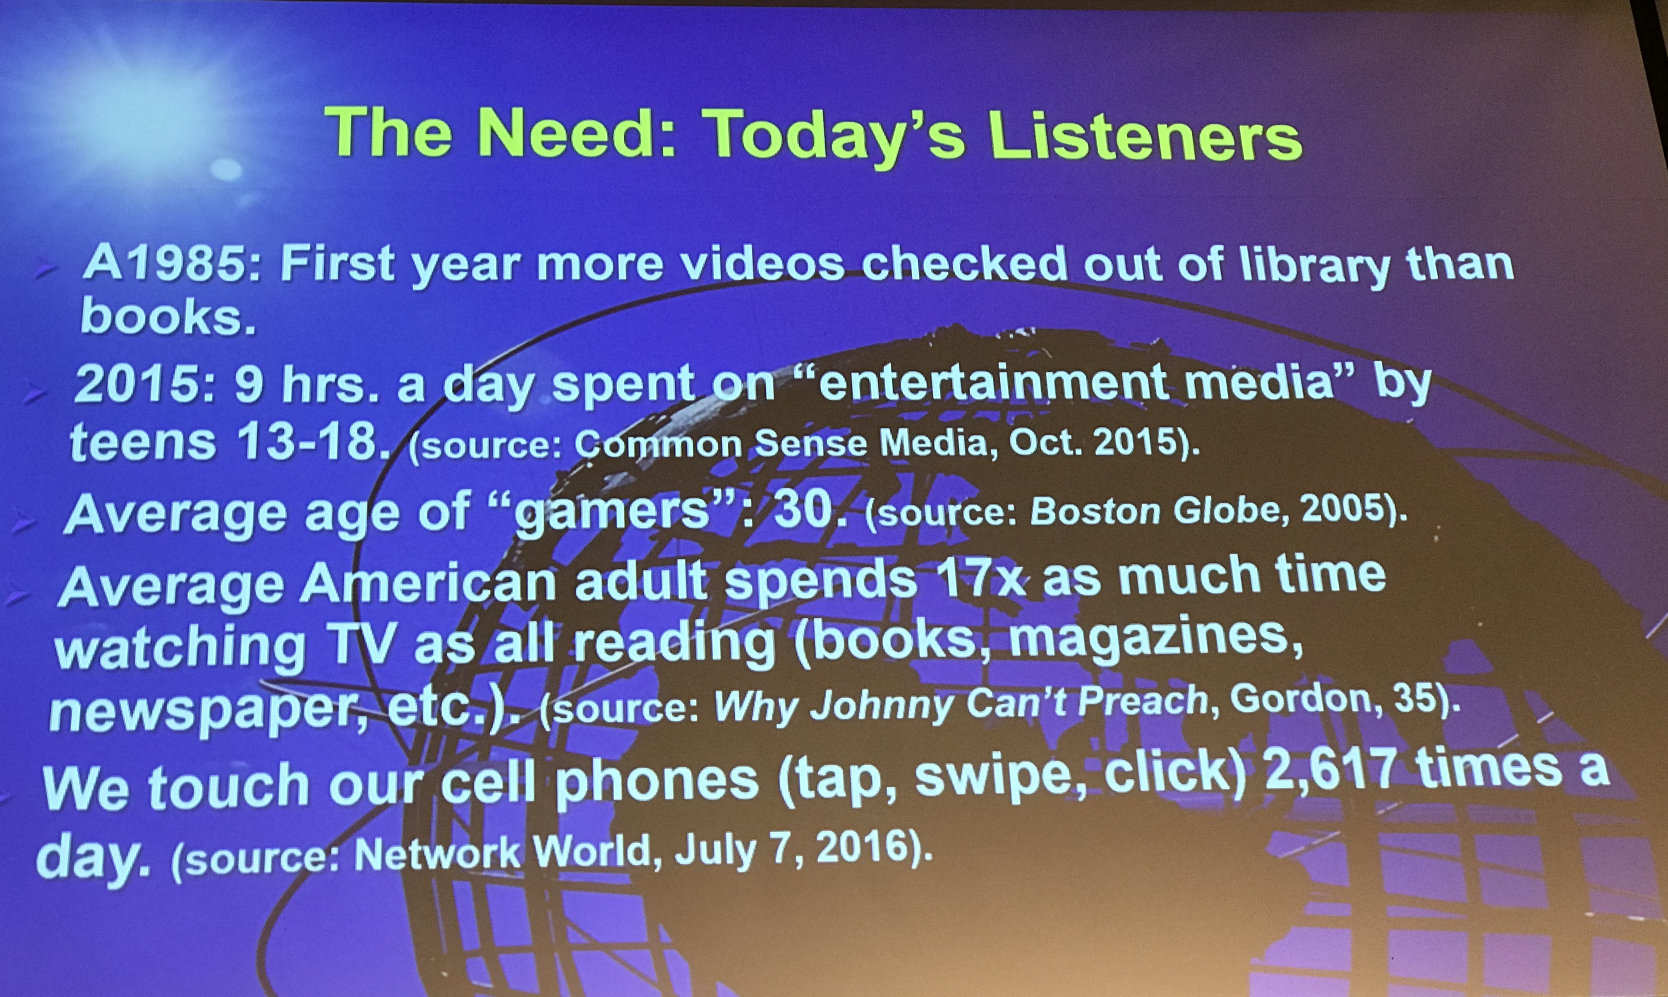
我们所知道的……
当代听众的需求
• 1985年：这是图书馆借出的录像带数量首次超过书籍的一年。
• 2015年：13-18岁的青少年每天花 9 小时 在“娱乐媒体”上。（来源：Common Sense Media，2015年10月）
• “玩家”的平均年龄：30岁。（来源：《波士顿环球报》（Boston Globe），2005年）
• 美国成年人花在看电视上的时间 是阅读（书籍、杂志、报纸等）的 17 倍。（来源：《为什么约翰不会讲道》（Why Johnny Can’t Preach），Gordon，第35页）
• 我们每天触摸手机（点击、滑动、点击） 2,617 次。（来源：Network World，2016年7月7日）

Slide 8
主题
23
以知识抵挡假教诲
彼得后书

Slide 9
关键节
284
“所以，亲爱的，你们既然预先知道了，就要谨慎，免得受恶人的错谬引导，就从自己坚固的地步上坠落。你们却要在我们的主、救主耶稣基督的恩典和知识上长进。愿荣耀归给他，从现在直到永远。阿们。” (3:17-18)。
彼得后书

Slide 10

在信仰
中成长
Notes:
You’ve likely heard much about growing in faith.
你可能已经听过很多关于在信仰中成长的信息。

Slide 11


grow in
GRACE
在恩典中成长
彼得后书3:18
Notes:
But Peter’s emphasis is on growing in grace. What does that mean?
______
To translate this slide, delete the picture and translate the text underneath it.
但彼得的重点是在恩典中成长。这是什么意思？
要翻译此幻灯片，请删除图片并翻译其下方的文本。

Slide 12

在我们主耶稣基督的恩典和知识上成长。
Notes:
Even further, Peter says his letter tells us to grow in the grace and knowledge of the Lord Jesus Christ. Put that in your own words for your neighbor sitting next to you.
更进一步，彼得说，他的书信教导我们要在主耶稣基督的恩典和知识上成长。请用你自己的话，将这句话分享给你身边的邻座。

Slide 13
关键节
284
“所以，亲爱的，你们既然预先知道了，就要谨慎，免得受恶人的错谬引导，就从自己坚固的地步上坠落。你们却要在我们的主、救主耶稣基督的恩典和知识上长进。愿荣耀归给他，从现在直到永远。阿们。” (3:17-18)。
彼得后书

Slide 14

要知道什么才能成长…

Slide 15

你需要知道什么才能在恩典里成长，而不要听信假教诲?
彼得后书

Slide 16

彼得后书的背景
Notes:
To answer this question, let’s see the context in which Peter wrote…
为了回答这个问题，让我们来看彼得写这封书信时的背景……

Slide 17

让我们一起考察经文
圣经：
每一卷书
创世记
Notes:
让我们一起考察经文
圣经：每一卷书

Slide 18
新约综览(普通书信 + 关键字)
38
124
39-41
“直 到 地 极” (使 徒 行 传 1:8)
使 徒 9 13 14 15 16 18 21 27 28
五月57-
八月59
大 马 色
安 提 阿
四月 48-
九月 49
1
加 拉 太
四月 50-
九月 52
2
爱琴海
春季 53-
五月 57
3
亚洲
五月 57-
八月 59
试验
二月 60-
三月 62
1
罗马
春季 62-
秋季 67
4
西班牙
秋季 67-
春季 68
2
罗马
秋季 49
理事会
春季68
教会扩长
35 48 49 50 52 53 57 60 62 67 68 95
天国
主权1
主权2
门徒
相 信
合一
秩序
教 义
因信称义
被提
成圣
提后
雅各
行为
大患难
使 徒
神性
行事为人
彼 前
称义
饶恕
受苦
福音书以及使徒行传
态度
彼后
知识
保罗书信
普通书信
普通书信,关键字

Slide 19
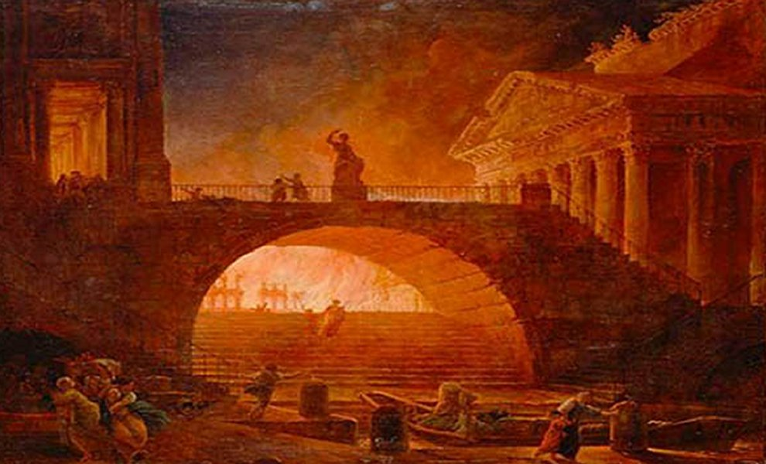
罗马大火
公元 64 年 7 月
Notes:
“On July 19, AD 64, a fire started in Rome. When the fire was extinguished six days later, more than 70% of the city was in ruins.”
____________
https://www.nationalgeographic.org/thisday/jul19/great-fire-rome/
“After six days the fire was brought under control, and before the damage could be measured, the fire reignited and burned for another three days. In the aftermath of the fire, two thirds of Rome had been destroyed.”
________
Great Fire of Rome
https://en.wikipedia.org/wiki/Great_Fire_of_Rome
公元64年7月19日，罗马发生大火。六天后大火被扑灭时，超过70%的城市已成废墟。
—— 来源：国家地理
六天后，大火终于得到控制，但在灾情尚未统计完成之前，火势再次复燃，并持续燃烧了三天。大火过后，罗马三分之二的城市被毁。
—— 来源：维基百科 - 罗马大火

Slide 20
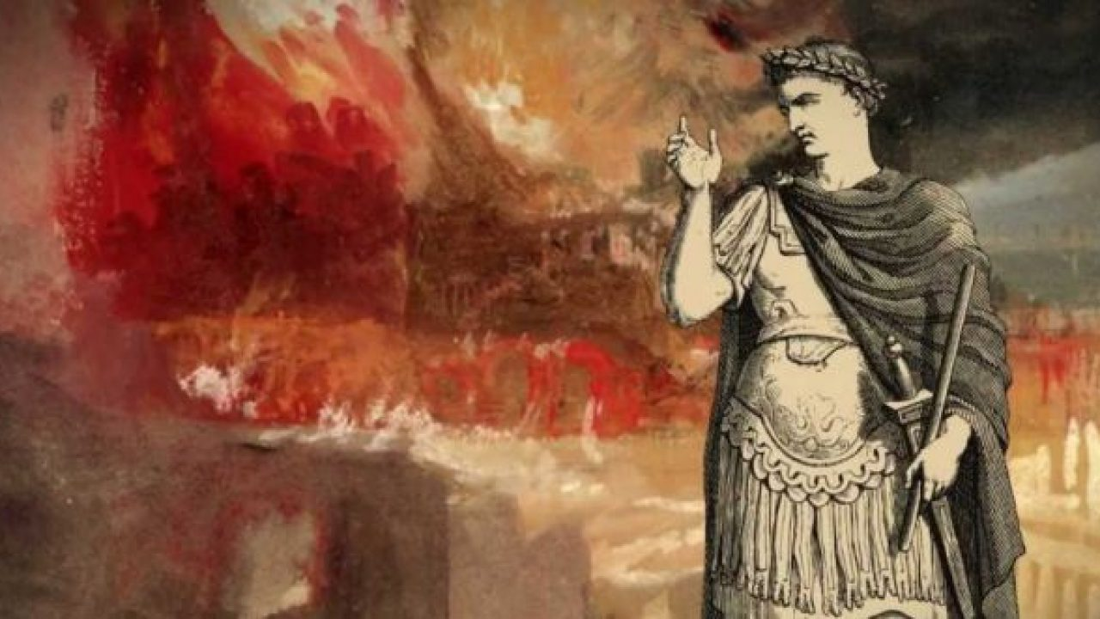
罗马大火
公元 64 年 7 月
Notes:
The “fire started in the enormous Circus Maximus stadium in Rome, now the capital of Italy. When the fire was finally extinguished six days later, 10 of Rome’s 14 districts were burned.
Ancient historians blamed Rome’s infamous emperor, Nero, for the fire. One historian said Nero was playing the fiddle while his city went up in flames [even though the fiddle wasn’t invented until another 1000 years later!]. Other historians say Nero wanted to raze the city so he could build a new palace.” This grand palace was planned to take 30% of the area of Rome!
_________
Jul 19, 64 CE: Great Fire of Rome
https://www.nationalgeographic.org/thisday/jul19/great-fire-rome/
这场大火起于罗马巨大的马克西穆斯竞技场（Circus Maximus），罗马如今是意大利的首都。大火最终在六天后被扑灭，罗马14个区中有10个被烧毁。
古代历史学家将这场火灾归咎于罗马臭名昭著的皇帝尼禄（Nero）。有一位历史学家称，在大火燃烧罗马城时，尼禄正拉着小提琴（尽管小提琴直到一千年后才被发明！）。其他历史学家则认为，尼禄想要夷平罗马，以便修建一座新的宫殿。 这座宏伟的宫殿计划占据罗马 30% 的土地！
—— 公元64年7月19日：罗马大火
来源：国家地理

Slide 21
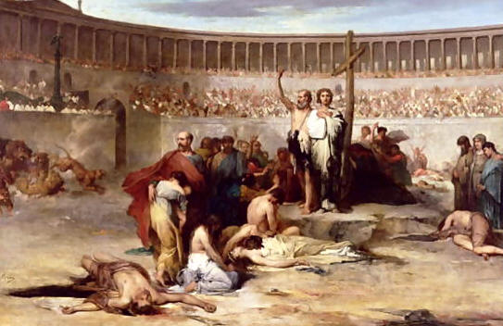
罗马大火
公元 64 年 7 月
Notes:
“Nero himself blamed [what he considered] a rebellious new cult—the Christians.
“Most modern historians don’t blame Nero for the Great Fire of Rome. Ancient Rome was a city of more than two million people, with thousands living in slums. These slums were filled with poorly constructed wooden apartment buildings. A fire in one apartment could quickly engulf the entire block.”
In any case, the fire made it very difficult to live as a Christian—especially in Rome. Christians were soon fed to lions and dogs and even used to light Nero’s evening gardens.
_________
Jul 19, 64 CE: Great Fire of Rome
https://www.nationalgeographic.org/thisday/jul19/great-fire-rome/
尼禄将这场大火归咎于他认为是反叛的新兴教派——基督徒。
大多数现代历史学家并不认为尼禄是罗马大火的罪魁祸首。
古代罗马是一个拥有超过两百万人口的城市，其中成千上万的人居住在贫民窟。这些贫民窟中充满了结构不稳固的木质公寓楼，一间公寓起火，整栋建筑很快就会被大火吞噬，甚至蔓延至整个街区。
无论如何，大火使基督徒的生存变得极其艰难，尤其是在罗马。
基督徒很快就被投入斗兽场，供狮子和狗吞食，甚至被用作火把来照亮尼禄的夜间花园。
—— 公元64年7月19日：罗马大火
来源：国家地理

Slide 22
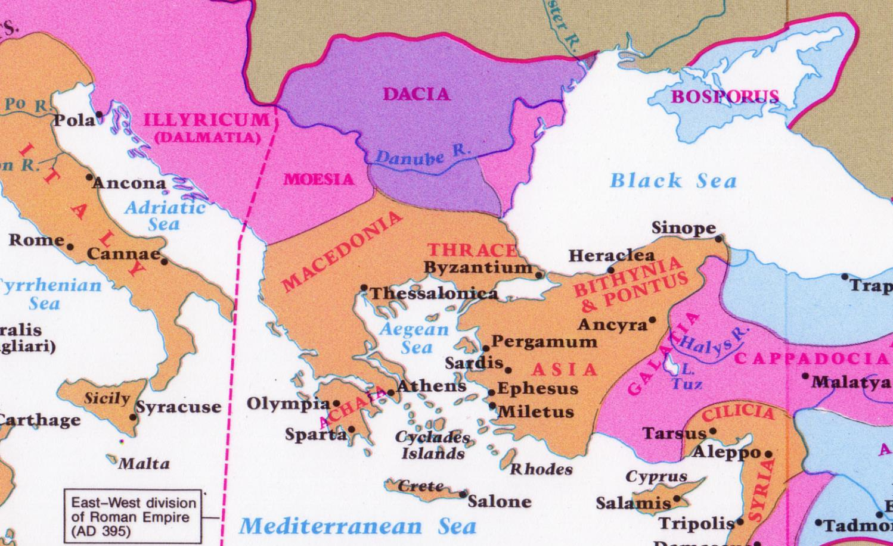
彼得给土耳其的通函…
从罗马

Slide 23
Contrast between 2 Letters
彼得后书
287
比较彼得的两封书信
彼得前书
彼得后书
问题本质
逼迫(敌意)
假教导 (异端)
问题来源
外部
内部
主题
希望
知识
关键词(以各种形态出现的次数)
“苦难”
(16次)
“知识”
(16 次)
日期
公元 64 年初
公元 64 年早春
Notes:
In AD 64, believers were falling away not due to persecution but due to lack of knowledge.
Peter had likely sent his first letter to the readers only months before.
In fact, more NT letters were written in the 60s than in any other decade. Why? Two reasons:
In 1 Peter, Peter advised believers to stand firm in God’s grace during unjust suffering—as this was the first big wave of suffering to hit the church.
More than that, though, was the proliferation of false teachers in the 60s.
在公元64年，信徒离弃信仰的原因不是因为逼迫，而是由于缺乏知识。
彼得很可能在几个月前才将他的第一封书信寄给这些读者。
事实上，新约书信在60年代的写作数量比任何其他十年都要多。为什么？有两个原因：
1. 在《彼得前书》中，彼得劝勉信徒，在不公义的苦难中要坚立在神的恩典里——因为这是教会所经历的第一波大规模苦难。
2. 更重要的是，60年代假教师的迅速泛滥，对教会带来了极大的挑战。

Slide 24


约书亚·哈里斯
Notes:
Perhaps you have heard of Joshua Harris. In 1997 at age 21 he wrote a significant book called I Kissed Dating Goodbye. It was a hit and God used it mightily to support the purity movement. He himself waited until marriage for sex and later wrote Boy Meets Girl.
或许你听说过约书亚·哈里斯。1997年，21岁的他写了一本重要的书籍《我与约会告别》（I Kissed Dating Goodbye）。
这本书大受欢迎，并被神大大使用来支持贞洁运动（Purity Movement）。
他本人也选择在婚后才发生性关系，并在后来写了**《男孩遇见女孩》（Boy Meets Girl）**。

Slide 25
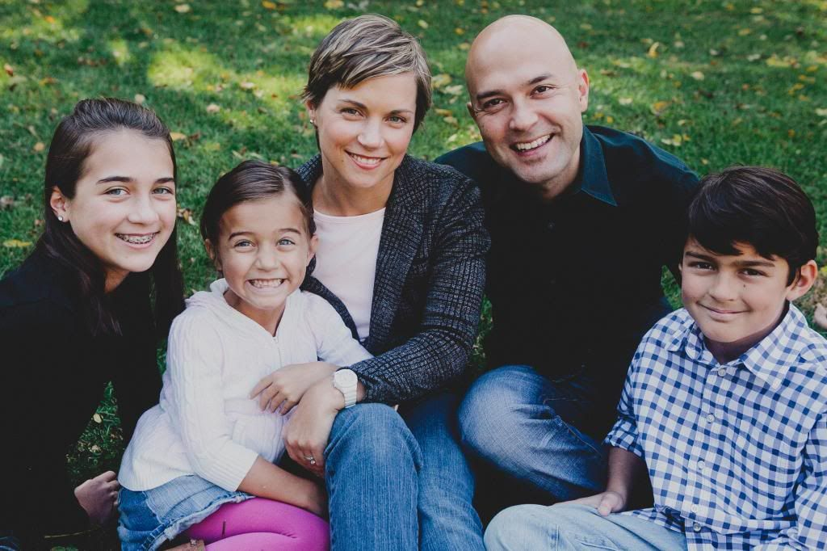
约书亚与香农·哈里斯
Notes:
It happened in his own life when God gave him his wife Shannon and three great kids.
当神赐给他妻子香农和三个优秀的孩子时，这也在他自己的生命中实现了。

Slide 26
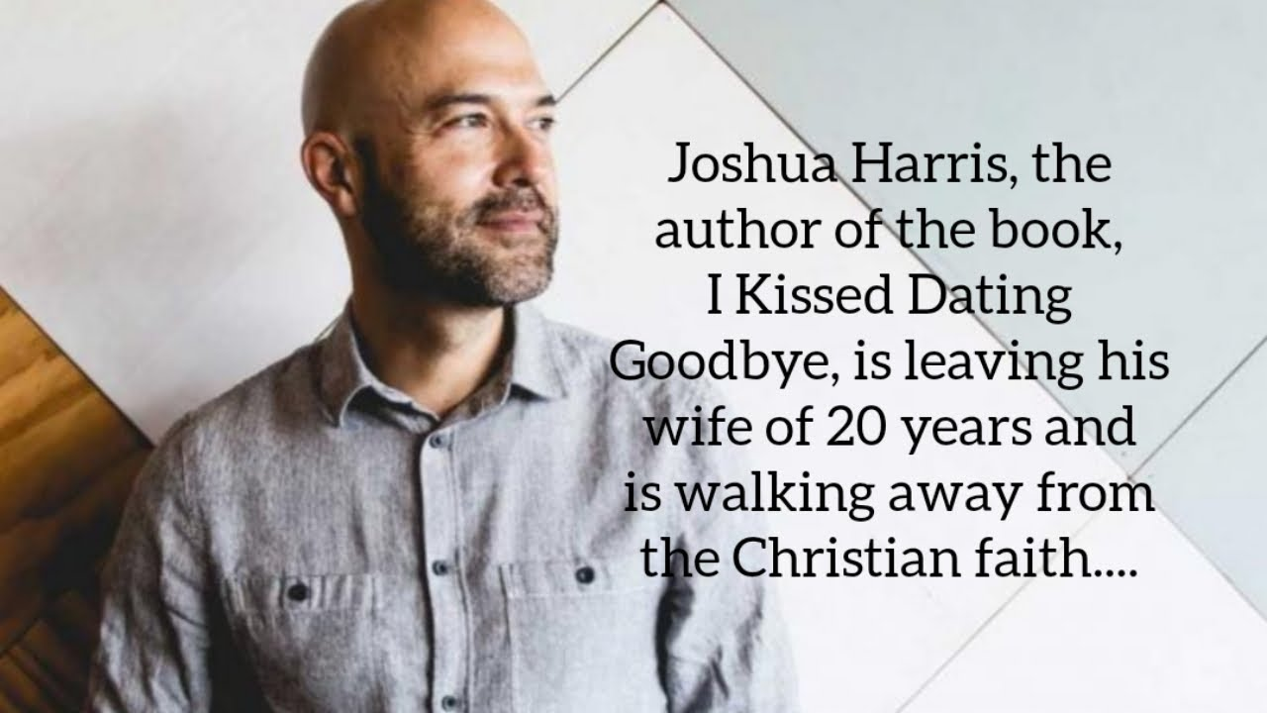
Apostasy of Joshua Harris
Notes:
Yet in July 2019, Harris announced the breakup of his marriage.
约书亚·哈里斯（Joshua Harris），《不再约会》（I Kissed Dating Goodbye）一书的作者，正在与结婚20年的妻子分开，并且正在远离基督教信仰……

Slide 27
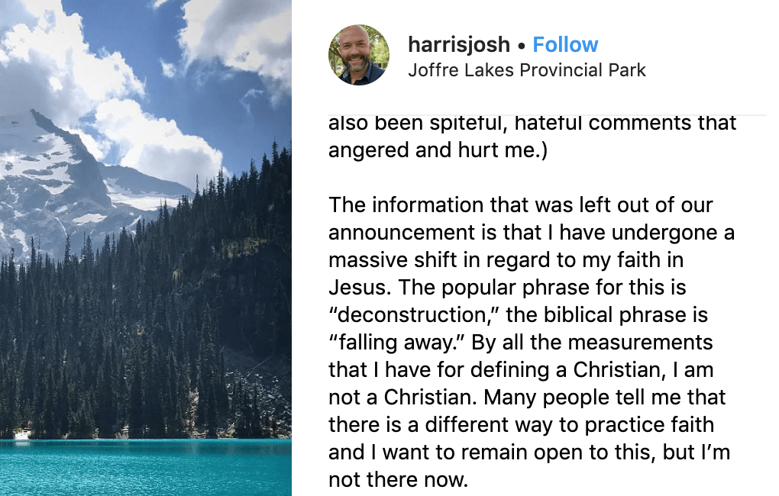
Apostasy of Joshua Harris
我们公告中未提及的信息是，我对耶稣的信仰经历了一次巨大的转变。如今，人们常用“信仰解构”（deconstruction）这个词来形容这种变化，而圣经中的表达是“离弃信仰”（falling away）。
按照我所理解的基督徒定义，我已不再是一个基督徒。许多人告诉我，信仰可以有不同的实践方式，我愿意对此保持开放的态度，但目前我尚未找到属于自己的方向。
Notes:
He also claimed to be leaving his faith [read second paragraph above].
他还声称自己正在放弃信仰【参见上方第二段】。

Slide 28
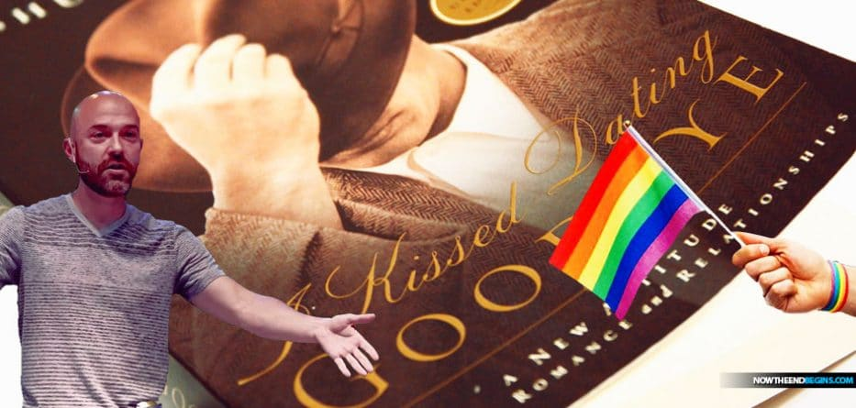
约书亚·哈里斯的弃教
Notes:
He has now started waving the rainbow flag too. Sadder than that…
他现在也开始挥舞彩虹旗了。比这更令人悲哀的是……

Slide 29
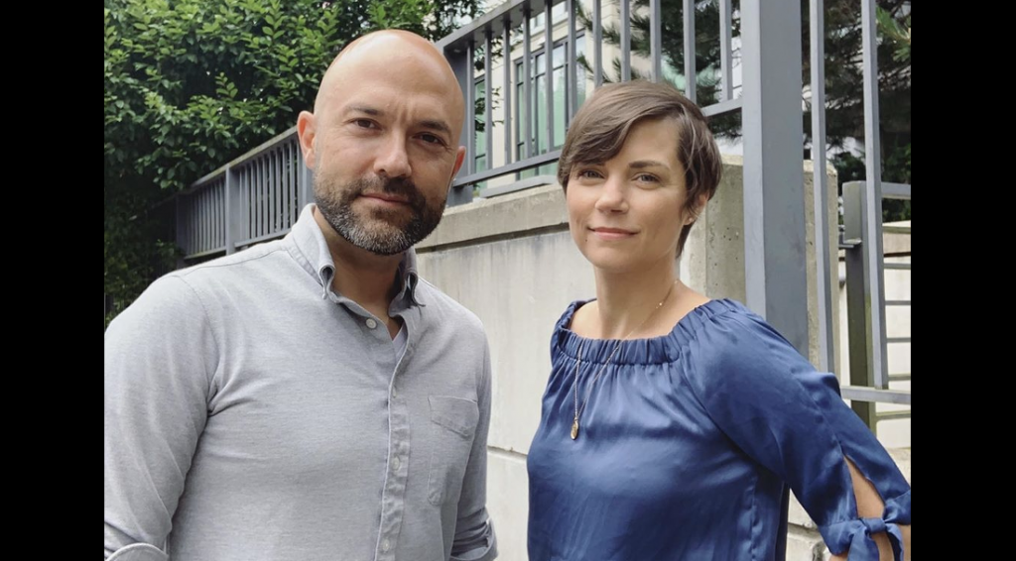
约书亚·哈里斯的弃教
“那个曾敦促基督徒坚持‘纯洁’，以获得幸福婚姻的人，如今却结束了自己的婚姻。”
—— 《友善无神论者》网站
Notes:
The website “Friendly Atheist” notes, “The man who urged Christians to embrace ‘purity’ if they wanted a happy marriage is now ending his own.”
————
“In news that surely marks the end of an era, Joshua Harris has announced that he and his wife Shannon are separating.
Why is that noteworthy? Because Harris is the infamous author of I Kissed Dating Goodbye, the 1997 book that jumpstarted the “purity culture” movement among evangelical Christians. He got married to Shannon a few years after his book was released and wrote about the relationship in Boy Meets Girl: Say Hello to Courtship (2000).
The man who urged Christians to embrace “purity” if they wanted a happy marriage is now ending his own.
We’re not saying that with any delight or schadenfreude. The couple has three kids who will be affected by this, and what they’re all going through is entirely between them. We don’t know why they’re separating, and frankly, it shouldn’t matter.
But it’s still worth mentioning because Harris is best known for telling other people how to conduct their relationships.
His book, which came out when he was only 21, advised an entire generation of Christians to practice “courtship” instead of dating, the latter of which he saw as a “fast track” to divorce. Harris also advised against “emotional infidelity” — that is, falling in love with someone whom you don’t eventually marry.
His words were embraced by untold numbers of parents, youth pastors, and other church authority figures. Consequently, many people took his words as gospel, and ended up marrying the first person they ever had a crush on, at extremely young ages, with no prior relationship experience.
A few years ago, Harris went on an apology tour of sorts, saying he regretted wrecking so many people’s lives. Many of his former fans, however, found his apologies empty and insincere. While he said the book would no longer be printed (or reprinted), Harris didn’t really acknowledge that he was wrong in principle. He still rejected LGBTQ relationships. While he now said that dating might have its benefits even if it didn’t lead to marriage, he blamed people for how they followed his advice, not the crux of the advice itself.
And now the man who convinced countless Christians to jump into a marriage before ever truly knowing themselves will be single once again.
Tempting though it may be to gloat about this news, keep in mind that Harris was indoctrinated, too. While he is fully responsible for perpetuating toxic ideologies as an adult, he grew up in the same toxic purity culture that he encouraged with his readers. He likely didn’t know any better when he inadvertently became the father of a movement.
The news of his separation essentially confirms what we already knew: Purity culture makes extraordinary promises that it ultimately cannot keep.
The prevailing message of I Kissed Dating Goodbye was this: Follow these rules, and your marriage will be safe. Your relationship will be happier and more successful than those of your peers who dated around before settling down.
As it turns out, relationships are as complex as the people in them. Being abstinent doesn’t change that. Dating around doesn’t change that. There aren’t any foolproof “rules” after all.
It’s long past time for the “purity” advocates to update their guidebooks.”
““Purity Culture” Advocate Joshua Harris Announces Separation from Spouse
By Sarahbeth Caplin
July 18, 2019
https://friendlyatheist.patheos.com/2019/07/18/purity-culture-advocate-joshua-harris-announces-separation-from-spouse/
《友善无神论者》网站报道：
“那个曾敦促基督徒拥抱‘纯洁’以获得幸福婚姻的人，如今却结束了自己的婚姻。”
“纯洁文化”倡导者约书亚·哈里斯宣布与妻子分居
作者：Sarahbeth Caplin
2019年7月18日
原文链接
在一则无疑标志着一个时代终结的新闻中，约书亚·哈里斯宣布他与妻子香农（Shannon）正在分居。
为什么这条新闻值得注意？因为哈里斯是1997年出版的《不再约会》（I Kissed Dating Goodbye）一书的作者，这本书在福音派基督徒群体中掀起了“纯洁文化（Purity Culture）”运动。他在书出版几年后与香农结婚，并在2000年出版的《男孩遇见女孩：向求婚说你好》（Boy Meets Girl: Say Hello to Courtship）一书中写到了他们的关系。
如今，那位曾敦促基督徒拥抱“纯洁”以获得幸福婚姻的人，正在结束自己的婚姻。
我们并不是带着幸灾乐祸的心态来看待这件事。哈里斯夫妇育有三个孩子，他们都会受到这次分开的影响，而他们的私事也完全属于他们自己。我们并不知道他们分居的具体原因，事实上，这也不重要。
但这件事仍然值得一提，因为哈里斯最为人所知的身份，就是教导别人如何建立关系。
哈里斯的书出版时，他才 21 岁，书中建议整个基督徒世代应该用“求婚”（courtship）取代“约会”（dating），因为他认为约会是一条“通往离婚的快车道”。他还反对“情感上的不忠”，即爱上一个最终没有结婚的人。
他的言论被无数的父母、青少年牧师和教会领袖接受，许多人甚至把他的话当作“福音真理”，结果，很多人在极其年轻、没有任何恋爱经验的情况下，就与他们的初恋结婚。
几年前，哈里斯开始了一场“道歉之旅”，表示他后悔毁掉了这么多人的生活。然而，许多曾追随他的信徒认为他的道歉空洞且缺乏诚意。虽然他宣布《不再约会》将不再出版（或再版），但他并未真正承认自己在原则上的错误。他仍然拒绝LGBTQ关系，尽管他现在承认“约会”可能有其好处，即使它并不一定导致婚姻。但他将错误归咎于人们对他建议的执行方式，而不是他的建议本身。
而如今，那位曾说服无数基督徒在真正了解自己之前就步入婚姻的人，即将再次成为单身。
尽管很多人可能想要对这条新闻幸灾乐祸，但我们需要记住，哈里斯自己也是被灌输这些观念的人。虽然作为成年人，他要对自己所推广的有害思想负责，但他自己也是在这个“纯洁文化”中长大的。当他无意间成为这场运动的领袖时，他可能并不知道有其他选择。
他的分居消息验证了一个我们早已知道的事实：纯洁文化许下了它最终无法兑现的承诺。
《不再约会》的核心信息是：“只要遵循这些规则，你的婚姻就会稳固，你的关系会比那些婚前有过恋爱经历的人更幸福、更成功。”
但现实是，人际关系的复杂性取决于其中的个体。
• 守贞不会改变这一点，
• 婚前恋爱也不会改变这一点，
• 事实上，并不存在任何“万无一失”的规则。
是时候让“纯洁文化”的倡导者们更新他们的手册了。

Slide 30

需要知道的三个真理……
彼得后书
在你们的主和救主耶稣基督的恩典和知识上成长。
Notes:
Today we will see three things that we need to know to grow in grace rather than fall for false teaching.
今天，我们将看到三个关键点，帮助我们在恩典中成长，而不是陷入虚假教导。

Slide 31
Summary Chart
与谬误争战的知识
彼得后书
284
神的拣选
将来的背道
主的再来
第一章
第二章
第三章
问候
1:1-2
供应一切所需
1:3-11
知识的根基
1:12-21
假师傅的到来
2:1-3a
入地狱的结局2:3b-10a
描述特征
2:10b-22
好讥诮的人在被提前出现3:1-4
天地被销化
3:5-13
圣洁的动机
3:14-16
保护，成长，敦促
3:17-18
信徒的完全
非信徒的不完全
信徒的盼望
圣洁
异端
希望
主的门徒
恶魔般的领袖
主的日子
罗马到小亚细亚
公元64

Slide 32
你需要知道什么才能在恩典里成长，而不要听信假教诲?
彼得后书

Slide 33
I. 要知道基督 拣选
与完全地装备了你
(第一章)。
彼得后书
要知道什么才能成长…

Slide 34
Slides on
彼得后 1

Slide 35

你真正需要知道的是什么？
Notes:
When you consider how many things there are to know, it can be daunting. You seminary students came to SBC to get answers to your questions, but now your list of questions has grown! So what are the essentials that we really need to know?
You've come to the right place, because Peter has an answer for you in today's text.
当你意识到世界上有这么多知识要学时，可能会感到不知所措。
你们这些神学院的学生来到 SBC，是为了找到问题的答案，
但现在，你们的问题清单反而变得更长了！
那么，我们真正需要知道的核心要点是什么呢？
你们来对地方了，因为彼得在今天的经文中为你们提供了答案。

Slide 36
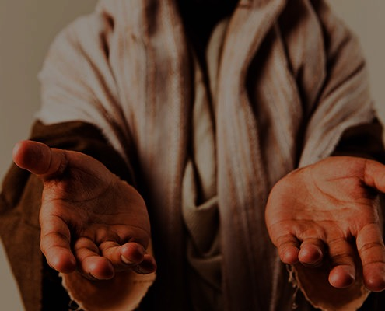
I. 你在基督里是完全的，因为祂是神（1-4）。
Notes:
God gives you all you need in your knowledge and faith in Jesus as deity.
神在你对耶稣作为神的知识和信心中，赐给你一切所需。

Slide 37

“耶稣基督的仆人和使徒西门．彼得，写信给那靠着我们的 神和救主耶稣基督的义，得着和我们同样宝贵信心的人。”
(彼得后 1:1 CNV).
Notes:
Peter notes that his readers had the same faith as "ours" (1a).
There is a great sense of humility here where the great apostle puts himself on the same level as his meek readers.
In this pre-Gnostic world, teachers prided themselves with their privileged, so-called "secret knowledge."
Yet Peter says the righteousness provided by Jesus Christ gives us all the "same faith"! Wow!
The phrase "our God and Savior" also teaches Christ's deity (1b).
"The grammar here clearly indicates that 'God and Savior' are one Person, not two (i.e., there is one Gr. article with two substantives). This passage ranks with the great Christological passages of the New Testament which plainly teach that Jesus Christ is coequal in nature with God the Father" (Gangel, BKC, 2:863-64).
We need to understand that our faith is in Jesus as God, not just some teacher of knowledge.
1. 因着基督的神性，神赐给你与使徒同样的信心。
彼得指出，他的读者拥有与“我们”相同的信心（1a）。
在这句话中，我们可以感受到极大的谦卑——伟大的使徒彼得将自己与那些谦卑的读者置于同等地位。
在这个**前诺斯底主义（pre-Gnostic）**的世界里，许多教师以自诩为特权阶层，自豪于他们所谓的“秘密知识”。
然而，彼得却说：耶稣基督所赐的公义，使我们都拥有“同样的信心”！ 哇！
此外，“我们的神与救主”（1b） 这一短语也直接教导了基督的神性。
“这里的语法清楚地表明，‘神与救主’（God and Savior）是指同一位（而非两位）——换句话说，希腊文中‘神’与‘救主’之间共用一个冠词，表明它们是同一位实体。这一段经文可以与新约中的伟大基督论经文并列，明确教导耶稣基督在本质上与天父神同等。”（Gangel，《圣经知识注释》（BKC），第2卷，第863-864页）
我们需要明白，我们的信心是建立在耶稣作为神的身份上，而不仅仅是把祂当作一位知识的教师。

Slide 38
“愿恩惠平安，因你们确实认识 神和我们的主耶稣，多多加给你们。”
(彼得后 1:2 CNV).
Notes:
God shows us Christ's person for grace and peace (2).
The word for "knowledge" here implies an intimate, personal relationship.
We need to know that grace is in Christ (2a).
We need to know that Christ alone gives us peace (2b).
神向我们显明基督的位格，使我们得着恩典和平安（2）。
这里的“知识”一词意味着一种亲密、个人的关系。
• 我们需要知道，恩典在基督里（2a）。
• 我们需要知道，唯独基督赐给我们平安（2b）。

Slide 39
“神以他神圣的能力，因着我们确实认识那位用自己的荣耀和美善呼召我们的，把一切有关生命和敬虔的事，都赐给了我们。”
(彼得后 1:3 CNV).
Notes:
God gives you Christ's power to live a godly life (3).
Too often we think that we're missing some great secret to godliness.
Peter says that we already have all we need!
If we already have everything we need for a godly life (3), then why does Peter wish his readers more grace and peace (2)?
Evidently we don't apply or access all that God has in store for us!
神赐给你基督的能力，使你过敬虔的生活（3）。
我们常常以为自己缺少某种通往敬虔的伟大秘诀。
然而，彼得告诉我们，我们已经拥有一切所需！
如果我们已经具备敬虔生活所需的一切（3），那么为什么彼得仍然希望他的读者得到更多的恩典与平安（2）呢？
显然，我们并没有完全运用或领取神为我们预备的一切！

Slide 40
“借着这些，他把又宝贵又极大的应许赐给了我们，好叫你们既然逃脱世上因私欲而来的败坏，就可以分享 神的本性。”
(彼得后 1:4 CNV).
Notes:
God gives you Christ's promises to live a godly life (4).
What specific promises does God give to help us be like Christ (4)?
神赐给你基督的应许，使你过敬虔的生活（4）。
神赐下哪些具体的应许，来帮助我们效法基督（4）？

Slide 41

五个应许
      我们拥有一切所需，可以过敬虔的生活（3）。
      我们分享“祂的神性”，最终会像基督一样（4b）。
      我们可以胜过一切罪恶（4c）。
      我们是蒙拣选的，并得着救恩的应许（10）。
      如果我们在品格上坚持不懈（5-9），我们就会得着丰盛的奖赏（10-11）。

Slide 42


按部就班地在基督的样式上成长（5-7）。

Slide 43
“正因这缘故，你们要多多努力：有了信心，又要增添美德；有了美德，又要增添知识”
(彼得后 1:5 CNV).

Slide 44
“有了知识，又要增添节制；有了节制，又要增添忍耐；有了忍耐，又要增添敬虔”
(彼得后 1:6 CNV).

Slide 45
“有了敬虔，又要增添弟兄的爱；有了弟兄的爱，还要增添神圣的爱”
(彼得后 1:7 CNV).

Slide 46
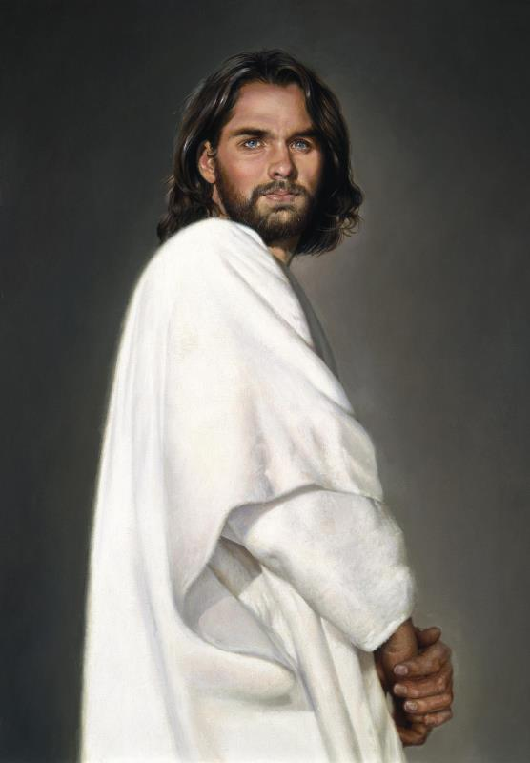

彼得后书1
289
C. (1:5-11)
有效多产的基督徒生活
圣洁如基督 (“与神的性情有分,” v. 4)
爱众人的心
爱弟兄的心
虔敬
忍耐
节制
知识
德行
信心

Slide 47

我们并不总是成长为基督的样式
（8-9）。

Slide 48
“因为你们有了这几样，并且继续增长，就必叫你们在确实认识我们的主耶稣基督上，不至于闲懒不结果子。”
(彼得后 1:8 CNV).
Notes:
Some believers continue to grow and become more effective (8).
有些信徒不断成长，变得更加有果效（8）。

Slide 49
“人若没有这几样，就是近视，简直是瞎眼的，忘记他过去的罪已经得了洁净。”
(彼得后 1:9 CNV).
Notes:
Others stop character growth by forgetting they're forgiven (9).
In fact, most of the NT addresses believers who are not living up to God's standards. This is why God moved authors like Peter and Paul and James and others to write!
有些人因忘记自己已被赦免，而停止了品格的成长（9）。
事实上，新约的大部分内容都是针对未能活出神标准的信徒而写的。
正因如此，神感动彼得、保罗、雅各等人写下这些话语！

Slide 50
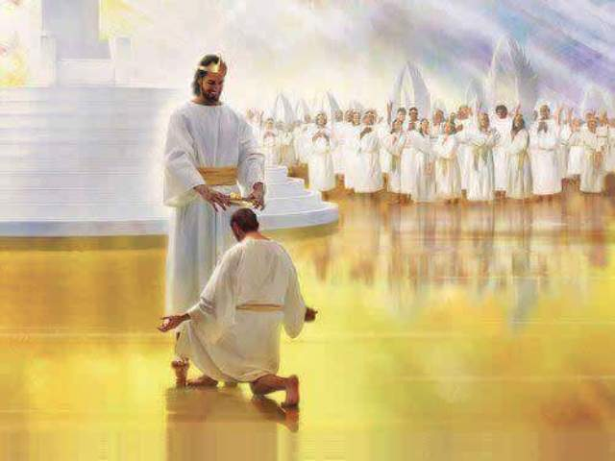
当我们努力行事时，我们将得着奖赏，而不是跌倒（10-11）。

Slide 51
“所以弟兄们，要更加努力，使你们所蒙的呼召和拣选坚定不移；你们若实行这几样，就决不会跌倒。”
(彼得后 1:10 CNV).
Notes:
When we work hard to show we're saved, we won't fall away (10).
Does "make your calling and election sure" (10) mean that we can add anything to Christ's work to be saved? No. It means we should live consistent with that salvation.
The NLT captures the idea well: "Work hard to prove that you really are among those God has called and chosen." When you seek to be more like Christ, you won't fall back. Instead…
当我们努力显明自己得救时，我们就不会跌倒（10）。
“坚定你们的呼召和拣选”（10）是否意味着我们可以为得救而在基督的工作上添加什么？
不是。 这意味着我们应该活出与救恩相称的生命。
新普及译本（NLT）很好地表达了这个概念：
“努力去证明自己确实是神所呼召和拣选的人。”
当你努力追求更像基督时，你不会后退，反而会……

Slide 52
“这样，你们就得着充分的装备，可以进入我们的主和救主耶稣基督永远的国。”
(彼得后 1:11 CNV).
Notes:
God will reward us when we live consistent to our calling (11).
Does receiving "a rich welcome into the eternal kingdom…" refer to a person as being saved (11)?
No, this refers to being fully rewarded like the person in verse 8 who keeps growing in character.
It means you do not "fall" (10b) like the person in verse 9 who has forgotten about his forgiveness.
当我们活出与呼召相称的生命时，神会赏赐我们（11）。
“丰丰富富地进入永恒的国度……” 是否指一个人得救（11）？
不是， 这指的是像第8节中不断在品格上成长的人一样，得着完全的奖赏。
这意味着你不会像第9节中忘记自己被赦免的人那样“跌倒”（10b）。

Slide 53
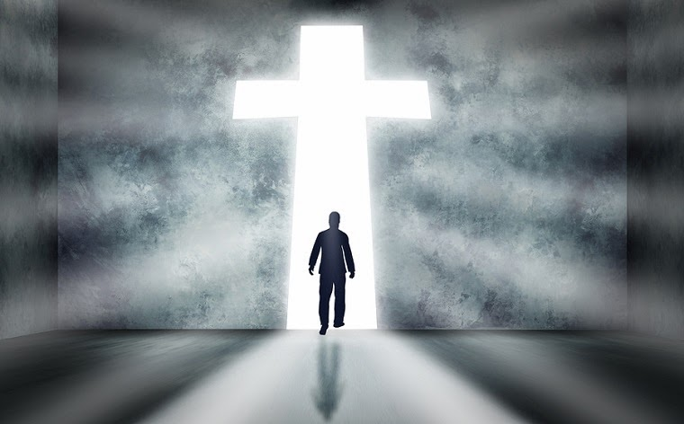
主要思想
要知道你在基督里是完全的，以便更加像基督。
Notes:
Have your knowledge of Christ lead you to be Christ-like (restated MI).
让你对基督的认识引导你活出基督的样式。（重述主要思想）

Slide 54

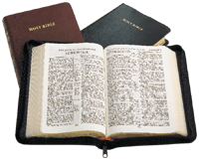
当今对圣经的攻击
289b
你今天听到什么样的意图破坏我们信仰的真实性教导?
Presentation_ID
54
54
© 2003 Cisco Systems, Inc. All rights reserved.
54

Slide 55
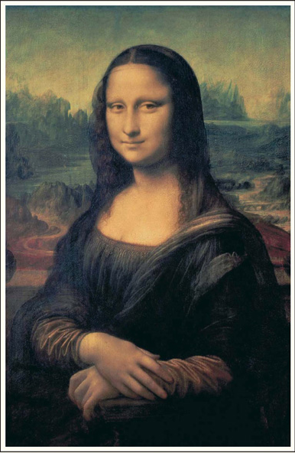

How should we fight heresy?
达芬奇密码

Slide 56
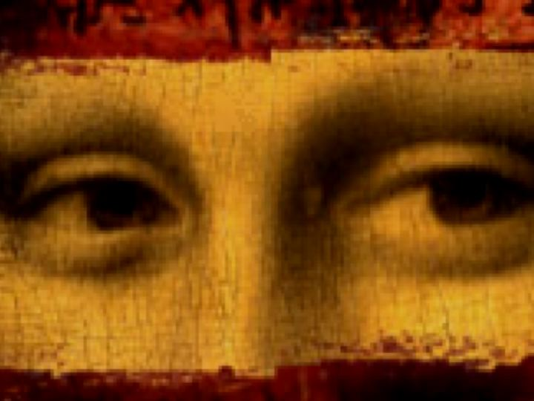
布朗的福音
耶稣娶了抹大拉的马利亚
他们的女儿在法国长大
他的神性在公元325年被虚构
我们的新约是错误的
基督教 = 神圣的女性
基督徒掩盖了这一阴谋

Slide 57

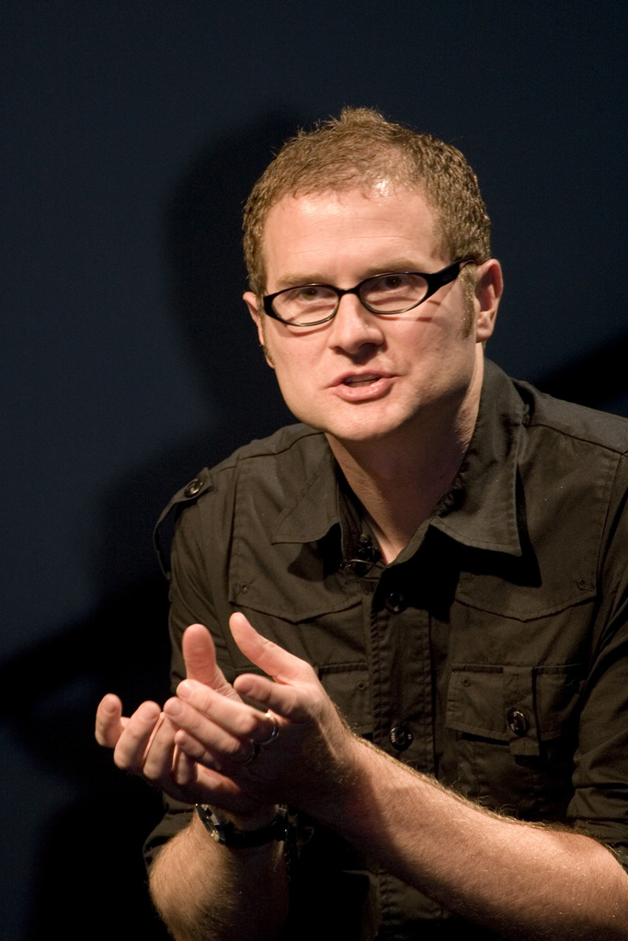
——罗伯·贝尔
Rob Bell
一本关于天堂、地狱和每一个曾经生活过的人的命运的书
Notes:
Another prominent pastor in the news in recent years is Pastor Rob Bell. Until 2011, he pastored Mars Hill Church in Michigan—one of the fastest growing churches in the USA. In 2011, Time named Bell on its list of the 100 Most Influential People in the World. That same year he wrote the book Love Wins: A Book About Heaven, Hell and the Fate of Every Person Who Ever Lived. What does he say about these things?
___________
“Rob Bell
From Wikipedia, the free encyclopedia
https://en.wikipedia.org/wiki/Rob_Bell accessed 10 Aug 2019
Jump to navigation Jump to search For other people with the same name, see Robert Bell (disambiguation).
Bell at the 2011 Time 100 gala
Robert Holmes "Rob" Bell Jr. (born August 23, 1970) is an American author, speaker and former pastor. Bell was the founder of Mars Hill Bible Church located in Grandville, Michigan, which he pastored until 2012. Under his leadership Mars Hill was one of the fastest-growing churches in America. He is also the author of the New York Times bestseller Love Wins and the writer and narrator of a series of spiritual short films called NOOMA. In 2011, Time named Bell on its list of the 100 Most Influential People in the World. He has since become a freelance writer and speaker appearing on various talk shows and national speaking tours on topics related to spirituality and leadership. He also hosts a popular podcast called,'The Robcast.' In 2018, a documentary about Bell called The Heretic was released.^{[1]}
Contents
1 Biography
1.1 Education and ministry
1.2 Mars Hill Bible Church
1.3 Other projects
1.4 Television
2 Beliefs
3 Publications
4 References
5 External links
Biography
Education and ministry
Bell is the son of U.S. District Judge Robert Holmes Bell, who was appointed to the federal bench by Ronald Reagan.^{[2][3]}
After graduating from high school, Bell attended Wheaton College in Illinois. While at Wheaton, he roomed with Ian Eskelin of All Star United. With friends Dave Houk, Brian Erickson, Steve Huber and Chris Fall, he formed the indie rock band, "_ton bundle", which was reminiscent of bands such as R.E.M. and Talking Heads. During this time _ton bundle wrote the song "Velvet Elvis", based upon the same Velvet Elvis painting that he used in his first book, Velvet Elvis: Repainting the Christian Faith. Wheaton College was also where Bell met his wife, Kristen. The band _ton bundle started to gain some local fame and was even asked to perform at large events, but when Bell was struck with viral meningitis^{[4]} these plans fell through.^{[5]}
Bell received his bachelor's degree in 1992 from Wheaton and taught water skiing in the summers at the college's Honey Rock Camp, making about thirty dollars a week. During this time, he offered to teach a Christian message to the camp counselors after no pastor could be found. He taught a message about rest and was later approached by several people, each of them telling him that he should pursue teaching as a career.
Bell moved to Pasadena, California to pursue this calling for teaching and received a M.Div. from Fuller Theological Seminary. According to Bell, he never received good grades in preaching class because he always tried innovative ways to communicate his ideas. During his time at Fuller he was a youth intern at Lake Avenue Church. He did, however, occasionally attend Christian Assembly in Eagle Rock, California, which led to him and his wife asking questions in the direction of how a new style of church would appear.
Between 1995 and 1997, Bell formed a band called Big Fil which released two CDs; the first was a self-titled disc and the second was titled Via De La Shekel. When asked what style of music they played, Bell would respond with "Northern Gospel!", which later became the name of a song on the second album. Even after Big Fil stopped performing, Bell continued with two more projects by the name of Uno Dos Tres Communications volume 1 and 2, both of which had a similar musical sound to Big Fil.
Mars Hill Bible Church
Bell and his wife moved from California to Grand Rapids to be close to family and on invitation to study under pastor Ed Dobson. He handled many of the preaching duties for the Saturday Night service at Calvary Church. Bell announced that he would be branching out on his own to start a new kind of community and he would call it "Mars Hill" after the Greek site where the apostle Paul told a group, "For as I walked around and looked carefully at your objects of worship, I even found an altar with this inscription: TO AN UNKNOWN GOD. Now what you worship as something unknown I am going to proclaim to you."^{[6]}
In February 1999, Bell founded Mars Hill Bible Church, with the church originally meeting in a school gym in Wyoming, Michigan. Within a year the church was given a shopping mall in Grandville, Michigan, and purchased the surrounding land. In July 2000 the 3,500 "grey chair" facility opened its doors. As of 2005, an estimated 11,000 people attended the two "gatherings" on Sundays at 9 and 11 AM.^{[7][full citation needed]} As of March 2011, Sunday attendance numbered between 8,000 and 10,000.^{[8]} His teachings at Mars Hill inspired the popular "Love Wins" bumper sticker, and the congregation freely distributed these stickers after services.^{[9]}
In order to maintain balance in his life, Bell maintained his Fridays as a personal sabbath, where he did not allow contact by electronic means, and had all pastoral duties transferred to other Mars Hill pastors.^{[10]}
In the January 2007 issue of the magazine TheChurchReport.com, Bell was named No. 10 in its list of "The 50 Most Influential Christians in America" as chosen by their readers and online visitors.^{[11]}
In June 2011, Bell was named by Time Magazine as one of the "2011 Time 100", the magazine's annual list of the 100 most influential people in the world.^{[12]}
Bell stepped down from the church he founded on September 22, 2011 in order to pursue other areas to reach a broader audience.^{[13][14]} He later said that his book Love Wins had led to a fallout with the congregation and forced him on a "search for a more forgiving faith."^{[15]}
In July 2012 Bell held his first major event since leaving Mars Hill, speaking at the famous Viper Room night club in Los Angeles.^{[16]} Bell hosts conferences and workshops in Laguna Beach for "leaders, teachers, preachers, entrepreneurs, artists, pastors—anyone whose work involves creating something and then turning it loose in the world."^{[17]}
Other projects
Bell is the featured speaker in NOOMA – a series of short films. The title of the video series, "NOOMA", is an English variation of the Greek word pneuma which means breath or spirit. All the videos feature the teachings of Bell accompanied by music written and sung by local independent artists with the exception of The Album Leaf's music being licensed for the NOOMA DVD Lump.
In August 2005, Zondervan Publishing published Bell's first book, Velvet Elvis: Repainting the Christian Faith. Velvet Elvis is, according to the official online summary, "for the millions of people who are fascinated by Jesus, but can’t do the standard Christian package. In his debut book, Bell explores a new understanding of the Christian faith."^{[18]}
Bell's Everything is Spiritual national speaking tour launched on June 30, 2006, in Chicago, drawing sold-out crowds in cities across North America. The proceeds from ticket sales were used to support WaterAid, an international non-profit organization dedicated to helping people escape the poverty and disease caused by living without safe water and sanitation.
Bell's second book, titled Sex God: Exploring the Endless Connections between Sexuality and Spirituality, was released in March 2007. In February and March 2007 Bell hosted a "Sex God" tour on six university campuses to promote his book. The tour functioned more as a time for engaging questions and conversation. Questions ranged from Old Testament codes to homosexuality to what should Christians do with the word "evangelical". Each night ended with the showing of NOOMA number 15 entitled "YOU".^{[citation needed]}
In June 2007 Bell toured the United Kingdom and Ireland with a series called Calling All Peacemakers.^{[19]}
Bell launched another speaking tour on November 5, 2007, in Chicago. "The Gods Aren't Angry" again drew sold-out crowds in cities across North America. The subject matter was a narrative defense of justification through faith and not works (sacrifice). Proceeds from this tour were used to support the Turame Microfinance program supporting the poor in Burundi, a mission supported by Bell's church.
Bell's 2009 project, Drops Like Stars, explores the links between creativity and suffering. Drops Like Stars was an international tour and a book, initially handwritten by Bell, with photographs. The title of the project comes from a young child's view of raindrops on a window at night. Rather than focusing on the conundrum of why an all-powerful God would allow suffering, Bell instead looks at the creativity, empathy, new connections, and growth that can spring from suffering. When asked in an interview how he had become interested in suffering, Bell replied that as a pastor he had been given a front row seat in the most poignant moments of people's lives. At the same time he was doing lectures on creativity and realized, "There was a connection between these two halves of my life – all these connections between suffering and art-making."^{[20]}
In September 2013 Bell was interviewed by Oprah for her Super Soul Sunday television show. Bell's book, What We Talk About When We Talk About God, was also listed as the first recommended book that month in Oprah's "Book of the Month" club.^{[21]}
Television
ABC television announced production of a new television drama, Stronger, co-written by Bell and Carlton Cuse, the executive producer of the television series, Lost.^{[22]} The show, based loosely on Bell's life and his unpublished novel-turned-pilot-script, would follow the life of Tom Stronger, a musician on a spiritual journey.^{[23]} Ultimately, Bell and Cuse were unable to get approval to shoot a pilot for Stronger.
Bell and Cuse have moved on to another project described as a "faith-inflected talk show" presented by Bell. Two tapings of the proposed show were filmed in September 2012 in a warehouse in Los Angeles' art district in order to put together a reel for network executives.^{[24]} At the time, they were referenced as either That One Show Rob Bell and Carlton Cuse Have Been Working On, or The September Shows for short.^{[25][26][27]} A trailer has since been produced using The Rob Bell Show as a title card. His first and second guest each night were Cathleen Falsani and James "Jame-o" Primbram, an eco-warrior.
Beliefs
In his writings, Bell says "I affirm the truth anywhere in any religious system, in any worldview. If it's true, it belongs to God."^{[28]}
Bell says, "This is not just the same old message with new methods. We're rediscovering Christianity as an Eastern religion, as a way of life. Legal metaphors for faith don't deliver a way of life. We grew up in churches where people knew the nine verses why we don't speak in tongues, but had never experienced the overwhelming presence of God."^{[9]}
Bell's book Love Wins caused a major controversy within the evangelical community. The controversy was the subject of a Time magazine cover story and a featured article in the New York Times.^{[29][30][31]} In the book, Bell states that "It's been clearly communicated to many that this belief (in hell as eternal, conscious torment) is a central truth of the Christian faith and to reject it is, in essence, to reject Jesus. This is misguided and toxic and ultimately subverts the contagious spread of Jesus' message of love, peace, forgiveness and joy that our world desperately needs to hear." In this book, Bell outlines a number of views of hell, including universal reconciliation. Though he does not choose any one view as his own, he states "Whatever objections a person may have of [the universalist view], and there are many, one has to admit that it is fitting, proper, and Christian to long for it."
The book was criticized by numerous conservative evangelical figures (in particular, some reformed church leaders), such as Albert Mohler, John Piper, and David Platt, with Mohler saying that the book was "theologically disastrous" for not rejecting universalism.^{[32][33]} Other evangelicals, such as Brian McLaren,^{[34][35]} Greg Boyd^{[36]} and Eugene Peterson^{[37][38][39]} defended Bell's views. Bell denies that he is a universalist and says that he does not embrace any particular view but argues that Christians should leave room for uncertainty on the matter. As Jon Meacham stated, Love Wins presents [Bell's] "case for living with mystery rather than demanding certitude."^{[40][41]} Some evangelicals argued that this "uncertainty" is incompatible with Scripture,^{[42]} while others say that the book is simply promoting overdue conversation about some traditional interpretations of Scripture.^{[43][44]} In the book, Bell also questions "evacuation theology" which has Christians focused on getting to heaven, instead of focusing on God's renewal and transformation of this world. Bell argues that Jesus (and the wider Jewish tradition of which he was a part) focused on God's ongoing restoration of this world, not getting individuals to heaven.^{[45][46]}
At his Viper Room appearance in July 2012, Bell took a question from an audience member concerned about the church's acceptance of gay members. Said Bell, "Some people are gay, and you're our brothers and you're our sisters, and we love you. We love you... [Gay people] are passionate disciples of Jesus just like I'm trying to be, so let's all get together and try to do something about the truly big problems in our world."^{[47]} On March 17, 2013, in an interview at Grace Cathedral in San Francisco, Bell said, "I am for marriage. I am for fidelity. I am for love, whether it's a man and a woman, a woman and a woman, a man and a man...And I think the ship has sailed. This is the world we are living in and we need to affirm people wherever they are."^{[48]}
In March 2013, Bell expressed frustration with the state of conservative evangelicalism, calling it "a very narrow, politically intertwined, culturally ghettoized Evangelical subculture." He says that Evangelicals have "turned away lots of people" from the church by talking about God in ways that "don't actually shape people into more loving, compassionate people," adding that Evangelicals "have supported policies and ways of viewing the world that are actually destructive, and we've done it in the name of God and we need to repent."^{[48]}
Publications
Velvet Elvis: Repainting the Christian Faith (Zondervan, 2005) ISBN 0-310-26345-X
Sex God: Exploring the Endless Connections between Sexuality and Spirituality (Zondervan, 2007) ISBN 0-310-26346-8
Everything is Spiritual (DVD) (Zondervan, 2007) ISBN 0-310-28556-9
The Gods Aren't Angry (DVD) (Flannel, 2008) ISBN 0-310-29074-0
Jesus Wants to Save Christians: A Manifesto for the Church in Exile (Zondervan, 2008) ISBN 0-310-27502-4
Drops Like Stars: A Few Thoughts on Creativity and Suffering (Zondervan, 2009) ISBN 0-310-32704-0
Love Wins (Harper One, 2011) ISBN 978-0-06-204964-3
What We Talk About When We Talk About God (HarperOne 2013) ISBN 978-0062049667
The Zimzum of Love: A New Way of Understanding Marriage co-written with Kristen Bell (HarperOne 2014) ISBN 978-0062194244
How to be Here (Harper Collins 2016) ISBN 978-0007591329
NOOMA Videos
What Is the Bible? (HarperOne 2017) ISBN 978-0062194268
近几年，另一位在新闻中频繁出现的牧师是罗布·贝尔（Rob Bell）。直到2011年，他一直担任位于密歇根州的火星山教会（Mars Hill Church）的牧师，这是美国增长最快的教会之一。2011年，《时代》杂志将贝尔列入其“全球100位最具影响力人物”榜单。就在同一年，他写了《爱赢：一本关于天堂、地狱和每个曾经活过的人的命运的书》（Love Wins: A Book About Heaven, Hell and the Fate of Every Person Who Ever Lived）。他在这本书中讲了些什么？
“罗布·贝尔”
来自维基百科，自由百科全书
https://en.wikipedia.org/wiki/Rob_Bell（访问日期：2019年8月10日）
贝尔在2011年《时代100》盛会上
罗伯特·霍尔姆斯·“罗布”·贝尔（Robert Holmes “Rob” Bell Jr.，1970年8月23日生）是一位美国作家、演讲者和前牧师。贝尔是火星山圣经教会（Mars Hill Bible Church）的创始人，该教会位于密歇根州的格兰德维尔，他一直担任牧师直到2012年。在他的领导下，火星山教会成为美国增长最快的教会之一。他还是《纽约时报》畅销书《爱赢》的作者，并且是名为NOOMA的灵修短片系列的编剧和旁白。2011年，《时代》杂志将贝尔列入“2011年全球100位最具影响力人物”名单。此后，他成为一名自由作家和演讲者，参加各种脱口秀节目和全国巡回演讲，讨论与灵性和领导力相关的话题。他还主持了一档受欢迎的播客节目《The Robcast》。2018年，一部名为《异端》（The Heretic）的关于贝尔的纪录片上映。[1]
内容：
1. 个人简介
1.1 教育和事工
1.2 火星山圣经教会
1.3 其他项目
1.4 电视节目
2. 信仰
3. 出版物
4. 参考文献
5. 外部链接
个人简介
贝尔是美国地区法院法官罗伯特·霍尔姆斯·贝尔（Robert Holmes Bell）的儿子，后者由罗纳德·里根总统任命担任联邦法官。[2][3]
贝尔高中毕业后进入伊利诺伊州的惠顿学院学习。在惠顿学院，他和All Star United乐队的伊恩·埃斯基林（Ian Eskelin）同住一间宿舍。他与朋友戴夫·霍克（Dave Houk）、布赖恩·埃里克森（Brian Erickson）、史蒂夫·胡伯（Steve Huber）和克里斯·法尔（Chris Fall）组成了独立摇滚乐队“_ton bundle”，该乐队的风格类似于R.E.M.和Talking Heads等乐队。在这段时间内，“_ton bundle”创作了歌曲《Velvet Elvis》，其灵感来自于贝尔在其第一本书《Velvet Elvis: Repainting the Christian Faith》中使用的同一幅“天鹅绒耶稣”画作。惠顿学院也是贝尔遇见妻子克里斯汀的地方。虽然“_ton bundle”开始在当地获得一定的知名度，并受邀在大型活动中表演，但由于贝尔患上了病毒性脑膜炎，这些计划被迫取消。[5]
贝尔于1992年获得了惠顿学院的学士学位，并在大学的Honey Rock Camp担任水上滑雪教练，每周工资约30美元。在此期间，由于找不到牧师，他主动提出为夏令营的辅导员传讲基督教信息，并讲述了关于休息的主题，后来有几个人找他，告诉他他应该追求教书的职业。
贝尔随后搬到加利福尼亚州的帕萨迪纳，决定追随自己的教学呼召，并获得了富勒神学院的神学硕士学位。贝尔曾表示，他在讲道课程中成绩并不理想，因为他总是试图用创新的方式来传达自己的思想。在富勒神学院期间，他曾在湖大道教会担任青少年实习牧师。尽管如此，他有时还是会去加利福尼亚州鹰岩的基督教集会，这促使他和妻子开始思考如何呈现一种新型的教会风格。
1995至1997年间，贝尔组成了名为Big Fil的乐队，并发布了两张专辑，分别为同名专辑和《Via De La Shekel》。当被问及他们演奏何种风格的音乐时，贝尔通常会回答：“北方福音！”这后来成为第二张专辑中的一首歌的名称。即使Big Fil停止了演出，贝尔仍然继续从事两项名为Uno Dos Tres Communications第一和第二卷的项目，两者的音乐风格与Big Fil相似。
火星山圣经教会
贝尔和妻子从加利福尼亚州搬到格兰德拉皮兹，以便靠近家人，并受邀向牧师艾德·多布森（Ed Dobson）学习。他负责加利福尼亚州圣地亚哥教会星期六晚上的讲道工作。贝尔宣布，他将开始自己的新事业，并称之为“火星山”，以此纪念保罗在希腊的一个地点，他曾在此对一群人说：“我走遍你们的城市，仔细观察你们的神像，甚至找到一个写着‘未知神’的祭坛。你们所敬拜的，虽然是未知的，我现在要向你们宣讲。”[6]
1999年2月，贝尔创办了火星山圣经教会，最初教会在密歇根州怀俄明市的一所学校体育馆里举行聚会。一年后，教会获得了位于密歇根州格兰德维尔的一家购物中心，并购买了周围的土地。2000年7月，拥有3500个“灰椅子”的教堂设施正式开放。到2005年，教会的周日两场聚会的参与人数大约为11,000人。[7] 截至2011年3月，周日的出席人数在8,000到10,000人之间。[8] 他的教导启发了流行的“爱赢”车贴，并在服务结束后，教会自由地分发这些贴纸。[9]
贝尔为保持生活的平衡，保持了每周五为个人安息日，不允许任何电子通信，所有牧师职务也交给了其他火星山教会的牧师。[10]
信仰
在他的著作中，贝尔表示：“我认同任何宗教体系中的真理，如果它是真的，那就属于上帝。”[28]
贝尔表示：“这不仅仅是用新方法传递同样的老消息。我们正在重新发现基督教作为一种东方宗教，一种生活方式。信仰的法律隐喻并不能提供一种生活方式。我们在那些教会长大，那里的人知道九段‘我们为什么不讲方言’的经文，但从未体验过上帝那种压倒一切的临在。”[9]
贝尔的书《爱赢》在福音派社群中引起了巨大的争议。争议成为《时代》杂志封面故事和《纽约时报》专题文章的主题。[29][30][31] 在书中，贝尔表示：“许多人已经被清楚地告知，地狱是永恒的、意识的折磨，这一信念是基督信仰的核心真理，拒绝它本质上就是拒绝耶稣。这样的看法是误导的、有毒的，最终破坏了耶稣的爱、和平、宽恕和喜乐的信息的传递，而这些恰恰是我们这个世界急需听到的信息。”在这本书中，贝尔列出了地狱的多种看法，包括普遍和解的观点。尽管他没有选择任何一个看法作为自己的立场，但他表示：“无论人们对[普遍主义观点]有何异议，且这些异议很多，但必须承认，这个观点是适当的、恰当的，也是基督徒的观点。”

Slide 58
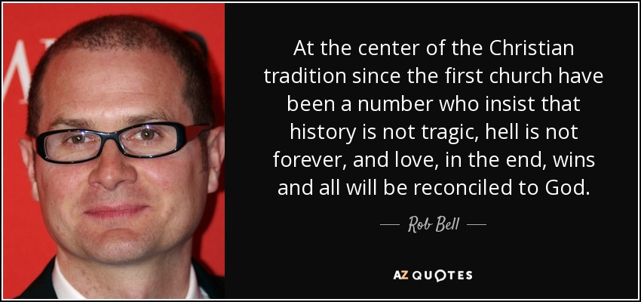
罗伯·贝尔的普救论（Universalism）
“自第一间教会以来，在基督教传统的核心，一直有一些人坚持认为：历史并非悲剧性的，地狱并非永恒的，最终爱将战胜一切，并且所有人都会与上帝和好。”
——罗伯·贝尔
Notes:
He says that he is not a universalist, but he writes…
__________
“In the book, Bell states that "It's been clearly communicated to many that this belief (in hell as eternal, conscious torment) is a central truth of the Christian faith and to reject it is, in essence, to reject Jesus. This is misguided and toxic and ultimately subverts the contagious spread of Jesus' message of love, peace, forgiveness and joy that our world desperately needs to hear." In this book, Bell outlines a number of views of hell, including universal reconciliation. Though he does not choose any one view as his own, he states "Whatever objections a person may have of [the universalist view], and there are many, one has to admit that it is fitting, proper, and Christian to long for it."
_______
From Wikipedia, the free encyclopedia
https://en.wikipedia.org/wiki/Rob_Bell accessed 10 Aug 2019
他说他不是一个普遍主义者，但他在书中写道……
“在书中，贝尔表示，‘许多人已经被清楚地告知，地狱是永恒的、意识的折磨，这一信念是基督信仰的核心真理，拒绝它本质上就是拒绝耶稣。这是误导的、有毒的，最终会破坏耶稣爱、和平、宽恕和喜乐信息的传递，而这些正是我们这个世界迫切需要听到的信息。’在这本书中，贝尔列出了关于地狱的多种观点，包括普遍和解。尽管他没有选择任何一个观点作为自己的立场，但他表示，‘无论一个人对[普遍主义观点]有多少异议，其中有很多，必须承认，渴望这一点是合适的、正当的，也是基督徒的。’”
来自维基百科，自由百科全书
https://en.wikipedia.org/wiki/Rob_Bell（访问日期：2019年8月10日）

Slide 59
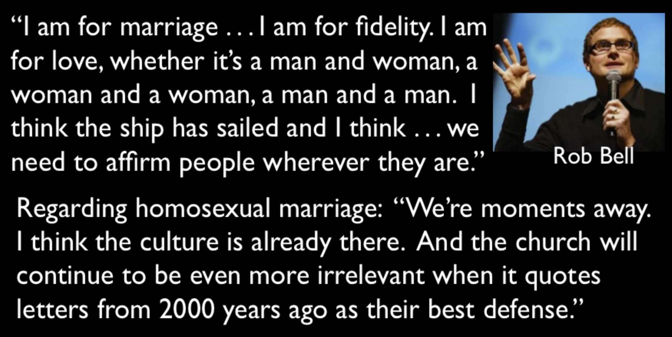
罗伯·贝尔的背道
“我支持婚姻……我支持忠诚。我支持爱，无论是一男一女、一女一女，还是一男一男。我认为这艘船已经起航，我认为……我们需要在任何情况下都肯定人们。”
关于同性婚姻，他表示：
“我们离实现它只差一步。我认为文化已经接受了这一点。而当教会继续引用2000年前的书信作为他们的最佳辩护时，它只会变得更加无关紧要。”
Notes:
Along with this nowadays seems to go the apology for what God says about homosexuality.
如今，与此一起出现的似乎是对上帝关于同性恋所说的话的道歉。

Slide 60
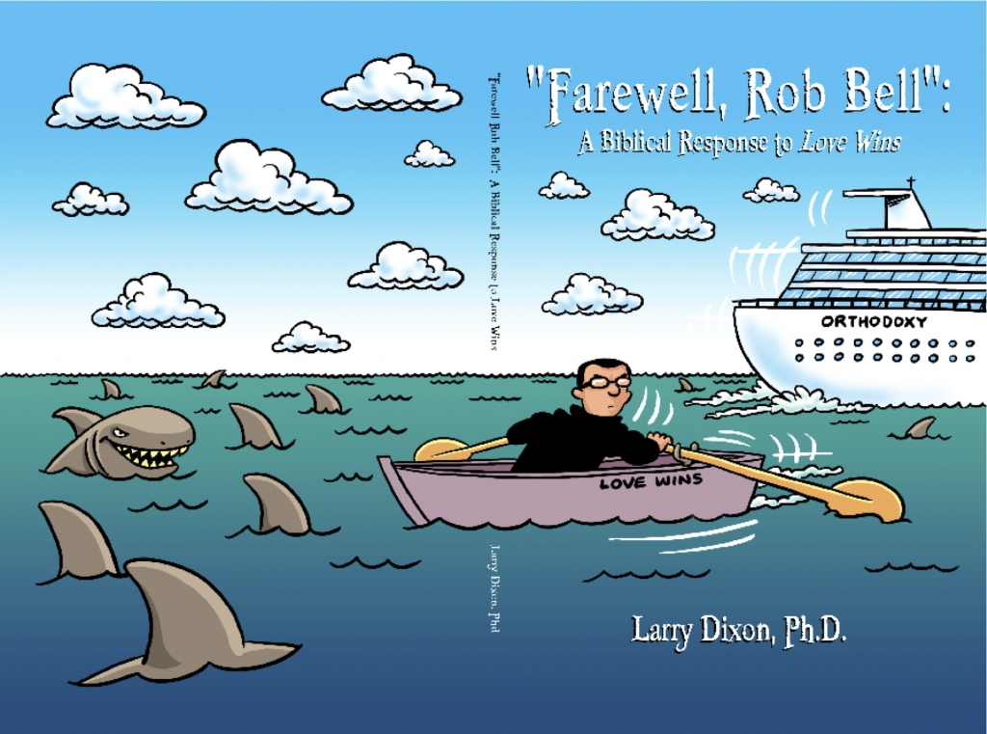
Rob Bell
《再见，罗布·贝尔》：对《爱胜利》的一种圣经回应
（拉里·迪克森博士）
Notes:
Bell, of course, has his critics who argue from the Bible that he has abandoned the faith. He left his church in 2011 but has new friends in Oprah Winfrey and other apostates like Joel Osteen.
当然，贝尔有他的批评者，他们根据圣经认为他已经背弃了信仰。他在2011年离开了他的教会，但如今与奥普拉·温弗瑞以及其他像乔尔·奥斯汀这样的叛教者成为了新朋友。

Slide 61

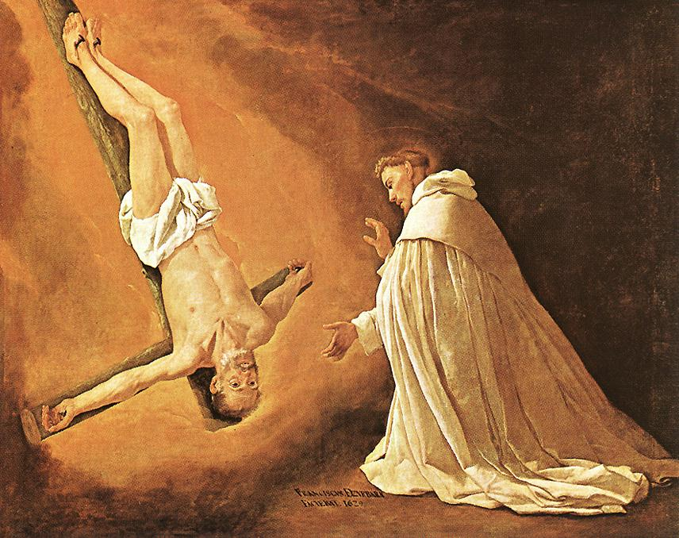
"14因为我知道我离世的时候快到了，正如我们的主耶稣基督清楚指示我的。15我也要努力，使你们在我去世以后，还时常追念这些事。" ( 彼得后书. 1:14-15 新译本)
教会传统认为，彼得请求被倒钉十字架。
61
61
61

Slide 62

什么是预言?
289b
“第 一 要 紧 的 ， 该 知 道 经 上 所 有 的 预 言 没 有 可 随 私 意 解 说 的 ；
因 为 预 言 从 来 没 有 出 於 人 意 的 ， 乃 是 人 被 圣 灵 感 动 ， 说 出 神 的 话 来 。”
彼得后书 1:20-21

Slide 63
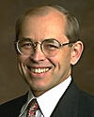
Wayne Grudem 关于预言
预言是…
“宣讲由神自发带入头脑的”
(“Why Christians Can Still Prophesy: Scripture Encourages Us to Seek this Gift Yet Today,” Christianity Today [September 16, 1988], 29)
（“为什么基督徒仍说预言：圣经鼓励我们在今天仍追求这恩赐” 基督教今天 [九月十六，一九九八，29]）
新约教授
凤凰城神学院

Slide 64
你需要知道什么才能在恩典里成长，而不要听信假教诲?
彼得后书

Slide 65
I. 要知道基督 拣选
与完全地装备了你
(第一章)。
彼得后书
II. 在遇见之前知道什么是 假 老师 (第二章)。
要知道什么才能成长…

Slide 66
Summary Chart
以知识抵挡假教诲
彼得后书
284
神的拣选
将来的背道
主的再来
第一章
第二章
第三章
问候
1:1-2
供应一切所需
1:3-11
知识的根基
1:12-21
假师傅的到来
2:1-3a
入地狱的结局2:3b-10a
描述特征
2:10b-22
好讥诮的人在被提前出现3:1-4
天地被销化
3:5-13
圣洁的动机
3:14-16
保护，成长，敦促
3:17-18
信徒的完全
非信徒的不完全
信徒的盼望
圣洁
异端
希望
主的门徒
恶魔般的领袖
主的日子
罗马到小亚细亚
公元64

Slide 67
Slides on
彼得后 2

Slide 68
主题
288
知识…
第一章 灵命的成长
第二章 与假教导争战
第三章 维持希望
彼得后书

Slide 69
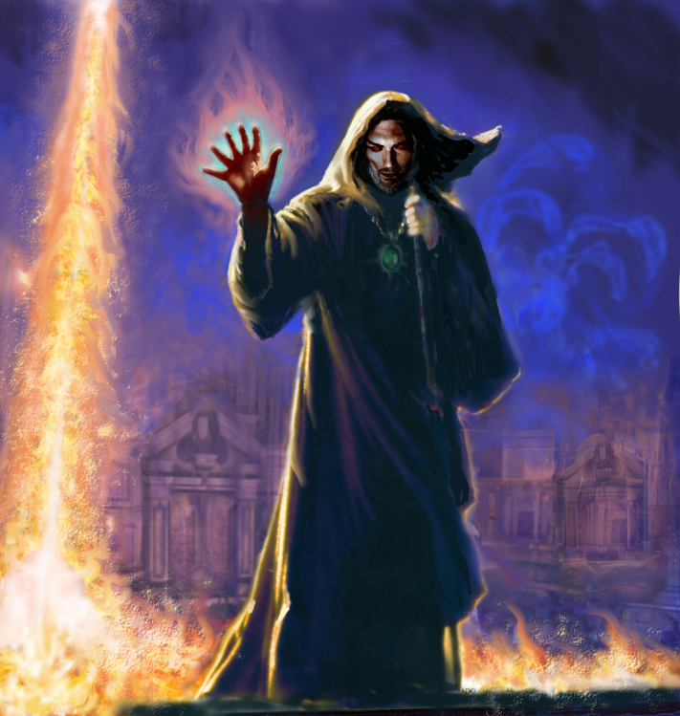
“从前在人民中，曾有假先知出来；照样，将来在你们中间，也必有假教师出现。他们偷偷把使人灭亡的异端引进来，甚至否认那曾经买赎他们的主，迅速地自取灭亡。”
(彼得后 2:1 CNV).
57

Slide 70

A. (2:1-3a)
假师傅的特征?
彼得后书 2
秘密渗透 (1a)
破坏性 (1b)
否认基督为主 (1c)
自我毁灭 (1d)
许多跟随着 (2a)
羞耻的行为 (2b)
败坏基督教的名誉 (2c)
贪婪 (3a)
取利 (3b)
被定罪的 (3c)

Slide 71

B. (2:3b-10a)
背道者下地狱
义者被保护
彼得后书 2
背教必下地狱的命运向信徒显明他们是受保护的，而背教者是被定了罪的.

Slide 72
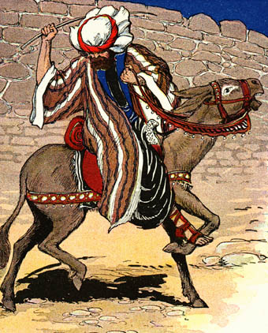
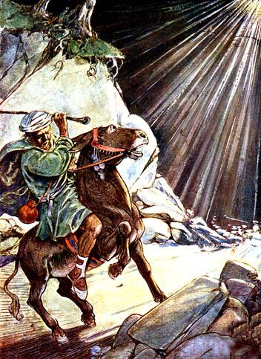
Balaam
巴 兰
民数记 22-24

Slide 73
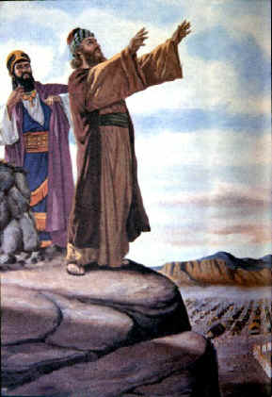
巴兰的故事
354
巴勒未能使神敌对以色列——反而借巴兰祝福了以色列（民数记 22-24）
Beitzel, Moody Atlas, 1st ed., 94

Slide 74
彼得后书 2:15-16
他 们 离 弃 正 路 ， 就 走 差 了 ， 随 从 比 珥 之 子 巴 兰 的 路 。 巴 兰 就 是 那 贪 爱 不 义 之 工 价 的 先 知 ，
他 却 为 自 己 的 过 犯 受 了 责 备 ； 那 不 能 说 话 的 驴 以 人 言 拦 阻 先 知 的 狂 妄 。

Slide 75

The Agony of Deceit
欺骗的痛苦
一些电视布道者真正的教导

Slide 76
你需要知道什么才能在恩典里成长，而不要听信假教诲?
彼得后书

Slide 77
I. 要知道基督 拣选
与完全地装备了你
(第一章)。
彼得后书
II. 在遇见之前知道什么是 假 老师 (第二章)。
III. 知道要以永恒的角度生活
– 不是暂时的
(第三章)。
要知道什么才能成长…

Slide 78
Summary Chart
以知识抵挡假教诲
彼得后书
284
神的拣选
将来的背道
主的再来
第一章
第二章
第三章
问候
1:1-2
供应一切所需
1:3-11
知识的根基
1:12-21
假师傅的到来
2:1-3a
入地狱的结局2:3b-10a
描述特征
2:10b-22
好讥诮的人在被提前出现3:1-4
天地被销化
3:5-13
圣洁的动机
3:14-16
保护，成长，敦促
3:17-18
信徒的完全
非信徒的不完全
信徒的盼望
圣洁
异端
希望
主的门徒
恶魔般的领袖
主的日子
罗马到小亚细亚
公元64

Slide 79
Slides on
彼得后 3

Slide 80
怀疑者嘲笑三大核心真理
290b
"…在末后的日子，必定有好讥笑的人出来，随着自己的私欲讥笑说：4“他要降临的应许在哪里呢？"
(彼得后书. 3:3b-4a 新译本).
基督的再来
Presentation_ID
80
80
© 2003 Cisco Systems, Inc. All rights reserved.
80

Slide 81
怀疑者嘲笑三大核心真理
290b
"'因为自从列祖睡了以来，万物依然存在，与起初创造的时候一样。”5他们故意忘记这事：在太古的时候，因着 神的话，就有了天，和从水而出、藉水而成的地。"
(彼得后书 3:4b-5 新译本).
基督的再来
创造
Presentation_ID
81
81
© 2003 Cisco Systems, Inc. All rights reserved.
81

Slide 82
怀疑者嘲笑三大核心真理
290b
"6当时的世界，因被水淹没而消灭了。"
(彼得后书 3:6 新译本).
基督的再来
创造
全球洪水
Presentation_ID
82
82
© 2003 Cisco Systems, Inc. All rights reserved.
82

Slide 83
怀疑者嘲笑三大核心真理
290b
基督的再来
全球洪水
创造
Presentation_ID
83
83
© 2003 Cisco Systems, Inc. All rights reserved.
83

Slide 84


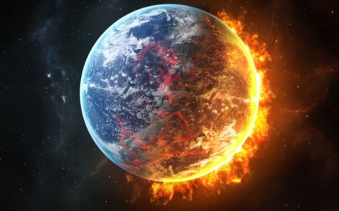
宇宙将如何终结？
进化论
圣经
Notes:
Big Bang: heat death (cold, dark universe) or big crunch (collapsing universe)? OR…
Bible: literal heat death and then new heavens and new earth?
大爆炸理论：热寂（冷暗宇宙）或大挤压（宇宙坍缩）？还是……
圣经：字面的热寂，随后新的天地？

Slide 85
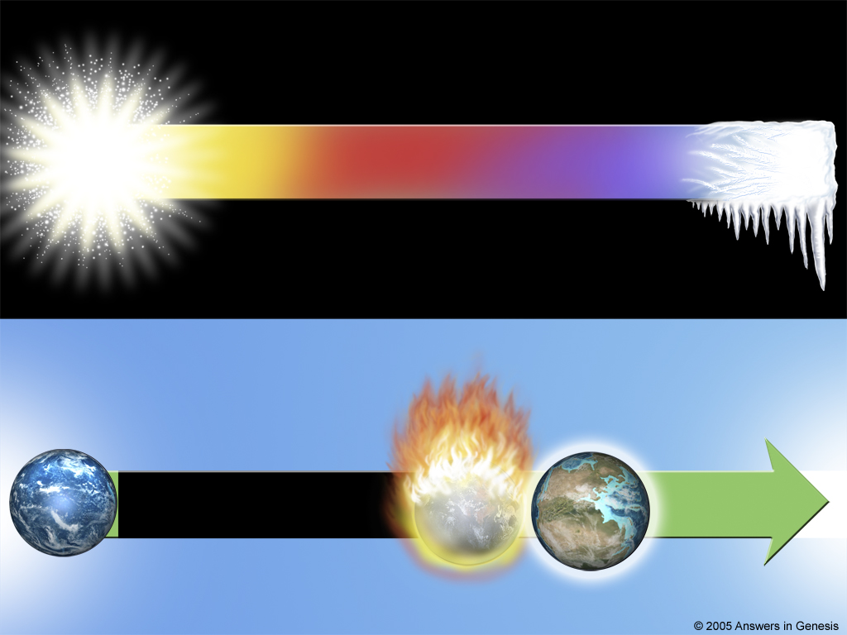
Big Bang Time line
宇宙的未来 - 根据大爆炸理论
宇宙
大爆炸
能源耗竭
几十亿年
Big Bang Time line
宇宙的未来 – 根据圣经的教导
烈火
沉沦
六天中
新天
几千年
永恒
创造万物
新地
罪与死亡
创世纪
彼得后书3
启示录

Slide 86
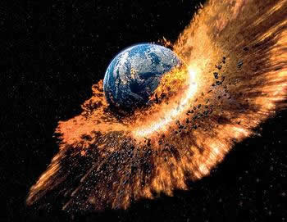
圣经如何说世界将会终结？
" 但主的日子必要像贼一样来到。在那日，天必轰然一声地消失，所有元素都因烈火而融化；地和地上所有的，都要被烧毁
（“被烧毁”有不少古抄本作“被发现”）。“
(彼后 3:10 CNVS)

Slide 87
如何在末日的光照下生活？
"这一切既然都要这样融化，你们应当怎样为人，过着圣洁和敬虔的生活， 等候并催促 神的日子降临呢？因为在那日，天要被火焚烧就融化了，所有元素都因烈火而融解！"
(彼后 3:11-12 CNVS)

Slide 88
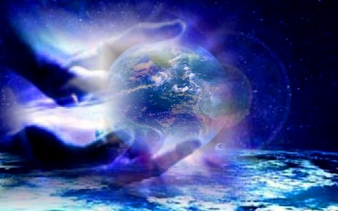
如何在末日的光照下生活？
“ 但是我们按照他所应许的，等候新天新地，有公义在那
里居住。”
(彼后3:13 CNVS)

Slide 89
关键节
284
“所以，亲爱的，你们既然预先知道了，就要谨慎，免得受恶人的错谬引导，就从自己坚固的地步上坠落。你们却要在我们的主、救主耶稣基督的恩典和知识上长进。愿荣耀归给他，从现在直到永远。阿们。” (彼得后 3:17-18).
彼得后

Slide 90
你需要知道什么才能在恩典里成长，而不要听信假教诲?
彼得后书

Slide 91
主要思想
要知道你是被基督拣选的，而祂再来的时候会审判背道者。
彼得后书

Slide 92
I. 要知道基督 拣选
与完全地装备了你
(第一章)。
彼得后书
II. 在遇见之前知道什么是 假 老师 (第二章)。
III. 知道要以永恒的角度生活
– 不是暂时的
(第三章)。
要知道什么才能成长…

Slide 93

Synthesis
彼得后书
综合
288
知道这些事来对抗异端
1 神的拣选
2 背道者的特征
3 主的再来

Slide 94
为了改变生命:
在你的经历中，哪个师傅你要向你自己和你的家人警告？如何警告?
彼得后书

Slide 95

神的华语是否在塑造你
在恩典与对神的认识中成长?
彼得后书

Slide 96
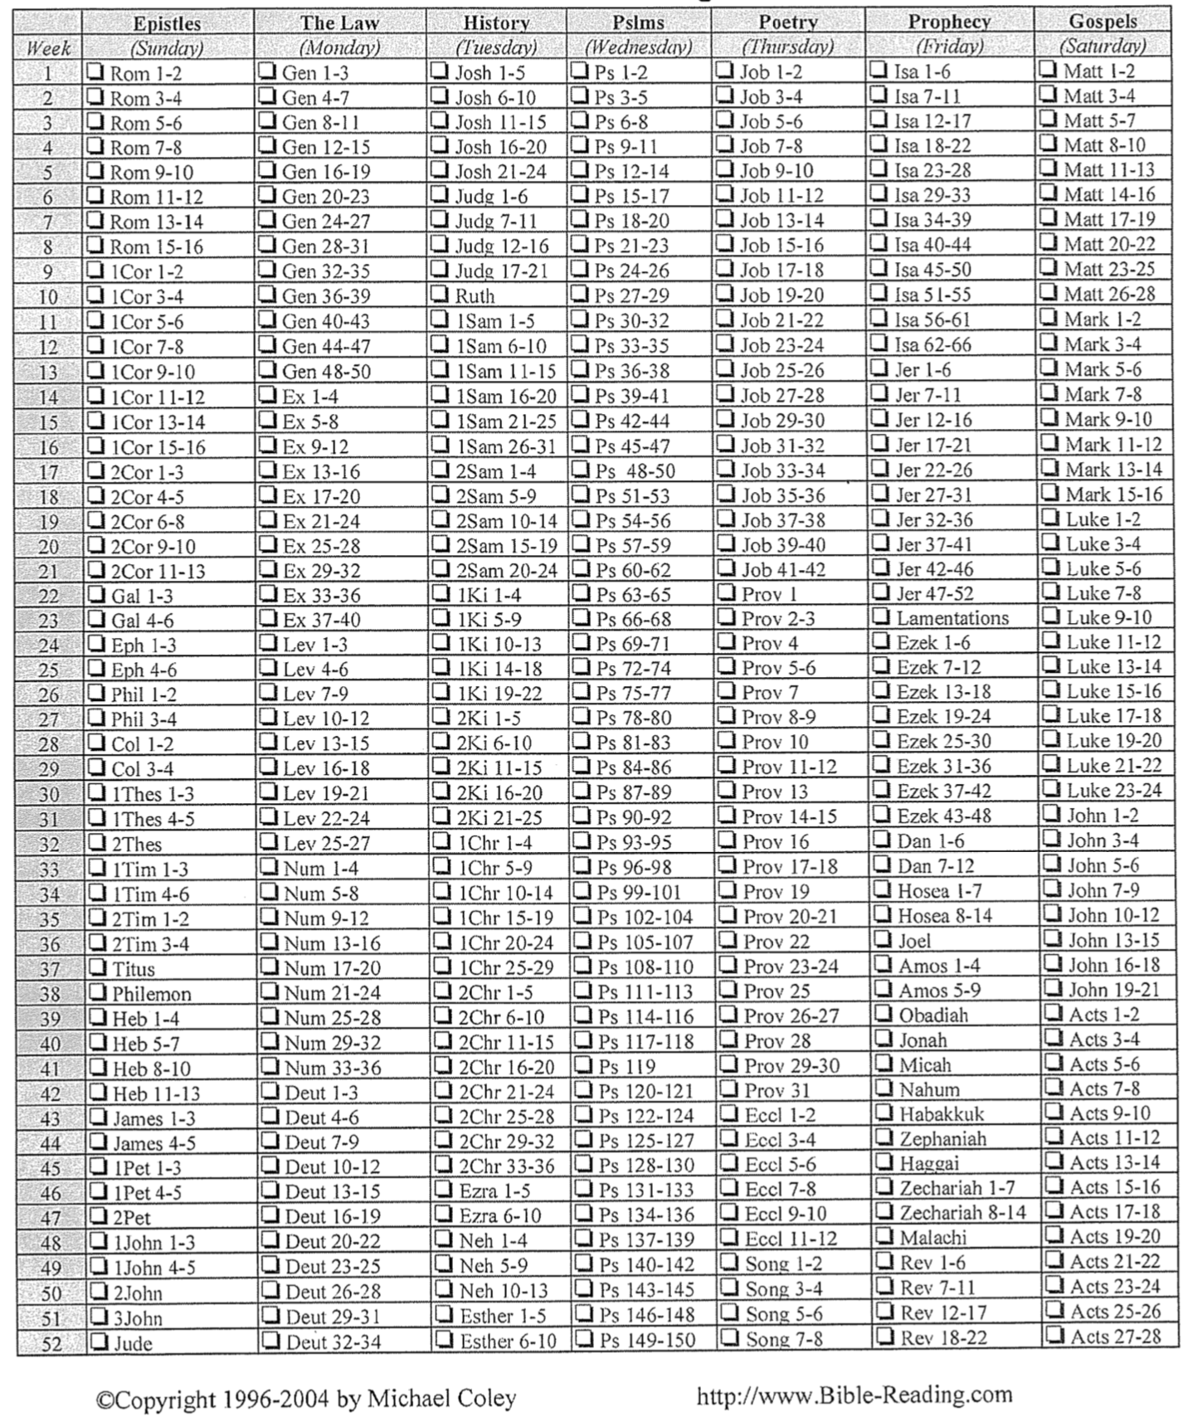
读经计划
289h

Slide 97

Know Jesus, Know Peace
没有耶稣，
没有平安。
认识耶稣，
认识平安。

Slide 98
Black

Slide 99

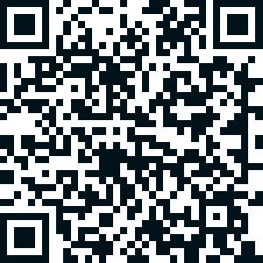
圣经阐释 • BibleStudyDownloads.org
免费获得该讲解!
圣经学习下载
你需要更好地了解圣经吗？谁不需要呢？BibleStudyDownloads （圣经学习下载）为神学生和教师们提供了从 创世纪 到 启示录的 30万份 可编辑的免费PowerPoint和Word文件。
本网站的大部分资料由Dr. Rick Griffith 博士设计，他从1991年到2021年在新加坡神学院教授圣经、神学和讲道学，现在是约旦福音神学院的圣经释经教授。
圣经学习下载
Notes:
BE Bible Exposition—Chinese

