Slide 1
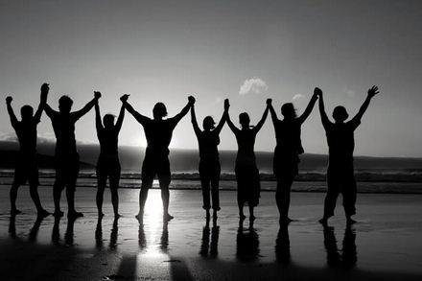
得到肯定
帖撒罗尼迦后书
Dr. Rick Griffith • Crossroads International Church Singapore
BibleStudyDownloads.org

Slide 2
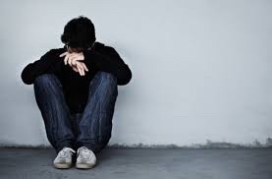
肯定
Notes:
Lately I have been thinking a lot about how we all need to be affirmed.
The past two weeks both Susan and I have had the most health issues ever in our 35-year marriage. Last Sunday was the first time we both ever missed church. My voice just wasn’t in shape to preach, I didn’t have the energy, etc. I won’t give you all the details lest it become “an organ recital.”
That’s not what is important. What is more significant is that some of you reached out to us and genuinely affirmed us! Thank you! Susan’s eye operation to correct her double vision did happen and was a success, despite our doubts about it going through with her rapid heartbeat days before the operation. Now, instead of seeing two husbands with her double vision, she is back to having only one husband.
最近，我一直在思考我们每个人都需要被肯定。
在过去的两周里，苏珊和我经历了我们 35 年婚姻中最严重的健康问题。上周日是我们第一次缺席教会聚会。我嗓子状态不好，无法讲道，也没有足够的精力，等等。我就不详细描述了，以免听起来像是在**“报告病情”**。
但这些都不是最重要的。更重要的是，你们中有些人主动关心我们，并真诚地肯定和鼓励我们！ 谢谢你们！
苏珊的矫正复视的眼部手术最终顺利进行，并取得了成功，尽管在手术前几天，她因心跳过快让我们一度怀疑是否能如期进行。现在，她不再看到两个丈夫，而是回到了只看到一个丈夫的正常状态。

Slide 3
我们的使命
Crossroads教会 的使命是通过接触居住在新加坡的国际人士，来触及列国。
Notes:
Let’s read this together…

Slide 4
我们的愿景
Crossroads教会 的愿景是带领国际人士与耶稣基督建立深刻的关系，使他们成为门徒，并在他们独特的影响领域中带来改变（提摩太后书 2:2）。
特别是，Crossroads 主要（但不限于）触及英语社群。
Notes:
4
Reading together again…

Slide 5
我们的愿景
爱列国
爱教会
爱神
Notes:
Repentance will bring restoration in a church: God wants our church to really trust him.
We still don’t see our need for him as we don’t see our need to pray.
We also need to be involved in his work: missions, teaching, accountability groups, finances, etc.
_______________
OS-29-Joel-128
NS-13-1 Thess-111
悔改会带来教会的复兴：神希望我们的教会真正信靠祂。 我们仍然没有真正意识到自己对神的需要，因为我们甚至没有意识到自己需要祷告。
此外，我们也需要积极参与祂的工作，包括：
宣教（missions）
教导（teaching）
责任团契（accountability groups）
财务管理（finances） 等。
OS-29-约珥书-128 NS-13-帖撒罗尼迦前书-111

Slide 6
言语可以肯定他人
特别的，美丽的
精彩的，温柔的
有爱心的，
鼓舞人心的，
强大的，英俊的
仁慈的，荣耀的
Notes:
Curious about this concept of affirmation, I began looking up the word “affirmation” on Google to see what I could find.
I was surprised to see that nearly everything I saw related to SELF-affirmation! I wonder if anyone is affirming OTHERS anymore!
我对“肯定（affirmation）”的概念很好奇，于是我在Google上搜索这个词，看能找到什么。 让我惊讶的是，几乎所有的内容都与**“自我肯定（self-affirmation）”**有关！ 我不禁想，现在还有人在肯定别人吗？

Slide 7
自我肯定
做最好的自己！
“感觉良好，
行动卓越，
并认可自己。
Notes:
Hmmmm, should we approve of everything we do?
嗯……我们应该认可自己所做的一切吗？

Slide 8
自我肯定
1,000 条
自我肯定语
Notes:
We are told to recite 1000 self-confidence affirmations!
我们被要求背诵 1000 条自信肯定语！

Slide 9
自我肯定
我
自己
我相信自己
Notes:
Some self affirming claims include “I love me.”
Also, I believe in me.
一些自我肯定的说法包括“我爱自己”。此外，我相信自己。

Slide 10
自我肯定
我足
够好
我用积极的想法
充满我的思维
我不仅足够好，我甚至超越了足够好。
Notes:
How about “I am enough”?
Not to be outdone, another has modified it: “I am MORE THAN enough.”
Or I fill me mind with positive thoughts.
那么，“我足够好吗？” 然而，不甘示弱的人修改了这句话：“我不仅足够，我甚至超越了足够。” 或者，“我用正面思想充满我的头脑。”

Slide 11
自我肯定是否足够？
今天最棒的人是谁?
我无条件的爱我自己。

Slide 12
我不配拥有自尊
Notes:
What if a person doubts that he or she deserves self-esteem?
如果一个人怀疑自己是否配得上自尊，该怎么办？

Slide 13
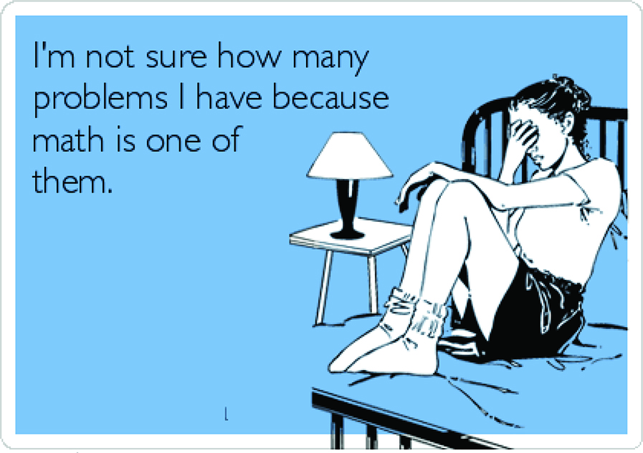
“我不确定自己有多少问题，因为数学就是其中之一。”
Notes:
What do you do if you say, “I am not sure how many problems I have because math is one of them”?
Isn’t it far better for others to praise you than for you to praise yourself?
今天，我们将看到一间教会被“逼迫的榨酒池”所压榨，却顺服于神，从而散发出神恩典的馨香之气。帖撒罗尼迦的信徒在保罗建立教会大约一年后，仍然经历着“逼迫和试炼”，但他们在重压之下仍然坚持信仰，虽被压迫，却仍然站立得住。

Slide 14
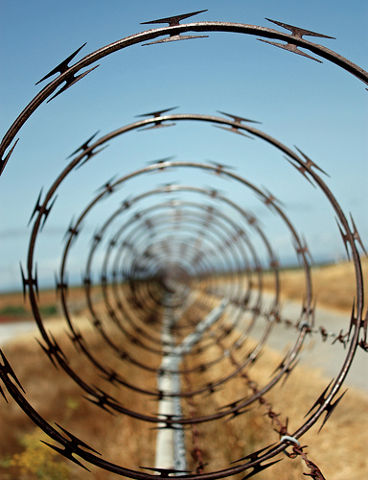
我们当中有多少人注意到他人被困在漩涡中？
Notes:
Love means seeing needs. I wonder how many of us have eyes to see when others have genuine needs—physical issues are easier to see, but spiritual needs are a greater challenge.
Life goes so fast, often it’s tough to take care of ourselves let alone others. I struggle with this—don’t you? Do you struggle with how to help those who are in tough straits? Do you know anyone afflicted in their relationship with their spouse, in financial woe, struggling with children or work or something else?
爱意味着看见需要。我想知道，我们当中有多少人有眼光去察觉他人的真实需要——身体上的问题容易看见，但属灵的需要却更难察觉。
生活节奏如此之快，我们往往连照顾自己都不容易，更何况去关心别人。我自己也在挣扎，你呢？
你是否在帮助那些身处困境的人时感到困难？你是否认识在婚姻、经济、子女、工作或其他方面受困的人？

Slide 15
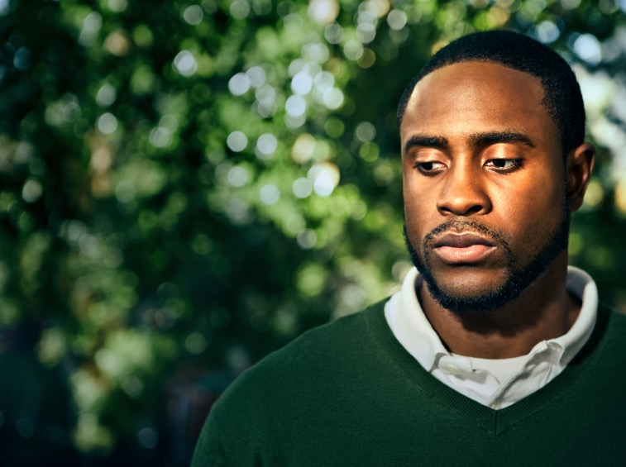
你如何帮助那些正在经历困难时期的人？
Notes:
How can you help those who are going through tough times? What should you say to ease the pain rather than add to it like Job’s counselors? What do you do to help people in difficulty?
你如何帮助那些正在经历困难时期的人？你应该说些什么来减轻他们的痛苦，而不是像约伯的朋友那样加重痛苦？你做些什么来帮助处于困境中的人？

Slide 16
神怎么在困难中肯定我们？

Slide 17
帖撒罗尼迦后书的背景
Notes:
Today we will look at a church caught in the “winepress of persecution” that had yielded to God, resulting in a fragrant display of God’s grace. The Thessalonians still had “persecutions and trials” about a year after Paul had established the church but they were bearing under it, though crushed.
今天，我们将看到一间教会被“逼迫的榨酒池”所压榨，却顺服于神，从而散发出神恩典的馨香之气。帖撒罗尼迦的信徒在保罗建立教会大约一年后，仍然经历着“逼迫和试炼”，但他们在重压之下仍然坚持信仰，虽被压迫，却仍然站立得住。

Slide 18
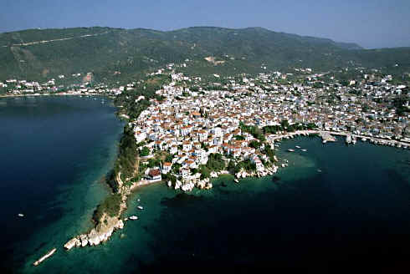
赛尔迈海湾的港口城市
Notes:
The church was located in northern Greece on a peninsula as both a key port city…
这间教会位于希腊北部的一个半岛上，既是一个重要的港口城市……

Slide 19
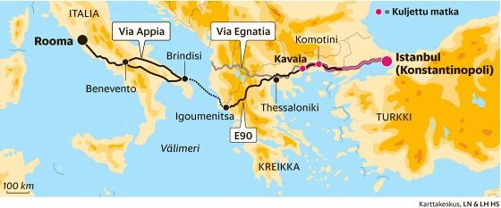
位于特洛亚湾的一个港口城市
它连接26个农村
也是马其顿的主要海港及海军基地
它是从港口和埃格那梯亚进入马其顿的主要通道
埃格那梯亚通道横跨城市的西北和东南
横跨主要陆路的路线
绵延493英里（790公里）

Slide 20
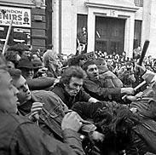
送他进监狱
打倒保罗
未完待续……

Slide 21
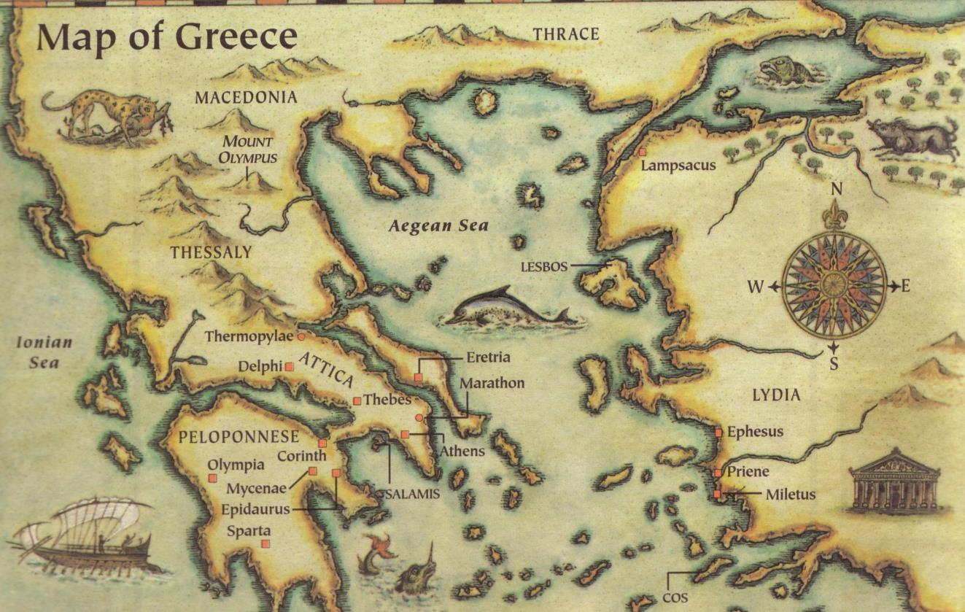
这书信是在主后51年写
帖撒罗尼迦
Berea
雅典
哥林多
三种鼓励人的方式...
听了提摩太的报告后，在哥林多写的
Notes:
Written in Corinth after hearing Tim's report
听了提摩太的报告后，在哥林多写的

Slide 22
做好准备
贴撒罗尼迦前书
Dr. Rick Griffith • Crossroads International Church Singapore
BibleStudyDownloads.org

Slide 23
Our Need
贴撒罗尼迦前书
Notes:
At some point in perhaps the not-too-distant future millions of people will just quickly rise to meet the Lord Jesus Christ.
在未来某个可能不会太遥远的时刻，数百万的人将迅速被提，与主耶稣基督相遇。

Slide 24
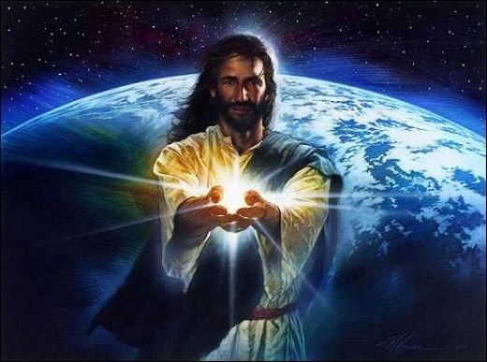
Black

Slide 25
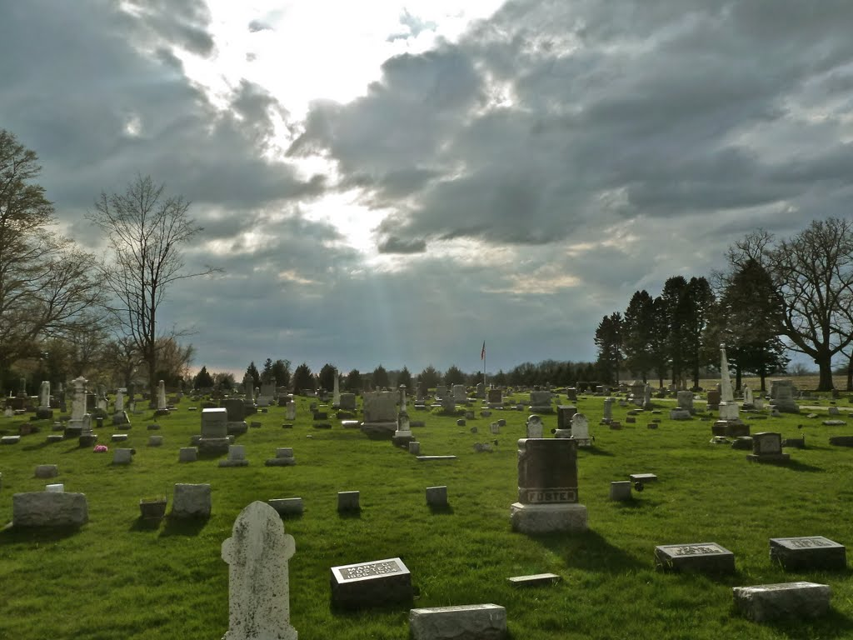
被提
“弟兄们，论到 睡了的人，我们不愿意你们知道， 免得你们忧伤， 像那些没有盼望的人一样。 ¹⁴ 我们若信耶稣死了， 又复活了， 照样， 也应该相信那些靠着耶稣已经睡了的人。” （帖撒罗尼迦前书 3：13-14）
Notes:
Paul speaks clearly of this next event on God’s prophetic calendar in 1 Thess 4:13-18…
保罗在帖撒罗尼迦前书 4:13-18 中清楚地谈到了神预言性日程上的下一个事件……

Slide 26
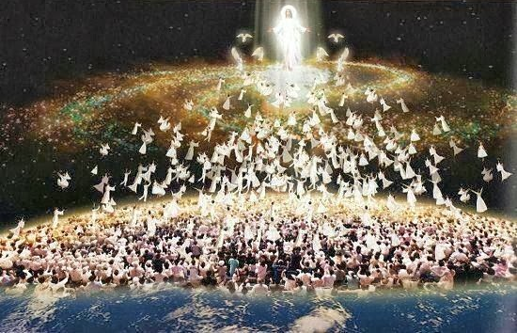
被提
¹⁶“ 因为主必亲自从天降临， 那时， 有法令的声音， 有天使长的呼声， 还有 神 的号声， 那些在基督里死了的人必先复活： ¹⁷然后， 我们还活着存留的人， 必和他们一同被提到云里， 自空中与主相会。 这样， 我们就要和主常常同在。”
（帖撒罗尼迦前书 4： 16 – 17）

Slide 27
要怎么为被提 做准备？
2 种方式。。。
贴撒罗尼迦前书
Notes:
What specific ways can you be ready for Jesus when he come back?
当耶稣再来时，你可以通过哪些具体的方式做好准备？

Slide 28
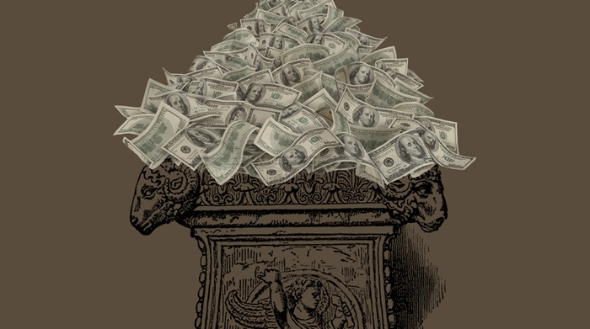
（一）没有贪婪地服侍耶稣 (第1–3章）。
贴撒罗尼迦前书
Notes:
Live for Christ as if money is not a big concern.
为基督而活，好像金钱不是大问题。

Slide 29
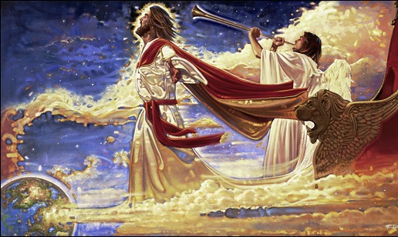
（二） 关心人和神学 (第 4–5章)。
+
贴撒罗尼迦前书
Notes:
Doctrine and relationships should occupy much of our time.
In particular, we need a theology of Christ’s second coming.
教义和关系应该占据我们大部分的时间。 特别是，我们需要建立关于基督再来的神学观。

Slide 30
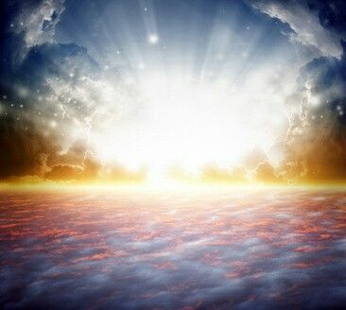
主要概念
以金钱， 朋友 和圣经为耶稣的回归做好准备
贴撒罗尼迦前书

Slide 31
我们都得做交待。
贴撒罗尼迦前书

Slide 32
贴撒罗尼迦前书5:2
“像夜间的贼来到”
Notes:
Do you think your home will be broken into tonight? At his return, Jesus will be as expected as much as you expect a thief to rob your house tonight.
Are you prepared for him to arrive at any time? Is there anything you do that will cause you to be ashamed if he came at that time you do it?
你认为你的家今晚会被盗吗？当耶稣再来时，祂的到来将像小偷入室行窃一样出乎意料。
你是否已经预备好，随时迎接祂的到来？ 如果祂在你做某件事的那一刻降临，你会因此感到羞愧吗？

Slide 33
新约综览
38 124 39-41
“直 到 地 极” (使 徒 行 传 1:8)
使 徒 9 13 14 15 16 18 21 27 28
四月 48- 九月 49
1 加 拉 太
四月 50- 九月 52
2 爱琴海
春季 53- 五月 57
3 亚洲
五月 57- 八月 59
试验
二月 60- 三月 62
1 罗马
春季 62- 秋季 67
4 西班牙
秋季 67- 春季 68
2 罗马
35-37
大 马 色 安 提 阿
秋季 49
理事会
春季68
教会扩长
35 48 49 50 52 53 57 60 62 67 68 95
马太
路加
使徒行传
马可
约翰
加拉太
帖前
雅各
帖后
福音书以及使徒行传
保罗书信
一二三四
旅程
普通书信
罗马
关押
动画

Slide 34
帖撒罗尼迦 前后书
马其顿
212
帖撒罗尼迦
哥林多
Notes:
But now, months later, Jesus had not come and the church was wondering if they had already entered the tribulation. So Paul wrote them another letter to show how God continued to affirm them.
但几个月后，耶稣仍未再来，教会开始疑惑他们是否已经进入大灾难。因此，保罗写了另一封信给他们，以此表明神如何继续坚固他们。

Slide 35
论点
214
保罗写信给信徒是来帮忙如何处理教会所面对的三相难题。
招受逼迫 (1:3-10),
不法者说主已经来了 (2:1-12), 和
懒惰的帖撒罗尼迦信徒在 “等待被提” (3:6-15).
保罗鼓励他们鉴定拯救的盼望来得奖赏 (ch. 1)和更正对主再来的日子错误的观念 (ch. 2)导致信徒懒惰 (ch. 3). 主题是关于主再来得日子所引起信徒的反应。

Slide 36
神怎么在困难中肯定我们？
3 ways…

Slide 37
Slides on 帖撒罗尼迦后 1

Slide 38
神如何肯定我 们
情绪
1
Notes:
Restated: He is not incomplete or piecemeal in his ministry to us.
• He touches the heart (emotionally),
• the mind (theologically),
• and the hands (practically).
换句话说，祂对我们的事工并非不完整或零散的。
• 祂触摸人的心（情感上），
• 祂启迪人的思维（神学上），
• 祂引导人的手（实践上）。

Slide 39
（一）情绪：神赐毅力以让我们成熟 （帖撒罗尼迦后书 第1章）
Notes:
The Lord helps us not to lose heart so we will grow.]
主帮助我们不至灰心，使我们得以成长。

Slide 40
Paul's Advice to Troubled Thessalonians: Focus on God!
215
Focus on God in the Thessalonian Epistles
Total Verses | "God" | "Jesus" | "Lord" | "Christ" | Total
1 Thess. (89) | 36 | 16 | 24 | 10 | 86
2 Thess. (47) | 18 | 13 | 22 | 10 | 63
Total (136) | 54 | 29 | 46 | 20 | 149
保罗对忧虑的帖撒罗尼迦人的劝告：
专注于上帝！
Focus on God in the Thessalonian Epistles
经文总数 | “神" | “耶稣" | “主" | “极度" | 总数
帖前 (89) | 36 | 16 | 24 | 10 | 86
帖后(47) | 18 | 13 | 22 | 10 | 63
总数(136) | 54 | 29 | 46 | 20 | 149
Number of Greek occurrences from Elwell & Yarbrough, Encountering the New Testament, 332
希腊文出现的数量-Elwell 和 Yarbrough, 《遇见新约》, 332

Slide 41
马太福音书的主要思想
服事主耶稣基督
上帝
神
王
耶稣
基督
救主
Notes:
Serve Jesus as Savior, God, and King of your life!
服事耶稣，作为你的救主、神和生命的君王！

Slide 42
一个值得重复的名字
帖后 1 章
帖后 2 章
帖后 3 章
主耶稣基督 (1:1)
主耶稣基督 (2:1)
主耶稣基督 (3:6)
主耶稣基督 (1:2)
主耶稣基督 (2:14)
主耶稣基督 (3:12)
主耶稣基督 (1:12)
主耶稣基督 (2:16)
主耶稣基督 (3:18)
Notes:
The lofty name of the “Lord Jesus Christ” appears 9 times in this book—three times each in all three chapters (NLT):
“主耶稣基督”这个尊贵的名字在《帖撒罗尼迦后书》中出现了 9 次——每章 3 次（新译本）：
2Th. 1:1 This letter is from Paul, Silas, and Timothy. We are writing to the church in Thessalonica, to you who belong to God our Father and the Lord Jesus Christ.
2Th. 1:2 May God our Father and the Lord Jesus Christ give you grace and peace.
2Th. 1:12 Then the name of our Lord Jesus will be honored because of the way you live, and you will be honored along with him. This is all made possible because of the grace of our God and Lord, Jesus Christ.
2Th. 2:1 Now, dear brothers and sisters, let us clarify some things about the coming of our Lord Jesus Christ and how we will be gathered to meet him.
2Th. 2:14 He called you to salvation when we told you the Good News; now you can share in the glory of our Lord Jesus Christ.
2Th. 2:16 Now may our Lord Jesus Christ himself and God our Father, who loved us and by his grace gave us eternal comfort and a wonderful hope,
2Th. 3:6 And now, dear brothers and sisters, we give you this command in the name of our Lord Jesus Christ: Stay away from all believers who live idle lives and don’t follow the tradition they received from us.
2Th. 3:12 We command such people and urge them in the name of the Lord Jesus Christ to settle down and work to earn their own living.
2Th. 3:18 May the grace of our Lord Jesus Christ be with you all.

Slide 43
从神的角度看待试炼 （1:1-2）
Notes:
So these first two verses show that seeing God's perspective helps us to reach out and affirm others. There’s another way to affirm others in verse 3…
这两节经文表明，看到神的视角能帮助我们伸出援手并肯定他人。此外，在第3节中，还有另一种肯定他人的方式……

Slide 44
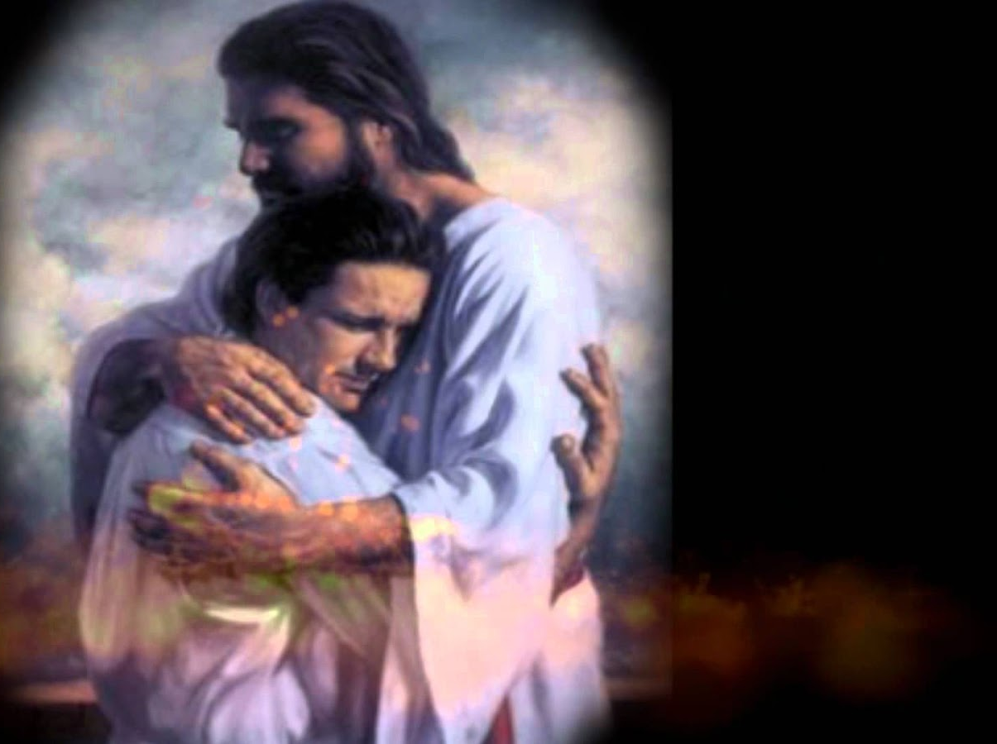
“ 1保罗、西拉和提摩太，写信给帖撒罗尼迦、在我们的父 神和主耶稣基督里的教会。2愿恩惠平安从父 神和主耶稣基督临到你们。”
2 Thessalonians 1:1-2 NLT
Notes:
You may be wondering why I say that these verses teach us to help afflicted people see God's perspective. Aren't they just the preliminaries to the letter that follows?
Yes, but notice how many times Paul mentions God in this one sentence—four times!
Twice he refers to the Father and twice to Christ, who is placed on equal level with the Father since He, too, is God.
你可能会想，为什么我说这些经文教导我们帮助受苦之人看到神的视角？难道它们只是信件的开场白吗？
是的，但请注意保罗在这句话中提到神的次数——四次！
他两次提到父神，两次提到基督，并且基督与父神被放在同等地位，因为祂也是神。

Slide 45
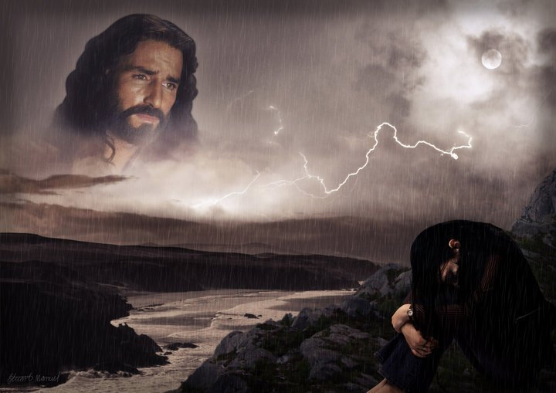
“当我们仰望我们崇高的主耶稣基督时，我们意识到，祂并不是冷漠地转脸不看我们，而是满怀怜悯地俯视我们。”
——查尔斯·史云道（Charles R. Swindoll），
《坚定的基督信仰》（Steadfast Christianity），第4页
Notes:
We all have peaks and valleys in our lives—peaks when it's easy to see the Lord and valleys when it's difficult to see Him. Swindoll writes…
我们的人生中都会有高山和低谷——在高山时，我们很容易看见主；在低谷时，我们往往难以看见祂。史云道写道……
• Text above

Slide 46
"1我要向群山举目，我的帮助从哪里来呢？ 2我的帮助是从造天地的耶和华而来。 (诗篇. 121:1-2)."
—Charles R. Swindoll, Steadfast Christianity, 4—

Slide 47
“当你身处谷底时，你是否仰望高峰？还是你已经陷入低谷太久，以至于忘记了山峰的存在？那些无法坚定信心的人，往往是因为他们未能在一切境遇中看见主。”
——查尔斯·史云道（Charles R. Swindoll），
《坚定的基督信仰》（Steadfast Christianity），第4页

Slide 48
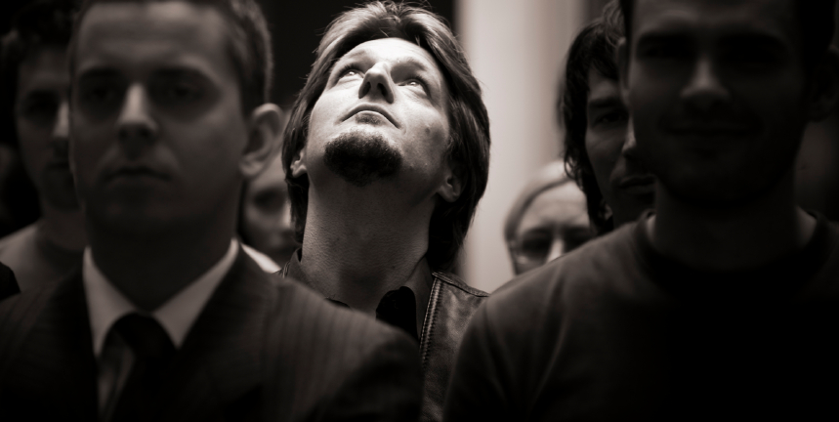
“当我们仰望时，我们被提醒：神并未远离……并未缺席……并未与我们隔绝。然后，我们得以一窥神对我们境遇的视角——而这只能在山巅之上看见，而非身处幽谷。”
—查尔斯·R·史云道（Charles R. Swindoll），
《坚定的基督信仰》（Steadfast Christianity），第 4 页

Slide 49
Seeing from God's Perspective
从神的视角看世界
你的生命经历，在神的视角下可以有所不同。
Notes:
Aren't you encouraged when you're around people who always talk about the Lord?
They see life from God's viewpoint—and there's no more encouraging view!
当你身边总是有人谈论主时，你是不是会感到被鼓舞？
他们从神的视角看待生命——没有比这更鼓舞人心的视角了！

Slide 50
We also need to help others focus on the Lord in their difficulty

Slide 51
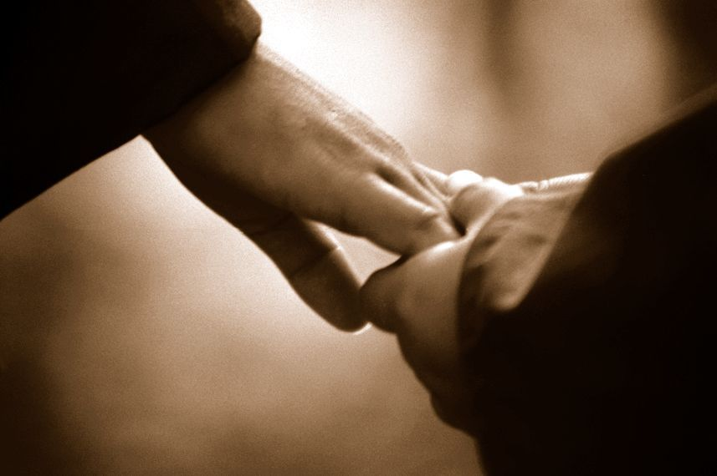
引导他人归向主
什么都不说
分享一处圣经经文
Notes:
There are ways of turning people's sights to the Lord without always quoting Scripture and saying, "Praise Jesus, Praise Jesus…"
• Sometimes we affirm and turn others to God by saying nothing at all.
• Often just writing down a Scripture reference for the person and encouraging him to look it up later is best.
有些方法可以让人转向主，而不需要一直引用圣经或说“赞美耶稣，赞美耶稣……”
• 有时候，我们什么都不说，反而能坚定他人，使他们归向神。
• 有时候，最好的方式就是写下一处圣经经文，并鼓励对方以后自己去查阅。

Slide 52
感谢神使他人成长（1:3）
Notes:
Others benefit in their spiritual walk when they hear you praise God for them.
当他人听到你为他们感谢神时，他们在属灵旅程中也会得益处。

Slide 53
弟兄们，我们应该常常为你们感谢 神，这是合适的。因为你们的信心格外长进，你们众人彼此相爱的心也在增加" (帖撒罗尼迦后书 1:3 新译本).
信
望
爱
Notes:
Paul thanked God for two things—their faith and their love (1:3).
I wonder how often you thank God for others’ spiritual growth. When someone is going through trials how do we generally pray?
I hate to admit it, but most of the time we ask God to remove the trials.
Notice the focus of Paul's prayer here—not a request that God take away their trials but thanksgiving!
He affirmed them by praying not for the removal of the trial but for character development through the trial.
Paul doesn't focus on what's going on around them—he looks at what God is doing within them—building qualities like faith, love, and perseverance mentioned in verse 4.
保罗为两件事感谢神——他们的信心和爱心（1:3）。
你有多常为他人的属灵成长感谢神呢？
当有人正在经历试炼时，我们通常如何祷告？
我不愿承认，但大多数时候，我们祈求神挪去试炼。
然而，请注意保罗的祷告重点——他并没有请求神除去他们的试炼，而是献上感恩！
他肯定了他们，不是通过祈求神除去试炼，而是通过试炼塑造他们的品格。
保罗的关注点不是他们周围发生了什么，而是神在他们里面所做的工作——建立信心、爱心和忍耐，正如第 4 节所提到的。

Slide 54
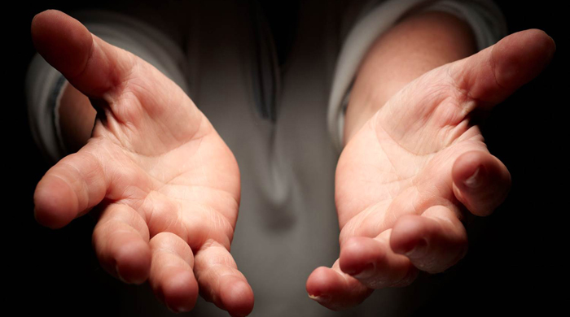
他肯定了他们，因他们彼此相爱的心不断增长——因此，我们看到保罗在肯定他们的肯定！

Slide 55
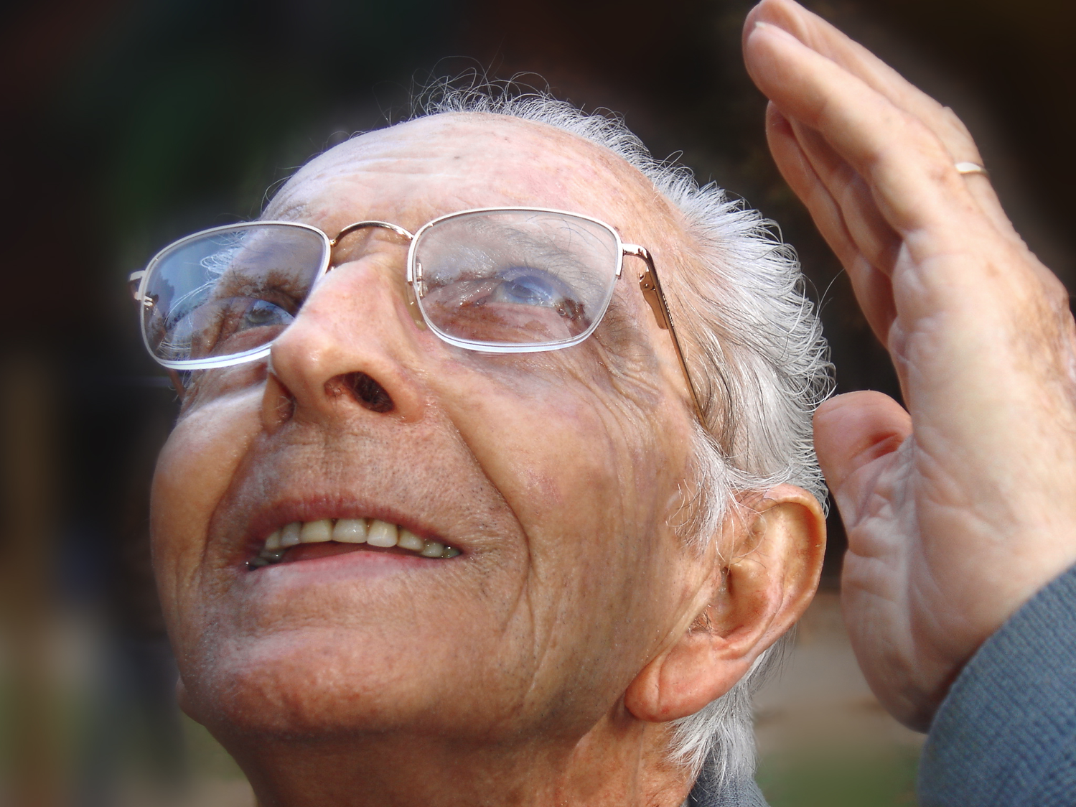
祷告的肯定
Notes:
Prayer for others is no doubt the best way to affirm others. That's why Paul did it!
I hope as a church we’ll grow to pray beyond a focus on the circumstances and pray that God will use difficulties to build the character of Christ within us.
The three qualities Paul notes are a great starting place—faith, love and perseverance.
MPI
I think our prayer times together as a church would be even better if we make it a point to thank God for others' growth right there in the group.
为他人祷告无疑是肯定他人的最佳方式。这正是保罗所做的！
我盼望作为教会，我们能超越仅关注环境的祷告，而是祈求神使用困境来塑造我们里面基督的品格。
保罗提到的三种品格是一个很好的起点——信心、爱心和忍耐。
MPI
我认为，如果我们在教会的祷告聚会中刻意感谢神使他人成长，那我们的共同祷告将会更加美好。

Slide 56
公开称赞他人的属灵成长 （1:4）。
Notes:
Make your praise common knowledge to help others persevere.
让你的赞美成为众人皆知的事，以帮助他人坚持到底。

Slide 57
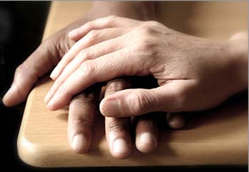
所以我们在 神的众教会里，亲自夸奖你们，因为你们在所受的一切迫害患难中，仍然存着坚忍和信心。5这正是 神公义判断的明证，使你们可以算是配得上他的国；你们也是为了 神的国而受苦。
帖撒罗尼迦后书 1:4新译本
Notes:
Paul told others how well they hung in there (1:4).
He could have been negative—“Man, you should see those Thessalonians’ hassles. Their theology is messed up so much they think they’re in the Tribulation!”
Not Paul! He said, "Wow! You should see how the church at Thessalonica continues to reach out, deepen in their love, make great strides in trusting God, and endure—despite the most intense persecutions in the Roman Empire. They're doing grrrrrrrreat!”
保罗告诉别人，他们坚持得多么好（1:4）。
他本可以消极地说：“哎呀，你们看看那些帖撒罗尼迦信徒的困境吧！他们的神学都乱套了，竟然以为自己已经进入大灾难了！”
但保罗不是这样！他赞叹道：
“哇！你们应该看看帖撒罗尼迦教会，他们仍然努力向外传福音，在爱中不断成长，在信靠神的道路上大有进展，并且在罗马帝国最严酷的逼迫下依然坚定忍耐。他们真的太棒了！”

Slide 58
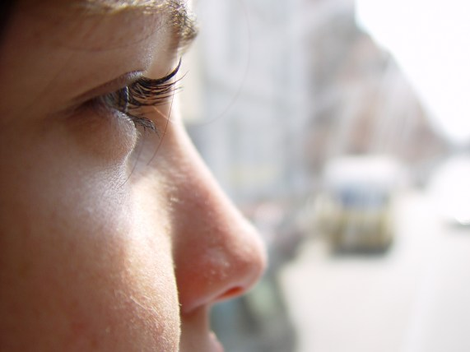
人往往会成为你对他们所宣告的样子。
Notes:
People often become what you tell them they will become.
This is especially true in parenting children.
人们往往会成为你对他们所说的那样的人。
这一点在养育孩子的过程中尤为真实。

Slide 59
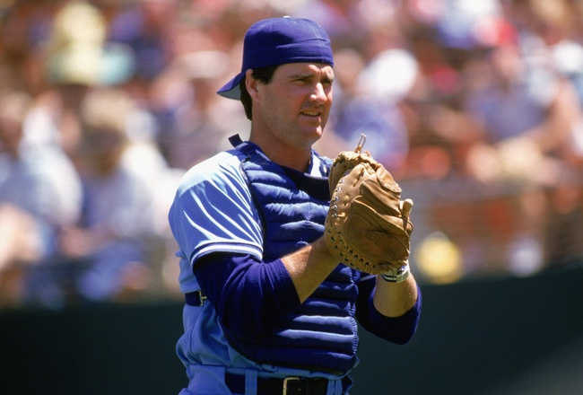
吉姆·桑德伯格（Jim Sundberg）
Notes:
Children tend to become what their parents tell them they will become. Major league baseball catcher Jim Sundberg said that his father was always telling Jim, “Jim, one day you’re going to be a great major league catcher.”
孩子往往会成为父母对他们的期望。美国职业棒球大联盟（MLB）捕手吉姆·桑德伯格曾说，他的父亲总是对他说：
“吉姆，总有一天你会成为一名伟大的大联盟捕手。”

Slide 60
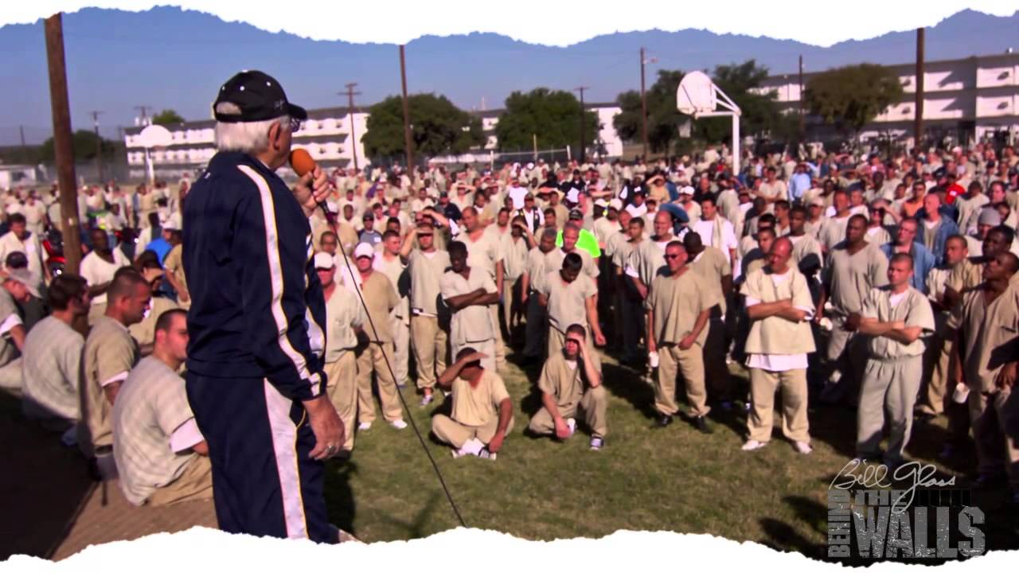
“你们当中有多少人曾经被父母告诉：‘你将来一定会进监狱’？”
Notes:
Evangelist Bill Glass asked a group of 1000 inmates, “How many of you had parents that told you that you would end up in prison one day?” Almost every one of the inmates raised their hands.
布道家比尔·格拉斯（Bill Glass）曾问一群1000名囚犯：
“你们当中有多少人曾经被父母告诉：‘你将来一定会进监狱’？”
几乎所有囚犯都举起了手。

Slide 61
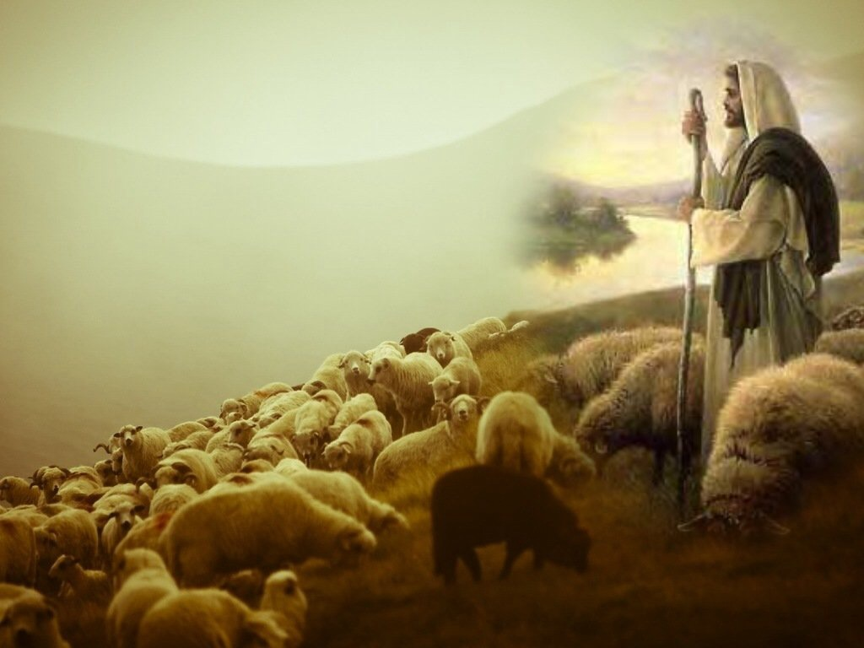
肯定受苦之人，帮助他们在基督里成长。
帖撒罗尼迦后书 1:1-4 的核心思想
Notes:
Encourge others to grow!
鼓励他人成长！

Slide 62
5这正是 神公义判断的明证，叫你们可算配得 神的国；你们就是为这国受苦。 6 神既是公义的，就必将患难报应那加患难给你们的人， (帖后1:5-6 和合本).
Notes:
God will reward the church’s perseverance during affliction but punish their persecutors by helping the church become mature (1:3-12).
神将在患难中奖赏教会的坚忍，并惩罚他们的逼迫者，同时借此使教会更加成熟（帖撒罗尼迦后书 1:3-12）。

Slide 63
7也必使你们这受患难的人与我们同得平安。那时，主耶稣同他有能力的天使从天上在火焰中显现， 8要报应那不认识 神和那不听从我主耶稣福音的人。 (帖后 1:7-8 和合本).

Slide 64
9他们要受刑罚，就是永远沉沦，离开主的面和他权能的荣光。 10这正是主降临、要在他圣徒的身上得荣耀、又在一切信的人身上显为希奇的那日子。我们对你们作的见证，你们也信了。 (帖后 1:9-10 和合本).

Slide 65
11因此，我们常为你们祷告，愿我们的 神看你们配得过所蒙的召，又用大能成就你们一切所羡慕的良善和一切因信心所做的工夫，
帖后 1:11

Slide 66
12叫我们主耶稣的名在你们身上得荣耀，你们也在他身上得荣耀，都照着我们的 神并主耶稣基督的恩。
帖后 1:12

Slide 67
在患难中坚持，会带来成熟。
——查尔斯·R·史云道（Charles R. Swindoll），
《坚定的基督信仰》（Steadfast Christianity），第 3 页

Slide 68
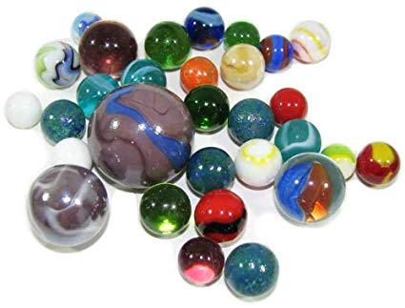
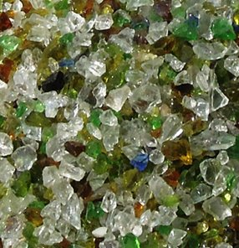
“玻璃弹珠还是葡萄？
Notes:
We decide how difficulties will change us. Do you agree? In his book No Greater Power, Richard C. Halverson, past chaplain of the US Senate, wrote:
“Crush marbles and you get fragmentation, disintegration—hard, sharp pieces. You can get hurt if you’re not careful.
Crush grapes and you get fragrant, refreshing wine.
Some people relate like marbles. The fear of vulnerability hardens them. They protect themselves, allow no one to penetrate. Being vulnerable is high-risk, and they want low-risk. They bump against others and ricochet around, never enjoying a vital relationship. In brittle lovelessness, they shatter when crushed, and hurt others.
Some people relate like grapes. They yield to pressure. They accept their weakness as essential to intimacy. They give love, knowing love is always vulnerable, knowing love is the heart and soul of our faith. When crushed, they bring blessing: fragrant, redemptive blessing.”
Difficulties certainly come our way for every one of us.
But how do you respond to these trials? Are you like a marble or like a grape? In either case, we get crushed, but marbles resist it while grapes welcome the benefits.
Are you angry at God for allowing difficulty into your life? Or do you see him affirming you?
Richard C. Halverson, No Greater Power (Portland, OR: Multnomah, 1986), 67; cited in Charles R. Swindoll, Steadfast Christianity: A Study of Second Thessalonians (Fullerton, CA: Insight for Living, 1986), 1.
我们决定困难如何改变我们。你同意吗？
在他的书《无上大能》（No Greater Power）中，美国参议院前牧师理查德·C·哈尔弗森（Richard C. Halverson）写道：
“压碎玻璃弹珠，你会得到碎片和分裂——又硬又尖的碎片。如果不小心，你可能会受伤。 压碎葡萄，你会得到芬芳、清新的酒。 有些人与人交往就像玻璃弹珠。他们害怕脆弱，因此让自己变得坚硬。他们保护自己，不允许任何人深入他们的内心。变得脆弱意味着高风险，而他们想要低风险。他们在人际关系中互相碰撞、弹开，从未享受过真正的关系。在这脆弱而无爱的状态中，当他们被压碎时，就会破裂，并伤害他人。 有些人与人交往则像葡萄。他们顺应压力，接受自己的软弱，并视之为亲密关系不可或缺的一部分。他们愿意付出爱，明白爱总是意味着脆弱，也明白爱是我们信仰的核心。当他们被压碎时，他们带来祝福——芬芳、救赎的祝福。”
困难无疑会临到我们每一个人。
但你会如何回应这些试炼呢？你是像玻璃弹珠，还是像葡萄？无论如何，我们都会经历被压碎的过程，但玻璃弹珠抗拒，而葡萄则欢迎其中的益处。
你是否因生活中的困难而对神愤怒？还是你看到神在其中对你的肯定？
——理查德·C·哈尔弗森，《无上大能》（No Greater Power）（波特兰，俄勒冈州：Multnomah出版社，1986年），第67页；引自查尔斯·R·斯温多尔（Charles R. Swindoll），《坚定的基督信仰：帖撒罗尼迦后书研读》（Steadfast Christianity: A Study of Second Thessalonians）（加州富勒顿：Insight for Living出版社，1986年），第1页。

Slide 69
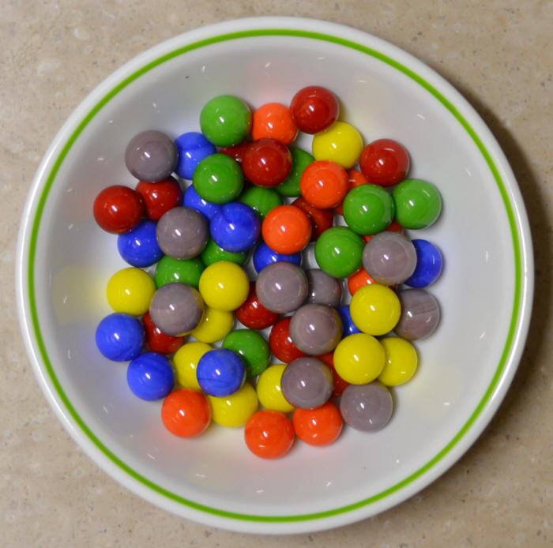
我的防卫心
Notes:
I have needed affirmation to overcome my own weakness of defensiveness.
As I have recently reflected on my early years as a Christian teenager, I recall one particular weakness. When someone expressed a concern about me, I reacted with defensiveness. This was a problem I had in my early years of marriage too. Susan would observe a weakness in me and I would defend myself as if she was attacking me.
After further consideration and prayer about this, I realized that it went back to my teenage years. My mother married a third time when I was age 13, and my step-father would point out a deficiency in me rather roughly. He had a horrible relationship with his own father—so much that he called him by his first name rather than “Dad” or “Father”—and he lacked an ability to gently tell me how to better sweep the floor or wash the dishes or whatever. I constantly felt attacked, even though that wasn’t his intention.
So I developed this defensive attitude in my other relationships too. I suspect I felt that way about God as well.
God really changed me, though. At least I think he did! I guess you can be the judge whether I defend myself right now. I think he has given me an ability to respond rather than react, to persevere in a way that helps me grow in maturity.
我需要别人的肯定，来克服自己防卫心的弱点。
最近，当我回顾自己青少年时期刚成为基督徒的日子时，我意识到自己有一个特别的弱点。每当有人对我提出关心或建议时，我的第一反应就是防卫。这种问题甚至延续到了我早期的婚姻生活。当苏珊指出我的某个缺点时，我会立刻为自己辩护，仿佛她是在攻击我。
经过进一步的思考和祷告，我发现这个问题可以追溯到我的青少年时期。我母亲在我 13 岁时第三次结婚，而我的继父常常用粗暴的方式指出我的缺点。他与自己的父亲关系极差，以至于从不称他为“爸爸”或“父亲”，而是直呼其名。他不会温和地告诉我如何更好地扫地或洗碗，而是直接批评我，让我感到不断受到攻击，尽管这并非他的本意。
于是，我在与他人的关系中也逐渐形成了这种防卫的态度。我甚至怀疑，我对待神的态度也是如此。
然而，神真正改变了我，至少我觉得是这样！当然，你们也可以来判断我现在是否还在为自己辩护。我相信，神赐给了我一种能力，让我能回应而不是单纯地反应，让我能坚持下去，并在这过程中成长为更加成熟的人。

Slide 70
神怎么在困难中肯定我们？

Slide 71
（一）情绪：神赐毅力以让我们成熟 （帖撒罗尼迦后书 第1章）
Notes:
The Lord helps us not to lose heart so we will grow.]
主帮助我们不丧胆，使我们得以成长。

Slide 72
Slides on 帖撒罗尼迦后 2

Slide 73
神如何肯定我 们
情绪
1
神学
2
Notes:
Restated: He is not incomplete or piecemeal in his ministry to us.
• He touches the heart (emotionally),
• the mind (theologically),
• and the hands (practically).
换句话说，祂对我们的事工是完整的、无缺的。
• 祂触动我们的心（情感上），
• 祂启迪我们的思维（神学上），
• 祂引导我们的手（实践上）。

Slide 74
（二）神学：神赐真理以带给我们稳定 （帖撒罗尼迦后书 第2章）
Notes:
Theology matters! The Lord corrects our misconceptions to give us firm footing.

Slide 75
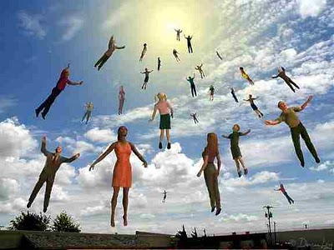
弟兄们，论到我们主耶稣基督降临和我们到他那里聚集， (帖后 2:1 ).

Slide 76
关键节
211
“无论有灵、有话、有冒我们的名的书信，说主的日子现在到了，你们都不要轻易动心，也不要惊慌。 3 不要让人用任何方法迷惑了你们，因为主的日子来到以前，必定有背道的事，并且那不法的人，就是那沉沦之子，必定显露出来” (贴后2:2-3).
帖撒罗尼迦后书

Slide 77
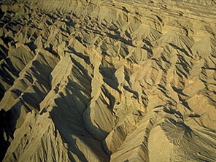
判定
Judgement！
216
followed by…
跟后是。。。
Notes:
Judgment! followed by…

Slide 78
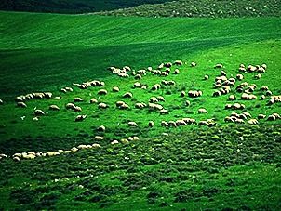
祝福!
216

Slide 79
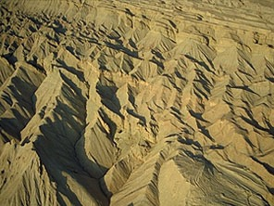
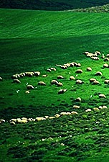
上帝的日子
216
审判
+
祝福
灾难
千年
启示 6–19
启示 20
7 年
1000 年

Slide 80
一个时代论“时间轴”
437
欢天喜地
第二次降临 （撒迦利亚书14:3-5）
大白 宝座 （启示录20:11-14)
教会时代
苦难 （撒迦利亚书14:1-2）
千年 （撒迦利亚书14:6-21）
歌革和玛（世界末日）
（以西结书38-39）
歌革和玛再访
(启示录20:7-10)
Notes:
80

Slide 81
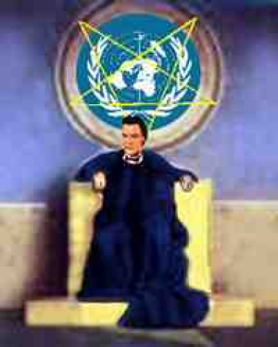
Antichrist Sets Up Image for Worship (贴后 2:3-4 CNVS)
80 I
为了被崇拜，敌基督自己设置崇拜i象式
(贴后 2:3-4 CNVS)
"不要让人用任何方法迷惑了你们，因为主的日子来到以前，必定有背道的事，并且那不法的人，就是那沉沦之子，必定显露出来。 4 他抵挡 神，抬举自己，高过一切称为神或受人敬拜的，甚至坐在 神的殿中，自称为 神。"

Slide 82
"That day will not come until…" (2:3a)
213
“因为主的日子来到以前。。。” (2:3a)
1. "the rebellion (apostasy) occurs" (3b)
1. “必定有背道的事” （3b)
= Christendom is completely apostate
= 基督教世界会完全背道的
2. "the man of lawlessness is revealed" (3c)
2. “并且那不法的人”(3c)
= Antichrist signs covenant with Israel (Dan. 9:27)
= 基督的敌人和以色列坚立盟约 (但以里书 9:27)
3. "the one who now holds [lawlessness] back will be taken out of the way" (7b)
3. “只是现在有一个箝制他的在那里，直等到那箝制解除了”
= restraining influence of the Holy Spirit in the Church is taken to heaven
= 圣灵克制教会的势力会被带到天堂

Slide 83
我还在你们那里的时候，曾把这些事告诉你们，你们不记得吗？ 6现在你们也知道，那拦阻他的是什么，是叫他到了的时候才可以显露。 7因为那不法的隐意已经发动，只是现在有一个拦阻的，等到那拦阻的被除去， 8那时这不法的人必显露出来。主耶稣要用口中的气灭绝他，用降临的荣光废掉他。 (帖后 2:5-8 ).

Slide 84
The Restrainer
209
限制者
圣灵通过教会克制邪恶将会不在。
(帖撒罗尼迦后书 2：6-7
⁶ 现在你们也知道，那箝制他，使他到了时候才可以显露出来的是甚么。 ⁷ 因为那不法的潜力已经发动，只是现在有一个钳制他的有在那里，直等到那箝制解除了， (CNVS).
to. kate,con (“那箝制他” = 中性, 2:6 = 福音传道)
to. kate,con ("what restrains" = neuter, 2:6 = gospel preaching)
o` kate,cwn (“有一个钳制他的” = 阳性, 2:7 = 一个人)
o` kate,cwn ("he who restrains" = masculine, 2:7 = a person)
pnue/ma (“圣灵” =中性 ，但是用于一个人)
pnue/ma ("Spirit" = neuter noun but used of a person)

Slide 85
耶和华的日子
帖撒罗尼迦后书 2:3-7 在主的日子之前的先决条件 （有3件）:
213
1
天堂的审判席位 哥林多后书5:10; 哥林多前书3:10-15
3 阻止者 (2:7b)
1
3 Restrainer (2:7b)
2
1 叛教 (2:3b)
2
1 Apostasy (2:3b)
2 基督的敌人 (2:3c)
2 Antichrist (2:3c)
3
1
The Day of the Lord
3
第二来临 启示录 19:11-21
Second Coming Rev. 19:11-21
被提 帖撒罗尼迦前书4:13-18
大灾难
千年
永恒
Rapture 1 Thess. 4:13-18
Eternal state
3
1000 年.
(Daniel‘s 70th week)
Matt 24:21
(长期的)
69 周 (但以里书9:24-27)
教会时代 马太福音 16:18 使徒行传 2:1-4
2
3½
3½
启示录20:4-6
(Timeless)
69 Weeks (Dan. 9:24-27)
Church Age Matt. 16:18 Acts 2:1-4
7年
(但以理的第70周) 马太福音 24:21
Matt. 27:50
马太福音27:50
短暂的准备时期; 基督的敌人的崛起 （时间长短未知）
《预言》 (达拉斯神学院视频系列， 1980s)
"Prophecy" (Dallas Seminary video series, 1980s)
Short Period of Preparation; Rise of the Antichrist (length of time unknown)

Slide 86
第七十“礼拜”的排列顺序
336
Adapted from J. Dwight Pentecost, Dallas Theological Seminary, 1988
人子的迹象 马太福音 24:30
基督的到来以完成
礼拜中
3½ 年
1290 天
但以理 12:11
30天
30 天
1260 天
45 天
启示录 11:3; 12:6
但以理 12:12
3½年
3½ 年
当选那兽 启示录 17:13
盟约 但以理 9:27a
违反盟约 但以理 9:27b
第二来临
最激烈的灾祸
灾祸

Slide 87
巨大的领导空虚
216a
A Huge Leadership Vacuum
困难时期总是会设置适合舞台， 好为独裁者提升到这种场合。
Difficult times always set the stage for dictators to rise to the occasion.

Slide 88
敌基督的不同名称
216a
79
Names for the Antichrist
Bloody & Deceitful Man (Ps 5:6)
凶残诡诈的(诗篇 5:6)
小角(但以理. 7:8)
Man of Sin
(2 Thess. 2:3)
沉沦之子
(帖后2：3)
Beast from the Sea (Rev. 13:1)
海中的兽(启示录. 13:1)
One Causing Desolation (但以理 9:27)
带来毁灭的 (但以理 9:27)

Slide 89
敌基督的行为
216a
79
The Activity of the Antichrist

Slide 90
第七十“礼拜”的排列顺序
336
Adapted from J. Dwight Pentecost, Dallas Theological Seminary, 1988
人子的迹象 马太福音 24:30
基督的到来以完成
礼拜中
3½ 年
1290 天
但以理 12:11
30天
30 天
1260 天
45 天
启示录 11:3; 12:6
但以理 12:12
3½年
3½ 年
当选那兽 启示录 17:13
盟约 但以理 9:27a
违反盟约 但以理 9:27b
第二来临
最激烈的灾祸
灾祸

Slide 91
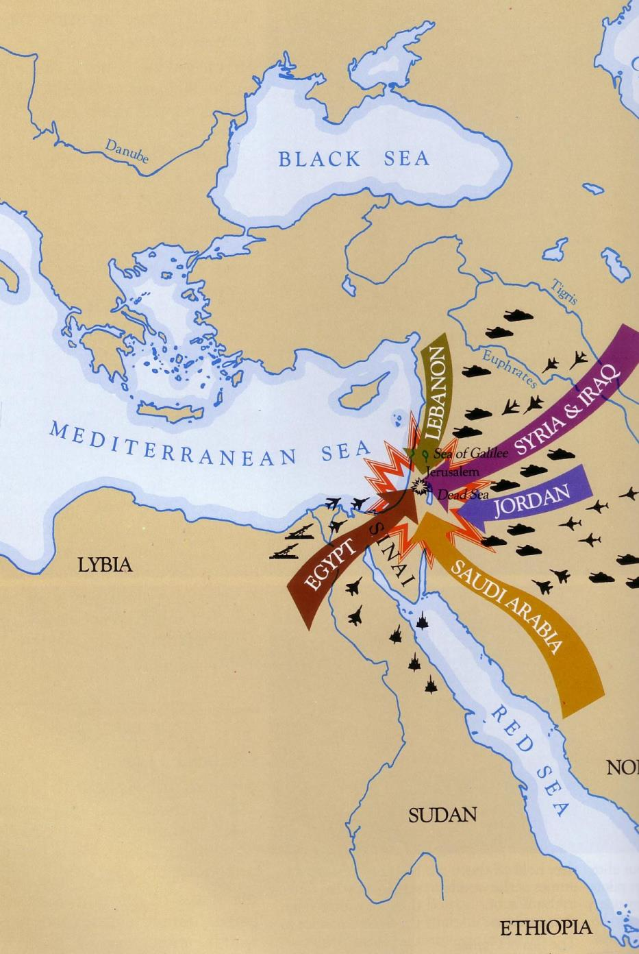
但以理书11:40
543
黑海
黎巴嫩
叙利亚和伊拉克
地中海
约旦
以色列的敌人们将侵袭她的领土
利比亚
埃及
沙特阿拉伯
红海
苏丹

Slide 92
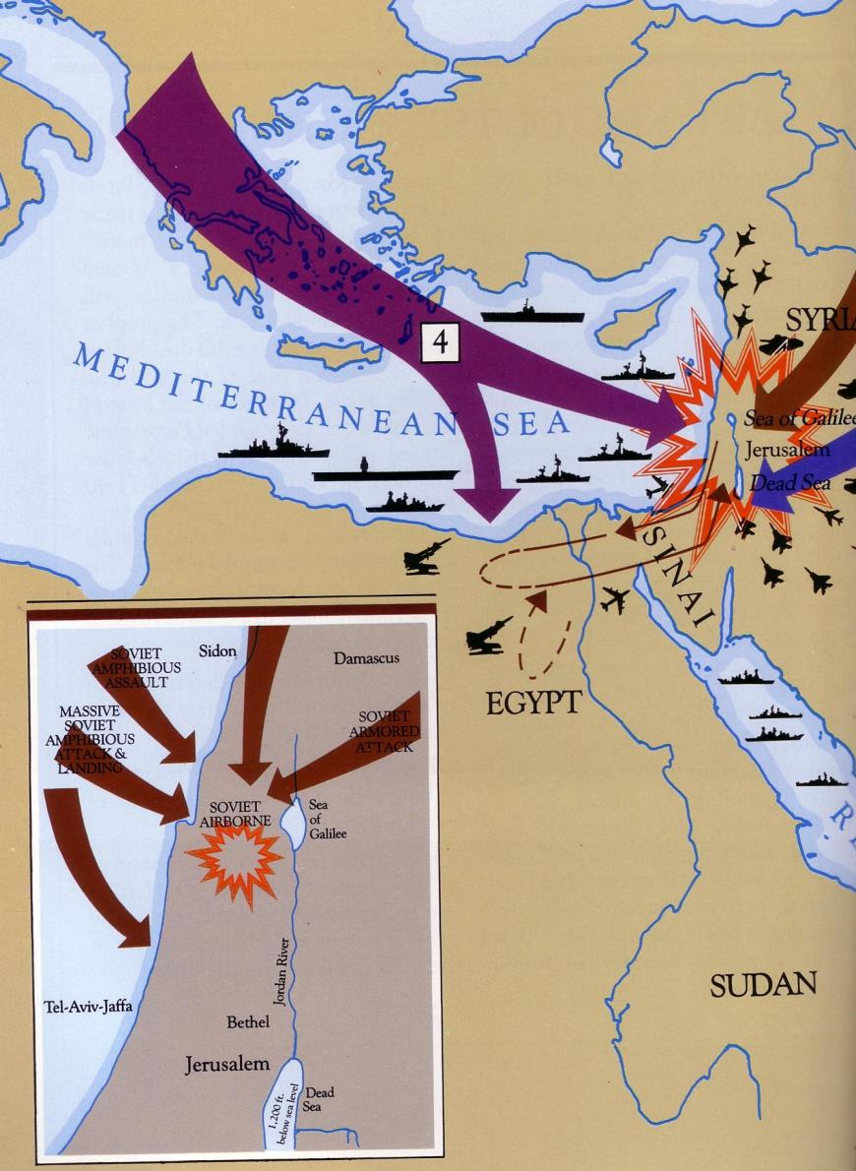
但以理书 11:40-45
543
地中海
西奈
在地中海的船只将有一场战役
俄罗斯水陆袭击
西顿
大马士革
大量俄罗斯人从水陆发起攻击和占领领土
埃及
俄罗斯水陆攻击
俄罗斯水陆
加利利海
约旦河
苏丹
伯利恒
耶路撒冷

Slide 93
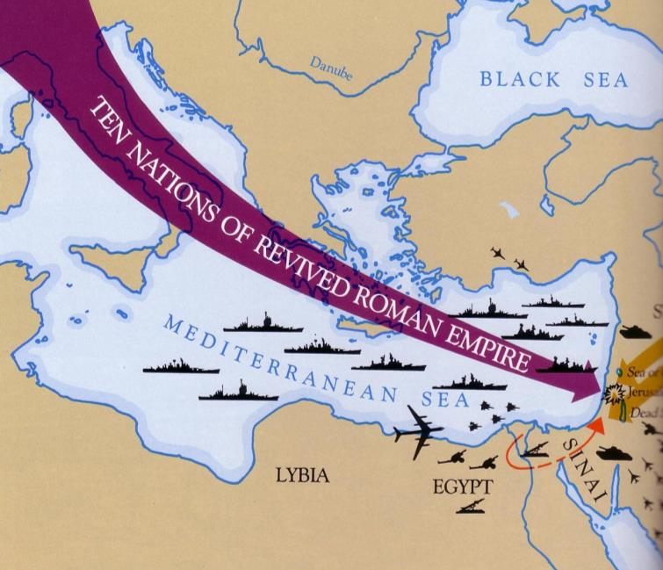
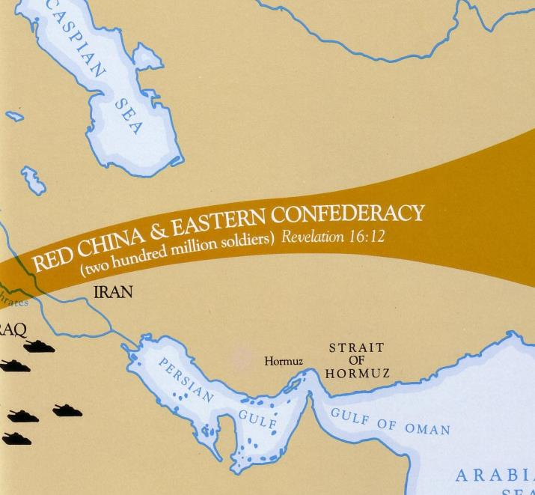
由东由西而来(但以理书11:44)
543
黑海
复兴的罗马帝国的十个国家
红色的中国和东方的
联盟
地中海
伊朗
霍尔木兹海峡
波斯湾
西奈
利比亚
埃及

Slide 94
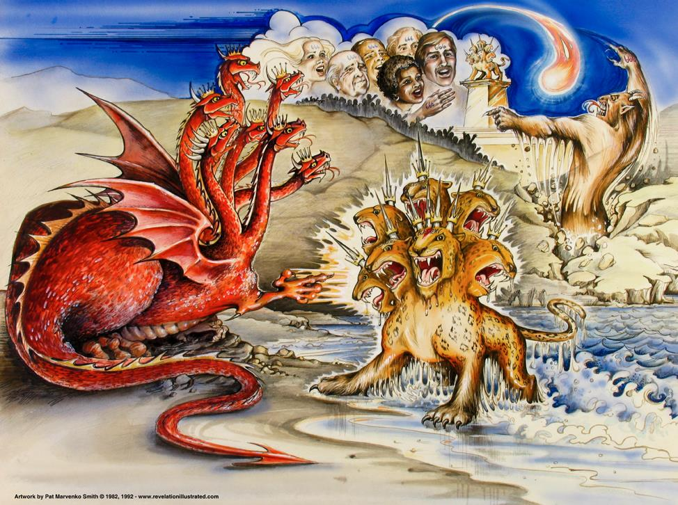
启 示 录 13 章 的 兽
龙 = 撒但
陸野兽 = 假先知
海野兽 = 敌基督
Used with permission
Notes:
Slides needing translation as of 12 Sep 2013: slides 90-91, 146

Slide 95
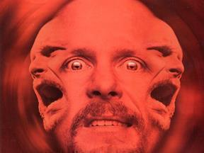
撒旦的三位一体”
“父亲”= 撒旦
“儿子”=
敌基督
“灵”=
假先知

Slide 96
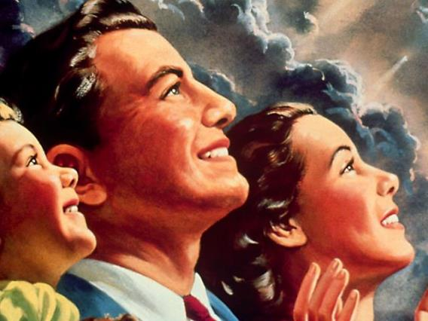
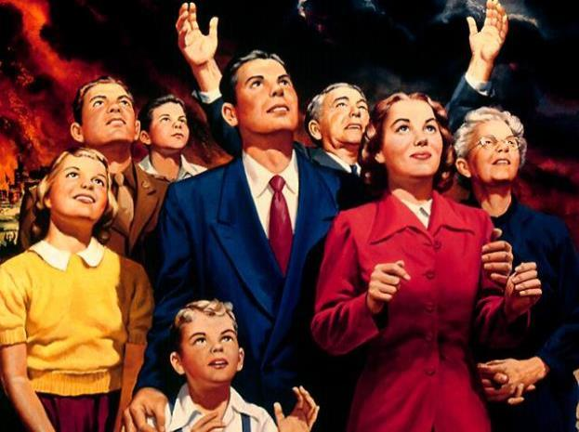
世界将拜兽

Slide 97
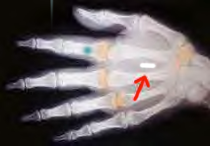
右手中的 印记
它 又 叫 众 人 ， 无 论 大 小 贫 富 ， 自 主 的 ， 为 奴 的 ， 都 在 右 手 上 ， 或 是 在 额 上 ， 受 一 个 印 记 。 ¹⁷除 了 那 受 印 记 ， 有 了 兽 名 ， 或 有 兽 名 数 目 的 ， 都 不 得 作 买 卖 。
启示录13:16, 17

Slide 98
13主所爱的弟兄们哪，我们本该常为你们感谢 神；因为他从起初拣选了你们，叫你们因信真道，又被圣灵感动，成为圣洁，能以得救。 14 神藉我们所传的福音召你们到这地步，好得着我们主耶稣基督的荣光。 （ 帖后 2:13-14 ).

Slide 99
15所以，弟兄们，你们要站立得稳，凡所领受的教训，不拘是我们口传的，是信上写的，都要坚守。 16但愿我们主耶稣基督和那爱我们、开恩将永远的安慰并美好的盼望赐给我们的父 神， 17安慰你们的心，并且在一切善行善言上坚固你们。 (帖后 2:15-17 ).

Slide 100
在混乱中信靠主会带来稳定。
——查尔斯·R·史云道（Charles R. Swindoll），
《坚定的基督信仰》（Steadfast Christianity），第 3 页
Notes:
There is an immense amount of theological confusion spouted all over today. The rise of the Internet has allowed YouTube and other avenues to spread heresies. It seems that the more hits or likes, the more bizarre and damaging the teaching. My own YouTube video has just a few hundred views, but the insane stuff has millions of views!
How can we keep trusting the Lord amidst such craziness?
Keep going back to the source—the Word of God.
How are you doing at your goal of reading the Bible each day this year?
如今到处充斥着大量的神学混乱。互联网的兴起使得YouTube和其他平台传播异端邪说。似乎点击量或点赞数越高，教导就越荒谬和有害。我的YouTube视频只有几百次观看，而那些疯狂的内容却有几百万次观看！
在如此疯狂的环境中，我们如何继续信靠主呢？
不断回到源头——神的话语。
你今年每天读圣经的目标进展如何？

Slide 101
神怎么在困难中肯定我们？

Slide 102
（一）情绪：神赐毅力以让我们成熟 （帖撒罗尼迦后书 第1章）
Notes:
The Lord helps us not to lose heart so we will grow.]
主帮助我们不灰心丧志，使我们得以成长。

Slide 103
（二）神学：神赐真理以带给我们稳定 （帖撒罗尼迦后书 第2章）
Notes:
Theology matters! The Lord corrects our misconceptions to give us firm footing.
神学很重要！主纠正我们的误解，为我们奠定坚实的基础。

Slide 104
Slides on 帖撒罗尼迦后 3

Slide 105
神如何肯定我 们
情绪
1
神学
2
实践
3
Notes:
Restated: He is not incomplete or piecemeal in his ministry to us.
• He touches the heart (emotionally),
• the mind (theologically),
• and the hands (practically).
换句话说，祂对我们的事工是完整的、无缺的。
• 祂触动我们的心（情感上），
• 祂启迪我们的思维（神学上），
• 祂引导我们的手（实践上）。

Slide 106
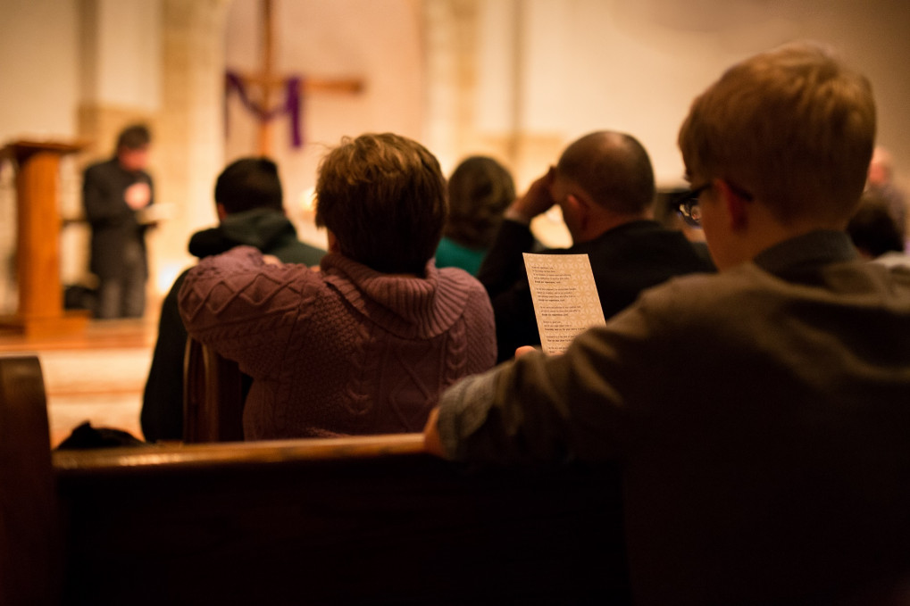
III. Practically: God cultivates discipline in us to build responsibility (2 Thess 3).
（三）实践：神让我们培养纪律以让我们训练出责任感 （帖撒罗尼迦后书 第3章）
Notes:
The Lord helps us hold one another accountable so we will be reliable.
• Rather than living an undisciplined life
• Each of us has had to show discipline to learn certain skills such as playing an instrument
• So we need that same type of discipline to know his Word
• And to be a vital part of his church.
主帮助我们彼此担当责任，使我们变得可靠。
• 我们不再过一种无纪律的生活，
• 我们每个人都需要展现出自律，学习某些技能，比如弹奏乐器，
• 同样，我们也需要这种自律来认识神的话语，
• 并且成为祂教会中一个重要的部分。

Slide 107
1弟兄们，我还有话说：请你们为我们祷告，好叫主的道理快快行开，得着荣耀，正如在你们中间一样， 2也叫我们脱离无理之恶人的手；因为人不都是有信心。 (帖后 3:1-2 ).

Slide 108
3但主是信实的，要坚固你们，保护你们脱离那恶者。 4我们靠主深信，你们现在是遵行我们所吩咐的，后来也必要遵行。 5愿主引导你们的心，叫你们爱 神，并学基督的忍耐！ (帖后 3:3-5 ).

Slide 109
6弟兄们，我们奉主耶稣基督的名吩咐你们，凡有弟兄不按规矩而行，不遵守从我们所受的教训，就当远离他。 7你们自己原知道应当怎样效法我们。因为我们在你们中间，未尝不按规矩而行， (帖后 3:6-7).

Slide 110
Discipline the idle (3:6-15)
教训游手好闲者 (3:6-15)
"…弟兄们，我们奉主耶稣基督的名吩咐你们，凡是游手好闲的弟兄，不按着你们从我们所领受的教训去行，就应当远离他。" (3:6 CNVS)

Slide 111
8也未尝白吃人的饭，倒是辛苦劳碌，昼夜做工，免得叫你们一人受累。 9这并不是因我们没有权柄，乃是要给你们作榜样，叫你们效法我们。 (帖后 3:8-9).

Slide 112
Discipline the idle (3:6-15)
教训游手好闲者 (3:6-15)
"…弟兄们，我们奉主耶稣基督的名吩咐你们，凡是游手好闲的弟兄，不按着你们从我们所领受的教训去行，就应当远离他。" (3:6 CNVS)
"我们在你们那里的时候，曾经吩咐过你们，如果有人不肯作工，就不可吃饭。" (3:10 CNVS)

Slide 113
11因我们听说，在你们中间有人不按规矩而行，什么工都不做，反倒专管闲事。 12我们靠主耶稣基督吩咐、劝戒这样的人，要安静做工，吃自己的饭。 13弟兄们，你们行善不可丧志。 (帖后 3:11-13).
因为我们听说，你们中间有人游手好闲，甚么工也不作，反倒专管闲事。
(帖后 3:11 新译本).

Slide 114
14若有人不听从我们这信上的话，要记下他，不和他交往，叫他自觉羞愧。 15但不要以他为仇人，要劝他如弟兄。 (帖后 3:14-15).

Slide 115
祝福
^{愿赐平安的主随时随事亲自给你们平安！愿主常与你们众人同在！}
帖后 3:16

Slide 116
17我－保罗亲笔问你们安。凡我的信都以此为记，我的笔迹就是这样。 18愿我们主耶稣基督的恩常与你们众人同在！ (帖后 3:17-18).

Slide 117
有纪律的等待培养责任感。
——查尔斯·R·史云道（Charles R. Swindoll），
《坚定的基督信仰》（Steadfast Christianity），第 3 页
Notes:
Hard-working Singapore weeds out lazy people. There is no unemployment insurance here that people can take advantage of, and there is no welfare program that can make people dependent.
However, occasionally we still have people go from church to church to try to get money out of each congregation. Like other churches, we try to have a balanced view where we help people in need—but we also expect our people to work for a living.
Would you say you are a disciplined person?
Do you discipline your time? Or do you waste time?
Do you serve others or spend most of your time on yourself?
The general rule in this passage is Paul’s maxim: “Those unwilling to work will not get to eat” (3:10 NLT).
努力工作的新加坡淘汰懒惰的人。这里没有可以利用的失业保险，也没有可以让人依赖的福利项目。
然而，偶尔我们还是会看到有人在不同的教会之间游走，试图从每个教会那里索取钱财。和其他教会一样，我们尽量保持平衡的观点，帮助有需要的人——但我们也期望我们的信徒要靠自己的劳动谋生。
你会说自己是一个有纪律的人吗？
你是否管理好自己的时间？还是你浪费时间？
你是否为他人服务，还是大部分时间都花在自己身上？
这段经文中的普遍原则是保罗的名言：“不肯做工的，就不可吃饭。”（3:10 新译本）

Slide 118
神怎么在困难中肯定我们？

Slide 119
神是全方面的肯定我们。 (帖撒罗尼迦后书 的主题)
神如何肯定我 们
情绪
1
神学
2
实践
3
Notes:
Restated: He is not incomplete or piecemeal in his ministry to us.
• He touches the heart (emotionally),
• the mind (theologically),
• and the hands (practically).
换句话说，祂对我们的事工是完整的、无缺的。
• 祂触动我们的心（情感上），
• 祂启迪我们的思维（神学上），
• 祂引导我们的手（实践上）。

Slide 120
（一）情绪：神赐毅力以让我们成熟 （帖撒罗尼迦后书 第1章）
Notes:
The Lord helps us not to lose heart so we will grow.]
主帮助我们不丧胆，使我们得以成长。

Slide 121
（二）神学：神赐真理以带给我们稳定 （帖撒罗尼迦后书 第2章）
Notes:
Theology matters! The Lord corrects our misconceptions to give us firm footing.
神学很重要！主纠正我们的误解，为我们奠定坚实的基础。

Slide 122
III. Practically: God cultivates discipline in us to build responsibility (2 Thess 3).
（三）实践：神让我们培养纪律以让我们训练出责任感 （帖撒罗尼迦后书 第3章）
Notes:
The Lord helps us hold one another accountable so we will be reliable.
• Rather than living an undisciplined life
• Each of us has had to show discipline to learn certain skills such as playing an instrument
• So we need that same type of discipline to know his Word
• And to be a vital part of his church.
主帮助我们彼此担当责任，使我们变得可靠。
• 我们不再过一种无纪律的生活，
• 我们每个人都需要展现出自律，学习某些技能，比如弹奏乐器，
• 同样，我们也需要这种自律来认识神的话语，
• 并且成为祂教会中一个重要的部分。

Slide 123
肯定的话语

Slide 124
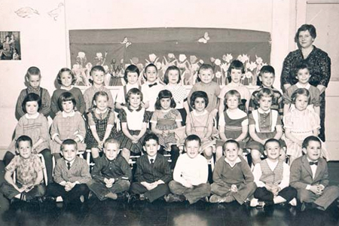
莫罗斯拉修女的三年级班 明尼苏达州莫里斯的圣玛丽学校
Notes:
A Catholic nun named Sister Helen P. Mrosla relates this story about affirmation…
He was in the first third grade class I taught at Saint Mary's School in Morris, Minn. All 34 of my students were dear to me, but Mark Eklund was one in a million. Very neat in appearance, but had that happy-to-be-alive attitude that made even his occasional mischievousness delightful.
___________
Nun's Lesson is Still Viral Decades Later
This story originally appeared in Proteus, A Journal of Ideas, published by Shippensburg University in Pennsylvania. Printed twice a year, each edition of Proteus is devoted to a theme and all its aspects from a number of viewpoints.
In 1991, Sister Helen Mrosla, a former third-grade teacher at our St. Mary's School, responded to the journal's request for stories about education. She submitted the text below. Later that year, Reader's Digest reprinted her submission. About a decade later, the story became a popular email chain letter, which tainted its authenticity. Chain letters are often understood to be hoaxes.
Today, however, this sweet letter has regained its authenticity and is used throughout the world to inspire educators and build students' self-esteem. It's since been republished thousands of times over.
http://assumptionofmorris.org/site/about/ourviralnun/
Accessed 6 Nov 2016
一位名叫海伦·P·莫罗斯拉修女的天主教修女讲述了这个关于肯定的故事……
他是我在明尼苏达州莫里斯圣玛丽学校教的第一届三年级班的学生。我的34个学生每一个我都很喜爱，但马克·艾克伦德是万中无一的。他外表整洁，但有着那种“活着真好”的态度，甚至偶尔的顽皮行为也让人觉得可爱。
修女的教训几十年后依然传播广泛
这个故事最初出现在《Proteus: A Journal of Ideas》杂志上，这本杂志由宾夕法尼亚州Shippensburg大学出版。每年出版两次，每期都会围绕一个主题，探讨从不同角度的各种相关内容。
1991年，海伦·莫罗斯拉修女，一位曾在圣玛丽学校担任三年级教师的人，回应了杂志关于教育故事的请求，并提交了下面的文字。该文后来被《读者文摘》转载。大约十年后，这个故事成为了一封流行的电子邮件连锁信，这影响了它的真实性，因为连锁信常常被认为是骗局。
然而，今天，这封温暖的信件恢复了其真实性，并在全球范围内用来激励教育工作者并提升学生的自尊心。此后，它已被再版数千次。
http://assumptionofmorris.org/site/about/ourviralnun/
访问时间：2016年11月6日

Slide 125
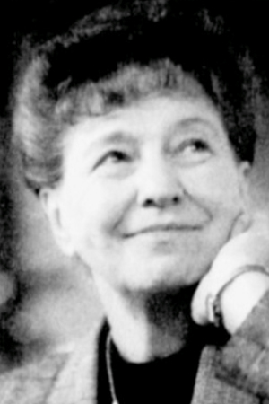
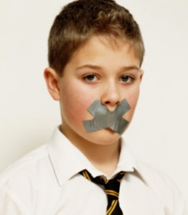
Helen P. Mrosla海伦莫罗斯拉修女
Mark Eklund
马克·艾克伦德
Notes:
Mark talked incessantly. I had to remind him again and again that talking without permission was not acceptable. What impressed me so much, though, was his sincere response every time I had to correct him for misbehaving: "Thank you for correcting me, Sister!" I didn't know what to make of it at first, but before long I became accustomed to hearing it many times a day.
One morning my patience was growing thin when Mark talked once too often, and then I made a novice teacher's mistake. I looked at him and said, "If you say one more word, I am going to tape your mouth shut!"
It wasn't ten seconds later when Chuck blurted out, "Mark is talking again." I hadn't asked any of the students to help me watch Mark, but since I had stated the punishment in front of the class, I had to act on it.
• I remember the scene as if it had occurred this morning. I walked to my desk, very deliberately opened my drawer and took out a roll of masking tape. Without saying a word, I proceeded to Mark's desk, tore off two pieces of tape and made a big X with them over his mouth. I then returned to the front of the room. As I glanced at Mark to see how he was doing, he winked at me. That did it! I started laughing. The class cheered as I walked back to Mark's desk, removed the tape and shrugged my shoulders. His first words were, "Thank you for correcting me, Sister." At the end of the year I was asked to teach junior high math. The years flew by, and before I knew it Mark was in my classroom again. He was more handsome than ever and just as polite. Since he had to listen carefully to my instructions in the "new math," he did not talk as much in ninth grade as he had in the third.
One Friday, things just didn't feel right. We had worked hard on a new concept all week, and I sensed that the students were frowning, frustrated with themselves — and edgy with one another. I had to stop this crankiness before it got out of hand. So I asked them to list the names of the other students in the room on two sheets of paper, leaving a space between each name. Then I told them to think of the nicest thing they could say about each of their classmates and write it down. It took the remainder of the class period to finish the assignment, and as the students left the room, each one handed me the papers. Charlie smiled. Mark said, "Thank you for teaching me, Sister. Have a good weekend."
That Saturday, I wrote down the name of each student on a separate sheet of paper, and I listed what everyone else had said about that individual. On Monday I gave each student his or her list. Before long, the entire class was smiling. "Really?" I heard whispered. "I never knew that meant anything to anyone!" "I didn't know others liked me so much!" No one ever mentioned those papers in class again. I never knew if they discussed them after class or with their parents, but it didn't matter. The exercise had accomplished its purpose. The students were happy with themselves and one another again.
That group of students moved on. Several years later, after I returned from vacation, my parents met me at the airport. As we were driving home, Mother asked me the usual questions about the trip — the weather, my experiences in general. There was a light lull in the conversation. Mother gave Dad a sideways glance and simply said, "Dad?"
My father cleared his throat as he usually did before something important. "The Eklunds called last night," he began.
"Really?" I said. "I haven't heard from them in years. I wonder how Mark is."
____
Credit: Sister Helen P. Mrosla. Sister Helen Mrosla, a Franciscan nun, submitted "All the Good Things" to Proteus, A Journal of Ideas in 1991. Her article also appeared in Reader's Digest that same year, was reprinted in the original Chicken Soup for the Soul book in 1993, and was offered yet again in 1996's Stories for the Heart.
All The Good Things
Helen P. Mrosla
http://mylifeyoga.com/2015/01/10/all-the-good-things/
Accessed 6 Nov 2016
马克总是喋喋不休。我不得不一遍又一遍地提醒他，没有许可的情况下不能讲话。然而，让我印象深刻的是，每当我纠正他不当行为时，他总是诚恳地回应：“谢谢你纠正我，修女！”刚开始我不知道该怎么理解这一点，但不久后，我习惯了一天听到好几次这样的回应。
有一天早晨，我的耐心快要耗尽了，因为马克又多说了一次话，然后我犯了一个新教师的错误。我看着他说：“如果你再说一句话，我就用胶带把你的嘴封起来！”
不到十秒钟，查克突然大声说：“马克又在说话。”我并没有要求学生帮我看管马克，但既然我在全班面前宣布了惩罚，我就不得不执行。
我记得那个场景，就像今天早晨发生的一样。我走到我的桌子旁，故意打开抽屉，拿出一卷胶带。我没有说一句话，走到马克的桌子前，撕下两片胶带，把它们交叉贴在他的嘴巴上。然后，我走回教室前面。当我回头看马克，想看看他怎么样时，他眨了眨眼。那一刻我忍不住笑了。全班同学欢呼起来，我走回马克的桌子，撕下胶带，耸了耸肩。他的第一句话是：“谢谢你纠正我，修女。”
年末时，我被邀请教授初中数学。岁月飞逝，不久后我又在教室里见到了马克。他比以前更英俊了，而且依旧彬彬有礼。由于他必须认真听我讲解“新数学”概念，他在九年级时不像三年级时那样多话了。
一个星期五，情况有些不对劲。我们整整一周都在努力学习一个新概念，我感觉学生们都皱着眉头，自己有些沮丧——彼此之间也有些紧张。我必须在事情失控之前阻止这种情绪蔓延。所以，我让他们在两张纸上列出班上其他同学的名字，每个名字之间留一空白。然后，我告诉他们，想一想他们能说出每个同学最好的优点，并写下来。剩下的课时都用来完成这个作业，当学生们离开教室时，每个人都把纸交给了我。查理笑了，马克说：“谢谢你教我，修女。周末愉快。”
那天星期六，我把每个学生的名字写在单独的纸上，列出其他同学对他们的评价。到了星期一，我把每个人的名单发给了他们。很快，整个班级都笑了起来。“真的吗？”我听到有人低声说，“我从没想到这些对别人有意义！”“我没想到别人这么喜欢我！”再也没有人在课堂上提到这些纸条。我不知道他们课后或与家人讨论过这些内容，但这无关紧要。这个活动达到了它的目的。学生们又开始对自己和彼此感到满意了。
那群学生毕业了。几年后，我度假回来，父母在机场接我。当我们开车回家时，妈妈像往常一样问我关于旅行的问题——天气如何，我的一般经历。车里一时安静下来。妈妈朝爸爸看了一眼，轻声说：“爸？”
爸爸像往常一样清了清喉咙，准备说点重要的话：“昨天，艾克伦德一家打电话来了。”
“真的？”我说，“我好多年没收到他们的消息了。我真想知道马克怎么样了。”
来源： 海伦·P·莫罗斯拉修女。海伦·P·莫罗斯拉修女是圣方济各会修女，她在1991年向《Proteus: A Journal of Ideas》杂志提交了《所有美好的事物》这篇文章。此文当年也在《读者文摘》上刊登，1993年被重新印刷在《心灵鸡汤》一书中，并在1996年的《故事与心灵》一书中再次出现。
所有美好的事物
海伦·P·莫罗斯拉
链接
访问日期：2016年11月6日

Slide 126
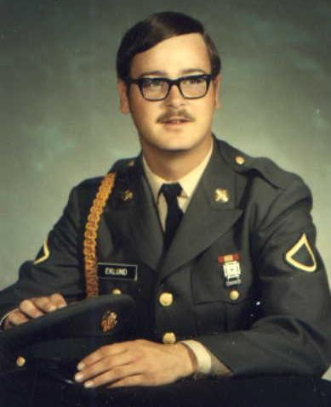
马克·艾克伦德（Mark Eklund ）
Notes:
Dad responded quietly. "Mark was killed in Vietnam," he said. "The funeral is tomorrow, and his parents would like if it you could attend." To this day I can still point to the exact spot on I-494 where Dad told me about Mark.
I had never seen a serviceman in a military coffin before. Mark looked so handsome, so mature. All I could think at that moment was, Mark, I would give all the masking tape in the world if only you would talk to me.
The church was packed with Mark's friends. Chuck's sister sang "The Battle Hymn of the Republic." Why did it have to rain on the day of the funeral? It was difficult enough at the graveside. The pastor said the usual prayers, and the bugler played taps. One by one those who loved Mark took a last walk by the coffin and sprinkled it with holy water. I was the last one to bless the coffin. As I stood there, one of the soldiers who had acted as pallbearer came up to me. "Were you Mark's math teacher?" he asked. I nodded as I continued to stare at the coffin. "Mark talked about you a lot," he said.
After the funeral, most of Mark's former classmates headed to Chuck's farmhouse for lunch. Mark's mother and father were there, obviously waiting for me. "We want to show you something," his father said, taking a wallet out of his pocket. "They found this on Mark when he was killed. We thought you might recognize it." Opening the billfold, he carefully removed two worn pieces of notebook paper that had obviously been taped, folded and refolded many times. I knew without looking that the papers were the ones on which I had listed all the good things each of Mark's classmates had said about him.
"Thank you so much for doing that," Mark's mother said. "As you can see, Mark treasured it."
Mark's classmates started to gather around us. Charlie smiled rather sheepishly and said, "I still have my list. It's in the top drawer of my desk at home." Chuck's wife said, "Chuck asked me to put his in our wedding album." "I have mine too," Marilyn said. "It's in my diary." Then Vicki, another classmate, reached into her pocketbook, took out her wallet and showed her worn and frazzled list to the group. "I carry this with me at all times," Vicki said without batting an eyelash. "I think we all saved our lists." That's when I finally sat down and cried. I cried for Mark and for all his friends who would never see him again.
_________
"A Morris native and St. Mary's alumni, Mark Eklund was killed in the Vietnam War. He was just 20 years old."
http://assumptionofmorris.org/site/about/ourviralnun/
爸爸低声回答道：“马克在越南战争中阵亡，”他说，“葬礼定在明天，他的父母希望你能出席。”直到今天，我仍能准确地指着I-494上的那个地方，那时爸爸告诉我马克的事。
我以前从未见过军人安葬在军用棺材里。马克看起来如此英俊、成熟。此刻我唯一能想到的就是，马克，如果你能和我说话，我愿意把全世界的胶带都给你。
教堂里挤满了马克的朋友。查克的妹妹唱了《共和国战歌》。为什么葬礼那天偏偏下雨呢？在墓地上已经够难受了。牧师念了通常的祷告，吹号手奏了《哀乐》。那些爱马克的人一个接一个地走到棺材旁，撒上圣水。我是最后一个为棺材祝福的人。当我站在那里时，一位曾担任抬棺人之一的士兵走了过来。“你是马克的数学老师吗？”他问。我点点头，继续盯着棺材。“马克常常提起你，”他说。
葬礼结束后，马克的大多数同学都去了查克的农场吃午饭。马克的父母也在那里，显然在等我。“我们想给你看看一些东西，”他爸爸说，拿出一个钱包。“他们在马克死时找到了这个，我们想你可能会认得它。”他小心地打开钱包，取出两张已经磨损的笔记纸，显然已经被反复折叠和贴合了。我不看也知道，那些纸就是我列出的，马克的同学们所说的所有好话。
“非常感谢你做了这件事，”马克的妈妈说。“如你所见，马克珍惜它。”
马克的同学们开始围过来。查理有些羞涩地笑了笑，说：“我还保存着我的名单，它在家里桌子的最上面一个抽屉里。”查克的妻子说：“查克让我把他的名单放进我们的结婚相册里。” “我也有，”玛丽莲说，“它在我的日记里。”然后，另一位同学维基从钱包里拿出她那张磨损褴褛的名单，展示给大家看。“我随时都带着它，”维基毫不犹豫地说，“我想我们大家都保存了我们的名单。”那时，我终于坐下哭了。我为马克和所有将永远无法再见到他的朋友们哭泣。
“马克·艾克伦德，来自莫里斯，是圣玛丽学校的校友，在越南战争中阵亡，享年仅20岁。”
链接

Slide 127
那你呢？
Notes:
The affirmation you give this week just might meet a specific need and inspire hope too.
Who needs your affirmation this week, today? Take some moments now to tell the Lord who you are going to encourage and how you're going to do it—
Take that person out for a meal?
Offer a helping hand?
Send a card or note?
Phone him or her to show that you care?
Make it simple—but most of all, make it genuine affirmation.
Maybe you need to receive affirmation today more than to give it.
Even if people fail to affirm you, God doesn’t.
He sent his own Son for you to affirm you—so tell him thanks!
If you need human affirmation, we are up here to talk afterwards.
你这周给予的肯定，可能正好满足某个特定的需求，并激发希望。
谁需要你这周，今天的肯定？花几分钟时间，现在告诉主你打算鼓励谁，以及你打算怎么做——
带那个人出去吃顿饭？
伸出援手？
寄张卡片或便条？
打个电话给他或她，表示你关心？
让它简单一点——但最重要的是，做出真诚的肯定。
也许今天你比给别人肯定，更需要得到肯定。
即使人们没有肯定你，神是不会忽视的。
祂差派祂自己的儿子来为你肯定——所以要感谢祂！
如果你需要人的肯定，我们稍后会在这里等你交流。

Slide 128
Black

Slide 129
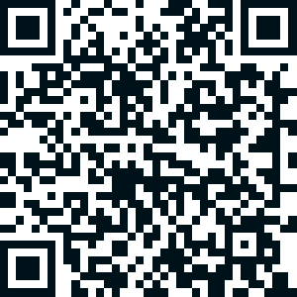
圣经阐释 • BibleStudyDownloads.org
免费获得该讲解!
圣经学习下载
你需要更好地了解圣经吗？谁不需要呢？BibleStudyDownloads （圣经学习下载）为神学生和教师们提供了从 创世纪 到 启示录的 30万份 可编辑的免费PowerPoint和Word文件。
本网站的大部分资料由Dr. Rick Griffith 博士设计，他从1991年到2021年在新加坡神学院教授圣经、神学和讲道学，现在是约旦福音神学院的圣经释经教授。
圣经学习下载
Notes:
BE Bible Exposition—Chinese

