Slide 1

作个关怀他人的人
约拿书
Dr. Rick Griffith, Crossroads International Church Singapore
BibleStudyDownloads.org

Slide 2

错失的机会
Notes:
In June 1991 a car in Singapore's East Coast area hit a 70-year-old Chinese man. The owner of the car was relieved to find a doctor at his clinic just a short distance away. When the doctor was begged to try to save the man's life, he replied that he was too busy, didn't have the right equipment, and needed the victim's approval or his family's approval before he would treat him. The doctor never tried to see the old man, who died five hours later.
1991年6月，新加坡东海岸地区发生一起车祸，一名70岁的华人男子被撞倒。车主发现附近不远处就有一间诊所，便松了口气。然而，当车主恳求医生抢救这名男子时，医生却回答说自己太忙了，设备不够齐全，而且在进行治疗前需要伤者本人或其家属的同意。医生从未尝试查看这位老人，老人最终在五小时后去世。

Slide 3
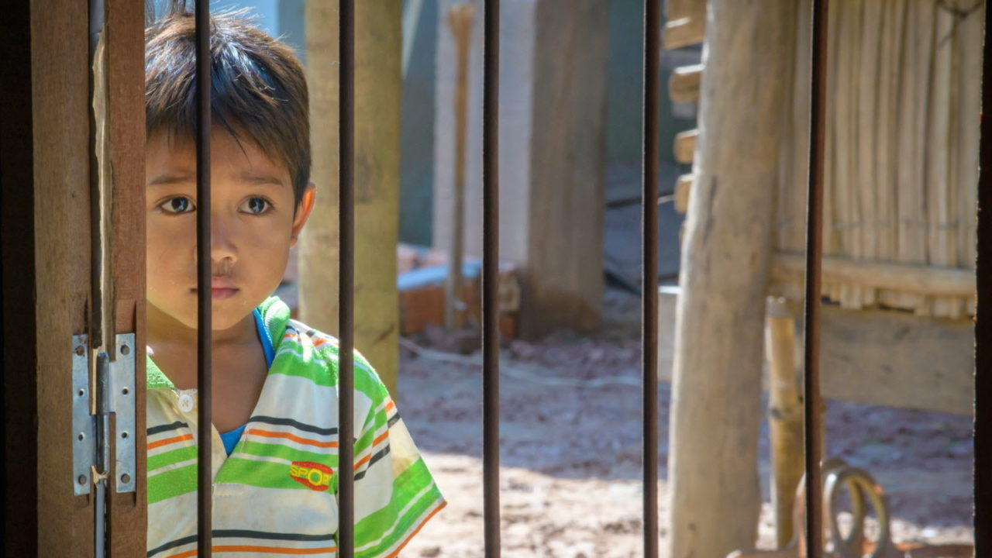
你关心其他人吗?
Notes:
I was shocked to read the account in the newspaper. How could anyone be so unfeeling—especially someone who has given himself to the "people's profession"? Would you have helped him? Do you care for people?
当我在报纸上读到这个事件时，我感到震惊。一个人怎么能如此冷漠无情——尤其是一个投身于“救人职业”的人？你会伸出援手吗？你关心他人吗？

Slide 4
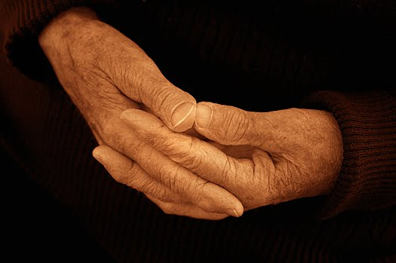
上帝如何让我们回应不悔改的人呢？
Notes:
上帝如何让我们回应不悔改的人呢？这样的事件太常见了。
事实上，今天我们将以同样无动于衷的态度看待圣经人物。
当我们这样做时，我相信上帝会用我们自己需要的四个原则来挑战我们，以彰显对他人的同情。

Slide 5
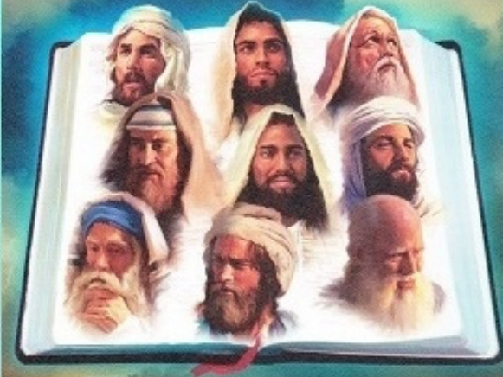
十二先知书
勇敢面对文化挑战
—小先知书系列讲道—
Notes:
Today we continue with part 2 of our series on the Minor Prophets that I'm calling simply "The Twelve."
今天，我们继续进行小先知系列的第二部分，我将这个系列简单地称为 “十二小先知”。

Slide 6
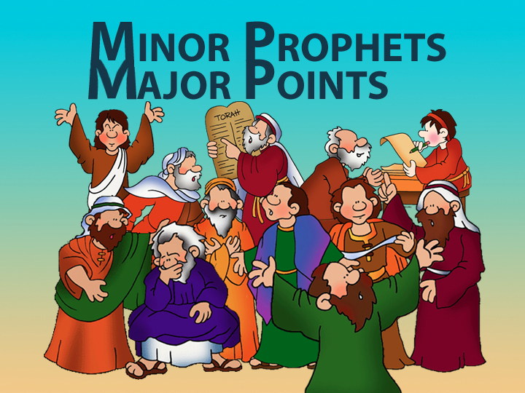
Minor Prophets—Major Points
小先知书 大重点

Slide 7

Title Slide
约拿

Slide 8
Unique Elements in 约拿书
600
约拿独特的元素
    约拿所讲的话完全是通过一个先知的经验—不是他的话。
    约拿是圣经中唯一的先知试图避开上帝。
    约拿书是在整个圣经里唯一记录以色列对希利尼国家的反应
    4. 约拿的历史真实存在被许多学者否认。
Notes:
8

Slide 9
“去！不！竭力划船！”
约拿书 1
上帝转变事件来向我们彰显祂对人的怜悯。
Notes:
主通过引起我们注意的事件来彰显他对人的关心

Slide 10
约拿书第一章: 去!
604
上帝命令他的人去告诉邪恶者，他是多么的痛恨他们的罪恶(1-2)

Slide 11
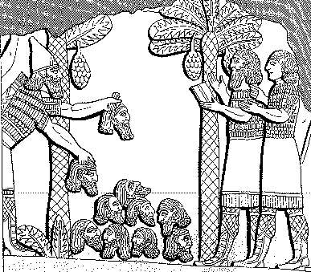
614
亚述的残暴
“我堆满如金字塔的人头在他的城市前面。我的火焰在燃烧他们的青少年和他们的姑娘.”
亚述王撒缦以色上，公元前859-824
= 约拿80年之前,
卢肯比尔，古代亚述和巴比伦记录1:213
Notes:
11

Slide 12
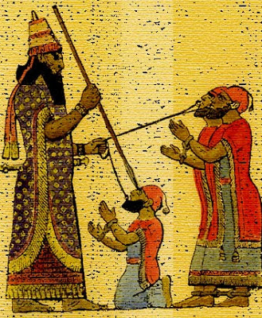
被俘王的待遇
614
"“亚述的处决可能涉及酷刑，例如剥皮……拔掉撒谎的舌头，烧灼，或……”
“我用我的锋利匕首刺入他的下巴。穿过他的下颚……我传了一条绳子，把一条狗链子套在他身上，并让他呆在狗舍里。”
——亚述王亚述巴尼拔，公元前669-626年，距约拿一百年，摘自**《亚述与巴比伦的古代记录》**第2:319页。

Slide 13
以撒哈顿的自豪骄傲(公元前660)
614
“我很强大，我是英雄，我很庞大，我很荣幸，我都全能了，我超于所有的国王，在亚述，纳布，并马尔杜克选择之一！”
卢肯比尔，古代亚述和巴比伦记录2:226

Slide 14
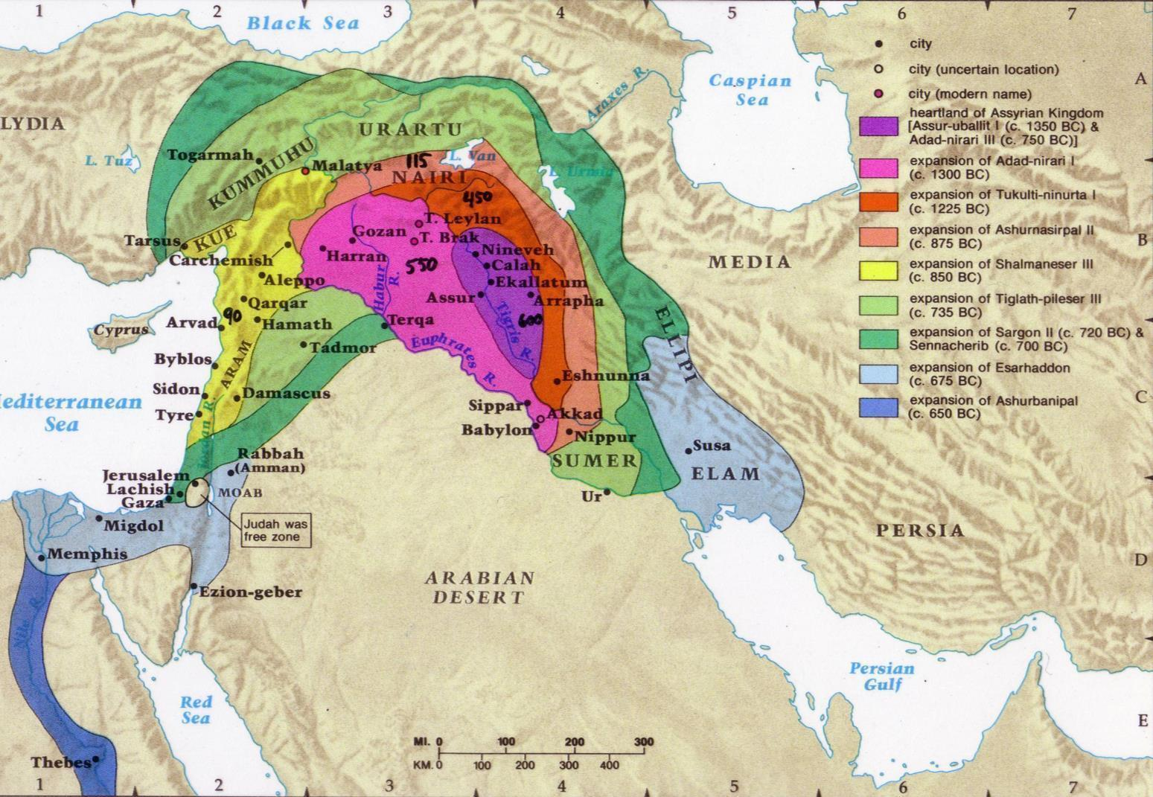
亚述的扩展
607
Notes:
14

Slide 15
亚述能力
443
刚强883-783
刚强745-626
软弱790-745
900
850
800
750
70 0
65 0
600
550
500
约拿

Slide 16
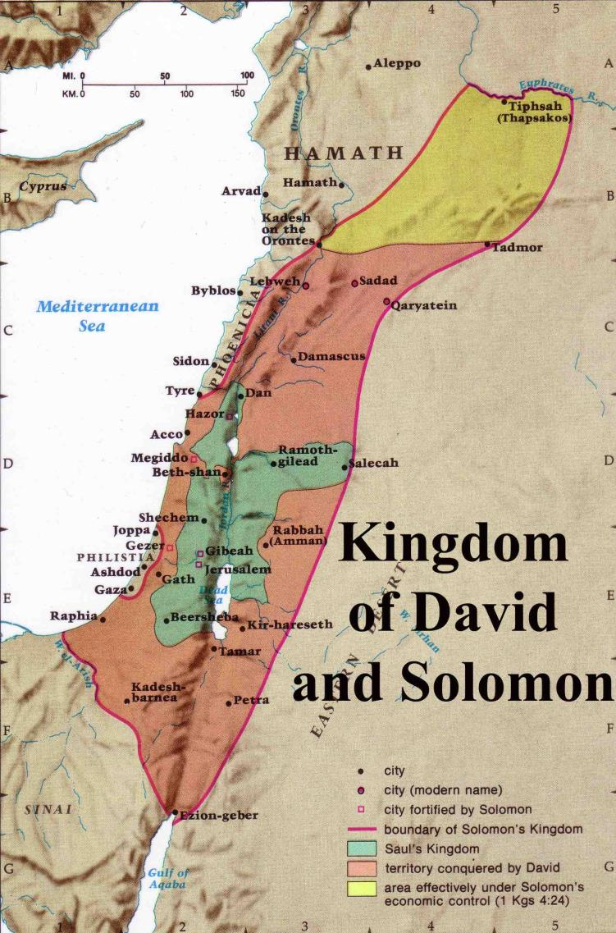
耶罗波安二世以下的扩展
446
耶 罗 波 安 (二)
“列 王 紀 下 14:25
耶 罗 波 安二世收 回 以 色 列 边 界 之 地 ， 从 哈 马 口 直 到 亚 拉 巴 海 ， 正 如 耶 和 华 ─ 以 色 列 的 神 藉 他 仆 人 迦 特 希 弗 人 亚 米 太 的 儿 子 先 知 约 拿 所 说 的 。
耶 罗 波 安 (一) 930 BC
大卫国王和所罗门的王国
Notes:
The boundaries under Jeroboam II went even farther than David and Solomon, who only had tribute sent from Hamath.
耶罗波安二世时期的疆界甚至超过了大卫和所罗门的时期，而大卫和所罗门时期只是从哈马那里收取贡物。

Slide 17
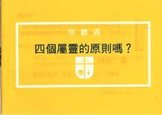
神 爱 你，并 且 为 你 的 生 命 有 一 奇 妙 的 计 划。
四个属灵的原则
四个属灵的原则
Notes:
Not exactly Law #1: God loves you and has a wonderful plan for your life
并非完全符合第一定律：上帝爱你，并为你的生命有奇妙的计划。

Slide 18
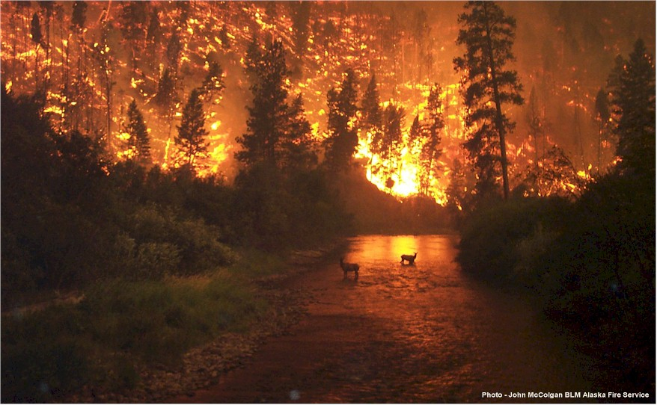
什么信息…
约拿的信息：
“尼尼微的罪过是上帝的疯狂！您好悔改或你会得到惩罚！”

Slide 19
约拿书第一章: 去! 不!
上帝命令从人告诉邪恶者，他是多么的痛恨他们的罪恶
上帝的人往往不喜欢提醒坏人，他们实在很坏

Slide 20
约拿能去哪?
他施去
尼尼微
迦特·希弗
约帕
Notes:
20

Slide 21
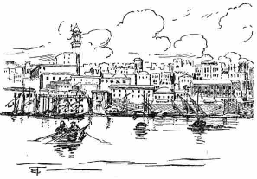
约帕是个很重要的海港
只有下到约帕才可以用船只来离开以色列-不像彼得800年后

Slide 22
约拿第一章: 去! 去! 所以 划!
上帝命令从人告诉恶达者，他是多么的痛恨他们的罪恶
上帝的人往往不喜欢提醒坏人，他们实在很坏
忽视传道带来的后果
Notes:
22

Slide 23
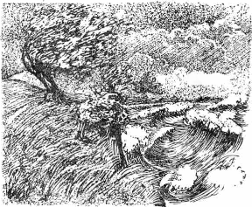
Raging Sea
Notes:
⁴ But the Lord hurled a powerful wind over the sea, causing a violent storm that threatened to break the ship apart. NLT
耶和华在海上刮起大风，海就狂风大作，船几乎破裂。

Slide 24
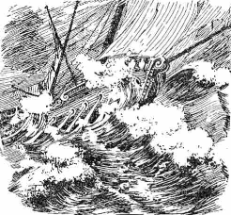
Ship Threatened to Break
Notes:
The Hebrew reads that the ship itself threatened to break up!
希伯来原文的意思是，船本身几乎要破裂了！

Slide 25
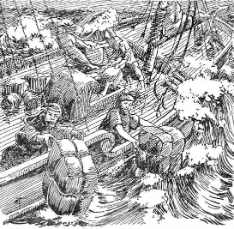
Cargo Overboard
Notes:
⁵ Fearing for their lives, the desperate sailors shouted to their gods for help and threw the cargo overboard to lighten the ship. NTL
The Bible in Pictures, drawn in 1922 but free to copy at www.creationism.org/books/
水手都惧怕，各人哀求自己的神明。他们把船上的货物抛进海里，为要减轻载重。约拿却下到舱底，躺卧沉睡。

Slide 26
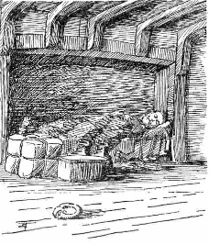
约拿书 Sleeping
Notes:
But all this time 约拿书 was sound asleep down in the hold. ⁶ So the captain went down after him. “How can you sleep at a time like this?” he shouted. “Get up and pray to your god! Maybe he will pay attention to us and spare our lives.”
NLT, Jon 1:5-6.
The Bible in Pictures, drawn in 1922 but free to copy at www.creationism.org/books/
但在这期间，约拿却在船舱底下沉沉地睡着了。
6 于是船长下到他那里，对他说：“这种时候你怎么还能睡得着呢？”他喊道，“起来，求告你的神！也许你的神会顾念我们，使我们不至于灭亡。”
——《约拿书》1:5-6（新普及译本）
图片来源：
1922年绘制的《圣经图解》可在 www.creationism.org/books/ 免费复制使用。

Slide 27

Black
7 水手就彼此说："来吧！让我们抽签，好知道这场灾祸临到我们，是因谁的缘故。"于是他们抽签，结果抽中了约拿。
8 他们就对约拿说：“请告诉我们，这场灾祸临到我们，是因谁的缘故？你是作什么的？你从哪里来？你是哪一国的人？哪一族的人？”
9 他回答说：“我是希伯来人，我敬畏耶和华天上的 神，就是那创造海洋和陆地的。”

Slide 28
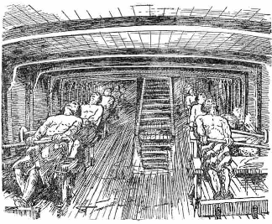
Sailors Rowing
Notes:
¹³ Instead, the sailors rowed even harder to get the ship to the land. But the stormy sea was too violent for them, and they couldn’t make it (1:13 NLT).
13然而那些人竭力划桨，想要把船靠回陆地，却是不能；因风浪愈来愈大，扑向他们。
The Bible in Pictures, drawn in 1922 but free to copy at www.creationism.org/books/

Slide 29
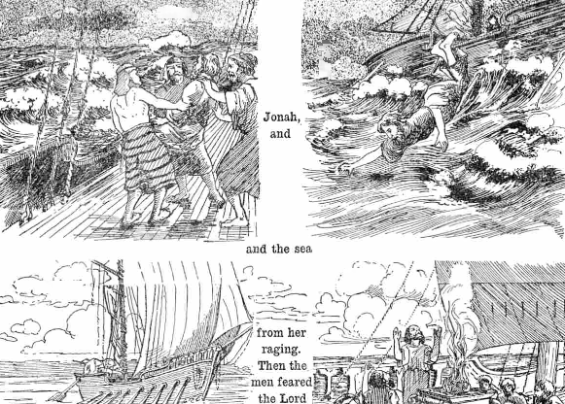
约拿书 Overboard
Notes:
¹⁴ Then they cried out to the Lord, 约拿书’s God. “O Lord,” they pleaded, “don’t make us die for this man’s sin. And don’t hold us responsible for his death. O Lord, you have sent this storm upon him for your own good reasons.”
¹⁵ Then the sailors picked 约拿书 up and threw him into the raging sea, and the storm stopped at once! ¹⁶ The sailors were awestruck by the Lord’s great power, and they offered him a sacrifice and vowed to serve him (Jon 1:14-16 NLT).
14于是他们求告耶和华说：“耶和华啊，求求你不要因这人的性命使我们灭亡，不要使流无辜人血的罪归给我们；因为你－耶和华随自己的旨意行事。” 15他们把约拿抬起来，抛进海里，海的狂浪就平息了。 16那些人就大大惧怕耶和华，向耶和华献祭许愿。

Slide 30
基督教扩展期
第一期
第二期
第三期
第四期
第五期
罗马书
野蛮人
北欧海盗
撒拉森人
天涯海角
0
400
800
1200
1600
2000
上帝时常将用入侵的机会改变侵入者!
拉尔夫冬李, 世界基督教运动
Notes:
30

Slide 31
约拿书第一章的主要思想
忽视传福音带来后果
上帝今天依然使用各种方式，向我们展示祂对传福音的严肃态度。

Slide 32
The Ten Million Dollar Question
一千万美金的题目
尽管我们的罪，我们应如何回应上帝的仁慈?
Notes:
32

Slide 33
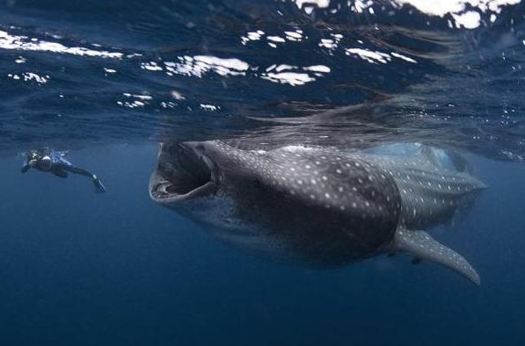
“囖!” 约拿书 2
感谢上帝对你的怜悯 - 尽管你犯了罪。
Notes:
33
你作为一个有罪的生物，你如何看待上帝，神又是如此的怜悯。我们应该为此而感恩。

Slide 34
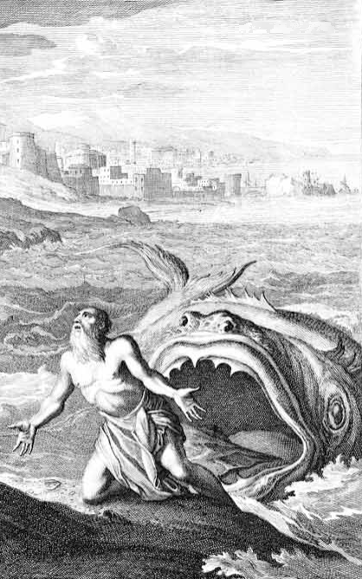
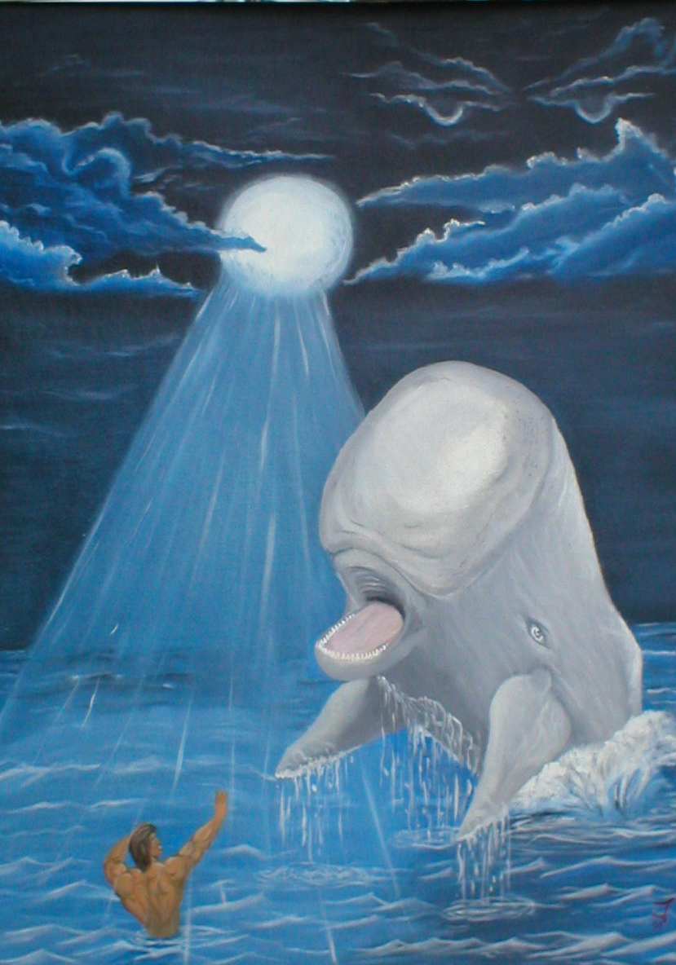
大鱼?
或 鲸?
圣经里:
Dag (“鱼”)
lAdêG" gD"
Notes:
34

Slide 35
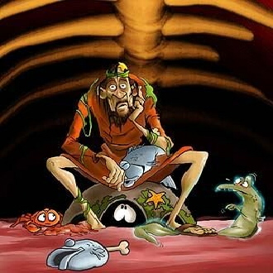
在大鱼里
Notes:
35
What would he eat? I hope he liked sea food!
Could he really breathe in there? Wouldn't the oxygen run out? Eco-system!
他会吃什么呢？希望他喜欢海鲜！
他真的能在里面呼吸吗？氧气不会耗尽吗？生态系统！

Slide 36
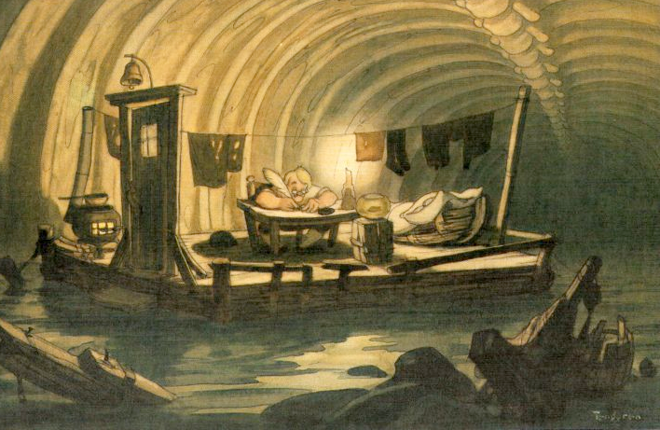
在大鱼里
Notes:
36

Slide 37
Black
Notes:
What would he eat? I hope he liked sea food!
Could he really breathe in there? Wouldn’t the oxygen run out? Eco-system!
他会吃什么呢？希望他喜欢海鲜！
他真的能在里面呼吸吗？氧气不会耗尽吗？生态系统啊！

Slide 38
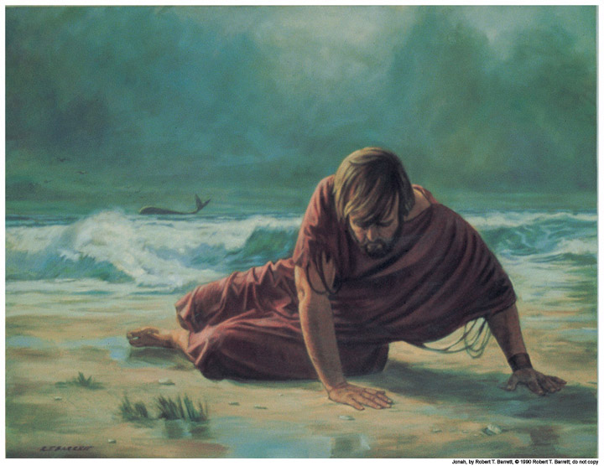
I. 约拿感谢上帝从溺水中拯救了他 (1:17-2:10)
你会吗？

Slide 39
审判？
拯救？
Notes:
39

Slide 40
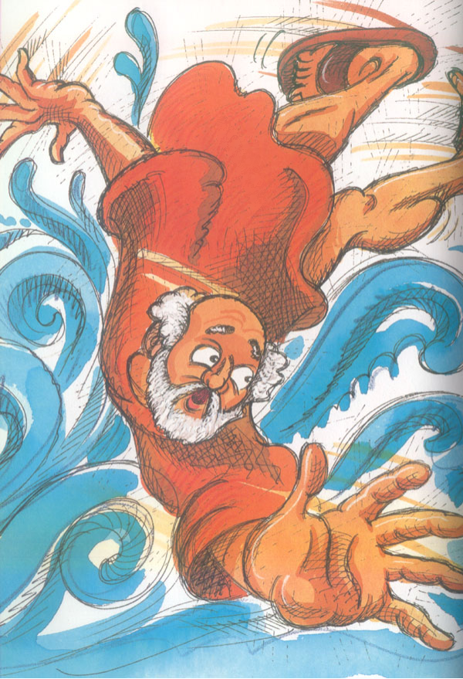
感恩诗
祈祷 (1-2)
悲叹 (3-7)
誓言 (8-9)
约拿书第二章
Notes:
40

Slide 41
感恩诗
祈祷 (1-2)
“我遭遇患难求告耶和华，你就应允我…”
约拿书第二章
Notes:
41

Slide 42
感恩诗
祈祷 (1-2)
悲叹 (3-7)
“你将我投下深渊”
(2:3, 参1:4, 5, 12, 15)
约拿书第二章

Slide 43
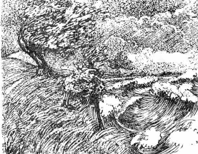
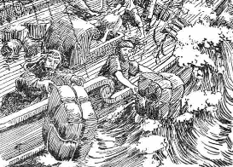
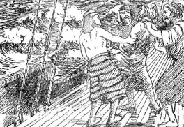
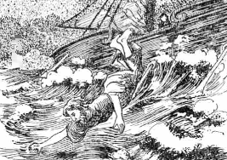
约拿书用的投字
耶和华在海上刮起大风 (1:4)
水手船上的东西拋在海里 (1:5)
他们把约拿投在海里 (1:15)
你们把我投在海里(1:12)
你把我投入深海 (2:3)

Slide 44
感恩诗
祈祷 (1-2)
悲叹 (3-7)
誓言 (8-9)
约拿书第2 章
Notes:
44

Slide 45
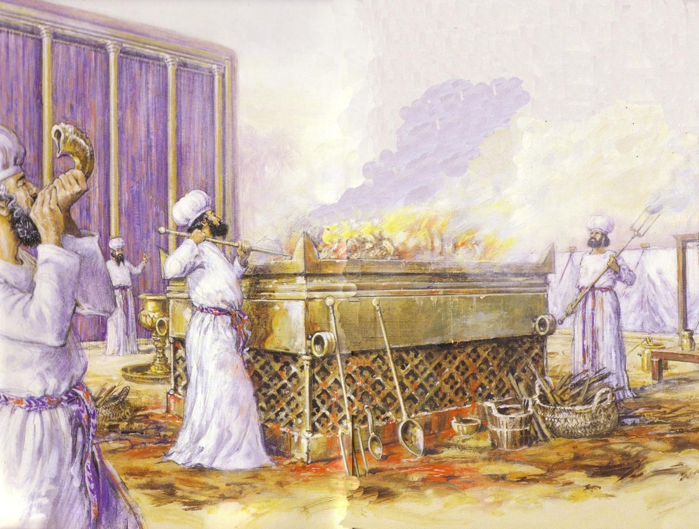
约拿的许愿
“但我必用感谢的声音献祭与你。我所许的愿，我必偿还。救恩出于耶和华 ” (2:9)
Notes:
45

Slide 46
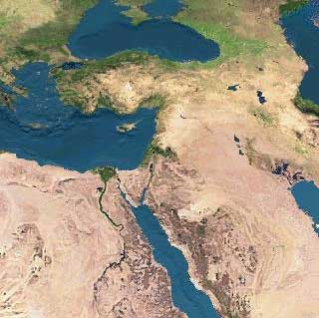
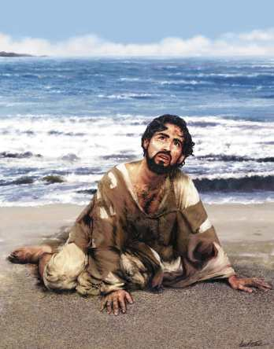
结果如何呢？约拿被吐出来
DRESSING
THE
STAGE
MS
SG
ER
“THE LAND”
DS
PG
RS
Handbook pg. 15-16
25

Slide 47
The Ten Million Dollar Question
一千万美金的题目
尽管我们的罪，我们应如何回应上帝的仁慈?
Notes:
47

Slide 48
我们应该感谢上帝，
尽管我们不顺服
上帝也饶恕我们
Notes:
48

Slide 49

区别以下主要重点…
恩典:上帝赐给我们所不应受的
怜悯: 上帝不赐给我们所应受的
公正: 上帝赐给我们所应受的
Notes:
49
So what have I learned? Everything I am, have, and do—it’s all because of God’s grace. Who would have ever thought that this shy boy—from a broken home whose parents and those they have married have endured 12 divorces—who would ever thought that this guy would be privileged to serve Him at SBC and beyond?
那么，我学到了什么呢？我之所以成为今天的我，拥有的一切，以及所做的每一件事，全是因为上帝的恩典。谁能想到，一个来自破碎家庭的内向男孩——他的父母和他们的再婚对象共经历了 12 次离婚——谁能想到，这样一个人竟有幸能在SBC及其他地方为祂而服事？

Slide 50

The Big Idea
约拿书第二章的主要思想
感谢上帝
祂的怜悯
遮盖了
祂的公义。

Slide 51
“去！哟！哇！”
约拿书 3
分享上帝的信息，因为人们都有回应。
Notes:
51

Slide 52

Success - Failure
成功
失败
Notes:
Susan’s HS reunion
Christopher Lee HK business cards
Dad’s 25th HS reunion

Slide 53
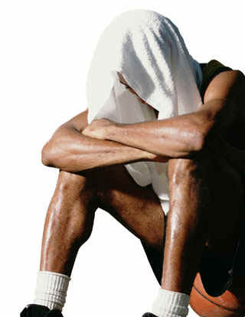
你害
你害怕失败吗？
怕
失
你害？
败
吗
?
Notes:
One western journalist referred to Singapore as a “city of fear”—fear of breaking the law, dear of not making the grade, fear of not having enough money, etc.
Years ago Lee Kuan Yew noted that Singaporeans are not risk-takers in business.
一位西方记者曾将新加坡称为**“恐惧之城”**——人们害怕触犯法律，害怕成绩不够好，害怕钱不够用，等等。
多年前，李光耀指出，新加坡人在经商方面并不喜欢冒险。

Slide 54
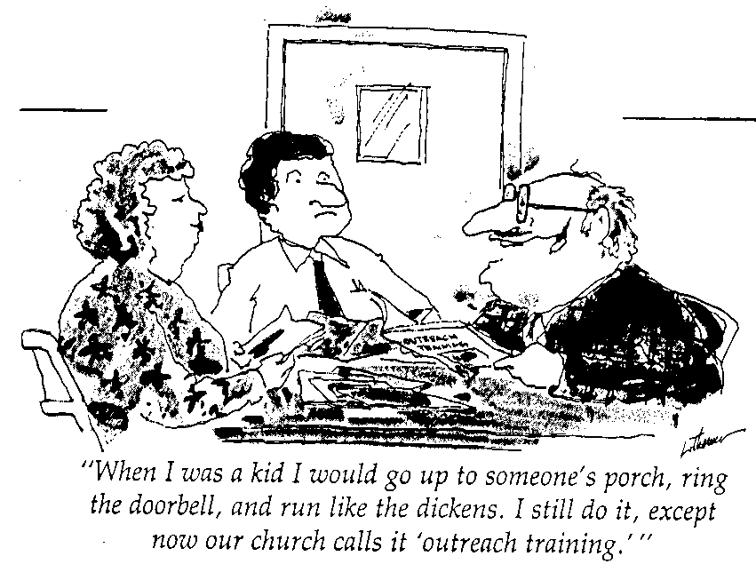
许多人害怕传福音
小时候，我会跑到他人家的门前，按下门铃，然后快跑。如今，我仍是这样做，但我们的教会称这为“拓展训练”。
Notes:
Have you not shared Christ for fear that you will be rejected?
Have you avoided sharing Christ with your family members due to fear?
Do you fear what your office mates will say if you witness?
Are you afraid that the Religious Harmony Bill could be used against you? (By the way, I’ve read it—it only outlaws ineffective methods of evangelism!)
Some of us may feel that our employment pass could be cancelled if we were caught witnessing inappropriately.
你是否因为害怕被拒绝而没有与他人分享基督？
你是否因为恐惧而避免与家人分享基督？
你是否害怕同事会如何看待你作见证？
你是否担心《宗教和谐法案》可能会被用来对付你？（顺便说一句，我读过该法案——它只禁止无效的传福音方法！）
我们中的一些人可能会担心，如果不恰当地作见证，自己的工作准证会被取消。

Slide 55
神如何看待失败—由其是传福音?
日起：
Notes:
55

Slide 56

约拿没服从命令
Notes:
56

Slide 57
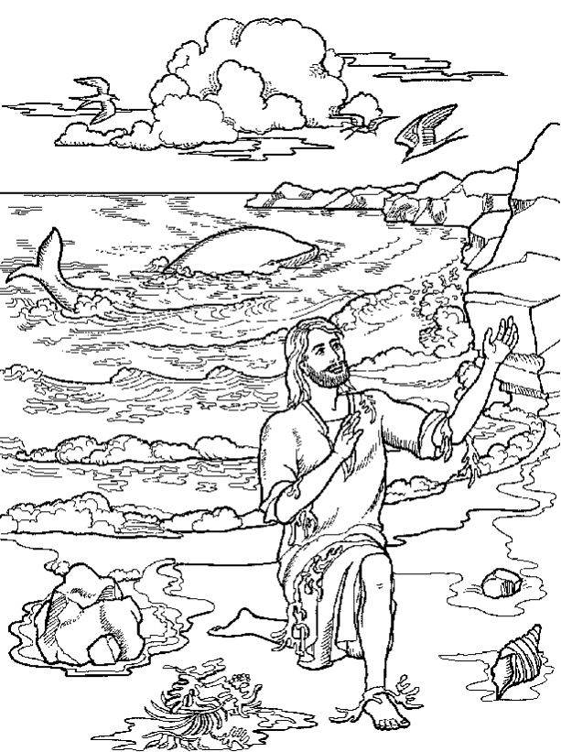
约拿书第3章: 去!
去! 神是怜悯的神。他给不忠心的先知第二次机会。
Notes:
57

Slide 58
“你无法在经文中找到被差遣的人会遭遇到失败”
--穆迪
Notes:
58

Slide 59
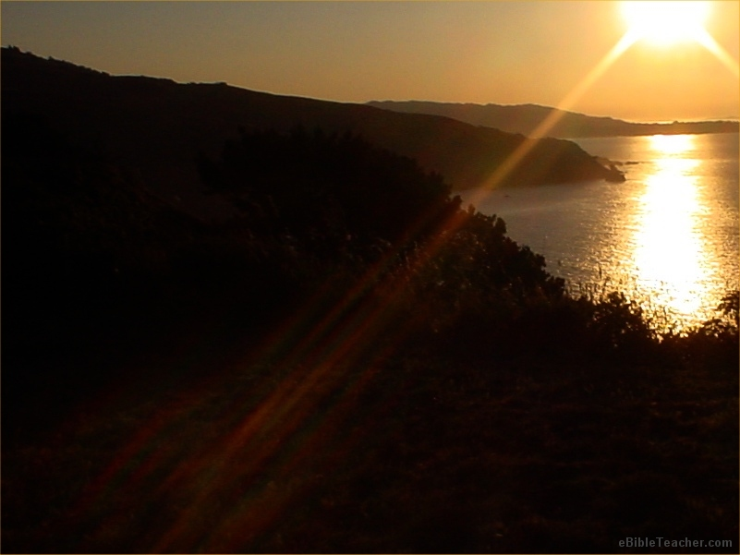
给第二个机会的神
亚伯拉罕
摩西
大卫
保罗
约翰马可
Notes:
59

Slide 60
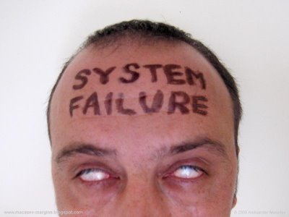
失败是一件事 而 不是一个人
Notes:
60

Slide 61
约拿书第三章: 去!哟!
去! 神给第二个机会给不信的使者 (1-2).
你! 神的子民更应该宣传神的信息给那些从没听过的人 (3-4).
Notes:
61
开始！神是为（1-2）不忠使者第二次机会的神。
哟！神的人，尤其是要申报他给那些从来没有听过谁（3-4）

Slide 62



尼尼微城
602
利河伯
新加坡的面积
尼尼微大城市
亚述
迦 拉
创世记 10:11-12
0
20
公里
Notes:
There’s a problem here regarding the three-day’s journey (cf. OTS, 602). Nineveh’s inner wall was less than eight miles, so the diameter of the city was only two miles—hardly a three-day journey. One day’s journey in the open was usually 15-20 miles (Hannah, BKC, 1:1463).
But this isn’t really a problem in either of two ways:
“The great city of Nineveh” (1:2; 3:2; cf. 4:11) almost surely included three other towns in the vicinity as well. Four cities (Nineveh, Rehoboth Ir, Calah, and Resen) are mentioned in Genesis 10:11-12 as “the great city” and they still exist today with different names (Kouyunjik, Khorsbad, Nimroud, and Karamles). This can be observed on the following map by Austin Henry Layard, Nineveh and Its Remains, 2:40.
If we superimpose a map of Singapore over it, we can see that walking through Nineveh would be like walking in Singapore from the far north in Yishun to Harbourfront in the south. That could take 3 days easily!
关于“三日的路程”这一问题（参见《旧约导论》，602页），尼尼微的内城墙长度不足八英里，因此整个城市的直径仅有两英里，根本算不上“三日的路程”。在开放地带，一天的步行距离通常是 15-20英里（参见 Hannah，《圣经知识注释》，第1卷1463页）。
但这个问题实际上并不难解决，原因有两点：
1. “尼尼微大城”（1:2；3:2；参见4:11）几乎可以肯定是包括周围另外三个城镇在内的整体区域。《创世记》10:11-12 提到的四个城市（尼尼微、利河伯、迦拉和利鲜）被称为**“那大城”**，这些城镇至今仍存在，只是名字不同（分别为库云吉克、科尔萨巴德、尼姆鲁德和卡拉姆勒斯）。这一点可以通过奥斯汀·亨利·莱亚德的地图《尼尼微与其遗迹》（第2卷40页）观察到。
2. 如果我们将新加坡的地图与尼尼微城重叠进行比较，就会发现，穿越尼尼微城就如同从新加坡北部义顺（Yishun）步行到南部的港湾（Harbourfront）。这样一趟旅程轻而易举就可能需要 三天的时间！
62

Slide 63
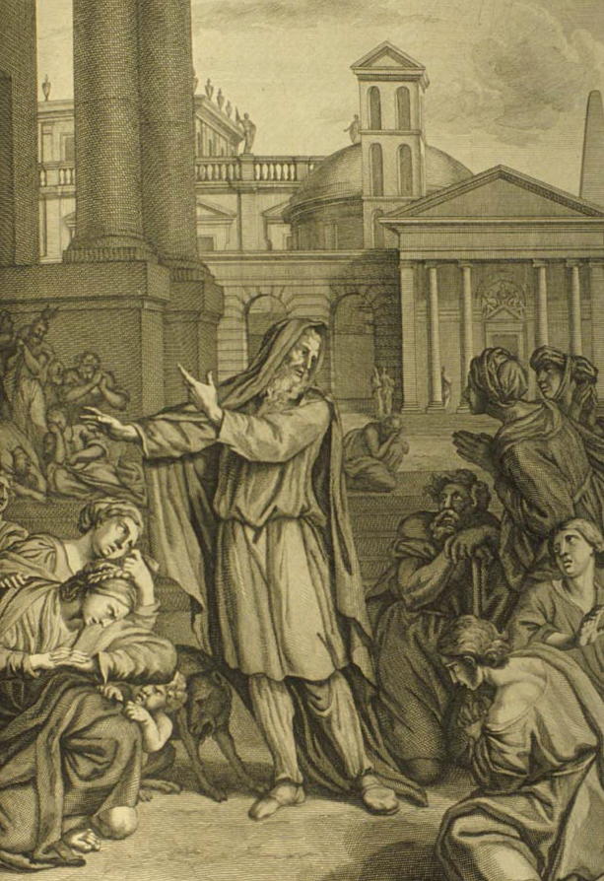
“再等四十日，尼尼微必倾覆了”
(希伯來语只用五个字)
`tk,P'(h.n< hwEßn>ynI)w> ~Ayë ~y[iäB'r>a; dA[
Notes:
63
http://www.mythfolklore.net/lahaye/150/LaHaye1728Figures150约拿书III4约拿书EntersNiniveh.jpg

Slide 64
约拿书第3章: 去!
去!神是怜悯的神。他给不忠心的先知第二次机会 (1-2)
神的子民应该把上帝的信息传给还没听见的人 (3-4)
热诚分享上帝会常带来意想不到的好的结果 (5-10)
Notes:
64

Slide 65
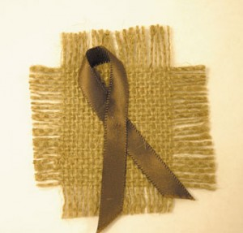
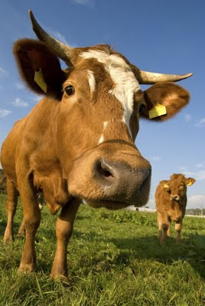
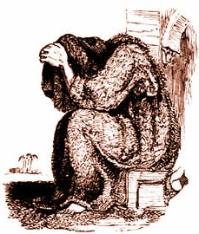
“我做了什么?”
约拿书3:5-10
Notes:
65
⁵ The people of Nineveh believed God’s message, and from the greatest to the least, they declared a fast and put on burlap to show their sorrow.
⁶ When the king of Nineveh heard what 约拿书 was saying, he stepped down from his throne and took off his royal robes. He dressed himself in burlap and sat on a heap of ashes. ⁷ Then the king and his nobles sent this decree throughout the city:
“No one, not even the animals from your herds and flocks, may eat or drink anything at all. ⁸ People and animals alike must wear garments of mourning, and everyone must pray earnestly to God. They must turn from their evil ways and stop all their violence. ⁹ Who can tell? Perhaps even yet God will change his mind and hold back his fierce anger from destroying us.”
¹⁰ When God saw what they had done and how they had put a stop to their evil ways, he changed his mind and did not carry out the destruction he had threatened (3:5-10 NLT)
5尼尼微人就信服上帝，宣告禁食，从最大的到最小的都穿上麻衣。
6这消息传到尼尼微王那里，他就从宝座起来，脱下朝服，披上麻布，坐在灰中。 7他叫人通告尼尼微全城，说：“王和大臣有令，人、畜、牛、羊都不可尝任何东西，不可吃，也不可喝水。 8人与牲畜都要披上麻布，切切求告上帝。各人要回转离开恶道，离弃自己掌中的残暴。 9谁知道上帝也许会回心转意，不发烈怒，使我们不致灭亡。”
10上帝察看他们的行为，见他们离开恶道，上帝就改变心意，原先所说要降与他们的灾难，他不降了。

Slide 66
约拿在乐园 ?
“他宣告后的效果是那么的奇妙! 连以色列最伟大的 先知也还未达到像他这样的效果… 我们就在仙境！当然这不是 记录实际的历史 事件也不打算这样做。我们把他的作品当成散文而作者是要做詩，这是得罪了作者。”
(Julius A. Bewer, A Critical and Exegetical Commentary on 约拿书, ICC, 3-4).
Notes:
66
http://www.mythfolklore.net/lahaye/150/LaHaye1728Figures150约拿书III4约拿书EntersNiniveh.jpg

Slide 67
预备认罪?
605
导致尼尼微在公元前758认罪的事件:
787 开始单一崇拜尼布
765 疫瘟在亚述散布
763 亚述人在城市里造反
763 日蚀
762 亚述人在城市里造反
761 亚拉发城市里造反
760 亚拉发城市里造反
759 另一个疫瘟
758 “天下太平” (在约拿的引导下认罪?)
Notes:
67

Slide 68
人们的反应比我们想象的更大!
约拿书第3章
主要的目的
Notes:
68

Slide 69
Book Chart
上帝对外邦人的怜悯
不遵守宣教士的责任 |  |  |  | 遵守宣教士的责任
第1—2章 |  |  |  | 第3—4章
上帝对约拿的怜悯 |  |  |  | 上帝对尼尼微人的怜悯
大海 |  |  |  | 大城
委任 1:1-2 | 不顺服 1:3 |  | 结果 1:4–2:10 | 重新委任 3:1-2 | 顺服 3:3-4 |  | 结果 3:5–4:10
“去!" | “不!" |  | “去，划!” “看!” | “去!" | 唷 |  | “咳!” “哦，不!”
约拿的邪恶 第1章 (约拿想去死) |  | 约拿的祷告 第2章 (约拿想活) |  | 约拿的讲道 第3章 (约拿想活) |  | 约拿赌气 第4章 (约拿想死)
约主前 760 年
599

Slide 70
“哦，不！”
约拿书 4
对人比事物表现出更大的同情心
Notes:
70

Slide 71
1。约拿因为自己的执著而忽略人（4:1-9）。

Slide 72
A. 上帝的关注的是尼尼微，但其拯救使约拿愤怒（4:1-4）。
603
关键节
“[约拿]祷告耶和华，”耶和华啊，这不是我说，当我还在家里？这就是我为什么这么快逃往他施。我知道，你是仁慈和怜悯的上帝，不轻易的愤怒，有丰盛的慈爱，並且后悔不降所说的灾难“（4:2）
Notes:
72
约拿书’s theology about God is correct—and I think 4:2 is the key verse of the book.
Most of us fear failure, but 约拿书 feared success! He feared that the Ninevites might repent—and they did!
But why was he angry? He wanted the people judged!
《约拿书》中关于上帝的神学是正确的——我认为4:2是整本书的关键经文。
我们大多数人害怕失败，但约拿害怕的是成功！他害怕尼尼微人会悔改——而他们的确悔改了！
但他为什么愤怒呢？因为他希望这些人受到审判！

Slide 73
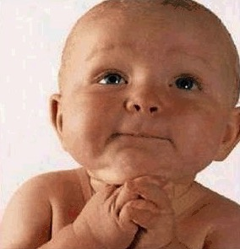
给我智慧来了解我的老板
给我智慧来
亲爱的主啊，我求你！
给我爱来原谅他
给我耐心来了解他的行为
但是亲爱的上帝，不要给我权力
因为如果你给我权力
我会打破他的头
Notes:
约拿书 was powerless too.

Slide 74

戴德生
Notes:
74
Like God, Hudson Taylor was a man who had compassion on lost people too [adapted from Hudson Taylor, A Retrospect, 85-87, in Evangelism notes, 18]:
Among the passengers on board the boat was one intelligent man, who in the course of his travels had been a good deal abroad, and had even visited England, where he went by the name of Peter. As might be expected he had heard something of the Gospel, but had never experienced its saving power. On the previous evening I had drawn him into earnest conversation about his soul's salvation. The man listened with attention, and was even moved to tears, but still no definite result was apparent. I was pleased, therefore, when he asked … to accompany me, and to hear me preach.
I went into the cabin of the boat to prepare tracts and books for distribution on landing with my Chinese friend, when suddenly I was startled by a splash and cry from without. I sprang on deck and took in the situation at a glance. Peter was gone! The other men were all there, on board, looking helplessly at the spot where he had disappeared, but making no effort to save him. A strong wind was carrying the junk rapidly forward in spite of a steady current in the opposite direction, and the low-lying shrub less shore afforded no landmark to indicate how far we had left the drowning man behind.
I instantly let down the sail and leapt overboard in the hope of finding him. Unsuccessful, I looked around in agonizing suspense, and saw close to me a fishing-boat with a peculiar drag-net furnished with hooks, which I knew would bring him up.
"Come!" I cried, as hope revived in my heart. "Come and drag over this spot directly; a man is drowning just here!"
"Veh bin" (It is not convenient), was the unfeeling answer.
"Don't talk of convenience!" I cried in an agony; "a man is drowning I tell you!"
"We are busy fishing," they responded, "and cannot come."
"Never mind your fishing," I said, "I will give you more money than many a day's fishing will bring; only come—come at once!"
"How much money will you give us?"
"We cannot stay to discuss that now! Come, or it will be too late. I will give you five dollars."
"We won't do it for that," replied the men. "Give us twenty dollars, and we will drag."
"I do not possess so much; do come quickly, and I will give you all I have!"
"How much may that be?"
"I don't know exactly, about fourteen dollars."
At last, but even then slowly enough, the boat was paddled over, and the net let down. Less than a minute sufficed to bring up the body of the missing man. The fisherman were clamorous and indignant because their exorbitant demand was delayed while efforts at resuscitation were being made. But all was in vain—life was extinct.
To myself this incident was profoundly sad and full of significance, suggesting a far more mournful reality. Were not those fishermen actually guilty of this poor Chinaman's death, in that they had the means of saving him at hand, if they would have but used them? Assuredly they were guilty. And yet, let us pause [before] we pronounce judgment against them lest a greater than Nathan answer, "Thou art the man." Is it so hard-hearted, so wicked a thing to neglect to save the body? [Isn't he much worse who leaves the soul to perish, and like Cain says], "Am I my brother's keeper?"
The Lord Jesus commands, commands me, commands you, my brother, and you, my sister. "Go," says He, "go ye into all the world, and preach the Gospel to every creature." Shall we say to Him, "No, it is not convenient"? shall we tell Him that we are busy fishing and cannot go? that we have bought a piece of ground and cannot go? that we have purchased five yoke of oxen, or married, or are engaged in other and more interesting pursuits, and cannot go? [Before] long "we must all appear before the judgment seat of Christ; that every one may receive the things done in his body." Let us remember, let us pray for, let us labour for the unevangelised Chinese; or we shall sin against our own souls.
像上帝一样，戴德生也是一个对失丧之人充满怜悯的人（改编自《戴德生回顾录》，85-87页，《传福音笔记》，18页）：
在船上的乘客中，有一位聪明的男子，名叫彼得，他在旅行中曾到过很多国家，甚至去过英国。他对福音多少有些了解，但从未真正经历过福音拯救的大能。前一晚，我与他展开了关于灵魂得救的真诚对话。他认真倾听，甚至感动落泪，但似乎仍未作出明确的回应。因此，当他提出要陪我一起听道时，我很高兴。
我走进船舱，准备一些福音单张和书籍，打算登陆后分发给人。但突然间，我被一声扑通的水声和喊叫惊醒。我迅速跑到甲板上，瞬间就明白了发生了什么——彼得不见了！其他人都在船上，惊慌失措地望着他消失的地方，却没有一个人采取任何救援行动。船正顶风快速向前，而相反的水流也未能阻止船速。光秃的低岸没有任何标记，无法判断我们离溺水的人有多远。
我立刻放下船帆，跳入水中，希望能找到他。但没有成功，我焦急地四处张望，看到附近有一艘渔船，船上有一个特殊的带钩的拖网。我知道那东西能将人从水中捞起。
“来啊！”我心中燃起希望，大声喊道，“快过来，把网撒到这里，有人落水了！”
“不方便。”渔夫冷漠地回答。
“不要谈什么方便！”我痛苦地喊道，“我告诉你，有人正在溺水啊！”
“我们在捕鱼，不能过来。”他们回应道。
“别管捕鱼了，”我说，“我给你们比捕鱼多得多的钱，只要过来，马上过来！”
“你愿意给多少钱？”
“现在没时间讨论这个！快过来，否则就太晚了。我给你们五块钱。”
“我们不会为这个价钱去的，”渔夫答道。“给我们二十块钱，我们才肯捞。”
“我没有那么多钱；求你们快点过来，我把我所有的钱都给你们！”
“那你有多少钱？”
“我也不知道，大约十四块钱左右。”
最后，渔船才慢慢地划了过来，把网撒下去。不到一分钟，失踪者的身体就被捞了上来。但为时已晚——生命已经逝去。而渔夫们却愤怒地嚷嚷，指责我耽误了他们索要的高额报酬，而我们正竭力进行抢救。
这件事对我来说既深感悲伤，又富有深意，它让我联想到更令人痛心的现实：这些渔夫手中明明有拯救那位中国人性命的工具，却拒绝使用它，他们难道不对这人的死亡负有责任吗？他们显然是有罪的。但在我们指责他们之前，不妨停下来，免得比拿单更伟大的那一位对我们说：“你就是那人。”
忽视拯救人的身体固然是无情且邪恶的，但若有人任凭人的灵魂灭亡，而像该隐那样说：“我岂是看守我兄弟的吗？” 他难道不是更大的罪人吗？
主耶稣命令我们，命令你，命令我，命令我们每一个人。“去，” 祂说，“你们往普天下去，传福音给万民听。” 我们会对祂说，“不，这不方便”吗？我们会告诉祂我们正忙着捕鱼，无法去吗？我们是不是因为买了地，试牛，结婚，或者忙于其他更让人感兴趣的事而无法去呢？
我们要记住，将来我们“都要显露在基督的审判台前，叫各人按着本身所行的，或善或恶受报。”让我们铭记、祷告，并为未得之民的中国人劳苦，否则我们就要得罪自己的灵魂。

Slide 75

约拿绷脸
二 约拿只关注的是一棵植物，所以它的破坏，使他生气（4:5-9）。
0
Notes:
I wonder how long he planned on staying there—forty days like in 3:4?
我想知道他打算在那里待多久——像3:4中所说的四十天吗？

Slide 76
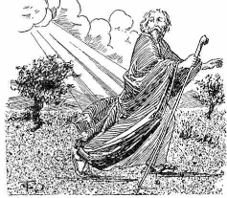
约拿
到城市的东部
Notes:
76
You would think he would go west back to Israel, right?
你可能会认为他会向西回到以色列，对吧？

Slide 77
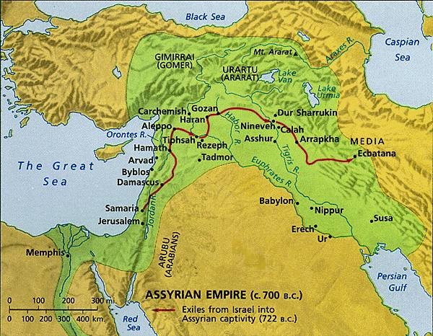
为什么约拿坐在城市的东部？
607
尼尼微城
耶路撒冷
也许他认为上帝的判决是在从西部的耶路撒冷而
来，他不希望被碰上！
Notes:
77
也许他认为上帝的判决是在从西部的耶路撒冷而来，他不希望被碰上！

Slide 78
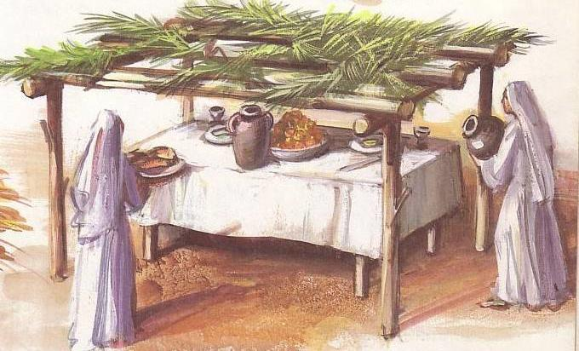
圣幕节（避风塘)
Notes:
He knew how to make shelters since he did this once a year for the Feast of Booths when Israelites lived for a whole week in a small shelter outside their homes住棚节（避风塘）
他知道如何搭建棚子，因为他每年都会在住棚节期间这样做。那时，以色列人会在自己家外的小棚子里住上一整周。

Slide 79
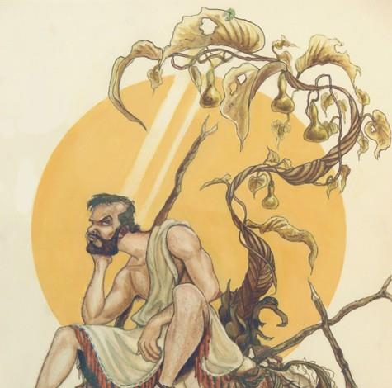
攻击与燃烧
Notes:
Some think this is a castor oil plant that grows 8 feet in five months.
But this is a miraculous one that grew in but a few minutes or hours.
There’s a word play here because it literally says,
“The worm attacked the plant and the sun attacked 约拿书.”
What a turn of events…
有人认为这是一种蓖麻树，它在五个月内能长到八英尺高。
但这里的却是一个神迹，这棵植物在几分钟或几个小时内就长了出来。
这里还有一个文字上的双关，因为原文字面意思是：
“虫子攻击了这棵植物，太阳攻击了约拿。”
事情的转折竟然如此戏剧化……
79

Slide 80
双关语
上帝。。。
612
• “安排一条鱼” (1:17)
• “安排排一棵蓖麻 ” (4:6)
• “安排一条虫子” (4:7)
• “安排炎热的东风” (4:8)
Notes:
Some think this is a castor oil plant that grows 8 feet in five months.
But this is a miraculous one that grew in but a few minutes or hours.
There's a word play here because it literally says,
"The worm attacked the plant and the sun attacked 约拿书."
What a turn of events…
有人认为这是一棵蓖麻树，它可以在五个月内长到八英尺高。
但这里所描述的却是一个神迹，这棵植物在几分钟或几个小时内就迅速生长起来了。
这里还有一个文字游戏，因为原文的字面意思是：
“虫子攻击了植物，太阳攻击了约拿。”
事情的转折竟然如此戏剧化……
80

Slide 81
又蚀又晒！
• “虫子蛀蚀蛀蚀这棵蓖麻” (4:7)
• “烈日晒在约拿的头上” (4:8)
Notes:
Some think this is a castor oil plant that grows 8 feet in five months.
But this is a miraculous one that grew in but a few minutes or hours.
There's a word play here because it literally says,
"The worm attacked the plant and the sun attacked 约拿书."
What a turn of events…
有人认为这是一棵蓖麻树，在五个月内可以长到八英尺高。
但这里描述的却是一个神迹，这棵植物在几分钟或几个小时内就生长了出来。
这里还有一个文字上的双关，因为原文字面意思是：
“虫子攻击了植物，太阳攻击了约拿。”
真是个戏剧性的转折啊……
81

Slide 82
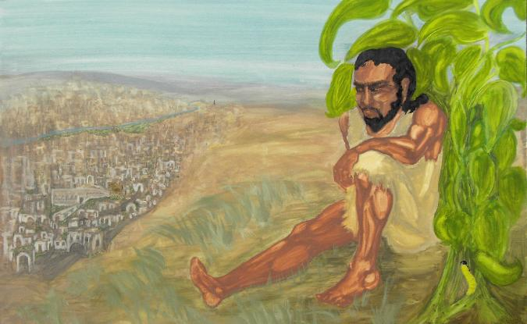
那是何等的事态发展…
第一章：约拿的信息...
““尼尼微的坏，上帝的疯狂！
你最好还是改变要不是就把你烧！ ”
第四章：约拿的刻薄...
“上帝的高兴和约拿的疯狂！
尼尼微已改变与约拿的怒火！”

Slide 83
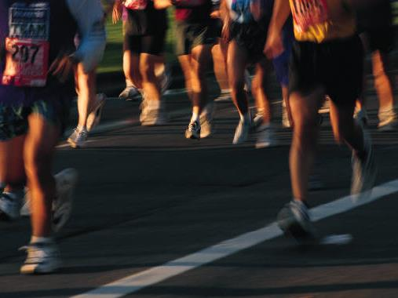

二。把人看得比事物更优先（4:10-11）
Notes:
We should be “people people” rather than “things people.”
Read verses 10-11
我们应该成为关心人的人，而不是关心物的人。
请阅读10-11节
83

Slide 84

东西吗？还是人民？
Notes:
A. We, like 约拿书, are often more concerned about things than people (4:10).
Actually, we don’t try to be concerned for earthly things—we just try to be concerned for everything all at once.
A. 我们像约拿书一样，常常比关心人更关心物质（4:10）。
1. 事实上，我们并不是故意去关注世上的事物——我们只是试图同时关注所有的事情。

Slide 85

4:10 NLT
东西吗？还是人？
然后主说：“你对这植物感到惋惜，但那却不是你把它放在那里的。它来得迅速也死亡得迅速”（4:10）。
Notes:
约拿书 was not spinning plates here, though.
He was actually enjoying the blessings of God’s goodness. The Lord pointed out that he neither planted nor cared for this plant.
I guess we also can get used to God’ goodness and resent it when he takes something away—as if we deserved this blessing.
约拿书在这里并不是在转动盘子。
他其实是在享受上帝恩典的祝福。主指出，他既没有种植这棵植物，也没有照顾它。
我想我们也常常习惯了上帝的恩典，当祂拿走一些东西时，我们反而心生不满——仿佛我们理应得到这些祝福一样。
85

Slide 86
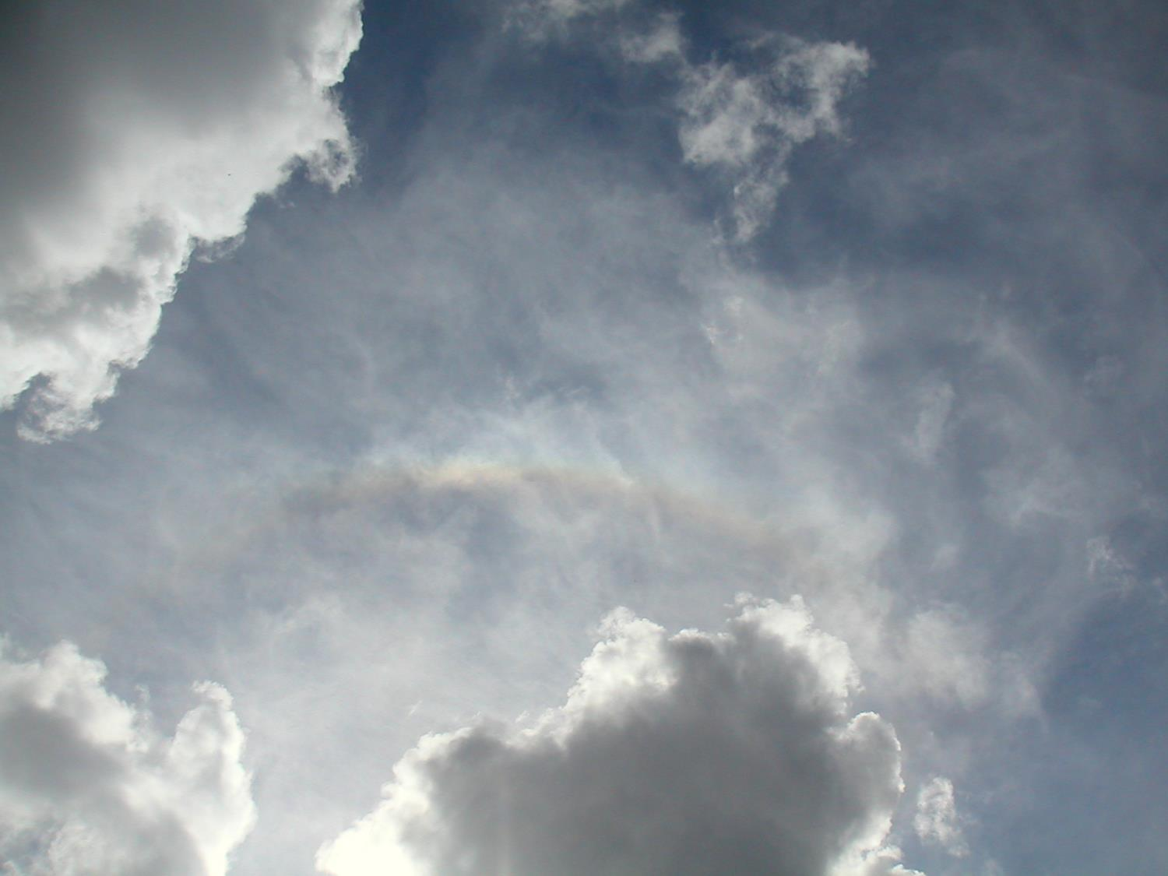
只有三件事是永恒的
神
神的话语
人
那么，你应该怎样投资你的生命？

Slide 87

我不应该为12万尼尼微人民惋惜？
约拿
神
审判
120,000
“你对植物感到惋惜...
拯救120,000
无知的人
野蛮人
谁关心他们的动物？
“我会”
...和动物吗？“
Notes:
87
B. We need to be like God, who is always more concerned about people than things (4:11).
B. 我们需要像上帝一样，始终比关心物质更加关心人（4:11）。

Slide 88

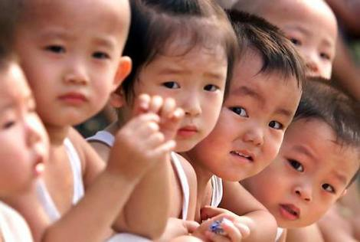
你怎么能有上帝对人的怜悯呢？
你的时间
你的金钱
你的看法
你的耳朵
“如果你不共享，那么你不关心”
Notes:
Your time—keep an open door for conversation. Are you available when someone wants to talk? Or do the numerous tasks get in the way? While preparing this message, a neighbor of mine came over six nights in a row to talk about difficulties he’s having with his son. So many times I wanted to say, “Hey, I can’t afford this much time with you. I have to go prepare a message on giving people priority!”
Your money—is it invested in things or people? Do you give God your first fruits or your leftovers after you spend money on yourself?
Your view—how do you see people? We often see people’s attractiveness, social status, or race. But I encourage you to see people not for what they are now, but what they will become after death—see that person as radiant, happy, eternally blessed in a place beyond imagination, or see the person as despondent, wretched, eternally suffering among flames. Take every chance to share the gospel.
Your ear—To see if you are compassionate, ask the person closest to you, “Am I a person of compassion?” Ask him or her right now if he or she is right next to you. Look for a nod and then the other person can ask the same question of you. If you’re afraid to ask the question, you already know the answer.
你的时间——保持开放的心态，随时准备与人交谈。当有人想谈话时，你是否能腾出时间？还是说各种任务会让你分心？在准备这篇讲道的时候，我的一个邻居连续六晚过来与我谈论他与儿子之间的困难。我好多次想说：“嘿，我没法腾出这么多时间陪你。我得去准备一篇关于优先考虑他人的讲道！”
你的钱——它是投资在物质上还是在别人身上？你是否把上帝的初熟之物奉献给祂，还是等自己花光钱后剩下的一点点才给祂？
你的眼光——你是如何看待人的？我们常常只看到一个人的外貌、社会地位或种族。但我鼓励你不要仅仅看到一个人现在的样子，而是要看到他死后将会成为怎样的人——看到这个人将会在一个超乎想象的地方，容光焕发、喜乐无比、永远蒙福；或者看到这个人将永远沉沦在火焰中的痛苦和绝望里。抓住每个机会传福音。
你的耳朵——要看自己是否有怜悯心，可以问问身边最亲近的人：“我是否是一个有怜悯心的人？”如果他/她就在你身边，就问他/她。看看他/她是否点点头，然后你也可以问同样的问题给对方。如果你不敢问，你已经知道答案。
88

Slide 89
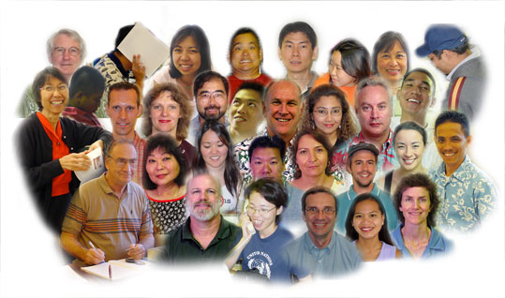
约拿书的要点：
599
把人放在我们在生活中最优先考虑的事件。
回应主的心意是指象他一样的看顾失落的。
Notes:
People are God’s first concern—so people should be our first concern.
Imitate God’s compassion for people by considering people more important than things.
Do you need to let some plates break?
人是上帝首先关心的对象——因此人也应该是我们最关心的。
效法上帝对人的怜悯，视人比物更重要。
你是否需要让一些盘子碎掉呢？

Slide 90

思考问题
599
你的生活和约拿书第4章之间有什么相似之处？
什么原因导致基督徒--尤其是老的—对失落的人失去怜悯？
你有什么做法有助于你对非信徒的怜悯保持不变？
Notes:
90

Slide 91
Black

Slide 92


圣经阐释 • BibleStudyDownloads.org
免费获得该讲解!
圣经学习下载
你需要更好地了解圣经吗？谁不需要呢？BibleStudyDownloads （圣经学习下载）为神学生和教师们提供了从 创世纪 到 启示录的 30万份 可编辑的免费PowerPoint和Word文件。
本网站的大部分资料由Dr. Rick Griffith 博士设计，他从1991年到2021年在新加坡神学院教授圣经、神学和讲道学，现在是约旦福音神学院的圣经释经教授。
圣经学习下载
Notes:
BE Bible Exposition—Chinese

