Slide 1

作个有爱心的人
雅歌
Dr. Rick Griffith • Crossroads International Church Singapore
CICFamily.com • BibleStudyDownloads.org

Slide 2

婚姻正遭受攻击。

Slide 3
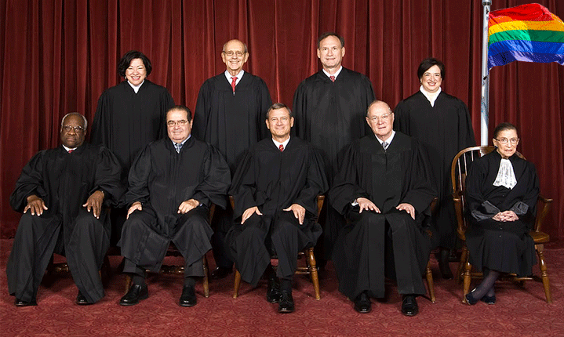
美国最高法院对婚姻重新定义
2015年6月26日

Slide 4
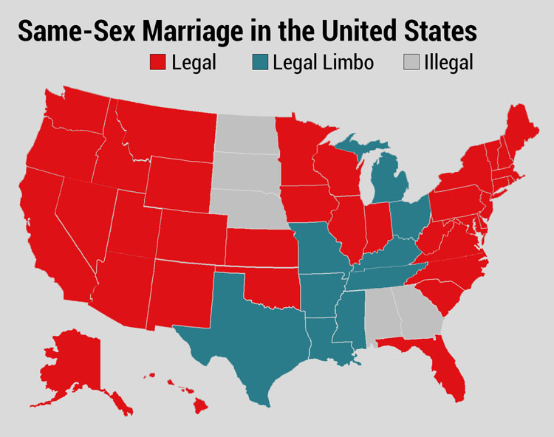
决定前
美国的同性婚姻
合法
中间地带
不合法

Slide 5

决定后

Slide 6
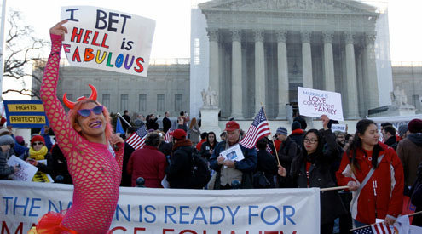
美国最高法院对婚姻重新定义
2015年6月26日

Slide 7
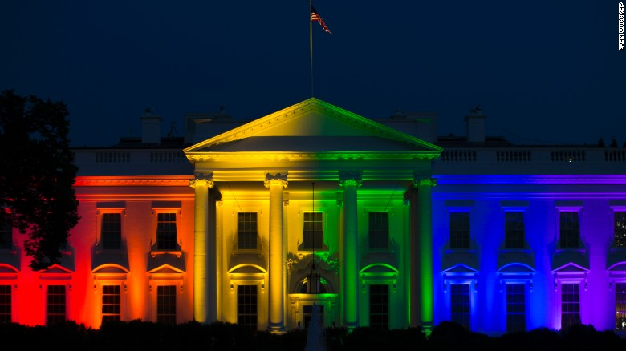
美国最高法院对婚姻重新定义
2015年6月26日

Slide 8
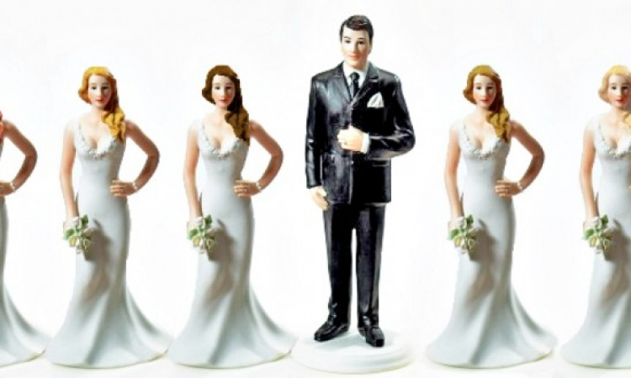
它会在哪里停止？
Notes:
Legalizing of polygamy is a natural future fear.
Now we are told there are 70 different sexes. This will not strengthen marriage!
一夫多妻制合法化是未来自然的担忧。
现在我们被告知有 70 种不同的性别。这不会巩固婚姻！

Slide 9
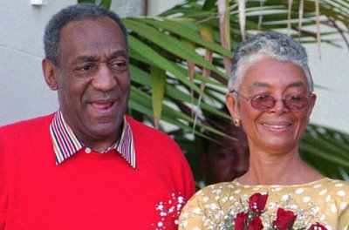

Bill Cosby
比尔·科斯比
“#MeToo”运动
Notes:
Bill Cosby’s sexual failures and the #MeToo movement have highlighted how women have become abused.
比尔·科斯比的性丑闻和“#MeToo”运动突显了女性如何遭受虐待。

Slide 10

比尔·海伯斯
Notes:
Many of us here have been blessed by the ministry of Bill Hybels, who has been married since 1974.
____
Bill Hybels is Living Happily With Wife Lynne Hybels and Children; Know about his Married Life and Children
May 18, 2018 First published on:May 18, 2018
我们中的许多人都因比尔·海伯斯的事工而受到祝福，他自 1974 年起就已结婚。
____
比尔·海伯斯与妻子琳恩·海伯斯和孩子幸福地生活在一起；了解他的婚姻生活和孩子
2018 年 5 月 18 日 首次发布于：2018 年 5 月 18 日

Slide 11
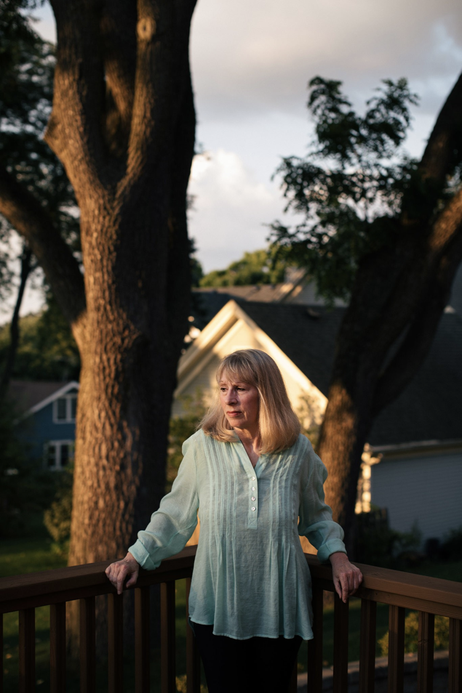
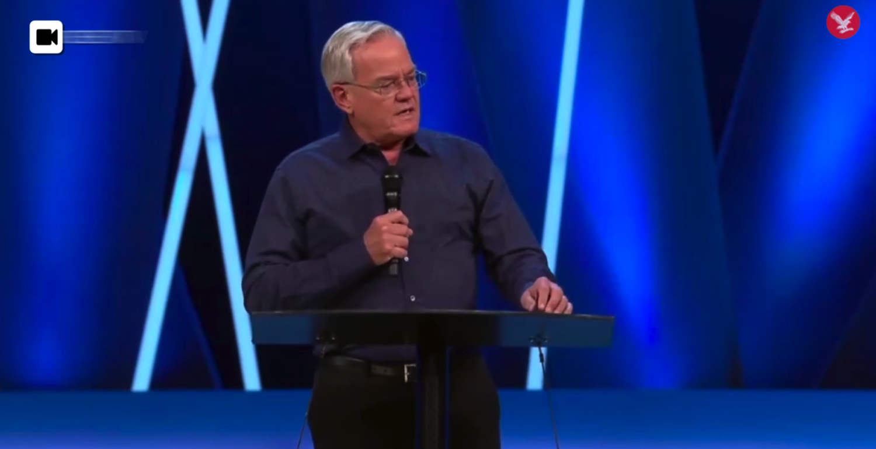
比尔·海伯斯
帕特·巴拉诺夫斯基
Notes:
But in April 2018 Hybels resigned from Willow Creek over sexual allegations.
______
He’s a Superstar Pastor. She Worked for Him and Says He Groped Her Repeatedly: Bill Hybels built an iconic evangelical church outside Chicago. A former assistant says that in the 1980s, he sexually harassed her.
By Laurie Goodstein
Aug. 5, 2018
https://www.nytimes.com/2018/08/05/us/bill-hybels-willow-creek-pat-baranowski.html
Pat Baranowski was the executive assistant to the Rev. Bill Hybels at the Willow Creek Community Church in South Barrington, Ill., one of the largest megachurches in the country.CreditAlyssa Schukar for The New York Times
SOUTH BARRINGTON, Ill. — After the pain of watching her marriage fall apart, Pat Baranowski felt that God was suddenly showering her with blessings.
She had a new job at her Chicago-area megachurch, led by a dynamic young pastor named the Rev. Bill Hybels, who in the 1980s was becoming one of the most influential evangelical leaders in the country.
The pay at Willow Creek Community Church was much lower than at her old job, but Ms. Baranowski, then 32, admired Mr. Hybels and the church’s mission so much that it seemed worth it. She felt even more blessed when in 1985 Mr. Hybels and his wife invited her to move into their home, where she shared family dinners and vacations.
Once, while Mr. Hybels’s wife, Lynne, and their children were away, the pastor took Ms. Baranowski out for dinner. When they got home, Mr. Hybels offered her a back rub in front of the fireplace and told her to lie face down.
Advertisement
Stunned, she remembered feeling unable to say no to her boss and pastor as he straddled her, unhooked her bra and touched her near her breasts. She remembered feeling his hands shake.
That first back rub in 1986 led to multiple occasions over nearly two years in which he fondled her breasts and rubbed against her. The incidents later escalated to one occasion of oral sex. Ms. Baranowski said she was mortified and determined to stay silent.
You have 4 free articles remaining.
Subscribe to The Times
[Read about the resignation of Willow Creek Church’s lead pastor and board of elders.]
“I really did not want to hurt the church,” said Ms. Baranowski, who is now 65, speaking publicly for the first time. “I felt like if this was exposed, this fantastic place would blow up, and I loved the church. I loved the people there. I loved the family. I didn’t want to hurt anybody. And I was ashamed.”
Mr. Hybels denied her allegations about her time working and living with him. “I never had an inappropriate physical or emotional relationship with her before that time, during that time or after that time,” he said in an email.
Since the #MeToo movement emerged last year, evangelical churches have been grappling with allegations of sexual abuse by their pastors. A wave of accusations has begun to hit evangelical institutions, bringing down figures like the Rev. Andy Savage, at Highpoint Church in Memphis, and the Rev. Harry L. Thomas, the founder of the Creation Festival, a Christian music event.
EDITORS’ PICKS
The Big Business of Being Gwyneth Paltrow
Love Filled Their Trip. On Day 369, ISIS Struck.
Maria Butina, Suspected Secret Agent, Used Sex in Covert Plan, Prosecutors Say
Advertisement
Ms. Baranowski is not the first to accuse Mr. Hybels of wrongdoing, though her charges are more serious than what has been reported before.
In March, The Chicago Tribune and Christianity Today reported that Mr. Hybels had been accused by several other women, including co-workers and a congregant, of inappropriate behavior that dated back decades. The allegations included lingering hugs, invitations to hotel rooms, comments about looks and an unwanted kiss.
The accusations did not immediately result in consequences for Mr. Hybels. At a churchwide meeting where Mr. Hybels denied the allegations, he received a standing ovation from the congregation.
The church’s elders conducted their own investigation of the allegations when they first surfaced four years ago and commissioned a second inquiry by an outside lawyer, completed in 2017. Both investigations cleared Mr. Hybels, though the church’s two lead pastors have since issued public apologies, saying that they believe the women.
In April, Mr. Hybels announced to the congregation he would accelerate his planned retirement by six months and step aside immediately for the good of the church. He continued to deny the allegations, but acknowledged, “I too often placed myself in situations that would have been far wiser to avoid.” The congregation let out a disappointed groan. Some shouted “No!”
On Sunday, one of the church’s two top pastors severed his ties with Willow Creek. After services, the Rev. Steve Carter announced that he was resigning immediately in response to Ms. Baranowski’s “horrifying” allegations about Mr. Hybels.
Mr. Carter said he had a “fundamental difference” with the church’s elders over how they had handled the allegations against Mr. Hybels, and had been planning to resign for some time.
Advertisement
Mr. Carter did not appear as scheduled at Sunday services at the church’s main campus, and the congregation at the second service was told that he was so sick that he was vomiting backstage.
No mention was made of Mr. Hybels or the allegations against him at either service at the main campus.
In many evangelical churches, a magnetic pastor like Mr. Hybels is the superstar on whom everything else rests, making accusations of harassment particularly difficult to confront. Such a pastor is seen as a conduit to Christ, giving sermons so mesmerizing that congregants rush to buy tapes of them after services.
In the evangelical world, Mr. Hybels is considered a giant, revered as a leadership guru who discovered the formula for bringing to church people who were skeptical of Christianity. His books and speeches have crossed over into the business world.
Mr. Hybels built a church independent of any denomination. In such churches, there is no larger hierarchy to set policies and keep the pastor accountable. Boards of elders are usually volunteers recommended, and often approved, by the pastor.
But the most significant reason sexual harassment can go unchecked is that victims do not want to hurt the mission of their churches.
“So many victims within the evangelical world stay silent because they feel, if they step forward, they’ll damage this man’s ministry, and God won’t be able to accomplish the things he’s doing through this man,” said Boz Tchividjian, a former sex crimes prosecutor who leads GRACE, an organization that works with victims of abuse in Christian institutions.
Advertisement
“Those leaders feel almost invincible,” said Mr. Tchividjian, a grandson of Billy Graham who has consulted with some former staff members accusing Mr. Hybels of wrongdoing. “They don’t feel like the rules apply to them, because they’re doing great things for Jesus, even though their behavior doesn’t reflect Jesus at all.”
A Sign
In 1984, Ms. Baranowski was walking to her car in the vast parking lot of Willow Creek one night after services. She had just been praying about whether to apply for a job at the church she saw posted.
Suddenly a car screeched to a stop beside her, and the driver rolled down his window. It was the church’s pastor.
“Could I drive you to your car or something?” offered Mr. Hybels, who was then 33. Her car was nearby, but she accepted the ride.
It seemed like a sign from God.
Mr. Hybels later also described the meeting as a miracle: He had been driving out of the parking lot when God urged him to go back and find the woman he drove by.
“That night I had no idea how offering help to a person who probably didn’t need it would affect my life and ministry,” he wrote in one of his first books.
Soon after, she left her position as a computer systems manager. She found great purpose in working for a church that was adding more than 1,000 new members a year. She served as Mr. Hybels’s gatekeeper, fielding calls from pastors across the country eager to tap him for advice.
Advertisement
“It was a wonderful time,” she said. “I thought maybe God was just being good to me, and I think he was. But I couldn’t understand: Why did he select me? Because I didn’t think that highly of myself.”
Ms. Baranowski kept handwritten notes she received from Mr. Hybels. In one, Mr. Hybels praised her work and said, “I am praying that your new small group” at church “will be a source of much happiness and strength in your life.” Then he added, “P.S. Plus, you are a knockout!”
Image
A letter Mr. Hybels wrote to Ms. Baranowski ends with a postscript saying “Plus, you are a knockout!”CreditAlyssa Schukar for The New York TimesMr. Hybels was regarded as a maverick in the evangelical world for giving women leadership positions.
Nancy Beach, who joined the staff soon after Ms. Baranowski, said the work was exhilarating.
“We were at the center of this grand adventure,” said Ms. Beach, the first woman appointed by Mr. Hybels to be a “teaching pastor,” meaning she could preach at services.
Ms. Beach recalled that Mr. Hybels was an exacting boss who got angry if the sound system was fuzzy or if a Christmas drama wasn’t performed smoothly. And he didn’t tolerate personal misconduct. After one staff member had an affair and another was discovered with pornography, she said, “They had to speak publicly to everyone affected. They lost their jobs.”
Ms. Beach is among the women who have recently come forward in articles accusing Mr. Hybels of harassment. She said that on a work trip to Spain in 1999, he invited her to his hotel room and gave her a long hug that made her feel uncomfortable.
Advertisement
She didn’t speak up until recently, when she heard there were other women with similar experiences.
“That’s what makes some of this so confusing, because he has been a champion for women,” said Ms. Beach, who has since left Willow but still preaches widely.
‘Humiliated, Guilty and Ashamed’
In the late 1980s, crusading against pornography was a top priority for evangelicals. Mr. Hybels told Ms. Baranowski that he had been told to educate himself on the issue by James Dobson, founder of the ministry Focus on the Family, who had been appointed by President Ronald Reagan to an anti-pornography commission.
Calling it research, Mr. Hybels once instructed Ms. Baranowski to go out and rent several pornographic videos, she said, to her great embarrassment. He insisted on watching them with her, she said, while he was dressed in a bathrobe.
One night, she said, Mr. Hybels felt too sick to go to a church event, so he sent his wife in his stead to introduce the guest speaker, a famous evangelist from India. He asked Ms. Baranowski to bring him something to eat, and fondled her again, she said.
Ms. Baranowski said that during the years of harassment, Mr. Hybels never kissed her, and they never had intercourse. She was particularly ashamed about the oral sex. She grew increasingly wracked by guilt and tried to talk with him. One day in his office, she told him that it was unfair to his wife, that it was sin, and that she felt humiliated.
That night she recorded in her journal what he had said in response: “It’s not a big deal. Why can’t you just get over it? You didn’t tell anyone, did you?”
Image
Mr. Hybels at Willow Creek in April. He announced his early retirement and acknowledged, “I too often placed myself in situations that would have been far wiser to avoid.”CreditMark Black/Daily Herald, via Associated PressHis attitude toward her slowly began to change, she said. She moved out of the house after two years. In the office, he began to suggest she was incompetent and unstable. He berated her work in front of others. She grew depressed and poured out her feelings to God, filling 20 spiral-bound journals.
Advertisement
On May 11, 1989, she wrote, “I feel like an abused wife.”
She feared that she would be forced to stand in front of the congregation and confess, like the other employees who were fired. She was relocated to work in a converted coat closet.
Mr. Hybels finally sketched out an exit plan for her on a piece of note paper, which she kept. She resigned from Willow after more than eight years.
Mr. Hybels said in an email last week that Ms. Baranowski had “wanted a bigger challenge than being my assistant” and changed jobs “on good terms.”
She saw a counselor, who said in an interview that she remembered only that Ms. Baranowski was “humiliated, guilty and ashamed” because of her relationship with Mr. Hybels. The counselor, who spoke with Ms. Baranowski’s permission, requested anonymity because she did not want to be part of the controversy.
She recalled of Ms. Baranowski, “She felt she had lost her connection to God.”
Since leaving the church, Ms. Baranowski said she has struggled to keep a job, lost her condominium, moved from state to state, and had migraines and panic attacks.
“I carried Bill’s responsibility, for things he should have been responsible for,” she said.
Ms. Baranowski told only one friend, the Rev. Don Cousins, about one month after she left the Willow staff. She begged him to stay silent, and he did, until now.
Advertisement
The entanglement with Mr. Hybels “altered the trajectory of her life,” said Mr. Cousins, a well-known evangelical leader who worked at Willow for 17 years.
“She had been a very high-performing person, committed, high-caliber, responsible,” said Mr. Cousins, now a pastor in Orlando, Fla. “And the church was her life.”
Mr. Hybels went on to expand Willow to eight sites with 25,000 worshipers. He published more than 50 books, many on ethics, like “Who Are You When No One’s Looking.”
He was a spiritual adviser to President Bill Clinton and stuck with him through his impeachment. He drew speakers like Colin Powell, Bono and Sheryl Sandberg to his annual Global Leadership Summit, which has continued and will be held later this week.
When news of the other allegations against Mr. Hybels broke, Mr. Cousins encouraged Ms. Baranowski to get in touch with Ms. Beach. The two women had a tearful reunion. Both wish they had confronted Mr. Hybels at the time so they could have spared other women from harassment.
Ms. Beach remembers traveling to 27 countries representing Willow Creek and hearing pastors say hundreds of times that they owed their churches’ success to Mr. Hybels.
“How could he have done all this good,” she asked, “when there were such dark things happening behind the scenes?”
Mitch Smith contributed reporting.
A version of this article appears in print on Aug. 6, 2018, on Page A1 of the New York edition with the headline: ‘I Loved the Church’: An Accuser and Her Pastor. Order Reprints | Today’s Paper | Subscribe
____
See also Willow Creek Members React to Bill Hybels' Resignation as Accuser Stands by Story
By Leonardo Blair , Christian Post Reporter | Apr 11, 2018 12:56 PM
https://www.christianpost.com/news/willow-creek-members-react-to-bill-hybels-resignation-as-accuser-stands-by-story-222796/

Slide 12
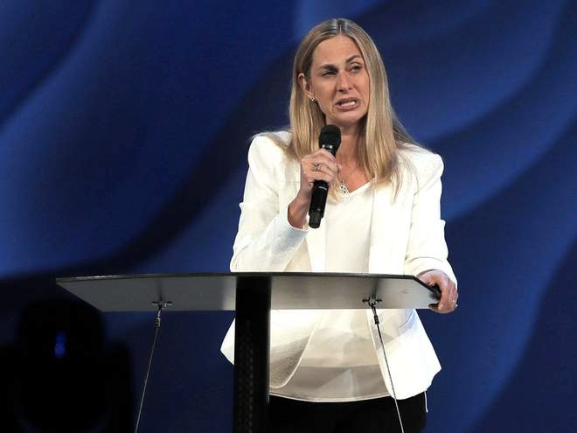
Bill Hybels
Notes:
The latest 10 August 2018 report now is: "The lead pastor of one of the largest evangelical churches in the US has said she is stepping down along with the entire Board of Elders after a string of sexual harassment allegations against its founder, Bill Hybels.
Heather Larson said the Willow Creek Community Church needed new leadership.
"To all of the women who have come forward, the church should always follow in Jesus’ footsteps to help the wounded find healing, and we are sorry we added to your pain,” she said in an announcement on the Chicago-area church’s website.
It has eight locations dotted around the Illinois city.
“That was not our intention, and we regret that it has taken us this long to acknowledge that. While we will probably never know with certainty everything that’s true about each of your stories, we have no reason not to believe you. We are sorry that our initial statements were so insensitive, defensive, and reflexively protective of Bill. We exhort Bill to acknowledge his sin and publicly apologise.”
Mr Hybels former assistant, Pat Baranowski, alleged to The New York Times that he repeatedly demanded oral sex and groped her while she worked for him the 1980s. After leaving her job, she struggled for 25 years with depression, becoming unemployed and homeless.
A number of other women have also accused Mr Hybels of sexual misconduct.
Although he denies the allegation, Mr Hybels resigned from the church in April.
The announcement from the Board of Elders came as the Willow Creek Association ahead of the megachurch's 23rd annual Global Leadership Summit.
Heather Larson, lead pastor at the Willow Creek Commnity Church, says the church needs new leadership in the wake of sexual harassment allegations against Bill Hybels (Steve Lundy/Daily Herald via AP)
Several speakers have backed out and over 100 churches cancelled plans to broadcast the event, after the allegations against Mr Hybels surfaced.
At least five participants, including Oscar winner Denzel Washington, also cancelled their scheduled appearances at the event, according to The Chicago Tribune.
Previous guests to appear at the summit over its 26-year history include U2 frontman Bono, Bill Clinton and Tony Blair.
Mr Hybels will not appear at the event, which he has previously hosted."
Willow Creek: Megachurch's lead pastor and board of elders resign in wake of sexual harassment allegations against founder Bill Hybels: 10 August 2018
https://www.independent.co.uk/news/world/americas/willow-creek-church-bill-hybels-sexual-harassment-pastor-elders-resign-chicago-a8484071.html accessed 11 Aug 2018
最新的2018年8月10日报告显示：“美国最大的福音派教会之一的主领牧师宣布，她与整个长老会将因其创始人比尔·海贝尔斯的一系列性骚扰指控而辞职。希瑟·拉森表示，威洛溪社区教会需要新的领导层。
‘对于所有站出来的女性，教会应始终遵循耶稣的脚步，帮助受伤的人找到医治，我们为给你们带来的痛苦感到抱歉，’她在芝加哥地区教会网站上的声明中说。
威洛溪教会在伊利诺伊州的多个地方设有分支。
‘这不是我们的本意，我们为承认这些问题拖延了这么久而感到遗憾。虽然我们可能永远无法确切了解每个故事的全部真相，但我们没有理由不相信你们。我们为最初的声明如此缺乏敏感性、防卫性并过度保护比尔而道歉。我们敦促比尔承认他的罪并公开道歉。’
海贝尔斯的前助手帕特·巴拉诺夫斯基向《纽约时报》指控称，海贝尔斯在1980年代多次要求她进行口交并对她进行性骚扰。在辞职后，她与抑郁症斗争了25年，并经历了失业和无家可归。
还有一些女性也指控海贝尔斯有不当行为。尽管他否认了这些指控，海贝尔斯于今年4月从教会辞职。
随着威洛溪协会准备举行第23届年度全球领导力峰会，长老会的公告随之而来。
在性骚扰指控曝光后，几位演讲者退出了该活动，超过100个教会取消了转播计划。据《芝加哥论坛报》报道，包括奥斯卡奖得主丹泽尔·华盛顿在内的至少五名参与者取消了他们的演讲安排。
在其26年的历史中，参加峰会的嘉宾包括U2乐队主唱波诺、比尔·克林顿和托尼·布莱尔。海贝尔斯不会出席此次活动，他以前曾主持过这场活动。”
来源：《独立报》，2018年8月10日，威洛溪：因创始人比尔·海贝尔斯的性骚扰指控，教会主领牧师及长老会辞职。

Slide 13
耶利米 5:20 CNV
那些称恶为善，称善为恶，
以暗为光，以光为暗，
以苦为甜，以甜为苦的人，
有祸了！

Slide 14
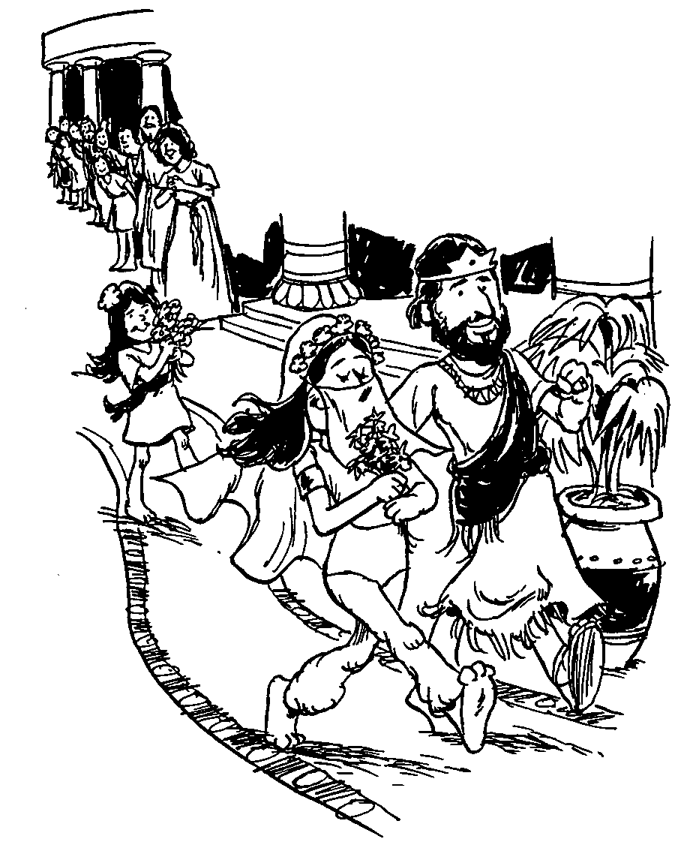
所罗门的雅歌
婚爱的对话

Slide 15

爱
钥字
425
钥句
“我属我的良人，他也恋慕我。”
(雅歌 7:10) CNV

Slide 16
作个有爱心的人
雅歌
Dr. Rick Griffith • Crossroads International Church Singapore
CICFamily.com • BibleStudyDownloads.org

Slide 17
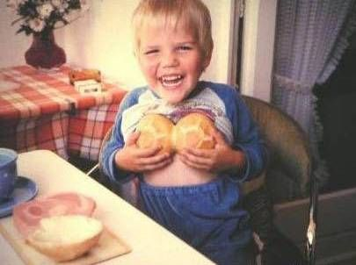
我们对性的好奇
从小就自然具有
然而，传统的犹太教不允许男子阅读雅歌书，直到他们三十岁才可以。

Slide 18

概述
425
婚恋的对话
从追求到婚礼
在婚姻中成长
1:1–5:1
5:2–8:14
爱的开始
爱的增长
自私的爱
“我的良人属我，我也属他” (2:16a)
无私的爱
“我属我的良人，我的良人也属我” (6:3a)
单身
已婚
早恋
爱情未经考验
经过考验的爱情 和真爱
回顾爱
求爱
1:1–3:5
婚礼
3:6–5:1
成长
5:2–8:4
回忆
8:5-14
渴望
1:1-11
加强
1:12–3:5
进程
3:6-11
圆满
4:1–5:1
挣扎
5:2–6:13
赞美和回应
7:1–8:4
爱的力量
8:5-7
爱的贞洁
8:8-14
都在葡萄园
蜜月开始
蜜月结束
都在葡萄园
分手
5:2-16
和好
6:1-13
约一年

Slide 19

如何让婚姻之爱成为神所定意的?
Notes:
What can you do now to have the fantastic marriage that God desires if he has marriage in his plan for you?
如果上帝为你安排了婚姻，那么你现在该做什么才能拥有上帝渴望的美满婚姻呢？

Slide 20

I. 婚前等待性 (雅歌 1:1–5:1)
Notes:
Be loving to God's person for you by preserving yourself now.
Solomon and the Shulammite begin their love relationship in courtship and marriage as an example of the need for premarital sexual restraint (1:1–5:1).
通过现在保持自己的纯洁，去爱神为你预备的那个人。所罗门和书拉密女子的爱情从恋爱到婚姻，展示了婚前性节制的重要性（雅歌 1:1–5:1）。

Slide 21
Slides on
雅歌 1

Slide 22

综述
430
婚爱的对话
1:1–5:1 求爱到婚礼
5:2–8:14 在婚姻中成长

Slide 23

所罗门的歌，是歌中之歌。
(1:1 CNV).

Slide 24

愿他用口中的热吻与我亲嘴，因为你的热爱比酒更美。
3你的膏油香气芬芳；你的名字如同倒出来的膏油；
所以众童女都爱你。
(1:2-3 CNV).
Notes:
Solomon and the Shulammite express longing, insecurity, and praise as a prelude to the content of the entire poem (1:2-11).
所罗门和书拉密女子表达了渴望、不安和赞美，作为整首诗歌内容的序曲（雅歌 1:2-11）。

Slide 25

愿你吸引我，我们必快跑跟随你。王领我进入他的内室。
王啊！ 我们要因你欢喜快乐；
我们要提说你的爱，
胜过提说美酒；
(1:4a-b CNV).
我們要提說你的愛，勝過提說美酒；
她們愛你是合理的。
(1:4b CUV).

Slide 26

The beloved’s “friends” (see NIV marg.), elsewhere referred to as the “daughters of Jerusalem”
(v. 5; 3:10; 5:8, 16) and “daughters of Zion” (3:11)
她们爱你是合理的
(1:4b CNY).
Notes:
The femaile inhabitants of Jerusalem as "The chorus is a literary device in the Song whereby the beloved and her lover express their emotions and thoughts more fully. By praising Solomon (you is masc. sing.) in 雅歌 1:4 the “daughters” seemed to be agreeing with one another that the couple had an ideal romance. The last line in verse 4 may be the words of the beloved (see niv marg.) or, perhaps better, the words of the friends" (Jack S. Deere, "雅歌," In The Bible Knowledge Commentary, 1:1014).
耶路撒冷的女子作为“合唱团”在《雅歌》中是一种文学手法，通过这种手法，所爱的人和她的爱人能够更充分地表达他们的情感和想法。在《雅歌》1:4中，女子们（“你”是阳性单数）通过赞美所罗门，似乎一致认为这对情侣拥有理想的浪漫关系。第4节的最后一句可能是所爱之人的话（见NIV旁注），或者更可能是朋友们的话。（Jack S. Deere，“雅歌”，《圣经知识评论》1:1014）。

Slide 27

耶路撒冷的众女子啊！ 我虽然黑，却是秀美，
如同基达的帐棚，
好像所罗门的幔幕。
6你们不要因为我黑，就盯着我，因为太阳把我晒黑了。
我母亲的儿子生我的气；
他们叫我看守家里的葡萄园，
我自己私人的葡萄园，我却没有看守。
(1:5-6 CNV).

Slide 28
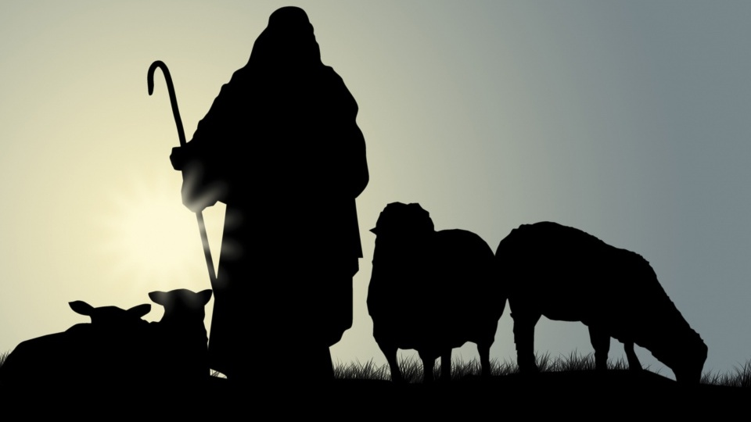
牧羊人
Notes:
Text

Slide 29
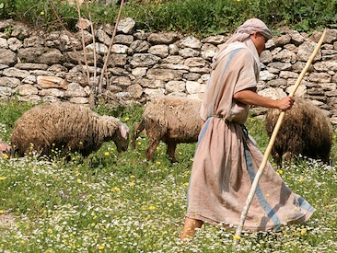
我心所爱的啊！ 求你告诉我，你在哪里放羊？
中午你在哪里使羊群躺卧休息。
我为甚么在你众同伴的羊群旁边，
好像蒙着脸的女人呢？
(1:7 CNV).

Slide 30
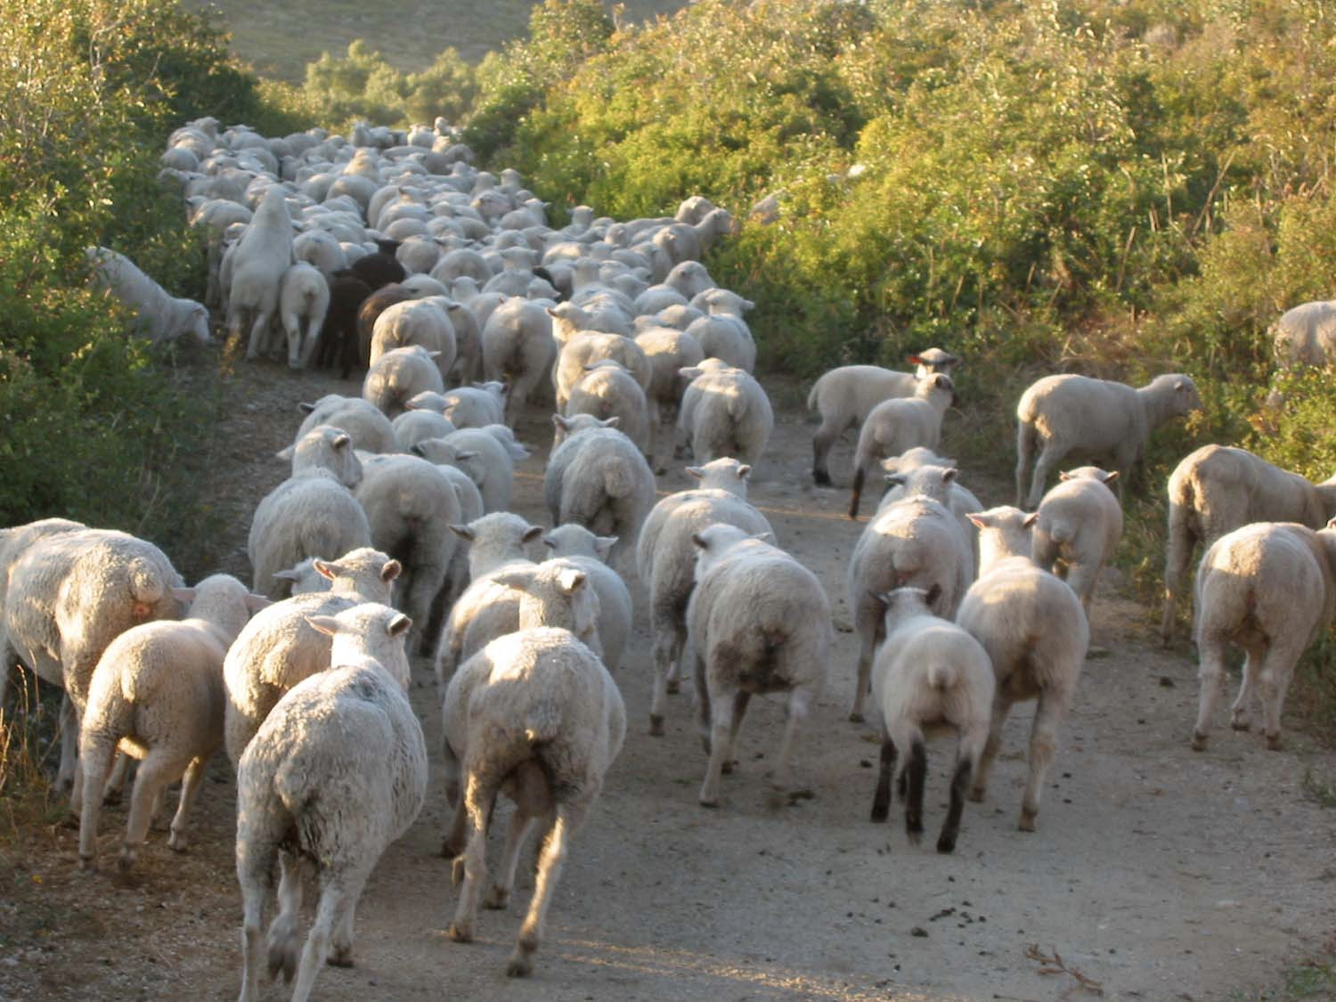
你这女子中最美丽的啊！ 你若不知道，
可以出去，跟随羊群的脚踪，
在牧人的帐棚边，
牧放你的山羊羔。
良人对佳偶的称讚
(1:8 CNV).

Slide 31

我的佳偶啊！ 我把你比作套在法老车上的骏马。 10 你的两腮因耳环显得秀丽；你的颈项因珠炼显得华美。
11我们要为你制金耳环，用银珠点缀。
(1:9-11 CNV).

Slide 32

12 王正坐席的时候，我的哪哒香膏散发芬芳的香味， 13 我以我的良人为一袋没药，挂在我的胸怀之中。 14 我以我的良人为一束凤仙花，开放在隐．基底的葡萄园里。
(1:12-14 CNV).
Notes:
The courtship between lover and beloved intensifies but they remain patient until their wedding day (1:12–3:5).
恋人与所爱之人之间的恋爱关系逐渐加深，但他们保持耐心，直到婚礼那一天（雅歌 1:12–3:5）。

Slide 33

我的佳偶啊！ 你很美丽；你很美丽。
你的眼好像鸽子的眼睛。
(1:15 CNV).

Slide 34

字面理解 或喻意理解?
年轻女子
¹⁶ ‪我的良人，你很英俊，你很可爱。
我们的床榻是青绿的树木；‬
¹⁷ ‪我们房屋的栋梁是香柏树，
房屋的椽子是松树。‬ (1:16-17 CNV).
年轻女子
¹⁶ 我的良人哪！你甚美丽可爱！
我们以青草为床榻，;
¹⁷ 以香柏树为房屋的栋梁，
以松树为椽子。 (1:16-17CUV).

Slide 35

比喻
我的良人，你很英俊，你很可爱。
我们的床榻是青绿的树木； 17 我们房屋的栋梁是香柏树，房屋的椽子是松树。
(1:16-17 CNV).
Notes:
"The beams of cedars and the rafters made of firs probably do not refer to a literal building but figuratively to the pastoral setting in which they first met. This is also suggested by the verdant (green) bed (couch). The field where they fell in love and sat talking was green" (Jack S. Deere, "雅歌," In The Bible Knowledge Commentary, 1:1014).
“香柏树的横梁和松木的椽子很可能不是指一个实际的建筑物，而是象征性地指他们第一次相遇的田园背景。这也可以从翠绿的床（躺椅）中看出。他们相爱的田野以及坐下来交谈的地方是绿意盎然的。” (杰克·S·迪尔，《圣经知识注释》，1:1014)。

Slide 36
Slides on
雅歌 2

Slide 37

睡哪儿？
他的左手托住我的头，他的右手拥抱着我。
(2:6).
Notes:
On my marriage night, my Beloved Susan and I approached our bed for the first time and I was at a loss which side of the bed I should sleep. However, I recalled Song 2:6…
• I figured the only way for me to get my left arm under her head was to lay on the left side of the bed. So, in an effort to sleep biblically, I have slept on that side sin 1983. (It also helps being right handed to embrace her with my stronger arm.)
在我的婚礼之夜，我亲爱的苏珊和我第一次走向我们的床时，我不知道应该睡在哪一边。然而，我想起了《雅歌》2:6...
• 我认为，要把我的左臂放在她的头下，唯一的办法就是睡在床的左边。所以，为了按照圣经的方式睡觉，自1983年以来，我一直睡在那一边。（这也有助于用我更强壮的右手臂抱住她，因为我是右撇子。）

Slide 38

Wait (Song 2:7)
耶路撒冷的众女子啊！
我指着田野的羚羊、母鹿恳求你们，
不要激动，不要挑动爱情，
等它自发吧。
(雅歌 2:7)
Notes:
The young woman feels blessed to have waited for God's best for her. She also wants other women to see the benefits of waiting for sex until marriage.
这位年轻女子觉得自己很幸运，能够等待上帝为她安排最好的一切。她还希望其他女性也能看到结婚后再发生性关系的好处。

Slide 39

那又如何?
425
禁止婚前性行为可以让婚姻充分被享受 (i.e.,让爱在它自己的时间绽放).
“不要惊动，不要叫醒我所亲爱的，等他自己情愿”
(2:7下 CNV).

Slide 40
Slides on
雅歌 3

Slide 41
那又如何?
425
禁止婚前性行为可以让婚姻充分被享受 (i.e.,让爱在它自己的时间绽放).
“不要惊动，不要叫醒我所亲爱的，等他自己情愿”
(2:7下 CNV).
“不要惊动，不要叫醒我所亲爱的，等他自己情愿”
(3:5下 CNV).

Slide 42

所罗门的婚礼？
那从旷野上来，好像烟柱；
用商人贩卖的各种香粉、
没药和乳香薰过的，是谁呢？ 7 看哪！ 是所罗门的御轿，四周有六十个勇士，
都是以色列中的勇士。
(3:6-7 CNV).

Slide 43
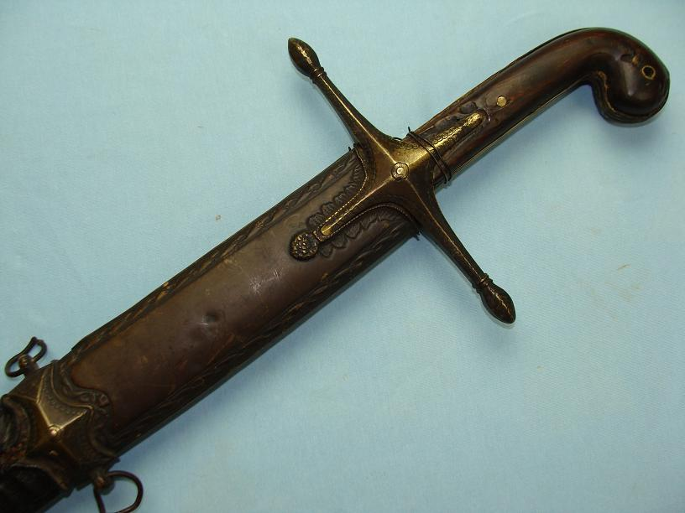
"他们都是熟练的剑士，有经验的战士。"
"个个手拿武器，能征惯战；
各人腿上配有利剑，以防夜间的袭击。”
（《雅歌》3:8).

Slide 44
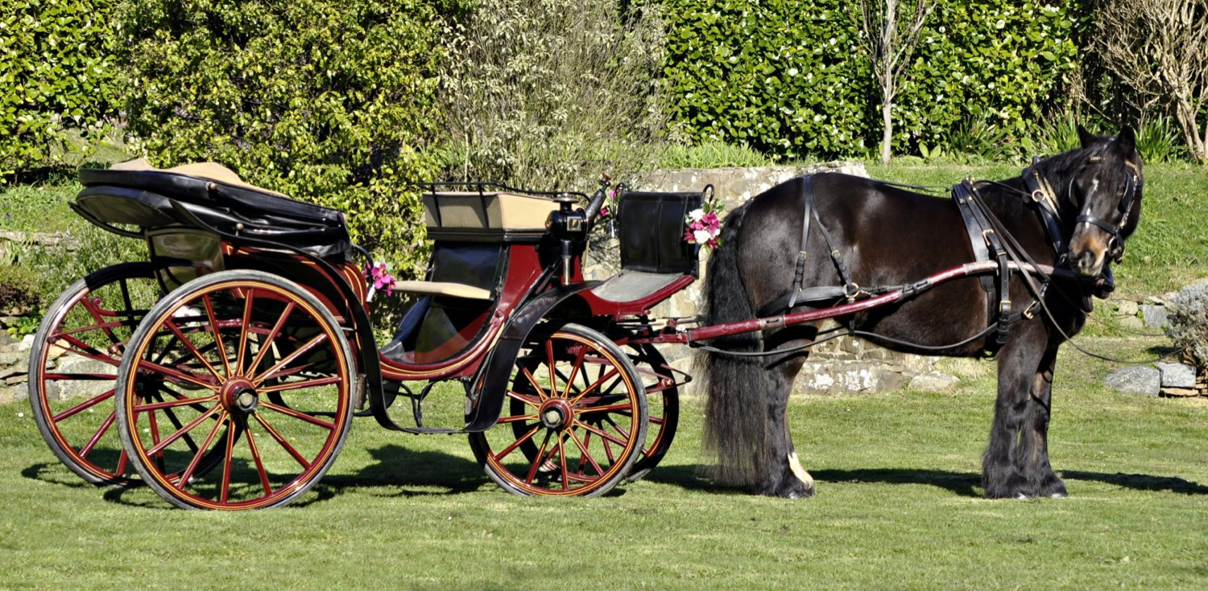
" 所罗门王用黎巴嫩木，为自己做了一乘华轿。
10他用银子做轿柱，用金子做轿底，用紫色料子做轿的座垫；内部所铺设的，是耶路撒冷众女子的爱情。
(3:9-10 ).

Slide 45
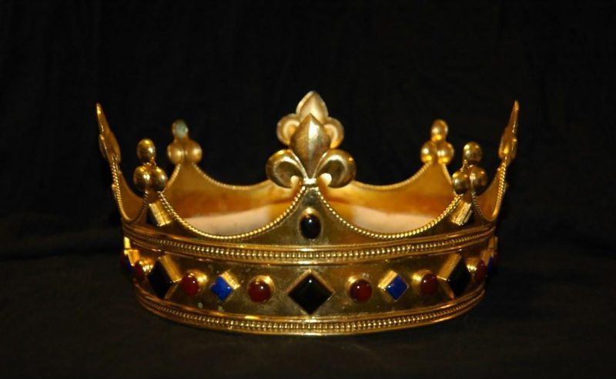
锡安的众女子啊！你们出来看看所罗门戴着的冠冕，就是在他结婚的日子，在他心里喜乐的时候，他母亲给他戴上的。
(3:11).

Slide 46
Slides on
雅歌 4

Slide 47
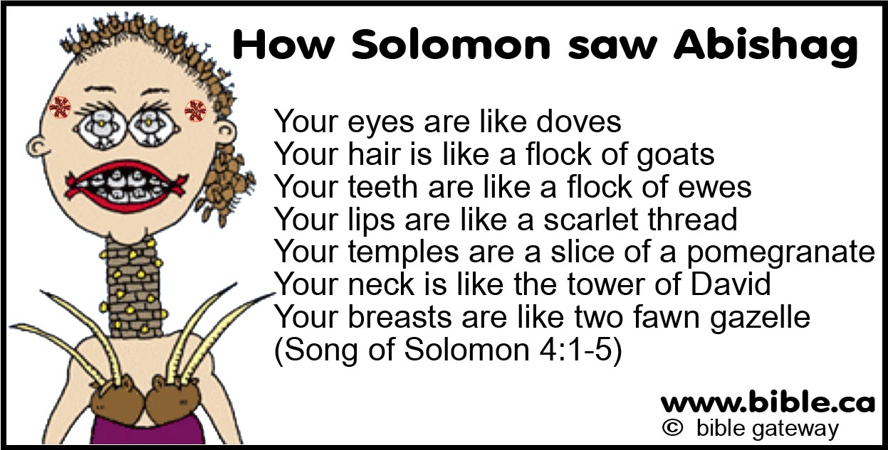
如何按字面理解雅歌?
所罗门如何看亚比煞？
你的眼睛像鸽子
你的头发如同山羊群
你的牙齿如新剪毛的一群母羊
你的唇好象一条朱红线
你的颈项好象大卫的高台
你的两乳好象一对小鹿
（雅歌4：1-5）

Slide 48


? R(A) 级
“北风啊！兴起。南风啊！吹来。吹进我的园里，让其中的香气散播出来。愿我的良人进入他自己的园中，享用他佳美的果子。”
(雅4:16 CNV)

Slide 49
Slides on
雅歌 5

Slide 50

我的妹妹，我的新妇啊！ 我进了我的园中；我采了我的没药与香料；
我吃了我的蜂房与蜂蜜；
我喝了我的酒和奶。(5:1 CNV).

Slide 51
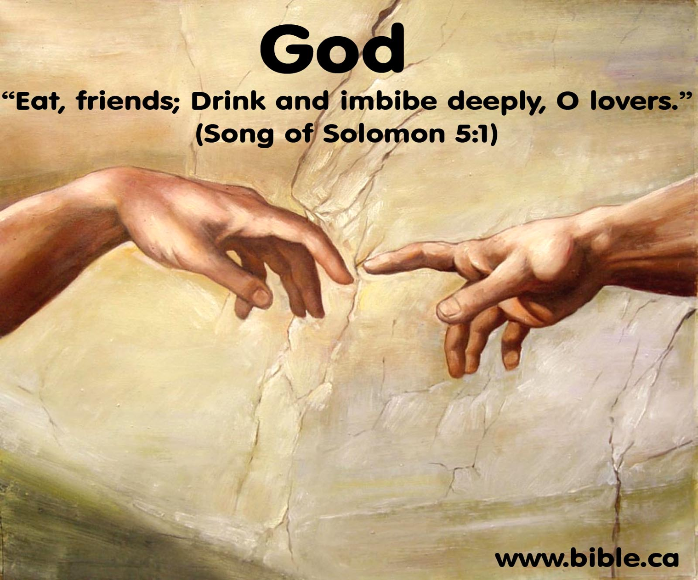
“吃吧，朋友们； 恋人们啊，尽情畅饮吧。
（所罗门之歌 5:1）
"Young Women of Jerusalem
Oh, lover and beloved, eat and drink!
Yes, drink deeply of your love!"
(5:1b NLT).
Notes:
"The NIV margin attributes the last part of the verse, Eat, O friends, and drink; drink your fill, O lovers, to the “friends” of the couple. However, it is unlikely that friends, wedding guests, or any other persons would have been present in the bedroom at the consummation of the couple’s marriage. A more plausible suggestion is that the speaker was God Himself. Only their Creator would have been a “guest” on that occasion. Since their love was from Him it was fitting that He approve it. He invited them to enjoy sexual love in marriage as if it were a banquet (“eat ... and drink”). This clearly indicates God’s approval of marriage, which He designed in the Garden of Eden (cf. Gen. 2:24)" (Deere, BKC, 1:1020).
NIV版本的旁注将这节经文的最后部分‘朋友们，请吃喝；恋人们，畅饮吧！’归于这对夫妻的‘朋友’。然而，在夫妻婚姻完成之际，朋友、婚礼宾客或任何其他人出现在卧室里是不太可能的。一个更合理的建议是，讲话者是神自己。只有他们的造物主才可能在那个场合‘作客’。既然他们的爱来自于祂，那么祂认可这份爱是很合适的。祂邀请他们在婚姻中享受性爱，如同享用盛宴（‘吃……喝’）。这清楚地表明了神对婚姻的赞同，祂是在伊甸园设计了婚姻（参创世记2:24）。”（迪尔，《圣经知识评论》1:1020）

Slide 52
如何让婚姻之爱成为神所定意的?
Notes:
What can you do now to have the fantastic marriage that God desires if he has marriage in his plan for you?
你现在可以做些什么来拥有神所期望的美满婚姻，如果婚姻在他的计划中为你预备了呢？

Slide 53
I. 婚前等待性 (雅歌 1:1–5:1)
Notes:
Be loving to God's person for you by preserving yourself now.
Solomon and the Shulammite begin their love relationship in courtship and marriage as an example of the need for premarital sexual restraint (1:1–5:1).
现在通过守护自己来对神为你预备的人表达爱意。所罗门和书拉密女子在求爱和婚姻中开始了他们的爱情关系，成为了婚前性节制的一个典范（1:1–5:1）。

Slide 54

II. 经营美好婚姻
(雅歌 5:2–8:14).
Notes:
No relationship is built without sweat and tears.
The love of the couple matures through various events until it is very strong to show the effort needed to grow in marital love (5:2–8:14).
没有哪一段感情是没有汗水和泪水就能建立起来的。
夫妻之间的爱情通过各种事件逐渐成熟，直到变得非常强烈，显示出婚姻爱情成长所需的努力（5:2–8:14）。

Slide 55

年轻女子
"我身虽然睡卧，我心却醒。
这是我的良人的声音，他敲着门说：“我的妹妹，我的佳偶，我的鸽子，我的完全人哪！求你给我开门；因为我的头满了露水，头发给夜露滴湿。”
(5:2 ).
Notes:
1. The Problem: The Wife’s Indifference and the Husband’s Absence (5:2-8)
5:2. In a dream (I slept but my heart was awake; cf. another recorded dream, 3:1-4) the wife was approached by her husband, who said Open to me (cf. 5:6). The fact that the lover no longer addressed her as “my bride” indicates there is a time lapse between verse 1 (the wedding night) and verse 2. The couple should no longer be regarded as newlyweds. But he did address her by other affectionate terms: my sister (see comments on 4:9), my darling (cf. 1:9, 15; 2:2, 10, 13; 4:1, 7; 6:4), my dove, and my flawless one (cf. 4:7). This is the first record of his using all these terms of endearment. His head and hair were covered with dew, as he had been outside. Dew in Israel was often heavy.
—Deere, BKC, 1:1020
1. 问题：妻子的冷淡与丈夫的缺席 (5:2-8)
5:2. 妻子在梦中（我睡着了，但我的心却醒着；参见另一个梦的记载，3:1-4）被丈夫接近，他说：“给我开门”（参见5:6）。情人不再称她为“新娘”表明第1节（婚礼之夜）与第2节之间有时间的间隔。这对夫妻不再被视为新婚夫妇。但他以其他充满爱意的称呼称呼她：我的妹妹（参见4:9的评论），我的爱人（参见1:9, 15；2:2, 10, 13；4:1, 7；6:4），我的鸽子，以及我的完美者（参见4:7）。这是他第一次使用所有这些爱称。他的头发被露水覆盖，因为他一直在外面。以色列的露水通常很重。
——摘自德尔，《圣经知识注释》，1:1020

Slide 56

" 我回答：“我脱了外衣，
怎能再穿上呢？
我洗了脚，
怎能再弄脏呢？
(5:3).
Notes:
She is indifferent to him at first.
起初她对他很冷漠。

Slide 57

"我的良人从门孔里伸进手来，
我的心因他大为激动。
5我起来，要给我的良人开门；我的两手滴下没药，指头滴下没药，滴在门闩上。
(5:4-5).
Notes:
But after he kept pursuing her, she then changed her mind about him
但在他不断追求她之后，她对他改变了看法。.

Slide 58

"我亲手给我的良人开门，
我的良人却已转身走了；
我发现他走了，差点昏倒；
我到处找他，却找不见，
我呼叫他，他却不回答。
7城中的守卫巡逻的时候，找着我；
他们打了我，伤了我；
看守城墙的人夺去了我身上的外衣。(5:6-7 ).

Slide 59

"耶路撒冷的众女子啊！我嘱咐你们：
你们若遇见我的良人，
你们要告诉他甚么呢？
你们要告诉他，我患了相思病。
(5:8).

Slide 60

他的口甜蜜；他全然可爱。
耶路撒冷的众女子啊！
这就是我的良人，
我的朋友。
(5:16 CNV).

Slide 61
你尴尬吗?
428
“我看牧师又要讲 ‘雅歌’ 了!”

Slide 62
Slides on
雅歌 6

Slide 63

我的佳偶啊！ 你美丽如得撒，秀丽如耶路撒冷，
威武如展开旗帜的军队。 5请你转眼不要看我，
因为你的眼使我心动！
你的头发如同从基列山下来的山羊群。
(6:4-5 CNV).

Slide 64
Slides on
雅歌 7

Slide 65
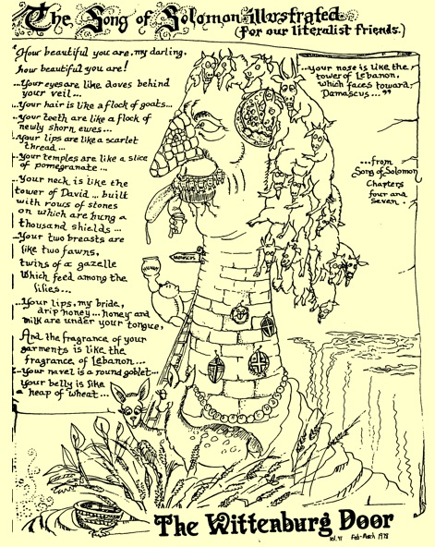
雅歌插画
436

Slide 66

我属我的良人，他也恋慕我。
(7:10).
Notes:
She responds to his request but also requests a countryside stroll and deeper intimacy in their marriage (7:9b–8:4).
她回应了他的请求，但也要求他们在乡间散步，并在婚姻中建立更深的亲密关系（7：9b–8：4）。

Slide 67
Slides on
雅歌 8

Slide 68
"求你把我放在你心上如印记，
把我带在你臂上如戳印；
因为爱情像死亡一般的坚强；
嫉妒如阴间一般的坚稳；
它的烈焰是火的烈焰，
是非常猛烈的火焰。
7爱情，众水不能熄灭，
洪流不能淹没；
如果有人拿自己家里所有的财产去换取爱情，
就必被藐视。
(8:6-7 NLT).
Notes:
The beloved exults in the awesome strength of genuine love by declaring that it is as universal and irresistible as death (8:5-7).
所爱的人赞美真正爱情的巨大力量，宣告它像死亡一样普遍且不可抗拒（8:5-7）。

Slide 69
年轻女子的兄弟
"我们有一个小妹妹，
她的两乳还未发育完全；
有人来提亲的时候，
我们当为她怎样办理呢？
9她若是墙，
我们就要在她上面建造银塔；
她若是门，
我们就要用香柏木板围护她。
(8:8-9).
Notes:
The brothers of the Shulammite protected her from losing her virginity while she was young (8:8-9).
书拉密女子的兄弟们在她年幼时保护她，使她没有失去贞洁（8:8-9）。

Slide 70
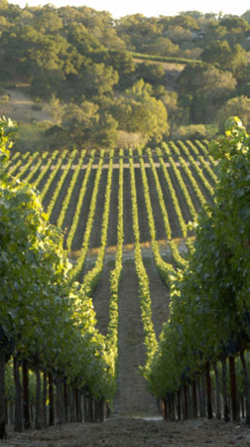
"所罗门在巴力．哈们有个葡萄园；他把这葡萄园租给看守的人，各人要为葡萄园所得的果子付一万一千四百克银子。
12我自己的葡萄园却在我面前，所罗门哪，一万一千四百克归给你，二千二百八十克归给那些看守果子的人。
(8:11-12 ).
Notes:
The love story of Solomon and the Shulammite is reviewed in flashback form (8:8-14).
所罗门和书拉密女子的爱情故事以闪回的形式回顾（8:8-14）。

Slide 71
结语
425
所罗门和他的书拉密女妻子
之间的爱情故事描绘了
从求爱到坚固婚爱的过程。
不论在婚前性约束方面，
还是在婚姻成长中所需的努力方
面，都树立了一个良好的榜样。

Slide 72
如何让婚姻之爱成为神所定意的?
Notes:
What can you do now to have the fantastic marriage that God desires if he has marriage in his plan for you?
如果上帝为你安排了婚姻，那么你现在该做什么才能拥有上帝渴望的美满婚姻呢？

Slide 73
I. 婚前等待性 (雅歌 1:1–5:1)
Notes:
Be loving to God's person for you by preserving yourself now.
Solomon and the Shulammite begin their love relationship in courtship and marriage as an example of the need for premarital sexual restraint (1:1–5:1).
现在通过守护自己来对神为你预备的人表达爱意。所罗门和书拉密女子在求爱和婚姻中开始了他们的爱情关系，成为了婚前性节制的一个典范（1:1–5:1）。

Slide 74
II. 经营美好婚姻
(雅歌 5:2–8:14).
Notes:
No relationship is built without sweat and tears.
The love of the couple matures through various events until it is very strong to show the effort needed to grow in marital love (5:2–8:14).
没有任何关系是在没有付出汗水和泪水的情况下建立起来的。这对夫妻的爱情通过各种事件逐渐成熟，直到变得非常坚固，以此表明在婚姻之爱中成长所需的努力（5:2–8:14）。

Slide 75

雅歌中心思想
通过等待与经营来相爱
Notes:
Restatement

Slide 76

我们需要帮助陷入困境的婚姻。

Slide 77
那又如何?
425
禁止婚前性行为可以让婚姻充分被享受 (i.e.,让爱在它自己的时间绽放).
“不要惊动，不要叫醒我所亲爱的，等他自己情愿”
(2:7下 CNV).
“不要惊动，不要叫醒我所亲爱的，等他自己情愿”
(3:5下 CNV).
“不要惊动，不要叫醒我所亲爱的，等他自己情愿”
(8:4下 CNV).

Slide 78

守贞直到婚姻
等待的女性对自己选择的感受。

Slide 79
美国的通奸率
100%
来源：今日美国
95%
1%
0%
1900
2002
Notes:
Most Americans have had premarital sex, study finds
Updated 12/19/2006 9:29 PM ET
usatoday30.usatoday.com/news/health/2006-12-19-premarital-sex_x.htm
Accessed 29 Feb 2016 (ten years later)
研究发现，大多数美国人都有过婚前性行为
更新时间：2006年12月19日晚上9:29
来源：USA Today
访问时间：2016年2月29日（十年后）

Slide 80
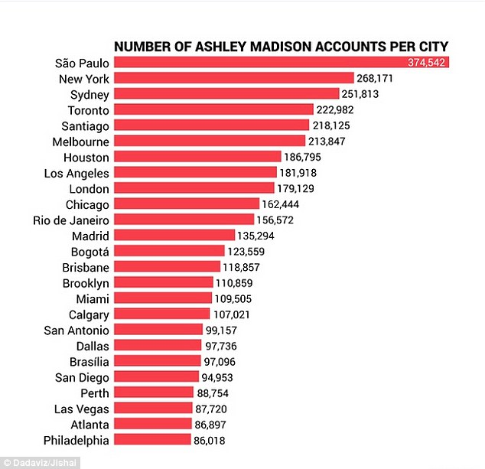
每个城市的账户
超过20,800,000个匿名会员加入了一个促进通奸的网站。

Slide 81

“和妇人通奸的，实在无知；
行这事的，是自我毁灭。
他必遭受击打，被凌辱，
他的耻辱永不能涂抹。”
(箴言6:32-33).

Slide 82
那又如何?
425
禁止婚前性行为可以让婚姻充分被享受 (i.e., 让爱在它自己的时间绽放–2:7b; 3:5b; 8:4b).
期待一个美好的婚姻，然后为之努力.
称赞你配偶的优点--不论是身体上的还是非身体上的.

Slide 83
Black

Slide 84


圣经阐释 • BibleStudyDownloads.org
免费获得该讲解!
圣经学习下载
你需要更好地了解圣经吗？谁不需要呢？BibleStudyDownloads （圣经学习下载）为神学生和教师们提供了从 创世纪 到 启示录的 30万份 可编辑的免费PowerPoint和Word文件。
本网站的大部分资料由Dr. Rick Griffith 博士设计，他从1991年到2021年在新加坡神学院教授圣经、神学和讲道学，现在是约旦福音神学院的圣经释经教授。
圣经学习下载
Notes:
BE Bible Exposition—Chinese

