Slide 1

Bersyon 9.65
Ang Biblia . . . Gipatin-aw
Ang presentasyon sa Ang Biblia…Gipatin-aw Ministeryo sa kanasoran.
Fort Worth, Texas
www.biblebasically.org
©2003 TBBMI
9.65.01.01

Slide 2
Ginatawag imong pagtagad… PAKI PALONG SA TANANG CELLPHONE, UG UBAN PANG GAMIT PANG KOMUNIKASYON KUNG MAGTUDLO NA.
ANG IMONG MGA AMIGO SA KLASE MAGPASALAMAT GYUD SA IMOHA.
9.65.01.02
1
©2003 TBBMI
Notes:
Same as text above

Slide 3
©
Ang Biblia…Gipatin-aw Ministeryo sa kanasoran
Doktor John Hannah
Inila na Profesor sa Masaysayon na Teyolohiya
Propesor sa Pagsusuri, Masaysayon na Telohiya
Dallas Theological Seminary
Dallas, Texas
Ang Komitiba sa mga punoan
Doktor Rick Griffith
D.Min Direktor
Profesor ng Biblical Studies
Singapore Bible College
Republika ng Singapore
Doktor Mark Bailey
Presidente
Dallas Theological Seminary
Dallas, Texas
John Maisel Kurt Nelson
Presidente Bise Presidente
East/West Ministries
Dallas, Texas
Doktor William R. Bright
Ang Nagmug-na sa
Campus Crusade for Christ
Orlando, Florida
Vasily Dimitrievski
Direktor sa Russia
Global Missions Fellowship (e3)
Penza, Russia
Rev. Douglas Valenzuela
Senior Pastor, Conservative Baptist Missions
Chiesa Battista Evangelica di Casoria
Naples, Italy
Doktor Ted Kitchens
Senior Pastor
Christ Chapel Bible Church
Ft. Worth, Texas
Karyn Granger
Direktor ng Bible Studies
Southwest Christian Schools
Ft. Worth, Texas
Doktor Kenneth Horton
Senior Pastor
McKinney Memorial Bible Church
Ft. Worth, Texas
©2006 TBBMI
9.65.01.03
Notes:
This seminar has been approved by many respectable leaders in the western world.

Slide 4
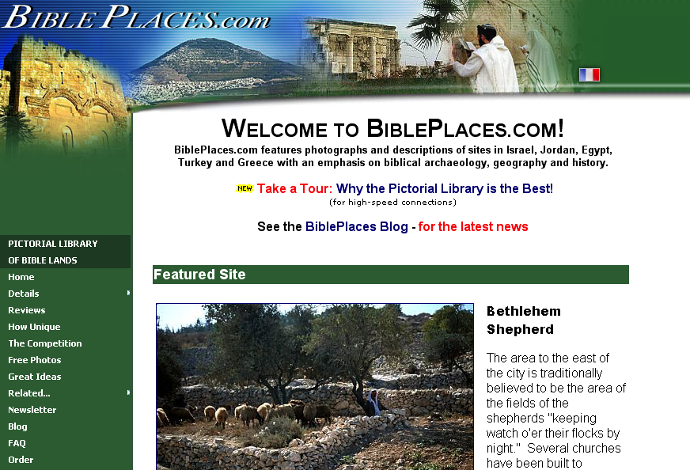
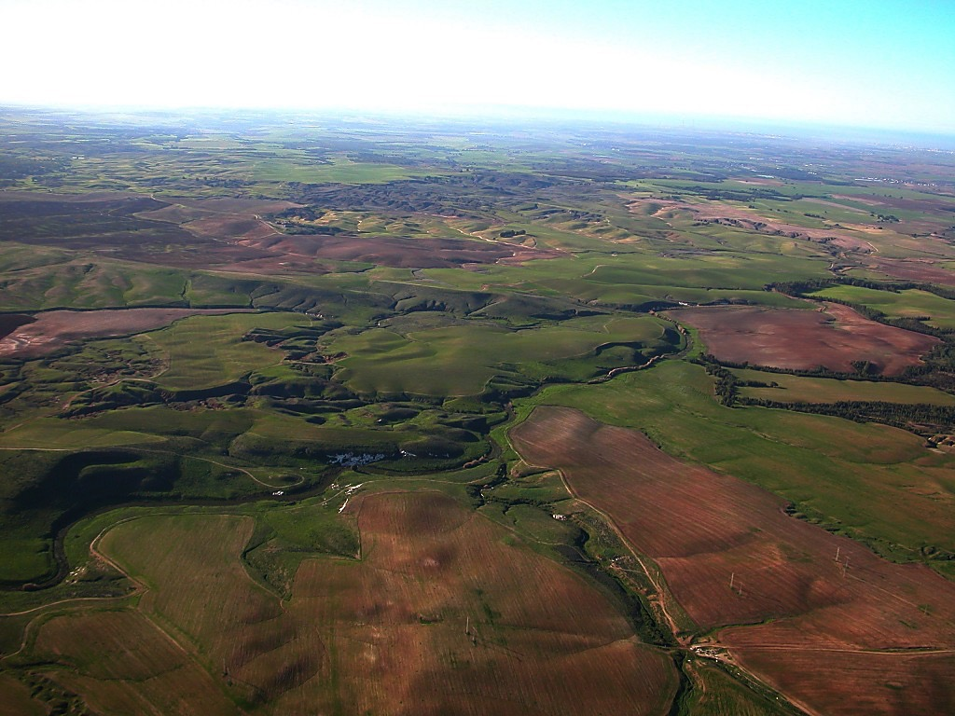
Ang hinulagway na librarya sa mga lugar sa Biblia
Ang kini na ministeryong dako na nagapasalamat kay Todd Bolen, ang tagamugna sa “Ang hinulagway na librarya sa mga Lugar sa Biblia” sa pagsugot na gamiton ang mga litrato na naa sa ANG BIBLIA…GIPATIN-AW. Ang mga nagagamit sa ABG ay ginadasig na magbisita sa BiblePlaces.com ug pag-usisa sa liboan na mga hulagway na gikan sa Balaan na Lugar hangtud sa tanang bahin sa Aegean at Mediteraneo paadto sa Europa kung asa nagsugod ang Kristyanismo. Ang BiblePlaces.com nagatanyag sa mga magnunudlo ug sa mga nagagama ug mga litrato na walay kaparis. Magbisita na! Daghang Salamat, Todd!
©2006 TBBMI
9.65.01.04
Notes:
This presentation has been granted use of almost 150 pictures from the BiblePlaces.com website. We thank Todd Bolen for his support!

Slide 5
Ang Proyekto na “Ang Biblia.. Gipatin-aw” ay nahunahunaan, naayos ug gihimo
ni John E. Fryman, Ph.D
Katungod sa pagkopya © 2003 Ang Biblia…Gipatin-aw Ministeryo sa kanasoran., Ft. Worth, Texas
Reserbado ang tanan na katungod. Kini ay protektado na katungod sa pagkoya sa Estados Unidos. Dili pwede magkopya sa unsa man na parte kung walay pormal na kasulatan na musugot gikan sa tag-iya sa katungod sa pagkoya, pero pwede sa kaso sa gamay lang na parte na naa sa kritikong artikulo.
Sa mga seksyon na naay permiso na gihatag ay pewede na makopya kung kinahanglan sa estudyante.
Ang ministro ay utang kay Todd Bolen, The Master’s College, Jerusalem, Israel, at BiblePlaces.com para sa pagsugot sa paggamit sa mga litrato dinhi. Kung ang materyal na naay katungod sa pagkoya ay gigamit na wala mi kahibalo, ang ministro ay naghangyu na masultihan dayon sila. Ang sulod ay bag-ohon dayon. Tanan himuon para dili mausab ang paggamit sa teksto ug larawan na walay permiso.
Gawas sa naay permiso, ang mga magtutudlo, mga nagatrabaho sa medya ay dili pweden bag-ohun ang PowerPoint, epekto na animasyon, o ayos sa unsa man na pamaagi, sa unsa man na kompyuter na aplikasyon gikan sa unsa man na sudlanan sa imahe, transmisyon o pamaagi sa Internet.
Gihimo sa Estados Unidos. Reserbado ang Katungod na Pangkalibotan.
.
©2006 TBBMI
9.65.01.05
Notes:
At biblestudydownloads.com you can download all of the PPT for this seminar so you can teach it to your own people. However, as this copyright page notes, we ask you not to change any of the content.

Slide 6
Bersyon 9.65
Ang Biblia . . . Gipatin-aw
Ang presentasyon sa Ang Biblia…Gipatin-aw Ministeryo sa Kanasoran.
Fort Worth, Texas
www.biblebasically.org
©2003 TBBMI
9.65.01.06

Slide 7



(katuyuan: Pagdumala sa Biblia gamit ang imong paghunahuna!)
ANG BIBLIA…
GIPATIN-AW
®
UNANG BAHIN
PAG-ABRI SA “HUNOS NA BIBLIA”
©2006 TBBMI
9.65.01.07
Notes:
Our goal during this seminar is to mentally manage the Bible.

Slide 8
UNSA ANG SINUGDANAN SA…
?
Atong sugdan ang kini na proyekto sa pamaagi sa usa ka lig-on ug tama pagpaghatag bili !
Kada Kristyanismo na Doktrina
Kada Kristyanismo na Tinuhoan
Kada libro na basehan ang Biblia:
Na naa sa kada librarya sa Seminaryo
Na naa sa kada Publiko na Librarya
Na naa sa kada Pribado na librarya
Na naa sa kada librarya sa Unibersidad
Na naa sa kada Nasod sa Kalibutan
Na naa halos sa tanan na kada Sinultihan
UG
Sa kada hunahuna sa tagatumutuo
ug sa dili pa tumutuo ug nagapuyo sa tanan na lugar sa kalibutan na gibasehan ang Biblia
9.65.01.08
15
©2006 TBBMI
Notes:
Our lonely planet floats in space while men on its surface struggle – sometimes in vain – to understand it! They ask the questions for which Christians have the valid answers. But too many of the questioners either will not listen…or else have never heard. Believers know very well that the answers have been given between the covers of God’s Word…His Bible.
//// So with that fact in mind…let’s launch this seminar with one massive thought!
//// What is the source of
//// every Christian doctrine,
//// Every Christian belief system,
//// In every Biblically based book in
//// Every seminary library,
//// Every public library,
//// Every personal library,
//// Every University library,
//// In every country in the world,
//// In almost every language,
//// And…besides all that…
//// The source of every biblically based thought of
//// every believer and nonbeliever across our planet?
//// (DIZ QUESTION MARK)

Slide 9
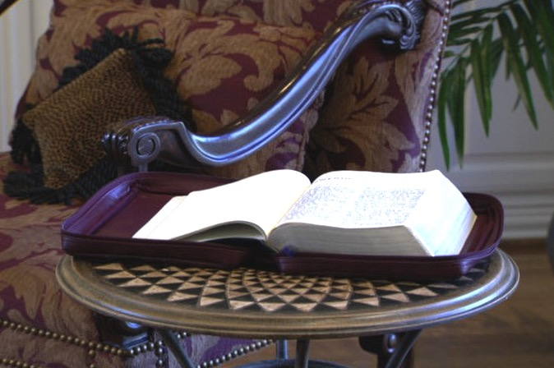
ANG PINAKA-IMPORTANTENG DOKUMENTO SA ATONG PAGTUO
Hanbuk pahina 6
©2006 TBBMI
2
9.65.01.09
Notes:
The answer? This book: Because Christian belief is built on personal faith in this Book... However…that faith is also built upon solid fact! The Word of God is an organized record of the facts of the faith.
//// We can call it: the BASIC DOCUMENT OF OUR FAITH!
However, around the world, well-grounded research and experience shows that -- for MOST people -- the facts and historical progression of scriptural storyline are a great and lasting mystery.
//// And a housekeeping note to begin: at the lower right-hand corner of many slides you’ll see a reference to locations in the TBB student handbook for your personal reference.

Slide 10

Sa iyang libro “What The Bible Is All About!”
(Unsa gyud ang Biblia!)
Gisulat ni Doktor Henrietta Mears
Hanbuk pahina 6
©2006 TBBMI
9.65.01.10
Notes:
One of the great Bible teachers of the 20th Century, Henrietta Mears....wrote about this idea in her book, “What The Bible Is All About.” She said…

Slide 11
Ang nahibal-an sa kadaghanang tao bahin sa Biblia murag lubid na perlas..
Pero sa panghunahuna sa nagabasa..
Hanbuk pahina 6
©2006 TBBMI
9.65.01.11
Notes:
SAME
Most people’s Bible knowledge is like a string of fine pearls…but in many readers’ minds…

Slide 12

…ang lubid naputol na… Ang hapsay na pagsunod-sunod sa istorya sa Biblia gubot na kaayo ug lisud sabtun!
Hanbuk pahina 6
©2006 TBBMI
9.65.01.12
Notes:
…the bead string is broken. The organized progression of the Biblical storyline is disorganized and confused. Each fine gem is separate…disorganized…just strewn about all around. It is impossible to appreciate the beauty of that complete necklace of lovely pearls.

Slide 13
Hanbuk pahina 6
©2006 TBBMI
9.65.01.13
Notes:
How can we restring the lovely pearls? In the same way…how can we reassemble the pieces of SCRIPTURE, bringing them together so that, just like the pearls, each piece is in its proper place...one leading to another…each gem or biblical fact placed in ITS proper relationship…as each relates to every other one in that grand panorama of biblical revelation…stretching across 4,000 years?
Only with an organized, mentally accessible knowledge base of Scripture can we begin to comprehend …

Slide 14
Ang Giladmon sa
Balaang Kasulatan
Ang gamay na kalainan sa kahulogan
Mas lalum na paggiya sa Balaan na Ispiritu
2
©2006 TBBMI
9.65.01.14
Notes:
…the depth of Scripture
//// the nuances of its meaning…and
//// the deeper leadings or instructions from the Holy Spirit…Who stands ready to teach us through every page of His Word.
Can that kind of comprehensive, coherent knowledge of Scripture be accomplished? Answer: Yes...it can be done...both swiftly and efficiently.

Slide 15
?
?
Ang Plano na Pagtubos sa Ginoo
Si Abraham ug ang mga
unang Israelita
Ang Pagabot sa Ginoong
Hesu-Kristu
Ang Pagpanganak sa Iglesia
?
?
?
?
?
?
?
5
©2006 TBBMI
9.65.01.15
Notes:
In this one book, we are told how to see…
//// The glorious wholeness of God’s Plan of Redemption recorded for us in words we can understand…framed by…
//// …the drama of old Abraham and ancient Israel…beginning in the Middle East some 4,000 years ago…
//// ….culminating in the appearance and gospel ministry of the Lord Jesus Christ…
//// …and the birth of the Church. Our part of the story is to understand the movement of the Gospel message of Jesus Christ …progressing right down to our own time.
//// But, sad to say, for the vast majority of people, this is often unfamiliar territory. In fact, for many, it's a downright intellectually fearful place.

Slide 16





  TAN-AWA ANG KINING TANAN NA BIBLIA!
©2006 TBBMI
9.65.01.16

Slide 17
Ug DINHI nagsugod ang problema!
Kini usa ka dako na paglibog!
• Libo nga mga Detalye
• Gatus na mga Tawo
• 750,000 na Pulong
• 1,200 na tsapter
• 31,000 Bersikulo
• Dili maihap na paghubad
7
©2006 TBBMI
9.65.01.17
Notes:
And that’s where the problem begins. For many people…believers included…
//// the Bible is a huge and unruly puzzle.
//// It has thousands of details...
//// hundreds of characters...
//// three/quarters of a million words...many exotic and unfamiliar...
//// 1,200 chapters...
//// 31,000 verses...
//// and those countless versions and translations...in unnumbered languages all across the planet...
Taken together, this situation produces an enormous problem for readers more accustomed to today's quick-in, quick-out approach to reading and to literature and entertainment in our age of high technology.

Slide 18
KINSA ANG NAGHIMO?
KINSA ANG NAG SULTI?
NGANO?
MGA AKLAT
MGA TAO
MGA PITSA
UNSA ANG NAAY KALABUTAN KAY KINSA UG UNSA?
7
©2006 TBBMI
9.65.01.18
Notes:
Here are some typical worries...
//// what about all those books...
//// all those people, all 3,000 of them...
//// all the dates...
//// and who said what...
//// why did they do what they did...
//// who did what...
//// and what relates to whom or what?

Slide 19
TABANG!
KINSA ANG NAGHIMO?
KINSA ANG NAGSULTI?
MGA LIBRO
NGANO?
MGA TAO
MGA PITSA
UNSA ANG NAAY KALABUTAN KAY KINSA UG UNSA?
©2006 TBBMI
9.65.01.19
Notes:
In fact, for many folks, they just yell, “ HELP! Get me through this puzzle…because I’m really lost!”

Slide 20
TABANG!
DILI NAKO MAKAYA !!!
MAU NA...
ANG PASTOR
NA ANG MAGHIMU
ANI!
©2006 TBBMI
9.65.01.20
Notes:
And many of them go one step farther...they say, I JUST CAN'T TAKE IT! SO...I'LL JUST LET THE PASTOR DO IT…Or whoever the Biblical expert in their world might be at the time.

Slide 21
WALA KOY
LABOT NO?
©2006 TBBMI
9.65.01.21
Notes:
And then again...WHO CARES?
[Often we end up apathetic]

Slide 22
UNSA MAN
KARON?
©2006 TBBMI
9.65.01.22
Notes:
And the next question might be...SO WHAT? [But why do we need an overview of Scripture?]

Slide 23
“Gawas kon ang atong pagtuo ay gitukod sa kamaturanan, kini dili mulabaw sa huna-huna, pagtuotuo ug sa abi .”
Miles Stanford
Gikan sa Prinsipyo sa Spiritwal na Tubo
kamaturanan
huna-huna
pagtuotuo
abi
4
©2006 TBBMI
9.65.01.23
Notes:
One answer comes from a great Christian writer...hear the words of Miles Stanford:
"Unless our faith is established on
//// facts, it is no more than
//// conjecture,
//// superstition and
//// presumption."

Slide 24
Ang puntos na mao ang angkla ng pag-tuon…
“Dili ta mutuo na labaw pa sa atong nahibal-an,
Ug dili ta magpuyo labaw pa sa atong tinuhoan.”
Albert Mohler, Presidente
Nang Southern Baptist Seminary Louisville, KY
3
©2006 TBBMI
9.65.01.24
Notes:
And think about this anchor point of study…
//// Dr. Albert Mohler, president of The Southern Baptist Seminary in Louisville, Kentucky, wrote this…
//// “We will not believe more than we know…
//// …and we will not live higher than our beliefs. The many fronts of Christian compromise in this generation can be directly traced to biblical illiteracy in the pews and the absence of biblical preaching and teaching in our homes and churches…This generation must get deadly serious about the problem of biblical illiteracy, or a frighteningly large number of Christians will go on thinking that Sodom and Gomorrah lived happily ever after.”

Slide 25
Sugod na ta!
(Ayaw pagsipyat maski sa usa ka sesyon. Taga sesyon pundasyon sa sunod!)
©2006 TBBMI
1
9.65.01.25
Notes:
Which brings us to the study that lies ahead. We are about to embark on a Biblical voyage named: THE BIBLE…BASICALLY. It’s a quick tour through ALL of Scripture, leaving you well equipped to THINK BIBLICALLY and to help others acquire that same skill!
You will have a new set of mental tools that can reshape your view of God’s Word and his message for your life and the lives of others around you…both believers and those still searching for life’s answers!
//// So here we go…and try to attend every session or class because each new idea steadily builds on those that have gone before!

Slide 26
ANG BIBLIA… GIPATIN-AW
®
usa ka pamaagi sa pagpuyo!
©2006 TBBMI
9.65.01.26
Notes:
TBB is new way of thinking Biblically!
CHANGED FROM THE ORIGINALS (TQC)
Old: We’ll first learn THE QUICK CHRONOLOGY of the Biblical story line…that will lead you directly into a new way of thinking Biblically!

Slide 27
ANG BIBLIA… PINATIN-AW
®
Mahibal-an nimo kung unsaon magdumala sa Biblia sa imong hunahuna lang!
©2006 TBBMI
9.65.01.27
Notes:
You’ll be learning to mentally manage your Bible!
CHANGED FROM THE ORIGINALS (TQC)

Slide 28
ANG BIBLIA… GIPATIN-AW
®
ANG PINAKAIMPORTANTE NA BUTANG NA DAPAT NIMO MAHIBAL-AN: Kini pwede
Nimo matudlo sa uban!
P 7 K H
Ug kini usa ka kahigayonan para sa pagsangyaw sa Maayong Balita !!!
1
©2006 TBBMI
9.65.01.28
Notes:
And there’s an important subtext going on here also: you will be learning something that you can teach to others!
//// And what an opening for witnessing to others around YOU!
So, here we ago…
CHANGED FROM THE ORIGINALS (TQC)

Slide 29
ANG BIBLIA… GIPATIN-AW
®
Ang Pag-abri sa IMONG
“Mga hunos na Biblia”
©2006 TBBMI
9.65.01.29
Notes:
…with first things first…Let's begin by opening up “Your Bible File.”
CHANGED FROM THE ORIGINALS (TQC)

Slide 30
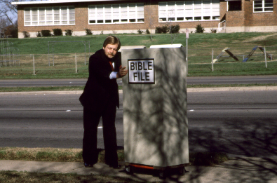
MGA HUNOS NA
BIBLIA
©2006 TBBMI
9.65.01.30
Notes:
I'd like to introduce you to our friend, Mike. Mike is about to go into church. He’s entering the building with a "Bible File" of information already in his head...well…somewhat!

Slide 31
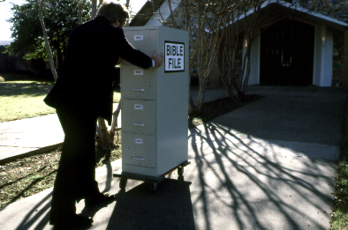
MGA HUNOS NA
BIBLIA
9.65.01.31
Notes:
There he is…walking up the sidewalk right into church with his mental Bible File...

Slide 32
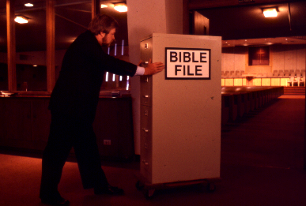
MGA HUNOS NA
BIBLIA
©2006 TBBMI
9.65.01.32
Notes:
... And Mike goes straight into the building, pushing that File Cabinet in his head right into the sanctuary or worship center.

Slide 33
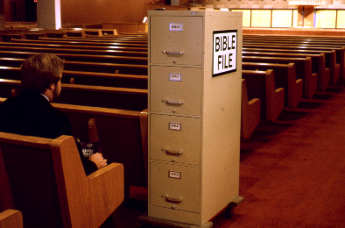
MGA HUNOS NA
BIBLIA
©2006 TBBMI
9.65.01.33
Notes:
Mike sits himself down ready for the preacher or the teacher to begin. And Mike is getting ready to open his Biblical file cabinet…

Slide 34
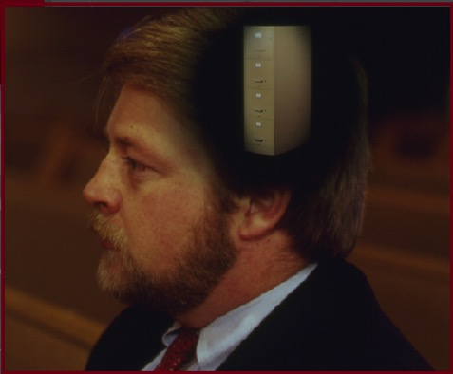
©2006 TBBMI
9.65.01.34
Notes:
…up there in his head! …….Well, there he sits... his Bible file all primed to plug into whatever the pastor or teacher is about to say.

Slide 35
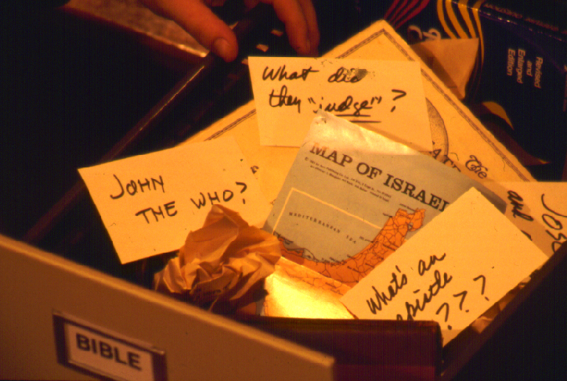
?
SO KARON….ASA KA MAGSUGOD MAGPILI SA MGA TAMA.. UG SA MGA DILI TAMA NA IMPORMASYON?
?
?
?
5
©2006 TBBMI
9.65.01.35
Notes:
When he opens up his mental Bible File…figuratively speaking of course…it is a mess!
//// John the Who? Baptist? Methodist? Catholic? Maybe Jewish? What’s that all about?
//// And what in the world did they Judge? Who were those judges anyway? Who elected them in the first place?
//// And ANY map of Israel...now that's a place of Biblical confusion! You mean to tell me, Mike says, that that is the very same place as today's Israel, the one in the newspapers and on TV?
//// And the “Epistles?”....truly, research shows that many people think that an EPISTLE was the wife of an APOSTLE! Yes, some really do think that!
//// So...where do you begin to sort out all that information...and a great deal of MISinformation?

Slide 36
WALA KO kabalo-!
Kung
Asa ko Magsugod?
©2006 TBBMI
9.65.01.36
Notes:
Most folks will say, "I have absolutely no idea!"
…So..."Where do I begin?"

Slide 37
7
Hanbuk pahina 8-14
©2006 TBBMI
9.65.01.37
Notes:
Let’s start with the number 7. But look closely and you'll see that dash through the stem of the 7.

Slide 38
7
7
Hanbuk pahina 8-14
1
©2006 TBBMI
9.65.01.38
Notes:
And that's important! The dashed line will remind you of something. In just a minute you'll divide that number 7 into two others: 4 and 3.
//// Also, as the visuals move along, many of them will have that 7 with a dashed line through its stem up in the right hand corner of each frame….a handy, continuing reminder of the mental tools we are learning to use.

Slide 39

7
ANG IMONG MGA HUNOS NA BIBLIA
Hanbuk pahina 8-14
©2006 TBBMI
9.65.01.39
Notes:
Now let's think again about a filing cabinet. This will be YOUR BIBLE FILE! Here is a look ahead to where we are going in this study.

Slide 40
7
ANG IMONG MGA HUNOS
NA BIBLIA
ANG MGA SINE NA NAKAAPIL DINHI DILI MAGAMIT
Hanbuk pahina 8-14
©2006 TBBMI
9.65.01.40

Slide 41
7
1
2
3
4
5
6
7
8
9
10
Hanbuk pahina 8-14
©2006 TBBMI
9.65.01.41
Notes:
As a starting point, begin thinking about 10 file folders in a filing cabinet.
You are going to organize your own Bible File into a collection of these ten mental file folders.
Very soon you’ll be applying labels to each of those 10 file folders. So…now to begin…and…

Slide 42
7
Ang Pag-abri sa Imong
“mga hunos na Biblia”
7
7
7
7
7
7
7
P
7
H
P
K
H
P
K
H
P
K
H
K
Hanbuk pahina. 8-14
4
©2006 TBBMI
9.65.01.42
Notes:
We begin right here...with the single number…. 7.
That's our mental anchor point. Simply the number 7 with that all-important dash through the stem.
//// Next step...surround that number with three alphabet letters. Set them firmly in place in your mind:
C 7 S J
Repeat the letter group aloud several times as you embed it in your mind... Because this is the very core of the Bible’s organization and time-line flow:
//// “C 7 S J....
//// C 7 S J....
//// C 7 S J...etc.”

Slide 43
Ang Pagabri sa Imong
“mga hunos na Biblia”
7
7
= 4+3
Hanbuk pahina 8-14
2
©2006 TBBMI
9.65.01.43
Notes:
Now...about that European style ‘7’.
//// You’ll remember that it has a dash through its stem... That’s an important reminder — a mind clue. Keep it mentally handy. That small dash divides the length of the 7’s stem into two parts. So, ask yourself the question: "What two numbers does 7 easily split into?"
//// One possible answer…and the right one…is: 4 and 3.

Slide 44
7
Ang Pag-abri sa Imong
“mga humos na Biblia”
P 4 3 K H
P 4 3 K H
Hanbuk pahina 8-14
1
©2006 TBBMI
9.65.01.44
Notes:
So, in the C 7 S J formula, by changing the 7 to a 4 and a 3, we have
C 4 3 S J.
As before, repeat that changed sequence aloud several times to help it hold tightly in your mind for easy recall.
//// C 4 3 S J.

Slide 45
5 ka importante na mga Pulong o Mugbo na pulong:
7
P = PAGBUHAT
4 = TAO
3 = KATILINGBAN
K = KAHILUM
H = HESUKRISTO
Hanbuk pahina 8-14
5
©2006 TBBMI
9.65.01.45
Notes:
Now, based on C 4 3 S J, we enlarge that idea into five key words or phrases. They will become the foundation of your mental Bible File. Here they are…say them aloud…
//// C = CREATION
//// 4 = 4 PEOPLE
//// 3 = 3 SOCIETIES
//// S = SILENCE
//// J = JESUS.
And that’s an organizational plan for the entire Bible! Those five words and phrases create an abbreviated outline map of the entire Bible’s basic design.

Slide 46
5 ka importante na mga Pulong o Mugbo na pulong:
7
P = PAGBUHAT
4 = TAO
3 = KATILINGBAN
K = KAHILUM
H = HESUKRISTO
Hanbuk pahina 8-14
5
©2006 TBBMI
9.65.01.46
Notes:
Now, based on C 4 3 S J, we enlarge that idea into five key words or phrases. They will become the foundation of your mental Bible File. Here they are…say them aloud…
//// C = CREATION
//// 4 = 4 PEOPLE
//// 3 = 3 SOCIETIES
//// S = SILENCE
//// J = JESUS.
And that’s an organizational plan for the entire Bible! Those five words and phrases create an abbreviated outline map of the entire Bible’s basic design.

Slide 47
5 ka Importante na mga Pulong o Mugbo na pulong:
7
P = PAGBUHAT
4 = TAO
3 = KATILINGBAN
K = KAHILUM
H = HESUKRISTO
Hanbuk pahina 8-14
5
©2006 TBBMI
9.65.01.47
Notes:
Now, based on C 4 3 S J, we enlarge that idea into five key words or phrases. They will become the foundation of your mental Bible File. Here they are…say them aloud…
//// C = CREATION
//// 4 = 4 PEOPLE
//// 3 = 3 SOCIETIES
//// S = SILENCE
//// J = JESUS.
And that’s an organizational plan for the entire Bible! Those five words and phrases create an abbreviated outline map of the entire Bible’s basic design.

Slide 48
ANG 4 NA MGA TAO AY SILA:
7
A BRAHAM
J OSE
M OISES
J OSUE
Hanbuk pahina 8-14
5
©2006 TBBMI
9.65.01.48
Notes:
Let's break apart “4 PEOPLE” into 4 specific people, in this order:
//// ABRAHAM
//// JOSEPH
//// MOSES
//// JOSHUA
It's helpful to remember the word order by repeating several times the first-letter order of the words:
//// "A-J-M-J ... A-J-M-J ... etc."

Slide 49
7
Ay lagi si
Jose ay
Mas tigulang kay
Josue!
Hanbuk pahina 8-14
©2006 TBBMI
9.65.01.49
Notes:
How can you remember the order of those letters and the names:
This simple sentence..."A JUDGE MUST JUDGE." The first letters of each word: AJMJ and then you have it.

Slide 50
ANG 4 KA MGA TAO AY SILA:
7
J OSE
A BRAHAM
Ay naku si
M OISES
Jose ay
J OSUE
Mas tigulang kay
Josue
Hanbuk pahina 8-14
8
©2006 TBBMI
9.65.01.50
Notes:
Just remember to repeat the four names aloud to yourself several times until you feel the rhythm of the words:
//// "ABRAHAM,
//// JOSEPH,
//// MOSES and
//// JOSHUA."
And here again is that mental tool…
//// A
//// JUDGE
//// MUST
//// JUDGE.

Slide 51
7
PAGBUHAT
ABRAHAM
JOSE
MOISES
JOSUE
Hanbuk pahina 8-14
5
©2006 TBBMI
9.65.01.51
Notes:
So, from the top of the list we now can say:
//// CREATION
//// ABRAHAM
//// JOSEPH
//// MOSES
//// JOSHUA
This step completes the main FOUR PEOPLE of your new Bible File. Of course, there are dozens of other Biblical characters, but these are the only ones we are using to build the Bible File right now. Repeat the four names aloud several times until they are firmly set mentally.

Slide 52
5 ka Importante na mga Pulong o Mugbo na pulong:
7
P = PAGBUHAT
4 = TAO
3 = KATILINGBAN
K = KAHILUM
H = HESUKRISTO
Hanbuk pahina 8-14
5
©2006 TBBMI
9.65.01.52
Notes:
Now, based on C 4 3 S J, we enlarge that idea into five key words or phrases. They will become the foundation of your mental Bible File. Here they are…say them aloud…
//// C = CREATION
//// 4 = 4 PEOPLE
//// 3 = 3 SOCIETIES
//// S = SILENCE
//// J = JESUS.
And that’s an organizational plan for the entire Bible! Those five words and phrases create an abbreviated outline map of the entire Bible’s basic design.

Slide 53
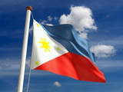
7
Adto Mo sa Pinas
Hanbuk pahina 8-14
2
©2006 TBBMI
9.65.01.53
Notes:
Another memory tool now…what do you call
//// that red section of the perimeter of a circle?
//// It's called an “arc,” spelled A-R-C. Those letters, then, remind you of the first letters of 3 KINDS OF SOCIETIES.

Slide 54
ANG 3 NA KATILINGBAN AY:
7
A NARKIYA
M GA HARI
PAGKABINIHAG
Hanbuk pahina 8-14
6
©2006 TBBMI
9.65.01.54
Notes:
The three societies are…
//// ANARCHY
//// ROYALTY
//// CAPTIVITY.
As before, please repeat that word order several times.
ANARCHY, ROYALTY, CAPTIVITY...
ANARCHY, ROYALTY, CAPTIVITY.
And the mental tool here:
//// A
//// R
//// C.

Slide 55
7
PAGBUHAT
ABRAHAM
JOSE
MOISES
JOSUE
ANARKIYA
MGA HARI
PAGKABINIHAG
Hanbuk pahina 8-14
©2006 TBBMI
9.65.01.55
Notes:
Now we add the 3 SOCIETIES group to the others, and we have:
CREATION
ABRAHAM
JOSEPH
MOSES
JOSHUA
ANARCHY
ROYALTY
CAPTIVITY

Slide 56
7
7
PAGBALIK SA PAGTULON-AN...
P 7 K H
P 4 3 K H
Hanbuk pahina 8-14
3
©2006 TBBMI
9.65.01.56
Notes:
To review the entire sequence so far…
Beginning with the single number
//// 7....
leading to…
//// C 7 S J...
which becomes...
//// C 4 3 S J.
These numbers and letters are then used to develop a mental list of TEN WORDS that will form a dependable mental outline of the entirety of Scripture.

Slide 57
PAGBUHAT
4 KA TAO
3 KA KATILINGBAN
KAHILUM
HESUKRISTO
7
Hanbuk pahina 8-14
©2006 TBBMI
9.65.01.57
Notes:
C 4 3 S J is then expanded into:
CREATION
4 PEOPLE
3 SOCIETIES
SILENCE
JESUS.

Slide 58
7
PAGBUHAT
ABRAHAM
JOSE
MOISES
JOSUE
ANARKYA
MGA HARI
PAGKABINIHAG
KAHILUM
HESUKRISTO
Hanbuk pahina 8-14
2
©2006 TBBMI
9.65.01.58
Notes:
Then further expanded into:
CREATION
ABRAHAM
JOSEPH
MOSES
JOSHUA
ANARCHY
ROYALTY
CAPTIVITY.
Finally, now, we add: //// SILENCEand//// JESUS.

Slide 59
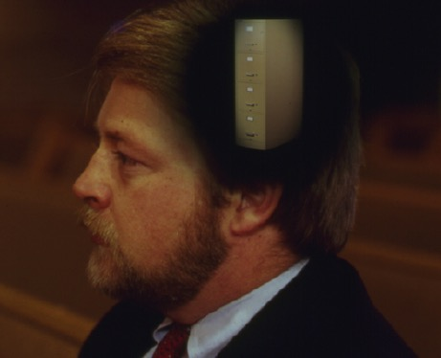
Ang “MGA HUNOS na Biblia”
na naa sa Imong Hunahuna
PAGBUHAT
PAGBUHAT
ABRAHAM
ABRAHAM
ABRAHAM
ABRAHAM
JOSEPH
ABRAHAM
JOSE
MOISES
JOSUE
MOISES
ANARKIYA
MGA HARI
JOSUE
PAGKABINIHAG
KAHILUM
ANARKIYA
HESUKRISTO
MGA HARI
PAGKABINIHAG
KAHILUM
HESUKRISTO
Hanbuk pahina 8-14
11
©2006 TBBMI
9.65.01.59
Notes:
Now it's time mentally to apply those ten words as labels to ten mental folders in your new Bible File –
//// right up there in your head. That mental picture might look something like this. And there they are...
//// CREATION//// ABRAHAM//// JOSEPH//// MOSES//// JOSHUA//// ANARCHY//// ROYALTY//// CAPTIVITY//// SILENCE…and…//// JESUS.
Now it's organized in a neat and orderly package in your mind --- ready for recall and use as you need it. Now just a few more
examples to drive home the point...

Slide 60
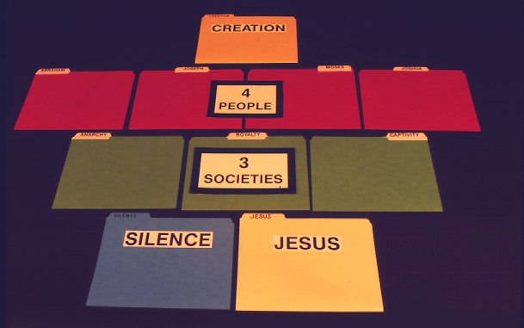
7
PAGBUHAT
Hanbuk pahina 8-14
©2006 TBBMI
9.65.01.60
Notes:
Let’s lay out the ten file folders of the Bible File as PAPER FILE FOLDERS in the now-familiar groups of…Creation…

Slide 61
7
PAGBUHAT
4
KA TAO
Hanbuk pahina 8-14
©2006 TBBMI
9.65.01.61
Notes:
…the 4 People…

Slide 62
7
PAGLIKHA
4
NA TAO
3 KA
KATILINGBAN
Hanbuk pahina 8-14
©2006 TBBMI
9.65.01.262
Notes:
…the 3 Societies…

Slide 63
7
PAGBUHAT
4
KA TAO
3 KA
KATILINGBAN
KAHILUM
HESUKRISTO
Hanbuk pahina 8-14
©2006 TBBMI
9.65.01.63
Notes:
….followed by Silence and Jesus….All placed securely in a personal Bible File in your mind!

Slide 64

7
Nagbag-o gyud ang kalibutan!
Hanbuk pahina 8-14
©2006 TBBMI
9.65.01.64
Notes:
Here is yet another way to think of your Bible File. Like many of us, this young woman spends hours every day at her computer.

Slide 65



7
PAGBUHAT
ABRAHAM
ABRAHAM
ABRAHAM
JOSE
ABRAHAM
MOSES
JOSUE
ANARKIYA
MGA HARI
PAGKABINIHAG
KAHILUMN
HESUKRISTO
©2006 TBBMI
9.65.01.65
Notes:
So...instead of thinking just of file folders as heavy folded paper, think about them as computer files on a floppy disk or on a computer hard drive.

Slide 66

Basura
Mga hunos
ANG MGA HUNOS NA BIBLIA
©2006 TBBMI
9.65.01.66
Notes:
Imagine this as the main screen of your own computer monitor – with a data folder you created named, naturally, Bible File. Double click on that imaginary folder….

Slide 67

Mga hunos na Biblia
C
PAGBUHAT
ABRAHAM
ANARKIYA
KAHILUM
HESUKRISTO
JOSE
MGA HARI
MOISES
PAGKABINIHAG
JOSUE
10
©2006 TBBMI
9.65.01.67
Notes:
…and you would get this...the ten sub-files, all as folders, named, in
order…and say them along with me…
//// CREATION
//// ABRAHAM
//// JOSEPH
//// MOSES
//// JOSHUA
//// ANARCHY
//// ROYALTY
//// CAPTIVITY
//// SILENCE
//// JESUS.

Slide 68
Mga Hunos na Biblia
C
{
}
PAGBUHAT
ABRAHAM
ANARKIYA
KAHILUM
HESUKRISTO
JOSE
MGA HARI
4 KA
TAO
3 KA
KATILINGBAN
MOISES
PAGKABINIHAG
JOSUE
10
©2006 TBBMI
9.65.01.68
Notes:
…and you would get this...the ten sub-files, all as folders, named, in
order…and say them along with me…
//// CREATION
//// ABRAHAM
//// JOSEPH
//// MOSES
//// JOSHUA
//// ANARCHY
//// ROYALTY
//// CAPTIVITY
//// SILENCE
//// JESUS.

Slide 69
ANG “MGA HUNOS NA BIBLIA”
NA NAA SA IMONG HUNAHUNA!
PAGGUHAT
ABRAHAM
JOSE
LIG-UN
MOISES
JOSUE
ANARKIYA
MGA HARI
PAGKABINIHAG
LAPAD ANG HAN-AY
KAHILUM
HESUKRISTO
KLARO
4
©2006 TBBMI
9.65.01.69
Notes:
So there you have the basic building blocks of a complete biblical filing system…in your head…the basic building plan of the Bible…how THE BASIC DOCUMENT OF THE FAITH is organized.
//// It’s your personal Mental Bible File!
From this point on, we will construct a
//// sturdy,
//// comprehensive,
//// and coherent mental map of God’s Word…each step of its progress built on this reliable basic mental mapping idea.

Slide 70

Sa karon ang imong gina hunahuna bahin sa Ang Biblia…Gipatin-aw ay..
•Ang Ideya na ginataway na “Mga hunos na Biblia”
•Ang liyabe para maabri ang “Mga hunos na Biblia”…P 7 K H
1. UNSA ANG NAHITABO!
TULO KA PANGUTANA NA KINAHANGLAN NA MATUBAG
2. NGANO NAHITABO!
3. ANG IMPLUWENSIYA INI SA PORMA UG SULOD SA BALAAN NA KASULATAN
4
©2006 TBBMI
9.65.01.70
Notes:
O.K. Now we’re on our way. By this time…you have that idea called THE BIBLE FILE…and the mental key to open it…C 7 S J. The way is clear now for building a new and organized approach to thinking about your entire Bible, everything in its place.
//// We’ll be able to answer three fundamental questions:
//// WHAT happened…
//// WHY it happened…and finally…
//// HOW the WHAT and the WHY influence the shape and content of Scripture…the organization of the book itself.

Slide 71
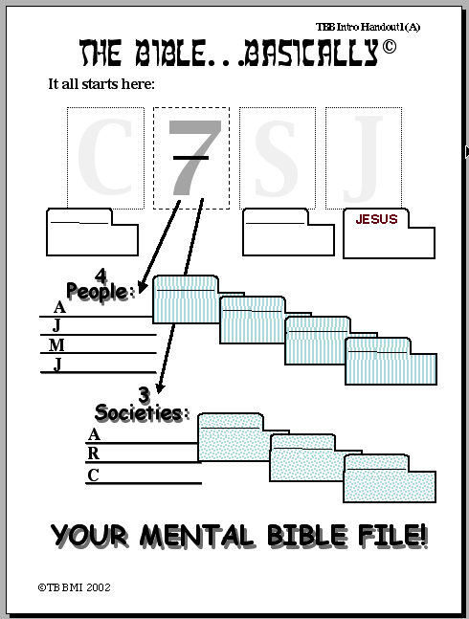
Ang Biblia…Pinasimple
Nagsimula dito:
P
7
K
H
PAGBUHAT
KAHILUM
HESU
KRISTO
4 Tao:
{
ABRAHAM
A
BRAHAM
JOSE
J
OSE
MOISES
OISES
M
JOSUE
OSUE
J
GIYA SA PAG-TUON #01
{
3 Katilingban:
A
ANARKYA
NARKIYA
MGA HARI
R
M
GA HARI
P
AGKABINIHAG
PAGKABINIHAG
C
ANG MGA HUNOS NA BIBLIA NA NAA SA IMONG HUNAHUNA!
©2006 TBBMI
9.65.01.71
20
Notes:
Now look at Study Help Number One in the student handbook. That sheet will help you to embed in your thinking how to keep these tools on the front of your mind…while also learning how to teach others.
//// Beginning with a large C…
//// for CREATION then…
//// the Number 7…the dashed line is already there…7 standing for the four people and then the three societies. So…first…the FOUR
PEOPLE…
//// who are ABRAHAM…
//// then added to his File Folder…
//// JOSEPH…
//// onto the JOSEPH folder
//// MOSES…
//// his Folder…and finally…
//// JOSHUA…
//// finishing out the FOUR GREAT PEOPLE and their file Folders in the Bible File. Then on to the THREE SOCIETIES…
//// beginning with ANARCHY…
//// and its folder…
//// ROYALTY…
//// and the folder…
//// finishing with CAPTIVITY…
//// and its folder.
Now we’ll finish it out…
//// S for
//// SILENCE…and
//// the culmination of all our thinking…J for JESUS.

Slide 72
02
Ang BibliaGipatina-aw
Karon, sulayan nimo abrihan ang mga Hunos na Biblia na naa sa imong hunahuna na ikaw lang usa o sa pagsulay sa uban.
Ang liyabe para maabrihan ang imong mga Hunos na Biblia ay:
P 7 K H
Ang titik na “P” ay pasabot na:
PAGBUHAT
7 = 4+3 mao ang :
4 KA TAO & 3 KATILINGBAN
Ang UPAT kaTAO na sila:
ABRAHAM JOSE MOISES
JOSUE
GIYA SA PAG-TUON #02
Ang TULO KA KATILINGBAN ay:
ANARKIYA
MGA HARI
PAGKABINIHAG
PAGBUHAT
ABRAHAM
Ang letra na “K” ay:
KAHILUM
JESUS
JOSE
Ang titik “H” ay:
...
HESUKRISTO
MOISES
Ang napulo ka pulong… ug ang imong napulo ka papeles mao ni:
JOSUE
ANARKIYA
MGA HARI
ANG HUNOS
NG BIBLIA NA
NAA SA IMONG
HUNAHUNA
PAGBINIHAG
KAHILUM
HESUKRISTO
©2006 TBBMI
9.65.01.72
9
Notes:
And here is STUDY HELP NUMBER 2….this is the one you can use for your own review-- or to hold in your hand while you teach THE BIBLE FILE idea to others.
//// First the key to open the file:
//// C 7 S J…
//// The letter C stands for CREATION.
//// 7 equals 4 plus 3…for the four people and the three societies.
//// FOUR PEOPLE…ABRAHAM, JOSEPH, MOSES, JOSHUA.
//// THREE SOCIETIES…ANARCHY, ROYALTY, CAPTIVITY.
//// The letter S standing for SILENCE
//// The letter J representing JESUS.
//// FINALLY the TEN WORDS. And there are your ten file folders in your new Bible File. Repeat them one last time:
CREATION, ABRAHAM, JOSEPH, MOSES, JOSHUA, ANARCHY, ROYALTY, CAPTIVITY, SILENCE, and JESUS.

Slide 73
7
©2006 TBBMI
9.65.01.73
Notes:
And it all begins right here...the number 7 with that now familiar dash through its stem. Now you know the value of that simple mental tool. It is truly A GATEWAY IDEA!

Slide 74
ANG BIBLIA… GIPATIN-AW
®
Ang Liyabe sa Pagabri sa Imong
“Mga Hunos na Biblia”
©2006 TBBMI
9.65.01.74
Notes:
Now it's time to move forward toward expanding this "key to opening up Your Bible File” -- for what we will call THE QUICK CHRONOLOGY. Through the next hours of THE BIBLE… BASICALLY training, here is what you’ll learn…

Slide 75
Karon na imong nasabtan na…
Kini ang atong padtuan..
•Ang Ideya na ginatawag na “ Mga hunos na Biblia”
•Ang liyabe sa imong pagabri sa“mga hunos na Biblia”:P 7 KH
•Ang mapa para makit-an ang mga importanteng nahitabo sa Biblia.
•Ang katibuk-an sa “Istorya”: “Ang Paspas na pagkasunod-sunod”
•Ang Abrahamik na Pundasyon sa Balaan na Pulong na paadto sa ministeryo sa atong Ginoo na si HesuKristo
•Ang mga“ Istorya” kung asa basehan ang Arkitektura sa Biblia.
•Ang mga libro ug Tema sa Karaan ug Bag-ong Kasabotan
 
8
©2006 TBBMI
9.65.01.75
Notes:
//// We’ve introduced the THE BIBLE FILE idea and…
//// The mental key to open that file…Then…
//// You’ll learn to make a mental map of the Ancient Near East…that’s next.
//// Then the so-called STORY CORE of Scripture, titled THE QUICK CHRONOLOGY…That’s the WHAT HAPPENED question to be answered.
//// Then we’ll explore the ABRAHAMIC FOUNDATIONS of the Great Plan…the WHY of Scripture…
//// leading to an understanding of the Bible’s basic architectural layout…
//// ending with a brief look at the Old and New Testament Books and their general themes or ideas behind them.
//// And through it all, it will become obvious– from start to finish – that SOMETHING IS HAPPENING HERE; GREAT EVENTS ARE TRANSPIRING. God was busy at work then and continues right up to this present moment!
Now it’s time to move on into a very valuable experience!
you’ll learn to make your own map of the Ancient Near East…AND RIGHT OUT OF YOUR OWN HEAD!

Slide 76
Bersyon 9.65
Ang Biblia . . . Gipatin-aw
Ang presentasyon sa Ang Biblia…Gipatin-aw Ministeryo sa kanasoran
Fort Worth, Texas
www.biblebasically.org
©2003 TBBMI
9.65.01.76

Slide 77
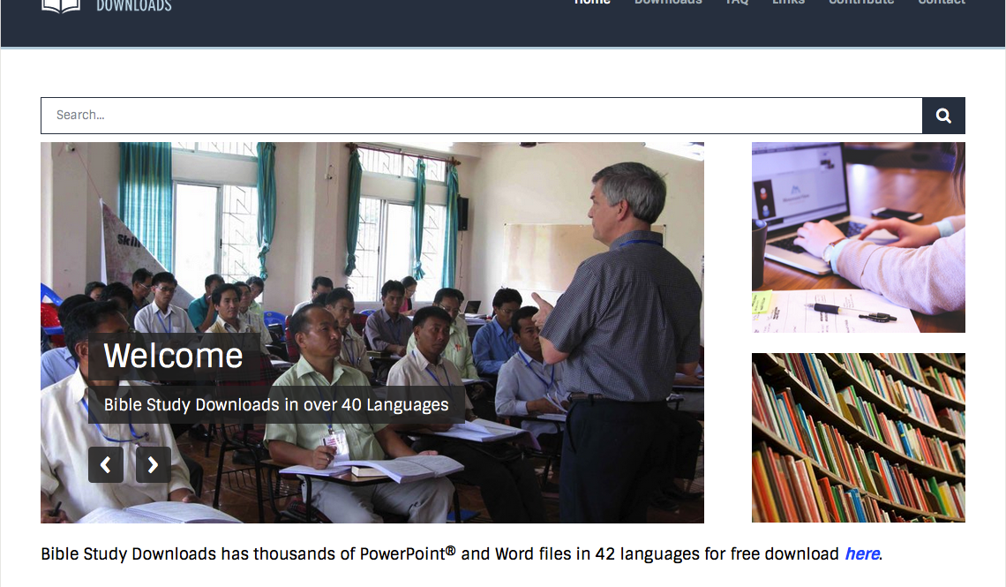

The Bible…Basically link at BibleStudyDownloads.org
Get this presentation for free!
Notes:
The Bible…Basically (bb)

Slide 78
©2006 TBBMI
9.65.01.77

