Slide 1

Chin
Lai Siangtho…Abulpi
A Presentation of The Bible…Basically Ministries International Inc. Fort Worth, Texas
Designed by Dr. John Fryman, Texas, USA • BibleBasically.org
Taught by Dr. Rick Griffith, Singapore Bible College
All files in many languages for free download at BibleStudyDownloads.org
www.biblebasically.org
©2004 TBBMI
8.0.01.
01

Slide 2



Thukhente pan Esther dong
7
PIANCIL
UKNA OMLO
Mi Masa
Mawhna Masa
P
Lungdamna Masa
Innkuan Masa
KUMPI GAM
(1000 B.C.)
Sina Masa
DT
Tuicin/Sakhi tuihup
Tausang
ABRAHAM
(2000 B.C.)
P 7 D J
SAPNA
AT
L - S - B
MI KIPAWLNA3
I - I
TT
J - E
12
SALTAN NA
7 = 4 + 3
JOSEPH
Saltan Na
430
MI 4
MOSI
(1500 B.C.)
(500 B.C.)
Paikhiatna
S
S
DAIHNA
Sinai
G - M - P
Kadesh Barnea
JESU
40
40
GT
Thuhilh 5
J
JOSHUA
Jericho/Ai
Gam Kihawm
01
3
Notes:
//// Now it's time to move on through THE BIBLE FILE from CREATION and 4 PEOPLE into the
//// 3 KINDS OF SOCIETIES or social structure. Remember their order “A-R-C”…
//// …ANARCHY, ROYALTY, CAPTIVITY.

Slide 3

Josh. 14:5; 24:29; Thukhen. 17:6
7
Muhna ki khel...
Canaan gam luah.
Canaan gam kihawm.
Joshua si.
Gam Makai kician nei lo!
02
4
Notes:
The scene now makes a dramatic shift…
//// The Land is generally subdued...
//// The Land is divided...the people are settled in. At last, they are in their Promised Land.
//// When General JOSHUA dies, Israel arrives at a significant turning point in her history.
//// No longer is there one great national leader of the people to arise and take command. Every tribe and its people are doing -- as we said earlier -- that which seemed right in their own eyes – and hearts.

Slide 4
7
?
Dotna khat:
Thu khat a pain ciang NANG bangna ngaihsun….
03
Notes:
Here is a question for you: what do you think happened when…

Slide 5
7
Thukhen17:6; 21:25
ASHER
NAPHTALI
Tui Lian Pi
ZEBULON
Galilee
Tui li
Tabor Mual
Carmel Mual
ISSACHAR
“Amau’ hoihsak bang ciatin Mi khempeuh a gamta uh hi.”
Gilboa Mual
MANASSEH
MANASSEH
JOSHUA
EPHRAIM
Jericho/Ai
Gam Kihawm
DAN
BENJAMIN
GAD
JUDAH
Hebron
Si Tuipi
REUBEN
LEVI: Khuapi sungbek ah om ding.
SIMEON..
04
Notes:
[ALLOW ALL TRIBAL NAMES TO APPEAR: SIMEON BEING THE LAST TO APPEAR]
..."each man – among those tribes of Israel, now settled in the Land –did that which was right in his own eyes”

Slide 6
7
Thukhen. 17:6
ASHER
NAPHTALI
Tui Lian Pi
ZEBULON
Galilee
Tui li
Mt. Tabor
Ukna Omlo!
Mt. Carmel
ISSACHAR
“Amau’ hoihsak bang ciatin Mi khempeuh a gamta uh hi”
Mt. Gilboa
MANASSEH
MANASSEH
JOSHUA
EPHRAIM
Jericho/Ai
Gam Kihawm
DAN
BENJAMIN
GAD
JUDAH
Hebron
Si Tui Pi
REUBEN
LEVI: Khuapi sungbek ah om ding.
SIMEON
Handbook pg. 31-32
05
Notes:
The result is ANARCHY …leading us to the first of three kinds of societies.

Slide 7
7
Thukhen & Ruth
U K S
PIANCIL
ABRAHAM
ABRAHAM
ABRAHAM
JOSEPH
ABRAHAM
MOSI
JOSHUA
UKNA OMLO
KUMPI GAM
SALTANG
DIAHNA
JESU
Handbook pg. 31-32
06
Notes:
And here is the ANARCHY file in its proper place in THE BIBLE FILE line-up.

Slide 8
7
Thukhen. 17:6
UKNA OMLO
MI KIPAWLNA
NAM THUM
pan
A KHATNA:
UKNA OMLO
350
Mipite in ukna kician a omlo lamtak thei cian uh.
U K S
Handbook pg. 31-32
07
Notes:
During this time, the people recognized no central governing authority as they had back in Israel's earlier days --in the time of MOSES and JOSHUA. Remember the A-R-C order? ANARCHY, ROYALTY, CAPTIVITY…this is the first of the three kinds of societies or social structures… ANARCHY.

Slide 9
7
Thukhen. 2:16-19
UKNA OMLO
THUKHEN TE
UKNA OMLO
Thukhen
350
GAM TAIH-SAN HUN!
Handbook pg. 31-32
08
1
Notes:
So, during this era, God raised up a series of JUDGES to get the people back into righteous obedience to God and to bring them again in line toward the righteous life-style required by The Mosaic Law. Many of the Judges were also great military leaders.
//// The time of the JUDGES was a period of Israel's national apostasy --- a falling away from the faith of Abraham. Circumstances go from bad to worse to good to bad to worse and on and on. But every time events seem to be at their worst, God calls out a new JUDGE for the Israelites.

Slide 10
7
Thukhen. 2:16-19
Othniel
Ehud
Shamgar
Deborah & Barak
Jair
Abimelech
Tola
Gideon
Jephthah
Ibzan
Elon
Abdon
Samson
Eli
Samuel
UKNA OMLO
Deborah & Barak
THUKHEN TE
Nang i simdan tawh ki
zui in… TANGLAI ISRAEL HUN THUKHEN TE 13 leh 15 kikal om
Gideon
Ukna Omlo
Thukhen
350
Samson
Handbook pg. 31-32
09
1
Notes:
Depending on how you count them, and here the scholars differ, there were between 13 and 15 JUDGES during the ANARCHY period.
//// Of those several JUDGES, you might recognize the names of some of them, such as Deborah & Barak…Deborah was a woman… there was Gideon…and of course, the legendary Samson

Slide 11
7
1 Sam. 7:15
ISRAEL GAMSUNG
THUKHEN TE TAMPI
LAKPAN...
A NUNUNG PEN LEH A LIAN PEN,
“ETTEH HUAI A NUNGTA,”
PA IN...
SAMUEL
Ukna Omlo
Thukhen
350
Handbook pg. 31-32
10
Notes:
But of those many Israelite Judges, the nation's last and greatest JUDGE, a "hinge character," was Samuel. Except for Moses, Samuel is the first of the long line of Israel's great prophets. His life marks the beginning of the Time of the Prophets.

Slide 12
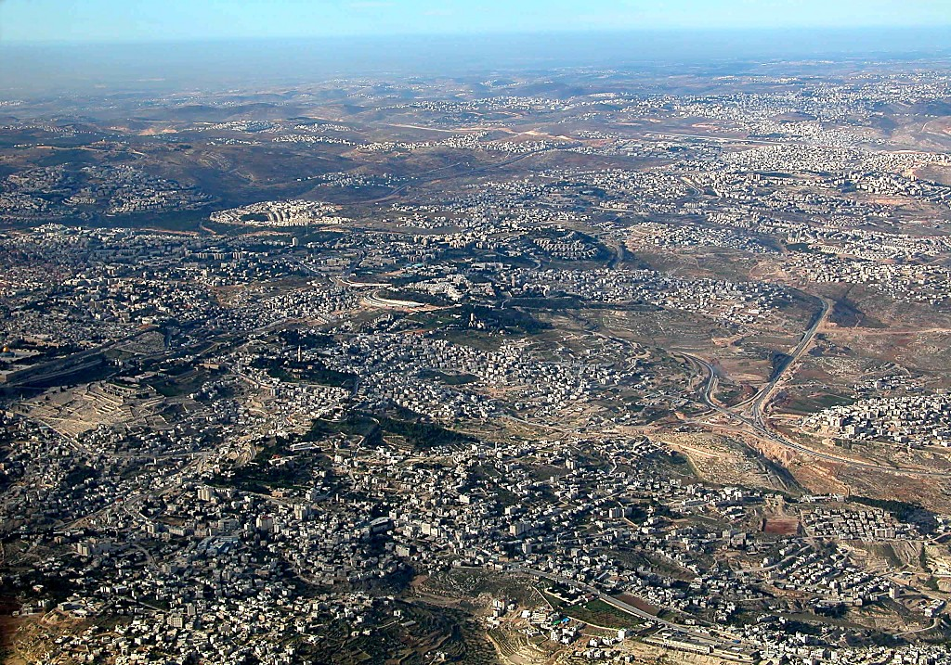
East Jerusalem and Mt of Olives aerial from s
1 Sam. 7:15
1 Sam. 8:4-22
7
Nebi Samwil (Ramah Gei)
BUT OF THE
MANY JUDGES
OF
ISRAEL...
Samuel: Prophet leh Thukhen; Ama om Inn leh a suahna Jerusalem Khua Leitaw lam
Biak Innpi Mual
THE LAST AND GREATEST,
THE “HINGE CHARACTER,” WAS...
SAMUEL
1 Sam. 8:4-19
ANARCHY
Olive Mual
Judges
Jericho Lampi
Suang Dumpi
Bethany
350
Handbook pg. 31-32
11
1
©2006 TBBMI
9.7.03d.
Notes:
Within a very few miles of this region…at either the villages of Ramah or today's Arabic Nebi Samwil…Samuel was born and lived out his life…within clear view of Jerusalem just a few miles to the south. From this aerial view, it's easy to see the neighboring closeness of the ancient Biblical sites.
//// In this area, north of Jerusalem, tribal elders from all over Israel converged to meet with Samuel. They begged him to anoint a king for Israel so that their nation could be more like the other kingdoms surrounding Israel at that time.

Slide 13
7
UKNA OMLO
THUKHEN TE
350
Ukna Omlo
Thukhen
“KO’N KUMPI DEIH UNG!”
350
“NOTE IN HIH NUAM TAKPI MAWH?”
350
Handbook pg. 31-32
12
2
Notes:
“We want a king!” they said. But through Samuel, God tells them that He is their only king, that they need no other. But the people are not satisfied.
//// Following their request, God says through Samuel, in effect, "Are you sure you want to do that?" God then tells Samuel, “All right, anoint a king for them so they will learn the difficult lessons in answering to an earthly sovereign instead of their heavenly authority.”
//// So after some 350 years of apostasy and national rebellion… a time of gross sin and falling away from the worship of the one true God, the era of ANARCHY comes to an end.

Slide 14
1 Sam. 9:17
7
OF THE
13 JUDGES
OF
ISRAEL...
DEBORAH
GIDEON
THE LAST AND GREATEST,
THE “HINGE CHARACTER,” WAS...
UK OMLO
KUMPI
SAMUEL
Handbook pg. 31-32
13
1
Notes:
…with Samuel serving as that hinge character -- that enormous historic figure who moves Israel forward into the period of its second kind of society…
//// … quite different from ANARCHY. We call it...“ROYALTY.”

Slide 15
7
K
U S
“KUMPI GAM”
14
2
Notes:
Still keeping in mind that geometric shape…
/// that finishes out a circle…called an arc…
//// spelled A…R…C…leading us to the period of Israel's ROYALTY.

Slide 16


7
Pancial pan 1 Samuel 8:22
PIANCIL
UKNA OMLO
Mi Masa
Thukhen
Mawhna Masa
350
P
Lungdamna Masa
350
Innkuan Masa
KUMPI GAM
(1000 B.C.)
Sina Masa
Tuicin/Sakhi tuihup
DT
Tausang
ABRAHAM
(2000 B.C.)
MI KIPAWLNA 3
P 7 D J
SAPNA
AT
L - S - B
I - I
TT
J - E
12
SALTANG
7 = 4 + 3
JOSEPH
UK OMLO
Saltang
Thukhen
430
350
MI 4
350
MOSI
(1500 B.C.)
(500 B.C.)
Paikhiatna
S
S
DAIHNA
Sinai
G - M - P
Kadesh Barnea
JESU
40
40
GT
Thuhilh 5
J
JOSHUA
Jericho/Ai
Gam Kihawm
15
4
Notes:
And here is the Bible File up to this point.
//// CREATION...
//// ABRAHAM.. JOSEPH...MOSES...JOSHUA...and
//// ANARCHY. Now we move into…
//// ROYALTY...with Samuel as the bridging character during the transition, a man of God enormously influential in the unfolding history of Israel.

Slide 17
A KINAI THEI PEN KUM:
ABRAHAM-JOSEPH 2000 B.C.
MOSI-JOSHUA 1500 B.C.
UK OMLO-KUMPI GAM 1000 B.C.
16
Notes:
The time line now moves to around 1000 BC…the most glorious time of ancient Israel's history.

Slide 18
1 Sam. 9:1 PAN 2 Kumpi 25:21
U K S
PIANCIL
ABRAHAM
ABRAHAM
ABRAHAM
JOSEPH
ABRAHAM
MOSI
JOSHUA
UK OMLO
KUMPI
SALTANG
DAIHNA
JESU
Handbook pg. 32-37
17
Notes:
And the ROYALTY folder takes its place in the Bible File lineup.
Repeat the entire series aloud as a review: CREATION, ABRAHAM, JOSEPH, MOSES, JOSHUA, ANARCHY, ROYALTY, CAPTIVITY, SILENCE and JESUS.

Slide 19
GAM OM
DAN LAK
NA
MS
N(A)
H
KIGAWM Israel mite leitungbup ah a thahat gam leh a cithei mama gam khat hong suak!
SG
C
ER
B
J
MN
DS
E
KB
U
MS
PG
RS
Handbook pg. 32-37
18
1
Notes:
On your map, there is no further path to be traced for now -- because the Israelites are NOW --- FINALLY settled in THE LAND of their inheritance! They will eventually occupy an area from south of the Dead Sea all the way up far north of the Sea of Galilee and from the Mediterranean Sea into the lands east of the Jordan River.
//// At this time…Israel is UNITED, She is to become an international power of enormous wealth and cultural influence among neighboring nations.

Slide 20

7
1 Sam. 9:1
KUMPI GAM
kim. 1000 B.C.
A NIHNA
mi
KI PAWL NA
in:
Kumpi gam
U K S
Handbook pg. 32-37
19
1
Notes:
ROYALTY is the largest file folder in the Bible File because it is certainly the most complex. But we'll take it apart…item by item.
//// Timeline again: around 1000 BC.

Slide 21
1 Sam. 15:1; 2 Sam. 2:4; 1 Kumpi 1:39
7
KUMPI TE
kim. 1000 B.C.
S - D - S
SAUL
U K S
DAVID
Kumpi Te
S - D - S
SOLOMON
Handbook pg. 32-37
20
4
Notes:
The period of ROYALTY begins as old Samuel anoints SAUL, the first of the three kings of united Israel:
//// SAUL, then…
//// DAVID followed by his son…
//// SOLOMON.
You can remember the order of Israel's first three kings this way:
//// S-D-S...SAUL, DAVID and SOLOMON.

Slide 22
7
1 Sam. 16:13-14
KUMPI TE
kim. 1000 B.C.
S - D - S
DT
DT
A R C
Kumpi Saul: a hepi huai mipa!
Samuel pen Saul zahlaih ding pa sathaunilh ding ki sawl:
Khangno David Bethlehem mi.
Kumpi Saul: a hepi huai mipa!
Samuel pen Saul zahlaih ding pa sathaunilh ding si sawl: Khangno David Bethelem mi.
KUMPI TE
S - D - S
Handbook pg. 32-37
21
Notes:
Once on the throne, SAUL is an increasingly tormented man. Eventually, God deposes SAUL for his many failures of character and weakness in national leadership. Then once again, the old prophet, Samuel, is called to anoint Saul's successor as a king for united Israel….and that is to be young David of Bethlehem.

Slide 23
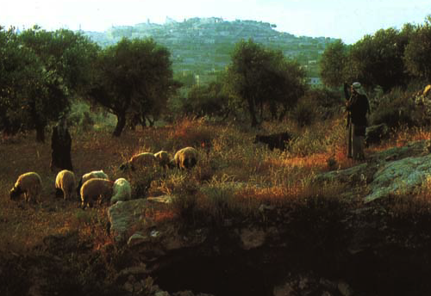
1 Sam. 16:1
7
KUMPI TE
kim. 1000 B.C.
S - D - S
U K S
Kumpi Te
S - D - S
Samuel in khangno David tuu a cinna mun va mu, Bethlehem khuapua.
Handbook pg. 32-37
22
1
Notes:
Samuel searches throughout the country, finally locating the family of:
//// …Jesse near Bethlehem. Jesse's young shepherd son, DAVID, is identified and anointed by Samuel as Israel's next and certain king.
In time, King DAVID, the “man after God's own heart,” succeeds SAUL on the throne of Israel.

Slide 24
7
KUMPI TE
kim. 1000 B.C.
S - D - S
DT
David tawh Thuciam
2 Sam 7:4-16
1 Khngtg 17:3-15
U K S
ROYALTY
S - D - S
Handbook pg. 32-37
23
1
Notes:
It is to DAVID that the Lord issues the great DAVIDIC COVENANT, His unconditional promise to Israel that she would always have a Son of David to sit upon her throne.
//// Notice that parchment scroll “DC” as it relates to the ROYALTY file folder. The coming Messiah is clearly prefigured…yet 1,000 years in Israel's future. This is another part of that eternal contract between God and His people that began with Abraham. Add “DC” to your scroll figure

Slide 25
7
DAVID TAWH THUCIAM
KAMCIAM NAM THUM
2 Samuel 7
¹⁶ Na suanlekhakte leh na kumpi gam keima mai-ah a kip tawntungin kibawl ding a, na
kumpi tokhom kip tawntung ding hi.
KUMPI TE
S - D - S
Handbook pg. 32-37
24
5
Notes:
Here are the central words of that unconditional Davidic contract: 2 Samuel 7, verse 16.
Through Nathan, David's household prophet, God speaks these words: "Your
//// house and your
//// kingdom will endure
//// forever before me; your
//// throne will be established
//// forever.”

Slide 26

Abraham Tawh Thuciam
(“SAP NA”)
Piancil 12: 1-3
Gam
Suan
THUPHA
Gam
David
Thuhilhkikna
30:1-10
2 Samuel
7:4-16
Handbook pg. 32-37
25
Notes:
So, then…the DAVIDIC COVENANT becomes an amplification of the Seed portion of the ABRAHAMIC COVENANT...the second part of the LAND, the SEED, and the BLESSING formula. This DAVIDIC promise is the SEED portion, the Davidic Covenant. Let's take a look at David's Jerusalem.

Slide 27
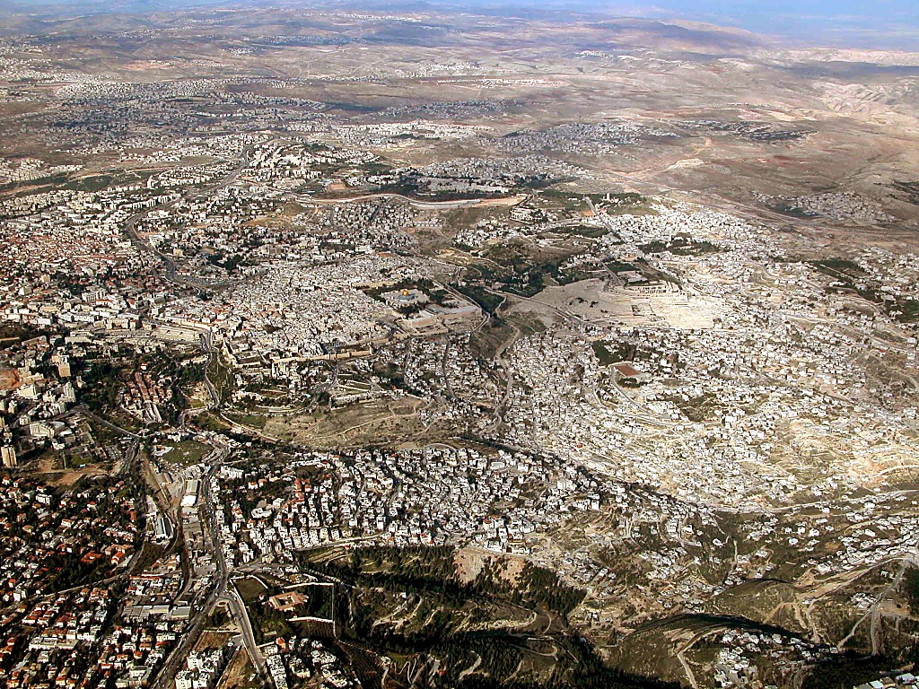
Jerusalem area aerial from south
Jerusalem: Leilu lam pan Biak Innpi omna Mual lam
26
©2003 TBBMI
7.2.03d.
Notes:
When you fly over Jerusalem today, this is the view as you approach the city from Bethlehem to the south.
//// And right there in the middle of this ancient city lies the focal point of almost every world crisis happening right now and certainly on into the future. It's the ancient Temple Mount of the Old City.

Slide 28

Old City aerial from north
2 Sam. 24:18-24; 2 Khangtang. 3:1
Biah Innpi Mual: Leitungbup ih munlaizang Jerusalem khuasung
9.7.03d.
©2006 TBBMI
27
Notes:
Flying closer, you would see on that Temple Mount the golden-roofed Islamic Dome of the Rock. Also known as Mount Moriah and Mount Zion, this site marks the location of the First Temple of King David and the later Second Temple – built by King Herod the Great -- around which Our Lord ministered to the multitudes. To the far left are the Mount of Olives and the Garden of Gethsemane.

Slide 29
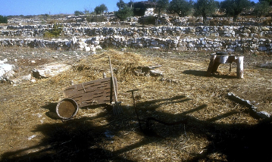
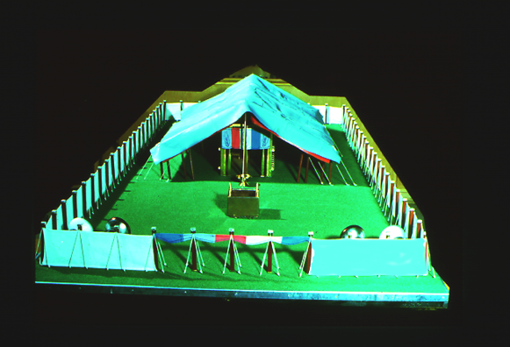
2 Sam. 24:18-24; 2 Khangtang. 3:1
Tanglai An cilna mun
Ornan' An cilna phual…
David in lei…
Pasain ading Biah Innpi Masa pen lamsawm!
Moriah Mual Ah!
28
5
©2006 TBBMI
9.7.03d.
Notes:
And the Temple Mount itself…47 acres of unending international intrigue, strife and dispute…currently controlled by local Moslem authorities. The octagonal Dome of the Rock has occupied this site for 1,400 years! Now…
//// Imagine this place without the Dome of the Rock…3,000 years ago, on the top of Mount Moriah…the same Moriah where Abraham had taken Isaac for sacrifice a thousand years earlier than that.
//// In David's time, it had become a threshing floor owned by a man named Araunah.
//// David bought that threshing floor from Araunah – similar to this one – on which to build a great worship center…because ever since the time of Moses…
//// …the old tabernacle, housing the sacred Ark of the Covenant, had existed in the fierce winds of the desert. David wanted to see the Furniture of the Lord protected in a fine building…
//// …such as a great Temple to the Lord there on Mount Moriah.

Slide 30


1 Kumpi 5:5
KUMPI TE
S - D - S
Kumpi David in geel…
Ahi hang…a tapa Solomon in lam!
Handbook pg. 32-37
29
1
Notes:
So David planned the Temple and brought supplies into town to build it. However, God did not allow David to erect it because he had spilled human blood.
//// It then became an assignment from God that David's son, Solomon, should build the First Temple.

Slide 31

1 Kumpi 5:5
KUMPI TE
S - D - S
Israel te ih “Amasa Pen” Biak Innpi
Handbook pg. 32-37
30
Notes:
Of course, we have no picture of that Temple. However, this painting shows us its probable grandeur and beauty.

Slide 32
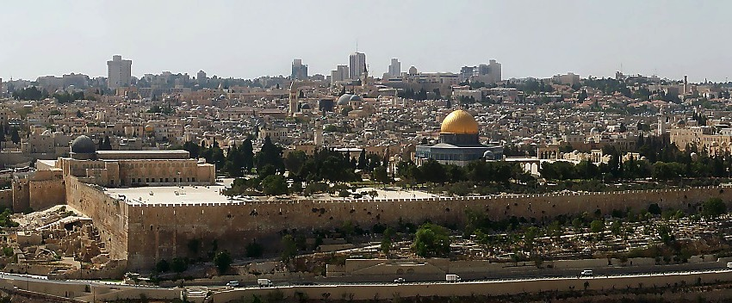
1 Kumpi 6:14-38
Tuhun Jerusalem’ Biak Innpi Mual
Abraham in-Isaac Biakpiakna in a neihna mun…Moriah Mual… Zion Mual
KHANGLUI MITE IN HIH INN KOI CI LAM?
ZAT DING VAN KICING LO!
COMPUTER OM NAI LO!
KUMPI TE
S - D - S
NASEP ZIA DING THUKHUN OM LO!
MIHING THA HATNA!
Handbook pg. 32-37
Handbook pg. 32-37
31
6
Notes:
Another idea about the Temple mount gives an appreciation of the thinking and planning processes of those ancient rulers and builders. Here is Jerusalem's famous Temple Mount as it looks today viewed from atop the Mount of Olives to the east.
//// This place was also the site of ABRAHAM's offering up of ISAAC…on Mount Moriah or Mount Zion…
A question is this…
//// How did the ancient builders accomplish these feats? Searching for that answer gives an interesting insight into this part of Israel's history. How, we ask, were those massive structures built...
//// in a time of no power equipment,
//// no computers,
//// not even a slide rule!
//// There was nothing available but manpower and hard work! How did they even clear the ground for the structure? We have to respect the technology and the brilliance of these ancient people. Here's an example:

Slide 33

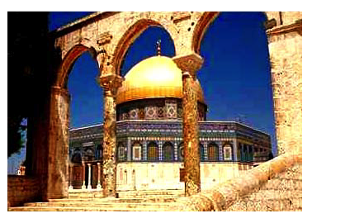
1 Kumpi 6:14-38
Tuhun Jerusalem’ Biak Innpi Mual
Abraham in-Isaac Biakpiakna in a neihna mun…Moriah Mual… Zion Mual
Hihbang a lamdang khuampi te lam uh!
Nitum nalam a “Kahna Kulhpi”
Solomon lam “Amasa pen” Biahinn pi
Tulaitak in Isalm te Biah innpi om
Herod’ lam Biahinn “Nihna” Jesu’ hunlai
Handbook pg. 32-37
32
6
Notes:
This could be an outline of Mt. Zion...the biblical name for today's Temple Mount.
//// To build these expensive structures, the first step was to clear off and level the top of the mountain ...
//// followed by the construction of a massive pavement with retaining walls of stone and gravel fill.
//// On the left, today, you can see a portion of the retaining wall known today as the Western Wall, or to some, the Wailing Wall.
//// At that site King Solomon built the First Temple to the Lord.
//// It was followed hundreds of years later by the Second Temple familiar in Jesus' time. Today though, and for the past 1,400 years….
//// the Moslem Dome of the Rock has occupied that same great pavement…since A.D. 685.

Slide 34

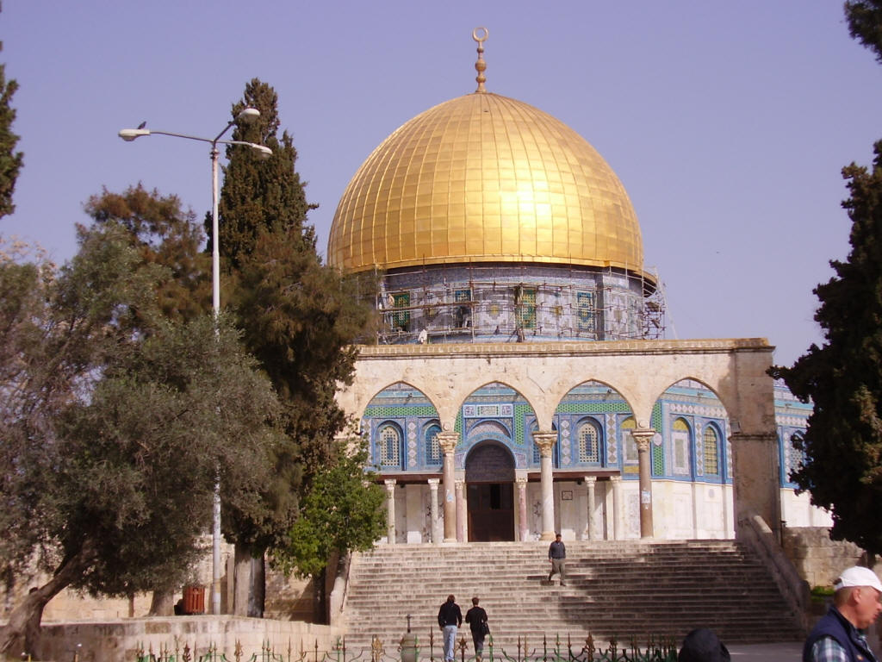
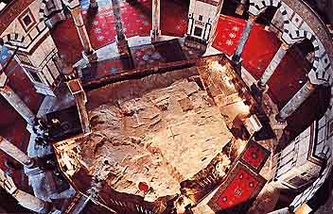
Tuhun Jerusalem’ Biak Inn Mual
Biak Inn sunga om Suang Mualpi
Suang Mualpi omna Biak Inn Mual
Handbook pg. 32-37
32a
1
Notes:
Here is the octagonal shrine as you would approach it from the south, leaving the famed Al Aqsa Mosque, also held by Islam to be one of its most holy sites.
//// Inside the Dome, looking downward, is “The Rock” from which Mohammed is said to have gone to the “Seventh Heaven” on a ladder. The building is covered throughout with hundreds of colorful carpets, its ancient roof supported by a multitude of stone columns.

Slide 35
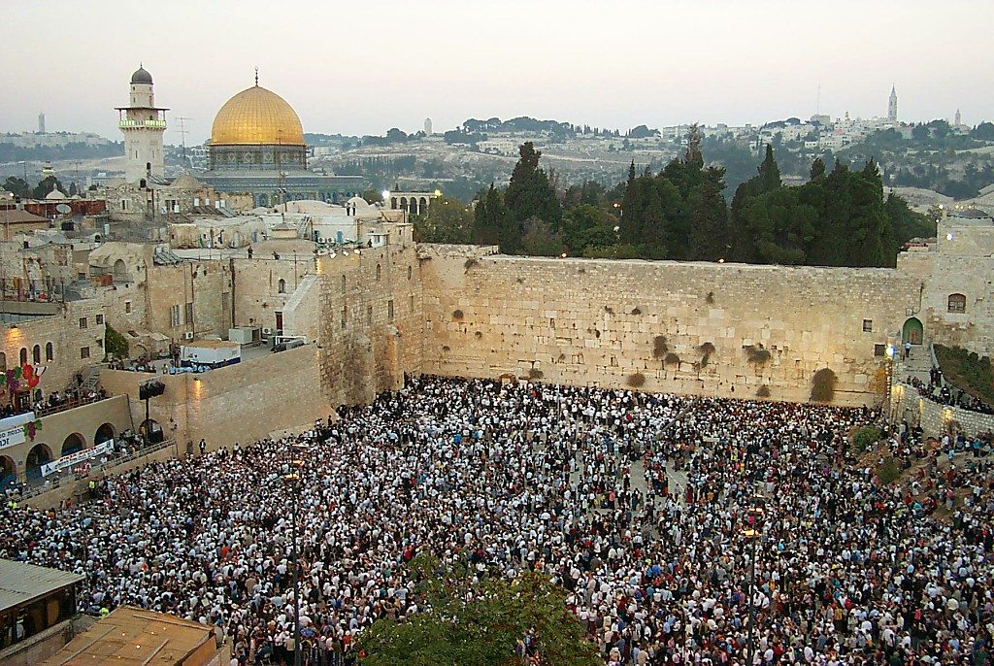
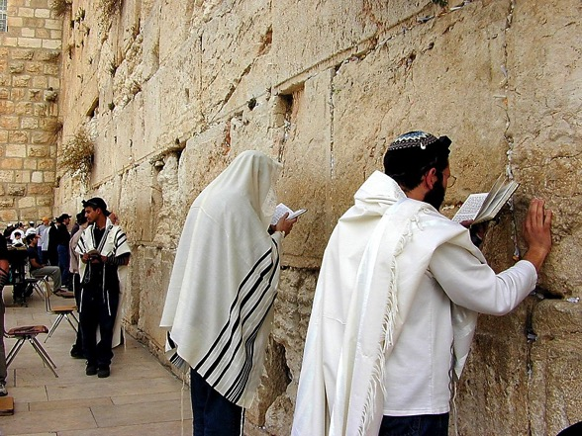
Nitum na lam Kahna Kulhpi, Biah Inn Mual
1 Kumpi 6:14-38
Kah Thungetna Kulhpi
KUMPI TE
S - D - S
Handbook pg. 32-37
33
1
Notes:
Directly below the great pavement is the Western Wall today. There are stones here from all the periods of Jerusalem's ancient history.
//// To Jewish people, like these multitudes at prayer, there is no place on the face of the earth more spiritually significant and historically important than right here. On the pavement above the Wall, where the cedars now grow, the great Second Temple stood and Jesus ministered to the multitudes of His day.

Slide 36

BIAH INN MUAL A THUPI NA!
1Kumpi 6:14-38; Matt 21:12-17
• Kha lam ah
• Pasian thu ah
• Ki Ukna lam ah
• Mual leh Gam thu ah
KUMPI TE
S - D - S
• Hun Nunung thu ah
Handbook pg. 32-37
34
6
Notes:
So now…every time you see news footage of Jerusalem, reports of its internal conflicts between Jews and Arabs…just remember the enormous importance of the Temple Mount…the center of it all…
//// The First Temple of King David, the Second Temple built for the Jews by Zerubbabel and expanded by King Herod the Great. Finally, today, the Moslem Dome of the Rock and Al Aqsa Mosque stand on this site. This small acreage was…
//// Israel's SPIRITUAL center and ritual focus…
//// its THEOLOGICAL and ritual cornerstone…
//// the POLITICAL center of the Jewish universe…
//// the GEOGRAPHICAL center of the Abraham's inheritance…and
//// for all believers, a key to our understanding of the events of the End Times…that being, the study of Biblical ESCHATOLOGY.

Slide 37

Tuhun Jerusalem Biak Inn Mual:
Leitungnbup ih Mun Laizang pen
1 Kumpi 6:14-38; Matt 21:12-17
Handbook pg. 32-37
35
Notes:
Now we can pull back and view the entire Jerusalem panorama with much greater appreciation of all that has happened there. The Temple Mount of today's Jerusalem continues as the tightly focused center of world concern as the sons of Sarah and the sons of Hagar continue their ancient dispute in the land where it all began!

Slide 38

SOLOMON: NGAIHSUTNA LIAN!
7
KUMPI TE
kim. 1000 B.C.
S - D - S
DT
2 Sam 7:4-16
1 Khangt 17:3-15
U K S
KUMPI TE
S - D - S
SEP LIAN: SUM LEH PAAI NGAH.
Handbook pg. 32-37
36
6
Notes:
Now back to the throne of international Israel in 1000 BC. Main players…
//// S-D-S...SAUL…the first anointed king, and not a very successful one at that.
//// While still living, old Samuel then anoints young DAVID, who follows SAUL to the throne. DAVID is then succeeded on Israel's throne by one of his many sons,
//// SOLOMON, born through Bathsheba. Under SOLOMON's rule,
//// the great Solomonic Temple is built, and united Israel arises as a national power and a center of enormous wealth and international influence. SOLOMON becomes internationally known for his wisdom and for his ambitious building projects.
//// He had some really big ideas…erected at great cost to his kingdom. But the question finally had to be answered…
//// when the bills came due: who paid for all that? The people…of course…as they always do…through high taxes and/or forced labor.

Slide 39
Solomon i Thubuai Pawlkhat
1 Kumpi 9, 10, 11
7
KUMPI TE
kim. 1000 B.C.
S - D - S
DC
Kumpi Inn Lam!
Siahdong Tam!
Sum Lawhsam!
Milim Bia!
2 Sam 7:4-16
1 Chron 17:3-15
U K S
KUMPI TE
S - D - S
Handbook pg. 32-37
37
4
Notes:
Solomon carried out a
//// construction program that was the envy of every king in the region.
//// But, in spite of his great wisdom, SOLOMON pays for it all through the burdens of enormous taxation which,
//// in the end, sent the country into bankruptcy…resulting in huge resentment on the part of the people toward their national government!
//// And if there were not enough problems: he himself fell into idolatry.

Slide 40
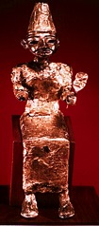
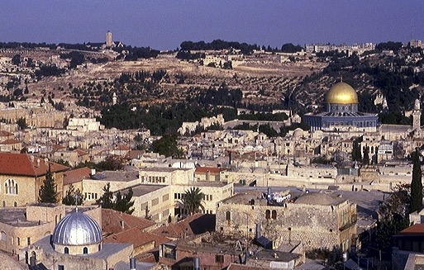

MILIM BIAKNA!
1 Kumpi 11:4-13
ROYALTY
Olive Mual
ca. 1000 B.C.
S - D - S
DC
2 Sam 7: 4-16
1 Chron 17:3-15
A R C
Biak Inn Mual
KUMPI TE
S - D - S
Handbook pg. 32-37
38
4
Notes:
Why? Along with Solomon's many foreign treaties he had also acquired many foreign wives from the country with which he made the treaty. The new wives moved into Jerusalem bringing with them their idolatrous religious practices.
//// On that site of today's Temple Mount…after SOLOMON had completed the first Temple to the God of Israel – and worshiped there - he later could be seen…
//// …over on The Mount of Olives across the Kidron Valley from his newly built temple…
//// worshipping the pagan gods brought into town by those foreign wives.
//// So…once again…idol worship entered the day to day life of ancient Israel, foreshadowing other great national problems to come

Slide 41
Solomon khit...
7
1 Kumpi 12:25 pan 14:31
KUMPI TE
kim. 1000 B.C.
S - D - S
D T
<<<< Kitam >>>>
LEILU LEITAW
2 Sam 7: 4-16
1 Khangt 17:3-15
U K S
ISRAEL JUDAH
10 2
KUMPI TE
S - D - S
••• KITAM •••
Leitlu Leitaw
Israel
Judah
10 2
Handbook pg. 32-37
39
3
Notes:
Upon the death of King SOLOMON, there was a vacuum of strong central leadership in Jerusalem.
//// There soon erupted a civil war... followed by a national SPLIT.
//// Quickly, the UNITED kingdom of the Israel of Saul, David, and Solomon...tears apart…becoming the TWO divided kingdoms of the NORTH and the SOUTH...as both descend into increasingly greater sin and spiritual separation from God.
//// TEN tribes join together to become known as the NORTHERN Kingdom, called ISRAEL, while the remaining TWO tribes (BENJAMIN and JUDAH) unite to become the SOUTHERN Kingdom of JUDAH. The Northern Kingdom was the larger…it retained the name ISRAEL.

Slide 42

Kumpi Gam Kitam
7
1 Kumpi 12:25 pan 14:31
SAKLAM KUMPI GAM:
ISRAEL
NAMPI 10
SAMARIA
KUMPI TE
S - D - S
••• KIMtam••
JERUSALEM
Leilu Leitaw
NAMPI 2
Israel
Judah
10 2
KHANGLAM KUMPI GAM:
JUDAH
Handbook pg. 32-37
40
1
Notes:
As a result of the national split…the 10 tribes of the Northern Kingdom, Israel, move their capital north into the region known, even today, as Samaria...
//// …while the two Southern Kingdom tribes, Judah and Benjamin, retain their national capital in Jerusalem.
So...now...the period of ROYALTY continues, but permanently split nationally between the two kingdoms, ISRAEL IN THE NORTH and JUDAH IN THE SOUTH.
Old alliances and ancient tribal relationships come alive as gross sin, idolatry and separation from God and the Law continue to grow and spread through both kingdoms, especially ISRAEL in the North.
Now it's clear to see that the Israel BEFORE the national split was an entirely different nation -- IN CHARACTER AND NATIONAL STYLE -- than that AFTER the split. That is a key idea toward keeping things straight in the Old Testament AFTER King Solomon.

Slide 43
PROPHET TE
1 Kumpi 17-22; Isaiah pan Malakhi
7
KUMPI TE
kim. 1000 B.C.
S - D - S
D T
<<<< KITAM >>>>
SAK KHANG
2 Sam 7: 4-16
1 Khangt 17:3-15
U K S
ISRAEL JUDAH
10 2
KUMPI TE
S - D - S
•••KITAMIT •••
Leilu Leitaw
Israel
Judah
10 2
PROPHET TE
Handbook pg. 32-37
41
Notes:
As the nation further disintegrates across the centuries, the Bible's great Old Testament PROPHETS raise strident voices against the national behavior, both NORTH and SOUTH.

Slide 44
7
Isaiah pan Malakhi
MALAKHI
MICAH
KUMPI TE
kim. 1000 B.C.
EZEKIEL
S - D - S
ZEPHANIAH
DANIEL
<<<<KITAM >>>>
ZECHARIAH
LEILU LEITAW
JEREMIAH
ISRAEL JUDAH
AMOS
HABAKKUK
JOEL
10 2
PROPHET TE
KUMPI TE
S - D - S
HAGGAI
••• KITAM •••
Leilu Leitaw
OBADIAH
Israel
Judah
ELISHA
10 2
PROPHET TE
ELIJAH
ISAIAH
HOSEA
NAHUM
JONAH…
Handbook pg. 32-37
42
Notes:
In many writings and in many other forms, the prophets repeatedly call the people back to the righteous ways of their Creator as handed down to MOSES in The Law. At the same time, they write and speak powerfully regarding a future Messiah whose appearance is imminent.

Slide 45
Thu Ciam Thak
7
KUMPI TE
kim. 1000 B.C.
S - D - S
D T
<<<< KITAM >>>>
LEILU LEITAW
2 Sam 7: 4-16
1 Khangt 17:3-15
U K S
ISRAEL JUDAH
10 2
KUMPI TE
PROPHET TE
Thu Ciam Thak
S - D - S
••• KITAm •••
Leilu Leitaw
Israel
Judah
10 2
Jer 31: 31-33
PROPHET TE
Handbook pg. 32-37
43
Notes:
In the midst of this national depression, however, God speaks through the prophet Jeremiah.
//// The NC in the scroll image represents THE NEW COVENANT -- Jeremiah 31:31-33 -- where God proclaims unconditionally the approaching inauguration of a new program with His people and with all the people of the earth. Add “NC” to the scroll figure on your Study Help.

Slide 46
7
Jeremiah 31
THU CIAM THAK
³¹ “En un, Topa in kong cihin-ah, Israel minamte leh Judah minamte tawh thuciamna thak khat ka bawl ni hun hong tung ding hi.”
KUMPI TE
S - D - S
••. KITAM •••
Leilu Leitaw
Israel
Judah
10 2
PROPHET TE
MESSIAH THU KAMCIAM!
Handbook pg. 32-37
44
3
Notes:
Here are the words of the wonderful promise, from the Weeping Prophet, Jeremiah: "The time is coming," declares the Lord, "when I will make…
//// …a new covenant…
//// …with the house of Israel and the house of Judah."
//// In this way, we learn that a Messiah is promised -- one who will deliver all Israel and Judah and all people of the earth -- from the bondage of sin. He is the One who will return them to their original created, sinless relationship to their Creator.

Slide 47
Abraham Tawh Thuciam
(“SAP NA”)
Piancil 12: 1-3
KUPI TE
GAM
THUPHA
S - D - S
GAM
SUAN
THUPHA
SUAN
••• KITAM •••
Leilu Leitaw
Israel
Judah
Gam
David
Thak
10 2
PROPHET TE
Thuhilhkikna
30:1-10
2 Samuel
7:4 -16
Jeremiah
31:31-33
Handbook pg. 32-37
45
5
Notes:
Now we can see…the full amplification of the Abrahamic promise...
the Land, the Seed, and the Blessing statements...all of it represented by
//// the LAND Promise or Covenant…,
//// the DAVIDIC covenant, and, now,
//// the NEW covenant.
So, Jeremiah's announcement specifically amplifies that BLESSING portion of that ABRAHAMIC CONTRACT.

Slide 48
7
1 Kumpi 12 pan 2 Kumpi 24
KUMPI TE
kim. 1000 B.C.
S - D - S
D T
<<<< KITAM >>>>
LEILU LEITAW
2 Sam 7:4-16
1 Khangt 17:3-15
U K S
ISRAEL JUDAH
10 2
T T
KUMPI TE
PROPHET TE
S - D - S
•••KITAM •••
Leilu Leitaw
20-J 20-R
Israel
Judah
10 2
Leitaw: Rehoboam
PROPHET TE
Leilu: Jeroboam
20-J 20-R
KUMPI HOIH OMLO
KUMPI PAWLKHAT HOIH
Handbook pg. 32-37
46
2
Notes:
In each of the two kingdoms,
//// …20 kings reigned in the Northern Kingdom and 20 kings in the Southern…beginning with JEROBOAM in the NORTH…remember it by 20-J….and REHOBOAM in the SOUTH…20-R. You can remember that order this way: North above South; J before R.
//// The NORTHERN KINGDOM OF ISRAEL is, by far, the more wicked, rebellious and idolatrous of the two. There were NO GOOD KINGS IN THE NORTHERN KINGDOM. However, in the South, there were some, though very few, good kings.

Slide 49
7
2 Kumpi 17:6
KUMPI TE
kim. 1000 B.C.
S - D - S
D T
<<<< KITAM >>>>
LEILU LEITAW
2 Sam 7: 4-16
1 Khangt 17:3-15
U K S
ISRAEL JUDAH
10 2
T T
KUMPI TE
PROPHET TE
S - D - S
••• KITAM •••
Leilu Leitaw
20-J 20-R
Israel
Judah
Jer 31: 31-33
10 2
200
PROPHET TE
20-J 20-R
200
ASSYRIA
Assyria
Handbook pg. 32-37
47
Notes:
Israel, the NORTHERN KINGDOM, existed for about 200 years. Then from out of the far northeast, God sends his judgment in the
form of the dreaded ASSYRIANS who…

Slide 50
2 Kumpi 17:6
GAM OM
DAN LAK
NA
MS
N(A)
H
SG
C
ER
B
J
MN
KUMPI TE
DS
S - D - S
••• KITAM •••
E
Leilu Leitaw
SAKLAM KUMPI GAM:
ISRAEL (722 B.C.)
JUDAH MITAMPI GAMLAL
Israel
Judah
KB
U
10 2
PROPHET TE
20-J 20-R
200
Assyria
MS
PG
RS
Handbook pg. 32-37
48
1
Notes:
…sweep down to take the NORTHERN KINGDOM away.
The people are dispersed -- absorbed by the Assyrians and other cultures of that day. This becomes known as the great Diaspora, or Dispersion, of the Jews.
//// The year is 722 BC. In all of our study, there are only two specific dates that are helpful to remember. The capture of the NORTHERN KINGDOM, 722 BC, is one of them. Never again do we hear of the NORTHERN KINGDOM as a united people. Through the following centuries they are gradually dispersed throughout the world.

Slide 51
GAM OM
DAN LAK
NA
MS
Ahi hang… Khanglam Kumpi gam?
N(A)
H
SG
C
ER
B
J
MN
KUMPI TE
DS
S - D - S
BABYLON IN ASSYRIA ZO!
••• KITAM •••
E
Leilu Leitaw
Israel
Judah
KB
U
10 2
PROPHET TE
20-J 20-R
200
Assyria
MS
PG
RS
Handbook pg. 32-37
49
2
Notes:
However…The SOUTHERN KINGDOM OF JUDAH experiences quite a different kind of judgment.
//// By this time, the Babylonians defeat the Assyrians. Then…
//// The Babylonian King Nebuchadnezzar now turns his attention toward Judah, that remaining Southern kingdom.

Slide 52
2 Kumpi 25
7
KUMPI TE
kim. 1000 B.C.
S - D - S
DT
<<<< KITAM >>>>
LEILU LEITAW
2 Sam 7:4-16
1 Khangt 17:3-15
U K S
ISRAEL JUDAH
10 2
TT
KUMPI TE
PROPHET TE
S - D - S
•••KITAM •••
Leilu Leitaw
20-J 20-R
Israel
Judah
Jer 31: 31-33
10 2
200
350
PROPHET TE
20-J 20-R
200
350
ASSYRIA
BABYLON
Assyria
Babylon
Handbook pg. 32-37
50
Notes:
IN JUDAH…where there were a few good kings…that kingdom lasts for about 150 years longer -- or for a total of 350 years after the national split.

Slide 53
2 Kumpi 25: 1-21
GAM OM
DAN LAK
NA
MS
N(A)
H
SG
C
ER
B
J
MN
KUMPI TE
DS
S - D - S
••• KITAM•••
E
Leilu Leitaw
Israel
Judah
KB
U
10 2
KHANGLAM KUMPI GAM:
JUDAH (586 B.C.)
BABYLON GAMAH SALTANG
PROPHET TE
20-J 20-R
200
350
Assyria
Babylon
MS
PG
RS
Handbook pg. 32-37
51
2
Notes:
Then, in the terrible onslaught of 586 BC, JUDAH, herself,
//// faces the invasion of the BABYLONIANS under King Nebuchadnezzar. All of Jerusalem -- including SOLOMON's great Temple -- is completely destroyed by the Babylonians. This is that second and important specific date to remember…586 B.C.
//// The SOUTHERN KINGDOM OF JUDAH is carried away into the famous Babylonian CAPTIVITY, sometimes called the EXILE.

Slide 54
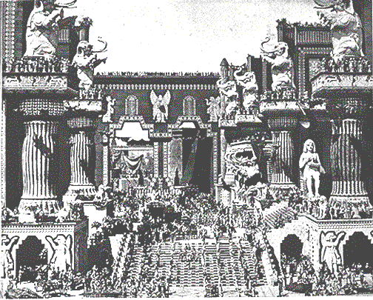
2 Kumpi 25: 1-21
KUMPI TE
S - D - S
••• KITAM •••
Leilu Leitaw
Israel
Judah
10 2
PROPHET TE
20-J 20-R
200
350
Assyria
Babylon
Tanglai Babylon Khuapi
Gamtatzia alak khia man “Gawtmun taneu”
Handbook pg. 32-37
52
Notes:
…into a distant city and country where two of Judah's most famous prophets, Daniel and Ezekiel, will speak and write their messages of hope in foretelling the glorious Messiah. In this artist's conception, you can sense the flavor of Babylon…that enormous capital of the ancient world.

Slide 55

Piancil pan Nehemiah
7
PIANCIL
UKNA OMLO
Mi Masa
Thukhente
Mawhna Masa
350
P
Lungdamna Masa
350
Innkuan Masa
(1000 B.C.)
Sihna Masa
KUMPI TE
(1000 B.C.)
Tuicin/Sakhi tui
S - D - S
DT
Tausang
•••KITAM •••
Leilu Leitaw
(2000 B.C.)
ABRAHAM
(2000 B.C.)
Israel
Judah
MI KIPAWLNA 3
SAP NA
AT
10 2
TT
P 7 D J
L - S - B
PROPHET TE
I - I
20-J 20-R
J - E
200 350
Assyria Babylon
12
SALTANG
7 = 4 + 3
JOSEPH
KUMPI TE
Saltang
S - D - S
430
••• KITAM •••
MI 4
Leilu Leitaw
(1500 B.C.)
Israel
Judah
MOSI
(1500 B.C.)
(500 B.C.)
10 2
Paikhiatna
D
S
DAIHNA
PROPHET TE
Sinai
20-J 20-R
G - M - P
200
350
Kadesh Barnea
JESU
Assyria
Babylon
40
40
GT
Thuhilh 5
J
JOSHUA
Jericho/Ai
Gam kihawm
53
Notes:
So the ROYALTY period and its folder in THE BIBLE FILE come to an end.
As Israel and Judah face the judgment of dispersion for the one, and temporary exile for the other, history moves us from ROYALTY …

Slide 56
7
S
U K
“SALTANG”
Handbook pg. 37-38
54
1
Notes:
...into the last of the three kinds of Biblical societies, CAPTIVITY.
//// Remember the geometric memory tool of A-R-C

Slide 57
2 Kumpi 25:21 pan Ezra 1:3
U K S
PIANCIL
ABRAHAM
ABRAHAM
ABRAHAM
JOSEPH
ABRAHAM
MOSI
JOSHUA
UKNA OMLO
KUMPI TE
SALTANG
DAIHNA
JESU
Handbook pg. 37-38
©2006 TBBMI
55
Notes:
….we come to the eighth Bible File folder, the one called... “CAPTIVITY”

Slide 58
A KINAI THEI PEN KUM:
ABRAHAM-JOSEPH 2000 B.C.
MOSI-JOSHUA 1500 B.C.
UKNA OMLO-KUMPI TE 1000 B.C.
SALTANG-DAIHNA 500 B.C.
56
Notes:
Its time-line...moving now 500 years closer to the time of the Savior... about 500 BC

Slide 59
JUDAH KITUAM KEP!
Isaiah 9:6-7
GAM OM
DAN LAK
NA
Akigawm in…
MS
N(A)
H
SG
C
ER
B
J
MN
DS
E
BANGHANG?
KB
U
MS
Ahang: Messiah pen Judah phung pan hong paing ding ki genkholh.
PG
RS
Handbook pg. 37-38
57
8

Slide 60
2 Kumpi 25:21
7
SALTANG
Mi KIPAWL
na
NAM THUM
pan:
SALTANG
U K S
Handbook pg. 37-38
58
Notes:
And here is CAPTIVITY's file folder from the Bible File sequence ready for the four items important to this period in the life of ancient Judah.

Slide 61

Daniel 1
Tanglai Babylon Khuapi
SALTANG
Euphrate Tuipi
Babylon Khua Huanpi
Handbook pg. 37-38
59
Notes:
Babylon -- that enormous Oriental metropolis next to the Euphrates River -- is the site of JUDAH's 70 years of captivity, shown here in an artist re-creation of the possible appearance of that incredible city. The famed Hanging Gardens of Babylon -- visible on the right -- were among the Seven Wonders of that Ancient World.

Slide 62
7
SALTANG
THU PIANNA MUN
Handbook pg. 37-38
60
Notes:
Remember, also, that Babylon -- located on your map many miles upstream from the Persian Gulf – was very near the heart of today's troubled Persian Gulf region in the Middle East.

Slide 63
Jer. 29:10; Ezra 3:8; Neh. 2:5-6
7
SALTANG
KUM 70
KHUALZIN3
U K S
SALTANG
Kum 70
Khualzin 3
“JEWS”
“JEWS”
“KIKHOP NA”
“KIKHOP NA”
Handbook pg. 37-38
61
3
Notes:
After the 70 years of Judah's exile, the Babylonian rulers allowed the captives from the SOUTHERN KINGDOM OF JUDAH to return to Jerusalem, and to rebuild their city, its walls and their Temple.
//// And it was during this time of the Babylonian Exile that the people of JUDAH came to be called Jews -- from the tribal name of JUDAH.
//// The worldwide Jewish tradition of the synagogue was also born in Babylon during Judah's Captivity or Exile.
//// The Return to The Land took place in 3 massive treks. These were difficult trips on foot from Babylon back to the Land.

Slide 64
7
3 VEI KHUALZIN
U K s
SALTANG
Kum 70
Khualzin 3
THU PIANNA MUN
Handbook pg. 37-38
62
Notes:
The returning Jews moved up along the Fertile Crescent route probably near the Euphrates River....then finally turning away southward toward the Land of Israel. That route was absolutely necessary. Otherwise the returnees would be unable to survive the harsh desert conditions that lay directly westward between Babylon and Jerusalem.

Slide 65
Ezra 1 pan 2
7
SALTANG
KUM 70
KHUALZIN 3
U K S
Kum 100 / 50,000
SALTANG
Kum 70
Khualzin 3
Kum 100 / 50,000
Handbook pg. 37-38
63
Notes:
The THREE TREKS back to the land lasted about 100 years. During that time some 50,000 people returned.

Slide 66
Ezra 1:4
50,000 CIAHKIK!
AHI HANG MI ATAM ZAW INN CIAH NANG
SUM ZONG LAI.
SALTANG
Kum 70
Khualzin 3
Kum 100 / 50,000
Handbook pg. 37-38
64
1
Notes:
Even though some 50,000 Jews left Babylon to return to the Land of their Promise…
//// …many Jews back in Babylon had been successful in business, living in their own houses. Those Jews were largely responsible for financing the trips back, and for the work of reconstruction by the returnees.

Slide 67
Jer. 29; Ezra 3; Neh. 2
7
ZERUBBABEL
SALTANG
EZRA
KUM 70
KHUALZIN 3
U K S
Kum 100 / 50,000
Z - E - N
SALTANG
NEHEMIAH
Kum 70
Khualzin 3
Kum 100 / 50,000
Z - E - N
Handbook pg. 37-38
65
4
Notes:
During those difficult journeys back to Israel from Babylon, three famous names move into national leadership.
//// Remember those names by recalling the word Z-E-N...these three great men, sometimes called diplomat-priests, in order, were
//// ZERUBBABEL...
//// EZRA... and
//// NEHEMIAH.

Slide 68
Neh. 3
7
ZERUBBABEL…ciahkik in Biak Innpi lam.
ZERUBBABEL
SALTANG
EZRA…ciahkik in Pasian Thukham hilh.
KUM 70
EZRA
Z-E-N
Khualzin 3
KUM 100 / 50,000
Z - E - N
SIAMPI MAKAI
MI THUM
SALTANG
NEHEMIAH
Kum 70
NEHEMIAH…ciahkik, Laisiangtho lui sungah Makai thupi khat leh kulhpi cing kik.
Khualzin 3
Kum 100 / 50,000
Z - E - N
Handbook pg. 37-38
66
3
Notes:
ZERUBBABEL is remembered because of his crucial role in beginning the rebuilding of the actual Temple structure, small though it was…
//// EZRA...the great priest who went to Jerusalem to teach the law of the Lord to the returned people...
//// While NEHEMIAH, that famed Old Testament administrator and leader, returned to rebuild the city's gates and walls. In an astonishingly short time, he and his men rebuilt Jerusalem's crucial defenses.
//// These three great men…Z-E-N….Zerubbabel, Ezra and Nehemiah…the diplomat-priests…were at the center of Judah's return, carefully guiding the development of an exiled nation now back in its homeland.

Slide 69
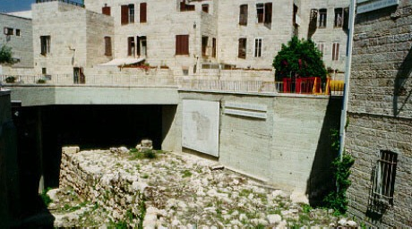
Neh. 3:8
Jerusalem: Nehemiah Lam Kulhpi
SALTANG
Kum 70
Khualzin 3
Kum 100 / 50,000
Z - E - N
Handbook pg. 37-38
67
Notes:
In fact, biblical scholars are quite certain that these archeological digs, in the heart of Jerusalem, are, indeed, the remains of those walls rebuilt by Nehemiah and his Jewish construction crews.

Slide 70
Jer. 29:10; Ezra 3:8; Neh. 2:5-6
7
ZERUBBABEL…ciahkik in Biak Innpi lam.
ZERUBBABEL
SALTANG
EZRA…ciahkik in Pasian Thukham hilh.
KUM 70
EZRA
Z-E-N
Khualzin 3
KUM 100 / 50,000
Z - E - N
SIAMPI MAKAI
MI THUM
SALTANG
NEHEMIAH
Kum 70
NEHEMIAH…ciahkik, Laisiangtho lui sungah Makai thupi khat leh kulhpi cing kik.
Khualzin 3
Kum 100 / 50,000
Z - E - N
Handbook pg. 37-38
66
3
Notes:
ZERUBBABEL is remembered because of his crucial role in beginning the rebuilding of the actual Temple structure, small though it was…
//// EZRA...the great priest who went to Jerusalem to teach the law of the Lord to the returned people...
//// While NEHEMIAH, that famed Old Testament administrator and leader, returned to rebuild the city's gates and walls. In an astonishingly short time, he and his men rebuilt Jerusalem's crucial defenses.
//// These three great men…Z-E-N….Zerubbabel, Ezra and Nehemiah…the diplomat-priests…were at the center of Judah's return, carefully guiding the development of an exiled nation now back in its homeland.

Slide 71
Piancil pan Esther
7
PIANCIL
UKNA OMLO
Mi Masa
Thukhente
Mawhna Masa
350
P
Lungdamna Masa
350
Innkuan Masa
(1000 B.C.)
Sihna Masa
KUMPI TE
(1000 B.C.)
Tuicin/Sakhitui
S - D - S
DT
Tausang
••KITAM •••
Leilu Leitaw
(2000 B.C.)
ABRAHAM
(2000 B.C.)
Israel
Judah
MI KIPAWLNA 3
SAP NA
AT
10 2
P 7 D J
L - S - B
PROPHET TE
I - I
20-J 20-R
200 350
TT
J - E
Assyria Babylon
12
SALTANG
7 = 4 + 3
JOSEPH
Kum 70
SALTANG
Saltang
Khualzin 3
Kum 70
430
Kum 100 / 50,000
MI 4
Khualzin 3
Z - E - N
100 Years / 50,000
(1500 B.C.)
Kum 100 / 50,000
MOSI
(1500 B.C.)
(500 B.C.)
Z - E - N
Paikhiatna
D
S
DIAHNA
Sinai
G - M - P
Kadesh Barnea
JESU
40
40
GT
Thuhilh 5
J
JOSHUA
Jericho/Ai
Gam Kihawm
69
1
Notes:
At the eighth file folder of CAPTIVITY in the series of ten BIBLE FILE FOLDERS we are at the end of the Old Testament…also bringing us to the end of the 3 great societies.…ANARCHY ...ROYALTY...and CAPTIVITY…
//// …and showing us in their complete presentations THE FOUR OLD TESTAMENT CONVENANT PROMISES…the ABRAHAMIC…the LAND…the DAVIDIC…and THE NEW COVENANTS. Moving on now to SILENCE.

Slide 72


Lai Siangtho...Abulpi • BibleStudyDownloads.org
Hih thuhilhna a awk na in lain!
Laisiangtho thutuk sina paunam 40 val omhi
Laisiangtho thuthuk hilhna limtawh, laimal tawh paunam 44 omhi
Notes:
The Bible…Basically (bb)

Slide 73
70
9.7.03d.

