Slide 1

Chin
Lai Siangtho…Abulpi
A Presentation of The Bible…Basically Ministries International Inc. Fort Worth, Texas
www.biblebasically.org
©2004 TBBMI
8.0.01.
01
Notes:
PLEASE PUT THE TITLE AND SUBTITLES INTO YOUR NATIONAL LANGUAGE AND LEAVE THE WEBSITE UNCHANGED

Slide 2



(Hitakah BANG Thupiang.)
LAISIANTHO… BULPI
®
KHEN THUM
Na kipat nang: “KHANGTHU A TOMKIM”
02
©2006 TBBMI
9.65.03a.
Notes:
Part Three…and here we get to the heart of the matter…the very story core of Scripture. We call it THE QUICK CHRONOLOGY. This is the ‘WHAT HAPPENED” of the great Biblical drama…in the briefest possible detail.

Slide 3
P
-
P
7
D
J
D
03
1
Notes:
First…a quick review…the 7 with a dash through the stem…
//// …surrounded by the C, the S, and the J.

Slide 4
7
NA PHAWKKIK NANG...
P 7 D J
=
4 3
04
1
Notes:
Just a reminder…the 7 in the upper left corner of the frame…almost always there as a mental help…
//// …the 7 breaks into the 4 and the 3.

Slide 5
7
NA PHAWKKIK NANG...
P 7 D J
P 4 3 D J
05
Notes:
…which leads to C 4 3 S J…

Slide 6
7
NA PHAWKKIK NANG...
P 7 D J
P 4 3 D J
PIANCILNA
MI 4
MI KIPAWLNA 3
DAIHNA
JESU
06
Notes:
….bringing us to the five ideas of
CREATION…4 PEOPLE…3 SOCIETIES…SILENCE…JESUS.

Slide 7
7
PIANCILNA
P
ABRAHAM
JOSEPH
MOSI
JOSHUA
UKNA OMLO
KUMPI KIUKNA
SALTANNA
DAIHNA
JESU
07
Notes:
And finally…the ten file folders of THE BIBLE FILE.
Say them with me: CREATION, ABRAHAM, JOSEPH, MOSES, JOSHUA, ANARCHY, ROYALTY, CAPTIVITY, SILENCE and JESUS.

Slide 8
A DAWL DAWL A
ETTOH NA
MUN 10
MS
PIANCILNA
6 4
ABRAHAM
N (A)
H
JOSEPH
A GAM
MOSI
SG
C
JOSHUA
UKNA OMLO
MN
B
J
KUMPI KIUKNA
SALTANNA
“THU APIAN
HUNTENG !”
D S
DAIHNA
U
E
JESU
KB
ST
SM
PG
08
1
Notes:
So now...with your own map of the Ancient Near East in your mind – THE STAGE OF THE ACTION -- and
//// THE BIBLE FILE FOLDERS outlined in their order...what's next?

Slide 9
7
PIANCILNA
ABRAHAM
ABRAHAM
ABRAHAM
JOSEPH
ABRAHAM
MOSI
JOSHUA
UKNA OMLO
KUMPI KIUKNA
SALTANNA
DAIHNA
JESU
•Lungsim a gamlim suai hihang!
•A kicing in sinlo ding hanga...
•A huampi a en ding hi hang.
•LST’ Ahuampi outline.
09
4
Notes:
//// Remember, first, that we’re building a mental map. We use the ten Bible Files as basic building blocks for what eventually can become a very large intellectual or mental structure! However, we are only building AN OUTLINE MAP of the Author's enormous literary work.
//// We’re learning no small details!
//// We will be dealing only with the big picture...
//// …only the Bible’s general outline. And that’s the great value of THE BIBLE…BASICALLY.
You’ll finally begin learning generally WHAT is WHERE in God’s great love letter to His Creation.

Slide 10
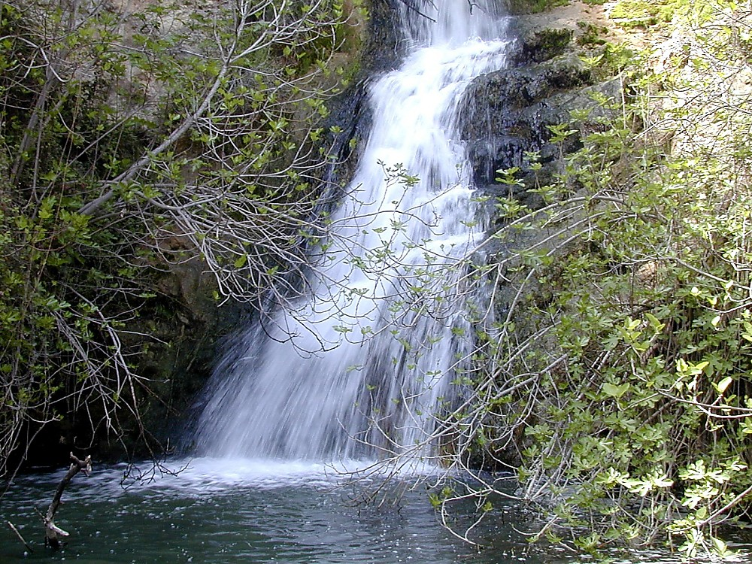
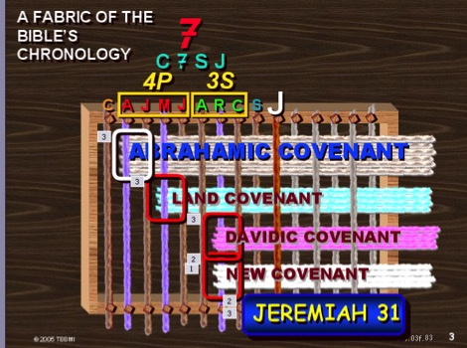
UHNA
10
Notes:
Based on the ten labeled Bible Files – with lots of visuals…lots of graphic assistance…we are now going to learn Scripture's basic chronology, its foundational story and time line. Keep in mind our main concern: learning only the most outstanding Biblical milestone events, along with some of the most well known Biblical characters. Many events and characters that you might expect to find will not be mentioned. But their places are reserved among those that are. And all this done while learning a mental tool to keep it all in order.
[blue “woven” fabric graphic is the last one]

Slide 11
PIANCILNA
ABRAHAM
ABRAHAM
ABRAHAM
JOSEPH
ABRAHAM
MOSI
JOSHUA
UKNA OMLO
KUMPI KIUKNA
SALTANNA
DAIHNA
JESU
11
Notes:
Then as we move through The Quick Chronology -- based on THE BIBLE FILE -- you'll be able to tie in each part –
each event and character --with one of those ten key words now placed on ten mental BIBLE FILE folders —
in the chronological order you learned them.

Slide 12
7
PIANCILNA
ABRAHAM
ABRAHAM
P
ABRAHAM
JOSEPH
ABRAHAM
MOSI
JOSHUA
UKNA OMLO
KUMPI KIUKNA
SALTANNA
DAIHNA
JESU
12
Notes:
The first of which will be the CREATION file. This is the beginning of your chronological thinking.

Slide 13
7
Pian. 1 pan 11
LST FILE TE SEHNA
PIANCILNA
UKNAOMLO
CREATION
ABRAHAM
P
KUMPI
PIANCILNA
ABRAHAM
ABRAHAM
JOSEPH
MIKIPAWLNA 3
ABRAHAM
MOSES
JOSHUA
ANARCHY
ROYALTY
CAPTIVITY
SALTANNA
MI 4
SILENCE
JESUS
D
DAIH
LAISIN HUHNA #04
13
1
Notes:
If you have the worksheet from the student handbook entitled INDEXING THE BIBLE FILE – STUDY HELP NUMBER 4 --
keep it handy as we work through the next section. All the Bible Files are located there as you work through them.
It will help you to embed THE QUICK CHRONOLOGY mentally as we move forward…beginning with the CREATION file.
//// Now let's move on to expand The Bible Files, always filling them with more details, building on what has gone before,
while still maintaining that high, outline view of the overall story line of Scripture.

Slide 14
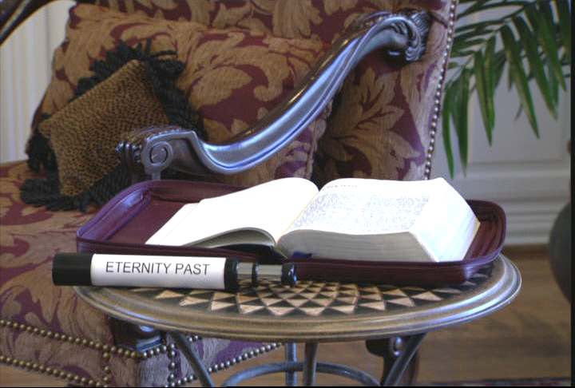
7
PIAN 1-11: ABEISA ATAWNTUNG HUN
BEISATAWNTUNG
Handbook pg. 17-19
14
1
Notes:
In the CREATION FILE, with great speed, we are swept through the first eleven chapters of the book of Genesis. We see the universe in its broadest dimensions of time and space…and then…
//// We view the earliest events in the opening chapters through that telescope into Eternity Past... In both early Genesis here and Revelation later on we see a telescoped view of enormous spans of time. [God breaks through eternity past by creating the earth.]

Slide 15
A BEISA A TAWNTUNG HUN “NEUCIN LANG” TAWH ETNA...
Handbook pg. 17-19
15
Notes:
Through this telescope into Eternity Past, the effect is quite similar to viewing mountain ranges from a great distance.
We can see the peaks lined up one after another into the far distance.

Slide 16
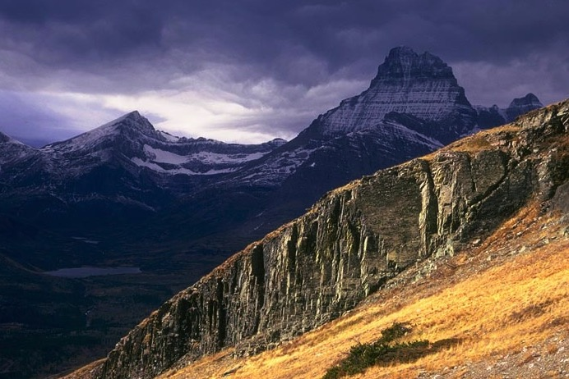
A BEISA TAWNTUNG HUN “NEUCIN LANG” TAWH ET NA...
Handbook pg. 17-19
16
1
Notes:
It is obvious that a great deal of land lies between the peaks.
//// But only when we get into the valleys between the peaks can we clearly see that the valleys are there…
and to estimate the distances that lie across the valleys between the mountain peaks.

Slide 17
Pian. 1:1
“a kipat cil in...”
17
1
©2006 TBBMI
8.0.03a.
Notes:
So…as we enter the CREATION BIBLE FILE…at Genesis 1:1…
//// …we are “In the Beginning…” those three small words that ring up a curtain of unfathomable depth and meaning for the unfolding Plan of the Ages.

Slide 18
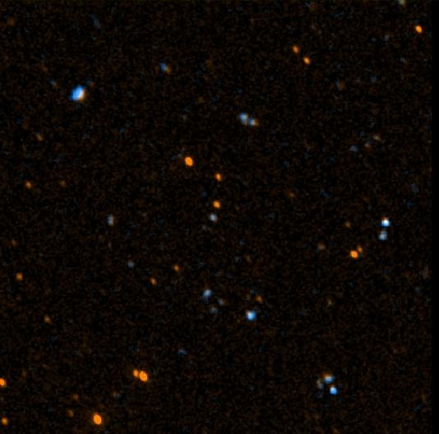
John 17:5
“PA AW, LEITUNG A KIPIAN’ SAK MA-IN NANG TAWH I NEIHKHAWM NA PIANZIA MAH TU-IN NANGMA OMNA MUNAH HONG PIA TA IN .”
18
©2006 TBBMI
8.0.03a.
Notes:
In the earliest phases of Genesis we are beamed backward as it were to a time before the world was. Jesus Himself spoke of that time. We know it to be so because He asked the Father – in John 17 -- to glorify him “with the glory which I had with you before the world was.” [John 17:5]

Slide 19

John 17:5
“Pa aw, leitung a kipian'sak ma-in nang tawh i neihkhawm na pianzia mah tu-in nangma omna munah hong pia ta in. ”
19
©2006 TBBMI
8.0.03a.
Notes:
In the earliest phases of Genesis we are beamed backward as it were to a time before the world was. Jesus Himself spoke of that time. We know it to be so because He asked the Father – in John 17 -- to glorify him “with the glory which I had with you before the world was.” [John 17:5]
[AUTO ADVANCE]

Slide 20
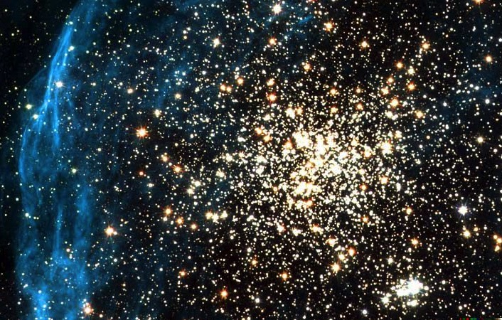
John 17:5
“Pa aw, leitung a kipian'sak ma-in nang tawh i neihkhawm na pianzia mah tu-in nangma omna munah hong pia ta in.”
20
©2006 TBBMI
8.0.03a.
Notes:
In the earliest phases of Genesis we are beamed backward as it were to a time before the world was. Jesus Himself spoke of that time. We know it to be so because He asked the Father – in John 17 -- to glorify him “with the glory which I had with you before the world was.” [John 17:5]
[AUTO ADVANCE]

Slide 21

John 17:5
“Pa aw, leitung a kipian'sak ma-in nang tawh i neihkhawm na pianzia mah tu-in nangma omna munah hong pia ta in.”
21
©2006 TBBMI
8.0.03a.
Notes:
In the earliest phases of Genesis we are beamed backward as it were to a time before the world was. Jesus Himself spoke of that time. We know it to be so because He asked the Father – in John 17 -- to glorify him “with the glory which I had with you before the world was.” [John 17:5]
[AUTO ADVANCE]

Slide 22
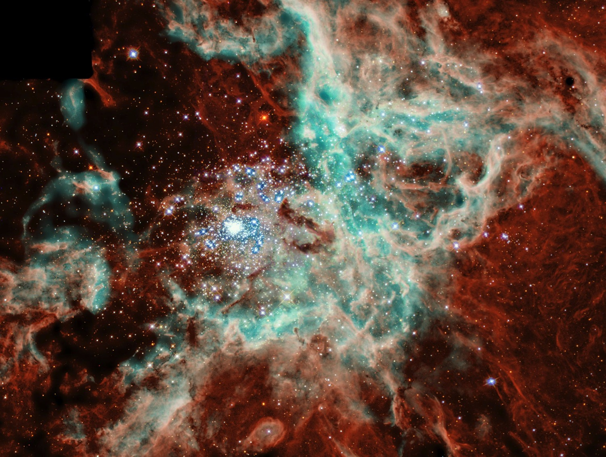
John 17:5
“Pa aw, leitung a kipian'sak ma-in nang tawh i neihkhawm na pianzia mah tu-in nangma omna munah hong pia ta in.”
22
©2006 TBBMI
8.0.03a.
Notes:
In the earliest phases of Genesis we are beamed backward as it were to a time before the world was. Jesus Himself spoke of that time. We know it to be so because He asked the Father – in John 17 -- to glorify him “with the glory which I had with you before the world was.” [John 17:5]
[LAST SLIDE IN AUTO SEQUENCE]

Slide 23
Job 38:4-18
“Leitung ka bawl laitakin
nang om na hi hiam ?”
CREATION
23
1
©2006 TBBMI
8.0.03a.
Notes:
And…should men get overwhelmed by their own earthly pride of accomplishment and conceit on this planet; the Creator set them straight when he asked Job the simple question… “Where were you when I laid the earth’s foundations?”

Slide 24
Pian. 1-11
Gen 3:15:…” Amah in na lutang
hong sunim ding a,
nang in ama khetul
na sunim ding hi .”
NIV footnote: “Numei suan in guulpi’ lutang satzan takpi a; Satan tungah Khazih’ gualzawhna pen kamciam tangtunna hi—thu-um mi khempeuh in tua gualzawhna ngah hi (Rom 16:20).
PIANCIL
Abraham-ma hun teng
CREATION
MI MASA TE
(Perfection)
MAWHNA MASA
(Miss the Mark)
PIANCILNA
ABRAHAM
GOSPEL MASA
(Redeemer)
THU 7
INKUAN MASA
(Contention)
TUALTHAT MASA
(Abject Sin)
TUICIIN/SAKHI TUIHUP
(Pgm #1: Noah)
TAUSANG
(Pgm #2: Babel)
Handbook pg. 42-45
24
10
Notes:
SO…As we open up the first file folder, CREATION, Genesis 1-11…the BIBLE FILE FOLDER image has spaces
//// ….provided for seven items.
//// All time prior to 2000 BC – call it pre-Abraham -- is included in the first eleven Genesis chapters. No one can possibly know the duration of time included there. The entire story of CREATION and the course of the universe and this planet up through the development of the first known civilizations are contained in Genesis, chapters 1 through 11. But in spite of the brevity of those first eleven Genesis chapters, they are priceless words that teach us many important “first things.”
Beginning now with A LIST OF FIRST THINGS…
//// The FIRST MAN and WOMAN
Man appears on earth in a perfect form and is placed in the sinless environment of God’s created perfection.
//// The FIRST SIN
Man is given a test of his gift of free will. He is tempted by Satan and falls from his created state of perfection into a sinful condition, having “missed the mark” for which he was created. A distance or gulf is created between the Creator and his created!
//// The FIRST GOSPEL
The Creator provides the first announcement that He will send a Redeemer to provide for man a way back to that original state of created perfection, innocence and holiness.
//// It’s important to note Genesis 3:15: “…he will crush your head, and you will strike his heel.” In a footnote in the NIV Study Bible is this statement: “The offspring of the woman would eventually crush the serpent’s head; a promise fulfilled in Christ’s victory over Satan…a victory in which all believers will share.”
//// The FIRST FAMILY
Adam and Eve have children. They provide the basis for future development of a race of men which must contend with satanic efforts to keep them from a restored relationship with the loving Father and Creator.
//// The FIRST MURDER
Sin is committed in its most abusive and abject form, man’s destruction of God’s ultimate gift, life itself.
And then we have two items of ancient history in those first eleven chapters. These are contained in two programs of God’s action among men.
//// The GREAT FLOOD and RAINBOW
First program: God determines to wipe out His Creation turned desperately sinful…and to begin it again. All mankind perishes except eight people who, under the leadership of righteous Noah, remain true to the Father, Who provides His rainbow promise as the waters recede. And then…
//// The TOWER OF BABEL
Second program: Man attempts to climb to an elevation equal to God Himself. God intervenes with a confusion of earthly languages in order to disperse the races.

Slide 25
A tom in: PIANCILNA file pen Pasian in Mi a bawl na thu leh mipa puk na thu hi. Hih sungah atawntung a kipan Pa in mipa, akipat cil a mawhneilo ahihna ngah kik a, Pasian tawh kizopkik theih na ding a geel sak na zong ki hel hi. “Tua akileh kik na tangthupen Laisiangtho I satak hi a, Gospel I thu lai gil hi.” John Walvoord
Handbook pg. 17-19
25
©2006 TBBMI
8.0.03a.
Notes:
So, then, Genesis 1 to 11...In summary: the CREATION file is the story of God’s creation of Man and his subsequent fall. It contains the declaration of the Father’s eternal plan for Man’s return to that original sinless state of close and intimate relationship with Him. As John Walvoord has written: “The story of that return is the substance of the Bible story, the very core of the Gospel.”

Slide 26

7
Pian. 1 pan 11
Piancil
UKNA OMLO
Mi masate
Mawhna Masa
P
Gospel Masa
Inkuan Masa
KUMPI
(1000 B.C.)
Tualthat Masa
Tuiciiin/Sakhituihup
Tausang
ABRAHAM
(2000 B.C.)
P 7 D J
MI KIPAWLNA 3
SALTANNA
7 = 4 + 3
JOSEPH
MI 4
MOSI
(1500 B.C.)
(500 B.C.)
D
DAIHNA
S
JESU
J
JOSHUA
Handbook pg. 17-19
26
Notes:
The CREATION folder is now complete. Think of these first eleven chapters of Genesis as a record of titanic human events squeezed into a few pages --- presented in only limited words…but with spiritual impact and instruction beyond our comprehension! The first Bible File folder is now complete.

Slide 27


Lai Siangtho...Abulpi • BibleStudyDownloads.org
Hih thuhilhna a awk na in lain!
Laisiangtho thutuk sina paunam 40 val omhi
Laisiangtho thuthuk hilhna limtawh, laimal tawh paunam 44 omhi
Notes:
The Bible…Basically (bb)

Slide 28
8.0.03a.
©2006 TBBMI
27

