Slide 1
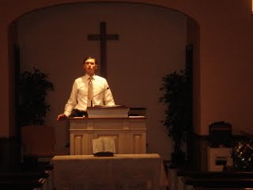
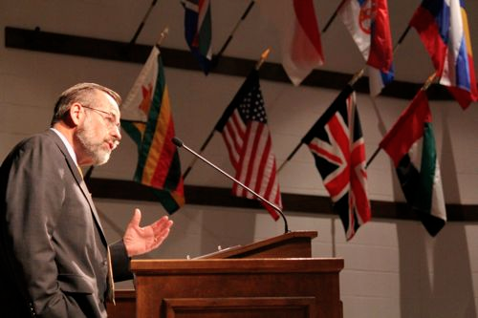
Reitheina:
Patheen Chawng Ameletheina dan
Reitheinarang Dawnruchukna 1
Dr. Rick Griffith • Singapore Bible College • BibleStudyDownloads.org

Slide 2
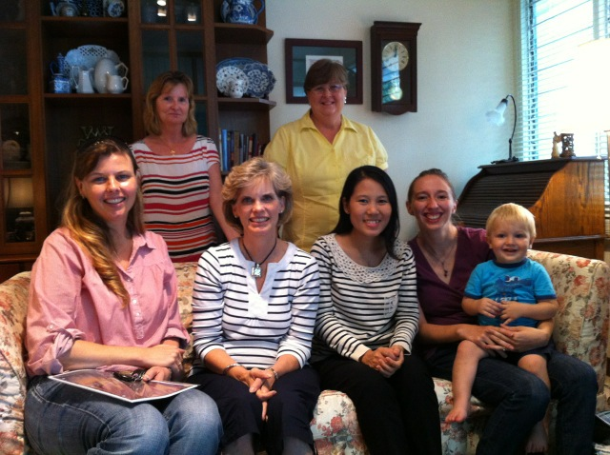

Our People
Susan na bek-inn nupang haihi uruchuk
Notes:
I also lead the woman's Precept Bible study at our church (Chiru: Bek-inn a nupang hai kha awm, Patheen-chawng kuruchuk thei)

Slide 3
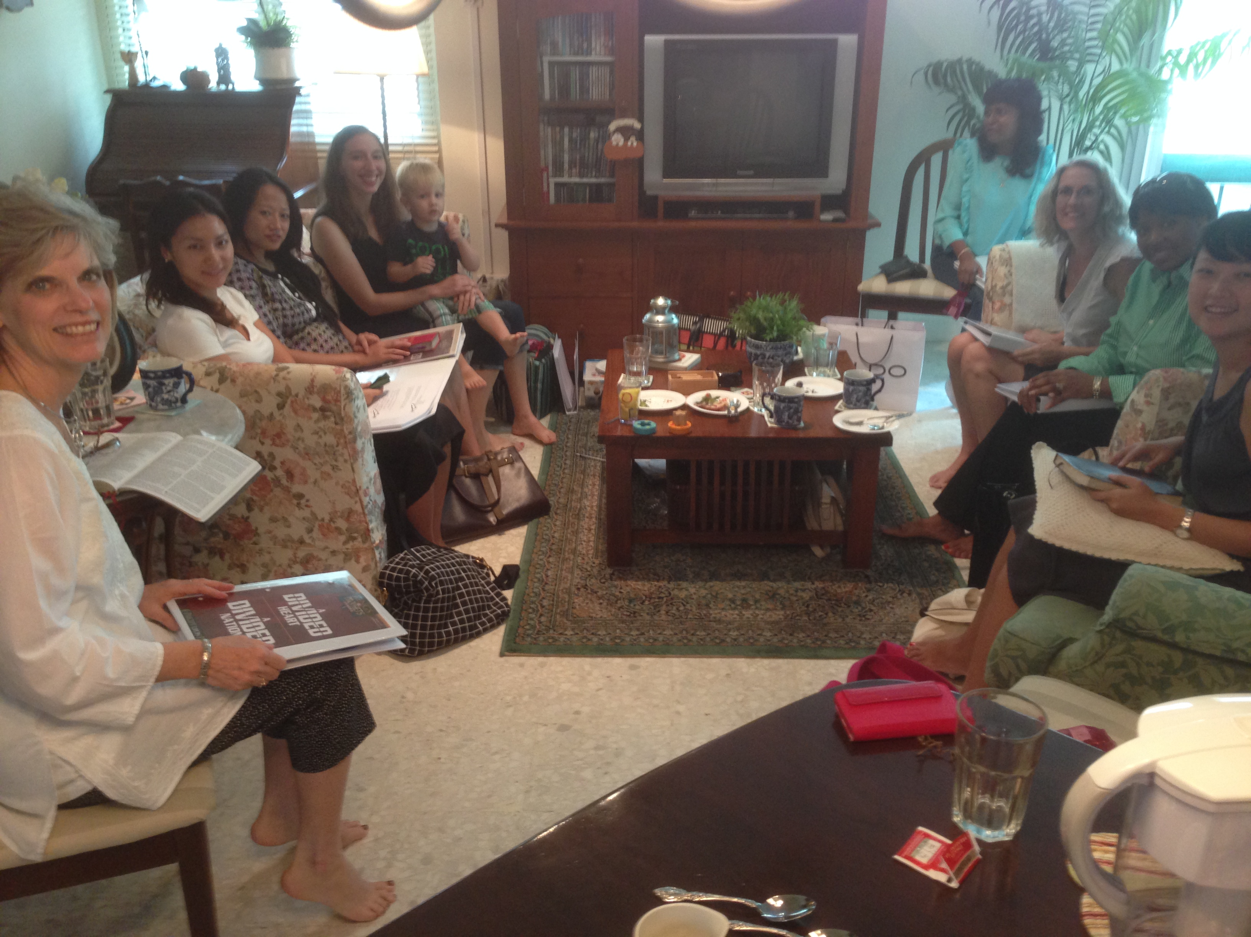
NUPANG HAI PATHEEN CHAWNG RUCHUK NA
1-2 THESS
USA • Singapore • New Zealand • Holland

Slide 4
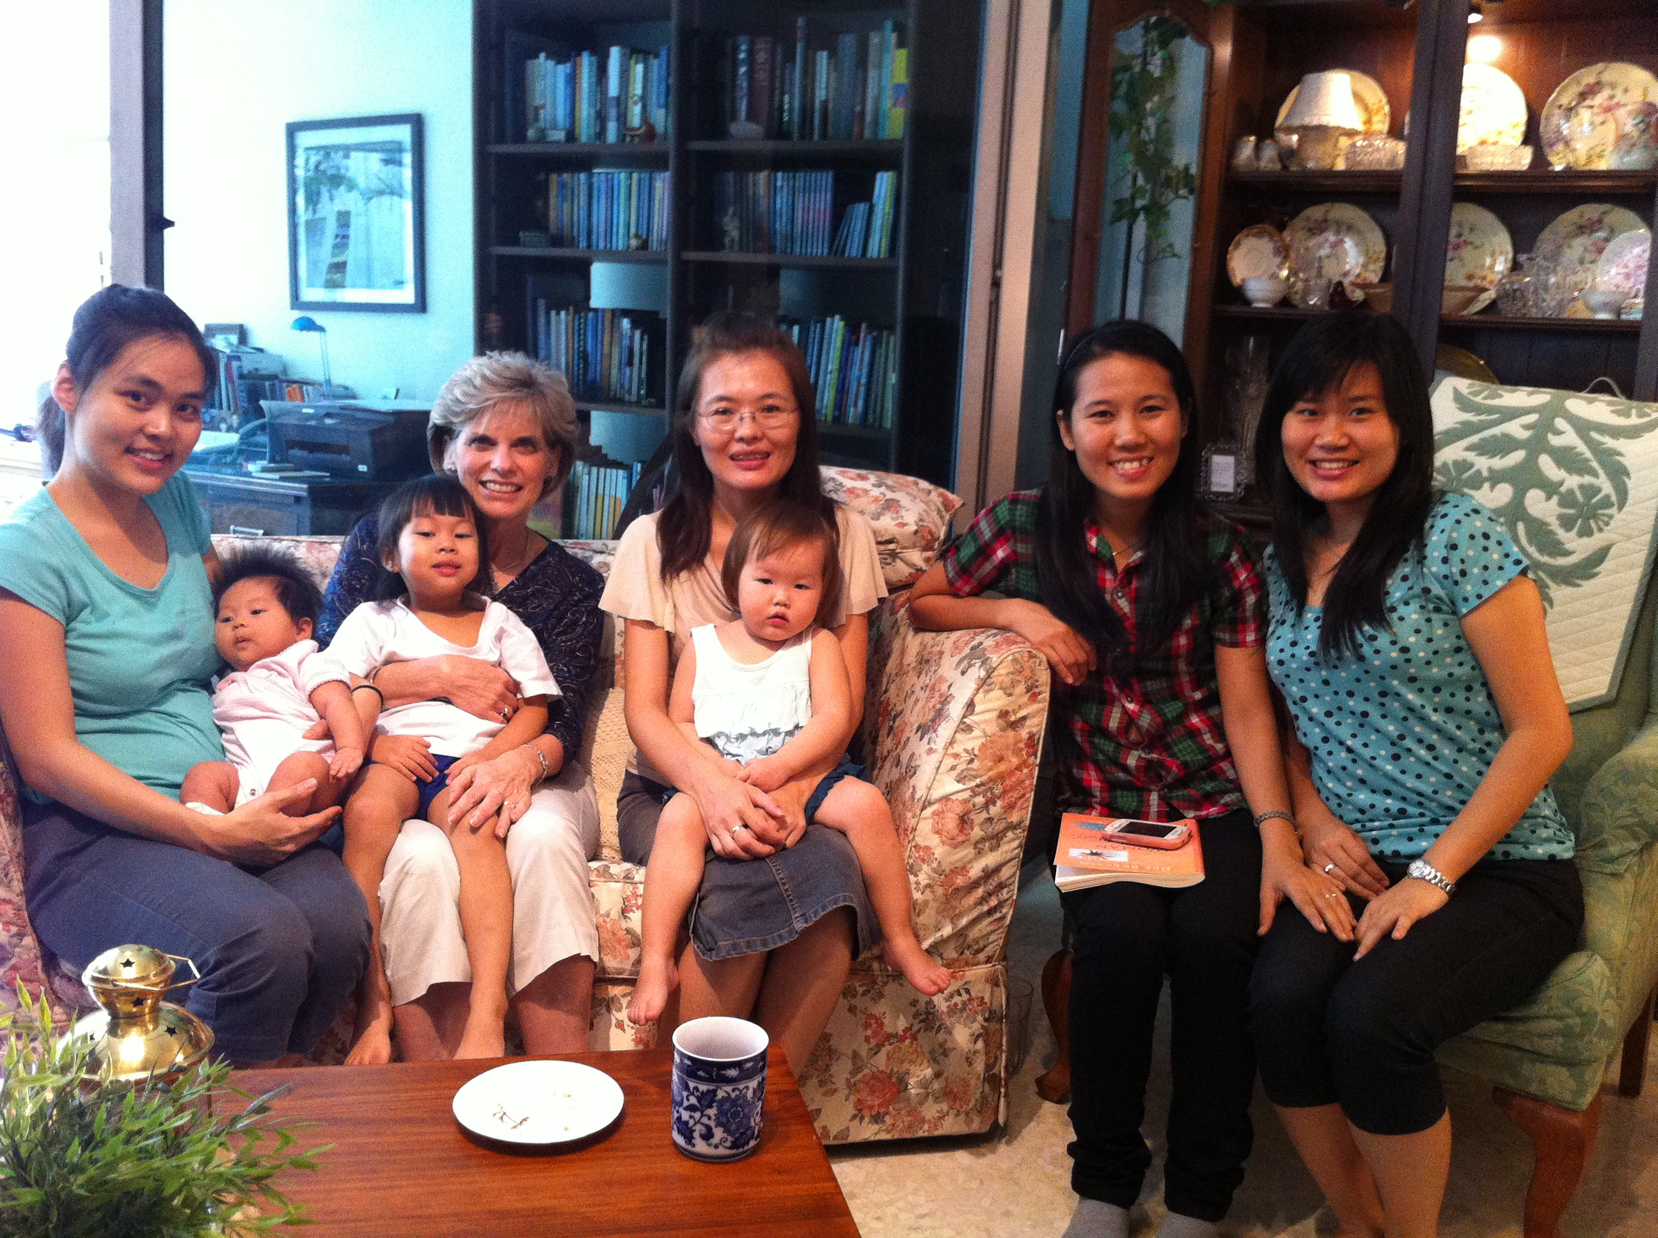
Thailand • Mongolia • Myanmar • Indonesia
Notes:
INTERVIEWER: And Susan, what ministries has the Lord granted you?
SUSAN: I have been teaching the wives of leaders at SBC. These 5 women come from 5 different nations!
SUSAN: I also lead the woman's Bible study at our church.
Chiru:
Arawdawn miring: Susa, e-ang chawnmun amo, patheen na ama chawn tho narang inokoi na hi?
Susan: SBC a awm aruchu hai, inn kawnu hi kai na Patheen chawng kuruchuk. Nainu hai miring ranga, mun ranga a put a hawng hai.
Susan: Khan bek-inn awm nai nuhai kha awm kai na Patheen-chawng kuruchuk.

Slide 5
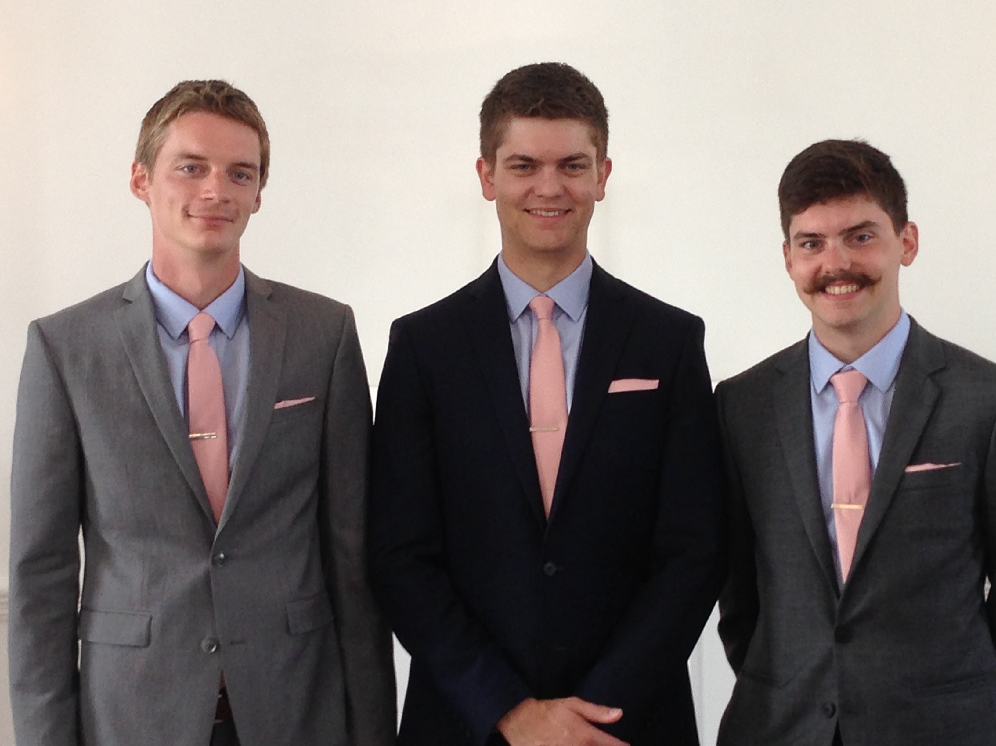
Kasapa thum hai

Slide 6
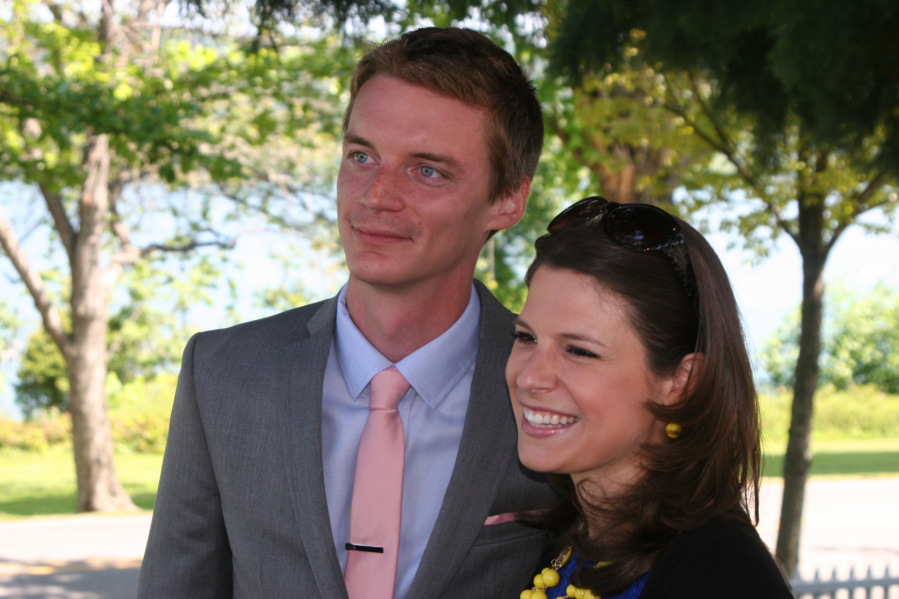
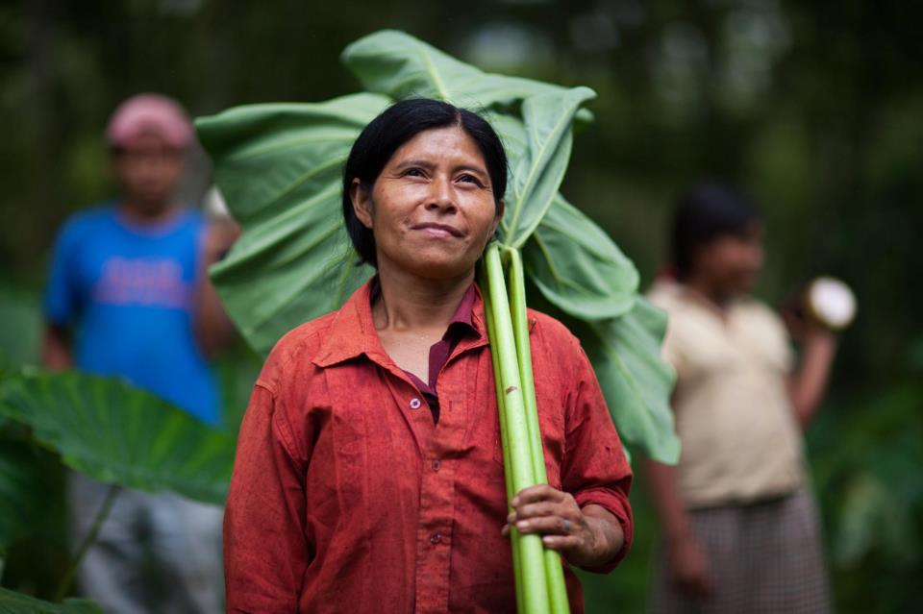

Kurt hi IT a chawnthaw
9g

Slide 7
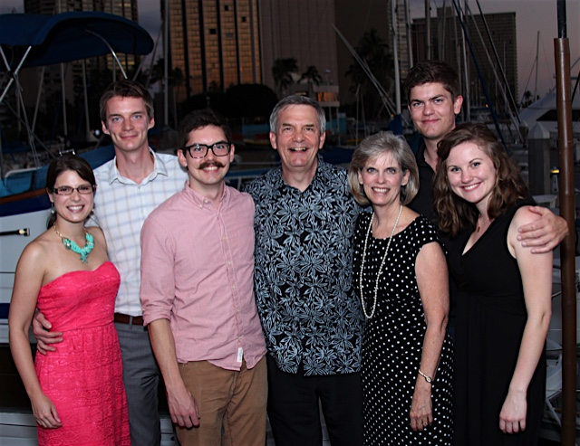
Griffiths Hai
9 Bopa 2016
2016
John
(23)
Rick & Susan
Kurt & Cara (29)
Stephen & Katie (26)

Slide 8
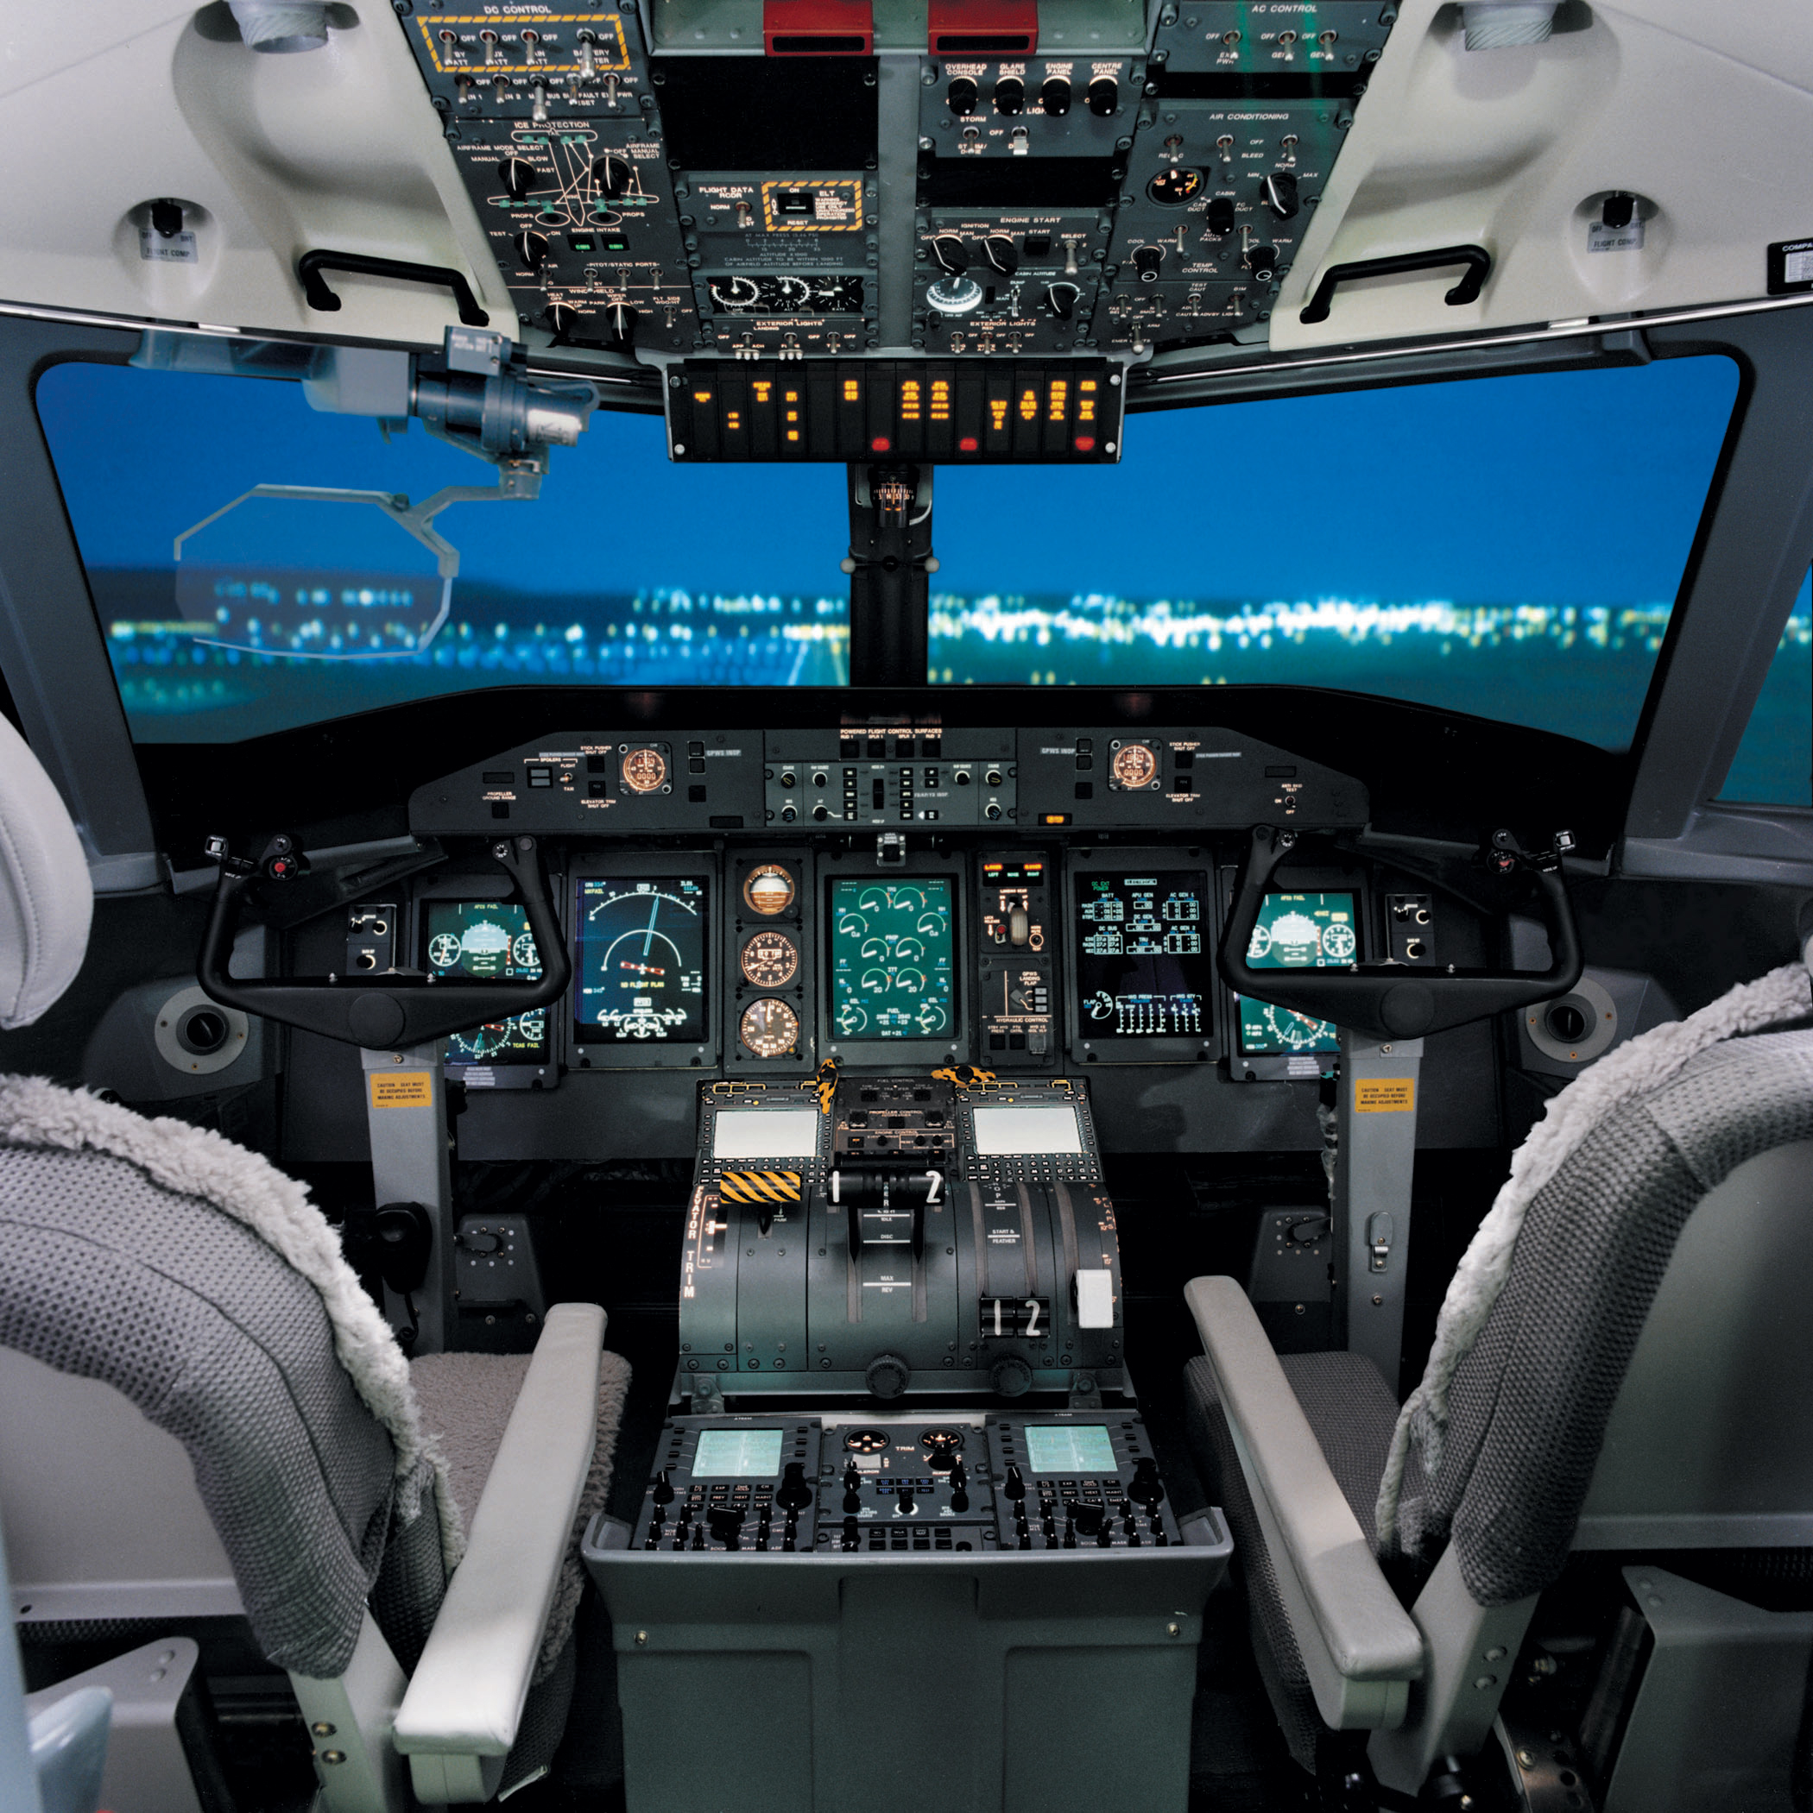
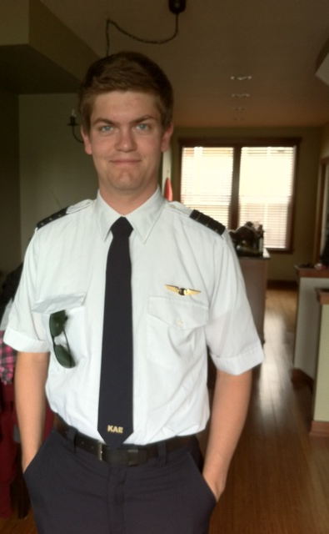
Stephen hi Spirit Airlines amehei inih, Boise, Idaho
6

Slide 9
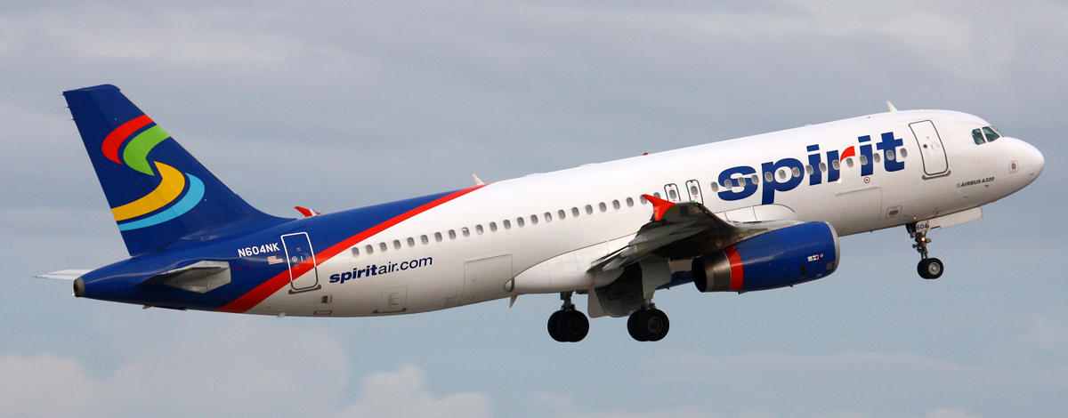
Spirit Airbus A320
8

Slide 10
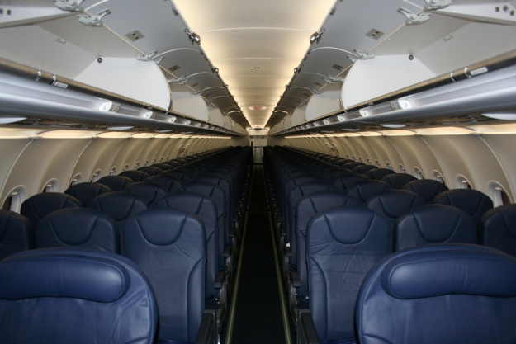
Stephen na 174 shutna balloon mehei
8

Slide 11
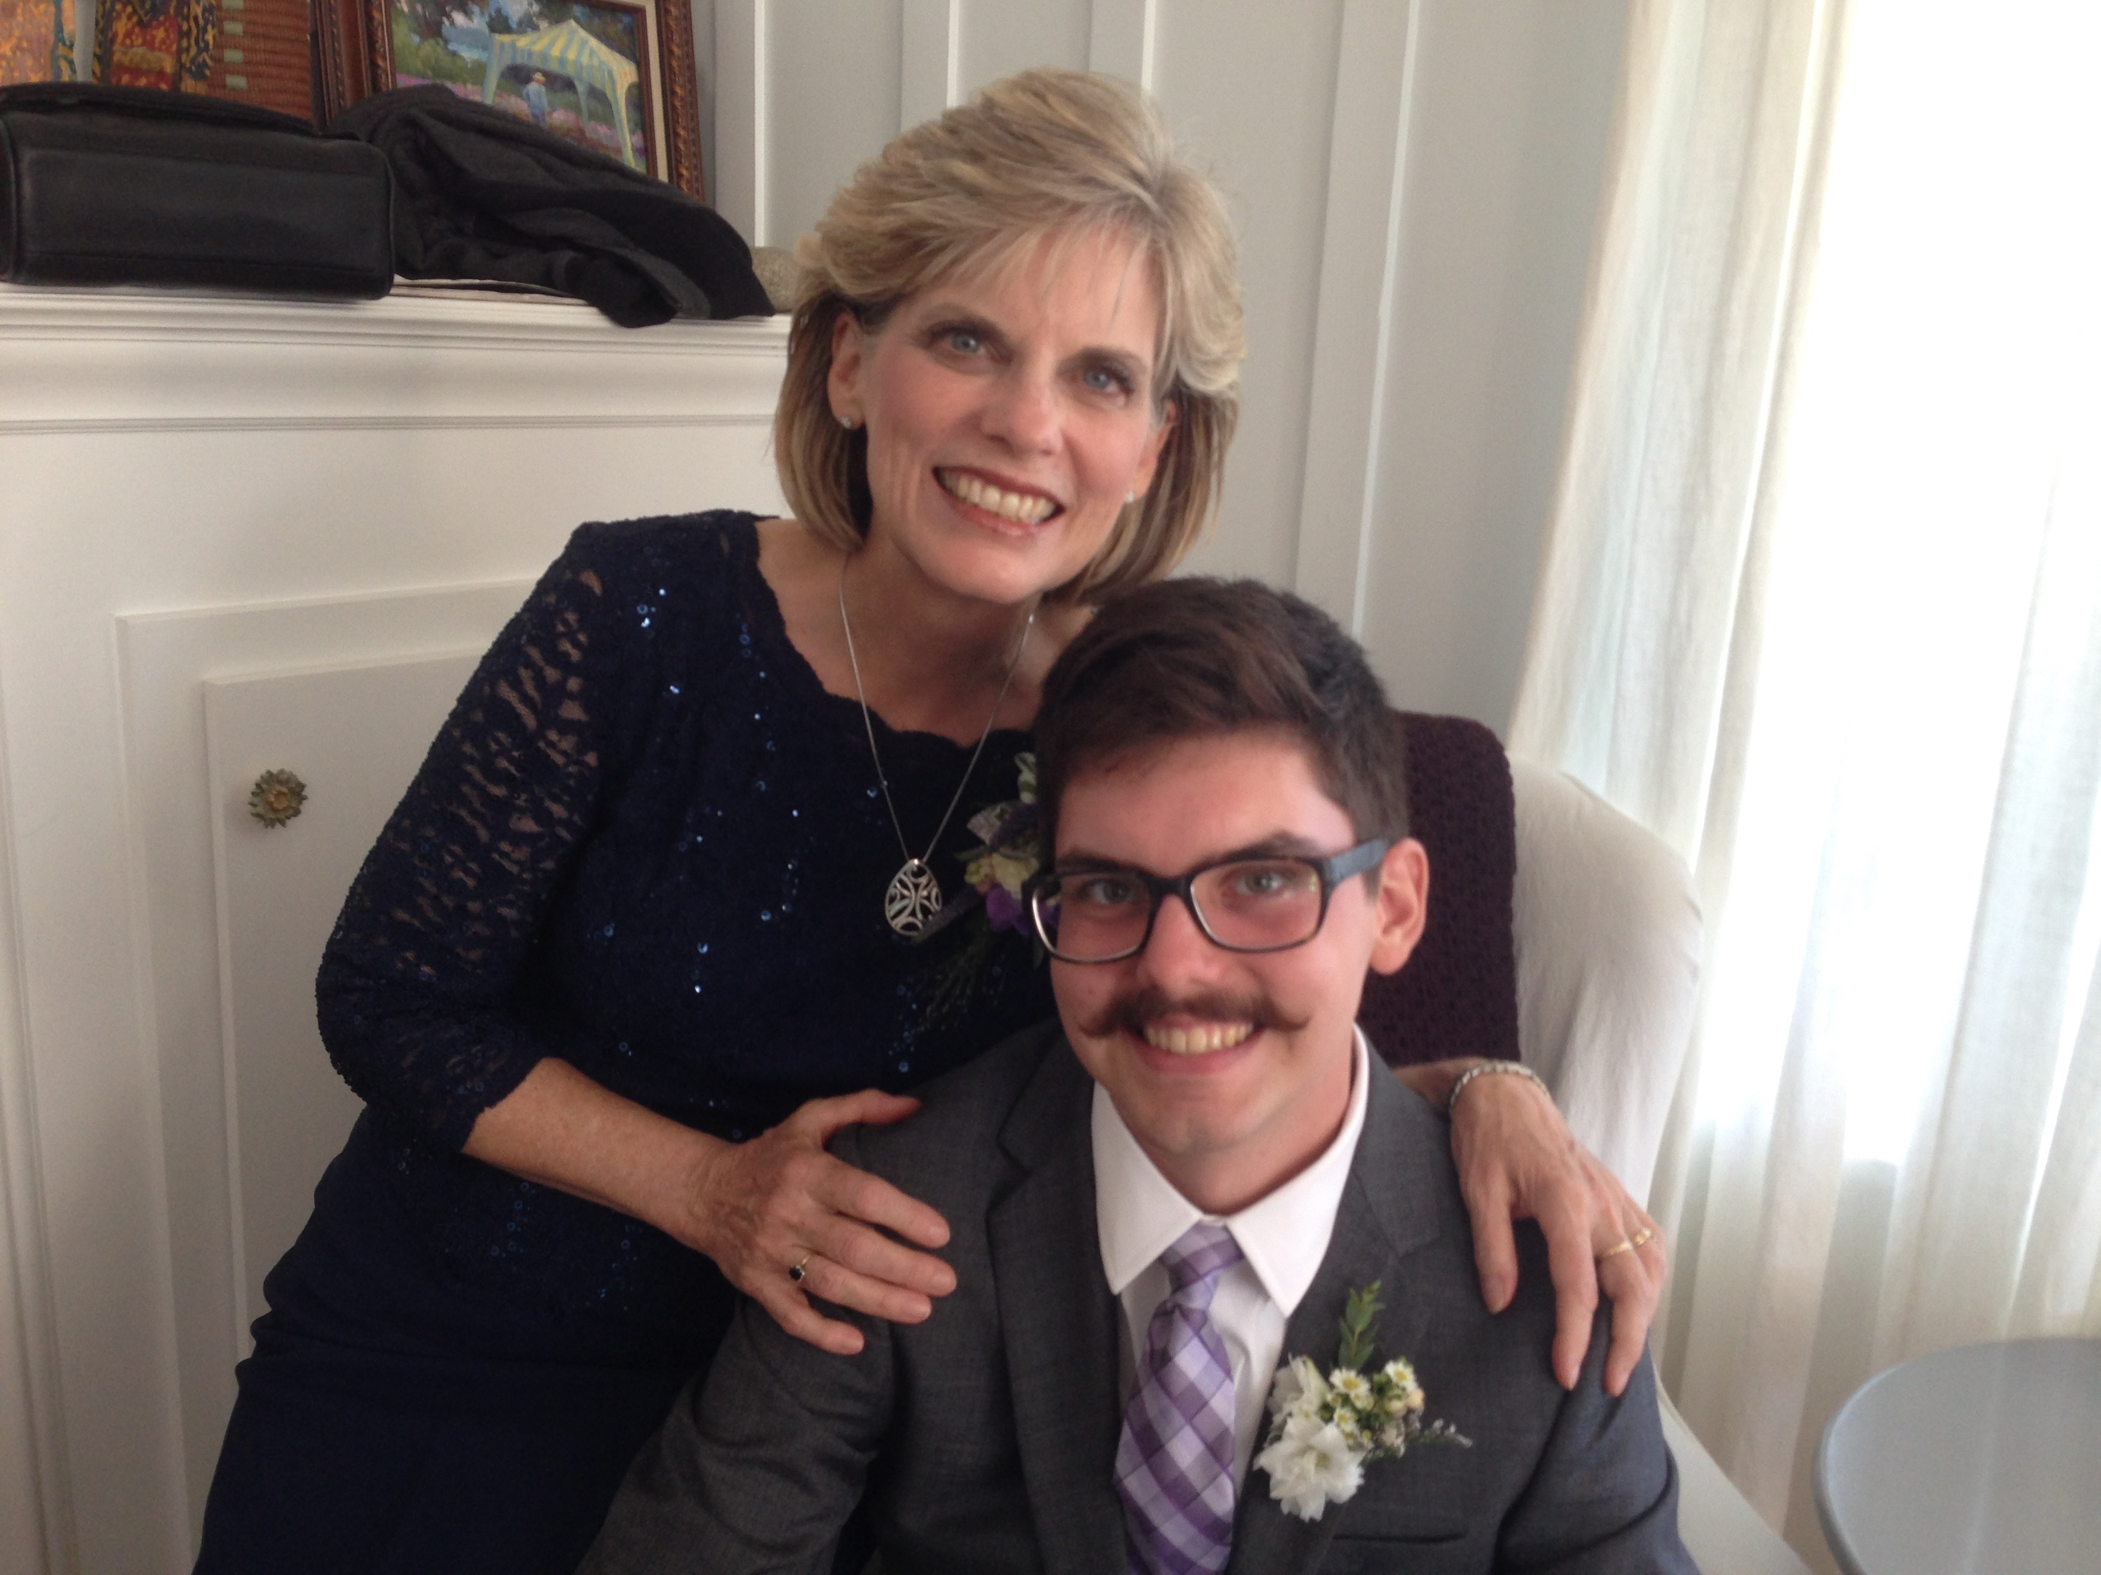


Kasapa uh mutum, John (23)

Slide 12

Kei na Patheen-chawn kithonamun…

Slide 13
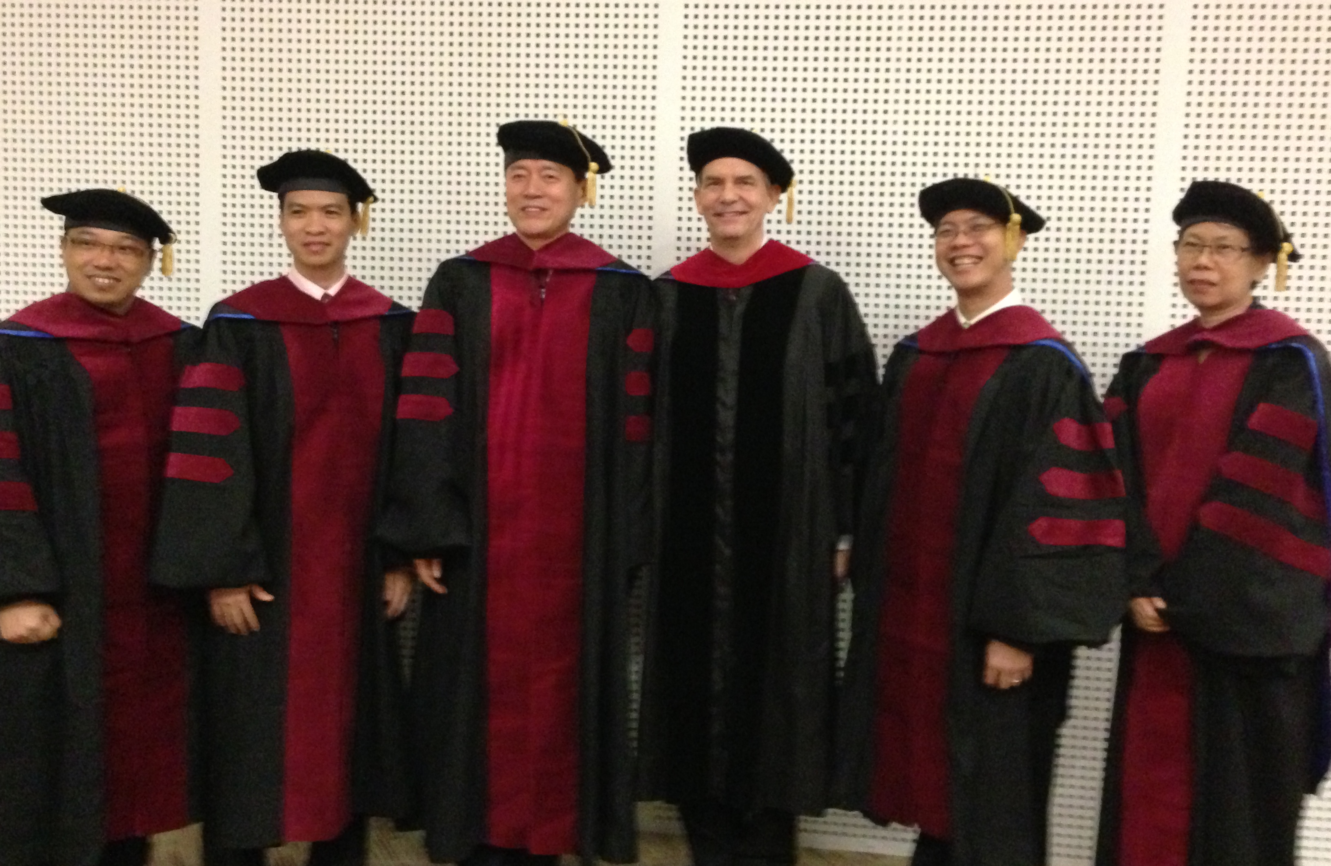
Keina SBC Doctor of Ministry ruchuknahin lamkai kanih (DMin)
9
Notes:
I'm also the director of the doctoral program at SBC that trains about 80 seminary professors and pastors throughout Asia in English and Chinese. Generallly each year about 5 of them received their Doctor of Ministry degree. (Chiru: SBC a doctoral ruchuk nahin, kai na director khat a aruchu 80, Asia aput Patheen chawn lamkai hai hi kuruchuk. Kum rikip miring masha 5 hi ruchukna omotor u).

Slide 14
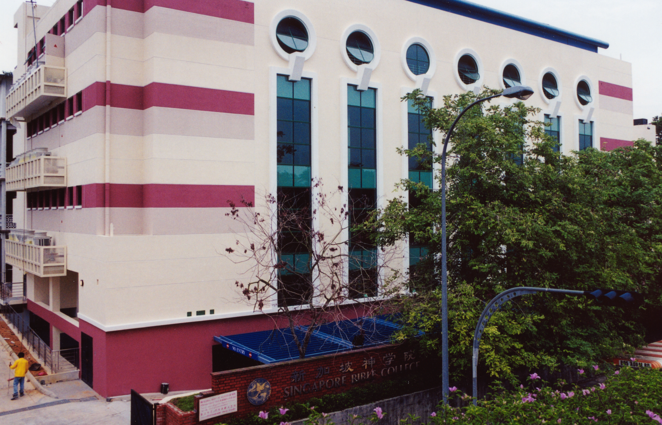
SINGAPORE BIBLE COLLEGE
Notes:
I’ve served as a seminary professor with 30 other faculty at Singapore’s largest training school: Singapore Bible College

Slide 15
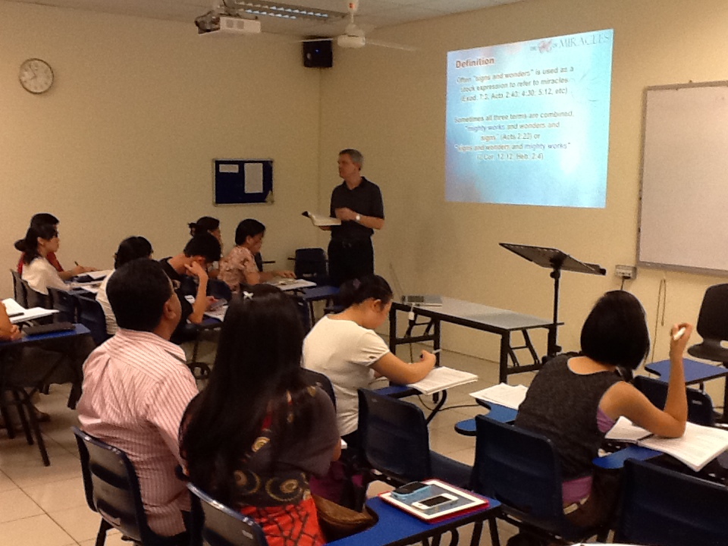
Singapore Bible College a aruchuhai
9
Notes:
Most of these students are first-generation Christians eager to share the gospel with their own people!

Slide 16
SBC Lawnchan Kiruchuk
(English • Bahasa • Chinese)
Majapna
RL RT
Nukteng aom
RL Manmesseh RT Manmesseh
Patheenjetnarang ruchukna
Bek-inn Ratha Motawn
Patheenchawngrei
Reitheina 1 Reitheina 2
Notes:
I get to teach these leaders every book of the Bible in survey courses, plus backgrounds to both the OT and NT, three areas of theology, and how to preach.

Slide 17
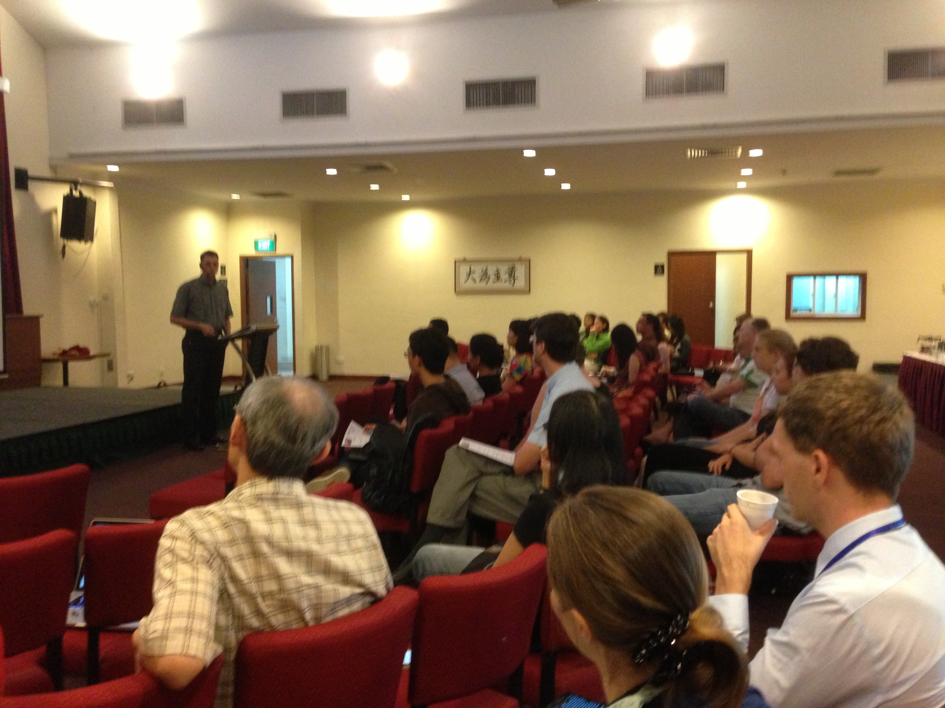
Our People
9
Miring 65 Ram 17 a put a
Monoi 2016

Slide 18
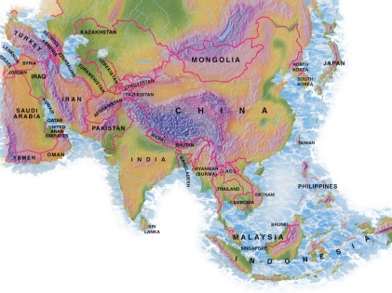

Crossroads ah miringhai, Murpa 2015
ITALY
FRANCE
JAPAN
NETHERLANDS
HONG KONG
KOREA
LEBANON
TAIWAN
CHINA
MYANMAR
INDIA
USA
PHILIPPINES
ZIMBABWE
MALAYSIA
SINGAPORE
CIC
NEW ZEALAND
INDONESIA
Notes:
Our March 2015 church people stem from 12 different countries around the world.
Netherlands (Desiree), Valentin (France), Nino Iager (Italy), Cynthia, Athan, Chanchan (India), Jieun (Korea), Mher & Liana (Lebanon), Raymond (Myanmar), Miriam (USA), Paolo (Philippines), Singapore (Albina), New Zealand (Matt & Julie), Zimbabwe (Memory)

Slide 19
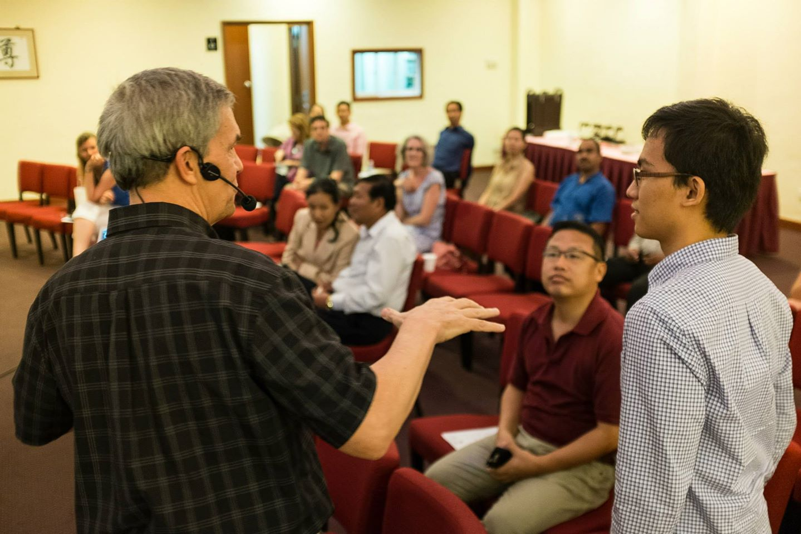
Our People
9
2016: Miring 65 Ram 20 a put
Notes:
We also helped start Crossroads International Church in 2006 where I serve as the pastor-teacher.

Slide 20
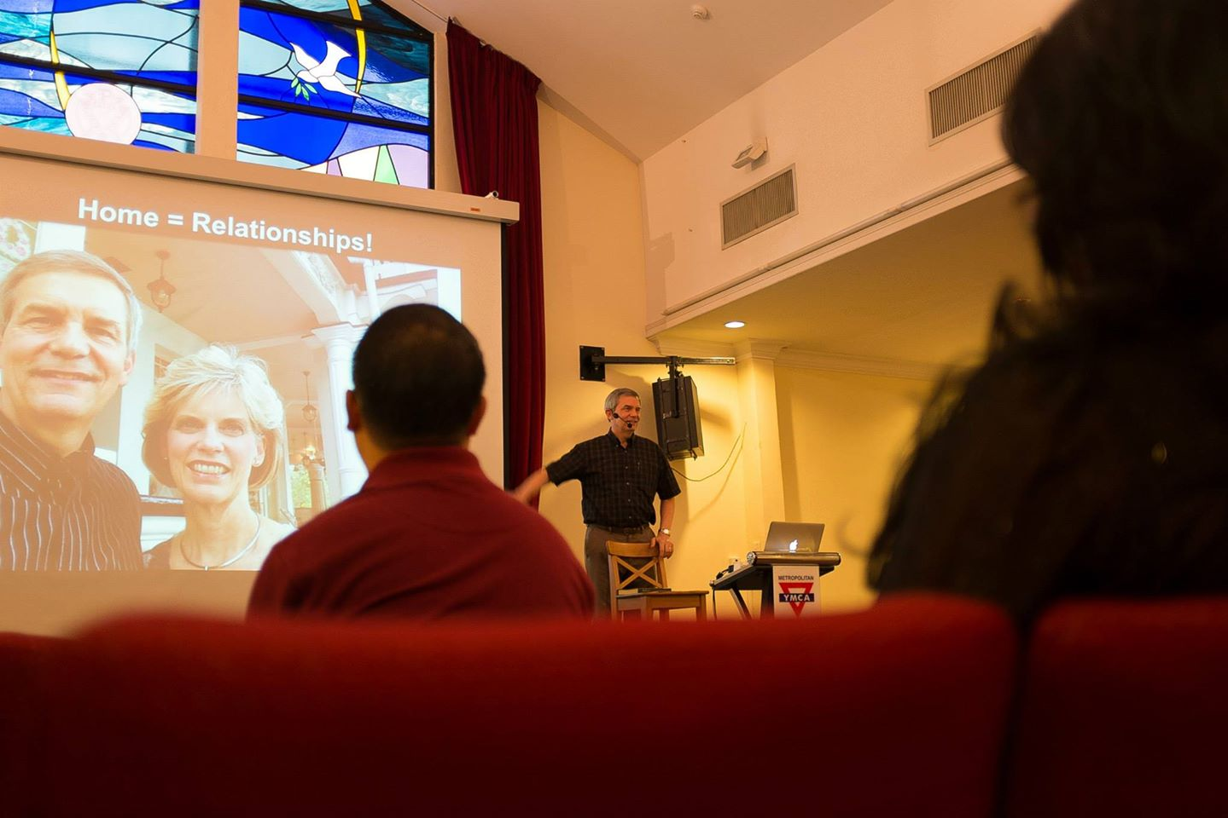
Our People
9
Mejek-chawng rophong na
Notes:
RICK: Yes, we helped start Crossroads International Church in 2006 and I serve as the pastor-teacher.

Slide 21
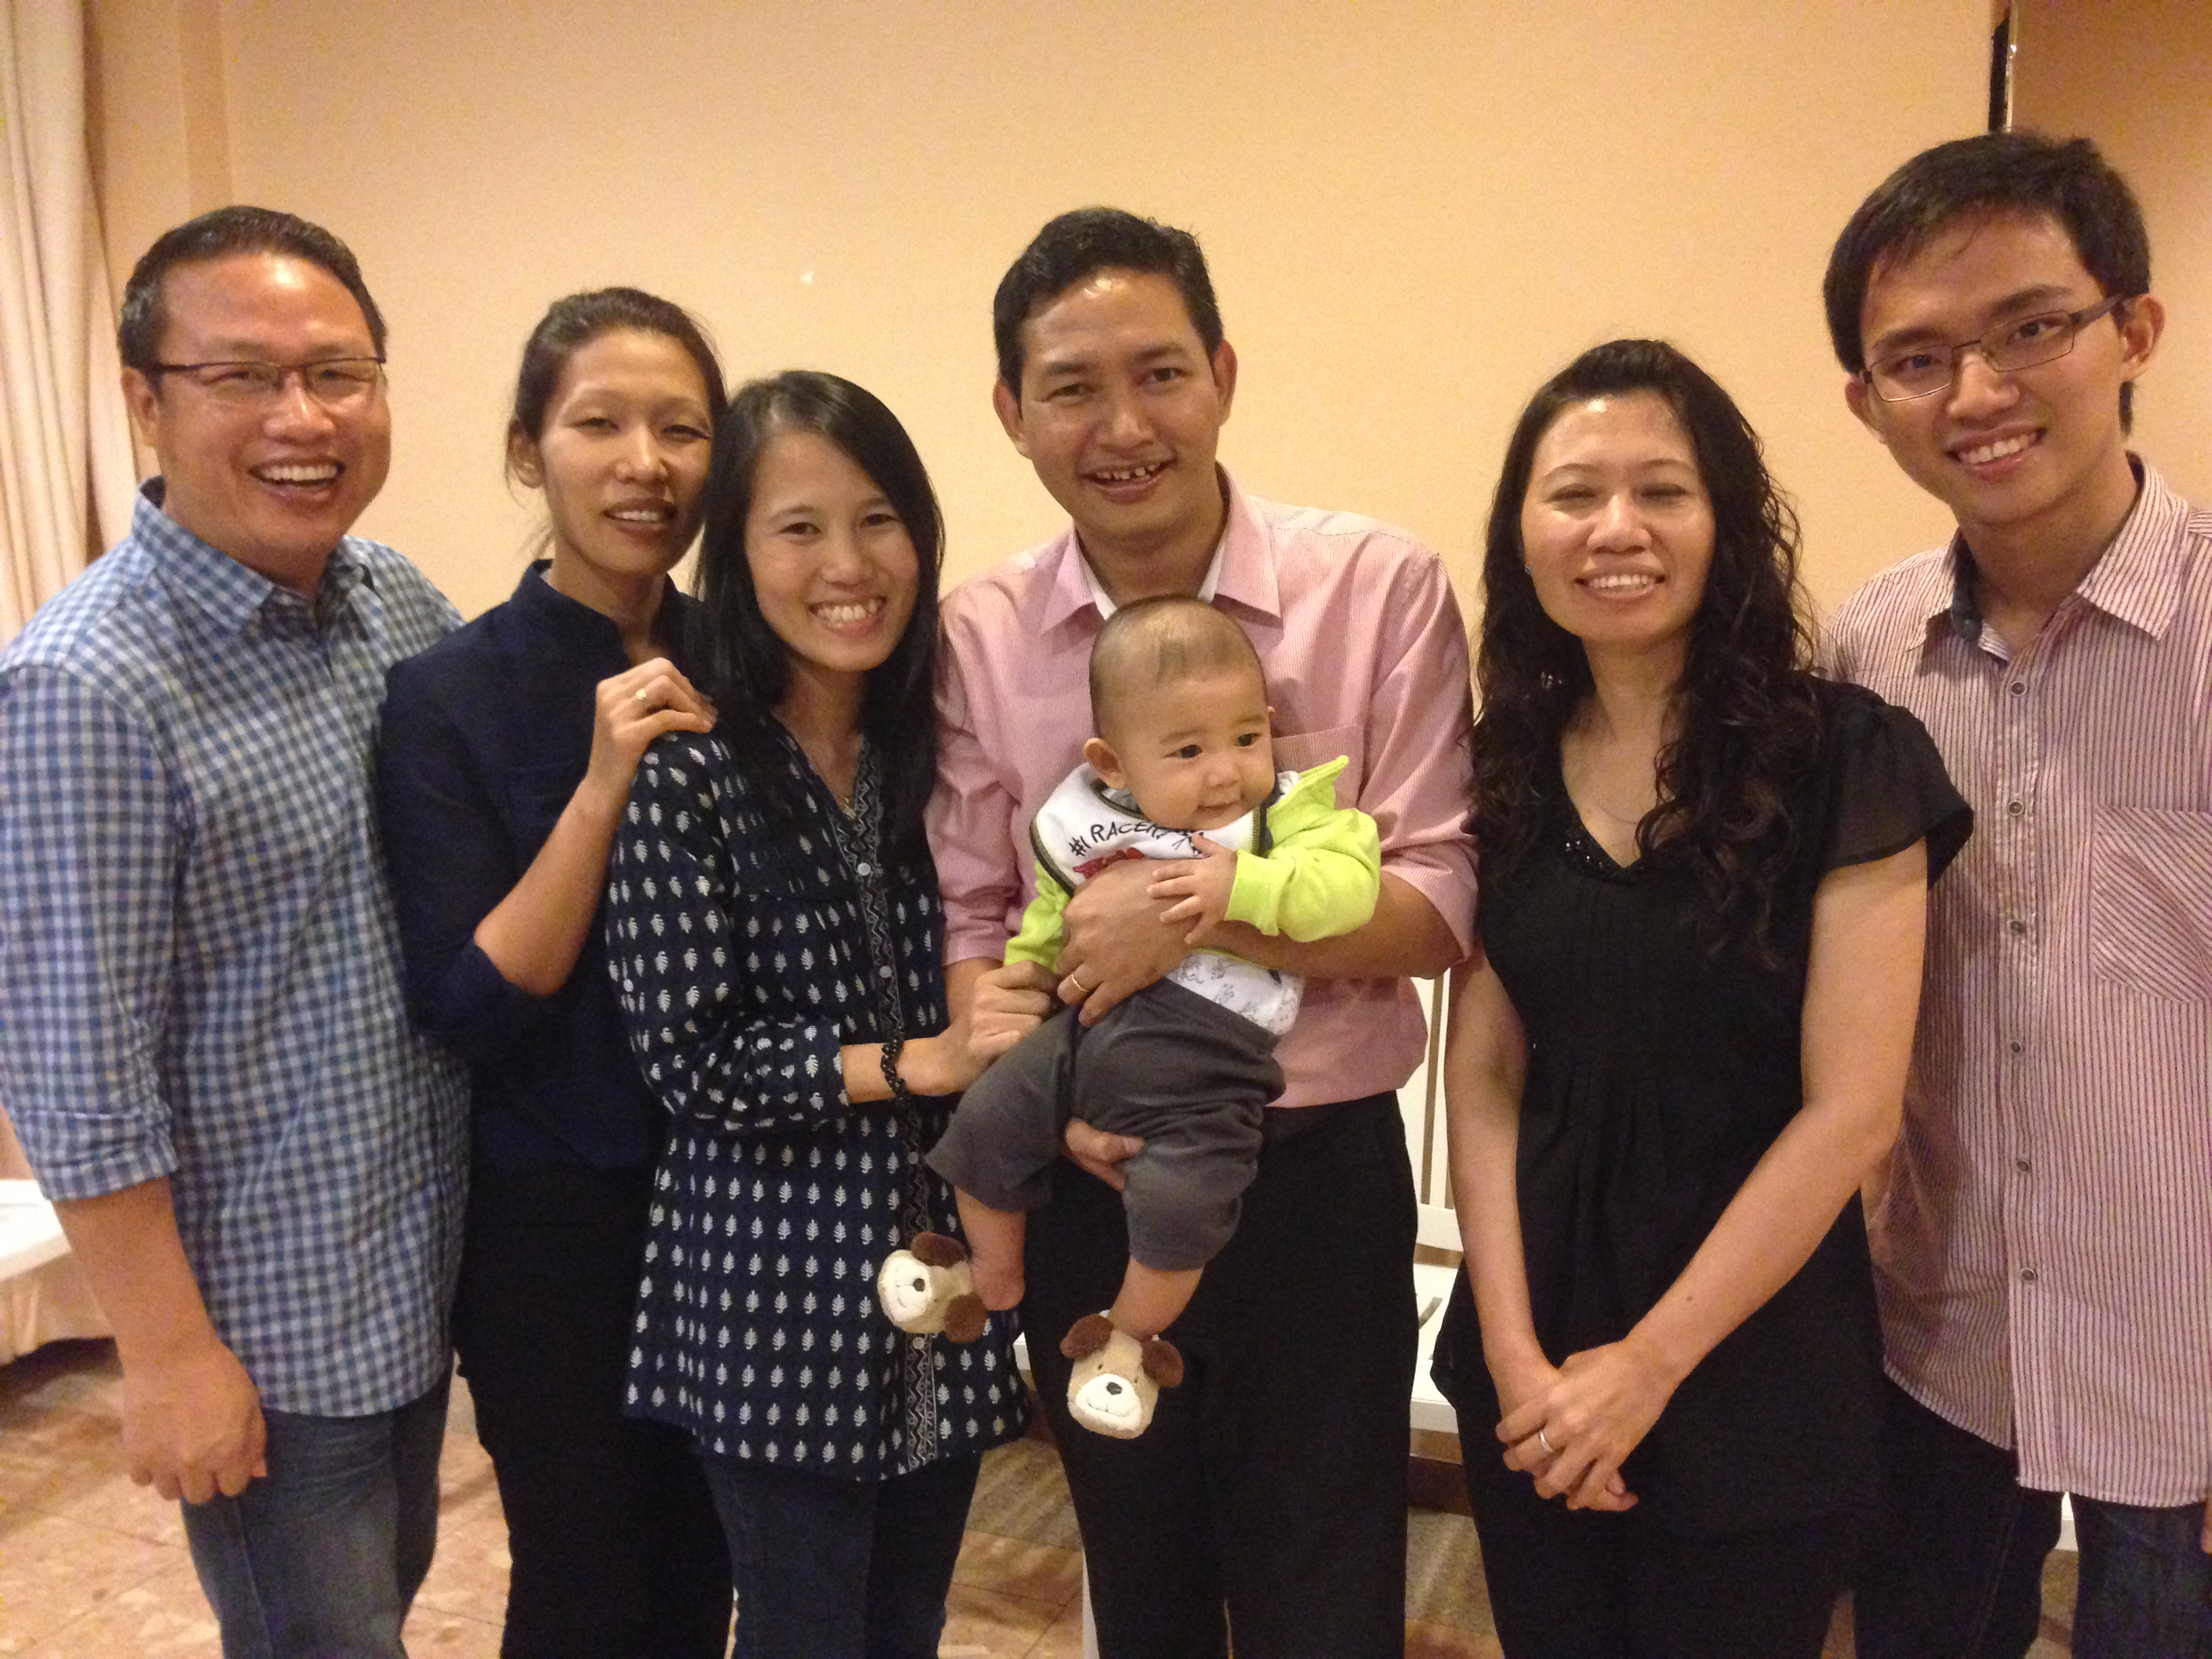
Our People
9
SBC a aruchu hai Bek-inn a chontho
Notes:
One special joy is mentoring my students who serve with us at church and led ministries to youth, children, home groups, and the worship team.

Slide 22
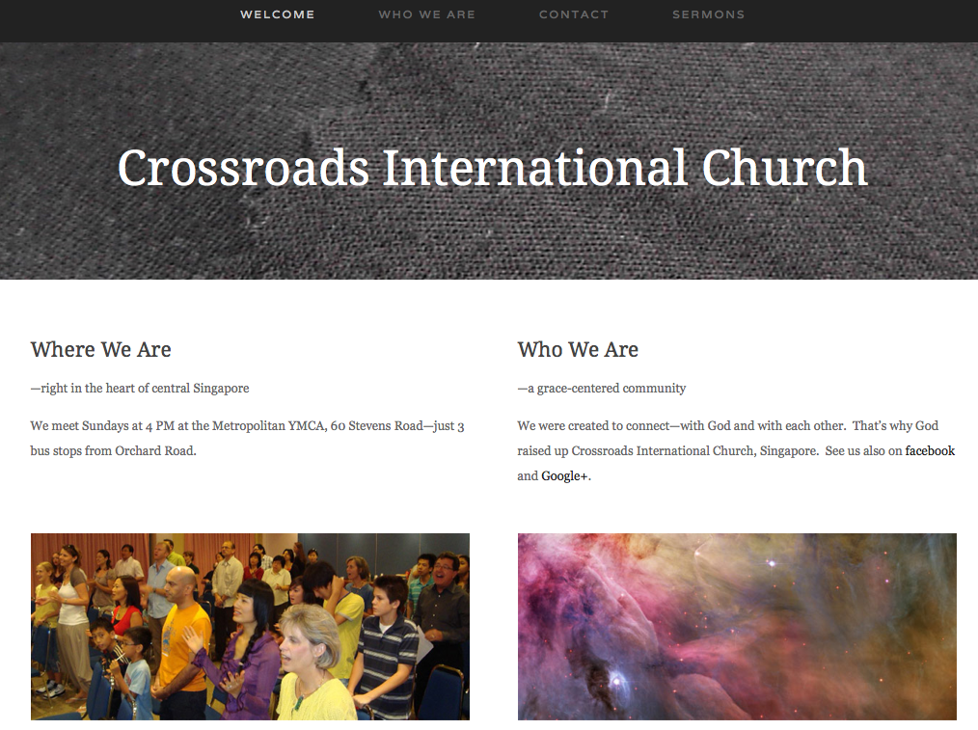
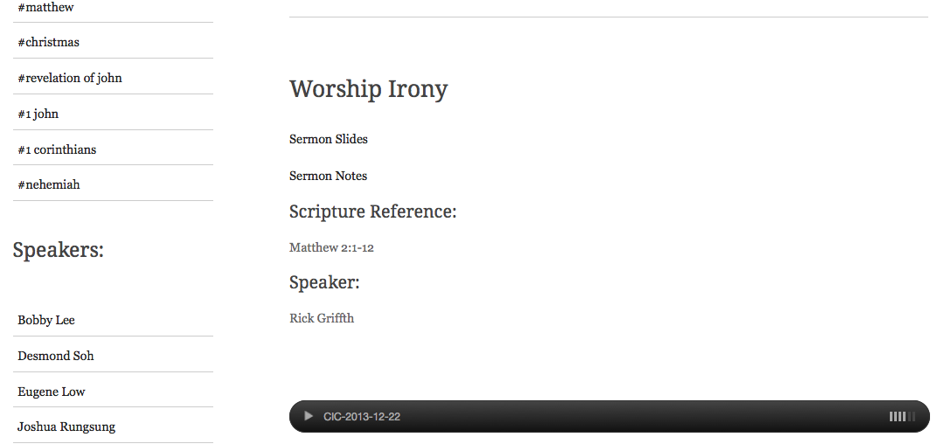
www.cicfamily.com
www.cicfamily.com

Slide 23

Patheen-chawng jenganale lurna (Isa. 55:8-9)
“Kimining haihi nangni mining umakche,” Pumi na erei.
“Nangsena uh lamkha kalam nimak.”
^{“9}Ravan haina relei nek a rasang hi ang ah kalam hai hi nanglam unek a rasang, rasang det kimining nang imining unek ah.”

Slide 24

Patheen-chawng jenganale lurna(Isa. 55:10a)
“Ro nah ravan na jongcho khan rodo nah ravan nah khan reelei cheer somalalim kirboiret angah.”

Slide 25
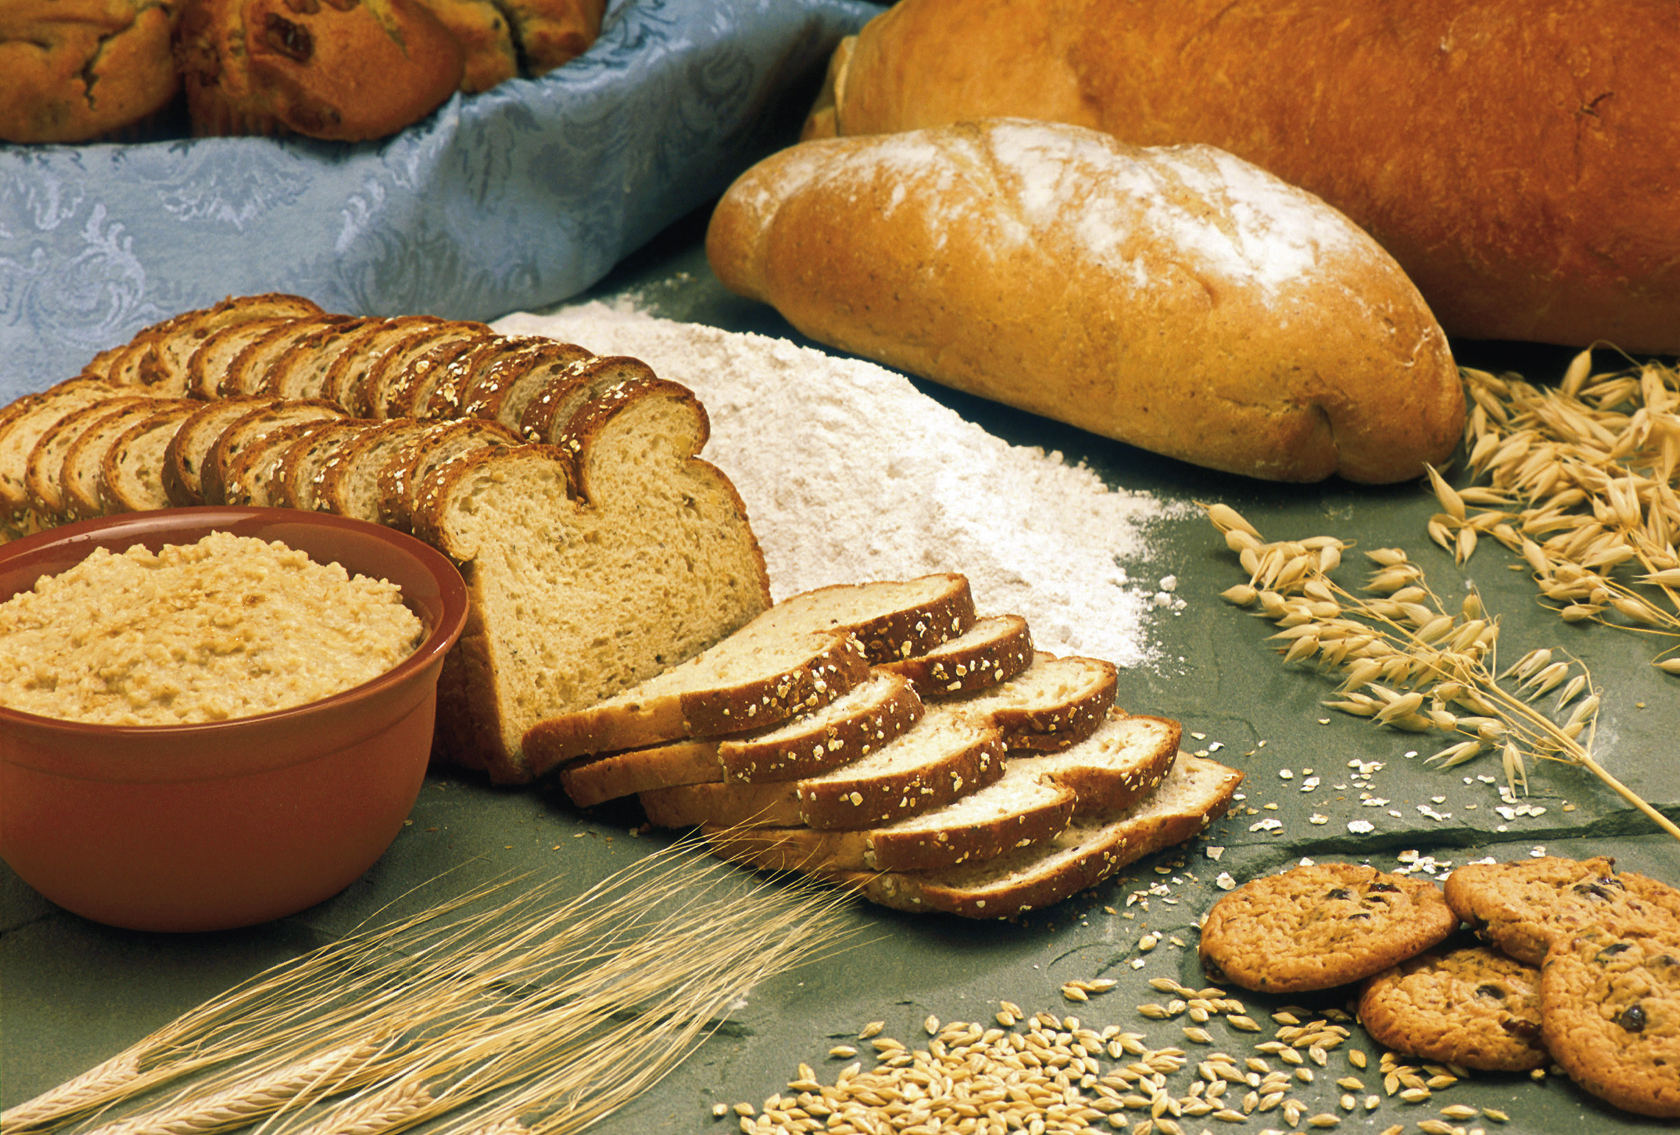
Patheen-chawng jenganale lurna(Isa. 55:10b)
“Iniah reelei cheer ah donthar mosok makhana ruvor haideng nimle sangpek khan asha rangah hai na sak.”

Slide 26
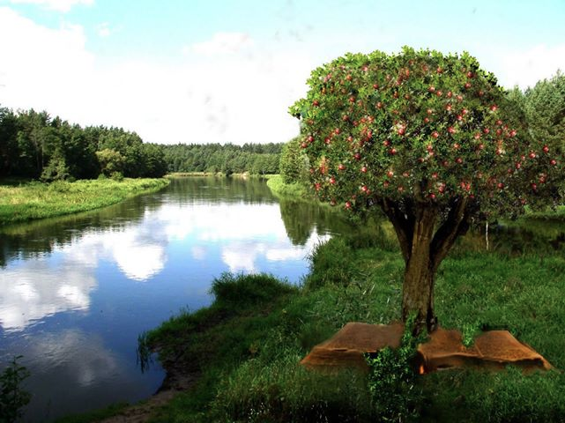
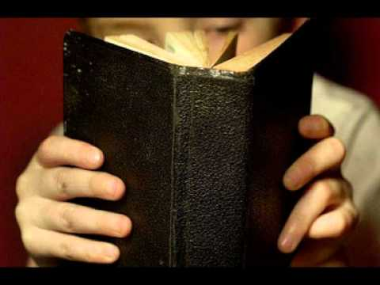
Patheen-chawng Jengnale lurna (Isa. 55:11)
“Kha angah hi anghin kabaiso kochawnghi aseh inih.
Keina kimining ditpok kha kitir nakhan len rangnih, tik teah awn rok ah vak kir nonih.”

Slide 27

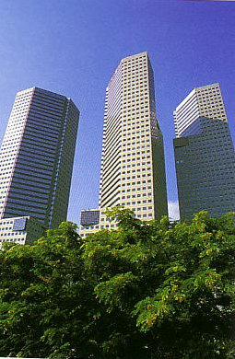
Our Course Goal
Nimotor rangah tu: Atongkha miship narang!

Slide 28
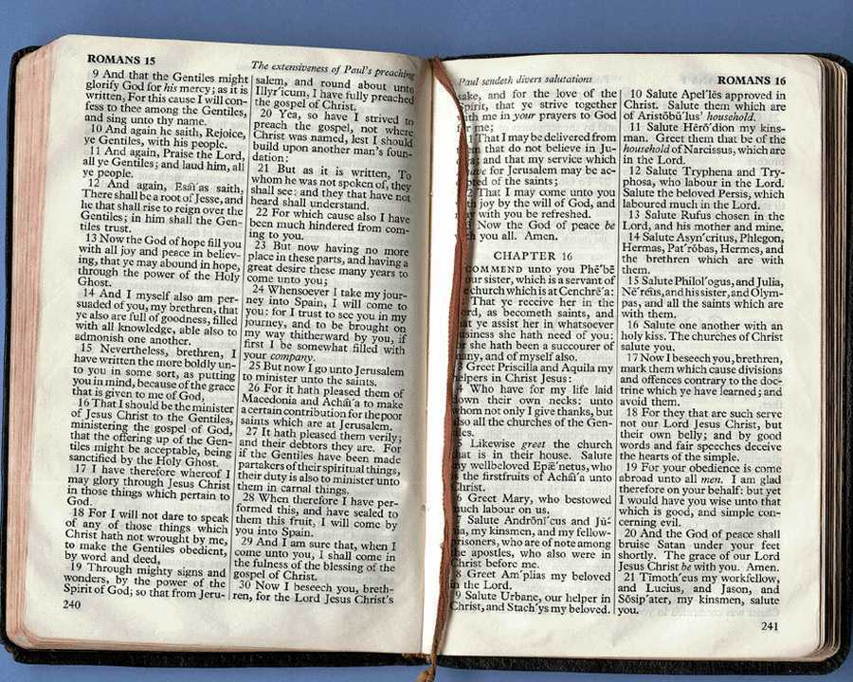
Lawnchan Angrei
v
Chawnglelah arama shoklak a reina dan,
  kup met a reithei narang khan arama shoklak a Patheen-chawng jet narang ruchukna,
  net met a ner a areinatheiranga kupmet a ruchukna,
  khutshun-rak (arethenghei, ),
  khan dongkhita voidi chawngrophongna awm rangnih. (chawngmawchawi na a put khan RL rishim a put). pung 3.
Rophongna nikho thakho khan uruneidet chawnglela (roishokna, khinnei-roi, bingaroi-reithei, patheen-chawngchawi, moiloi, thitna chawnglelah) hai hi awm reshe na awm.

Slide 29

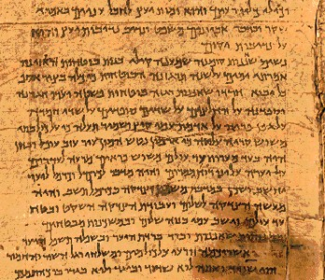
Lawnchan Lungdin
v
Mahi Lawnchan mutum na a nang jet rangni…
Patheen Chawngmele na a imoni khan iloiamoni kha mumuk roh
Chawng majarna khan reitheina kha ma-rit pero
Omolongna, atak, khan umutumna kha reiroh
Chawngrophong na a rangamna nang hong nei rang nih.
Lawnchan hi uruchukna le amelena a jetroh
Mejekchawng a put orolotna le rotoknathei peroh
Chawnglelah hai kha athatna det rang mandan roh.
Rophongro (“imoni” iti) chawngmawchawi khan roishokna chawnglelah hai kha
Rophongro (“itiamo”) adik, Ohoina, aretheng, aracha chongmun (Pek 25 a mukthei inih).

Slide 30
Lungdin Mili:
Makhala chawnglela…
25
Adik
Ohoina
Aretheng
Arolotna

Slide 31
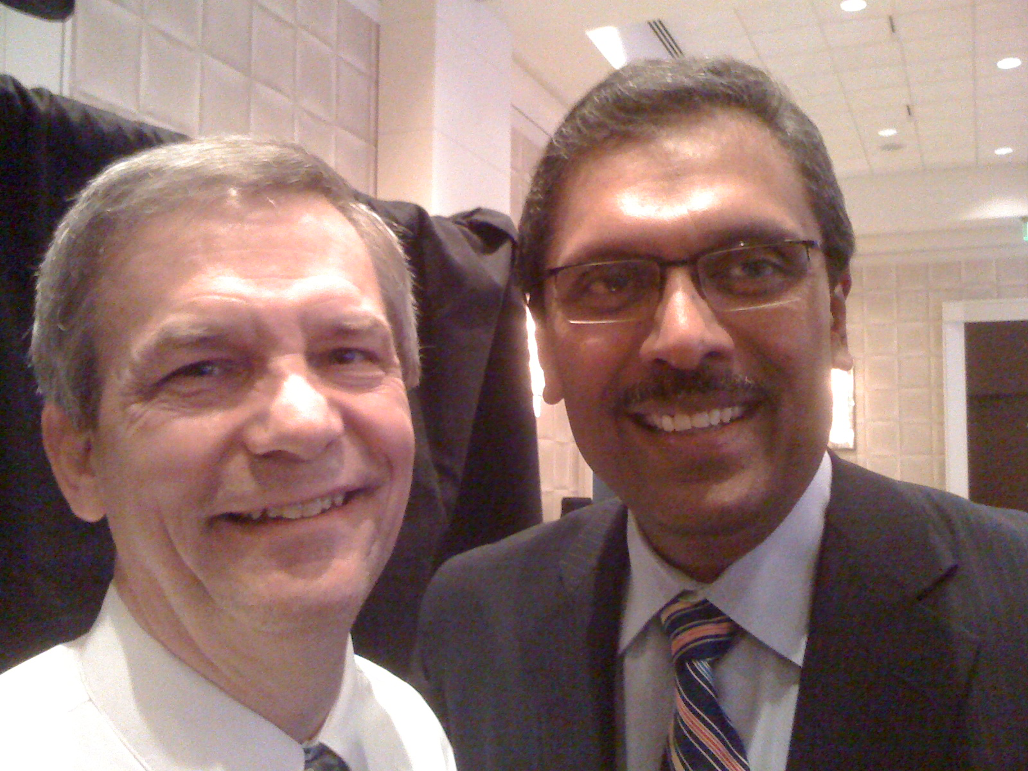
Dr. Rick & Dr. Ramesh Richard

Slide 32
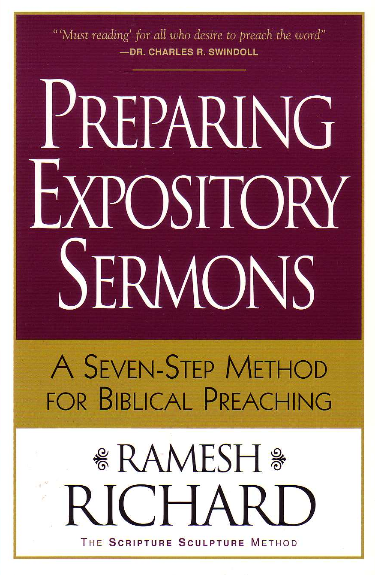


Lawnchan darkar anih
v
Aparanga seng (10%)
Patheen Chawngthirna ranga rasamna
ATHATVAK A CHAWNG ROPHONGNA
PATHEEN CHAWNG REINA THEI RANGA LAM SIRI

Slide 33

Akhatchang na nang Chawn modawn
Mahi pek (somdi) 20-hi ruparoh unuk ah rese narang

Slide 34
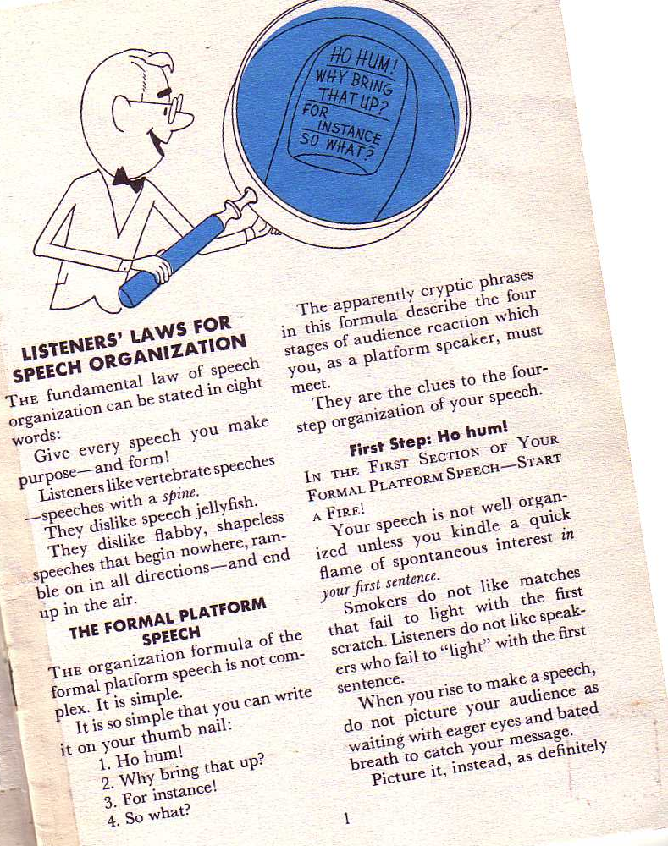
Borden Kungthoina
10-11
Chawngrei nathei kungnet met dan chawngrama eret ah reeinah: Nang Chawngreina kholoka kungchang
-khan arama mosok hetroh!
Richard Borden, How to Communicate Ideas, 1
Notes:
Same slide for presentation 01.30 and 03.05 so translators may copy from one to the other

Slide 35
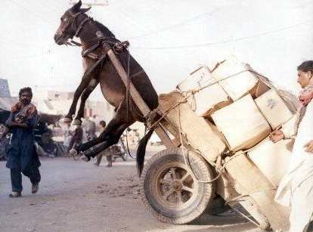
SBC Lawnchan Darkar anih
v
Parangasheng (10%)
Chawnmun (15%)

Slide 36

Arakharna
KHAICHOI NITNAH
Arakharna

Slide 37

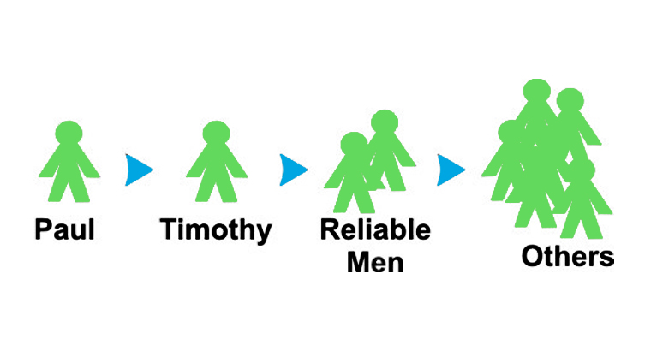

Miteitang Hai khaom Arophongthei minit roi!
“Kungchang hai tampui kar a kei deng a nangirujet hai kha, shik miring hai kha awm ruchuh ngam rang a takashawn rang a rutuk miring hai deng khan ngashe roh” (2 Tim. 2:2).
Khaichoi Nitnah
Paul
Timothy
Rangampui Miring
Teitang
hai

Slide 38
Arachu Richichon 1997-2015
MONGOLIA
JORDAN
KOREA
CHINA
NEPAL
MYANMAR
INDIA
THAILAND
VIETNAM
MALAYSIA
SRI LANKA
SINGAPORE
SBC
INDONESIA
Notes:
From 1997-July 2014 God has seen fit to grant me the privilege to train pastors in 12 other countries on 53 trips. Often pastors in the US team-teach with me on these trips.

Slide 39


Chawngrophongna (Reitheina) hin awn BibleStudyDownloads.org
Mahi ruchukna hi arem ah mukthei inih!
Notes:
Preaching (pr)
Homiletics

Slide 40
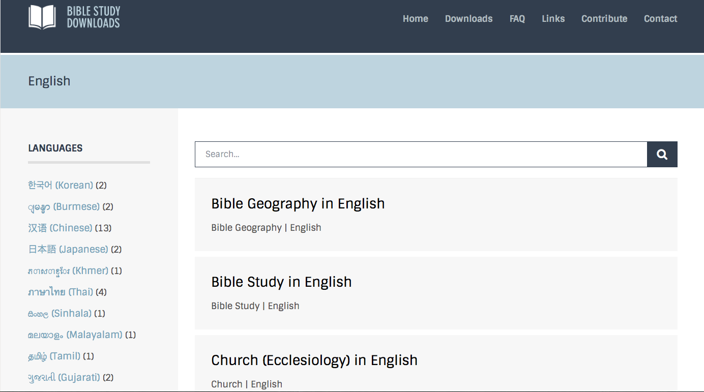
BibleStudyDownloads.org
7
Notes:
This has resulted in Bible teaching and study materials—mostly PowerPoint—in 42 languages! All a teacher needs to do is to click on a file and it downloads for free to teach any book of the Bible and many other subjects.

Slide 41
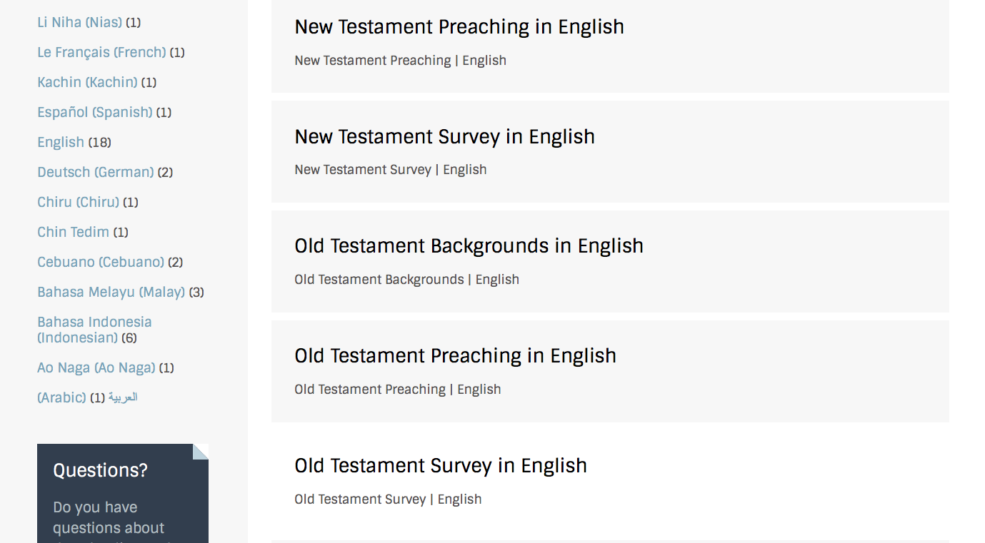
BibleStudyDownloads.org
7
Notes:
This has resulted in Bible teaching and study materials—mostly PowerPoint—in 42 languages! All a teacher needs to do is to click on a file and it downloads for free to teach any book of the Bible and many other subjects.

Slide 42
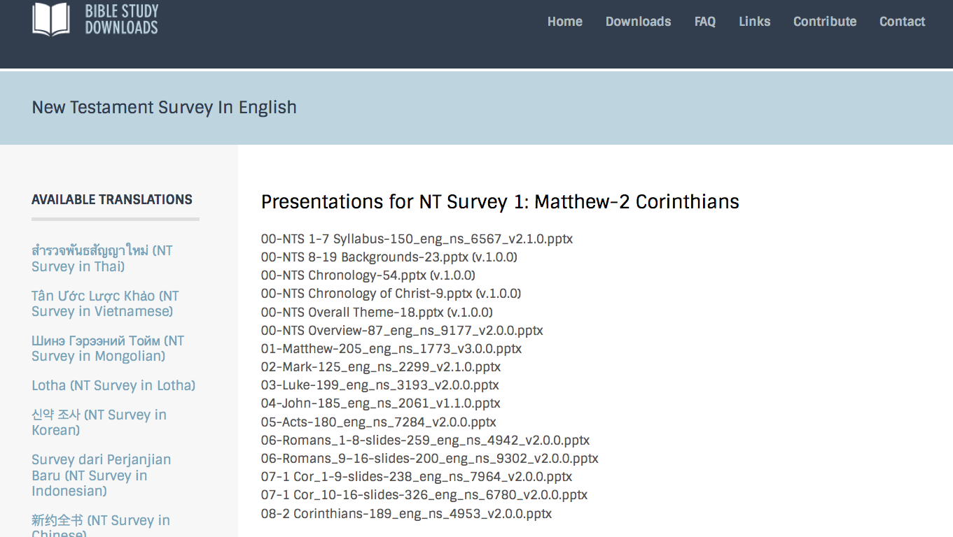
BibleStudyDownloads.org
7
Notes:
This has resulted in Bible teaching and study materials—mostly PowerPoint—in 42 languages! All a teacher needs to do is to click on a file and it downloads for free to teach any book of the Bible and many other subjects.

Slide 43
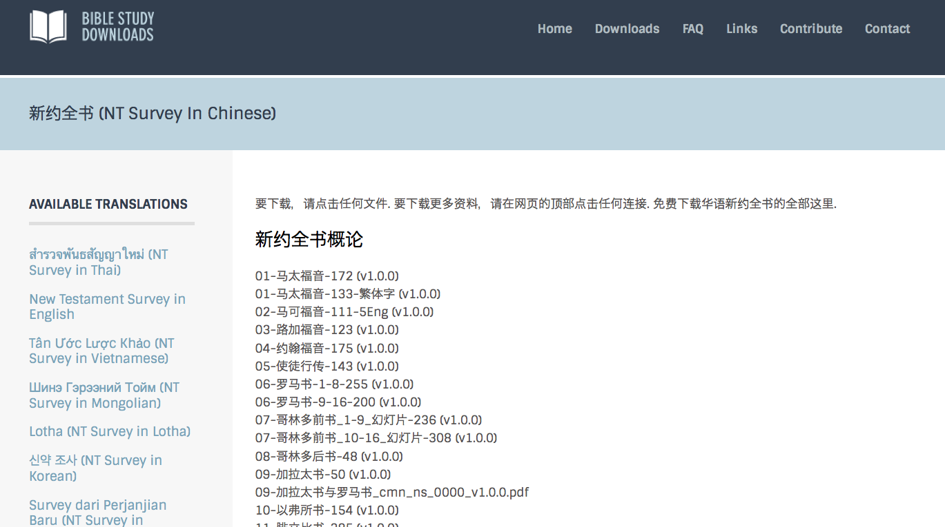
BibleStudyDownloads.org
7
Notes:
This has resulted in Bible teaching and study materials—mostly PowerPoint—in 42 languages! All a teacher needs to do is to click on a file and it downloads for free to teach any book of the Bible and many other subjects.

Slide 44
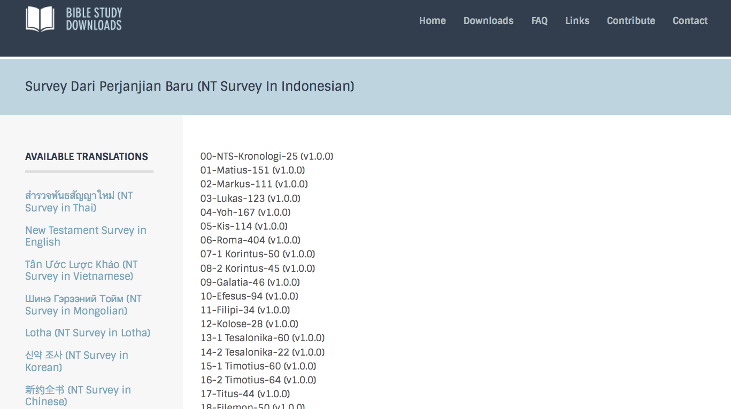
BibleStudyDownloads.org
7
Notes:
This has resulted in Bible teaching and study materials—mostly PowerPoint—in 42 languages! All a teacher needs to do is to click on a file and it downloads for free to teach any book of the Bible and many other subjects.

Slide 45
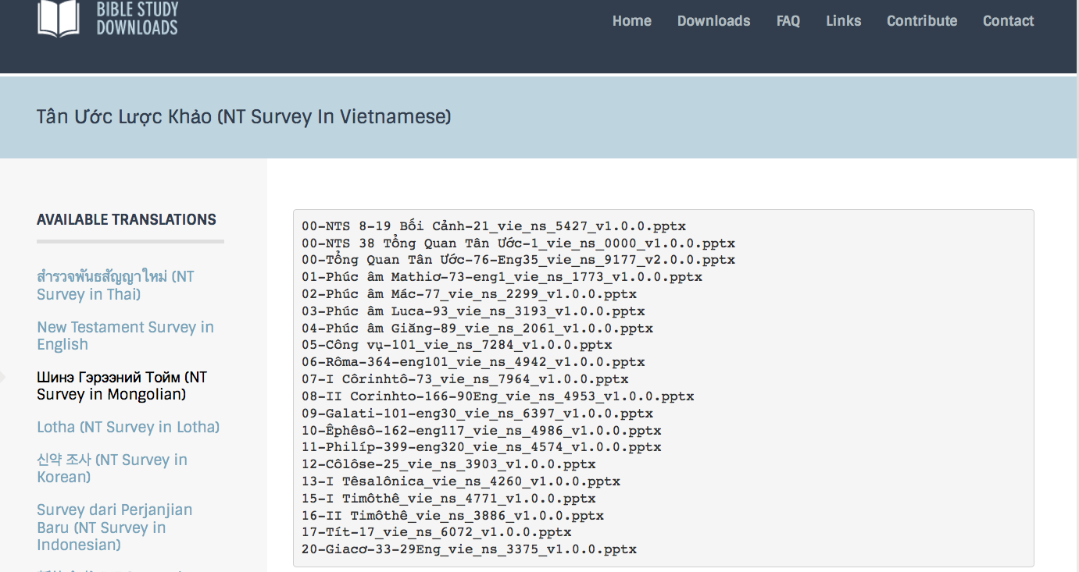
BibleStudyDownloads.org
7
Notes:
This has resulted in Bible teaching and study materials—mostly PowerPoint—in 42 languages! All a teacher needs to do is to click on a file and it downloads for free to teach any book of the Bible and many other subjects.

Slide 46
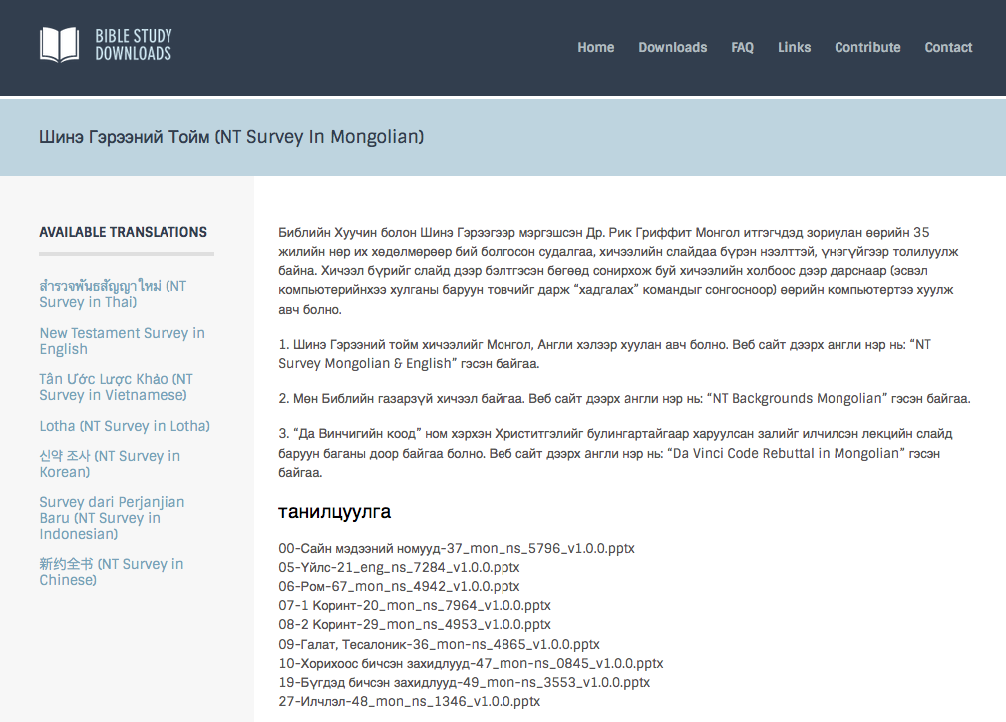
BibleStudyDownloads.org
7
Notes:
This has resulted in Bible teaching and study materials—mostly PowerPoint—in 42 languages! All a teacher needs to do is to click on a file and it downloads for free to teach any book of the Bible and many other subjects.

Slide 47
Reitheina Chawnmun Riming Mejek Nah
Riming | HP | Chawg Mele |  |  | Rachakna
 |  | HOM | HSB | Chawng | HOM | HSB | Chawng
X | X | X |  | X
X | X |  | X | X
X | X |  |  |  | X |  | X
X | X |  |  |  |  | X | X

Slide 48
SBC Lawnchan Darkar anih
vi
Pa-ranga Lim (10%)
Chawnmun (15%)
Chawnmundawn (25%)

Slide 49

Mejek rangah Chawnmundawn 12
vi
Mahina nikrei rang ah kha, anarasam masak

Slide 50
Nang chawngkungchang na kah eloi a rei rang a monih?
16
Arei rang a nang rang avaidet
Nang nininga nang rejet det
Patheenchawng reinalam inih
Dr Rick Griffith, Singapore Bible College
www.biblestudydownloads.com
Notes:
Same slide for presentation 01.49 and 02.03 so translators may copy from one to the other except that 02.03 expands the 01.49 slide

Slide 51
Chawngkungchangna reidan
16
Athar a shokshule:
Nik imining
Erelekna
Riding masak roh!
Athar a shokna:
Ashokha reiroh
Imo nang rangampui
Riding masak roh!
Nikreina lawn kha riding pip a tet roh!
Athar a shok mala:
Nik imining
Niktho
Riding masak roh!
Notes:
Same slide for presentation 01.50 and 02.04 so translators may copy from one to the other

Slide 52
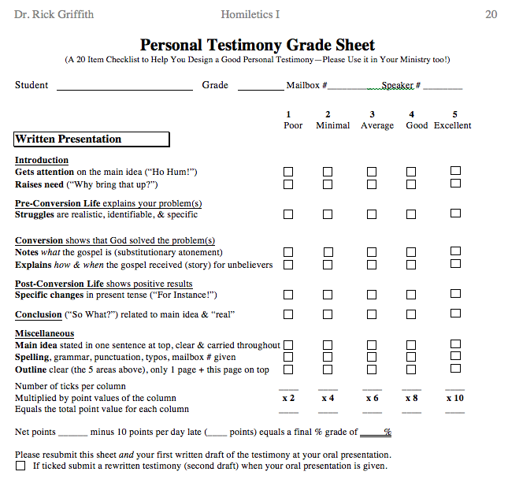
Testimony Grade Sheet
20
Omolongna
Athar-a Shok mala
Athar-a Shokna
Athar-a Shokshule
Umutum Nah
Teitang Jet-thei

Slide 53
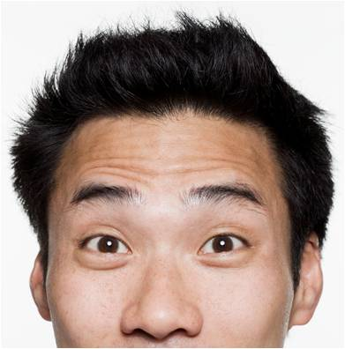
Ruchukna idi a rokhoina
Dr Rick
Dr Des

Slide 54
SBC Lawnchan Darkar anih
vii
Pa-ranga Lim (10%)
Chawnmun (15%)
Thoranga pekna (25%)
Chawngreina (50%)

Slide 55


Chawngreina a ratna
vii
Omolongna (1 min.)
Chawngkungchangna risim (2-3 min.)
Takahmoson narang irei (2 min.)
Mejekchawng achawi (15 min.)
Richijar a asok chongrokhom (15 min.)
Notes:
Same slide for presentation 01.54 and 02.07 so translators may copy from one to the other

Slide 56
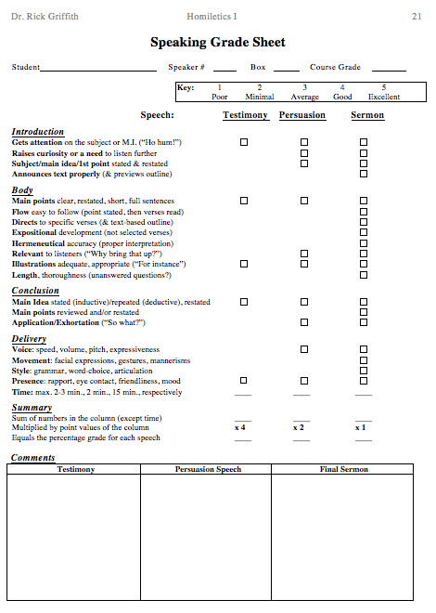
Chawngrei hai amadan na
21
"Ho hum!”*
Uru khindet
“Chongkhat a!”
Uru neidet
Awmnapui
Notes:
“Ho Hum” itihi, Chawnglelah, arei hai na, nijet rang atu; Nang chawng rangai haikar a, mitetan boi hai kha amothoi na inih.

Slide 57
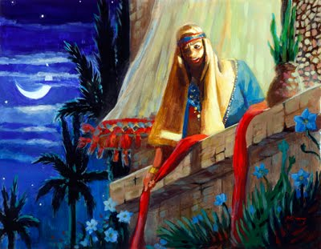
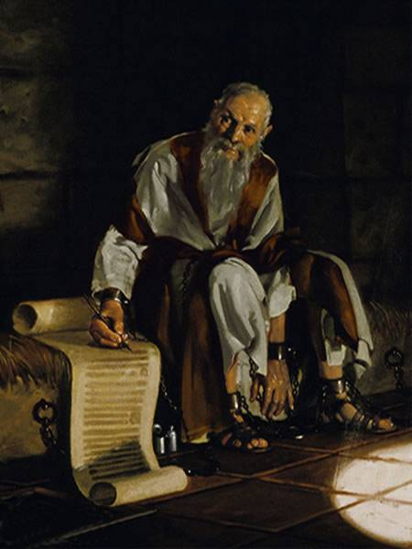
Nang chawnglelah idi
vi
Chawngmaw-chawi
Avaidet
Chawngtang 1-2
Joshua
Amatatdet
Temun 1

Slide 58
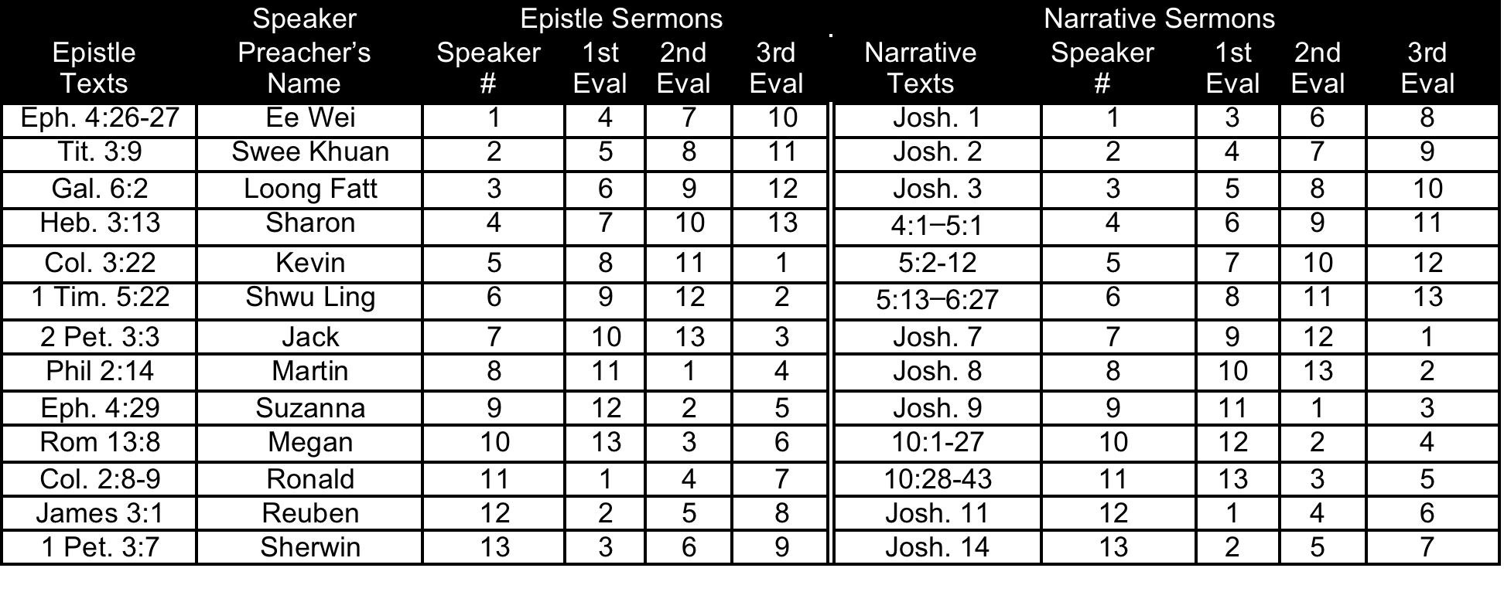
SBC 2015 Chawngrei khan Mandarei hai
vi
Murpa-Thaapa 15

Slide 59
Chawngmawchawi Chawnglelah Chawngtang (15 min.)
B
Rom. 13:8
Khatlekhat deng a numpok ranga kha niboia, tute deng leishe ton u naw roh. Ajarla shik khat deng a numapoh ama kha na Dan kha irupummashak inih.
Rom. 14:22-23
²²Takashawn kha nangnei maw? Makha Patheen le nang kar a tet roh. Nining a imenet chung a reheng nana boi ama kha rahvanmuh miring kha inih. ²³Khania rakhana anei amakha na shak joiatu, ama kha iheng inih. Ih nita awm, takashawn ah put ah anih boi kha tu munu inih.
Gal. 6:2
²Khatlekhat pokrik khan rashan uroh. Khatinkhan Khrista dan kha rupummashak uroh.

Slide 60
B
Chawngmawchawi Chawnglelah Chawngtang (15 min.)
Eph. 2:10
¹⁰Ajarla keini hi Patheen khutkon kha nanih. Christa Jesu jar a, ama na irurashamsha chon atha hai kha thawna rang, inurukon u inih. Makha amani deng khan niringna urang a inih.
Eph. 4:26-27
²⁶Munu thaw boi a shang uroh. Nang mulung hangna u khan ni tah naw rosho. ²⁷Raikho rang khan mun peh u naw roh.
Eph. 4:28
²⁸Murusha hai kha na murulai naw rosho. Kha ruhut a chon thaw reshe rangai miring le reshem rang, atha kha thaw rosho.

Slide 61
Chawngmawchawi Chawnglelah Chawngtang (15 min.)
B
Eph. 4:29
²⁹Turnei chawng kha nang ner uah put ah vak shok naw rosho, inia mothoina rang a nemna kha, rangai dungjuia rei uroh. Makha rangai hai deng khan numpokmirit kha peknathei rang a inih.
Eph. 6:4
⁴Khan apa hai, nang nai hai kha ningmeshet pe u naw roh, khania Pumi chawngrachakna kha le riji uroh.
Phil. 2:13
¹³ajarla ama ningnitna rangbak mining a chon thawna rang a nang kar ua chonathaw kha Patheen inih.
Phil. 2:14
¹⁴Reishet boi a le chawngreshet boi a chon kholok thaw uroh.

Slide 62
Chawngmawchawi Chawnglelah Chawngtang (15 min.)
B
Col. 2:8-9
⁸Riring uroh, tukhat na nangni kha lungthim le nemna boi mohonna chawng a nimikhit unih. Makha miring shena le manmeshe miruchukna dungjuia inih, inia Christa miruchukna dungjuia nimak. ⁹Christa deng khan Patheen changna shipna kholok kha na miring pumtak a awm.
1 Tim. 2:11-12
¹¹Nupang khat na rede kholok le miri ir a ruchuh rosho. ¹²Nupang khatna na mirichu rang a ninawkle apa khat chung a chamnei rang hin kei jawt mi ing, a awmchen rang a inih.
1 Tim. 5:22
²²Tute chung a nawshun a nang khut dong naw roh. Khan munu hai khan jaw naw roh. Nang pumtak kha retheng a tet roh.

Slide 63
B
Chawngmawchawi Chawnglelah Chawngtang (15 min.)
Titus 3:9
⁹Inia chawngreshet amawng hai, thoinakeina hai, roshona hai, Dan chungchanga reshetna hai kha lawi uroh. Ajarla amani kha nemna boi le arok neinak kha inih.
Heb. 3:13
¹³Inia “Von nikho,” iti awmlai hin khatlekhat deng mulung ngarna kha ningthingkip repeh uroh. Makha munu mimohonna kha na nang mulung u kha michimmashakna boi rang a inih.
Heb. 13:2
²Jinchonthaw kha menei u naw roh. Ajarla khatikhan a thaw kha na jet boi a ravantir hai kha imutung inih.

Slide 64
Chawngmawchawi Chawnglelah Chawngtang (15 min.)
B
1 Peter 2:2
²Ashok thar naite hai ang a, runutui retheng a ang Patheen chawng kha vanhat uroh. Makha jara nangni nangrawshawn u rangnih.
1 Peter 3:7
⁷Inkopai hai, khatikhan nang nungak hai kha riringtak a awm pui uroh. Bekoirat khat a le ringkho numpokmirit kha atumshom khat a loi u tana amani kha richit peh uroh. Makha nang inikna u hai kha kharna boi rang a inih.
2 Peter 3:3
³Akhat changna a mahi jet uroh, makhala nikho dawng hai khan erawh thaw miring hai kha jong rangnih. Amani na amani ditrekhe dungjuia ring u rangnih.

Slide 65
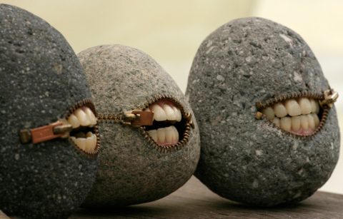
Nangna nang rophong nok atu, lung hai khawna hawng ra ai rangnih!
Luke 19:40 Jesu na mashang a ruti, “Kei na nangni deng kirei inih, amani khaw a awmchen u rang a nitjoiatu, lung hai khaw na hawng ra ai rangnih.”

Slide 66
Mahi shenghi Minute 15 chawnglelah nang rei nikhan hawngroshong puiroh…
vii
Nang rophongna nikho mala…
Marit Chawnmawdawn. 7 & 8 (or 11 & 12)
PPT slide(s) chawnglelah marit
Khutrak chawnlelah marit vanoi rang
Khutshun amadangna rang a ikhin
Nang chawng rophong na nikho khan…
Nangchawnglelah urutung
Nidishung a nang rophong sule…
Chawngreina Mandanrei (p. 104)

Slide 67
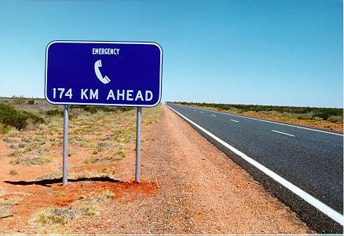
Nang chonmun ah remei namo nubuk?
Rashan na niroh!

Slide 68

Numpoktak-ah mahi chonmun hi computer ah namroh
Rojot na hi rocho roh!

Slide 69
Teitang Reshena
xi
Hikhutrak hi anamthei inih
Nang numuk thei
SBC box L19 nit nokle phone (6559-1513)
Mobile number 9113-7090
Kaw awm na inn hi SBC Block 2-302 a inih
Kaw awm na inn a phone tu awm laimak
E-mail: griffith@sbc.edu.sg
Kaw Chawn thaw pha…
Bu nenek sawm thei!

Slide 70

Mikhat se na awm aruchu hi avaitek rangni timak
School a kir jot lai miing! Mikhatse na-awm nadit mak! Analai u, kasam na pot pe-u, nepe u! Dit miing!

Slide 71
Chawngrophongna (Retheina) hin awm BibleStudyDownloads.org
Mahi rachakna hi arem ah mukthei inih!
Notes:
Preaching (pr)
Homiletics

Slide 72
Black

