Slide 1
الإصلاح
في 1500
تعليم د. رون مان دكتور الخدمات الطلابية تحميل د. ريك جريفيث • مؤسسة الدراسات اللاهوتية الأردنية الملفات بعدة لغات للتنزيل المجاني على BibleStudyDownloads.org
Notes:
During the month of October we will be celebrating the 500th anniversary of the Protestant Reformation.

Slide 2
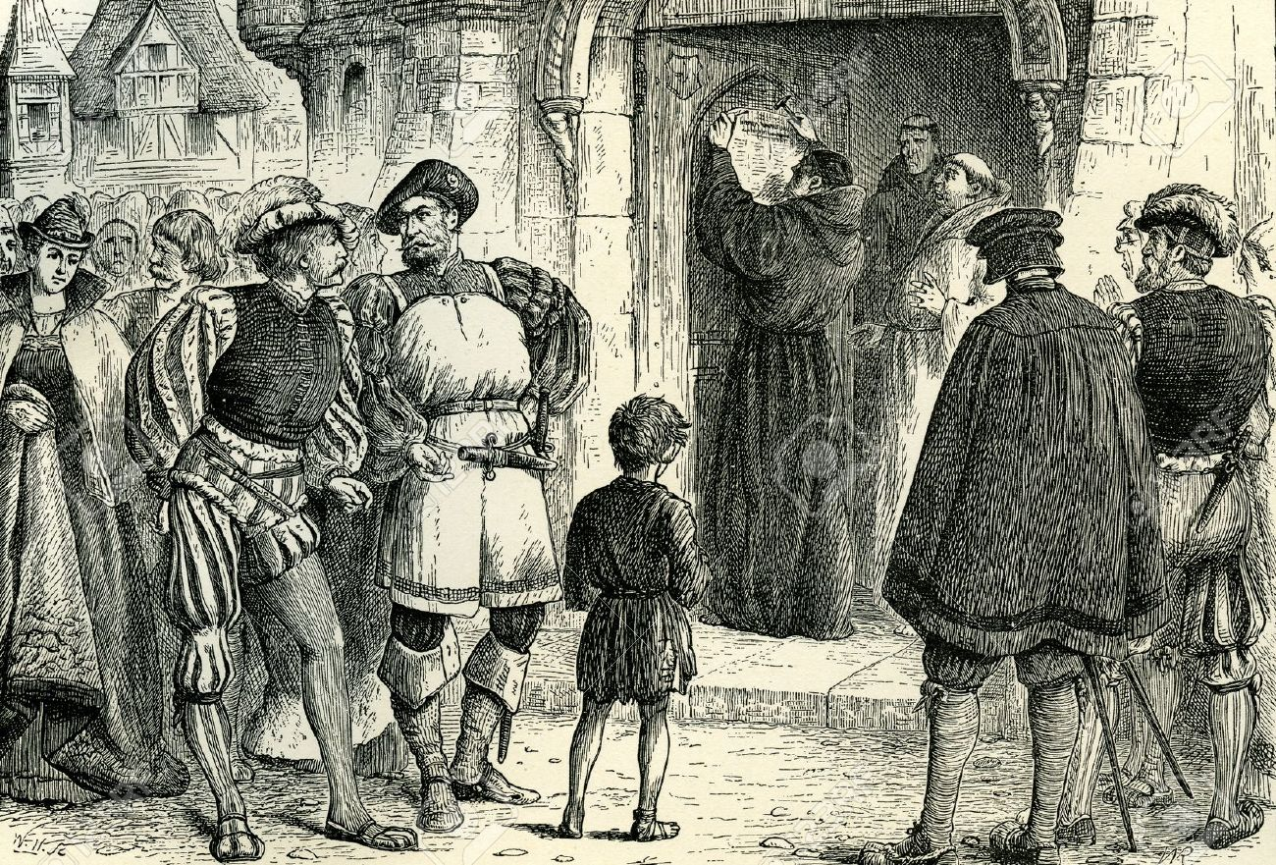
October 31, 1517
31 تشرين أول، 1517
Notes:
Because 500 years ago, on October 31, 1517, was when Martin Luther nailed his 95 These to the church door in Wittenberg, Germany. The concerns he expressed in this document about the practices and teaching of the established church of his day ended up touching off what we now know as the Reformation.

Slide 3
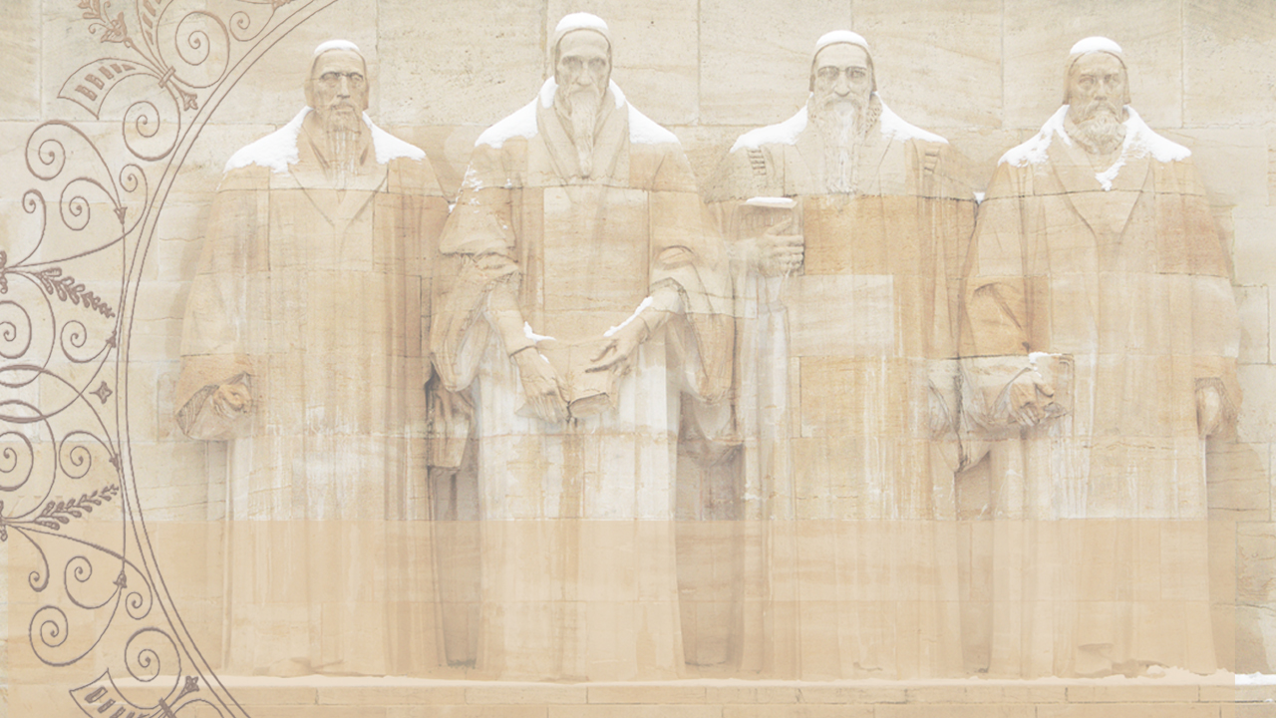
جان هوس
جون ويكليف
وليم تندل
مارتن لوثر
آلريتش زوينجلي
توماس كرانمار
الحرق
إعلان الهرطقة
الخنق
الطرد
القتل في معركة
الحرق
Notes:
At tremendous personal cost, as you can see here, the Reformers took a bold and courageous stand against all the civil and religious authorities of their day, armed only with an unshakeable confidence in God and commitment to the truth of Scripture.

Slide 4
اذكروا مرشديكم الذين كلموكم بكلمة الله.
انظروا إلى نهاية سيرتهم فتمثلوا بإيمانهم.
(عبرانيين 13: 7)
Notes:
We honor these true Christian heroes. We owe them a great debt, because in a very real sense every one of us is here today because God used them to restore the biblical gospel that had been obscured.

Slide 5
اصلاح العقيدة
استعادة الإنجيل الكتابي
استرداد التعليم الرسولي عن الخلاص
Notes:
Luther and the other Reformers were not seeking to start a new church, but wanted to reform the church from within. They were not bringing new teachings, but rather seeking to restore the biblical gospel and the apostolic teachings about the way of salvation and how a sinner can be justified before a holy God.

Slide 6
التبرير
بالنعمة فقط
من خلال الإيمان فقط
في المسيح فقط
كما هو معلن في الكتاب المقدس فقط
لمجد الله فقط
Notes:
The reformers stressed the New Testament teaching that justification comes from God, as a gift of His grace received through faith, faith in Christ, as revealed in the Scriptures; that salvation is a work of God for which He receives all the glory. These 5 “solas” (meaning “alone”) will be unpacked by Cole through October, and will also be the focus of our worship.

Slide 7
اصلاح العبادة
Notes:
But the Reformation was not just a Reformation of doctrine, but was a Reformation of WORSHIP in some crucial ways. For the next 3 weeks we’re to take a few minutes to highlight some of the major changes in worship effected by the Reformers.

Slide 8
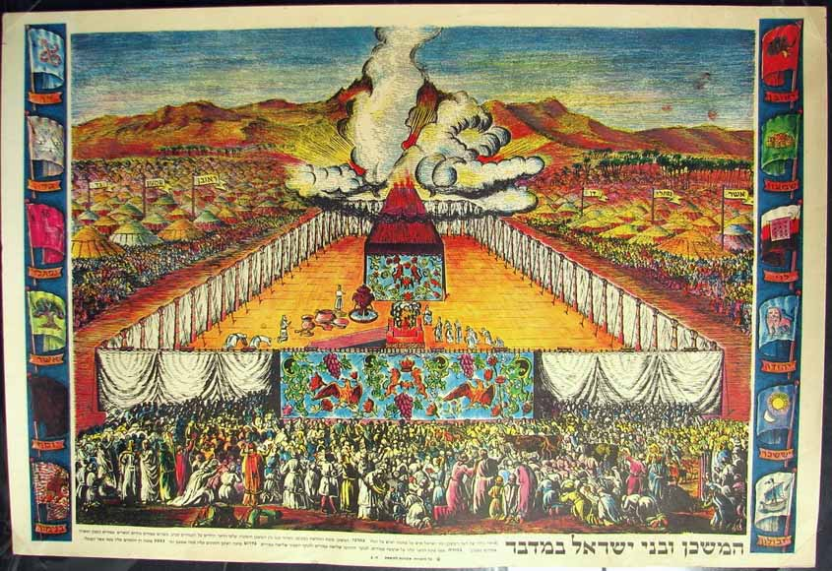
Notes:
In the Old Testament, the people of God had to stand outside the Tabernacle, and could only watch as the priests inside did their worship for them.

Slide 9
العصور الوسطى
تشاركية أقل فأقل
الإستمرار باللغة اللاتينية
Notes:
While the New Testament emphasized that Christian worship should actively engage the whole people of God, yet during the Middle Ages turned back more and more to the Old Testament model, where priests did it all and the people sat silently and watched. In fact, services continued to be conducted in Latin, even though most people did not even understand it anymore. So they didn’t even know what was going on.

Slide 10
الإصلاح
العودة إلى العبادة التشاركية
العبادة بلغة الشعب
الإيمان بالخبر
والخبر بكلمة الله
(رومية 10: 17)
Notes:
The Reformers initiated a major change to a much more participatory kind of worship. They insisted that worship be held in the language of the people, so that they could understand and fully participate.

Slide 11
الإصلاح
العودة إلى العبادة التشاركية
دور نشيط لشعب الله
كهنوت كل المؤمنين
Notes:
The Reformers reemphasized the New Testament teaching about the priesthood of all believers, that every Christian has direct access to the presence of God through Christ.

Slide 12
الإصلاح
العودة غلى العبادة التشاركية
الترنيم الجماعي
لتسكن فيكم كلمة المسيح بغنى ... بمزامير وتسابيح وأغاني روحية، بنعمة، مترنمين في قلوبكم للرب.
(كولوسي 3: 16)
Notes:
Key to this full participation of the people in worship is congregational singing, which Luther, Calvin and other Reformers especially emphasized the importance of the people singing God’s truth, as well as hearing it preached.

Slide 13
العبادة فعل
إنها شيء نفعله، وليست شيئاً نشاهده
Notes:
One important book is entitled Worship is a VERB, reflecting the biblical and Reformational truth that worship is something we DO, not something we watch.

Slide 14
ليست: هل لدي صوت؟
لكن: هل لدي ترنيمة؟
Notes:
The question being: NOT Do I have a VOICE? BUT: Do I have a SONG? Every believer in Christ has a song of gratitude to sing to the God who saved us.

Slide 15
اصلاح العبادة
العودة إلى العبادة التشاركية
الخدمة بلغة الشعب
دور نشيط لشعب الله
الترنيم الجماعي
Notes:
In previous weeks we saw that the Reformers brought about a RETURN TO PARTICIPATORY WORSHIP—by insisting that the worship service be conducted in the language of the people, and that the congregation have amore active role in worship, especially through congregational singing, which the Reformers were great champions of.

Slide 16
اصلاح العبادة
العودة إلى العبادة التشاركية
الكتاب المقدس بلغة الشعب
أولوية الكلمة في العبادة
أهمية الوعظ في العبادة
Notes:
Last week we celebrated the Word of God and how the Reformers brought it back to its proper place in the church and in the lives of people—first by translating the Bible into the local language of the people, then by bringing it back to the center of worship to be read, prayed, sung and preached; and then by elevating the ministry of preaching as the faithful exposition of the Scripture.

Slide 17
اصلاح العبادة
العودة إلى كهنوت المسيح الوحيد
Notes:
Finally today we want to see how the Reformers brought Christ back into the center of worship as our priest who leads us into the presence of God.

Slide 18
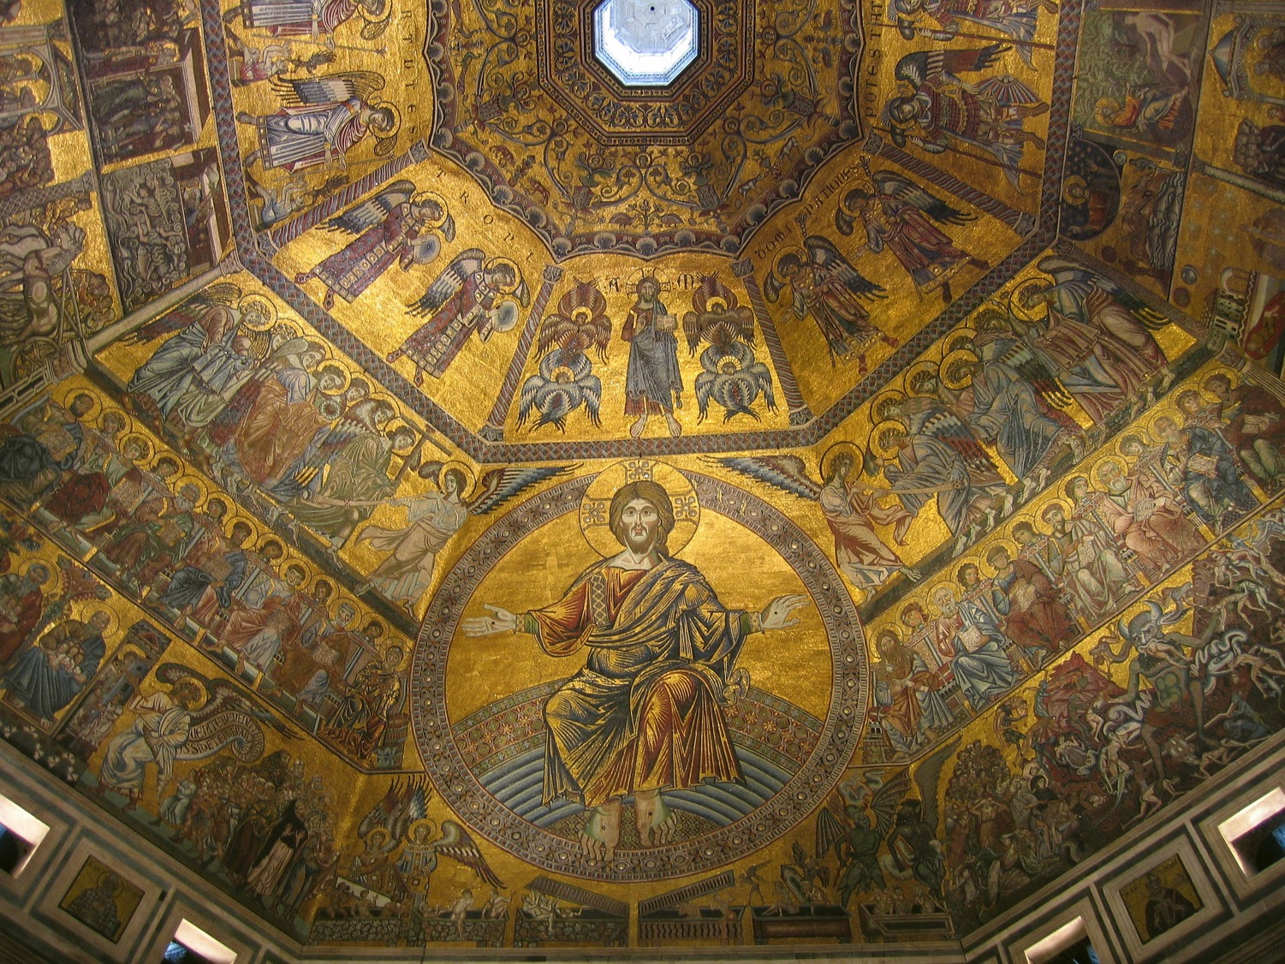
Notes:
During the early church there were many debates about the true nature of Christ, especially about His true deity. Church councils and creeds finally settled these issues. But in the process, because there was no much needed emphasis on Christ’s deity, the true humanity of Christ began to be neglected in the Middle Ages, with huge implications for the church.

Slide 19
الدفاع عن ألوهية المسيح في الكنيسة الأولى
أدى إلى رفض بشريته في العصور الوسطى
Notes:
But in the process, because there was no much needed emphasis on Christ’s deity, the true humanity of Christ began to be neglected in the Middle Ages, with huge implications for the church.

Slide 20
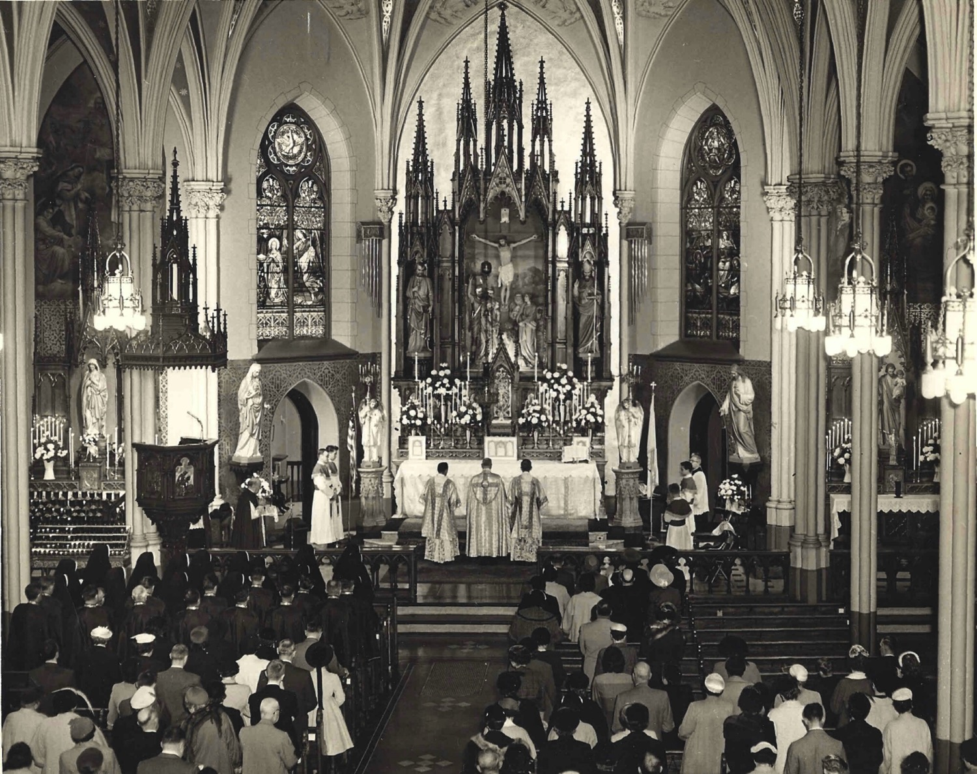
افترضت العصور الوسطى أن هناك حاجة لكهنوت بشري وسيط بين البشرية الخاطئة والمسيح الممجد، القاضي والملك المهيب.
Praying through the saints
Notes:
In the Middle Ages, the church, as we’ve seen, tended to gravitate back to Old Testament type of practices, and that included a growing emphasis on the need to go through a PRIEST in order to get to God.

Slide 21
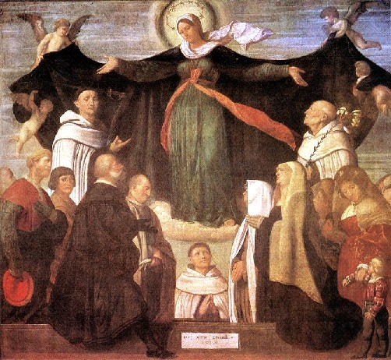
الصلاة من خلال مريم
Notes:
And not only was there the emphasis on going through a priest to reach God, but there arose the teaching that in order to get your prayers heard and answered, you had to pray through Mary…

Slide 22
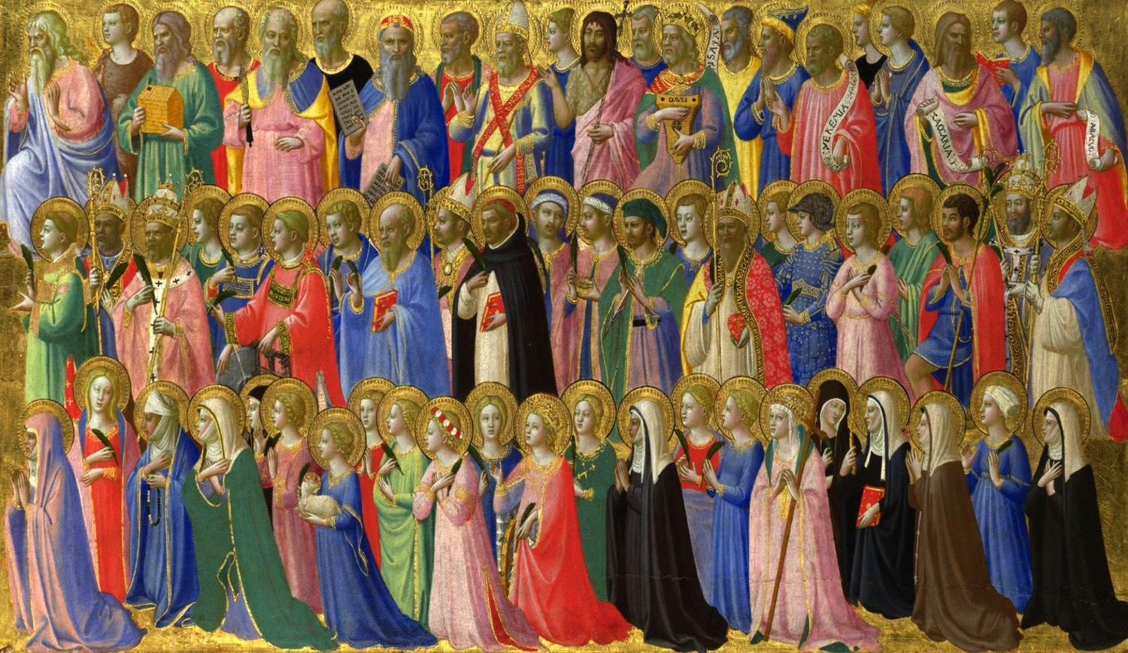
الصلاة من خلال القديسين
Notes:
… or you had to pray to one of the saints, as someone who could represent you before God.

Slide 23
يوجد إله واحد
ووسيط واحد
بين الناس والله
الإنسان يسوع المسيح
(1 تيموثاوس 2: 5)
Notes:
One of the great emphases of the Reformers was that, in Paul’s words, “There is ONE mediator between God and man, the man Christ Jesus.” Every believer has DIRECT access to God through Jesus Christ—He is the only Priest, the only go-between we need. We do not need to go through a priest, or through Mary, or through one of the saints to get to God. We go THROUGH CHRIST.

Slide 24
Solus Christus
في المسيح وحده
فإذ لنا أيها الإخوة ثقة بالدخول إلى الأقداس بدم يسوع ... لنتقدم بقلب صادق في يقين الإيمان.
(عبرانيين 10: 19، 22)
Notes:
Salvation is by grace through in Christ alone, and He is the one way to the Father—through Him we can draw near with confidence and assurance, as the writer of Hebrews encourages us.

Slide 25
حقيقة موحدة لعبادتنا
مهما كان شكلها الخارجي
الذي قد تتخذه عبادتنا،
هناك طريقة واحدة فقط
كي نأتي إلى الآب،
أي من خلال المسيح
بقوة الروح القدس
Notes:
This is a critical unifying truth for the church’s worship: Whatever outward form our worship may take, there is ONLY ONE WAY to come to the Father, and that is through CHRIST in the power of the Holy spirit.

Slide 26
لا يستطيع قائد عبادة، راعي، فرقة موسيقية، أو ترنيمة أبداً أن يقربنا إلى الله
العبادة نفسها لا تستطيع أن تقودنا إلى حضور الله.
فقط يسوع بنفسه يستطيع أن يحضرنا إلى حضور الله
(بوب كاوفلين)
Notes:
And a crucial corollary is this: No worship leader, pastor, band, or song will ever bring us close to God….Worship itself cannot lead us into God’s presence, Only Jesus Himself can bring us into God’s presence.

Slide 27
ليس فقط يرينا الطريق:
باعتباره وسيطنا ورئيس كهنتنا
فإنه يأخذنا معه
Notes:
And a crucial corollary is this: doesn’t just show us the way to he Father. As Our Mediator and High Priest HE TAKES US WITH HIM into the Father’s presence. HE leads us in our worship. (I’ll have the opportunity of sharing some of these great truths in Wittenberg later this week.)

Slide 28
Black

Slide 29
BibleStudyDownloads.org • لاهوت العبادة وممارسته
أحصل على هذا العرض التقديمي مجاناً
Notes:
WV Worldviews

