Slide 1

لاهوت العبادة وممارستها

Slide 2
هلم نرنم للرب
نهتف لصخرة خلاصنا.
نتقدم أمامه بحمد
وبترنيمات نهتف له.
لأن الرب إله عظيم
ملك كبير على كل الآلهة.
الذي بيده مقاصير الأرض
وخزائن الجبال له.
الذي له البحر وهو صنعه
ويداه سبكتا اليابسة.

Slide 3
هلم نسجد ونركع
ونجثو أمام الرب خالقنا
لأنه هو إلهنا، ونحن شعب مرعاه
وغنم يده.
(مزمور 95: 1-7)

Slide 4
رون مان

Slide 5
RON MAN

Slide 6
RON MAN
I

Slide 7
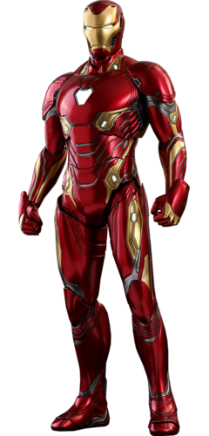
I
RON MAN

Slide 8
الرجل الحديدي

Slide 9
الرجل الحديدي

Slide 10
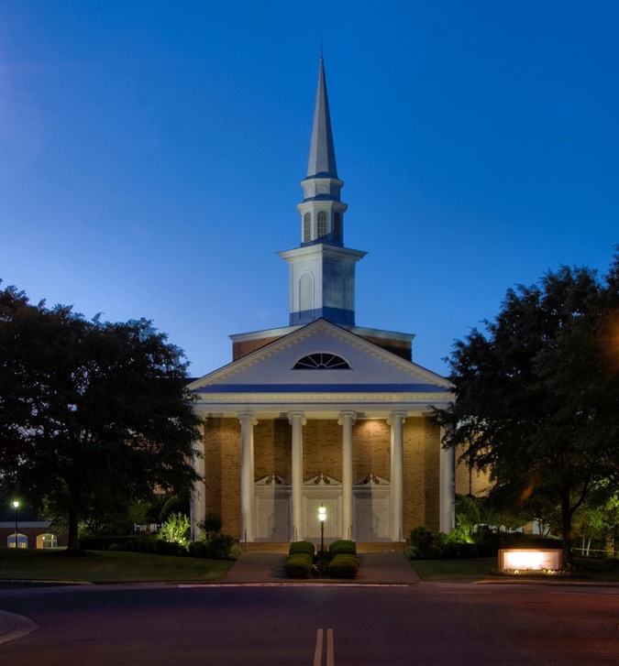
الكنيسة الإنجيلية
الأولى
ممفيس، تينيسي

Slide 11
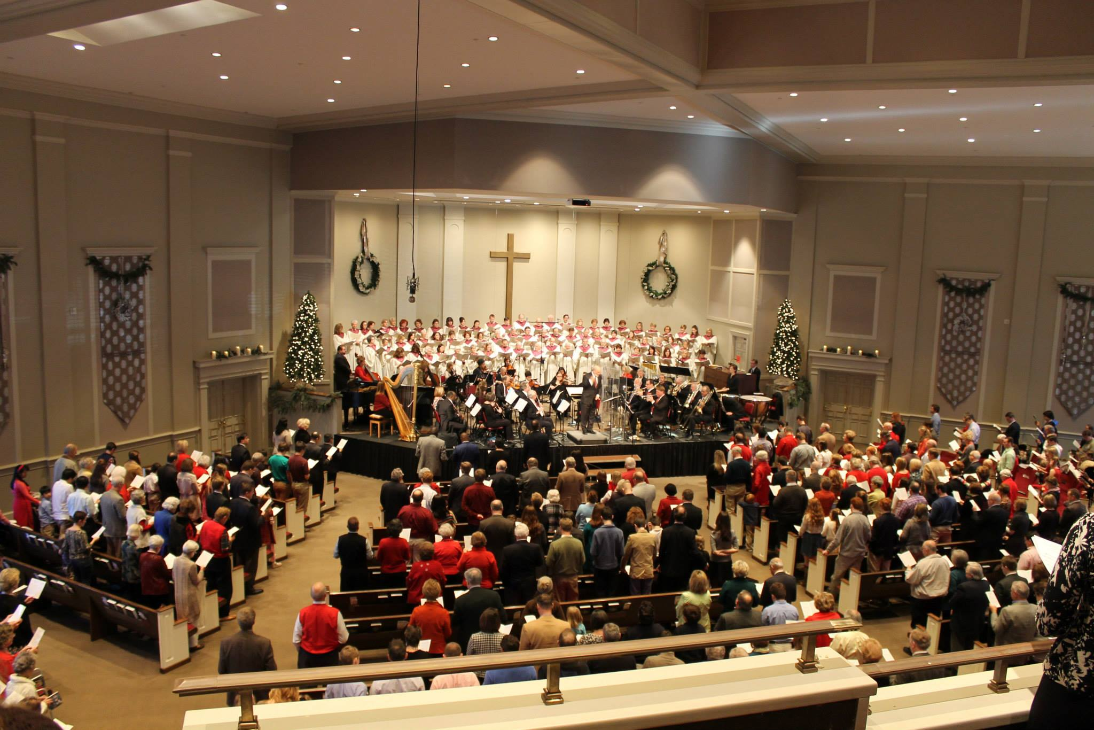

ETERNAL PRAISE
AND THE NATIONS
Revelation 7

Slide 12
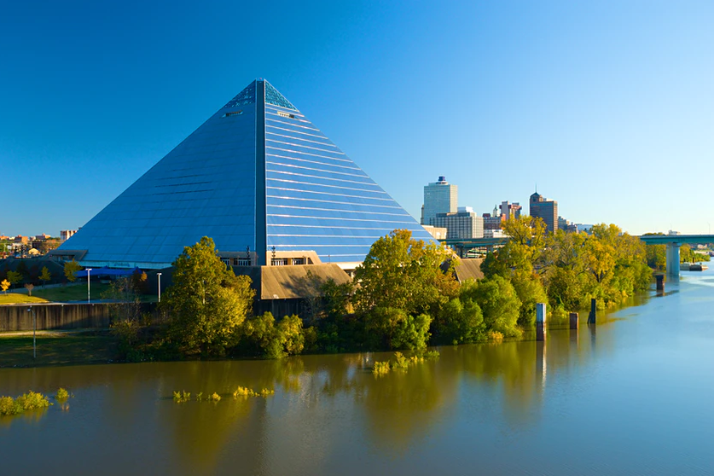

Slide 13
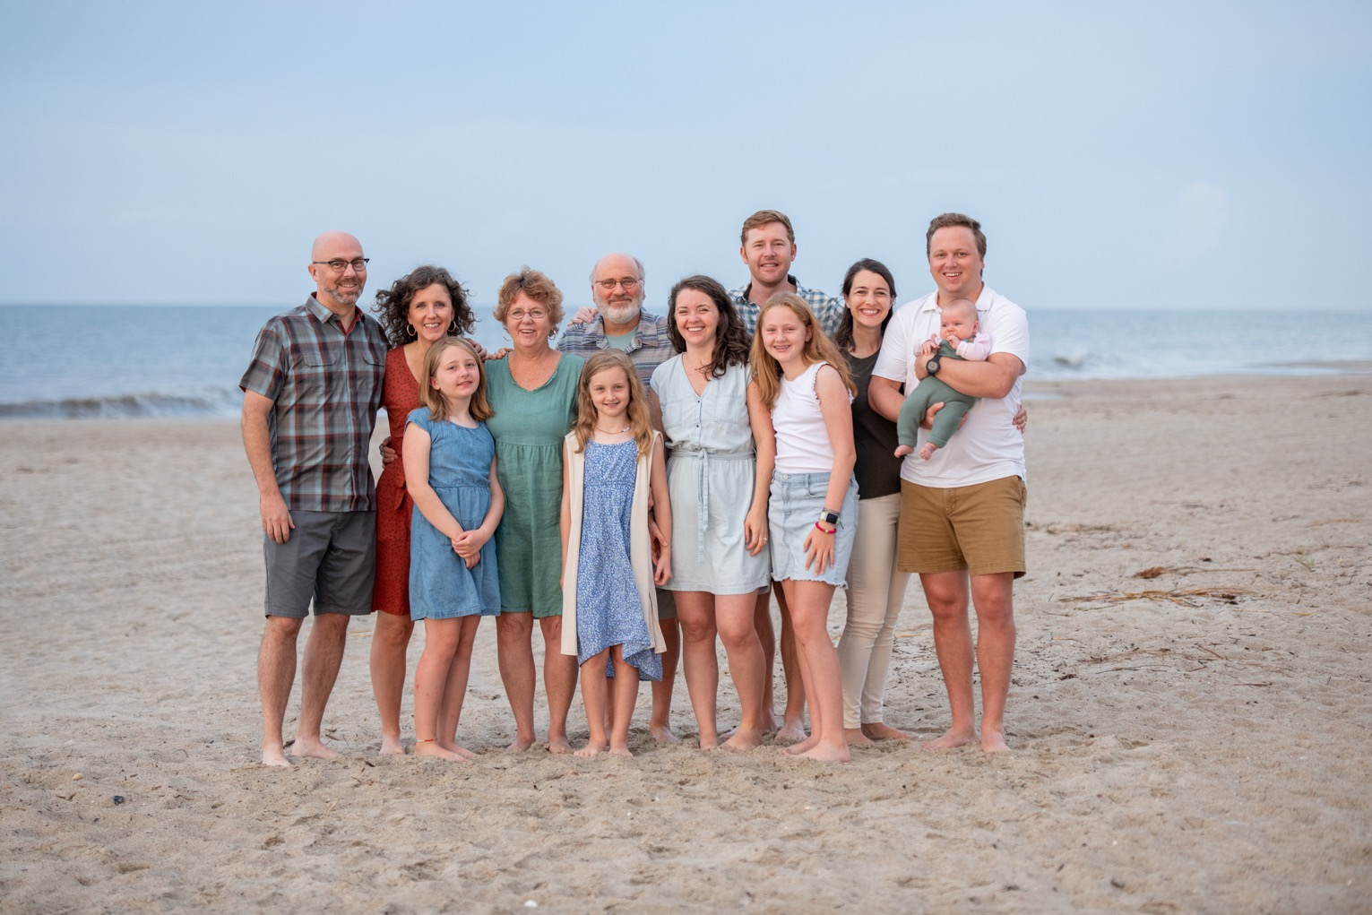

Slide 14
قصصك
قصتي

Slide 15
مخطط المساق
1. الله الذي نعبده.
2. مركزية العبادة
3. االعبادة في العهد القديم
4. العبادة في العهد الجديد
5. العبادة في تاريخ الكنيسة
6. العبادة في الكنيسة

Slide 16

مقدمة، الجزء 1
لاهوت العبادة وممارستها
لاهوت العبادة

Slide 17
نعرف الآن أن العبادة هي الجوهرة المفقودة في الإنجيلية الحديثة.
نحن منظمون؛ نحن نعمل؛ نحن لدينا جدول أعمال.
نحن لدينا كل شيء تقريباً، لكن هناك شيء واحد لا تمتلكه الكنائس حتى كنائس «الإنجيل»
هذا الشيء هو القدرة على العبادة
فنحن لا ننمي فن العبادة فينا
انها الجوهرة البراقة الضائعة في الكنيسة الحديثة
وأعتقد أنه ينبغي علينا أن نبحث عنها حتى نجدها.
(أ. و. توزر، 1961)

Slide 18
منذ ذلك الحين
كتب عن العبادة
مؤتمرات عبادة
ترانيم عبادة
مساقات عبادة
درجات أكاديمية في العبادة
نقاشات واستفتاءات بخصوص العبادة

Slide 19
أخبار جيدة
و
أخبار سيئة

Slide 20
لماذا ندرس لاهوت العبادة؟
ما هو لاهوت .....
ما هو لاهوت العبادة

Slide 21
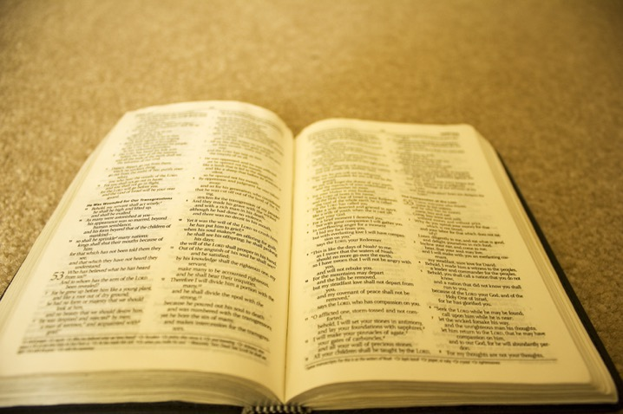
أهمية لاهوت العبادة
لاهوت = ( الفهم الكتابي)

Slide 22

أهمية لاهوت العبادة ( الفهم الكتابي للعبادة)
1. تخبرنا كلمة الله من هو الله.
الله هو مدار( موضوع ) عبادتنا
عبادتنا متعلقة فيه .
يجب أن نعبده كما هو حقيقة.ً
Notes:
SUBJECT

Slide 23
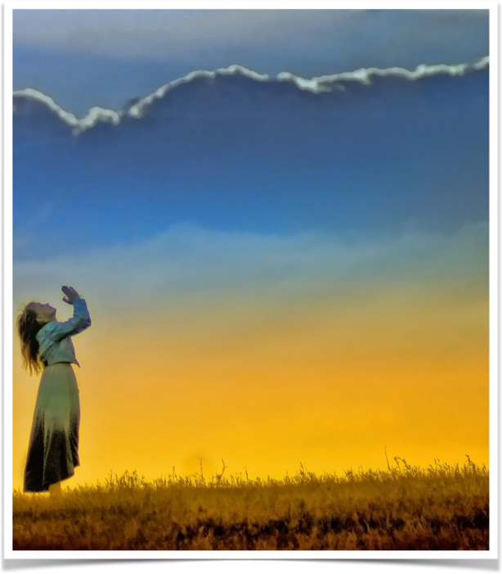
أهمية لاهوت العبادة ( الفهم الكتابي للعبادة)
2. تخبرنا كلمة الله ما يريده الله.
          الله هو من نوجه عبادتنا له.
          العبادة له ولمسرته
          يجب أن نعبده كما يريد هو أن يُعبَد
Notes:
SUBJECT

Slide 24

أهمية لاهوت العبادة ( الفهم الكتابي للعبادة)
3. كلمة الله هي مرشدنا
سراج لرجلي كلامك ونور لسبيلي
( مزمور 119: 105)
Notes:
SUBJECT

Slide 25
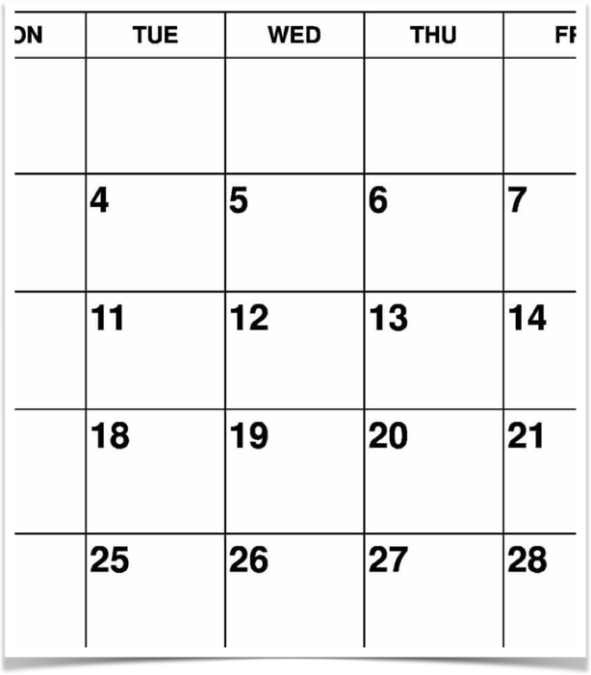
أهمية لاهوت العبادة ( الفهم الكتابي للعبادة)
4. تخبرنا كلمة الله أن كل حياتنا يجب أن تكون عبادة.
... أن تقدموا أجسادكم ذبيحة حية مقدسة مرضية عند الله عبادتكم العقلية.
( رومية 12: 1)
Notes:
SUBJECT

Slide 26
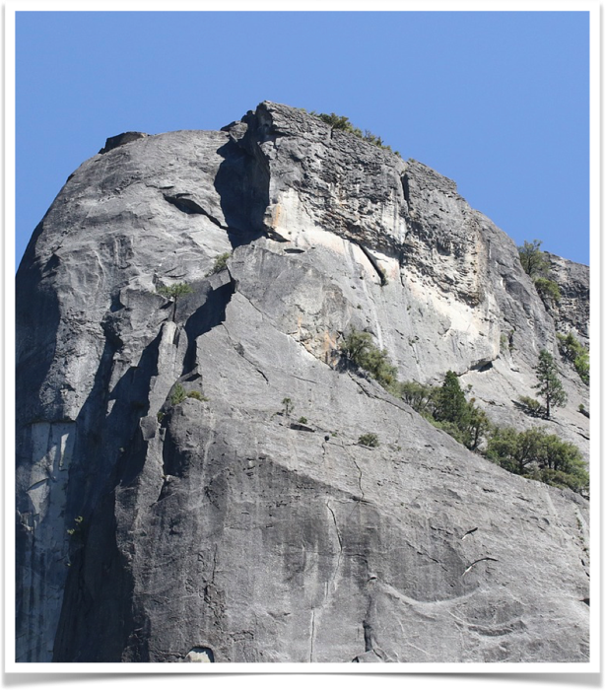
أهمية لاهوت العبادة ( الفهم الكتابي للعبادة)
5. كلمة الله هي معيارنا الوحيد الذي لا يتغيّر.
إلى الأبد يا رب كلمتك مثبتة في السماوات
( مزمور 119: 89)
Notes:
SUBJECT

Slide 27
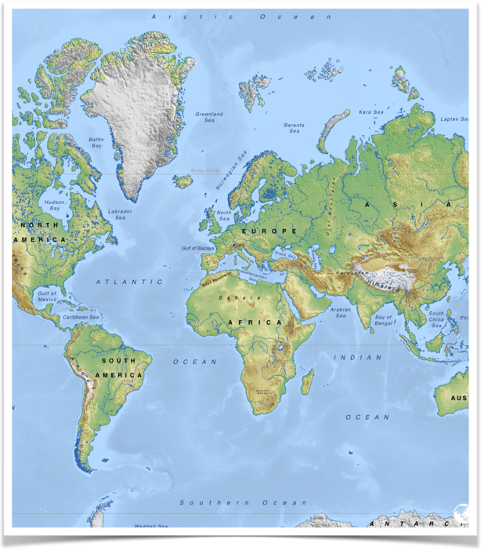
أهمية لاهوت العبادة ( الفهم الكتابي للعبادة)
6. فقط كلمة الله تستطيع أن تعطينا فَهماً موحَّداً للعبادة.
ما هي الأمور الجوهريّة؟
ما هي الأمور التي لا تتغير؟
Notes:
SUBJECT

Slide 28
أهمية لاهوت العبادة ( الفهم الكتابي للعبادة)
تخبرنا كلمة الله من هو الله.
تخبرنا كلمة الله ما الذي يريده الله.
كلمة الله هي مرشدنا ( دليلنا).
تخبرنا كلمة الله أن كل الحياة يجب أن تكون عبادة.
كلمة الله هي معيارنا الوحيد اللامتغير.
تعطينا كلمة الله فقط فهماً موحداً للعبادة.
ناقش في مجموعات
1. كيف تتفاعل مع النقاط السابقة؟
هل يمكنك التفكير في أسباب إضافية لأهمية لاهوت العبادة؟
كيف يمكن للاهوت العبادة أن يرتبط بجوانب أخرى من اللاهوت ؟

Slide 29
أهمية العبادة للاهوت
1. اللاهوت/ الدراسات الكتابيّة هي وسيلة لأجل غاية.
  هدف اللاهوت هو التّمجيد، نحن ندرس لكي نُسَبّح
  (ج. ل. باكر)
Notes:
SUBJECT

Slide 30
أهمية العبادة لللاهوت
2. شددت معظم الكنائس البروتستانتية على العقيدة أكثر منها على العبادة.
Notes:
SUBJECT

Slide 31
سوف نتحدّث عن
الأسس الكتابية للعبادة؛ لن نركز كثيراً على شكل أو أسلوب العبادة.
المبادئ الكتابية للعبادة والتي يمكن تطبيقها في أي ثقافة.
مركزية العبادة في كل الحياة والخدمة وليس فقط في صباح الأحد.
Notes:
SUBJECT

Slide 32
دليل المساق

Slide 33
Black

Slide 34


• BibleStudyDownloads.org لاهوت العبادة وممارستها
أحصل على هذا العرض التقديمي مجاناً
Notes:
Worship (wo)

Slide 35
المقدمة، الجزء الثاني
لاهوت وممارسة العبادة
.
الإعلان
و
التجاوب

Slide 36
الإعلان
والتجاوب
نمط العبادة الصحيحة
Notes:
God reveals His glory, worship is our response
Order is important: God always initiates
Rom. 11:33-36 eleven chapters of doctrine, then Paul bursts out in praise: „Oh, the depth of the riches ¹both of the wisdom and knowledge of God!”
Worship services to be a dialogue betw, God and man, a dialogue of revel. & response
This is why the Scriptures are so important; Stott and others remind us how we need much more Scr. In our services– been in many churches where first first of Scr. Is when preacher gets up– means 30 mintues of response w/o anything to respond to!!

Slide 37
التجاوب
الإعلان
Notes:
Basic paradigm for God’s dealings with us

Slide 38
ترتيب حاسم
Notes:
God reveals His glory, worship is our response
Order is important: God always initiates
Rom. 11:33-36 eleven chapters of doctrine, then Paul bursts out in praise: „Oh, the depth of the riches ¹both of the wisdom and knowledge of God!”
Worship services to be a dialogue betw, God and man, a dialogue of revel. & response
This is why the Scriptures are so important; Stott and others remind us how we need much more Scr. In our services– been in many churches where first first of Scr. Is when preacher gets up– means 30 mintues of response w/o anything to respond to!!

Slide 39
الله بعد ما كلم الآباء بالأنبياء قديماً بأنواع وطرق كثيرة، كلمنا في هذه الأيام الأخيرة في ابنه.
(عبرانيين 1: 1-2)
Notes:
God reveals His glory, worship is our response
Order is important: God always initiates
Rom. 11:33-36 eleven chapters of doctrine, then Paul bursts out in praise: „Oh, the depth of the riches ¹both of the wisdom and knowledge of God!”
Worship services to be a dialogue betw, God and man, a dialogue of revel. & response
This is why the Scriptures are so important; Stott and others remind us how we need much more Scr. In our services– been in many churches where first first of Scr. Is when preacher gets up– means 30 mintues of response w/o anything to respond to!!

Slide 40
عبادتنا هي إجابتنا لله الذي خاطبنا أولاً ... يعبد الإنسان الله الذي أعلن عن نفسه ... كل عبادتنا ما هي إلا استجابتنا نحو الله الذي قدم نفسه في الإعلان والفداء
(وليام نيكولز، سلم يعقوب: معنى العبادة، 37، 53)
Notes:
God reveals His glory, worship is our response
Order is important: God always initiates
Rom. 11:33-36 eleven chapters of doctrine, then Paul bursts out in praise: „Oh, the depth of the riches ¹both of the wisdom and knowledge of God!”
Worship services to be a dialogue betw, God and man, a dialogue of revel. & response
This is why the Scriptures are so important; Stott and others remind us how we need much more Scr. In our services– been in many churches where first first of Scr. Is when preacher gets up– means 30 mintues of response w/o anything to respond to!!

Slide 41
الدين / البيلاجية
مبادرة الإنسان
Notes:
God reveals His glory, worship is our response
Order is important: God always initiates
Rom. 11:33-36 eleven chapters of doctrine, then Paul bursts out in praise: „Oh, the depth of the riches ¹both of the wisdom and knowledge of God!”
Worship services to be a dialogue betw, God and man, a dialogue of revel. & response
This is why the Scriptures are so important; Stott and others remind us how we need much more Scr. In our services– been in many churches where first first of Scr. Is when preacher gets up– means 30 mintues of response w/o anything to respond to!!

Slide 42
المسيحية / الأوغسطينية
مبادرة الله
Notes:
God reveals His glory, worship is our response
Order is important: God always initiates
Rom. 11:33-36 eleven chapters of doctrine, then Paul bursts out in praise: „Oh, the depth of the riches ¹both of the wisdom and knowledge of God!”
Worship services to be a dialogue betw, God and man, a dialogue of revel. & response
This is why the Scriptures are so important; Stott and others remind us how we need much more Scr. In our services– been in many churches where first first of Scr. Is when preacher gets up– means 30 mintues of response w/o anything to respond to!!

Slide 43
1 يوحنا 4: 19
نحن نحب ...
لأنه أحبنا أولاً
Notes:
God reveals His glory, worship is our response
Order is important: God always initiates
Rom. 11:33-36 eleven chapters of doctrine, then Paul bursts out in praise: „Oh, the depth of the riches ¹both of the wisdom and knowledge of God!”
Worship services to be a dialogue betw, God and man, a dialogue of revel. & response
This is why the Scriptures are so important; Stott and others remind us how we need much more Scr. In our services– been in many churches where first first of Scr. Is when preacher gets up– means 30 mintues of response w/o anything to respond to!!

Slide 44
نمط كتابي
Notes:
God reveals His glory, worship is our response
Order is important: God always initiates
Rom. 11:33-36 eleven chapters of doctrine, then Paul bursts out in praise: „Oh, the depth of the riches ¹both of the wisdom and knowledge of God!”
Worship services to be a dialogue betw, God and man, a dialogue of revel. & response
This is why the Scriptures are so important; Stott and others remind us how we need much more Scr. In our services– been in many churches where first first of Scr. Is when preacher gets up– means 30 mintues of response w/o anything to respond to!!

Slide 45
أمثلة في الكتاب المقدس
آدم وحواء
إبراهيم
آخرون؟
التجاوب
الإعلان
Notes:
Adam & Eve, Moses, David, Saul/Paul, Jesus calling disciples,
Order is important: God always initiates
Rom. 11:33-36 eleven chapters of doctrine, then Paul bursts out in praise: „Oh, the depth of the riches ¹both of the wisdom and knowledge of God!”
Worship services to be a dialogue betw, God and man, a dialogue of revel. & response
This is why the Scriptures are so important; Stott and others remind us how we need much more Scr. In our services– been in many churches where first first of Scr. Is when preacher gets up– means 30 mintues of response w/o anything to respond to!!

Slide 46

النمط الكتابي للفداء
Notes:
God reveals His glory, worship is our response
Order is important: God always initiates
Rom. 11:33-36 eleven chapters of doctrine, then Paul bursts out in praise: „Oh, the depth of the riches ¹both of the wisdom and knowledge of God!”
Worship services to be a dialogue betw, God and man, a dialogue of revel. & response
This is why the Scriptures are so important; Stott and others remind us how we need much more Scr. In our services– been in many churches where first first of Scr. Is when preacher gets up– means 30 mintues of response w/o anything to respond to!!

Slide 47
العهد القديم
آمن إبراهيم بالرب فحسب له براً
(تكوين 15: 6)
وعود الله لإبراهيم
التجاوب
الإعلان
Notes:
God reveals His glory, worship is our response
Order is important: God always initiates
Rom. 11:33-36 eleven chapters of doctrine, then Paul bursts out in praise: „Oh, the depth of the riches ¹both of the wisdom and knowledge of God!”
Worship services to be a dialogue betw, God and man, a dialogue of revel. & response
This is why the Scriptures are so important; Stott and others remind us how we need much more Scr. In our services– been in many churches where first first of Scr. Is when preacher gets up– means 30 mintues of response w/o anything to respond to!!

Slide 48
العهد القديم
الفداء من مصر
نظام الذبائح
التجاوب
الفداء
Notes:
God reveals His glory, worship is our response
Order is important: God always initiates
Rom. 11:33-36 eleven chapters of doctrine, then Paul bursts out in praise: „Oh, the depth of the riches ¹both of the wisdom and knowledge of God!”
Worship services to be a dialogue betw, God and man, a dialogue of revel. & response
This is why the Scriptures are so important; Stott and others remind us how we need much more Scr. In our services– been in many churches where first first of Scr. Is when preacher gets up– means 30 mintues of response w/o anything to respond to!!

Slide 49
الناموس
لا يكن لك آلهة أخرى أمامي ... الخ
(خروج 20: 3-17)
أنا الرب إلهك الذي أخرجك من أرض مصر من بيت العبودية.
(خروج 20: 2)
التجاوب
الفداء
Notes:
God reveals His glory, worship is our response
Order is important: God always initiates
Rom. 11:33-36 eleven chapters of doctrine, then Paul bursts out in praise: „Oh, the depth of the riches ¹both of the wisdom and knowledge of God!”
Worship services to be a dialogue betw, God and man, a dialogue of revel. & response
This is why the Scriptures are so important; Stott and others remind us how we need much more Scr. In our services– been in many churches where first first of Scr. Is when preacher gets up– means 30 mintues of response w/o anything to respond to!!

Slide 50
لم تكن الوصايا سلماً للوصول إلى الله، لكنها أظهرت كيف يجب أن يعيش شعب مفدي كشعب الله.
(أودري ناش، قصة العهد القديم: رؤية العهد القديم ككل، ٣١)
Notes:
worship Him as He really is, as He wants to be worshiped
Order is important: God always initiates
Rom. 11:33-36 eleven chapters of doctrine, then Paul bursts out in praise: „Oh, the depth of the riches ¹both of the wisdom and knowledge of God!”
Worship services to be a dialogue betw, God and man, a dialogue of revel. & response
This is why the Scriptures are so important; Stott and others remind us how we need much more Scr. In our services– been in many churches where first first of Scr. Is when preacher gets up– means 30 mintues of response w/o anything to respond to!!

Slide 51
دائماً ما تسبق مؤشرات النعمة أوامر الناموس.
(جيمس تورانس)
الله: لقد فعلت ذلك من أجلك، والآن افعل هذا
Notes:
worship Him as He really is, as He wants to be worshiped
Order is important: God always initiates
Rom. 11:33-36 eleven chapters of doctrine, then Paul bursts out in praise: „Oh, the depth of the riches ¹both of the wisdom and knowledge of God!”
Worship services to be a dialogue betw, God and man, a dialogue of revel. & response
This is why the Scriptures are so important; Stott and others remind us how we need much more Scr. In our services– been in many churches where first first of Scr. Is when preacher gets up– means 30 mintues of response w/o anything to respond to!!

Slide 52
العهد الجديد
التجاوب بالأعمال
(أف 2: 10، 1 كو 6: 20
الخلاص بالنعمة بالإيمان
(أف 2: 8-9)
التجاوب
الفداء
Notes:
God reveals His glory, worship is our response
Order is important: God always initiates
Rom. 11:33-36 eleven chapters of doctrine, then Paul bursts out in praise: „Oh, the depth of the riches ¹both of the wisdom and knowledge of God!”
Worship services to be a dialogue betw, God and man, a dialogue of revel. & response
This is why the Scriptures are so important; Stott and others remind us how we need much more Scr. In our services– been in many churches where first first of Scr. Is when preacher gets up– means 30 mintues of response w/o anything to respond to!!

Slide 53
النمط الكتابي للعبادة
Notes:
God reveals His glory, worship is our response
Order is important: God always initiates
Rom. 11:33-36 eleven chapters of doctrine, then Paul bursts out in praise: „Oh, the depth of the riches ¹both of the wisdom and knowledge of God!”
Worship services to be a dialogue betw, God and man, a dialogue of revel. & response
This is why the Scriptures are so important; Stott and others remind us how we need much more Scr. In our services– been in many churches where first first of Scr. Is when preacher gets up– means 30 mintues of response w/o anything to respond to!!

Slide 54
يحتاج الله أن يكون معروفاً قبل أن يكون معبوداً
(إريك ألكسندر)
Notes:
God reveals His glory, worship is our response
Order is important: God always initiates
Rom. 11:33-36 eleven chapters of doctrine, then Paul bursts out in praise: „Oh, the depth of the riches ¹both of the wisdom and knowledge of God!”
Worship services to be a dialogue betw, God and man, a dialogue of revel. & response
This is why the Scriptures are so important; Stott and others remind us how we need much more Scr. In our services– been in many churches where first first of Scr. Is when preacher gets up– means 30 mintues of response w/o anything to respond to!!

Slide 55
النمط الأساسي للعبادة الكتابية .... هي أن الله هو من يبادر للمقابلة، وليس العابد.
(روبي كاسلمان، العبادة على شكل قصة، ٣٧)
Notes:
God reveals His glory, worship is our response
Order is important: God always initiates
Rom. 11:33-36 eleven chapters of doctrine, then Paul bursts out in praise: „Oh, the depth of the riches ¹both of the wisdom and knowledge of God!”
Worship services to be a dialogue betw, God and man, a dialogue of revel. & response
This is why the Scriptures are so important; Stott and others remind us how we need much more Scr. In our services– been in many churches where first first of Scr. Is when preacher gets up– means 30 mintues of response w/o anything to respond to!!

Slide 56
إن العبادة المقبولة لا تبدأ بحدس الإنسان أو اختراعه، بل بعمل الله.
(ديفيد باترسون، الإرتباط بالله، 26
Notes:
God reveals His glory, worship is our response
Order is important: God always initiates
Rom. 11:33-36 eleven chapters of doctrine, then Paul bursts out in praise: „Oh, the depth of the riches ¹both of the wisdom and knowledge of God!”
Worship services to be a dialogue betw, God and man, a dialogue of revel. & response
This is why the Scriptures are so important; Stott and others remind us how we need much more Scr. In our services– been in many churches where first first of Scr. Is when preacher gets up– means 30 mintues of response w/o anything to respond to!!

Slide 57
السقوط
رومية 1
لأن أموره غير المنظورة ترى منذ خلق العالم مدركة بالمصنوعات، قدرته السرمدية ولاهوته، (ع 20)
لأنهم لما عرفوا الله لم يمجدوه أو يشكروه كإله (ع 21)
الذين عبدوا المخلوق دون الخالق.
(ع 25)
التجاوب
الإعلان
Notes:
God reveals His glory, worship is our response
Order is important: God always initiates
Rom. 11:33-36 eleven chapters of doctrine, then Paul bursts out in praise: „Oh, the depth of the riches ¹both of the wisdom and knowledge of God!”
Worship services to be a dialogue betw, God and man, a dialogue of revel. & response
This is why the Scriptures are so important; Stott and others remind us how we need much more Scr. In our services– been in many churches where first first of Scr. Is when preacher gets up– means 30 mintues of response w/o anything to respond to!!

Slide 58
المذابح الكنعانية
بنيت بهدف:
الإستحضار
الإسترضاء
التهدئة
ترجو:
الرحمة البركة
Notes:
God reveals His glory, worship is our response
Order is important: God always initiates
Rom. 11:33-36 eleven chapters of doctrine, then Paul bursts out in praise: „Oh, the depth of the riches ¹both of the wisdom and knowledge of God!”
Worship services to be a dialogue betw, God and man, a dialogue of revel. & response
This is why the Scriptures are so important; Stott and others remind us how we need much more Scr. In our services– been in many churches where first first of Scr. Is when preacher gets up– means 30 mintues of response w/o anything to respond to!!

Slide 59
المذابح في سفر التكوين
(روبي كسلمان، 37)
تكلم الله أعلن عن نفسه
نوح (8: 20)
أبرام (12: 7-8، 13: 3-4، 13: 18، 22-9)
إسحق (26: 25)
يعقوب (28: 18، 33: 20، 35: 7)
التجاوب
الإعلان
Notes:
God reveals His glory, worship is our response
Order is important: God always initiates
Rom. 11:33-36 eleven chapters of doctrine, then Paul bursts out in praise: „Oh, the depth of the riches ¹both of the wisdom and knowledge of God!”
Worship services to be a dialogue betw, God and man, a dialogue of revel. & response
This is why the Scriptures are so important; Stott and others remind us how we need much more Scr. In our services– been in many churches where first first of Scr. Is when preacher gets up– means 30 mintues of response w/o anything to respond to!!

Slide 60
إبراهيم
الوعود العهدية
أسماء الله
الظهورات
يبني المذابح
يدعو باسم الرب
التجاوب
الإعلان
Notes:
God reveals His glory, worship is our response
Order is important: God always initiates
Rom. 11:33-36 eleven chapters of doctrine, then Paul bursts out in praise: „Oh, the depth of the riches ¹both of the wisdom and knowledge of God!”
Worship services to be a dialogue betw, God and man, a dialogue of revel. & response
This is why the Scriptures are so important; Stott and others remind us how we need much more Scr. In our services– been in many churches where first first of Scr. Is when preacher gets up– means 30 mintues of response w/o anything to respond to!!

Slide 61
الناموس الموسوي
فتحب الرب إلهك من كل قلبك ومن كل نفسك ومن كل قوتك.
(تث 6: 5)
اسمع يا إسرائيل الرب إلهنا رب واحد
(تث 6: 4)
التجاوب
الإعلان
Notes:
God reveals His glory, worship is our response
Order is important: God always initiates
Rom. 11:33-36 eleven chapters of doctrine, then Paul bursts out in praise: „Oh, the depth of the riches ¹both of the wisdom and knowledge of God!”
Worship services to be a dialogue betw, God and man, a dialogue of revel. & response
This is why the Scriptures are so important; Stott and others remind us how we need much more Scr. In our services– been in many churches where first first of Scr. Is when preacher gets up– means 30 mintues of response w/o anything to respond to!!

Slide 62
المزامير
تسبيحك إلى أقاصي الأرض نظير اسمك يا الله 48: 10
وحميد جداً لأن الرب عظيم 96: 4
سبحوه على قواته 150: 2
التجاوب
الإعلان
Notes:
God reveals His glory, worship is our response
Order is important: God always initiates
Rom. 11:33-36 eleven chapters of doctrine, then Paul bursts out in praise: „Oh, the depth of the riches ¹both of the wisdom and knowledge of God!”
Worship services to be a dialogue betw, God and man, a dialogue of revel. & response
This is why the Scriptures are so important; Stott and others remind us how we need much more Scr. In our services– been in many churches where first first of Scr. Is when preacher gets up– means 30 mintues of response w/o anything to respond to!!

Slide 63
المزامير
نظير اسمك يا الله تسبيحك إلى أقاصي الأرض 48: 10
لأن الرب عظيم وحميد جداً 96 : 4
على قواته سبحوه 150: 2
التجاوب
الإعلان
Notes:
God reveals His glory, worship is our response
Order is important: God always initiates
Rom. 11:33-36 eleven chapters of doctrine, then Paul bursts out in praise: „Oh, the depth of the riches ¹both of the wisdom and knowledge of God!”
Worship services to be a dialogue betw, God and man, a dialogue of revel. & response
This is why the Scriptures are so important; Stott and others remind us how we need much more Scr. In our services– been in many churches where first first of Scr. Is when preacher gets up– means 30 mintues of response w/o anything to respond to!!

Slide 64
رومية 12: 1
أن تقدموا أجسادكم ذبيحة حية مقدسة
برأفة الله
الإصحاحات (1-11)
فأطلب إليكم أيها الإخوة
التجاوب
الإعلان
Notes:
God reveals His glory, worship is our response
Order is important: God always initiates
Rom. 11:33-36 eleven chapters of doctrine, then Paul bursts out in praise: „Oh, the depth of the riches ¹both of the wisdom and knowledge of God!”
Worship services to be a dialogue betw, God and man, a dialogue of revel. & response
This is why the Scriptures are so important; Stott and others remind us how we need much more Scr. In our services– been in many churches where first first of Scr. Is when preacher gets up– means 30 mintues of response w/o anything to respond to!!

Slide 65
2 كورنثوس 1: 20
لأن مهما كانت مواعيد الله فهو فيه النعم
وفيه الآمين لمجد الله بواسطتنا.
التجاوب
الإعلان
Notes:
God reveals His glory, worship is our response
Order is important: God always initiates
Rom. 11:33-36 eleven chapters of doctrine, then Paul bursts out in praise: „Oh, the depth of the riches ¹both of the wisdom and knowledge of God!”
Worship services to be a dialogue betw, God and man, a dialogue of revel. & response
This is why the Scriptures are so important; Stott and others remind us how we need much more Scr. In our services– been in many churches where first first of Scr. Is when preacher gets up– means 30 mintues of response w/o anything to respond to!!

Slide 66
عبرانيين 2: 12
وفي وسط الكنيسة أسبحك
أخبر باسمك إخوتي
التجاوب
الإعلان
Notes:
God reveals His glory, worship is our response
Order is important: God always initiates
Rom. 11:33-36 eleven chapters of doctrine, then Paul bursts out in praise: „Oh, the depth of the riches ¹both of the wisdom and knowledge of God!”
Worship services to be a dialogue betw, God and man, a dialogue of revel. & response
This is why the Scriptures are so important; Stott and others remind us how we need much more Scr. In our services– been in many churches where first first of Scr. Is when preacher gets up– means 30 mintues of response w/o anything to respond to!!

Slide 67
عبرانيين 10: 19-22
لذلك أيها الإخوة
ثقة بالدخول إلى الأقداس بدم يسوع
إذ لنا كاهن عظيم على بيت الله
لنتقدم بثقة
الإعلان
التجاوب
Notes:
God reveals His glory, worship is our response
Order is important: God always initiates
Rom. 11:33-36 eleven chapters of doctrine, then Paul bursts out in praise: „Oh, the depth of the riches ¹both of the wisdom and knowledge of God!”
Worship services to be a dialogue betw, God and man, a dialogue of revel. & response
This is why the Scriptures are so important; Stott and others remind us how we need much more Scr. In our services– been in many churches where first first of Scr. Is when preacher gets up– means 30 mintues of response w/o anything to respond to!!

Slide 68
النمط الكتابي
للعبادة
التجاوب
الإعلان
Notes:
worship Him as He really is, as He wants to be worshiped
Order is important: God always initiates
Rom. 11:33-36 eleven chapters of doctrine, then Paul bursts out in praise: „Oh, the depth of the riches ¹both of the wisdom and knowledge of God!”
Worship services to be a dialogue betw, God and man, a dialogue of revel. & response
This is why the Scriptures are so important; Stott and others remind us how we need much more Scr. In our services– been in many churches where first first of Scr. Is when preacher gets up– means 30 mintues of response w/o anything to respond to!!

Slide 69
www.tinyurl.com/JETSWORSHIP

Slide 70
الآثار العملية للعبادة الجماعية
Notes:
God reveals His glory, worship is our response
Order is important: God always initiates
Rom. 11:33-36 eleven chapters of doctrine, then Paul bursts out in praise: „Oh, the depth of the riches ¹both of the wisdom and knowledge of God!”
Worship services to be a dialogue betw, God and man, a dialogue of revel. & response
This is why the Scriptures are so important; Stott and others remind us how we need much more Scr. In our services– been in many churches where first first of Scr. Is when preacher gets up– means 30 mintues of response w/o anything to respond to!!

Slide 71
1. الكلمة في العبادة
يجب علينا أن ندرك المكانة التي لا غنى عنها للكتاب المقدس، في كل من العبادة العامة والخاصة، إنها كلمة الله التي تدعو إلى عبادة الله.
(جون ستوت)
مزيد من الكلمة
Notes:
– been in many churches where first first of Scr. Is when preacher gets up– means 30 minutes of response w/o anything to respond to!!
This is why the Scriptures are so important; Stott and others remind us how we need much more Scr. In our services– been in many churches where first first of Scr. Is when preacher gets up– means 30 mintues of response w/o anything to respond to!!

Slide 72
في كل مهمة من مهام الكنيسة، تعتبر خدمة كلمة الله أمراً مركزياً، إنها الكلمة التي تدعونا إلى العبادة، وتخاطبنا في العبادة، وتعلمنا كيف نعبد، وتمكننا من تسبيح الله وتشجيع بعضنا البعض. في إرسالية الكنيسة، كلمة الله هي التي تدعو الأمم إلى الرب: ففي تعليم الكلمة نصنع تلاميذ من الأمم.
(إدموند ب. كلاوني، الكنيسة، 199)

Slide 73
المشكلة
لماذا كثيرون ممن يدعون أنهم ورثة الإصلاح، أو على الأقل الذين يطلقون على أنفسهم المؤمنين بالكتاب المقدس، لا يملكون إلا القليل من الكتاب المقدس في خدمات عبادتهم العامة؟
(دوغلاس سميث)

Slide 74
ماذا يوجد على المحك؟
عندما يكون دور الكتاب المقدس في العبادة ضئيلاً، وعندما يُستخدم الكتاب المقدس فقط لإطلاق عظة، فإن ما يتم توصيله هو أن الكتاب المقدس هامشي في الحياة المسيحية أيضاً. إن استخدامنا للكتاب المقدس أو فشلنا في استخدامه في عبادتنا يقول الكثير عن التلمذة المسيحية أكثر مما قد ندرك.
(جيمس ف. وايت)

Slide 75
التفويض الكتابي
اعكف على القراءة
(1 تيموثاوس 4: 13)
لتسكن فيكم كلمة المسيح بغنى
(كولوسي 3: 16)

Slide 76
المزيد من الكلمة
التقييم الكتابي للترانيم.
اختيار الترانيم التي تتماشى مع النص الكتابي، وليس النص الكتابي الذي يتماشى مع الترانيم.
اقرأ، غنِّ، رتل، صلِّ، احفظ، افعل الكتاب المقدس
Notes:
– been in many churches where first first of Scr. Is when preacher gets up– means 30 minutes of response w/o anything to respond to!!
This is why the Scriptures are so important; Stott and others remind us how we need much more Scr. In our services– been in many churches where first first of Scr. Is when preacher gets up– means 30 mintues of response w/o anything to respond to!!

Slide 77
اقرأ الكتاب المقدس
اطبعه على ورقة، اعرضه على الشاشة.
اقرأ مقاطع أطول.
قراءات متناغمة ومستجيبة ومضادة للصوت
مسرح القراء
قراءات من وسط الجماعة
القراءات المستجيبة الأصلية
دع الله يتكلم أولاً
Notes:
God reveals His glory, worship is our response
Order is important: God always initiates
Rom. 11:33-36 eleven chapters of doctrine, then Paul bursts out in praise: „Oh, the depth of the riches ¹both of the wisdom and knowledge of God!”
Worship services to be a dialogue betw, God and man, a dialogue of revel. & response
This is why the Scriptures are so important; Stott and others remind us how we need much more Scr. In our services– been in many churches where first first of Scr. Is when preacher gets up– means 30 mintues of response w/o anything to respond to!!

Slide 78
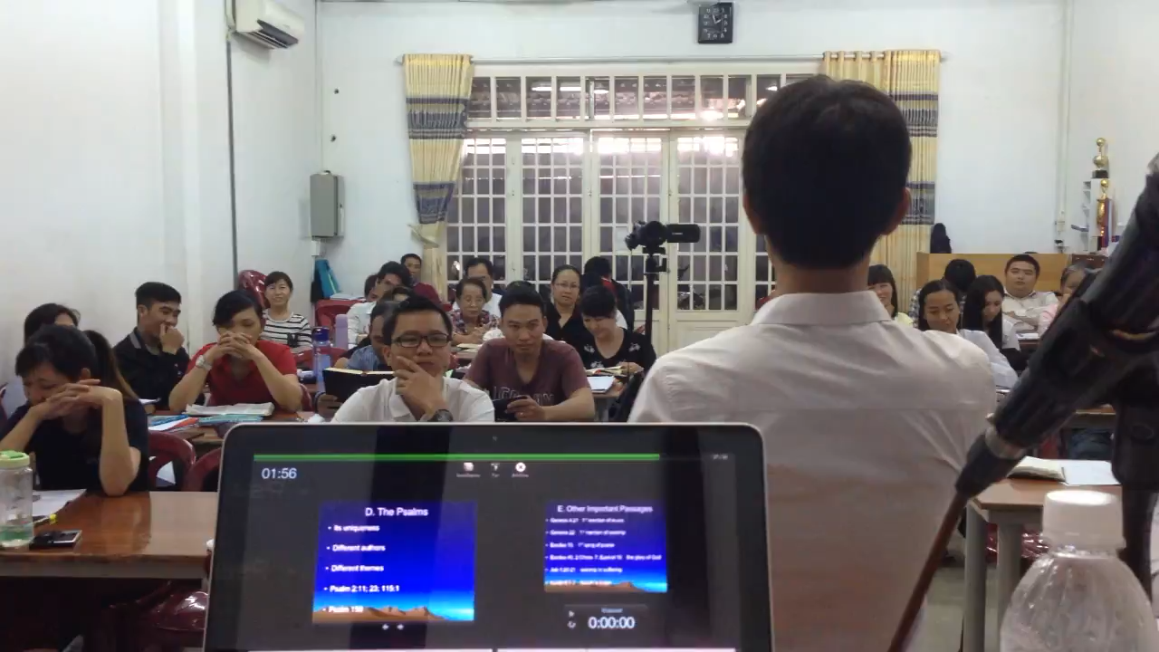

Slide 79
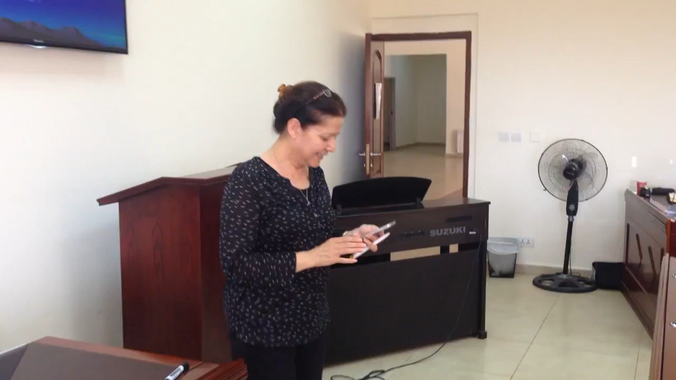

Slide 80
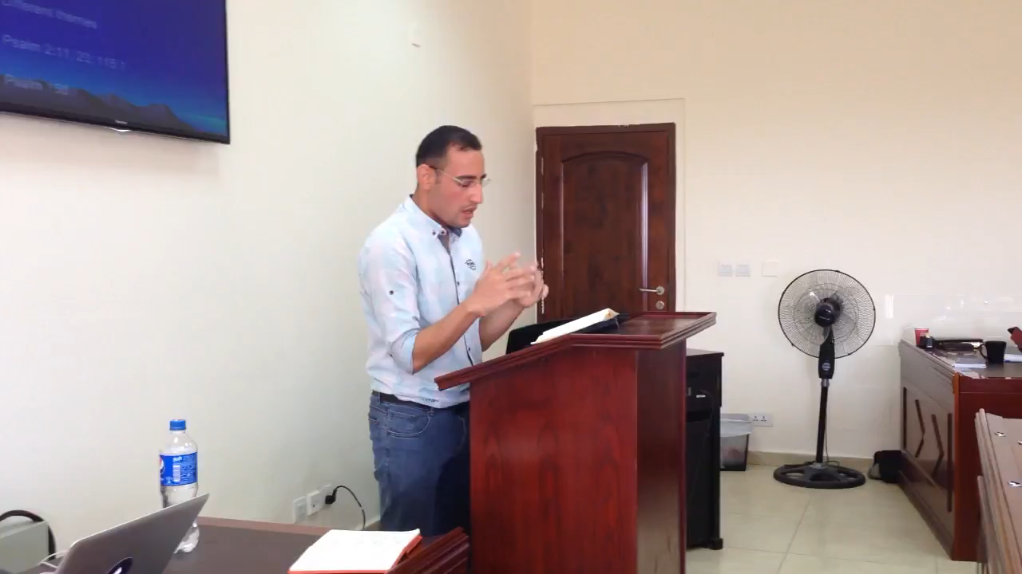

Slide 81
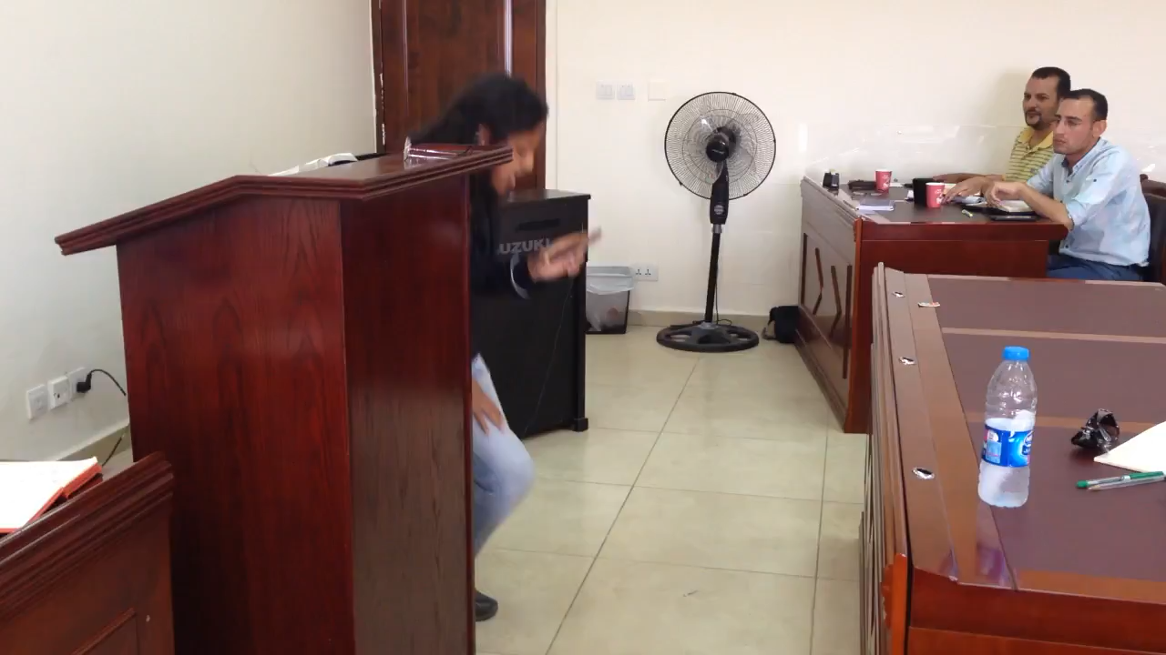

Slide 82
الدعوة للعبادة
مستضيف خدمة العبادة هو الله
نحن لا ندعوه ليكون حاضراً، بل هو من يدعونا
هو يبادر، ونحن نتجاوب
(برايان تشابل)
Notes:
God reveals His glory, worship is our response
Order is important: God always initiates
Rom. 11:33-36 eleven chapters of doctrine, then Paul bursts out in praise: „Oh, the depth of the riches ¹both of the wisdom and knowledge of God!”
Worship services to be a dialogue betw, God and man, a dialogue of revel. & response
This is why the Scriptures are so important; Stott and others remind us how we need much more Scr. In our services– been in many churches where first first of Scr. Is when preacher gets up– means 30 mintues of response w/o anything to respond to!!

Slide 83
عبادتنا هي إجابتنا لله الذي خاطبنا أولاً، إن الإنسان يعبد الله الذي أعلن عن نفسه.
(وليم نيكولز)
لا يوجد لدينا ما نقوله له حتى يتكلم هو
Notes:
God reveals His glory, worship is our response
Order is important: God always initiates
Rom. 11:33-36 eleven chapters of doctrine, then Paul bursts out in praise: „Oh, the depth of the riches ¹both of the wisdom and knowledge of God!”
Worship services to be a dialogue betw, God and man, a dialogue of revel. & response
This is why the Scriptures are so important; Stott and others remind us how we need much more Scr. In our services– been in many churches where first first of Scr. Is when preacher gets up– means 30 mintues of response w/o anything to respond to!!

Slide 84
. أكمل دائرة2
الإعلان والتجاوب
في الدراسة الشخصية والعبادة
في العبادة الجماعية
Notes:
God reveals His glory, worship is our response
Order is important: God always initiates
Rom. 11:33-36 eleven chapters of doctrine, then Paul bursts out in praise: „Oh, the depth of the riches ¹both of the wisdom and knowledge of God!”
Worship services to be a dialogue betw, God and man, a dialogue of revel. & response
This is why the Scriptures are so important; Stott and others remind us how we need much more Scr. In our services– been in many churches where first first of Scr. Is when preacher gets up– means 30 mintues of response w/o anything to respond to!!

Slide 85
التجاوب
التمجيد
الإعلان
اللاهوت
Notes:
worship Him as He really is, as He wants to be worshiped
Order is important: God always initiates
Rom. 11:33-36 eleven chapters of doctrine, then Paul bursts out in praise: „Oh, the depth of the riches ¹both of the wisdom and knowledge of God!”
Worship services to be a dialogue betw, God and man, a dialogue of revel. & response
This is why the Scriptures are so important; Stott and others remind us how we need much more Scr. In our services– been in many churches where first first of Scr. Is when preacher gets up– means 30 mintues of response w/o anything to respond to!!

Slide 86
القصد من
اللاهوت هو التمجيد
نحن ندرس حتى نعبد
(ج. ل. باكر)
Notes:
God reveals His glory, worship is our response
Order is important: God always initiates
Rom. 11:33-36 eleven chapters of doctrine, then Paul bursts out in praise: „Oh, the depth of the riches ¹both of the wisdom and knowledge of God!”
Worship services to be a dialogue betw, God and man, a dialogue of revel. & response
This is why the Scriptures are so important; Stott and others remind us how we need much more Scr. In our services– been in many churches where first first of Scr. Is when preacher gets up– means 30 mintues of response w/o anything to respond to!!

Slide 87
إكمال الدائرة
عناصر التوازن بين الإعلان والتجاوب
الكتاب المقدس كقائد للترنيم
تجاوب مهم بعد الوعظ
اعتبار الخدمة بأكملها عبادة
والخدمة بأكملها كخدمة الكلمة
Notes:
John Armstrong: thank you for ministering the Word . . .

Slide 88
لا وجود للاهوت
دون التمجيد
لا ينبغي أن يكون هناك لاهوت بدون تمجيد، هناك شيء معيب بشكل أساسي في الإهتمام الأكاديمي بالبحت عن الله، لا، إن المعرفة الحقيقية لله ستقودنا دائمًا إلى العبادة كما فعل بولس، مكاننا على وجوهنا أمامه في سجود.
(جون ستوت)
Notes:
God reveals His glory, worship is our response
Order is important: God always initiates
Rom. 11:33-36 eleven chapters of doctrine, then Paul bursts out in praise: „Oh, the depth of the riches ¹both of the wisdom and knowledge of God!”
Worship services to be a dialogue betw, God and man, a dialogue of revel. & response
This is why the Scriptures are so important; Stott and others remind us how we need much more Scr. In our services– been in many churches where first first of Scr. Is when preacher gets up– means 30 mintues of response w/o anything to respond to!!

Slide 89
رومية 1-11
التمجيد
11: 33-36
اللاهوت
التجاوب
الإعلان
Notes:
God reveals His glory, worship is our response
Order is important: God always initiates
Rom. 11:33-36 eleven chapters of doctrine, then Paul bursts out in praise: „Oh, the depth of the riches ¹both of the wisdom and knowledge of God!”
Worship services to be a dialogue betw, God and man, a dialogue of revel. & response
This is why the Scriptures are so important; Stott and others remind us how we need much more Scr. In our services– been in many churches where first first of Scr. Is when preacher gets up– means 30 mintues of response w/o anything to respond to!!

Slide 90
يا لعمق غنى الله وحكمته وعلمه، ما أبعد أحكامه عن الفحص وطرقه عن الإستقصاء.
لأن من عرف فكر الرب؟ أو من صار له مشيراً؟
أو من سبق فأعطاه فيكافأ؟
لأن منه وبه وله كل الأشياء، له المجد إلى الأبد. آمين.
(رومية 11: 33-36)

Slide 91
لا يوجد تمجيد
بدون لاهوت
لا يمكن أن يكون هناك تمجيد بدون لاهوت، كل العبادة الحقيقية هي استجابة لإعلان الله عن نفسه في المسيح والكتاب المقدس، وتنشأ من تفكيرنا فيمن هو وماذا فعل.
(جون ستوت)
Notes:
God reveals His glory, worship is our response
Order is important: God always initiates
Rom. 11:33-36 eleven chapters of doctrine, then Paul bursts out in praise: „Oh, the depth of the riches ¹both of the wisdom and knowledge of God!”
Worship services to be a dialogue betw, God and man, a dialogue of revel. & response
This is why the Scriptures are so important; Stott and others remind us how we need much more Scr. In our services– been in many churches where first first of Scr. Is when preacher gets up– means 30 mintues of response w/o anything to respond to!!

Slide 92
يحتاج الله أن يكون معروفاً قبل أن يكون معبوداً
(إريك ألكسندر)
مزيد من الكلمة
Notes:
God reveals His glory, worship is our response
Order is important: God always initiates
Rom. 11:33-36 eleven chapters of doctrine, then Paul bursts out in praise: „Oh, the depth of the riches ¹both of the wisdom and knowledge of God!”
Worship services to be a dialogue betw, God and man, a dialogue of revel. & response
This is why the Scriptures are so important; Stott and others remind us how we need much more Scr. In our services– been in many churches where first first of Scr. Is when preacher gets up– means 30 mintues of response w/o anything to respond to!!

Slide 93
رومية 12: 1
برأفة الله
الإصحاحات (1-11)
أن تقدموا أجسادكم ذبيحة حية مقدسة
فأطلب إليكم أيها الإخوة
التجاوب
الإعلان
Notes:
God reveals His glory, worship is our response
Order is important: God always initiates
Rom. 11:33-36 eleven chapters of doctrine, then Paul bursts out in praise: „Oh, the depth of the riches ¹both of the wisdom and knowledge of God!”
Worship services to be a dialogue betw, God and man, a dialogue of revel. & response
This is why the Scriptures are so important; Stott and others remind us how we need much more Scr. In our services– been in many churches where first first of Scr. Is when preacher gets up– means 30 mintues of response w/o anything to respond to!!

Slide 94
يوجد عنصرين مرتبطين معاً
في أفضل الترانيم التعبدية
كلمات ذاتية
تعبر عن التجاوب القلبي
إلى الكلمات التي تذكر
الحقيقة الموضوعية
عن الله بوضوح ودقة وطريقة شعرية وقوة.
(بوب كوفلين)
Notes:
John Armstrong: thank you for ministering the Word . . .

Slide 95
يا سيدي لما أرى نجومك
وكل ما يدور في الأفلاك
أسمع صوت الرعد في غيومك
وكلها قد صنعت يداك

Slide 96
نفسي تغني يا مخلصي
ما أعظمك ما أعظمك
نفسي تغني يا مخلصي
ما أعظمك ما أعظمك

Slide 97
وكلما ذكرت كيف ربي
قد بذل ابنه عن الخطاة
بموته أزال كل ذنبي
وردني للسير في رضاه

Slide 98
نفسي تغني يا مخلصي
ما أعظمك ما أعظمك
نفسي تغني يا مخلصي
ما أعظمك ما أعظمك

Slide 99
. العبادة كحوار3
حوار بين الله وشعبه
الإعلان والتجاوب المنظم
Notes:
God reveals His glory, worship is our response
Order is important: God always initiates
Rom. 11:33-36 eleven chapters of doctrine, then Paul bursts out in praise: „Oh, the depth of the riches ¹both of the wisdom and knowledge of God!”
Worship services to be a dialogue betw, God and man, a dialogue of revel. & response
This is why the Scriptures are so important; Stott and others remind us how we need much more Scr. In our services– been in many churches where first first of Scr. Is when preacher gets up– means 30 mintues of response w/o anything to respond to!!

Slide 100
Notes:
God reveals His glory, worship is our response
Order is important: God always initiates
Rom. 11:33-36 eleven chapters of doctrine, then Paul bursts out in praise: „Oh, the depth of the riches ¹both of the wisdom and knowledge of God!”
Worship services to be a dialogue betw, God and man, a dialogue of revel. & response
This is why the Scriptures are so important; Stott and others remind us how we need much more Scr. In our services– been in many churches where first first of Scr. Is when preacher gets up– means 30 mintues of response w/o anything to respond to!!

Slide 101
العبادة كحوار
دعوة للعبادة
قراءة الكتاب المقدس
الوعظ
الترانيم الكتابية
ترانيم عن شخصية وأعمال الله
ترانيم التسبيح، الرثاء ... الخ
الصلاة
الإعتراف
التأمل
عشاء الرب
التكريس
الإعلان
التجاوب
Notes:
God reveals His glory, worship is our response
Order is important: God always initiates
Rom. 11:33-36 eleven chapters of doctrine, then Paul bursts out in praise: „Oh, the depth of the riches ¹both of the wisdom and knowledge of God!”
Worship services to be a dialogue betw, God and man, a dialogue of revel. & response
This is why the Scriptures are so important; Stott and others remind us how we need much more Scr. In our services– been in many churches where first first of Scr. Is when preacher gets up– means 30 mintues of response w/o anything to respond to!!

Slide 102
1. كيف هو التوازن في خدمات كنيستك؟
2. ما هي الطرق التي يمكنك من خلالها تضمين المزيد من الكلمة في خدماتك؟
انطلق
كيف هو التوازن في خدمات كنيستك؟
ما هي الطرق التي يمكنك من خلالها تضمين المزيد من الكلمة في خدماتك؟
Notes:
God reveals His glory, worship is our response
Order is important: God always initiates
Rom. 11:33-36 eleven chapters of doctrine, then Paul bursts out in praise: „Oh, the depth of the riches ¹both of the wisdom and knowledge of God!”
Worship services to be a dialogue betw, God and man, a dialogue of revel. & response
This is why the Scriptures are so important; Stott and others remind us how we need much more Scr. In our services– been in many churches where first first of Scr. Is when preacher gets up– means 30 mintues of response w/o anything to respond to!!

Slide 103
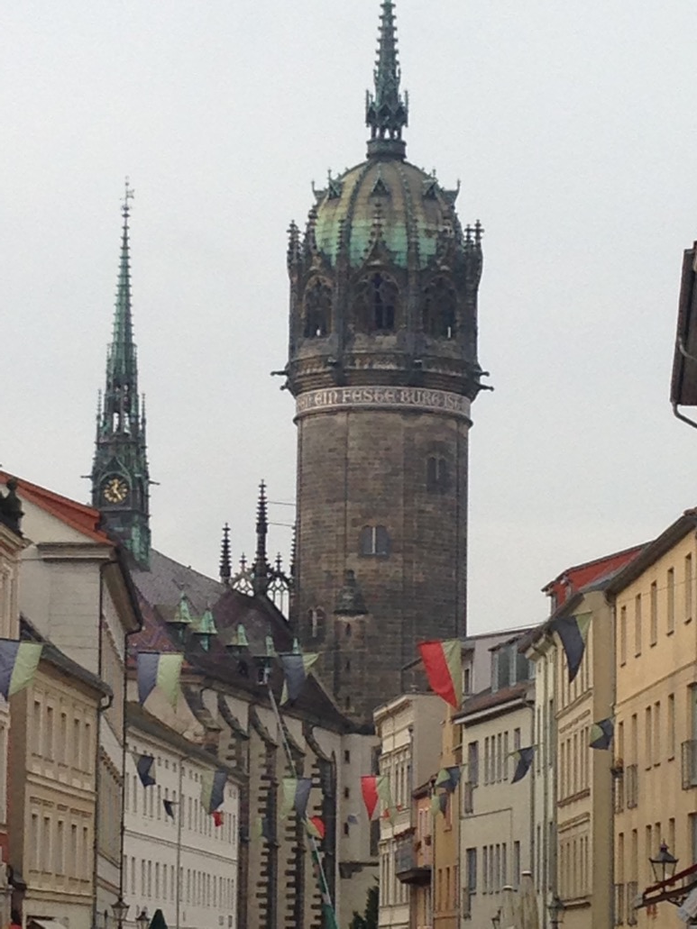

Slide 104
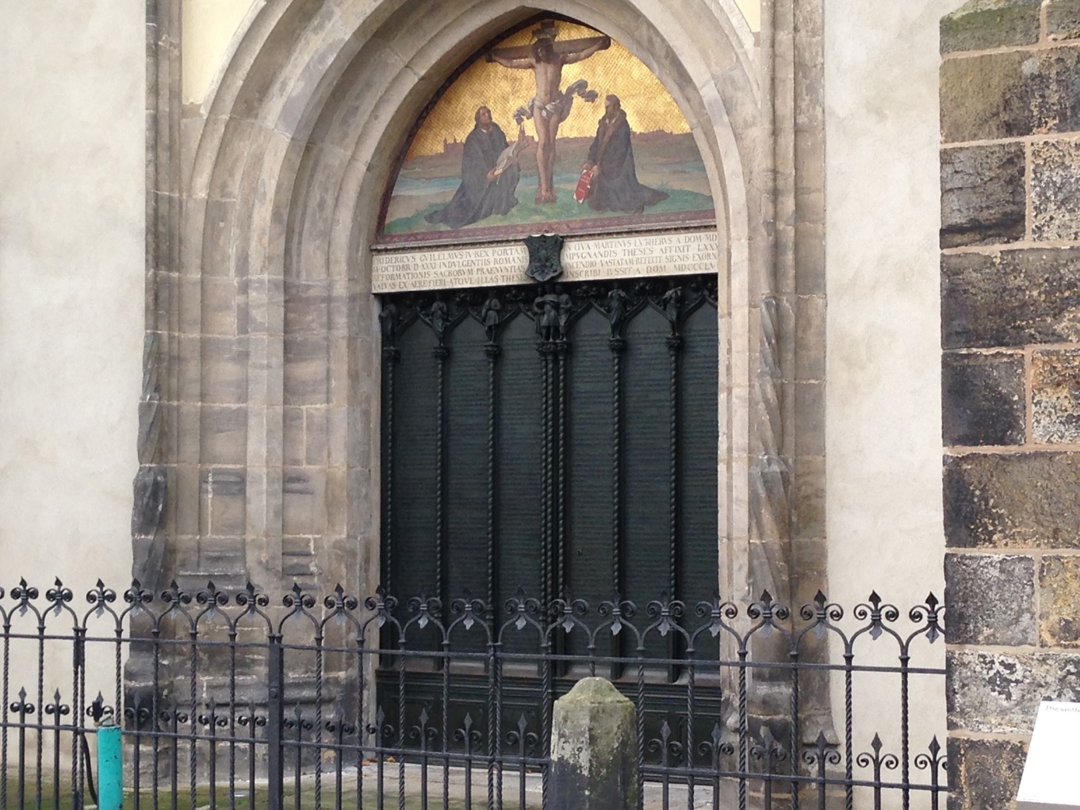

Slide 105
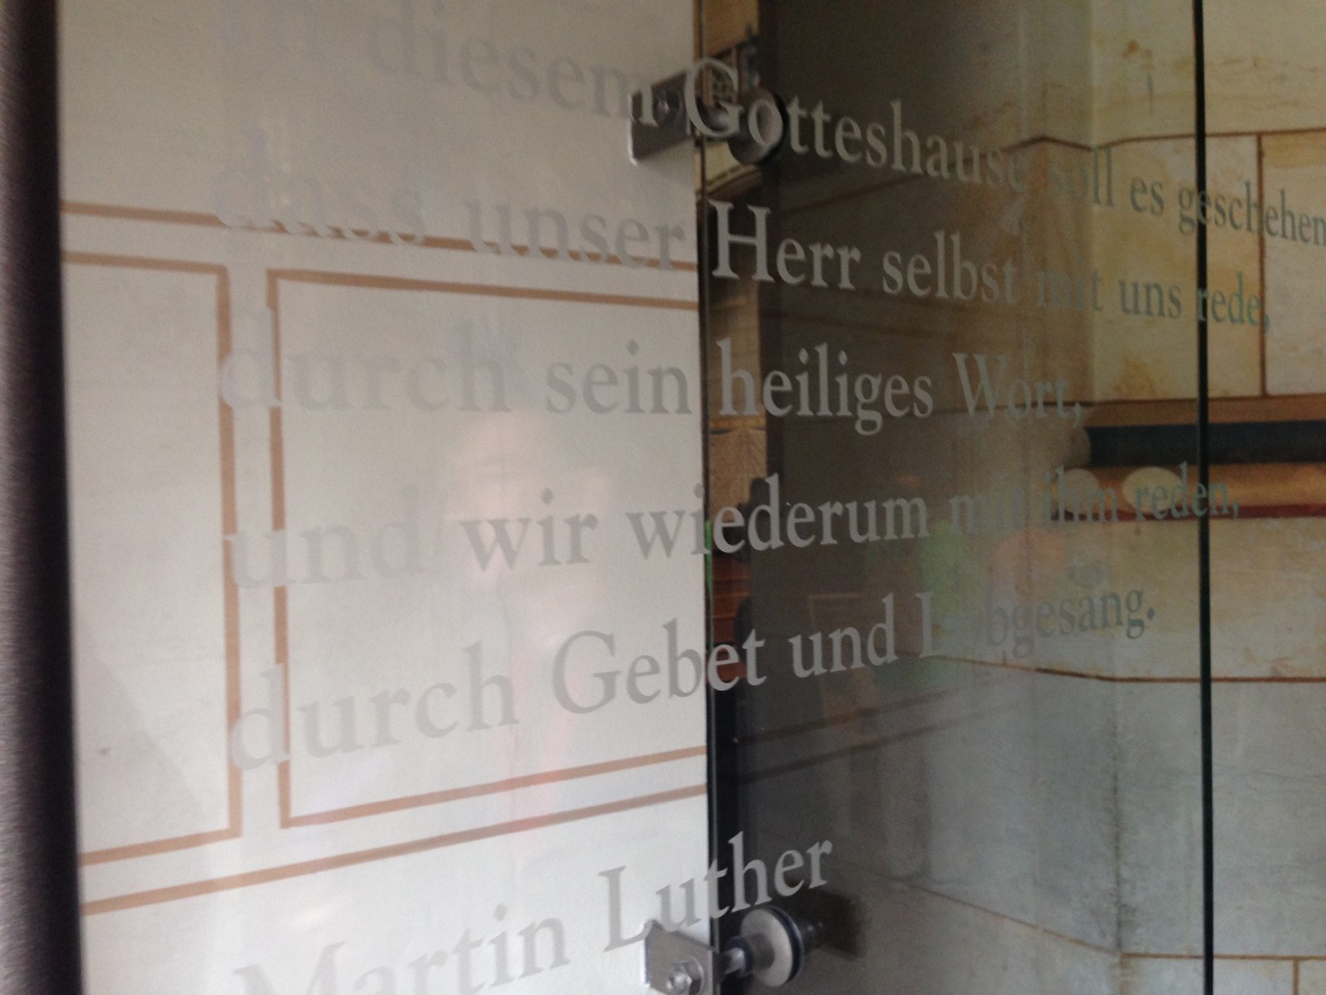
Notes:
“It should always happen in this house of God that the Lord speaks to us through His holy Word, and that we then speak to Him with our prayers and songs of praise.” Luther’s testimony to the Revelation-Response pattern of worship!

Slide 106
يجب أن يحدث هذا دائمًا في بيت الله أن الرب يتحدث إلينا من خلال كلمته المقدسة، ثم نتحدث إليه بصلواتنا وأغاني التسبيح.
Notes:
Luther’s testimony to the Revelation-Response pattern of worship!

Slide 107
لا يوجد تمجيد
بدون لاهوت
لا يوجد لاهوت
بدون تمجيد
Notes:
God reveals His glory, worship is our response
Order is important: God always initiates
Rom. 11:33-36 eleven chapters of doctrine, then Paul bursts out in praise: „Oh, the depth of the riches ¹both of the wisdom and knowledge of God!”
Worship services to be a dialogue betw, God and man, a dialogue of revel. & response
This is why the Scriptures are so important; Stott and others remind us how we need much more Scr. In our services– been in many churches where first first of Scr. Is when preacher gets up– means 30 mintues of response w/o anything to respond to!!

Slide 108
أساس
أساسات العبادة
هي كلمة الله
وعظها
الإيمان بها
قراءتها
ترنيمها
الصلاة بها
تكريمها
العمل بها
Notes:
God reveals His glory, worship is our response
Order is important: God always initiates
Rom. 11:33-36 eleven chapters of doctrine, then Paul bursts out in praise: „Oh, the depth of the riches ¹both of the wisdom and knowledge of God!”
Worship services to be a dialogue betw, God and man, a dialogue of revel. & response
This is why the Scriptures are so important; Stott and others remind us how we need much more Scr. In our services– been in many churches where first first of Scr. Is when preacher gets up– means 30 mintues of response w/o anything to respond to!!

Slide 109
لذلك:
العبادة الكتابية
Notes:
God reveals His glory, worship is our response
Order is important: God always initiates
Rom. 11:33-36 eleven chapters of doctrine, then Paul bursts out in praise: „Oh, the depth of the riches ¹both of the wisdom and knowledge of God!”
Worship services to be a dialogue betw, God and man, a dialogue of revel. & response
This is why the Scriptures are so important; Stott and others remind us how we need much more Scr. In our services– been in many churches where first first of Scr. Is when preacher gets up– means 30 mintues of response w/o anything to respond to!!

Slide 110
الإعلان والتجاوب
نمط العبادة الصحيح
Notes:
God has spoken. And He calls all nations to respond to His gracious invitation and celebration His glorious grace.

Slide 111
Black

Slide 112
• BibleStudyDownloads.org لاهوت العبادة وممارسته
أحصل على هذا العرض التقديمي مجاناً
Notes:
Worship (wo)

