Slide 1
لاهوت العبادة وممارستها

Slide 2
هلم نرنم للرب
نهتف لصخرة خلاصنا.
نتقدم أمامه بحمد
وبترنيمات نهتف له.
لأن الرب إله عظيم
ملك كبير على كل الآلهة.
الذي بيده مقاصير الأرض
وخزائن الجبال له.
الذي له البحر وهو صنعه
ويداه سبكتا اليابسة.

Slide 3
هلم نسجد ونركع
ونجثو أمام الرب خالقنا
لأنه هو إلهنا، ونحن شعب مرعاه
وغنم يده.
(مزمور 95: 1-7)

Slide 4
رون مان

Slide 5
الرجل الحديدي

Slide 6
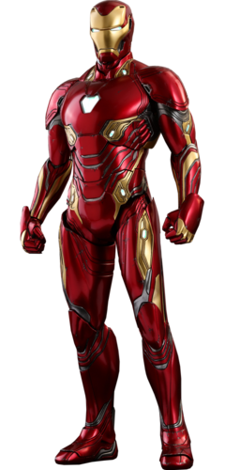
الرجل الحديدي

Slide 7
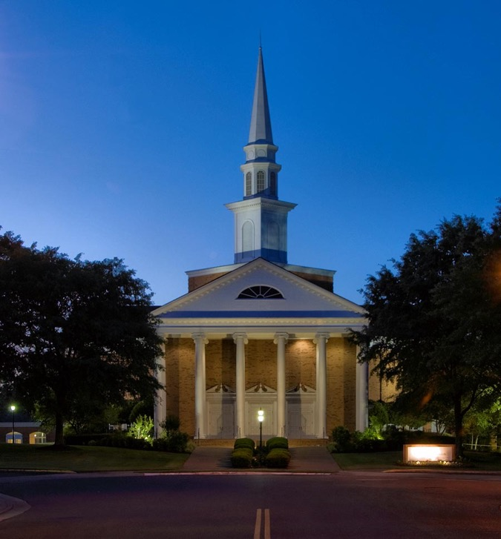
الكنيسة الإنجيلية الأولى
ممفيس، تينيسي

Slide 8
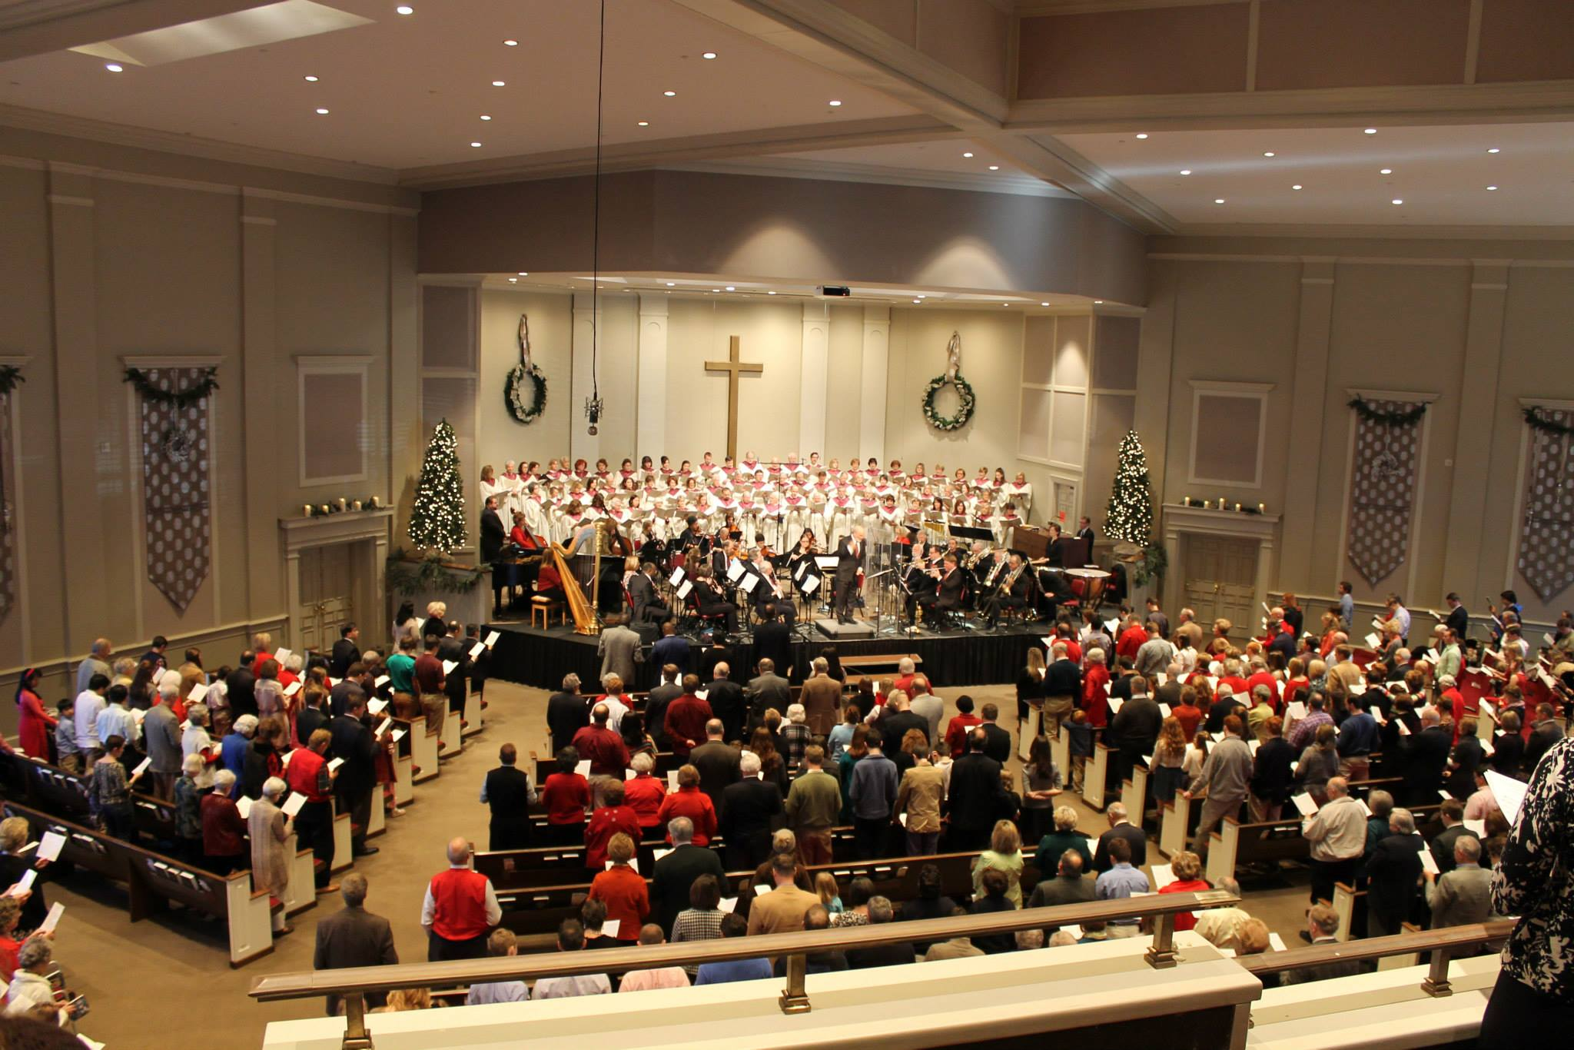
ETERNAL PRAISE
AND THE NATIONS
Revelation 7

Slide 9
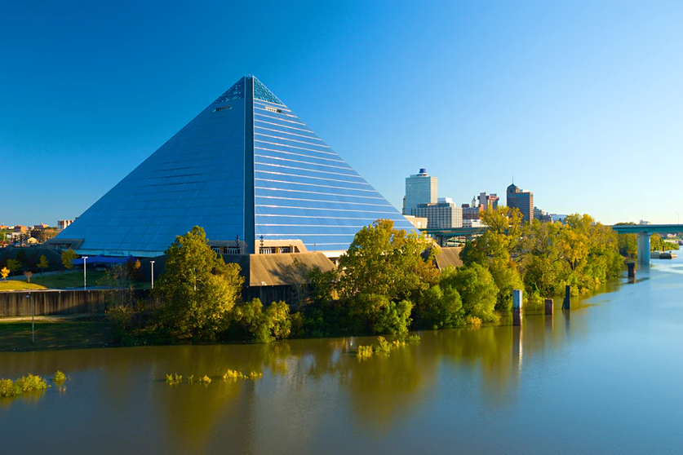

Slide 10
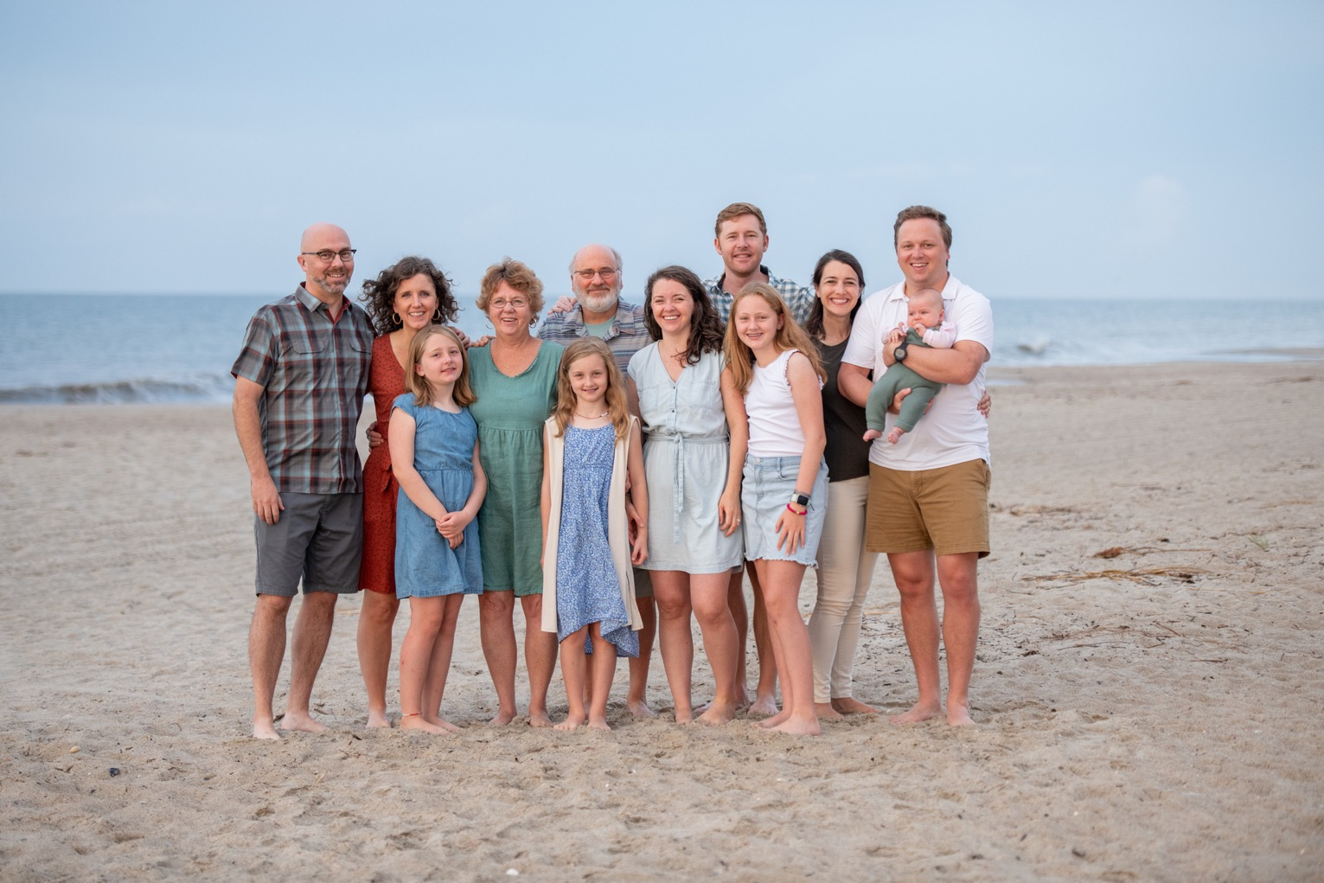

Slide 11
قصصك
قصتي

Slide 12
مخطط المساق
1. الله الذي نعبده.
2. مركزية العبادة
3. االعبادة في العهد القديم
4. العبادة في العهد الجديد
5. العبادة في تاريخ الكنيسة
6. العبادة في الكنيسة

Slide 13
مقدمة، الجزء 1
لاهوت العبادة وممارستها
لاهوت العبادة

Slide 14
نعرف الآن أن العبادة هي الجوهرة المفقودة في الإنجيلية الحديثة.
نحن منظمون؛ نحن نعمل؛ نحن لدينا جدول أعمال.
نحن لدينا كل شيء تقريباً، لكن هناك شيء واحد لا تمتلكه الكنائس حتى كنائس «الإنجيل»
هذا الشيء هو القدرة على العبادة
فنحن لا ننمي فن العبادة فينا
انها الجوهرة البراقة الضائعة في الكنيسة الحديثة
وأعتقد أنه ينبغي علينا أن نبحث عنها حتى نجدها.
(أ. و. توزر، 1961)

Slide 15
منذ ذلك الحين
كتب عن العبادة
مؤتمرات عبادة
ترانيم عبادة
مساقات عبادة
درجات أكاديمية في العبادة
نقاشات واستفتاءات بخصوص العبادة

Slide 16
أخبار جيدة
و
أخبار سيئة

Slide 17
لماذا ندرس لاهوت العبادة؟
ما هو لاهوت .....
ما هو لاهوت العبادة

Slide 18
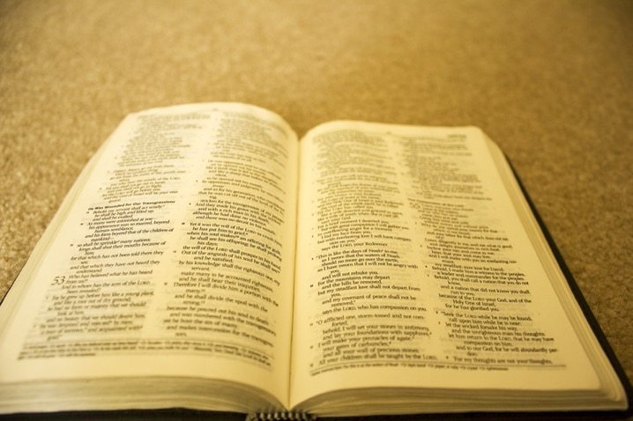
أهمية لاهوت العبادة لاهوت = ( الفهم الكتابي)

Slide 19
أهمية لاهوت العبادة ( الفهم الكتابي للعبادة)
1. تخبرنا كلمة الله من هو الله.
الله هو مدار( موضوع ) عبادتنا
عبادتنا متعلقة فيه .
يجب أن نعبده كما هو حقيقة.ً
Notes:
SUBJECT

Slide 20
أهمية لاهوت العبادة ( الفهم الكتابي للعبادة)
2. تخبرنا كلمة الله ما يريده الله.
الله هو من نوجه عبادتنا له.
العبادة له ولمسرته
يجب أن نعبده كما يريد هو أن يُعبَد
Notes:
SUBJECT

Slide 21
أهمية لاهوت العبادة ( الفهم الكتابي للعبادة)
3. كلمة الله هي مرشدنا
سراج لرجلي كلامك ونور لسبيلي
( مزمور 119: 105)
Notes:
SUBJECT

Slide 22
أهمية لاهوت العبادة ( الفهم الكتابي للعبادة)
4. تخبرنا كلمة الله أن كل حياتنا يجب أن تكون عبادة.
... أن تقدموا أجسادكم ذبيحة حية مقدسة مرضية عند الله عبادتكم العقلية.
( رومية 12: 1)
Notes:
SUBJECT

Slide 23
أهمية لاهوت العبادة ( الفهم الكتابي للعبادة)
5. كلمة الله هي معيارنا الوحيد الذي لا يتغيّر.
إلى الأبد يا رب كلمتك مثبتة في السماوات
( مزمور 119: 89)
Notes:
SUBJECT

Slide 24
أهمية لاهوت العبادة ( الفهم الكتابي للعبادة)
6. فقط كلمة الله تستطيع أن تعطينا فَهماً موحَّداً للعبادة.
ما هي الأمور الجوهريّة؟
ما هي الأمور التي لا تتغير؟
Notes:
SUBJECT

Slide 25
أهمية لاهوت العبادة ( الفهم الكتابي للعبادة)
تخبرنا كلمة الله من هو الله.
تخبرنا كلمة الله ما الذي يريده الله.
كلمة الله هي مرشدنا ( دليلنا).
تخبرنا كلمة الله أن كل الحياة يجب أن تكون عبادة.
كلمة الله هي معيارنا الوحيد اللامتغير.
تعطينا كلمة الله فقط فهماً موحداً للعبادة.
ناقش في مجموعات
1. كيف تتفاعل مع النقاط السابقة؟
هل يمكنك التفكير في أسباب إضافية لأهمية لاهوت العبادة؟
كيف يمكن للاهوت العبادة أن يرتبط بجوانب أخرى من اللاهوت ؟

Slide 26
أهمية العبادة للاهوت
1. اللاهوت/ الدراسات الكتابيّة هي وسيلة لأجل غاية.
هدف اللاهوت هو التّمجيد، نحن ندرس لكي نُسَبّح
(ج. ل. باكر)
Notes:
SUBJECT

Slide 27
أهمية العبادة لللاهوت
2. شددت معظم الكنائس البروتستانتية على العقيدة أكثر منها على العبادة.
Notes:
SUBJECT

Slide 28
سوف نتحدّث عن
الأسس الكتابية للعبادة؛ لن نركز كثيراً على شكل أو أسلوب العبادة.
المبادئ الكتابية للعبادة والتي يمكن تطبيقها في أي ثقافة.
مركزية العبادة في كل الحياة والخدمة وليس فقط في صباح الأحد.
Notes:
SUBJECT

Slide 29
دليل المساق

Slide 30
Black

Slide 31
• BibleStudyDownloads.org لاهوت العبادة وممارستها
أحصل على هذا العرض التقديمي مجاناً
Notes:
Worship (wo)

Slide 32
المقدمة، الجزء الثاني
لاهوت وممارسة العبادة
.
الإعلان
و
التجاوب

Slide 33
الإعلان
والتجاوب
نمط العبادة الصحيحة
Notes:
God reveals His glory, worship is our response
Order is important: God always initiates
Rom. 11:33-36 eleven chapters of doctrine, then Paul bursts out in praise: „Oh, the depth of the riches ¹both of the wisdom and knowledge of God!”
Worship services to be a dialogue betw, God and man, a dialogue of revel. & response
This is why the Scriptures are so important; Stott and others remind us how we need much more Scr. In our services– been in many churches where first first of Scr. Is when preacher gets up– means 30 mintues of response w/o anything to respond to!!

Slide 34
الإعلان
التجاوب
Notes:
Basic paradigm for God’s dealings with us

Slide 35
لك
التجاوب
الإعلان
Notes:
Basic paradigm for God’s dealings with us

Slide 36
ترتيب حاسم
Notes:
God reveals His glory, worship is our response
Order is important: God always initiates
Rom. 11:33-36 eleven chapters of doctrine, then Paul bursts out in praise: „Oh, the depth of the riches ¹both of the wisdom and knowledge of God!”
Worship services to be a dialogue betw, God and man, a dialogue of revel. & response
This is why the Scriptures are so important; Stott and others remind us how we need much more Scr. In our services– been in many churches where first first of Scr. Is when preacher gets up– means 30 mintues of response w/o anything to respond to!!

Slide 37
الله بعد ما كلم الآباء بالأنبياء قديماً بأنواع وطرق كثيرة، كلمنا في هذه الأيام الأخيرة في ابنه.
(عبرانيين 1: 1-2)
Notes:
God reveals His glory, worship is our response
Order is important: God always initiates
Rom. 11:33-36 eleven chapters of doctrine, then Paul bursts out in praise: „Oh, the depth of the riches ¹both of the wisdom and knowledge of God!”
Worship services to be a dialogue betw, God and man, a dialogue of revel. & response
This is why the Scriptures are so important; Stott and others remind us how we need much more Scr. In our services– been in many churches where first first of Scr. Is when preacher gets up– means 30 mintues of response w/o anything to respond to!!

Slide 38
عبادتنا هي إجابتنا لله الذي خاطبنا أولاً ... يعبد الإنسان الله الذي أعلن عن نفسه ... كل عبادتنا ما هي إلا استجابتنا نحو الله الذي قدم نفسه في الإعلان والفداء
(وليام نيكولز، سلم يعقوب: معنى العبادة، 37، 53)
Notes:
God reveals His glory, worship is our response
Order is important: God always initiates
Rom. 11:33-36 eleven chapters of doctrine, then Paul bursts out in praise: „Oh, the depth of the riches ¹both of the wisdom and knowledge of God!”
Worship services to be a dialogue betw, God and man, a dialogue of revel. & response
This is why the Scriptures are so important; Stott and others remind us how we need much more Scr. In our services– been in many churches where first first of Scr. Is when preacher gets up– means 30 mintues of response w/o anything to respond to!!

Slide 39
الدين / البيلاجية
مبادرة الإنسان
Notes:
God reveals His glory, worship is our response
Order is important: God always initiates
Rom. 11:33-36 eleven chapters of doctrine, then Paul bursts out in praise: „Oh, the depth of the riches ¹both of the wisdom and knowledge of God!”
Worship services to be a dialogue betw, God and man, a dialogue of revel. & response
This is why the Scriptures are so important; Stott and others remind us how we need much more Scr. In our services– been in many churches where first first of Scr. Is when preacher gets up– means 30 mintues of response w/o anything to respond to!!

Slide 40
المسيحية / الأوغسطينية
مبادرة الله
Notes:
God reveals His glory, worship is our response
Order is important: God always initiates
Rom. 11:33-36 eleven chapters of doctrine, then Paul bursts out in praise: „Oh, the depth of the riches ¹both of the wisdom and knowledge of God!”
Worship services to be a dialogue betw, God and man, a dialogue of revel. & response
This is why the Scriptures are so important; Stott and others remind us how we need much more Scr. In our services– been in many churches where first first of Scr. Is when preacher gets up– means 30 mintues of response w/o anything to respond to!!

Slide 41
1 يوحنا 4: 19
نحن نحب ...
لأنه أحبنا أولاً
Notes:
God reveals His glory, worship is our response
Order is important: God always initiates
Rom. 11:33-36 eleven chapters of doctrine, then Paul bursts out in praise: „Oh, the depth of the riches ¹both of the wisdom and knowledge of God!”
Worship services to be a dialogue betw, God and man, a dialogue of revel. & response
This is why the Scriptures are so important; Stott and others remind us how we need much more Scr. In our services– been in many churches where first first of Scr. Is when preacher gets up– means 30 mintues of response w/o anything to respond to!!

Slide 42
نمط كتابي
Notes:
God reveals His glory, worship is our response
Order is important: God always initiates
Rom. 11:33-36 eleven chapters of doctrine, then Paul bursts out in praise: „Oh, the depth of the riches ¹both of the wisdom and knowledge of God!”
Worship services to be a dialogue betw, God and man, a dialogue of revel. & response
This is why the Scriptures are so important; Stott and others remind us how we need much more Scr. In our services– been in many churches where first first of Scr. Is when preacher gets up– means 30 mintues of response w/o anything to respond to!!

Slide 43
أمثلة في الكتاب المقدس
آدم وحواء
إبراهيم
آخرون؟
الإعلان
التجاوب
Notes:
Adam & Eve, Moses, David, Saul/Paul, Jesus calling disciples,
Order is important: God always initiates
Rom. 11:33-36 eleven chapters of doctrine, then Paul bursts out in praise: „Oh, the depth of the riches ¹both of the wisdom and knowledge of God!”
Worship services to be a dialogue betw, God and man, a dialogue of revel. & response
This is why the Scriptures are so important; Stott and others remind us how we need much more Scr. In our services– been in many churches where first first of Scr. Is when preacher gets up– means 30 mintues of response w/o anything to respond to!!

Slide 44
النمط الكتابي للفداء
Notes:
God reveals His glory, worship is our response
Order is important: God always initiates
Rom. 11:33-36 eleven chapters of doctrine, then Paul bursts out in praise: „Oh, the depth of the riches ¹both of the wisdom and knowledge of God!”
Worship services to be a dialogue betw, God and man, a dialogue of revel. & response
This is why the Scriptures are so important; Stott and others remind us how we need much more Scr. In our services– been in many churches where first first of Scr. Is when preacher gets up– means 30 mintues of response w/o anything to respond to!!

Slide 45
العهد القديم
آمن إبراهيم بالرب فحسب له براً
(تكوين 15: 6)
وعود الله لإبراهيم
الإعلان
التجاوب
Notes:
God reveals His glory, worship is our response
Order is important: God always initiates
Rom. 11:33-36 eleven chapters of doctrine, then Paul bursts out in praise: „Oh, the depth of the riches ¹both of the wisdom and knowledge of God!”
Worship services to be a dialogue betw, God and man, a dialogue of revel. & response
This is why the Scriptures are so important; Stott and others remind us how we need much more Scr. In our services– been in many churches where first first of Scr. Is when preacher gets up– means 30 mintues of response w/o anything to respond to!!

Slide 46
العهد القديم
الفداء من مصر
نظام الذبائح
الفداء
التجاوب
Notes:
God reveals His glory, worship is our response
Order is important: God always initiates
Rom. 11:33-36 eleven chapters of doctrine, then Paul bursts out in praise: „Oh, the depth of the riches ¹both of the wisdom and knowledge of God!”
Worship services to be a dialogue betw, God and man, a dialogue of revel. & response
This is why the Scriptures are so important; Stott and others remind us how we need much more Scr. In our services– been in many churches where first first of Scr. Is when preacher gets up– means 30 mintues of response w/o anything to respond to!!

Slide 47
الناموس
أنا الرب إلهك الذي أخرجك من أرض مصر من بيت العبودية.
(خروج 20: 2)
لا يكن لك آلهة أخرى أمامي ... الخ
(خروج 20: 3-17)
الفداء
التجاوب
Notes:
God reveals His glory, worship is our response
Order is important: God always initiates
Rom. 11:33-36 eleven chapters of doctrine, then Paul bursts out in praise: „Oh, the depth of the riches ¹both of the wisdom and knowledge of God!”
Worship services to be a dialogue betw, God and man, a dialogue of revel. & response
This is why the Scriptures are so important; Stott and others remind us how we need much more Scr. In our services– been in many churches where first first of Scr. Is when preacher gets up– means 30 mintues of response w/o anything to respond to!!

Slide 48
لم تكن الوصايا سلماً للوصول إلى الله، لكنها أظهرت كيف يجب أن يعيش شعب مفدي كشعب الله.
(أودري ناش، قصة العهد القديم: رؤية العهد القديم ككل، ٣١)
Notes:
worship Him as He really is, as He wants to be worshiped
Order is important: God always initiates
Rom. 11:33-36 eleven chapters of doctrine, then Paul bursts out in praise: „Oh, the depth of the riches ¹both of the wisdom and knowledge of God!”
Worship services to be a dialogue betw, God and man, a dialogue of revel. & response
This is why the Scriptures are so important; Stott and others remind us how we need much more Scr. In our services– been in many churches where first first of Scr. Is when preacher gets up– means 30 mintues of response w/o anything to respond to!!

Slide 49
دائماً ما تسبق مؤشرات النعمة أوامر الناموس.
(جيمس تورانس)
الله: لقد فعلت ذلك من أجلك، والآن افعل هذا
Notes:
worship Him as He really is, as He wants to be worshiped
Order is important: God always initiates
Rom. 11:33-36 eleven chapters of doctrine, then Paul bursts out in praise: „Oh, the depth of the riches ¹both of the wisdom and knowledge of God!”
Worship services to be a dialogue betw, God and man, a dialogue of revel. & response
This is why the Scriptures are so important; Stott and others remind us how we need much more Scr. In our services– been in many churches where first first of Scr. Is when preacher gets up– means 30 mintues of response w/o anything to respond to!!

Slide 50
العهد الجديد
الخلاص بالنعمة بالإيمان
(أف 2: 8-9)
التجاوب بالأعمال
(أف 2: 10، 1 كو 6: 20
الفداء
التجاوب
Notes:
God reveals His glory, worship is our response
Order is important: God always initiates
Rom. 11:33-36 eleven chapters of doctrine, then Paul bursts out in praise: „Oh, the depth of the riches ¹both of the wisdom and knowledge of God!”
Worship services to be a dialogue betw, God and man, a dialogue of revel. & response
This is why the Scriptures are so important; Stott and others remind us how we need much more Scr. In our services– been in many churches where first first of Scr. Is when preacher gets up– means 30 mintues of response w/o anything to respond to!!

Slide 51
النمط الكتابي للعبادة
Notes:
God reveals His glory, worship is our response
Order is important: God always initiates
Rom. 11:33-36 eleven chapters of doctrine, then Paul bursts out in praise: „Oh, the depth of the riches ¹both of the wisdom and knowledge of God!”
Worship services to be a dialogue betw, God and man, a dialogue of revel. & response
This is why the Scriptures are so important; Stott and others remind us how we need much more Scr. In our services– been in many churches where first first of Scr. Is when preacher gets up– means 30 mintues of response w/o anything to respond to!!

Slide 52
يحتاج الله أن يكون معروفاً قبل أن يكون معبوداً
(إريك ألكسندر)
Notes:
God reveals His glory, worship is our response
Order is important: God always initiates
Rom. 11:33-36 eleven chapters of doctrine, then Paul bursts out in praise: „Oh, the depth of the riches ¹both of the wisdom and knowledge of God!”
Worship services to be a dialogue betw, God and man, a dialogue of revel. & response
This is why the Scriptures are so important; Stott and others remind us how we need much more Scr. In our services– been in many churches where first first of Scr. Is when preacher gets up– means 30 mintues of response w/o anything to respond to!!

Slide 53
النمط الأساسي للعبادة الكتابية .... هي أن الله هو من يبادر للمقابلة، وليس العابد.
(روبي كاسلمان، العبادة على شكل قصة، ٣٧)
Notes:
God reveals His glory, worship is our response
Order is important: God always initiates
Rom. 11:33-36 eleven chapters of doctrine, then Paul bursts out in praise: „Oh, the depth of the riches ¹both of the wisdom and knowledge of God!”
Worship services to be a dialogue betw, God and man, a dialogue of revel. & response
This is why the Scriptures are so important; Stott and others remind us how we need much more Scr. In our services– been in many churches where first first of Scr. Is when preacher gets up– means 30 mintues of response w/o anything to respond to!!

Slide 54
إن العبادة المقبولة لا تبدأ بحدس الإنسان أو اختراعه، بل بعمل الله.
(ديفيد باترسون، الإرتباط بالله، 26
Notes:
God reveals His glory, worship is our response
Order is important: God always initiates
Rom. 11:33-36 eleven chapters of doctrine, then Paul bursts out in praise: „Oh, the depth of the riches ¹both of the wisdom and knowledge of God!”
Worship services to be a dialogue betw, God and man, a dialogue of revel. & response
This is why the Scriptures are so important; Stott and others remind us how we need much more Scr. In our services– been in many churches where first first of Scr. Is when preacher gets up– means 30 mintues of response w/o anything to respond to!!

Slide 55
السقوط
رومية 1
لأن أموره غير المنظورة ترى منذ خلق العالم مدركة بالمصنوعات، قدرته السرمدية ولاهوته، (ع 20)
لأنهم لما عرفوا الله لم يمجدوه أو يشكروه كإله (ع 21)
الذين عبدوا المخلوق دون الخالق.
(ع 25)
الإعلان
التجاوب
Notes:
God reveals His glory, worship is our response
Order is important: God always initiates
Rom. 11:33-36 eleven chapters of doctrine, then Paul bursts out in praise: „Oh, the depth of the riches ¹both of the wisdom and knowledge of God!”
Worship services to be a dialogue betw, God and man, a dialogue of revel. & response
This is why the Scriptures are so important; Stott and others remind us how we need much more Scr. In our services– been in many churches where first first of Scr. Is when preacher gets up– means 30 mintues of response w/o anything to respond to!!

Slide 56
المذابح الكنعانية
بنيت بهدف:
الإستحضار
الإسترضاء
التهدئة
ترجو:
الرحمة البركة
Notes:
God reveals His glory, worship is our response
Order is important: God always initiates
Rom. 11:33-36 eleven chapters of doctrine, then Paul bursts out in praise: „Oh, the depth of the riches ¹both of the wisdom and knowledge of God!”
Worship services to be a dialogue betw, God and man, a dialogue of revel. & response
This is why the Scriptures are so important; Stott and others remind us how we need much more Scr. In our services– been in many churches where first first of Scr. Is when preacher gets up– means 30 mintues of response w/o anything to respond to!!

Slide 57
المذابح في سفر التكوين
(روبي كسلمان، 37)
تكلم الله أعلن عن نفسه
نوح (8: 20)
أبرام (12: 7-8، 13: 3-4، 13: 18، 22-9)
إسحق (26: 25)
يعقوب (28: 18، 33: 20، 35: 7)
الإعلان
التجاوب
Notes:
God reveals His glory, worship is our response
Order is important: God always initiates
Rom. 11:33-36 eleven chapters of doctrine, then Paul bursts out in praise: „Oh, the depth of the riches ¹both of the wisdom and knowledge of God!”
Worship services to be a dialogue betw, God and man, a dialogue of revel. & response
This is why the Scriptures are so important; Stott and others remind us how we need much more Scr. In our services– been in many churches where first first of Scr. Is when preacher gets up– means 30 mintues of response w/o anything to respond to!!

Slide 58
إبراهيم
الوعود العهدية
أسماء الله
الظهورات
يبني المذابح
يدعو باسم الرب
الإعلان
التجاوب
Notes:
God reveals His glory, worship is our response
Order is important: God always initiates
Rom. 11:33-36 eleven chapters of doctrine, then Paul bursts out in praise: „Oh, the depth of the riches ¹both of the wisdom and knowledge of God!”
Worship services to be a dialogue betw, God and man, a dialogue of revel. & response
This is why the Scriptures are so important; Stott and others remind us how we need much more Scr. In our services– been in many churches where first first of Scr. Is when preacher gets up– means 30 mintues of response w/o anything to respond to!!

Slide 59
الناموس الموسوي
فتحب الرب إلهك من كل قلبك ومن كل نفسك ومن كل قوتك.
(تث 6: 5)
اسمع يا إسرائيل الرب إلهنا رب واحد
(تث 6: 4)
الإعلان
التجاوب
Notes:
God reveals His glory, worship is our response
Order is important: God always initiates
Rom. 11:33-36 eleven chapters of doctrine, then Paul bursts out in praise: „Oh, the depth of the riches ¹both of the wisdom and knowledge of God!”
Worship services to be a dialogue betw, God and man, a dialogue of revel. & response
This is why the Scriptures are so important; Stott and others remind us how we need much more Scr. In our services– been in many churches where first first of Scr. Is when preacher gets up– means 30 mintues of response w/o anything to respond to!!

Slide 60
المزامير
تسبيحك إلى أقاصي الأرض نظير اسمك يا الله 48: 10
وحميد جداً لأن الرب عظيم 96: 4
سبحوه على قواته 150: 2
الإعلان
التجاوب
Notes:
God reveals His glory, worship is our response
Order is important: God always initiates
Rom. 11:33-36 eleven chapters of doctrine, then Paul bursts out in praise: „Oh, the depth of the riches ¹both of the wisdom and knowledge of God!”
Worship services to be a dialogue betw, God and man, a dialogue of revel. & response
This is why the Scriptures are so important; Stott and others remind us how we need much more Scr. In our services– been in many churches where first first of Scr. Is when preacher gets up– means 30 mintues of response w/o anything to respond to!!

Slide 61
رومية 12: 1
فأطلب إليكم أيها الإخوة
برأفة الله
الإصحاحات (1-11)
أن تقدموا أجسادكم ذبيحة حية مقدسة
الإعلان
التجاوب
Notes:
God reveals His glory, worship is our response
Order is important: God always initiates
Rom. 11:33-36 eleven chapters of doctrine, then Paul bursts out in praise: „Oh, the depth of the riches ¹both of the wisdom and knowledge of God!”
Worship services to be a dialogue betw, God and man, a dialogue of revel. & response
This is why the Scriptures are so important; Stott and others remind us how we need much more Scr. In our services– been in many churches where first first of Scr. Is when preacher gets up– means 30 mintues of response w/o anything to respond to!!

Slide 62
2 كورنثوس 1: 20
لأن مهما كانت مواعيد الله فهو فيه النعم
وفيه الآمين لمجد الله بواسطتنا.
الإعلان
التجاوب
Notes:
God reveals His glory, worship is our response
Order is important: God always initiates
Rom. 11:33-36 eleven chapters of doctrine, then Paul bursts out in praise: „Oh, the depth of the riches ¹both of the wisdom and knowledge of God!”
Worship services to be a dialogue betw, God and man, a dialogue of revel. & response
This is why the Scriptures are so important; Stott and others remind us how we need much more Scr. In our services– been in many churches where first first of Scr. Is when preacher gets up– means 30 mintues of response w/o anything to respond to!!

Slide 63
عبرانيين 2: 12
وفي وسط الكنيسة أسبحك
أخبر باسمك إخوتي
الإعلان
التجاوب
Notes:
God reveals His glory, worship is our response
Order is important: God always initiates
Rom. 11:33-36 eleven chapters of doctrine, then Paul bursts out in praise: „Oh, the depth of the riches ¹both of the wisdom and knowledge of God!”
Worship services to be a dialogue betw, God and man, a dialogue of revel. & response
This is why the Scriptures are so important; Stott and others remind us how we need much more Scr. In our services– been in many churches where first first of Scr. Is when preacher gets up– means 30 mintues of response w/o anything to respond to!!

Slide 64
عبرانيين 10: 19-22
لذلك أيها الإخوة
ثقة بالدخول إلى الأقداس بدم يسوع
إذ لنا كاهن عظيم على بيت الله
لنتقدم بثقة
الإعلان
التجاوب
Notes:
God reveals His glory, worship is our response
Order is important: God always initiates
Rom. 11:33-36 eleven chapters of doctrine, then Paul bursts out in praise: „Oh, the depth of the riches ¹both of the wisdom and knowledge of God!”
Worship services to be a dialogue betw, God and man, a dialogue of revel. & response
This is why the Scriptures are so important; Stott and others remind us how we need much more Scr. In our services– been in many churches where first first of Scr. Is when preacher gets up– means 30 mintues of response w/o anything to respond to!!

Slide 65
النمط الكتابي
للعبادة
الإعلان
التجاوب
Notes:
worship Him as He really is, as He wants to be worshiped
Order is important: God always initiates
Rom. 11:33-36 eleven chapters of doctrine, then Paul bursts out in praise: „Oh, the depth of the riches ¹both of the wisdom and knowledge of God!”
Worship services to be a dialogue betw, God and man, a dialogue of revel. & response
This is why the Scriptures are so important; Stott and others remind us how we need much more Scr. In our services– been in many churches where first first of Scr. Is when preacher gets up– means 30 mintues of response w/o anything to respond to!!

Slide 66
الآثار العملية للعبادة الجماعية
Notes:
God reveals His glory, worship is our response
Order is important: God always initiates
Rom. 11:33-36 eleven chapters of doctrine, then Paul bursts out in praise: „Oh, the depth of the riches ¹both of the wisdom and knowledge of God!”
Worship services to be a dialogue betw, God and man, a dialogue of revel. & response
This is why the Scriptures are so important; Stott and others remind us how we need much more Scr. In our services– been in many churches where first first of Scr. Is when preacher gets up– means 30 mintues of response w/o anything to respond to!!

Slide 67
1. الكلمة في العبادة
يجب علينا أن ندرك المكانة التي لا غنى عنها للكتاب المقدس، في كل من العبادة العامة والخاصة، إنها كلمة الله التي تدعو إلى عبادة الله.
(جون ستوت)
مزيد من الكلمة
Notes:
– been in many churches where first first of Scr. Is when preacher gets up– means 30 minutes of response w/o anything to respond to!!
This is why the Scriptures are so important; Stott and others remind us how we need much more Scr. In our services– been in many churches where first first of Scr. Is when preacher gets up– means 30 mintues of response w/o anything to respond to!!

Slide 68
في كل مهمة من مهام الكنيسة، تعتبر خدمة كلمة الله أمراً مركزياً، إنها الكلمة التي تدعونا إلى العبادة، وتخاطبنا في العبادة، وتعلمنا كيف نعبد، وتمكننا من تسبيح الله وتشجيع بعضنا البعض. في إرسالية الكنيسة، كلمة الله هي التي تدعو الأمم إلى الرب: ففي تعليم الكلمة نصنع تلاميذ من الأمم.
(إدموند ب. كلاوني، الكنيسة، 199)

Slide 69
المشكلة
لماذا كثيرون ممن يدعون أنهم ورثة الإصلاح، أو على الأقل الذين يطلقون على أنفسهم المؤمنين بالكتاب المقدس، لا يملكون إلا القليل من الكتاب المقدس في خدمات عبادتهم العامة؟
(دوغلاس سميث)

Slide 70
ماذا يوجد على المحك؟
عندما يكون دور الكتاب المقدس في العبادة ضئيلاً، وعندما يُستخدم الكتاب المقدس فقط لإطلاق عظة، فإن ما يتم توصيله هو أن الكتاب المقدس هامشي في الحياة المسيحية أيضاً. إن استخدامنا للكتاب المقدس أو فشلنا في استخدامه في عبادتنا يقول الكثير عن التلمذة المسيحية أكثر مما قد ندرك.
(جيمس ف. وايت)

Slide 71
التفويض الكتابي
اعكف على القراءة
(1 تيموثاوس 4: 13)
لتسكن فيكم كلمة المسيح بغنى
(كولوسي 3: 16)

Slide 72
عبادتنا هي إجابتنا لله الذي خاطبنا أولاً، إن الإنسان يعبد الله الذي أعلن عن نفسه.
(وليم نيكولز)
لا يوجد لدينا ما نقوله له حتى يتكلم هو
Notes:
God reveals His glory, worship is our response
Order is important: God always initiates
Rom. 11:33-36 eleven chapters of doctrine, then Paul bursts out in praise: „Oh, the depth of the riches ¹both of the wisdom and knowledge of God!”
Worship services to be a dialogue betw, God and man, a dialogue of revel. & response
This is why the Scriptures are so important; Stott and others remind us how we need much more Scr. In our services– been in many churches where first first of Scr. Is when preacher gets up– means 30 mintues of response w/o anything to respond to!!

Slide 73
المزيد من الكلمة
التقييم الكتابي للترانيم.
اختيار الترانيم التي تتماشى مع النص الكتابي، وليس النص الكتابي الذي يتماشى مع الترانيم.
اقرأ، غنِّ، رتل، صلِّ، احفظ، افعل الكتاب المقدس
Notes:
– been in many churches where first first of Scr. Is when preacher gets up– means 30 minutes of response w/o anything to respond to!!
This is why the Scriptures are so important; Stott and others remind us how we need much more Scr. In our services– been in many churches where first first of Scr. Is when preacher gets up– means 30 mintues of response w/o anything to respond to!!

Slide 74
اقرأ الكتاب المقدس
اطبعه على ورقة، اعرضه على الشاشة.
اقرأ مقاطع أطول.
قراءات متناغمة ومستجيبة ومضادة للصوت
مسرح القراء
قراءات من وسط الجماعة
القراءات المستجيبة الأصلية
دع الله يتكلم أولاً
Notes:
God reveals His glory, worship is our response
Order is important: God always initiates
Rom. 11:33-36 eleven chapters of doctrine, then Paul bursts out in praise: „Oh, the depth of the riches ¹both of the wisdom and knowledge of God!”
Worship services to be a dialogue betw, God and man, a dialogue of revel. & response
This is why the Scriptures are so important; Stott and others remind us how we need much more Scr. In our services– been in many churches where first first of Scr. Is when preacher gets up– means 30 mintues of response w/o anything to respond to!!

Slide 75
الدعوة للعبادة
مستضيف خدمة العبادة هو الله
نحن لا ندعوه ليكون حاضراً، بل هو من يدعونا
هو يبادر، ونحن نتجاوب
(برايان تشابل)
Notes:
God reveals His glory, worship is our response
Order is important: God always initiates
Rom. 11:33-36 eleven chapters of doctrine, then Paul bursts out in praise: „Oh, the depth of the riches ¹both of the wisdom and knowledge of God!”
Worship services to be a dialogue betw, God and man, a dialogue of revel. & response
This is why the Scriptures are so important; Stott and others remind us how we need much more Scr. In our services– been in many churches where first first of Scr. Is when preacher gets up– means 30 mintues of response w/o anything to respond to!!

Slide 80
2. العبادة كحوار
حوار بين الله وشعبه
الإعلان والتجاوب المنظم
Notes:
God reveals His glory, worship is our response
Order is important: God always initiates
Rom. 11:33-36 eleven chapters of doctrine, then Paul bursts out in praise: „Oh, the depth of the riches ¹both of the wisdom and knowledge of God!”
Worship services to be a dialogue betw, God and man, a dialogue of revel. & response
This is why the Scriptures are so important; Stott and others remind us how we need much more Scr. In our services– been in many churches where first first of Scr. Is when preacher gets up– means 30 mintues of response w/o anything to respond to!!

Slide 81
انطلق
كيف هو التوازن في خدمات كنيستك؟
ما هي الطرق التي يمكنك من خلالها تضمين المزيد من الكلمة في خدماتك؟
Notes:
God reveals His glory, worship is our response
Order is important: God always initiates
Rom. 11:33-36 eleven chapters of doctrine, then Paul bursts out in praise: „Oh, the depth of the riches ¹both of the wisdom and knowledge of God!”
Worship services to be a dialogue betw, God and man, a dialogue of revel. & response
This is why the Scriptures are so important; Stott and others remind us how we need much more Scr. In our services– been in many churches where first first of Scr. Is when preacher gets up– means 30 mintues of response w/o anything to respond to!!

Slide 82
العبادة كحوار
دعوة للعبادة
قراءة الكتاب المقدس
الوعظ
الترانيم الكتابية
ترانيم عن شخصية وأعمال الله
ترانيم التسبيح، الرثاء ... الخ
الصلاة
الإعتراف
التأمل
عشاء الرب
التكريس
الإعلان
التجاوب
Notes:
God reveals His glory, worship is our response
Order is important: God always initiates
Rom. 11:33-36 eleven chapters of doctrine, then Paul bursts out in praise: „Oh, the depth of the riches ¹both of the wisdom and knowledge of God!”
Worship services to be a dialogue betw, God and man, a dialogue of revel. & response
This is why the Scriptures are so important; Stott and others remind us how we need much more Scr. In our services– been in many churches where first first of Scr. Is when preacher gets up– means 30 mintues of response w/o anything to respond to!!

Slide 83
انطلق
1. كيف هو التوازن في خدمات كنيستك؟
2. ما هي الطرق التي يمكنك من خلالها تضمين المزيد من الكلمة في خدماتك؟
انطلق
كيف هو التوازن في خدمات كنيستك؟
ما هي الطرق التي يمكنك من خلالها تضمين المزيد من الكلمة في خدماتك؟
Notes:
God reveals His glory, worship is our response
Order is important: God always initiates
Rom. 11:33-36 eleven chapters of doctrine, then Paul bursts out in praise: „Oh, the depth of the riches ¹both of the wisdom and knowledge of God!”
Worship services to be a dialogue betw, God and man, a dialogue of revel. & response
This is why the Scriptures are so important; Stott and others remind us how we need much more Scr. In our services– been in many churches where first first of Scr. Is when preacher gets up– means 30 mintues of response w/o anything to respond to!!

Slide 84
3. أكمل دائرة
الإعلان والتجاوب
في الدراسة الشخصية والعبادة
في العبادة الجماعية
Notes:
God reveals His glory, worship is our response
Order is important: God always initiates
Rom. 11:33-36 eleven chapters of doctrine, then Paul bursts out in praise: „Oh, the depth of the riches ¹both of the wisdom and knowledge of God!”
Worship services to be a dialogue betw, God and man, a dialogue of revel. & response
This is why the Scriptures are so important; Stott and others remind us how we need much more Scr. In our services– been in many churches where first first of Scr. Is when preacher gets up– means 30 mintues of response w/o anything to respond to!!

Slide 85
الإعلان
اللاهوت
التجاوب
التمجيد
Notes:
worship Him as He really is, as He wants to be worshiped
Order is important: God always initiates
Rom. 11:33-36 eleven chapters of doctrine, then Paul bursts out in praise: „Oh, the depth of the riches ¹both of the wisdom and knowledge of God!”
Worship services to be a dialogue betw, God and man, a dialogue of revel. & response
This is why the Scriptures are so important; Stott and others remind us how we need much more Scr. In our services– been in many churches where first first of Scr. Is when preacher gets up– means 30 mintues of response w/o anything to respond to!!

Slide 86
لا وجود للاهوت
دون التمجيد
لا ينبغي أن يكون هناك لاهوت بدون تمجيد، هناك شيء معيب بشكل أساسي في الإهتمام الأكاديمي بالبحت عن الله، لا، إن المعرفة الحقيقية لله ستقودنا دائمًا إلى العبادة كما فعل بولس، مكاننا على وجوهنا أمامه في سجود.
(جون ستوت)
Notes:
God reveals His glory, worship is our response
Order is important: God always initiates
Rom. 11:33-36 eleven chapters of doctrine, then Paul bursts out in praise: „Oh, the depth of the riches ¹both of the wisdom and knowledge of God!”
Worship services to be a dialogue betw, God and man, a dialogue of revel. & response
This is why the Scriptures are so important; Stott and others remind us how we need much more Scr. In our services– been in many churches where first first of Scr. Is when preacher gets up– means 30 mintues of response w/o anything to respond to!!

Slide 87
القصد من
اللاهوت هو التمجيد
نحن ندرس حتى نعبد
(ج. ل. باكر)
Notes:
God reveals His glory, worship is our response
Order is important: God always initiates
Rom. 11:33-36 eleven chapters of doctrine, then Paul bursts out in praise: „Oh, the depth of the riches ¹both of the wisdom and knowledge of God!”
Worship services to be a dialogue betw, God and man, a dialogue of revel. & response
This is why the Scriptures are so important; Stott and others remind us how we need much more Scr. In our services– been in many churches where first first of Scr. Is when preacher gets up– means 30 mintues of response w/o anything to respond to!!

Slide 88
رومية 1-11
التمجيد
11: 33-36
اللاهوت
الإعلان
التجاوب
Notes:
God reveals His glory, worship is our response
Order is important: God always initiates
Rom. 11:33-36 eleven chapters of doctrine, then Paul bursts out in praise: „Oh, the depth of the riches ¹both of the wisdom and knowledge of God!”
Worship services to be a dialogue betw, God and man, a dialogue of revel. & response
This is why the Scriptures are so important; Stott and others remind us how we need much more Scr. In our services– been in many churches where first first of Scr. Is when preacher gets up– means 30 mintues of response w/o anything to respond to!!

Slide 89
يا لعمق غنى الله وحكمته وعلمه، ما أبعد أحكامه عن الفحص وطرقه عن الإستقصاء.
لأن من عرف فكر الرب؟ أو من صار له مشيراً؟
أو من سبق فأعطاه فيكافأ؟
لأن منه وبه وله كل الأشياء، له المجد إلى الأبد. آمين.
(رومية 11: 33-36)

Slide 90
لا يوجد تمجيد
بدون لاهوت
لا يمكن أن يكون هناك تمجيد بدون لاهوت، كل العبادة الحقيقية هي استجابة لإعلان الله عن نفسه في المسيح والكتاب المقدس، وتنشأ من تفكيرنا فيمن هو وماذا فعل.
(جون ستوت)
Notes:
God reveals His glory, worship is our response
Order is important: God always initiates
Rom. 11:33-36 eleven chapters of doctrine, then Paul bursts out in praise: „Oh, the depth of the riches ¹both of the wisdom and knowledge of God!”
Worship services to be a dialogue betw, God and man, a dialogue of revel. & response
This is why the Scriptures are so important; Stott and others remind us how we need much more Scr. In our services– been in many churches where first first of Scr. Is when preacher gets up– means 30 mintues of response w/o anything to respond to!!

Slide 91
يحتاج الله أن يكون معروفاً قبل أن يكون معبوداً
(إريك ألكسندر)
مزيد من الكلمة
Notes:
God reveals His glory, worship is our response
Order is important: God always initiates
Rom. 11:33-36 eleven chapters of doctrine, then Paul bursts out in praise: „Oh, the depth of the riches ¹both of the wisdom and knowledge of God!”
Worship services to be a dialogue betw, God and man, a dialogue of revel. & response
This is why the Scriptures are so important; Stott and others remind us how we need much more Scr. In our services– been in many churches where first first of Scr. Is when preacher gets up– means 30 mintues of response w/o anything to respond to!!

Slide 92
إكمال الدائرة
عناصر التوازن بين الإعلان والتجاوب
الكتاب المقدس كقائد للترنيم
تجاوب مهم بعد الوعظ
اعتبار الخدمة بأكملها عبادة
والخدمة بأكملها كخدمة الكلمة
Notes:
John Armstrong: thank you for ministering the Word . . .

Slide 93
يوجد عنصرين مرتبطين معاً
في أفضل الترانيم التعبدية
كلمات ذاتية تعبر عن التجاوب القلبي
إلى الكلمات التي تذكر
الحقيقة الموضوعية
عن الله بوضوح ودقة وطريقة شعرية وقوة.
(بوب كوفلين)
Notes:
John Armstrong: thank you for ministering the Word . . .

Slide 94
يا سيدي لما أرى نجومك
وكل ما يدور في الأفلاك
أسمع صوت الرعد في غيومك
وكلها قد صنعت يداك

Slide 95
نفسي تغني يا مخلصي
ما أعظمك ما أعظمك
نفسي تغني يا مخلصي
ما أعظمك ما أعظمك

Slide 96
وكلما ذكرت كيف ربي
قد بذل ابنه عن الخطاة
بموته أزال كل ذنبي
وردني للسير في رضاه

Slide 97
نفسي تغني يا مخلصي
ما أعظمك ما أعظمك
نفسي تغني يا مخلصي
ما أعظمك ما أعظمك

Slide 98
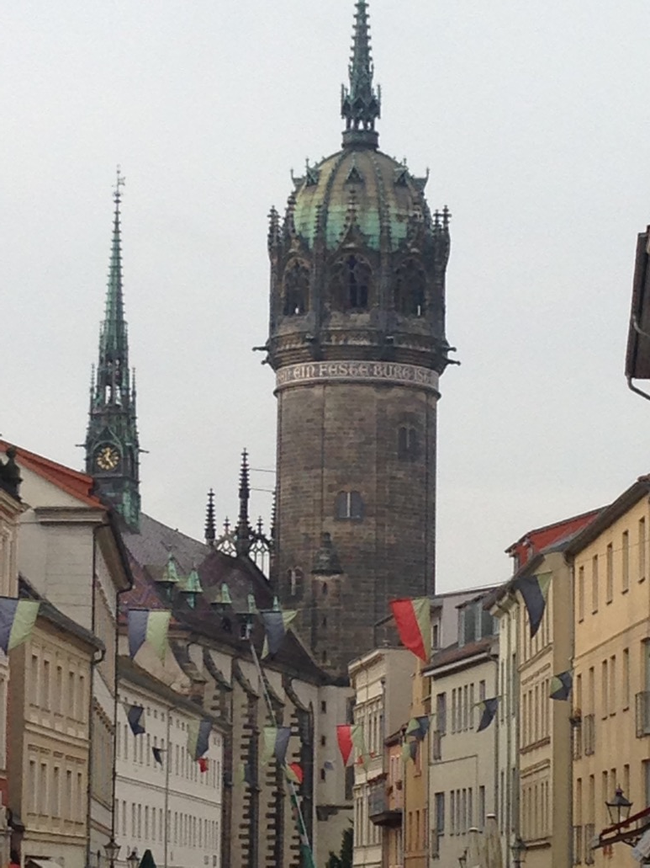

Slide 99
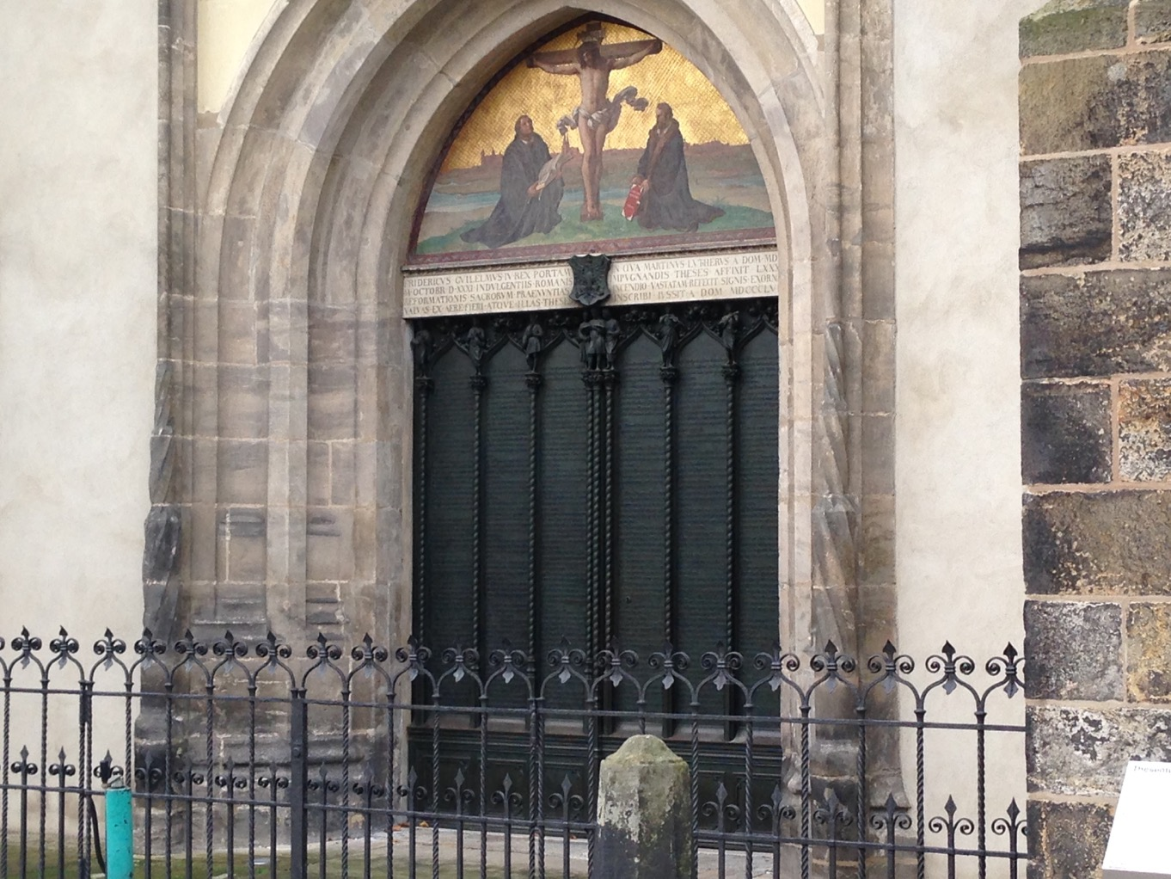

Slide 100
Notes:
“It should always happen in this house of God that the Lord speaks to us through His holy Word, and that we then speak to Him with our prayers and songs of praise.” Luther’s testimony to the Revelation-Response pattern of worship!

Slide 101
يجب أن يحدث هذا دائمًا في بيت الله أن الرب يتحدث إلينا من خلال كلمته المقدسة، ثم نتحدث إليه بصلواتنا وأغاني التسبيح.
Notes:
Luther’s testimony to the Revelation-Response pattern of worship!

Slide 102
أساس
أساسات العبادة
هي كلمة الله
وعظها
الإيمان بها
قراءتها
ترنيمها
الصلاة بها
تكريمها
العمل بها
Notes:
God reveals His glory, worship is our response
Order is important: God always initiates
Rom. 11:33-36 eleven chapters of doctrine, then Paul bursts out in praise: „Oh, the depth of the riches ¹both of the wisdom and knowledge of God!”
Worship services to be a dialogue betw, God and man, a dialogue of revel. & response
This is why the Scriptures are so important; Stott and others remind us how we need much more Scr. In our services– been in many churches where first first of Scr. Is when preacher gets up– means 30 mintues of response w/o anything to respond to!!

Slide 103
الإعلان والتجاوب
نمط العبادة الصحيح
Notes:
God has spoken. And He calls all nations to respond to His gracious invitation and celebration His glorious grace.

Slide 104
Black

Slide 105
• BibleStudyDownloads.org لاهوت العبادة وممارسته
أحصل على هذا العرض التقديمي مجاناً
Notes:
Worship (wo)

