Slide 1
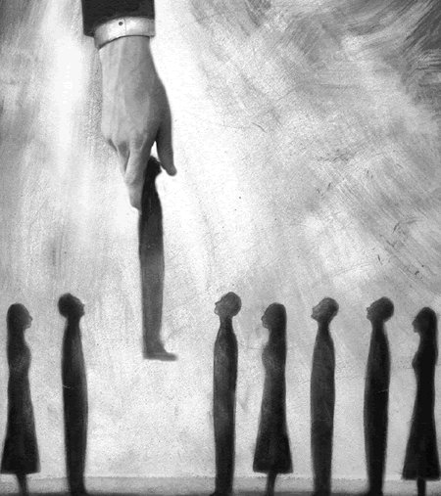
عقيدة
الإختيار
علم الخلاص: برنامج الله الخلاصي
د. ريك جريفيث • مؤسسة الدراسات اللاهوتية الأردنية • BibleStudyDownloads.org

Slide 2

تعريف الإختيار
55
اختيار الله
لشخص أو مجموعة
لقصد أو مصير محدد

Slide 3
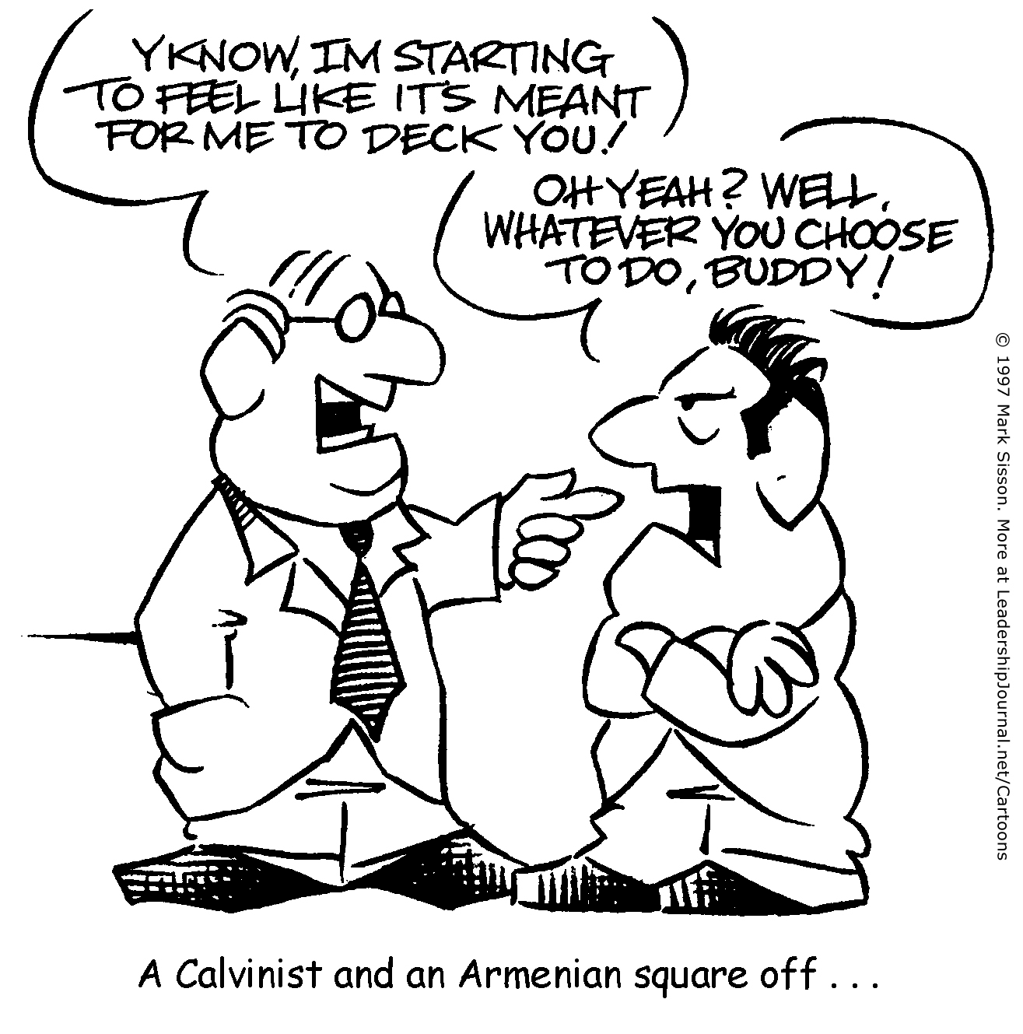
ساحة كلفينية وأرمينية
كما تعلم، لقد بدأت أشعر أنه
من المفترض أن أقوم بتزيينك!
أوه نعم؟ حسنًا، أيًا كان
ما اخترت القيام به يا صديقي!
؟

Slide 4


ساحة كلفينية وأرمينية
كما تعلم، لقد بدأت أشعر أنه
من المفترض أن أقوم بتزيينك!
أوه نعم؟ حسنًا، أيًا كان
ما اخترت القيام به يا صديقي!

Slide 5

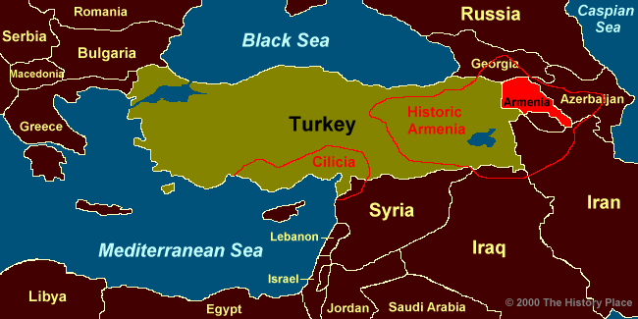
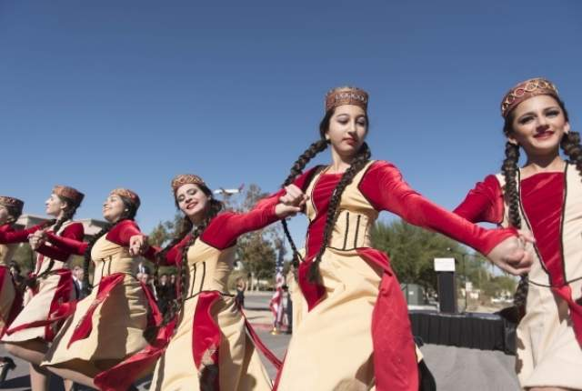
أرمني أم أرميني ؟

Slide 6

التعيين المسبق

Slide 7

لا شروط في الإختيار
فساد كامل
إختيار غير مشروط
كفارة محدودة
نعمة لا تقاوم
مثابرة القديسين

Slide 8

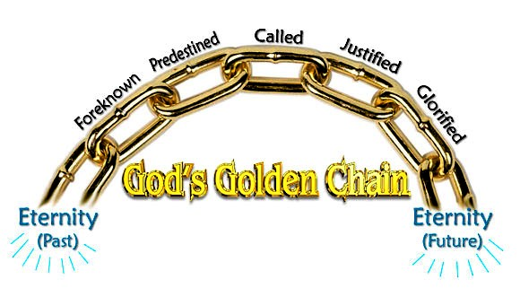
خمسة روابط غير قابلة للكسر في خطة الله للخلاص
51
مدعو
معين سابقاً
مبرر
معروف سابقاً
ممجد
سلسلة الله الذهبية
الأزل
الأبد
Notes:
Five Golden Links in God's Chain of Salvation
Posted by Editorial on July 14, 2015 at 6:46 pm
http://www.dallastelegraph.com/58850
Accessed 14 May 2016
By Elder Herb Hatfield, Pastor, Aberdeen Primitive Baptist Church, Aberdeen, Mississippi, USA
"For whom he did foreknow, he also did predestinate to be conformed to the image of his Son, that he might be the firstborn among many brethren. Moreover whom he did predestinate, them he also called: and whom he called, them he also justified: and whom he justified, them he also glorified." ROMANS 8:29-30
Introduction: Salvation is a grand and glorious subject. The salvation of a Hell-deserving soul from the torments of an eternal Hell is both amazing and glorious. What a wonderful thing that a person can, by the grace of God, be saved from eternal Hell. However, salvation is more than just deliverance from Hell, it involves much more. It includes our Redemption, our Regeneration, our Adoption as sons of God, our Sanctification and our eternal dwelling with God in glorified bodies. Dwelling eternally in Heaven with Jesus Christ our Saviour in our glorified bodies is the final result of the whole process of our salvation.
There are only two places that a soul can go after death, Hell or Heaven. Salvation is the whole process whereby God justifies, saves a Hell-deserving sinner by His free and sovereign grace, and gives them eternal life. They are regenerated, causing them to desire to live godly and glorified so they can then enjoy eternity with God the Father, God the Son, God the Holy Spirit, with the Holy angels and all the redeemed saints from all ages, with glorified bodies. That, my friends, is what salvation is all about; it is the delivering of a mortal soul from Hell's damnation and giving it eternal glory in Heaven. It is amazing! It is marvelous! It is wonderful and it is all true! God's plan for salvation ends in eternal glorification for all the saints of God.
These scripture verses set forth this glorious program of salvation. These verses say that those whom God did foreknow, He also did predestinate to be conformed to the image of His Son, and those whom He did predestinate, them He also called, and whom He called, them He also justified, and whom He justified, them He also glorified. There are five very important words in these verses. They are: Foreknow, Predestinate, Called, Justified and Glorified. These five words cover the whole program of God in the salvation of His people. This salvation is what I want to talk to you about, using these five words. I call them Five Golden Links in God's Chain of Salvation.
The Bible says that God has declared the end from the beginning (Isaiah 46:10).
Therefore, I want to take these five words in Romans, chapter eight, verses 29-30 in the reverse order that we have here. The last word is Glorification. That's where salvation ends, in our glorification, so I want to start with glorification and then work backwards. I want you to think with me about each of these five golden links in this chain of salvation.
The FIRST link in the chain that I want to discuss with you is the last one, GLORIFICATION. What a wonderful subject. Do you ever think about it? The Bible talks about it right here in these verses. It is what happens to the saints of God when they are given bodies in which they shall live forever. In I Corinthians chapter fifteen, the Apostle Paul talks about the resurrection and the glorification of our bodies. He even says that every saint may not necessarily die, but that we all shall be glorified. He says: "Behold, I shew you a mystery; We shall not all sleep, (that means die, that's what death is for the saints), but we shall ALL BE CHANGED, in a moment, in the twinkling of an eye, at the last trump: for the trumpet shall sound, and the dead shall be raised incorruptible, and we shall be changed. For this corruptible must put on incorruption, and this mortal must put on immortality" (I Cor.15:51-53). That's the same thing that the Apostle is talking about in Philippians chapter three where in verses 20 and 21 he says; "For our conversation (citizenship) is in heaven: from whence also we look for the Saviour, the Lord Jesus Christ: who shall CHANGE OUR VILE BODIES, that it may be fashioned like unto His glorious body".
This is what all the saints of God are looking forward to, when we shall have glorified bodies. We will have bodies that have been changed by the power of God, so that we put off mortality and put on immortality. These are bodies that have been "fashioned like unto His glorious body"! That is what the Apostle John is speaking about in I John chapter three, verses one and two when he says, "Behold what manner of love the Father hath bestowed upon us that we should be called the sons of God:…Beloved, now are we the sons of God, and it doth not yet appear what we shall be: but we know that, when He shall appear, we SHALL BE LIKE HIM, because we shall see him as He is."
Can you imagine it? Glorified bodies! Bodies that have been made like unto Jesus Christ's body. Not that we shall be gods, but we shall have bodies that will never die; there will be no pain or sickness, but most of all, no sin in them. We shall possess sinless bodies so we can sing and praise the Lord our Saviour for all eternity with pure hearts and glorified bodies. That's what Romans chapter eight says that salvation is all about. It says in verse 29 that we have been PREDESTINATED "to be conformed (that means made like) to the image of His Son". All who have trusted Jesus Christ as their Lord and Saviour in this life shall receive glorified bodies in eternity. That is our hope, it is our comfort in the time of sorrow and trouble, and it is what God has promised us, it is what He has predestined for us. Paul says in Romans 8:18: "For I reckon that the sufferings of this present time are not worthy to be compared with the glory which shall be revealed in us". HALLELUJAH!!! This is what makes the struggle and suffering for Christ all worthwhile. We who are the saints of God shall all, some day, be given glorified bodies to enjoy for all eternity in Glory. That is what David is referring to when he said, "As for me, I will behold thy face in righteousness: I shall be satisfied, when I awake, with thy likeness" (Ps 17:15). That, my friends, has been the hope of all saints in all ages. Job, in the oldest book in the Bible said, "For I know that my redeemer liveth, and that he shall stand at the latter day upon the earth: And though after my skin worms destroy this body, yet in my flesh shall I see God: Whom I shall see for myself, and mine eyes shall behold, and not another; though my reins be consumed within me." (Job 19:25-27)
I want you to see whom it is that is to be glorified. Paul says here in these verses that it is those who have been justified. In verse 29 of this eighth chapter of Romans, he says that those "whom He (God) justified, them He also glorified". I want you to see here that ONLY those who have been JUSTIFIED by God are going to be GLORIFIED. That's what the Bible says right here. It does not say those who live right, or those who joined the church, or those who have been baptized, or those who have done anything. No, it is ONLY those whom God has JUSTIFIED. This then is the second link in the golden chain of salvation, JUSTIFICATION.
JUSTIFICATION is a very, very important subject. It's a legal term. It speaks about our standing before the bar of God's Holy Law. The Word of the Lord says in Romans chapter three, that "all have sinned and come short of the glory of God", and that "there is none righteous, no not one". Therefore, before the bar of God's Holy Law, all mankind stands guilty of sin. We are all sinners because we all sinned in Adam and we are therefore worthy of eternal death in Hell. (Rom.5:12). But God did a wonderful and marvelous thing. He sent His only begotten Son into the world and laid upon Him all the sins of all those whom He would ever justify. Therefore, since the death and resurrection of Jesus Christ, God's Law has forever been satisfied concerning the sins of those whom He would justify and the guilty sinner has been declared, by God, to be just.
First, I want to show you the KIND OF PEOPLE that God justifies. In Romans 4:5 we read, "To him that worketh not, but believeth on Him (God) that justifieth the ungodly". There it is in black and white. Friend, read it and rejoice! The only kind of people that God justifies is "the ungodly"! It is not good people, nor religious people, nor those that feel themselves to be good people, but ONLY UNGODLY SINNERS! Paul says in First Timothy 1:15 that Christ died to save even the chief of sinners. In Romans 5:6, Paul tells us "when we were yet without strength …Christ died for the ungodly."
Now, I want to show you HOW it is that we are Justified. It is not by works that we do or by keeping the Law. In Acts 13:39, Paul says: "By Him (Jesus Christ) all that believe are justified from all things, from which ye could not be justified by the law of Moses". You see, the Law of Moses is good, but the Law cannot justify, it only condemns. It shows us our sin. It is like a mirror that we hold up and see our dirty faces. The mirror cannot cleanse our faces; we must use soap and water. Likewise, the Law of God shows us our sins, but it cannot justify us. The Bible teaches that it is God that justifies. In Romans 3:24 the Word of God says: "Being justified by His grace through the redemption that is in Christ Jesus".
You see, it is God that justifies us by His grace. Grace means without any merit. Therefore, God, by the good pleasure of His sovereign grace, justifies the guilty sinner. He does it "through the redemption that is in Christ Jesus." What that means is that Jesus Christ has paid the sin debt for all His people (Matt.1:21). The word "redemption" means, "to deliver by paying a price". That's what Jesus Christ did. He paid the price of death for the transgression of the guilty sinner. We read in the Book of I Peter 1:18-19: "Forasmuch as ye know that ye were not redeemed with corruptible things, as silver and gold, from your vain conversation (sinful conduct ) received by tradition from your fathers; but with the precious blood of Christ, as of a lamb without blemish and without spot." There is only one thing that could pay the price of our redemption; it was "the precious blood of Christ." .
In Romans 8:33, we see WHO it is that God justifies. "Who shall lay any thing to the charge of God's elect? It is God that justifies." There it is in black and white again. The people that God justifies are called "God's elect". They are the same people that we read about in Romans 8:28: "who are the called according to His purpose." God has justified His elect people by His free grace.
This brings us to the third word in the Golden Link of the Chain of our Salvation, it is the word CALLED. It is right there in our text in Romans chapter 8 and verse 30: "Moreover whom He did predestinate, them He also CALLED and whom He called, them He justified." Therefore, the people that God justifies are those who are "the called".
Paul began this Book of Romans by saying in chapter one and verse one: "Paul, a servant of Jesus Christ, called to be an apostle, separated unto the gospel of God." Then in verses six and seven, he addresses the book to "the called of Jesus Christ, to all that be in Rome, beloved of God, called to be saints". The word "called" is the Greek word "kaleo". This word is used 145 times in the New Testament. It means to name, or to bid, or command to come. It is used in Matthew 2:7 where we read "Then Herod, when he had privily called the wise men, inquired of them diligently what time the star appeared." You see its true meaning here. King Herod called the wise men to come to tell him about the star they had seen. These wise men had no choice about this matter, it was an invitation from one with supreme authority and it was to be obeyed. The same word is used in Matthew 4:21-22 where we read that Jesus "saw other two brethren, James the son of Zebedee, and John his brother, in a ship with Zebedee their father, mending their nets; and he called them. And they immediately left the ship and their father, and followed him".
Jesus Christ said in Matthew 9:13, "I am not come to call the righteous, but sinners to repentance." Peter says in Acts 2:39: "For the promise is unto you, and to your children, and to all that are afar off, even as many as the Lord shall call". Again, Paul says in I Thess. 2:12: "That ye would walk worthy of God, who hath called you unto His kingdom and glory." In First Peter 2:9, we read, "But ye are a chosen generation, a royal priesthood, an holy nation, a peculiar people; that ye should shew forth the praises of him who hath called you out of darkness into his marvelous light". God, by His Holy Spirit, has called (commanded to come) us from the spiritual darkness into which we were born by nature, into the marvelous light of the Son of God. It is what Christ did at the tomb of Lazarus in John chapter 11, when He said, "Lazarus, come forth" and next we read, "he that was dead came forth". So the call of God by His Holy Spirit to His elect, is both effectual and irresistible. Jesus Christ said in John 6:37, "All that the Father giveth me shall come to me." They are called by an IMMEDIATE, EFFECTUAL and IRRESISTIBLE drawing of the Holy Spirit of God, so that they willingly, by faith, come unto Jesus Christ, trusting Him as their Lord and Saviour.
If today you believe that, by the grace of God, you have been given a hope of your salvation in Jesus Christ, or if you shall ever be saved and glorified, it will be because God has called you. We would never have called on the Lord if God had not first called us. The Word of God says, "there is none that understandeth, there is none that seeketh after God" (Rom.3:11). Jesus Christ said in John 6:44: "No man can come to me, except the Father which hath sent me draw him…" We have all gone astray from God, so God must call us by His Holy Spirit and cause us to come unto Him. Psalms 65:4 says, "Blessed is the man whom thou choosest, and causest to approach unto thee". You see Friend; we come to God because He calls us and draws us to Himself. Therefore, in Jeremiah 31:3, God says, "with loving kindness have I drawn thee". Like Lazarus of old, we were dead in our trespasses and sins and God must first come to us and call us from darkness unto light. Whenever it is that the Holy Spirit comes to our dead hearts and calls us to Jesus Christ, we will be made alive and given eternal life.
We manifest God's spiritual life in us by believing the Gospel, by repenting of our sins, and by following Jesus Christ. All those that God has justified, He shall call from deadness unto life by His Holy Spirit, every one of them He will also glorify. It is very important that we see this clearly. The Holy Spirit of God shall call everyone whom God has justified by the death of His Son on the cross. This involves regenerating us so that we have faith in Jesus Christ as our Saviour. This is the work of the Holy Spirit of God as the third party to the eternal covenant of our salvation.
All of those whom the Holy Spirit has regenerated shall follow Jesus Christ. Christ said in John 10:27-28, "My sheep hear my voice (that is by the work of the Holy Spirit) and I know them (set my love upon them before the foundation of the world) and they follow me and I give unto them eternal life; and they shall never perish, neither shall any pluck them out of my hand". This means that all whom the Holy Spirit genuinely regenerates will be kept by the power of God until they are glorified. They will not lose their salvation because they are in the Almighty hand of God the Father and God the Son. They are sealed by the Holy Spirit of God (Eph.1:13), therefore they are eternally safe and secure and shall all be glorified, by the power and grace of God.
This brings us to the fourth word in the Five Golden Links of Our Salvation. It is the word PREDESTINATED. Again, it is right here in our text in Rom. 8:30 in black and white: "Moreover whom He did predestinate, them He also called." You see, the reason God called us unto salvation is because He had predestinated us to salvation. Predestination comes from the Greek word "proorizo" which according to Strong's Concordance means, "to limit in advance, determine before, ordain, or predestinate". Some people are afraid of this word, but do not be. It is a blessed word and has given the saints of God in all ages great comfort to know that God, before the world began, purposed all things, whatsoever comes to pass. It was a comfort to the saints at Jerusalem when they knew that all that Christ had suffered at the hand of Pilate or that they would suffer, was "whatsoever thy (God) hand and thy counsel determined before (proorizo) to be done" (Acts 4:28). Paul says in Ephesians 1:11 that, God "worketh all things after the counsel of his own will." Is that not a comforting thought, Dear One? Is it not good news to know that God is in control of all things and that He is working all things after the counsel of His own will? We read in Daniel 4:35, "He (God) doeth according to his will in the army of heaven, and among the inhabitants of the earth: and none can stay his hand, or say unto him, What doest thou? God is all-powerful and all-wise. He is the sovereign ruler over the universe.
God is in control of all events here on earth, working them to accomplish His predetermined will (Psa.76:10; Eph.1:11). If that were not true, we could not believe a single word of prophecy, because that is the very foundation of all prophecy. It is simply God foretelling by His prophets what He has predetermined to do. Every prophecy in the Bible is true, because it is God telling forth what He has before predetermined. God then moves and controls all the necessary events in time to accomplish what He determined before the world began. Jesus Christ was born in Bethlehem, fulfilling the ancient prophecy found in Micah 5:2, "But thou, Bethlehem Ephratah, though thou be little among the thousands of Judah, yet out of thee shall he come forth unto me that is to be ruler in Israel; whose goings forth have been from of old, from everlasting".
It was by the will of God, "that there went out a decree from Caesar Augustus, that all the world should be taxed" (Luke 2:1). This meant that Joseph must take Mary, when she was "great with child", carrying our Lord and Saviour in her womb, from Nazareth in Galilee to Bethlehem in Judah, a distance of over 60 miles, to pay his taxes. It was while they were there that Jesus Christ was born in Bethlehem, fulfilling the prophecy of Micah written about 700 years before the time of Jesus' birth. This prophecy was fulfilled because it was God's predetermined will and He brought it to pass just as He had foretold it by the prophets.
It is the same with our salvation. Paul says in II Tim.1:9: Who hath saved us and called us with an holy calling, not according to our works, but according to His own purpose and grace, which was given us in Christ Jesus before the world began". Isn't that amazing? Before time began, before there was an earth, or Adam and Eve, God had already predetermined to give grace to all His people whom He had chosen in Christ Jesus "before the foundation of the world, that we should be holy and without blame before Him" (Eph.1:4). He purposed before the world began to save them and to call them unto salvation by His Holy Spirit. You see, God does it all. He purposed to save His people from their sins. He sent His only begotten Son to die for their sins, and then He sends the Holy Spirit to call them to this wonderful salvation. They are made willing in the day of His power. (Psa.110:3)
The Apostle Paul says in Second Thessalonians 2:13, "But we are bound to give thanks alway to God for you, brethren beloved of the Lord, because God hath from the beginning chosen you to salvation through sanctification of the Spirit and belief of the truth". It is because God the Holy Spirit regenerates us, creating a new nature within us that causes us to have faith and believe the Gospel, hearing with a quickened ear. The Word of God says, "Eye hath not seen, nor ear heard, neither have entered into the heart of man, the things which God hath prepared for them that love him. But God hath revealed them unto us by His Spirit:" (1 Cor. 2:9-10)
You see friend, all of us were born, dead in sin. We were born spiritually dead, so that we could not understand spiritual things. Paul says, "But the natural man receiveth not the things of the Spirit of God: for they are foolishness unto him: neither can he know them, because they are spiritually discerned". (I Corinthians 2:14) Because of the spiritual deadness that we all were born into by nature, we cannot understand or know anything about the things of God until the Holy Spirit has regenerated us. That is why Jesus Christ told Nicodemus, and all of us, in John chapter three, "Verily, verily, I say unto thee, Except a man be born again, he cannot see the kingdom of God". It must be that God the Holy Spirit comes to us while we are yet dead in our sins, spiritually blind with spiritually deaf ears. He regenerates us, gives us a new birth that is from above, enabling the quickened soul to hear effectually the Gospel and believe in Jesus Christ as Lord and Saviour. So the saints of God can sing:
"My Lord, I did not choose You, for that could never be:
My heart would still refuse You, had You not chosen me.
You took the sin that stained me, You cleansed me made me new,
Of old You have ordained me, that I should live with You."
Now we come to the fifth word and final link in the golden chain of salvation, and it is the word FOREKNOW. There are various ideas about what this word means. Many think it only means to foreknow about things. They say that since God is all wise and eternal, He foreknows about events before they ever happen. It is certainly true that God is all wise and eternal and that He does foreknow all events before they ever happen. However, if you will think about it, you can only foreknow with any certainty what you have pre-determined to do. I have illustrated this by hitting another person. I foreknew that event because I had pre-determined that I would hit that person. However, I certainly did not know what would be the reaction of the other person whom I had hit. I did not foreknow whether they would hit me with a club or just laugh, but in no way did I foreknow with any certainty what they would do. The whole purpose of this illustration was to show that we could only foreknow with certainty what we had pre-determined to do. God foreknows all events with certainty. This is why anything prophesied in the Bible happened exactly as it was prophesied. God had before pre-determined the event and all the means necessary to accomplish that which had been pre-determined and prophesied.
However, the word "foreknow" as used in the Bible is not merely referring to God foreknowing events. The word is used in Romans chapter eight, verse 29 and Romans chapter eleven, verse 2. In both these cases, it is very clear that the writer is speaking about God foreknowing people. In Matthew chapter seven, the Lord speaks about the time of judgment when "Many will say to me in that day, Lord, Lord, have we not prophesied in thy name? and in thy name have cast out devils? and in thy name done many wonderful works? And then will I profess unto them, I never knew you: depart from me, ye that work iniquity."(verses 22-23). Most certainty the Lord knew about these people, so when He says, "I never knew you", He is speaking about something other than just the knowledge of their existence and their activity. He means, "I never knew you in a love relationship". This can be more clearly seen when we look at some other scriptures:
Genesis 4:1 "And Adam knew Eve his wife; and she conceived, and bare Cain,"
Genesis 4:17 "And Cain knew his wife; and she conceived, and bare Enoch:"
Genesis 4:25 "And Adam knew his wife again; and she bare a son, and called his name Seth"
Luke 1:34 "Then said Mary unto the angel, How shall this be, seeing I know not a man?
In each of these verses, it can be easily seen that the word "know" is used in such a way as to mean much more than merely knowing about someone. The way the word is used in these verses means to have a love relationship. That is how we should understand the word in Matthew 7:22-23, Romans 8:29, and Romans 11:2. The very first thing that God did when He determined to save some and give them eternal life, was to sovereignly set His love upon them and then predestinated them to eternal life and glorification.
So we read in Romans 8:29, "For whom (not what) He did foreknow (know in a love relation) He also did predestinate to be conformed to the image of His Son…"
This is the same order in Jeremiah 1:5 where God told Jeremiah, "Before I formed thee in the belly, I knew thee (set His love upon him); and before thou camest forth out of the womb, I sanctified thee, and I ordained thee a prophet unto the nations".
It is the same order in Ephesians 1:4-5 where we read, "according as He (God the Father) hath chosen us in Him (God the Son) before the foundation of the world, that we should be holy and without blame, in love having predestinated us unto the adoption of children by Jesus Christ…" Thus, we should learn that God has first set His love upon us and then He predetermines our eternal glorification.
This is the very order that is set forth here in Romans chapter eight. Read it again. The very first word in the order is foreknow. It is those WHOM God did foreknow in an eternal love relationship that He predestinated to be glorified. This is the reason we shall be glorified, it is because God foreknew us. He sovereignly set His love upon us before the foundation of the world and predestinated us to be conformed to the image of His only Son in eternal glory.
This then is the Golden Chain of God's Salvation. It reaches from eternity past where God foreknew His people before the foundation of the world and then did predestinate them to be conformed to the image of His dear Son. All those who were foreknown by God the Father in eternity past were also predestinated to be conformed to the image of His Son. Those whom He did foreknow and predestinated, He sent His only begotten Son into the world to die for their sins, that they might be "justified freely by His grace through the redemption that is in Christ Jesus' (Rom.3:24). He has died for them, they are therefore freely justified, and the Holy Spirit effectually calls them in time unto salvation. All of them shall also be glorified at the resurrection at the second coming of Christ (I Cor.15).
This is God's plan of Salvation. This plan of God works! It works because it is all linked together. Like any other chain, take one link out and the chain is broken and will not do the job, but this chain is an unbreakable chain. It is held together by the all-powerful, sovereign will of God. It is an all-wise plan that glorifies God, its author and finisher (Heb.12:2). This plan works because it is all of grace. There is nothing for the sinner to do, God does it all (Eph.2:8-9). It is all by God's free and sovereign grace that any are saved from the awful wages of sin. Yet, by the grace of God, all those whom He did foreknow before the foundation of the world are saved. They all shall be called, justified and glorified.
Friend, if you have any hope of ever being glorified and dwelling in eternal glory with God the Father, with Jesus Christ the Son of God, with all the Holy Angels and with the redeemed saints of God, it will only be because the Golden Chain of God's Salvation included you.
"Unless Your grace had called me and taught my quickened mind,
The world would have enthralled me, to heavenly glories blind.
My heart knows none above You, for Your rich grace I thirst,
I know that if I love You, You must have loved me first."
"Your love has been forever, from all eternity;
Its drawing power never shall be withdrawn from me.
I know that I am kept by the strength of love Divine,
And when I wake in Heaven, all glory shall be Thine."
My Lord, I Did Not Choose You, Josiah Conder, 1789-1855

Slide 9
خمسة روابط غير قابلة للكسر في خطة الله للخلاص
51
ونحن نعلم أن (الله) يجعل كل الأشياء (حتى التجارب والمعاناة،
أنظر ع18 و35-36) تعمل معاً (في تناغم منظم) للخير
(فائدتنا الروحية لنشابه صورة جمال المسيح، ع29)
للذين يحبون الله (كما هو ظاهر من وجهة نظر بشرية) الذين هم مدعوون حسب قصده (كما هو ظاهر من وجهة نظر إلهية)
رومية 8: 28
ترجمة يوحنا د. غراسميك، كلية دالاس، 1985

Slide 10
خمسة روابط غير قابلة للكسر في خطة الله للخلاص
51
(نحن نعلم) لأن الذين سبق (الله) فعرفهم (في نعمة الإختيار)
سبق فعينهم (هدفه في الإختيار المسبق) ليكونوا مشابهين
صورة (داخلياً وخارجياً) ابنه حتى يكون هو (الإبن يسوع المسيح) بكراً (الأبرز) بين إخوة كثيرين
(الذين هم أبناء الله، أنظر الأعداد 14-16)
رومية 8: 29
ترجمة يوحنا د. غراسميك، كلية دالاس، 1985

Slide 11
خمسة روابط غير قابلة للكسر في خطة الله للخلاص
51
والذين سبق (الله) فعينهم فهؤلاء (بدون خسارة أحد) دعاهم أيضاً
(الدعوة الفعالة والمولدة للتحول والتي يستجيب لها الشخص بإطاعة الإيمان، أنظر رو 1: 5، 10: 16، 15: 18، 16: 26)
رومية 8: 30أ
ترجمة يوحنا د. غراسميك، كلية دالاس، 1985

Slide 12
خمسة روابط غير قابلة للكسر في خطة الله للخلاص
51
والذين دعاهم فهؤلاء (بدون خسارة أحد) بررهم أيضاً (عطية الله بالوقوف الصحيح أمامه تستقبل بالإيمان، أنظر رو 5: 1) والذين بررهم فهؤلاء (بدون خسارة أحد) مجدهم أيضاً (حدث أكيد تم مسبقاً أنظر ع29 مع أنه غير مدرك بعد ولا يزال مستقبلياً)
رو 8: 30ب
ترجمة يوحنا د. غراسميك، كلية دالاس، 1985

Slide 13

في كل الأشياء يعمل الله للخير ...
(8: 28-30)
51
ممجد
مبرر
مدعو
معيّن سابقاً
معروف سابقاً

Slide 14
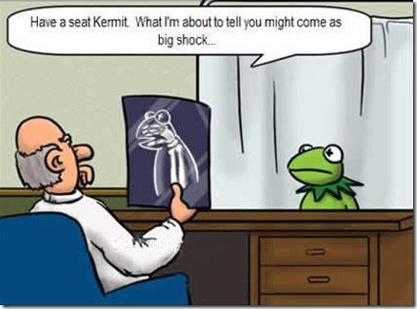
تفضل بالجلوس يا كيرميت. أريد أن أقول لك
ما قد يكون بمثابة صدمة كبيرة ...

Slide 15
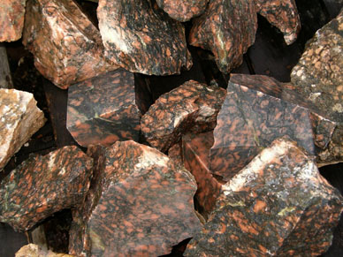
مثل على رومية 8: 28-30
51
في أحد الأيام
أراد نحات حكيم وماهر
أن يصنع تمثالاً رخامياً جميلاً...

Slide 16
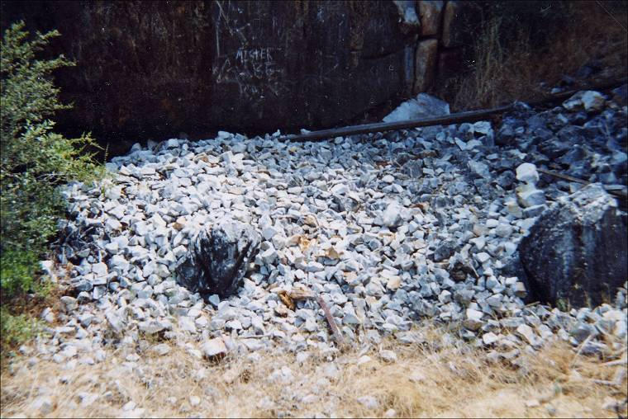
المعرفة السابقة
51
ومن بين الإمكانيات العديدة
الموجودة في مقلع الرخام،
اختار حجرًا خامًا واحدًا ليستخدمه لهذا الغرض.

Slide 17
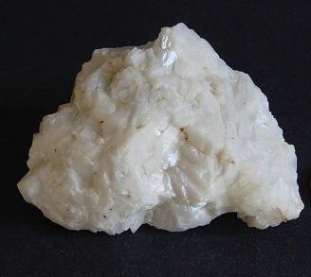
التعيين المسبق
51
لقد وضع عليه علامة وبالتالي عينها
للمنتج النهائي الجميل الذي كان يدور في ذهنه.
وقد حفظتها هذه العلامة من التخلص منها وتدميرها.

Slide 18
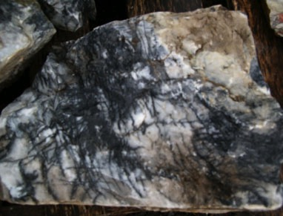
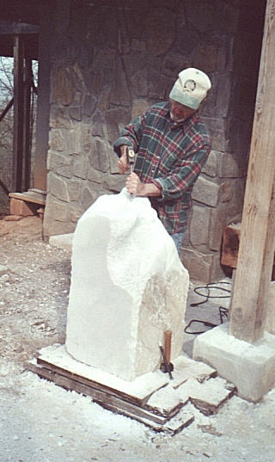
الدعوة والتبرير
51
في وقت لاحق أرسل مساعده
لإحضار الحجر
ووضعه على طاولة عمله.

Slide 19
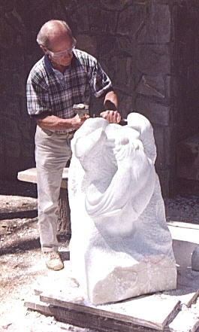
التقديس المتدرج والضمان الأبدي
51
ثم بدأ النحات بإزميل وتقطيع وبرد
تلك الكتلة من الحجر الخام
ليشكلها على شكل نموذج الطين
الذي كان بمثابة نموذجه.
ومع ذلك، في هذه العملية،
لم يفعل شيئًا لإتلاف الحجر
وتأكد من عدم تشويهه
من قبل أي شخص آخر.

Slide 20
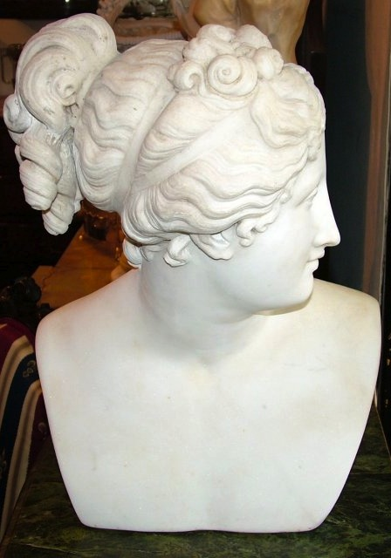
الإختطاف
51
ثم في أحد الأيام انتهى عمله. كان التمثال كاملاً بجميع معالمه المصقولة بدقة بما يتوافق تمامًا مع نموذجه الطيني. لقد حان الوقت لإخراجه من فوضى طاولة العمل ونقلها إلى بلاط القصر حيث سيتم كشف النقاب عنها للعرض العام.

Slide 21
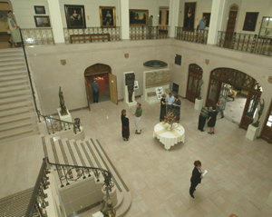
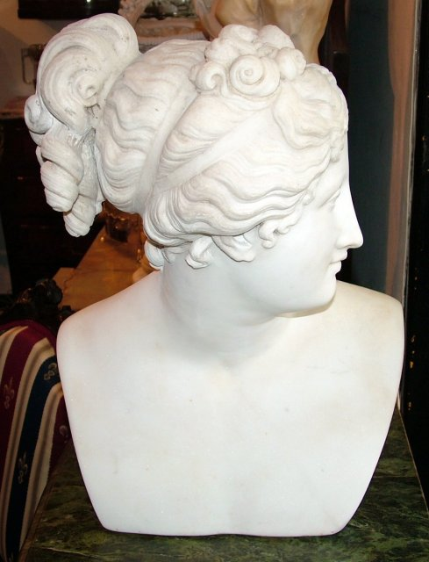
التمجيد
51
وابتسم جميع المارة
معبرين عن استحسانهم وقدموا أوسمة الثناء
للنحات الحكيم والماهر.

Slide 22
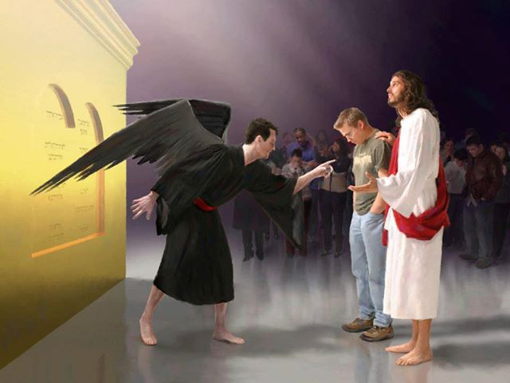
مَنْ هُوَ الَّذِي يَدِينُ؟ الْمَسِيحُ هُوَ الَّذِي مَاتَ بَلْ بِالْحَرِيِّ قَامَ أَيْضاً الَّذِي هُوَ أَيْضاً عَنْ يَمِينِ اللهِ الَّذِي أَيْضاً يَشْفَعُ فِينَا!
رومية ٨ : ٣٤

Slide 23
الكلمات اللاهوتية في رومية
155د
الإختيار
رومية 9: 10-13
اختيار الله لشخص أو مجموعة لهدف أو مصير معين
التبرير
رومية 4: 25، 5: 18
عمل الله في إعلاننا في حالة البراءة
وأننا في وضع صحيح معه
الكفارة
رومية 3: 25
إزالة الله لعقوبة الخطية من خلال الذبيحة الكاملة ليسوع المسيح حتى يتم إرضاء غضب الله البار
الفداء
رومية 3: 24، 8: 23
دفع يسوع المسيح الثمن حتى نصير أحراراً، أجرة الخطية هي موت وقد دفع يسوع الثمن بدمه
التقديس
رومية 5: 2، 15: 16
أن نصير أكثر فأكثر مثل يسوع المسيح
من خلال عمل الروح القدس
التمجيد
رومية 8: 18، 19، 30
الحالة النهائية للمؤمن وهو أن يكون في توافق كامل مع شخصية يسوع المسيح في الجسد المقام الذي سيدوم إلى الأبد (يوحنا الأولى 3: 2).

Slide 24

رومية ٨ : ٣٨-٣٩
فَإِنِّي مُتَيَقِّنٌ أَنَّهُ لاَ مَوْتَ وَلاَ حَيَاةَ وَلاَ مَلاَئِكَةَ وَلاَ رُؤَسَاءَ وَلاَ قُوَّاتِ وَلاَ أُمُورَ حَاضِرَةً وَلاَ مُسْتَقْبَلَةً ٣٩ وَلاَ عُلْوَ وَلاَ عُمْقَ وَلاَ خَلِيقَةَ أُخْرَى تَقْدِرُ أَنْ تَفْصِلَنَا عَنْ مَحَبَّةِ اللهِ الَّتِي فِي الْمَسِيحِ يَسُوعَ رَبِّنَا.

Slide 25
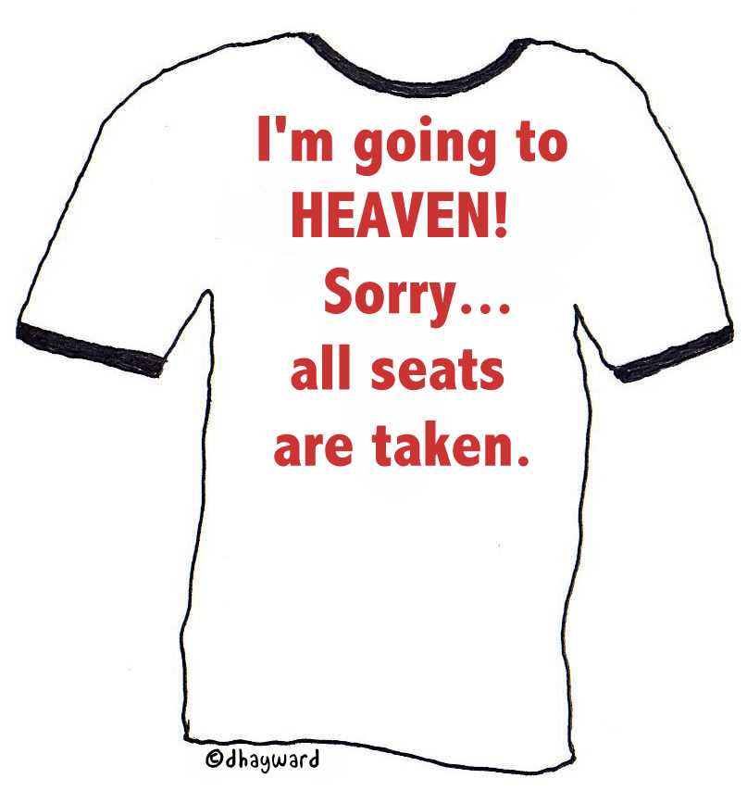
أنا ذاهب
إلى السماء
أعتذر
كل المقاعد
محجوزة

Slide 26

هل اختيار الله عادل؟

Slide 27
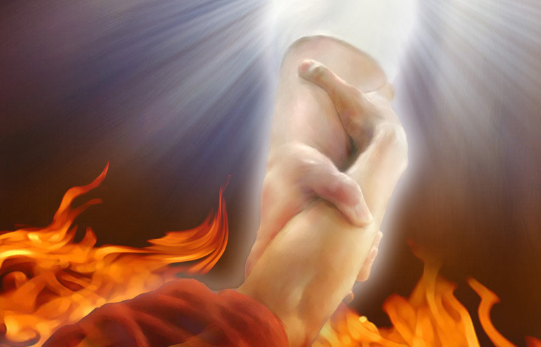
١٤ فَمَاذَا نَقُولُ؟ أَلَعَلَّ عِنْدَ اللهِ ظُلْماً؟ حَاشَا!
١٥ لأَنَّهُ يَقُولُ لِمُوسَى: «إِنِّي أَرْحَمُ مَنْ أَرْحَمُ وَأَتَرَاءَفُ عَلَى مَنْ أَتَرَاءَفُ». ١٦ فَإِذاً لَيْسَ لِمَنْ يَشَاءُ وَلاَ لِمَنْ يَسْعَى بَلْ لِلَّهِ الَّذِي يَرْحَمُ.
رومية ٩ : ١٤-١٦

Slide 28
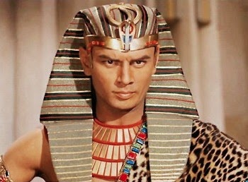
لأَنَّهُ يَقُولُ الْكِتَابُ لِفِرْعَوْنَ:
«إِنِّي لِهَذَا بِعَيْنِهِ أَقَمْتُكَ لِكَيْ أُظْهِرَ فِيكَ قُوَّتِي وَلِكَيْ يُنَادَى بِاسْمِي فِي كُلِّ الأَرْضِ».
١٨ فَإِذاً هُوَ يَرْحَمُ مَنْ يَشَاءُ وَيُقَسِّي مَنْ يَشَاءُ.
رومية ٩ : ١٧-١٨

Slide 29
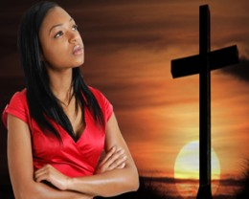
١٩ فَسَتَقُولُ لِي:
«لِمَاذَا يَلُومُ بَعْدُ لأَنْ مَنْ يُقَاوِمُ مَشِيئَتَهُ؟»
٢٠ بَلْ مَنْ أَنْتَ أَيُّهَا الإِنْسَانُ الَّذِي تُجَاوِبُ اللهَ؟ أَلَعَلَّ الْجِبْلَةَ تَقُولُ لِجَابِلِهَا: «لِمَاذَا صَنَعْتَنِي هَكَذَا؟»
رومية ٩ : ١٩-٢٠

Slide 30
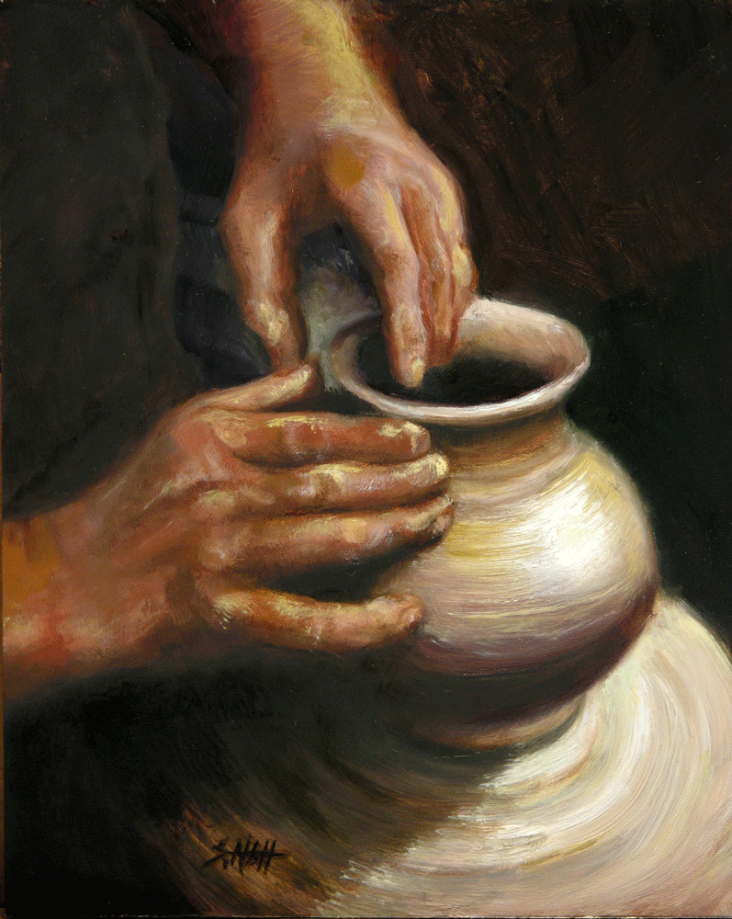
٢١ أَمْ لَيْسَ لِلْخَزَّافِ سُلْطَانٌ عَلَى الطِّينِ أَنْ يَصْنَعَ مِنْ كُتْلَةٍ وَاحِدَةٍ إِنَاءً لِلْكَرَامَةِ وَآخَرَ لِلْهَوَانِ؟
رومية ٩ : ٢١

Slide 31
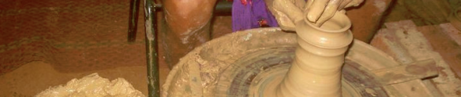
٢٢ فَمَاذَا إِنْ كَانَ اللهُ وَهُوَ يُرِيدُ أَنْ يُظْهِرَ غَضَبَهُ وَيُبَيِّنَ قُوَّتَهُ احْتَمَلَ بِأَنَاةٍ كَثِيرَةٍ آنِيَةَ غَضَبٍ مُهَيَّأَةً لِلْهَلاَكِ - ٢٣ وَلِكَيْ يُبَيِّنَ غِنَى مَجْدِهِ عَلَى آنِيَةِ رَحْمَةٍ قَدْ سَبَقَ فَأَعَدَّهَا لِلْمَجْدِ ٢٤ الَّتِي أَيْضاً دَعَانَا نَحْنُ إِيَّاهَا لَيْسَ مِنَ الْيَهُودِ فَقَطْ بَلْ مِنَ الأُمَمِ أَيْضاً.
رومية ٩ : ٢٢-٢٤

Slide 32

البر في رومية
145
الموضوع | الحاجة | المتاح | الممنوح | الإثبات | التطبيق | المنتشر
مقدمة 1: 1-17 | الدينونة 1: 18- 3: 20 | التبرير 3: 21- 5: 21 | التقديس 6-8 | الإختيار 9-11 | التحول 12: 1- 15: 13 | النمو 15: 14- 16: 27
البداية | الخطية | الخلاص | الإنفصال | السيادة | الخدمة | الإرسال
Notes:
We will take the “fast track” through Paul’s letter to the Romans today and see seven reasons must we accept one another! I don’t normally have a seven-part sermon, so that’s too much, just think of chapters 1–11 as Paul’s theology and Romans 12–16 as the application.

Slide 33
هل كل الأشخاص التاليين
مُدانون حقًا بدون المسيح؟
اجعله مشهوراً
قاب قوسين أو أدنى وفي جميع أنحاء العالم
讓 全 世 界 都 知 道
～直到全地，直到地極～

Slide 34

مُدان?

Slide 35
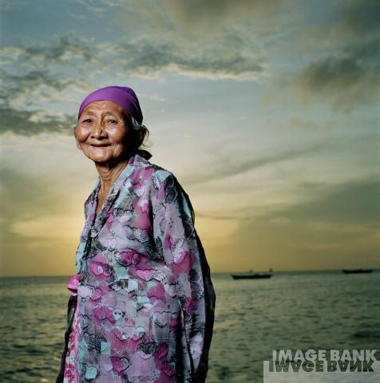
مُدان?

Slide 36
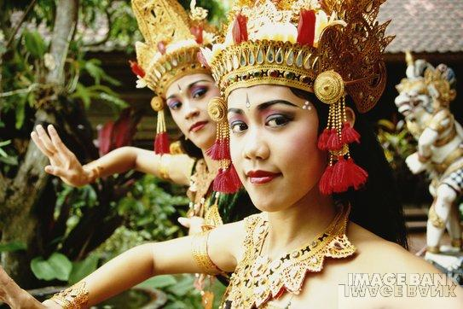
مُدان?

Slide 37
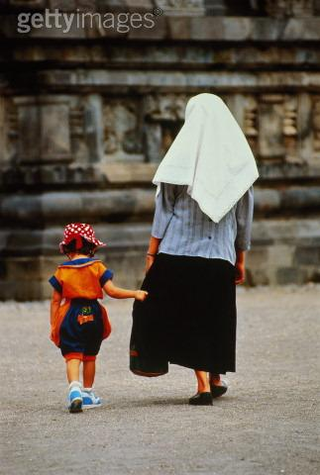
مُدان?

Slide 38
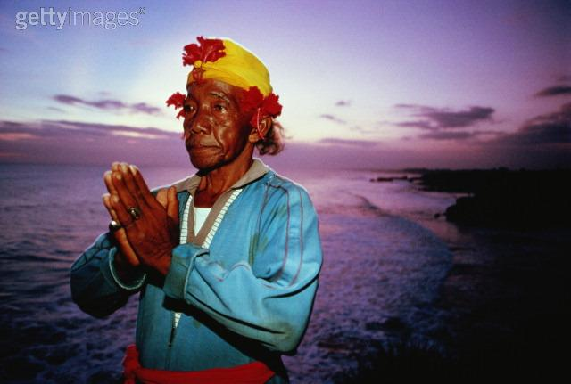
مُدان?

Slide 39

مُدان?

Slide 40

مُدان?

Slide 41

مُدان?

Slide 42

مُدان?

Slide 43
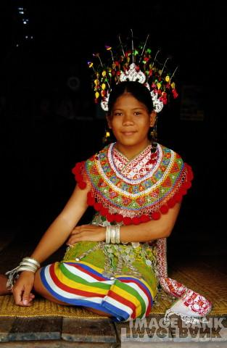
مُدان?

Slide 44
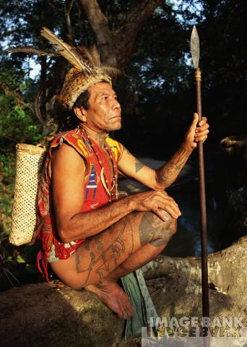
مُدان?

Slide 45

مُدان?

Slide 46
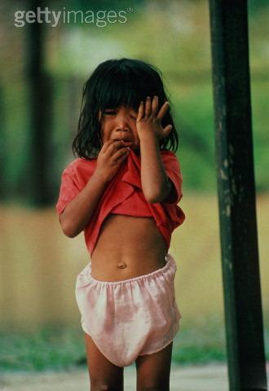
مُدان?

Slide 47
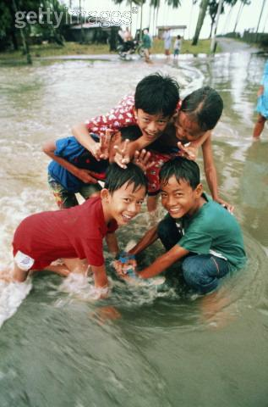
مُدان?

Slide 48
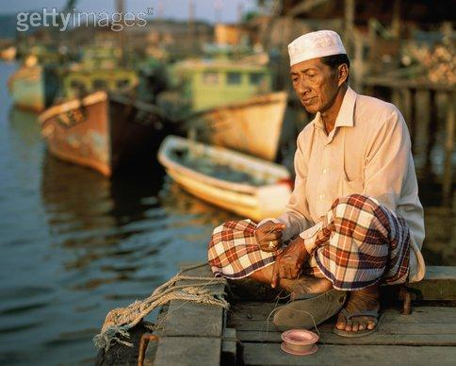
مُدان?

Slide 49
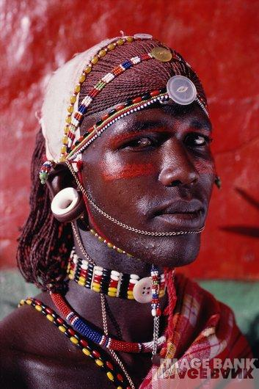
مُدان?

Slide 50
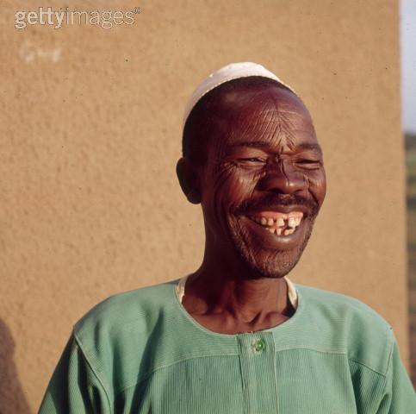
مُدان?

Slide 51

مُدان?

Slide 52
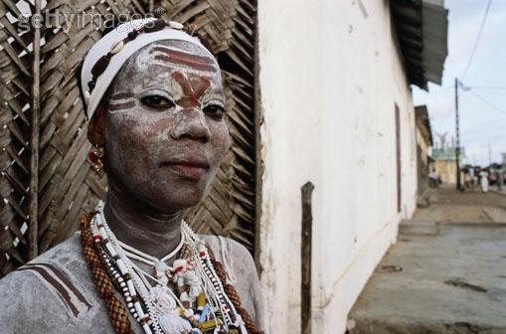
مُدان?

Slide 53
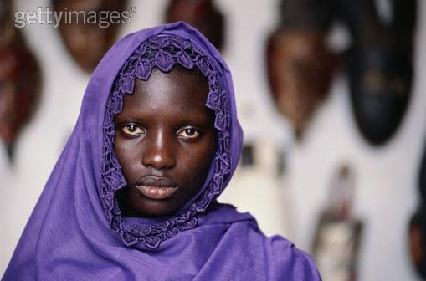
مُدان?

Slide 54
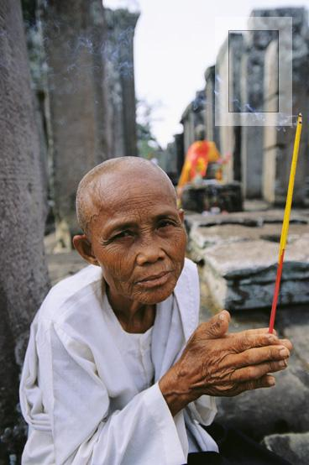
مُدان?

Slide 55

مُدان?

Slide 56
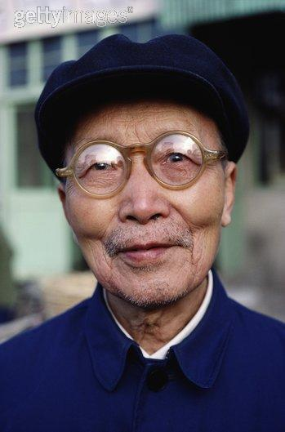
مُدان?

Slide 57

مُدان?

Slide 58

مُدان?

Slide 59

مُدان?

Slide 60

مُدان?

Slide 61
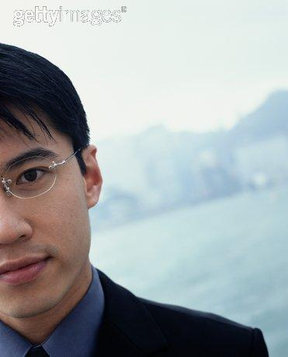
مُدان?

Slide 62
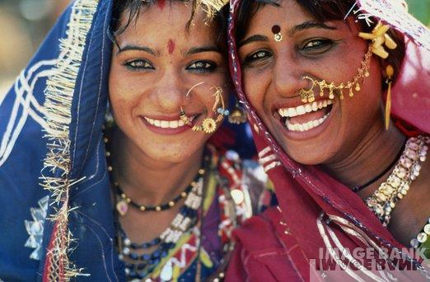
مُدان?

Slide 63
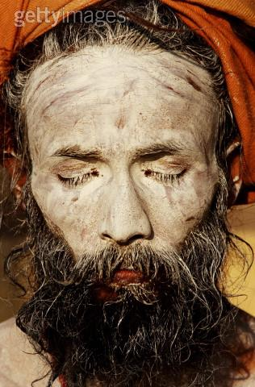
مُدان?

Slide 64
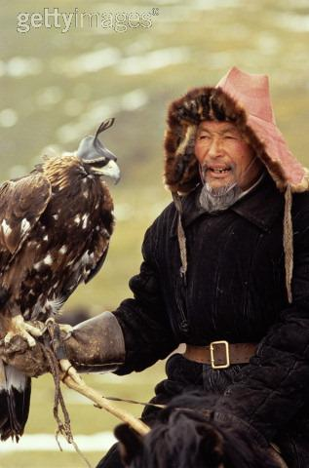
مُدان?

Slide 65
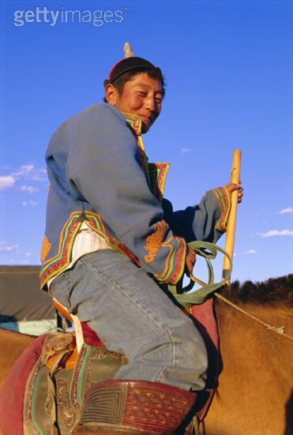
مُدان?

Slide 66

مُدان?

Slide 67

مُدان?

Slide 68

مُدان?

Slide 69

مُدان?

Slide 70

مُدان?

Slide 71

مُدان?

Slide 72

مُدان?

Slide 73

مُدان?

Slide 74
هل كل الأشخاص التاليين
مُدانون حقًا بدون المسيح؟
اجعله مشهوراً
قاب قوسين أو أدنى وفي جميع أنحاء العالم
讓 全 世 界 都 知 道
～直到全地，直到地極～

Slide 75
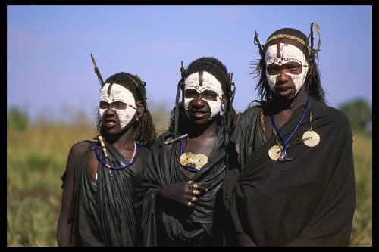

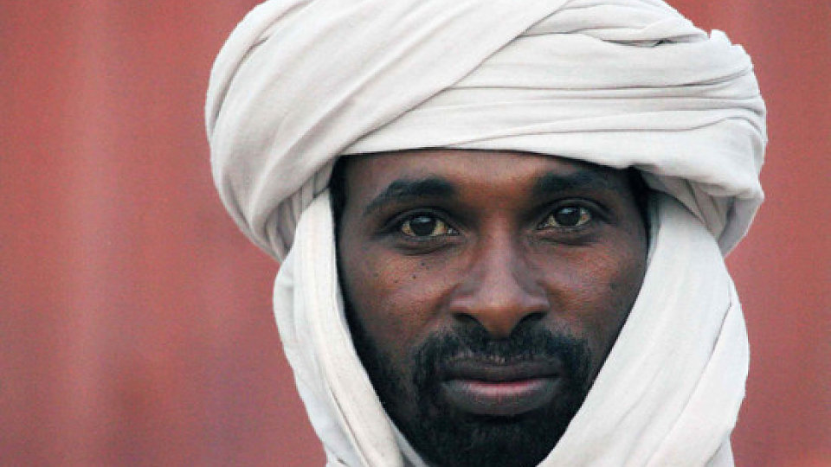
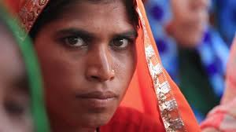
ماذا عن الذين لم نصل إليهم بعد؟
52

Slide 76
الجحيم: ماذا لو
كانت حقيقة؟
Notes:
tomstyle.com/ archive/hell.jpg

Slide 77
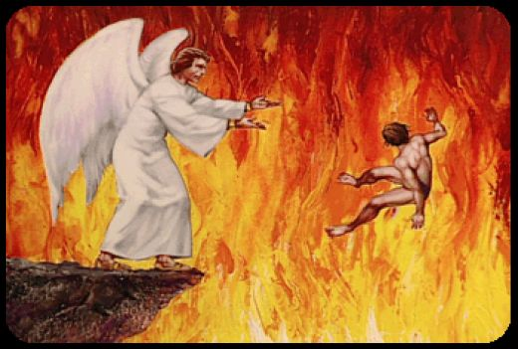
رؤيا ٢٠ : ١٥
وَكُلُّ مَنْ لَمْ يُوجَدْ مَكْتُوباً فِي سِفْرِ الْحَيَاةِ طُرِحَ فِي بُحَيْرَةِ النَّارِ.
438

Slide 78
هجومات على الجحيم
52
الشمولية
الإبادة
المطهر

Slide 79
الشمولية
52
الجزء أ
ما هي:
الحجج المذكورة
الدحض

Slide 80

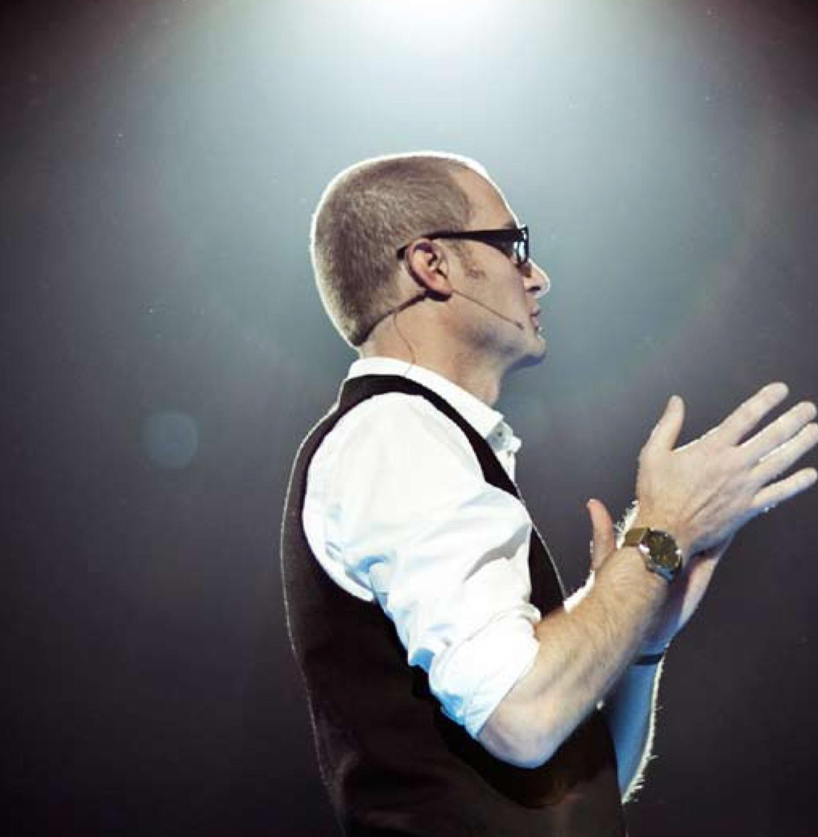
الشمولية
الحالية
Notes:
http://www.cbn.com/cbnnews/us/2011/april/love-wins-pastor-caught-off-guard-by-controversy/
'Love Wins' Pastor Caught Off Guard by Controversy
By Crystal Woodall CBN News Internet Producer
Sunday, April 10, 2011
Print 35 Comment(s)
Ad Feedback
Evangelical megachurch pastor Rob Bell says he was caught off guard by the condemnation his new book has received from leaders in the Christian community.
Standing before an audience of about 1,600 at Nashville's Belmont University, Bell said the last several weeks had been the "most painful" of his life.
"It has taken me to a place of profound brokenness," said Bell, who pastors the 10,000-member Mars Hill Bible Church in Grand Rapids, Mich.
Love Wins: Heaven, Hell, and the Fate of Every Person Who Ever Lived, released March 29, challenges the traditional Christian belief that few will enter Heaven.
"Will only a few select people make it into Heaven and will billions of people burn forever in Hell?" Bell asks in a promotional video of his book, recently released by publisher HarperOne. "And if that's the case, how do you become one of the few?" Watch the video here.
Bell insists it was never his intent to stir controversy, but to bring focus back to a message he suggests has got lost in dogma -- the love of God.
"I kept meeting religious people who were incredibly dogmatic about heaven and hell when you die but didn't seem to care about the fact that 8 million people will go to bed hungry tonight," Bell explained.
Bell denies charges that his book promotes a universalist theology - the belief that everyone, regardless of belief, will be saved by God.
"No, if by universalist we mean there's a giant cosmic arm that swoops everybody in at some point whether you want to be there or not," he told The Christian Post.
"That violates the laws of love and love is about freedom," he explained. "It's about choice; it's about do you want to be there? Because that's what would make it heaven."
According to the Associated Press, Bell says hell is something freely chosen that already exists on earth.
"Apparently this is a pastor who has written a book who has grown uncomfortable contending for the faith," CBN chaplain and Regent University theology professor Joel Palser said. "He is no longer able to defend what the Bible says and has endeavored to make that more palatable to modern culture."
"It may be trendy and it might sell a lot of books, but in fact Jesus speaks very clearly about heaven and hell," Palser added.

Slide 81
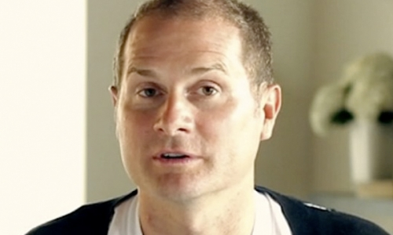
من بين 10000 عضو في كنيسة جراند رابيدز مارس هيل للكتاب المقدس غادر 3000 بعد نشر الكتاب، ثم غادر بيل نفسه إلى كاليفورنيا
لإدارة برنامج حواري متأثر بالإيمان
Notes:
http://www.cbn.com/cbnnews/us/2011/april/love-wins-pastor-caught-off-guard-by-controversy/
'Love Wins' Pastor Caught Off Guard by Controversy
By Crystal Woodall CBN News Internet Producer
Sunday, April 10, 2011
Print 35 Comment(s)
Ad Feedback
Evangelical megachurch pastor Rob Bell says he was caught off guard by the condemnation his new book has received from leaders in the Christian community.
Standing before an audience of about 1,600 at Nashville's Belmont University, Bell said the last several weeks had been the "most painful" of his life.
"It has taken me to a place of profound brokenness," said Bell, who pastors the 10,000-member Mars Hill Bible Church in Grand Rapids, Mich.
Love Wins: Heaven, Hell, and the Fate of Every Person Who Ever Lived, released March 29, challenges the traditional Christian belief that few will enter Heaven.
"Will only a few select people make it into Heaven and will billions of people burn forever in Hell?" Bell asks in a promotional video of his book, recently released by publisher HarperOne. "And if that's the case, how do you become one of the few?" Watch the video here.
Bell insists it was never his intent to stir controversy, but to bring focus back to a message he suggests has got lost in dogma -- the love of God.
"I kept meeting religious people who were incredibly dogmatic about heaven and hell when you die but didn't seem to care about the fact that 8 million people will go to bed hungry tonight," Bell explained.
Bell denies charges that his book promotes a universalist theology - the belief that everyone, regardless of belief, will be saved by God.
"No, if by universalist we mean there's a giant cosmic arm that swoops everybody in at some point whether you want to be there or not," he told The Christian Post.
"That violates the laws of love and love is about freedom," he explained. "It's about choice; it's about do you want to be there? Because that's what would make it heaven."
According to the Associated Press, Bell says hell is something freely chosen that already exists on earth.
"Apparently this is a pastor who has written a book who has grown uncomfortable contending for the faith," CBN chaplain and Regent University theology professor Joel Palser said. "He is no longer able to defend what the Bible says and has endeavored to make that more palatable to modern culture."
"It may be trendy and it might sell a lot of books, but in fact Jesus speaks very clearly about heaven and hell," Palser added.

Slide 82
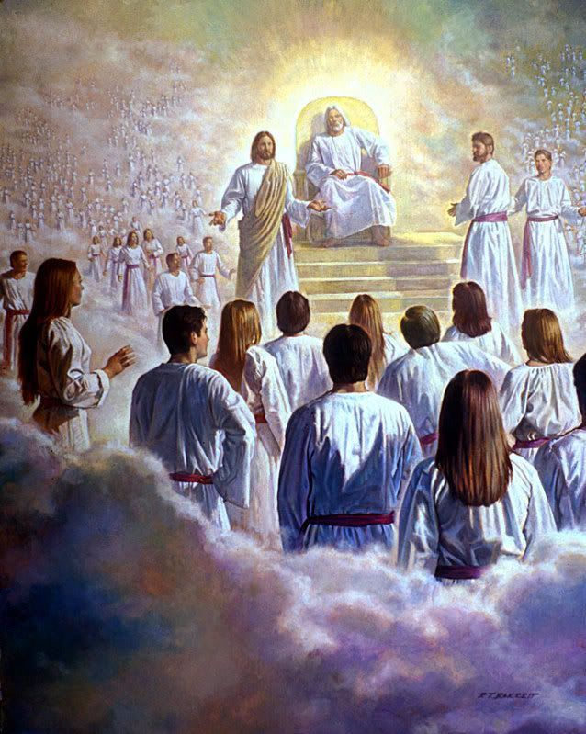
رؤيا ٢٠ : ١١
ثُمَّ رَأَيْتُ عَرْشاً عَظِيماً أَبْيَضَ
438

Slide 83
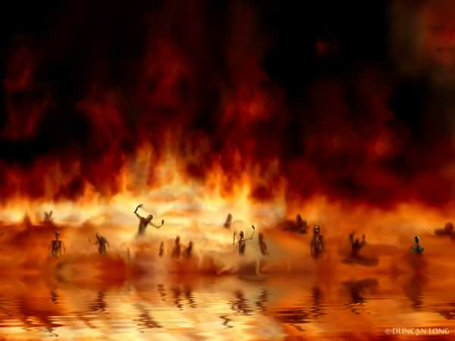
بُحَيْرَةِ النَّارِ
رؤيا ٢٠ : ١٤-١٥
438

Slide 84

الإبادة
52
ما هي؟
الحجج المذكورة
الدحض

Slide 85

مجموعات الإبادة
52
الأدفنتست السبتيين
شهود يهوه
بعض الإنجيليين ؟

Slide 86

حجج الإبادة
52
دحض
الله لطيف جداً فلا يرسل الناس إلى الجحيم الأبدي
الله عادل وقدوس جداً
الدمار يدل على الإبادة
الدمار يشير إلى
الموت الجسدي

Slide 87
تقرير كنيسة إنجلترا
كانون ثاني 1996
الجحيم باعتباره اللاوجود المطلق هو الطريقة التي وضعناها بها. الشياطين الرهيبة هي خيال المخترعين وأهل العصور الوسطى
المطران جون تايلور
أحد مؤلفي التقرير

Slide 88

المطهر
52
الجزء ب
ما هو؟

Slide 89

الحجج المذكورة
للمطهر
52
الجزء ب
ليس صالحاً كفاية للذهاب إلى السماء لكنه ليس شريراً كفاية للذهاب إلى جهنم
2 مكابيين

Slide 90

دحض فكرة
المطهر
52
الجزء ب
الخلاص بالأعمال
سفر أبوكريفي
لا يوجد فرصة ثانية

Slide 91

حجة "الصدق هو الأهم".
52
الجزء ب

Slide 92


وجهة نظر أخرى ...
52
الجزء ب
التجاوب بالإيمان
مع
النور الممنوح
يخلصهم الله
بناء على
موت المسيح
=

Slide 93
الرد المناسب الوحيد على حالة غير المبشرين هو أنهم بالفعل هالكون بدون المسيح.
ويتم دعم ذلك بعدة طرق…
52
الجزء ج

Slide 94

غضب الله (رومية 1: 18-20)
155ي
جزء 1
الحقيقة (18أ)
السبب (18ب-20أ)
النتيجة (20ب)

Slide 95


Why You Are Without Excuse (Romans 1:20)
لماذا أنت بدون
عذر
رومية 1: 20
Notes:
Please translate the text at the left and then drag everything over this slide so no English shows. Make sure the fonts remain.

Slide 96

رومية 1: 20
155ي
شخص غير محدود
شخص خارق للطبيعة
لأن أموره غير المنظورة ترى منذ خلق العالم مدركة بالمصنوعات قدرته السرمدية و لاهوته حتى إنهم بلا عذر

Slide 97
رومية 1: 20
161
منذ بداية الخليقة
يرى الناس الله
24 يوم حرفي
لأن أموره غير المنظورة ترى منذ خلق العالم مدركة بالمصنوعات قدرته السرمدية ولاهوته حتى إنهم بلا عذر

Slide 98

إنه قرارك

Slide 99

لماذ الله غاضب على الأمم
(رو 1: 21-32)
155ي
ي.1 ب
رفضوا الله (21-23)
سلمهم الله
النجاسة (24)
الوثنية (25)
سلمهم الله
الشذوذ الجنسي (26-27)

Slide 100

ماذا عن المثلية الجنسية؟

Slide 101

ماذا عن الزواج من نفس الجنس ؟
أنظر مجلس أبحاث الأسرة على موقع يوتيوب
Notes:
The link is http://www.youtube.com/watch?v=nPgZ2Mq1Ugw

Slide 102
لماذ الله غاضب على الأمم
(رو 1: 21-32)
155ي
ي.1 ب
رفضوا الله (21-23)
سلمهم الله
النجاسة (24)
الوثنية (25)
سلمهم الله
الشذوذ الجنسي (26-27)
سلمهم الله
الفساد (28-32)

Slide 103

الجميع تحت الخطية
155ي
^{10ب أنه ليس بار ولا واحد}
11 ليس من يفهم ليس من يطلب الله
12 الجميع زاغوا وفسدوا معاً ليس من يعمل صلاحاً ليس ولا واحد
13 حنجرتهم قبر مفتوح بألسنتهم قد مكروا سم الأصلال تحت شفاههم
^{14 وفمهم مملوء لعنة ومرارة}
^{15 أرجلهم سريعة إلى سفك الدم}
^{16 في طرقهم اغتصاب وسحق}
^{17 وطريق السلام لم يعرفوه}
^{18 ليس خوف الله قدام عيونهم}
  (رو 3: 10ب-18)

Slide 104
لأَنَّهُ بِأَعْمَالِ النَّامُوسِ كُلُّ ذِي جَسَدٍ لاَ يَتَبَرَّرُ أَمَامَهُ
^{رومية ٣ : ١٩-٢٠}
١٩ وَنَحْنُ نَعْلَمُ أَنَّ كُلَّ مَا يَقُولُهُ النَّامُوسُ فَهُوَ يُكَلِّمُ بِهِ الَّذِينَ فِي النَّامُوسِ لِكَيْ يَسْتَدَّ كُلُّ فَمٍ وَيَصِيرَ كُلُّ الْعَالَمِ تَحْتَ قِصَاصٍ مِنَ اللهِ.
٢٠ لأَنَّهُ بِأَعْمَالِ النَّامُوسِ كُلُّ ذِي جَسَدٍ لاَ يَتَبَرَّرُ أَمَامَهُ. لأَنَّ بِالنَّامُوسِ مَعْرِفَةَ الْخَطِيَّةِ.

Slide 105

أعمال ٨:١
أقصى الأرض
لكنكم ستنالون قوة
متى حل
الروح القدس عليكم وتكونون لي شهوداً
في أورشليم
وفي كل اليهودية والسامرة
وإلى أقصى الأرض
السامرة
أورشليم
اليهودية
Notes:
What is the significance of the threefold regions (8)?
Geographically, they go from the near to the far.
By size, it begins with a city, goes to regions and then beyond regions.
Culturally, they begin with the familiar and stretch to the unfamiliar.
Chronologically, it begins in AD 33 and finishes in AD 62—as well as to today.
__________
NS-05-Acts1-2-slides 63, 204

Slide 106

دعوة بولس
الأمم ضمن الجسد
155ح
ج3

Slide 107

خدمة بولس غرباً
155ح
ج3
إلليريكون
روما
أورشليم

Slide 108

رومية 15:20-22
رومية ١٥ : ٢٠-٢٢
وَلَكِنْ كُنْتُ مُحْتَرِصاً أَنْ أُبَشِّرَ هَكَذَا: لَيْسَ حَيْثُ سُمِّيَ الْمَسِيحُ لِئَلاَّ أَبْنِيَ عَلَى أَسَاسٍ لِآخَرَ. ٢١ بَلْ كَمَا هُوَ مَكْتُوبٌ: «الَّذِينَ لَمْ يُخْبَرُوا بِهِ سَيُبْصِرُونَ وَالَّذِينَ لَمْ يَسْمَعُوا سَيَفْهَمُونَ». ٢٢ لِذَلِكَ كُنْتُ أُعَاقُ الْمِرَارَ الْكَثِيرَةَ عَنِ الْمَجِيءِ إِلَيْكُمْ.
155ح
ج3

Slide 109

الحجة المنطقية
155ح
ج4
إذا لم يكن الذين لم يتم الوصول إليهم متجهين إلى الجحيم، فأسوأ شيء يمكن أن يفعله المسيحي هو أن يخبرهم عن المسيح! لماذا؟ لأنهم إذا سمعوا الرسالة، هناك احتمال أن يرفضوها ويذهبوا إلى الجحيم؛ ومع ذلك، إذا لم يسمعوا الرسالة في المقام الأول، فإن الجحيم ليس احتمالًا. ولذلك فإن أفضل قرار هو إعادة استدعاء جميع المبشرين لدينا.

Slide 110


ما هو الفرق؟
155ح
الجزء 2
النعمة
الرحمة
... الله
يعطينا
ما لا
نستحقه
... الله
لا يعطينا
ما نستحقه
بالفعل

Slide 111

ماذا عن الأطفال
الذين يموتون؟
155ح
الجزء 2
أؤمن أنهم يذهبون إلى السماء بالإعتماد على نصين كتابيين
1. أظهر داود ثقته في رؤية ابنه الرضيع الذي مات (2 صم 12: 23)
2. ذكر يسوع أن ملكوت الله هو للأطفال (مر 10: 14-15)

Slide 112

كيف يمكنني
إيصال الجحيم
إلى غير المسيحيين؟
155ح
الجزء 3
بعض الإقتراحات:
أ. لا تخف أن تتكلم عن الجحيم فيسوع لم يخف. تكلم يسوع عن الجحيم أكثر مما تكلم عن السماء.
ب. تكلم عن الخطية في مشاركاتك للإنجيل. تكلم عن كون الله قدوساً وعادلاً ولهذا فإنه سيدين الخطية
ت. ذكر غير المؤمنين أن الجحيم معد لإبليس وملائكته (مت 25: 41) والإنسان من خلال عصيانه سيدخل إلى هذا الإعداد

Slide 113
كيف يمكنني
إيصال الجحيم
إلى غير المسيحيين؟
155ح
الجزء 3
بعض الإقتراحات:
ث. تجنب الحديث عن الجحيم والخطية كانفصال روحي عن الله. فغير المؤمنين أصلاً منفصلين عن الله وبسبب خطيتهم فقد أقنع الكثيرون أنفسهم أن الإنفصال عن الله هو أمر جيد – فلا يبدو ذلك لهم نوعاً من العقوبة
ج. علّم عن الجحيم بتوازن مع المزيد من العقائد الأساسية

Slide 114
الخلاص بالأعمال
آيات عن الأعمال
رو 2: 6 الذي سيجازي كل واحد حسب أعماله
رو 2: 7 أما الذين بصبر في العمل الصالح يطلبون المجد والكرامة والبقاء فبالحياة الأبدية
رو 2: 8 وأما الذين هم من أهل التحزب ولا يطاوعون للحق بل يطاوعون للإثم فسخط وغضب
رو 2: 13 لأن ليس الذين يسمعون الناموس هم أبرار عند الله بل الذين يعملون بالناموس هم يبررون
التفسير
يبدو أن هذه الآيات تعلم الخلاص بالأعمال بينما تعلم الآيات الأخرى الخلاص بالإيمان (على سبيل المثال، رومية 3: 20). ويبدو أن بولس يعلم الخلاص بالأعمال في أماكن أخرى (راجع ١ كورنثوس ٦: ٩-١١؛ ٢ كورنثوس ٥: ١٠؛ غلاطية ٥: ٢١) لكنه لم يرى أن هذه الأمور متناقضة.
من الأفضل أن ننظر إلى رومية 2: 7، 13 على أنها افتراضية. يقول بولس ببساطة أن الحياة الأبدية ستكون ممكنة إذا تمكن الإنسان من حفظ الناموس بالكامل، ولكن بما أنه لا يستطيع أحد أن يفعل ذلك، فالجميع على حد سواء تحت الخطية.
هذا يتفق مع حجته أن كل البشر هم تحت الدينونة في رومية 1-3 وهذا يتناغم بشكل جيد مع 3: 19-20
155g
54

Slide 115

هل يمكنك فعلاً القول
الله يحبك
لأي شخص؟

Slide 116
Black

Slide 117


الرابط للعرض التقديميِّ "علم الخلاص (سوتوريولوجيا)" متاحٌ على الموقع الإلكترونيّ:
BibleStudyDownloads.org
أحصل على هذا العرض التقديميِّ مجَّانًا
Notes:
SA Salvation (Soteriology) in Arabic
_____________
Common-38

