Slide 1
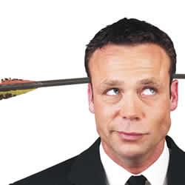
المزاح في الوعظ
254
د. ريك جريفيث مؤسسة الدراسات اللاهوتية الأردنية
BibleStudyDownloads.org

Slide 2
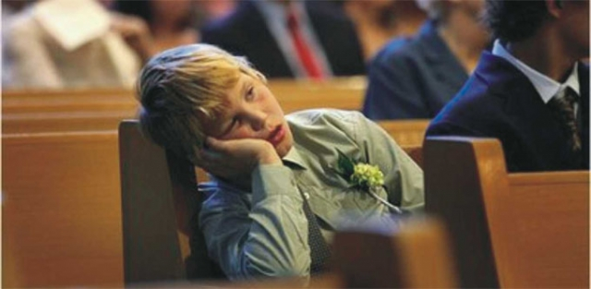
كيف نستطيع أن نوقظهم؟
Notes:
Laughter is good medicine for us all—but especially for youth and kids who think church is boring.
Somehow church is one od the sleepiest places on earth—so how can we wake them up?

Slide 3
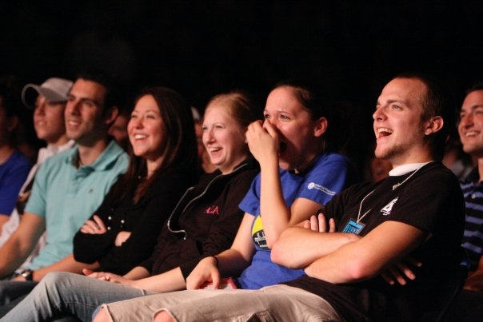
مازحهم
Notes:
Laughing is one of the best ways to keep your audience’s attention.

Slide 4
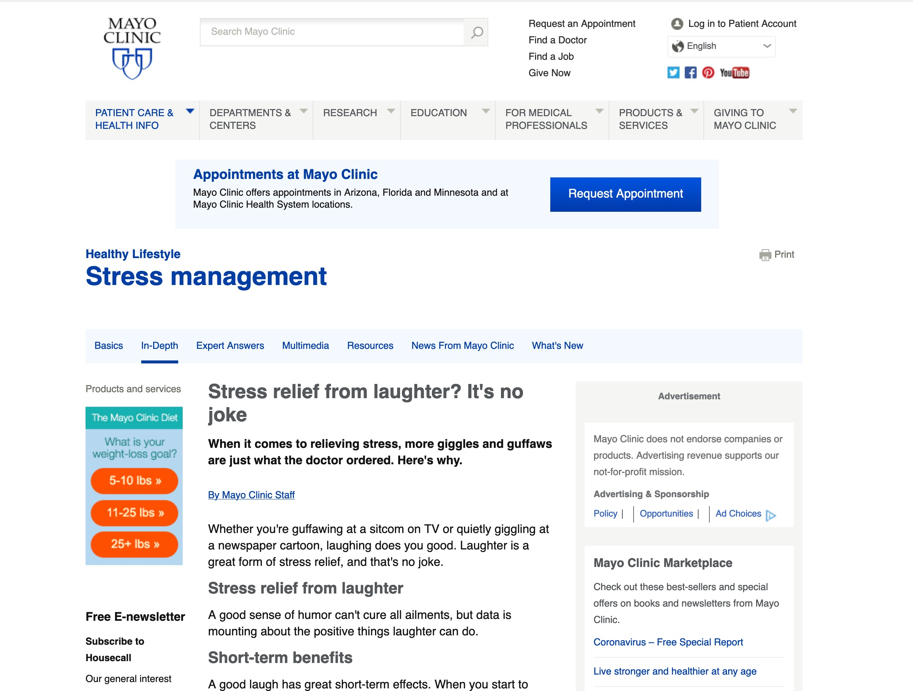
تخفيف التوتر من الضحك؟ انها ليست نكتة.
Notes:
Stress relief from laughter? It's no joke
When it comes to relieving stress, more giggles and guffaws are just what the doctor ordered. Here's why.
By Mayo Clinic Staff
Whether you're guffawing at a sitcom on TV or quietly giggling at a newspaper cartoon, laughing does you good. Laughter is a great form of stress relief, and that's no joke.
Stress relief from laughter
A good sense of humor can't cure all ailments, but data is mounting about the positive things laughter can do.
Short-term benefits
A good laugh has great short-term effects. When you start to laugh, it doesn't just lighten your load mentally, it actually induces physical changes in your body. Laughter can:
Stimulate many organs. Laughter enhances your intake of oxygen-rich air, stimulates your heart, lungs and muscles, and increases the endorphins that are released by your brain.
Activate and relieve your stress response. A rollicking laugh fires up and then cools down your stress response, and it can increase and then decrease your heart rate and blood pressure. The result? A good, relaxed feeling.
Soothe tension. Laughter can also stimulate circulation and aid muscle relaxation, both of which can help reduce some of the physical symptoms of stress.
Long-term effects
Laughter isn't just a quick pick-me-up, though. It's also good for you over the long term. Laughter may:
Improve your immune system. Negative thoughts manifest into chemical reactions that can affect your body by bringing more stress into your system and decreasing your immunity. By contrast, positive thoughts can actually release neuropeptides that help fight stress and potentially more-serious illnesses.
Relieve pain. Laughter may ease pain by causing the body to produce its own natural painkillers.
Increase personal satisfaction. Laughter can also make it easier to cope with difficult situations. It also helps you connect with other people.
Improve your mood. Many people experience depression, sometimes due to chronic illnesses. Laughter can help lessen your depression and anxiety and may make you feel happier.
Improve your sense of humor
Are you afraid you have an underdeveloped — or nonexistent — sense of humor? No problem. Humor can be learned. In fact, developing or refining your sense of humor may be easier than you think.
Put humor on your horizon. Find a few simple items, such as photos, greeting cards or comic strips, that make you chuckle. Then hang them up at home or in your office. Keep funny movies, books, magazines or comedy videos on hand for when you need an added humor boost. Look online at joke websites. Go to a comedy club.
Laugh and the world laughs with you. Find a way to laugh about your own situations and watch your stress begin to fade away. Even if it feels forced at first, practice laughing. It does your body good.
Consider trying laughter yoga. In laughter yoga, people practice laughter as a group. Laughter is forced at first, but it can soon turn into spontaneous laughter.
Share a laugh. Make it a habit to spend time with friends who make you laugh. And then return the favor by sharing funny stories or jokes with those around you.
Knock, knock. Browse through your local bookstore or library's selection of joke books and add a few jokes to your list that you can share with friends.
Know what isn't funny. Don't laugh at the expense of others. Some forms of humor aren't appropriate. Use your best judgment to discern a good joke from a bad or hurtful one.
Laughter is the best medicine
Go ahead and give it a try. Turn the corners of your mouth up into a smile and then give a laugh, even if it feels a little forced. Once you've had your chuckle, take stock of how you're feeling. Are your muscles a little less tense? Do you feel more relaxed or buoyant? That's the natural wonder of laughing at work.
Published 5 April 2019
https://www.mayoclinic.org/healthy-lifestyle/stress-management/in-depth/stress-relief/art-20044456
Accessed 21 April 2020

Slide 5
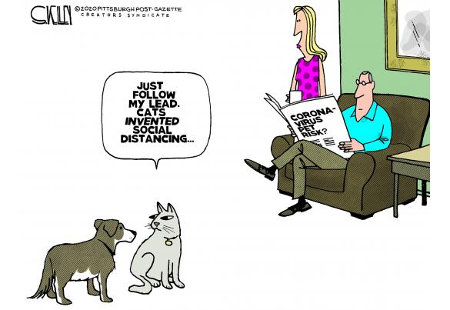
كوفيد - 19
اتبع قيادتي فقط
اخترعت القطط
التباعد الإجتماعي
Notes:
Restatement

Slide 6
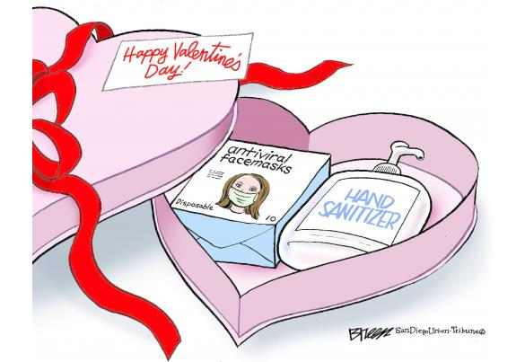
COVID-19
Notes:
Restatement

Slide 7
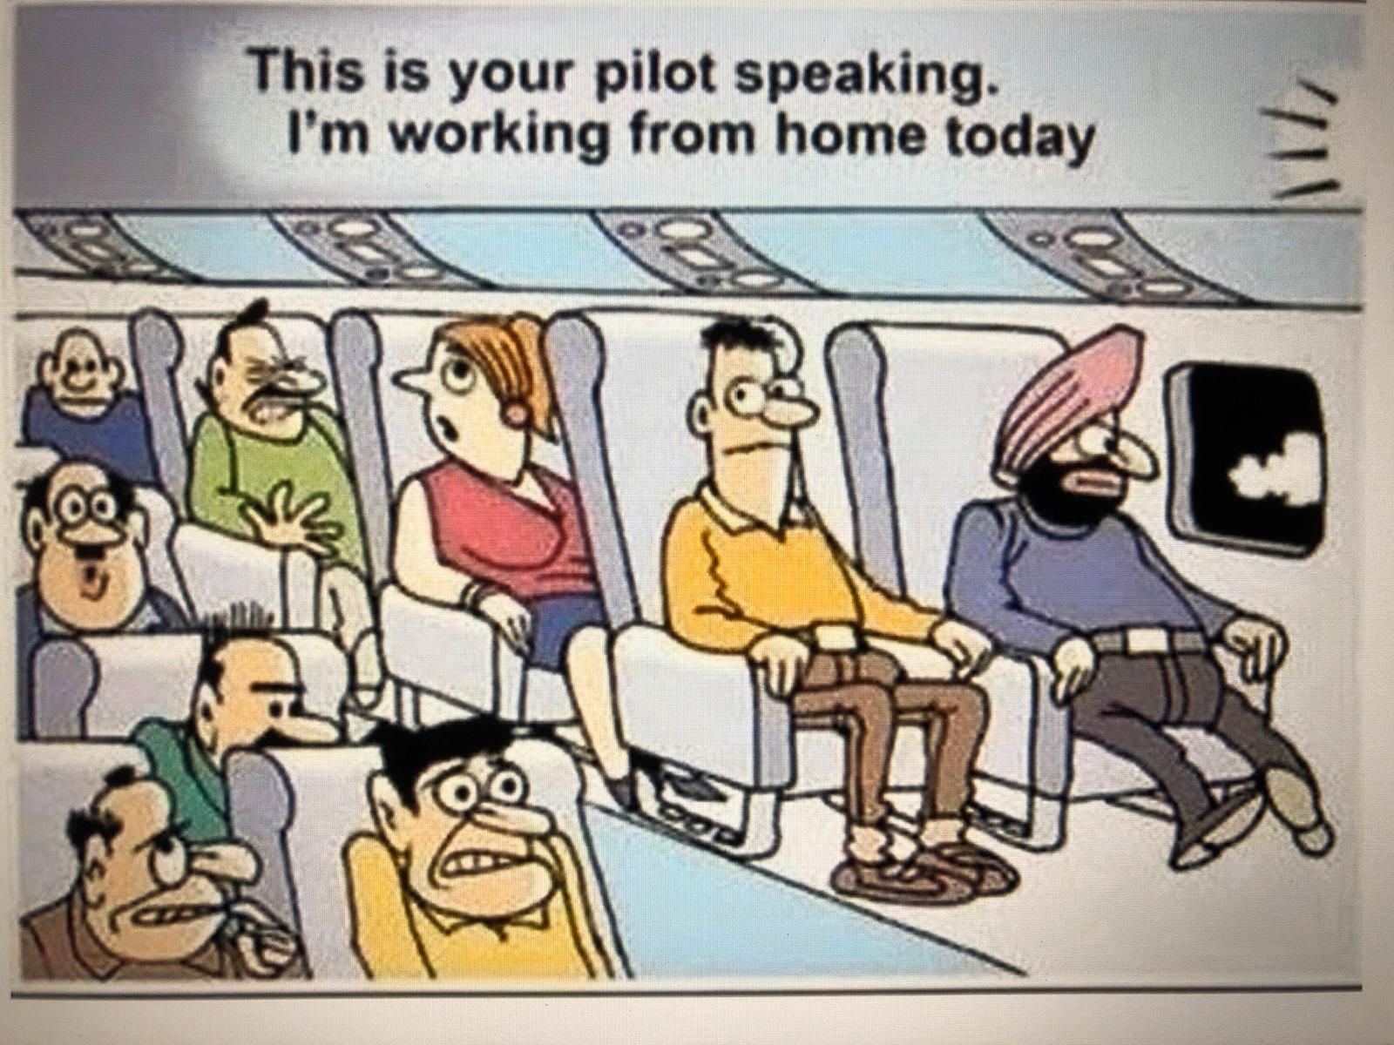
COVID-19
الطيار يتكلم هنا انا أعمل من المنزل اليوم
Notes:
Restatement

Slide 8
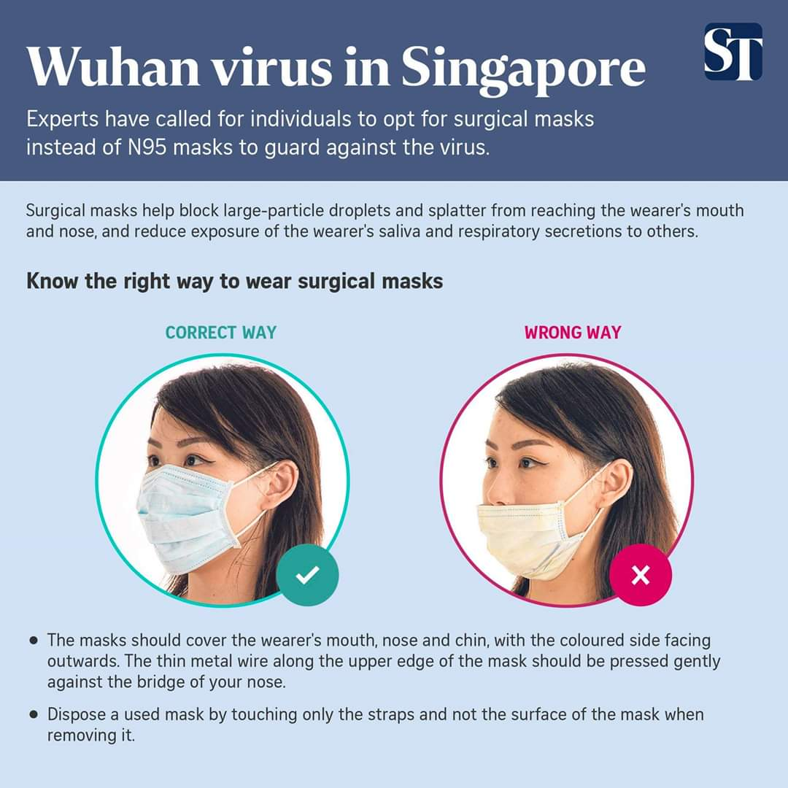
COVID-19
اعرف الطريقة الصحيحة لارتداء الأقنعة الطبية
الطريقة الصحيحة
الطريقة الخاطئة
Notes:
Restatement

Slide 9
كوفيد - 19
الرجاء ارتداء القناع
في المنزل أيضاً ...
خصوصاً عندما تكون
وحيداً ...
سوف يمنعك من
الأكل أكثر
Notes:
Restatement

Slide 10
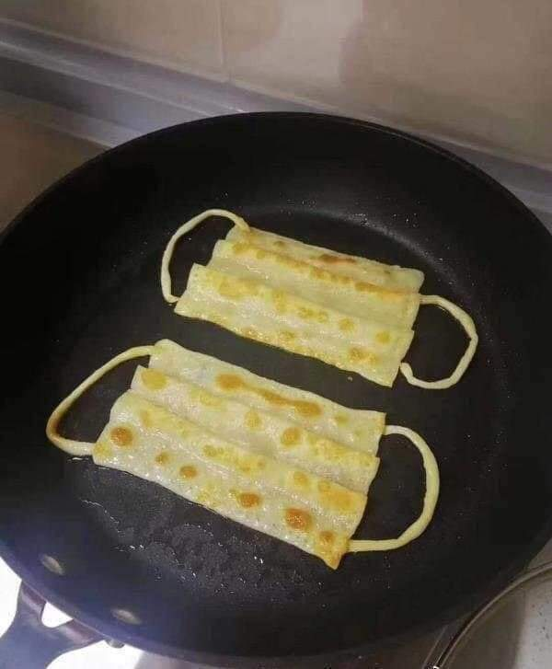
أقنعة براتا
Notes:
Restatement

Slide 11
COVID-19
هل تعلم لماذا يوجد حالات كوفيد في الولايات المتحدة أكثر من اليابان
اليابان مقابل أمريكا
أنظر إلى الطريقة التي يرتدون بها الأقنعة
Notes:
Restatement

Slide 12
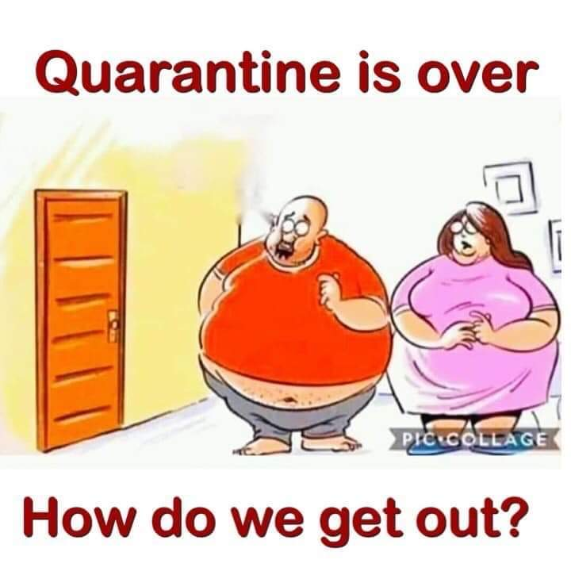
COVID-19
انتهى الحجر
والآن كيف نستطيع الخروج؟
Notes:
Restatement

Slide 13
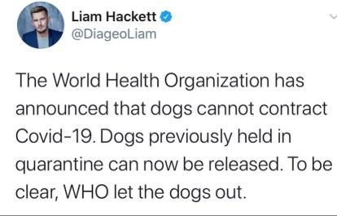
COVID-19
أعلنت منظمة الصحة العالمية أن الكلاب لا يمكن أن تصاب بفيروس كورونا. يمكن الآن إطلاق سراح الكلاب المحتجزة سابقاً في الحجر الصحي. لنكون واضحين فإن منظمة الصحة العالمية هي التي سمحت للكلاب بالخروج
Notes:
Restatement

Slide 14
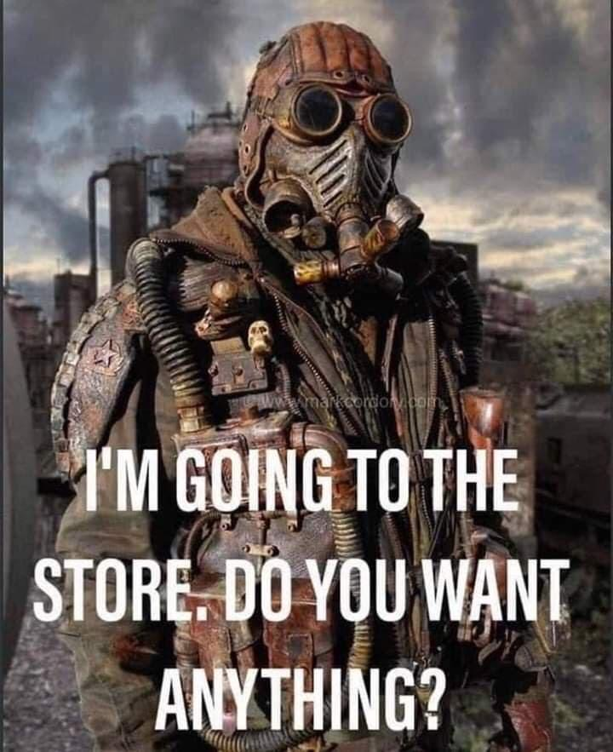
أنا ذاهب إلى المتجر أتريد شيئاً؟
Notes:
Restatement

Slide 15
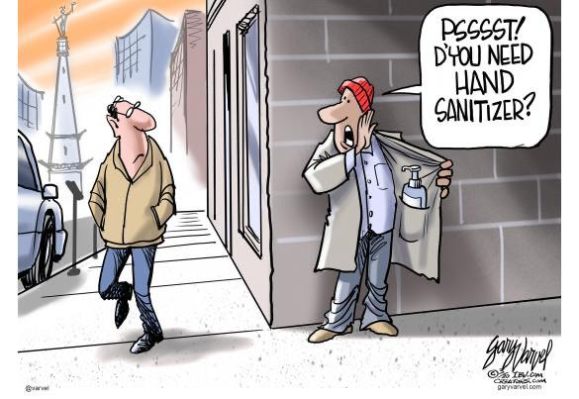
COVID-19
بست
هل تريد
معقم الأيدي؟
Notes:
Restatement

Slide 16
COVID-19
يجب حضور الكنيسة لسببين
Notes:
Restatement

Slide 17
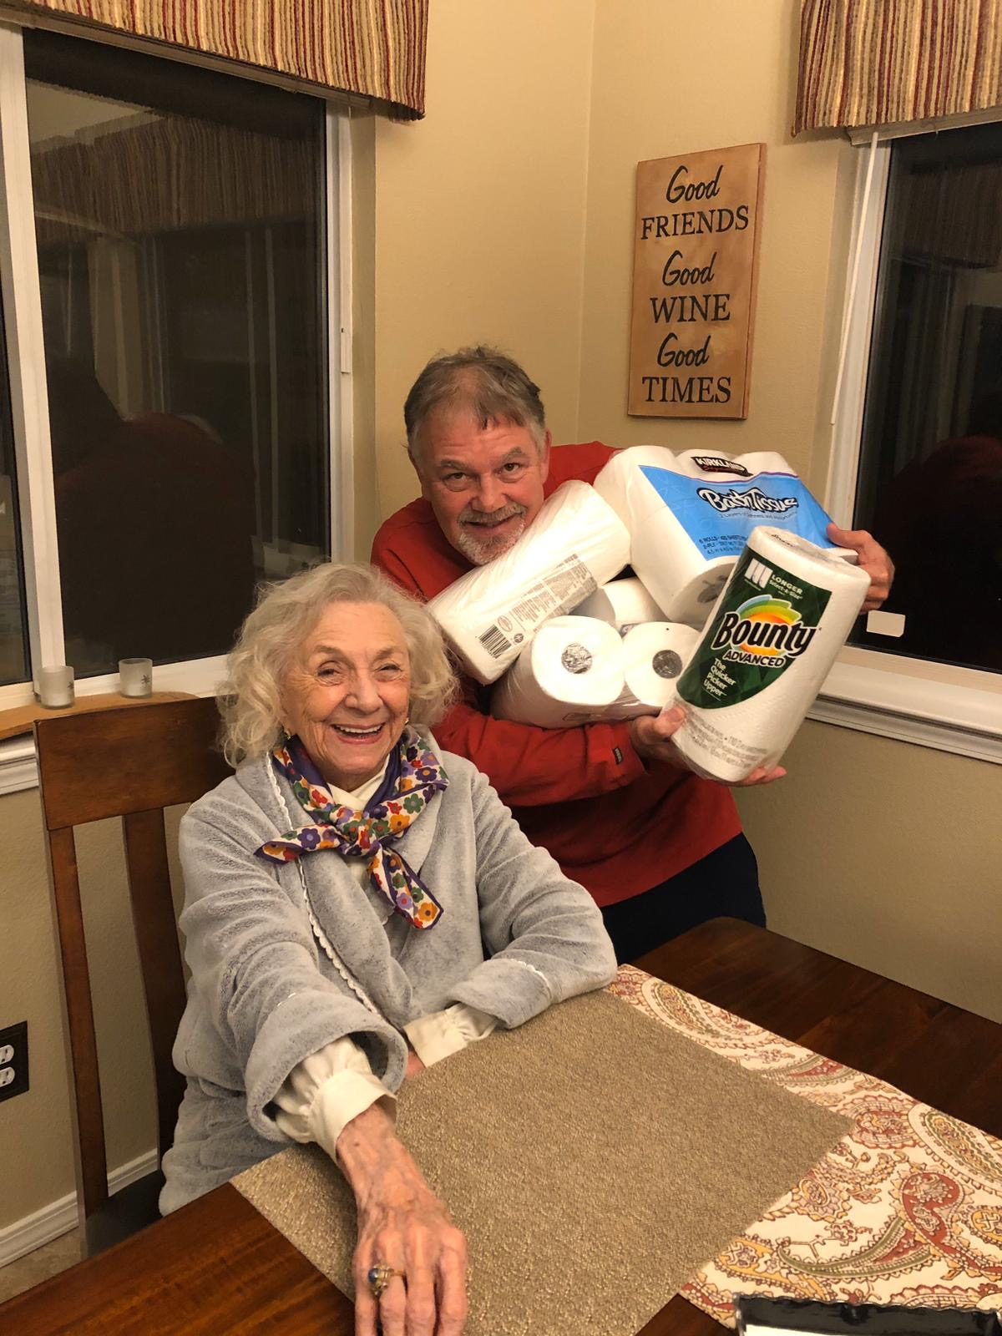
ذهبت أمي لتعيش مع إخوتي وحزمت أمتعتها وفقاً لذلك
Notes:
Restatement

Slide 18
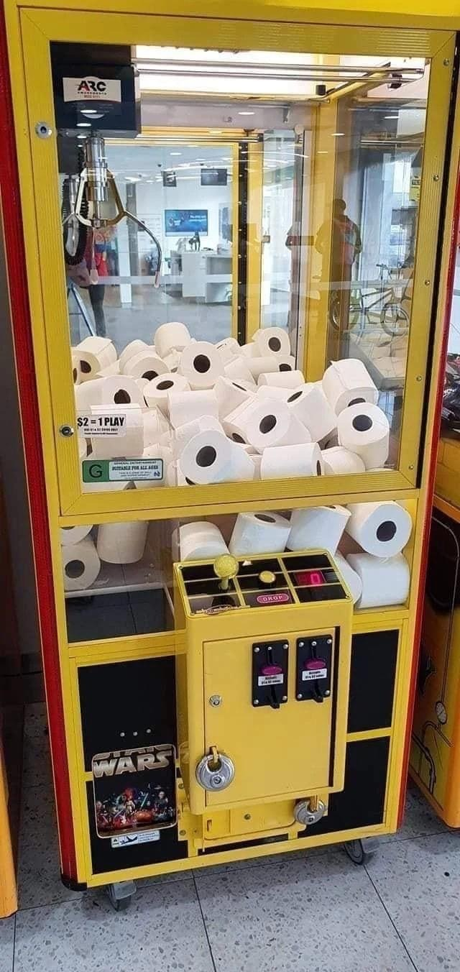
جرّب حظك

Slide 19
COVID-19
ورق التواليت 3999 دولار
مجاناً: خاتم ألماس قيراط واحد عند الشراء
Notes:
Restatement

Slide 20
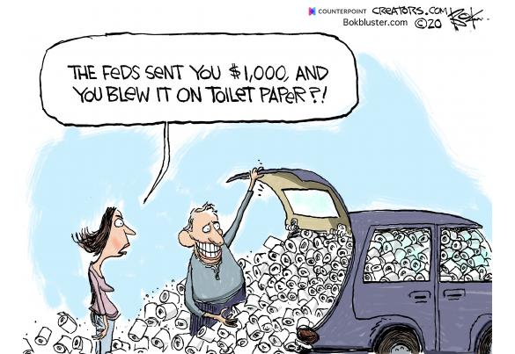
COVID-19
أرسل لك البنك الفيدرالي 1000 دولار، وقمت بصرفها على ورق التواليت؟
Notes:
Restatement

Slide 21
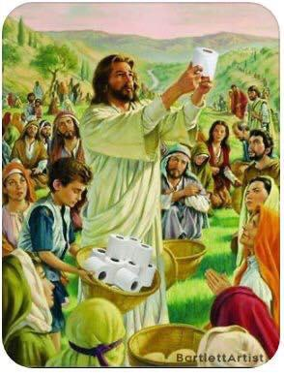
COVID-19
Notes:
Restatement

Slide 22
COVID-19
وقال يسوع: حلّوه ...
نحن نحتاج بالفعل إلى ورق التواليت
Notes:
Restatement

Slide 23
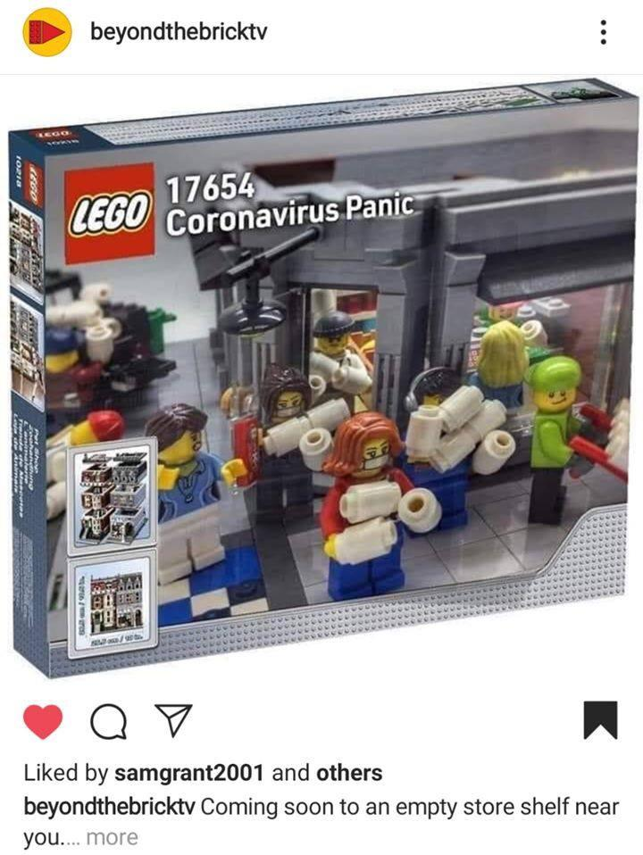
COVID-19
Notes:
Restatement

Slide 24
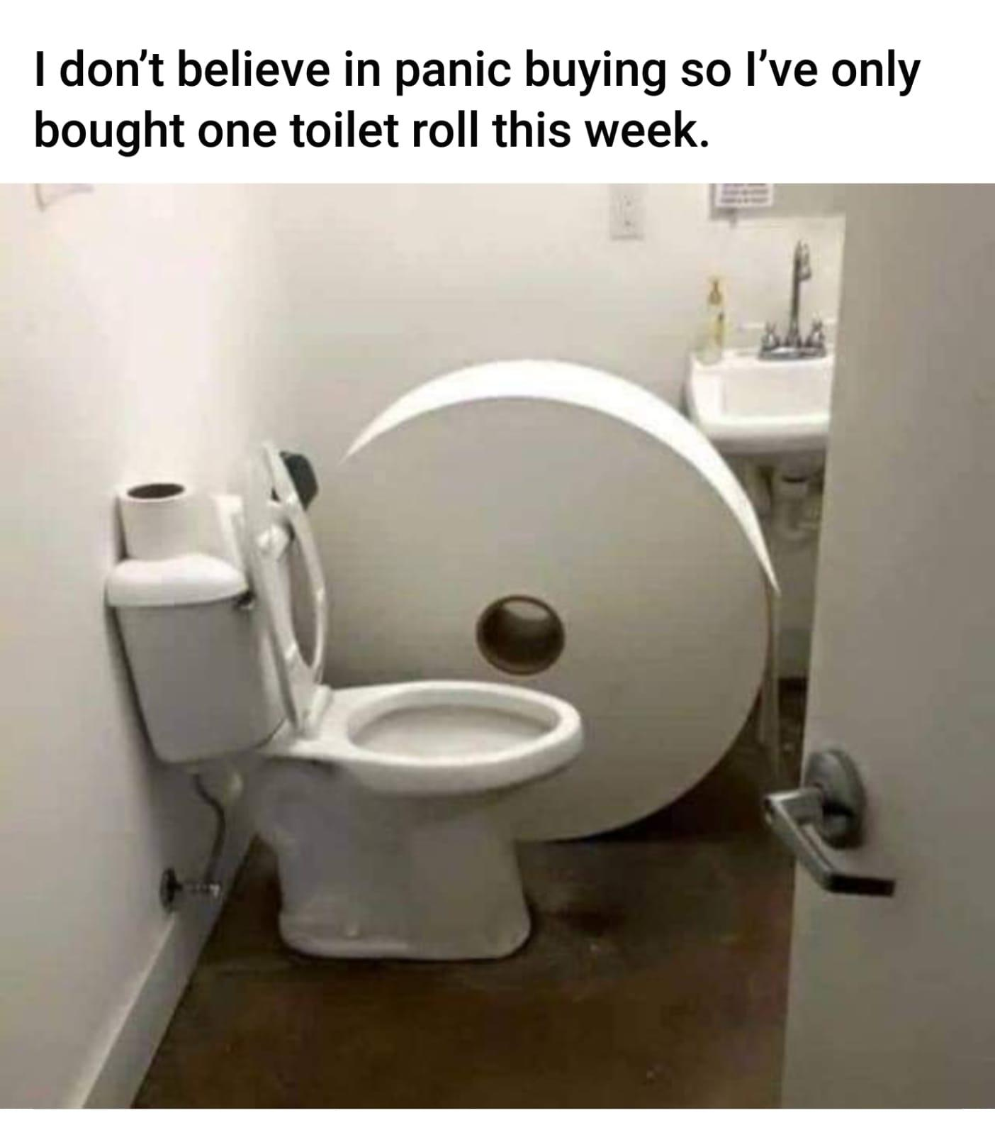
COVID-19
أنا لا أؤمن بالشراء بدافع الذعر
لذا اشتريت مناديل حمام واحدة فقط هذا الأسبوع.
Notes:
Restatement

Slide 25
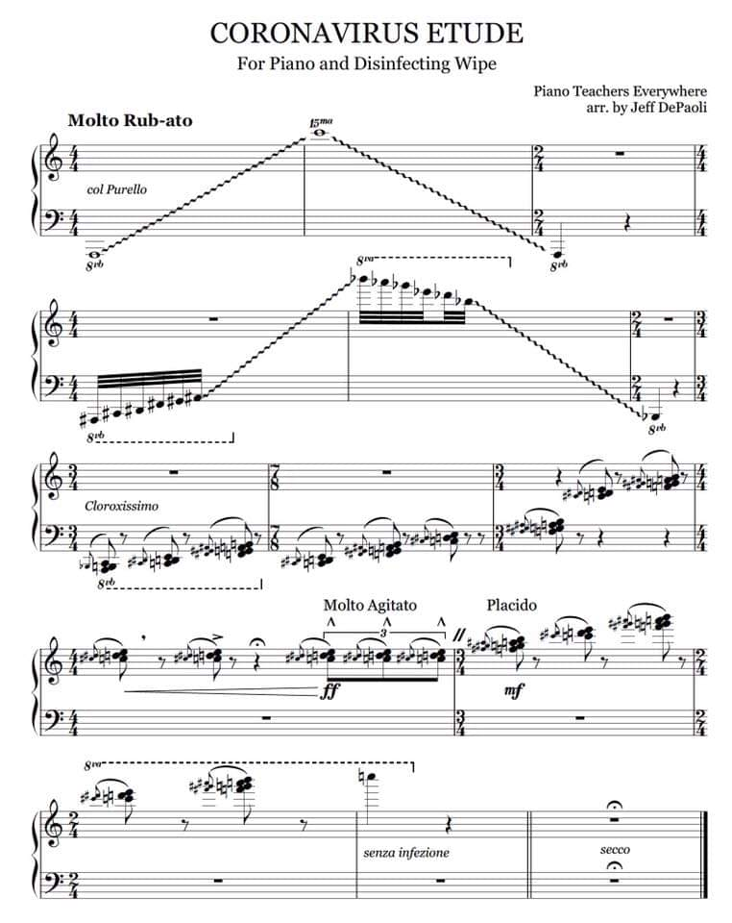
COVID-19
قطعة فيروس كورونا الفنية
للبيانو ومسح التطهير
Notes:
Restatement

Slide 26
هل تعرف أحداً لا يحب المزاح؟
يبدو أننا لا نسير على أرض خطرة هنا.
حاول أن تخفف من حدة الناس قليلاً

Slide 27
صفيحة...
254
د. روي لو
ق. جيم إنغ

Slide 28
لماذا هذا الدماغ الأيسر؟

Slide 29
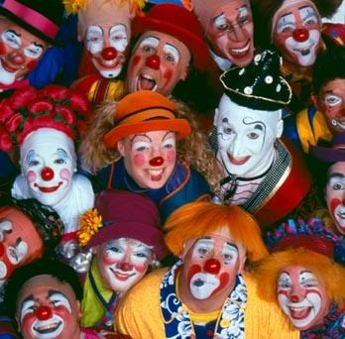
كيف تكون مرحاً

Slide 30
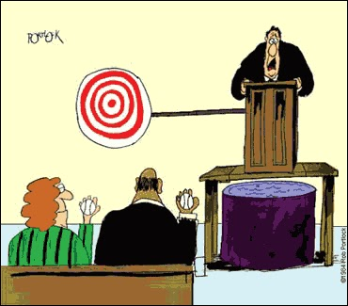
مخاطر المزاح

Slide 31
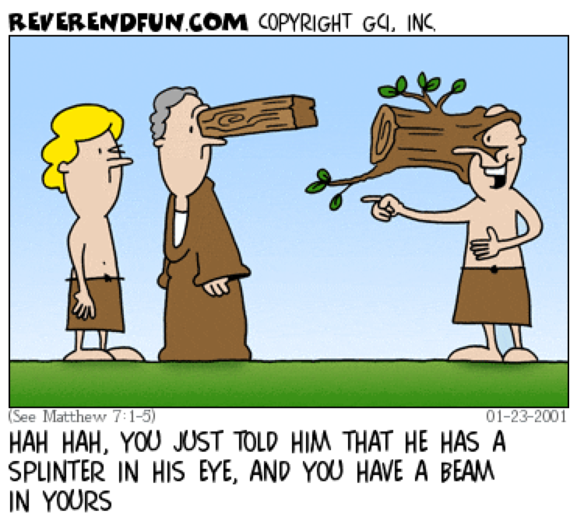
كان يسوع مرحاً
هاها، لقد أخبرته للتو أن لديه قذى في عينه وأنت لديك عارضة خشبية في عينك.

Slide 32
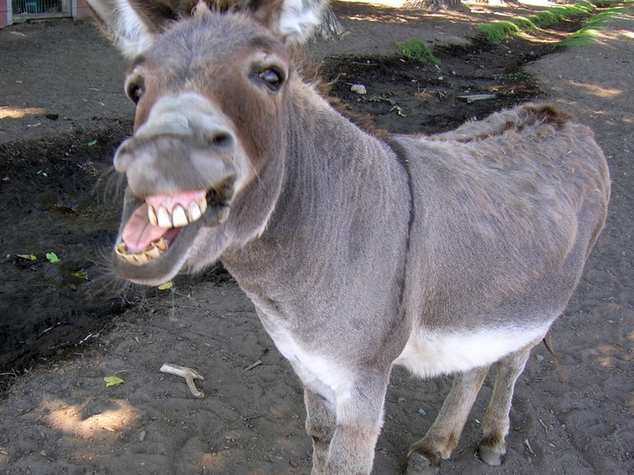
BLACK

Slide 33
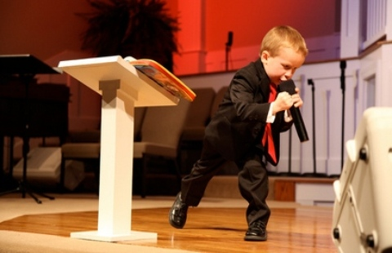
اذهب خلفها
Notes:
The USA has a 4-year-old child preacher…
Kanon Tipton, 4, first took the microphone at his family's church when he was just 21 months old. Two years and a few million YouTube hits later, the young preacher has developed quite a reputation. His emotional delivery, dramatic cadence and back-and-forth pacing behind the pulpit are faithful replications of the mannerisms he's seen demonstrated by other preachers.
On Tuesday, Kanon and his parents appeared on NBC's The Today Show to talk about the young preacher's amazing talent. Asked whether he thought Kanon has a true calling for ministry or if he was merely mimicking what he had seen from others, Kanon's father, Pastor Damon Tipton, said, "I think it's a little of both ... I do feel like the hand of God is on him in a special way." Kanon is the third generation of preachers in his family, following in the footsteps of both his father and grandfather.
https://www.huffpost.com/entry/kanon-tipton-child-preacher_n_928208
Kanon Tipton, 4-Year-Old Preacher, Gains YouTube Fame (VIDEO)
WATCH: 4-Year-Old Preaching Sensation
Aug 16, 2011, 11:56 AM EDT| Updated Dec 6, 2017
Accessed 28 Jan 2024

Slide 34
لا تظن أن الكتاب المقدس نفسه ليس مرحاً

Slide 35
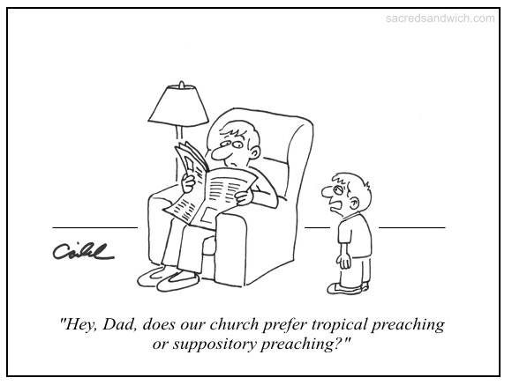
Suppository Preaching
يا أبي هل تفضل كنيستنا الوعظ الموضوعي أم الوعظ التحميلي؟

Slide 36
BLACK

Slide 37
الرابط للعرض التقديميِّ "فن الوعظ" متاحٌ على الموقع الإلكترونيّ: BibleStudyDownloads.org
أحصل على هذا العرض التقديمي مجاناً
Notes:
PR Preaching (Homiletics) Arabic
_____________
Common-36

