Slide 1
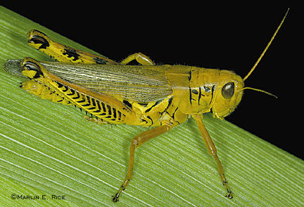
عنوان يوئيل
يوئيل
د. ريك جريفيث. مؤسسة الدراسات اللاهوتية الأردنية
BibleStudyDownloads.org

Slide 2
الكلمة المفتاحية
575
343
الجراد
يوئيل

Slide 3
الموضوع الرئيسي
575
يوم الرب
يوئيل

Slide 4
الآية المفتاحية
575
لأن يوم الرب عظيم ومخوف جداً فمن يطيقه؟
ولكن الآن يقول الرب ارجعوا إليَّ بكل قلوبكم
وبالصوم والبكاء والنوح (2: 11ب -12)
يوئيل

Slide 5

بيان الملكوت
343
أدّب الله إسرائيل عن طريق الجراد
وسيفعل ذلك ثانية بطرق أخرى
(2: 1-17) لكنه في الأخير
سيعيد حكم الأمة بعد توبتها
(2: 18-3: 21).
يوئيل

Slide 6
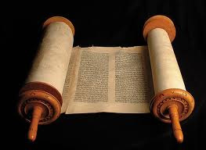
البيان الموجز
575
346
إن دينونة يهوذا الأخيرة عن طريق الجراد
يجب أن تجعل الناس يتوبون
لأن يوم الرب المخوف سيأتي
عن طريق الغزو البابلي.
ومع ذلك فإن الله يعد بالمغفرة
والخلاص والإسترداد من خلال دينونة الأمم.
يوئيل

Slide 7

العهد
347 ج
إن وعد الله بالسكن في أورشليم إلى الأبد (3: 17-21) وإرسال روحه (2: 18-32) متجذر في عهده لحماية أورشليم كمدينته المختارة
(1مل 8: 23-61؛ قارن مع رؤ 21: 3).
يوئيل

Slide 8

الفداء
347 ج
الخلاص من دينونة الله (1: 1-2: 17)
سيأتي فقط لإسرائيل التائبة
التي تدعو باسم الرب (2: 32؛ قارن مع 2: 12-14).
يوئيل

Slide 9
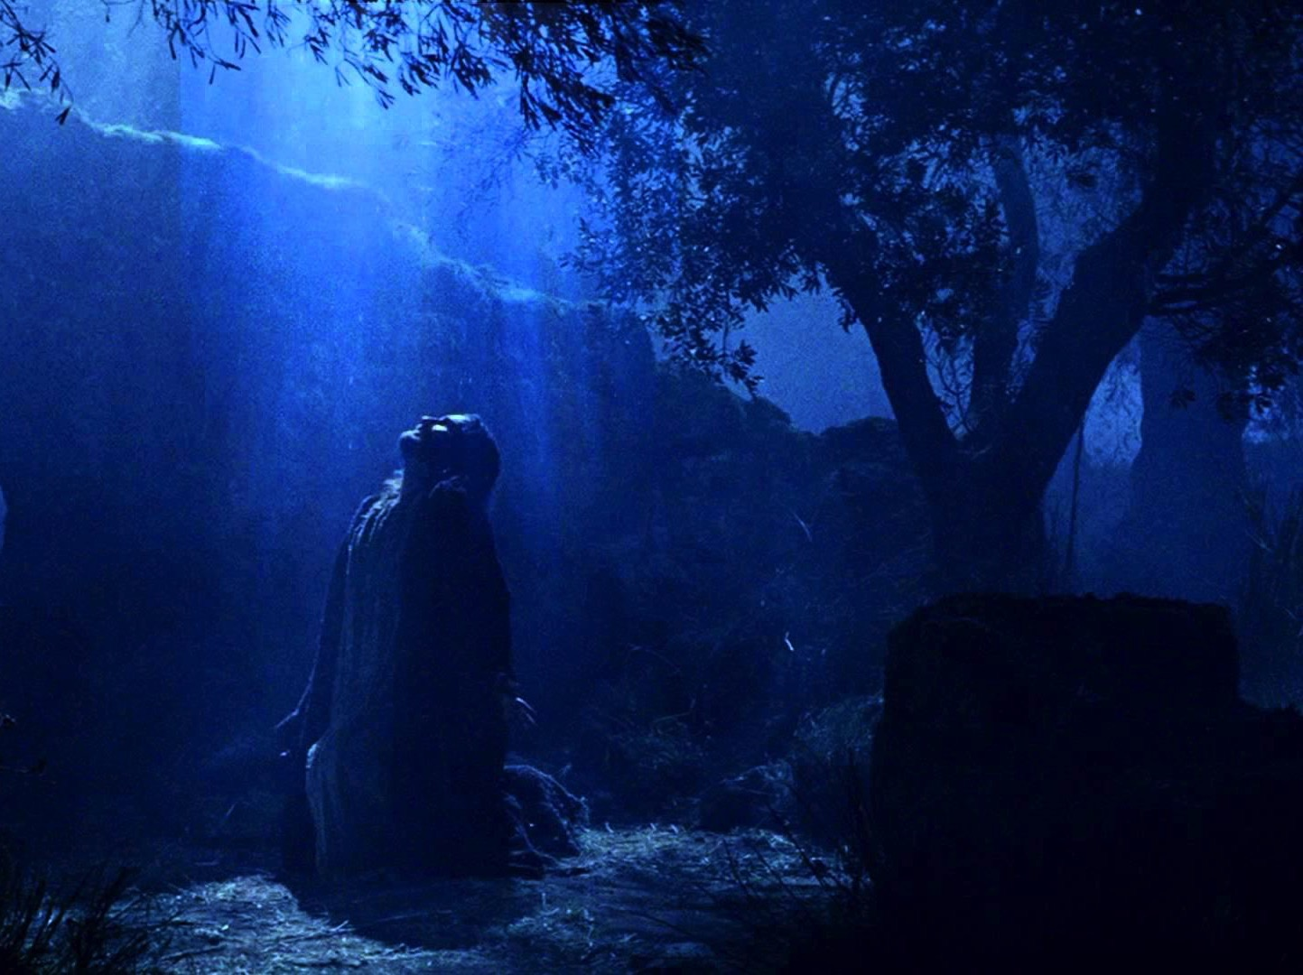
المسيا
347 ج
إن دور المسيح في دينونة وادي يهوشافاط (3: 2، 12؛ قارن مع مت 25) يوازن إرساله الروح القدس (2: 28-32؛ قارن مع يو 16: 7- 15؛ أع 1: 8) في يوم الخمسين (أع 2: 16-21).
يوئيل

Slide 10
Outline 4 (Griffith)
575
يوم الرب
ضربات الجراد
البركة
1:1 -2: 17
2: 18- 3: 21
تأديب صهيون
خلاص صهيون
الله يحارب ضد إسرائيل
الله يحارب لأجل إسرائيل
مقدمة
1: 1-3
التوبة
من
الجراد
حرفياً
1: 4-20
التوبة
من
الجراد البابلي/
هرمجدون
2: 1-17
الغفران
بعد
التوبة
2: 18-27
اليقظة
الروحية
2: 28- 3: 21
المراثي
1: 1- 2: 17
الخلاص
2: 18-32
الدينونة
3: 1-21
ماضي
مستقبل
يوئيل
يهوذا
590 ق.م

Slide 11
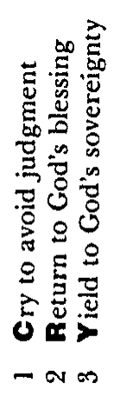
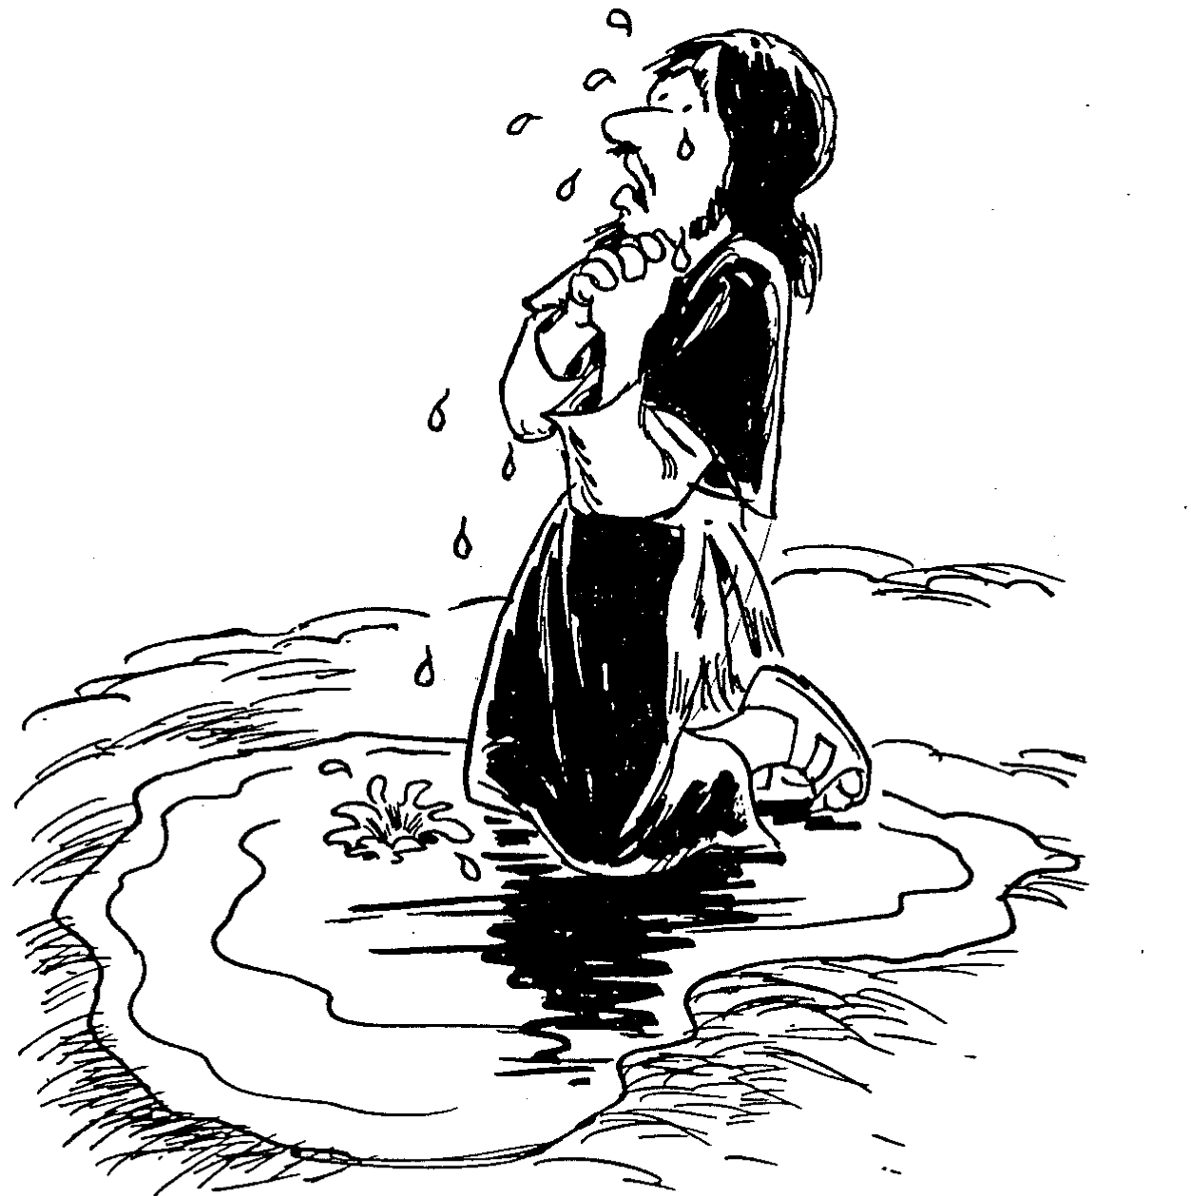
باري هادلستون، الكتاب المقدس الملخص بالأحرف الصوتية (غراند رابيدز: بيكر، 1992)
يوئيل
1. أبكي لتجنب الدينونة
2. أرجع إلى بركة الله
3. أخضع لسيادة الله

Slide 12

كن متأدباً
سفر
يوئيل
د. ريك جريفيث. مؤسسة الدراسات اللاهوتية الأردنية
BibleStudyDownloads.org

Slide 13
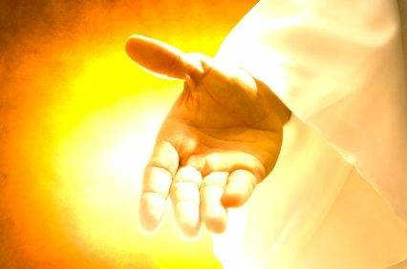
ماذا يجب أن نفعل عندما نكون متأدبين؟
يوئيل
Notes:
لذا عد إلى سؤالنا الأصلي ...

Slide 14

1. يجب أن يجلب التأديب التوبة.
يوئيل 1: 1- 2: 17
Notes:
أوقات الصعوبة هي أوقات رائعة لتغيير وجهات نظرنا.

Slide 15
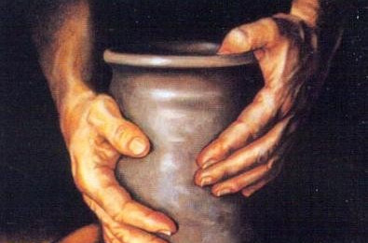
2. التوبة ستجلب الإسترداد.
يوئيل 2: 18- 3: 21
Notes:
تغيير أفكارنا عن الله يقودنا الى تغيير مستقبلنا.

Slide 16

الفكرة الرئيسيّة
يوئيل
التأديب
التوبة
الإسترداد
دع التأديب يجلب التوبة
والتوبة تجلب الإسترداد.

Slide 17

أسئلة للتفكير
1. هل تحتاج أن يجردك الله
من كل شيء قبل أن تتوب؟
(هوانغ سابين)
يوئيل

Slide 18
أسئلة للتفكير
2. هل يؤدبك الله للفت انتباهك
إليه مرة أخرى؟
يوئيل

Slide 19
أسئلة للتفكير
3. هل فكرت في الصيام (1: 14؛ 2: 12)
أو هل تعتقد أن الصوم ليس مناسباً
لعصرنا الحديث؟ لماذا لا يكون كذلك؟
يوئيل

Slide 20
Black

Slide 21
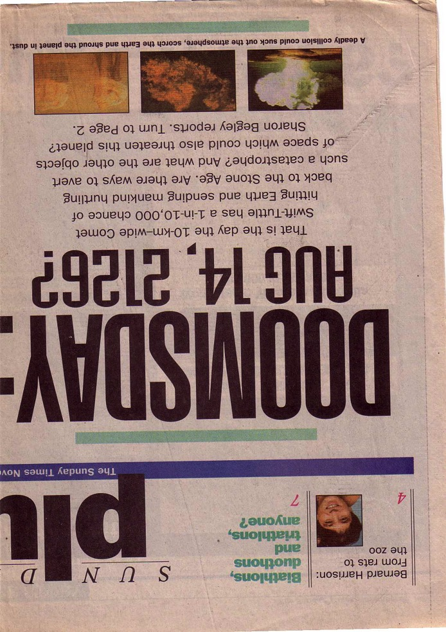
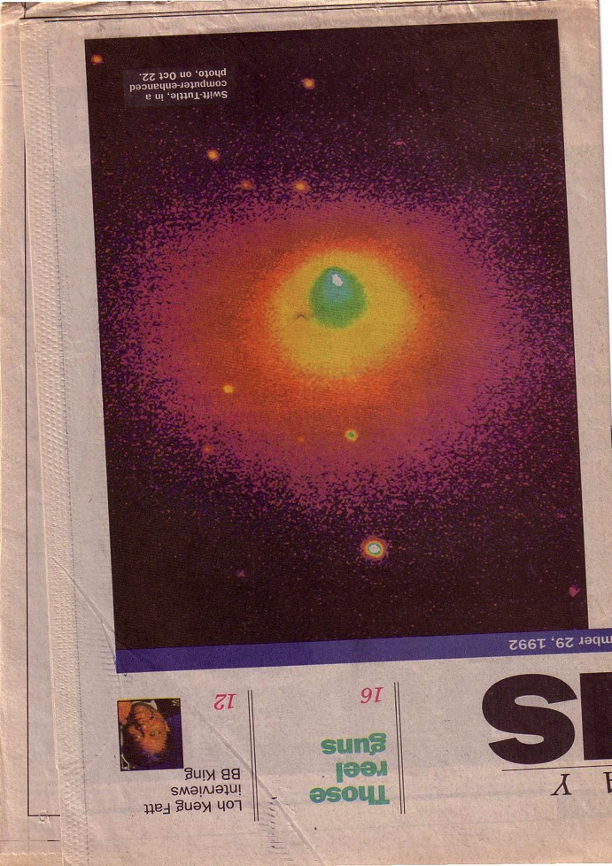
الدينونة قادمة
كيف تشعر حيال هذا التقرير؟
كيف يشعرك هذا التقرير الآن؟

Slide 22
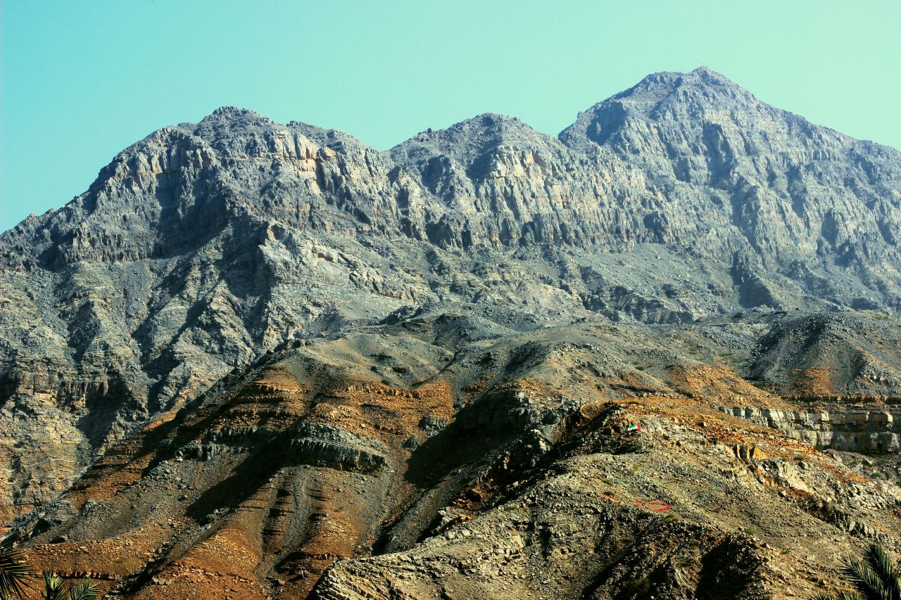
السعي نحو القمة

Slide 23

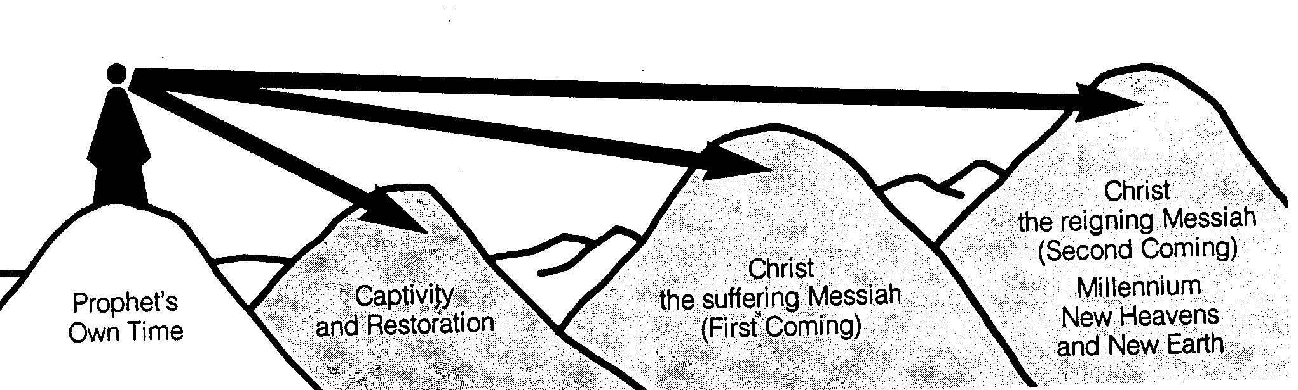
الفترات الزمنية للأنبياء
442
السماء
الجديدة
والأرض
الجديدة
المجيء
الثاني للمسيح
للحكم
في الألفية
المجيء
الأول للمسيح
للمعاناة
السبي و
العودة
وقت النبي
الخاص به
مقتبس بشكل كبير من سالم كيربان، مخططات سفر الرؤيا (1979)، 49
Notes:
ومع ذلك قد تكون هناك فجوات بين القمم. هذه لم ترى من قبل الأنبياء الذين عرفوا أنهم تحدثوا عن المستقبل فقط، لكنهم لم يعرفوا إلى أي مدى تشير نبوءاتهم. بشكل عام وجد هناك خمس فترات زمنية، تخللت عصر النبي نفسه.
The prophets often looked to the future, but did not know how far their prophecies referred. It is like a person standing on mountain looking into the distance and seeing what appears to be the same mountain. However, the person standing at these same mountains from the side can clearly see significant gaps between the peaks. Such is the viewpoint that we have thousands of years later. Generally there existed five time periods, including the prophet’s own era.
____________
Common Slides English-151
BE-31-Obadiah-64
OS-OT_Book_Overviews-782_pp42a_and_347a-613
OS-23-Prophets_Introduction-19
OS-31-Obadiah-13

Slide 24

نحن نرى الوديان

Slide 25
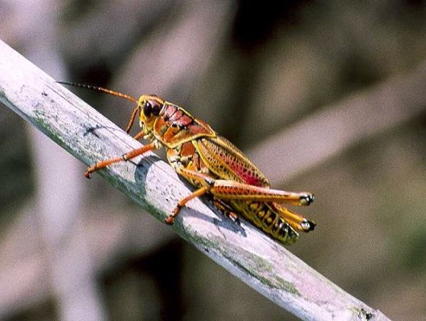
2. الهيكل والملخص
ملخص
1. مقدمة
3. الإقتراب من العهد الجديد
4. نص المشكلة
5. القيم اللاهوتية
6. التطبيق

Slide 26
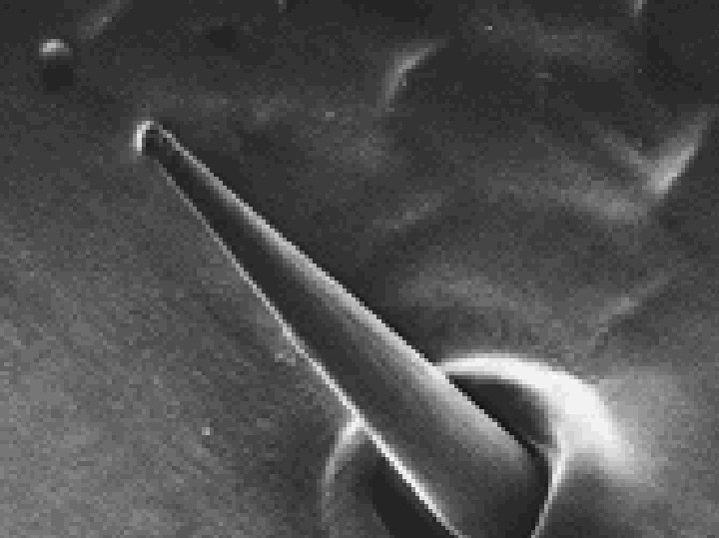
نظرة عامة على المقدمة
577
1. مقدمة السفر
أ. العنوان
ب. التأليف
ت. التاريخ
ث. المستلمون
ج. المناسبة
ح. القانونية والنص
خ. الوحدة
مستقبلات طعم الجراد

Slide 27
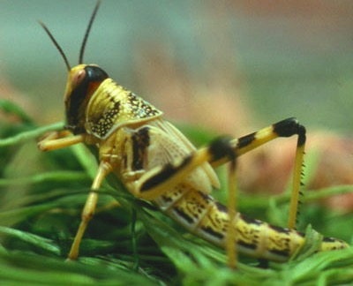
مقدمة إلى يوئيل أ. العنوان
576
:(Yo'el) الرب هو الله
قد تكون هناك معاني أخرى ذات صلة مثل قوي الإرادة واللجوء.
ب. التأليف (الدليل الداخلي)
ابن فثوئيل (1: 1)
عاش قرب أورشليم (أنظر 1: 9، 13-14، 2: 15-17، 23، 32، 3: 1، 5-6، 16-17، 20-21)
نبي الهيكل (أنظر 1: 13-14، 2: 17)

Slide 28
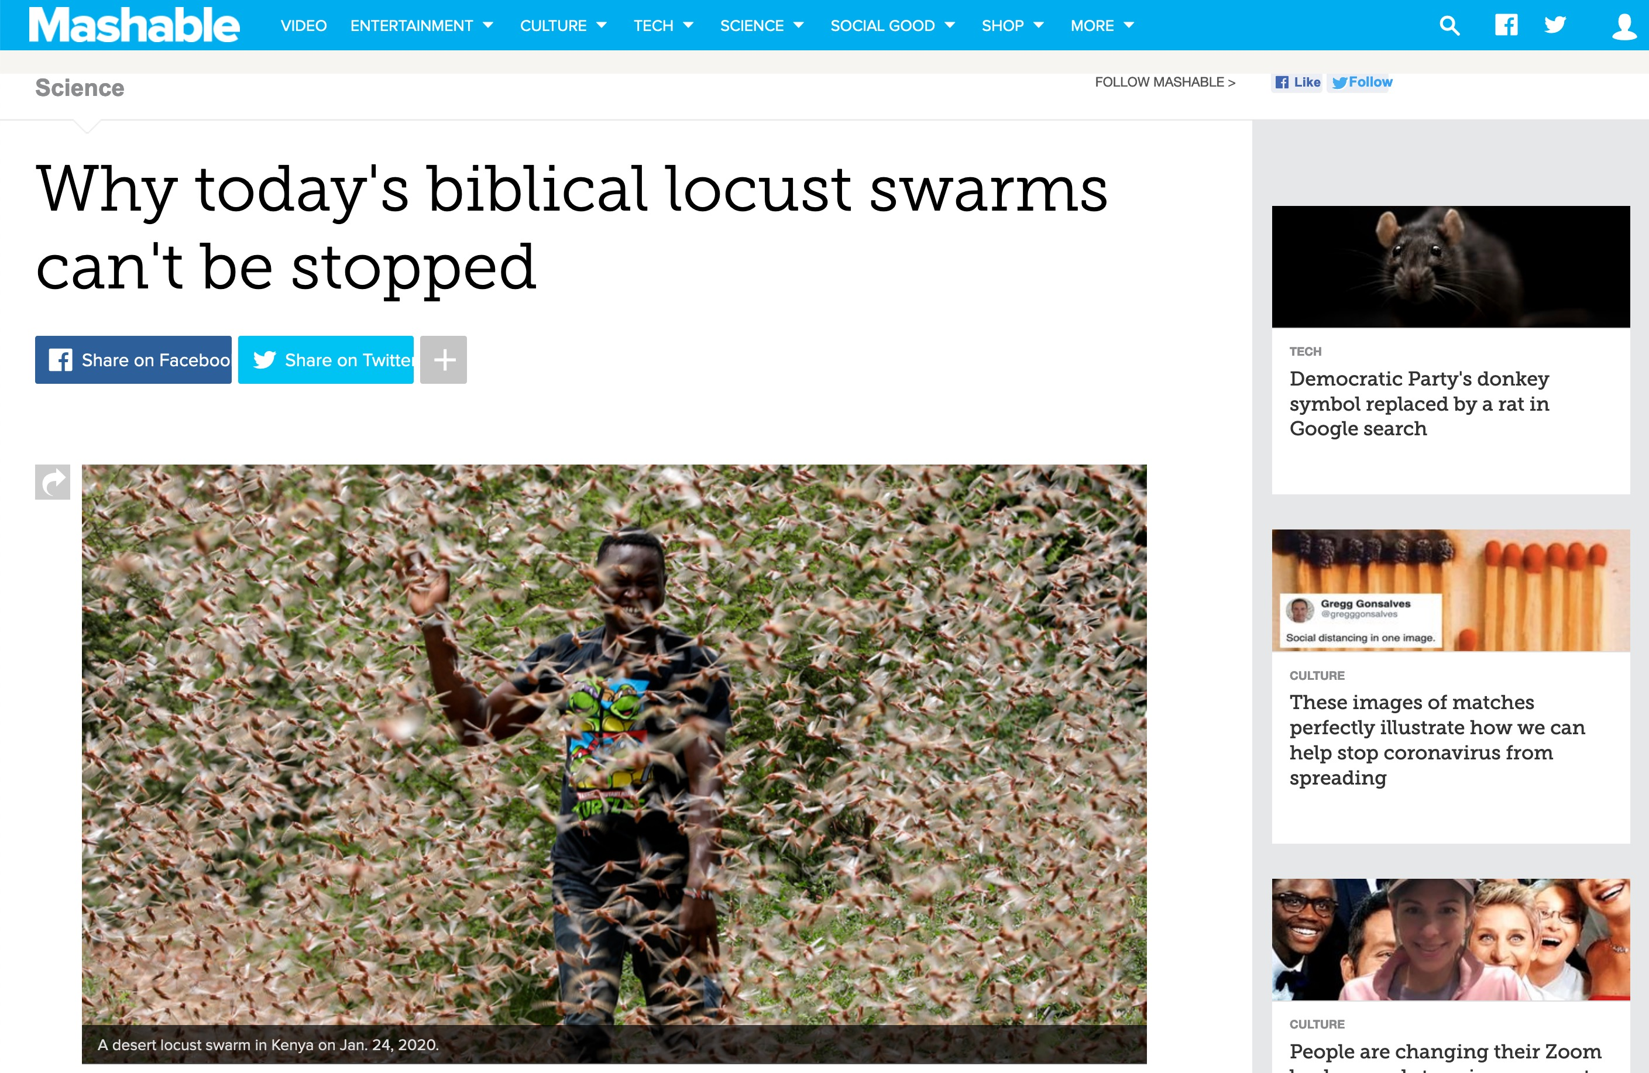
جراد كينيا 2020
Locust swarms in Kenya on Jan. 24.
Notes:
WHOLE ARTICLE BROKEN INTO PARTS IN FOLLOWING SLIDES:
In 1937, aboard slowly-moving trains, the Army National Guard used flamethrowers in an attempt to quell a relentless plague of locusts crossing through Colorado.
But the flamethrowers failed. And so did explosives. The locusts easily endured, devouring farmland.
Over 80 years later, great locust swarms still can't be contained. Last week, the U.N. announced that desert locusts — the most devastating type — descended upon East Africa, and over the coming months the insects may increase their populations by a whopping 500-fold. "Kenya has not faced a locust threat of this magnitude in 70 years," the U.N. said.
A single swarm of locusts, which are voracious grasshopper species that can spread over 460-square miles of land, have been a scourge — at least through the eyes of humans — for thousands of years. In more modern times, the British formed an anti-locust unit at the height of World War II to combat the pests in Africa and the Middle East, and a New York Times reporter pondered, in 1976, if "swarms that darken the sky" and "denude the land of crops" could be eliminated by progressing technology. Still today, the locust affliction continues.
"It's not surprising to me that we still don’t have a grip on this," said Iain Couzin, the director of the Max Planck Institute of Animal Behavior who researches locust swarms.
Today, the best humanity can do is try and predict where the swarms will form before a massive population outbreak can occur and ultimately consume vast tracts of crops, which are often rural people's sustenance. "You need to catch it early," said Rick Overson, the research coordinator at Arizona State University's Global Locust Initiative.
Locust swarms in Kenya on Jan. 24.
Image: Ben Curtis / AP / Shutterstock
Desert locust movements and prediction released on Jan. 28, 2020.
Image: UN Fao
Once locusts grow wings as mature adults, there's no turning back. "They’re powerful fliers," said Overson. "They can be in one country and move to another by the end of the week." And "during plagues" of the desert locust, the U.N. notes swarms can "affect 20 percent of the Earth's land, more than 65 of the world's poorest countries, and potentially damage the livelihood of one-tenth of the world's population."
After an outbreak occurs or the swarming begins, the blunt strategy is often to drop millions of liters of chemical pesticides on the insects, which is bad for the environment and human health, Overson explained.
But identifying exactly where the locusts start to swarm can be enormously daunting, especially when it comes to desert locusts in Africa and neighboring areas, which naturally inhabit remote, mostly-uninhabited regions some 16 million square kilometers, or over 6 million square miles, in size. The creatures usually live solitary lives, but, when the right environmental conditions align (like after a good rainy season), the creatures become intensely attracted to each other, change color, and often grow longer wings and become more muscular. They transform into a formidable swarm.
"Locusts are highly cannibalistic" "We’re not going to solve this problem as a human society anytime soon," Overson said.
Critically, humanity shouldn't endeavor to completely wipe out locust swarms, just because their populations can explode. After all, locust swarms are wild, natural phenomena. Attempting to eliminate the insects, even if that were possible, could have unforeseen, cascading environmental consequences. "It's one of the wonders of the natural world," said Couzin."We don't want to stop them. We just want to manage them."
Locust swarms have similarities to wildfires, explained Overson. Sure, no one wants their house to burn down. But wide-scale suppression of wildfire, a natural phenomenon, has resulted in vastly overgrown forests, contributing to explosive infernos in the Western U.S. What might killing billions of locusts do? It's best not to find out.
To fend off some super-swarms from devouring human food, the primary mission today is prediction. The Food and Agricultural Organization of the United Nations currently strives to forecast the swarms. Where will the locusts strike? Locust populations can explode after the right rains, at the right times, or after mild winters, explained Overson.
But, there's a slew of other things to better account for stressed Couzin. "We’re at the tip of the iceberg of what we need to know" for better predictions, he said, like how billions of insects will react to changing weather, what there is to eat hundreds of miles ahead — and how much locusts will eat each other.
The green "recession area" is where locusts naturally live, before swarming.
Image: nasa
A Kenyan farmer picks up a desert locust in Jan. 2020.
Image: DAI KUROKAWA / EPA-EFE / Shutterstock
"Locusts are highly cannibalistic," explained Couzin, noting that they start cannibalizing when swarming begins and food starts to vanish. "As soon as resources are limited they turn on each other."
Though locust swarms impact about one in 10 people on Earth, there's a glaring lack of funding for swarm research. In part, this is because the swarms exist in boom and bust cycles, so there might be less research interest in the years, or sometimes decades, between outbreaks. What's more, Couzin pointed out that locust swarms usually aren't descending upon the rich world. "It's affecting poor people," he said, so there's a lack of interest from wealthier nations.
Humanity, though, isn't a completely hapless observer as clouds of locusts come swarming from the horizon. It's quite likely civilization is giving these swarms a boost, both Couzin and Overson agreed.
"We’re trying to change the dogma that humans are passive victims of locust swarms," said Overson.
SEE ALSO: Why Australia won't escape its vicious fire spiral
We irrigate vast tracts of land, providing locusts with the carbohydrate-rich foods they (and we) love. Climate change might make swarms more extreme, as rainfall events become more intense on a warming planet, perhaps giving rise to swarms feeding on plentiful growth following deluges. These questions demand more research.
In the coming months, locusts in East Africa will devour plants and croplands before their food runs out and they fade away — until the next swarm. It's what they're destined to do.
"It's quite extraordinary," said Couzin. "The locusts have found this trick to survive in booms and busts."
"It works well for them," he added. "Unfortunately, it doesn't work well for us."
Why today's biblical locust swarms can't be stopped
By Mark Kaufman Jan 28, 2020
https://mashable.com/article/locust-swarm-africa-explained/
Accessed 17 March 2020

Slide 29
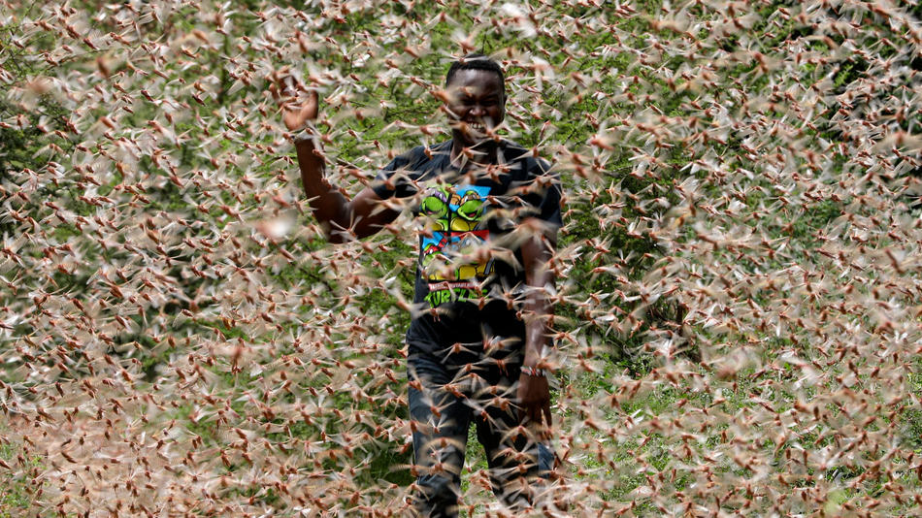
جراد كينيا 2020
سرب من الجراد الصحراوي في كينيا في 24 كانون ثاني 2020.
Notes:
In 1937, aboard slowly-moving trains, the Army National Guard used flamethrowers in an attempt to quell a relentless plague of locusts crossing through Colorado.
But the flamethrowers failed. And so did explosives. The locusts easily endured, devouring farmland.
Over 80 years later, great locust swarms still can't be contained. Last week, the U.N. announced that desert locusts — the most devastating type — descended upon East Africa, and over the coming months the insects may increase their populations by a whopping 500-fold. "Kenya has not faced a locust threat of this magnitude in 70 years," the U.N. said.
Why today's biblical locust swarms can't be stopped
By Mark Kaufman Jan 28, 2020
https://mashable.com/article/locust-swarm-africa-explained/
Accessed 17 March 2020

Slide 30
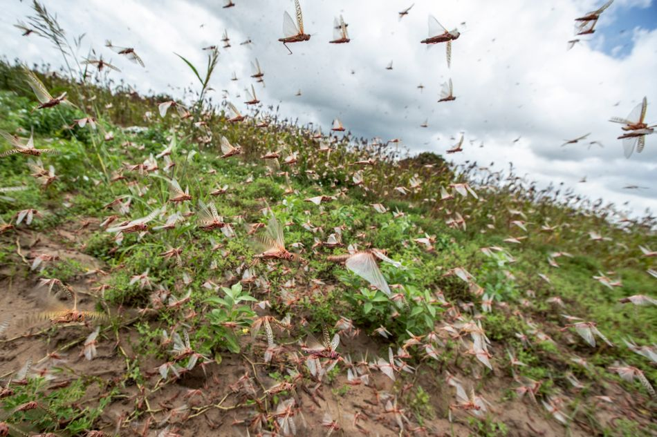
جراد كينيا 2020
أسراب الجراد في كينيا في 24 كانون ثاني.
Notes:
A single swarm of locusts, which are voracious grasshopper species that can spread over 460-square miles of land, have been a scourge — at least through the eyes of humans — for thousands of years. In more modern times, the British formed an anti-locust unit at the height of World War II to combat the pests in Africa and the Middle East, and a New York Times reporter pondered, in 1976, if "swarms that darken the sky" and "denude the land of crops" could be eliminated by progressing technology. Still today, the locust affliction continues.
"It's not surprising to me that we still don’t have a grip on this," said Iain Couzin, the director of the Max Planck Institute of Animal Behavior who researches locust swarms.
Today, the best humanity can do is try and predict where the swarms will form before a massive population outbreak can occur and ultimately consume vast tracts of crops, which are often rural people's sustenance. "You need to catch it early," said Rick Overson, the research coordinator at Arizona State University's Global Locust Initiative.
Locust swarms in Kenya on Jan. 24.
Image: Ben Curtis / AP / Shutterstock
Why today's biblical locust swarms can't be stopped
By Mark Kaufman Jan 28, 2020
https://mashable.com/article/locust-swarm-africa-explained/
Accessed 17 March 2020

Slide 31
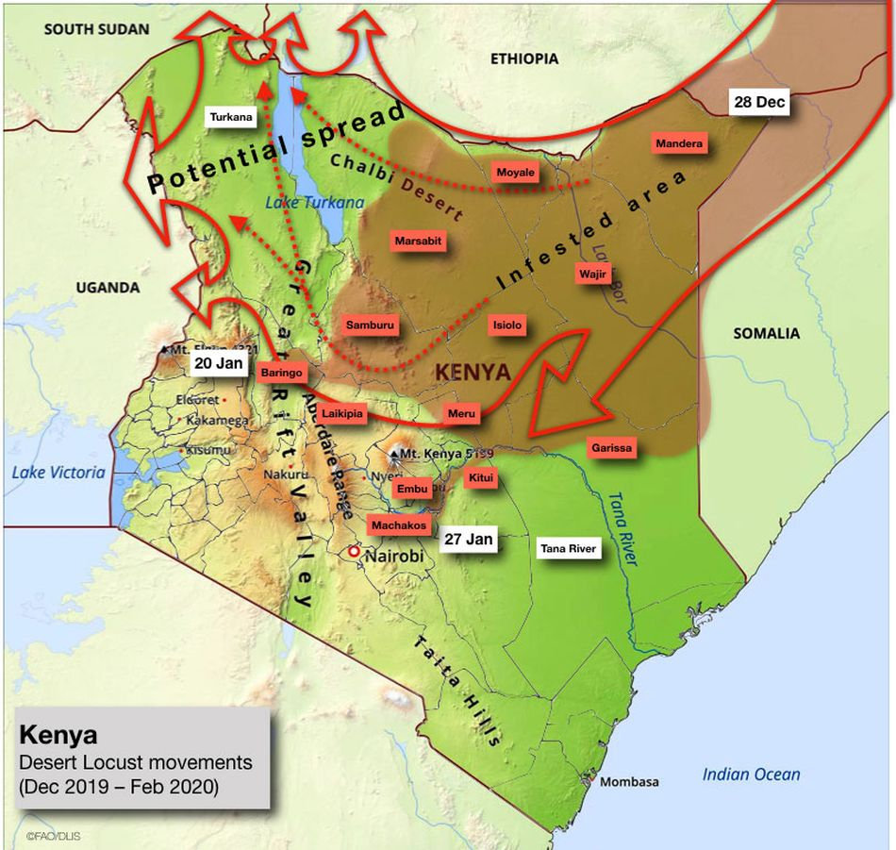
2020 Kenyan Locusts
إصدار تحركات الجراد الصحراوي والتنبؤ بها في 28 كانون ثاني 2020
Notes:
Once locusts grow wings as mature adults, there's no turning back. "They’re powerful fliers," said Overson. "They can be in one country and move to another by the end of the week." And "during plagues" of the desert locust, the U.N. notes swarms can "affect 20 percent of the Earth's land, more than 65 of the world's poorest countries, and potentially damage the livelihood of one-tenth of the world's population."
After an outbreak occurs or the swarming begins, the blunt strategy is often to drop millions of liters of chemical pesticides on the insects, which is bad for the environment and human health, Overson explained.
But identifying exactly where the locusts start to swarm can be enormously daunting, especially when it comes to desert locusts in Africa and neighboring areas, which naturally inhabit remote, mostly-uninhabited regions some 16 million square kilometers, or over 6 million square miles, in size. The creatures usually live solitary lives, but, when the right environmental conditions align (like after a good rainy season), the creatures become intensely attracted to each other, change color, and often grow longer wings and become more muscular. They transform into a formidable swarm.
"Locusts are highly cannibalistic" "We’re not going to solve this problem as a human society anytime soon," Overson said.
Critically, humanity shouldn't endeavor to completely wipe out locust swarms, just because their populations can explode. After all, locust swarms are wild, natural phenomena. Attempting to eliminate the insects, even if that were possible, could have unforeseen, cascading environmental consequences. "It's one of the wonders of the natural world," said Couzin."We don't want to stop them. We just want to manage them."
Why today's biblical locust swarms can't be stopped
By Mark Kaufman Jan 28, 2020
https://mashable.com/article/locust-swarm-africa-explained/
Accessed 17 March 2020

Slide 32
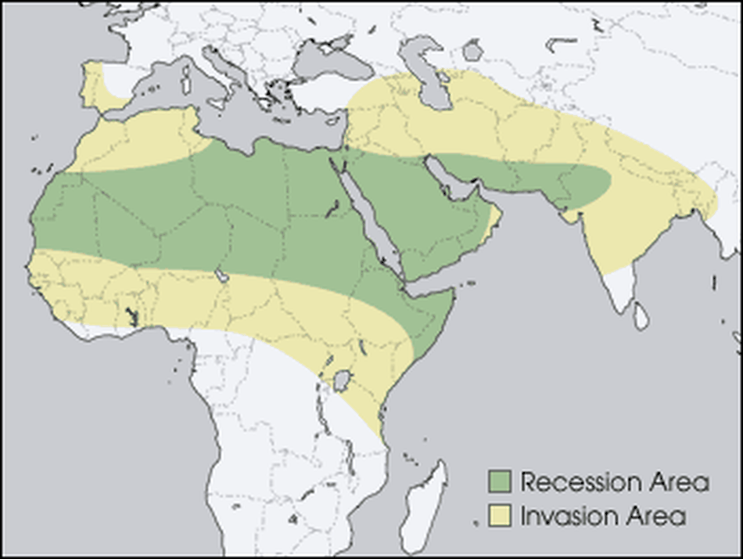
جراد كينيا 2020
منطقة الإنحسار الخضراء هي المكان الذي يعيش فيه الجراد بشكل طبيعي قبل أن يتجمع
Notes:
Locust swarms have similarities to wildfires, explained Overson. Sure, no one wants their house to burn down. But wide-scale suppression of wildfire, a natural phenomenon, has resulted in vastly overgrown forests, contributing to explosive infernos in the Western U.S. What might killing billions of locusts do? It's best not to find out.
To fend off some super-swarms from devouring human food, the primary mission today is prediction. The Food and Agricultural Organization of the United Nations currently strives to forecast the swarms. Where will the locusts strike? Locust populations can explode after the right rains, at the right times, or after mild winters, explained Overson.
But, there's a slew of other things to better account for stressed Couzin. "We’re at the tip of the iceberg of what we need to know" for better predictions, he said, like how billions of insects will react to changing weather, what there is to eat hundreds of miles ahead — and how much locusts will eat each other.
The green "recession area" is where locusts naturally live, before swarming.
Image: nasa
Why today's biblical locust swarms can't be stopped
By Mark Kaufman Jan 28, 2020
https://mashable.com/article/locust-swarm-africa-explained/
Accessed 17 March 2020

Slide 33
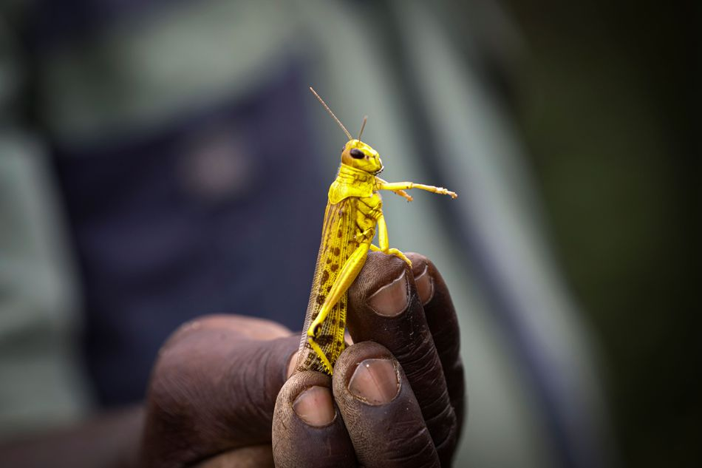
جراد كينيا 2020
يلتقط مزارع كيني جرادة صحراوية في كانون ثاني 2020
Notes:
Though locust swarms impact about one in 10 people on Earth, there's a glaring lack of funding for swarm research. In part, this is because the swarms exist in boom and bust cycles, so there might be less research interest in the years, or sometimes decades, between outbreaks. What's more, Couzin pointed out that locust swarms usually aren't descending upon the rich world. "It's affecting poor people," he said, so there's a lack of interest from wealthier nations.
Humanity, though, isn't a completely hapless observer as clouds of locusts come swarming from the horizon. It's quite likely civilization is giving these swarms a boost, both Couzin and Overson agreed.
"We’re trying to change the dogma that humans are passive victims of locust swarms," said Overson.
SEE ALSO: Why Australia won't escape its vicious fire spiral
We irrigate vast tracts of land, providing locusts with the carbohydrate-rich foods they (and we) love. Climate change might make swarms more extreme, as rainfall events become more intense on a warming planet, perhaps giving rise to swarms feeding on plentiful growth following deluges. These questions demand more research.
In the coming months, locusts in East Africa will devour plants and croplands before their food runs out and they fade away — until the next swarm. It's what they're destined to do.
"It's quite extraordinary," said Couzin. "The locusts have found this trick to survive in booms and busts."
"It works well for them," he added. "Unfortunately, it doesn't work well for us."
Why today's biblical locust swarms can't be stopped
By Mark Kaufman Jan 28, 2020
https://mashable.com/article/locust-swarm-africa-explained/
Accessed 17 March 2020

Slide 34
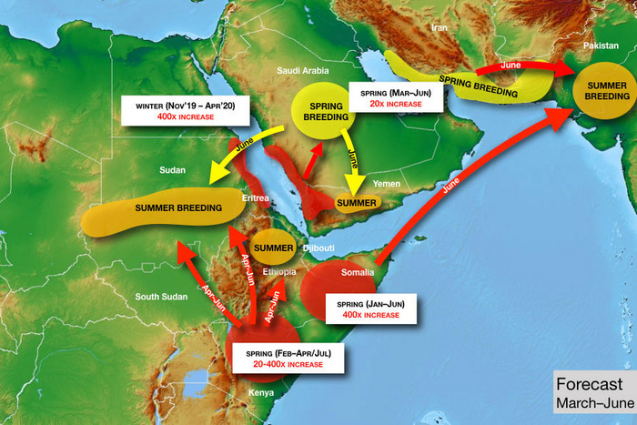
جراد كينيا 2020
الصورة: الأمم المتحدة
Notes:
just asking questions Mar. 14, 2020
So There’s a Locust Plague Too?
By Matt Stieb
A volunteer sprays pesticide in eastern Kenya — which is suffering from its worst locust outbreak in 70 years. Photo: Tony Karumba/AFP via Getty Images
It’d be easy to quip biblically about the simultaneous breakout of pandemic and plague if not for the vast human toll that the intercontinental crises are exacting. As the coronavirus continues to spread on six continents, a desert locust outbreak has inundated East Africa with hundreds of billions of bugs, causing food shortages in Kenya, Somalia, and Ethiopia. “It was like an umbrella had covered the sky,” Joseph Katone Leparole, a 68-year-old living in central Kenya, told the New York Times.
In our age of overlapping crises, it shouldn’t be a surprise that climate change can be identified as a factor in the upsurge, the technical term used for such a natural disaster that is just below plague. It began in 2018, when a pair of cyclones came in from the Indian Ocean and hit the “empty quarter” of the Arabian peninsula — the vast desert region near the borders of Saudi Arabia, Yemen, and Oman. In a speech before the African Union in February, U.N. general secretary António Guterres explained the unfortunate cycle: “Warmer seas mean more cyclones, generating the perfect breeding ground for locusts.”
“When you have rains associated with cyclones, they’re much stronger than normal,” said Keith Cressman, the senior locust-forecasting officer at the United Nations’ Food and Agriculture Organization. “When those rains fall in desert areas with sandy soil, that will flood the soil. Once those floods recede, the soil retains so much moisture that it allows desert locust females to lay their eggs probably for a period of around six months.”
From these ideal conditions, the bugs moved south into Yemen (already in a food crisis, Yemenis turned to them as a protein source) and into the Horn of Africa. The spread was rapid: A single locust can travel up to 90 miles in a day and eat its own weight in plant matter, of which there was a bounty, thanks to the excessive rains. They also turned north, across the Persian Gulf into Iran, and into India and Pakistan last summer. National emergencies have been declared in Pakistan, Jordan, and Somalia to help mobilize a response: The only effective control operation once a swarm is in motion is to spray pesticide directly on the bugs from the air.
To help understand the crisis, Intelligencer spoke with the FAO’s Cressman about some of the bugs’ idiosyncrasies and what to expect in the coming months.
Today Only! Save 60% on unlimited access to Intelligencer and everything else New York
LEARN MORE » The FAO projects that the number of locusts could grow 400 times by June if not treated. Could you break that down?
The life cycle of a locust is about three months, so after three months the adults are ready to lay eggs again. With each three-month generation, there’s a 20-fold increase in locust numbers. Locust females lay around 300 or more eggs — more than 90 percent of them die or the resulting hoppers don’t make it to adulthood. Out of all that breeding, for every single female locust there’s about 20 locusts in the new generation that make it. It’s an exponential increase, so after three months you have 20 times, after six months you have 20 squared, so that’s 400 times. After nine months, you’d have 20 cubed, which is 8,000 times. When you get that type of exponential breeding, then those locust numbers rapidly increase, and that’s how swarms form, basically.
So with these new generations, countries in East Africa that have already been inundated could face even more locusts?
Absolutely. There’s a generation in progress now and breeding in Ethiopia, Somalia, and in Kenya. Conditions will probably remain favorable there because of a cyclone in northeastern Somalia in December. Conditions are probably favorable in those three countries until June, so that will allow another generation to occur before then.
How are the outbreaks in Pakistan, Iran, and China connected to those in East Africa?
For China, it’s a completely different species — apples and oranges. But the one in Iran and Pakistan, yes. What’s going on now in Pakistan is old swarms leftover from last summer that have been slowly maturing and now they’re ready to lay eggs, not in the deserts on the border of India and Pakistan but in the desert closer to Iran and Afghanistan.
There’s an FAO map that shows them traveling directionally from the horn of Africa over Arabian sea. Can they travel over water?
No problem. In the late ’80s, they went from West Africa to the Caribbean. They crossed the Atlantic in about ten days.
Photo: United Nations
How does that work if there’s no food?
They eat a lot before or after! The way it worked crossing the Atlantic was, they had enough fuel in the tanks but still needed to rest sometimes, so they’d rest onboard ships, and then they’d take off again. If there weren’t any ships, they’d land on the surface of the ocean, and then a second swarm would come and land on top of the first swarm and rest, and the second swarm would take off and continue flying and the first swarm would drown.
My impression was that they choose to go where food is. Do they have choice as a unit where they’re going or is it randomized by wind?
They seem to decide whether they want to take off or fly with the prevailing wind or not, in which case they’ll sit on the ground. They can somehow sense winds when they come from different directions, but they can’t fly like birds against the wind. So they are a victim of the wind, but still they do control motion to an extent.
Without human intervention, how does a locust outbreak end?
There would have to be a failure of the seasonal rains — that’s usually how mother nature helps to bring these things under control. Sometimes the winds will push locusts into areas they just don’t want to be in. For instance, if they got pushed further into the Democratic Republic of the Congo or into cold areas where they would die, or areas that are very tropical where they would pick up a lot of pathogens and die. They’re very susceptible to funguses. Like those guys that got pushed across the Atlantic ocean in the ’80s, they died immediately when they landed.
What happens in a country like Iran where there’s a simultaneous outbreak of locusts and the coronavirus.
Fortunately, different parts of the government are responding, so the Ministry of Agriculture is dealing with locusts and the Ministry of Health has to deal with the coronavirus. The resources and manpower are in completely different sectors of the economy. But any additional challenges that a country faces, they can have impacts on the control operations, and they might not be as effective as hoped.
What about states in open conflict or with major security issues, like Yemen or Somalia?
Yemen is very critical because it’s a frontline country for desert locusts. Desert locusts are there every year, and there’s a number of different breeding areas along the coast in the wintertime in the interior. It’s a country that has a really spectacular habitat for desert locusts, and when it rains, those locusts take advantage of it.
That’s probably one of the reasons why the locust infestation shifted from the empty corridor in 2019 across to the Horn of Africa in the summer, because they stopped off in Yemen for a generation of breeding in the spring. Because of the conflict, there’s very little that can be done. It’s just not safe for the national locust teams to to operate throughout the country to undertake the survey for control operations. There are a few limited areas they can work in, but it simply isn’t enough.
Fortunately, in Somalia, the key locust breeding areas are in the north of the country, which is a region that’s much easier to operate in. It’s much safer, so national teams can get in there and do the survey and control operations. However, in the south and central parts of the country, it is much more challenging. Those parts of the country don’t see locusts often, maybe once every few decades, so they also have very little capacity.
What about in South Sudan, where there is already a food shortage?
The good news is, it’s not really their typical habitat. It’s not dry enough, and they don’t have so much sandy soil. It’s more of a clay soil, and there’s much more vegetation cover, so this makes it hard for the females to find bare, empty places to lay their eggs. And we’ve seen this with those locusts that got into northeastern Uganda and the southeast of South Sudan: They flew around, and the females became so desperate that they just kind of dropped their eggs on top of the soil, which means that they immediately dry out and die. Desert locusts don’t do this very often. These guys are masters of survival. They’re professionals, so this means that those females are really desperate. So probably South Sudan is much more of a transit zone. Later on in the spring, a new generation of swarms will likely form in northern Kenya. Once it drys out there, they will be moving back into Somalia, back into Ethiopia, and probably into north Sudan to get really into the Sahara and the deserts they prefer.
What’s the most effective form of prevention and treatment if an outbreak is already in motion?
When you have these cyclones, it comes back to climate change: We’re starting to see more patterns of severe weather, which means unusually heavy rainfall, cyclones,t hese things. You can’t prevent them really. So we’re going to have to develop better mechanisms to respond to them better. Basically it means that countries are going to have to be very well prepared. To visit a wildfire metaphor, you need to have a lot of good fire stations with well trained crews and fire trucks — it’s the same with desert locusts. You need to have a good national locust program that’s well-equipped, well-trained, well-funded so that they can respond to these situations. But it’s probably too idealist to think these nations are always going to have sufficient resources. At one point, it will probably overwhelm capacities — that’s what’s happened now in Kenya, Somalia, and Ethiopia. Then the international community has to step in.
The U.N. is calling for $138 million to mitigate the crisis. What does the allocation of that money look like?
Roughly, it’s about half for control operations — that’s upscaling the aerial control operations and getting in more aircraft, more ground logistical teams, supplemented by ground control like vehicles, sprayers, pesticide. The other half is basically to protect the livelihoods or to help those who have already been damaged to help them to recover. This can be seed packages to farmers if their initial crop has been lost. For pastures, it would be animal feed, because there’s a lot of pastoralists in the Horn of Africa who rely on pastures for their grazing animals.
What are the most concerning and the most hopeful aspects about the upsurge as it stands today?
The greatest concern is where it’s occurring, in the Horn of Africa — which is already extremely vulnerable to any slight disruption to food security and livelihood, simply because they’ve had a series of droughts in the past. Now they’ve got floods and heavy rains, and on top of that, locusts. No. 2 is that the swarms are in countries that either do not have very robust national programs or don’t have them at all. Kenya has seen locusts twice in the last 70 years — don’t expect it to have a strong locust program compared to a country that has to deal with locusts every year that’s much better.
Maybe the silver lining here is that they’re not going to stay in the Horn of Africa forever. Desert locusts are migratory in nature. When they move, they’ll move back north and into those countries where they are normally present — like Sudan, Eritrea, Saudi Arabia, Oman, Iran, Pakistan, India, and Egypt — and those countries have much stronger national programs to address them.
Sign Up for the Intelligencer Newsletter
intelligencer is a Vox Media Network. © 2020 Vox Media, Inc. All rights reserved.
https://nymag.com/intelligencer/2020/03/a-u-n-locust-forecaster-explains-the-crisis-in-east-africa.html
Accessed 17 March 2020

Slide 35
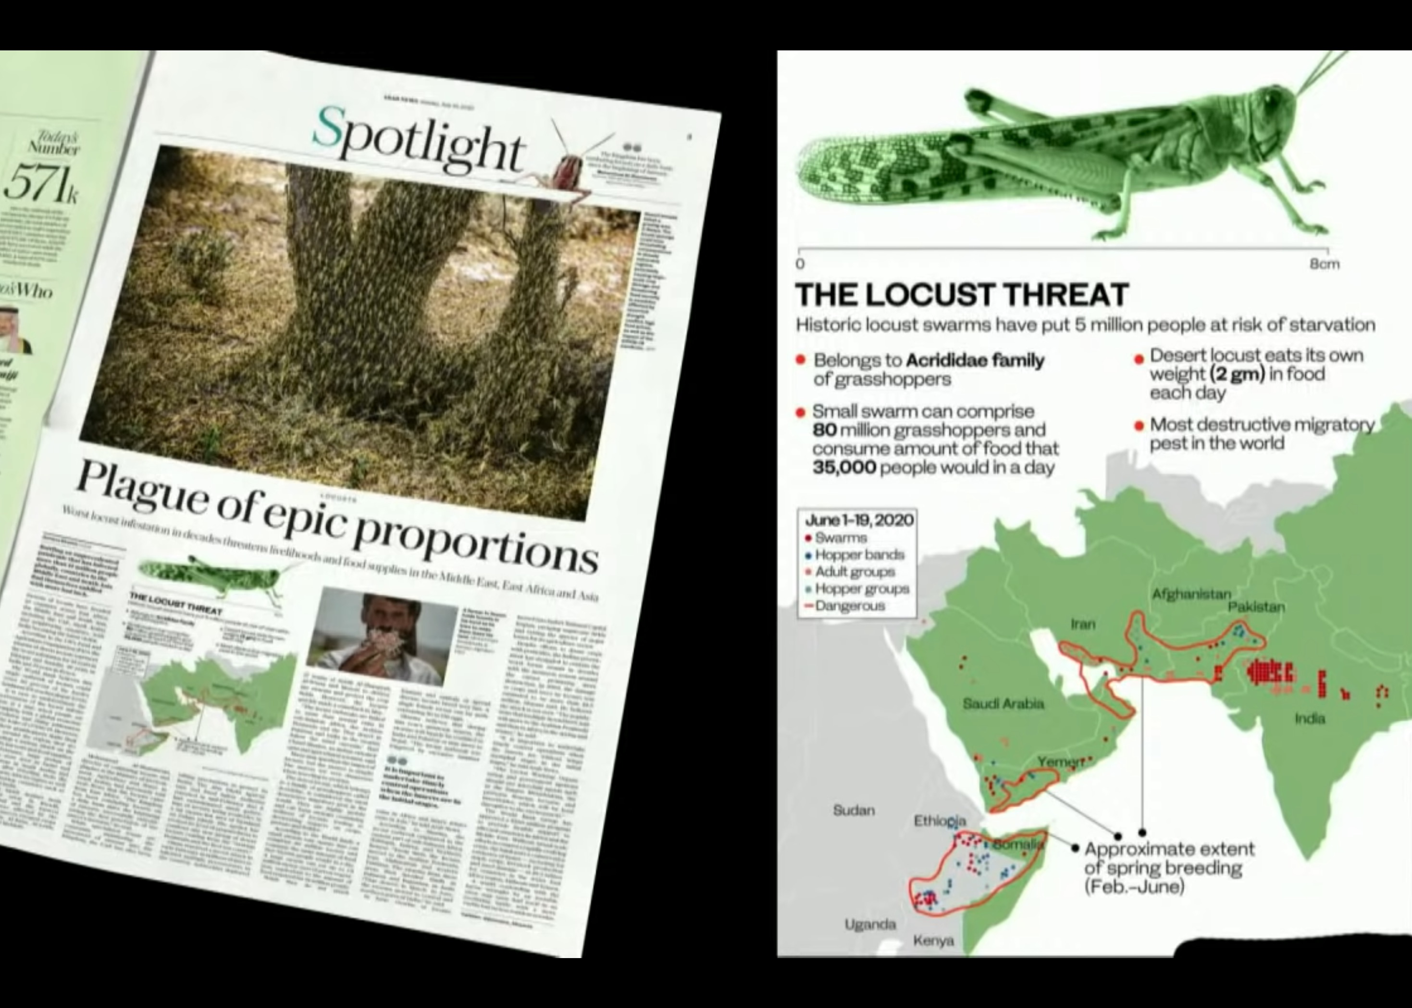
2020 الجراد المتوسع

Slide 36
كن متأدباً
سفر
يوئيل
د. ريك جريفيث. مؤسسة الدراسات اللاهوتية الأردنية
BibleStudyDownloads.org

Slide 37

الإنضباط
Notes:
Be disciplined or you will be disciplined.

Slide 38

الإنضباط
Notes:
This is true because any good leader disciplines those he cares about, and ultimately, God is the best disciplinarian.

Slide 39

كن منضبطاً وإلا سيتم تأديبك
Notes:
Which better describes your life now? Disciplining yourself or being disciplined by God?
If your experiences are sweet, thank God. Maybe you are disciplining yourself so God doesn’t have to get your attention. But if your experiences are sour, thank God also. Maybe this is just what you need for God to get your attention. Are you listening?

Slide 40

"Hear this, you leaders of the people. Listen, all who live in the land" (Joel 1:2a NLT).
The traditional Chinese character for "listen" consists of six radicals
عندما نستمع إلى شخص ما، فإننا نتعامل معه كملك أو ملكة. الخادم لا يقاطع الملك أبداً بل يلف أذنه حوله وينظر إلى كل كلمة وتعبيرات الوجه بعشر عيون وقلب واحد
الإستماع يعطي الشخص الآخر احترامنا الكامل
وانتباهنا غير المنقسم
Notes:
Are you really listening to what God is trying to tell you in your life?
Maybe he is trying to discipline you.

Slide 41
ماذا يجب أن نفعل لنكون منضبطين؟
Notes:
What should we do when we are disciplined?
Do you catch my double meaning here?

Slide 42

الخلفية

Slide 43

صفنيا ١ : ١ كلمة الرب التي صارت إلى صفنيا بن كوشي بن جدليا بن أمريا بن حزقيا، في أيام يوشيا بن آمون ملك يهوذا

Slide 44
صفنيا من النسل الملكي
238
حزقيا
ملك يهوذا (نسل داود)
الأبناء الذين حكموا
الأبناء الذين لم يحكموا
منسّى
أمريا
آمون
جدليا
يوشيا
كوشي
صفنيا
الصالحون باللون الأبيض، الأشرار باللون الأصفر

Slide 45
Placing the Prophets
ترتيب الأنبياء
342
التواريخ الرئيسية
931
عوبديا
722
يونان
عاموس
هوشع
أشعياء
ميخا
ناحوم
صفنيا
يوئيل
586
Notes:
Although I cannot be dogmatic about dating Joel, the best option is that Joel prophesied after the Babylonians took 10,000 people of Judah captive in 597 BC.
However, he doesn’t mention the fall of Jerusalem in 586 BC. Therefore, he seemed to have ministered during this 11-year period just after a locust invasion and drought.

Slide 46

وألقوا قرعة على شعبي وأعطوا الصبي بزانية وباعوا البنت بخمر ليشربوا (يوئيل 3: 3)
Notes:
Ar

Slide 47
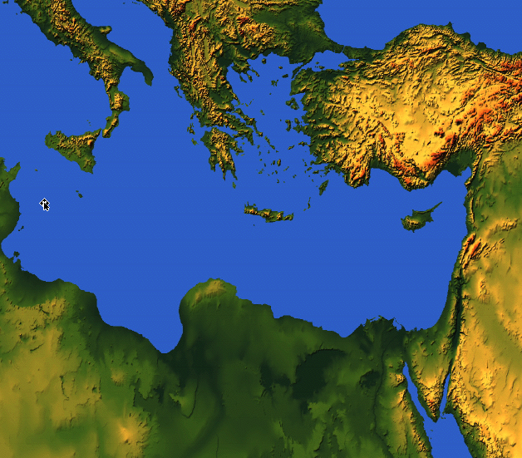

بيع بيت يهوذا لليونانيين
4 وماذا أنتن لي يا صور وصيدون وجميع دائرة فلسطين؟ هل تكافئونني عن العمل أم هل تصنعون بي شيئاً سريعاً بالعجل أرد عملكم على رؤوسكم 5 لأنكم أخذتم فضتي وذهبي وأدخلتم نفائسي الجيدة إلى هياكلكم
(يوئيل 3: 4-5)
219
صيدون
صور
يهوذا
فلسطين
Notes:
Joel also mentions selling people to Greeks, which also happened only after about 600 BC when Greece became strong.

Slide 48
بيع بني يهوذا لليونانيين
وبعتم بني يهوذا وبني أورشليم لبني الياوانيين لكي تبعدوهم عن تخومهم
(يوئيل 3: 6)
219
اليونان
صيدون
صور
لم يكن لليونانيين سطوة كبيرة حتى 600-500 ق.م ولهذا فمن المحتمل أن يكون لسفر يوئيل تاريخ متأخر
يهوذا
فلسطين

Slide 49
سقوط أورشليم
232
و
342
سقوط أورشليم
تواريخ رئيسية
627
إرميا
605
دانيال
597
حزقيال
586
538
يوئيل
مراثي
حبقوق
Notes:
OS-12-2Kings-219
OS-14-2Chron-282
OS-24-Jeremiah-37, 212, 236
OS-27-Daniel-105

Slide 50
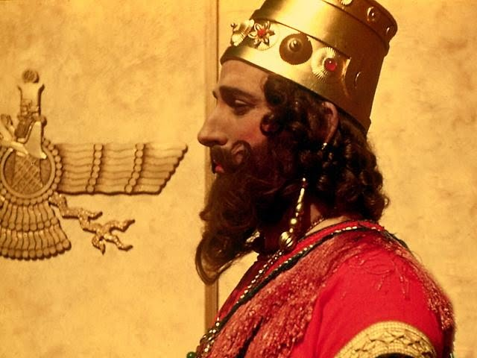
خدم يوئيل خلال فترة حكم الملك نبوخدنصر
Notes:
God's instrument of discipline was this pagan Babylonian king.

Slide 51

1. ماذا نفعل الآن؟
2. كيف سينتهي هذا
الأمر؟
قائمة المهام لهذا اليوم
Notes:
Today we’ll see what to do about present difficulties, and then how these will all turn out in the end.

Slide 52
ماذا نفعل عندما نكون منضبطين؟
Notes:
First, what should we do when we are disciplined?

Slide 53
1. الإنضباط يجب أن يأتي بالتوبة
يوئيل 1: 1-2: 17
Notes:
Times of difficulty are great times to change our perspective.

Slide 54
يوئيل
دمار 1: 1-2: 17
تحرير 2: 18-3: 21
الإسترداد 2: 18-32
البركة 3: 17-21
الدينونة 3: 1-16
الكوارث 1: 1-20
الغزو 2: 1-17
تاريخ
نبوة
يوم الرب

Slide 55
يوئيل ١

Slide 56

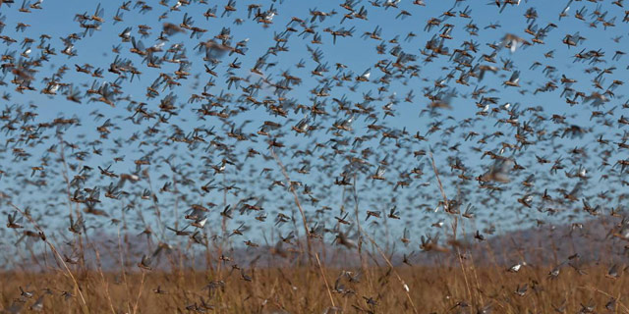
أخبرهم عن الجراد
لا يتم ذكر ملك
= لا يتم ذكر تاريخ
قول الرب الذي صار إلى يوئيل بن فثوئيل
(يوئيل 1: 1)
حسناً

Slide 57
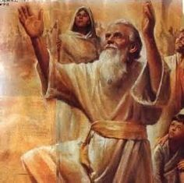
الإسم يوئيل = الرب هو الله
يو = يهوه = الرب
إيل = إلوهيم = الله

Slide 58
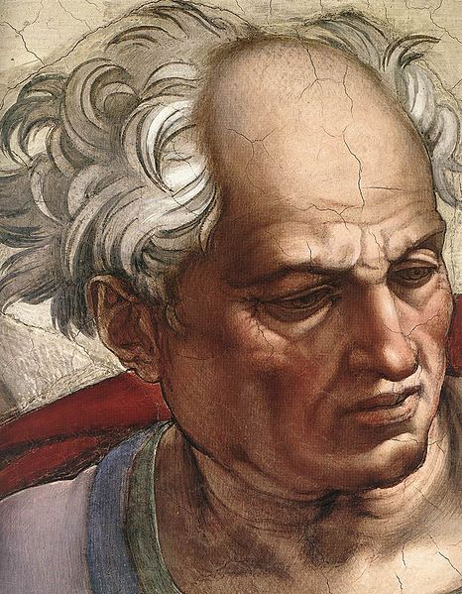
2 اسمعوا هذا أيها الشيوخ وأصغوا يا جميع سكان الأرض هل حدث هذا في أيامكم أو في أيام آبائكم 3 أخبروا بنيكم عنه وبنوكم بنيهم وبنوهم دوراً آخر (يوئيل 1: 2-3)

Slide 59
باري هادلستون، الكتاب المقدس الملخص بالأحرف الصوتية (غراند رابيدز: بيكر، 1992)
يوئيل
1. أبكي لتجنب الدينونة
2. أرجع إلى بركة الله
3. أخضع لسيادة الله

Slide 60
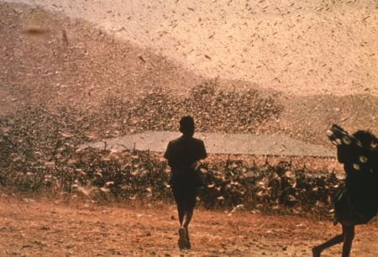
التاريخ والمستلمين
577
ت. التاريخ : فترة زمنية متأخرة بعد السبي (بين 597
و586 ق.م)
ث. المستلمون: الناس في يهوذا بسبب إشارات كثيرة إلى
صهيون والهيكل (1: 9 ، 13-14 ؛ 2: 15-17 ، 23
، 32 ؛ 3: 1 ، 5-6 ، 16-17 ، 20-21 ).

Slide 61
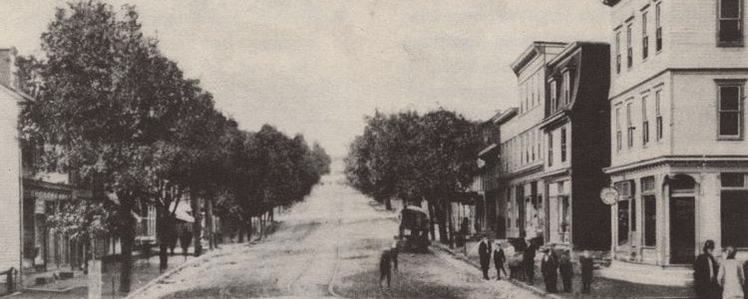
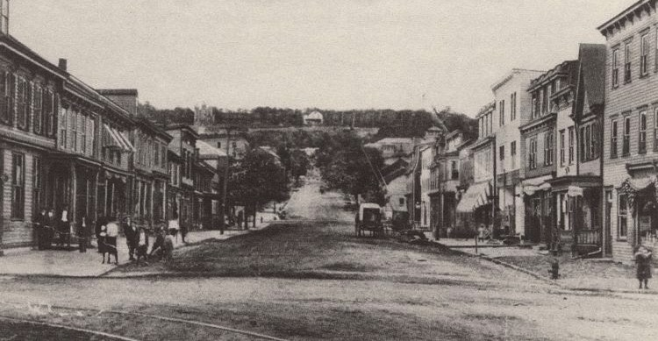
غزو ​​الجراد الحديث (سينتراليا ، بنسلفانيا ، الولايات المتحدة الأمريكية)
قبل غزو الجراد
بعد غزو الجراد

Slide 62
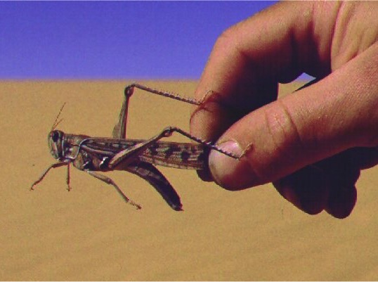
ج. المناسبة
577
اجتاح وباء الجراد يهوذا مؤخراً

Slide 63
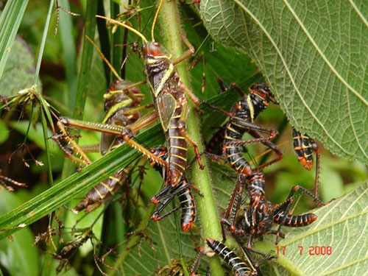
فضلة القمص أكلها الزحاف وفضلة الزحاف أكلها الغوغاء وفضلة الغوغاء أكلها الطيار (يوئيل 1: 4)

Slide 64
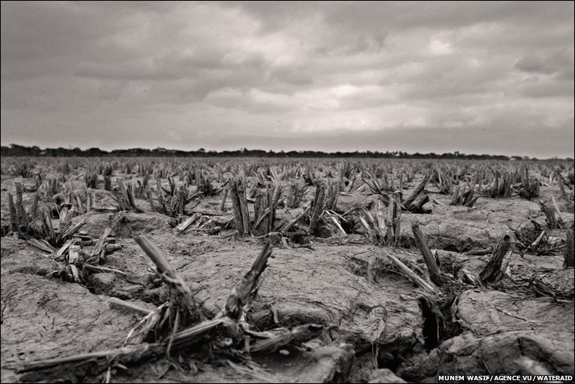
اصحوا أيها السكارى وابكوا وولولوا يا جميع شاربي الخمر على العصير لأنه انقطع عن أفواهكم (يوئيل 1: 5)

Slide 65
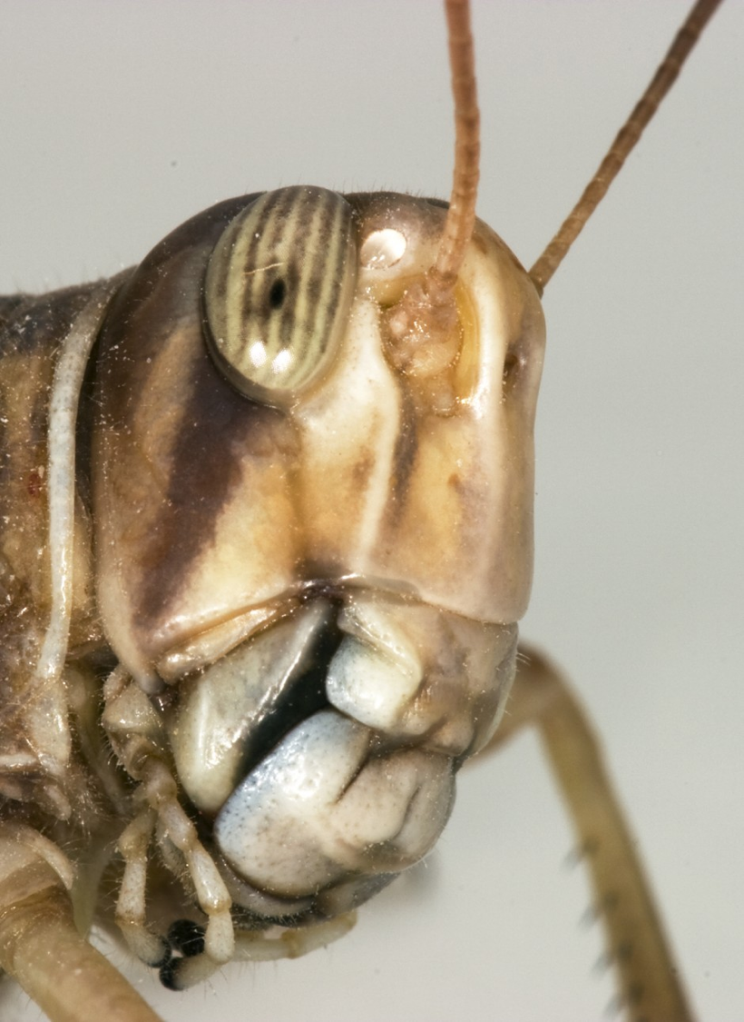
إذ قد صعدت على أرضي أمة قوية بلا عدد أسنانها أسنان الأسد ولها أضراس اللبوة (يوئيل 1: 6)

Slide 66
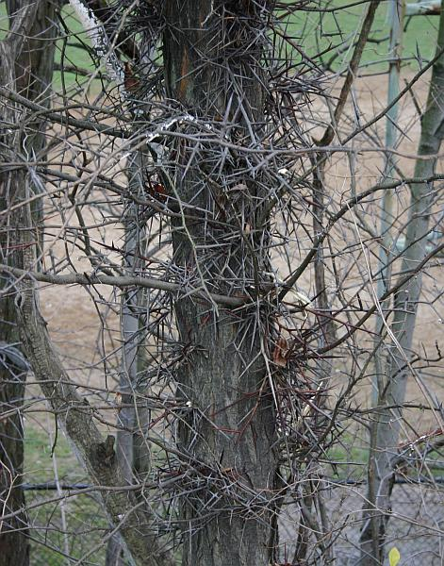
جعلت كرمتي خربة وتينتي متهشمة قد قشرتها وطرحتها فابيضت قضبانها (يوئيل 1: 7)

Slide 67
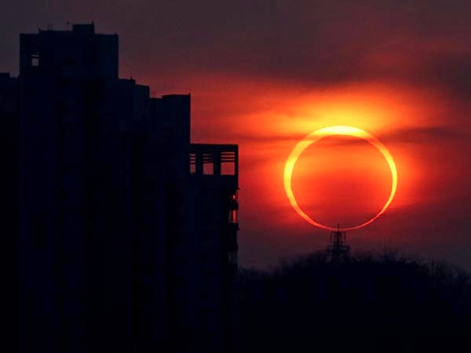
يوم الرب (يوئيل 1: 15)
آه على اليوم
لأن يوم الرب قريب
يأتي كخراب
من القادر على كل شيء

Slide 68
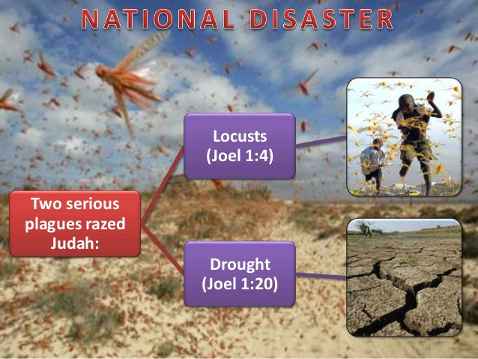
الكوارث الوطنية في يوئيل 1
الجراد (يوئيل 1: 4)
ضربت ضربتان خطيرتان يهوذا:
الجفاف (يوئيل 1: 20)

Slide 69
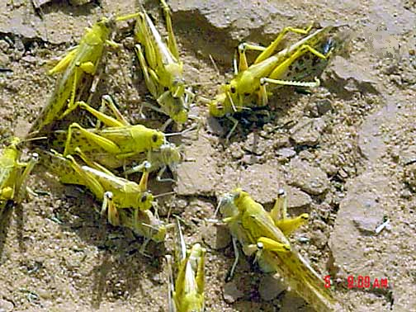
البالغون الناضجون يتزاوجون
Notes:
Mali: mature gregarious adults copulating (Tamesna, 11/03) http://www.fao.org/NEWS/GLOBAL/LOCUSTS/outbreakpix03.htm

Slide 70
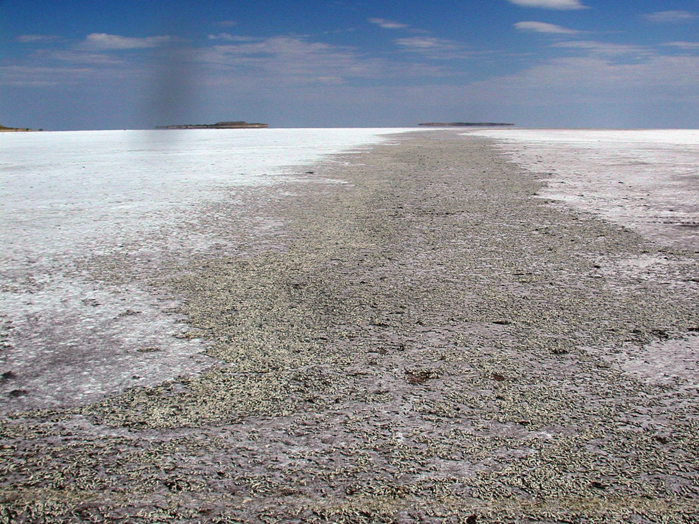
ساحة قبر الجراد ، سالت ليك ، يوتا

Slide 71

الكلمة المفتاحية
577
الجراد

Slide 72
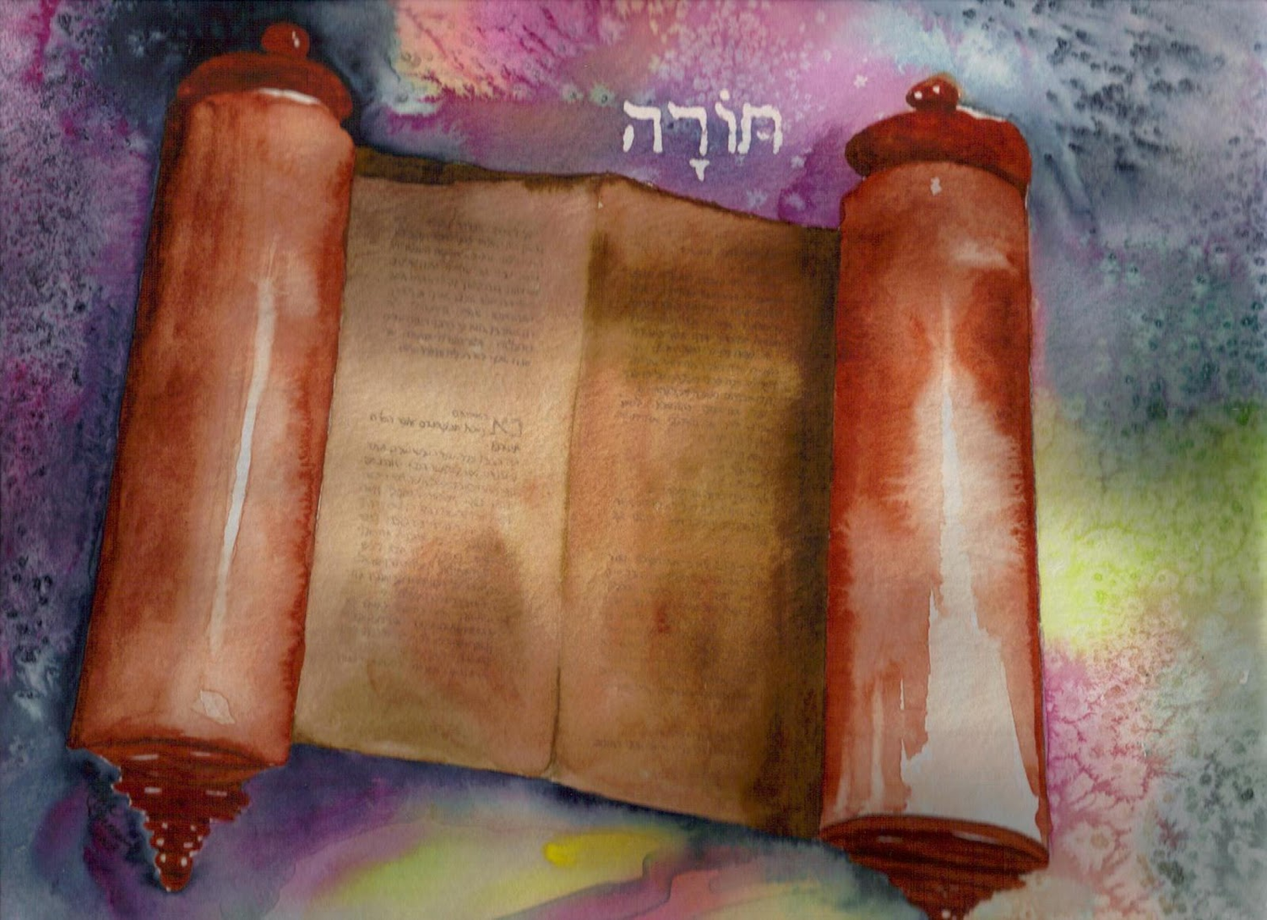
فماذا تقول التوراة عن الجراد؟

Slide 73
البركات اللعنات و
577 154 220
تثنية 28
مباركاً تكون في المدينة
ومباركاً تكون في الحقل (3)
ملعوناً تكون في المدينة
وملعوناً تكون في الحقل (16)
مباركة تكون ثمرة بطنك
وثمرة أرضك (4)
ملعونة تكون ثمرة بطنك
وثمرة بطنك (18)
مباركة تكون سلتك
ومعجنك (5)
ملعونة تكون سلتك
ومعجنك (17)
مباركاً تكون في دخولك
ومباركاً تكون في خروجك (6)
ملعوناً تكون في دخولك
وملعوناً تكون في خروجك (19)
في طريق واحدة يخرجون عليك
وفي سبع طرق ينهزمون أمامك (7)
في طريق واحدة تخرج عليهم
وفي سبع طرق تهرب أمامهم (25)
تقرض أمماً كثيرة
وأنت لا تقترض (12)
هو يقرضك
وأنت لا تقرضه (44)

Slide 74
اللعنات النبوية
577 154 220
لماذا؟
السبي
تث 28
Notes:
The curses of prophets like Joel are based on God's warnings to Israel hundreds of years earlier in Deut 28.

Slide 75
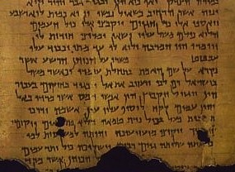
ماذا تعني ضربة الجراد؟
577
تثنية 28: 38
بذاراً كثيراً تخرج إلى الحقل وقليلاً تجمع لأن الجراد يأكله

Slide 76
يوئيل ٢

Slide 77

اضربوا بالبوق في صهيون صوتوا في جبل قدسي ليرتعد جميع سكان الأرض لأن يوم الرب قادم لأنه قريب (يوئيل 2: 1)

Slide 78
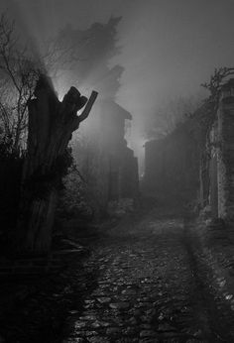
يوم ظلام وقتام يوم غيم وضباب مثل الفجر ممتداً على الجبال شعب كثير وقوي لم يكن نظيره منذ الأزل ولا يكون أيضاً بعده إلى سني دور فدور (يوئيل 2: 2)

Slide 79
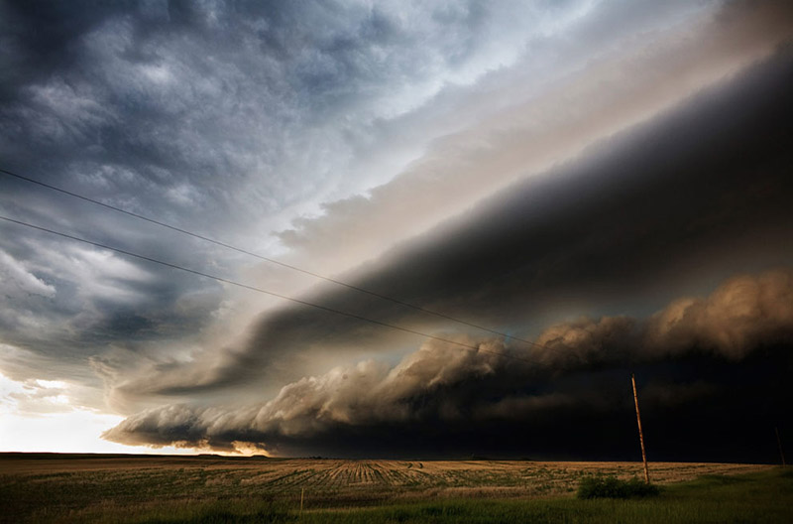
قدامه نار تأكل وخلفه لهيب يحرق الأرض قدامه كجنة عدن وخلفه قفر خرب ولا تكون منه نجاة (يوئيل 2: 3)

Slide 80
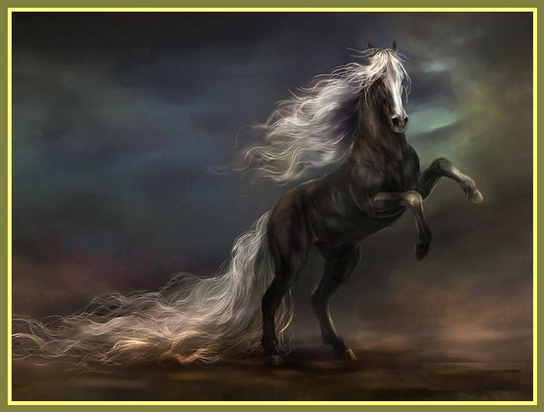
كمنظر الخيل منظره ومثل الأفراس يركضون (يوئيل 2: 4)

Slide 81
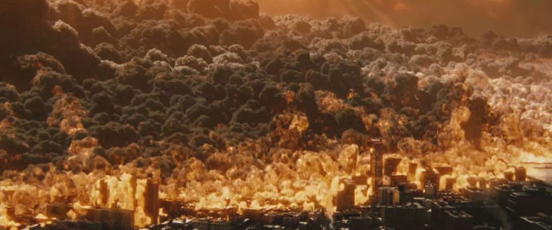
كصريف المركبات على رؤوس الجبال يثبون كزفير لهيب نار تأكل قشاً كقوم أقوياء مصطفين للقتال (يوئيل 2: 5)

Slide 82

كصريف المركبات على رؤوس الجبال يثبون كزفير لهيب نار تأكل قشاً كقوم أقوياء مصطفين للقتال (يوئيل 2: 5)

Slide 83
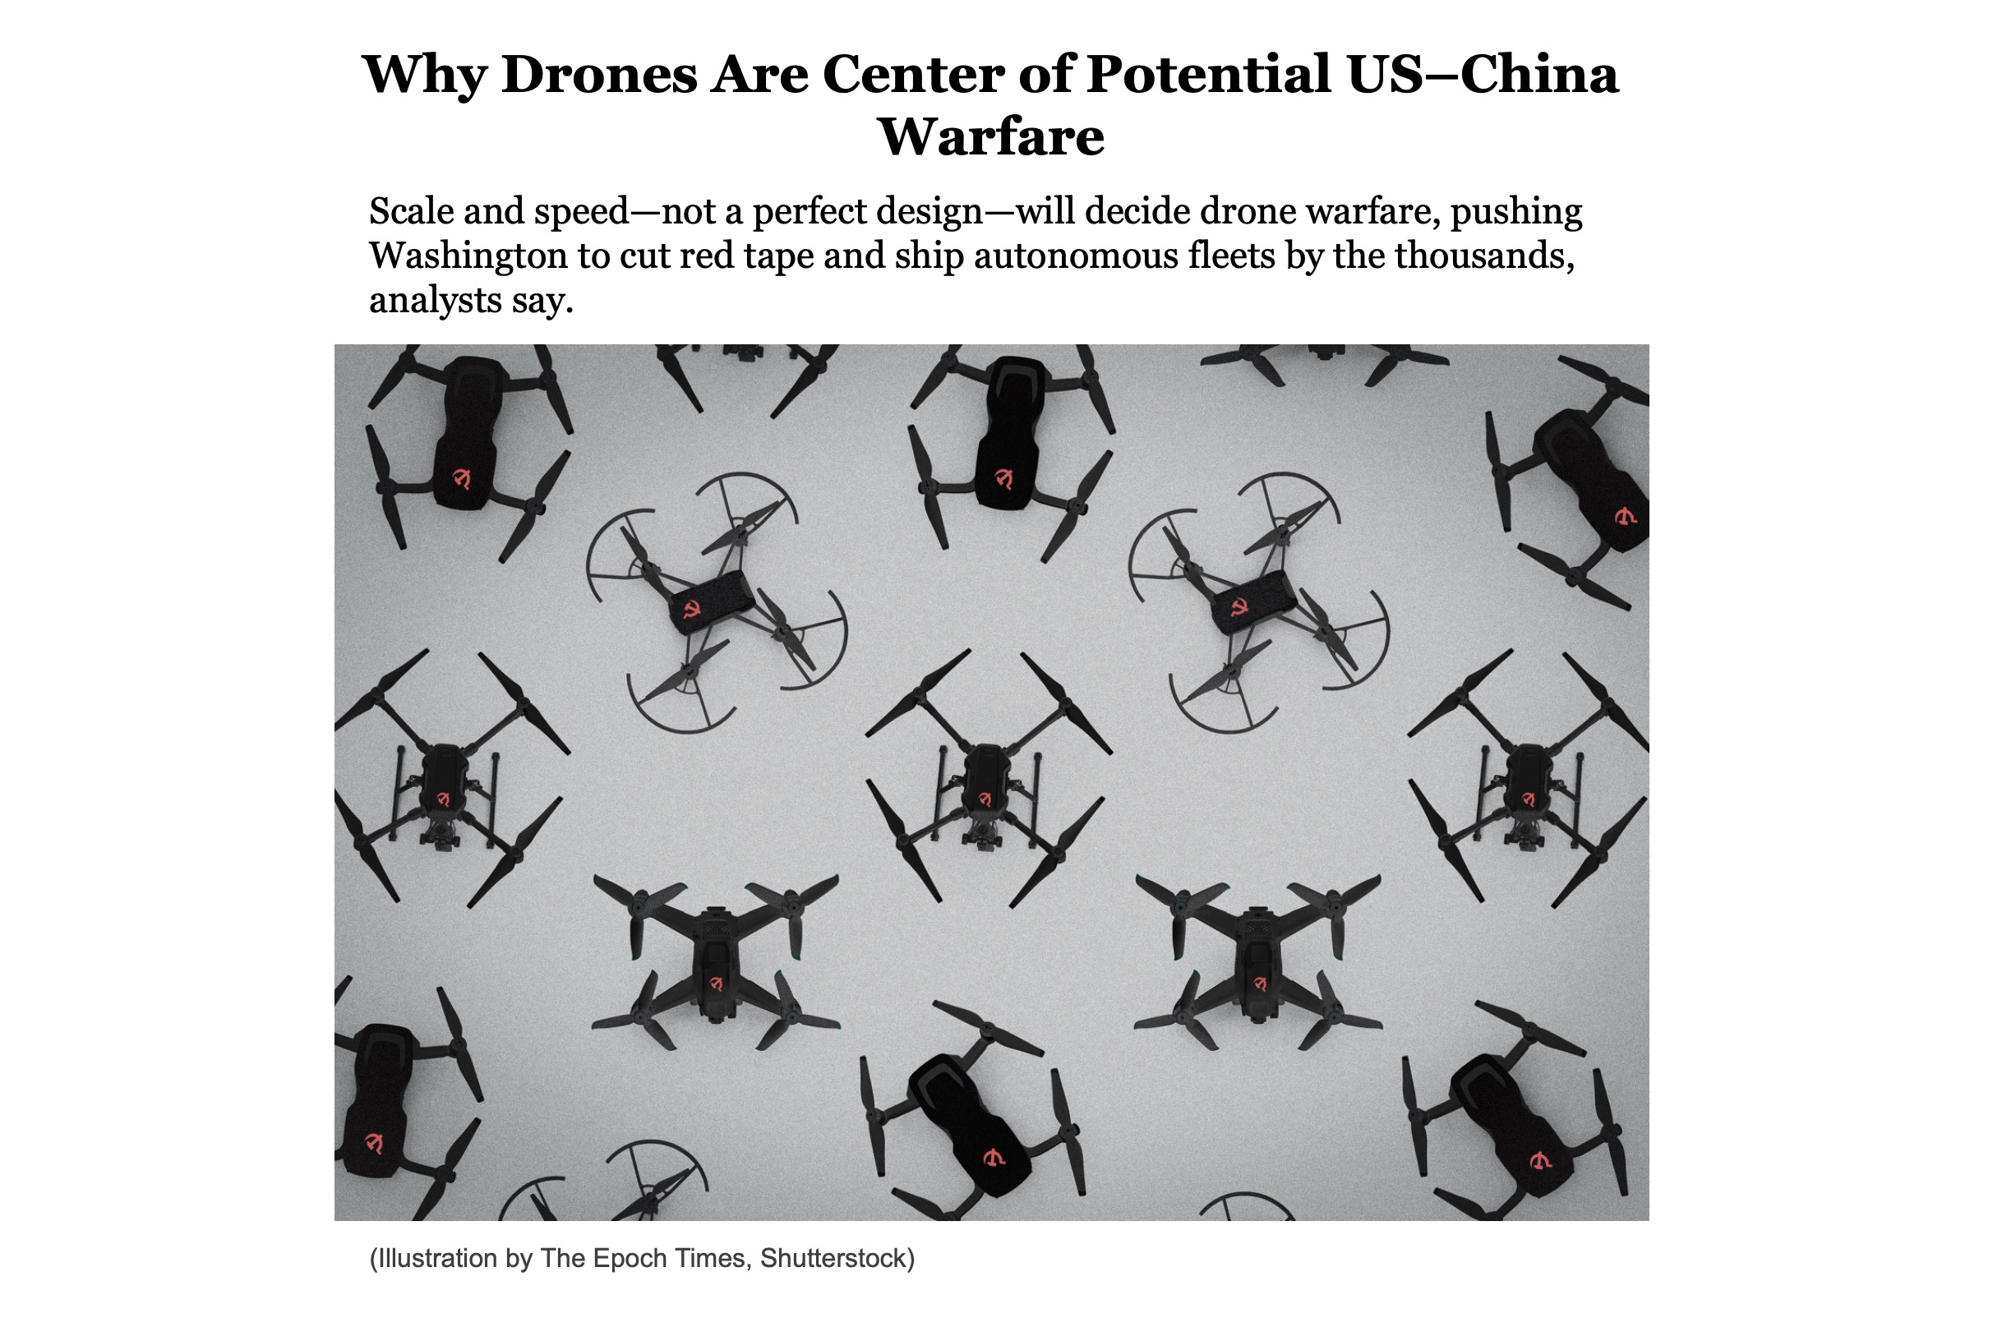
"Look at them as they leap along the mountaintops. Listen to the noise they make—like the rumbling of chariots, like the roar of fire sweeping across a field of stubble, or like a mighty army moving into battle" (Joel 2:5 NLT).
Notes:
Why Drones Are Center of Potential US–China Warfare
October 12, 2025
The Epoch Times
https://lists.theepochtimes.com/archive/w04KnL1FU/RontmvJPy/wCIDFYUap
Scale and speed—not a perfect design—will decide drone warfare, pushing Washington to cut red tape and ship autonomous fleets by the thousands, analysts say.
On today’s battlefields, inexpensive flying robots are capable of locating, jamming, and eliminating targets faster than any human can react. China is determined to flood the skies with them.
In response, the United States is working on building its own swarms, refining smarter software, and tightening curbs on Chinese technology, while Ukraine’s front lines serve as a testing ground for evaluating effective and ineffective technologies.
The contest is not about a single “best drone,” an analyst told The Epoch Times. Instead, it’s a race between China’s ability to mobilize a huge civilian drone industry for war and America’s effort to turn clever prototypes into mass production, then bind them together with software and allied networks.
To prevail, the analyst said, Washington must move faster on approvals and testing, buy in large quantities, and adopt strategies proven effective on Ukraine’s battlefield on a larger scale, such as embracing open systems, facilitating quick upgrades, and shipping technology in the thousands.
Any future clash, especially over Taiwan, will be decided by scale, speed, and the lessons that endure from Ukraine, according to the analyst.
China’s Civil‑Military Fusion
China’s consumer drone machine is enormous.
China delivered more than 3.17 million civilian drones in 2023, with more than 2,300 companies and at least 1,000 models in mass production, the vice minister of industry and information technology told a press conference in April 2024.
That ecosystem—anchored by Chinese company DJI, the world’s largest drone maker—feeds a low-cost parts chain of motors, optics, radios, and flight controllers that can pivot to military use almost overnight.
This illustrates the civil-military fusion strategy of the Chinese Communist Party (CCP): a state-guided process that transforms consumer dominance into wartime readiness.
Beijing is investing just as heavily in technology used to attack drones.
In July, state-owned giant Norinco showcased a truck-mounted 50-kilowatt laser, the OW5-A50, billed as a swarm killer, during a widely publicized “border-control” drill that also paraded an array of uncrewed systems.
In September, a military parade pushed new drones alongside anti-drone lasers and microwave weapons. However, such equipment—such as the Hurricane-3000 microwave system—remains under field tests, according to an exclusive report by Army Recognition Group, a defense news website.
Civil feats could serve as evidence of military capabilities. In Yunnan, for example, in July, a coordinated fleet of heavy-lift drones hauled 180 metric tons of steel and concrete up a mountain to build power-line towers in days rather than weeks—a glimpse of the logistics muscle that could matter in wartime resupply.
At recent air shows, China has also touted a “drone mothership,” a large unmanned aircraft designed to launch and retrieve dozens of smaller drones.
However, due to the limited technical details available, observers say its practicality and battlefield value in real-world scenarios remain uncertain.
“The message is clear: Beijing wants scale on both offense and defense,” Stephen Xia, a former People’s Liberation Army engineer who now works as a military-equipment analyst, told The Epoch Times.
US Counters China
Sensing the urgency, Washington is trying to decouple from Chinese parts while ramping up U.S. capacity.
In June, the Trump administration issued an executive order aimed at accelerating domestic drone manufacturing and reducing reliance on foreign suppliers.
The following month, the Commerce Department opened a national-security probe under Section 232 into imports of drones and related components—a move that may lead to tariffs or outright limits.
In September, U.S. authorities signaled new rules that could restrict or ban many Chinese drones and parts outright, building on earlier measures. A federal court also upheld the Pentagon’s authority to label DJI a Chinese military company, further tightening restrictions on the world’s biggest consumer drone brand.
The Pentagon’s Blue unmanned aerial system (UAS) program maintains a public, vetted roster of small drones and components that meet cybersecurity and supply-chain requirements—excluding those made in China—and guides Department of War buyers and other agencies toward trusted options.
“Policy only sets the stage—the real test is deploying hardware at scale,” said Mark Cao, a U.S.-based military-tech analyst, former materials engineer, and host of the Chinese-language military-news YouTube channel “Mark Space.”
The Department of War’s Replicator initiative, launched in August 2023, pledged to deliver “multiple thousands” of low-cost, expandable, autonomous systems by August 2025, pressing the military services to procure faster and in bulk.
The program prioritizes drone systems that can be produced quickly and at scale, bypassing traditional slow defense procurement methods.
Defense officials told DefenseScoop last month that hundreds have reached military units so far—still short of the original mark—but funding and momentum continue. The Epoch Times could not independently verify this claim.
The concept dovetails with Indo-Pacific Commander Admiral Samuel Paparo’s vow to turn the Taiwan Strait into an “unmanned hellscape” if the Chinese regime launches an attack, using swarms across air, sea, and land to slow the People’s Liberation Army and buy time for heavier forces. He made the remarks during an interview with The Washington Post on the sidelines of the Shangri-La Dialogue in Singapore in June 2024.
At the high end, the Air Force’s robotic wingmen are already in the air. General Atomics’ YFQ‑42A began flight tests in August, while Anduril’s YFQ‑44A is slated to fly in mid-October, the Air Force’s top civilian announced last month.
The glue that holds it all together is software. L3Harris’s AMORPHOUS aims to enable a single operator to task and retask thousands of mixed drones and unmanned boats through a single interface—the command-and-control backbone for large-scale swarming demands.
A YFQ-44A production representative test vehicle is staged in a testing chamber at Costa Mesa, Calif. The vehicle is one of two such test vehicles that will be critical in securing air dominance for the Joint Force in future conflicts, leveraging autonomous capabilities, and crewed-uncrewed teaming to defeat enemy threats in contested environments.
Russian Drones Rely on Chinese Parts
Crack open a wrecked Russian drone and the global supply chain comes into view.
“There is a good number of Chinese components and microprocessors in Russian drones, along with basically everything that is needed to assemble first-person view drones,” Samuel Bendett, an adviser at the Center for Naval Analyses’ Russia Studies Program who focuses on unmanned systems, told the Epoch Times.
“The transfer is direct and unobstructed.”
He noted that Russian builders order first-person view drone parts straight from Chinese factories and online marketplaces.
“The supply is cheap and plentiful,” Bendett said, claiming that it was so plentiful that it hurts Russia’s own attempts to make those parts domestically.
A Reuters investigation published in July tracked Chinese L550E engines—relabeled as “industrial refrigeration units”—to a sanctioned Russian maker of attack drones used in Ukraine. Kyiv has also blacklisted several Chinese suppliers after finding their parts in downed aircraft.
Beijing has tightened some dual-use exports since July 2024 to safeguard its national security interests—moves that have driven up prices and complicated shipments of components such as infrared cameras and inertial sensors.
Yet this display of leverage also underscored how dependent global buyers remain on Chinese supply, accelerating Washington’s push to reduce reliance through Section 232 measures, the Blue UAS program, and procurement bans, according to Cao.
Ukrainian Drones
“If China’s advantage lies in its mass and supply capabilities, Ukraine’s advantage is speed and adaptation,” Cao told The Epoch Times.
He noted that over the past year, Ukrainian units have transitioned from solo-drone strikes to artificial intelligence (AI)-assisted swarms that coordinate their own attacks under heavy jamming—still small in scale, but designed to expand in scope.
The Pentagon has allocated $50 million for 33,000 AI “strike kits” from Auterion, a Swiss-American defense and robotics software company, to equip the Ukrainian military. These kits transform low-cost drones into jam-resistant, target-tracking weapons, integrating battlefield upgrades into regular inventories.
Ukrainian sea drones such as the Magura V5 forced key Russian naval assets to pull back from Crimea, reshaping Black Sea operations since late 2023. U.S. naval planners are taking notes as they draft deterrence concepts for Taiwan.
Electronic warfare delivers the hardest lessons, according to Cao.
“Jamming can blind or hijack a drone; the counter is better autonomy and navigation that doesn’t rely on GPS,” he said, pointing to Russia’s fiber-optic-tethered first-person view drones, which sidestep conventional jammers.
Bendett said that when AI-driven drone swarms arrive in force, cyber defenses alone won’t be enough—armies will also need physical shields such as wire netting, cage armor, decoys, and old-fashioned kinetic weapons.
Both Russia and Ukraine are already developing lasers for that role, he noted.
The United States is also experimenting with directed-energy weapons.
At a live-fire trial in late August, U.S. electromagnetic-warfare company Epirus proved that a single pulse from its Leonidas high-power microwave system can disable a swarm of 61 drones, showcasing a potential low-cost shield.
Who’s Ahead and Why It Matters
In consumer and commercial drones, as well as the parts ecosystem that supports them, China leads by a considerable margin.
Civil-military fusion lets Beijing field “good-enough” platforms quickly and back them with a growing suite of counter-drone weapons, Cao said, noting that much of the PLA’s newest gear remains untested in combat.
“The parade ground is not a battlefield,” he said.
The United States still sets the pace in high-end autonomy, battlefield-proven intelligence, surveillance, and reconnaissance; strike drones; and software that integrates mixed fleets. Its stumbling block is turning rapid-fire innovation into industrial-scale output—precisely what initiatives such as Replicator, the Collaborative Combat Aircraft program, and Blue UAS aim to fix, Cao explained.
The United States pioneered military drones starting from the Vietnam War, setting benchmarks with Predator and Reaper, while China’s early advances leaned heavily on copying, according to Cao.
“But today’s race isn’t about cloning airframes,” he said. “It’s about standardization, modularity, and speed—treating autonomy like software that can be pushed quickly and bought by the thousand once it works.”
What the US Can Learn From Ukraine
Cao identified three lessons that he says frequently reappear.
First, numbers matter more than perfection: Open-architecture designs, fast logistics, and continual software updates consistently outperform exquisite weapons that arrive too late.
Second, signals have become a battlefield; jammers cut control links, driving drones to rely on onboard autonomy, which, in turn, demands smarter counters. Those counters must be cheap—microwave pulses, lasers, decoys, even wire cages—so a soldier does not fire a million-dollar missile at a hundred-dollar quadcopter, he said.
Third, supply chains are a strategic element; as long as Chinese parts dominate, sanctions turn into a cat-and-mouse game, according to Cao. The more innovative approach is to out-produce and adapt quickly with allies—and it must be done fast.
China’s strength is mass mobilization. America’s answer must be software, allied production, and speed, Cao said. If Washington can convert today’s demos—AI strike kits, swarm control, robotic wingmen—into repeat orders and fielded units, it can offset China’s factory edge and raise the cost of any fight for Beijing. If not, he warned, the skies and seas around Taiwan may be dominated by those who ship faster, rather than those who design better.
🔗 RELATED
The Commerce Department added 19 Chinese entities that have supported or supplied drones to terrorist organizations to an entity list on Oct. 8. Among them are Goodview Global, found to be part of an illicit network supplying the sanctioned Islamic Revolutionary Guard Corps with drone parts. The U.S. government in March offered rewards of up to $15 million for information that would disrupt the Islamic Revolutionary Guard Corps funding network, which supports the Hamas terrorist group, the Hezbollah terrorist group, and other proxies. The bounty notice named four Chinese nationals allegedly providing the terrorists with arms.
Chinese drone experts have traveled to Russia to work on military drones at a state-owned weapons manufacturer already under Western sanctions, Reuters reported. The Chinese experts visited IEMZ Kupol’s weapon facilities more than six times since mid-2024, Reuters reported on Thursday, citing two European security officials and company documents reviewed by the outlet.
War-torn Ukraine has much to offer its allies and partners in the expanding drone arms race, Ukrainian President Volodymyr Zelenskyy said in a speech before the U.N. General Assembly on Sept. 24. Noting recent developments in unmanned weapons systems and artificial intelligence, Zelenskyy told the assembly, “We are now living through the most destructive arms race in human history.” The Ukrainian president touted his country’s successes in employing drones to slow the march of the numerically superior Russian military.

Slide 84
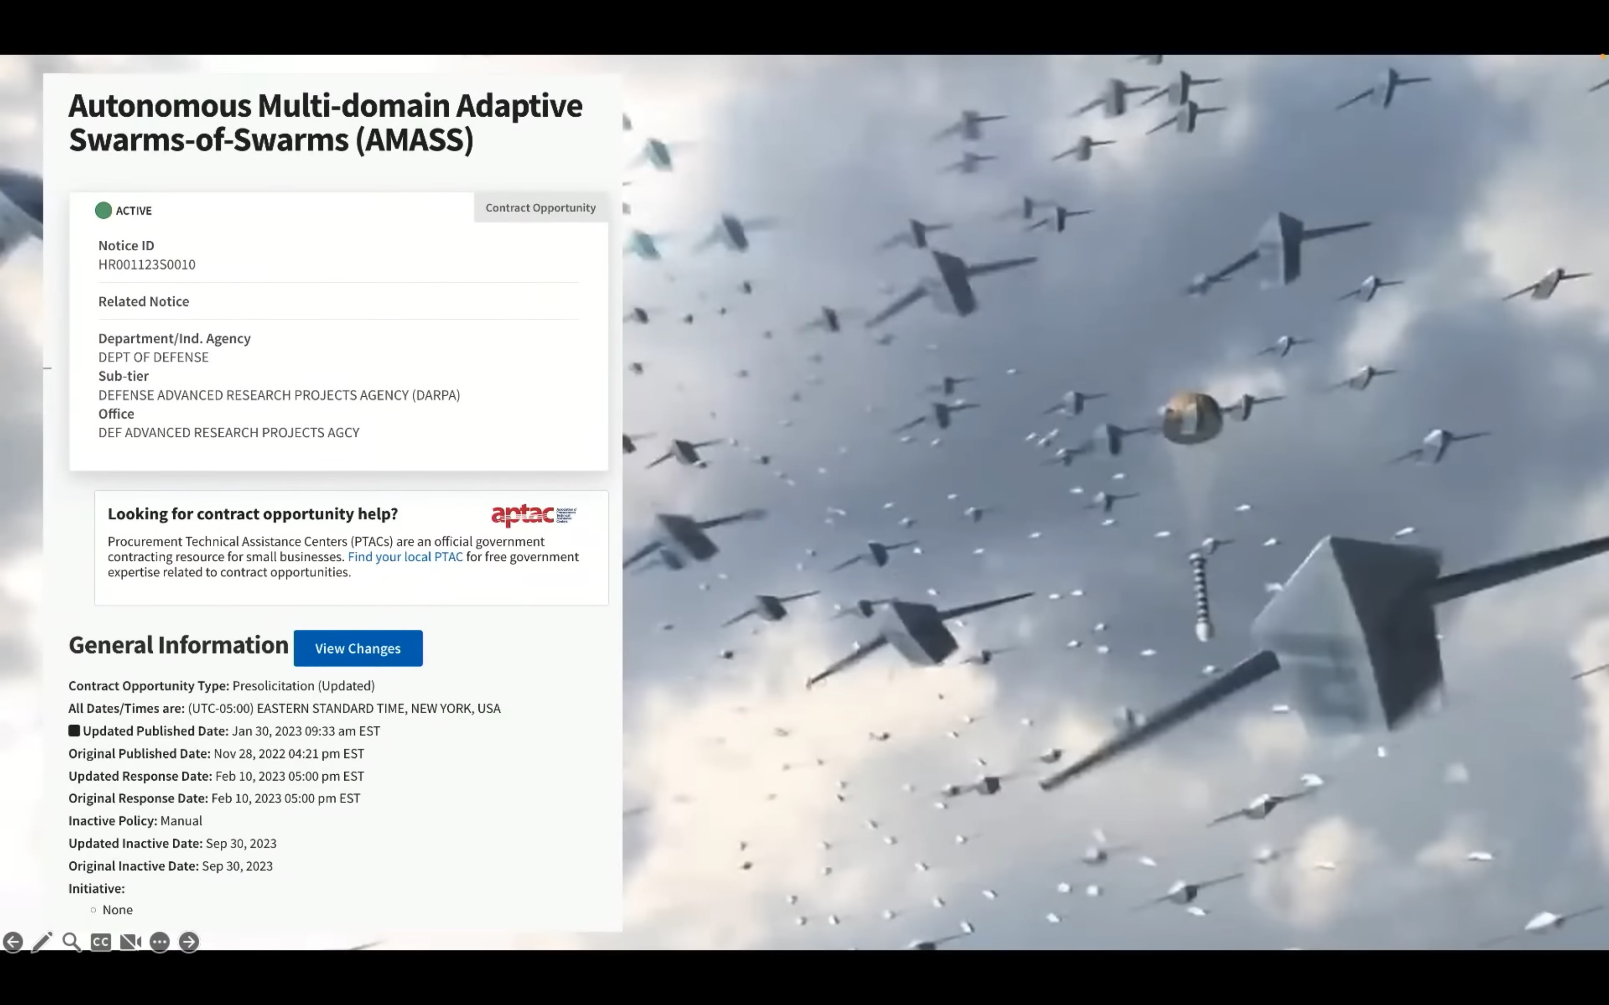
"Look at them as they leap along the mountaintops. Listen to the noise they make—like the rumbling of chariots, like the roar of fire sweeping across a field of stubble, or like a mighty army moving into battle" (Joel 2:5 NLT).

Slide 85
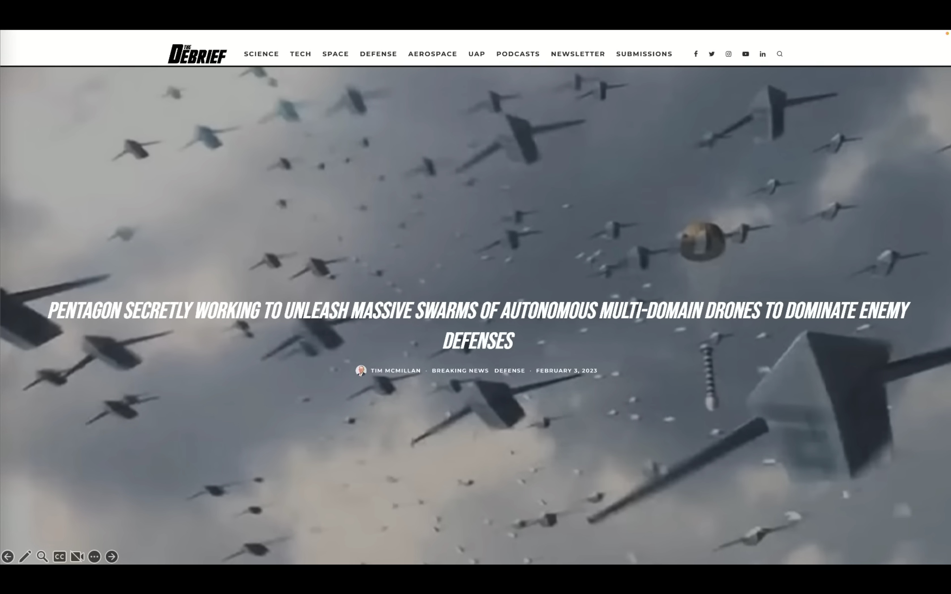
"Look at them as they leap along the mountaintops. Listen to the noise they make—like the rumbling of chariots, like the roar of fire sweeping across a field of stubble, or like a mighty army moving into battle" (Joel 2:5 NLT).

Slide 86
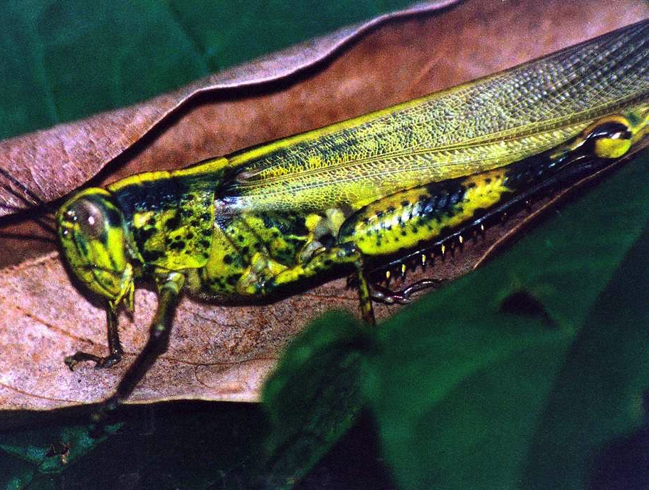
الآية المفتاحية
575
لأن يوم الرب عظيم ومخوف جداً فمن يطيقه ولكن الآن يقول الرب ارجعوا إليَّ بكل قلوبكم وبالصوم والبكاء والنوح
)يوئيل 2: 11ب-12(

Slide 87
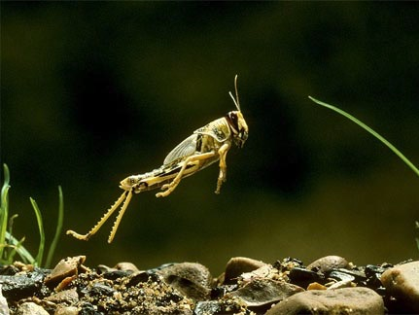
ما هو الجراد في يوئيل 2: 1-11؟
578
كل من الجراد والجيوش؟
مخلوقات خارقة للطبيعة؟
جراد حرفي؟
صورة رمزية لجيش واحد؟
صورة رمزية لجيوش عديدة؟
Notes:
Desert leaping locust

Slide 88
يوئيل
دمار 1: 1-2: 17
تحرير 2: 18-3: 21
الإسترداد 2: 18-32
البركة 3: 17-21
الدينونة 3: 1-16
الكوارث 1: 1-20
الغزو 2: 1-17
تاريخ
نبوة
يوم الرب

Slide 89

مستقبلي لماذا؟
578
1. تصعيد الصور: زلزال ، علامات في السماء (يوئيل 2:10 ، 30-31 ؛ متى 24:29)

Slide 90

مستقبلي لماذا؟
578
1. تصعيد الصور: زلزال ، علامات في السماء (يوئيل 2:10 ، 30-31 ؛ متى 24:29)
2. جيش (يوئيل 2: 2، 11)

Slide 91


مستقبلي لماذا؟
578
1. تصعيد الصور: زلزال ، علامات في السماء
(يوئيل 2:10 ، 30-31 ؛ متى 24:29)
2. جيش (يوئيل 2: 2، 11)
3. لا يغزو الجراد من الشمال مثل هذا الجيش (يوئيل 2:20)
4. الشمال (يوئيل 2:20) يتطابق مع الأعداء الأخرويين الذين يغزون من الشمال
(زك . 6: 8 ، إلخ.)

Slide 92

الدينونة

Slide 93

البركة

Slide 94


يوم الرب
638-639
الدينونة
+
البركة
الضيقة
الحكم الألفي
رؤيا 6-19
رؤيا 20
7 سنوات
1000 سنة
Notes:
The Day of the LORD theme appears in every prophetic writing except Jonah. It has a dual emphasis where judgment is followed by blessing. In the near fulfillment, it warns of the judgment of Israel in the Assyrian captivity or of Judah in the Babylonian exile.
But the ultimate referent is the the judgment of the whole earth for a short period, followed by a long era of blessing. Daniel 9:27 identifies this judgment as lasting seven years. Daniel also divides that period into two segments lasting 3.5 years (Dan 7:25; 12:7; Rev. 12:14) which Revelation calls “42 months” (Rev 13:5) or “1260 days” (Rev 12:6).
The NT builds upon this common OT teaching regarding the blessing period. When we get to Rev 20:1-6, we see that the blessing of the kingdom era will last 1000 years.
————————————
OS-29-Joel-86
OS-36-Zephaniah-132

Slide 95
الجدول الزمني التدبيري
437
العرش
العظيم
الأبيض
(رؤ 20: 11-14)
الإختطاف (1 تس 4: 13-18)
المجيء الثاني
(زك 14: 3-5)
يوم الرب
عصر الكنيسة
الضيقة
(زك 14: 1-2)
الألفية
(زك 14: 6-21)
جوج وماجوج (هرمجدون) (حز 38-39)
عودة
جوج وماجوج
(رؤ 20: 7-10)
Notes:
95

Slide 96
ما العمل؟
12 ولكن الآن يقول الرب ارجعوا إليَّ بكل قلوبكم وبالصوم والبكاء والنوح 13 ومزقوا قلوبكم لا ثيابكم وارجعوا إلى الرب إلهكم لأنه رؤوف رحيم بطيء الغضب وكثير الرأفة ويندم على الشر (يوئيل 2: 12-13)

Slide 97

هل ترفض تأديب الله؟
Notes:
God’s disciplining us should motivate us to seek the Lord.

Slide 98

الله والولايات المتحدة
Notes:
The moral height of the USA was in the 1950s. The USA rebuilt its former enemies Japan and Germany, adopted “In God We Trust” as the national motto, and began to see many turn to Christ under Billy Graham as well send out missionaries to the nations.
Home > 2015 > July
Jul 3, 2015
God and Country: Americans' Views of God's 'Relationship' with the U.S
What do Americans think about the United States and God? Fascinating new data. |
Ed Stetzer
http://www.christianitytoday.com/edstetzer/2015/july/god-and-country-new-research-on-americans-views-of-country.html
Accessed 9 April 2017
Happy Fourth of July weekend folks, my American readers!
Two hundred thirty-nine years ago tomorrow, Congress adopted the Declaration of Independence, nearly a month before it would eventually be signed. I hope you're having a fun weekend, getting to enjoy some time with family and friends.
As I explained in a post last year:
Christians are, in a sense, dual citizens-- of the Kingdom and of the nation where they live. I live in a country that is not without fault, but I am proud to be a citizen of that nation. I teach my children to be proud of their nation-- not unaware of its challenges-- and patriotic citizens.
Just this week, LifeWay Research released some new data on how Americans view their country and how God relates with it. Here's an excerpt from our report:
In a nation founded on religious liberty, most Americans believe God has a special relationship with the United States, and they’re optimistic the best is yet to come.
Despite headlines lamenting the global decline of the United States since the Cold War, 54 percent of Americans believe the nation is on the upswing, according to a September survey by LifeWay Research. Only 4 in 10 think “America’s best days are behind us.”
And though the U.S. Constitution makes no mention of God, 53 percent of Americans say they believe God and the nation have a special relationship, a concept stretching back to Pilgrim days. Even a third of atheists, agnostics, and those with no religious preference believe America has a special relationship with God.
“‘God Bless America’ is more than a song or a prayer for many Americans,” said Ed Stetzer, executive director of LifeWay Research. “It is a belief that God has blessed America beyond what is typical for nations throughout history. I am sure that would spawn many theological conversations, but it’s important to note most Americans think God has a special relationship with their country.”
Christianity Today reported on the data, and added additional research, in their article, "God and America: It's Complicated," explaining, "A third of Americans say the United States is a Christian nation. But more than half say the country has a special relationship with the Almighty."
Christianity Today also included a link to my post providing cautions about combining patriotism and worship, where I explained the importance of patriotism (and not just in the U.S.), but also cautioned, "If your church service was driven more by America than by Jesus, I think you need a change."
Here are a couple of the graphs depicting the major findings:
One of the most interesting parts of the survey was the gender divide among the views:
Women are significantly more likely than men to believe God has a special relationship with the United States. While 49 percent of men have that view, the number rises to 58 percent for women.
LifeWay Research also found differences by age, race, geography, education, and religious preference.
Nearly two-thirds (63 percent) of Americans 45-54 years old think God has a special relationship with the United States, a belief shared by 48 percent of those 18-44.
Belief in a special relationship is also high among:
African-Americans, at 62 percent, compared to whites at 51 percent. Southerners, at 59 percent, compared to 49 percent of Midwesterners and 50 percent of Westerners. Those with a high school degree or less, at 66 percent. For those with some college, the rate drops to 51 percent. It drops further to 40 percent of those with a bachelor’s degree and 29 percent of those with a graduate degree. Evangelical Christians are the most likely to believe in a special relationship, with 67 percent agreeing. Among evangelicals 45 and older, the share soars to 71 percent.
“Americans, particularly those in more religious segments or geography, are most likely to believe in this special relationship,” Stetzer said. “But, considering the history of the nation, from Manifest Destiny to Ronald Reagan’s ‘City on a Hill’ speech, it’s not surprising this long-held theme continues today.”
A lot of this, of course, is rooted in our sense of American exceptionalism. Here's a bit on that from our report, including a thought from me:
Both ends of the political spectrum—from President Obama to the Republican Party platform—have touted American exceptionalism, the belief that the United States plays a unique role in human history. For some, the concept includes the idea of a special relationship with God, although beliefs about the nature of the relationship vary.
“Some Christians view America as an archetype of biblical Israel, chosen and uniquely blessed by God,” Stetzer said. “That’s why Christians sometimes speak of God ‘healing our land,’ when most theologians say this American ‘land’ is not in the same category as the ‘land’ of biblical Israel.”
What do you think? Is America exceptional? Does God have a special relationship with the United States? Comment below.
Click here to see the full research report.
Support our work. Subscribe to CT and get one year free.

Slide 99

تأديب الله للولايات المتحدة الأمريكية
Notes:
But the 1960s became a turning point: corporations wanting to prolong the Vietnam War to make more money off it, making it illegal to pray and read the Bible in schools, chaos in the many riots, and assassinations of key leaders like John F Kenney and Martin Luther King.
The last straw was America turning its back on Israel in recent years, even sponsoring a conference against Israel in January 2017 a week before the change of power in Washington.

Slide 100

تأديب الله للولايات المتحدة الأمريكية
المشكلة ليست الأسلحة
إنها قلوب بدون الله
بيوت بلا تأديب
مدارس بلا صلاة
ومحاكم بلا عدل
Notes:
As a result, the USA has been in horrible disarray: 78 million abortions, half of births to unwed mothers, 110 million people with STDs, disrespect around the world, involved in the longest war in US history in Afghanistan and Iraq, etc.
The USA has been under the disciplining hand of God in order that the country might turn back to him.

Slide 101

تأديب الأفراد
قسم الدروس
التي تم تعلمها
قسم الدروس التي تم تعلمها مرتين
قسم…أوه، على الصراخ بصوت عالٍ
Notes:
Some of us could share our stories.
Some have played with sin until we finally got disgusted with ourselves.
Others of us have become complacent so that we hardly give God a thought until Sunday.

Slide 102
أنا لا أصنع أعذاراً أنا أصنع نتائج
Notes:
The result? We lack love, joy, peace, patience, kindness, goodness, faithfulness, gentleness and self-control. How could we expect the fruit of the Spirit without being controlled by the Spirit?
God is calling us to repentance—a change of mind in whom we trust. He also wants to see in us the fruits of repentance—a change of actions that reveal we really did change our mind.

Slide 103
1. يجب أن يجلب التأديب التوبة.
يوئيل 1: 1- 2: 17
Notes:
أوقات الصعوبة هي أوقات رائعة لتغيير وجهات نظرنا.

Slide 104
2. التوبة ستجلب الإسترداد.
يوئيل 2: 18- 3: 21
Notes:
تغيير أفكارنا عن الله يقودنا الى تغيير مستقبلنا.

Slide 105
يوئيل
دمار 1: 1-2: 17
تحرير 2: 18-3: 21
الإسترداد 2: 18-32
البركة 3: 17-21
الدينونة 3: 1-16
الكوارث 1: 1-20
الغزو 2: 1-17
تاريخ
نبوة
يوم الرب

Slide 106

توبة إسرائيل سوف تحضر الغفران، التحرير والإسترداد (يوئيل 2: 18-3: 21)

Slide 107


فيغار الرب لأرضه ويرق لشعبه ويجيب الرب ويقول لشعبه هأنذا مرسل لكم قمحاً ومسطاراً وزيتاً لتشبعوا منها ولا أجعلم أيضاً عاراً بين الأمم (يوئيل 2: 18-19)
Notes:
Israel’s repentance will bring forgiveness and blessing (2:18-27).

Slide 108
حماية الله المستقبلية لإسرائيل
219
والشمالي أبعده عنكم
وأطرده إلى أرض ناشفة ومقفرة
مقدمته إلى البحر الشرقي
وساقته إلى البحر الغربي
فيصعد نتنه
وتطلع زهمته
لأنه قد تصلف في عمله (يوئيل 2: 20)
الشمال
إسرائيل

Slide 109
تباين يوئيل 1 مع 2: 21-27
582
مقتبس من نشرة مجهولة المصدر (كلية دالاس اللاهوتية، 1985)
 | في أيام يوئيل | في يوم الرب
الأرض | حزن (1: 10) | فرح وسرور (2: 21)
الحيوانات | تأوه، توهان، جوع شديد (1: 18) | لا خوف (2: 22أ)
الحقول والبساتين | قاحلة وغير منتجة (1: 7، 10-12) | نمو وإثمار وإنتاجية (2: 22)
الأمطار | قحط مع جفاف يسبب الحرائق (1: 20) | سقوط بوفرة (2: 23)
الحبوب والنبيذ والزيت | مدمرة وجافة (1: 10) | تكون وفيرة (2: 24)
المحاصيل | مدمرة بسبب الجراد (1: 4) | يتم استبدال الدمار بالإنتاجية (2: 25-26)

Slide 110


تناقضات الأرض في سفر يوئيل ٢: ٢١-٢٧
582
نواح
... ناحت الأرض (يوئيل 1: 10)
سوف تبتهج
لا تخافي أيتها الأرض ابتهجي وافرحي لأن الرب يعظم عمله

Slide 111


تناقضات الحيوانات في يوئيل 2: 21-27
582
أنين، توهان، جوع
كم تئن البهائم
هامت قطعان البقر
لأن ليس لها مرعى
حتى قطعان الغنم تفنى
لن تكون خائفة
لا تخافي يا بهائم الصحراء
فإن مراعي البرية تنبت (يوئيل 2: 22أ)

Slide 112


تناقضات الحقول في يوئيل 2: 21-27
582
قاحلة وغير منتجة
جعلت كرمتي خربة
وتينتي متهشمة
قد قشرتها وطرحتها
فابيضت قضبانها
(يوئيل 1: 7، 1: 10-12)
ستنمو .... مثمرة ومنتجة
لأن الأشجار تحمل ثمرها
التينة والكرمة تعطيان قوتهما
(يوئيل 2: 22ب)

Slide 113


تناقضات المطر في يوئيل 2: 21-27
582
الجفاف (الجفاف يسبب الحريق)
حتى بهائم الصحراء تنظر إليك
لأن جداول المياه قد جفت
والنار أكلت مراعي البرية (يوئيل 1: 20)
سوف يسكب في وفرة
ويا بني صهيون ابتهجوا وافرحوا بالرب إلهكم لأنه يعطيكم المطر المبكر على حقه وينزل عليكم مطراً مبكراً ومتأخراً في أول الوقت
(يوئيل 2: 23)

Slide 114


القمح، الخمر والزيت في يوئيل 2: 21-27
582
مدمر وجاف
تلف الحقل ناحت الأرض لأنه قد تلف القمح جف المسطار ذبل الزيت (يوئيل 1: 10)
ستكون وفيرة
فتملأ البيادر حنطة وتفيض حياض المعاصر خمراً وزيتاً (يوئيل 2: 24)

Slide 115


تناقضات المحاصيل في يوئيل 2: 21-27
582
تم تدميرها من الجراد
فضلة القمص أكلها الزحاف
وفضلة الزحاف أكلها الغوغاء
وفضلة الغوغاء أكلها الطيار
(يوئيل 1: 4)
منتجة
وأعوض لكم عن السنين التي أكلها الجراد الغوغاء والطيار والقمص جيشي العظيم الذي أرسلته عليكم فتأكلون أكلاً وتشبعون وتسبحون اسم الرب إلهكم الذي صنع معكم عجباً ولا يخزى شعبي إلى الأبد (يوئيل 2: 25-26)

Slide 116

المصطلحات الأخروية في يوئيل
1. قدسوا ... نادوا (1: 14، 3: 9)
2. لأن يوم الرب قريب (1: 15، 2: 12، 3: 14)
3. يوم الرب قادم (2: 1، 2: 31)
4. ظلام (2: 2، 2: 31)
5. نجاة (2: 3، 2: 32)
6. ترجف السماء والأرض (2: 10، 3: 16)
7. تظلم الشمس والقمر والنجوم (2: 10، 3: 15)
8. الرب يعطي صوته (2: 11، 3: 16)
9. يوم الرب العظيم المخوف (2: 11، 2: 31)
10. اجمعوا (2: 16، 3: 2)
11. شعبي وميراثي (2: 17، 3: 2)

Slide 117

يوئيل 2: 28-29 في العهد الجديد (أعمال 2)
579
بل هذا ما قيل بيوئيل النبي (أعمال 2: 16)
Notes:
In the day of the LORD, God will send the indwelling of the Spirit upon all Jews and celestial signs [when the Jewish nation repents at the return of Christ] (Joel 2:28-32).

Slide 118

يوئيل 2: 28-29
579
28 ويكون بعد ذلك أني أسكب روحي على كل بشر فيتنبأ بنوكم وبناتكم ويحلم شيوخكم أحلاماً ويرى شبابكم رؤى
29 وعلى العبيد أيضاً وعلى الإماء أسكب روحي في تلك الأيام

Slide 119

يوئيل 2: 28-29 في العهد الجديد (أعمال 2)
579
البعض يقول أن المعنى هو أن كل شعب الرب سيصيرون أنبياء – لكن هل هذا ما يقوله يوئيل؟
لا، لقد قال فقط أن هناك عدة أنواع من الأنبياء سيكونون موجودين

Slide 120

يوئيل 2: 30-31
وأعطي عجائب في السماء والأرض دماً وناراً وأعمدة دخان تتحول الشمس إلى ظلمة والقمر إلى دم قبل أن يجيء يوم الرب العظيم المخوف
579
Notes:
God notes these phenomena in the skies which were NOT at Pentecost in Acts 2. This clues us in that only the first part of the prophecy was fulfilled then in the outpouring of the Spirit. The rest will be fulfilled when Christ returns and the “terrible day of the LORD arrives.”

Slide 121
يوئيل 2: 32
ويكون أن كل من يدعو باسم الرب ينجو لأنه في جبل صهيون وفي أورشليم تكون نجاة كما قال الرب وبين الباقين من يدعوه الرب
579

Slide 122

4. المشاكل خمس وجهات نظر عن تتميم يوئيل 2: 28-32
أ. الإلغاء في يوم الخمسين
ب. التتميم في يوم الخمسين
ت. لا تتميم أو نظرة أخروية
ث. وجهة نظر التتميم النموذجي
ج. وجهة نظر التتميم المستمر

Slide 123

الإنجيل للعالم أجمع
إن روح المسيح هو روح الإرساليات، وكلما اقتربنا منه يجب أن نصبح أكثر قوة في الإرسالية. — هنري مارتين —
Notes:
“Another reason for this gift of tongues was to let the people know that the Gospel was for the whole world. God wants to speak to every person in his or her own language and give the saving message of salvation in Jesus Christ. The emphasis in the Book of Acts is on worldwide evangelization, ‘unto the uttermost part of the earth’ (Acts 1:8). ‘The Spirit of Christ is the spirit of missions,’ said Henry Martyn, ‘and the nearer we get to Him, the more intensely missionary we must become’” (Wiersbe, BEC).

Slide 124


Slide 125


This Photo by Unknown Author is licensed under CC BY-SA
This Photo by Unknown Author is licensed under CC BY

Slide 126
يوئيل ٣
Notes:
When God restores Israel as a nation He will judge the nations for abusing Judah (3:1-16).

Slide 127

يوئيل ٣ : ١-٢ 1 لأنه هوذا في تلك الأيام وفي ذلك الوقت عندما أرد سبي يهوذا وأورشليم 2 أجمع كل الأمم وأنزلهم إلى ...
Notes:
The time of these events is revealed at the end of Joel 2 to be when Jesus returns.
²⁹ In those days I will pour out my Spirit
even on servants—men and women alike.
³⁰ And I will cause wonders in the heavens and on the earth—
blood and fire and columns of smoke.
³¹ The sun will become dark,
and the moon will turn blood red
before that great and terribleª day of the LORD arrives.
³² But everyone who calls on the name of the LORD
will be saved,
for some on Mount Zion in Jerusalem will escape,
just as the LORD has said.
These will be among the survivors
whom the LORD has called.
___________ OS-06-Joshua-187
OS-29-Joel-123

Slide 128



يوئيل ٣ : ٢ وادي يهوشافاط وأحاكمهم هناك على شعبي وميراثي إسرائيل الذين بددوهم بين الأمم وقسموا أرضي
حيفا
تل أبيب
فلسطين
إسرائيل
أورشليم
فلسطين
مصر
صحراء النقب
الأردن
Notes:
This verse teaches that, at the return of Christ, when the prosperity of Israel is restored and the nations judged (Joel 3:1-2a), Gentile armies will be judged for three crimes:
Harming Israel
Scattering Jews among the nations, and
Dividing Israel into various parts.
The 2020 peace accords between Israel and Bahrain and between Israel and UAE were accomplished on the condition that Israel keep the land divided among Israel and the Palestinians.
___________ OS-06-Joshua-188
OS-29-Joel-124

Slide 129

امتحان الخريطة للصف السادس (منهج جمعية مراقبة حقوق الإنسان التابعة للأمم المتحدة، 2021)
Notes:
Notice how the word "Israel" does not even appear on this UN Map test.
____________
ES-29-How the Nations Treat Israel-56
OS-29-Joel-125

Slide 130

أنواع العهود غير المشروطة
60
الإبراهيمي
الأرض
الداوودي
الجديد
الأرض | النسل | البركة
مادي | سياسية | روحي
تث 30 | 2 صم 7 | إر 31
Notes:
OS-12-2Sam-79
OS-29-Joel-122

Slide 131

عهود الوعد
البركة
Walt Russell, Playing with Fire, p. 121
تم تضخيمه في
الإبراهيمي
الداوودي
عهود إدارية كيف تختبر البركة
الموسوي
شروط طاعة إسرائيل
حل محلها
الجديد
شروط الطاعة تحت المسيا
والت راسل، اللعب بالنار
Notes:
OS-10-2Sam-79
OS-29-Joel-123

Slide 132
وألقوا قرعة على شعبي وأعطوا الصبي بزانية وباعوا البنت بخمر ليشربوا (يوئيل 3: 3)

Slide 133
دينونة صور وصيدون
وماذا أنتن لي يا صور وصيدون وجميع دائرة فلسطين هل تكافئونني عن العمل أم هل تصنعون بي شيئاً سريعاً بالعجل أرد عملكم على رؤوسكم لأنكم أخذتم فضتي وذهبي وأدخلتم نفائسي الجيدة إلى هياكلكم (يوئيل 3: 4-5)
219
صيدون
صور
يهوذا
فلسطين

Slide 134
بيع بيت يهوذا لليونانيين
وبعتم بني يهوذا وبني أورشليم لبني الياوانيين ليكي تبعدوهم عن تخومهم (يوئيل 3: 6)
219
اليونانيين
صيدون
صور
يهوذا
فلسطين

Slide 135
استرداد يهوذا
هأنذا أنهضهم من الموضع
الذي بعتموهم إليه
وأرد عملكم على رؤوسكم
وأبيع بنيكم وبناتكم
بيد بني يهوذا
ليبيعوهم للسبائيين لأمة بعيدة لأن الرب قد تكلم (يوئيل 3: 7-8)
219
اليونانيين
صيدون
صور
يهوذا
العربية

Slide 136

نادوا بهذا بين الأمم قدسوا حرباً أنهضوا الأبطال ليتقدم ويصعد كل رجال الحرب
اطبعوا سكاتكم سيوفاً ومناجلكم رماحاً
ليقل الضعيف بطل أنا
أسرعوا وهلموا يا جميع الأمم
من كل ناحية واجتمعوا إلى هناك
أنزل يا رب أبطالك
(يوئيل 3: 9-11)

Slide 137

12 تنهض وتصعد الأمم إلى وادي يهوشافاط لأني هناك أجلس لأحاكم جميع الأمم من كل ناحية 13 أرسلوا المنجل لأن الحصيد قد نضج هلموا دوسوا لأنه قد امتلأت المعصرة فاضت الحياض لأن شرهم كثير (يوئيل 3: 12-13)

Slide 138

جماهير جماهير في وادي القضاء لأن يوم الرب قريب في وادي القضاء الشمس والقمر يظلمان والنجوم تحجز لمعانها (يوئيل 3: 14-15)

Slide 139

والرب من صهيون يزمجر ومن أورشليم يعطي صوته فترجف السماء والأرض ولكن الرب ملجأ لشعبه وحصن لبني إسرائيل (يوئيل 3: 16)

Slide 140

فتعرفون أني أنا الرب إلهكم ساكناً في صهيون جبل قدسي وتكون أورشليم مقدسة ولا يجتاز فيها الأعاجم فيما بعد (يوئيل 3: 17)

Slide 141

إسرائيل و مصر
ويكون في ذلك اليوم أن الجبال تقطر عصيراً والتلال تفيض لبناً وجميع ينابيع يهوذا تفيض ماء ومن بيت الرب يخرج ينبوع ويسقي وادي السنط (يوئيل 3: 18)

Slide 142

النهر من هيكل حزقيال (47: 1-12)

Slide 143

النهر والأرض (حزقيال 47: 1)
519
النهر الذي ينبع من الجهة الجنوبية لمدخل الهيكل
واين أودونيل • "حزقيال 40-48: جولة في هيكل حزقيال" • http://bible.ag/en/enezekieltranscript.htm
Notes:
"Ezekiel 47-48. The River and the Land
See Picture #32. The river that starts on the south side of the temple entrance.
Ezekiel 47:1, "Afterward he brought me again unto the door of the house," the temple, "and, behold, waters issued out from under the threshold of the house eastward: for the forefront of the house stood toward the east, and the waters came down from under from the right side of the house, at the south side of the altar." Picture #32 shows a trickle of water flowing from south side of the threshold of the temple. "The right side of the house" is the south side, since the temple faces east."
Wayne ODonnell, "Ezekiel 40–48: Tour of Ezekiel's Temple"
http://bible.ag/en/mr4web.html#EZanchor-anchor
Recorded December 30, 2007
Accessed 30 Aug 2016

Slide 144

بداية النهر (حزقيال 47: 2)
519
يتدفق النهر خارج الجهة الجنوبية من البوابة الشرقية الخارجية
واين أدونيل •حجز 40-48 جولة في هيكل حزقيال • http://bible.ag/en/enezekialtranscript.htm
Notes:
"See Picture #33. The river flowing out the south side of the outer east gate.
حزقيال 47:2, "Then brought he me out of the way of the gate northward, and led me about [around] the way without [outside] unto the utter [outer] gate by the way that looketh eastward; and, behold, there ran out waters on the right side." "The right side" of the gate is the south side, since the gate faces east. Why did the angel take حزقيال out the north gate and around when he wanted to show him something outside the outer east gate? Why didn't he just take him through the outer east gate? Well, remember, the outside of the outer east gate has been sealed. So in Picture #33, we are outside the outer east gate where we started this tour, and we see the waters from the temple coming from the south side."
Wayne ODonnell, "حزقيال 40–48: Tour of حزقيال's Temple"
http://bible.ag/en/mr4web.html#EZanchor-anchor
Recorded December 30, 2007
Accessed 30 Aug 2016

Slide 145

النهر من هيكل حزقيال (47: 1-12)
ثم أرجعني إلى مدخل البيت وإذا بمياه تخرج من تحت عتبة البيت نحو المشرق لأن وجه البيت نحو المشرق. والمياه نازلة من تحت جانب البيت الأيمن عن جنوب المذبح.
حزقيال ٤٧ : ١
Notes:
Bible Study Pictures and Notes for حزقيال 38-40
http://www.jesuslovesyoutoday.org/bible_study_pictures_and_notes/حزقيال_38-40
Accessed 30 Aug 2016

Slide 146

النهر من هيكل حزقيال (47: 1-12)
ثم أرجعني إلى مدخل البيت وإذا بمياه تخرج من تحت عتبة البيت نحو المشرق لأن وجه البيت نحو المشرق. والمياه نازلة من تحت جانب البيت الأيمن عن جنوب المذبح.
حزقيال ٤٧ : ١

Slide 147

النهر من هيكل حزقيال (47: 1-12)
ثم أرجعني إلى مدخل البيت وإذا بمياه تخرج من تحت عتبة البيت نحو المشرق لأن وجه البيت نحو المشرق. والمياه نازلة من تحت جانب البيت الأيمن عن جنوب المذبح.
حزقيال ٤٧ : ١

Slide 148

يصير النهر أعمق (47: 3-5)
519
النهر المتدفق شرق مجمع الهيكل يصبح أعمق وأوسع
واين أدونيل •حجز 40-48 جولة في هيكل حزقيال • http://bible.ag/en/enezekialtranscript.htm
Notes:
"See Picture #34. The river flowing east from the temple compound and getting deeper and wider.
حزقيال 47:3-5, "And when the man that had the line in his hand went forth eastward, he measured a thousand cubits, and he brought me through the waters; the waters were to the ankles. Again he measured a thousand, and brought me through the waters; the waters were to the knees. Again he measured a thousand, and brought me through; the waters were to the loins. Afterward he measured a thousand; and it was a river that I could not pass over: for the waters were risen, waters to swim in." The waters get deeper and deeper as they flow east. The angel is using the flax string to measure each 1000-cubit stretch. The angel gets to stay on dry ground, while حزقيال has to go through the water.
This passage is another reason why the word "reeds" in حزقيال 42:16-19 seems incongruous. If the angel brought the flax line to measure long distances, like these 1,000 cubit stretches, why would he use the reed to measure 500 reeds, or 3,000 cubits, in حزقيال 42? But if the word "reeds" was not in the original in 42:16-19, then the 500 cubit outside wall of the temple compound in حزقيال 42 was the longest distance the angel measured with the reed, and we could assume all longer distances were measured with the flax line, which would probably be in common medium cubits.
حزقيال 47:7-8, "Now when I had returned, ... then said he unto me, These waters issue out toward the east country, and go down into the desert, and go into the sea: which being brought forth into the sea, the waters shall be healed." The river from the temple goes down to the Dead Sea, and heals their salty waters.
حزقيال 47:9-11, "And it shall come to pass, that every thing ... whithersoever the rivers shall come, shall live ... And ... fishers shall stand upon it from Engedi even unto Eneglaim, ... their fish shall be according to their kinds, as the fish of the great sea [the Mediterranean], exceeding many. But the miry places thereof and the marshes thereof shall not be healed; they shall be given to salt." There's no fish in the Dead Sea today, but there will be great fishing there soon.
حزقيال 47:12, "And by the river upon the bank ... shall grow all trees for meat, whose leaf shall not fade, neither shall the fruit thereof be consumed: it shall bring forth new fruit according to his months, because their waters they issued out of the sanctuary: and the fruit thereof shall be for meat, and the leaf thereof for medicine." The trees that are watered by the river from the temple will have leaves that provide healing, so no one will remain sick.
Not only will the waters go east and down to the Dead Sea, but half will go towards the Mediterranean Sea. Zechariah 14:8, "And it shall be in that day, that living waters shall go out from Jerusalem; half of them toward the former sea, and half of them toward the hinder sea: in summer [dryer season] and in winter [wetter season] shall it be."
In the east, the river can go down the great valley through the split in the Mount of Olives we talked about earlier to the Dead Sea. In the west, the waters from the temple, which may be at the highest point on the mountain, may first water the rest of the mountain via irrigation channels and so forth, before being gathered at the western base of the mountain to flow on to the Mediterranean. "Look upon Zion, the city of our solemnities, there the glorious LORD will be unto us a place of broad rivers and streams; wherein shall go no galley with oars, neither shall gallant ship pass thereby," Is33:20,21. See picture #36. "I am the LORD your God dwelling in Zion, my holy mountain: ... in that day ... a fountain shall come forth out of the house of the LORD, and shall water the valley of Shittim," Joel3:17-18."
Wayne ODonnell, "حزقيال 40–48: Tour of حزقيال's Temple"
http://bible.ag/en/mr4web.html#EZanchor-anchor
Recorded December 30, 2007
Accessed 30 Aug 2016
"The pictures in this chapter were taken from a video tour of a computer-generated model of the future Messianic Kingdom temple. The video tour is available from http://bible.ag. You can also download the computer model and the software to view it from Google SketchUp Warehouse, and walk through it yourself."

Slide 149

The River from Ezekiel's Temple (47:1-12)
وعند خروج الرجل نحو المشرق والخيط بيده قاس ألف ذراع وعبرني في المياه و المياه إلى الكعبين (حز 47: 3)

Slide 150

The River from Ezekiel's Temple (47:1-12)
ثم قاس ألفاً وعبرني في المياه والمياه إلى الركبتين
(حز 47: 4أ)

Slide 151

The River from Ezekiel's Temple (47:1-12)
ثم قاس ألفاً وعبرني والمياه إلى الحقوين (حز 47: 4ب)

Slide 152

The River from Ezekiel's Temple (47:1-12)
ثم قاس ألفاً وإذا بنهر لم أستطع عبوره لأن المياه طمت مياه سباحة نهر لا يعبر (حز 47: 5)

Slide 153

نهر الألفية
جبع
الهيكل الألفي
أورشليم المبنية ثانية
رمون
البحر الميت
الأغوار
حزقيال ٤٧ : ١-١٢
Notes:
At his return, Jesus will split the Mount of Olives in half (Zechariah 14:4), making a large east-west valley for which to channel water eastward from Temple Mount all the way to the Dead Sea.

Slide 154
نهر الألفية
جبع
الهيكل الألفي
أورشليم المبنية ثانية
رمون
البحر الميت
الأغوار
زك ١٤: ٨
ويكون في ذلك اليوم أن مياهاً حية تخرج من أورشليم نصفها إلى البحر الشرقي
ونصفها إلى البحر الغربي في الصيف وفي الخريف تكون
Notes:
NLT 2nd ed
The Millennial River from the Temple appears in Ezekiel 47:1-10, but also in Joel 3:17 and Zechariah 14:8. Ezekiel notes only the water flowing eastward, but Zechariah 14:8 adds that westward water will also reach the Mediterranean.

Slide 155
نهر الألفية
جبع
الهيكل الألفي
أورشليم المبنية ثانية
رمون
البحر الميت
الأغوار
يوئيل 3: 18
ويكون في ذلك اليوم أن الجبال تقطر عصيراً والتلال تفيض لبناً وجميع ينابيع يهوذا تفيض ماء ومن بيت الرب يخرج ينبوع ويسقي وادي السنط
Notes:
NLT 2nd ed
The Millennial River from the Temple appears in Ezekiel 47:1-10, but also in Joel 3:17 and Zechariah 14:8.

Slide 156

المحاصيل من واحة المياه العذبة
550
حزقيال ٤٧ : ١٠
Notes:
Israel grows crops next to the Dead Sea today. How?
• An underground oasis!

Slide 157

جيران إسرائيل
إسرائيل
مصر
مصر تصير خراباً وأدوم تصير قفراً خرباً من أجل ظلمهم لبني يهوذا الذين سفكوا دماً بريئاً في أرضهم (يوئيل 3: 19)
أدوم

Slide 158

20 ولكن يهوذا تسكن إلى الأبد وأورشليم إلى دور فدور 21 وأبرئ دمهم الذي لم أبرئه والرب يسكن في صهيون (يوئيل 3: 20-21)

Slide 159

ثقتك في الرب وحده سوف تأتي ببركاته

Slide 160
استرداد الله للولايات المتحدة الأمريكية
Notes:
Repentance will bring restoration in a nation: Repentance in the USA is bringing about his blessing.
In April 2016, Antonin Scalia, the most conservative Supreme Court justice, died suddenly, and his body was pronounced dead by a coroner who never actually saw the body, then the body was cremated within hours. This set the stage for a huge showdown on whether the Court would shift to the Left for the next generation.

Slide 161

مقاطعات الولايات المتحدة : الأحمر محافظون + الأزرق متحررون
Notes:
The breaking point came in 2016 when the USA had a candidate (Hillary Clinton) running for office under FBI investigation who destroyed 30,000 government documents.
God brought American Christians to this breaking point. Franklin Graham devoted the year to 50 prayer vigils—one on the steps of each capital of each state in the USA.
Election night in Nov 2016 showed a huge lead for Clinton until a massive prayer effort nationwide surged at about 8-9 PM, when it totally shifted.
The result? From 2008-2016, over 1000 liberal elected officials were removed from office, culminating in the first Republican president, House and Senate in nearly 100 years in 2016. Only 17 of the 50 state governors were liberal in 2016.

Slide 162

نيل غورسيتش
Notes:
The culmination came on 7 April 2017 when Neil Gorsuch was confirmed to the Court, restoring the 5-4 Constitutional edge. This was by far the most enduring act President Trump had in his 4-year term of office from 2016-2020. He later went on to appoint two more Justices in this four-year term.

Slide 163
رؤيتنا
حب الأمم
حب الكنيسة
حب
الله
Notes:
Repentance will bring restoration in a church: God wants our church to really trust him.
We still don’t see our need for him as we don’t see our need to pray.
We also need to be involved in his work: missions, teaching, accountability groups, finances, etc.
——————————
BE-05-Deut-82
OP-05-Deut-71
OS-05-Deut-237
OS-29-Joel-159

Slide 164
ماذا يجب أن نفعل عندما نكون متأدبين؟
يوئيل
Notes:
لذا عد إلى سؤالنا الأصلي ...

Slide 165
الفكرة الرئيسية
يوئيل
التأديب
التوبة
الإستعادة
دع التأديب يجلب التوبة
والتوبة تجلب الإسترداد.
Notes:
God makes things difficult, so we refocus on him, and this change of mind renews our lives.

Slide 166
1. يجب أن يجلب التأديب التوبة.
يوئيل 1: 1- 2: 17
Notes:
أوقات الصعوبة هي أوقات رائعة لتغيير وجهات نظرنا.

Slide 167

2. التوبة ستجلب الإسترداد.
يوئيل 2: 18- 3: 21
Notes:
تغيير أفكارنا عن الله يقودنا الى تغيير مستقبلنا.

Slide 168

كن منضبطاً وإلا سيتم تأديبك
Notes:
The book Celebration of Discipline shows the value of the spiritual disciplines.

Slide 169

Accept God's discipline.
يا ابني لا تحتقر تأديب الرب ولا تكره توبيخه لأن الذي يحبه الرب يؤدبه وكأب بابن يسر به
أمثال 3: 11-12

Slide 170
أسئلة للتفكير
1. هل تحتاج أن يجردك الله
من كل شيء
قبل أن تتوب؟
(هوانغ سابين)
يوئيل

Slide 171
أسئلة للتفكير
2. هل يؤدبك الله
للفت أنتباهك إليه
مرة أخرى؟
يوئيل

Slide 172
أسئلة للتفكير
3. هل فكرت في الصيام
(1: 14؛ 2: 12)
أو هل تعتقد أن الصوم
ليس مناسباً لعصرنا الحديث؟
لماذا لا يكون كذلك؟
يوئيل

Slide 173
Black

Slide 174


مسح العهد القديم • BibleStudyDownloads.org
أحصل على هذا العرض التقديمي مجاناً
Notes:
OP Arabic OT Preaching

Slide 175

ح. القانونية ونص يوئيل
· لا يوجد مشاكل حقيقية موجودة حول القانونية والنص
· الترجمة السبعينية، البشيطة، ونسخة الفولجاتا اللاتينية للانجيل تختلف قليلاً فقط عن الترجمة الماسورية وعن بعضها البعض.
· الجزء الذي تم العثور عليه مؤخرًا من يوئيل من وادي المربعات يقف في تقليد الترجمة الماسورية
· الإضافات البسيطة إلى النص في الترجمة السبعينية (1: 5، 8، 18؛ 2: 12، 3: 1) ذات قيمة مشكوك فيها.
· الفساد المفترض في الترجمة الماسورية (١: ٧، ١٧-١٨؛ ٢:١١؛ ٣:١١) هو موضع شك.

Slide 176
خ. وحدة يوئيل
تشكيك
ب. دوم ، شروح على الأنبياء الاثني عشر، زاو 31 (1911) 1-43، 184-88 يدعي فقط الأقسام غير المتعلقة بنهاية العالم من الفصلين 1 و2.
يتفق آخرون مثل بيوير، ويؤيدون فقط الأقسام غير الرؤيوية في الإصحاحين 1 و2، بالإضافة إلى 2: 28-31 أ، 3: 2 أ؛ و٣: ٩-١٤ أ.
تأييد
مع ذلك فإن العلماء الأحدث (ألين، شاري، كابيلرود، كيلر، مايرز، رودولف، ستيوارت، طومسون، وايزر، وولف) ينظرون إلى الكتاب على أنه تأليف واحد.
مع ذلك هناك إضافات تحريرية طفيفة

Slide 177

إنكار وحدة يوئيل
يفترض وجود اختلافات أدبية
الإختلاف في الفكر أو النظرة
نبوة واحدة؟
يوئيل واحد؟
Notes:
How many authors wrote this small prophecy called Joel?
• Some scholars argue that chapters 1 and chapters 2–3 supposedly have a different writing style, thus indicating two or more authors.
• Others add that the content also differs, which is true in that it speaks of both judgment and blessing. But this does not mean that two or more authors penned it. The same Joel could speak positively and negatively, as we do today.

Slide 178
على كل حال فإن نظرة فاحصة تظهر ...
ثبات في النمط والمفردات
لا يمكن إثبات وجهات النظر المختلفة المفترضة
هناك موضوع موحد واحد: ضربة الجراد
إن يوم الرب بدلًا من خيانة يد أخرى يعمل على توحيد الحدث التاريخي بالدرس الروحي
تشهد جميع المخطوطات العبرية الموجودة والنسخ القديمة على وحدة السفر

Slide 179

د. القيمة اللاهوتية
فكرة الله
العبادة
الدينونة
الأخرويات
يوم الرب

Slide 180
يوم الرب
638-639
الدينونة
+
البركة
الضيقة
الحكم الألفي
رؤيا 6-19
رؤيا 20
7 سنوات
1000 سنة
Notes:
The Day of the LORD theme appears in every prophetic writing except Jonah. It has a dual emphasis where judgment is followed by blessing. In the near fulfillment, it warns of the judgment of Israel in the Assyrian captivity or of Judah in the Babylonian exile.
But the ultimate referent is the the judgment of the whole earth for a short period, followed by a long era of blessing. Daniel 9:27 identifies this judgment as lasting seven years. Daniel also divides that period into two segments lasting 3.5 years (Dan 7:25; 12:7; Rev. 12:14) which Revelation calls “42 months” (Rev 13:5) or “1260 days” (Rev 12:6).
The NT builds upon this common OT teaching regarding the blessing period. When we get to Rev 20:1-6, we see that the blessing of the kingdom era will last 1000 years.
————————————
OS-29-Joel-90, 176
OS-36-Zephaniah-132

Slide 181

اختبار مراجعة حول سفر يوئيل
1. يستخدم يوئيل تشبيه ضربة ــــــــــــــــــــــــــــ .
2. يحدث تعبير يوم الرب ــــــــــــــــــــــــــ مرات في هذا السفر .
3. ص خ سفر يوئيل مؤرخ بدقة
4. يوئيل 2: 28-32 مقتبس من قبل شخصية العهد الجديد (ــــــــــــــــــــــ) في عيد من العهد القديم هو (ــــــــــــــــــــــ)؟

Slide 182
اختبار مراجعة حول سفر يوئيل
1. يستخدم يوئيل تشبيه ضربة الجراد .
2. يحدث تعبير يوم الرب ــــــــــــــــــــــــــ مرات في هذا السفر .
3. ص خ سفر يوئيل مؤرخ بدقة
4. يوئيل 2: 28-32 مقتبس من قبل شخصية العهد الجديد (ــــــــــــــــــــــ) في عيد من العهد القديم هو (ــــــــــــــــــــــ)؟

Slide 183
اختبار مراجعة حول سفر يوئيل
1. يستخدم يوئيل تشبيه ضربة الجراد .
2. يحدث تعبير يوم الرب 5 مرات في هذا السفر .
3. ص خ سفر يوئيل مؤرخ بدقة
4. يوئيل 2: 28-32 مقتبس من قبل شخصية العهد الجديد (ــــــــــــــــــــــ) في عيد من العهد القديم هو (ــــــــــــــــــــــ)؟

Slide 184
اختبار مراجعة حول سفر يوئيل
1. يستخدم يوئيل تشبيه ضربة الجراد .
2. يحدث تعبير يوم الرب 5 مرات في هذا السفر .
3. ص خ سفر يوئيل مؤرخ بدقة
4. يوئيل 2: 28-32 مقتبس من قبل شخصية العهد الجديد (ــــــــــــــــــــــ) في عيد من العهد القديم هو (ــــــــــــــــــــــ)؟

Slide 185
اختبار مراجعة حول سفر يوئيل
1. يستخدم يوئيل تشبيه ضربة الجراد .
2. يحدث تعبير يوم الرب 5 مرات في هذا السفر .
3. ص خ سفر يوئيل مؤرخ بدقة
4. يوئيل 2: 28-32 مقتبس من قبل شخصية العهد الجديد (بطرس) في عيد من العهد القديم هو (عيد الخمسين)؟

Slide 186
2. الهيكل
أ. مراجعة ويليامسون الجدولية لتحليل ألين
الجزء 1. 1: 2-2: 17
أ. 1: 2-20
ب. 2: 1-17
متوازي
الجزء 2. 2: 18-3: 21
أ. 2: 18-32
ب. 3: 1-21
متوازي

Slide 187

ب. العلاقات الهيكلية (فينلي)
دعوة للتوبة (1: 2-14) // عطية الروح (2: 28-29)
يوم الرب (1: 15-2: 2أ) // يوم الرب (2: 28-32)
جيش الرب (2: 2ب-11) // جيوش الأمم (3: 1-3)
عهد رحمة الله (2: 12-14) // عهد اهتمام الله (3: 4-8)
دعوة للتوبة (2: 15-17) // دعوة للحرب المقدسة (3: 9-11)
استجابة الرب (2: 18-20) // استجابة الرب (3: 12-17)
البركة المتجددة (2: 21-27) // البركة المتجددة (3: 18-21)

Slide 188
ت. الملخص 1 (باترسون)
1. تعليمات يوئيل الحالية: معتمدة على ضربة الجراد (1: 1-2: 27)
2. مقاصد الله المستقبلية: البرنامج الأخروي (2: 28-3: 21)

Slide 189
ث. الملخص 2 (ماك كوميسكي)
1. ضربة الجراد: الكارثة الفورية (1: 2-20)
2. يوم الرب: الكارثة الوشيكة (2: 1-17)
3. استجابة الرب (2: 18-3: 21)

Slide 190
ج. الملخص 3 (فينلي)
1. جراد في الأرض (1: 1-14)
2. دينونة في الأرض (1: 15-2: 11)
3. رحمة في الأرض (2: 12-27)
4. عجائب في الأرض (2: 28-32)
5. دينونة في الأرض (3: 1-21)

Slide 191
يوئيل
دمار 1: 1-2: 17
تحرير 2: 18-3: 21
الإسترداد 2: 18-32
البركة 3: 17-21
الدينونة 3: 1-16
الكوارث 1: 1-20
الغزو 2: 1-17
تاريخ
نبوة
يوم الرب

Slide 192

د. التطبيق
576
البيان الموجز:
إن دينونة يهوذا الأخيرة عن طريق الجراد يجب أن تجعل الناس يتوبون لأن يوم الرب المخوف سيأتي عن طريق الغزو البابلي وفي هرمجدون. ومع ذلك فإن الله يعد بالمغفرة والخلاص والإسترداد من خلال دينونة الأمم.
هل تحتاج إلى أن يجردك الله من كل شيء قبل أن تتوب؟ (هوانغ سابين)

Slide 193
Black

Slide 194
مسح العهد القديم • BibleStudyDownloads.org
أحصل على هذا العرض التقديمي مجاناً
Notes:
OS is OT Survey (os) Arabic

