Slide 1
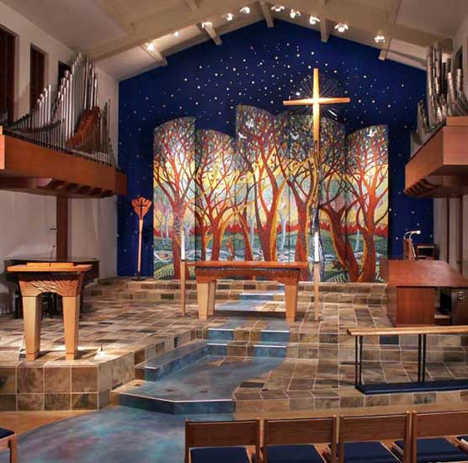
٤٤-٤٨ حزقيال
توقع
المجد
في أرض جديدة
د. ريك جريفيث• مؤسسة الدراسات اللاهوتية الأردنية• BibleStudyDownloads.org

Slide 2
لكن بعض الضيقة سيتم تدمير الهيكل ويستبدل بهيكل حزقيال في الألفية
(حقبة الهيكل الرابعة)
Artwork by Sunny Chandra

Slide 3
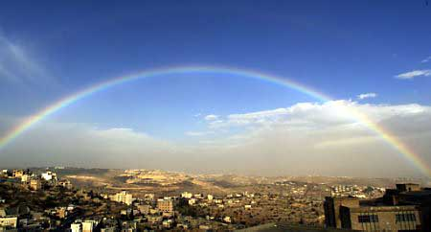
مجتمع إسرائيل المُسترَد
هيكل جديد (40-43)
عبادة جديدة (44-46)
أقاليم جديدة (47-48)

Slide 4


المجد يعود
502
656
حزقيال

Slide 5
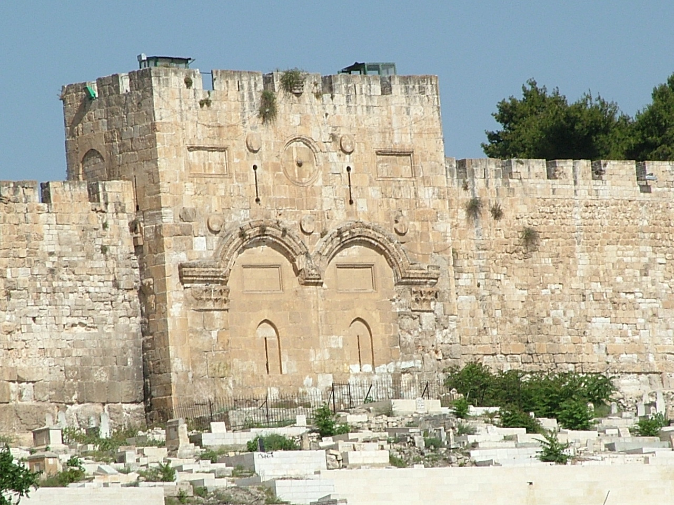
البوابة الشرقية
(حزقيال 43: 1)
1 ثم ذهب بي إلى الباب، الباب المتجه نحو الشرق

Slide 6
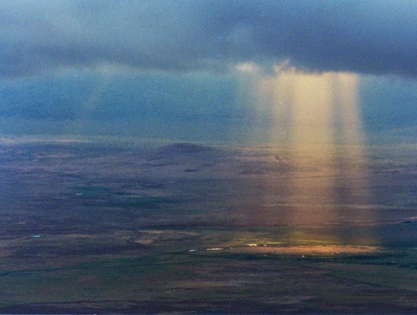
مجد الله سوف يعود
البوابة الشرقية (حزقيال 43: 2-3)
2 وإذا بمجد إله إسرائيل جاء من طريق الشرق وصوته كصوت مياه كثيرة والأرض أضاءت من مجده 3 والمنظر كالمنظر الذي رأيته لما جئت لأخرب المدينة والمناظر كالمنظر الذي رأيته عند نهر خابور فخررت على وجهي

Slide 7
البوابة الشرقية
(حزقيال 43: 4)
4 فجاء مجد الرب إلى البيت من طريق الباب المتجه نحو الشرق

Slide 8
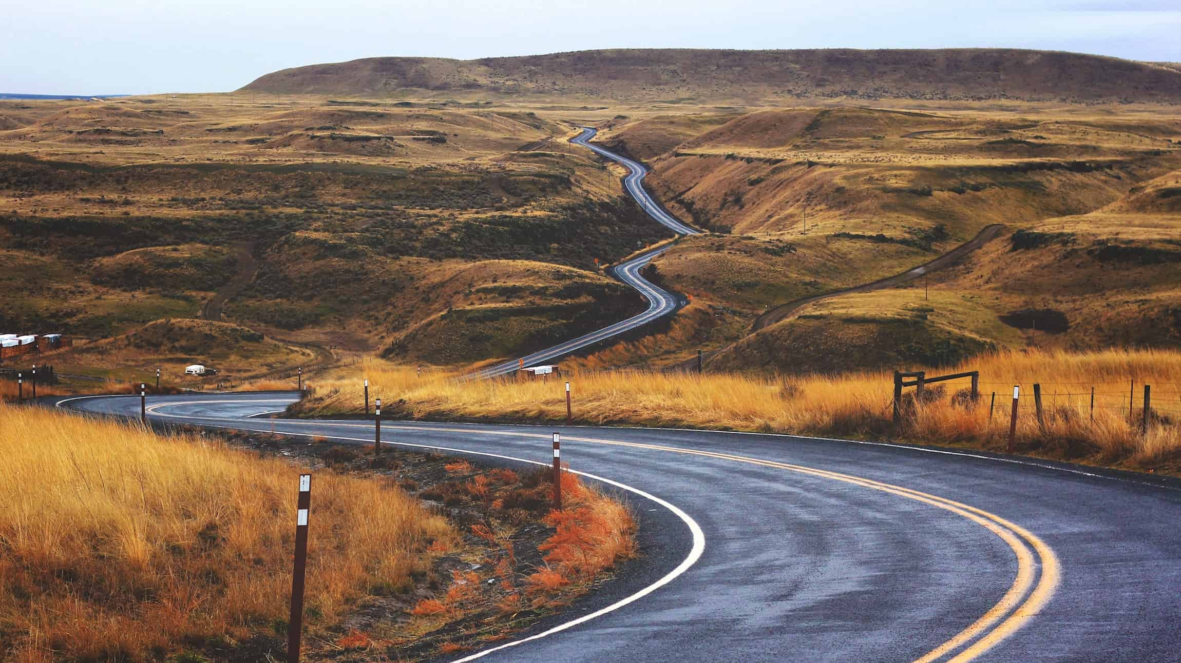
كيف سيظهر الله أمانته نحونا في المستقبل؟

Slide 9
حزقيال 40-48
أمانة الله المستقبلية
سوف يعيش الله معنا ثانية (40-43)
سوف يساعد الله الشعب للتوبة عن الخطية (44-46)

Slide 10

أعياد الكتاب المقدس
لاوِيّين ٢٣
تثنية ١٦
الفداء
الإنفصال
القيامة
الروح
الإختطاف
التوبة
الملكوت
1 نيسان
2 أيار
3 سيفان
4 تموز
5 آب
6 أيلول
7 تشري
8 تششفان
9 كسليف
10 طيفيت
11 شباط
12 آذار
Notes:
God commanded seven annual feasts for Israel.
_________
OS-03-Leviticus-264
OS-26-Ezek44-48-slide 10

Slide 11
Slides on
حزقيال ٤٤

Slide 12
تباين الأعياد
530
النظام الموسوي
(لا 23)
نظام الألفية
(حز 40-45)
الفصح (تقدمة خروف)
الفصح
1 نيسان
2 أيار
3 سيفان
4 تموز
5 آب
6 أيلول
7 تشري
8 شيشفان
9 كسلو
10 تيبيت
11 شباط
12 آذار
الخبز غير المختمر
الخبز غير المختمر
1 نيسان
2 أيار
3 سيفان
4 تموز
5 آب
6 ~أيلول
7 تشري
8 شيشفان
9 كسلو
10 تيبيت
11 شباط
12 آذار
الباكورة
ذبيحة الخطية
الحصاد
المظال
المظال
الكفارة
الأبواق
ذبيحة الخطية
Notes:
The annual Hebrew calendar of Leviticus 23 will find a partial repetition in the millennium.
• This was especially seen at the Day of Atonement among the seven annual feasts (Lev 23; Deut 16).
• But in the millennium only the first and last will be celebrated. Passover with Unleavened Bread will occur annually for seven days as in the past (Ezek 45:21), as will Tabernacles (Zech 14:16).
• As the sin offering in the Day of Atonement was central to the year, so this offering will be central to millennial worship. However, there will be no Day of Atonement then as the blood of Jesus is the final atonement for sin.
• Instead, the sin offering will be offered to commemorate Christ’s death, yet at Passover (Ezek 45:21-25). This is because there will be no ark of the covenant in the millennial temple (Jer 3:16, “’And when your land is once more filled with people,’ says the Lord, ‘you will no longer wish for ‘the good old days’ when you possessed the Ark of the Lord’s Covenant. You will not miss those days or even remember them, and there will be no need to rebuild the Ark”). Passover will be a fitting time to look back on Israel’s redemption from Egypt (Exod 12) as well as redemption from sin through Christ (1 Cor 5:7).
The Passover Lamb previously offered at Passover will have been fulfilled by Christ, yet the need for ongoing forgiveness related to ongoing sin will require a sin offering for the prince and those in mortal bodies (Ezek 40:39; 43:19, 21-22, 25).
One must not take the prophecy of Ezekiel in isolation, for millennial sacrifices are affirmed elsewhere in the prophetic writings. Isaiah notes that God will accept burnt offerings from both Israelites (Isa. 60:7; 66:20) and foreigners who bind themselves to the LORD (Isa. 56:6-7). Zechariah's last verse of his prophecy after the return of Christ (Zech 14:4) also affirms the presence of millennial sacrifices in the temple (Zech. 14:21).

Slide 13
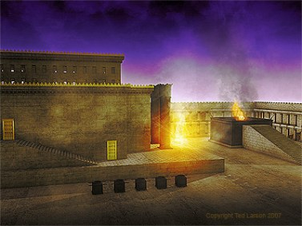
حزقيال ١٠ : ٤
فَارْتَفَعَ مَجْدُ الرَّبِّ عَنِ الْكَرُوبِ إِلَى عَتَبَةِ الْبَيْتِ. فَامْتَلأَ الْبَيْتُ مِنَ السَّحَابَةِ, وَامْتَلأَتِ الدَّارُ مِنْ لَمَعَانِ مَجْدِ الرَّبِّ.
Notes:
Why was God's glory leaving the temple and going into the courtyard? Ezekiel 11 shows pagan ceremonies right in the temple itself!

Slide 14
البوابة الشرقية
)حزقيال 43: 1-2)
١ ثُمَّ ذَهَبَ بِي إِلَى الْبَابِ الْمُتَّجِهِ نَحْوَ الشَّرْقِ. ٢ وَإِذَا بِمَجْدِ إِلَهِ إِسْرَائِيلَ جَاءَ مِنْ طَرِيقِ الشَّرْقِ وَصَوْتُهُ كَصَوْتِ مِيَاهٍ كَثِيرَةٍ, وَالأَرْضُ أَضَاءَتْ مِنْ مَجْدِهِ.

Slide 15
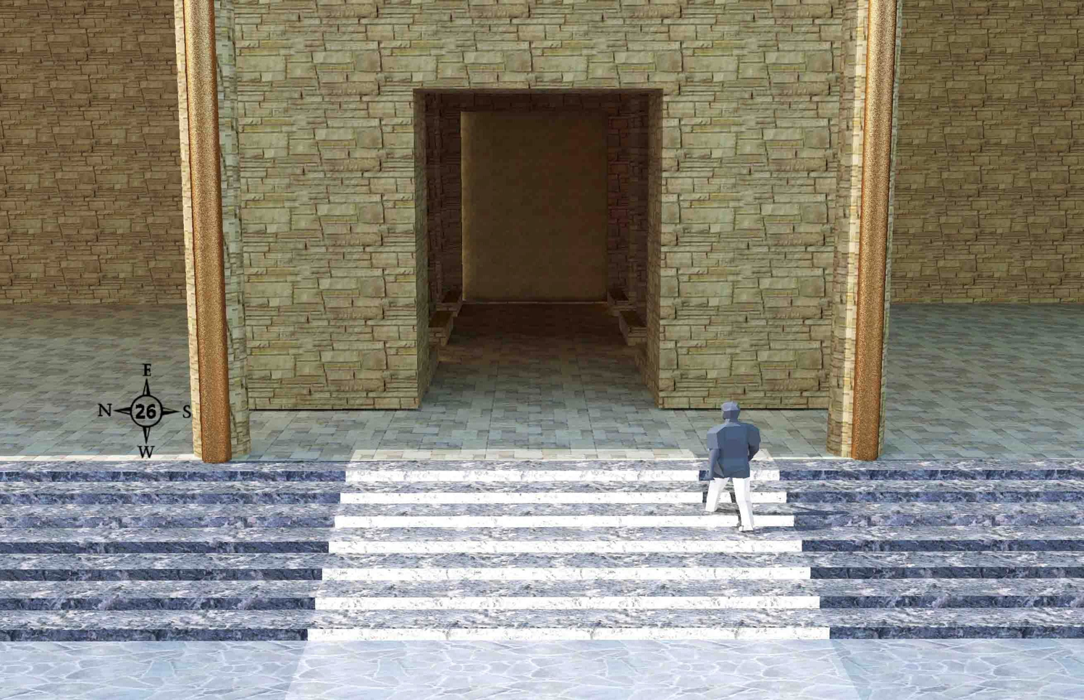
دخول البوابة الشرقية (44: 1-3)
519
الأمير داود يدخل البوابة الشرقية الخارجية من الرواق على جانب الفناء الخارجي
واين أدونيل •حجز 40-48 جولة في هيكل حزقيال • http://bible.ag/en/enezekialtranscript.htm
Notes:
"See Picture #26. Prince David entering the outer east gate from the porch on the outer court side. The gate is sealed up on the outside because the shekinah glory entered the temple compound through that gate. The light on the steps is shining from the shekinah glory in the temple through the east inner gate behind him.
Ezekiel 44:1-3, "Then he brought me back the way of the gate of the outward sanctuary which looketh toward the east; and it was shut. Then said the LORD unto me; This gate shall be shut, it shall not be opened, and no man shall enter in by it; because the LORD, the God of Israel, hath entered in by it, therefore it shall be shut." The outside of the outer east gate will be sealed after the shekinah glory enters through it. This gate does not yet exist. People confuse it with the sealed eastern gate in Jerusalem today, and say it will be unsealed for Messiah to enter by. That is the opposite of what scripture teaches here, that a future gate will be sealed after the Messiah enters through it, with the shekinah glory.
"It is for the prince; the prince, he shall sit in it to eat bread before the LORD; he shall enter by the way of the porch of that gate, and shall go out by the way of the same." The prince gets to use this sealed gate to sit and eat in. He will have a nice view of the inner east gate and the temple from here, and be out of the sun. He has to enter and leave the gate through the porch because the outside doorway is sealed.
The prince is Prince David. He will be a king to Israel, but a prince to Yeshua, the King of Kings. Jeremiah 30:9, "They shall serve the LORD their God, and David their king, whom I will raise up unto them," along with all the other people whose bodies are resurrected before the kingdom is established.
Serving under David, in either the federal or tribal governments, will be the resurrected and glorified twelve apostles, including Paul in place of Judas. "And Jesus said unto them, Verily I say unto you, That ye which have followed me, in the regeneration when the Son of man shall sit in the throne of his glory, ye also shall sit upon twelve thrones, judging the twelve tribes of Israel," Mt19:28."
Wayne ODonnell, "Ezekiel 40–48: Tour of Ezekiel's Temple"
http://bible.ag/en/mr4web.html#EZanchor-anchor
Recorded December 30, 2007
Accessed 30 Aug 2016

Slide 16
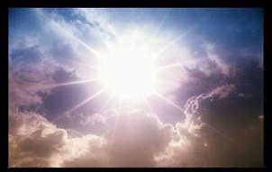
الكلمة المفتاحية
500
المجد
حزقيال
Notes:
In حزقيال the key word is GLORY! The whole book is about God’s presence with the nation, departing from them and returning in the last days in the millennial temple.

Slide 17
Slides on
حزقيال ٤٥

Slide 18


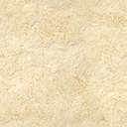
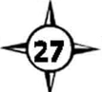
الأرض المحيطة (45: 1-8)
519
< 25000 ذراع >
< 10000 ذراع >
الكهنة 45: 1، 3-4
الهيكل + الحدود
600×600 ذراع
45: 2
رئيس داود
45: 7-8
رئيس داود
45: 7-8
< 5000 >
المدينة 45: 6
N
< 10000 ذراع >
اللاويين 45: 5
W
E
S
واين أدونيل •حجز 40-48 جولة في هيكل حزقيال • http://bible.ag/en/enezekialtranscript.htm
Notes:
"See picture #27. The Holy Section of the Land.
For the Priests: 25,000 x 10,000. "Moreover, when ye shall divide by lot the land for inheritance, ye shall offer an oblation unto the LORD, an holy portion of the land: the length shall be the length of five and twenty thousand reeds, and the breadth shall be ten thousand ... The holy portion of the land shall be for the priests, ... a place for their houses, and an holy place for the sanctuary," Ez45:1-3. There is a 25,000 by 10,000 area, shown at the top of picture #27, for the priests' houses and the temple compound. Notice that the word "reeds," in verse 45, is in italics, meaning it was added by the King James translators to help us. But in picture #27, I put all the measurements in cubits, rather than reeds.
Except for the four verses in Ezekiel 42:16-19, which we looked at already, every other measurement in the book, in which the unit of measure is explicitly stated, that is greater than one reed long, is given in cubits. The following five verses say something is exactly one reed long: 40:5; 40:6; 40:7; 40:8; and 41:8. And the following three verses say something is more than one reed long, but the word "reed" is in italics to show it was added by the translators: 42:20; 45:1; and 48:8.
The reason the translators added the word "reeds" in verse 1, is because the next verse talks about the 500 x 500 temple compound area, and in 42:16-19, the outer-most portion of the temple area, according to the Hebrew text, is a 500 reed (3,000 cubit) wall around and further out from the temple compound.
Temple Compound: 500 x 500 something. Either 600 cubits square including the border, or 500 reeds + 50 cubits square including the border. "Of this [in the priests' portion] there shall be for the sanctuary five hundred in length, with five hundred in breadth, square round about; and fifty cubits round about for the suburbs thereof," Ez45:2. The small black square labeled "The Temple + Border" within the priests' rectangle in picture #27.
Notice the word "cubits" is specifically mentioned for the "suburbs," or 'border,' of the sanctuary. If the unit of measurement in this chapter is cubits, the 50 cubit border goes around the temple compound, making the total temple area 600 x 600 cubits (50 more on each side of the 500 cubits). If the unit of measurement in this chapter is reeds, the 50 cubit border goes around the 500 reed wall, making the total temple area 500 reeds plus 50 cubits.
This is another reason why it is more natural, to assume the measurements in this chapter are in cubits. Most of the measurements we have seen so far, have been in fairly round numbers, not something like 500 reeds + 50 cubits. Also, a 50 cubit border around a 500 cubit area (10%) is more in perspective, than a 50 cubit border around a 3,000 cubit (500 reed) area (0.01667%). In chapter 48, we'll see that the city is a 4,500 x 4,500 area with a 250 border around it (5.56%) so the total area comes out to a nice round 5,000 (4,500 + 250 on each side).
Also, if the angel's purpose in chapter 42:15-20, had been to measure the adjacent land around the temple, why wouldn't he have told us about the 50 cubit border at that time along with the measurement of the outlying 3,000 cubit wall. But if his purpose was only to give us the overall dimensions of the temple compound, after having given us the detailed internal measurements of its parts, it is understandable that he did not mention the 50 cubit border at that time, but waited until he was dealing with the placement of the temple within the land.
For the Levites: 25,000 x 10,000. "And the five and twenty thousand of length, and the ten thousand of breadth shall also the Levites, the ministers of the house, have for themselves," Ez45:5. The bottom white rectangular area on the mountain in picture #27. Ezekiel is not listing the portions in geographical order, but rather in order of importance. Priests and sanctuary first, then Levites, and next the city.
For the City: 5000 x 25,000. "And ye shall appoint the possession of the city five thousand broad, and five and twenty thousand long, over against the oblation of the holy portion: it shall be for the whole house of Israel," Ez45:6. The central 5,000 by 25,000 area in picture #27.
For Prince David: "And a portion shall be for the prince on the one side and on the other side of the oblation of the holy portion, and of the possession of the city, ... from the west border unto the east border," Ez45:7. The land shown on the far right and left of picture #27, is for the resurrected Prince David and his descendants.
This land might also pay the expenses of his federal government (versus the tribal governments). "Moreover the prince shall not take of the people's inheritance by oppression, to thrust them out of their possession ... that my people be not scattered every man from his possession," Ez46:17-18."
Wayne ODonnell, "Ezekiel 40–48: Tour of Ezekiel's Temple"
http://bible.ag/en/mr4web.html#EZanchor-anchor
Recorded December 30, 2007
Accessed 30 Aug 2016

Slide 19
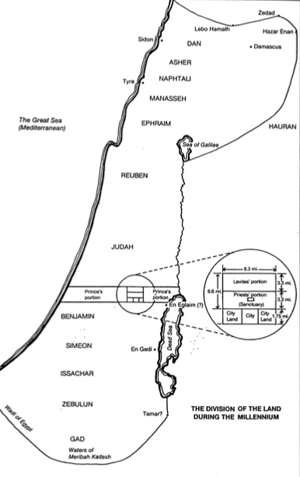
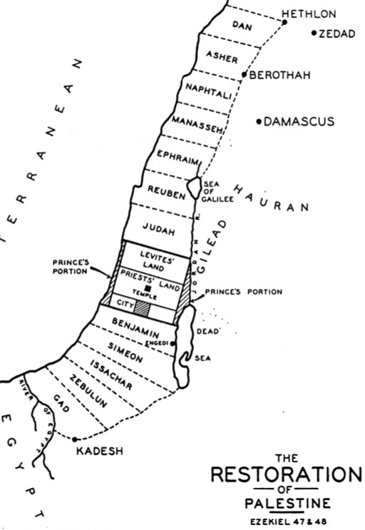
جغرافية
الأيام الأخيرة
م ع ق
531د
م ع ق
531ي
المظلل باللون الأزرق
حز 45: 1-8، 48: 9-22
Notes:
The significant differences between the two depictions of the leadership territory is due to two views on the measuring rod used.

Slide 20
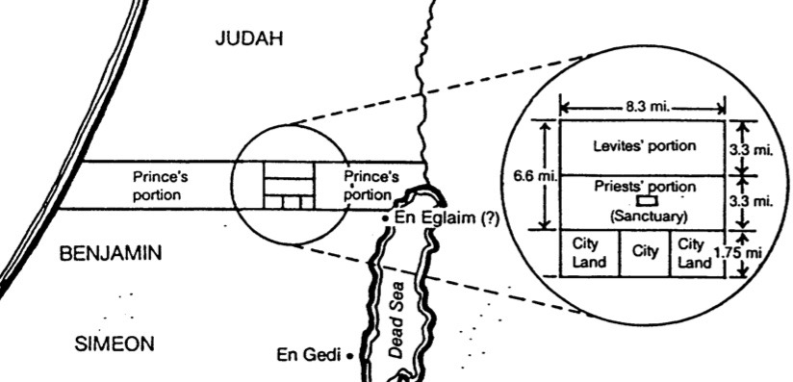
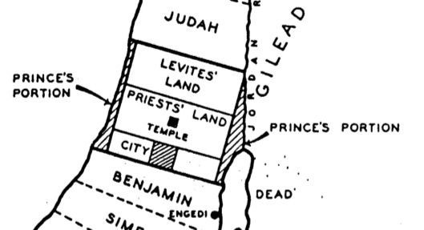
مقارنات الكهنة واللاويين والأمراء
م ع ق
531 ي-د
المظلل باللون الأزرق من
حز 45: 1-8، 48: 9-22
Notes:
In either case, the center of Canaan will comprise land for the priests, Levites, and Prince.

Slide 21
Slides on
حزقيال ٤٦

Slide 22
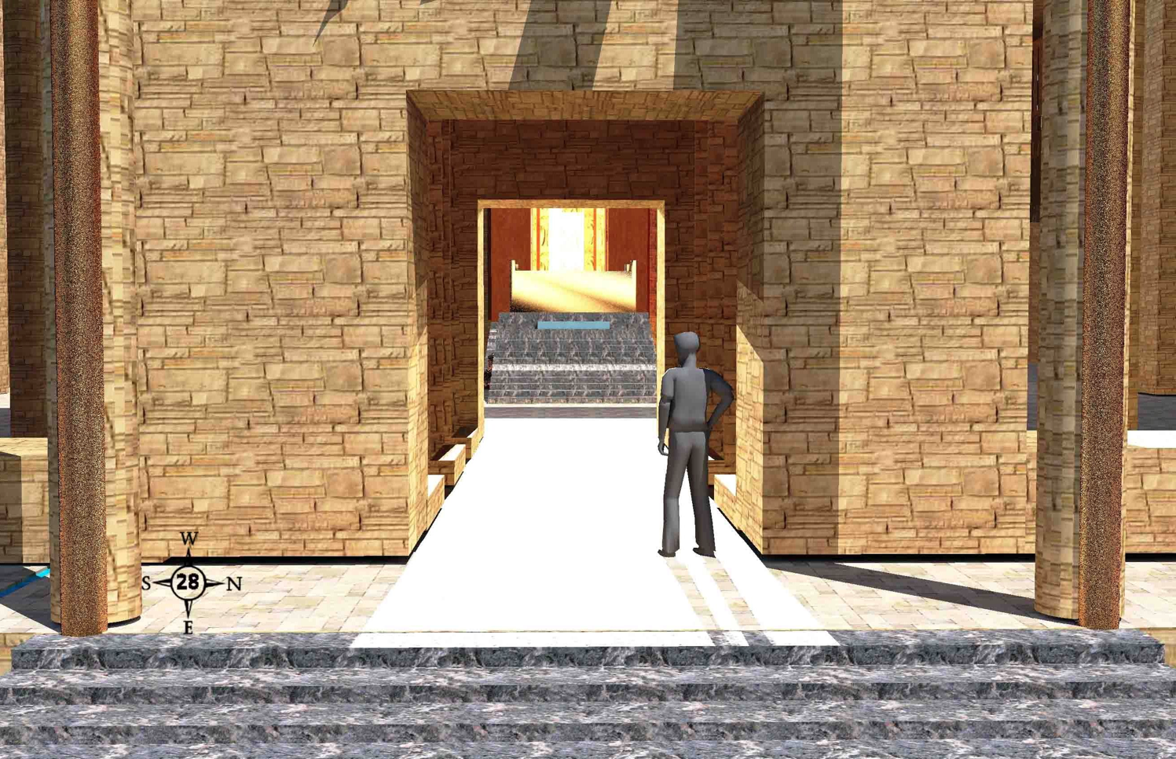
رؤية سحابة المجد (46: 1-3)
519
يقف الرئيس داود على شرفة البوابة الشرقية الداخلية ثم يأتي النور من مجد السحابة في الهيكل عندما ننظر غرباً إلى الساحة الداخلية والهيكل
واين أدونيل •حجز 40-48 جولة في هيكل حزقيال • http://bible.ag/en/enezekialtranscript.htm
Notes:
"See Picture #28. Prince David standing on the porch of the inner east gate. The light is from the shekinah glory in the temple. We are looking west into the inner court and the temple.
Ezekiel 46:1-3,"The gate of the inner court that looketh toward the east shall be shut the six working days; but on the sabbath it shall be opened, and in the day of the new moon it shall be opened. And the prince shall enter by the way of the porch of that gate without, and shall stand by the post of the gate, and the priests shall prepare his burnt offering and his peace offerings, and he shall worship at the threshold of the gate: then he shall go forth; but the gate shall not be shut until the evening. Likewise the people of the land shall worship at the door of this gate before the LORD in the sabbaths and in the new moons." Most of the time, the inner east gate will be closed. But on Sabbaths and new moons, it will be open. Then the prince can go up on the porch, and watch as the priests offer his sacrifices. But that means he can't go into the inner court, even though he is in his resurrected and glorified body, and so we won't be able to either."
Wayne ODonnell, "Ezekiel 40–48: Tour of Ezekiel's Temple"
http://bible.ag/en/mr4web.html#EZanchor-anchor
Recorded December 30, 2007
Accessed 30 Aug 2016

Slide 23
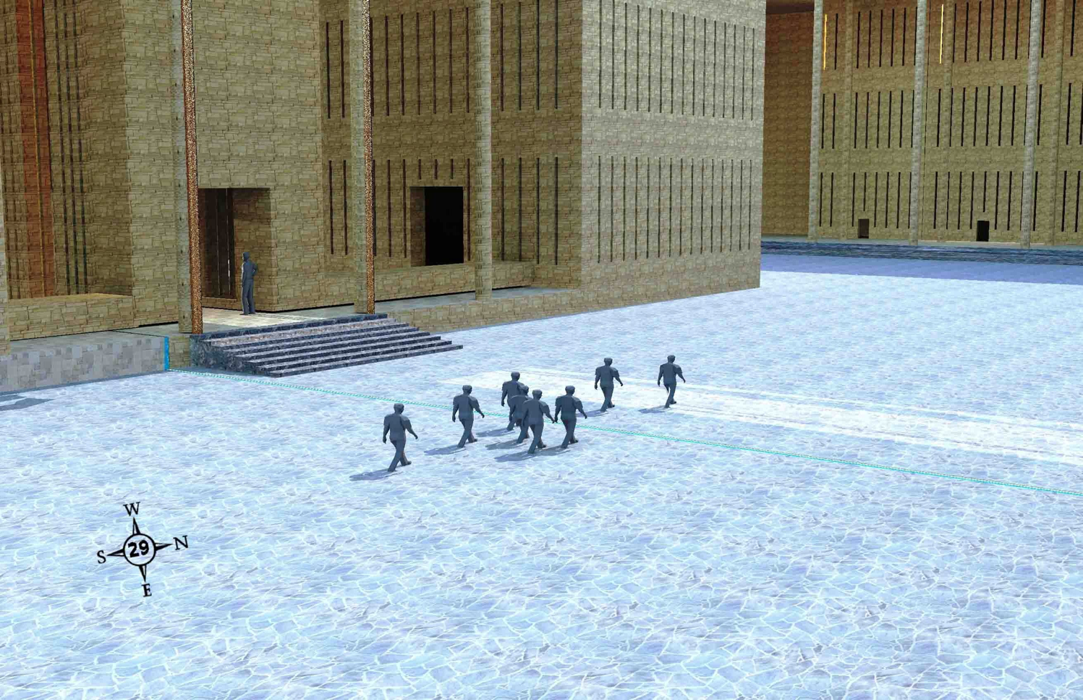
المخرج المواجه للبوابة الخارجية (46: 8-12)
الناس الذين يدخلون الساحة الخارجية للهيكل من خلال البوابة الخارجية الجنوبية سوف يمرون من البوابة الشرقية الداخلية ليخرجوا من خلال البوابة الخارجية الشمالية
واين أدونيل •حجز 40-48 جولة في هيكل حزقيال • http://bible.ag/en/enezekialtranscript.htm
Notes:
"See Picture #29. People who entered the outer court of the temple compound by the outer south gate, walking past the inner east gate, to exit by the outer north gate.
Ezekiel 46:8-12, "When the people of the land shall come before the LORD in the solemn feasts, he that entereth in by the way of the north gate to worship shall go out by the way of the south gate; and he that entereth by the way of the south gate shall go forth by the way of the north gate: he shall not return by the way of the gate whereby he came in." People will enter the temple compound by the north gate and go out by the south, or they will go in by the south and out by the north. Do you remember why no one will enter or exit by the outer east gate?
Ezekiel 46:8 only talks about "the people of the land," meaning the Jewish people and probably the Gentiles who dwell among them in Israel. But Zechariah says that the Gentiles outside the land will go to Jerusalem to celebrate the feast of tabernacles. Zechariah 14:16-17, "It shall come to pass, that every one that is left of all the nations which came against Jerusalem, shall even go up from year to year to worship the King, the LORD of hosts, and to keep the feast of tabernacles. And it shall be, that whoso will not come up of all the families of the earth unto Jerusalem to worship the King, the LORD of hosts, even upon them shall be no rain." So I don't expect to be living in the land of Israel during the Messianic Kingdom. I expect to be laboring in one of the Gentile nations, but I expect to come up for the feast of tabernacles with other people from my nation whenever it's my turn.
Isaiah 66:20-21 may indicate some Gentiles may serve as priests and 'Levites' in the temple. "And they [saved Gentiles] shall bring all your brethren for an offering unto the LORD out of all nations ... to my holy mountain Jerusalem, and I will also take of them for priests and for Levites." More likely, "take of them" refers to taking priests and Levites from among the Jewish people brought back by the Gentiles. Would Gibeonites and Nethinim (temple servants) be referred to as 'Levites?' If God does take any Gentiles as priests and 'Levites', they will at least need to be born again spiritually, and circumcised physically, according to Ezekiel 44:9.
"Thus saith the Lord GOD; No stranger, uncircumcised in heart, nor uncircumcised in flesh, shall enter into my sanctuary, of any stranger that is among the children of Israel," Ez44:9. This probably indicates that no unsaved men, even descendants of Zadok, will be able to serve as priests and Levites in the temple. It probably does not indicate exclusion of anyone from the temple compound. It would be more feasible to verify circumcision of heart and flesh as a prerequisite to priesthood than to temple compound access.
Zechariah concludes and summarizes his book by saying, "Every pot in Jerusalem and in Judah shall be holiness unto the LORD of hosts: and all they that sacrifice shall come and take of them, and seethe therein: and in that day there shall be no more the Canaanite in the house of the LORD of hosts," Zech14:21. There will certainly be some people of Canaanite descent in the kingdom, who enter by resurrection, and who enter in unglorified bodies at the end of the tribulation period and their descendants born during the kingdom, and they will probably have entrance to the temple compound, though perhaps none any longer as temple servants. Probably this verse means that, whereas most priests and Levites in the temple throughout history have been unbelievers, and to God this was equivalent to Canaanites like the Gibeonites serving in the temple, in the kingdom the priests and Levites will be both descendants of Levi and, more importantly, regenerate of heart."
Wayne ODonnell, "Ezekiel 40–48: Tour of Ezekiel's Temple"
http://bible.ag/en/mr4web.html#EZanchor-anchor
Recorded December 30, 2007
Accessed 30 Aug 2016

Slide 24
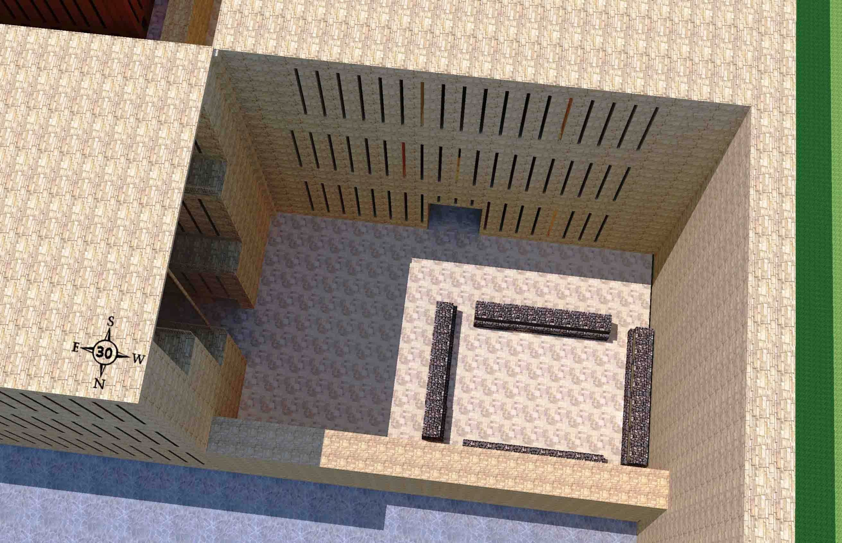
أماكن طبخ الكهنة (46: 19-20)
النظر إلى أماكن طبخ الكهنة في أقصى الطرف الغربي من الرصيف العلوي الشمالي بجوار المبنى الغربي وغرف الكهنة المكونة من ثلاث طبقات.
واين أدونيل •حجز 40-48 جولة في هيكل حزقيال • http://bible.ag/en/enezekialtranscript.htm
Notes:
"See Picture #30. Looking down on the priests' boiling places at the extreme west end of the northern upper pavement by the west building and the 3-tiered priest's chambers.
Ezekiel 46:19-20, "After he brought me through the entry, which was at the side of the gate," through a side arch of the inner north gate, "into the holy chambers of the priests, which looked toward the north, and, behold, there was a place on the two sides westward," the west ends of the upper pavement on both the north and south of the temple. "Then said he unto me, This is the place where the priests shall boil the trespass offering and the sin offering, where they shall bake the meat offering; that they bear them not out into the utter [outer] court, to sanctify the people." The priests have their own places to boil and bake sacrifices, separate from the people, so they don't take any holiness out to the people; just as we saw how in Ezekiel 42:13-14, they had to change their clothes before going out to the people."
Wayne ODonnell, "Ezekiel 40–48: Tour of Ezekiel's Temple"
http://bible.ag/en/mr4web.html#EZanchor-anchor
Recorded December 30, 2007
Accessed 30 Aug 2016

Slide 25
مكان الطبخ الشمالي الغربي (حزقيال 46: 21-24)
519
مكان الطبخ الشمالي الغربي لذبائح الشعب وبه 4 قاعات صغيرة مثل هذه في كل ركن من أركان الساحة الخارجية
واين أدونيل •حجز 40-48 جولة في هيكل حزقيال • http://bible.ag/en/enezekialtranscript.htm
Notes:
"See Picture #31. The northwest boiling place for the peoples' sacrifices. There are 4 mini-courts like this one; one in each corner of the outer court.
Ezekiel 46:21-24, "Then he brought me forth into the utter [outer] court, and caused me to pass by the four corners of the court; and, behold, in every corner of the court there was a court ... forty cubits long and thirty broad.... And there was a row of building round about in them, ... and it was made with boiling places under the rows round about. Then said he unto me, These are the places of them that boil, where the ministers of the house shall boil the sacrifice of the people." Four 40x30 cubit mini-courts, one in each corner of the outer court, for the priests to come out and boil the peoples' sacrifices, because the people cannot enter into the inner court, where the priests offer other sacrifices."
Wayne ODonnell, "Ezekiel 40–48: Tour of Ezekiel's Temple"
http://bible.ag/en/mr4web.html#EZanchor-anchor
Recorded December 30, 2007
Accessed 30 Aug 2016
_________
Common-210
OS-26-Ezek44-48-slide 25

Slide 26
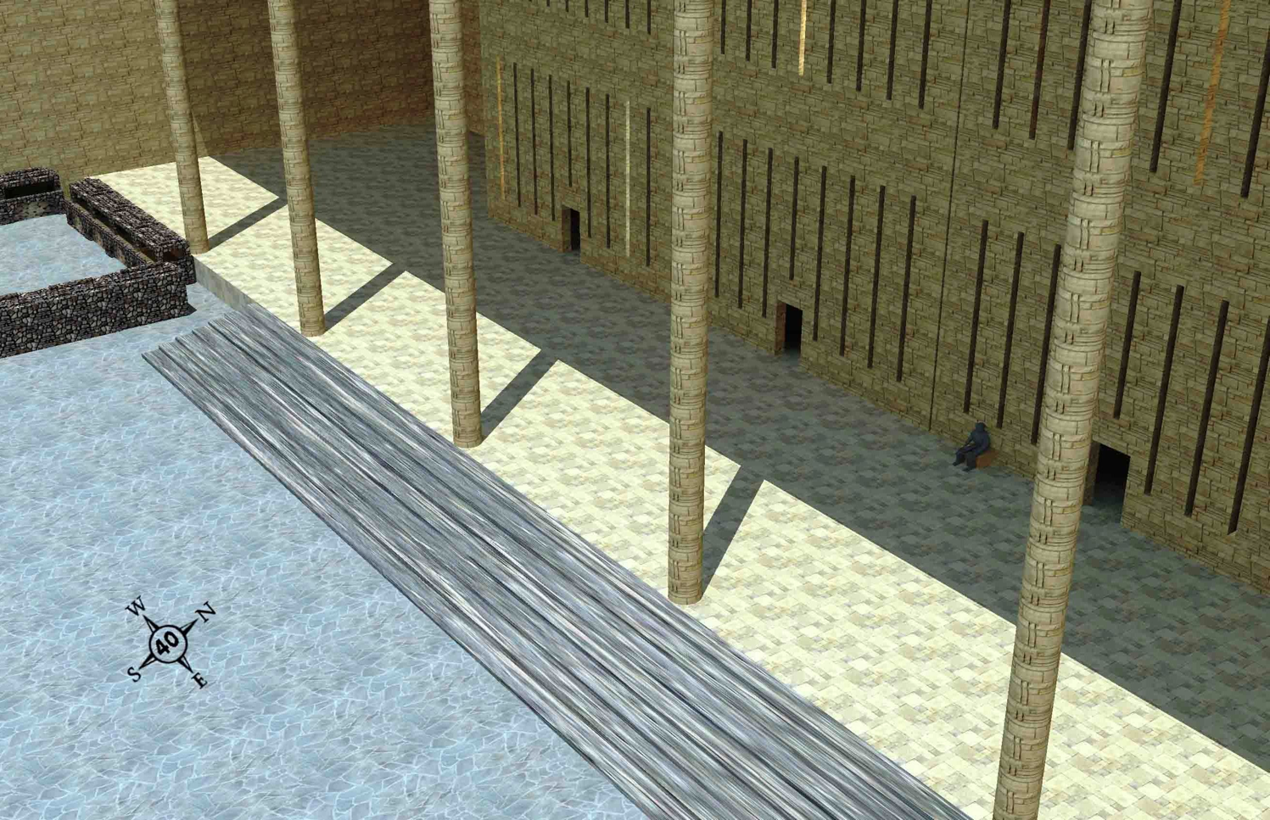
الغرف الشمالية الشرقية
519
الغرفة الثالثة من الركن الشمالي الشرقي لمجمع الهيكل على الرصيف السفلي
واين أدونيل •حجز 40-48 جولة في هيكل حزقيال • http://bible.ag/en/enezekialtranscript.htm
Notes:
"Application
Jesus said, "Verily, verily, I say unto thee, Except a man be born again, he cannot see the kingdom of God," Jn3:3. You definitely want to see the kingdom of God. And you won't see it unless you are born again.
"As Moses lifted up the serpent in the wilderness, even so must the Son of man be lifted up: that," whosoever looks to him in faith, "whosoever believeth in him should not perish, but have eternal life. For God so loved the world, that he gave his only begotten Son, that whosoever believeth in him should not perish, but have everlasting life," Jn3:14-16.
"He that believes on the Son has everlasting life," Jn3:36; not he that goes to church, or he that is good, because "there is none that doeth good, no, not one," Rm3:12; Ps53:3. "All have sinned and come short of glory of God," Rm3:23. But he that simply "believes on the Son," and takes God at his Word that Jesus' sacrifice and death for our sake as our substitute was sufficient, has everlasting life.
Call upon the Lord (Rm10:13), and tell him that you accept his sacrifice, that you put your faith in him and in what he did for you, and that you take him at his word to give you everlasting life.
For those who already know the Lord, knowing about the kingdom will help us to be willing to suffer. Paul said, "What advantageth it me, if the dead rise not?" 1Cor15:32. But he was able to fight with beasts at Ephesus because he knew that any damage to his body was temporary. It would be raised again and be in the kingdom. He knew he will see these buildings and the other things that the Bible prophesies about the kingdom.
And knowing about the kingdom helps us to labor confidently. "Therefore, my beloved brethren, be ye stedfast, unmoveable, always abounding in the work of the Lord, forasmuch as ye know that your labour is not in vain in the Lord," 1Cor15:58. We have a sure and certain destination.
See Picture #40. The third room from the northeast corner of the temple compound on the lower pavement.
For those who are interested in meeting, let's meet, if our schedules permit, at the third room from the northeast corner of the temple compound, on the lower pavement, on 3/3/3 AK (After Kingdom); the third year, third month, and third day after the start of the kingdom. I don't know if we will be allowed to meet at that location, but if not, and you are interested in meeting with us, try to meet as close to there as possible, perhaps just outside the outer north gate. Remember, 3/3/3 AK. You can't get there unless you use John 3:3. You have to be born again to enter the kingdom.
So that is our presentation of the temple. I pray that it will be used for your benefit to know the Lord and to be more fruitful in his service."
Wayne ODonnell, "Ezekiel 40–48: Tour of Ezekiel's Temple"
http://bible.ag/en/mr4web.html#EZanchor-anchor
Recorded December 30, 2007
Accessed 30 Aug 2016

Slide 27
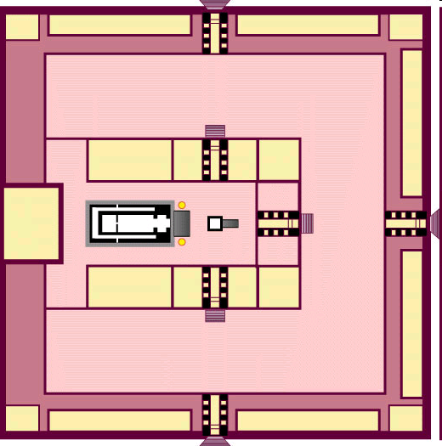
هيكل حزقيال
517

Slide 28


تباين
هيكلي
سليمان
وحزقيال
518
Notes:
28

Slide 29
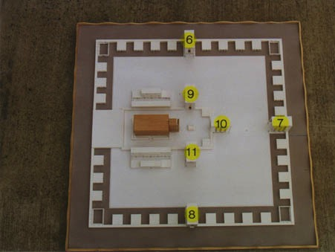
View from Above
517
6. البوابة الشمالية للساحة الخارجية – 40: 20-23
7. البوابة الشرقية للساحة الخارجية – 40: 6-16
8. البوابة الجنوبية للساحة الخارجية – 40: 24-27
9. البوابة الشمالية للساحة الداخلية – 40: 35-37
10. البوابة الشرقية للساحة الداخلية – 40: 32-34
11. البوابة الجنوبية للساحة الداخلية – 40: 28-31
www.pauljab.net/temple/ TemplePictures.html
Notes:
29

Slide 30

هيكل حزقيال لن يتناسب مع جبل الهيكل الحالي
521
656
www.pauljab.net/temple/ TemplePictures.html

Slide 31
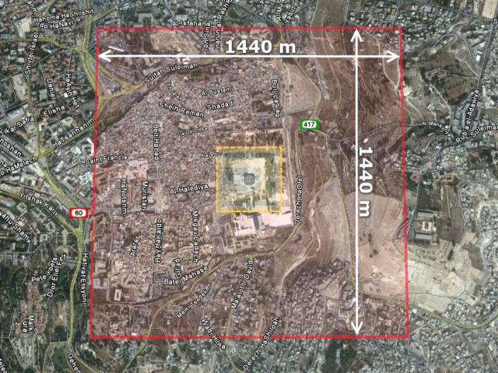
منطقة الهيكل
فوق أورشليم الحالية
521
656
هيكل حزقيال: جولة في هيكل رؤيا حزقيال• http://ezekial-temple.narod.ru/ezekial_45.htm •
تخطط هذه المجموعة لبناء الهيكل في صحراء إسرائيل
Notes:
Accessed 31 August 2016

Slide 32
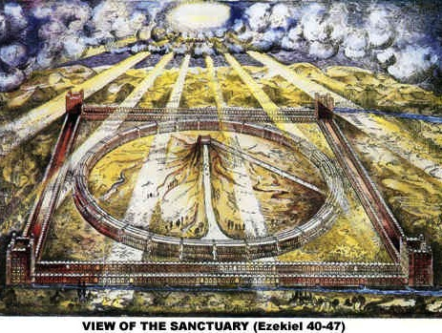
مشهد حرم الهيكل (حزقيال 40-48)
521
www.antipas.org/.../ezekiels_temple/ ezekiels_temple.html
Notes:
Ezekiel's depiction matches Isaiah 2…
Is. 2:2 In the last days, the mountain of the LORD’s house
will be the highest of all—
the most important place on earth.
It will be raised above the other hills,
and people from all over the world will stream there to worship.
³ People from many nations will come and say,
“Come, let us go up to the mountain of the LORD,
to the house of Jacob’s God.
There he will teach us his ways,
and we will walk in his paths.”
For the LORD’s teaching will go out from Zion;
his word will go out from Jerusalem.
⁴ The LORD will mediate between nations
and will settle international disputes.
They will hammer their swords into plowshares
and their spears into pruning hooks.
Nation will no longer fight against nation,
nor train for war anymore.

Slide 33
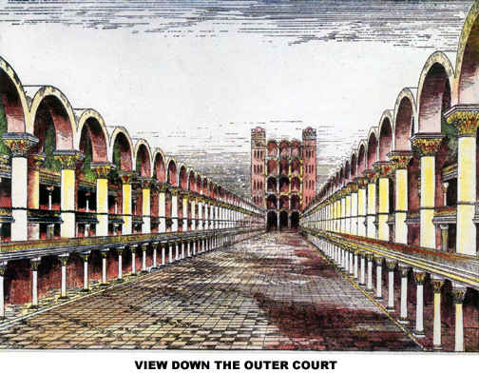
عرض أسفل الساحة الخارجية
Notes:
If you think Solomon's temple was glorious, how much more so Ezekiel's!

Slide 34
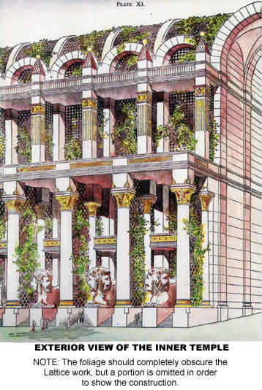
منظر خارجي
للهيكل الداخلي

Slide 35
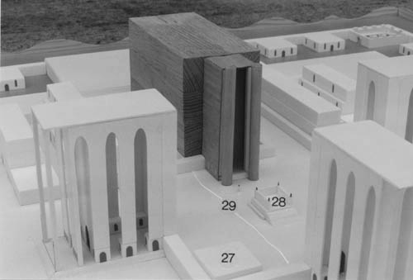
هيكل وبوابات حزقيال (حز 40-43)

Slide 36
الأهمية الأخروية للسبت
23
529
NS 266k
ملخص مرئي لأطروحة الدكتوراه التي كتبها ريتشارد جيمس جريفيث، مدرسة دالاس اللاهوتية، 1990
مجيء المسيح الثاني على مرحلتين
ما قبل السقوط
ما قبل موسى
العهد الموسوي
الكنيسة
الضيقة
المملكة الألفية
الأزل
الخلق
سقوط الإنسان
جبل سيناء
موت المسيح
الإختطاف
رؤيا
رؤ 20 : 1 - 6
الأبدية
6 أيام
(عمل)
تك 1
اليوم 7
(راحة)
تك 2 : 1 - 3
وضع
الشريعة
خر 20
إلغاء الشريعة
رو 7 : 1 - 6
غل 3 : 19, 23 - 29
1 كو 9 : 20
2 كو 3 : 6 - 11
الأسبوع 70 من نبوة دانيال عن 70 أسبوعاً
دا 9 : 27
إعادة ترتيب بعض أجزاء الناموس
حز 40 – 48
عمل الله
عمل الخلق
تك 1
عمل الحفظ
يو 5 : 17
عمل إعادة الخلق
رؤ 21 - 22
رفض إسرائيل المتكرر لعرض الله عن أرض الراحة الموعودة
راحة الله
لا يرتاح
راحة من النشاط الخلاق
تك 2 : 2 - 3
تتوقف الراحة بالخطية
الراحة مرتبطة بأرض كنعان
تك 12 : 1 – 3, 15 : 18
تث 30 : 1 - 10
مرفوض في البرية
تك 14 : 23, عب 3 : 9
مرفوض في زمن داود
مز 95 : 7ب - 11
مرفوض في المسيا
مت 23 : 37 - 39
مرفوض في عظة بطرس
أع 3 : 19 - 20
قبول و إعادة الراحة
عب 3 : 7 – 4 : 11
راحة إسرائيل
لا راحة للجنس البشري
توقع راحة إسرائيل
تك 2 : 3
تنظيم السبت
خر 16
نح 9 : 13 - 14
علامة العهد الموسوي
خر 31 : 13 و 17
حز 20 : 12 و 20
ألغاء السبت
كو 2 : 16 – 17
غل 4 : 9 – 10
رو 14 : 5
هو 2 : 11
تأسيس يوم الرب
أع 20 : 7
1 كو 16 : 1 - 2
رؤ 1 : 10
إعادة تأسيس السبت
مت 24 : 20
إعادة تأسيس السبت
حز 46 : 1
أش 66 : 23
بدء الإنتقال
نهاية الإنتقال
تاريخ إسرائيل الوطني
تأسيس الشعب على جبل سيناء
خر 19
69 أسبوع
（483 سنة）
444 ق.م – 33م
دا 9 : 25
وضع الشعب جانباً في فترة عصر الكنيسة
“أزمنة الأمم”
دا 9 : 26
لو 21 : 24
أسبوع واحد
(7 سنوات)
؟؟؟ ميلادي
دا 9 : 27
توبة الشعب و إيمانه بالمسيا و إعادة تأسيسه
حز 36 - 39
نمط الملكوت
لغة المملكة
تك 1
العهد الإبراهيمي و عهد الأرض
تك 12 : 1 – 3, 15 : 18, تث 30 : 1 - 10
عودة السبت إلى الخليقة و الفداء
خر 20 : 8 – 11
تث 5 : 12 – 15
السبت ينظر للأمام و يمثل الملكوت
عب 4 : 9
لا 23 : 1 – 3
يتمثل السبت بمعنى مزدوج
Notes:
OB-25-Feasts-80
OS-00-Intro-26
OS-02-Exodus-320
OS-26-Ezek 40-48-slide 98
NS-19-Hebrews-175

Slide 37
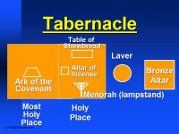
مقارنات الأثاث
144 أ
خيمة
الشهادة الموسوية
هيكل
سليمان
هيكل
حزقيال
مذبح إصعاد المحرقات
(حزقيال 43: 13- 27)
تابوت العهد
(خروج 40: 34)
تابوت العهد
(1 مل 8: 21)
تباينات مراكز العبادة:
المنقول من اثاث الألفية:
مذبح إصعاد المحرقة من الخارج (خروج 40: 6) إلى الدار الداخلية (حزقيال 43: 13)
المفقود من أثاث الألفية:
تابوت العهد (خروج 25: 22)، الحجاب، المنارة، مائدة خبز الوجوه والمرحضة

Slide 38
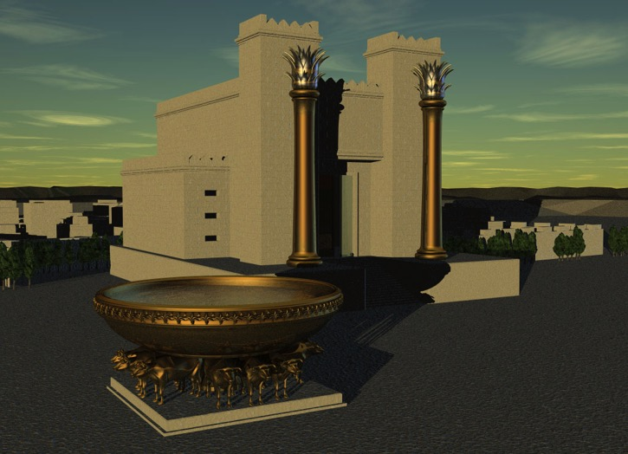
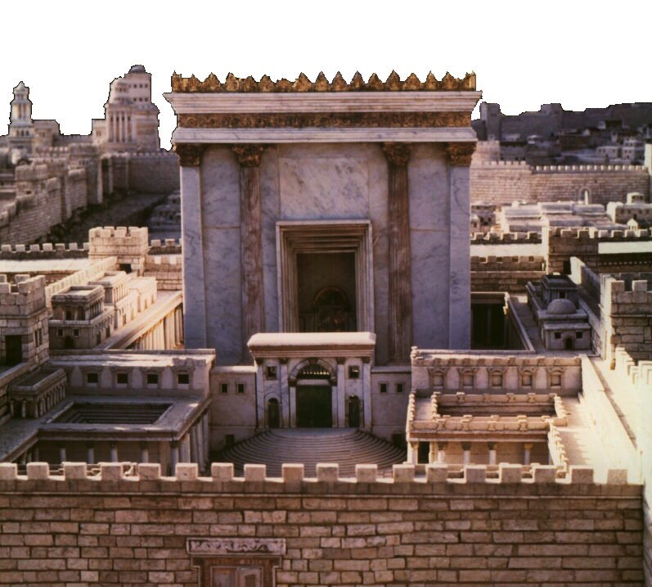
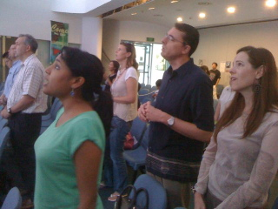
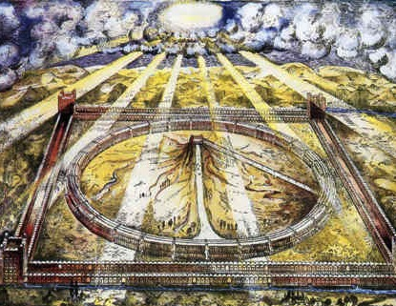
أي هيكل لحزقيال؟
520
سليمان
زربابل / هيرودس
ثلاث
نظرات
حرفية
مشروط
الألفية
الكنيسة

Slide 39
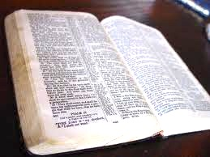
تفسيرات 40-48
الحرفي/التاريخي: الهيكل الأول
الحرفي التاريخي: هيكل زربابل
الحرفي/التاريخي: هيكل هيرودس
الرمزي/الحاضر: الكنيسة
الأخروي/الحاضر: الهيكل المثالي
الحرفي/المستقبلي: هيكل الألفية
الحرفي/الأبدي: ملكوت الله

Slide 40
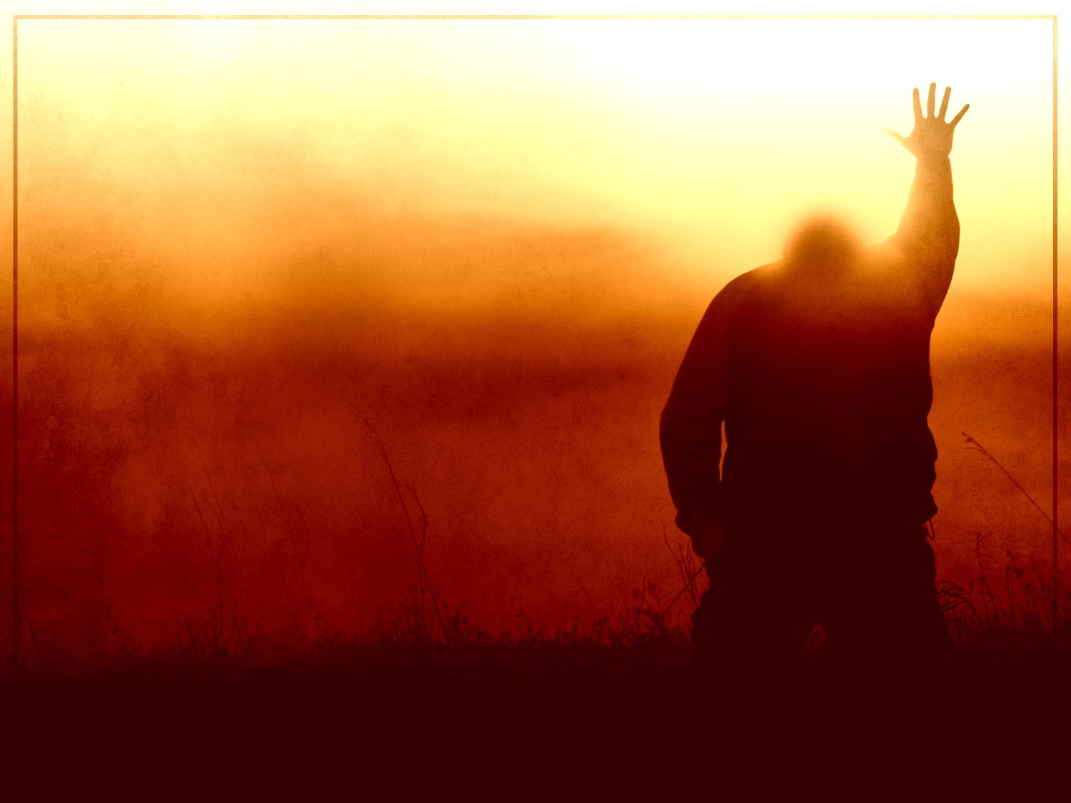
عبرانيين ١٠ : ١٨
وَإِنَّمَا حَيْثُ تَكُونُ مَغْفِرَةٌ لِهَذِهِ لاَ يَكُونُ بَعْدُ قُرْبَانٌ عَنِ الْخَطِيَّةِ.

Slide 41
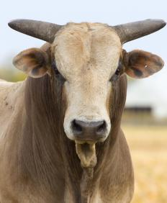
وَكُلُّ شَيْءٍ تَقْرِيباً يَتَطَهَّرُ حَسَبَ النَّامُوسِ بِالدَّمِ وَبِدُونِ سَفْكِ
دَمٍ لاَ تَحْصُلُ مَغْفِرَةٌ!
عبرانيين ٩ : ٢٢

Slide 42
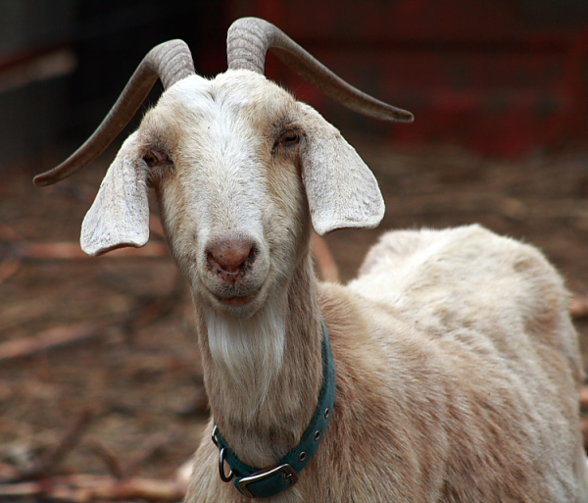
عبرانيين ١٠ : ٣-٤
٣ لَكِنْ فِيهَا كُلَّ سَنَةٍ ذِكْرُ خَطَايَا ٤ لأَنَّهُ لاَ يُمْكِنُ أَنَّ دَمَ ثِيرَانٍ وَتُيُوسٍ يَرْفَعُ خَطَايَا.

Slide 43
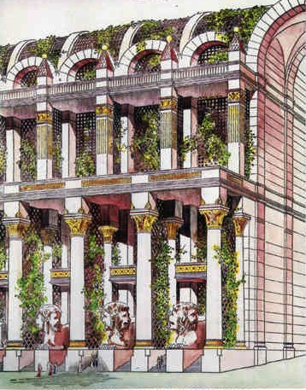
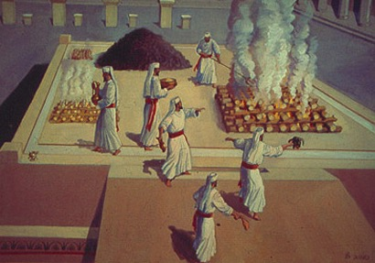
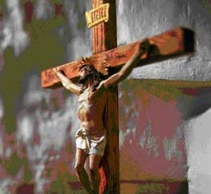
مشاكل في كلتا الحالتين
525
قبل الألفية :
ذبائح عن الخطية
(حز 40: 39) في ضوء موت المسيح
اللاألفية :
التخلي عن التأويل الطبيعي للبوابات والأبواب والجدران والأضاحي
Notes:
We should not stop the normal way we read words in Ezekiel just because we feel uncomfortable with the idea of future sacrifices. Spiritualizing these chapters leads to even greater problems in determining what is meant by these parts of the temple and sacrifices when the Bible does not tell us what else they mean other than the plain use of words and phrases.
____________
OS-26-Ezekiel44-48—slide 43
OS-38-Zechariah-218

Slide 44
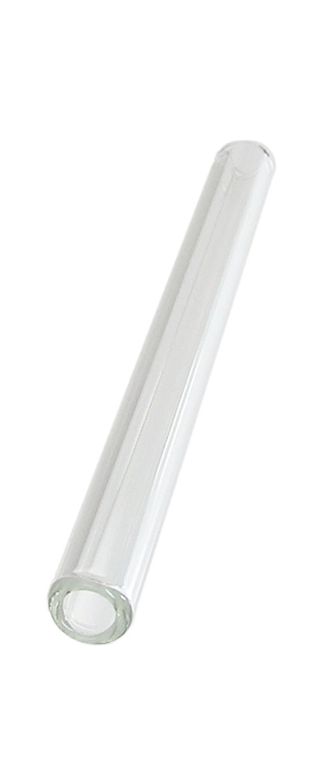
غفران الخطية في العهد القديم
121ب
قناة = العلاقة مع الله
(لا تتغيّر أبدًا)
الخطيئة
عائق = الشركة مع الله
(تعوقها الخطيئة)
الذبائح = الإعتراف بالخطية
(الخطية مغفورة لاستعادة الشركة
لكن العلاقة لم تكن مهددة أبدًا)
Notes:
هل ما يزال لنا علاقة مع الله عندما نخطيء؟ نعم!
الخطية لا تعيق علاقتنا مع الله بل شركتنا معه.
لم تؤسس ذبائح العهد القديم علاقة مع الله بل بالحري استعادت الشركة مع الله.
Do we still have a relationship with God when we sin? Yes!
Sin does not hinder our relationship with God but our fellowship with Him.
OT sacrifices did not establish a relationship with God but rather they restored their fellowship with God
________
OS-03-Leviticus-14
OS-04-Num-29
OP-02-Lev-28
NS-23-1Jn-58
SA-03-Biblical Terms-9
SA-15-Inheritance-27

Slide 45
غفران الخطية في العهد الجديد
121ب
قناة = العلاقة مع الله
(لا تتغيّر أبدًا)
"إِنِ ٱعْتَرَفْنَا بِخَطَايَانَا
فَهُوَ أَمِينٌ وَعَادِلٌ،
حَتَّى يَغْفِرَ لَنَا
خَطَايَانَا وَيُطَهِّرَنَا
مِنْ كُلِّ إِثْمٍ."
(1 يوحنا 1: 9)
الخطيئة
عائق = الشركة مع الله
(تعوقها الخطيئة)
فداء المسيح = الأساس الإعتراف
بالخطية، (تغفر الخطية
لاستعادة الشركة
ولكن العلاقة لم
تتعرض أبدًا للتهديد).
Notes:
هل ما يزال لنا علاقة مع الله عندما نخطيء؟ نعم!
الخطية لا تعيق علاقتنا مع الله بل شركتنا معه.
لم تؤسس ذبائح العهد القديم علاقة مع الله بل بالحري استعادت الشركة مع الله.

Slide 46
غفران الخطيَّة في المُلْك الألفيّ
121ب
"ثُمَّ قَالَ لِي: «هَذَا بَيْتُ ٱلطَّبَّاخِينَ حَيْثُ يَطْبُخُ خُدَّامُ ٱلْبَيْتِ ذَبِيحَةَ ٱلشَّعْبِ"
حزقيال 46: 24
القناة (الماسورة) = العلاقة مع الله
(لا تتغيَّر أبدًا)
الخطيَّة
الإنسداد = الشركة مع الله
(تعوقها الخطيَّة)
ذبيحة المسيح = هي الأساس الذي يعتمد عليه الإعترافُ بالخطيَّة (تُغفَر الخطيَّة فيُفتَح المجال لاستعادة الشركة، ولكن لم يكنْ هناك أيُّ خطرٍ لفقدان العلاقة)
Notes:
لن تقدر الذبائحُ الحيوانيَّة- في حدِّ ذاتها- أن تمنح الغفران عن الخطيَّة في المُلْك الألفيّ، وهي تُشبِه في ذلك جميعَ الذبائح السابقة على مرِّ التاريخ. إنَّ هذه الذبائح تُشير فقط إلى الربِّ يسوع على أنَّه الذبيحة النهائيَّة من أجْلِ الخطيَّة. سيكون تقديم هذه الذبائح نوعًا من الاعتراف بالخطيَّة.
Sacrifices in the millennium—like all sacrifices throughout history—will not in themselves forgive sin. They only point to the Lord Jesus as the final sacrifice for sin. Offering them will be a form of confession of sin.
_________
Common-209
OB-38-Salvation-11
OS-03-Leviticus-56, 72, 130
OS-04-Numbers-30
OS-36-Zephaniah-123
NS-23-1Jn-59
SA-03-Biblical Terms-9

Slide 47
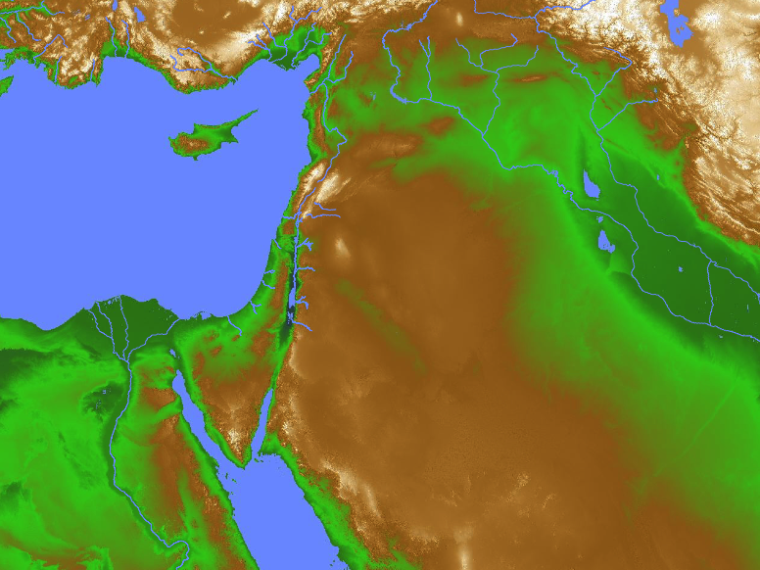
تضرع كوش
(صف 3: 9-11)
9 لأني حينئذ أحول الشعوب إلى شفة نقية ليدعوا كلهم باسم الرب ليعبدوه بكتف واحدة 10 من عبر أنهار كوش المتضرعون إلي متبددي يقدمون تقدمتي 11 في ذلك اليوم لا تخزين من كل أعمالك التي تعديت بها علي لأني حينئذ أنزع من وسطك مبتهجي كبريائك ولن تعودي بعد إلى التكبر في جبل قدسي
إسرائيل
كوش

Slide 48
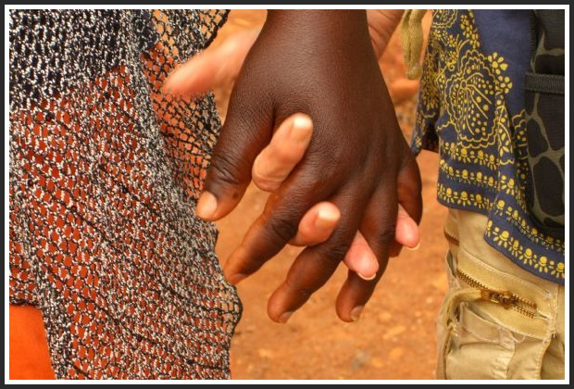
العبادة الألفية
ويكون أن كل الباقي من جميع الأمم الذين جاؤوا على أورشليم يصعدون من سنة إلى سنة ليسجدوا للملك رب الجنود وليعيدوا عيد المظال ويكون أن كل من لا يصعد من قبائل الأرض إلى أورشليم ليسجد للملك رب الجنود لا يكون عليهم مطر وإن لا تصعد ولا تأت قبيلة مصر ولا مطر عليها تكن عليها الضربة التي يضرب بها الرب الأمم الذين لا يصعدون ليعيدوا عيد المظال هذا يكون قصاص مصر وقصاص كل الأمم الذين لا يصعدون ليعيدوا عيد المظال
(زك 14: 16-19)

Slide 49
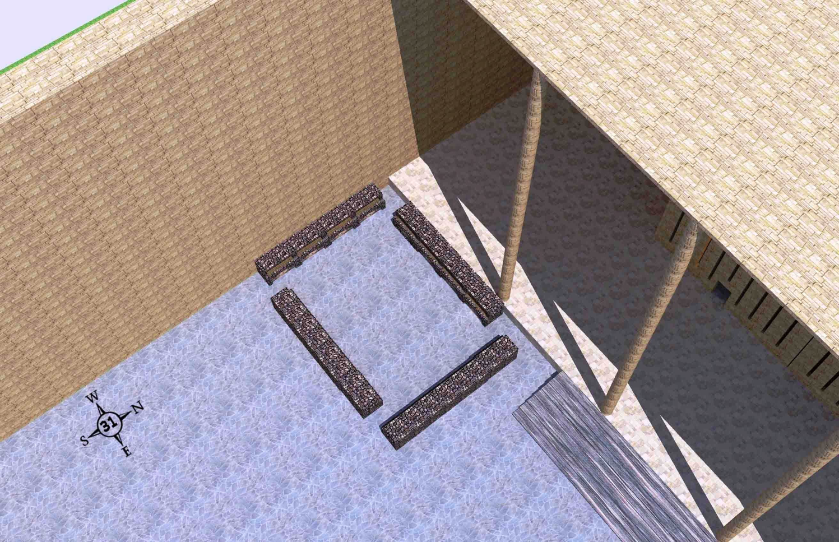
مكان الطبخ الشمالي الغربي (حزقيال 46: 21-24)
مكان الطبخ الشمالي الغربي لذبائح الشعب وبه 4 قاعات صغيرة مثل هذه في كل ركن من أركان الساحة الخارجية
واين أدونيل •حجز 40-48 جولة في هيكل حزقيال • http://bible.ag/en/enezekialtranscript.htm
Notes:
"See Picture #31. The northwest boiling place for the peoples' sacrifices. There are 4 mini-courts like this one; one in each corner of the outer court.
Ezekiel 46:21-24, "Then he brought me forth into the utter [outer] court, and caused me to pass by the four corners of the court; and, behold, in every corner of the court there was a court ... forty cubits long and thirty broad .... And there was a row of building round about in them, ... and it was made with boiling places under the rows round about. Then said he unto me, These are the places of them that boil, where the ministers of the house shall boil the sacrifice of the people." Four 40x30 cubit mini-courts, one in each corner of the outer court, for the priests to come out and boil the peoples' sacrifices, because the people cannot enter into the inner court, where the priests offer other sacrifices."
Wayne ODonnell, "Ezekiel 40–48: Tour of Ezekiel's Temple"
http://bible.ag/en/mr4web.html#EZanchor-anchor
Recorded December 30, 2007
Accessed 30 Aug 2016

Slide 50
لماذا الذبائح في الألفية؟
527
قبل الصليب :
النظر للأمام نحو موت المسيح
بعد الصليب :
النظر للخلف نحو موت المسيح
ثيوقراطي: مثل الاعتراف بالخطيئة (١ يوحنا ١: ٩)
الذكرى: مثل العشاء الرباني الذي ينظر إلى الوراء
قدم بولس ذبيحة هيكل في عام 57 م (أع ٢٦: ٢١) دون أن يرى مشكلة الانحراف
Notes:
Sacrifices are a problem in this present age but will not be an issue in the future.
___________
OS-26-Ezekiel44-48—slide 50
OS-38-Zechariah-219

Slide 51
شجرة عائلة الآباء
النسل الملكي
91
تارح
هاران
ناحور
إبراهيم
لوط
بتوئيل
(من هاجر) إسماعيل
(من سارة) إسحق
لابان رفقة
زوجة
عيسو
يعقوب
ليئة
راحيل
(من ليئة) رأوبين شمعون لاوي
يهوذا يساكر زبولون
(من زلفة) جاد، أشير
(من بلهة) دان، نفتالي
(من راحيل)
يوسف، بنيامين
منسى
أفرايم
أحمر : مع أن يهوذا لم يكن البكر لكن يعقوب صرح بأن ملوك إسرائيل سيكونون من نسله

Slide 52
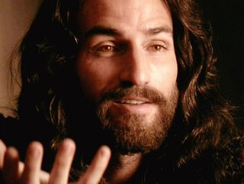
من هو الأمير في حزقيال 40-48؟
531
1. ليس المسيح
أ. يحتاج ذبيحة خطية (45: 22)
ب. تقدمات من الآخرين (46: 2)
ت. لديه أبناء (46: 16-18)
ث. يسوع ملك وليس أمير

Slide 53
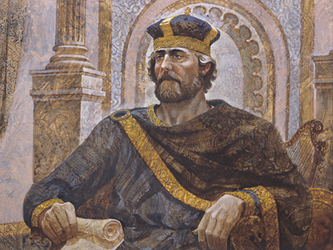
من هو الأمير في حزقيال 40-48؟
531
2. إنسان يخدم تحت سلطة المسيح
أ. لا يزال يسوع هو الأكثر سلطة
ب. لا يحكم على عرش داود
ت. لديه دور ديني (ليس حكم)
ث. كل القادة البشريين يخطئون

Slide 54



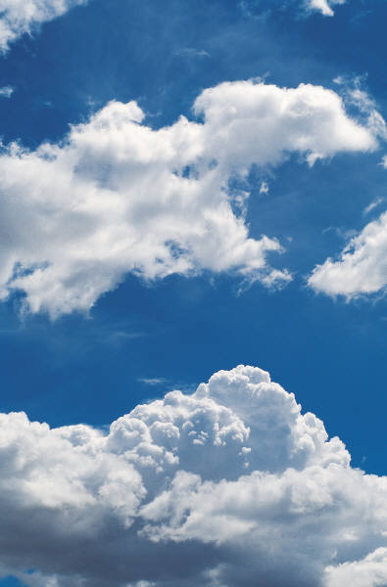


الروح يغادر ويرجع
656
حز 8: 4، 9: 3، 10: 4، 10: 18-19، 11: 23
لو 19: 37، 24: 50، أع 1: 10
أع 1: 11، زك 14: 4، حز 43: 1-5
Notes:
The Mount of Olives repeatedly plays a vital role in biblical prophecy. Ezekiel last saw the glory of God leave the temple and land on this mount. More than 500 years later, some Galilean Jews last proclaimed Jesus as Messiah on the Mount of Olives at the Triumphal Entry days before Jerusalem's leaders had him crucified, but Christ rose and returned to the Mount of Olives and ascended from there. The next time Jesus will be seen on earth is at this same Mount of Olives!
___________
Common Arabic-286
BE-38-Zechariah-126
OS-26-Ezek40-48-slide 114
OS-38-Zechariah-179
NS-03-Luke13-14-slide 111
NS-05-Acts1-2-slide 215

Slide 55
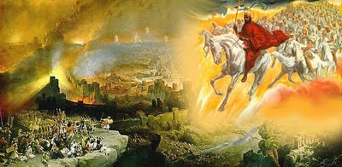
المجيء الثاني
وتقف قدماه في ذلك اليوم على جبل الزيتون الذي قدام أورشليم من الشرق
(زك 14: 4)

Slide 56
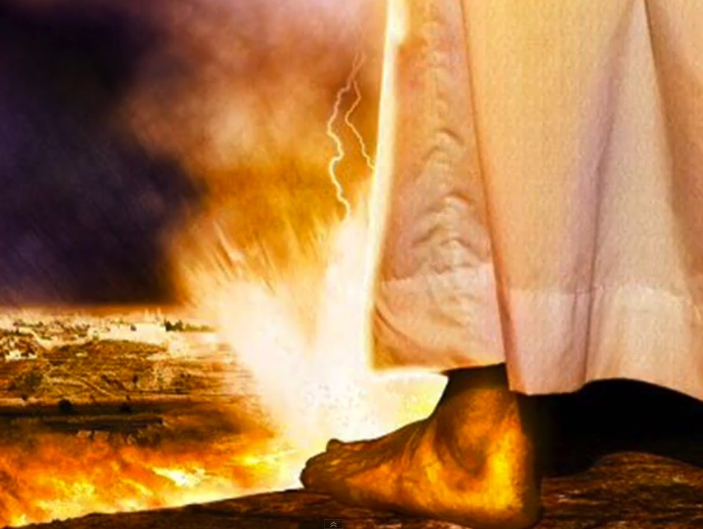
المجيء الثاني
وتقف قدماه في ذلك اليوم على جبل الزيتون الذي قدام أورشليم من الشرق
(زك 14: 4أ)

Slide 57
Slides on
حزقيال ٤٧

Slide 58
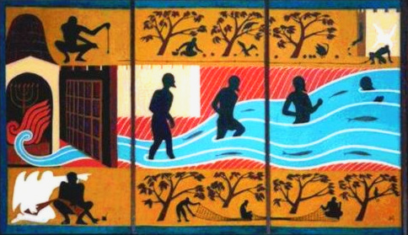
النهر من هيكل حزقيال
(47: 1-12)

Slide 59
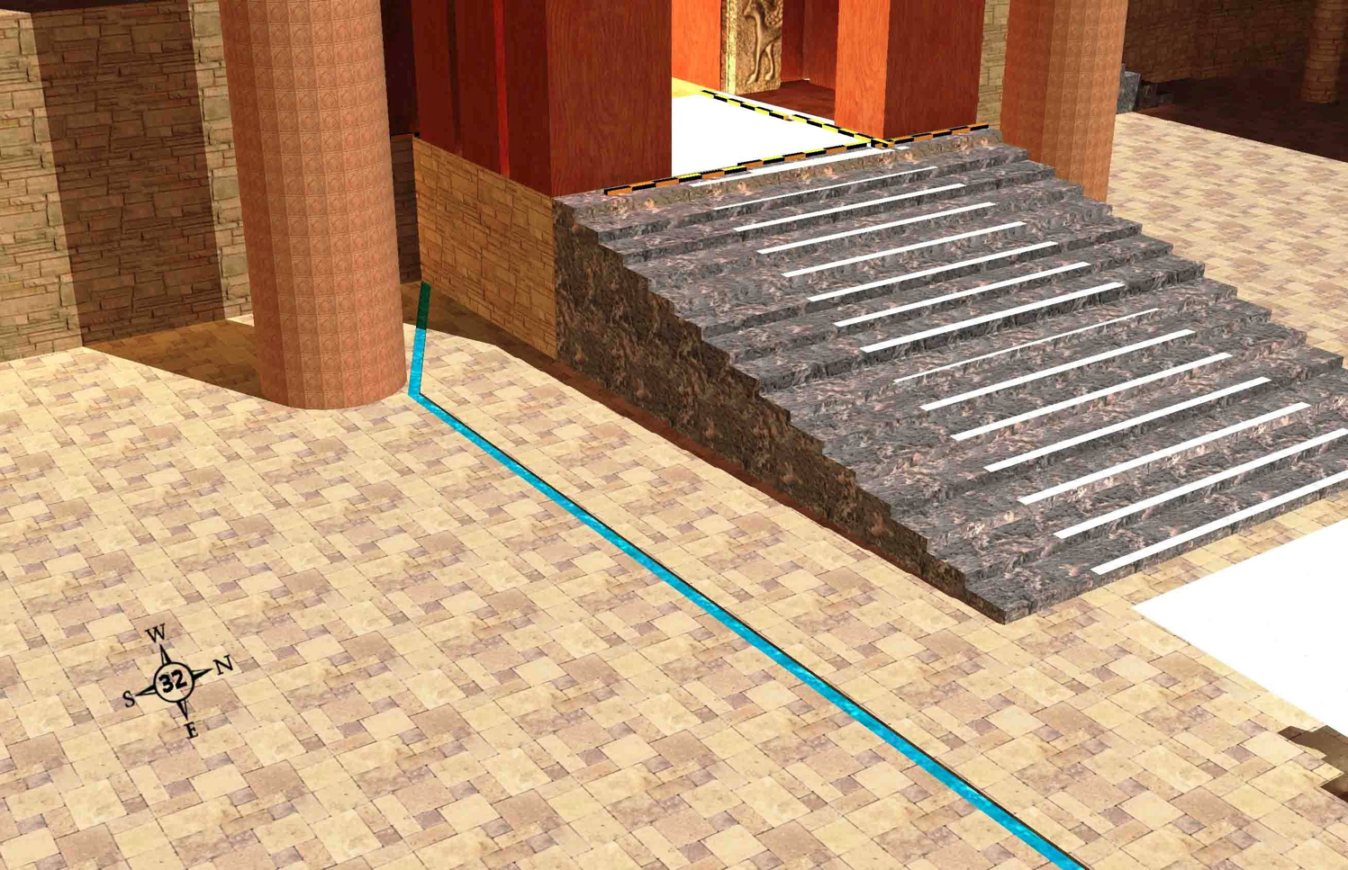
النهر والأرض (حزقيال 47: 1)
519
النهر الذي ينبع من الجهة الجنوبية لمدخل الهيكل
واين أدونيل •حجز 40-48 جولة في هيكل حزقيال • http://bible.ag/en/enezekialtranscript.htm
Notes:
"Ezekiel 47-48. The River and the Land
See Picture #32. The river that starts on the south side of the temple entrance.
Ezekiel 47:1, "Afterward he brought me again unto the door of the house," the temple, "and, behold, waters issued out from under the threshold of the house eastward: for the forefront of the house stood toward the east, and the waters came down from under from the right side of the house, at the south side of the altar." Picture #32 shows a trickle of water flowing from south side of the threshold of the temple. "The right side of the house" is the south side, since the temple faces east."
Wayne ODonnell, "Ezekiel 40–48: Tour of Ezekiel's Temple"
http://bible.ag/en/mr4web.html#EZanchor-anchor
Recorded December 30, 2007
Accessed 30 Aug 2016

Slide 60
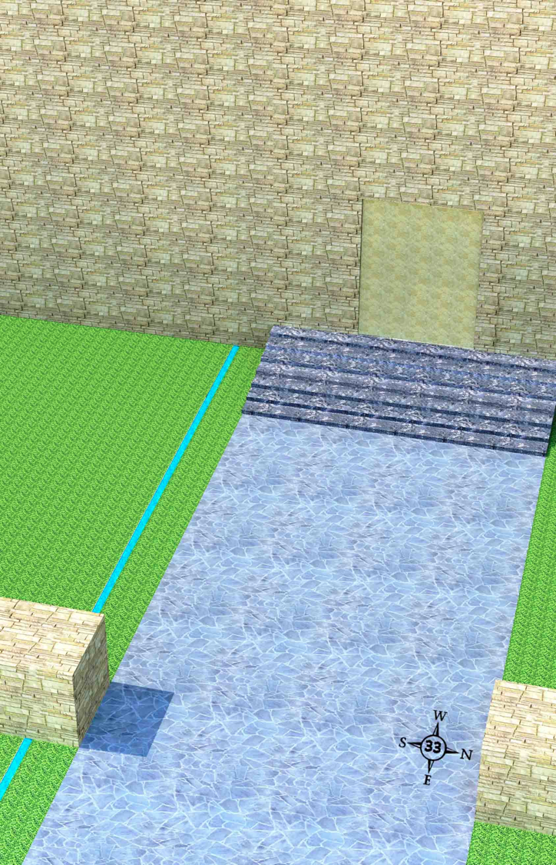
بداية النهر (حزقيال 47: 2)
519
يتدفق النهر خارج الجهة الجنوبية من البوابة الشرقية الخارجية
واين أدونيل •حجز 40-48 جولة في هيكل حزقيال • http://bible.ag/en/enezekialtranscript.htm
Notes:
"See Picture #33. The river flowing out the south side of the outer east gate.
حزقيال 47:2, "Then brought he me out of the way of the gate northward, and led me about [around] the way without [outside] unto the utter [outer] gate by the way that looketh eastward; and, behold, there ran out waters on the right side." "The right side" of the gate is the south side, since the gate faces east. Why did the angel take حزقيال out the north gate and around when he wanted to show him something outside the outer east gate? Why didn't he just take him through the outer east gate? Well, remember, the outside of the outer east gate has been sealed. So in Picture #33, we are outside the outer east gate where we started this tour, and we see the waters from the temple coming from the south side."
Wayne ODonnell, "حزقيال 40–48: Tour of حزقيال's Temple"
http://bible.ag/en/mr4web.html#EZanchor-anchor
Recorded December 30, 2007
Accessed 30 Aug 2016

Slide 61
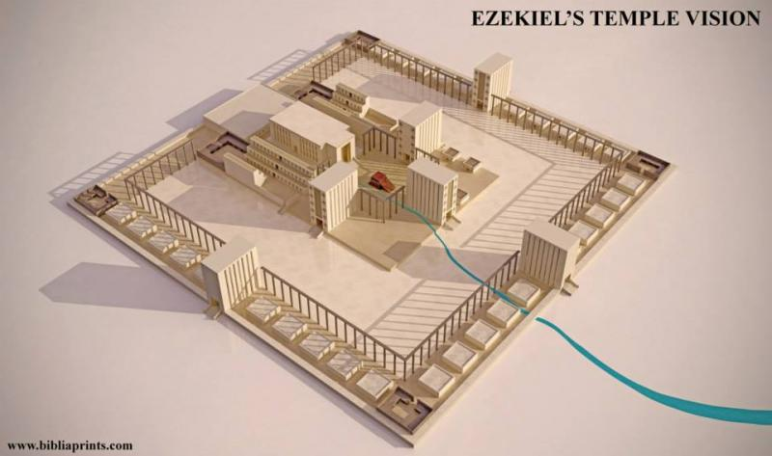
النهر من هيكل حزقيال
(47: 1-12)
ثُمَّ أَرْجَعَنِي إِلَى مَدْخَلِ الْبَيْتِ وَإِذَا بِمِيَاهٍ تَخْرُجُ مِنْ تَحْتِ عَتَبَةِ الْبَيْتِ نَحْوَ الْمَشْرِقِ, لأَنَّ وَجْهَ الْبَيْتِ نَحْوَ الْمَشْرِقِ. وَالْمِيَاهُ نَازِلَةٌ مِنْ تَحْتِ جَانِبِ الْبَيْتِ الأَيْمَنِ عَنْ جَنُوبِ الْمَذْبَحِ.
حزقيال ٤٧ : ١
Notes:
Bible Study Pictures and Notes for حزقيال 38-40
http://www.jesuslovesyoutoday.org/bible_study_pictures_and_notes/حزقيال_38-40
Accessed 30 Aug 2016

Slide 62
النهر من هيكل حزقيال
(47: 1-12)
ثُمَّ أَرْجَعَنِي إِلَى مَدْخَلِ الْبَيْتِ وَإِذَا بِمِيَاهٍ تَخْرُجُ مِنْ تَحْتِ عَتَبَةِ الْبَيْتِ نَحْوَ الْمَشْرِقِ, لأَنَّ وَجْهَ الْبَيْتِ نَحْوَ الْمَشْرِقِ. وَالْمِيَاهُ نَازِلَةٌ مِنْ تَحْتِ جَانِبِ الْبَيْتِ الأَيْمَنِ عَنْ جَنُوبِ الْمَذْبَحِ.
حزقيال ٤٧ : ١

Slide 63

النهر من هيكل حزقيال
(47: 1-12)
ثُمَّ أَرْجَعَنِي إِلَى مَدْخَلِ الْبَيْتِ وَإِذَا بِمِيَاهٍ تَخْرُجُ مِنْ تَحْتِ عَتَبَةِ الْبَيْتِ نَحْوَ الْمَشْرِقِ, لأَنَّ وَجْهَ الْبَيْتِ نَحْوَ الْمَشْرِقِ. وَالْمِيَاهُ نَازِلَةٌ مِنْ تَحْتِ جَانِبِ الْبَيْتِ الأَيْمَنِ عَنْ جَنُوبِ الْمَذْبَحِ.
حزقيال ٤٧ : ١

Slide 64

يصير النهر أعمق (47: 3-5)
519
النهر المتدفق شرق مجمع الهيكل يصبح أعمق وأوسع
واين أدونيل •حجز 40-48 جولة في هيكل حزقيال • http://bible.ag/en/enezekialtranscript.htm
Notes:
"See Picture #34. The river flowing east from the temple compound and getting deeper and wider.
حزقيال 47:3-5, "And when the man that had the line in his hand went forth eastward, he measured a thousand cubits, and he brought me through the waters; the waters were to the ankles. Again he measured a thousand, and brought me through the waters; the waters were to the knees. Again he measured a thousand, and brought me through; the waters were to the loins. Afterward he measured a thousand; and it was a river that I could not pass over: for the waters were risen, waters to swim in." The waters get deeper and deeper as they flow east. The angel is using the flax string to measure each 1000-cubit stretch. The angel gets to stay on dry ground, while حزقيال has to go through the water.
This passage is another reason why the word "reeds" in حزقيال 42:16-19 seems incongruous. If the angel brought the flax line to measure long distances, like these 1,000 cubit stretches, why would he use the reed to measure 500 reeds, or 3,000 cubits, in حزقيال 42? But if the word "reeds" was not in the original in 42:16-19, then the 500 cubit outside wall of the temple compound in حزقيال 42 was the longest distance the angel measured with the reed, and we could assume all longer distances were measured with the flax line, which would probably be in common medium cubits.
حزقيال 47:7-8, "Now when I had returned, ... then said he unto me, These waters issue out toward the east country, and go down into the desert, and go into the sea: which being brought forth into the sea, the waters shall be healed." The river from the temple goes down to the Dead Sea, and heals their salty waters.
حزقيال 47:9-11, "And it shall come to pass, that every thing ... whithersoever the rivers shall come, shall live ... And ... fishers shall stand upon it from Engedi even unto Eneglaim, ... their fish shall be according to their kinds, as the fish of the great sea [the Mediterranean], exceeding many. But the miry places thereof and the marshes thereof shall not be healed; they shall be given to salt." There's no fish in the Dead Sea today, but there will be great fishing there soon.
حزقيال 47:12, "And by the river upon the bank ... shall grow all trees for meat, whose leaf shall not fade, neither shall the fruit thereof be consumed: it shall bring forth new fruit according to his months, because their waters they issued out of the sanctuary: and the fruit thereof shall be for meat, and the leaf thereof for medicine." The trees that are watered by the river from the temple will have leaves that provide healing, so no one will remain sick.
Not only will the waters go east and down to the Dead Sea, but half will go towards the Mediterranean Sea. Zechariah 14:8, "And it shall be in that day, that living waters shall go out from Jerusalem; half of them toward the former sea, and half of them toward the hinder sea: in summer [dryer season] and in winter [wetter season] shall it be."
In the east, the river can go down the great valley through the split in the Mount of Olives we talked about earlier to the Dead Sea. In the west, the waters from the temple, which may be at the highest point on the mountain, may first water the rest of the mountain via irrigation channels and so forth, before being gathered at the western base of the mountain to flow on to the Mediterranean. "Look upon Zion, the city of our solemnities, there the glorious LORD will be unto us a place of broad rivers and streams; wherein shall go no galley with oars, neither shall gallant ship pass thereby," Is33:20,21. See picture #36. "I am the LORD your God dwelling in Zion, my holy mountain: ... in that day ... a fountain shall come forth out of the house of the LORD, and shall water the valley of Shittim," Joel3:17-18."
Wayne ODonnell, "حزقيال 40–48: Tour of حزقيال's Temple"
http://bible.ag/en/mr4web.html#EZanchor-anchor
Recorded December 30, 2007
Accessed 30 Aug 2016
"The pictures in this chapter were taken from a video tour of a computer-generated model of the future Messianic Kingdom temple. The video tour is available from http://bible.ag. You can also download the computer model and the software to view it from Google SketchUp Warehouse, and walk through it yourself."

Slide 65

The River from Ezekiel's Temple (47:1-12)
وعند خروج الرجل نحو المشرق والخيط بيده قاس ألف ذراع وعبرني في المياه والمياه إلى الكعبين
(حز 47: 3)

Slide 66

The River from Ezekiel's Temple (47:1-12)
ثم قاس ألفاً وعبرني في المياه والمياه إلى الركبتين
(حز 47: 4أ)

Slide 67

The River from Ezekiel's Temple (47:1-12)
ثم قاس ألفاً وعبرني والمياه إلى الحقوين
(حز 47: 4ب)

Slide 68

The River from Ezekiel's Temple (47:1-12)
ثم قاس ألفاً وإذا بنهر لم أستطع عبوره لأن المياه طمت مياه سباحة نهر لا يعبر
(حز 47: 5)

Slide 69

المحاصيل من واحة المياه العذبة
550
حزقيال ٤٧ : ١٠

Slide 70

نهر الألفية
جبع
هيكل الألفية
أورشليم المعاد بنائها
رمون
البحر الميت
الأغوار
حزقيال ٤٧ : ١-١٢
Notes:
At his return, Jesus will split the Mount of Olives in half (Zechariah 14:4), making a large east-west valley for which to channel water eastward from Temple Mount all the way to the Dead Sea.
____________
OS-26-Ezekiel44-48—slide 70
OS-38-Zechariah-204

Slide 71
نهر الألفية
جبع
هيكل الألفية
أورشليم المعاد بنائها
رمون
البحر الميت
الأغوار
زكريا 14: 8
ويكون في ذلك اليوم أن مياها حية تخرج من أورشليم نصفها إلى البحر الشرقي ونصفها إلى البحر الغربي في الصيف وفي الخريف تكون.
Notes:
NLT 2nd ed
The Millennial River from the Temple appears in Ezekiel 47:1-10, but also in Joel 3:17 and Zechariah 14:8. Ezekiel notes only the water flowing eastward, but Zechariah adds that westward water will also reach the Mediterranean.
____________
OS-26-Ezekiel44-48—slide 71
OS-38-Zechariah-205

Slide 72
نهر الألفية
جبع
هيكل الألفية
أورشليم المعاد بنائها
رمون
البحر الميت
الأغوار
يوئيل 3: 18
ويكون في ذلك اليوم أن الجبال تقطر عصيراً والتلال تفيض لبناً وجميع ينابيع يهوذا تفيض ماء ومن بيت الرب يخرج ينبوع ويسقي وادي السنط
Notes:
NLT 2nd ed
The Millennial River from the Temple appears in Ezekiel 47:1-10, but also in Joel 3:17 and Zechariah 14:8.
____________
OS-26-Ezekiel44-48—slide 72
OS-38-Zechariah-206

Slide 73

إسرائيل
و
مصر
ويكون في ذلك اليوم أن الجبال تقطر عصيراً والتلال تفيض لبناً وجميع ينابيع يهوذا تفيض ماء ومن بيت الرب يخرج ينبوع ويسقي وادي السنط
(يوئيل 3: 18)

Slide 74
طبوغرافيا اسرائيل
http://www.studylight.org/se/maps/browse.cgi?st=51&pn=11

Slide 75
توسع العناصر
60
7
العهد الإبراهيمي
تكوين 12 : 1 - 3
الأرض النسل البركة
ABRAHAM
The CALL
L - S - B
12 : 1
12 : 2
12 : 3
أ – ن - ب
Handbook pg. 19-24
15

Slide 76

حرفي – أبدي – غير مشروط
تك 13 : 15, تك 15
60
7
العهد الإبراهيمي
تكوين 12 : 1 - 3
الأرض النسل البركة
ABRAHAM
The CALL
L - S - B
حرفي
أبدي
غير مشروط
Handbook pg. 19-24
16
3

Slide 77

أنواع العهود غير المشروطة
60
الإبراهيمي
الأرض
الداوودي
الجديد
الأرض | النسل | البركة
مادي | سياسي | روحي
تث 30 | 2 صم 7 | إر 31

Slide 78
خط سير الملكوت و العهود
22 و 379
9ج
تعليم الملكوت
آدم يحكم مع الله تك 1: 26, 28 تك 2: 19
الشيطان يحكم كاله هذا العالم تك 3: 15 2 كو 4: 4
عهود الله مع إبراهيم لإعادة تأسيس حكم الإنسان من خلال إسرائيل كمملكة كهنة
تك 12 : 1 – 3
خر 19 : 6
فشل إسرائيل في الشهادة للأمم كمملكة كهنة أدين من خلال السبي تحت حكم أجنبي
رفضت إسرائيل عرض المسيا بخصوص الملكوت
مت 12 : 41 – 42
مت 23 : 37 – 39
وسع يسوع ملكوته بشكل غامض للكنيسة
مت 13
أخاف يسوع أعداء اسرائيل و الأمة آمنت
رو 11 : 26 – 27
المسيح يحكم على كل شيء مع القديسين
أف 1 : 9 – 10
رؤ 20 : 1 – 6
رؤ 22 : 5ب
سقوط الإنسان
تك 3
العهد النوحي
تك 6 : 18, 9 : 8 – 17
عهد الأرض
إسرائيل
الكنيسة
الألفية الملكوت
(التركيز على الأمة)
الإنسان الجديد (أف 2: 15)
المسيانية الأبدي
الأرض
تك 15 : 18 ( قارن مع تث 30 : 1 – 10 ) يعد :
. الأرض من وادي مصر إلى نهر الفرات (أش 27 : 12)
. امتلاك أبدي للأرض (تك 17 : 8) بعد السبي و التجديد
. بركة العالم أجمع من خلال الأرض (أش 14 : 1-2)
أدينت اسرائيل لرفضها المسيا بالتشتت من الأرض لتسعة عشر قرناً ( 70م – 1948م ) لكنها الآن استردت جزئياً ( حز 37 : 1 – 7 )
تجديد كامل
(حز 37 : 8-28)
أورشليم عاصمة العالم
(أش 2 : 1-5)
أورشليم الجديدة
(رؤ 21 – 22)
العهد الداوودي
المسيح هو رأس كنيسته التي هي هيكل روحي
( أف 2 : 19 – 22, 2 كو 6 : 16)
المسيح يحكم على العالم
(أش 11)
مع القديسين
(رؤ 5 : 10, 20 : 4-6)
يسلم المسيح الملكوت إلى الآب
(1كو 15 : 24)
العهد الإبراهيمي
2 صم 7 : 12 يعد بالإزدهار الدائم :
. أبناء (بيت لا يزول)
. مملكة (سلالة حاكمة سياسياً)
. عرش (حق الحكم من خلال النسل)
. الهيكل (الإبن سيبنيه)
تك 12 : 1 - 3
النسل
العهد الجديد
كل الأشياء تصير جديدة
(رؤ 21 : 5)
العناصر الخمسة كاملة تتم في تجديد وطني
(زك 8)
إر 31 : 31 – 34 يعد :
. الغفران
. سكنى الروح
. قلب و فكر و طبيعة جديدة
. لم شمل إسرائيل و يهوذا
. لا داعي للكرازة
تم استبدال العهد الموسوي بالعناصر الثلاثة الأولى من العهد الجديد
( لو 22 : 20, 2 كو 3 : 6 )
البركة
العهد الموسوي
إلغاء و تتميم و استبدال الناموس على الصليب
(رو 7: 1-6, 1كو 9: 19-21, عب 8: 13)
الطبعة السادسة
15 حزيران 2012
مؤقت (غل 3 : 19 ) و مشروط ( تث 28 ) ليعلن الخطية ( رو 7 : 7 ) و ينظم إسرائيل
( غل 3 : 23 – 25 )
الكتاب المقدس يحتوي على تركيز مزدوج على الملكوت – العهد, يتوسع دور إسرائيل من إبراهيم إلى المسيح ليشمل الكنيسة (الإستمرارية) مع أن الكنيسة لن تحل محل الأمة كإسرائيل الجديدة (عدم الإستمرارية) سوف تستمتع إسرائيل ثانية بحكم العالم بعد الإيمان بالمسيح في مجيئه الثاني
Notes:
All agree that a partial fulfillment of the covenant to Abraham exists now to the Church in the indwelling Holy Spirit and forgiveness of sins (Jer 31:31-34)—and the ultimate fulfillment will be in the eternal state.
The main area of disagreement relates to the time period from now to eternity. Will there be a literal land, throne, and worldwide blessing to national (ethnic) Israel before the eternal kingdom? This chart shows verses giving a resounding YES to that question in a present partial fulfillment and a future full fulfillment in the normal sense of language in the verses cited. But the messianic kingdom will be in two stages—first in a millennial fulfillment to last 1000 years, but then, after that, the eternal stage in the new Jerusalem after the destruction of our present heavens and earth (Rev 21–22). What an amazing future remains for those who trust Jesus!
____________
Common English-7
CH-02-Nature-103-p34a
OC-10-Chronology-42
OS-00-Intro & Biblical Theology-25 & 90
OS-02-Exodus-27٦-p22
OS-05-Deut-248-p22
OS-10-2Sam-96-p22
OS-13-1 Chron-46
OS-24-Jeremiah-174-p337
OS-23-Isaiah-97-p337
NS-09-Gal-143-p9g
NS-19-Hebrews-342-p9g
SA-08-Mosaic Law-19-p38a

Slide 79

دعم الراحة الألفية المستقبلية في عبرانيين 4
تخصيص الأراضي في الألفية
(حزقيال 47-48)
266 آي

Slide 80
مشاركة الأرض بين اليهود و الأمم
21 فتقتسمون هذه الأرض لكم لأسباط إسرائيل ويكون أنكم تقسمونها بالقرعة لكم وللغرباء المتغربين في وسطكم الذين يلدون بنين في وسطكم فيكونون لكم كالوطنيين من بني إسرائيل يقاسمونكم الميراث في وسط أسباط إسرائيل ويكون أنه في السبط الذي فيه يتغرب غريب هناك تعطونه ميراثه يقول السيد الرب
(حز 47: 21-23)
Notes:
This is millennial and not today. No one argues for distributing the land to the twelve tribes today, but they only say that the land should be shared with Gentiles today.
_____________
OS-23-Isaiah49-59—slide 79
OS-26-Ezek44-48—slide 80

Slide 81
Slides on
حزقيال 48

Slide 82

حدود الأرض الموعودة لإبراهيم
سوريا
لبنان
إسرائيل
الأردن
تكوين 15: 18
"فِي ذَلِكَ اليَوْمِ قَطَعَ اللهُ عَهْداً
مَعَ أبْرامَ فَقالَ:
لِنَسلِكَ سَأُعْطِي هَذِهِ الأرْضِ،
مِنْ نَهْرِ مِصْرَ إلَى النَّهْرِ العَظِيمِ،
نَهْرِ الفُراتِ."
India
مصر
Notes:
امتدت أرض الله الموعودة نحو الشمال من وادي مصر الصغير جنوبًا في سيناء إلى نهر الفرات الكبير في أقصى الشمال – قطعة كبيرة جدًا من الممتلكات! عندما يتم تعيين حدود اليوم على الأرض، نستطيع أن نرى الصراع الذي يتعين على إسرائيل الحديثة أن تخوضه للمطالبة بأراضٍ من مصر، ولبنان، وسوريا وحتى من الأردن على الجانب الآخر من نهر الأردن.
OS-01-Gen12
OS-04-Numbers-235

Slide 83
الأرض الأبدية لنسل إبراهيم
تكوين 17: 7-8
وأقيم عهدي بيني وبينك وبين نسلك من بعدك في أجيالهم عهداً أبدياً لأكون إلهاً لك ولنسلك من بعدك وأعطي لك ولنسلك من بعدك أرض غربتك كل أرض كنعان ملكاً أبدياً وأكون إلههم
إسرائيل
Notes:
God’s promised land stretched northward from the small wadi of Egypt south in the Sinai to the large Euphrates River in the far north—a HUGE piece of real estate! When today’s boundaries are placed over this land we can see the struggle modern Israel has to claim land from Egypt, Lebanon, Syria and possibly even Jordan on the other side of the Jordan River.

Slide 84


إعادة توزيع الأسباط
دان
م ع ق 531 د
531 ي
أشير
بعد الإمتلاك (يش 13)
إسرائيل
في الألفية
(حز 47-48)
نفتالي
منسى
أفرايم
رأوبين
يهوذا
القادة والهيكل
بنيامين
شمعون
يساكر
زبولون
جاد
Notes:
Ezekiel 47–48 show that, in the millennium, the 12 tribal allotments under Joshua will all lie on the west side of the Jordan River.

Slide 85

أقسام الأرض
(48: 1-7)
531ج
تتجه أجزاء من الأرض لقبائل إسرائيل مباشرة من الشرق إلى الغرب. لم أحاول تقديم حدود دقيقة ، لكني أحاول إظهار الترتيب العام للأجزاء القبلية. على سبيل المثال ، من المحتمل أن تكون مرتفعات الجولان داخل حدود إسرائيل ، على الرغم من أن الصورة لا تظهرها على هذا النحو.
واين أدونيل •حجز 40-48 جولة في هيكل حزقيال • http://bible.ag/en/enezekialtranscript.htm
Notes:
"See Picture #35. Portions of land for the tribes of Israel going straight across from east to west. I have not tried to present accurate boundaries, but rather to show the general arrangement of the tribal portions. For example, the Golan Heights will probably be within the borders of Israel, though the picture doesn't show it that way.
Northern Boundaries. Ezekiel 48:1, "Now these are the names of the tribes. From the north end to the coast of the way of Hethlon, as one goeth to Hamath, Hazarenan, the border of Damascus northward, to the coast of Hamath." Hamath is present day Hama in Syria. The northern border of Israel during the Messianic Kingdom will extend to about the present northern border of Lebanon. Present day Lebanon will be part of millennial Israel.
Seven Northern Tribes. Ezekiel 48:2-7, "These are his sides east and west; a portion for Dan. And by the border of Dan, from the east side unto the west side, a portion for Asher. And by the border of Asher, from the east side even unto the west side, a portion for Naphtali. And by ... Naphtali, ... a portion for Manasseh. And by ... Manasseh, ... a portion for Ephraim. And by ... Ephraim, ... a portion for Reuben. And by ... Reuben, ... a portion for Judah." Each tribe's portion will extend completely across from the western boundaries, like the Jordan River, to the Mediterranean Sea.
Today most Jewish people don't know which tribe they are descended from, the exception being some descendants of priests and Levites who have family names like Cohen, the Hebrew word for priest, or Levi. But now we have genetic tests, and anyway the Lord knows the genealogy of everyone. Jewish tradition says that when Elijah returns before the Messianic Kingdom is set up, he will provide Jewish people with their tribal identities.
So although physical things like genealogies have no relevance in the church age or for spiritual salvation; in the future, genealogies will be important again, at least in determining how physically close to the shekinah glory a person will be able to live.
Some Gentiles, possibly proselytes, will dwell among the tribes in the land, "in what tribe the stranger sojourneth, there shall ye give him his inheritance," Ez47:23. And some Gentiles in their natural bodies during the kingdom will become servants to Israelites so they can live in the land. "Strangers shall stand and feed your flocks, and the sons of the alien shall be your plowmen and your vinedressers ... For your shame, ye shall have double [blessing, joy, inheritance, etc.]," Is60:1-61:7."
Wayne ODonnell, "Ezekiel 40–48: Tour of Ezekiel's Temple"
http://bible.ag/en/mr4web.html#EZanchor-anchor
Recorded December 30, 2007
Accessed 30 Aug 2016

Slide 86

السكان حسب
الأسباط
171
أشير
53.400
نفتالي
45.400
عدد 26
يشوع 13: 1- 19: 48
زبولون
60.500
منسى
يساكر
64.300
إفرايم
32.500
لاوي
23.000
موزعون في جميع أنحاء إسرائيل
جاد
40.500
منسى
52.700
دان
64.400
بنيامين45.600
رأوبين
43.730
يهوذا
76.500
شمعون
22.200
Notes:
OS-04-Numbers-214
OS-06-Joshua-

Slide 87
جغرافية
الأيام الأخيرة
م ع ق
531د
م ع ق
531ي
المظلل باللون الأزرق
حز 45: 1-8، 48: 9-22
THE
RESTORATION
OF PALESTINE
Ezekiel 47–48
THE DIVISION OF THE LAND DURING THE MILLENNIUM
Raymond Ludwigson, A Survey of Bible Prophecy, 56
Charles Dyer, "Ezekiel," in The Bible Knowledge Commentary, 1:1314
Notes:
The significant differences between the two depictions of the leadership territory is due to two views on the measuring rod used.
Note that the holy land of the Temple Mount today lies south of Benjamin and north of Judah. However, the millennial location will the same, but Judah will shift NORTH of the temple area and Benjamin shift SOUTH so that these two tribes will switch places and yet still keep the temple in between them.
_____________
ES-26-Restoration of Israel-
OS-06-Joshua-185
OS-26-Ezek44-48-slide 83

Slide 88
مقارنات الكهنة واللاويين والأمراء
م ع ق
531 ي-د
المظلل باللون الأزرق من
حز 45: 1-8، 48: 9-22
Notes:
In either case, the center of Canaan will comprise land for the priests, Levites, and Prince.

Slide 89

لا يمكن أن تكون هذه المنطقة في البحر
521
656
هيكل حزقيال: جولة في رؤيا رؤيا حزقيال• http://حزقيال-temple.narod.ru/ezekial_45.htm •
تخطط هذه المجموعة لبناء الهيكل في صحراء إسرائيل
Notes:
They say (with poor English!):
"Why is the Temple according to the prophecy of حزقيال can not be built in Jerusalem?"
1. حزقيال 40:2
The Temple is located on the south side of the mountain.
Solomon's Temple was built in the north-east side of Mount Zion. On the south side of Mount Zion is the steep rock.
حزقيال's Mountain is "very high."
Mount Zion looks like a hill.
- Where to get a high mountain which has a gently sloping southern slope? This would be another mountain, not Zion.
Accessed 31 August 2016
Ezek 45:2 Of this there shall be for the sanctuary five hundred in length, with five hundred in breadth, square round about; and fifty cubits round about for the suburbs thereof.
3 And of this measure shalt thou measure the length of five and twenty thousand, and the breadth of ten thousand: and in it shall be the sanctuary and the most holy place.
2 "Out of this there shall be for the holy place a square round about five hundred by five hundred cubits, and fifty cubits for its open space round about.
3 "From this area you shall measure a length of 25,000 cubits and a width of 10,000 cubits; and in it shall be the sanctuary, the most holy place.

Slide 90

يريد البعض الهيكل في الصحراء
521
656
هيكل حزقيال: جولة في رؤيا رؤيا حزقيال• http://حزقيال-temple.narod.ru/ezekial_45.htm •
تخطط هذه المجموعة لبناء الهيكل في صحراء إسرائيل
Notes:
Accessed 31 August 2016
Ezek 45:2 Of this there shall be for the sanctuary five hundred in length, with five hundred in breadth, square round about; and fifty cubits round about for the suburbs thereof.
3 And of this measure shalt thou measure the length of five and twenty thousand, and the breadth of ten thousand: and in it shall be the sanctuary and the most holy place.
2 "Out of this there shall be for the holy place a square round about five hundred by five hundred cubits, and fifty cubits for its open space round about.
3 "From this area you shall measure a length of 25,000 cubits and a width of 10,000 cubits; and in it shall be the sanctuary, the most holy place.

Slide 91

تحركت منطقة الهيكل جنوباً فوق إسرائيل الحالية
521
656
هيكل حزقيال: جولة في رؤيا رؤيا حزقيال• http://حزقيال-temple.narod.ru/ezekial_45.htm •
تخطط هذه المجموعة لبناء الهيكل في صحراء إسرائيل
Notes:
Accessed 31 August 2016

Slide 92


يخطط البعض أن يكون الهيكل في الصحراء
521
656
هيكل حزقيال: جولة في رؤيا رؤيا حزقيال• http://حزقيال-temple.narod.ru/ezekial_45.htm •
تخطط هذه المجموعة لبناء الهيكل في صحراء إسرائيل
Notes:
Accessed 31 August 2016

Slide 93
يريد البعض الهيكل في الصحراء
521
656
هيكل حزقيال: جولة في رؤيا رؤيا حزقيال• http://حزقيال-temple.narod.ru/ezekial_45.htm •
تخطط هذه المجموعة لبناء الهيكل في صحراء إسرائيل
Notes:
Accessed 31 August 2016
Ezek 45:2 Of this there shall be for the sanctuary five hundred in length, with five hundred in breadth, square round about; and fifty cubits round about for the suburbs thereof.
3 And of this measure shalt thou measure the length of five and twenty thousand, and the breadth of ten thousand: and in it shall be the sanctuary and the most holy place.
2 "Out of this there shall be for the holy place a square round about five hundred by five hundred cubits, and fifty cubits for its open space round about.
3 "From this area you shall measure a length of 25,000 cubits and a width of 10,000 cubits; and in it shall be the sanctuary, the most holy place.

Slide 94
منطقة الهيكل فوق إسرائيل الحالية
521
656
هيكل حزقيال: جولة في رؤيا رؤيا حزقيال• http://حزقيال-temple.narod.ru/ezekial_45.htm •
تخطط هذه المجموعة لبناء الهيكل في صحراء إسرائيل
Notes:
Accessed 31 August 2016

Slide 95

يريد البعض الهيكل في الصحراء
521
656
هيكل حزقيال: جولة في رؤيا رؤيا حزقيال• http://حزقيال-temple.narod.ru/ezekial_45.htm •
تخطط هذه المجموعة لبناء الهيكل في صحراء إسرائيل
Notes:
Accessed 31 August 2016
Ezek 45:2 Of this there shall be for the sanctuary five hundred in length, with five hundred in breadth, square round about; and fifty cubits round about for the suburbs thereof.
3 And of this measure shalt thou measure the length of five and twenty thousand, and the breadth of ten thousand: and in it shall be the sanctuary and the most holy place.
2 "Out of this there shall be for the holy place a square round about five hundred by five hundred cubits, and fifty cubits for its open space round about.
3 "From this area you shall measure a length of 25,000 cubits and a width of 10,000 cubits; and in it shall be the sanctuary, the most holy place.

Slide 96


يريد البعض الهيكل في الصحراء
521
656
هيكل حزقيال: جولة في رؤيا رؤيا حزقيال• http://حزقيال-temple.narod.ru/ezekial_45.htm •
تخطط هذه المجموعة لبناء الهيكل في صحراء إسرائيل
Notes:
Accessed 31 August 2016
Ezek 45:2 Of this there shall be for the sanctuary five hundred in length, with five hundred in breadth, square round about; and fifty cubits round about for the suburbs thereof.
3 And of this measure shalt thou measure the length of five and twenty thousand, and the breadth of ten thousand: and in it shall be the sanctuary and the most holy place.
2 "Out of this there shall be for the holy place a square round about five hundred by five hundred cubits, and fifty cubits for its open space round about.
3 "From this area you shall measure a length of 25,000 cubits and a width of 10,000 cubits; and in it shall be the sanctuary, the most holy place.

Slide 97

يريد البعض الهيكل في الصحراء
521
656
هيكل حزقيال: جولة في رؤيا رؤيا حزقيال• http://حزقيال-temple.narod.ru/ezekial_45.htm •
تخطط هذه المجموعة لبناء الهيكل في صحراء إسرائيل
Notes:
Accessed 31 August 2016
Ezek 45:2 Of this there shall be for the sanctuary five hundred in length, with five hundred in breadth, square round about; and fifty cubits round about for the suburbs thereof.
3 And of this measure shalt thou measure the length of five and twenty thousand, and the breadth of ten thousand: and in it shall be the sanctuary and the most holy place.
2 "Out of this there shall be for the holy place a square round about five hundred by five hundred cubits, and fifty cubits for its open space round about.
3 "From this area you shall measure a length of 25,000 cubits and a width of 10,000 cubits; and in it shall be the sanctuary, the most holy place.

Slide 98

يريد البعض الهيكل في الصحراء
521
656
هيكل حزقيال: جولة في رؤيا رؤيا حزقيال• http://حزقيال-temple.narod.ru/ezekial_45.htm •
تخطط هذه المجموعة لبناء الهيكل في صحراء إسرائيل
Notes:
Accessed 31 August 2016
Ezek 45:2 Of this there shall be for the sanctuary five hundred in length, with five hundred in breadth, square round about; and fifty cubits round about for the suburbs thereof.
3 And of this measure shalt thou measure the length of five and twenty thousand, and the breadth of ten thousand: and in it shall be the sanctuary and the most holy place.
2 "Out of this there shall be for the holy place a square round about five hundred by five hundred cubits, and fifty cubits for its open space round about.
3 "From this area you shall measure a length of 25,000 cubits and a width of 10,000 cubits; and in it shall be the sanctuary, the most holy place.

Slide 99

يريد البعض الهيكل في الصحراء
521
656
هيكل حزقيال: جولة في رؤيا رؤيا حزقيال• http://حزقيال-temple.narod.ru/ezekial_45.htm •
تخطط هذه المجموعة لبناء الهيكل في صحراء إسرائيل
Notes:
Accessed 31 August 2016
Ezek 45:2 Of this there shall be for the sanctuary five hundred in length, with five hundred in breadth, square round about; and fifty cubits round about for the suburbs thereof.
3 And of this measure shalt thou measure the length of five and twenty thousand, and the breadth of ten thousand: and in it shall be the sanctuary and the most holy place.
2 "Out of this there shall be for the holy place a square round about five hundred by five hundred cubits, and fifty cubits for its open space round about.
3 "From this area you shall measure a length of 25,000 cubits and a width of 10,000 cubits; and in it shall be the sanctuary, the most holy place.

Slide 100

الموقع المركزي
21
أورشليم العهد القديم كانت ضمن بنيامين شمال يهوذا لكنها قريبة من الأسباط الشمالية
أورشليم
Notes:
100
Some say Jerusalem was in the “navel” of Israel, meaning the center!
OB-27-Israel Geography-13
OS-05-Deut-311
OS-26-Ezek44-48-slide 96

Slide 101

كانت أورشليم مدينة حدودية
21
حدود العهد القديم بين بنيامين ويهوذا اتجهت جنوب المدينة
بنيامين
يهوذا
Notes:
Jerusalem, though the city of the kings of Judah, did not lie within Judah. It was just north of the border in the land of Benjamin, the tribe of Saul, the first king of the United Kingdom.
OB-27-Israel Geography-14
OS-05-Deut-312
OS-26-Ezek44-48-slide 97

Slide 102

الجزء الكهنوتي (48: 8-21)
531ج
تقسيم الأرض وبجانب جبل الرب
واين أدونيل •حجز 40-48 جولة في هيكل حزقيال • http://bible.ag/en/enezekialtranscript.htm
Notes:
"See picture #36. Division of the land on and beside the mountain of the Lord.
Now we have a repeat of the description of the holy portion of the land that we saw in chapter 45, but with some added details.
Levi (Including the Priests), Prince David, and the Temple Compound. حزقيال 48:8, "And by the border of Judah, from the east side unto the west side, shall be the offering which ye shall offer of five and twenty thousand reeds in breadth, and in length as one of the other parts, from the east side unto the west side: and the sanctuary shall be in the midst of it." Just like each tribe's portion is a strip of land going all the way from the east to the west border, the land offering is a 25,000 broad strip, that goes all the way from the east border to the west border.
Here in chapter 48, we have, like in 45:1-8, a long passage with many dimensions, with no unit of measure provided. Once again, the KJV translators have tried to help us out by adding the word "reeds" in verse 8, near the mention of the sanctuary, which was said to be measured in reeds in 42:16-19.
It is interesting that the Lord could easily have provided us one mention of the word "reeds" in 45:1-8, and one mention here in chapter 48, just as the translators have done. Instead, if 42:16-19 is not a gloss, we have to refer back to those four verses to know what these units of measures are. What could be the Lord's purpose in making the interpretation so indirect? Did he want to leave open the possibility of a 'cubit' interpretation for those who might stumble in faith at the huge sizes of a 'reed' interpretation?
On the other hand, if 42:16-19 is a gloss, and the gloss had not been made, there would be no mystery in the text, and the interpretation would be straightforward, because the unit of measure throughout this entire vision has been cubits. As mentioned earlier, apart from 42:16-19, only verses 40:5; 40:6; 40:7; 40:8; and 41:8 measured anything in reeds, and all five measurements were exactly one reed long.
حزقيال 48:9-11, "The oblation that ye shall offer unto the LORD shall be of five and twenty thousand in length, and of ten thousand in breadth ... and the sanctuary of the LORD shall be in the midst thereof. It shall be for the priests that are sanctified of the sons of Zadok; which have kept my charge, which went not astray when the children of Israel went astray, as the Levites went astray." The 25,000 by 10,000 cubit portion for the priests, is specifically for the sons of Zadok. It includes the temple compound. I did not show the temple compound centered in the middle of the priests' portion, because the Hebrew word translated "in the midst thereof" in the KJV, simply means "in it."
حزقيال 48:12-14, "And this oblation of the land that is offered shall be unto them a thing most holy by the border of the Levites. And over against the border of the priests the Levites shall have five and twenty thousand in length, and ten thousand in breadth ... And they shall not sell of it, neither exchange, nor alienate the firstfruits of the land: for it is holy unto the LORD."
When حزقيال was delineating the tribal portions, he kept using the Hebrew word "al," meaning "on" or "against," to show that each portion was right next to and up against the previous one. "By ['al'] the border of Dan ... a portion for Asher, ... by ['al'] the border of Asher ... a portion for Naphtali, ... by ['al'] the border of Naphtali ... a portion for Manasseh, [etc.] ... by ['al'] the border of Judah ... shall be the offering, ... it shall be for the priests," Ez48:2-8. If حزقيال went on using 'al,' "by the border of the priests, a portion for Levi; by the border of the Levites, a portion for the city, by the border of the city, a portion for Benjamin," we would know the order of the sub-portions within the holy portion.
But the sub-portions within the holy portion of the land are described in order of importance, not in geographical order. The portion of the Levites does not lie next to the portion of the priests, because حزقيال changes from the Hebrew word 'al,' meaning 'against,' to the Hebrew word 'el,' meaning 'to' or 'towards,' and also to the Hebrew word 'umah,' meaning 'corresponding to' or 'parallel to,' but not necessarily up against, as in 2 Samuel 16:13, "As David and his men went by the way, Shimei went along on the hill's side over against ['umah'] him, and cursed as he went, and threw stones at him, and cast dust."
He says, "A thing most holy [the priests' portion] by ["towards"; 'el,' not 'al'] the border of the Levites. And over against ["corresponding to," 'umah'] the border of the priests, the Levites," Ez48:12-13. This shows that the Levites portion is probably not right next to the priests' portion; the city is probably in between.
حزقيال 48:15-17, "And the five thousand, that are left in the breadth over against the five and twenty thousand, shall be a profane place for the city, for dwelling, and for suburbs: and the city shall be in the midst thereof. And these shall be the measures thereof; the north side ... and the south side ... and on the east side ... and the west side four thousand and five hundred. And the suburbs of the city shall be toward the north ... and toward the south ... and toward the east ... and toward the west two hundred and fifty." The city will be 4,500 x 4,500, with a 250 cubit border all around, for a total size of 5,000 x 5000 cubits square.
حزقيال 48:18-19, "And the residue in length over against the oblation of the holy portion shall be ten thousand eastward, and ten thousand westward: ... and the increase thereof shall be for food unto them that serve the city. And they that serve the city shall serve it out of all the tribes of Israel." On both sides of the city, there is a 5,000 by 10,000 cubit area left over, to be used for growing food for the city. The city will be inhabited with people from all the tribes, even though each tribe has its own portion elsewhere.
حزقيال 48:20, "All the oblation ['offering' of the land] shall be five and twenty thousand by five and twenty thousand: ye shall offer the holy oblation foursquare, with ['including'] the [profane] possession of the city." The total of the priests' portion with the temple, the Levites' portion, and Jerusalem's portion, is 25,000 by 25,000 square.
حزقيال 48:21, "And the residue shall be for the prince, on the one side and on the other of the [25,000 x 25,000] holy oblation, and of the possession of the city; over against the five and twenty thousand of the oblation toward the east border, and westward over against the five and twenty thousand toward the west border." On each side of the 25,000 by 25,000 square area, running to the Mediterranean Sea on the west, and to the Jordan River and the Dead Sea (or shall we call it the Living Sea by this time) on the east, shall be a 25,000 cubit wide portion for David, and his descendants, and his government expenses."
Wayne ODonnell, "حزقيال 40–48: Tour of حزقيال's Temple"
http://bible.ag/en/mr4web.html#EZanchor-anchor
Recorded December 30, 2007
Accessed 30 Aug 2016

Slide 103

السهل والجزء المقدس بالأذرع (زك 14: 10)
531ج
واين أدونيل •حجز 40-48 جولة في هيكل حزقيال • http://bible.ag/en/enezekialtranscript.htm
Notes:
"See picture #37. The Plain and the Holy Portion in Cubits.
Zechariah says the plain that the mountain of the Lord will sit upon will extend from Geba (see picture #37), Jaba today, about 6 miles northeast of Jerusalem; to Rimmon (see picture #37), probably En-Rimmon, about 36 miles southeast of Jerusalem, near Beersheba.
"All the land shall be turned into a plain from Geba to Rimmon south of Jerusalem. She shall be raised up and inhabited in her place from Benjamin's Gate to the place of the First Gate and the Corner Gate, and from the Tower of Hananel to the king's winepresses," NKJV Zech14:10. All the Judean Mountains, which you can see within the dashed oval in the center of picture #37, will be leveled; but the Samarian Hills, the area within the dashed oval to the right of picture #37, will remain. Jerusalem will be lifted up "in her place"; probably with the same geographical features that are there now, only higher.
How much higher? The current elevation of Jerusalem is about 2,500 feet. Altitude sickness, in our present time at least, begins around 8,000 feet. The highest alpine tree line in the world is at about 17,000 feet, so that's not an issue. So probably, the mountain of the Lord's house will be less than 8,000 feet high. But in addition to Jerusalem being raised, other mountains in the earth will be lowered, so the mountain at Jerusalem will be the highest, and yet still have a pleasant environment.
In picture #37, the temple, the very tiny black square at the northeast corner of the city square, is located on the temple mount; and the northeast corner of the city, the small square in the middle of the mountain, is at the location of the original city of Jerusalem (the city of David)."
Wayne ODonnell, "حزقيال 40–48: Tour of حزقيال's Temple"
http://bible.ag/en/mr4web.html#EZanchor-anchor
Recorded December 30, 2007
Accessed 30 Aug 2016

Slide 104

السهل والجزء المقدس بالقصبات (زك 14: 10)
531e
واين أدونيل •حجز 40-48 جولة في هيكل حزقيال • http://bible.ag/en/enezekialtranscript.htm
Notes:
"See picture #38. The Plain and the Holy Portion in Reeds.
Although I used a lot of space describing why it seems a scribe may have added the word "reeds" four times to the Hebrew of حزقيال 42:16-19; it may very well be that "reeds" is the correct reading, so I have presented picture #38 as a possible representation of the holy portion of the land in reeds. However, I used a reed of 6 medium cubits, rather than 6 long cubits, in preparing picture #38.
Again, the temple, the very tiny black square at the northeast corner of the city, is located on the temple mount; and the city's northeast corner is at the location of the original city of Jerusalem (the city of David).
If the measurements are in reeds, the land boundaries for the priests, Levites, the city, and the prince would probably have to extend beyond the mountain of the Lord, because otherwise the mountain would have to extend over the Dead Sea. Now, I have no problem believing the God who made the earth can make major changes to the land of Israel before the Messianic Kingdom is set up. But when God describes the borders of messianic Israel as being from the Jordan River to the Mediterranean Sea, it doesn't sound like he is talking about a repositioned Jordan River and Mediterranean Sea. "From the land of Israel by Jordan, ... this is the east side. ... The west side also shall be the great sea." Ez47:18-20."
Wayne ODonnell, "حزقيال 40–48: Tour of حزقيال's Temple"
http://bible.ag/en/mr4web.html#EZanchor-anchor
Recorded December 30, 2007
Accessed 30 Aug 2016

Slide 105

الكهنة والهيكل
531ج
زكريا 1: 10-11، 14-17، حزقيال 48: 22-35
واين أدونيل •حجز 40-48 جولة في هيكل حزقيال • http://bible.ag/en/enezekialtranscript.htm
Notes:
"See picture #39. Jerusalem in Cubits.
Picture #39 shows Jerusalem "raised up and inhabited in her place," Zech14:10, with her existing geography intact, and the large valley through the mount of Olives, with the east river flowing down it, as a way up to the city on the mountain of the Lord's house.
The measurements are in cubits, because if the measurements were in reeds, a 250 reed border around the city where there can be no houses would cover all of what is shown as "The City" in picture #39, and more. In that case, the inhabited part of the city couldn't include the original Jerusalem, the city of David, or any of the landmarks mentioned in Zechariah 14:10, "from Benjamin's Gate to the place of the First Gate and the Corner Gate, and from the Tower of Hananel to the king's winepresses. The people shall dwell in it. ... Jerusalem shall be safely inhabited," Zech14:10-11.
It is hard to tell where those old gates and landmarks were. They may be south of the temple mount, because what we call the "Old City" today, was actually the "New City" before, part of it even being called "Bezetha," meaning "New City". Picture #39 shows where the "So-called 'Old' City" is today, and also where the "So-called Mt. Zion" is today. But the real Mt. Zion, and the original location of Jerusalem, and an area called the "Ophel," is marked as "Zion & City of David" and "Levi Gate" in the picture. The city was located there because it had access to the Gihon Spring from tunnels within its fortifications, which made the city very difficult to capture by siege.
Or, alternatively, if the landmarks Zechariah 14:10-11 talks about were north of the temple mount, then perhaps the verses refer to priests dwelling in those places in the future.
God made many promises regarding Zion and Jerusalem, and it sounds like he is referring to the same Zion and Jerusalem that we know of, not ones in new locations. "Thus saith the LORD of hosts; I am jealous for Jerusalem and for Zion with a great jealousy ... I am returned to Jerusalem with mercies: my house shall be built in it, ... and a line shall be stretched forth upon Jerusalem ... The LORD shall yet comfort Zion, and shall yet choose Jerusalem," Zech1:14-17.
Picture #39 tries to place the altar of the future temple compound, in the same location as the altar of the first and second temples. As far as I can see from 2 Samuel 24, it is the altar's location that is important to be the same, rather than the location of the holy of holies being the same, even though the future altar has steps to the east, and the previous altars had ramps to the south.
David built the altar on the threshing floor where the plague stopped at Jerusalem, and it was the location of the altar that determined the location of the most holy place. Also, it is the altar, rather than the most holy place, that is at the exact center of the future temple. The message of these chapters in حزقيال, and the meaning of the Messianic Kingdom and the mountain of the Lord's house, is not only that God is holy, but that God who is holy will dwell with men, and that is only made possible by the altar, or more specifically, by what it symbolizes, the substitutionary death of Yeshua.
There are various theories as to where the 1st and 2nd temples stood on the temple mount. I used a southern placement, with the assumption that the Antonia Fortress was located where the Dome of the Rock is now, as you can see in picture #39.
Southern Tribes. حزقيال 48:22-27, "As for the rest of the tribes, from the east side unto the west side, Benjamin shall have a portion. And by the border of Benjamin, from the east side unto the west side, Simeon shall have a portion. And by ... Simeon, ... Issachar a portion. And by ... Issachar, ... Zebulun a portion. And by the border of Zebulun, from the east side unto the west side, Gad a portion."
Southern Border. حزقيال 48:28, "And by the border of Gad, at the south side southward, the border shall be even from Tamar unto the waters of strife in Kadesh, and to the river toward the great sea. This is the land which ye shall divide by lot unto the tribes of Israel for inheritance." The southern border will extend to the Brook of Egypt, the Wadi el-Arish.
حزقيال 48:30-34, "And the gates of the city shall be after the names of the tribes of Israel: three gates northward; Reuben, ... Judah, ... Levi. And at the east side ... Joseph ... Benjamin ... Dan. And at the south side ... Simeon ... Issachar ... Zebulun. At the west side ... Gad ... Asher ... Naphtali." Jerusalem will have three gates on each side, named after the twelve tribes. The name of Levi, which is often left out when naming the 12 tribes, will be included; and Ephraim and Manasseh, which are often named separately when naming the 12 tribes, will be represented as "Joseph." In picture #39, I showed four of these gates, starting with the Reuben Gate in the northwest, and going clockwise to the Joseph gate.
حزقيال 48:35, "And the name of the city from that day shall be, The LORD is there." Jerusalem will be given a new name "from that day" than it has during our day. It will be called "Jehovah Shammah," meaning "Jehovah Is There." 'There', not 'here', since most of the world's population will be referring to it while living outside the land.
Jehovah Shammah is what this is all about. The place will be special, because the Lord will be there, and God has allowed us to see some of it in advance, and we will be going there various times during the Messianic Kingdom."
Wayne ODonnell, "حزقيال 40–48: Tour of حزقيال's Temple"
http://bible.ag/en/mr4web.html#EZanchor-anchor
Recorded December 30, 2007
Accessed 30 Aug 2016

Slide 106
شجرة عائلة الآباء
شجرة عائلة الآباء
91
1 أخ 2 : 1 - 5
تارح
هاران
ناحور
إبراهيم
لوط
بتوئيل
(من هاجر) إسماعيل
(من سارة) إسحق
لابان رفقة
زوجة
عيسو
يعقوب
ليئة
راحيل
(من ليئة) رأوبين شمعون لاوي
يهوذا يساكر زبولون
(من زلفة) جاد
أشير
(من بلهة ) دان، نفتالي
(من راحيل)
،بنيامين يوسف
منسى
أفرايم
الأخضر = خط البركة مع حقوق البكر على الرغم من أن أياً من هؤلاء لم يولد أولاً (1 أخبار الأيام 5: 1-2)
Notes:
Note that Isaac married into his family but Rebekah was a generation younger as he married his second cousin Rebekah.
Leah was not the favorite wife but God helped compensate for this by giving her 6 of Jacob’s 12 sons.
The tribes of Zilpah and Bilhah’s sons never became significant in Israel.
The line of blessing followed the younger sons, showing that God does not follow man’s ways of favoring the oldest sons.
Finally, since Levi received no inheritance of land, the double blessing went to Joseph (the 11th youngest son) when Jacob adopted as his own sons his grandsons—the sons of Joseph, Manasseh and Ephraim.
God’s ways are not our ways!
—————————
Common English slides-60
OS-01-Gen21-36-slide 78
OS-02-Exodus-29
OS-04-Numbers-72, 213

Slide 107
السكان حسب
الأسباط
171
أشير
53.400
نفتالي
45.400
عدد 26
يشوع 13: 1- 19: 48
زبولون
60.500
منسى
يساكر
64.300
إفرايم
32.500
لاوي
23.000
موزعون في جميع أنحاء إسرائيل
جاد
40.500
منسى
52.700
دان
64.400
بنيامين45.600
رأوبين
43.730
يهوذا
76.500
شمعون
22.200
Notes:
OS-04-Numbers-214
OS-06-Joshua-
OS-26-Ezek40-48-slide 162

Slide 108
إعادة توزيع الأسباط
دان
531ج
146
147
أشير
بعد الإمتلاك
(يش 13)
إسرائيل
الألفية
(حز 47-48)
نفتالي
منسى
أفرايم
رأوبين
يهوذا
القادة و الهيكل
بنيامين
شمعون
يساكر
تحتفظ أورشليم الألفية في حزقيال 47 بموقعها المركزي ولكنها تقع جنوب (وليس شمال) يهوذا
زبولون
جاد

Slide 109

نظرة أخرى على الحدود الشرقية
تيم لاهاف
سيؤدي هذا إلى إعادة الحدود
إلى موطن إبراهيم الأصلي في أور

Slide 110

هل ستصل حدود إسرائيل الألفية
كل الطريق شرقاً حتى نهر الفرات؟

Slide 111
أقسام الأرض
(48: 1-7)
531ج
تتجه أجزاء من الأرض لقبائل إسرائيل مباشرة من الشرق إلى الغرب. لم أحاول تقديم حدود دقيقة ، لكني أحاول إظهار الترتيب العام للأجزاء القبلية. على سبيل المثال ، من المحتمل أن تكون مرتفعات الجولان داخل حدود إسرائيل ، على الرغم من أن الصورة لا تظهرها على هذا النحو.
واين أدونيل •حجز 40-48 جولة في هيكل حزقيال • http://bible.ag/en/enezekialtranscript.htm
Notes:
"See Picture #35. Portions of land for the tribes of Israel going straight across from east to west. I have not tried to present accurate boundaries, but rather to show the general arrangement of the tribal portions. For example, the Golan Heights will probably be within the borders of Israel, though the picture doesn't show it that way.
Northern Boundaries. Ezekiel 48:1, "Now these are the names of the tribes. From the north end to the coast of the way of Hethlon, as one goeth to Hamath, Hazarenan, the border of Damascus northward, to the coast of Hamath." Hamath is present day Hama in Syria. The northern border of Israel during the Messianic Kingdom will extend to about the present northern border of Lebanon. Present day Lebanon will be part of millennial Israel.
Seven Northern Tribes. Ezekiel 48:2-7, "These are his sides east and west; a portion for Dan. And by the border of Dan, from the east side unto the west side, a portion for Asher. And by the border of Asher, from the east side even unto the west side, a portion for Naphtali. And by ... Naphtali, ... a portion for Manasseh. And by ... Manasseh, ... a portion for Ephraim. And by ... Ephraim, ... a portion for Reuben. And by ... Reuben, ... a portion for Judah." Each tribe's portion will extend completely across from the western boundaries, like the Jordan River, to the Mediterranean Sea.
Today most Jewish people don't know which tribe they are descended from, the exception being some descendants of priests and Levites who have family names like Cohen, the Hebrew word for priest, or Levi. But now we have genetic tests, and anyway the Lord knows the genealogy of everyone. Jewish tradition says that when Elijah returns before the Messianic Kingdom is set up, he will provide Jewish people with their tribal identities.
So although physical things like genealogies have no relevance in the church age or for spiritual salvation; in the future, genealogies will be important again, at least in determining how physically close to the shekinah glory a person will be able to live.
Some Gentiles, possibly proselytes, will dwell among the tribes in the land, "in what tribe the stranger sojourneth, there shall ye give him his inheritance," Ez47:23. And some Gentiles in their natural bodies during the kingdom will become servants to Israelites so they can live in the land. "Strangers shall stand and feed your flocks, and the sons of the alien shall be your plowmen and your vinedressers ... For your shame, ye shall have double [blessing, joy, inheritance, etc.]," Is60:1-61:7."
Wayne ODonnell, "Ezekiel 40–48: Tour of Ezekiel's Temple"
http://bible.ag/en/mr4web.html#EZanchor-anchor
Recorded December 30, 2007
Accessed 30 Aug 2016

Slide 112
قد تكون
النظرة الوسطية
أكثر دقة
دمشق
حوران
حزقيال 47: 18
وجانب الشرق بين حوران ودمشق وجلعاد وأرض إسرائيل الأردن من التخم إلى البحر الشرقي تقيسون وهذا جانب المشرق
جلعاد
ثامار

Slide 113
دعم الراحة الألفية المستقبلية في عبرانيين 4
تخصيص الأراضي في الألفية
(حزقيال 47-48)
266 آي
1. السياق
2. وعد الأرض
3. نصوص كتابية أخرى
4. مراجع غير كتابية
5. الفترة الزمنية لعبرانيين 4: 8

Slide 114

461ب
أورشليم الألفية
لأنه من صهيون تخرج الشريعة
ومن أورشليم كلمة الرب
أش 2 : 3
Notes:
114

Slide 115
إسرائيل الألفية ستبارك الأمم
531ج
الجبال
أشور
يوم بناء حيطانك
ذلك اليوم يبعد الميعاد
هو يوم يأتون إليك
من أشور و مدن مصر
و من مصر إلى النهر
و من البحر إلى البحر
و من الجبل إلى الجبل
(ميخا 7: 11-12)
البحار
إسرائيل
الأردن
مصر
Notes:
God’s promised land stretched northward from the small wadi of Egypt south in the Sinai to the large Euphrates River in the far north—a HUGE piece of real estate! When today’s boundaries are placed over this land we can see the struggle modern Israel has to claim land from Egypt, Lebanon, Syria and possibly even Jordan on the other side of the Jordan River.
_______
OS-05-Deut-294
OS-26-Ezek33-39-slide 111
OS-33-Micah-188

Slide 116
أين يمكن أن نكون بدون
...... الله
حضور؟
غفران؟
عدل؟
Notes:
We might think that we are fair, but each of our judgments is flawed and biased. Only God can judge and he will choose to allocate fair boundaries.
But what about Gentiles? Is this land only for Jews? Not at all…

Slide 117
مشاركة الأرض بين اليهود والأمم
21 فتقتسمون هذه الأرض لكم لأسباط إسرائيل ويكون أنكم تقسمونها بالقرعة لكم وللغرباء المتغربين في وسطكم الذين يلدون بنين في وسطكم فيكونون لكم كالوطنيين من بني إسرائيل يقاسمونكم الميراث في وسط أسباط إسرائيل ويكون أنه في السبط الذي فيه يتغرب غريب هناك تعطونه ميراثه يقول السيد الرب
(حز 47: 21-23)

Slide 118

الحكم البابلي على فلسطين
56
الترحيلات
التطورات
الإنفصال
المجمع
لا مزيد من الوثنية
بيتزيل, أطلس مودي للأراضي الكتابية, الطبعة الأولى, 145
Notes:
• Babylonians deported those left in Jerusalem to Babylon (cf. Dan 1).
• Jews in Babylon resulted in the term “Judaism,” with three key developments:
• They resisted intermarriage with the pagan peoples.
• They established local places of teaching (but no sacrifices) called synagogues (=“together marketplace”)
• Despite living in the most idolatrous city ever, they were cured of idol worship!
______________
OS-12-2 Kings-241
OS-35-Haggai-33
NB-05 Politics 2 Ptolemies to 63 BC (Pompey)-5

Slide 119

الأشياء لا تنهار
إنها تتداعى معًا.
Notes:
God has restored Israel and is preparing nations to attack Israel to fulfill Ezek 38–39.
Serve the Lord Jesus like he really is coming back to reward you.

Slide 120

حز 38 يظهر تحالف تركي – روسي - إيراني ضد إسرائيل
TEXT

Slide 121

حز 38 يظهر تحالف تركي – روسي - إيراني
ضد إسرائيل
TEXT

Slide 122

القمة الثلاثية في 7 سبتمبر 2018
TEXT
Notes:
Watchman Report: Why Russia, Iran, and Turkey have to make their move against Israel very soon.
Why Russia, Iran, and Turkey have to make their move against Israel very soon!
https://ai-tube.com/videoai/Th_XDmQA2Cp
Accessed 23 Sep 2018
Pastor J.D. talks about why Russia, Iran, and Turkey have to make their move against Israel very soon.
http://www.calvarychapelkaneohe.com/
All the signs of the last days are converging at the same time. Bible Prophecy is happening right before our eyes and like birth pains, the predicted events are happening more frequently and more intently. Never, in the history throughout the world have so many forces, including economic, scientific, techno-logic, ecologic, cultural, geopolitical, moral, spiritual and religion, converged together to bring this world that's already teetering over the edge into the abyss, to a point of no return. Jesus said when you see all these signs happening, know that I am near, even at the door.
For more in-depth studies, commentary, and analysis of Bible Prophecy and End Times events visit our web site www.prophecyupdate.com and sign-up for our free newsletter…

Slide 123

خطط الهيكل الثالث في المكان الآن
TEXT

Slide 124

الكهنوت يستعد
TEXT

Slide 125

ولدت البقرة الحمراء في 28 آب 2018
تقول جماعة يهودية أنه في نهاية المطاف تحققت نبوءة الكتاب المقدس، يمكن أن تشير البقرة الحمراء الخالية من العيوب إلى الهيكل الثالث
في اللاهوت اليهودي البقرة الحمراء ضرورية لإعادة بناء الهيكل الثالث في القدس وستكون هناك حاجة للتضحية بها لإكمال طقوس التطهير للهيكل.
Notes:
The Temple Institute has announced the birth of a flawless all-red heifer that could pave the way for the fulfillment of a major End Times biblical prophecy.
The reddish-colored female calf was reportedly born in Israel on August 28 and is being raised in accordance with the Jewish laws of the Torah, according to the Temple Institute.
In Jewish theology, the red heifer is essential to the rebuilding of the third Holy Temple in Jerusalem and will be needed to be sacrificed to complete the ritual of purification for the Temple.
Related
Sounding the Shofar, a Call to Repentance
A Sign of the End Times? Another Blood Moon Appears July 27
'The Trump Prophecy' Hitting Theaters: How God Told This Firefighter His Plan for America
'Super Blue Blood Moon' Over Jerusalem: Does It Have Prophetic Significance?
Jews believe this event is part of the process that would mark the coming of the Messiah and the final judgment.
But the significance of the red heifer also relates to Christians who believe the completion of the third Temple is a symbol heralding the second coming of Jesus Christ.
READ: Sounding the Shofar, a Call to Repentance
It is claimed there have only been nine true red heifers, and the 10th will herald the construction of the third Temple. Several red heifers have been born in the past, but have been disqualified for not meeting the Biblical requirements.
Israel News reports this year's newborn red heifer was certified by a board of rabbis one week after its birth.
"If there has been no red heifer for the past 2,000 years, perhaps it is because the time was not right; Israel was far from being ready," Rabbi Chaim Richman, the international director of the Temple Institute, wrote on their website. For one thing, the modern state of Israel wasn't reestablished until 1948. This year marked the 70th anniversary of that historic event.
Rabbi Richman continued, "But now what could it mean for the times we live in, to have the means for purification so close at hand? With the words of Maimonides in mind, we cannot help but wonder and pray: If there are now red heifers, is ours the era that will need them?"
To meet requirements, the heifer must be born from a natural birth and be entirely red with no more than two non-red hairs on its body. It must also never have been used for any labor or have been impregnated.
The Bible refers to the red heifer in Numbers 19 which begins, "And the Lord spoke to Moses and Aaron, saying: This is the ordinance of the Torah which the Lord has decreed, saying, Speak to the children of Israel and have them bring you a red heifer without defect, in which there is no blemish, and upon which never came a yoke..."
The rabbis emphasized that the heifer could, at any time, acquire a blemish rendering it unsuitable. They will be inspecting the calf periodically to verify its condition.
Jewish tradition requires the heifer to be three-to-four years old when it is used for the purification and rebuilding the Temple, so that could also affect a possible End Times timeline.
Meanwhile, there's a verse about that heifer and purification in the New Testament of the Bible, and it's all about salvation.
"The blood of goats and bulls and the ashes of a heifer sprinkled on those who are ceremonially unclean sanctify them so that they are outwardly clean. How much more, then, will the blood of Christ, who through the eternal Spirit offered himself unblemished to God, cleanse our consciences from acts that lead to death, so that we may serve the living God!" - ‭‭Hebrews‬ ‭9:13-14‬ ‭NIV
09-16-2018 by Kayla Root
CBN News
https://www1.cbn.com/cbnnews/world/2018/september/jewish-group-says-end-times-biblical-prophecy-fulfilled-first-flawless-red-heifer-could-signal-the-third-temple
Accessed 23 Sep 2018

Slide 126
كيف سيظهر الله أمانته نحونا في المستقبل؟
سوف نرى مجد الله في نظام الألفية الجديد
Notes:
This is not the pagan, man-centered "New World Order" espoused today. No, this is God-centered based on his faithful design. So how should we live now?

Slide 127
٤٤-٤٨ حزقيال
توقّع
المجد
في أرضٍ جديدة
د. ريك جريفيث• مؤسسة الدراسات اللاهوتية الأردنية• BibleStudyDownloads.org

Slide 128
حزقيال 40-48
أمانة الله المستقبلية
سوف يعيش الله معنا ثانية (40-43)
سوف يساعد الله شعبه للتوبة عن الخطية (44-46)
سيقسم الله أرضه بالعدل (47-48)
Notes:
God's presence will be among us.
God's provision for sin will help those in their mortal flesh.
God's place of rest will be allocated for Jew and Gentile.

Slide 129

سوف يُرى مجد الله في حياتك إلى الحد الذي تسمح به
Notes:
—He is faithful to be the ultimate gentleman who will not force himself into your life.
—But he is also faithful to remain the King of the Universe who does not need your permission.
—Are you drawing closer to God? What evidence is there for that? How is he speaking to you to better anticipate his faithfulness in the future?

Slide 130

كيف يمكن أن تكون مُتوقِّعاً لمجد الله في حياتك من جديد؟
٣ خطوات
Notes:
How can you be expectant of God’s glory once again in your life?
Through the entire book of Ezekiel, we will see three steps to expect God’s glory to return in your life.
What is the first step to expect God’s glory to return in your life? To see a solution, we must first confess there is a problem, so…

Slide 131
خطوات لعودة مجد الله
١- الإعتراف بأن مجد الله قد رحل بالحقيقة
(١-٢٤)
اعترف
Notes:
The sense of God's presence will not remain when we insist on sin.

Slide 132
خطوات لعودة مجد الله
٢- السماح لله أن يتعامل مع جميع المنافسين لأجل مجده (٢٥-٣٢)
اعترف
اسمح
Notes:
Know that the Shekinah presence of the LORD will purge all forms of darkness.

Slide 133
خطوات لعودة مجد الله
٣- توقع عودة مجد الله (٣٣-٤٨)
اعترف
اسمح
توقّع
Notes:
Live as if the future really does include God’s blessing once again.

Slide 134
توقع من الله أن يعمل على تأديبك لاستعادتك لمجده
اعترف
اسمح
توقّع
الفكرة الرئيسة من سفر حزقيال
Notes:
Expect God to discipline and restore you for his glory.
Live as if the future really does include God’s blessing once again.
Act like God will transform your present discipline into his future glory.

Slide 135

التطبيق
كيف تكشف وتظهر مجد الله في حياتك؟
كيف قام الله بتأديبك لأجل خطاياك واستردك وأعادك بنعمته؟
كيف يمكن أن تلاحظ يد الله في أحداث العالم اليوم؟
هل ستعود لله حتى يظهر عمله من جديد في حياتك؟
Notes:
Are you expectant?
Will you return to him so he can return to you?

Slide 136
Black

Slide 137


مسح العهد القديم • BibleStudyDownloads.org
أحصل على هذا العرض التقديمي مجاناً
Notes:
OP Arabic OT Preaching

Slide 138

مواضيع لاهوتية
الله
  إله إسرائيل
  قداسة الله
  الأمانة للعهد
  روح يهوه
  مجد يهوه
المسؤولية الشخصية
الإسترداد
  العهد الجديد
  النظام المادي الجديد
  المثل العليا

Slide 139

الخلاصة
إعادة توحيد يهوذا وإسرائيل
هزيمة الأعداء
عودة سحابة المجد
إعادة بناء الهيكل
استرداد نظام العبادة
الفداء (غفران الخطايا)
سيعرف الجميع أنني يهوه
استرداد الأقاليم
سكنى الروح
ضمان الطاعة
قلب جديد
راعي إسرائيل

Slide 141
مسح العهد القديم • BibleStudyDownloads.org
أحصل على هذا العرض التقديمي مجاناً
Notes:
OS is OT Survey (os) Arabic

