Slide 1
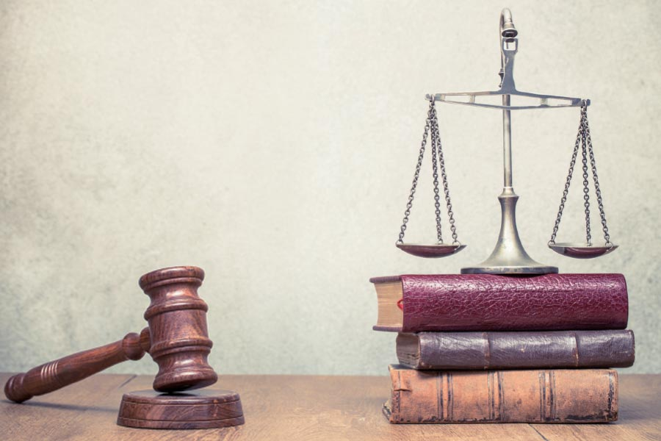
دع الله
يقضي
حزقيال ٢٥-٣٢
د. ريك جريفيث• مؤسسة الدراسات اللاهوتية الأردنية• BibleStudyDownloads.org
Notes:
لذلك، في سبعة إصحاحات، يوجه حزقيال اهتمامه نحو البلدان المحيطة بإسرائيل ليعلن أن الله لن ينخدع منهم أيضًا – لذلك يجب على إسرائيل أن تسمح له بالتعامل مع جميع المنافسين لحكمه السيادي (تكرر شريحة العنوان).

Slide 2
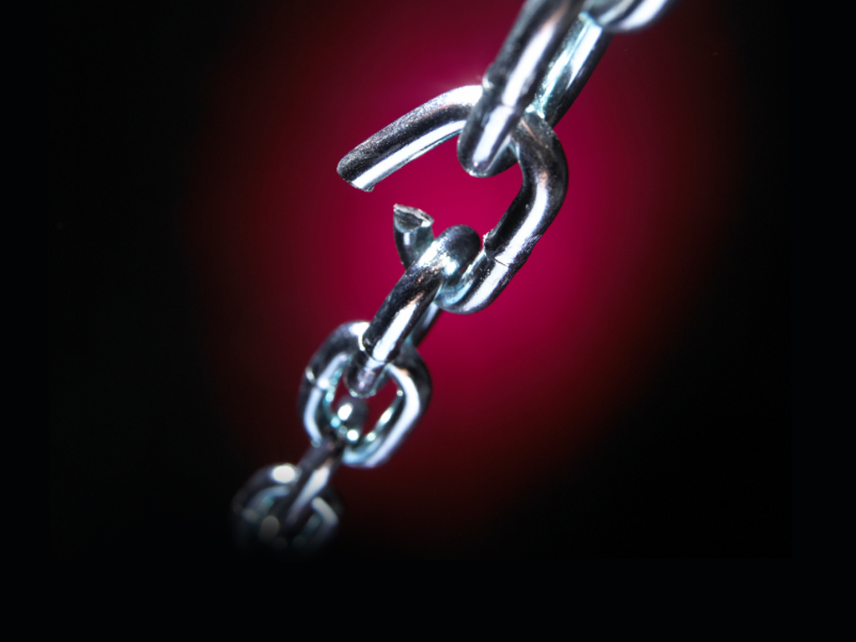
الشعور بالضعف
Notes:
Interest: We often feel like we are the weak ones.

Slide 3


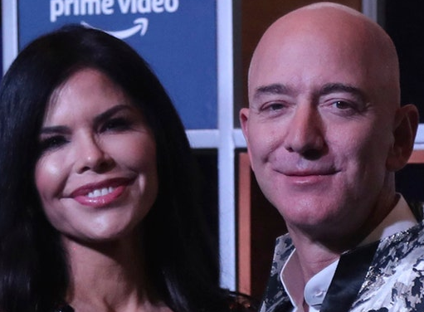
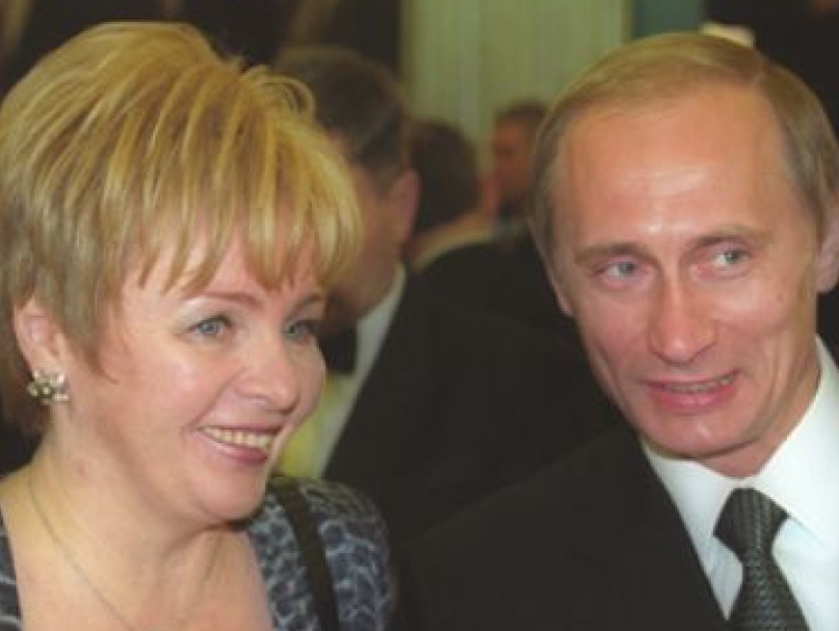
أصحاب المليارات
إيلون ماسك
بيل غيتس
جيف بيزوس
فلاديمير بوتين
Notes:
We have billionaires with amazing wealth while we struggle financially.
______________
Elon Musk’s Ex-Wife Denies Being Hand-Chosen By Ghislaine Maxwell To Be His ‘Child Bride’
6 July 2020
https://brobible.com/culture/article/elon-musk-wife-denies-ghislaine-maxwell/
Tesla and SpaceX founder Elon Musk has had himself quite a past couple of months.
He had a kid with his partner Grimes and named him something so bizarre that even she can’t explain properly.
Then he denied having a threesome with actresses Amber Heard and Cara Delevingne while Heard was married to Johnny Depp.
And now, his ex-wife, actress and model Talulah Riley, has felt the need to go on record stating that despite rumors, Jeffrey Epstein companion Ghislaine Maxwell did not hand-choose her to be Musk’s child bride back in 2008 when she was 23 and Musk was 36.
Here’s how their love story goes.
Riley and Musk began dating in 2008. Then in 2010 the couple got married. In January 2012, Musk announced the marriage was over and they got divorced. In July 2013, Musk and Riley got married for a second time. In December 2014, Musk once again filed for divorce. Then he withdrew his filing. Then she filed for divorce in March 2016. The couple’s second divorce became official in October of 2016.
The actress, now 34, and who many will recognized from her role playing Angela on Westworld, apparently heard some rumors following Maxwell’s arrest that Epstein’s cohort procured her to be Musk’s child bride back in the day.
————————
Bill Gates, wife Melinda announce divorce after 27 years of their marriage
https://www.indiatvnews.com/lifestyle/people-bill-gates-wife-melinda-gates-announce-divorce-after-27-years-of-their-marriage-net-worth-children-memes-702346
Bill Gates and his wife Melinda Gates revealed their decision of taking divorce in a joint statement which was shared by the Microsoft co-founder on Twitter. “After a great deal of thought and a lot of work on our relationship, we have made the decision to end our marriage. Over the last 27 years, we have raised three incredible children and built a foundation that works all over the world to enable people to lead healthy, productive lives,” read the statement.
Edited by: India TV Lifestyle Desk
New Delhi Updated on: May 04, 2021 12:50 IST
___________
Jeff Bezos' ex-wife MacKenzie's post-divorce revenge
Not since Jennifer Aniston has a wronged woman done so much right
By Maureen Callahan New York Post
https://www.foxbusiness.com/business-leaders/jeff-bezos-ex-wife-mackenzies-post-divorce-reven
Published August 3, 2020
MacKenzie Scott, the fourth-richest woman in the world, announced on Tuesday that she has dropped Bezos from her name and donated $1.7 billion to 119 nonprofits, with an emphasis on racial equality, marginalized groups and economic mobility.
JEFF BEZOS NABS BEVERLY HILLS ESTATE NEXT TO HIS RECORD-SETTING $165M COMPOUND
Meanwhile, her ex-husband, Amazon founder Jeff Bezos — who publicly left MacKenzie for her close friend Lauren Sanchez — spent the week dropping $10 million on an LA home, just near the $165 million mansion he bought from David Geffen.
On Friday, Amazon posted a second-quarter profit of $5.2 billion, the biggest in its 26-year-history, due to a pandemic that is otherwise ravaging the economy.
Days earlier, Bezos testified before Congress in an antitrust hearing, seeking to downplay Amazon’s global dominance while casually snacking on camera.
Video
“Just like the world needs small companies, it also needs big ones,” Bezos said.
Such a smug, reductive assertion, but one typical of a Big Tech overlord who knows his money will buy all the lawmakers it needs to keep Amazon intact.
WHAT’S HOUSE HUNTING LIKE FOR THE WORLD’S RICHEST MAN
This is the arrogance Bezos deems publicly acceptable. Can you imagine what he’s like in private? As a husband?
Amazon CEO Jeff Bezos, right along with American news anchor Lauren Sanchez poses for photographs during a blue carpet event organized by Amazon Prime Video in Mumbai, India, Thursday, Jan. 16, 2020. (AP Photo/Rafiq Maqbool)
“I love you, alive girl,” a still-married Bezos texted Sanchez in 2018. “I will show you with my body, and my lips and my eyes, very soon.”
“I want to get a little drunk with you tonight,” went another text to Sanchez amid raunchy selfies. “Not falling down. Just a little drunk. I want to talk to you and plan with you. Listen and laugh. I basically WANT TO BE WITH YOU!!!”
“You make me better,” read another. “You’re meant for me. I know it more clearly than I’ve ever known anything.”
LONDON, ENGLAND: Jeff Bezos and his partner, Lauren Sanchez, look on from the Royal Box on Centre Court on Day 13 of The Championships - Wimbledon 2019 at the All England Lawn Tennis and Croquet Club on July 14, 2019 in London, England. (Photo by Sim
Those texts wound up splashed all over the National Enquirer, and federal investigators told The Wall Street Journal that the sexts were leaked by none other than Sanchez’s brother, who got a $200,000 payday from the tabloid. (Her brother denies the claims.)
WEST HOLLYWOOD, CA: (L-R) CEO of Amazon Jeff Bezos and writer MacKenzie Bezos attend the Amazon Studios Oscar Celebration at Delilah on February 26, 2017 in West Hollywood, California. (Photo by Jerod Harris/Getty Images)
For MacKenzie, these indiscretions must have dealt the same blow that the infamous W cover (and accompanying 60-page spread) of Brad Pitt and Angelina Jolie playing happy families did to Aniston.
JEFF BEZOS SETS NEW LA REAL ESTATE RECORD WITH $165M BEVERLY HILLS BUY
Especially as Bezos’ sexts were written months before MacKenzie and Bezos celebrated their 25th wedding anniversary in Miami.
Imagine MacKenzie’s humiliation. Imagine what she must have done to hide the worst from their four children while Bezos and Sanchez kept flying all over the country, checking out multimillion-dollar homes and parading their status as Big Tech’s Most Scandalous Couple.
LOS ANGELES, CA: WME's Patrick Whitesell, Lauren Sanchez and Amazon CEO Jeff Bezos attend Jeff Bezos and Matt Damon's "Manchester By The Sea" Holiday Party on December 3, 2016 in Los Angeles, California. (Photo by Todd Williamson/Getty Images for Ama
When MacKenzie married Bezos in 1993, he was just another computer nerd.
“I do remember the first time I heard him laugh,” she told the Seattle Post-Intelligencer in 2005. “I met him at the hedge fund where we worked in New York … I would hear him laughing all day. I fell in love with his laugh.”
At the time, MacKenzie was publicizing her debut novel, which took her eight years to write while she raised small children. Little is known of her story, but clearly she put her ambitions on hold so Bezos could pursue world domination.
After Jeff got himself a midlife mogul makeover in 2017 and began seeing Sanchez, a former host on “So You Think You Can Dance,” MacKenzie said nothing.
FILE - In this March 4, 2018 file photo, Jeff Bezos and wife MacKenzie Bezos arrive at the Vanity Fair Oscar Party in Beverly Hills, Calif. (Photo by Evan Agostini/Invision/AP, File)
She maintained her dignity, got a great divorce lawyer and walked away with more money than she’ll ever need (current worth: $62.3 billion).
GET FOX BUSINESS ON THE GO BY CLICKING HERE
Their divorce was settled out of court, which kept the custody arrangement for their three minor kids secret. She signed the Giving Pledge and said on Tuesday, in part:
“Like many, I watched the first half of 2020 with a mixture of heartbreak and horror.”
Subtext: My ex-husband soullessly profits from this pandemic while firing workers who are refused bathroom breaks and basic human dignity.
She also wrote: “There’s no question in my mind that anyone’s personal wealth is the product of a collective effort” — ahem — “and of social structures which present opportunities to some people, and obstacles to countless others.”
Bezos is notoriously stingy when it comes to charitable giving, preferring to compete with Elon Musk over colonizing space.
As Aniston infamously said of ex-husband Brad Pitt in 2005, “There‘s a sensitivity chip that’s missing.”
It’s hard to think of a more apt description of Bezos — or a better post-divorce life awaiting MacKenzie than the one she has designed for herself.
____________
Where is Putin’s family right now? Confirmed one thing before approving Ukraine invasion; What happened to Russians who went to find his girlfriend?
Thursday 03 March, 2022 | 3:17 PMfamily-oneMOSCOW: Russian President Vladimir Putin is the prince of tactics
Read full news at https://keralakaumudi.com/en/news/news.php?id=763488&u=where-is-putin%E2%80%99s-family-right-now-confirmed-one-thing-before-approving-ukraine-invasion-what-happened-to-russians-who-went-to-find-his-girlfriend
The first thing Putin did after sending troops to Ukraine was to make his family safe. He had shifted his family to a secret underground bunker in Siberia, prior to the Ukraine invasion… Putin's wife was Lyudmila Skrebneva, a former air hostess. They were married in 1983 and got divorced in 2013.

Slide 4

كيف حال المسيحيين هنا؟
الإقتصاد
الفنون
الحكومة
الإعلام
التعليم
الدين
Notes:
In which area are we experiencing victory? It seems that Satan controls just about every domain—education, government, economy, arts, media, and even religion.
We aren’t doing a great job in any of these.
But how is God doing in running the world?

Slide 5

كيف يقوم الله بتسيير أمور العالم؟

Slide 6
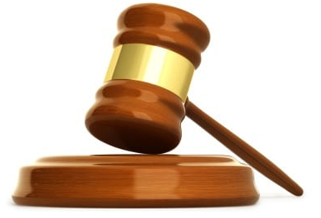
4 أسباب تجعل الله قاضي سيء
ـــ جيريمي مايرز
الله قاضي رهيب بصراحة، لو خدم في محكمة في بلدنا سوف يتم وضعه في السجن. أنا لا أحاول أن أوذي الله بل أن أضع الأمور في نصابها الصحيح، أنظروا إلى الحقائق
Notes:
https://redeeminggod.com/god-is-a-bad-judge/#comments
Accessed 9 June 2022
God is a terrible judge. Seriously. If He served in any court in our country, He would probably wind up in prison.
I am not trying to malign God; I am just stating the way things are.
Look at the facts:
1. God is the judge of the world, but the world is in quite a mess.
NT Wright put it this way: “What on earth might it mean today to speak of Jesus being ‘king’ or ‘in charge,’ in view of the fact that so many things in the world give no hint of such a thing?” (Simply Jesus, 55).
Have you looked around the world recently? Does it look like God is in charge? Nope. In fact, for this very reason, many theologians think that God is “in charge” in name only, and that Satan is still the the one pulling the strings. God will not be fully in charge, they say, until the new heavens and the new earth.
Yes, well, though there is some truth in that perspective, the fact of the matter is that most of the New Testament seems to lead us to believe that God truly is in charge, not just in name, but in practice as well. Of course, what does it mean to be “in charge”? Nobody disputes that God is “in control.” What is disputed is, “How?”
Is it absolute control (entailing the loss of freedom), mind control (hardly), crowd control (I like that image), ultimate control (certainly)? Most seem to use the word in the sense of absolute control, and that is deeply unfortunate language (Creation Untamed, 62).
2. It takes God way too long to pass judgment.
When God pronounces judgment on someone (or a group of someones), we expect fireballs and lightning bolts to fall out of heaven right then and there. But they never do. God waits. And waits. And waits.
And while He waits, the evil persists and grows. People suffer and die. And we begin to think that maybe God didn’t mean what He said.
God pronounced judgment on the people living during the days of Noah (Gen 6:5, 11-13). But he let this evil continue for another 120 years (Gen 5:32; 6:3; 7:6). One wonders how many women got raped during that 120 years? How many people murdered? How many slaves tortured? How many children molested? If “the wickedness of man was great in the earth, and every intent of the thoughts of his heart was only evil continually” (Gen 6:5), imagine the evil that continued to take place during those 120 years?!
Actually, don’t imagine it. It is too depressing and shocking.
This is why biblical writer after writer call on God to act, to judge, to pay attention, to look at the suffering. God says one thing, and we wait for justice to appear, but it never does. God seems to sit idly by while evil goes unchecked and his judgments go unenforced. Which raises the second point.
3. When God does make a judgment, He is way too lenient.
Even when God does pass judgment, it often seems that His decisions are way too lenient.
Sometimes God seems like a parent who just doesn’t want to admit that his child is doing anything wrong. While all the world is saying, “Kill them! Lock them up! Send them away forever!” God gives “slaps on the wrist” over and over, sometimes to the point of embarrassment. He literally lets people get away with murder, and frequently, much worse than murder.
Terence Fretheim writes about the leniency of God this way:
God is more like a parent, openly anguished over what to do about a wayward child. (e.g., Hosea 6:4, “What shall I do with you?” and 11:1-9). What would courtrooms be like if judges were to display such personal anguish and anger? To mix metaphors: if God is viewed as the divine judge behind the bench, remember that God is also the spouse of the accused one in the dock! Objectivity or neutrality goes out the door!
Sure, theologians tell us that a day is coming when all will be set straight and all wrongs will be corrected. But what comfort is for the woman who was raped now, and lives her whole life in shame and fear without ever seeing justice? What comfort is some sort of future retribution for the child who has been abused since birth?
It is none. At least, none I can discern.
There is certainly something about all this that I do not understand with God, but I have trouble figuring out how it will make a little girl feel better when she was raped and beaten continually from the time she was two years old until she died at age 16 to get to heaven and look down upon the earth and see her abuser living a rich life and for God to say to her, “Don’t worry. I’ll discipline him some day. But for now, let him enjoy his steak dinners, his vacations, his fancy houses, and all the other girls he is going to rape.”
WHAT?!!!!
4. God allows His judgments to be influenced by people.
God sets out to obliterate everybody in Sodom and Gomorrah, but Abraham gets him to agree to not destroy these cities if 10 righteous people can be found in them.
God decided to destroy Israel for their insolence, but Moses persuades Him to hold off.
God tells Jonah to preach judgment upon Nineveh, but because they show some signs of repentance, He holds off for a couple hundred years while they continue to run roughshod over the entire Ancient World (some repentance that was!).
So it seems that God makes a judgment and then backs off of His decisions when people complain, or when they show the least little sign of remorse for what they have done. What kind of judgments are these if God can be so easily and quickly turned away from what He had decided to do?
One wonders if God would have held back the flood during the days of Noah if the people would have shown some signs of remorse.
What is the solution to all this?
There are only a few things that can be said in the face of all this (seemingly) divine injustice. At least, here is how I try to make sense of it in my own mind.
God alone knows everything about everyone.
Based on what God knows about people, He forgives and loves them still, and is patient with them.
I do not know everything about everyone.
If I did, maybe I would see (as God does) why some people deserve extra grace, patience, and longsuffering.
This is partly why it is so dangerous for us, as mere humans, to pass judgement and condemnation on others. We do not see what God sees. We do not know what God knows. If the only Being in the universe Who knows everything about everybody refused to pounce on people every time they go against His will (and thank God He doesn’t do this with us, either!), who are we to think we can rightly judge and condemn another person based on our extremely limited knowledge of what has happened in their lives?
Yes, yes, the law courts and our government must pass judgment. I am not talking about that at all. I am talking about us as individuals trying to sit in judgment on other people about the decisions they have made in their own lives. Look, when we fail in life, we want other people to give us the benefit of the doubt. We see some of the things that have happened to us in life and how these things led us to make bad decisions, which led to even more bad decisions, and sometimes even good decisions which went wrong, so that we ended up doing something terrible. We see some of this in our own lives, and want grace, mercy, and understanding from others. And God, who sees all, gives it. So let us, as God’s people, try to show the same grace, mercy, and patience toward others as we hope they would show toward us.
This isn’t a solution to the problem of evil, but simply a willingness to reserve judgment and trust in the goodness and graciousness of God.
So it seems that the problem is not so much with God, but with our own limited understanding and knowledge. We do not see or know all that God sees and knows.
In the end, it is not exactly that God is a bad judge, as much as He is a merciful and compassionate judge, slow to anger and abounding in love.

Slide 7
4 أسباب تجعل الله قاضي سيء
ـــ جيريمي مايرز
1. الله هو قاضي العالم لكن العالم عبارة عن فوضى
2. يستغرق الله وقتاً طويلاً جداً لتتميم الدينونة
3. عندما يصنع الله الدينونة يبدو وكأنه متساهل جداً
4. يسمح الله بأن تكون دينوناته متأثرة بالناس
Notes:
https://redeeminggod.com/god-is-a-bad-judge/#comments
Accessed 9 June 2022
God is a terrible judge. Seriously. If He served in any court in our country, He would probably wind up in prison.
I am not trying to malign God; I am just stating the way things are.
Look at the facts:
1. God is the judge of the world, but the world is in quite a mess.
NT Wright put it this way: “What on earth might it mean today to speak of Jesus being ‘king’ or ‘in charge,’ in view of the fact that so many things in the world give no hint of such a thing?” (Simply Jesus, 55).
Have you looked around the world recently? Does it look like God is in charge? Nope. In fact, for this very reason, many theologians think that God is “in charge” in name only, and that Satan is still the the one pulling the strings. God will not be fully in charge, they say, until the new heavens and the new earth.
Yes, well, though there is some truth in that perspective, the fact of the matter is that most of the New Testament seems to lead us to believe that God truly is in charge, not just in name, but in practice as well. Of course, what does it mean to be “in charge”? Nobody disputes that God is “in control.” What is disputed is, “How?”
Is it absolute control (entailing the loss of freedom), mind control (hardly), crowd control (I like that image), ultimate control (certainly)? Most seem to use the word in the sense of absolute control, and that is deeply unfortunate language (Creation Untamed, 62).
2. It takes God way too long to pass judgment.
When God pronounces judgment on someone (or a group of someones), we expect fireballs and lightning bolts to fall out of heaven right then and there. But they never do. God waits. And waits. And waits.
And while He waits, the evil persists and grows. People suffer and die. And we begin to think that maybe God didn’t mean what He said.
God pronounced judgment on the people living during the days of Noah (Gen 6:5, 11-13). But he let this evil continue for another 120 years (Gen 5:32; 6:3; 7:6). One wonders how many women got raped during that 120 years? How many people murdered? How many slaves tortured? How many children molested? If “the wickedness of man was great in the earth, and every intent of the thoughts of his heart was only evil continually” (Gen 6:5), imagine the evil that continued to take place during those 120 years?!
Actually, don’t imagine it. It is too depressing and shocking.
This is why biblical writer after writer call on God to act, to judge, to pay attention, to look at the suffering. God says one thing, and we wait for justice to appear, but it never does. God seems to sit idly by while evil goes unchecked and his judgments go unenforced. Which raises the second point.
3. When God does make a judgment, He is way too lenient.
Even when God does pass judgment, it often seems that His decisions are way too lenient.
Sometimes God seems like a parent who just doesn’t want to admit that his child is doing anything wrong. While all the world is saying, “Kill them! Lock them up! Send them away forever!” God gives “slaps on the wrist” over and over, sometimes to the point of embarrassment. He literally lets people get away with murder, and frequently, much worse than murder.
Terence Fretheim writes about the leniency of God this way:
God is more like a parent, openly anguished over what to do about a wayward child. (e.g., Hosea 6:4, “What shall I do with you?” and 11:1-9). What would courtrooms be like if judges were to display such personal anguish and anger? To mix metaphors: if God is viewed as the divine judge behind the bench, remember that God is also the spouse of the accused one in the dock! Objectivity or neutrality goes out the door!
Sure, theologians tell us that a day is coming when all will be set straight and all wrongs will be corrected. But what comfort is for the woman who was raped now, and lives her whole life in shame and fear without ever seeing justice? What comfort is some sort of future retribution for the child who has been abused since birth?
It is none. At least, none I can discern.
There is certainly something about all this that I do not understand with God, but I have trouble figuring out how it will make a little girl feel better when she was raped and beaten continually from the time she was two years old until she died at age 16 to get to heaven and look down upon the earth and see her abuser living a rich life and for God to say to her, “Don’t worry. I’ll discipline him some day. But for now, let him enjoy his steak dinners, his vacations, his fancy houses, and all the other girls he is going to rape.”
WHAT?!!!!
4. God allows His judgments to be influenced by people.
God sets out to obliterate everybody in Sodom and Gomorrah, but Abraham gets him to agree to not destroy these cities if 10 righteous people can be found in them.
God decided to destroy Israel for their insolence, but Moses persuades Him to hold off.
God tells Jonah to preach judgment upon Nineveh, but because they show some signs of repentance, He holds off for a couple hundred years while they continue to run roughshod over the entire Ancient World (some repentance that was!).
So it seems that God makes a judgment and then backs off of His decisions when people complain, or when they show the least little sign of remorse for what they have done. What kind of judgments are these if God can be so easily and quickly turned away from what He had decided to do?
One wonders if God would have held back the flood during the days of Noah if the people would have shown some signs of remorse.
What is the solution to all this?
There are only a few things that can be said in the face of all this (seemingly) divine injustice. At least, here is how I try to make sense of it in my own mind.
God alone knows everything about everyone.
Based on what God knows about people, He forgives and loves them still, and is patient with them.
I do not know everything about everyone.
If I did, maybe I would see (as God does) why some people deserve extra grace, patience, and longsuffering.
This is partly why it is so dangerous for us, as mere humans, to pass judgement and condemnation on others. We do not see what God sees. We do not know what God knows. If the only Being in the universe Who knows everything about everybody refused to pounce on people every time they go against His will (and thank God He doesn’t do this with us, either!), who are we to think we can rightly judge and condemn another person based on our extremely limited knowledge of what has happened in their lives?
Yes, yes, the law courts and our government must pass judgment. I am not talking about that at all. I am talking about us as individuals trying to sit in judgment on other people about the decisions they have made in their own lives. Look, when we fail in life, we want other people to give us the benefit of the doubt. We see some of the things that have happened to us in life and how these things led us to make bad decisions, which led to even more bad decisions, and sometimes even good decisions which went wrong, so that we ended up doing something terrible. We see some of this in our own lives, and want grace, mercy, and understanding from others. And God, who sees all, gives it. So let us, as God’s people, try to show the same grace, mercy, and patience toward others as we hope they would show toward us.
This isn’t a solution to the problem of evil, but simply a willingness to reserve judgment and trust in the goodness and graciousness of God.
So it seems that the problem is not so much with God, but with our own limited understanding and knowledge. We do not see or know all that God sees and knows.
In the end, it is not exactly that God is a bad judge, as much as He is a merciful and compassionate judge, slow to anger and abounding in love.

Slide 8
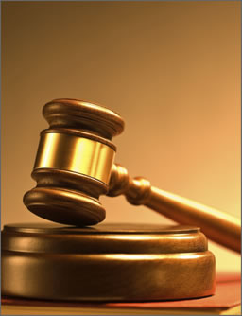
كيف يجب أن نتصرف عندما نشعر أننا في الجانب الخاسر؟
Notes:
What can we do during those times when we feel so weak and insignificant?

Slide 9
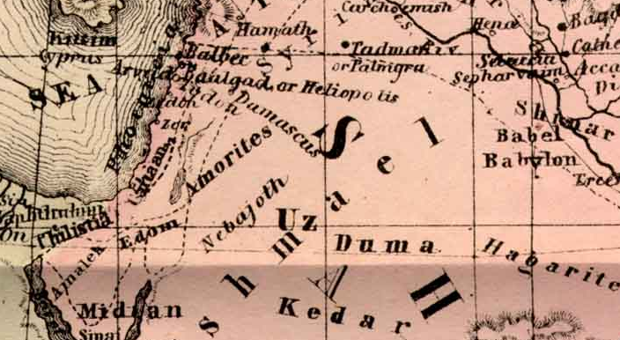
Sin
الدينونة
الوثنية
الغضب
دانيال
حزقيال
العقوبة
الخطية
العصيان
Notes:
Ezekiel was an exile with the exiles, yet he witnessed God’s glory departing the temple in Jerusalem and then returning in the future.

Slide 10
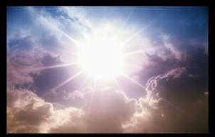
شارك
مجدهُ
حزقيال 1- 3
د. ريك جريفيث• مؤسسة الدراسات اللاهوتية الأردنية• BibleStudyDownloads.org

Slide 11

اعترف أن
مجده
قد غادر
حزقيال 4- 24
د. ريك جريفيث• مؤسسة الدراسات اللاهوتية الأردنية• BibleStudyDownloads.org

Slide 12
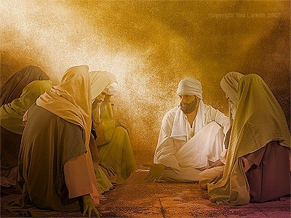
حزقيال ٢٤ : ٢
يَا ابْنَ آدَمَ, اكْتُبْ لِنَفْسِكَ اسْمَ الْيَوْمِ, هَذَا الْيَوْمَ بِعَيْنِهِ. فَإِنَّ مَلِكَ بَابِلَ قَدِ اقْتَرَبَ إِلَى أُورُشَلِيمَ هَذَا الْيَوْمَ بِعَيْنِهِ.
Notes:
Now the city of Jerusalem was already under attack and would fall (24:2).

Slide 13
مخطط حزقيال التقني
500
سيادة للمسبيين وعودة للمجد
المجد يعود ٣٣-٤٨ |  | الأمم تدان (وليس هناك مجد) ٢٥-٣٢ |  |  | المجد يغادر ١-٢٤
الإسترداد |  | سيادة مبررة |  |  | السبي
بركة إسرائيل |  | دينونة الأمم |  |  | الحكم على يهوذا
مستقبل يهوذا |  | أعداء يهوذا |  |  | سقوط يهوذا
بعد الحصار |  | أثناء الحصار |  |  | قبل الحصار
أمراً جديداً ٤٠-٤٨ | حياة جديدة ٣٣-٣٩ | مصر ٢٩-٣٢ | صور وصيدا ٢٦-٢٨ | عمون مؤاب، إدوم، فلسطين ٢٥ | قبل السبي حالة يأس ٤-٢٤ | الدعوة في المجد ١-٣
نهر الخابور في مملكة بابل (٥٩٢-٥٧٠ ق م)

Slide 14
دع الله
يقضي
حزقيال 25- 32
د. ريك جريفيث• مؤسسة الدراسات اللاهوتية الأردنية• BibleStudyDownloads.org
Notes:
لذلك، في سبعة إصحاحات، يوجه حزقيال اهتمامه نحو البلدان المحيطة بإسرائيل ليعلن أن الله لن ينخدع منهم أيضًا – لذلك يجب على إسرائيل أن تسمح له بالتعامل مع جميع المنافسين لحكمه السيادي (تكرر شريحة العنوان).

Slide 15
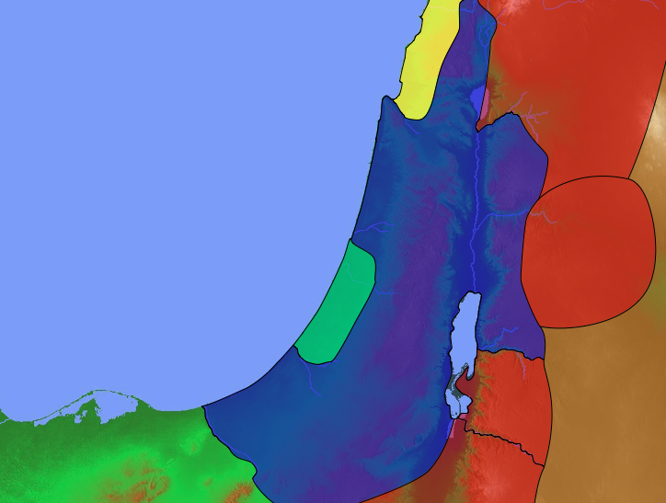
زوجات سليمان الوثنيات
صيدون
140
1 ملوك 11: 1 وأحب الملك سليمان نساء غريبة كثيرة مع بنت فرعون مؤابيات وعمونيات وأدوميات وصيدونيات وحثيات
الحثيين
إسرائيل
عمون
مؤاب
مصر
أدوم
Notes:
The historical context is not one of ignorance but knowledge.
God had already judged Solomon for marrying into these countries and worshipping the gods of these nations.

Slide 16
زوجات سليمان الوثنيات
صيدون
140
الحثيين
إسرائيل
عمون
مؤاب
مصر
أدوم
Notes:
The historical context is not one of ignorance but knowledge.
God had already judged Solomon for marrying into these countries and worshipping the gods of these nations.

Slide 17
الآلهة الباطلة المحيطة بإسرائيل
عشتاورث
140
صيدون
بعل
سليمان تركني وسجد لعشتورث إلهة الصيبدونيين ولكموش إله المؤابيين ولملكوم إله بني عمون
(1 ملوك 11: 33أ)
ملكوم
إسرائيل
عمون
داجون
فلسطين
كموش
مؤاب
رع، حورس، آمون ... الخ
كوس ... الخ
مصر
أدوم
Notes:
Solomon's problem with marrying pagan women was that they brought their gods to Jerusalem so that Solomon ended up worshipping these false gods.

Slide 18
كيف يجب أن نتصرف عندما نشعر أننا في الجانب الخاسر؟
Notes:
How should we handle our “no glory” times?
What can we do during those times when we feel so weak and insignificant?
Preview: Today we will see how God would deal with all Israel’s rivals on every side—and then we will see how he will do the same in our lives also.

Slide 19
حزقيال 25-32
يجب على إسرائيل
أن ترى مجد الله
في أسبابه
لتدمير أعدائه
Notes:
(What hope was there for exiled Israel? What should Israel do?)
I. See God’s glory in his reasons for destroying their enemies (Ezek 25–32).
[Israel would see why God would show his sovereignty over each rebel nation.]

Slide 20
Slides on
حزقيال 25

Slide 21
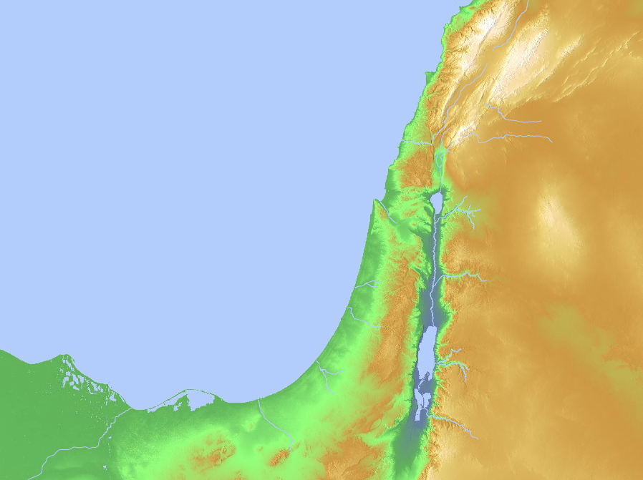
الأمم التي
ستدان
(حز 25-32)
صيدون
(26-20:28)
صيدا
(19:28–1:26)
عمون
(7-1:25)
فلسطين
(17-15:25)
مؤاب
(11-8:25)
مصر
(32–29)
أدوم
(14-12:25)
Notes:
God will judge Ammon for rejoicing at the temple’s destruction to show his sovereignty (25:1-7).
God will judge Moab for thinking that Israel was like all of the other nations to show God's sovereignty (25:8-11).
God will judge Edom for avenging Judah to show God's sovereignty (25:12-14).
God will judge Philistia for avenging Judah to show God's sovereignty (25:15-17).
God will judge Tyre so it will never be rebuilt due to its pride in its beauty, power, trade, and leaders to show God's sovereignty (26:1–28:19).
God will judge Sidon for maliciousness against Judah to show his sovereignty by gaining glory in the judgment (28:20-26).
God will judge Egypt by Nebuchadnezzar who will take exiles to Babylon to show God's sovereignty (Ezek 29–32; fulfilled in 571 BC).
__________
Common-336
OS-25-Lamentations-118
OS-26-Ezek25-32-slide 21
OS-26-Ezek33-39-slide 13

Slide 22
الأمم
التي
ستدان
(حز 25-32)
عمون
(25: 1-7)
Notes:
Ammon rejoiced at the temple’s destruction (25:1-7).

Slide 23
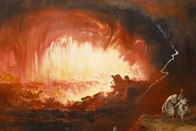
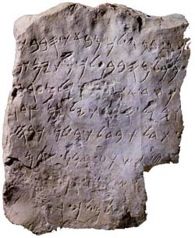
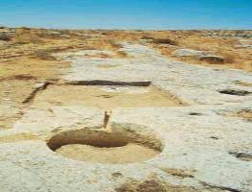
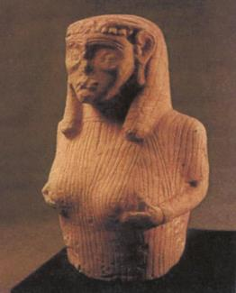
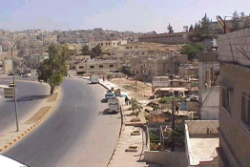

العمونيون
د. ريك جريفيث • مؤسسة الدراسات اللاهوتية الأردنية • BibleStudyDownloads.org

Slide 24
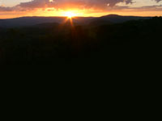
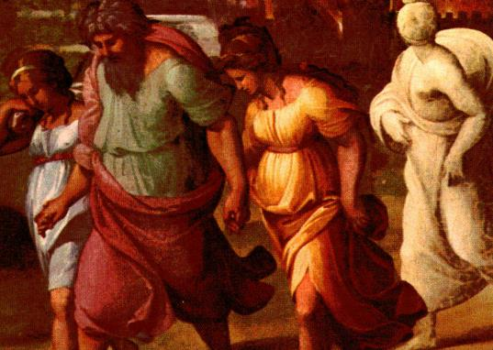
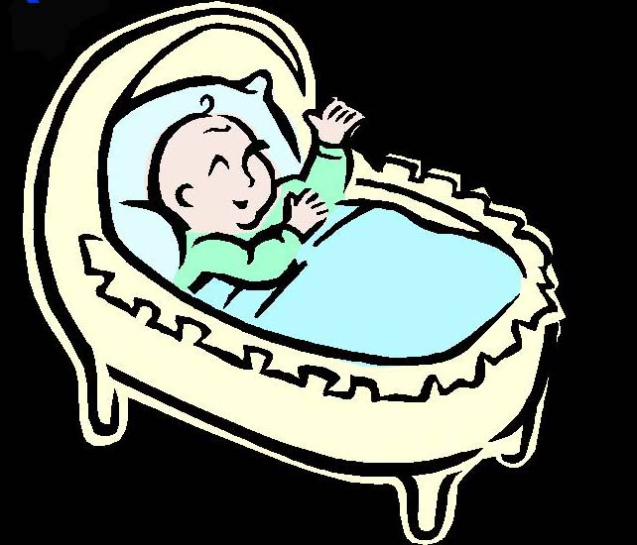
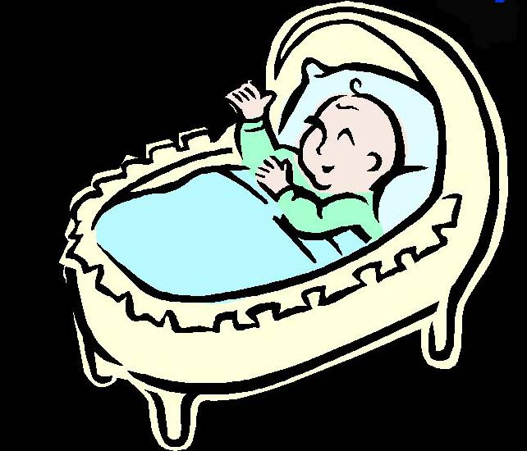
Genesis 19:36-38
95
اسمي مؤاب
اسمي بن عمي
تكوين 19: 36-38
36 فحبلت ابنتا لوط من أبيهما
37 فولدت البكر ابناً ودعت اسمه مؤاب وهو أبو المؤابين إلى اليوم
38 والصغيرة أيضاً ولدت ابناً ودعت اسمه بن عمي وهو أبو بني عمون إلى اليوم
Notes:
Ammon started

Slide 25
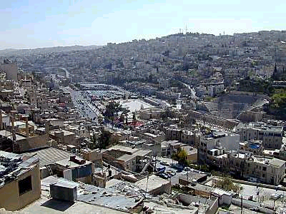
عمّان
مبنية على سبع تلال
تعتبر واحدة من أقدم المدن المأهولة بالسكان في العالم بشكل مستمر
صارت ربة عمون هي عاصمة العمونيين منذ 1200 ق.م
أعيد تسميتها باسم فيلادلفيا في 400 ق.م
تم السيطرة على فيلادلفيا من قبل الحاكم الروماني الملك هيرودس في 30 ق.م
سيطرت الجيوس العربية الإسلامية عليها حوالي 635 م

Slide 26
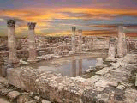
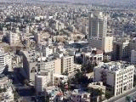
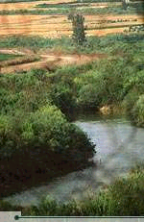
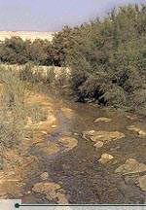
السلط
اعتبرت السلط (قرب عمان) المثوى الأخير لأيوب، كما أن يثرون حمو موسى دفن في قبر قرب السلط في وادي شعيب
Jordan River

Slide 27
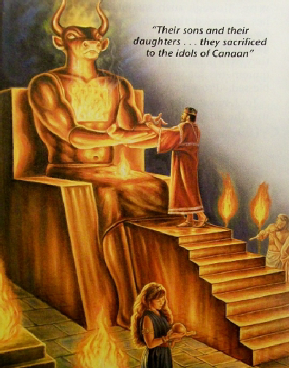
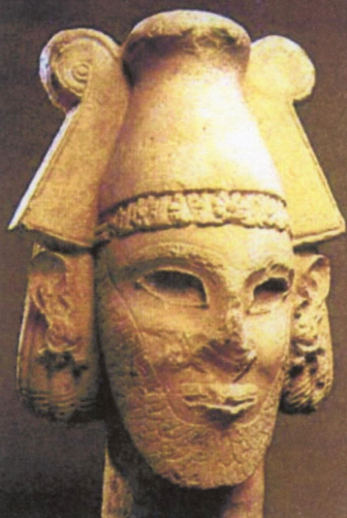

ذبيحة الأطفال لمولك
95
Notes:
The saddest reality about Amman is that live babies used to be offered on the altars to Molech downtown.

Slide 28
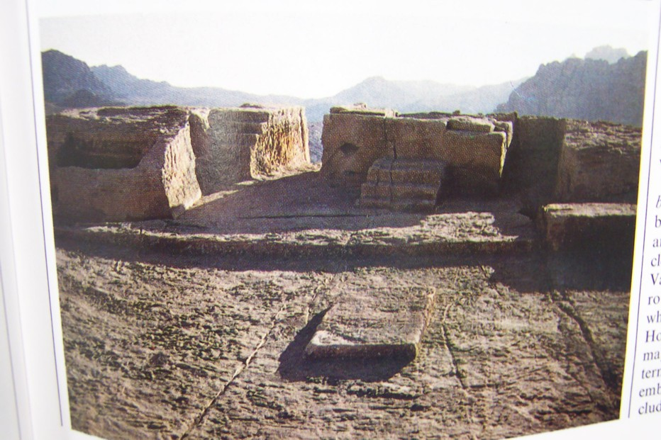
الوثنية المستوردة
96
أقام سليمان المرتفعات خارج أورشليم لعبادة مولك إله العمونيين

Slide 29
الأمم
التي
ستدان
(حز 25-32)
٦ لأَنَّهُ هَكَذَا قَالَ السَّيِّدُ الرَّبُّ: مِنْ أَجْلِ أَنَّكَ صَفَّقْتَ بِيَدَيْكَ وَخَبَطْتَ بِرِجْلَيْكَ وَفَرِحْتَ بِكُلِّ إِهَانَتِكَ لِلْمَوْتِ عَلَى أَرْضِ إِسْرَائِيلَ. ٧ فَلِذَلِكَ هَئَنَذَا أَمُدُّ يَدِي عَلَيْكَ وَأُسَلِّمُكَ غَنِيمَةً لِلأُمَمِ وَأَسْتَأْصِلُكَ مِنَ الشُّعُوبِ وَأُبِيدُكَ مِنَ الأَرَاضِي. أَخْرِبُكَ فَتَعْلَمُ أَنِّي أَنَا الرَّبُّ].
عمون
(25: 1-7)
Notes:
God will judge Ammon for rejoicing at the temple’s destruction to show his sovereignty (25:1-7).
God will judge Moab for thinking that Israel was like all of the other nations to show God's sovereignty (25:8-11).
God will judge Edom for avenging Judah to show God's sovereignty (25:12-14).
God will judge Philistia for avenging Judah to show God's sovereignty (25:15-17).
God will judge Tyre so it will never be rebuilt due to its pride in its beauty, power, trade, and leaders to show God's sovereignty (26:1–28:19).
God will judge Sidon for maliciousness against Judah to show his sovereignty by gaining glory in the judgment (28:20-26).
God will judge Egypt by Nebuchadnezzar who will take exiles to Babylon to show God's sovereignty (Ezek 29–32; fulfilled in 571 BC).

Slide 30
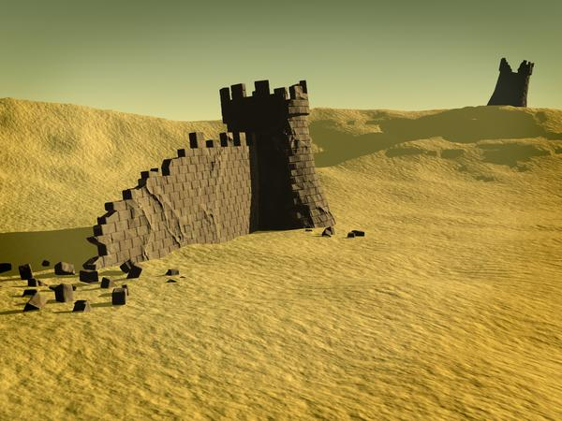
سقوط عمون
قام نبوخدنصر بحملة صغيرة ضد العمونيين
في عامه الثالث والعشرين (582-581)
96
سرعان ما توقف العمونيون عن أن يكونوا أمة، لكن الشعب الستمر بشكل جيد خلال العصور الهلينستية
Notes:
God had the last word about Ammon, as the Babylonians destroyed the place about a decade after this prophecy in Ezekiel 25:1-7.

Slide 31
الأمم
التي
ستدان
(حز 25-32(
مؤاب
(11: 8-25)
Notes:
Moab still has the same name today—like Amman.

Slide 32

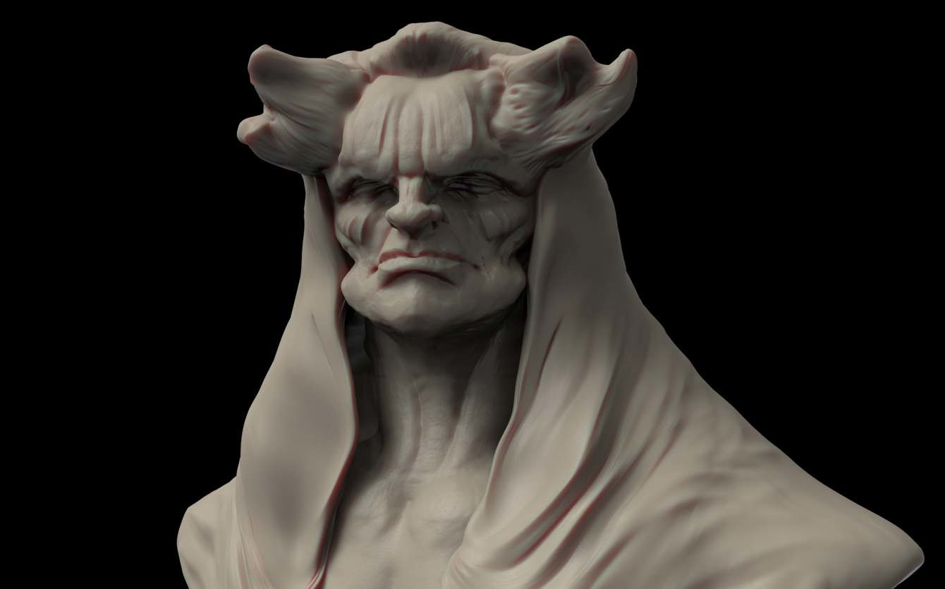
الآلهة الموآبية
98
كموش
الإله الرئيسي،
الإله الوطني،
الإله المحارب
الإله الذي تكفل بجميع جوانب الحياة
1 مل 11: 7، عد 21: 27-30
عشتاروت
الآلهة الأم
ذكر عشتار كموش
في نقش ميشا

Slide 33
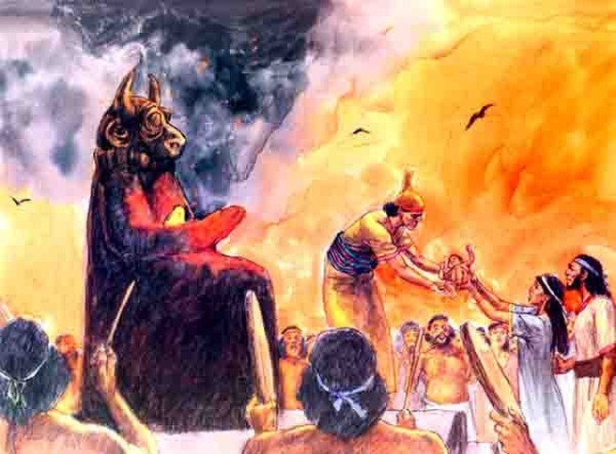
التضحية بالطفل لكموش
98

Slide 34
٨ هَكَذَا قَالَ السَّيِّدُ الرَّبُّ: [مِنْ أَجْلِ أَنَّ مُوآبَ وَسَعِيرَ يَقُولُونَ: هُوَذَا بَيْتُ يَهُوذَا مِثْلُ كُلِّ الأُمَمِ. ٩ لِذَلِكَ هَئَنَذَا أَفْتَحُ جَانِبَ مُوآبَ مِنَ الْمُدُنِ, مِنْ مُدُنِهِ مِنْ أَقْصَاهَا, بَهَاءِ الأَرْضِ, بَيْتِ بَشِيمُوتَ وَبَعْلِ مَعُونَ وَقَرْيَتَايِمَ, ١٠ لِبَنِي الْمَشْرِقِ عَلَى بَنِي عَمُّونَ, وَأَجْعَلُهُمْ مُلْكاً لِكَيْلاَ يُذْكَرَ بَنُو عَمُّونَ بَيْنَ الأُمَمِ.
مؤاب
(25: 8-11)
Notes:
Yet Moab had the audacity to say that Judah was like all other nations‚ so God would judge them for this.

Slide 35
أدوم
(25: 12-14)
Notes:
Edom avenged Judah (25:12-14).

Slide 36
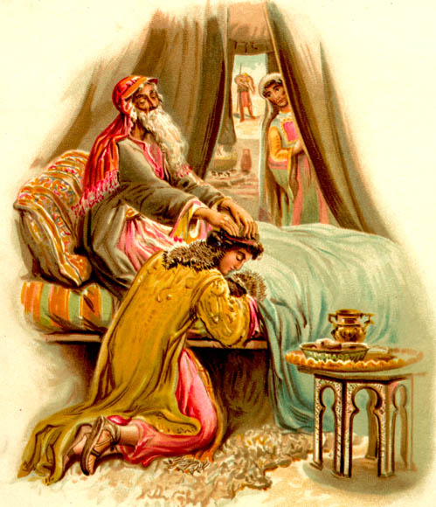
اختار الله يعقوب وليس عيسو
تكوين 27
Notes:
Isaac opposed God's declaration of firstborn rights to Jacob, but God overruled him. Even if Jacob had not deceived his father for the blessing, God's sovereign plan would still have prevailed.
_________
Common English-131
OS-01-Gen21-36-slide 47
OS-39-Malachi-41

Slide 37

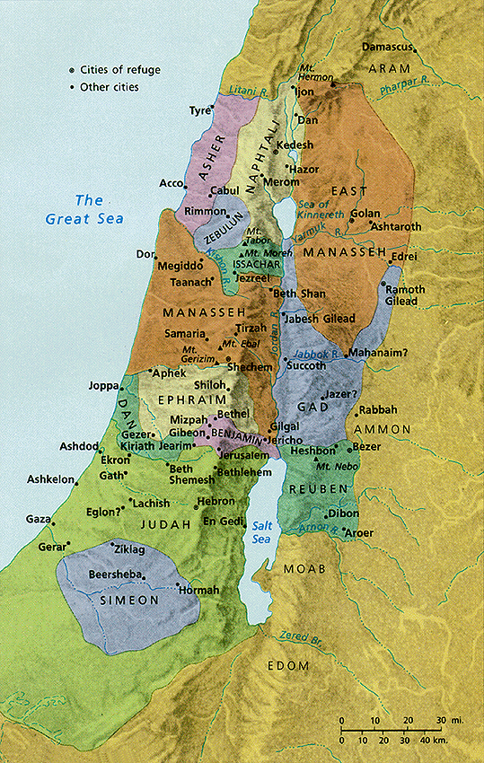
الجغرافيا
يعقوب
إسرائيل
عيسو
أدوم

Slide 38

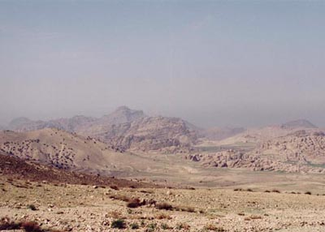
أرض مهجورة

Slide 39
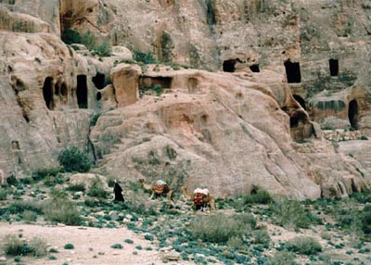
سكان الصخور في البتراء
Notes:
Petra was the capital within the rocks.

Slide 40
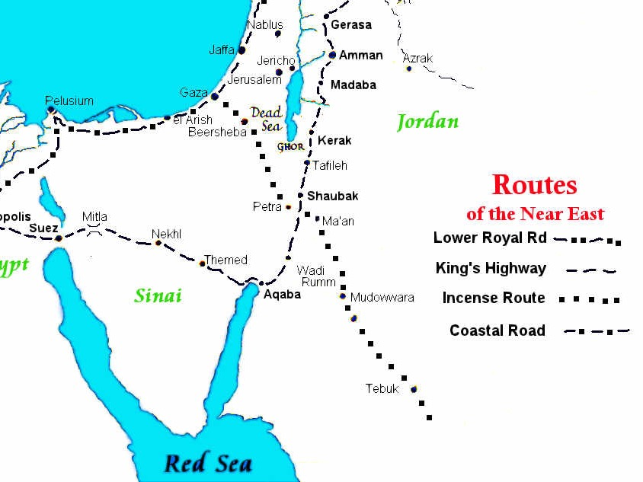
تقاطعات الطرق التجارية
طرق الشرق الأدنى
البتراء
طريق الملوك
طريق التوابل
الطريق الساحلي
Notes:
Petra controlled both the north-south trade and the east-west Spice trade from India to Europe.

Slide 41
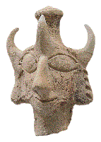
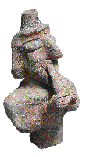
الألوهية
غطاء الرأس ذو القرون الثلاثة للتمثال ليس له مثيل معروف
يظن أن عازف الفلوت المزدوج
صُنِع من قبل نفس الحرفي
في نفس المشغل
Notes:
Their false deity had three horns.

Slide 42
١٢ هَكَذَا قَالَ السَّيِّدُ الرَّبُّ: [مِنْ أَجْلِ أَنَّ أَدُومَ قَدْ عَمِلَ بِالاِنْتِقَامِ عَلَى بَيْتِ يَهُوذَا وَأَسَاءَ إِسَاءَةً وَانْتَقَمَ مِنْهُ, ١٣ لِذَلِكَ هَكَذَا قَالَ السَّيِّدُ الرَّبُّ: وَأَمُدُّ يَدِي عَلَى أَدُومَ وَأَقْطَعُ مِنْهَا الإِنْسَانَ وَالْحَيَوَانَ, وَأُصَيِّرُهَا خَرَاباً. مِنَ التَّيْمَنِ وَإِلَى دَدَانَ يَسْقُطُونَ بِالسَّيْفِ. ١٤ وَأَجْعَلُ نَقْمَتِي فِي أَدُومَ بِيَدِ شَعْبِي إِسْرَائِيلَ, فَيَفْعَلُونَ بِأَدُومَ كَغَضَبِي وَكَسَخَطِي, فَيَعْرِفُونَ نَقْمَتِي يَقُولُ السَّيِّدُ الرَّبُّ].
أدوم
(25: 12-14)
Notes:
God said that they had sinned greatly by avenging themselves against the people of Judah (25:12).

Slide 43
فلسطين
(25: 15-17)
Notes:
Most of us have heard much about the Philistines since Goliath was a Philistine.

Slide 44
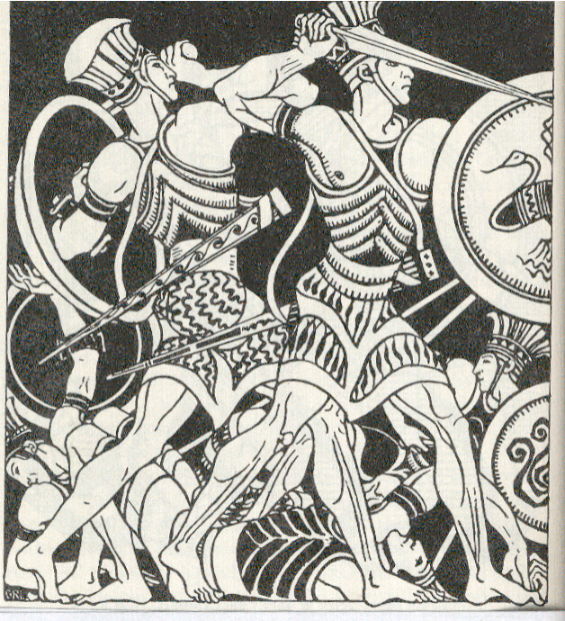
كان الفلسطينيون شعبًا مخيفاً

Slide 45
١٥ هَكَذَا قَالَ السَّيِّدُ الرَّبُّ: مِنْ أَجْلِ أَنَّ الْفِلِسْطِينِيِّينَ قَدْ عَمِلُوا بِالاِنْتِقَامِ وَانْتَقَمُوا نَقْمَةً بِالإِهَانَةِ إِلَى الْمَوْتِ لِلْخَرَابِ مِنْ عَدَاوَةٍ أَبَدِيَّةٍ, ١٦ فَلِذَلِكَ هَكَذَا قَالَ السَّيِّدُ الرَّبُّ: هَئَنَذَا أَمُدُّ يَدِي عَلَى الْفِلِسْطِينِيِّينَ وَأَسْتَأْصِلُ الْكَرِيتِيِّينَ وَأُهْلِكُ بَقِيَّةَ سَاحِلِ الْبَحْرِ. ١٧ وَأُجْرِي عَلَيْهِمْ نَقْمَاتٍ عَظِيمَةً بِتَأْدِيبِ سَخَطٍ فَيَعْلَمُونَ أَنِّي أَنَا الرَّبُّ, إِذْ أَجْعَلُ نَقْمَتِي عَلَيْهِمْ.
فلسطين
(25: 15-17)
Notes:
But God declared that Philistia fought not to protect themselves but out of revenge and contempt.
____________
OB-14-Philistines-46
OS-26-Ezek25-32—slide 45

Slide 46
Slides on
حزقيال 26

Slide 47
صور
(26: 1 – 28: 19)
Notes:
Tyre took pride in its beauty, power, trade, and leaders (26:1–28:19).

Slide 48
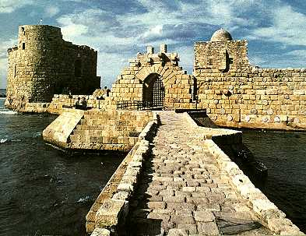
The Phoenicians
فينيقية
Notes:
Tyre of Phoenicia was the most significant seaport city in the ancient world.

Slide 49
صور عاصمة فنينيقية
خ ع ق 115
فينيقية من الكلمة اليونانية phoinix وتعني الأحمر الأرجواني
ميناء بحري قوي
الأهداف: للحصول على فهم أفضل
    العلاقة مع إسرائيل
    التأثير على الأمم المحيطة بهم
    دروس نتعلمها منهم

Slide 50
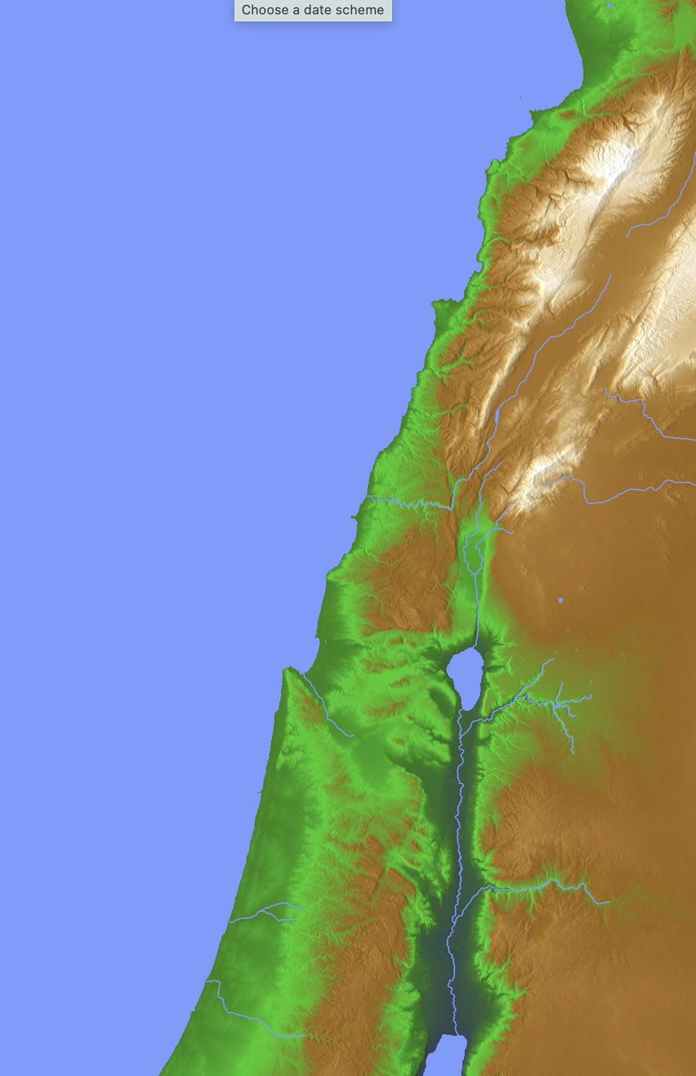
جغرافية
أوغاريت
جبيل
فينيقية
بيريتوس
قطاع من الأرض بين البحر الأبيض المتوسط والجبال
أرض خصبة
قلب المنطقة: صور، صيدا وجبيل
صيدا
فينيقية
صور
جبل
الكرمل
قيصرية
يافا
أورشليم
Notes:
50
كان رجال وصيدا يبحرون أفضل من الأشخاص الآخرين في العصور القديمة، وانشأوا موانئ تجارية عبر جميع أنحاء منطقة البحر الأبيض المتوسط. لا عجب أن سليمان استأجرهم أيضًا للإبحار في البحر الأحمر وصولاً إلى اليمن الحديث للحصول على الذهب (2 أخبار الأيام 9). تنبأ عليهم إشعياء (اصحاح 23) فيما بعد بالخراب بسبب كبريائهم.
_____________
مسح شامل للعهد القديم – 14 أخبار الأيام الثاني - 132
مسح شامل للعهد القديم 23 - إشعياء 13- 23 سلايد 130

Slide 51
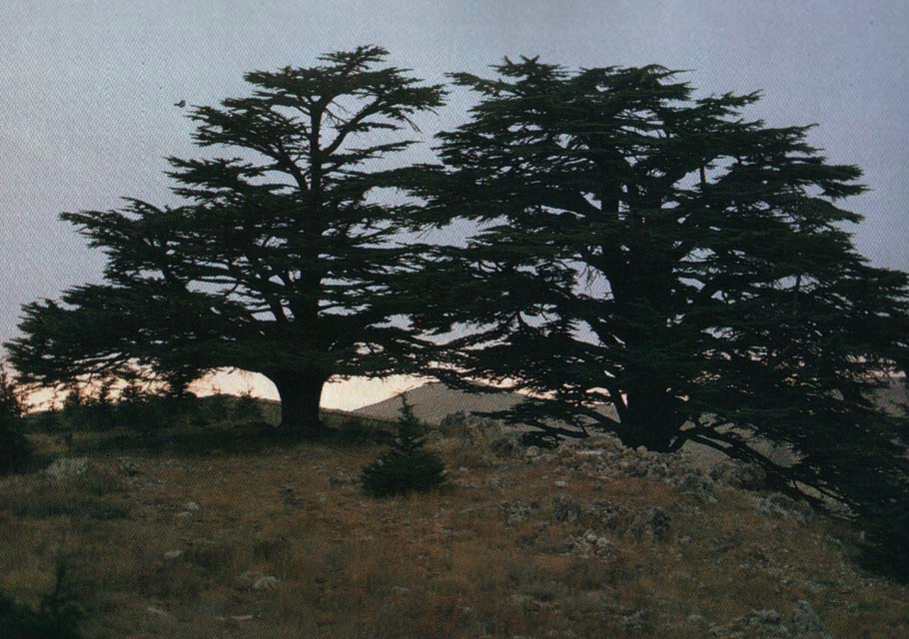
أرز لبنان
115
Notes:
Cedars of Lebanon were the premier trees of antiquity used for Solomon’s temple.

Slide 52
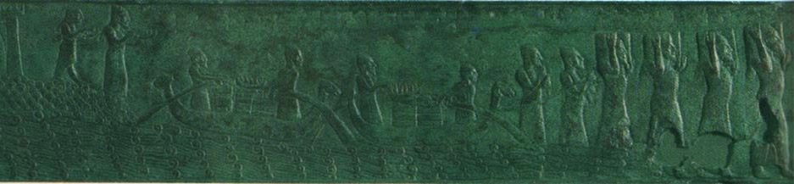
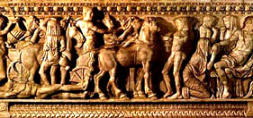
التاريخ
115
3000 ق.م = <المستعمرة الفينيقية الأولى
1800 ق.م =< تحت السيطرة المصرية
1600 ق.م =< التجارة مع المدن الأجنبية
1400 ق.م =< تحت السيطرة الحثية
1200 ق.م =< مستعمرة ومستقلة
800 ق.م =< تحت الأشوريين
586 ق.م =< احتلها نبوخدنصر
332 ق.م =< احتلها الإسكندر
64 ق.م =< صارت ضمن الإمبراطورية الرومانية

Slide 53
يا ابن آدم من أجل أن صور قالت على أورشليم ...
صيدا
(19:28–1:26)
هه قد انكسرت مصاريع الشعوب قد تحولت إلي أمتلئ إذ خربت (26: 1-2)

Slide 54
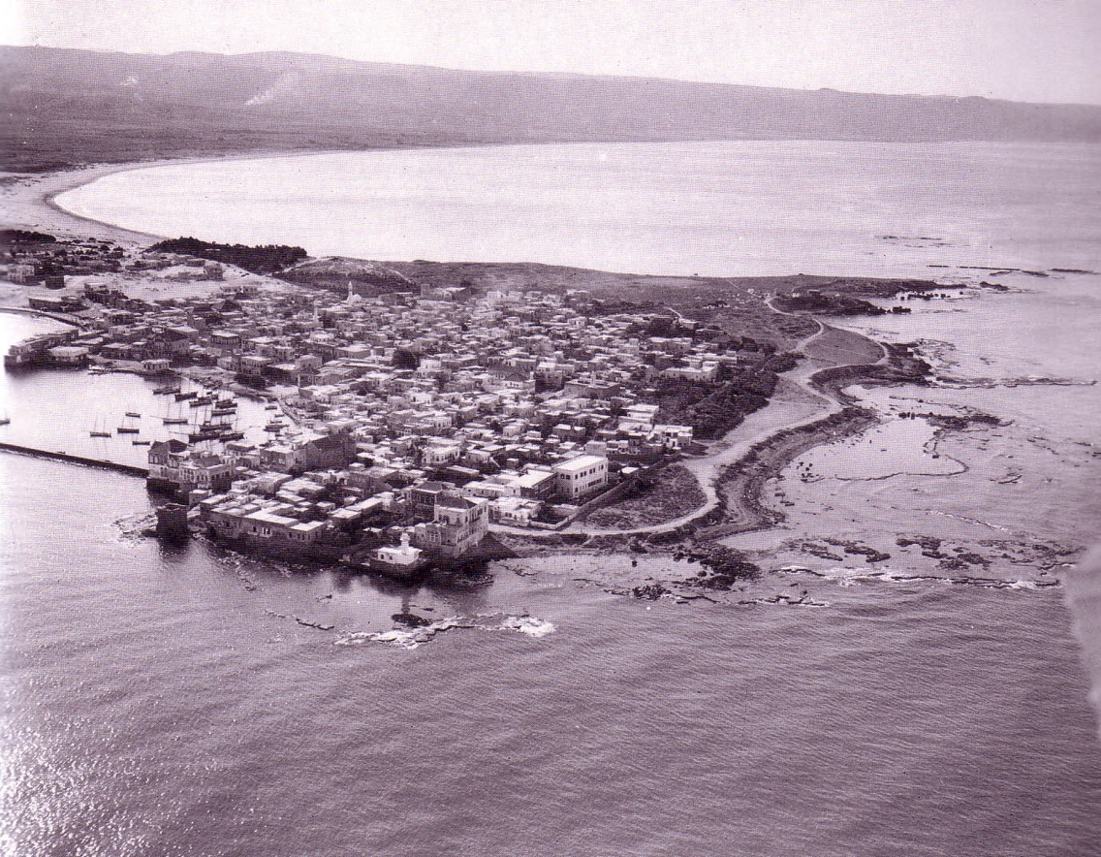
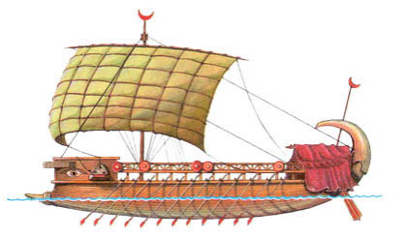
السهل الساحلي الفينيقي
صور
Notes:
Tyre had both a mainland and island fortress that took Babylon 13 years to conquer—but they did it.
_______
Charles H. Dyer, "Ezekiel," in The Bible Knowledge Commentary, 1:1278-1279: "26:7-14. God said He would bring from the north ... Nebuchadnezzar. Tyre's gloating over Jerusalem's fall would be short-lived. The king who destroyed Jerusalem would also attack Tyre. After defeating Jerusalem, Nebuchadnezzar moved his army north to Tyre in 585 B.C. and besieged the city for 13 years till all settlements on the mainland were destroyed. Tyre could hold out for all those years because her navy brought in supplies that would otherwise have been depleted. Nebuchadnezzar destroyed mainland Tyre (depicted graphically by Ezekiel, vv. 8-12), but not the island stronghold. However, other evidence indicates that the island surrendered to Nebuchadnezzar in 573-572 B.C. That year Baal II succeeded Ethbaal III to the throne of Tyre. Most likely this was a political move by Nebuchadnezzar to remove the rebellious king and install a loyal vassal king. Some think Ethbaal III was deported to Babylon, but 28:8-9 seems to indicate that Nebuchadnezzar assassinated him."

Slide 55
Slides on
حزقيال 27

Slide 56
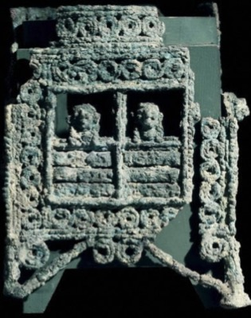
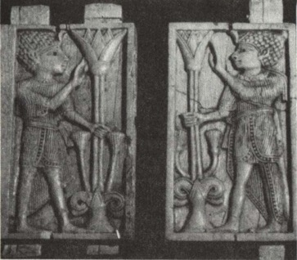
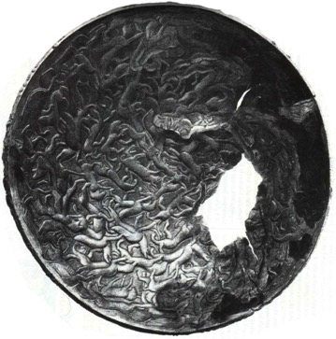
التجارة
الحرف المصدرة والمواد الخام المستوردة من دول بعيدة:
البرونز : تم تصديرة إلى آشور، قبرص، اليونان وإيطاليا
العاج - يستورد من سوريا ويعاد تصديره إلى الغرب
أيضا أعمال الزجاج ، حشوات الصوف المصبوغة باللون الأرجواني ، إلخ.
Notes:
56
The men of Tyre and Sidon sailed the seas better than anyone in antiquity, establishing trading ports throughout the Mediterranean. No wonder Solomon hired them to also sail the Red Sea down to modern Yemen to acquire gold (2 Chron 9). Isaiah 23 later prophesied their destruction for their pride.
_____________
OS-14-2Chron-132
OS-23-Isaiah13-23-slide 131

Slide 57
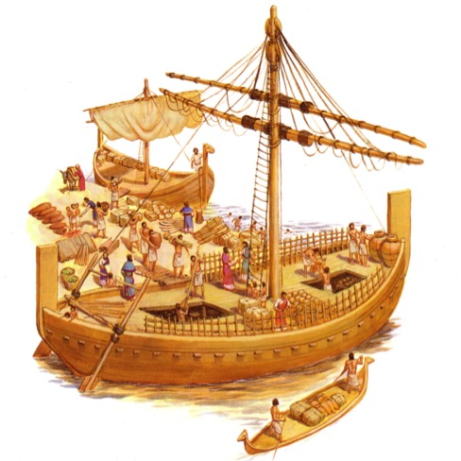
التجارة
خبرة تجارية - المعاهدات التجارية المستخدمة والتحالفات السياسية:
كانت فينيقية منخرطة بالتجارة مع داود (2 صم 5: 11، 1 مل 5: 1)
العلاقات بين الملك حيرام وسليمان في البناء والمشاريع الخارجية
تصدير الزيت، النبيذ والأخشاب
Notes:
57
The men of Tyre and Sidon sailed the seas better than anyone in antiquity, establishing trading ports throughout the Mediterranean. No wonder Solomon hired them to also sail the Red Sea down to modern Yemen to acquire gold (2 Chron 9). Isaiah 23 later prophesied their destruction for their pride.
_____________
OB-15-Phoenicians-15
OS-14-2Chron-134
OS-23-Isaiah13-23-slide 134
OS-Ezek25-32—slide 57

Slide 58


المستعمرات الفينيقية
حزقيال ٢٧ : ١٢
تَرْشِيشُ تَاجِرَتُكِ بِكَثْرَةِ كُلِّ غِنًى. بِالْفِضَّةِ وَالْحَدِيدِ وَالْقَصْدِيرِ وَالرَّصَاصِ أَقَامُوا أَسْوَاقَكِ.
119
اوروبا
ترشيش
آسيا الصغرى
افريقيا
صور
خطوط السفن الفينيقية
اراضي فينيقية
خطوط التجارة
Notes:
Quality ships enabled Tyrians to travel all the way to Tarshish—modern Spain—to buy precious metals and slaves on the way to Greece.
———————
The Phoenicians were the master shipbuilders and sailors of antiquity. Their ability to conquer the seas gave them an empire of colonies spanning the Mediterranean. This brought untold wealth to them, despite being on the geographical edge of the "Great Sea," or the Mediterranean.
_____________
The men of Tyre and Sidon sailed the seas better than anyone in antiquity, establishing trading ports throughout the Mediterranean. No wonder Solomon hired them to also sail the Red Sea down to modern Yemen to acquire gold (2 Chron 9). Isaiah 23 later prophesied their destruction for their pride.
_____________
OB-15-Phoencians-12
OS-14-2Chron-132
OS-23-Isaiah13-23-slide 140
OS-26-Ezek25-32—slide 58

Slide 59
Slides on
حزقيال 28

Slide 60

مقاطع صعبة
يا ابن آدم (2: 1 و93 مرة)
الروح في الداخل (36: 26-27)
ملك صور (28: 2)
Notes:
The prince of Tyre would be overthrown for his claim to be God in order to prove God's sovereignty (28:1-10).

Slide 61

من هو ملك صور (إشعياء 23)؟
عملات صورية
Notes:
Some think him only the human king. Other say he was Satan. Probably he was the human king who acted like Satan long before him in his pride and splendor.
__________
OB-14-Phonecians-14
OS-23-Isaiah13-23-slide 143
OS-Ezek25-32—slide 61

Slide 62

هيكل بوسيدون
يا ابن آدم قل لرئيس صور هكذا قال السيد الرب من أجل أنه قد ارتفع قلبك وقلت أنا إله في مجلس الآلهة أجلس في قلب البحار وأنت إنسان لا إله وإن جعلت قلبك كقلب الآلهة
ملك صور أعلن نفسه كإله البحر
(حز 28: 2)

Slide 63

حزقيال ٢٨ : ٢
يَا ابْنَ آدَمَ, قُلْ لِرَئِيسِ صُورَ. هَكَذَا قَالَ السَّيِّدُ الرَّبُّ: مِنْ أَجْلِ أَنَّهُ قَدِ ارْتَفَعَ قَلْبُكَ وَقُلْتَ: أَنَا إِلَهٌ. فِي مَجْلِسِ الآلِهَةِ أَجْلِسُ فِي قَلْبِ الْبِحَارِ. وَأَنْتَ إِنْسَانٌ لاَ إِلَهٌ, وَإِنْ جَعَلْتَ قَلْبَكَ كَقَلْبِ الآلِهَةِ.
سقوط الشيطان
(أنظر رؤ 12: 7-13)‏
Notes:
63

Slide 64

حزقيال ٢٨ : ٣-٥
٣ هَا أَنْتَ أَحْكَمُ مِنْ دَانِيآلَ! سِرٌّ مَا لاَ يَخْفَى عَلَيْكَ! ٤ وَبِحِكْمَتِكَ وَبِفَهْمِكَ حَصَّلْتَ لِنَفْسِكَ ثَرْوَةً, وَحَصَّلْتَ الذَّهَبَ وَالْفِضَّةَ فِي خَزَائِنِكَ! ٥ بِكَثْرَةِ حِكْمَتِكَ فِي تِجَارَتِكَ كَثَّرْتَ ثَرْوَتَكَ, فَارْتَفَعَ قَلْبُكَ بِسَبَبِ غِنَاكَ!
سقوط لوسيفر، النجم اللامع
(أنظر رؤ 12: 7-9)‏

Slide 65

The angels pursue
١٢ [يَا ابْنَ آدَمَ, ارْفَعْ مَرْثَاةً عَلَى مَلِكِ صُورَ وَقُلْ لَهُ: هَكَذَا قَالَ السَّيِّدُ الرَّبُّ: أَنْتَ خَاتِمُ الْكَمَالِ, مَلآنٌ حِكْمَةً وَكَامِلُ الْجَمَالِ. ١٣ كُنْتَ فِي عَدْنٍ جَنَّةِ اللَّهِ… ١٥ أَنْتَ كَامِلٌ فِي طُرُقِكَ مِنْ يَوْمَ خُلِقْتَ حَتَّى وُجِدَ فِيكَ إِثْمٌ.

Slide 66
The angels pursue
١٦ بِكَثْرَةِ تِجَارَتِكَ مَلأُوا جَوْفَكَ ظُلْماً فَأَخْطَأْتَ. فَأَطْرَحُكَ مِنْ جَبَلِ اللَّهِ وَأُبِيدُكَ أَيُّهَا الْكَرُوبُ الْمُظَلِّلُ مِنْ بَيْنِ حِجَارَةِ النَّارِ. ١٧ قَدِ ارْتَفَعَ قَلْبُكَ لِبَهْجَتِكَ. أَفْسَدْتَ حِكْمَتَكَ لأَجْلِ بَهَائِكَ. سَأَطْرَحُكَ إِلَى الأَرْضِ وَأَجْعَلُكَ أَمَامَ الْمُلُوكِ لِيَنْظُرُوا إِلَيْكَ.
حزقيال ٢٨ : ١٢-١٧

Slide 67
٢٢ وَقُلْ: هَكَذَا قَالَ السَّيِّدُ الرَّبُّ: هَأَنَذَا عَلَيْكِ يَا صَيْدُونُ وَسَأَتَمَجَّدُ فِي وَسَطِكِ, فَيَعْلَمُونَ أَنِّي أَنَا الرَّبُّ حِينَ أُجْرِي فِيهَا أَحْكَاماً وَأَتَقَدَّسُ فِيهَا. ٢٣ وَأُرْسِلُ عَلَيْهَا وَبَأً وَدَماً إِلَى أَزِقَّتِهَا وَيُسْقَطُ الْجَرْحَى فِي وَسَطِهَا بِالسَّيْفِ الَّذِي عَلَيْهَا مِنْ كُلِّ جَانِبٍ, فَيَعْلَمُونَ أَنِّي أَنَا الرَّبُّ. ٢٤ [فَلاَ يَكُونُ بَعْدُ لِبَيْتِ إِسْرَائِيلَ سُلاَّءٌ مُمَرِّرٌ وَلاَ شَوْكَةٌ مُوجِعَةٌ مِنْ كُلِّ الَّذِينَ حَوْلَهُمُ الَّذِينَ يُبْغِضُونَهُمْ, فَيَعْلَمُونَ أَنِّي أَنَا السَّيِّدُ الرَّبُّ.
صيدون
(28: 20-26)
Notes:
Sidon showed maliciousness against Judah (28:20-26).
This Phoenician city north of Tyre was also wealthy and powerful.
But God said that judgment would come via plague and war due to oppressing Israel.

Slide 68
Slides on
حزقيال 29

Slide 69

اعتبرت مصر قوية

Slide 70
حزقيال ٢٩ : ١-٢
١ فِي السَّنَةِ الْعَاشِرَةِ فِي الثَّانِي عَشَرَ مِنَ الشَّهْرِ الْعَاشِرِ كَانَ إِلَيَّ كَلاَمُ الرَّبِّ: ٢ [يَا ابْنَ آدَمَ, اجْعَلْ وَجْهَكَ نَحْوَ فِرْعَوْنَ مَلِكِ مِصْرَ وَتَنَبَّأْ عَلَيْهِ وَعَلَى مِصْرَ كُلِّهَا.
مصر
(29-32)
Notes:
But God was stronger than Egypt.

Slide 71

حزقيال ٢٩ : ٣
٣ تَكَلَّمْ وَقُلْ: هَكَذَا قَالَ السَّيِّدُ الرَّبُّ: هَئَنَذَا عَلَيْكَ يَا فِرْعَوْنُ مَلِكُ مِصْرَ, التِّمْسَاحُ الْكَبِيرُ الرَّابِضُ فِي وَسَطِ أَنْهَارِهِ, الَّذِي قَالَ: نَهْرِي لِي وَأَنَا عَمِلْتُهُ لِنَفْسِي.
Notes:
God likens Egypt to a huge but clumsy water monster.

Slide 72
حزقيال ٢٩ : ١٣-١٥
١٣ لأَنَّهُ هَكَذَا قَالَ السَّيِّدُ الرَّبُّ: عِنْدَ نَهَايَةِ أَرْبَعِينَ سَنَةً أَجْمَعُ الْمِصْرِيِّينَ مِنَ الشُّعُوبِ الَّذِينَ تَشَتَّتُوا بَيْنَهُمْ ١٤ وَأَرُدُّ سَبْيَ مِصْرَ, وَأُرْجِعُهُمْ إِلَى أَرْضِ فَتْرُوسَ إِلَى أَرْضِ مِيلاَدِهِمْ, وَيَكُونُونَ هُنَاكَ مَمْلَكَةً حَقِيرَةً. ١٥ تَكُونُ أَحْقَرَ الْمَمَالِكِ فَلاَ تَرْتَفِعُ بَعْدُ عَلَى الأُمَمِ, وَأُقَلِّلُهُمْ لِكَيْلاَ يَتَسَلَّطُوا عَلَى الأُمَمِ.
مصر
(32–29)
Notes:
And God promises that Egypt—the superpower of the day—would be the lowliest of nations even until today!

Slide 73

بابل تحتل مصر (571 ق.م)
صور
حزقيال ٢٩ : ١٨
يَا ابْنَ آدَمَ, إِنَّ نَبُوخَذْنَصَّرَ مَلِكَ بَابِلَ اسْتَخْدَمَ جَيْشَهُ خِدْمَةً شَدِيدَةً عَلَى صُورَ. كُلُّ رَأْسٍ قَرِعَ, وَكُلُّ كَتِفٍ تَجَرَّدَتْ, وَلَمْ تَكُنْ لَهُ وَلاَ لِجَيْشِهِ أُجْرَةٌ مِنْ صُورَ لأَجْلِ خِدْمَتِهِ الَّتِي خَدَمَ بِهَا عَلَيْهَا.
مصر
Notes:
Ironically, the conqueror got no pay from the wealthiest city of all (29:18)!

Slide 74
بابل تحتل مصر (571 ق.م)
حزقيال ٢٩ : ١٩-٢٠
١٩ لِذَلِكَ هَكَذَا قَالَ السَّيِّدُ الرَّبُّ: هَئَنَذَا أَبْذُلُ أَرْضَ مِصْرَ لِنَبُوخَذْنَصَّرَ مَلِكِ بَابِلَ فَيَأْخُذُ ثَرْوَتَهَا وَيَغْنَمُ غَنِيمَتَهَا وَيَنْهَبُ نَهْبَهَا فَتَكُونُ أُجْرَةً لِجَيْشِهِ. ٢٠ قَدْ أَعْطَيْتُهُ أَرْضَ مِصْرَ لأَجْلِ شُغْلِهِ الَّذِي خَدَمَ بِهِ لأَنَّهُمْ عَمِلُوا لأَجْلِي يَقُولُ السَّيِّدُ الرَّبُّ.
صور
مصر
Notes:
But God would pay Babylon for Tyre by defeating Egypt (29:19-21).

Slide 75
Slides on
حزقيال 30

Slide 76

ممممصر غير جديرة بالثقة
يقول الرب: «ويل للبنين المتمردين الذين ينصاعون لمشورة لم تصدر عني، ويبرمون عهداً ليس من روحي، ليضيفوا خطيئة إلى خطيئة. الذين يتأهبون للإنحدار إلى مصر من غير أن يلجأوا إلى مشورتي، ليلوذوا بحمى فرعون ويعتصموا بظل مصر، لذلك يصير لكم حصن فرعون عاراً، والإحتماء بظل مصر خزياً
أشعياء 30: 1- 3

Slide 77

تدمير مصر وحلفائها
ويأتي سيف على مصر ويكون في كوش خوف شديد عند سقوط القتلى في مصر ويأخذون ثروتها وتهدم أسسها
—حزقيال 30: 4

Slide 78

تدمير مصر وحلفائها
ليديا
... تسلب أرض كوش
5 يسقط معهم بالسيف
كوش وفوط ولود وكل اللفيف
وكوب وبنو أرض العهد
(حزقيال 30: 4-5)
ليبيا
العربية
مصر
الحبشة

Slide 79
Slides on
حزقيال 31

Slide 80

لا تثق في مصر
ويل للمنحدرين إلى مصر طلباً للعون المتوكلين على الخيل الواثقين بكثرة المركبات وببأس الفرسان، من غير أن يلتفتوا إلى قدوس إسرائيل، أو يطلبوا مشورة الرب.
(أشعياء 31: 1).

Slide 81

على بابل أن تدمر مصر
لذلك هكذا قال السيد الرب
من أجل أنك ارتفعت قامتك
وقد جعل فرعه بين الغيوم
وارتفع قلبه بعلوه
أسلمته إلى يد قوي الأمم
فيفعل به فعلاً لشره طردته
(حزقيال 31: 10-11)
Notes:
Egypt was like a towering cedar with deep roots—but it would be cut down.

Slide 82
Slides on
حزقيال 32

Slide 83

مصر في الهاوية
حزقيال ٣٢ : ١٨-١٩
١٨ [يَا ابْنَ آدَمَ, وَلْوِلْ عَلَى جُمْهُورِ مِصْرَ وَأَحْدِرْهُ هُوَ وَبَنَاتِ الأُمَمِ الْعَظِيمَةِ إِلَى الأَرْضِ السُّفْلَى مَعَ الْهَابِطِينَ فِي الْجُبِّ. ١٩ مِمَّنْ نَعِمْتَ أَكْثَرَ؟ انْزِلْ وَاضْطَجِعْ مَعَ الْغُلْفِ.
Notes:
God lamented the downfall of Pharaoh by Babylon to show his sovereign workings in poetic form (32:1-16).
Babylon would destroy Egypt as it did Assyria, Persia (Elam), Meshech, Tubal, Edom, and Sidon to show God's sovereignty (32:17-32).

Slide 84

كيف يمكن أن تكون مُتوقِّعاً لمجد الله في حياتك من جديد؟
٣ خطوات
Notes:
How can you be expectant of God’s glory once again in your life?
Through the entire book of Ezekiel, we will see three steps to expect God’s glory to return in your life.
What is the first step to expect God’s glory to return in your life? To see a solution, we must first confess there is a problem, so…

Slide 85
خطوات نحو مجد الله
1- اعترف أن مجد الله قد غادر
(حز 1-24)
اعترف
Notes:
The sense of God's presence will not remain when we insist on sin.

Slide 86
خطوات لعودة مجد الله
٢- السماح لله أن يتعامل مع جميع المنافسين لأجل مجده (٢٥-٣٢)
اعترف
اسمح
Notes:
Know that the Shekinah presence of the LORD will purge all forms of darkness.

Slide 87
مخطط حزقيال التقني
500
سيادة للمسبيين وعودة للمجد
المجد يعود ٣٣-٤٨ |  | الأمم تدان (وليس هناك مجد) ٢٥-٣٢ |  |  | المجد يغادر ١-٢٤
الإسترداد |  | سيادة مبررة |  |  | السبي
بركة إسرائيل |  | دينونة الأمم |  |  | الحكم على يهوذا
مستقبل يهوذا |  | أعداء يهوذا |  |  | سقوط يهوذا
بعد الحصار |  | أثناء الحصار |  |  | قبل الحصار
أمراً جديداً ٤٠-٤٨ | حياة جديدة ٣٣-٣٩ | مصر ٢٩-٣٢ | صور وصيدا ٢٦-٢٨ | عمون مؤاب، إدوم، فلسطين ٢٥ | قبل السبي حالة يأس ٤-٢٤ | الدعوة في المجد ١-٣
نهر الخابور في مملكة بابل (٥٩٢-٥٧٠ ق م)

Slide 88

العشرة الكبار

Slide 89

لماذا يجب أن يكون هناك دينونة؟
1. حتى يتوب الناس
2. حتى يعرف الناس أن الله يقول ويفعل
3. حتى يثبت الله أنه قدوس
4. حتى يظهر الله أنه عادل
5. حتى يطهر الله الناس ويعدهم لاسترداد مستقبلي
الله لا يزال عادلاً – لهذا يجب أن يكون هناك دينونة
Notes:
God is still just (fair)—so there must be judgment.
There are at least five reasons for judgment.

Slide 90

هل يمكنك إصدار دينونة صحيحة للعالم؟
Notes:
Is God unjust about anything he does?
We can’t even decide how to spell the word!
Are we able to determine justice instead of the creator of the world?
If God is not the standard for justice, then who is that standard? You? Me?

Slide 91

مزامير ٧٣ : ٦
لِذَلِكَ تَقَلَّدُوا الْكِبْرِيَاءَ. لَبِسُوا كَثَوْبٍ ظُلْمَهُمْ.
Notes:
He will do what is right those who wear pride like a necklace (Psalm 73:6).

Slide 92
كيف يجب أن نتصرف عندما نشعر أننا على الجانب الخاطئ؟
Notes:
How should we handle our “no glory” times?
What can we do during those times when we feel so weak and insignificant?

Slide 93

الفكرة الرئيسية في حزقيال 25-32
اسمح لله أن يتعامل مع جميع المقاومين
Notes:
In other words, accept his judgment.

Slide 94
كن صبوراً
لا تضع في الميكرويف ما يضعه الله في وعاء من الفخار
Notes:
When you want God to act now… wait.

Slide 95

لن يشع مجد الله في حياتك بوجود منافسين له
استثمر في القيم الكتابية
Notes:
Tech stocks are down but the attack against oil has made many wealthy.
Envoy Financial has values-based investments.
——————————
One wonders why Israel ever trusted any of these nations that were doomed themselves.
But the same question can be asked of us: Why do we trust anything or anyone other than Almighty God? Why trust something weaker that does not have our best interest in mind?
Who will be king in your life?

Slide 96
أصحاب المليارات
2012، 2014، 2016
2021
إيلون ماسك
بيل غيتس
جيف بيزوس
فلاديمير بوتين
2020
2013
Notes:
The four multi-billionaires have all been divorced.
———————
Elon Musk’s Ex-Wife Denies Being Hand-Chosen By Ghislaine Maxwell To Be His ‘Child Bride’
6 July 2020
https://brobible.com/culture/article/elon-musk-wife-denies-ghislaine-maxwell/
Tesla and SpaceX founder Elon Musk has had himself quite a past couple of months.
He had a kid with his partner Grimes and named him something so bizarre that even she can’t explain properly.
Then he denied having a threesome with actresses Amber Heard and Cara Delevingne while Heard was married to Johnny Depp.
And now, his ex-wife, actress and model Talulah Riley, has felt the need to go on record stating that despite rumors, Jeffrey Epstein companion Ghislaine Maxwell did not hand-choose her to be Musk’s child bride back in 2008 when she was 23 and Musk was 36.
Here’s how their love story goes.
Riley and Musk began dating in 2008. Then in 2010 the couple got married. In January 2012, Musk announced the marriage was over and they got divorced. In July 2013, Musk and Riley got married for a second time. In December 2014, Musk once again filed for divorce. Then he withdrew his filing. Then she filed for divorce in March 2016. The couple’s second divorce became official in October of 2016.
The actress, now 34, and who many will recognized from her role playing Angela on Westworld, apparently heard some rumors following Maxwell’s arrest that Epstein’s cohort procured her to be Musk’s child bride back in the day.
————————
Bill Gates, wife Melinda announce divorce after 27 years of their marriage
https://www.indiatvnews.com/lifestyle/people-bill-gates-wife-melinda-gates-announce-divorce-after-27-years-of-their-marriage-net-worth-children-memes-702346
Bill Gates and his wife Melinda Gates revealed their decision of taking divorce in a joint statement which was shared by the Microsoft co-founder on Twitter. “After a great deal of thought and a lot of work on our relationship, we have made the decision to end our marriage. Over the last 27 years, we have raised three incredible children and built a foundation that works all over the world to enable people to lead healthy, productive lives,” read the statement.
Edited by: India TV Lifestyle Desk
New Delhi Updated on: May 04, 2021 12:50 IST
___________
Jeff Bezos' ex-wife MacKenzie's post-divorce revenge
Not since Jennifer Aniston has a wronged woman done so much right
By Maureen Callahan New York Post
https://www.foxbusiness.com/business-leaders/jeff-bezos-ex-wife-mackenzies-post-divorce-reven
Published August 3, 2020
MacKenzie Scott, the fourth-richest woman in the world, announced on Tuesday that she has dropped Bezos from her name and donated $1.7 billion to 119 nonprofits, with an emphasis on racial equality, marginalized groups and economic mobility.
JEFF BEZOS NABS BEVERLY HILLS ESTATE NEXT TO HIS RECORD-SETTING $165M COMPOUND
Meanwhile, her ex-husband, Amazon founder Jeff Bezos — who publicly left MacKenzie for her close friend Lauren Sanchez — spent the week dropping $10 million on an LA home, just near the $165 million mansion he bought from David Geffen.
On Friday, Amazon posted a second-quarter profit of $5.2 billion, the biggest in its 26-year-history, due to a pandemic that is otherwise ravaging the economy.
Days earlier, Bezos testified before Congress in an antitrust hearing, seeking to downplay Amazon’s global dominance while casually snacking on camera.
Video
“Just like the world needs small companies, it also needs big ones,” Bezos said.
Such a smug, reductive assertion, but one typical of a Big Tech overlord who knows his money will buy all the lawmakers it needs to keep Amazon intact.
WHAT’S HOUSE HUNTING LIKE FOR THE WORLD’S RICHEST MAN
This is the arrogance Bezos deems publicly acceptable. Can you imagine what he’s like in private? As a husband?
Amazon CEO Jeff Bezos, right along with American news anchor Lauren Sanchez poses for photographs during a blue carpet event organized by Amazon Prime Video in Mumbai, India, Thursday, Jan. 16, 2020. (AP Photo/Rafiq Maqbool)
“I love you, alive girl,” a still-married Bezos texted Sanchez in 2018. “I will show you with my body, and my lips and my eyes, very soon.”
“I want to get a little drunk with you tonight,” went another text to Sanchez amid raunchy selfies. “Not falling down. Just a little drunk. I want to talk to you and plan with you. Listen and laugh. I basically WANT TO BE WITH YOU!!!”
“You make me better,” read another. “You’re meant for me. I know it more clearly than I’ve ever known anything.”
LONDON, ENGLAND: Jeff Bezos and his partner, Lauren Sanchez, look on from the Royal Box on Centre Court on Day 13 of The Championships - Wimbledon 2019 at the All England Lawn Tennis and Croquet Club on July 14, 2019 in London, England. (Photo by Sim
Those texts wound up splashed all over the National Enquirer, and federal investigators told The Wall Street Journal that the sexts were leaked by none other than Sanchez’s brother, who got a $200,000 payday from the tabloid. (Her brother denies the claims.)
WEST HOLLYWOOD, CA: (L-R) CEO of Amazon Jeff Bezos and writer MacKenzie Bezos attend the Amazon Studios Oscar Celebration at Delilah on February 26, 2017 in West Hollywood, California. (Photo by Jerod Harris/Getty Images)
For MacKenzie, these indiscretions must have dealt the same blow that the infamous W cover (and accompanying 60-page spread) of Brad Pitt and Angelina Jolie playing happy families did to Aniston.
JEFF BEZOS SETS NEW LA REAL ESTATE RECORD WITH $165M BEVERLY HILLS BUY
Especially as Bezos’ sexts were written months before MacKenzie and Bezos celebrated their 25th wedding anniversary in Miami.
Imagine MacKenzie’s humiliation. Imagine what she must have done to hide the worst from their four children while Bezos and Sanchez kept flying all over the country, checking out multimillion-dollar homes and parading their status as Big Tech’s Most Scandalous Couple.
LOS ANGELES, CA: WME's Patrick Whitesell, Lauren Sanchez and Amazon CEO Jeff Bezos attend Jeff Bezos and Matt Damon's "Manchester By The Sea" Holiday Party on December 3, 2016 in Los Angeles, California. (Photo by Todd Williamson/Getty Images for Ama
When MacKenzie married Bezos in 1993, he was just another computer nerd.
“I do remember the first time I heard him laugh,” she told the Seattle Post-Intelligencer in 2005. “I met him at the hedge fund where we worked in New York … I would hear him laughing all day. I fell in love with his laugh.”
At the time, MacKenzie was publicizing her debut novel, which took her eight years to write while she raised small children. Little is known of her story, but clearly she put her ambitions on hold so Bezos could pursue world domination.
After Jeff got himself a midlife mogul makeover in 2017 and began seeing Sanchez, a former host on “So You Think You Can Dance,” MacKenzie said nothing.
FILE - In this March 4, 2018 file photo, Jeff Bezos and wife MacKenzie Bezos arrive at the Vanity Fair Oscar Party in Beverly Hills, Calif. (Photo by Evan Agostini/Invision/AP, File)
She maintained her dignity, got a great divorce lawyer and walked away with more money than she’ll ever need (current worth: $62.3 billion).
GET FOX BUSINESS ON THE GO BY CLICKING HERE
Their divorce was settled out of court, which kept the custody arrangement for their three minor kids secret. She signed the Giving Pledge and said on Tuesday, in part:
“Like many, I watched the first half of 2020 with a mixture of heartbreak and horror.”
Subtext: My ex-husband soullessly profits from this pandemic while firing workers who are refused bathroom breaks and basic human dignity.
She also wrote: “There’s no question in my mind that anyone’s personal wealth is the product of a collective effort” — ahem — “and of social structures which present opportunities to some people, and obstacles to countless others.”
Bezos is notoriously stingy when it comes to charitable giving, preferring to compete with Elon Musk over colonizing space.
As Aniston infamously said of ex-husband Brad Pitt in 2005, “There‘s a sensitivity chip that’s missing.”
It’s hard to think of a more apt description of Bezos — or a better post-divorce life awaiting MacKenzie than the one she has designed for herself.
____________
Where is Putin’s family right now? Confirmed one thing before approving Ukraine invasion; What happened to Russians who went to find his girlfriend?
Thursday 03 March, 2022 | 3:17 PMfamily-oneMOSCOW: Russian President Vladimir Putin is the prince of tactics
Read full news at https://keralakaumudi.com/en/news/news.php?id=763488&u=where-is-putin%E2%80%99s-family-right-now-confirmed-one-thing-before-approving-ukraine-invasion-what-happened-to-russians-who-went-to-find-his-girlfriend
The first thing Putin did after sending troops to Ukraine was to make his family safe. He had shifted his family to a secret underground bunker in Siberia, prior to the Ukraine invasion… Putin's wife was Lyudmila Skrebneva, a former air hostess. They were married in 1983 and got divorced in 2013.

Slide 97
أمثال ٢٨ : ٥
اَلنَّاسُ الأَشْرَارُ لاَ يَفْهَمُونَ الْحَقَّ وَطَالِبُو الرَّبِّ يَفْهَمُونَ كُلَّ شَيْءٍ.

Slide 98
الفكرة الرئيسية في حزقيال 25-32
اسمح لله أن يتعامل مع جميع المقاومين
Notes:
In other words, accept his judgment.

Slide 99
جامعة ١٢ : ١٣-١٤
١٣ فَلْنَسْمَعْ خِتَامَ الأَمْرِ كُلِّهِ: اتَّقِ اللَّهَ وَاحْفَظْ وَصَايَاهُ لأَنَّ هَذَا هُوَ الإِنْسَانُ كُلُّهُ. ١٤ لأَنَّ اللَّهَ يُحْضِرُ كُلَّ عَمَلٍ إِلَى الدَّيْنُونَةِ عَلَى كُلِّ خَفِيٍّ إِنْ كَانَ خَيْراً أَوْ شَرّاً.
Notes:
Fear God and keep his commandments—because God will judge us (Eccl 12:13-14).

Slide 100
Black

Slide 101


مسح العهد القديم • BibleStudyDownloads.org
أحصل على هذا العرض التقديمي مجاناً
Notes:
OP Arabic

Slide 102

مواضيع لاهوتية
الله
  إله إسرائيل
  قداسة الله
  الأمانة للعهد
  روح يهوه
  مجد يهوه
المسؤولية الشخصية
الإسترداد
  العهد الجديد
  النظام المادي الجديد
  المثل العليا

Slide 103

الخلاصة
إعادة توحيد يهوذا وإسرائيل
هزيمة الأعداء
عودة سحابة المجد
إعادة بناء الهيكل
استرداد نظام العبادة
الفداء (غفران الخطايا)
سيعرف الجميع أنني يهوه
استرداد الأقاليم
سكنى الروح
ضمان الطاعة
قلب جديد
راعي إسرائيل

Slide 105
مسح العهد القديم • BibleStudyDownloads.org
أحصل على هذا العرض التقديمي مجاناً
Notes:
OT Survey (os) Arabic

