Slide 1
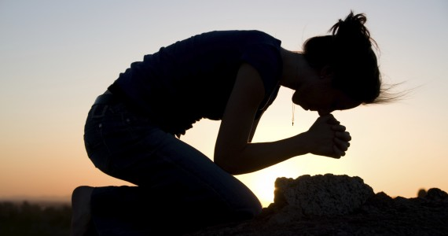
الخضوع والفرح
الجامعة 8
د. ريك جريفيث • مؤسسة الدراسات اللاهوتية الأردنية
CICFamily.com • BibleStudyDownloads.org

Slide 2
Pulpit Freedom Sunday

Slide 3
Pulpit Freedom Sunday

Slide 4
Pulpit Freedom Sunday

Slide 5
Pulpit Freedom Sunday

Slide 6
Pulpit Freedom Sunday

Slide 7
إلى اي مدى يجب أن نطيع الحكومة؟
Notes:
Should a Christian always, without question do everything the governing authorities demand?
If so, how can you have God as your highest priority in life?
If not, then how do you decide where you draw the line on the areas where you will not obey?
Christians need to know how to relate to authority—especially when their country is doing things that are very controversial.
We also need to see how to respond when we don't understand all God is doing as our ultimate authority.

Slide 8
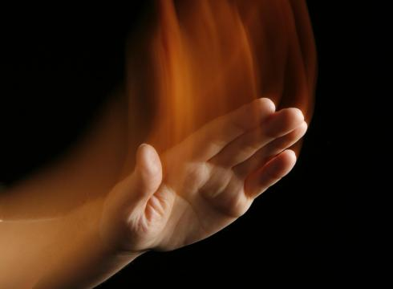
كيف يجب أن نتجاوب مع السلطة لكل من الله والناس؟

Slide 9
الفكرة الرئيسية في 7: 15-29
الحكمة
متوازنة،
قوية
و
متبصرة
Notes:
The Myth of the Balanced Life—Success Comes from Imbalance, not Balance
http://goaltriangle.com/advanced-goal-setting/the-myth-of-the-balanced-life-success-comes-from-imbalance-not-balance/
Is your life "balanced"?
If you are one of the rare people who would answer yes, then here's a follow-up question: how long have you been "balanced" and how long do you expect it to last?
We're told by psychologists, talk show hosts, life-coaches, and parents that we should be seeking "more balance".
From my experience, people who are spending their time seeking a "balanced" life fall into two categories:
a) People who have not accomplished anything remarkable, and never will, because they are constantly striving for "balance" (and are thus secretly afraid that doing what it takes to achieve true success in one area will put them out of balance).
b) People who have already achieved amazing things in one (or many) areas of their lives, and are now attending to the previously ignored aspects. Better term here would be people seeking to "rebalance".
These are two vastly different approaches to living. And I'll argue that the second is more admirable than the first. You see,
To accomplish truly great things, you need to seek an imbalanced life.
This imbalance I'm referring to is usually temporary. And the degree of imbalance depends on your specific goals.
But make no mistake, achievement of your most important, most ambitious goals, you need to embrace imbalance.
Let's start with a simple example, using the three corners of The Goal Triangle: family/relationships, fitness and health, and finances/career.
Imagine trying this coming month to "balance" these. If you are accustomed to goal setting, you will quickly come up with measureable, timebound goals for this month in each area. And you'll make some progress. But will you accomplish anything truly great, without having to "borrow" time, energy, or resources from another area?
For examples, here are three truly great (in terms of ambitious) goals for 30 days:
Fitness: Lose 10 pounds of fat without losing muscle.
Family: Spend extra time every day with your teenage kids (or working on strategies), beyond what you are already spending, resulting in 50% fewer arguments each week.
Finances: Perform so well in your job, through ingenuity or extra effort, that you could ask your boss in 30 days for a 5% raise and she would grant it.
Are these the "best" goals? Maybe not, but they are all examples of amazing accomplishments for a single month.
Could anyone achieve all of them at once? Not a chance. (Ok, maybe 1 out of 1000 people could; I know I couldn't. But later in this article I'll share how you can accomplish them all, just not in the same month.)
In fact, each one of these is so ambitious that I would argue accomplishing even one of them would be difficult.
And doing so – accomplishing just one of them – would require some sacrifices in the other areas of your Goal Triangle. If you dedicated yourself to fat loss, you'll need to exercise more, spend more time planning your menus, extra time doing research into food and calories, and possibly even extra time meditating to get through the emotional/mental struggle involved in losing so much fat without losing muscle!
The best-case result: your family and your work are simply "maintained" at their previous level of effectiveness. The worst case: less time and energy for your family and work, either of which hurts those corners of your Goal Triangle.
In other words, for that month, you will be imbalanced.
I'll repeat it again, knowing that I'm repeating myself: To accomplish truly great things, you need to seek an imbalanced life.
Does That Mean The Other Areas Must Suffer?
No, it doesn't mean that the other areas must suffer. Quite possibly, you can still accomplish small things. In the example above, while focused on losing the fat, you should still able to do your job at work. You'd still spend time with your kids. You may even make a little progress on small goals in each of those areas, but that depends on how deep you need to go into the main goal (in this case, fat-loss).
The more ambitious your goal (in terms of aggressive timelines or amazing results), the more likely other areas of your life could decline.
This is "temporary imbalance in the interest of achieving something truly great."
How Much Imbalance Is Too Much?
Depending on your main goal, you may be willing to go deep into imbalance or not so much. There is no single formula.
Stephen Covey talks about the "emotional bank account". The basic concept is that you are always either making deposits into or withdrawals out of your life's key areas. With work, you are either doing things to improve your skills, relationships, and performance or you are letting those things slip a bit. With your family, you are either building stronger relationships or you are straining them. Same with your fitness.
Taking relationships as a deeper example, you can miss one of your kids' basketball games (a withdrawal from the emotional bank account) if you've already been to the past three games (previous deposits into the emotional bank account). You can only withdraw what you've deposited. If you are taking more withdrawals than you've made deposits, then you are in trouble. Once an account balance is negative, it not only takes much more effort to restore good standing; you may also never recover.
I'm not advocating having a negative account balance in any area of your life. So you have to stay very aware of the impacts of your chosen imbalance. If you take the imbalance too deep or for too long, you obviously have to pull back.
So how does imbalance actually result in a greater life, full of diverse areas of achievement?
The Key To Balancing Imbalance
A simple but extremely effective way to avoid too much imbalance is this:
Cycle your imbalance.
Focus on one area, intentionally being imbalanced, for a period of time. Then switch gears to a different area, while simply maintaining the gains you made in the first area.
Over time, you are actually achieving life-long balance, even though there is never a single point in time where you are balanced. Think of it as a helix, where you are cycling around but over time climbing higher and higher because you are periodically rebalancing your life.
How Often To "Rebalance"?
I like to think of most big things in longer blocks than a month. Three months works pretty well for most ambitious objectives, because it's enough time to accomplish truly great things but short enough that less attention to the other areas won't do too much damage. This gives you 4 really ambitious goals to accomplish each year.
But some goals may require longer periods of imbalance. If you've been a horrible dad for 10 years and suddenly want to be a great dad, you are going to need to make that your primary focus for much longer than 3 months, even if that means you make little to no progress on career and fitness.
And some goals could take shorter than 3 months. For example, quitting smoking.
You're not looking for a balanced life, you're looking to constantly shift your balance one way then another.
And the magic of this is that once you achieve an ambitious goal, it usually is long lasting with reduced effort. You focus on learning the basics of a certain language, and then maintaining your fluency is easier than the initial learning. You focus for a few months really hard on learning everything about the right way to eat, even to the point where other parts of your life become secondary, but then you have that knowledge. It doesn't go away. It's like an investment.
What Goals Are Worth Being Imbalanced Over?
When you're setting a goal that feels really ambitious, ask "Is this goal really important enough to me that I'm willing to be imbalanced as I pursue it? Am I willing to somewhat neglect other areas of my life to achieve it?"
If it is truly a great, ambitious goal, then you should feel some butterflies in your stomach as you ask those questions. Achieving great things doesn't come easily. If you don't feel butterflies, then maybe it's not ambitious enough to earn the description of "truly great".
Perhaps there's a better big, ambitious goal to pursue. One whose achievement is worth being "temporarily imbalanced".

Slide 10
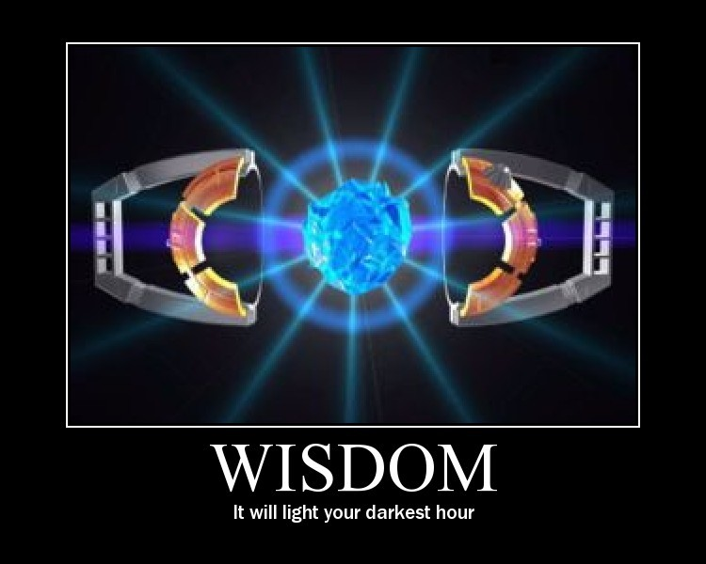
تأتي كلمة حكيم وحكمة أكثر من 30 مرة في جامعة 7-12

Slide 11
1. أطع السلطات بسبب الفوائد العديدة (8: 1-9)

Slide 12
جامعة ٨ : ١ من كالحكيم؟ ومن يفهم تفسير أمر؟ حكمة الإنسان تنير وجهه، وصلابة وجهه تتغير.

Slide 13
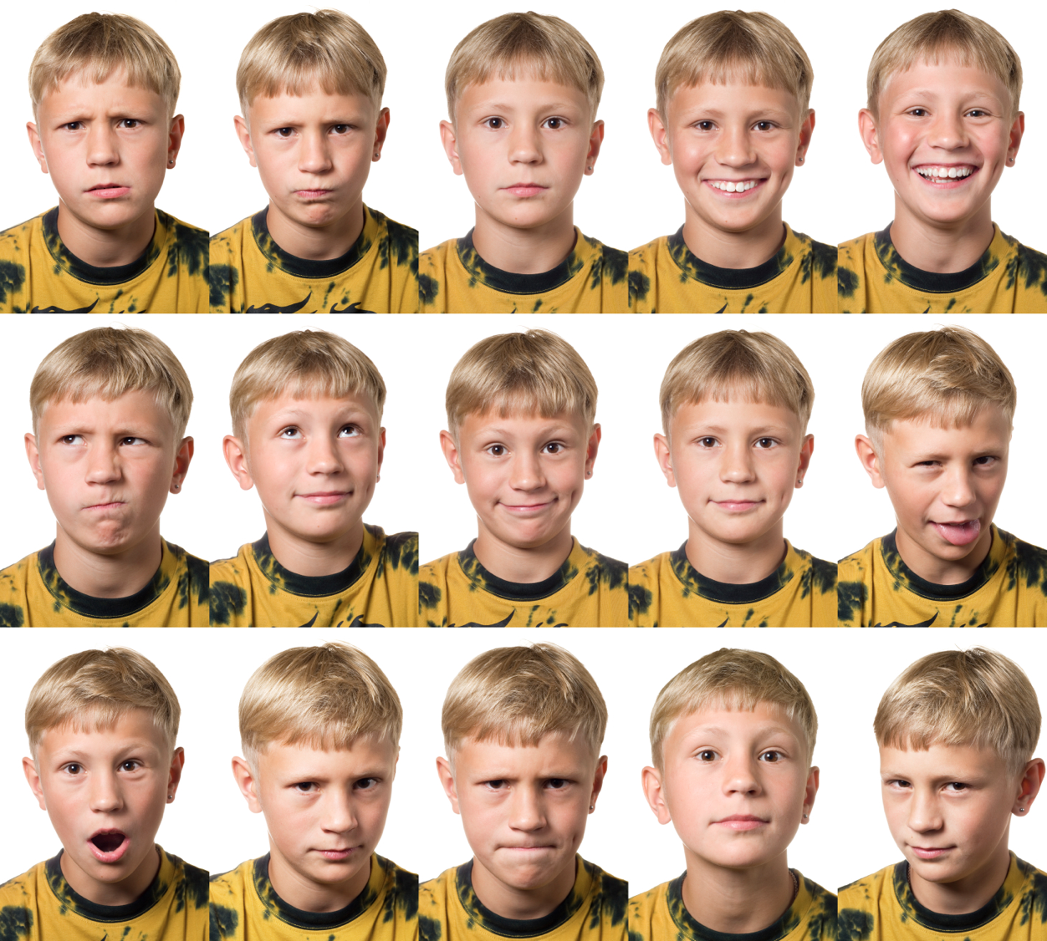
Varied Expressions

Slide 14
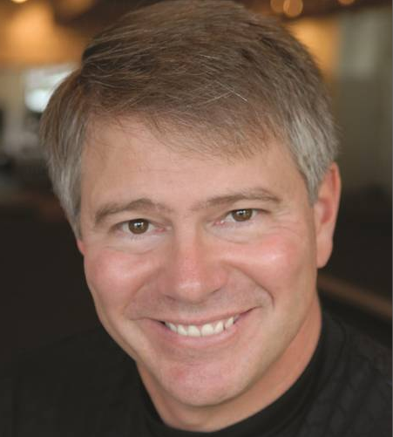
تخبر الحكمة عادة عن وجهك.
القس آلان رايت
Notes:
http://www.joyfm.org/2011/02/turn-it-around-with-alan-wright/
Ask the Pastor
Alan Wright
Joy FM is Real Music for Real Life … because Real Life happens to us all. Do you wonder how the Gospel applies to YOUR problem or need RIGHT NOW, TODAY? Maybe you're interested to know what God's word says on a topic, but not sure where to turn. You can "Ask the Pastor" when you email our staff pastor, Alan Wright
pastor@joyfm.org
Pastor and Author, Alan Wright
Alan and Anne, are the parents of Bennett and Abigail. They make their home in Winston-Salem, NC where Alan has served as Sr. Pastor of the historic and dynamic Reynolda Presbyterian Church. Alan loves golf, tennis, piano and still going on dates with Anne. Anne, a former teacher, is back at it again as she accommodates the family's ministry schedule by home educating Bennett and Abigail. Bennett is a golfer and avid reader. Abby is a dancer and horseback rider.
Alan was always devoted to sharpening his mind (Phi Beta Kappa from the University of North Carolina Chapel Hill and valedictorian of his Columbia Theological Seminary class), but his heart was touched by the Spirit in deep and profound ways in 1993. That touch of grace began a healing journey in which Alan discovered how the love of God mends the emptiness left from a broken home. Since 1997, Alan has authored several books, all published by the Random House subsidiary, Multnomah Publishers. Readers are inspired by the tapestry of word images that Alan paints and transformed as the truths of God's Word become vivid in new ways. Currently, in addition to his pastoral leadership and weekly preaching, Alan ministers around the world sharing the light of God's love. The daily radio broadcast, Sharing the Light with Alan Wright debuted in 2008. Since 2011, Alan joined The Morning JoyRide as Joy FM's Staff Pastor and tackles the "Ask the Pastor" questions on-air. (Send your questions to pastor@joyfm.org)
- See more at: http://www.joyfm.org/2011/02/turn-it-around-with-alan-wright/#sthash.t33O8Oed.dpuf

Slide 15
أرني كيف يبدو وجه الحكمة

Slide 16
يرى الحكيم فوائد الخضوع للسلطات البشرية (8: 2-9)

Slide 17
أنا أقول: احفظ أمر الملك، وذاك بسبب يمين الله (8: 2)

Slide 18
لا تعجل إلى الذهاب من وجهه، لا تقف في أمر شاق، لأنه يفعل كل ما شاء. حيث تكون كلمة الملك فهناك سلطان، ومن يقول له: ماذا تفعل؟ (8: 3-4)

Slide 19
اخضع للسلطات لأن العصيان له عواقب (8: 5-9)

Slide 20
حافظ الوصية لا يشعر بأمر شاق، وقلب الحكيم يعرف الوقت والحكم (8: 5)

Slide 21
لأن لكل أمر وقتاً وحكماً، لأن شر الإنسان عظيم عليه، لأنه لا يعلم ما سيكون لأنه من يخبره كيف يكون؟ (8: 6-7)

Slide 22
ليس لإنسان سلطان على الروح ليمسك الروح، ولا سلطان على يوم الموت، ولا تخلية في الحرب، ولا ينجي الشر أصحابه (8: 8)

Slide 23
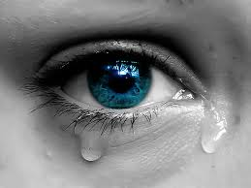
جامعة ٨ : ٩ كل هذا رأيته إذ وجهت قلبي لكل عمل عُمِل تحت الشمس وقتما يتسلط إنسان على إنسان لضرر نفسه.

Slide 24
من نعاقب؟
نحن لا نعاقب الأشخاص السيئين (8: 10-13)

Slide 25
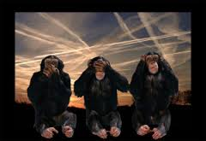
وهكذا رأيت أشراراً يدفنون وضموا، والذين عملوا بالحق ذهبوا من مكان القدس ونسوا في المدينة، هذا أيضاً باطل. (8: 10)

Slide 26
لأن القضاء على العمل الرديء لا يجرى سريعاً، فلذلك قد امتلأ قلب بني البشر فيهم لفعل الشر. (8: 11)

Slide 27
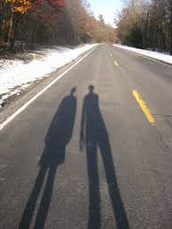
الخاطئ وإن عمل شراً مئة مرة وطالت أيامه، إلا أني أعلم أنه يكون خير للمتقين الله الذين يخافون قدامه، ولا يكون خير للشرير، وكالظل لا يطيل أيامه لأنه لا يخشى قدام الله. (8: 12-13)

Slide 28
من نعاقب؟
نحن لا نعاقب الأشخاص السيئين (8: 10-13)
نحن نعاقب الأشخاص الصالحين بدلاً منهم (8: 14)

Slide 29
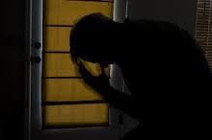
يوجد باطل يجرى على الأرض: أن يوجد صديقون يصيبهم مثل عمل الأشرار، ويوجد أشرار يصيبهم مثل عمل الصديقين. فقلت: إن هذا أيضاً باطل.

Slide 30
1. أطع السلطات بسبب الفوائد العديدة (8: 1-9)

Slide 31
2. نحن نعاقب الأشخاص الخطأ – لهذا فإنها تحيرنا (8: 10-14)

Slide 32
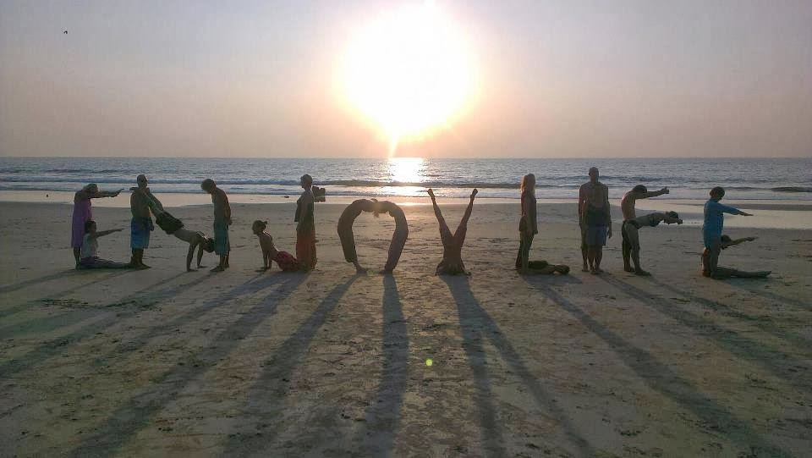
3. تمتع بالحياة واخضع لله حتى لو لم يخبرنا عن أسبابه (8: 15-17)

Slide 33
هل يجب أن تكون الحياة كلها عملاً شاقاً؟

Slide 34
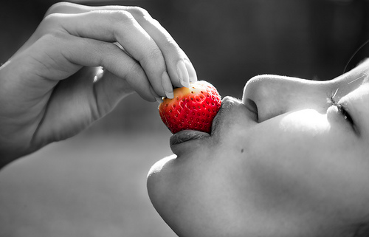
فمدحت الفرح لأنه ليس للإنسان خير تحت الشمس إلا أن يأكل ويشرب ويفرح
وهذا يبقى له في تعبه مدة أيام حياته التي يعطيه الله إياها تحت الشمس
(8: 15)

Slide 35
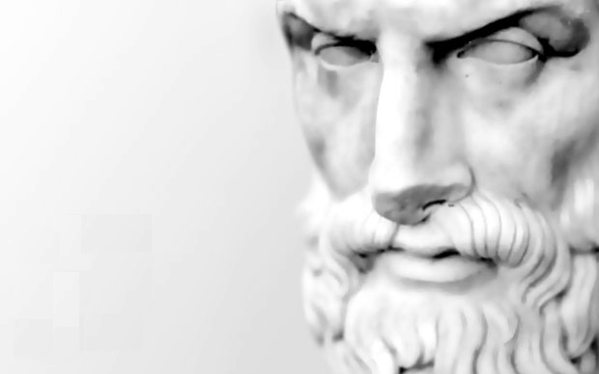
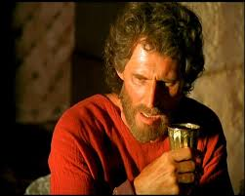
هل كان سليمان أبيقورياً؟ كل واشرب وكن سعيداً
لأننا غداً نموت ــــ أبيقورس

Slide 36
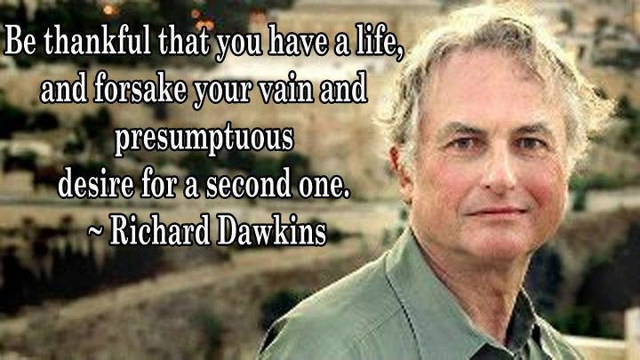
كن شاكراً لأن لديك حياة، وتخلى عن رغبتك العبثية والمتغطرسة في الحصول على حياة ثانية (ريتشارد دوكينز).

Slide 37
يعلمنا الأطفال الكثير عن التمتع بالحياة.

Slide 38
نصيحة عظيمة
عش جيداً
اضحك غالباً
أحبب كثيراً

Slide 39
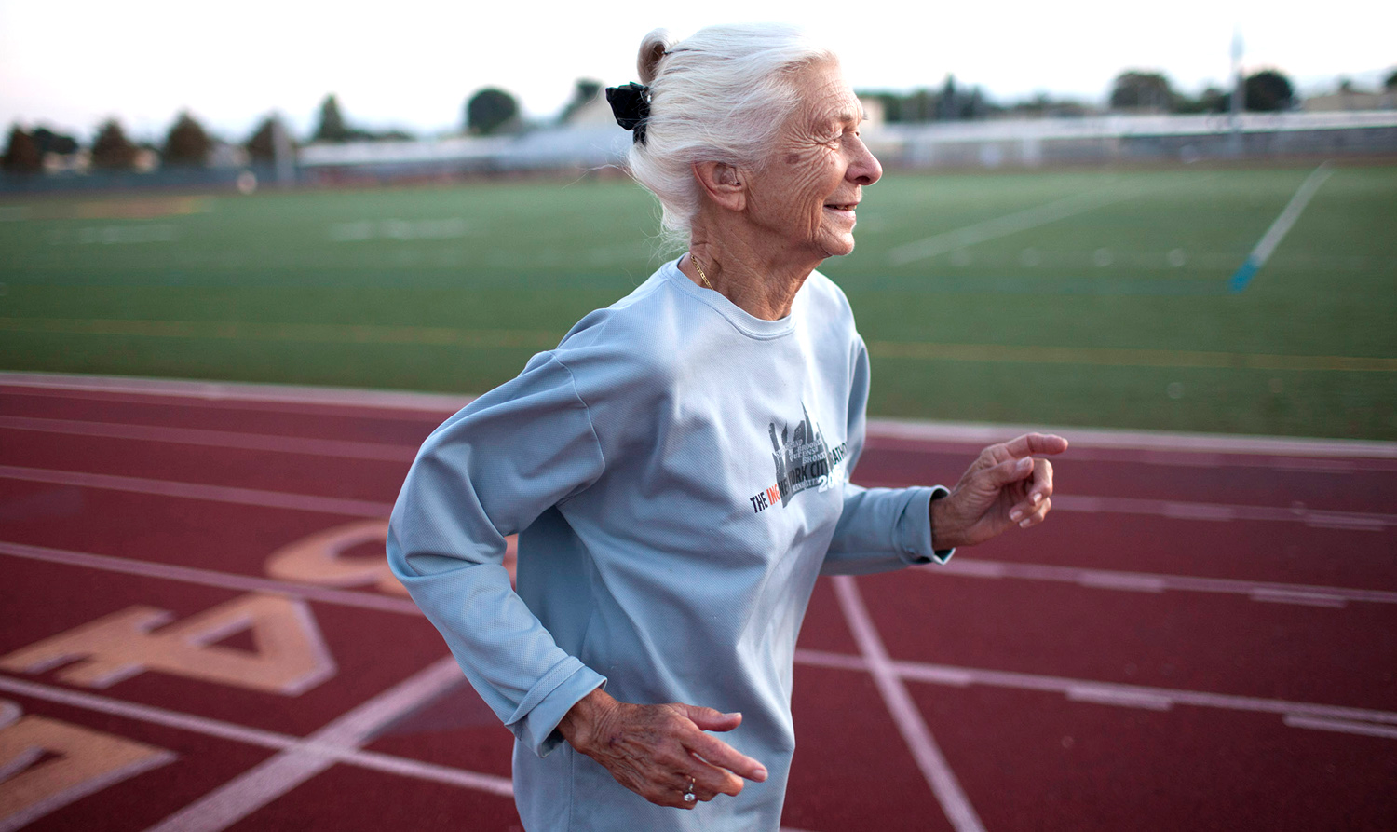
جوي جونسون، 86
أرادت أن تموت وهي تركض. لقد فعلت مباشرة بعد عبور خط النهاية
Notes:
Marathoner 'dies happy' after chasing dream to last mile
http://nypost.com/2013/11/05/i-want-to-die-running-race-fall-fatal-for-marathoner-86/
Published: November 5, 2013 | 5:23pm
She crossed the finish line — and then continued on to the great beyond.
An celebrated octogenarian runner who loved the sport so much that she proclaimed "I want to die running" suffered a deadly injury when she stumbled during Sunday's New York City Marathon.
Joy Johnson, 86, of San Jose, Calif., died Monday from complications of blunt trauma to her head and blood-thinning drug therapy for a heart ailment, according to the Medical Examiner's Office.
Johnson's death was ruled an accident, spokeswoman Grace Brugess said.
Johnson's younger sister, Faith Anderson, said Johnson — who was running her 25th consecutive New York City Marathon — told her that she tripped and fell around Mile 20 of the five-borough foot tour.
That stretch features a dreaded uphill approach to the Willis Avenue Bridge, where many runners hit "the Wall" and lose steam.
Another competitor helped Johnson to her feet and she resumed running, with unofficial results showing that she crossed the finish line after 7 hours, 51 minutes, 41 seconds, making her the oldest woman to complete Sunday's race.
"She did what she wanted," said Anderson, 83, of Young America, Minn.
"She said: If I can die running I'll die happy."
A spokesman for marathon organizer New York Road Runners said Johnson went to the medical tent after finishing the 26.2-mile course and was "alert and in good spirits."
"When evaluated by our medical team she was strongly advised to allow our Emergency Medical Services team to take her to the hospital for further evaluation, but Joy declined," said Chris Weiller of NYRR.
"Our deepest condolences go out to Joy's family and friends. She was an inspiration to us all."
Johnson's death came shortly after she and her sister made their annual post-race pilgrimage to Rockefeller Center to see "Today" show host Al Roker, who greeted Johnson warmly.
"He says to her, 'What happened to you? You have some bandages,'" Anderson recalled.
"She said, 'I wasn't watching where I was running.' She said, 'I'm fine, it just looks awful."
But when they returned to their room at the Roosevelt Hotel, Johnson lay down on her bed and lapsed into unconsciousness, Anderson said.
Hotel security workers and EMTs were unable to revive her, and Johnson was taken to Bellevue Hospital where doctors pronounced her brain dead and Anderson decided to have her taken off life-support machines, she said.
Anderson said her widowed sister began running after retiring as a physical-education teacher, and had completed more than 70 marathons across the country.
"I always said, if we started at the same time I'd get there two weeks later," Anderson said.
A devout Lutheran who ran every day but Sunday so she could attend church, Johnson sang hymns to herself and "thought happy thoughts" to pass the time while running, Anderson said,
Daughter Diana Boydston, 54, said of her mom: "She was always a happy runner — and besides her faith and family, this was something she loved the most."

Slide 40
اخضع لله حتى لو كنت لا تعرف طرقه (8: 16-17).

Slide 41
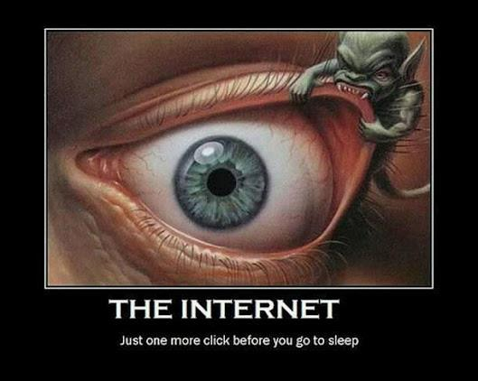
لما وجهت قلبي لأعرف الحكمة، وأنظر العمل الذي عمل على الأرض، وأنه نهاراً وليلاً لا يرى النوم بعينيه (8: 16)
الإنترنت
نقرة واحدة فقط قبل أن تذهب إلى النوم

Slide 42
العلماء = مدمنو العمل السعداء؟
Notes:
A new study has found what many already know – that when the sun goes down researchers don't go to bed, but continue working on into the wee small hours of the night. And many of them also carry on working through the weekend too.
'In the science community, achievements always correlate with hard work,' according to a paper written by a team of Chinese researchers, who have been following the working habits of scientists around the world. 'Motivated by the pressure of competition from all over the world, most scientists today are living and breathing their work.'
In the Chinese study, researchers at Dalian University of Technology used a 'novel method' to monitor researcher work habits. They analysed global downloads of scientific papers from the German publisher Springer Verlag, which provides real time download information on its website Realtime.springer.com.
Beyond expectations
The team monitored download data in April 2012 during the working week and over two separate weekends, dividing each day into 144 slots of 10 minutes. The researchers focused on the three biggest downloaders: the US (29.6% of total), Germany (15%), and China (9.6%). The UK came in at fourth place with 3.9% of total downloads.
Chinese scientists are more likely to be downloading papers at weekends than their counterparts in the US and Germany. © Elsevier
Unsurprisingly, downloads in the three countries slowed down during the night and on weekends, but never ceased. However, scientists in the US were most likely to be working through the night, with post-midnight to sunrise downloads remaining between 100 and 300 downloads for each 10-minute time slot, compared with the weekday late afternoon highs of around 700 downloads. Downloads in Germany and China generally tapered off sharply after midnight to below 50 downloads every 10 minutes until sunrise.
On weekends, night time downloads in all three nations were nearly identical to night time downloads on weekdays. However, weekend downloads during the day in all three nations were down from weekday levels, but not as sharply in China as in the US and Germany.
Scientists: workaholics but happy
6 September 2012Ned Stafford
http://www.rsc.org/chemistryworld/2012/09/scientists-workaholics-research-downloads-long-hours

Slide 43
رأيت كل عمل الله أن الإنسان لا يستطيع أن يجد العمل الذي عمل تحت الشمس، مهما تعب الإنسان في الطلب فلا يجده، والحكيم أيضاً وإن قال بمعرفته لا يقدر أن يجده. (8: 17)

Slide 44
كيف يجب أن نتجاوب مع السلطة لكل من الله والناس؟

Slide 45
اخضع بتواضع للناس والله وسوف تنال الفرح
الفكرة الرئيسية في الجامعة 8

Slide 46
أين تحتاج أن
• تخضع للسلطة؟
• تدرك فهمك المحدود؟

Slide 47
Black

Slide 48
الرابط للعرض التقديميِّ "وعْظُ العهد القديم" متاحٌ على الموقع الإلكترونيّ: BibleStudyDownloads.org
أحصل على هذا العرض التقديمي مجاناً
Notes:
OP Arabic OT Preaching
_____________
Common-29

