Slide 1
شؤون المال
المال
شؤون
الجامعة 5: 8-6: 9
د. ريك جريفيث • مؤسسة الدراسات اللاهوتية الأردنية
CICFamily.com • BibleStudyDownloads.org

Slide 2
هل يستطيع المال أن يشتري السعادة؟
Notes:
Most people believe that more money leads to more happiness.
Many make fun of the old adage about money leading to happiness.

Slide 3
Title
لا يستطيع المال أن يشتري السعادة
ولكنه يستطيع شراء زلاجة مائية، هل سبق لك أن رأيت أحداً حزيناً على الزلاجة المائية؟

Slide 4
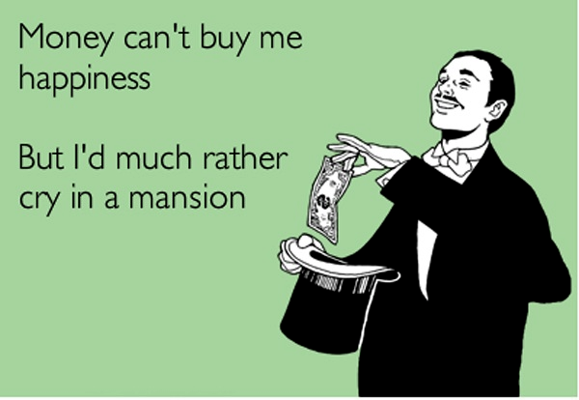
Title
لا يستطيع المال أن يشتري لي السعادة
لكنني أفضل البكاء في القصر.

Slide 5
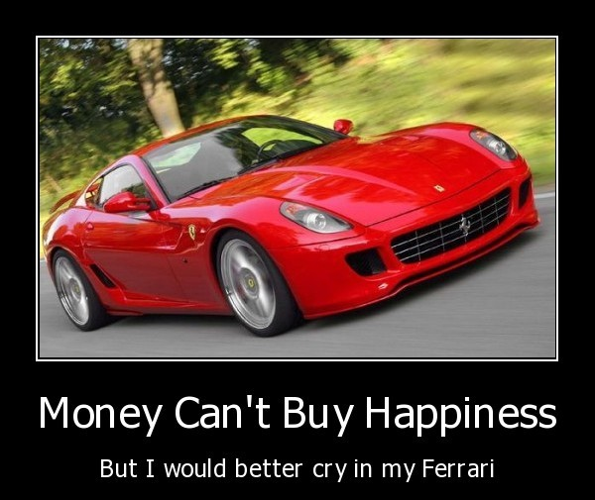
Title
لا يستطيع المال أن يشتري السعادة
لكني أفضل البكاء في سيارتي الفيراري

Slide 6
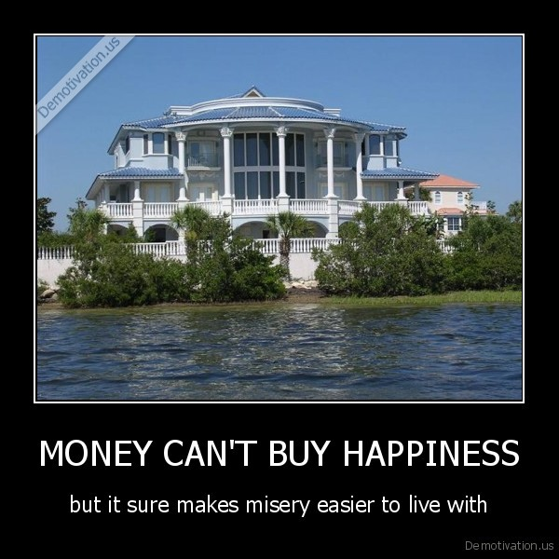
Title
لا يستطيع المال أن يشتري السعادة
لكن من المؤكد أنه يجعل البؤس أسهل للتعايش معه

Slide 7
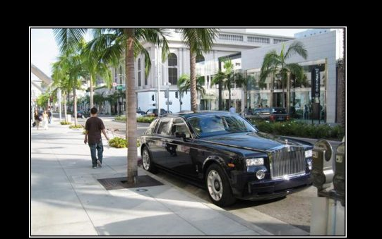
Title
لا يستطيع المال أن يشتري السعادة
ولكن يتيح لك التسوق للحصول عليه في حي أفضل

Slide 8
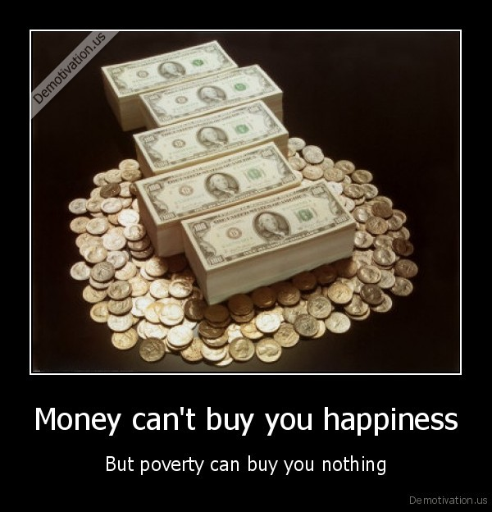
Title
لا يستطيع المال أن يشتري السعادة
لكن الفقر لا يشتري لك شيئاً

Slide 9
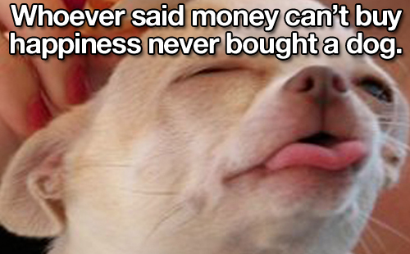
Title
من قال
أن المال لا يشتري السعادة لم يشترِ كلباً أبداً.

Slide 10
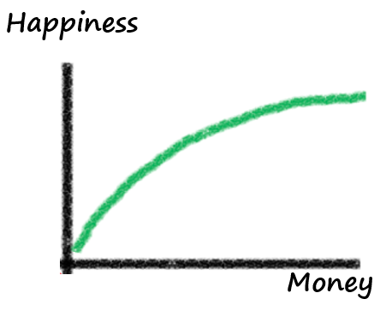
مال أكثر = سعادة أكثر؟
السعادة
المال
Notes:
One article on “Money and Happiness” that I consulted gave some interesting data. The author writes, "The idea here is that while controlling for other factors that might influence happiness, a person's level of happiness should increase with the level of money that they possess. The same also applies to other items that are 'good' and also experiences. If you love chocolate, then two pieces of chocolate are better than one piece. If a holiday is enjoyable, two weeks on a holiday are better than only one week.
The happiness associated with money or the amount of a good thing does not increase in a straight line. The relationship is curved so that the more of something that you already have, the harder it is to increase your level of happiness by having more of it. So going from $10,000 to $20,000 yields a lot more happiness than going from $1,000,000 to $1,020,000. The second chocolate is not quite as enjoyable as the first one (unless you are a very serious chocoholic!). The second week on holiday doesn't bring quite as much relaxation benefits or fun as the first week. Economists call this diminishing marginal utility because the additional satisfaction (marginal utility) from having more of something diminishes with each additional unit. In other words, the additional happiness from one more dollar will be lower than it was for the previous dollar.
Now this all might make a lot of sense. The problem is that people simply don't assess happiness or satisfaction this way on a day-to-day basis. Sure, when people with more money are asked to take stock of their lives, they give the 'socially right' answer by saying that they are happier. However, when asked how happy they are at any particular point of time, people with more money are barely different to those with less money [Diener, Ng, Hartner and Arora (2010)].
So while this classical view of the relationship between money and happiness might make a lot of sense, it is completely wrong!"
Adapted from http://ahingston.wordpress.com/2012/12/14/money-and-happiness/

Slide 11
مكال أكثر = سعادة أكثر؟
يوحنا
يمتلك 300000$
داود
يمتلك 500000$
باري
يمتلك 1000000$
Notes:
I'd like you to conduct a quick thought experiment. Imagine three people: John, David and Barry. For the sake of the thought experiment, I'd like you to imagine that their lives are pretty much the same. They are all equally satisfied with their jobs, they are physically healthy and are all equally happy with their family and relationships. They drive the same type of cars and live in similar houses. Their lives are basically the same.
The only thing that is different is how much money they have. John has $300,000, David has $500,000 and Barry has $1,000,000.
Adapted from http://ahingston.wordpress.com/2012/12/14/money-and-happiness/

Slide 12
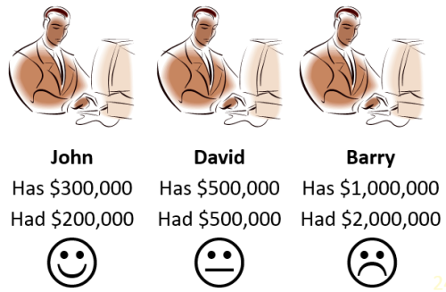
مكال أكثر = سعادة أقل؟
يوحنا
يمتلك 300000$
يمتلك 200000$
داود
يمتلك 500000$
يمتلك 500000$
باري
يمتلك 1000000$
يمتلك 2000000$
Notes:
"To illustrate why the classical view of the relationship between money and happiness is so wrong, let me add one more piece of information to our earlier thought experiment. One year ago, John had $200,000, David had $500,000 and Barry had $2,000,000. Do you see how this extra piece of information changes things quite a bit? John might only have $300,000 but he feels as though things are much better now. He has gained $100,000 in money over the last year. Indeed he has increased his money by 50% in one year and feels good about it. David has the same amount of money that he had one year ago. He is pretty neutral about his money since nothing has changed. He neither feels a sense of gain nor a sense of loss. Barry, on the other hand, is the least happy of the three. In fact, he is very annoyed. Last year he had $2,000,000 but he has lost half of it! He feels as though he has gone backwards."
Adapted from http://ahingston.wordpress.com/2012/12/14/money-and-happiness/

Slide 13
إذا كان المال يأتي بالسعادة، بالتالي يجب أن يمتلك الغني ...
صداقات أكثر أصالة
معدل طلاق أقل
ابتسامات أكثر أصالة
ضحك أكثر
مزيد من وقت الفراغ للإستمتاع بالحياة
قصد وتوجه أكبر في الحياة

Slide 14
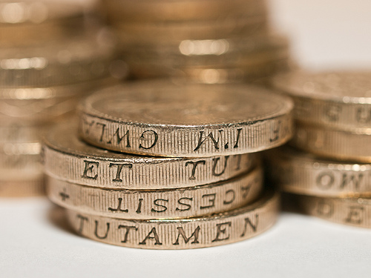
ماذا يجب أن تكون نظرتنا للمال؟
Notes:
Is there any correlation between wealth and happiness?

Slide 15
شؤون المال
Notes:
Our title today is Money Matters. It does! So let's look at the poor and the rich to see if there is any correlation between who is satisfied or dissatisfied with life.

Slide 16
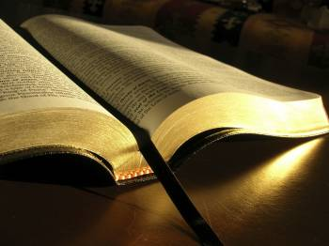
سليمان عن المال في جامعة 5: 8-6: 9
Notes:
Solomon knew about wealth more than anyone, so what correlation did he discover between money and fulfillment in life?
He penned his conclusions in Ecclesiastes 5:8–6:9.
Solomon’s first conclusion regarding wealth here is a command…

Slide 17
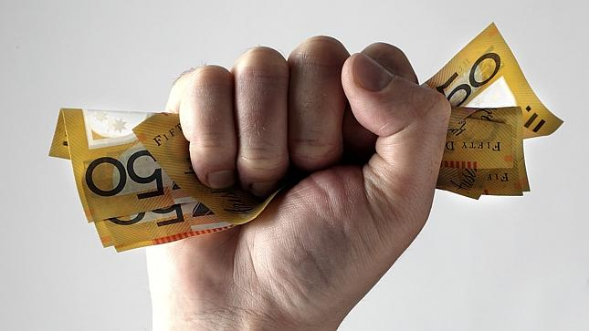
1. لا تستغرب أن بعض المسؤولين الفاسدين يكنزون الثروة (5: 8-9)

Slide 18
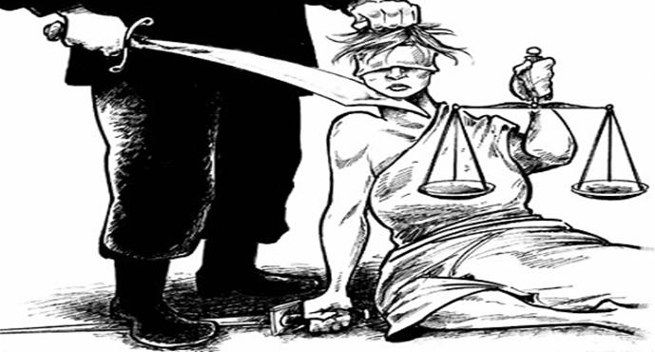
أ: لا ينبغي أن يكون الظلم وإنكار العدل والبر مفاجئاً (5: 8 أ).
ب. يحدث الإبتزاز والجشع على جميع مستويات الحكومة، بما في ذلك المستويات العليا (5: 8ب-9).

Slide 19
رسم حرف (ن) العربي على بيوت المسيحيين (وضع علامة عليها للتدمير) وهو الحرف الأول من كلمة نصراني
Notes:
ISIS continues its march across Iraq.

Slide 20
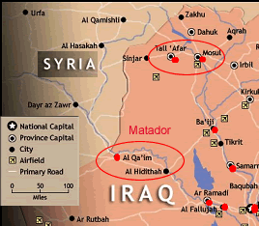
Map

Slide 21
1. لا تستغرب أن بعض المسؤولين الفاسدين يكنزون الثروة (5: 8-9)

Slide 22
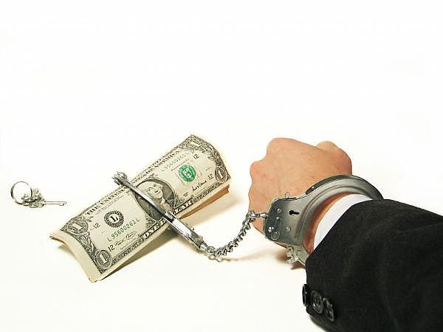
2. للمادية نتائج محزنة كثيرة (5: 10-17)

Slide 23
عدم الإكتفاء من يحب الفضة لا يشبع من الفضة، ومن يحب الثروة لا يشبع من دخل. هذا أيضا باطل. (5: 10)
نتائج المادية المحزنة

Slide 24
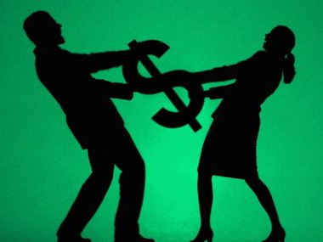
الخلافات الزوجية
نتائج المادية المحزنة

Slide 25
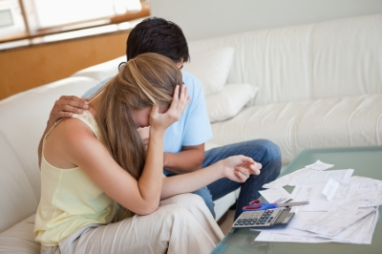
كن متوافقاً فيما يتعلق بالمال
نتائج المادية المحزنة

Slide 26
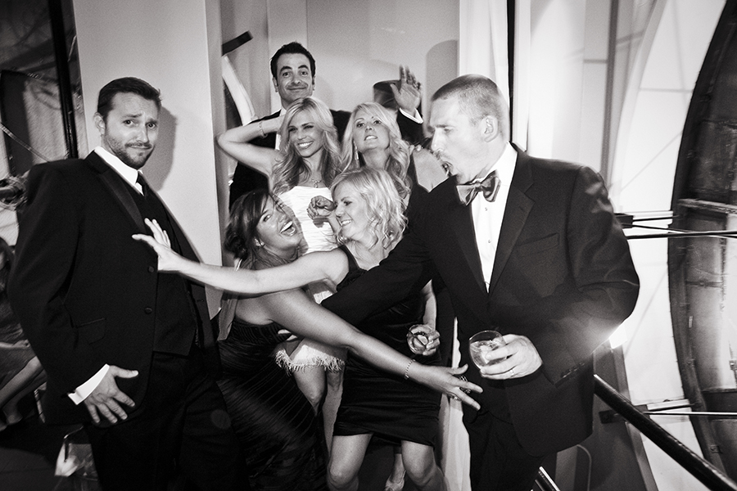
مصاريف أعلى: إذا كثرت الخيرات كثر الذين يأكلونها ... (5: 11أ)
نتائج المادية المحزنة

Slide 27
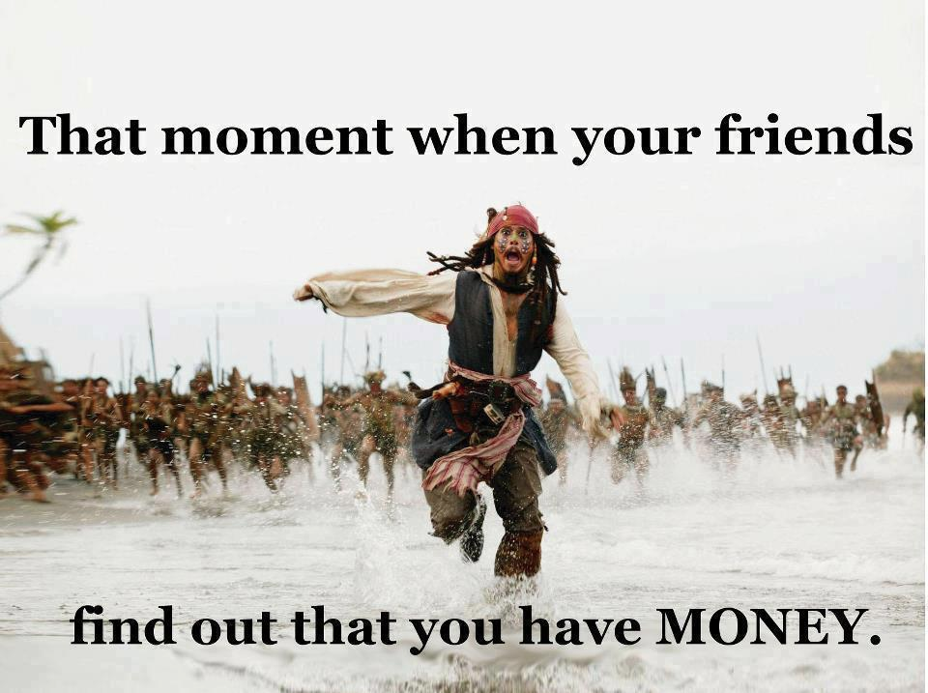
"The more you have, the more people come to help you spend it…" (5:11a NLT).
نتائج المادية المحزنة
تلك اللحظة التي يكتشف فيها أصدقائك
أنك تمتلك المال.

Slide 28
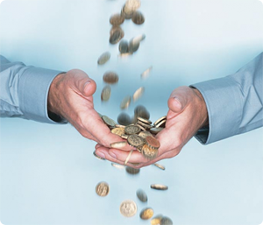
وأي منفعة لصاحبها إلا رؤيتها بعينيه؟ (5: 11)
نتائج المادية المحزنة

Slide 29
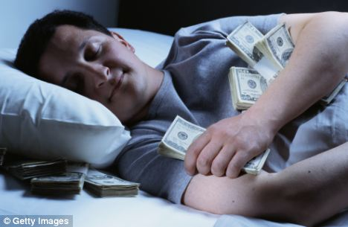
حقاً؟
نتائج المادية المحزنة

Slide 30
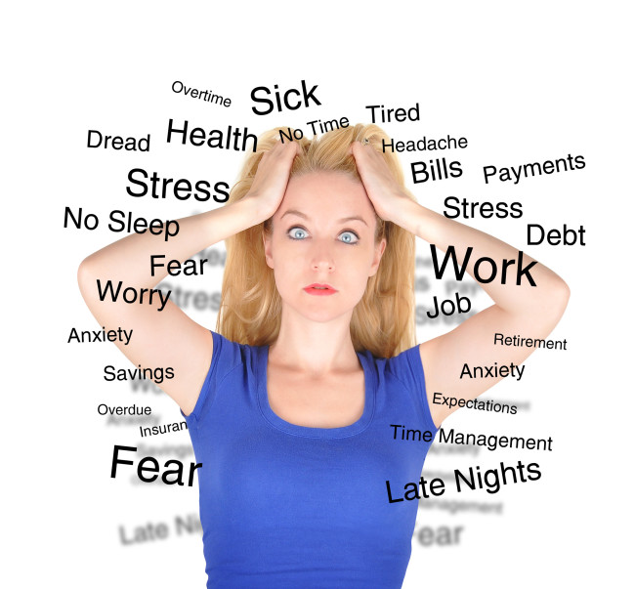
الأرق: نوم المشتغل حلو إن أكل قليلاً أو كثيراً، ووفر الغني لا يريحه حتى ينام. (5: 12)
نتائج المادية المحزنة

Slide 31
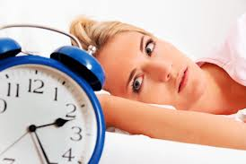
هل تفقد النوم بسبب المال؟
نتائج المادية المحزنة

Slide 32
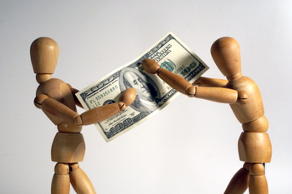
يوجد شر خبيث رأيته تحت الشمس: ثروة مصونة لصاحبها لضرره. (5: 13)
نتائج المادية المحزنة
آلام النفس

Slide 33
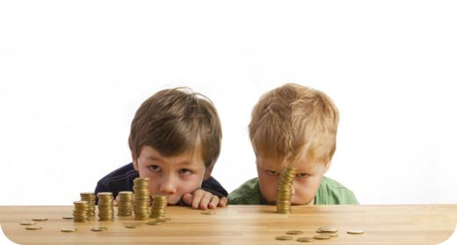
فهلكت تلك الثروة بأمر سيء، ثم ولد ابناً وما بيده شيء. (5: 14)
نتائج المادية المحزنة
لم يترك ميراثاً لمن يعولهم

Slide 34
لا يوجد شيء لأخذه إلى الحياة القادمة: كما خرج من بطن أمه عرياناً يرجع ذاهباً كما جاء، ولا يأخذ شيئاً من تعبه فيذهب به في يده. وهذا أيضاً مصيبة رديئة، في كل شيء كما جاء هكذا يذهب، فأية منفعة له، للذي تعب للريح؟ (5: 15-16)
نتائج المادية المحزنة

Slide 35
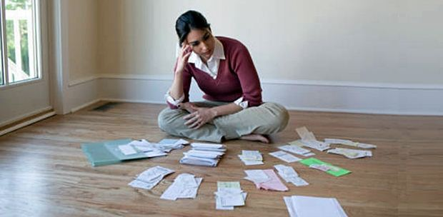
أيضا يأكل كل أيامه في الظلام، ويغتم كثيراً مع حزن وغيظ (5: 17)
نتائج المادية المحزنة

Slide 36
1. لا تستغرب أن بعض المسؤولين الفاسدين يكنزون الثروة (5: 8-9)

Slide 37
2. للمادية نتائج محزنة كثيرة (5: 10-17)

Slide 38
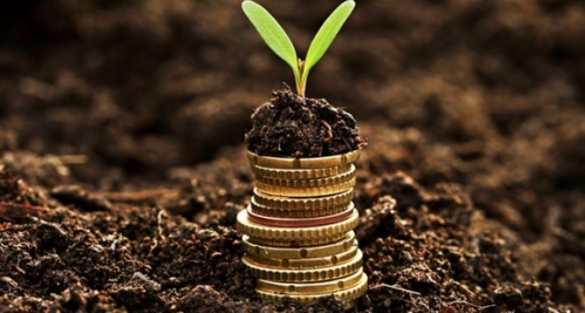
3. يعطي الله المال إما للعاملين أو للآخرين كي يتمتعوا (5: 18-6: 9)
Notes:
The Lord wants someone to benefit from money—either you or someone else!

Slide 39
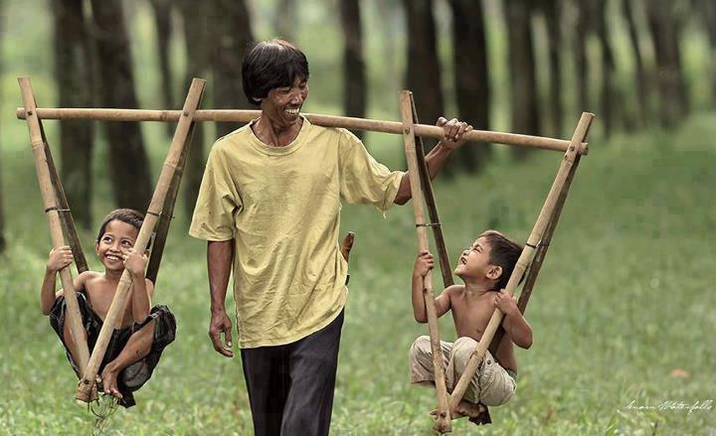
هوذا الذي رأيته أنا خيراً، الذي هو حسن: أن يأكل الإنسان ويشرب ويرى خيراً من كل تعبه الذي يتعب فيه تحت الشمس
مدة أيام حياته التي أعطاه الله إياها، لأنه نصيبه.
(5: 18)

Slide 40
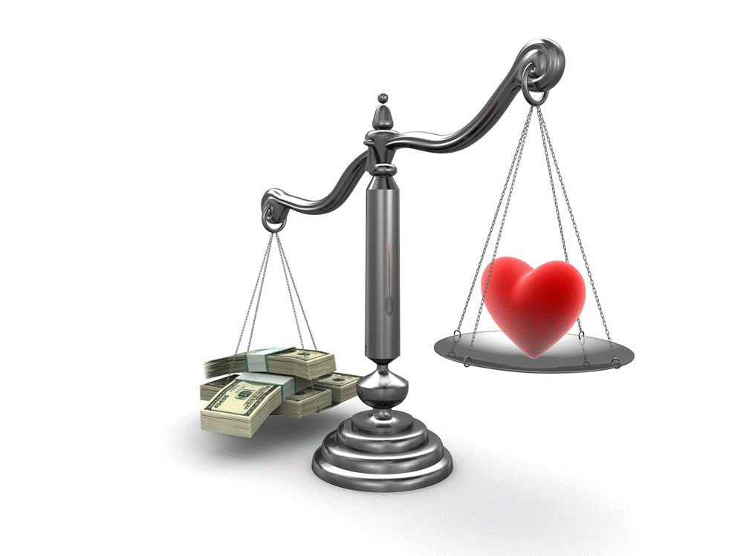
الغني هو من يكسب أكثر مما ينفق، والفقير من زادت نفقاته على دخله.
Notes:
How do you know if you are rich or poor? Someone has said, “Rich is the one who earns more than he spends and poor is the one whose expenses exceed his income.”

Slide 41
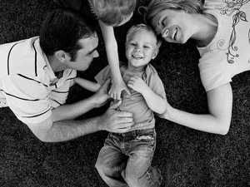
استمتع بما تملك مع من تملك

Slide 42
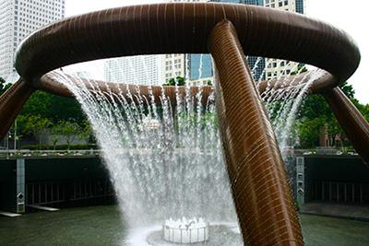
يسمح الله للبعض أن يتمتعوا بثروتهم كعطية من الله (5: 19-20)

Slide 43
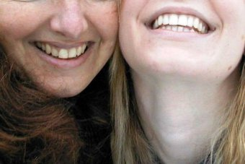
أيضاً كل إنسان أعطاه الله غنى ومالاً وسلطه عليه حتى يأكل منه، ويأخذ نصيبه ويفرح بتعبه، فهذا هو عطية الله (5: 19)
Notes:
Verse 19 shows us that God isn’t against money!

Slide 44
لأنه لا يذكر أيام حياته كثيراً، لأن الله ملهيه بفرح قلبه. (5: 20)
Website
Notes:
Verse 20 says that accepting your lot in life helps you look forward instead of looking back at the past.

Slide 45
يمنع الله كثيرين من التمتع بثرواتهم وكرامتهم (6: 1-2).

Slide 46
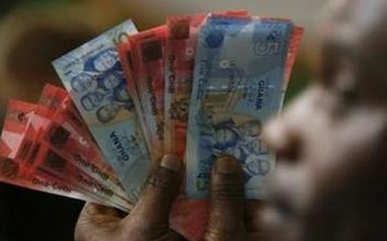
يوجد شر قد رأيته تحت الشمس وهو كثير بين الناس: رجل أعطاه الله غنى ومالاً وكرامة، وليس لنفسه عوز من كل ما يشتهيه، ولم يعطه الله استطاعة على أن يأكل منه، بل يأكله إنسان غريب. هذا باطل ومصيبة رديئة هو. (6: 1-2)
Notes:
God prevents some people from enjoying their wealth and honor (6:1-2a).
God gives their wealth to others instead, which is very perplexing and painful (6:2b).

Slide 47
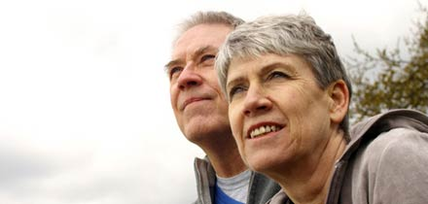
إذا لم تستمتع بممتلكاتك، فلن تستمتع بالحياة أبداً (6: 3-9).

Slide 48
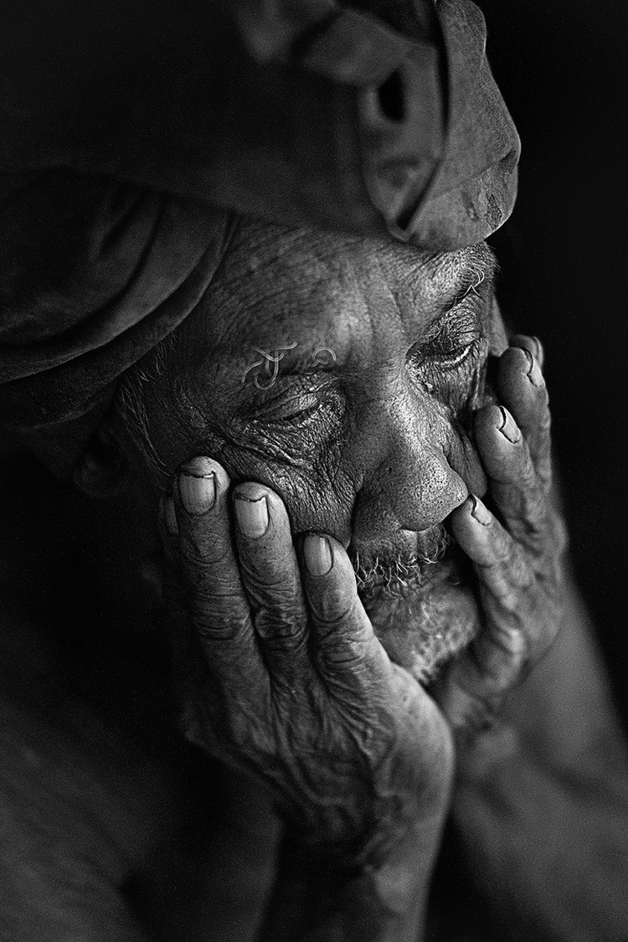
إن ولد إنسان مئة، وعاش سنين كثيرة حتى تصير أيام سنيه كثيرة، ولم تشبع نفسه من الخير، وليس له أيضاً دفن، فأقول إن السقط خير منه (6: 3)
Notes:
It is better to be stillborn than to be wealthy and miserable (6:3-6).

Slide 49
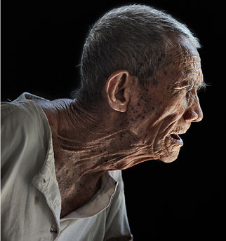
لأنه في الباطل يجيء، وفي الظلام يذهب، واسمه يغطى بالظلام. وأيضاً لم ير الشمس ولم يعلم. فهذا له راحة أكثر من ذاك. (6: 4-5)
Notes:
Miscarriages don't benefit from being born (6:4).
Miscarriages don't have any joys so they don't miss them (6:5).

Slide 50
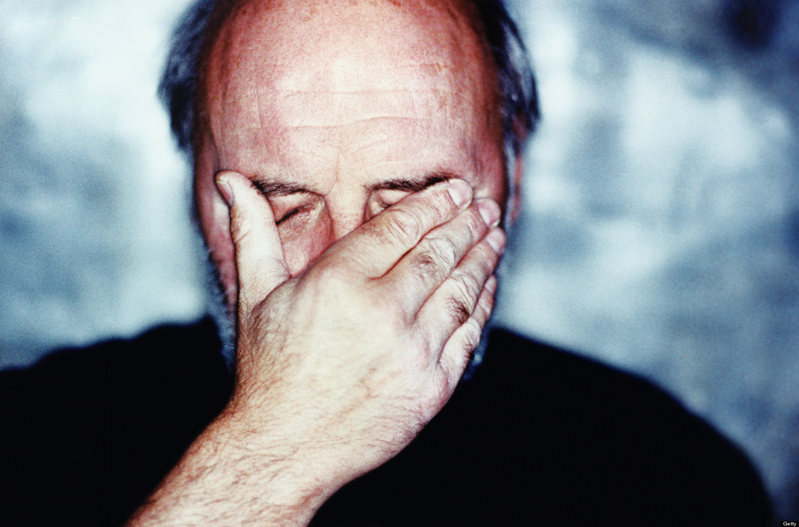
وإن عاش ألف سنة مضاعفة ولم ير خيراً، أليس إلى موضع واحد يذهب الجميع؟ (6: 6)
Notes:
Miscarriages and rich, unfulfilled men both eventually die anyway (6:6).

Slide 51
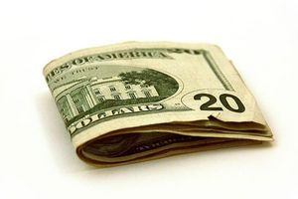
الحياة عقيمة بالنسبة لأولئك الذين لا يشبعون من أموالهم (6: 7-9).

Slide 52
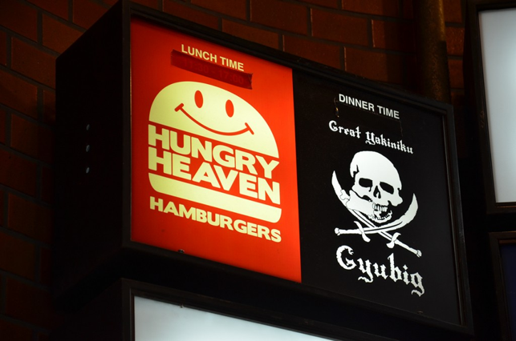
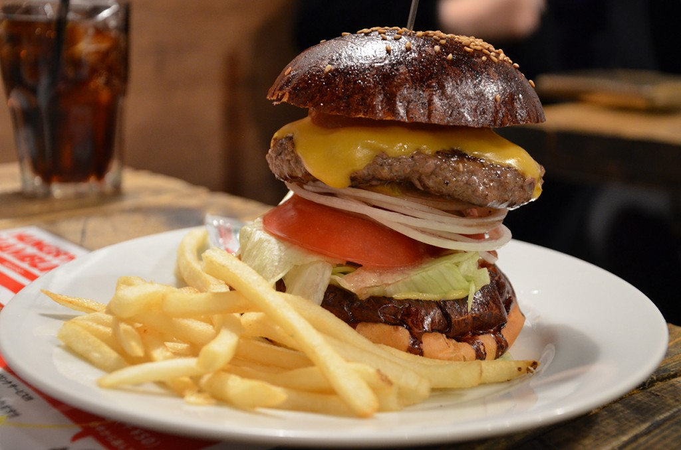
كل تعب الإنسان لفمه، ومع ذلك فالنفس لا تمتلئ. (6: 7)
Notes:
We work to eat but food doesn't ultimately satisfy (6:7).
Some think that eating at places like Hungry Heaven in Tokyo will satisfy.

Slide 53
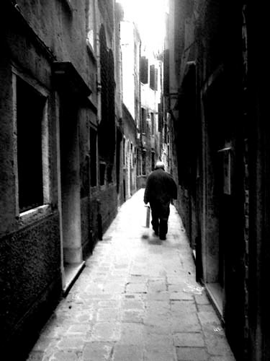
لأنه ماذا يبقى للحكيم أكثر من الجاهل؟ ماذا للفقير العارف السلوك أمام الأحياء؟ (6: 8)
Notes:
Wisdom and poverty don’t conquer materialism (6:8).

Slide 54
رؤية العيون خير من شهوة النفس. (6: 9 أ)
Notes:
Materialists are never satisfied (6:9a).

Slide 55
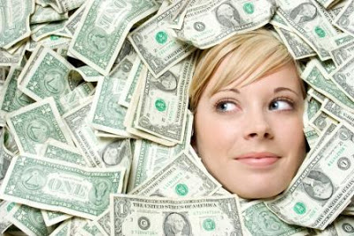
هذا أيضاً باطل وقبض الريح(6: 9ب)
Notes:
Materialism is a worthless pursuit (6:9b).

Slide 56
كيف يجب أن تكون نظرتنا للمال؟
Notes:
Wow, a lot of wisdom on money in one chapter! Can we sum it all up in a sentence? Try this…

Slide 57
الفكرة الرئيسية في 5: 8-6: 9
للمادية نتائج سلبية كثيرة
لكن الناس الأتقياء يستطيعون التمتع بالثروة
Notes:
Hoarding money brings many disillusioning results, but one who honors God can enjoy money (restated MI).

Slide 58
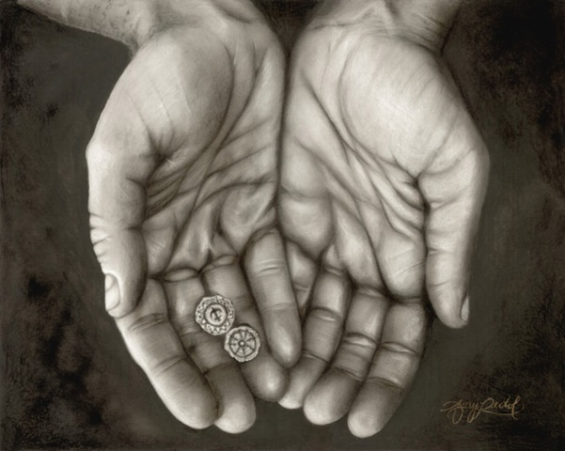
ثلاث حقائق عميقة عن المال...
Notes:
Solomon has given us three profound truths today:

Slide 59
1. لا تستغرب أن بعض المسؤولين الفاسدين يكنزون الثروة (5: 8-9)

Slide 60
2. للمادية نتائج محزنة كثيرة (5: 10-17)

Slide 61
3. يعطي الله المال إما للعاملين أو للآخرين كي يتمتعوا (5: 18-6: 9)
Notes:
The Lord wants someone to benefit from money—either you or someone else!

Slide 62
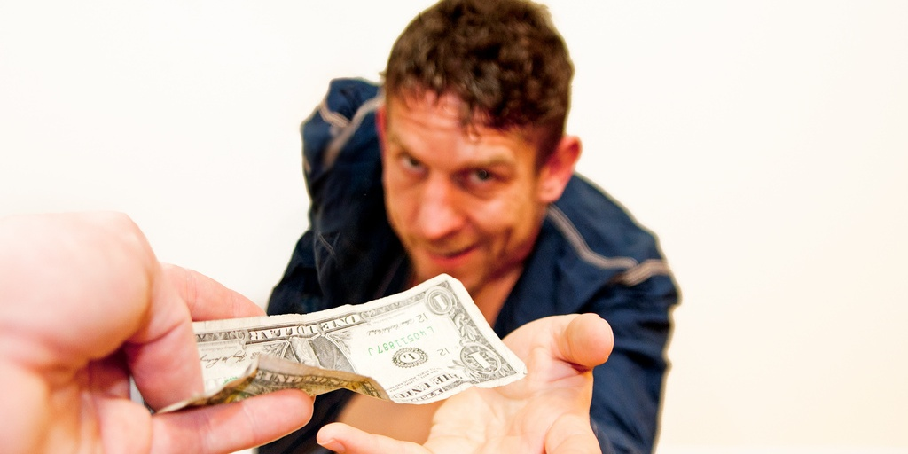
هل أنت راضٍ بما لديك من المال؟

Slide 63
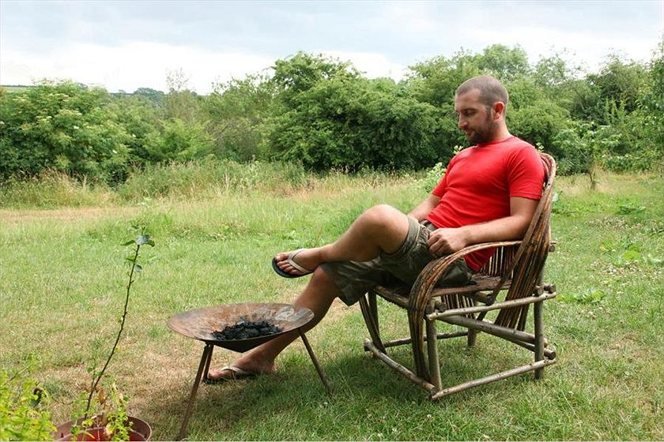
رجل بلا مال يجد السعادة
Notes:
Moneyless man finds happiness
Mark Boyle ABC Environment 9 Oct 2013
Mark Boyle believes that a life free of money liberates and inspires. Credit: Jose Lasheras (supplied)
See also
Related Story: The man who lives without money Mark Boyle 12 Apr 2010
Comments (174) Mark Boyle, a man who 5 years ago decided to live without money, is surviving and thriving. He has plans for a new venture and he just got engaged.
IT WAS 2008 and news of the deep-rooted problems in the financial industry had begun to hit the headlines. People were losing their jobs and their homes, and the institutions we perceived to be the bedrock of our society were crumbling around us. Within days we were on the verge of an "economic meltdown". Whilst my heart despaired for the ordinary people's lives that were being drastically affected by decisions made outside of their control, I remained insulated from it all through the unlikeliest of routes: I had just begun living completely without money.
Up to that point I had spent years feeling overwhelmed by the horrors I was witnessing around me — the mass extinction of species, homogenisation of cultures, mechanisation of our livelihoods and the general flat-packing of the Earth along the assembly line of industrial civilisation. I wanted to do something to act as a counter-friction to the cogs of the machine economy, which I believed were reducing our beautifully diverse world to cold, inanimate numbers. But as globalisation disempowers us through its sheer scale, I, like most of us, had absolutely no idea what meaningfully to do about any of it.
That all changed one day, after a long process of inquiry. I came to the understanding that, in general terms, these issues had a common denominator: they were symptoms of our perceived separation from the natural world and each other. This can seem like an abstract concept to grasp, but at its heart it means that, through various means, we have convinced ourselves that our own health is not dependent on the health of the Earth as a whole, and that somehow our fate is not linked to that of the intricate web of life we're inextricably dependent on. Through this realisation came a second one: that money is the most potent tool we possess in creating and perpetuating this illusion of separation and independence.
Through its function as a medium of exchange, money allows us to consume products with components or ingredients from all over the Earth. On a short-term and often superficial level, this can seem like it has many benefits. What wasn't being spoken about at the time, however, were the unintended consequences of money, and like all technologies, it has far-reaching and deep consequences. Apart from its widely ignored psychological, emotional, spiritual and physical effects on us personally, it also affords us an unwise buffer from the abuses and massacres that occur throughout the supply chains of the products we consume, and all the social and ecological problems associated with that.
After speaking out about these for a time, I began to feel that talk was cheap. I was also embroiled in the world of money as much as the next person, and so my arguments felt arrogant and theoretical. How could I know if a life without money was even possible or desirable, and if it was, how would it feel as a human to live without money in a world increasingly addicted to it? So in 2008 I decided to live without money, as a one year experiment initially. It became the greatest experience of my life.
A lot has changed since I started out on this path, both in myself and the world around me. As the financial world began to crumble, it became clear to me that this 'economic meltdown' was a misnomer; what it was, in fact, was a 'financial meltdown'. Politicians and economists alike have been conflating 'finance' with 'economics' for so long that we can now only imagine an economy facilitated by money.
The man who lives without money "If someone told me seven years ago, in my final year of a business and economics degree, that I'd now be living without money, I'd have probably choked on my microwaved ready meal..." Read the first part of Mark's story here. However, despite the headlines, another model — what anthropologists refer to as gift culture — was filling the void left by the dearth of money and credit. Economics, contrary to popular opinion, has very little to do with money; it is simply a social science concerned with how we meet our needs. Money is obviously one way of doing this. What I began learning in 2008 was that there are no end of ways you can meet your needs without money, and more than one way of being human in this world.
The gift economy has since become the only booming economy in the world. This ancient form has taken a very modern evolution, and much of it is now organised online. Many popular websites such as Couch-surfing, Freeconomy and Freecycle have seen an astronomical growth in membership as money has become scarcer, and more join every second. Many others projects, both local, national and global, are also helping people reduce their dependency on money. Thankfully this emerging movement is also moving away from its own dependence on industrial infrastructure, and ideas such as Freeshops, gift circles (regular meetings where people offer/request skills, tools, lifts, advice, stuff and so forth for free), clothes swapping parties and freeskilling evenings are quickly taking modern gift culture into a more personal, localised realm.
Life has changed for myself also. Three years after starting to live without money, I was lucky enough to meet someone who shared a similar outlook on life as myself, and within three months we were engaged. Next year we are planning a moneyless wedding. We want to show that you can have a celebration of love without burdening your first years of marital bliss with enormous debt ($37,500 is the average wedding spend), or racking up a hefty ecological footprint, in the process. The home-brew is already being made, and plans for the feast are being formulated. Instead of bringing presents and money for the bride and groom, friends and family will be invited to bring along something to be shared with everyone on the day: an instrument and a song, a bottle of raspberry wine, or their favourite dish. It will be based on participation instead of consumption.
We've also just begun setting up a three acre small-holding in Ireland. We've called it An Teach Saor, meaning The Free House in my mother tongue. Here we plan to merge fossil-fuel free permaculture principles with gift-based values. We're integrating everything from forest gardening to pedal-powered washing machines and humanure composting systems, no-dig perennial crops to rocket stoves and wormeries, into one holistic culture. Augment that with music, storytelling and art and you have the potential to create truly sustainable ways of living.
Our aim, apart from living free and happy lives, is to create closed loop systems that require no ongoing external inputs. It hasn't got all the glamour and glitz of urban life, but I feel it gives me a great sense of freedom, peace, meaning and connection to the entire community of life mine is dependent on. Those are experiences that I believe money can never buy.
Mark Boyle is the author of The Moneyless Man and The Moneyless Manifesto, released by his publishers under a Creative Commons licence. He is the founder of Freeconomy.
http://www.abc.net.au/environment/articles/2013/10/09/3864668.htm accessed 30 Aug 2014

Slide 64
ماذا يقول الكتاب المقدس عن المال؟

Slide 65
الشخص الذي يعطي يُبارَك

Slide 66
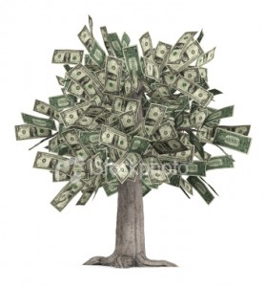
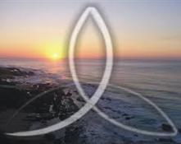
الله؟
أم المال؟
Notes:
Our happiness comes from whether we seek God or money. Which of these two do you seek more: knowing God or accumulating wealth?
Which pursuit takes more of your time? Or think about more?
Are you more interested in passing on to your children Jesus or money?

Slide 67
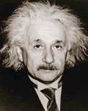
الحياة التي نعيشها من أجل الآخرين هي الحياة الجديرة بالإهتمام آلبرت آينشتاين—
Notes:
Einstein said to live for others…

Slide 68
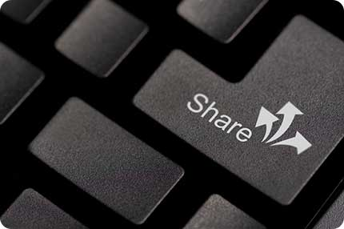
Share!
Notes:
—so do you share your money?

Slide 69
الرابط للعرض التقديميِّ "وعْظُ العهد القديم" متاحٌ على الموقع الإلكترونيّ: BibleStudyDownloads.org
أحصل على هذا العرض التقديمي مجاناً
Notes:
OP Arabic OT Preaching
_____________
Common-29

