Slide 1
ماذا تفعل مع مستقبل غير مؤكد؟
الجامعة 11: 1-6
د. ريك جريفيث, مؤسسة الدراسات اللاهوتية الأردنية
BibleStudyDownloads.org

Slide 2
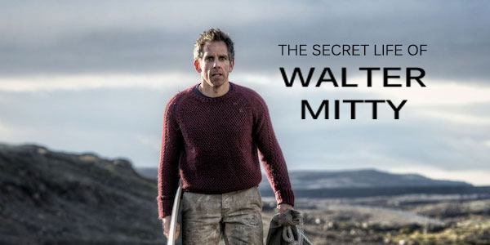
The Secret Life of Walter Mitty Trailer
Notes:
https://www.youtube.com/watch?v=HddkucqSzSM
In the 2013 movie, “The Secret Life of Walter Mitty,” Ben Stiller epitomizes the longings for adventure that many of us have for our future. Yet the future is unknown.

Slide 3
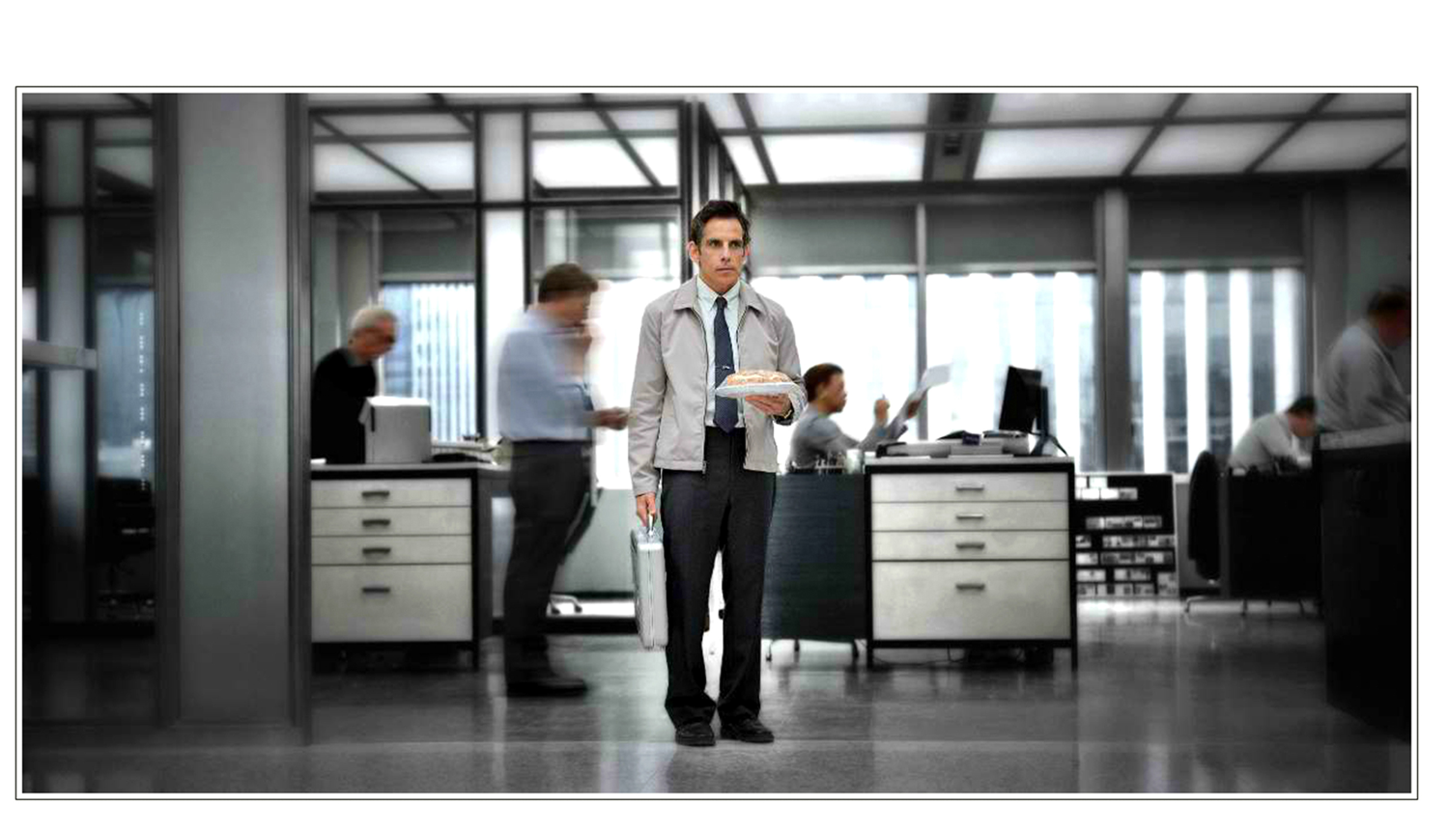
الحياة الحذرة
Notes:
Walter lives what I call “the cautious life.”

Slide 4
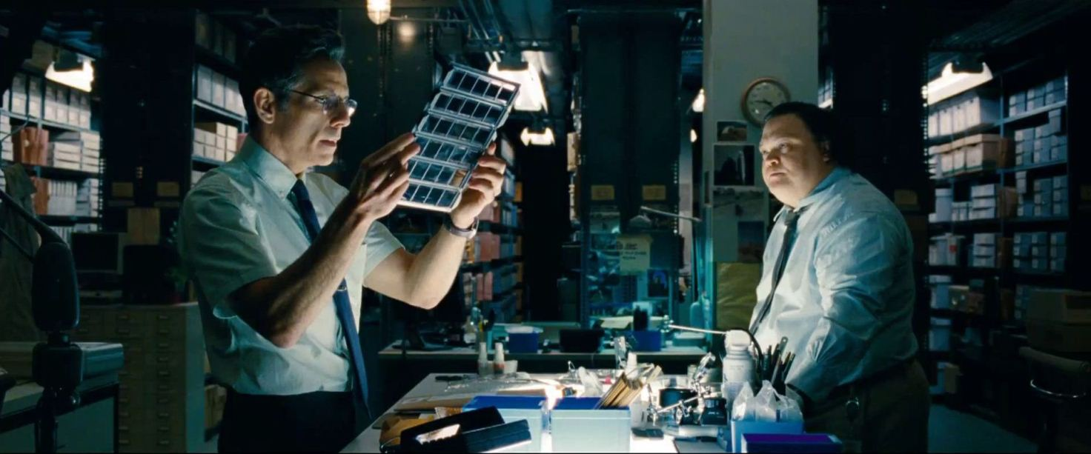
الحياة الحذرة
Notes:
He handles negatives for Life magazine—an insignificant, dead-end job.

Slide 5
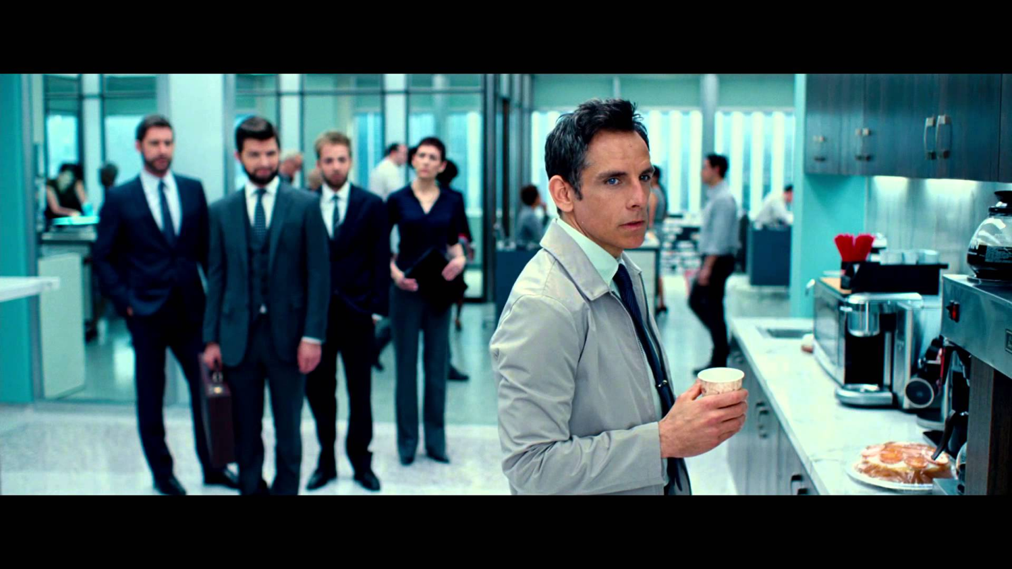
الحياة الحذرة
Notes:
A company reshuffling forces him out.

Slide 6
The Cautious Life
Notes:
So he dreams how he could ever see his dream woman there again. His “secret life” refers to his daydreaming about doing something he deems significant.

Slide 7
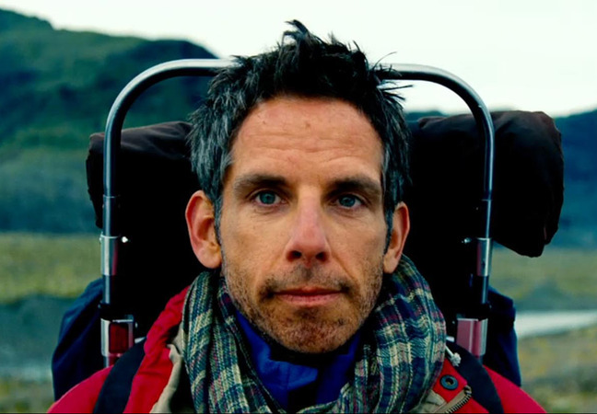
الحياة المغامرة
Notes:
So he, all-of-a-sudden, dares to embrace what I call “The Adventuresome Life.”

Slide 8
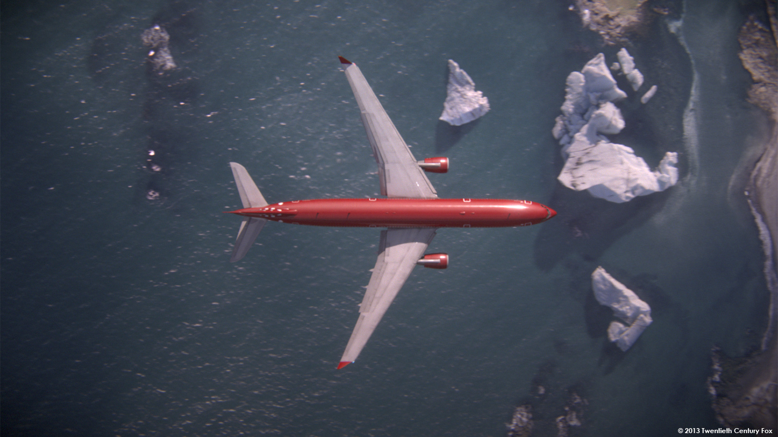
الحياة المغامرة
Notes:
This leads him to Iceland…
He takes on a shark in the ocean…
Skateboards towards a volcano…
…all with dreams of being a “real somebody” in his future.
Why? He wants to embrace his uncertain future with confidence, risk, and no fear.

Slide 9
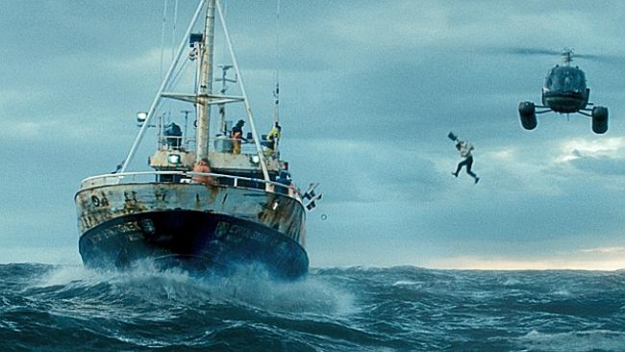
الحياة المغامرة
Notes:
This leads him to Iceland…
He takes on a shark in the ocean…
Skateboards towards a volcano…
…all with dreams of being a “real somebody” in his future.
Why? He wants to embrace his uncertain future with confidence, risk, and no fear.

Slide 10
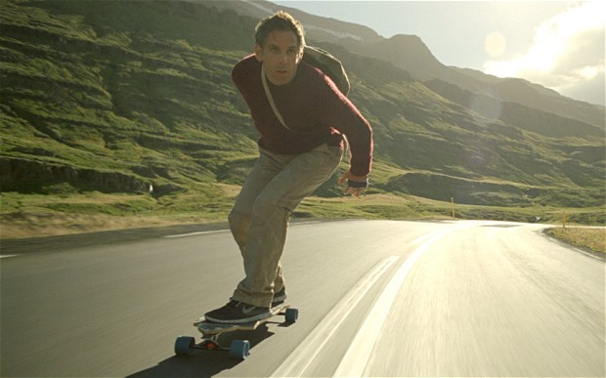
الحياة المغامرة
Notes:
This leads him to Iceland…
He takes on a shark in the ocean…
Skateboards towards a volcano…
…all with dreams of being a “real somebody” in his future.
Why? He wants to embrace his uncertain future with confidence, risk, and no fear.

Slide 11
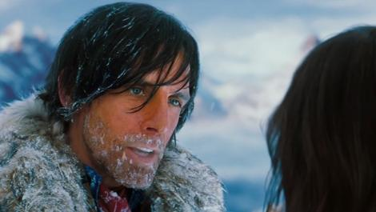
الحياة المغامرة
Notes:
This leads him to Iceland…
He takes on a shark in the ocean…
Skateboards towards a volcano…
…all with dreams of being a “real somebody” in his future.
Why? He wants to embrace his uncertain future with confidence, risk, and no fear.

Slide 12
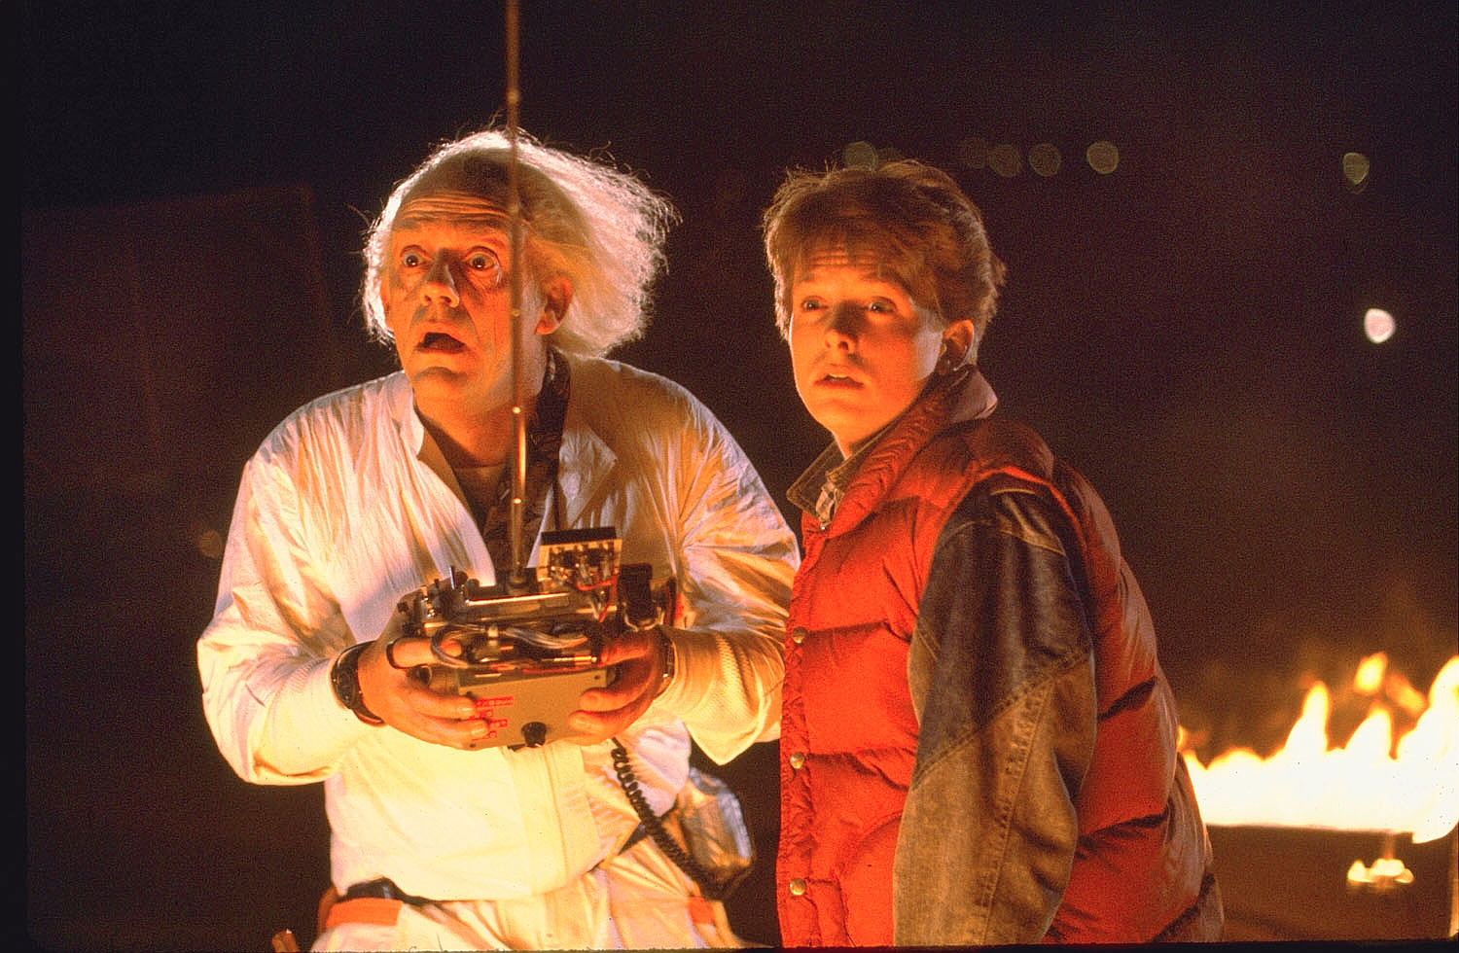
العودة إلى المستقبل
Notes:
None of us knows the future.

Slide 13
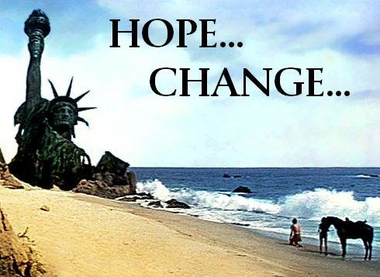
Hope… Change…
Notes:
The 2008 US presidential election was won on “Hope and Change” in the future.

Slide 14
Pulpit Freedom Sunday
Notes:
This very weekend we see one of those changes—The Reformation Project—a so-called “Bible-based, Gospel-Centered, LGBT Inclusion” conference!

Slide 15
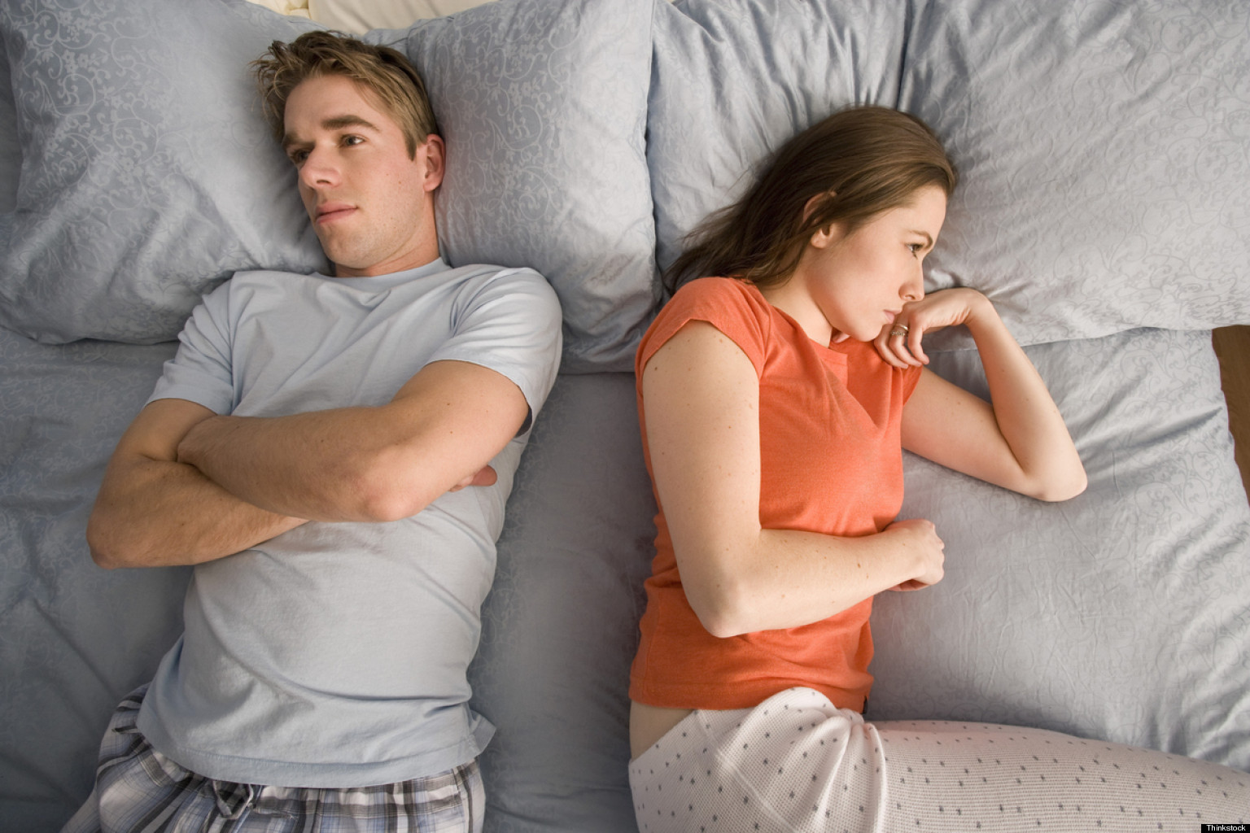
ماذا سيحدث للزواج؟
Notes:
None of us knows the future of the institution of marriage

Slide 16
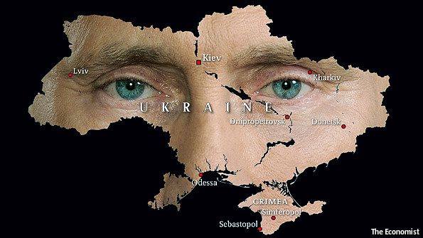
أوكرانيا
Notes:
We don’t know what’s going to happen in Ukraine or any other place
________
Crisis in Ukraine
Kidnapped by the Kremlin
The West can punish Putin's Russia for its belligerence in Ukraine. But only if it is prepared to pay a price
Mar 8th 2014
http://www.economist.com/news/leaders/21598639-west-can-punish-putins-russia-its-belligerence-ukraine-only-if-it-prepared

Slide 17
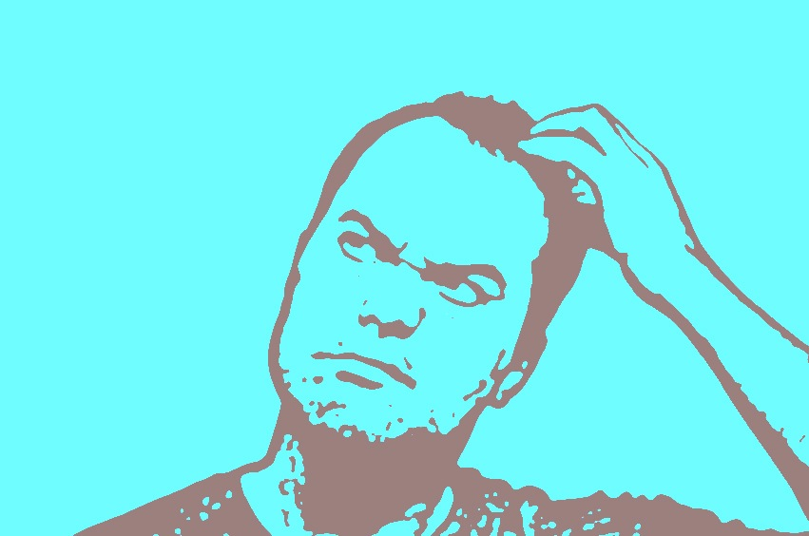
كيف يؤثر عليك المستقبل غير المؤكد؟
• العطاء؟ • الإستثمار؟ • العمل؟
Notes:
How does an uncertain future influence your giving?
How does an uncertain future influence your investments?
How does an uncertain future influence your work?

Slide 18
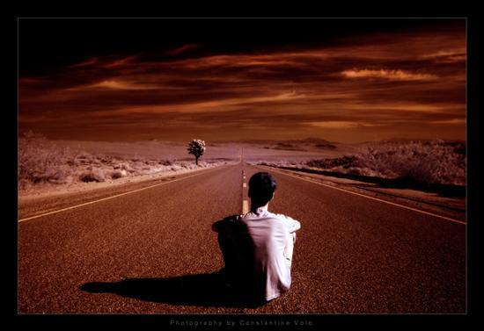
كيف يجب أن يؤثر عليك مستقبلك غير المؤكد؟
Notes:
You don't know what is ahead, so how should you respond to your ignorance?

Slide 19
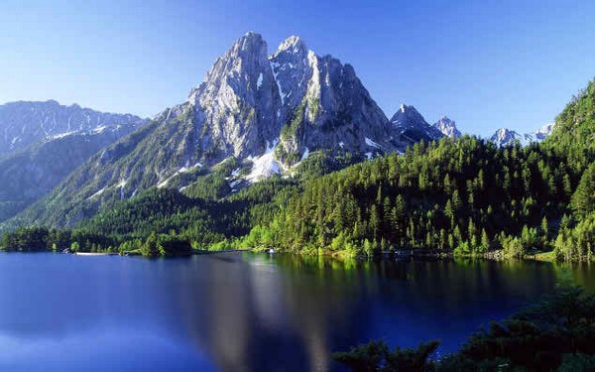
عِش لا تكن موجوداً فقط
Notes:
Solomon's advice is, “Don’t just exist—live!”
“Don’t be satisfied with ho-hum existence—live!”

Slide 20
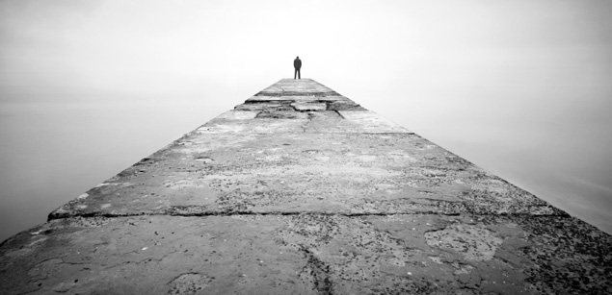
مستقبلنا غير المؤكد
جامعة 11: 1-6
المال (1-3)
العمل (4-6)
Notes:
Today we will see how our ignorance of the future gives us wisdom about money (11:1-3) and work (11:4-6)
Here Solomon first says that your uncertain future affects your view of your money—so...

Slide 21
1. أعط بسخاء واستثمر بحكمة (11: 1-3)
Notes:
Hold money loosely but discerningly since you don't know the future

Slide 22
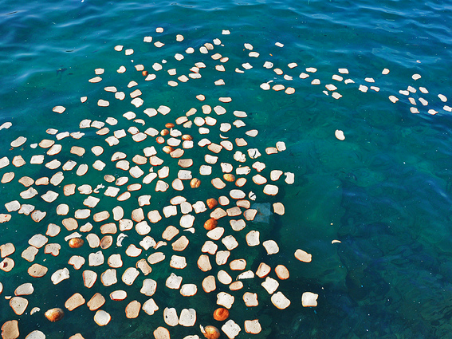
ارم خبزك على وجه المياه فإنك تجده بعد أيام كثيرة (11: 1) فاندايك
افعل الخير
حيثما أمكنك ذلك
فبعد وقت
طال أو قصر
ستجد أن ذلك قد عاد عليك بالخير
(11: 1) المبسطة
Notes:
“Cast your bread upon the waters,” says the NIV. And what will you get? Soggy bread?
What’s the point?
Give generously, for your gifts will return to you later (11:1)
The NLT sees this exclusively referring to business profits [read NLT]
However, can’t it also refer to giving?

Slide 23
عطاء الإرساليات
20%
Notes:
We do this as a family, as we support about seven missionary families—Poolman (Thailand), Roxas (Philippines), Shehadeh (Jordan), Gleason (Nepal), Low (Hong Kong), Berkey (Venezuela), Children of Promise (Africa). We also manage giving from our USA church to students from Mongolia and India.
Our church supports work outside of Singapore with 20% of the offerings given.

Slide 24
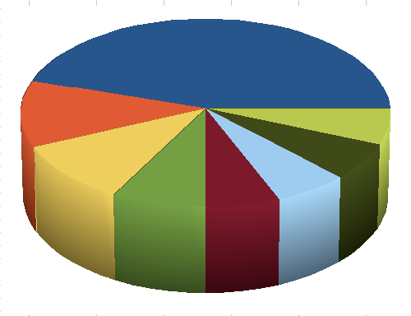
أعط نصيباً لسبعة ولثمانية أيضاً لأنك لست تعلم أي شر يكون على الأرض (11: 2)
Notes:
Don't hoard but give and invest since you don't know the future (11:2).

Slide 25
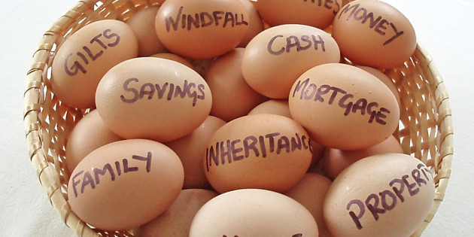
لا تضع كل البيض الذي لديك في سلة واحدة.
Notes:
Don’t "put all your eggs in one basket" since you don't know which ventures will fail (11:2b).

Slide 26
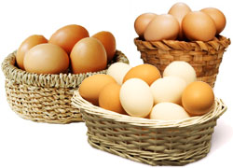
لا تضع كل البيض الذي لديك في سلة واحدة.
Notes:
It is wise to put those eggs into different baskets.

Slide 27
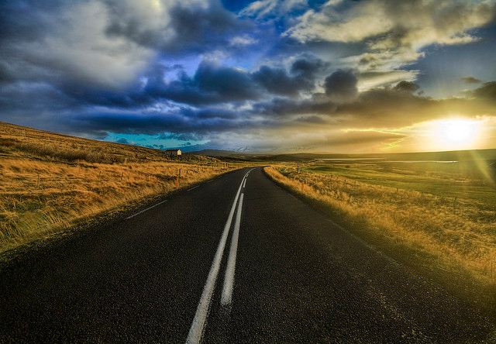
مستقبل غير مؤكد
Notes:
Why? Uncertain future. No one knows which eggs will hatch.

Slide 28
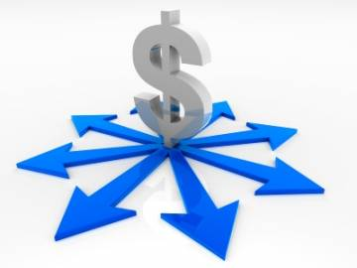
التنويع
Notes:
Susan and I discovered yesterday that we have our retirement planning divided into nine different sources of income. Since we don’t own a home, this is especially necessary in our case.

Slide 29
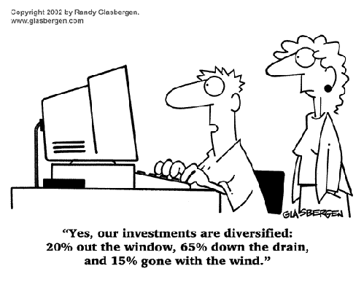
Diversify Investments
نعم، استثماراتنا متنوعة: 20% خارج النافذة، و65% هباء، و15% ذهبت مع الريح.
Notes:
I can relate to this as I really have little idea about our investments.

Slide 30
دعم إرساليات الطرق المتقاطعة 2014
منغوليا
ينغلادش
باكستان
نيبال
ميانمار
الهند
نافذة 10-40
تايلاند
أندونيسيا
سنغافورة
Notes:
CIC regularly supports cross-cultural missionaries in Thailand, Myanmar, and a family headed to Indonesia. Semi-regular gifts go to Pakistan, India, Bangladesh, Nepal and Mongolia.

Slide 31
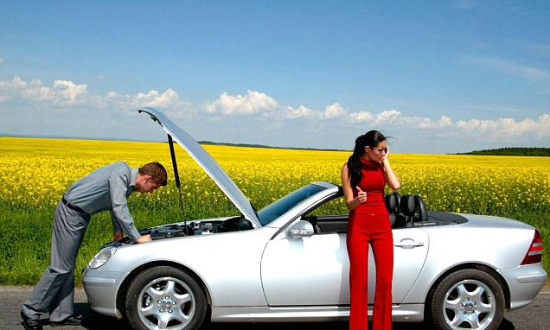
بيضة واحدة ...

Slide 32
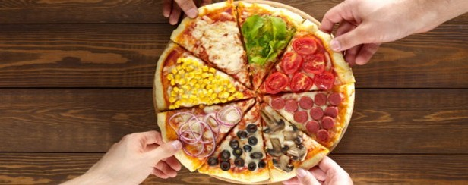
توزيع المخاطر

Slide 33
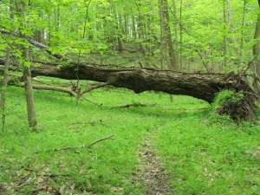
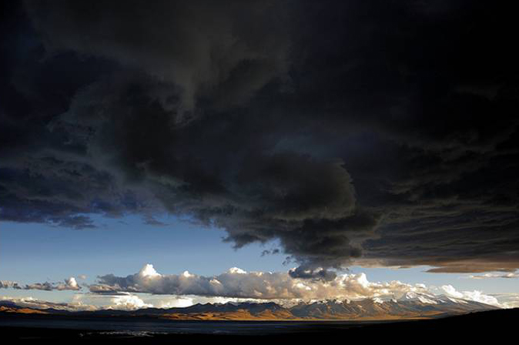
إذا امتلأت السحب مطراً تريقه على الأرض. (11: 3أ)
وإذا وقعت الشجرة نحو الجنوب أو نحو الشمال، ففي الموضع حيث تقع الشجرة هناك تكون. (11: 3ب)
إن تدبير الله يسيطر على كل شيء لا نستطيع السيطرة عليه – لذا أعط بسخاء واستثمر بحكمة.
Notes:
Man can't stop the clouds from giving rain (11:3a).
Man can't control where trees fall (11:3b).

Slide 34
1. أعط بسخاء واستثمر بحكمة (11: 1-3)
Notes:
Hold money loosely but discerningly since you don't know the future

Slide 35
مستقبلنا غير المؤكد
جامعة 11: 1-6
المال (1-3)
العمل (4-6)
Notes:
Today we will see how our ignorance of the future gives us wisdom about money (11:1-3) and work (11:4-6)
Here Solomon first says that your uncertain future affects your view of your money—so...

Slide 36
2. اعمل بجد بسبب المستقبل غير المؤكد (11: 4-6)
Notes:
Don’t let your ignorance of the days to come lead to apathy.

Slide 37
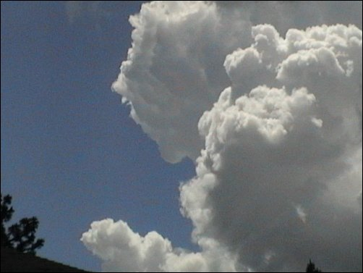
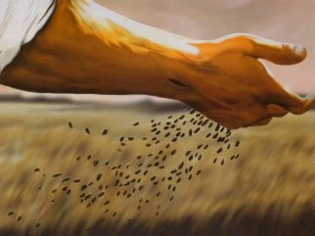
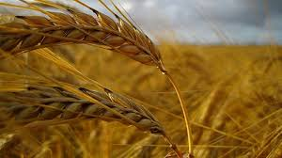
جامعة ١١ : ٤ من يرصد الريح لا يزرع ومن يراقب السحب لا يحصد
Notes:
Don’t wait for the wind to die down (so the seed won't be scattered) or you’ll never plant seed (11:4a).
Don’t watch the clouds (to make sure it won't rain) or you’ll never harvest a crop (11:4b).

Slide 38
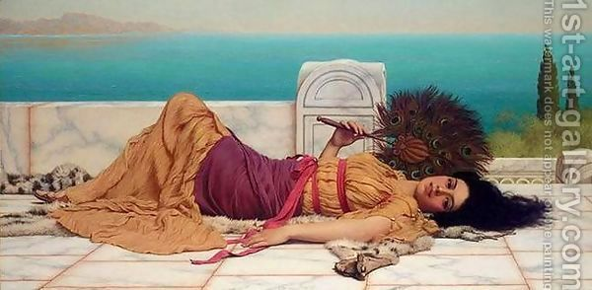
الكسل أو المماطلة لا يفيدان شيئاً (11: 4)

Slide 39
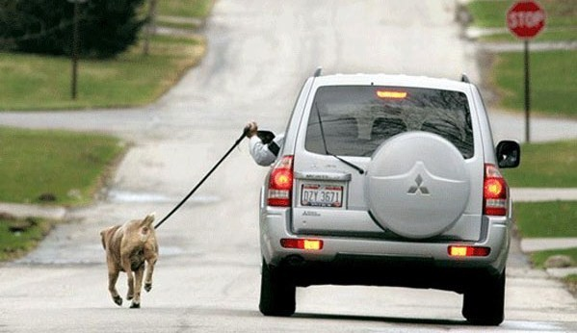
الكسل
Notes:
It’s amazing the ingenuity lazy people can show—too bad they don’t take all that creativity and apply it to actual work!

Slide 40
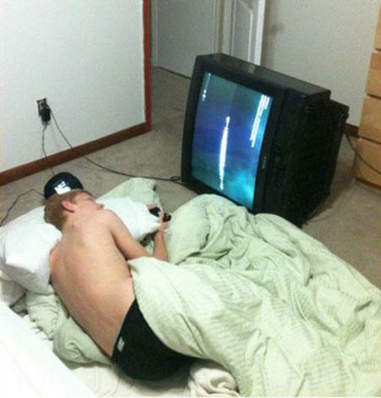
الكسل
هل تحريك التلفاز أم الجسد أصعب؟

Slide 41
الكسل
لكن العصا قد اعترضت طريقي

Slide 42
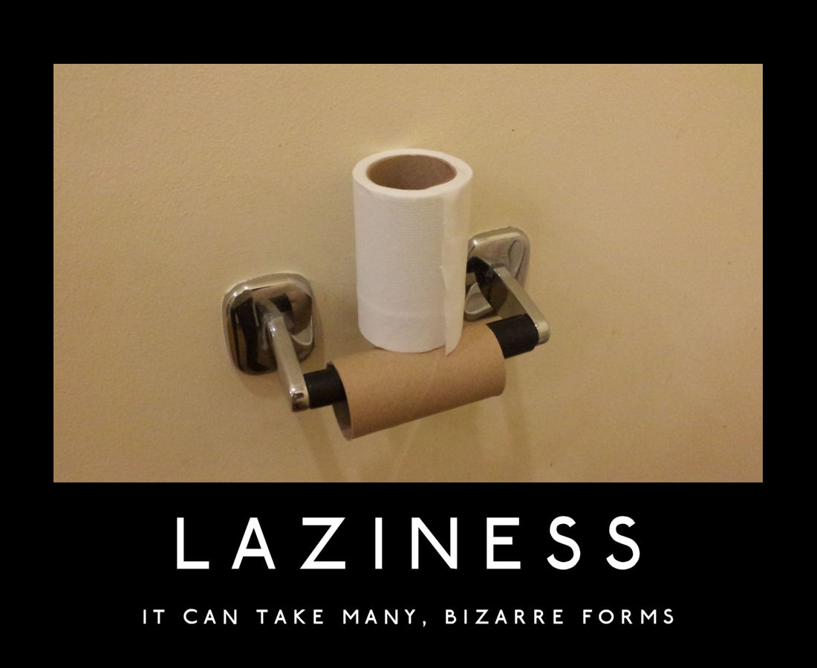
الكسل
يمكن أن تتخذ أشكالاً عديدة وغريبة

Slide 43
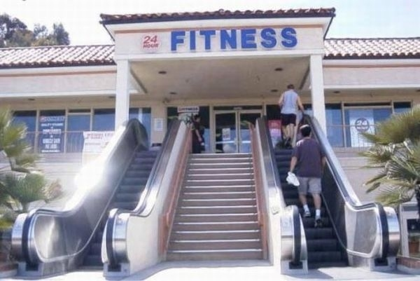
ليس هناك عذر

Slide 44
كما أنك لست تعلم ما هي طريق الريح ...
Notes:
We don't know how God works (11:5)

Slide 45
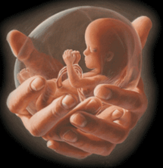
... ولا كيف العظام في بطن الحبلى، كذلك لا تعلم أعمال الله الذي يصنع الجميع. (11: 5)
Notes:
We can't know how God controls everything any more than we can know the wind or prenatal growth (11:5c).

Slide 46
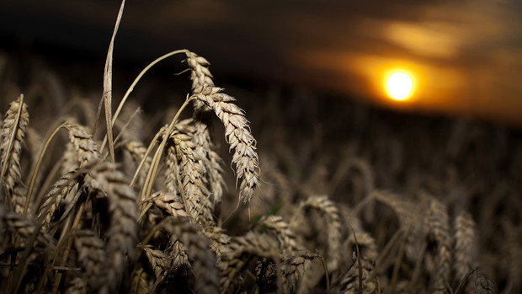
في الصباح ازرع زرعك، وفي المساء لا ترخ يدك، لأنك لا تعلم أيهما ينمو: هذا أو ذاك، أو أن يكون كلاهما جيدين سواء (11: 6)
Notes:
Work many tasks since you don't know which ones will succeed (11:6).

Slide 47
أعطانا الله هذه الخدمات في آسيا
WorldVenture قائد حقل سنغافورة
JETS أستاذ تفسير الكتاب المقدس
Adjunct Professor أستاذ مساعد للتعليم في 12 دولة
The Bible…Basically مدير الترجمة
BibleStudyDownloads.org مؤسس الموقع
Amman International Church واعظ على فترات متقطعة
Notes:
لقد أتاح لنا الربُّ بأمانته فرصًا للخدمة في الكثير من المجالات.
The Lord has faithfully brought opportunities to us to serve in many capacities.
___________
Common-113
جرى التحديث في أيَّار 2023:
Updated in May 2023:
WorldVenture overseas worker
JETS Bible Exposition professor
Adjunct Professor teaching in 12 nations
The Bible…Basically translation director
BibleStudyDownloads.org web author
Amman International Church occasional preacher

Slide 48
www.cicfamily.com
Notes:
At cicfamily.com we post the sermons, not knowing how many downloads.

Slide 49
www.cicfamily.com
Notes:
We "cast our bread upon the waters" with the belief that God will bless these efforts, but we have no idea which language or message or book will succeed.

Slide 50
كيف يجب أن يؤثر عليك مستقبلك غير المؤكد؟
Notes:
You don't know what is ahead, so how should you respond to your ignorance?

Slide 51
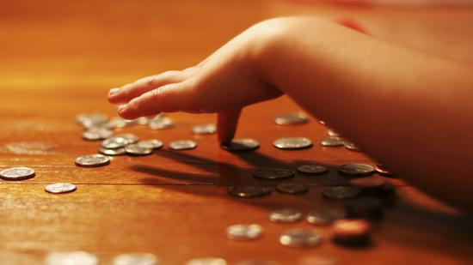
أعط بسخاء، استثمر بحكمة واعمل بجد بما أنك لا تعرف مستقبلك
الفكرة الرئيسية في 11: 1-6
Notes:
Ignorance of the future should give us wisdom about money and work (MI restated).

Slide 52
1. أعط بسخاء واستثمر بحكمة (11: 1-3)
Notes:
Hold money loosely but discerningly since you don't know the future

Slide 53
2. اعمل بجد بسبب المستقبل غير المؤكد (11: 4-6)
Notes:
Don’t let your ignorance of the days to come lead to apathy.

Slide 54
إذاً كيف يجب أن أعيش في ضوء مستقبلي غير المؤكد؟

Slide 55
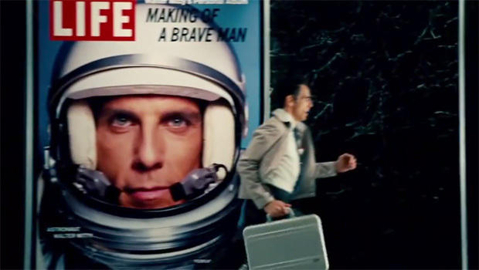
لقد أخطأ والتر ميتي
Notes:
Walter Mitty only got it partly right—to live with adventure. Yet he never did anything that benefited others.
This is where you and I must be different, to the glory of God.

Slide 56
اعمل شيئاً واحداً يخيفك كل يوم
Notes:
When was the last time you broke away from your routine and did something unusual (and even a bit strange) without being overly cautious?

Slide 57
Don't be regular
Notes:
Don’t misunderstand. I’m not saying to be stupid, but to entrust yourself to God in new areas!

Slide 58
أعطِ بسخاء
Notes:
Giving: To what extent do you give out of love without concern for return?

Slide 59
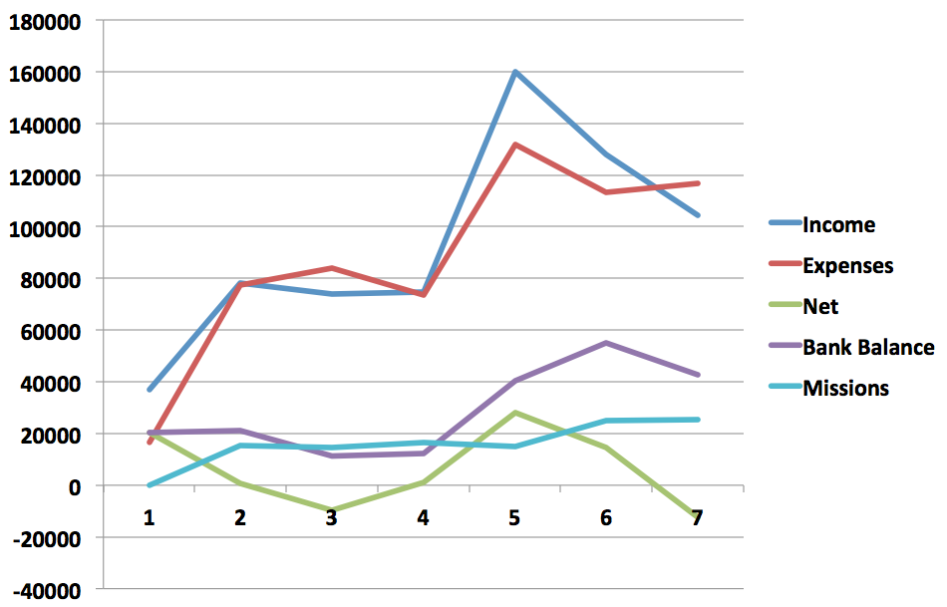
CIC Finances
الأمور المالية 2007-2014
تفوق المصاريف الدخل 1000$/شهرياً
07
08
09
10
11
12
13-14
Notes:
The issue is not amount, though we certainly need the giving here to improve as we lack about S$1000 monthly.

Slide 60
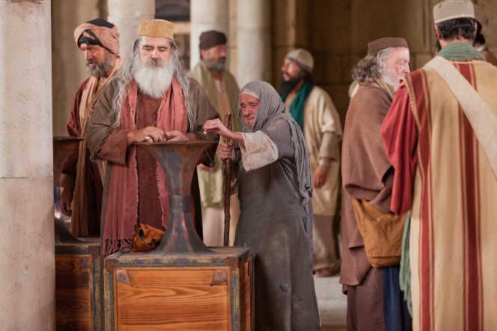
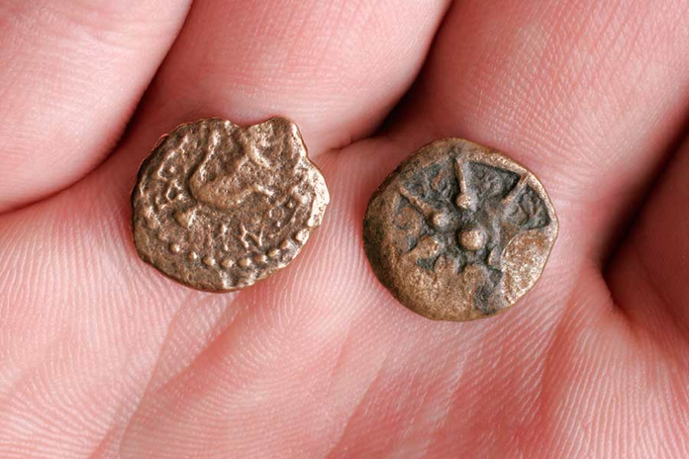
فلسي الأرملة
Notes:
The key person Jesus approved for giving was a widow who gave two mites—two tiny copper coins worth less than a cent. Since then, most have given her credit for only one mite! Either way…

Slide 61
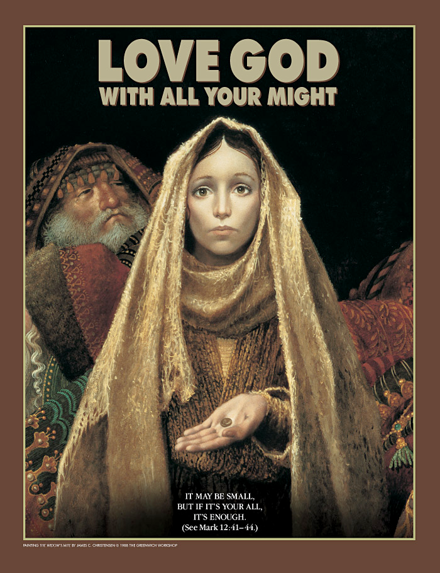
قد يكون هذا قليلاً، ولكن إذا كان هذا كل ما لديك، فهذا يكفي (مرقس 41:12-44)
Notes:
Are you giving him your all?

Slide 62
A Sign
Notes:
Work Hard: What job have you been putting off due to being overcautious? If you were waiting for a sign, this is it!

Slide 63
Black

Slide 64
الرابط للعرض التقديميِّ "وعْظُ العهد القديم" متاحٌ على الموقع الإلكترونيّ: BibleStudyDownloads.org
أحصل على هذا العرض التقديمي مجاناً
Notes:
OP Arabic OT Preaching
_____________
Common-29

