Slide 1
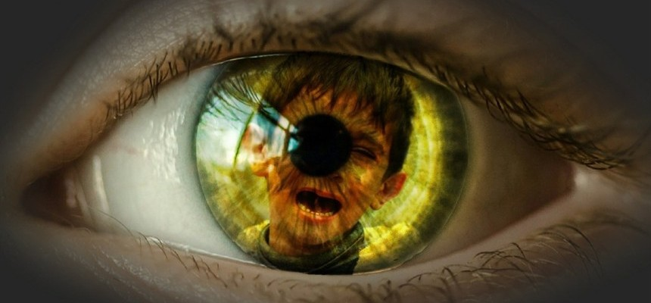
سرائر الله
تثنية ٢٩: ٢٩
الدكتور ريك غريفث . الهيئة الانجيلية الثقافية- الاردن
BibleStudyDownloads.org

Slide 2

ماذا تريد أن تعرف؟
Notes:
In our world’s explosion of knowledge, we still don’t know many things.
We don’t know why God chose such a tiny nation like Singapore for his great plans.
We don’t know what will happen to our ministries of family and mentoring.
We all have questions that remain. So what would you like to know?
Why is it that some of the wealthiest people you know are often the most ungodly?
Why do some women who don’t want a child easily get pregnant but you long for a child in your barrenness?
Why can’t you seem to hear from God on that key question that you have?

Slide 3

كيف يجب أن تتعامل مع جهلك بطرق الله؟
Notes:
What should you do since you do not really know why God does what he does?

Slide 4
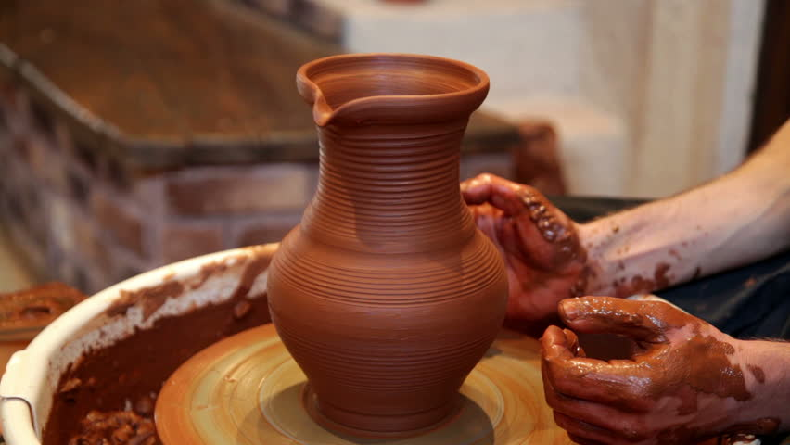
سياق سفر التثنية
Notes:
Israel was poised to enter Canaan but still needed to know much about God even after Moses recorded all five books of the Pentateuch. They still needed forming.

Slide 5
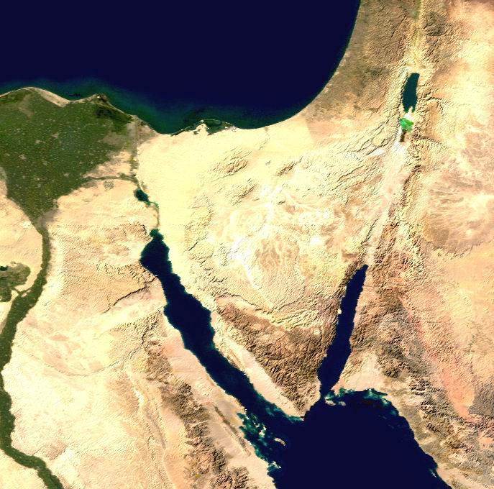
موسى في موآب
موآب
«هَذَا هُوَ الكَلامُ الذِي كَلمَ بِهِ مُوسَى جَمِيعَ إِسْرَائِيل فِي عَبْرِ الأُرْدُنِّ فِي البَرِّيَّةِ فِي العَرَبَةِ قُبَالةَ سُوفٍ بَيْنَ فَارَانَ وَتُوفَل وَلابَانَ وَحَضَيْرُوتَ وَذِي ذَهَبٍ»
( تثننية 1:1)
قادش برنيع
جبل حور
جبل سيناء
Notes:
Our text is given at the end of 40 years of wilderness wandering. In Deuteronomy Moses, the covenant mediator, speaks to Israel's new generation opposite the Jordan (1:1).
Imagine traveling your whole life in the desert—even being born amidst the dirt, dry plants, and scorpions—and the nicest thing you’ve ever seen is an interesting rock formation!
Finally your parents have been fully disciplined by God for failing to trust them to bring then into a rich, lush land.
Your parents are buried along the way as a testimony to God’s word of judgment that they wouldn’t come into Israel’s inheritance.

Slide 6
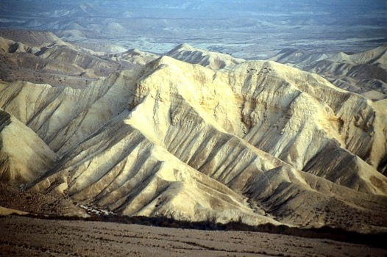
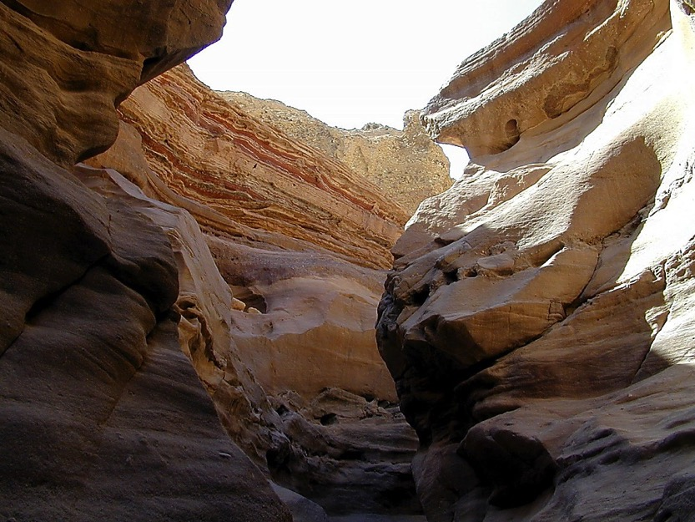
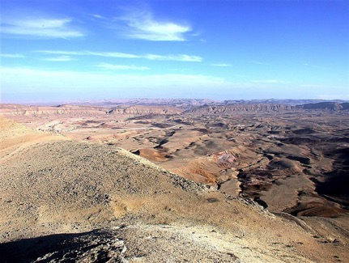
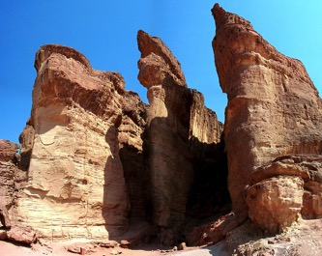
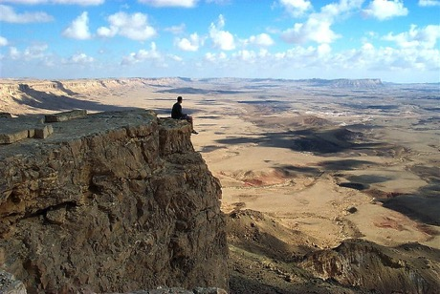
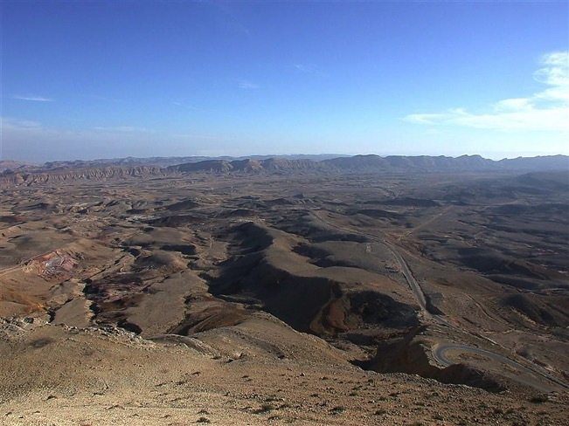
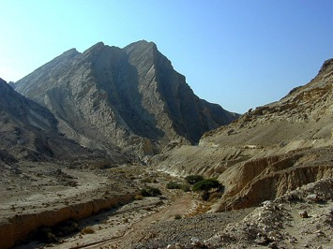
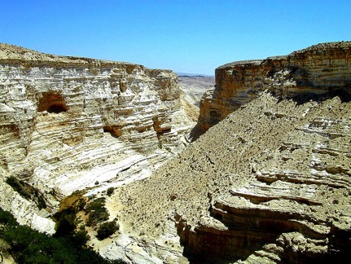
هل تقصد خلال الأربعين عاماً هناك ؟
Num. 32:13
DRESSING
THE
STAGE
MOSES
Exodus
Sinai
M - C - C
Kadesh Barnea
40
40
Handbook pg. 26-29
23
Notes:
Israel has just had 400 years in Egypt. We pick up the account where they had gotten out of Egypt, but Egypt hadn’t gotten out of them. They need a fresh look at who they are after generation of slavery in s foreign land.

Slide 7
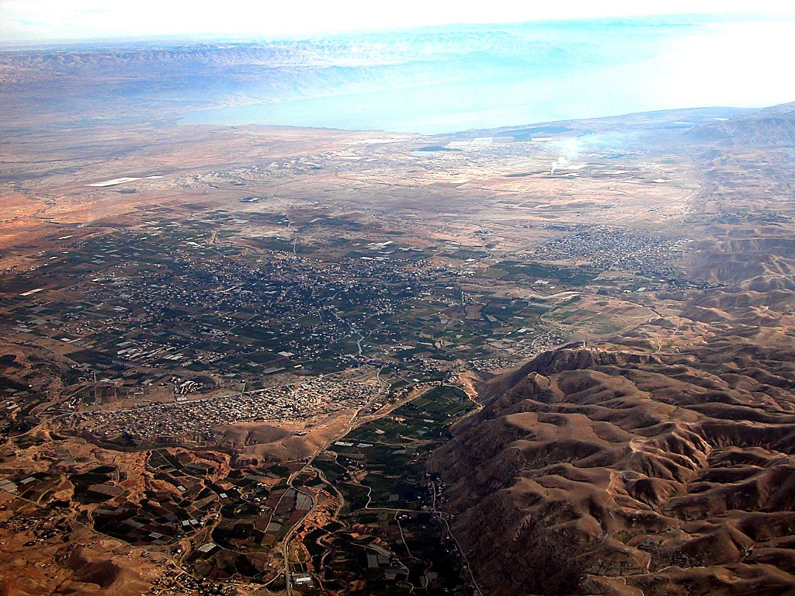
أريحا
البحر الميت
نهر الأردن
أريحا الحديثة
JOSHUA
Jericho/Ai
اريحا القديمة
من أريحا
النظر شرقاً عبر نهر الأردن
Handbook pg. 26-29
42
Notes:
God told Moses that he will die in the wilderness—so how could Moses best prepare the nation to enter the land of Canaan?

Slide 8
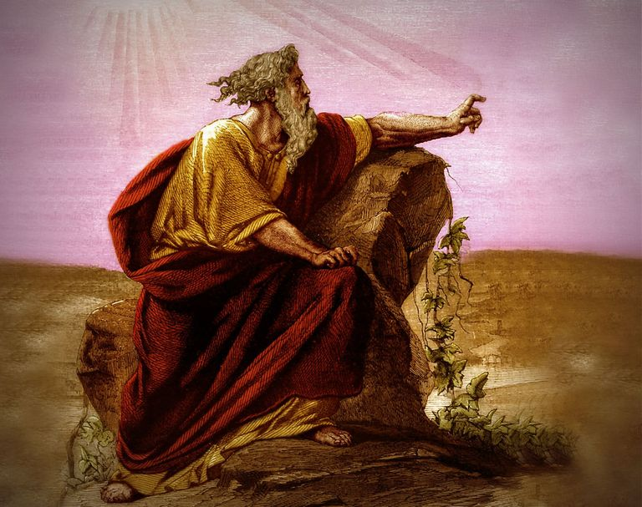
تثنية
تجديد
العهد
الموسوي
Renewal of the Mosaic Covenant
د. ريك جريفيث • كلية سنغافورة للكتاب المقدس• BibleStudyDownloads.org

Slide 9
كيف يجب أن تتعامل مع جهلك بطرق الله؟
ثلاثة امور رئيسة
Notes:
Today we will see three keys in Deuteronomy 29:29 on how to deal with what we can know and not know.
How should you deal with your ignorance of God’s ways? Here is the first thing to do…

Slide 10

1. لا تقلق من جهة أن الله لا يخبرك بكل ما تريد أن تعرفه.
( تث 29: 29 أ)
Notes:
The LORD isn’t obligated to answer all your questions—so deal with it.

Slide 11
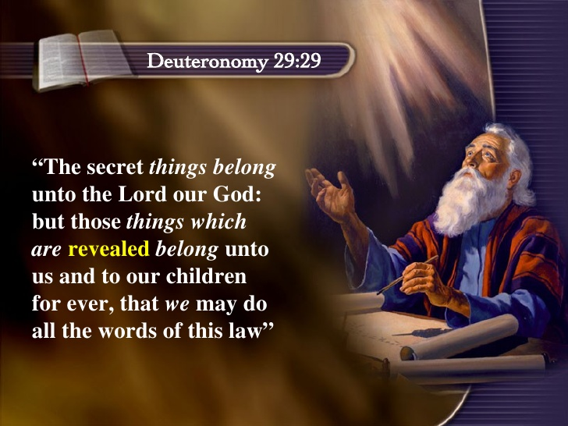
تث 29: 29
»السَّرَائِرُ لِلرَّبِّ إِلهِنَا وَالمُعْلنَاتُ لنَا وَلِبَنِينَا إِلى الأَبَدِ لِنَعْمَل بِجَمِيعِ كَلِمَاتِ هَذِهِ الشَّرِيعَةِ».
Notes:
NLT: “The Lord our God has secrets known to no one. We are not accountable for them, but we and our children are accountable forever for all that he has revealed to us, so that we may obey all the terms of these instructions."
SECRET THINGS:
Why godless people live so long with so much money (Pss. 37, 73)
Why hundreds of millions of mothers kill their own children in the womb which totally defies their maternal instincts
Why the ones most calling for tolerance are the least tolerant
Why God would cause his son to suffer so much on our behalf
Why I would be the only boy from a broken home in my school growing up
Why God allowed me to come to know him when so many others never do or do so later in life
Why I have so many privileges to serve him throughout Asia in 35 countries when others never get to leave the USA

Slide 12
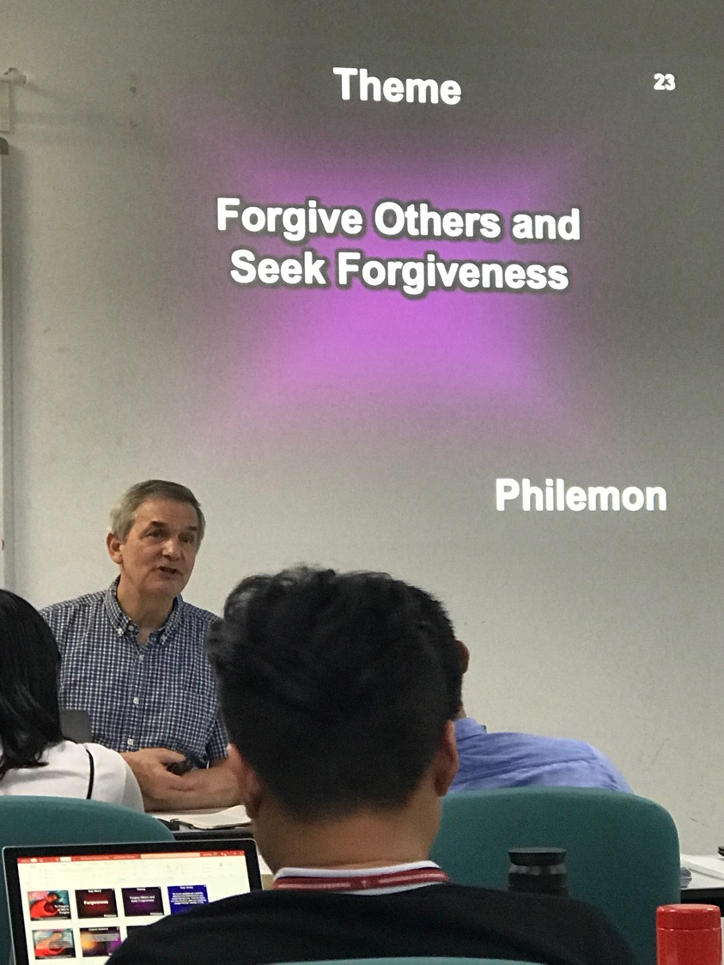
خططنا لكي نبقى في سنغافورة حتى الـ70 من العمر، نعلّم الكتاب المقدّس واللاهوت...
Notes:
My goal has been to teach Bible and theology until age 70—which is 7 more years as I am now 63 years old.
But the College recently decided to shift me to teach only preaching rather than my master degree specialty of theology and my PhD area in Bible Exposition.
So we have been praying whether to try to stay 7 more years in Singapore without teaching Bible and theology.
Singapore law also seeks to retire expatriates in their 60s so more Singaporeans can take these positions.

Slide 13
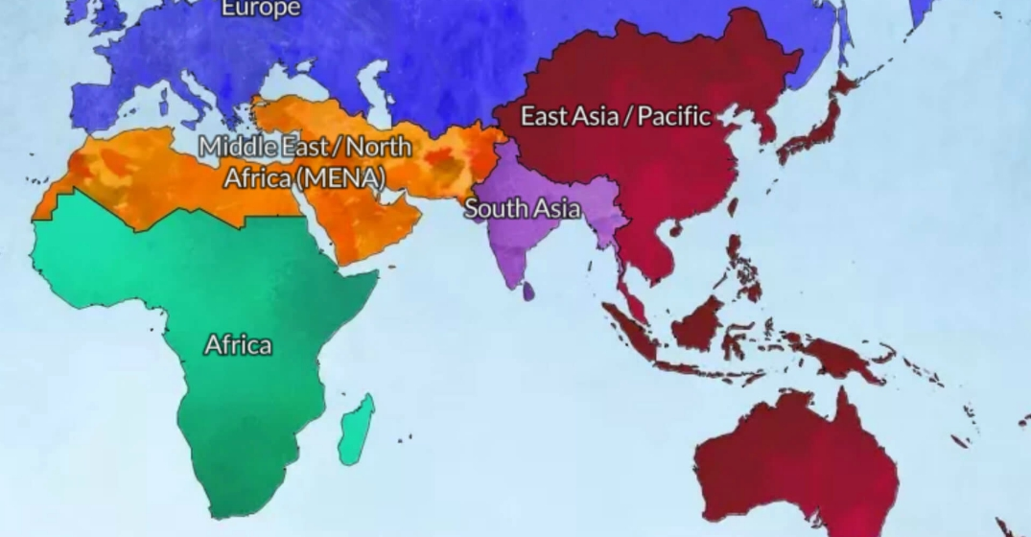
الله يقودنا من آسيا إلى الشرق الأوسط وشمال افريقيا
الاردن
سنغافورة

Slide 14
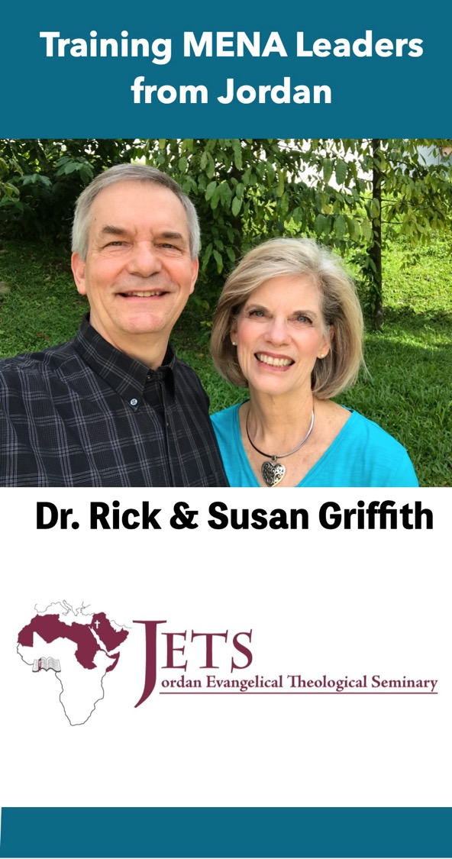
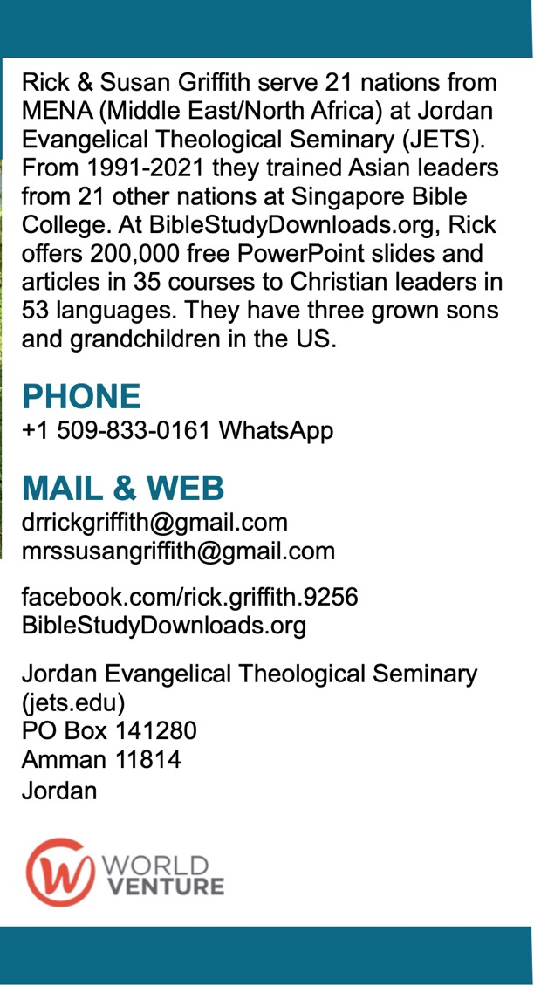
رجاء احصل على بطاقة طلبات الصلاة
Front
Back

Slide 15
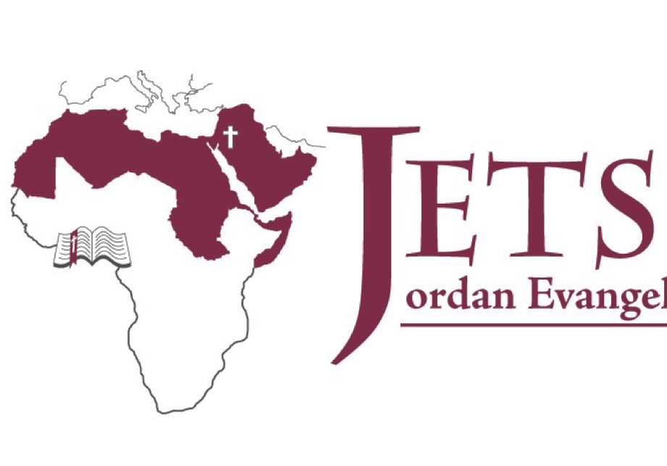


الاساتذة
25 استاذ
25 يحملون درجة الدكتوراه
15 استاذ
4 يحملون درجة الدكتوراه

Slide 16
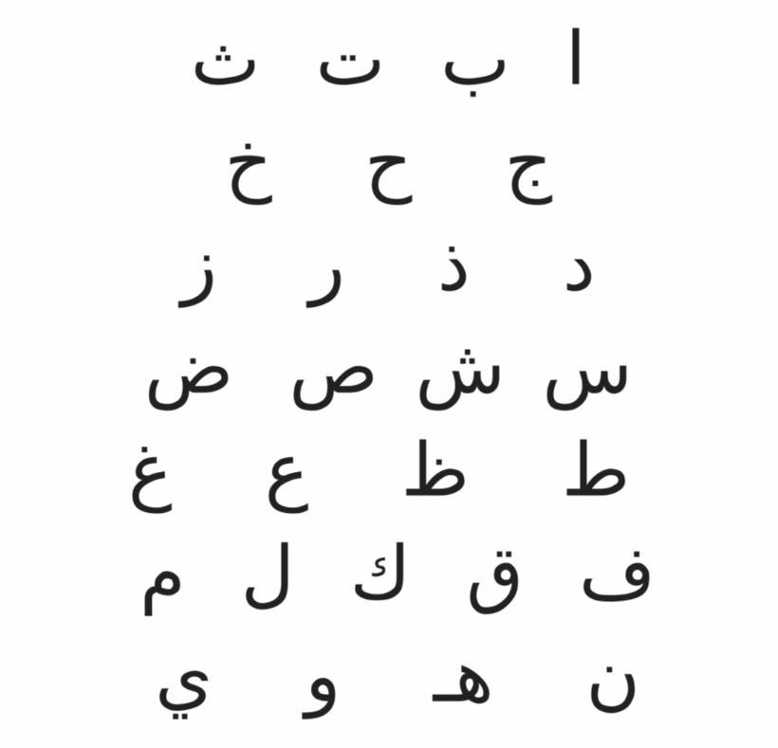

Arabic
Dr. Rick Griffith
Notes:
I will need to be translated into Arabic—but I did learn this Arabic. Do you know what it says?
• Here is the translation—my name!

Slide 17
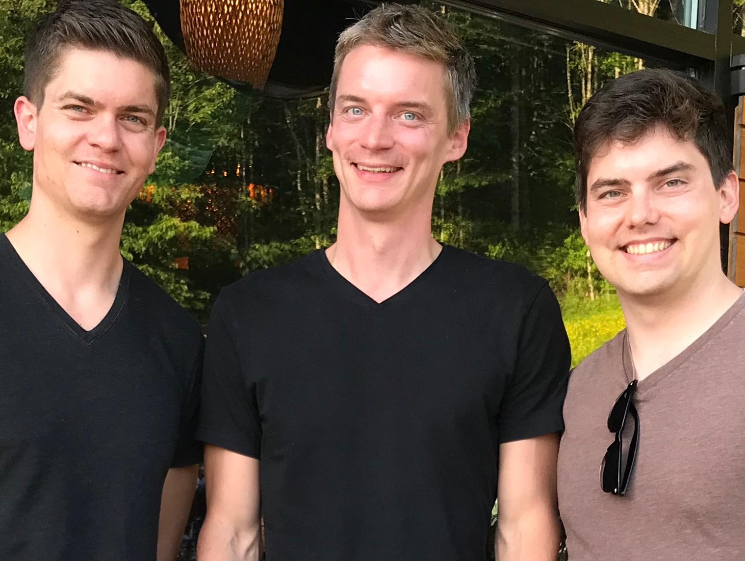
أولادنا الثلاثة

Slide 18
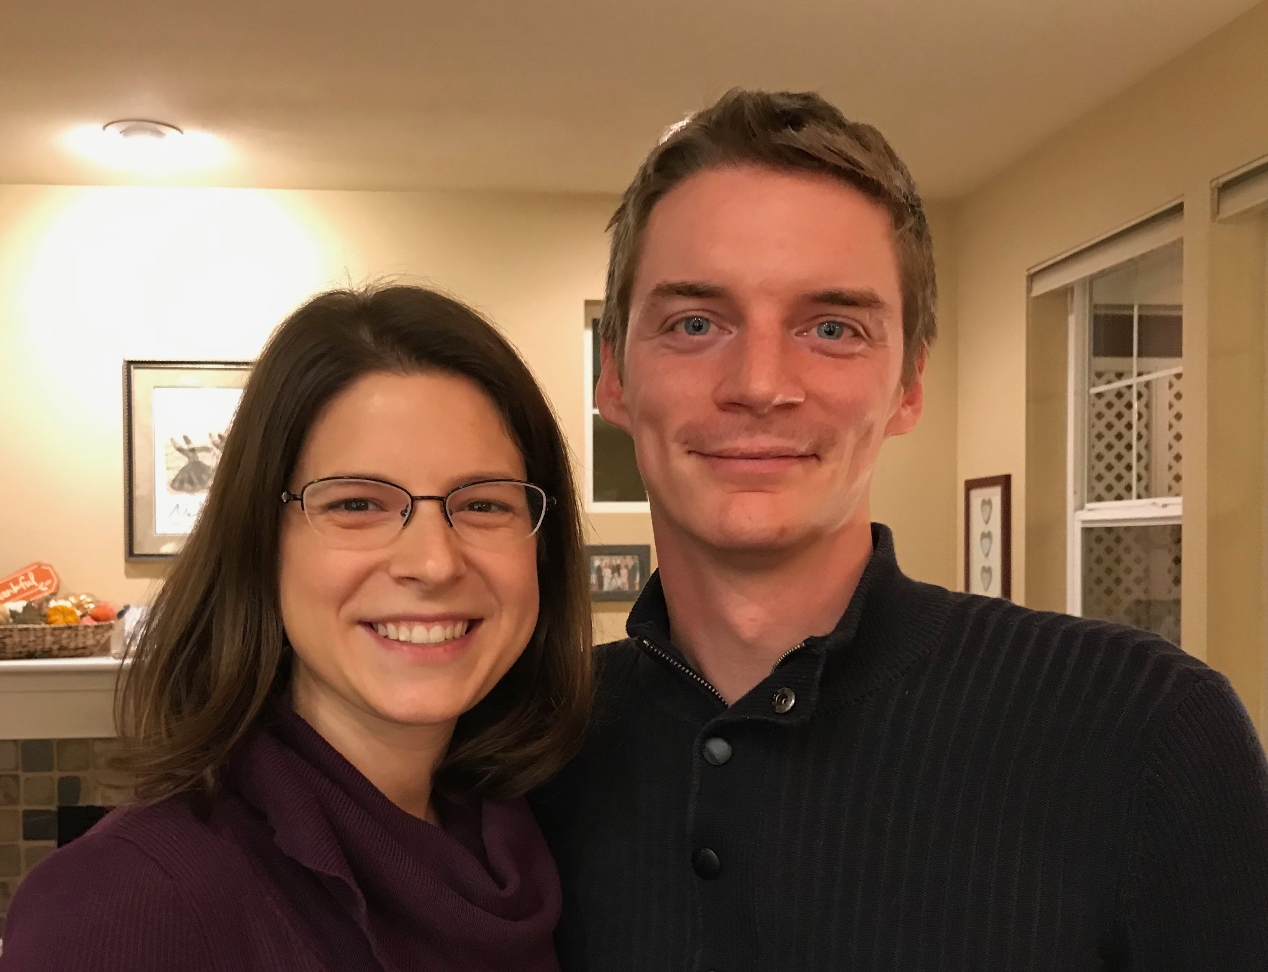
كيرت (34) و كارا يمتلكون شركة أعمال استشارية قرب مدينة سياتل
Notes:
كيرت وزوجته كارا في مدينة سياتل

Slide 19
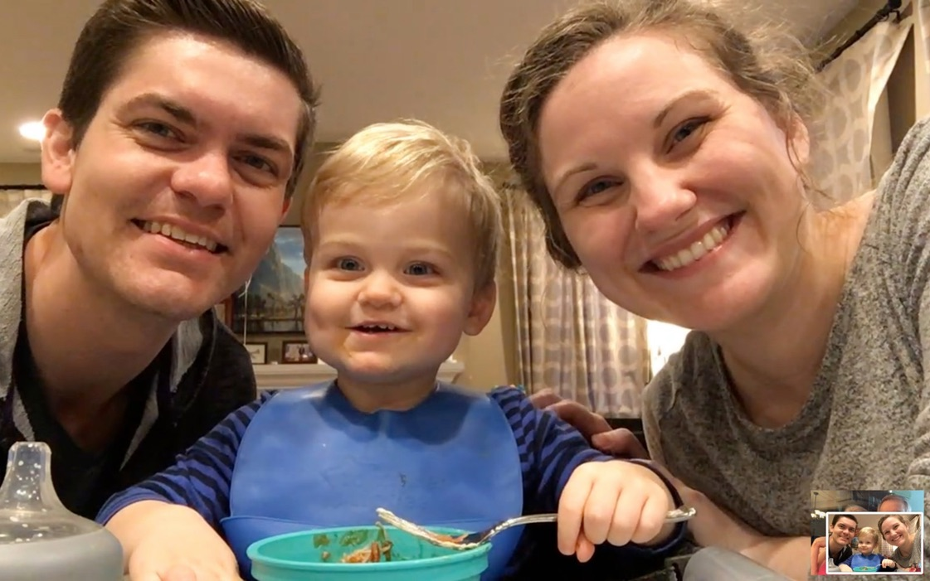
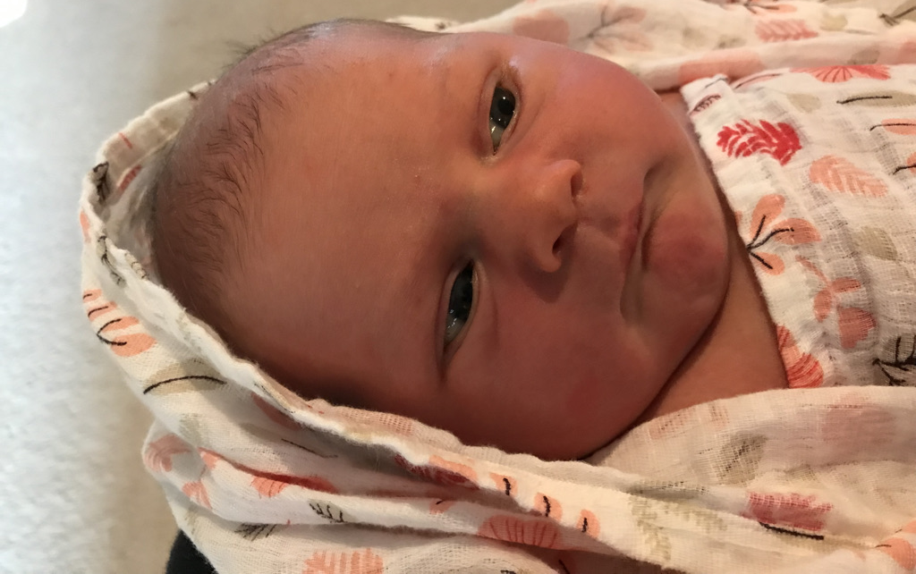
ستيفن, كيتي و جيسي في جيج هاربور
ولدت نورا في 31 تموز
Notes:
انضمت حفيدتنا إلى العائلة في 31 تموز 2021, ولكننا نتسائل لماذا أخذنا الله الآن من هناك؟ لا أعلم

Slide 20
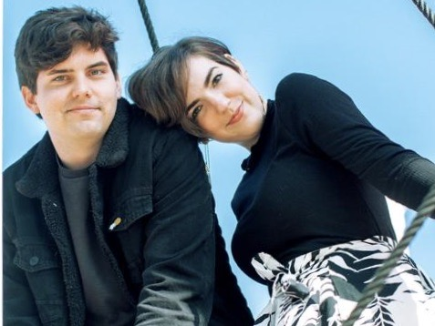
جون (28) فنان تشكيلي في ريدلاندز, كاليفورنيا
8
Notes:
جون و صديقته كلوي يعملان في شركة إسري – مؤسسة أبحاث الأنظمة البيئية – يقومان بتصميم المواقع لهذا الشركة ذات الأنظمة الرقمية

Slide 21
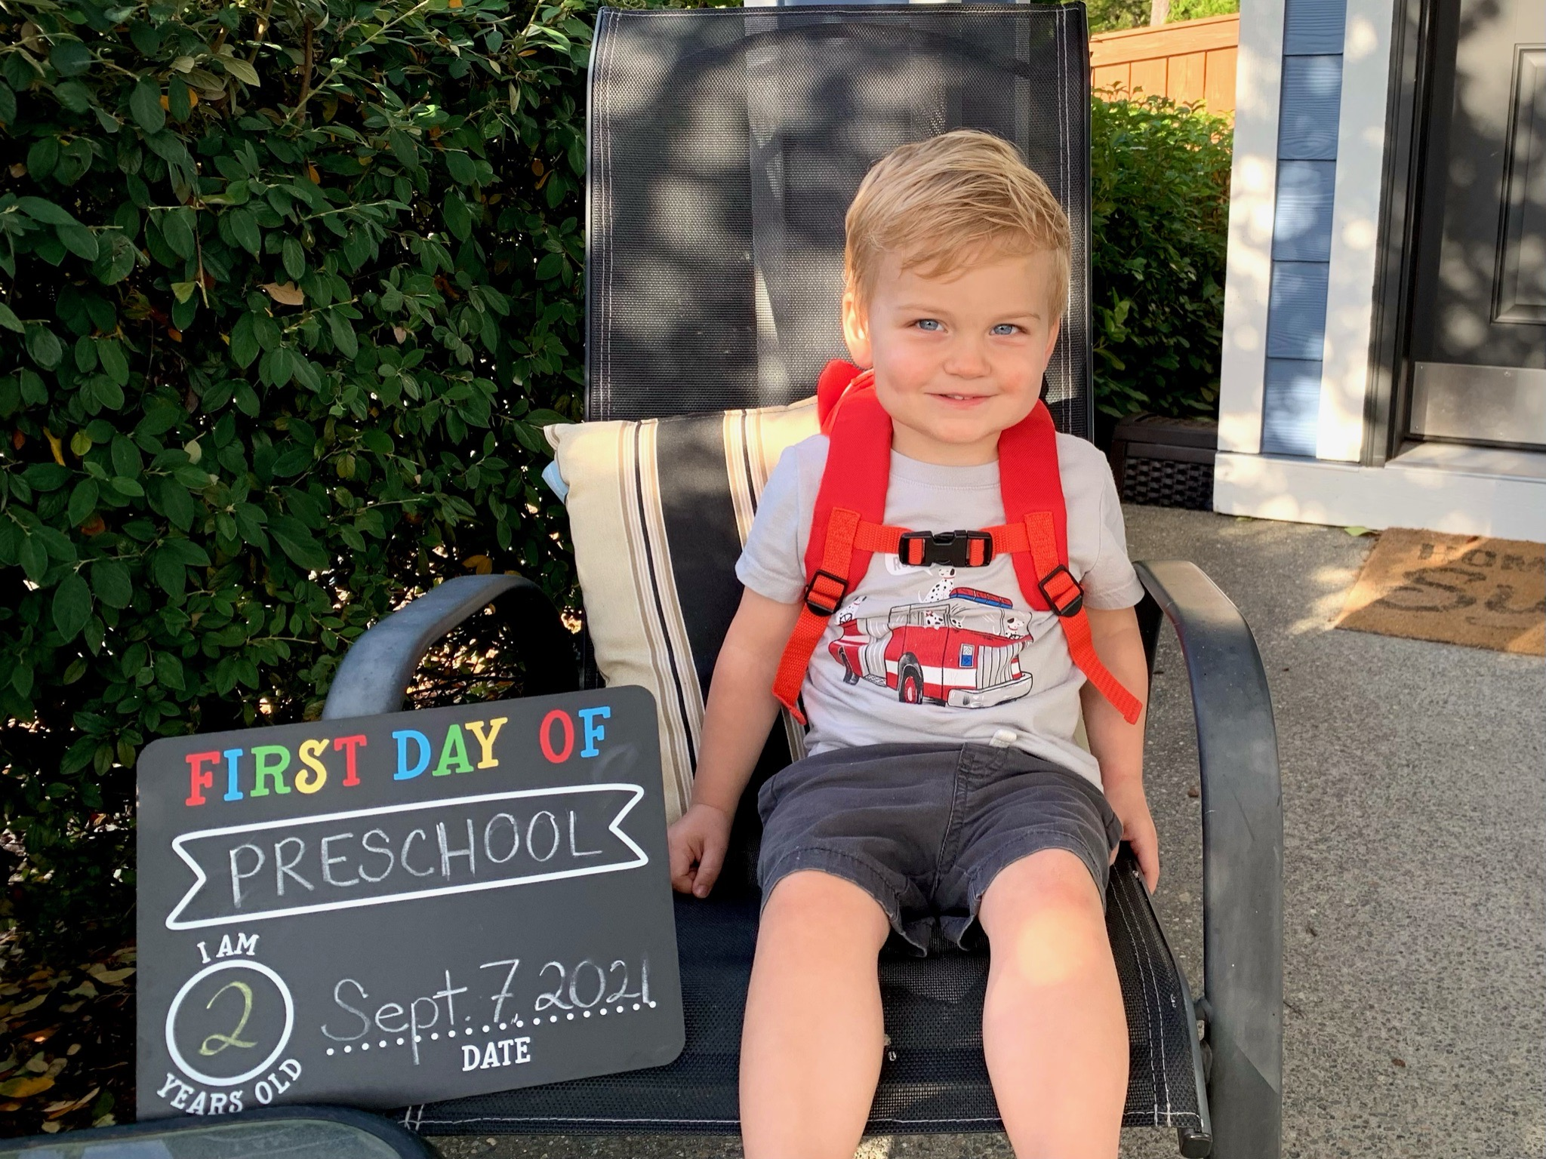
لماذا يفوتنا بعض الايام المهمة؟

Slide 22
كيف يجب أن تتعامل مع جهلك بطرق الله؟
ثلاثة امور رئيسة
Notes:
Today we will see three keys in Deuteronomy 29:29 on how to deal with what we can know and not know.
How should you deal with your ignorance of God’s ways? Here is the first thing to do…

Slide 23
1. لا تقلق من جهة أن الله لا يخبرك بكل ما تريد أن تعرفه.
( تث 29: 29 أ)
Notes:
The LORD isn’t obligated to answer all your questions—so deal with it.

Slide 24

.2عوضاً، اسعَ لأن تعرف ما يخبرك به الله .
( تث 29: 29ب)
Notes:
The LORD speaks—though he doesn’t say all we want to know. So listen to him.

Slide 25
تث 29: 29
»السَّرَائِرُ لِلرَّبِّ إِلهِنَا وَالمُعْلنَاتُ لنَا وَلِبَنِينَا إِلى الأَبَدِ لِنَعْمَل بِجَمِيعِ كَلِمَاتِ هَذِهِ الشَّرِيعَةِ».
Notes:
NLT: “The Lord our God has secrets known to no one. We are not accountable for them, but we and our children are accountable forever for all that he has revealed to us, so that we may obey all the terms of these instructions."
SECRET THINGS:
Why godless people live so long with so much money (Pss. 37, 73)
Why hundreds of millions of mothers kill their own children in the womb which totally defies their maternal instincts
Why the ones most calling for tolerance are the least tolerant
Why God would cause his son to suffer so much on our behalf
Why I would be the only boy from a broken home in my school growing up
Why God allowed me to come to know him when so many others never do or do so later in life
Why I have so many privileges to serve him throughout Asia in 35 countries when others never get to leave the USA

Slide 26
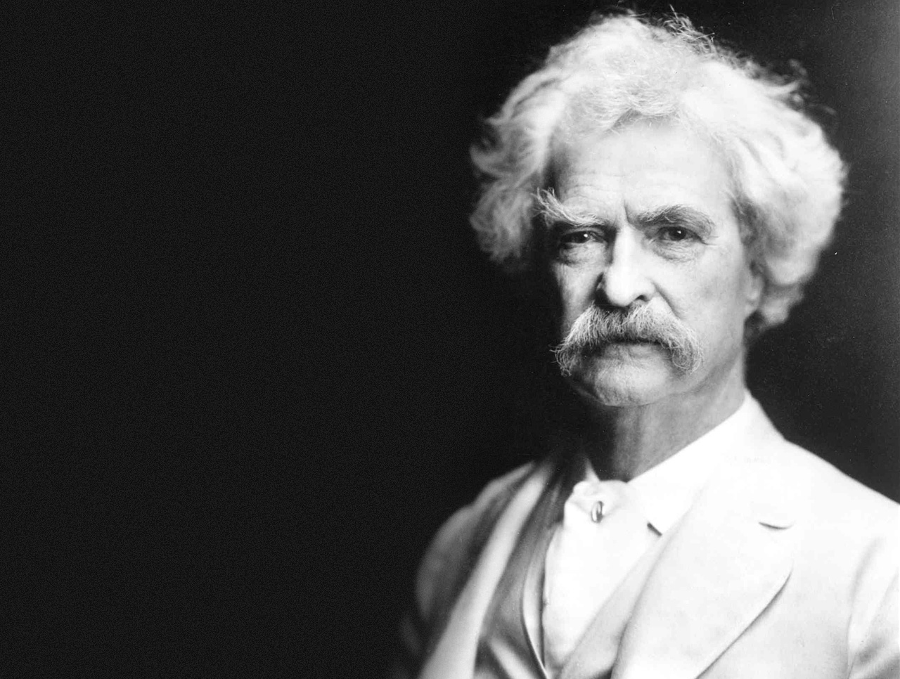
— Mark Twain —
« لا تربكني الأجزاء التي لا أفهمها من الكتاب المقدّس لكن الأجزاء التي أفهمها «

Slide 27
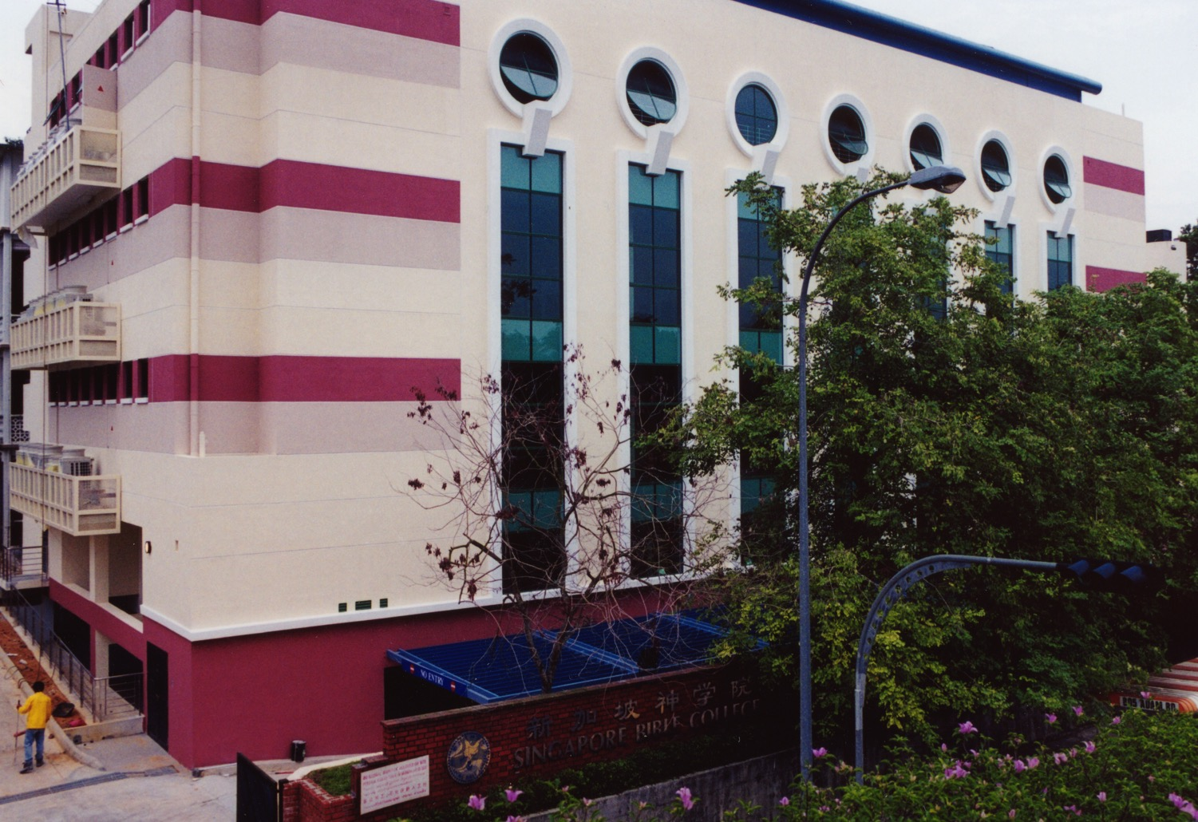
كلية الكتاب المقدس - سنغافورة
Notes:
I've served as a seminary professor with 30 other faculty at Singapore's largest training school: Singapore Bible College

Slide 28
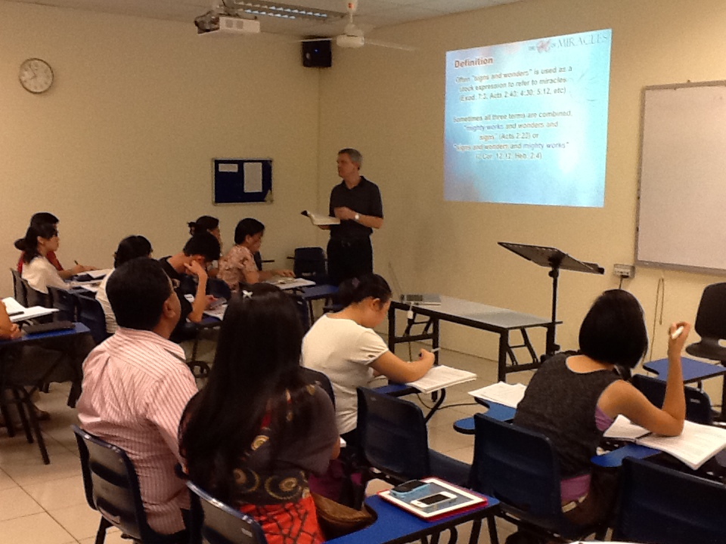
طلاب كليّة الكتاب المقدّس في سنغافورة
9
Notes:
Most of these students are first-generation Christians eager to share the gospel with their own people!

Slide 29
مساقات أدرسها في كلية الكتاب سنغافورة
(الإنجليزية • البهاسا • الصينية)
مسح الكتاب المقدس بشكل أساسي
العهد القديم العهد الجديد درس الكتاب
الخلفيات • البحث و الكتابة
العهد القديم العهد الجديد الجغرافيا
اللاهوت . الخليقة . يسوع
الكنيسة . الروح . الخلاص . المستقبل
الوعظ
الوعظ 1 الوعظ 2
Notes:
I get to teach these leaders every book of the Bible in survey courses, plus backgrounds to both the OT and NT, three areas of theology, and how to preach.

Slide 30
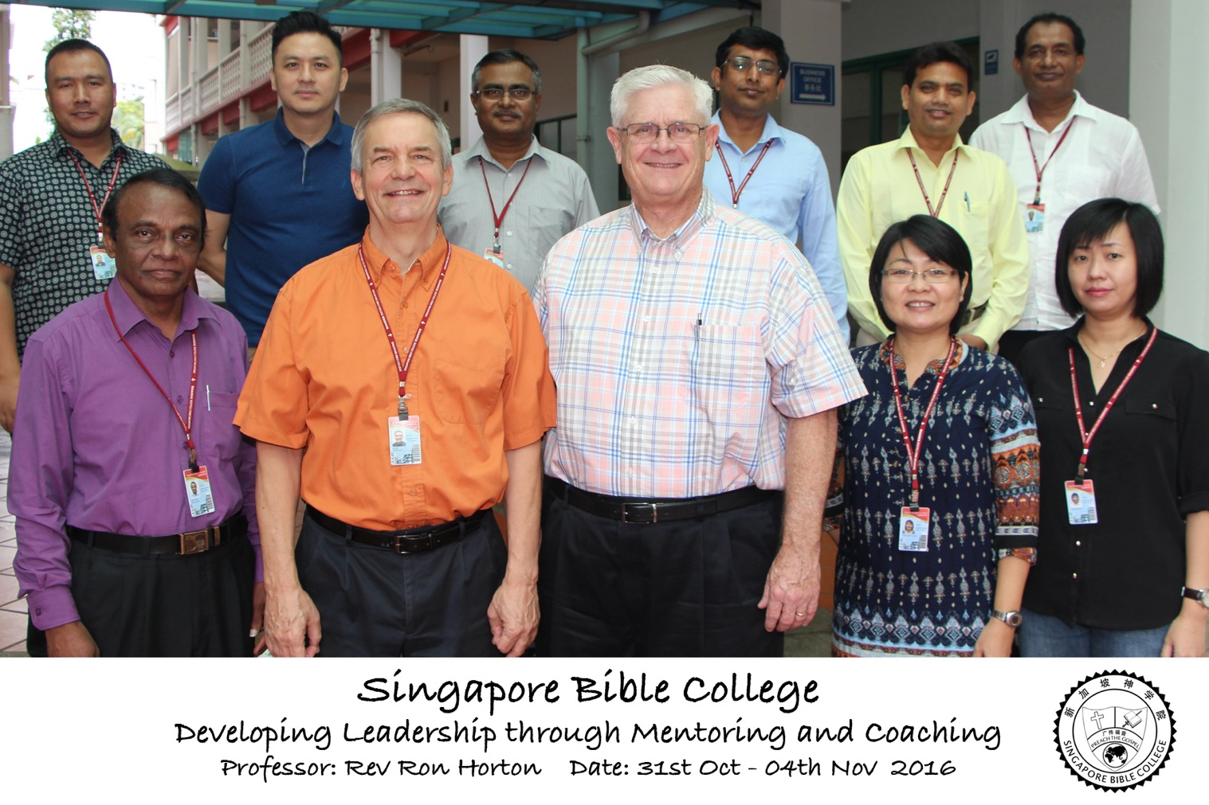
Developing Leadership Through Mentoring & Coaching
(Ron Horton)

Slide 31
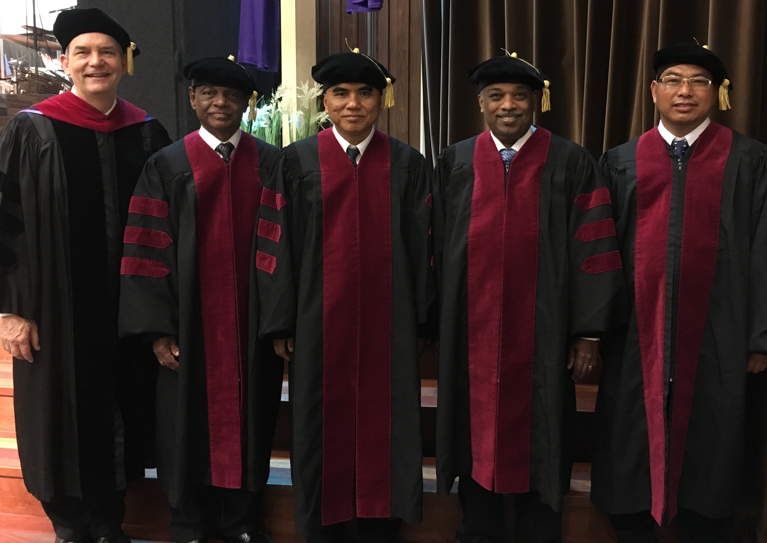
أشرفت على طلاب الدكتوراة في الخدمة في كلية سنغافورة للكتاب المقدس
Notes:
I also directed the doctoral program at SBC that trains about 50 seminary professors and pastors throughout Asia in English and Chinese. Generally each year about 4 of them received their Doctor of Ministry degree.

Slide 32
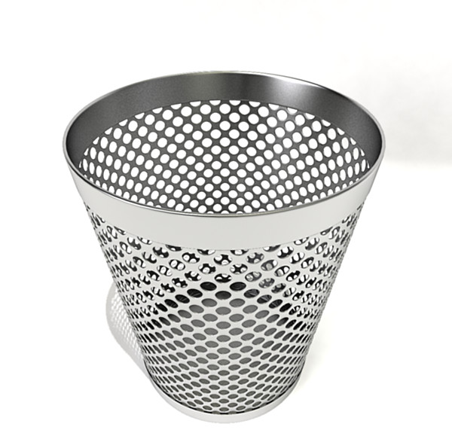
نظام ملف الواجبات
Notes:
Too often students simply look at the grade on their research paper and toss it into this type of file system. There must be a better way!

Slide 33

TBB

Slide 34

TBB Vision

Slide 35

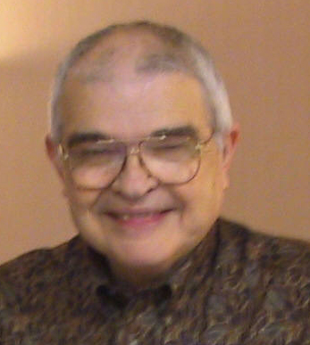
Dr John Fryman
د. جون فرايمان
Notes:
Dr. Fyman invested 30 years of his life to develop "The Bible…Basically," a 10-hour seminar that brings audiences through the whole Bible SIX times!

Slide 36

English

Slide 37

Burmese
Lai S
iangtho…Abulpi
A Presentation of The Bible…Basically Ministries International Inc. Fort Worth, Texas
www.biblebasically.com
©2004 TBBMI
8.0.01.
04

Slide 38


French
LA BIBLE…
EN BASE
Une Présentation du Ministère Internationale de La Bible… En Base Inc. Fort Worth, Texas
www.biblebasically.com
©2006 TBBMI
8.0.01.
04
©2004 TBBMI
9.6.01.

Slide 39
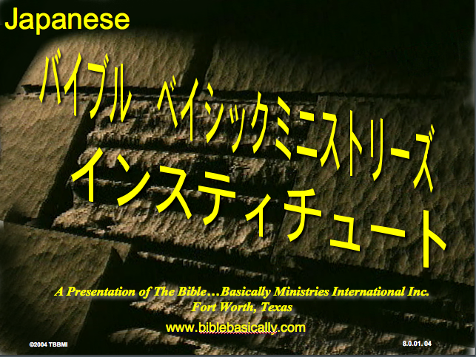
Japanese
バイブル ベイシックミニストリーズ
インスティチュート
A Presentation of The Bible…Basically Ministries International Inc. Fort Worth, Texas
www.biblebasically.com
©2004 TBBMI
8.0.01.
04
Notes:
Japanese title slide

Slide 40

Khmer (Cambodian)
mUldæanRKwH>>>
énRBHKm<IIr
karbgðaj[sÁal;nUvRBHKm<Ir>>> EdlCamUldæanRKw³ kñúg B½n§kic©shKmnGnþrCati GayGinsIu.
Fort Worth, Texas
www.biblebasically.com
©2004 TBBMI
8.0.01.
04

Slide 41
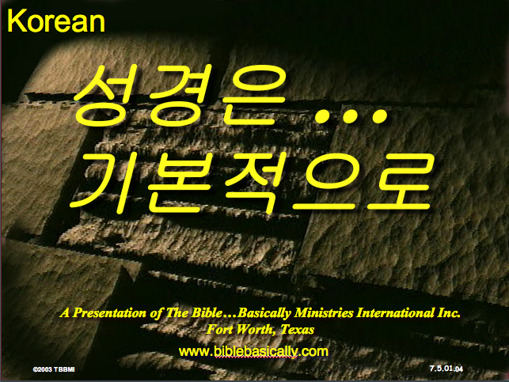
Korean
성경은 …
기본적으로
A Presentation of The Bible…Basically Ministries International Inc. Fort Worth, Texas
www.biblebasically.com
7.5.01.
©2003 TBBMI
04

Slide 42

Malay
Alkitab…
Dasar
Presentasi dari The Bible…Basically Ministries International Inc. Fort Worth, Texas
www.biblebasically.com
©2004 TBBMI
8.0.01.
04

Slide 43

Mao (India)
Bible…
Amolo Leino
Bible…Ngashankakhuina Ministries International Inc. pashina semkashok Fort Worth, Texas
www.biblebasically.com
©2004 TBBMI
8.0.01.
04

Slide 44
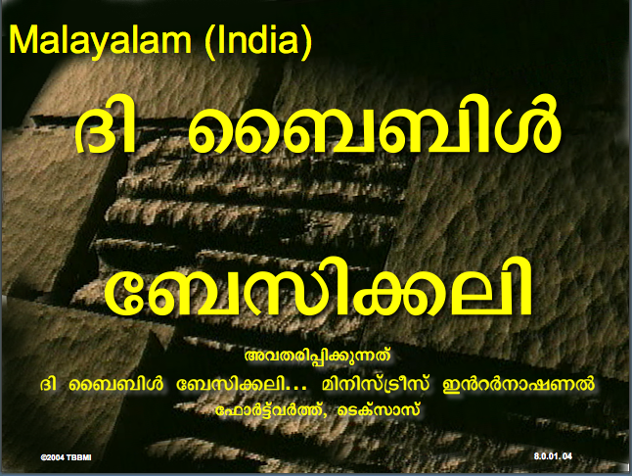
Malayalam (India)
Æß èÌÌßZ
çÌØßAÜß
¥ÕÄøßMßAáKÄí Æß èÌÌßZ çÌØßAÜß… ÎßÈßØíd¿àØí §aVÈÞ×ÃW çËÞVGíÕVJí, æ¿µíØÞØí
©2004 TBBMI
8.0.01.
04

Slide 45
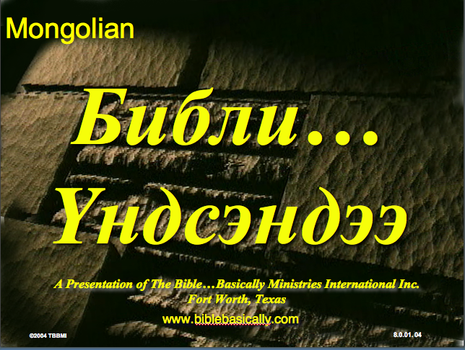
Mongolian
Библи…
Үндсэндээ
A Presentation of The Bible…Basically Ministries International Inc. Fort Worth, Texas
www.biblebasically.com
©2004 TBBMI
8.0.01.
04

Slide 46

Nepali
afOan======
cfwf/e[\t
A Presentation of The Bible…Basically Ministries International Inc. Fort Worth, Texas
www.biblebasically.com
8.0.01.
©2004 TBBMI
04

Slide 47
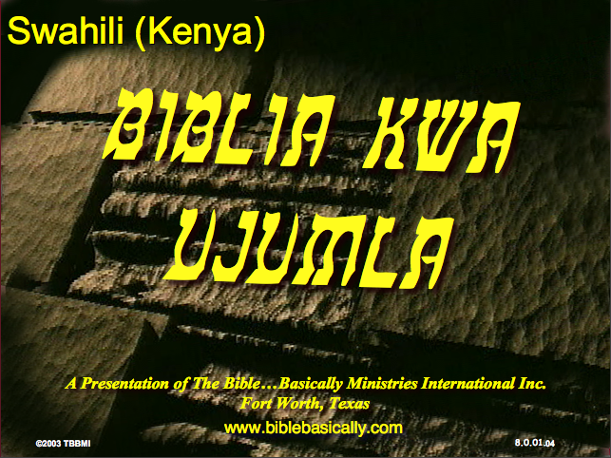
Swahili (Kenya)
biblia kwa ujumla
A Presentation of The Bible…Basically Ministries International Inc. Fort Worth, Texas
www.biblebasically.com
8.0.01.
©2003 TBBMI
04

Slide 48

Tagalog (Philippines)
Ang Biblia . . . Pinasimple
A Presentation of The Bible…Basically Ministries International Inc. Fort Worth, Texas
www.biblebasically.com
©2004 TBBMI
8.0.01.
04
Notes:
PLEASE PUT THE TITLE AND SUBTITLES INTO YOUR NATIONAL LANGUAGE AND LEAVE THE WEBSITE UNCHANGED

Slide 49

Tangkhul (India)
Bible…
Ngashankakhui
Bible…Ngashankakhuina Ministries International Inc. pashina semkashok Fort Worth, Texas
www.biblebasically.com
©2004 TBBMI
8.0.01.
04

Slide 50

Tamil (Sri Lanka/India)
jpUkiwapd;…
mbg;gil
A Presentation of The Bible…Basically Ministries International Inc. Fort Worth, Texas
www.biblebasically.com
©2004 TBBMI
8.0.01.
04

Slide 51
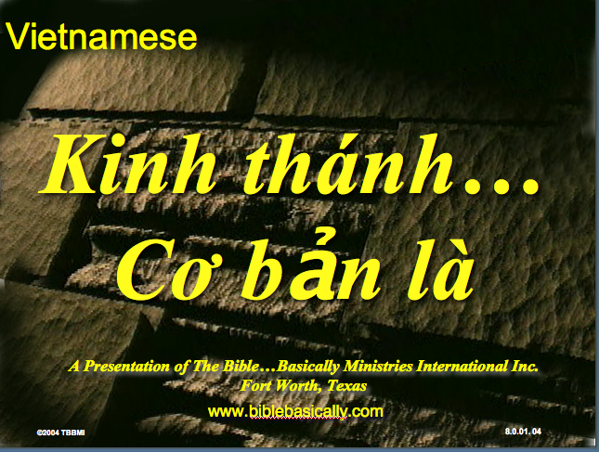
Vietnamese
Kinh thánh…
Cơ bản là
A Presentation of The Bible…Basically Ministries International Inc. Fort Worth, Texas
www.biblebasically.com
©2004 TBBMI
8.0.01.
04

Slide 52


Bahasa Indonesia
Presentasi dari The Bible…Basically Ministries International Inc. Fort Worth, Texas
www.biblebasically.com
7.5.01.
©2003 TBBMI
04

Slide 53
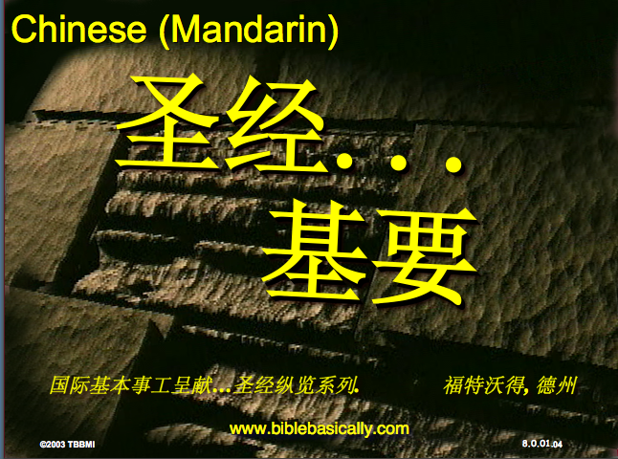
Chinese (Mandarin)
圣经...
基要
国际基本事工呈献…圣经纵览系列. 福特沃得, 德州
www.biblebasically.com
8.0.01.
©2003 TBBMI
04

Slide 54
العرض التقديمي ( 945 شريحة )
كتاب الطالب ( 100 صفحة )
مخطوطة المعلم ( 400 صفحة )
TBB مواد
كاملة باللغة
الإنجليزية • الصينية • الهندية • الأندونيسية • الكورية • الماليزية • المنغولية • الروسية • الإسبانية
©2004 TBBMI
8.0.01.
04

Slide 55
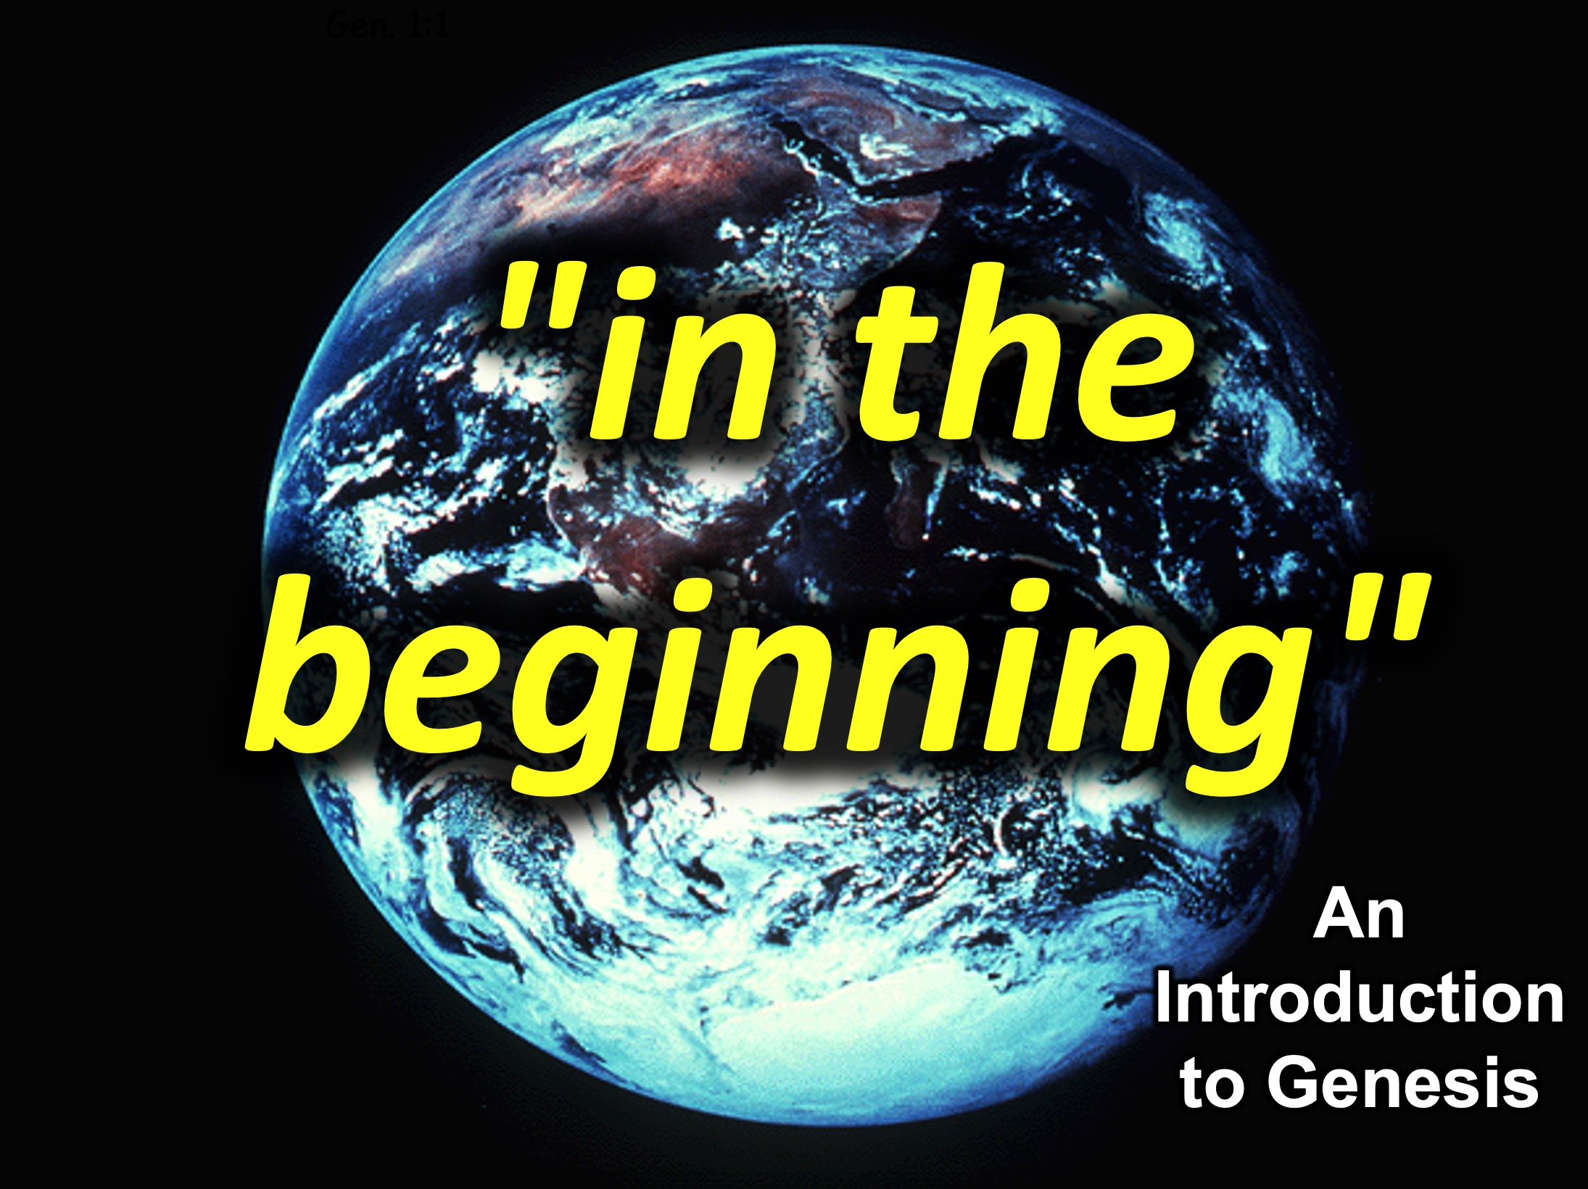
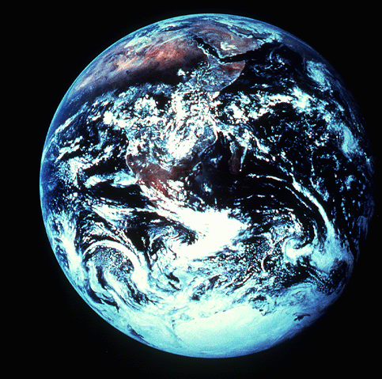
"in the beginning"
Gen. 1:1
An Introduction to Genesis

Slide 56
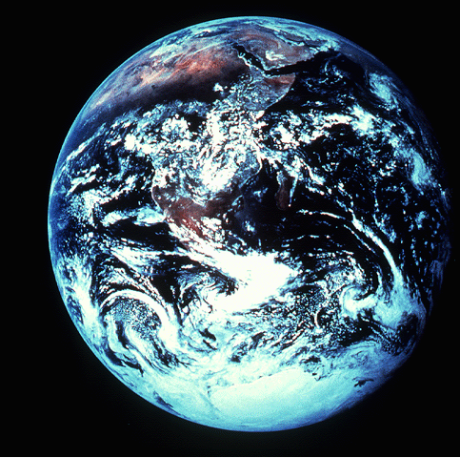
"pada mulanya"
Gen. 1:1
Pengenalan kitab Kejadian

Slide 57

"起初"
Gen. 1:1
创世记导论

Slide 58
في البدء
Gen. 1:1
مقدمة
لسفر التكوين

Slide 59
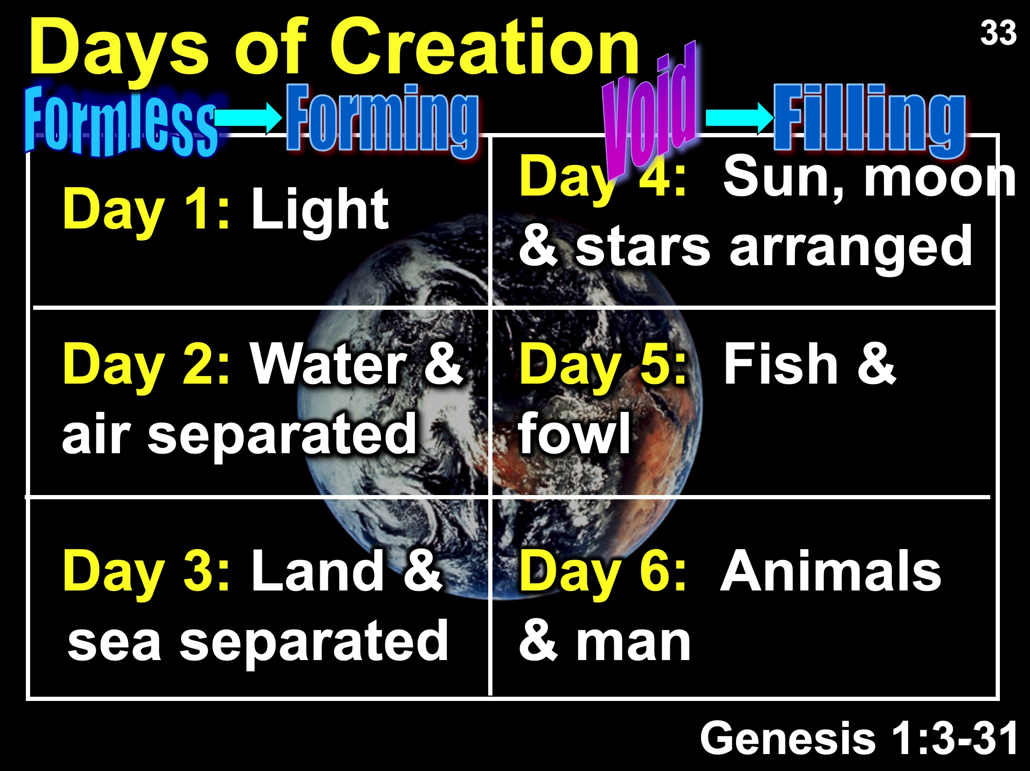
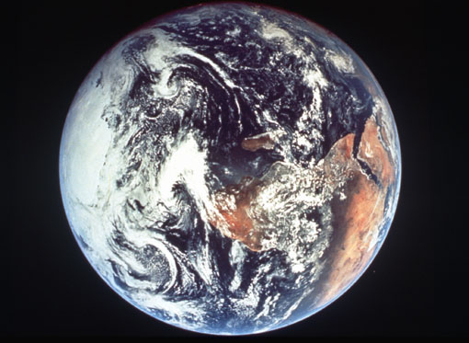
Days of Creation
33
Void
Formless
Forming
Filling
Day 4: Sun, moon & stars arranged
Day 1: Light
Day 2: Water & air separated
Day 5: Fish & fowl
Day 3: Land & sea separated
Day 6: Animals & man
Genesis 1:3-31

Slide 60
Days of Creation in Bahasa Indonesian
Hari-hari penciptaan
64
Kosong
Tidak berbentuk
Dibentuk
Diisi
Hari 4: Matahari, bulan & bintang diatur
Hari 1: Terang
Hari 2: Air &
udara dipisahkan
Hari 5: Ikan & unggas
Hari 3: Darat & laut dipisahkan
Hari 6: Binatang & manusia
Kejadian 1:3-31

Slide 61
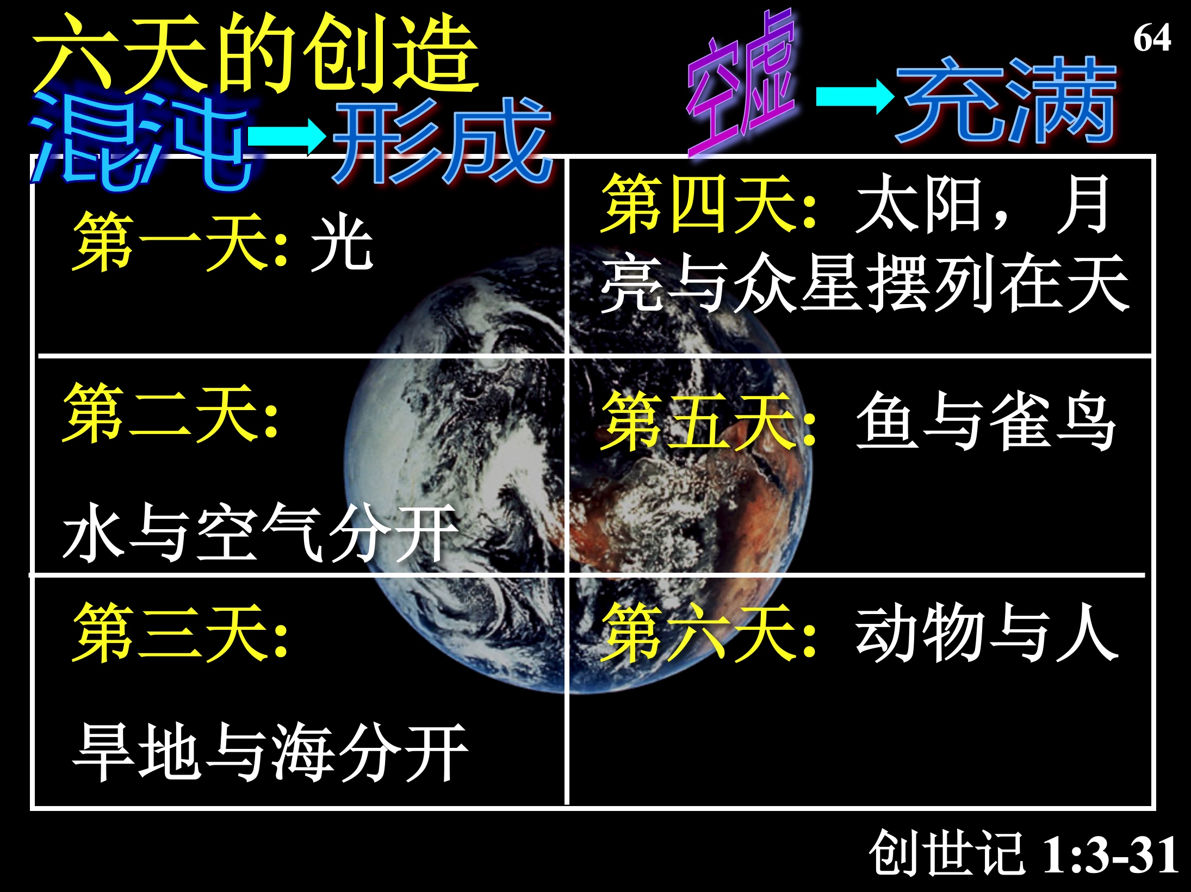
六天的创造
空虚
64
充满
混沌
形成
第四天: 太阳，月亮与众星摆列在天
第一天: 光
第二天:
水与空气分开
第五天: 鱼与雀鸟
第三天:
旱地与海分开
第六天: 动物与人
创世记 1:3-31

Slide 62
أيام الخلق
64
خالية
ملأ
خربة
تشكيل
اليوم 4 : ترتيب الشمس و القمر و النجوم
اليوم 1 : نور
اليوم 2 : فصل الجلد و المياه
اليوم 5 : الأسماك و الطيور
اليوم 3 : فصل البحر و اليابسة
اليوم 6 : الحيوانات و الإنسان
تكوين 1 : 3 - 31
Notes:
There is no accident or evolution of trial-and-error in Genesis 1—God carefully made everything by his choice. As expected, he formed the world for three days before he filled it.

Slide 63
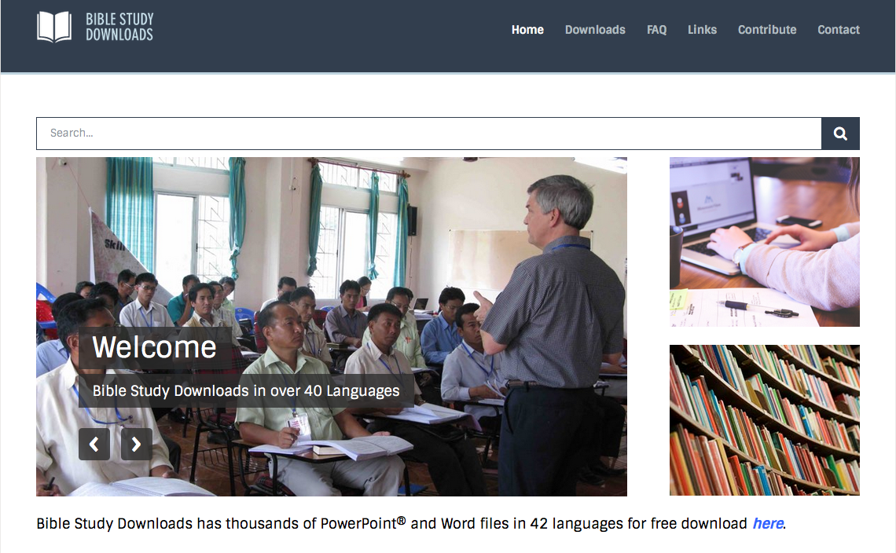

BibleStudyDownloads.org
احصل على 200,000 شريحة بوربوينت مجاناً!
Notes:
Student translation since 2003 with 700 translators has resulted in Bible teaching and study materials—mostly PowerPoint—in 53 languages! All a teacher needs to do is to click on a file and it downloads for free to teach any book of the Bible and many other subjects.

Slide 64
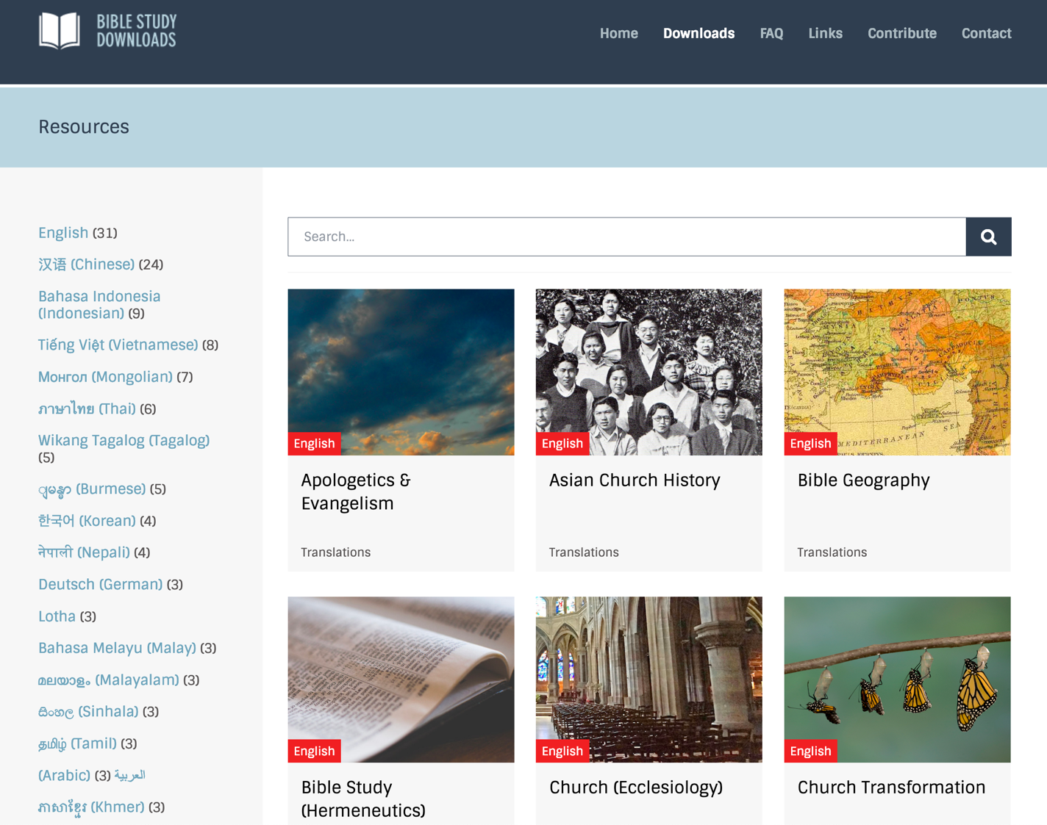
BibleStudyDownloads.org
7
Notes:
This has resulted in Bible teaching and study materials—mostly PowerPoint—in 53 languages! All a teacher needs to do is to click on a file and it downloads for free to teach any book of the Bible and many other subjects.

Slide 65
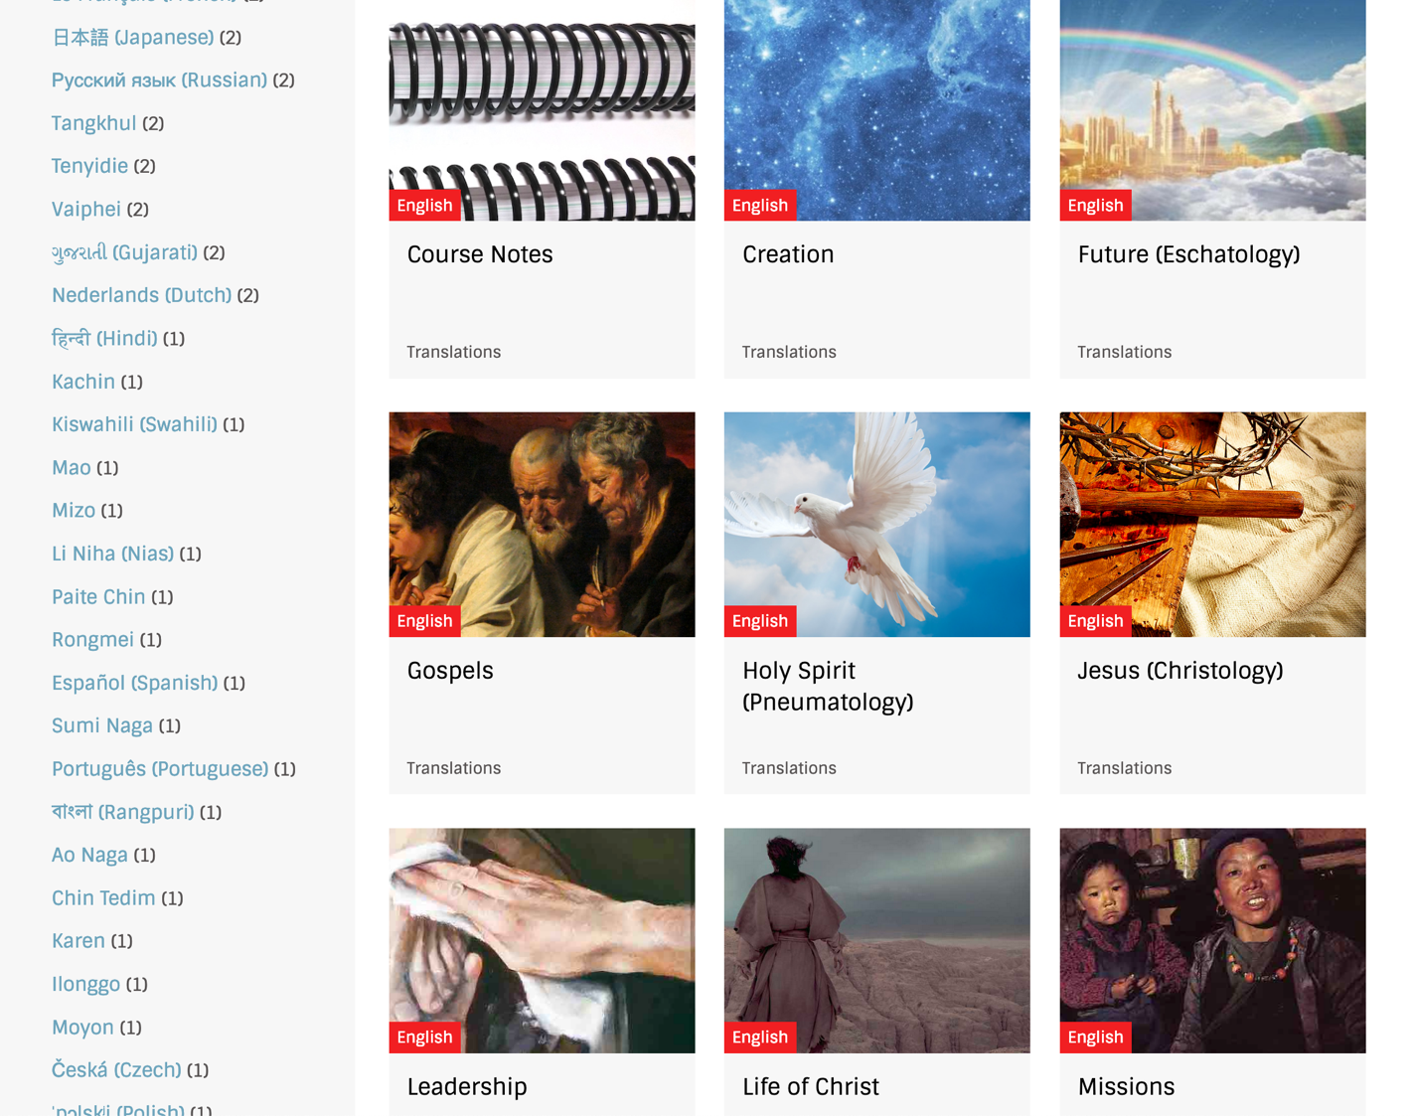
BibleStudyDownloads.org
7
Notes:
This has resulted in Bible teaching and study materials—mostly PowerPoint—in 53 languages! All a teacher needs to do is to click on a file and it downloads for free to teach any book of the Bible and many other subjects.

Slide 66
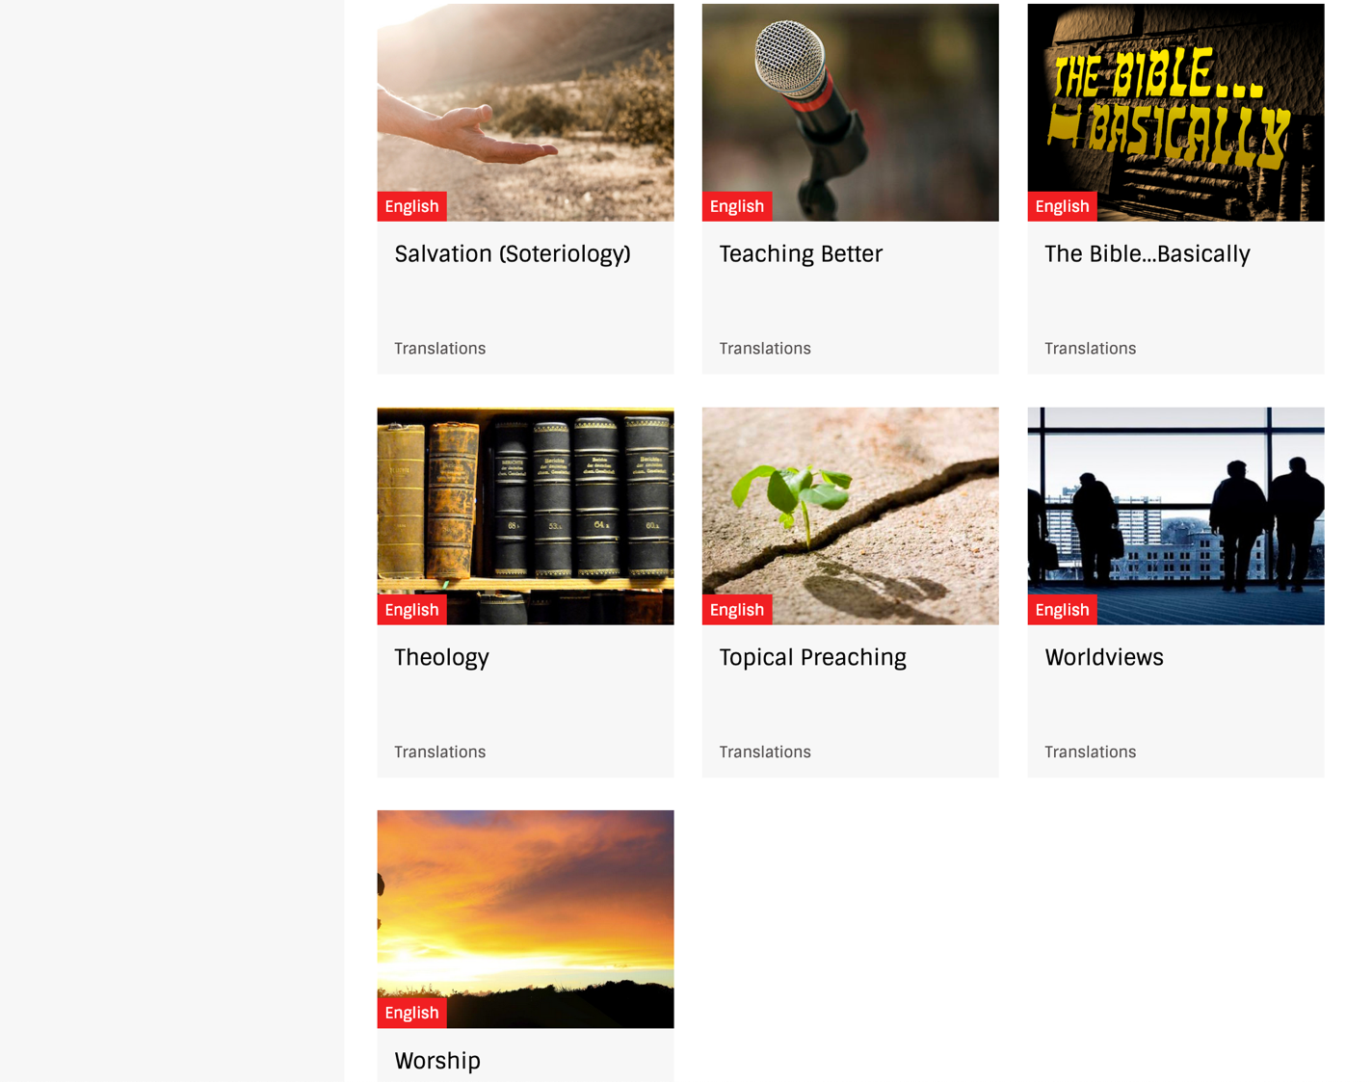
BibleStudyDownloads.org
7
Notes:
This has resulted in Bible teaching and study materials—mostly PowerPoint—in 53 languages! All a teacher needs to do is to click on a file and it downloads for free to teach any book of the Bible and many other subjects.

Slide 67

BibleStudyDownloads.org
7
Notes:
This has resulted in Bible teaching and study materials—mostly PowerPoint—in 53 languages! All a teacher needs to do is to click on a file and it downloads for free to teach any book of the Bible and many other subjects.

Slide 68

BibleStudyDownloads.org
7
Notes:
This has resulted in Bible teaching and study materials—mostly PowerPoint—in 53 languages! All a teacher needs to do is to click on a file and it downloads for free to teach any book of the Bible and many other subjects.

Slide 69

BibleStudyDownloads.org
7
Notes:
This has resulted in Bible teaching and study materials—mostly PowerPoint—in 53 languages! All a teacher needs to do is to click on a file and it downloads for free to teach any book of the Bible and many other subjects.

Slide 70

BibleStudyDownloads.org
7
Notes:
This has resulted in Bible teaching and study materials—mostly PowerPoint—in 53 languages! All a teacher needs to do is to click on a file and it downloads for free to teach any book of the Bible and many other subjects.

Slide 71

BibleStudyDownloads.org
7
Notes:
This has resulted in Bible teaching and study materials—mostly PowerPoint—in 53 languages! All a teacher needs to do is to click on a file and it downloads for free to teach any book of the Bible and many other subjects.

Slide 72

BibleStudyDownloads.org
7
English
Notes:
This has resulted in Bible teaching and study materials—mostly PowerPoint—in 53 languages! All a teacher needs to do is to click on a file and it downloads for free to teach any book of the Bible and many other subjects.

Slide 73

BibleStudyDownloads.org
7
Notes:
This has resulted in Bible teaching and study materials—mostly PowerPoint—in 53 languages! All a teacher needs to do is to click on a file and it downloads for free to teach any book of the Bible and many other subjects.

Slide 74

Chinese
7
Notes:
This has resulted in Bible teaching and study materials—mostly PowerPoint—in 53 languages! All a teacher needs to do is to click on a file and it downloads for free to teach any book of the Bible and many other subjects.

Slide 75

Indonesian
7
Notes:
This has resulted in Bible teaching and study materials—mostly PowerPoint—in 53 languages! All a teacher needs to do is to click on a file and it downloads for free to teach any book of the Bible and many other subjects.

Slide 76


Vietnamese
7
Notes:
This has resulted in Bible teaching and study materials—mostly PowerPoint—in 53 languages! All a teacher needs to do is to click on a file and it downloads for free to teach any book of the Bible and many other subjects.

Slide 77

العربية
7
Notes:
This has resulted in Bible teaching and study materials—mostly PowerPoint—in 53 languages! All a teacher needs to do is to click on a file and it downloads for free to teach any book of the Bible and many other subjects.

Slide 78
كيف يجب أن تتعامل مع جهلك بطرق الله؟
ثلاثة امور رئيسة
Notes:
Today we will see three keys in Deuteronomy 29:29 on how to deal with what we can know and not know.
How should you deal with your ignorance of God’s ways? Here is the first thing to do…

Slide 79
1. لا تقلق من جهة أن الله لا يخبرك بكل ما تريد أن تعرفه.
( تث 29: 29 أ)
Notes:
The LORD isn’t obligated to answer all your questions—so deal with it.

Slide 80
.2عوضاً، اسعَ لأن تعرف ما يخبرك به الله .
( تث 29: 29ب)
Notes:
The LORD speaks—though he doesn’t say all we want to know. So listen to him.

Slide 81

3. أطع ما تعرفه حقاً.
( تث 29: 29ت)
Notes:
Put into practice your limited knowledge.

Slide 82
تث 29: 29
»السَّرَائِرُ لِلرَّبِّ إِلهِنَا وَالمُعْلنَاتُ لنَا وَلِبَنِينَا إِلى الأَبَدِ لِنَعْمَل بِجَمِيعِ كَلِمَاتِ هَذِهِ الشَّرِيعَةِ».
Notes:
NLT: “The Lord our God has secrets known to no one. We are not accountable for them, but we and our children are accountable forever for all that he has revealed to us, so that we may obey all the terms of these instructions."
SECRET THINGS:
Why godless people live so long with so much money (Pss. 37, 73)
Why hundreds of millions of mothers kill their own children in the womb which totally defies their maternal instincts
Why the ones most calling for tolerance are the least tolerant
Why God would cause his son to suffer so much on our behalf
Why I would be the only boy from a broken home in my school growing up
Why God allowed me to come to know him when so many others never do or do so later in life
Why I have so many privileges to serve him throughout Asia in 35 countries when others never get to leave the USA

Slide 83


Our People
9
حزيران 2021
90 شخص من 16 أمة

Slide 84


شعب الطرق المتقاطعة• حزيران 2021
المملكة المتحدة
المملكة المتحدة
روسيا
هولندا
منغوليا
إيطاليا
فرنسا
كوريا
هونغ كونغ
لبنان
مصر
اليابان
الصين
مينامار
ألمانيا
تايوان
كندا
الهند
أمريكا
تايلاند
أثيوبيا
ماليزيا
زيمبابوي
جنوب أفريقيا
الفلبين
سنغافورة
أندونيسيا
CIC
أستراليا
نيوزيلاندا
كينيا
Notes:
لدينا حوالي 20% من الهنود في كنيستنا, نقدم الشكر للقديس توما الذي تغلب على شكه ليشهد ليسوع في الهند
Our June 2021 church of 90 people stem from 16 different countries around the world: Australia (David & Fiona), China (Jianji), Egypt (Tamara), France (Valentin), Korea (Grace Kim), India (Cynthia), Indonesia (Rena), Kenya (Jacqueline Ngare), Nepal (Joshua Limbu), Netherlands (Toes), Singapore (Albina), South Africa (Melody Hertenberger), Taiwan (Maple), Thailand (Mae), UK (James & Gabi), USA (Jim & Jacqui).
This does not include people who have recently attended only once:
Nor does it include missionaries living back in their countries but still are members of CIC: Maple (Taiwan), Budmaa (Mongolia)
Previous: Canada (Gloria Lee), Ethiopia (Lele), Malaysia (Aston, Naomi), Netherlands (Dies & Desiree), Philippines (Micah), South Africa (Melody),

Slide 85

Rick & Susan
2006-2021
Jim & Jacqui
2019-2021
Notes:
We are passing the baton to the Harmelings, who have been with us nearly two years now.

Slide 86

Our People
الوعظ من الكتاب المقدس
Notes:
RICK: Yes, we helped start Crossroads International Church in 2006 and I serve as the pastor-teacher.

Slide 87

دعونا ندرس الكلمة المقدسة
الكتاب المقدس :
سفراً سفراً
Notes:
This preaching series looks at each book in the Bible in a single sermon—66 messages that each cover an overview of an entire book.
I have taught through the Bible 37 times but never preached through it. Therefore, as I just finished 12 messages on the Minor Prophets, so now I will preach the other 54 books in the coming year until we learn all 66 books.
I encourage you to read through the Bible during this series, one book at a time.

Slide 88

كن
أميناً
سفر التكوين
د. ريك جريفيث, كنيسة الطرق المتقاطعة الدولية سنغافورة
CICFamily.com • BibleStudyDownloads.org
Notes:
The natural outworking of God choosing us for salvation and fulfilling his promise to bless us is to respond in faithfulness to him—to be reliable, dependable, and devoted to him.

Slide 89

كن منتصراً
سفر الرؤيا
Dr. Rick Griffith • Crossroads International Church Singapore
BibleStudyDownloads.org
Notes:
…and so on all the way to Revelation entitled “Be Triumphant.”

Slide 90
كيف يجب أن تتعامل مع جهلك بطرق الله؟
Notes:
What should you do since you do not really know why God does what he does?

Slide 91

الفكرة الرئيسية
أطع ما يقوله الله بدل أن تقلق من جهة ما لن يخبرك به أبدا.

Slide 92
تث 29: 29
«السَّرَائِرُ لِلرَّبِّ إِلهِنَا وَالمُعْلنَاتُ لنَا وَلِبَنِينَا إِلى الأَبَدِ لِنَعْمَل بِجَمِيعِ كَلِمَاتِ هَذِهِ الشَّرِيعَةِ».
( تث 29:29)
Notes:
How can you better follow all the words of this law?
Stop worrying about how much you know since God isn’t telling many things.
Be more concerned with who you are becoming.
But are you doing what he asks of you? James 4:17 says, “To him who knows what is right to do and does not do it, to him it is sin.”

Slide 93
Black

Slide 94

وعظ العهد القديم • BibleStudyDownloads.org
أحصل على هذا العرض مجانا!
Notes:
OT Preaching (op) Arabic

