Slide 1
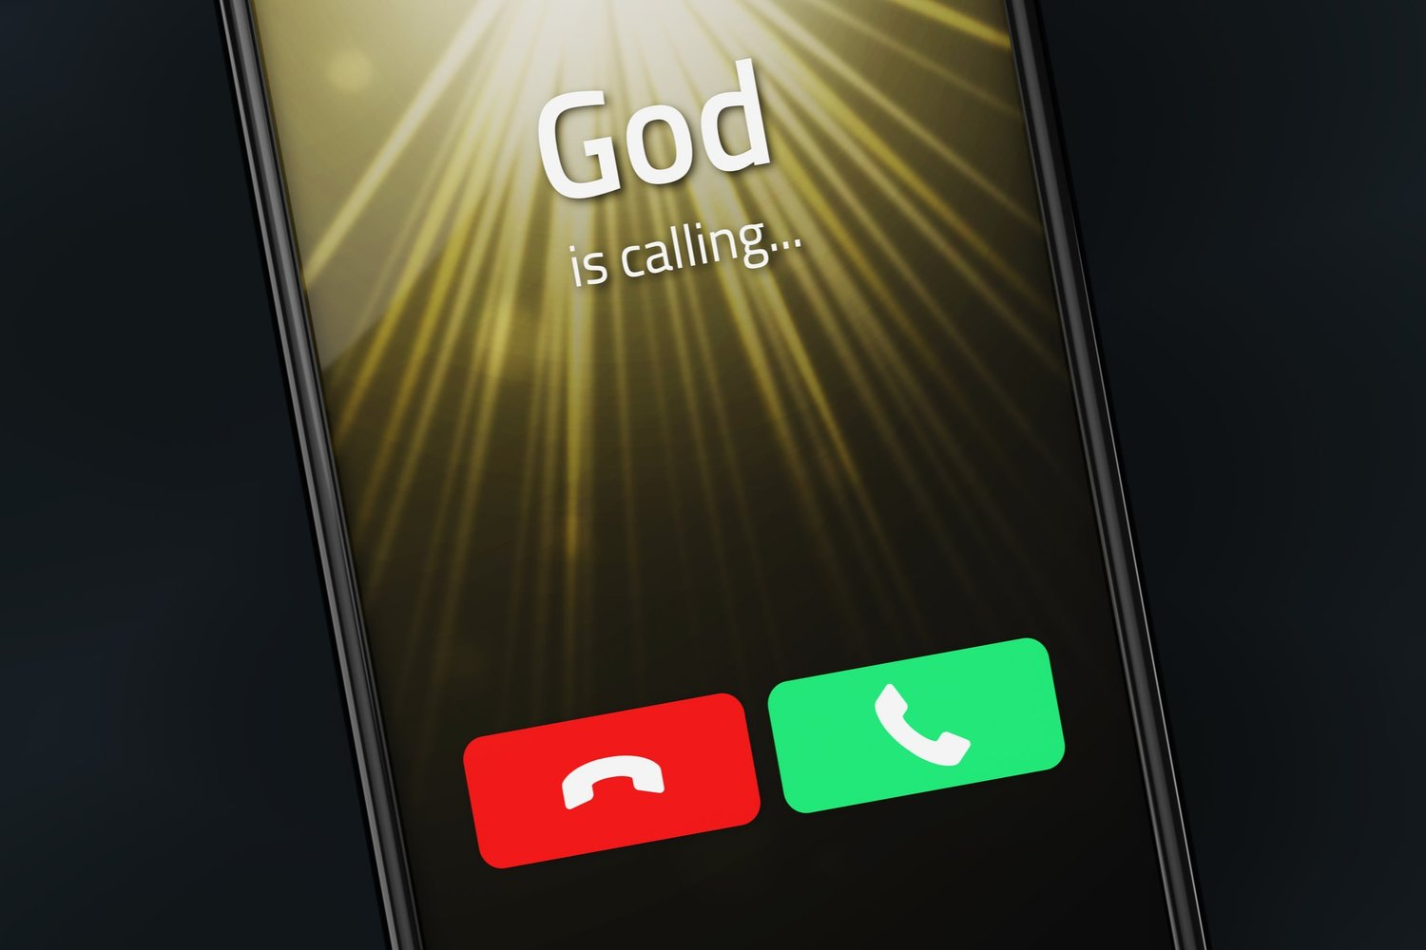
عندما يدعو الله
خروج ٣- ٤
Dr. Rick Griffith • Jordan Evangelical Theological Seminary • BibleStudyDownloads.org

Slide 2
الله يدعو...
Dr. Rick Griffith • Jordan Evangelical Theological Seminary • BibleStudyDownloads.org
Notes:
We are all used to ignoring spam calls, but what if God calls us?

Slide 3

يدعو الله المؤمنين اليوم إلى طاعته.
هل تريد أن تتبع دعوة الله لحياتك؟
Notes:
God is calling believers today to obey him. If he has called you to serve him, raise your hand.
• Do you want to follow God’s calling for your life?
How many of us want to obey the Lord?
Raise your hand again if that includes you.
Good. Willingness is the first step.

Slide 4

كيف يمكنك اتباع دعوة الله؟
Notes:
Now the question is how to obey.

Slide 5
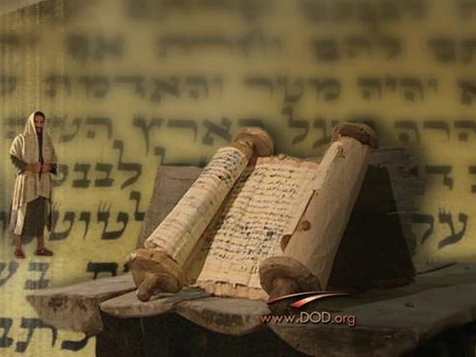
خلفيات
خروج 3-4
Notes:
Exodus 1–2 shows how God prepared the scene to call his servant Moses in Exodus 3–4.

Slide 6
Slides on
خروج ١

Slide 7
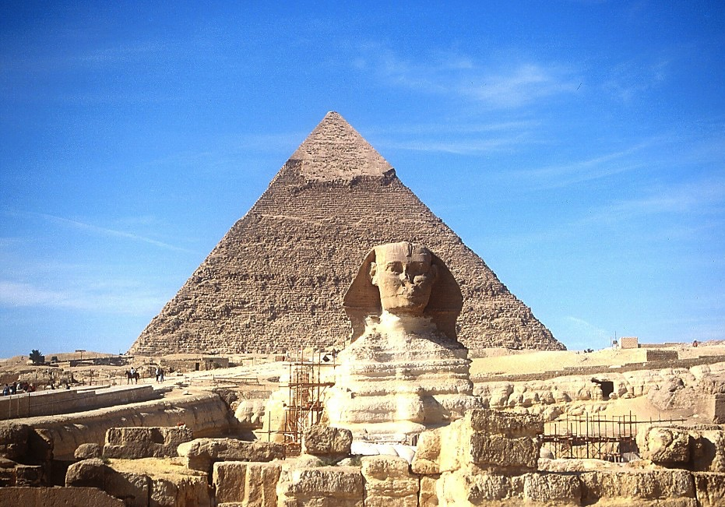
أبو الهول والهرم الأكبر
7
يوسف
Handbook pg. 24-25
57
Notes:
The Sphinx and the Great Pyramid still visible today remind us of Egypt’s great power.

Slide 8
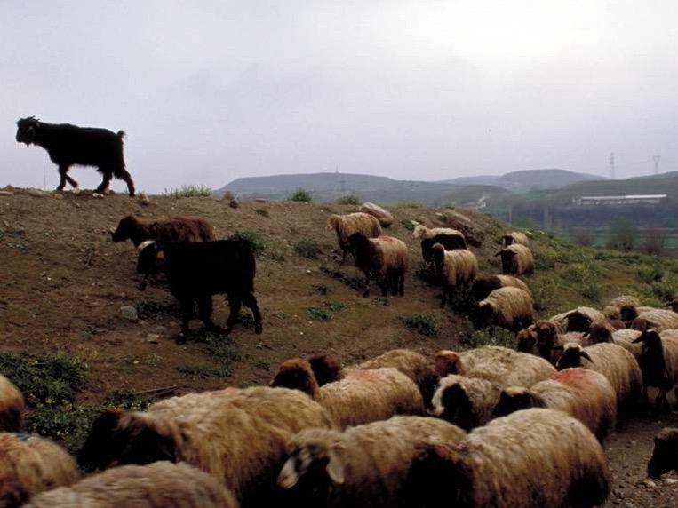
اااحتقر المصريون اليهود لكونهم رعاة غنم
Notes:
In contrast, Egyptians despised Israelites for being shepherds.

Slide 9
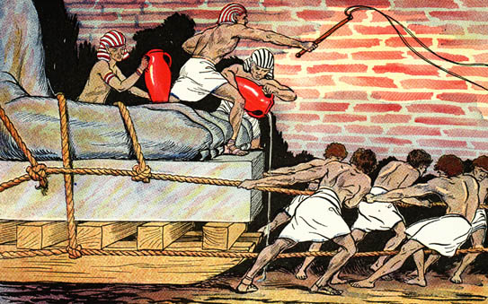
اضطهد المصريون بني إسرائيل بلا رحمة

Slide 10
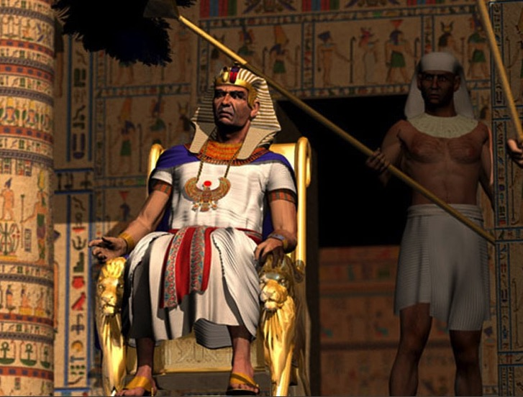
السلطة "المطلقة"
Notes:
Pharaoh was viewed as the ultimate power.

Slide 11
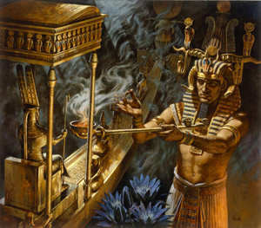
من لديه قوّة أكبر –
فرعون أم يهوه؟
Notes:
This raised the question of who had the greater power—Pharaoh or Yahweh, the Lord of the Hebrews.

Slide 12
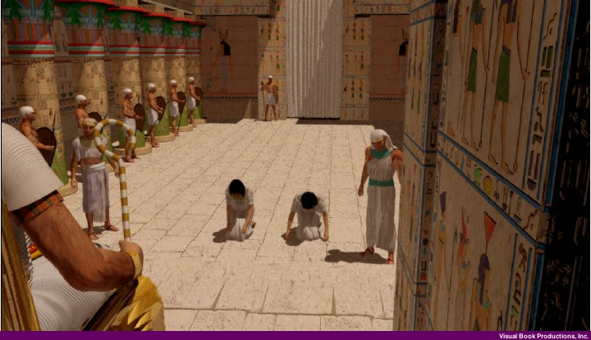
مثول قابلتي العبرانيات أمام فرعون
(خر 1: 15- 22)
Notes:
Pharaoh even abused his power by commanding the Hebrew midwives to kill the baby Hebrew boys.

Slide 13
Slides on
خروج ٢

Slide 14
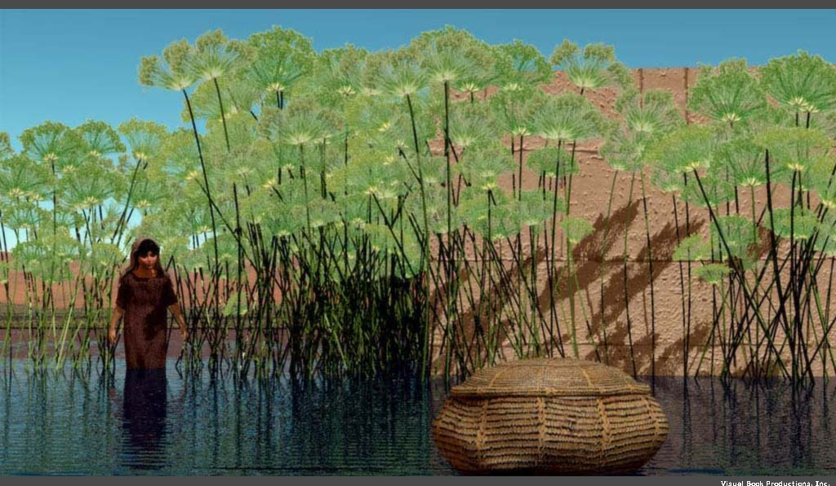
ألقي موسى "في نهر النيل" (خر 1: 22)
Notes:
So the mother of Moses “obeyed” Pharaoh’s command and gently tossed Moses into the Nile!

Slide 15

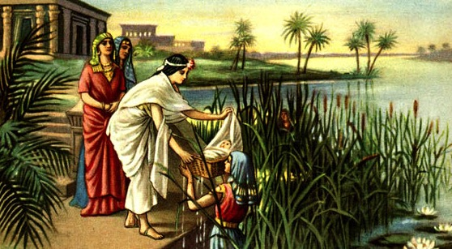
كلمة موسى تشبه الكلمة العبرية للانتشال (2: 10)
الملكة حتشبسوت تشبسوت
Notes:
But God worked amazingly so Pharaoh’s own daughter found the baby Moses.

Slide 16
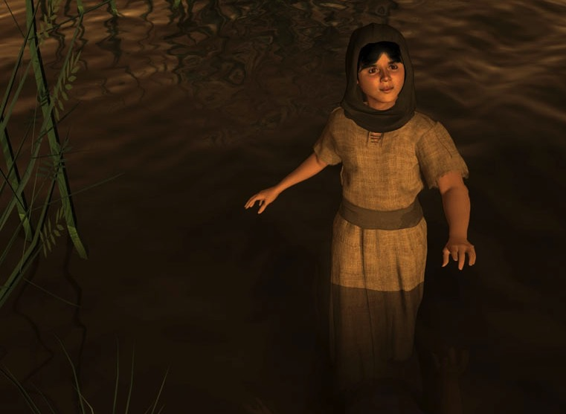
مريم (خر 2: 4)
Notes:
God even used Miriam—the older sister of Moses—to pay the mother of Moses to nurse him!

Slide 17
أع 7: 20- 21 (ن. د. ج)
"فِي تِلْكَ الْفَتْرَةِ وُلِدَ مُوسَى. وَكَانَ جَمِيلاً جِدّاً،
فَرَبَّاهُ وَالِدَاهُ فِي بَيْتِهِمَا
ثَلاثَةَ أَشْهُرٍ، وَلَكِنَّهُمَا
اضْطُرَّا أَخِيراً إِلَى التَّخَلِّي عَنْهُ،
فَأَنْقَذَتْهُ ابْنَةُ فِرْعَوْنَ
وَتَبَنَّتْهُ وَرَبَّتْهُ."
Notes:
Acts 7 notes that Pharaoh’s daughter raised Moses as if he were her own son!

Slide 18

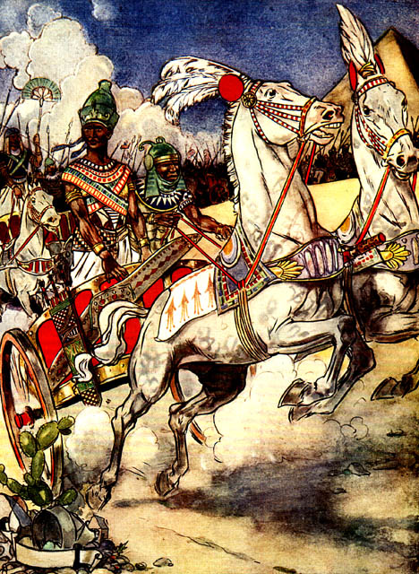
موسى يهرب
تحتمس الثالث
Notes:
Acts 7 notes that Pharaoh’s daughter raised Moses as if he were her own son!

Slide 19
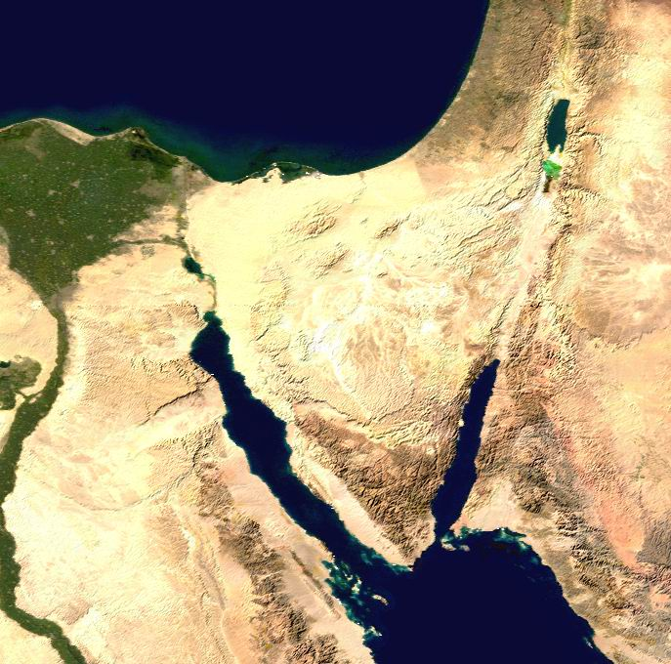
موقع
مِديان
كنعان
جاسان
جبل
سيناء
نهر النيل
مصر
مِديان
Notes:
In Exodus 3, we find Moses far away in Midian, traveling to Mount Sinai with his sheep.

Slide 20
ككيف يمكنك اتباع دعوة الله؟
كيف يمكن لموسى ان بتبع الله؟
Notes:
• How can you follow God's calling?

Slide 21
دورنا
دور الله
Notes:
Today, in Exodus 3–4, we will first see God’s role
• and then our role regarding God’s call on our lives.
We will summarize Exodus 3–4 in two principles relating to (1) God’s calling and (2) our response.

Slide 22
Slides on
خروج ٣
Notes:
(How does the LORD convince us to respond to Him? It starts when…)

Slide 23
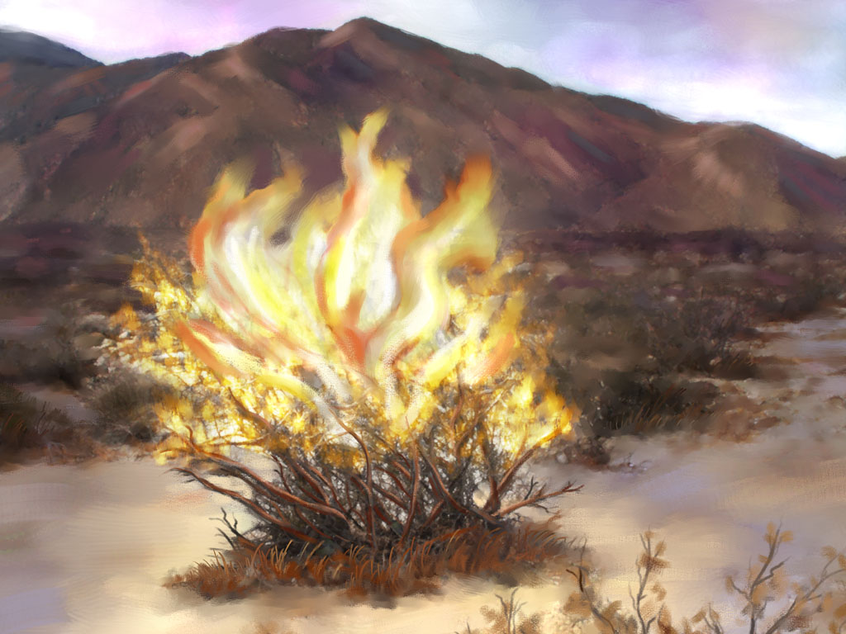
الله يدعوعبده
(خر 3)
Notes:
[The Lord tells us to do the impossible to show us our inadequacy and need.]

Slide 24
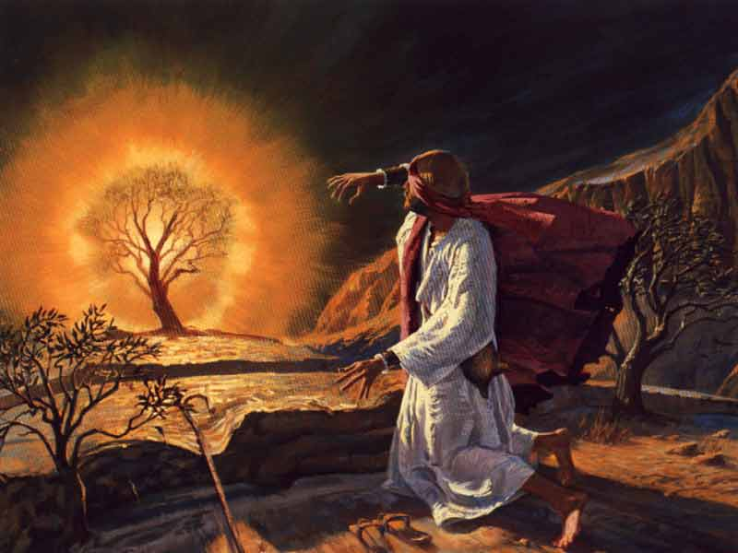
العليقة
المشتعلة
(خر 3: 1 – 4: 17)
Notes:
God called Moses to lead all Israel out of Egypt (3:1-10).

Slide 25
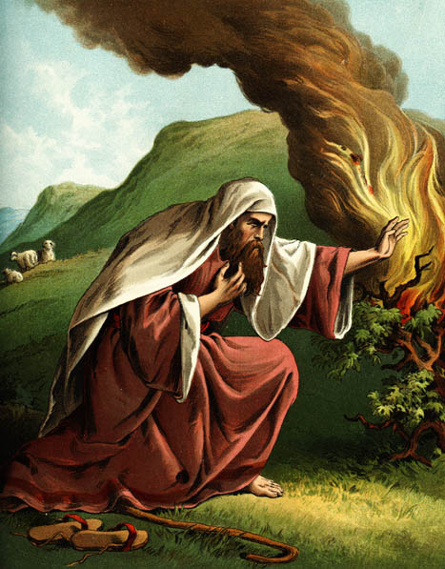
أعذار
1- من أنا (3: 11)؟
Notes:
Moses gave excuses instead of obeying God’s call (3:11–4:17).
• 1. "Who am I?"
This is not a relevant question, but Moses asked it.
God could have focused on Moses, "You are my chosen servant with the perfect balance of 40 years in Egypt and 40 in the wilderness."
But God answered, “I will be with you. And this is your sign that I am the one who has sent you: When you have brought the people out of Egypt, you will worship God at this very mountain” (3:12).

Slide 26
أعذار
1- من أنا (3: 11)؟
2- من أنتَ (3: 13)؟
"فقالَ اللهُ لِموسى: أنا هوَ الّذي هوَ‌.
هكذا تُجيـبُ بَني إِسرائيلَ:
هوَ الّذي هوَ أرسلَني إليكُم."
خروج 3: 14 (ن. د. ج)
Notes:
God didn't accept this excuse of who Moses was.
• 2. So Moses then questioned who God was!
But this wasn't any better an excuse.
• "God replied to Moses, 'I Am Who
I Am. Say this to the people of Israel:
I Am has sent me to you'"
(Exodus 3:14 NLT).

Slide 27
أعذار
1- من أنا (3: 11)؟
2- من أنتَ (3: 13)؟
3- ماذا لو فشلتُ (4: 1)؟
Notes:
3. "What if they do not believe me?" is essentially, "What if I fail?"

Slide 28

الله لا يدعو المؤهلين بل يؤهل المدعوين

Slide 29
أعذار
1- من أنا (3: 11)؟
2- من أنتَ (3: 13)؟
3- ماذا لو فشلتُ (4: 1)؟
4- أنا لستُ موهوبًا (4: 10)
Notes:
Ex. 4:10 But Moses pleaded with the LORD, “O Lord, I’m not very good with words. I never have been, and I’m not now, even though you have spoken to me. I get tongue-tied, and my words get tangled.”
This is like saying, “But God, I need a translator!”

Slide 30
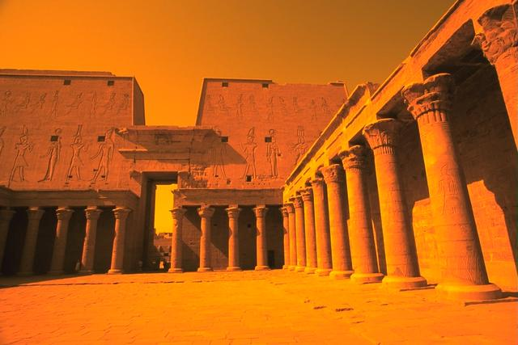
أع 7: 22 (ن. د. ج)
"فَتَثَقَّفَ مُوسَى بِعُلُومِ مِصْرَ كُلِّهَا،
حَتَّى صَارَ مُقْتَدِراً فِي الْقَوْلِ وَالْعَمَلِ."
Notes:
His self-perception was poor, but Stephen in Acts 7 notes, “Moses was educated in all the wisdom of the Egyptians and was powerful in speech and action."

Slide 31
أعذار
1- من أنا (3: 11)؟
2- من أنتَ (3: 13)؟
3- ماذا لو فشلتُ (4: 1)؟
4- أنا لستُ موهوبًا (4: 10)
5- لا أريد الالتزام (4: 13)
Notes:
Ex. 4:13 But Moses again pleaded, “Lord, please! Send anyone else.”
This is like saying, “Here am I, Lord! But please, send Aaron!”

Slide 32
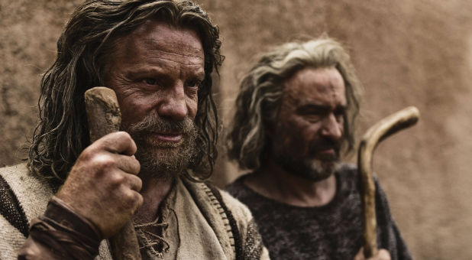
انتهى الحديث بين الله وموسى
فقط بعد تعيين هارون
كشريكٍ في الخدمة
(خر 4: 13- 17)

Slide 33
الله يدعوعبده
(خر 3)
Notes:
[The Lord tells us to do the impossible to show us our inadequacy and need.]
This is God's role—to call us.
What is our role?
How should we respond to God’s calling?

Slide 34
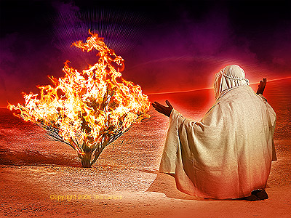
خادم الله يجب أن يقدم نفسه باعتباره أداة الله
(خر 4)
Notes:
[Offer yourself to God as an inadequate vessel trusting in God’s sufficiency.]
Moses finally obeyed God’s call by returning to Egypt (4:18-31).

Slide 35
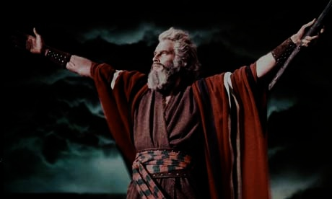
حياة موسى
100
الفترة
المرجع
التواريخ
الموقع
40 سنة
أميرًا
خر 2: 1- 10
1485 -1525
ق. م
مصر
(أكاديمي)
40 سنة
راعيًا
خر 2: 11- 25
1485- 1445
ق. م
مِديان
(تعليم ميداني)
40 سنة
قائدًا
خر 3: 1 –
تث 34: 8
1445-1405
ق. م
مِديان
مصر
البريّة
Notes:
Moses’ life had three distinct periods that helped him see God’s sufficiency.
• To lead Israel, God gifted Moses with a typical lifetime in his era to understand palace life, undoubtedly including speaking Egyptian.
• Yet that would not prepare him to lead two million Israelites in the desert, so God gave Moses another typical lifetime leading sheep in the wilderness.
• God promised that Moses would return to Mount Sinai, so he invested his final 40-year period to lead people wandering in the desert, which was far more complex than leading sheep.
Moses spent the perfect balance of 40 years in the palace and 40 years in the desert, beginning at age 80 when he began his life's most arduous calling.

Slide 36
كيف يمكنك اتباع دعوة الله؟
Notes:
Now, back to the question of how to obey.

Slide 37
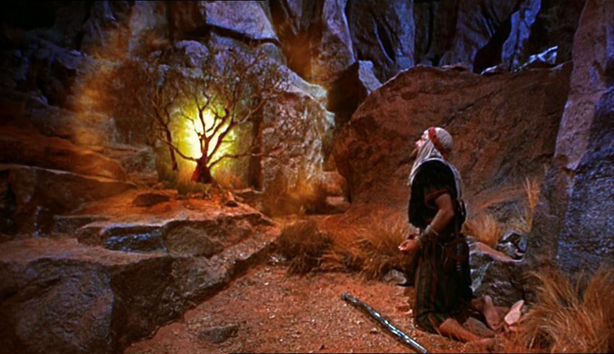
    اعترف بعدم كفايتك لمعرفة كفاية الله
الفكرة الرئيسية
Notes:
God's servant who understands his own inadequacy will show God's sufficiency
(Exodus 3–4 restated).

Slide 38
الله يدعوعبده
(خر 3)
Notes:
[The Lord tells us to do the impossible to show us our inadequacy and need.]

Slide 39
خادم الله يجب أن يقدم نفسه باعتباره أداة الله
(خر 4)
Notes:
[Offer yourself to God as an inadequate vessel trusting in God’s sufficiency.]
Moses finally obeyed God’s call by returning to Egypt (4:18-31).

Slide 40
كفاية الله على عجزي
شاهد في المدرسة الثانوية
مدرس الكتاب المقدس في المدرسة الثانوية
مبشر الموسيقى في الفلبين
طالب في معهد لاهوتي في دالاس
قسيس خلال المدرسة
أستاذ في كلية سنغافورة للكتاب المقدس
زارع مدرسة في سنغافورة
زارع كنيسة في سنغاغفورة
استاذ في جتس
العميد الأكاديمي في جتس
Notes:
Witness at Hayward High School—but my parents opposed it.
Teacher in Barnabas Brothers—but I knew only one more week of the Bible than them.
Music evangelist in Crossroads—but I had never preached before.
Student at DTS—but it took me much more time to learn than it did others.
Pastor at Grace Fellowship—but the people were 75% divorced with many issues.
Professor at Singapore Bible College—but I never fit the academic mold as an author.
School planter at ICS—but I had never had a child in primary school before.
Church planter at CIC—but I had too little time and no idea how to start a church.
Professor at JETS—but I started teaching five days after arrival and have little capacity to learn Arabic.
Academic Dean at JETS—but I am closest to retirement and know Arabic the least of anyone at JETS.

Slide 41

كيف يدعوك الله؟
ما الذي يقوله لك أن تفعل ويظهر عدم كفايتك وكفايته؟
هل ستقول له نعم؟

Slide 42
Black

Slide 43


مسح العهد القديم • BibleStudyDownloads.org
احصل علي هذا العرض مجانا!
Notes:
OP Arabic OT Preaching

