Slide 1
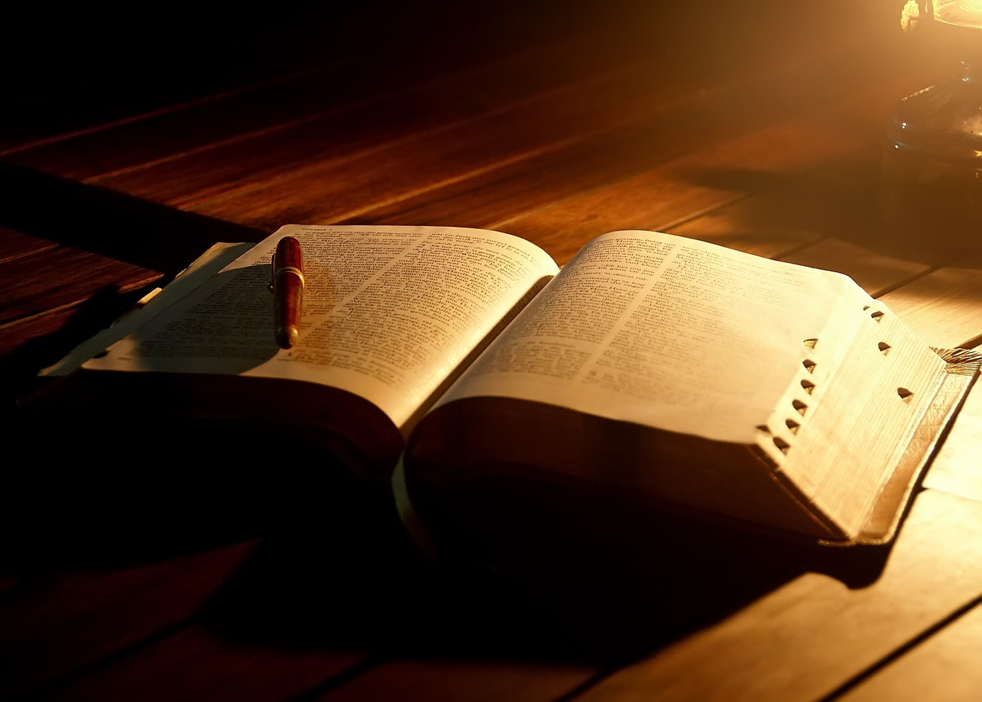
الختام بشكل جيد
جامعة 12: 8-14
د. ريك جريفيث • كنيسة الطرق المتقاطعة الدولية سنغافورة
CICFamily.com • BibleStudyDownloads.org

Slide 2
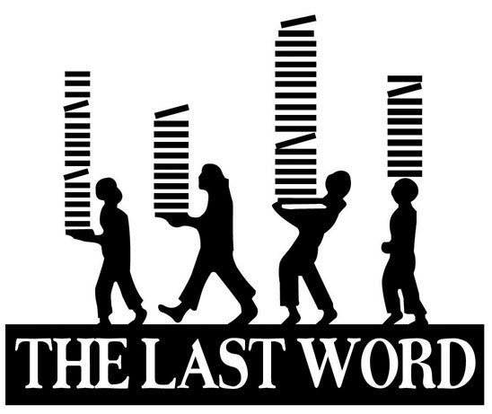
الكلمة الأخيرة
Notes:
Today I want to take us all down a road—your future road to the last words that you will utter in this life. People's last words are significant as they reveal a lot about the life of those who spoke them—whether a life of regret or hope.

Slide 3

الكلمات الأخيرة المشهورة
Notes:
Just listen to some last words spoken by well-known Christians…

Slide 4
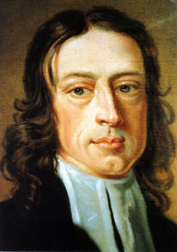
كلمات جون ويسلي الأخيرة
الأفضل من كل شيء هو أن الله معنا
وداعاً ... وداعاً
Notes:
The founder of Methodism, John Wesley's last words were…

Slide 5
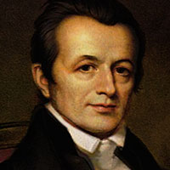
كلمات أدونيرام جودسون الأخيرة
أنا لا أتعب من عملي، ولا أتعب من العالم، ومع ذلك عندما يدعوني المسيح إلى المنزل، سأذهب بسعادة صبي يهرب من المدرسة.
Notes:
Adoniram Judson, America's first missionary who gave his life to Burma, said at his deathbed…

Slide 6
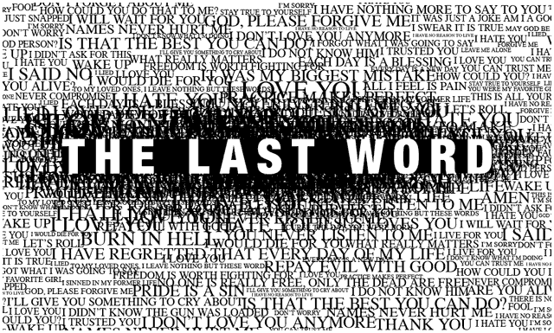
الكلمة الأخيرة
Notes:
Contrast these with the final moments of some who rejected Christ…

Slide 7
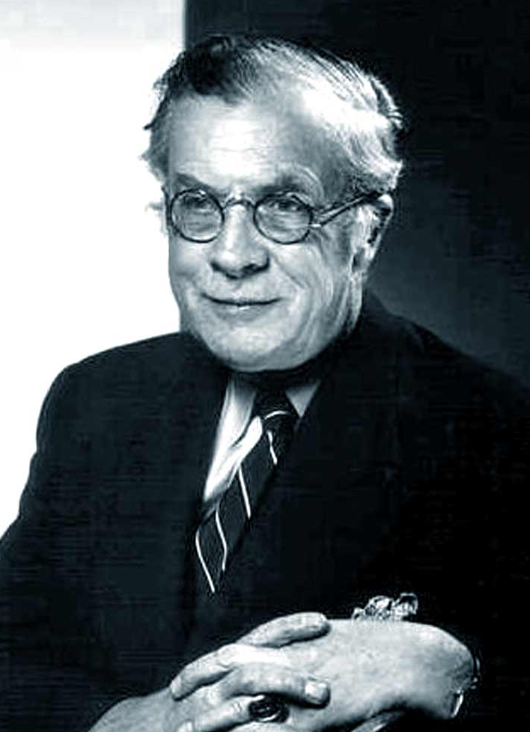
كلمات ج. هـ. هوكسلي الأخيرة
إذاً هي صحيحة
Notes:
As the godless professor J. H. Huxley lay dying, the great skeptic suddenly looked up at some sight invisible to human eyes, and, staring a while, whispered at last, "So it is true." Then he died.

Slide 8
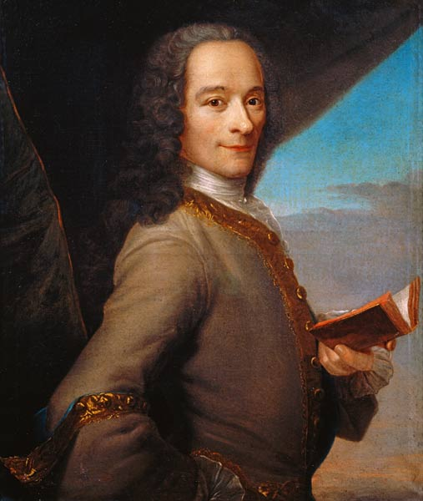
كلمات فولتير الأخيرة
لقد تخلى عني الله والإنسان، سأعطيك نصف ما أساوي إذا أعطيتني ستة أشهر من الحياة، فأجاب الطبيب: سيدي، لا يمكنك أن تعيش ستة أسابيع، فرد عليه فولتير: إذن سأذهب إلى الجحيم وأنت معي.
Notes:
On his deathbed, the atheist Voltaire told his doctor…

Slide 9
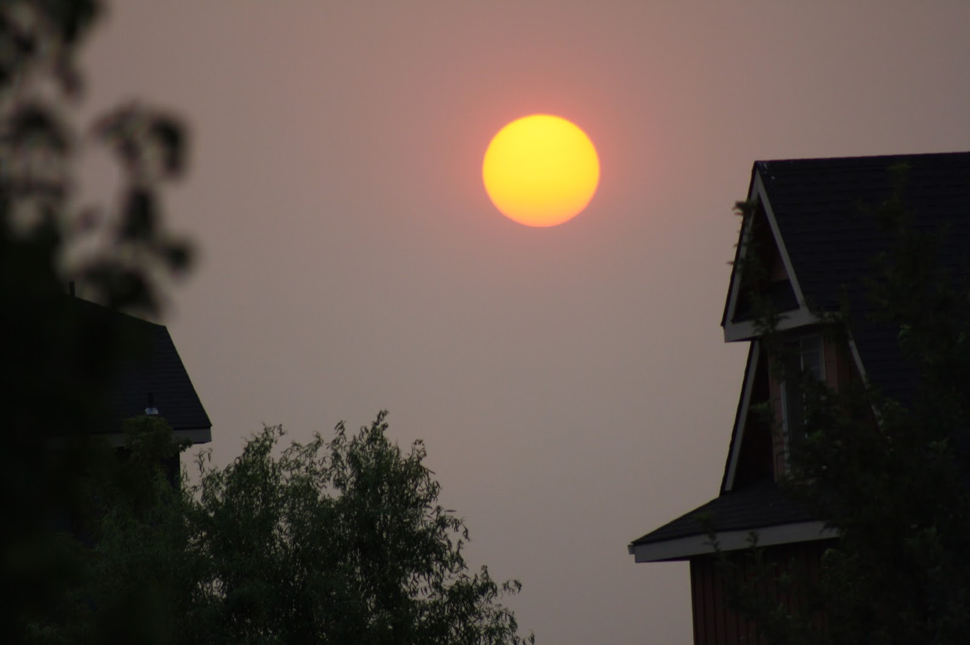
عش الآن في ضوء نهايتك

Slide 10

كيف تستطيع أن تختم بشكل جيد؟

Slide 11
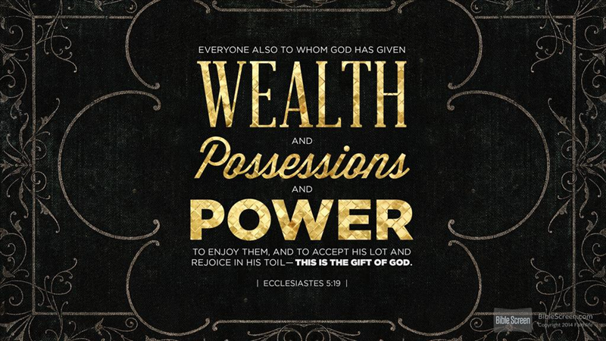
مساعي سليمان
Notes:
To explain true success, I can think of no better source than the most successful man who ever lived—at least in the world's eyes. What were his last words?
He was the richest man who ever lived.
He was also the smartest man ever.
So today let's heed the last words of a man who had experienced far more in life than any of us could ever dream.

Slide 12
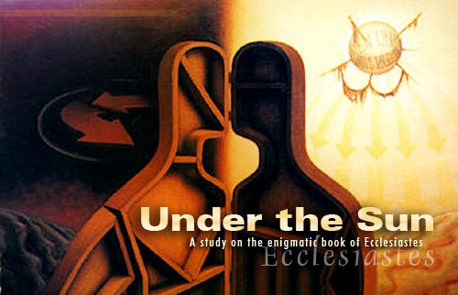
Cover
تحت الشمس
دراسة لسفر الجامعة
Notes:
You may have guessed I'm talking about King Solomon. He wrote the book of Ecclesiastes at the end of his life—so it gives his last words to us. Today we'll look at the last verses of the last chapter of his last book to see the lasting secret of lasting success.

Slide 13
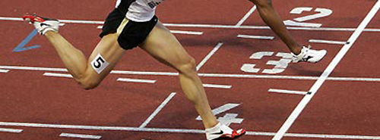
جامعة 12: 8-14
الكلمات الأخيرة للختام بشكل جيد
Notes:
Today we'll zero in on his last words in Ecclesiastes 12:8-14.
These final seven verses conclude the book by citing three things: the theme, the authority of the book, and the way to true success.
Verse 8 repeats the theme of the entire book, that…

Slide 14

1. الموضوع: الحياة عابرة
(12: 8)
الكل باطل
يقول الجامعة
باطل الأباطيل
الكلمة الرئيسية في سفر الجامعة

Slide 15
تعني كلمة هيبيل حرفياً
نفس، ريح أو بخار
(أم 21: 6، أش 57: 13)
الكلمة الرئيسية في سفر الجامعة

Slide 16
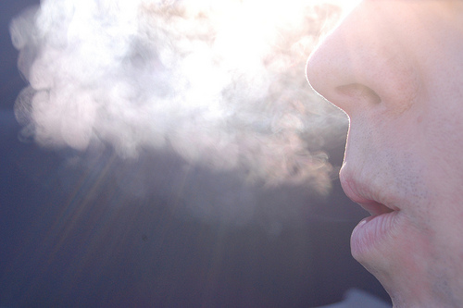
ترجمة حرفية جداً
استعارة:
ما لا يدوم (ما هو بدون جوهر حقيقي أو قيمة أو ديمومة أو أهمية أو معنى
(BKC، 1: 976)

Slide 17


معنى هيبيل
lbh
باطل (KJV، ESV، NAU)
لا معنى له (NIV، NLT)
عديم الجدوى (NET، TLB، (BKC
عابر
الجامعة

Slide 18
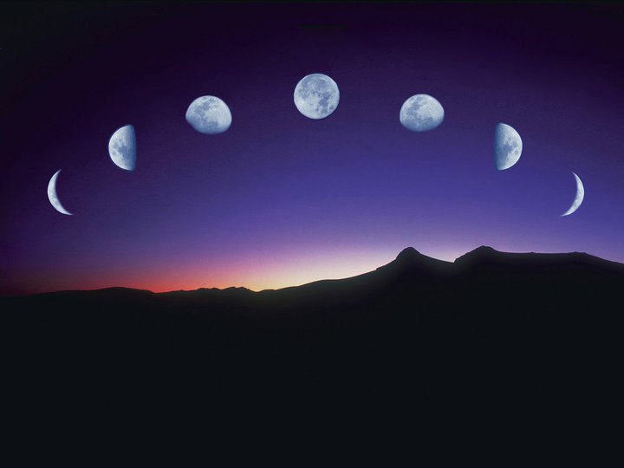
دراستنا في سفر الجامعة
العمل والحكمة لا يدومان

Slide 19
1. الموضوع: الحياة عابرة
(12: 8)
الكل باطل
يقول الجامعة
باطل الأباطيل
الكلمة الرئيسية في سفر الجامعة

Slide 20
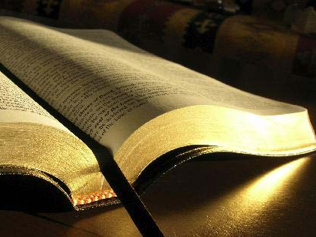
2. السلطة: عش بحسب كلمات الله
(12: 9-12)

Slide 21

كلمة الله تخترق

Slide 22
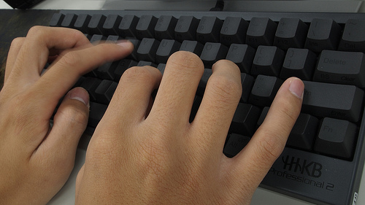
كلمات الله مهمة
78
9 بقي أن الجامعة كان حكيماً، وأيضا علم الشعب علماً، ووزن وبحث وأتقن أمثالاً كثيرة. 10 الجامعة طلب أن يجد كلمات مسرة مكتوبة بالإستقامة، كلمات حق (جا 12: 9-10)
Notes:
Solomon put his wisdom to work by teaching (12:9-10).
Solomon was a wise man who taught others knowledge (12:9a).
Solomon taught with proverbs (12:9b-d).
Some proverbs he thought up himself (12:9b).
Some proverbs he got from others (12:9c).
Some proverbs he arranged together [in the book of Proverbs?] (12:9d).
Solomon taught with the best words (12:10).
He used words that were aesthetically pleasing (12:10a).
He wrote with precision to guard the truth (12:10b).

Slide 23
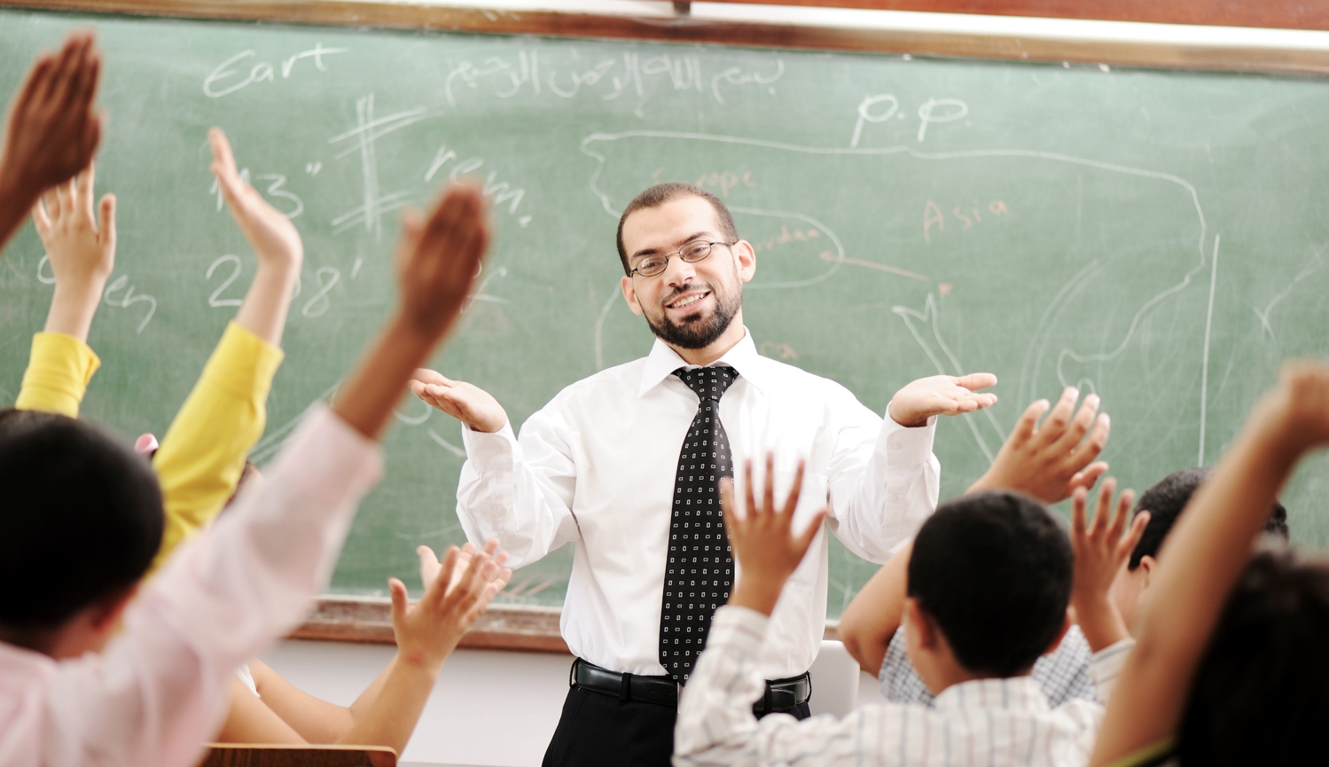
لقد علمك معلموك بأحكم كلمات يعرفونها.
Notes:
Can you think of any of their proverbs?
My best teacher used to say, "If you can read, you can cook!" Who? Mom!
Don't let their proverbs escape you. Write them down now so you won't forget them.

Slide 24
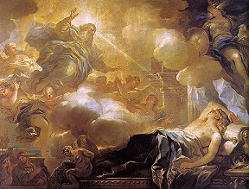
يعطي الكتاب المقدس الحكمة ولكن الكتب غير الموحى بها لا تحتوي على إجابات نهائية وترهقنا فقط (12: 11-12)

Slide 25
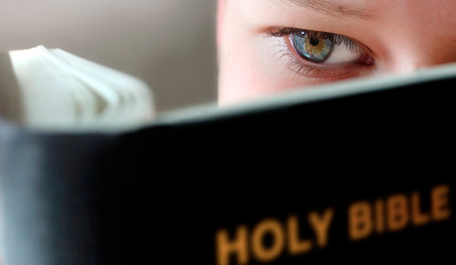
لكن كيف يعطي تعليم الكتاب المقدس من خلال الرجال الحكماء حكمة حقيقية (١٢: ١١)؟

Slide 26
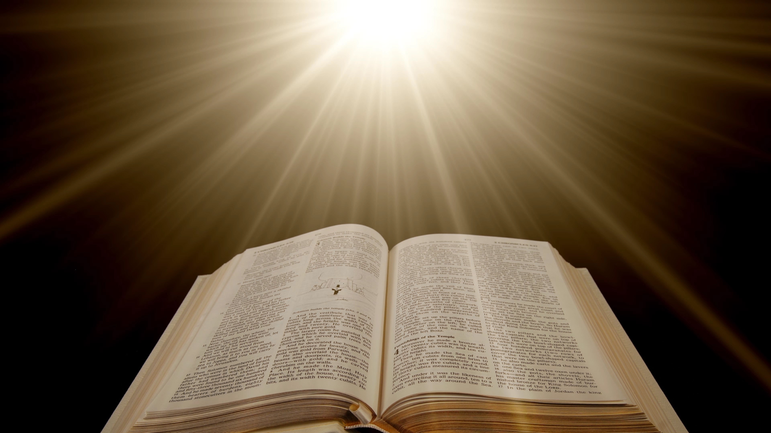
حكمة الكتاب المقدس
78
11 كلام الحكماء كالمناسيس، وكأوتاد منغرزة، أرباب الجماعات، قد أعطيت من راع واحد. 12 وبقي فمن هذا يا ابني تحذر:
لعمل كتب كثيرة لا نهاية، والدرس الكثير تعب للجسد.
(جا 12: 11-12)

Slide 27
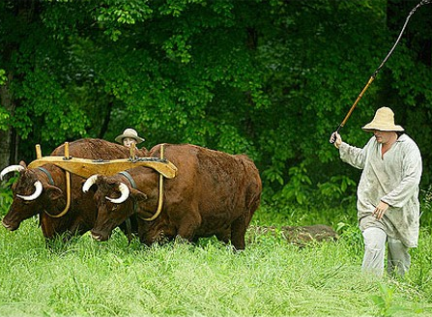
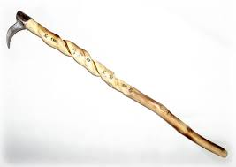
يحفزنا الكتاب المقدس ويرشدنا في الحياة الحكيمة
78
كلام الحكماء كالمناسيس (12: 11أ)

Slide 28
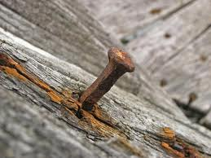
الكتاب المقدس يعطي أساساً قوياً للحياة الحكيمة
78
... وكأوتاد منغرزة (جا 12: 11ب)
Notes:
Years ago our 5-year-old, John, ran around the corner in our house and almost hit our 8-year-old, Stephen, who was carrying food to the table.
So I interviewed John: "Can you tell me why we don't run in the house?" "Because it can hurt people and break things," John responded.
When we all sat down to eat a few minutes later, John announced to the family, "I have good news and bad news. The good news is what is right, is right! The bad news is what is wrong, is wrong!"
We all laughed, but the realization hit us that much of what the world calls "wrong" is right and much of what the world calls "right" is wrong.
(But how can we tell the difference between right and wrong? God has to tell us, and…)

Slide 29
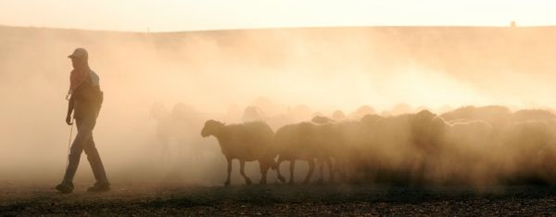
الكتاب المقدس هو الكتاب الوحيد الموحى به إلهياً
78
أرباب الجماعات، قد أعطيت من راع واحد (جا 12: 11ت)

Slide 30
حكمة الكتاب المقدس
78
11 كلام الحكماء كالمناسيس، وكأوتاد منغرزة، أرباب الجماعات، قد أعطيت من راع واحد. 12 وبقي فمن هذا يا ابني تحذر:
(جا 12: 11-12أ)
Notes:
In contrast, man's books provide no ultimate answers and wear us out (12:12).
Don't rely on books other than words of the wise (12:12a).

Slide 31

لعمل كتب كثيرة لا نهاية ...
(جا 12: 12ب)
Notes:
Man's many books still have not answered our most vital questions (12:12b).

Slide 32
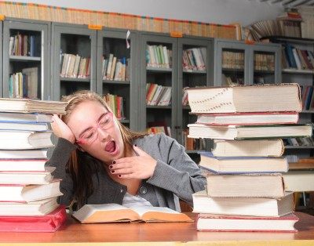
... والدرس الكثير تعب للجسد.
(12: 12ت)

Slide 33
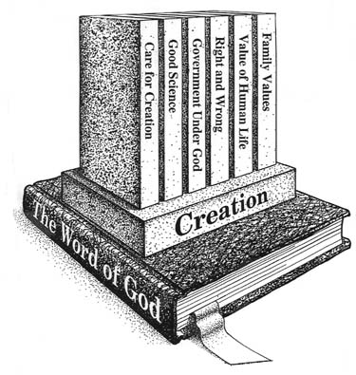
جد أساساً كتابياً
Notes:
Every one of us is headed towards more learning throughout our lives—and towards being wearied by a lot more study and books!
How can you survive all the books and study yet ahead?
Make the Book you study most be the only one that genuinely refreshes!
Sure, study other books, but make this Book the one you read every day, OK?

Slide 34
1. الموضوع: الحياة عابرة
(12: 8)
الكل باطل
يقول الجامعة
باطل الأباطيل
الكلمة الرئيسية في سفر الجامعة

Slide 35
2. السلطة: عش بحسب كلمات الله
(12: 9-12)
Notes:
Since only Scripture has ultimate value for us, the best thing we can do in life is to respect the Author and live in light of His plan. In fact, this is just what the conclusion tells us…

Slide 36
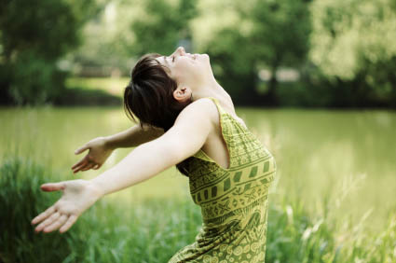
3. الخلاصة: احترم وأطع الله لأن هذا ينطبق على الجميع (12: 13-14)
Notes:
Live in awe of God and do what He says so that you'll always be doing the right thing.

Slide 37
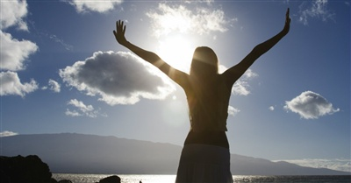
فلنسمع ختام الأمر كله:
اتق الله واحفظ وصاياه
(12: 13أ-ب)
Notes:
You'll succeed when you respect God's person (13a).
Fearing Him means living aware of his awesome love for you!

Slide 38
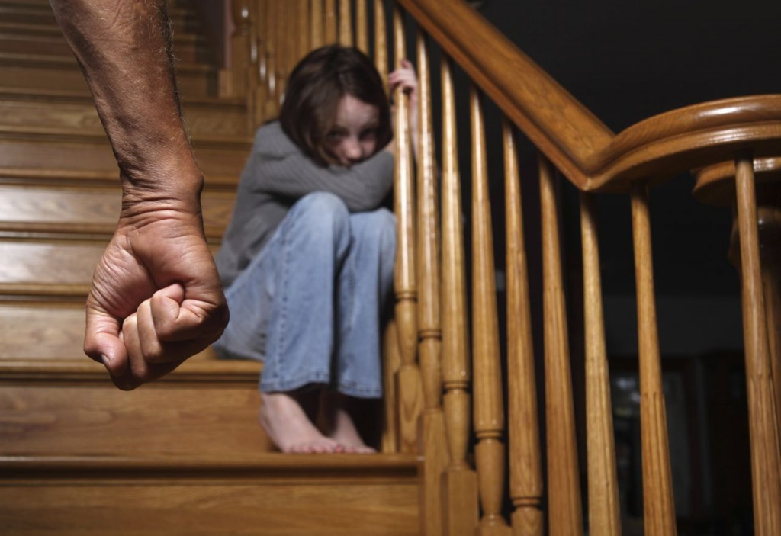
اتقِ الله؟ لا
Notes:
Does this mean we cower before God as if he's going to hit us? No.

Slide 39
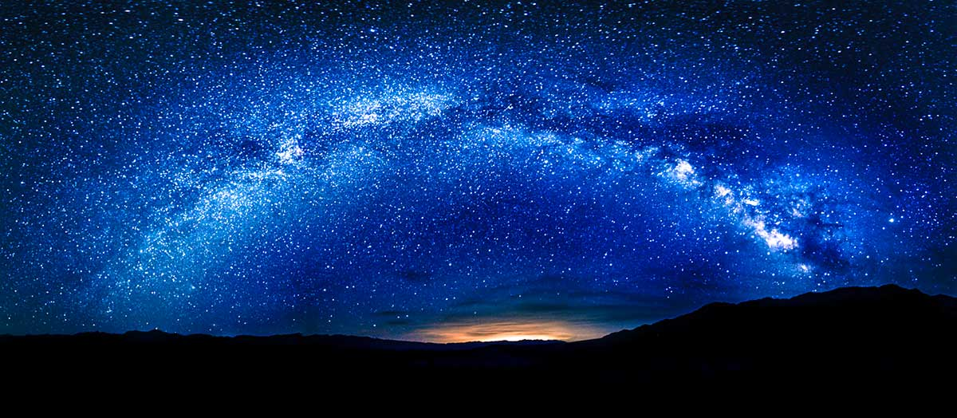
اتقِ الله؟ نعم
Notes:
Fearing Him means living aware of his awesome love for you!

Slide 40
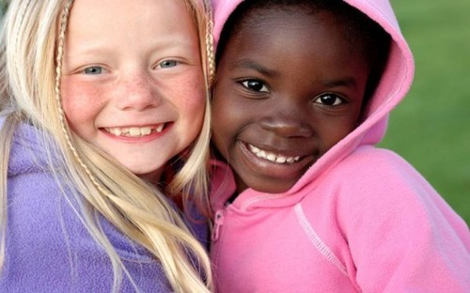
فاذكر خالقك في أيام شبابك
(12: 1)

Slide 41

استمتع بالحياة لكن أكرم الله
(11: 7-12: 7)

Slide 42

طريقة الإستمتاع بالشباب
هي في إكرام الله
الفكرة الرئيسية في
(11: 7-12: 7)

Slide 43
فلنسمع ختام الأمر كله:
اتق الله واحفظ وصاياه
(12: 13أ-ب)
لكن لماذا؟
Notes:
You'll succeed when you respect God's person (13a).
Fearing Him means living aware of his awesome love for you!
You'll also succeed when you follow God's standards (13b). Do what He says!
Realize that he gives us commands to live by because he has your best interest in mind

Slide 44
فلنسمع ختام الأمر كله:
اتق الله واحفظ وصاياه،
لأن هذا هو الإنسان كله.
(12: 13)
Notes:
Respecting and obeying God is the main task for which we'll be accountable (13c-14).
Respect and obey God as it ensures you'll do everything else that's important (13c).

Slide 45
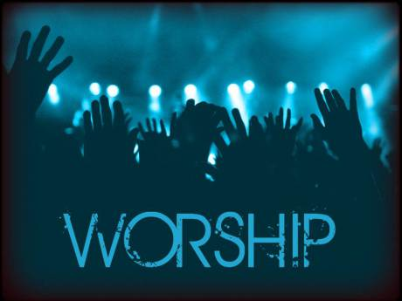
العبادة
Notes:
Worship is one of the very few things we do on earth that we will do in heaven.

Slide 46

رعب
Notes:
What a tragedy that I have discovered in Singapore that most churches have two thirds of their people show up late for worship! They don't seem to have a problem getting to work on time. I suspect that most would be on time to have an appointment with the Prime Minister, but to do so for God is much harder—even though God is far greater!

Slide 47
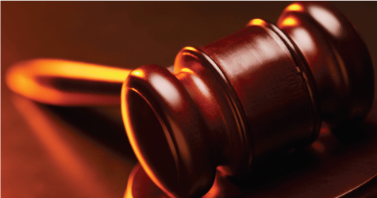
لأن الله يحضر كل عمل إلى الدينونة، على كل خفي، إن كان خيراً أو شراً (12: 14)
Notes:
Respect and obey God because you'll account to Him for every good and bad act (14).

Slide 48
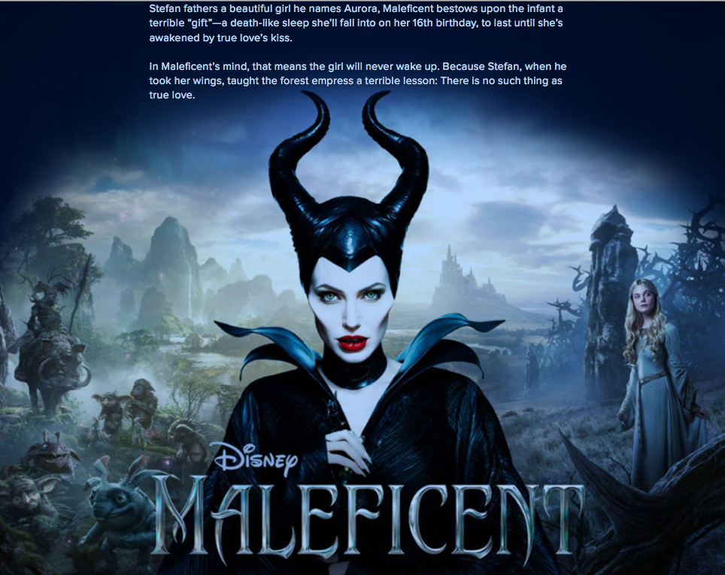
Maleficent
Notes:
The 2014 movie Maleficent portrays a frightening ruler of an evil realm.

Slide 49

شريرة
Notes:
She is called Maleficent and has great power but is betrayed.

Slide 50
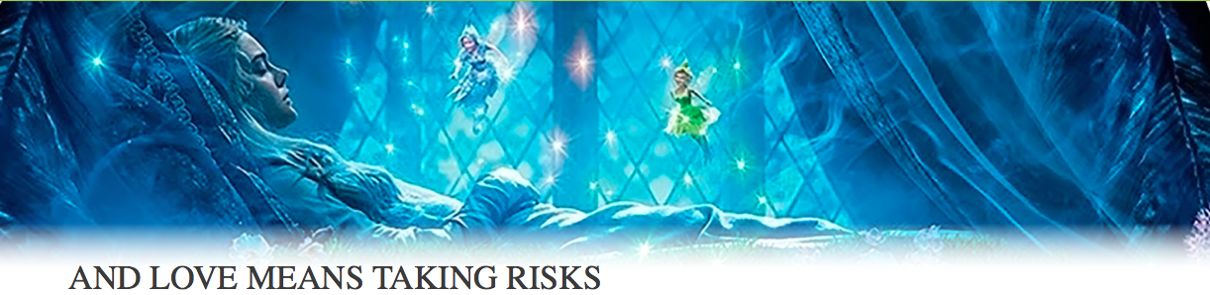
شريرة
Notes:
In revenge she causes a little girl to become a "Sleeping Beauty." Enter the typical love story of this little girl who grows up and wins over the heart of evil Maleficent—

Slide 51
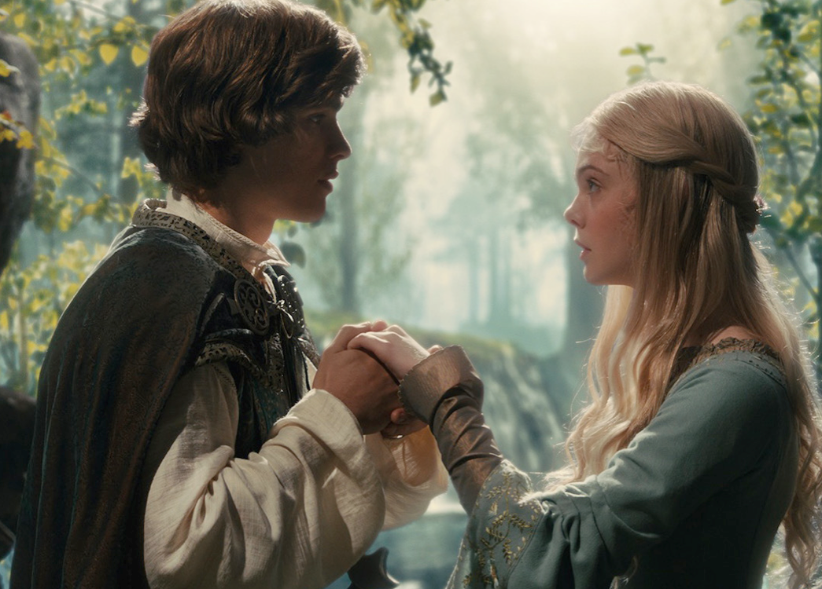
Maleficent
Notes:
as well as that of her own Prince Charming.

Slide 52
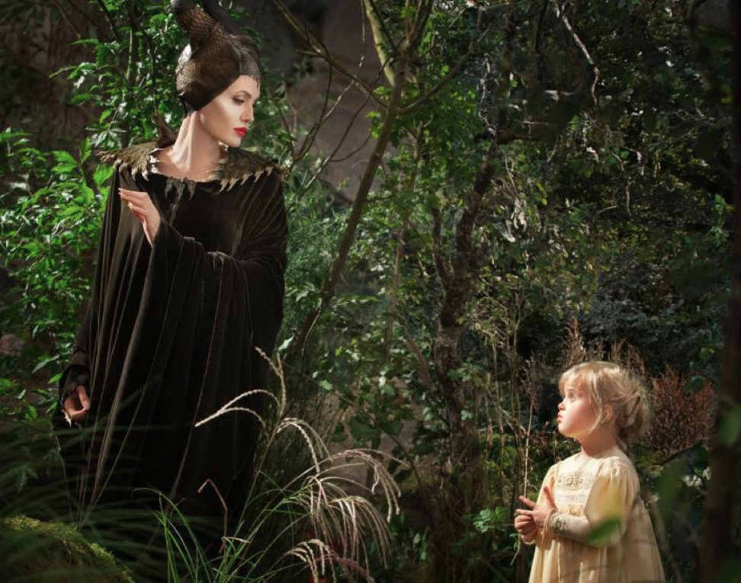
Maleficent
Notes:
One key scene of the movie was difficult to shoot, though.
The movie critics, Plugged In notes, "Note that it's Jolie's daughter, Vivienne, who plays the 5-year-old Aurora—waddling over to Maleficent and saying, 'Up, up!' Maleficent dutifully picks the girl up, and the young Aurora plays with the witch's fearsome horns—the beginning, it would seem, of Maleficent's softening stance...
"Jolie later told Entertainment Weekly that they originally tried to get other girls to play the young Aurora, but they were terrified of Jolie's makeup and outfit. 'It had to be a child that liked me and wasn't afraid of my horns and my eyes and my claws,' Jolie said. 'So it had to be Viv.'"

Slide 53
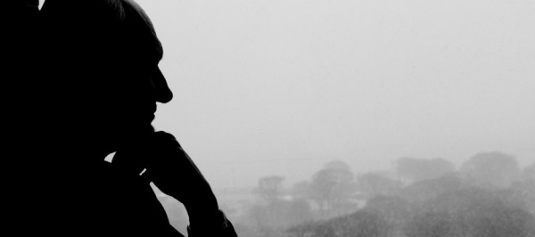
كيف تتقرب إلى الله؟
Notes:
When I read this, I thought. Hmmm, how like us approaching God. He seems terrifying to those who do not know him as they will give an account of their lives to him. However, to those of us who place childlike faith in him, he is not a frightening God but rather a loving Father, worthy of our respect.

Slide 54
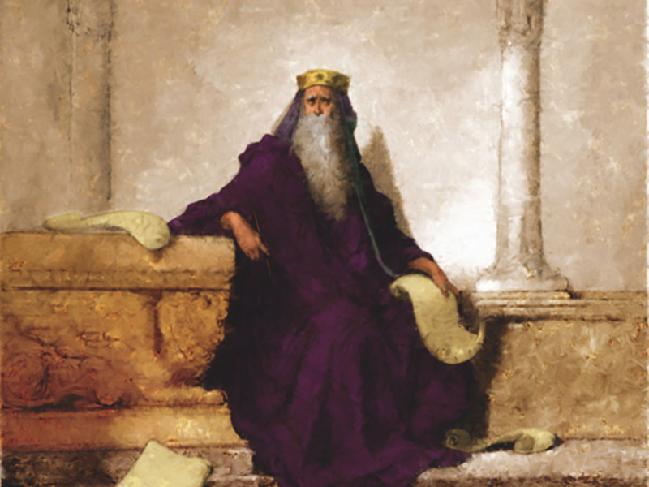
إذاً ماذا يقول لنا أحكم وأغنى وأنجح رجل في التاريخ البشري في كلماته الأخيرة؟

Slide 55
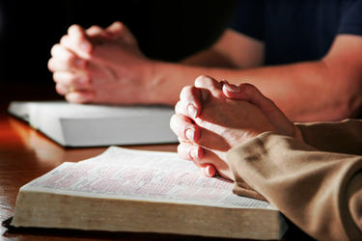
فكرة سليمان الرئيسية
احترم وأطع الله
حتى تختم بشكل جيد

Slide 56
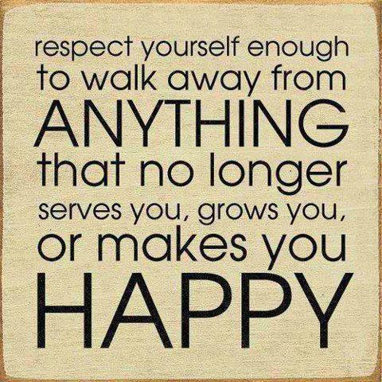
نصيحة عالمية
احترم نفسك
بما يكفي
للإبتعاد عن
أي شيء
لم يعد يخدمك
أو ينميك
أو يجعلك
سعيداً
Notes:
The key to success is not to respect yourself—it is to honor God!

Slide 57
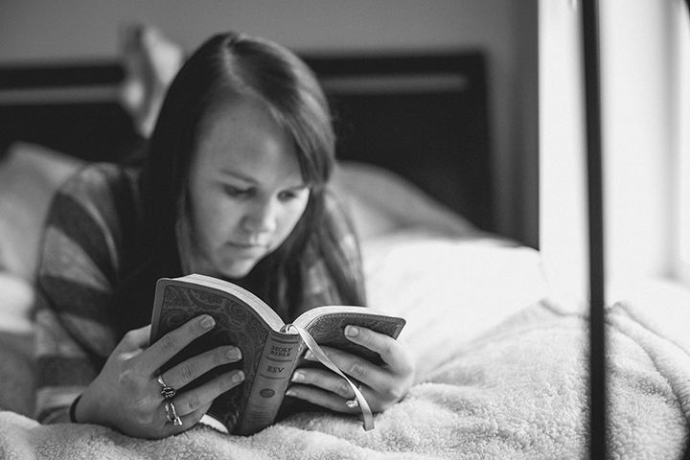
هل أنت جائع؟
Notes:
Do you give priority more to Scripture or to learning from other sources—TV, social media, movies, magazines, newspapers, secular books, even Christian books?

Slide 58

كيف يمكنك التمييز بين طالب السنة الأولى وطالب السنة الرابعة في كلية اللاهوت؟
السنة الأولى
طالب السنة الرابعة
?
تعصب كامل لا معرفة
معرفة كاملة لا تعصب
Notes:
During my first year of seminary, a graduating student asked me, "Do you know how to tell the difference between a first year and a fourth year student?" I confessed I didn't. He said, "First year men are all zeal, no knowledge. Fourth year men are all knowledge, no zeal."
And then came SMF chapel's slide show where guys spotted a man reading by the campus fountain. "Hey, he's reading his Bible!' they said. "Must be a first year student!" Everyone laughed, but I thought how much I wanted to make sure my heart for the Word didn't dissipate during seminary.

Slide 59
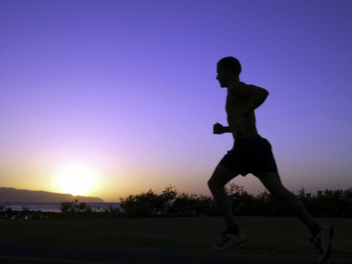
سعيك؟
Notes:
You may need to read other books more than this Book, but may I encourage you to read this Book first? Make it your daily habit to get God's view on life before you get any other!

Slide 60

Bible Reading Plans
5 دقائق/يوم = 288/1 جزء من اليوم
bible-reading.com
Notes:
Are you willing to tell God even right now that you'll read this Book at least 5 minutes daily—for the rest of your life?
In 1977 I committed to reading the Bible at least 5 minutes a day—but that's only 1/12th of an hour and 1/288th of a day! Not really a big decision…
If you won't make a commitment even this small, then I can offer little hope that you will be successful in what really counts in life.
But if you will commit to allow His words to change you daily, you will be making one of the best decisions possible.

Slide 61
Black
Notes:
Will you finish well? What will your last words be? May they reflect that you understood what it means to "Fear God and keep his commandments."
Prayer

Slide 62


على رابط وعظ العهد القديم BibleStudyDownloads.org
أحصل على العرض التقديمي والنص مجاناً

