Slide 1
كيف تستمتع بشبابك
جامعة 11: 7 – 12: 7
د. ريك جريفيث • كنيسة الطرق المتقاطعة الدولية سنغافورة
CICFamily.com • BibleStudyDownloads.org
Notes:
Today we see how to enjoy your youth.

Slide 2
هل أنت شاب؟
Notes:
But are you a youth? How would you know?

Slide 3
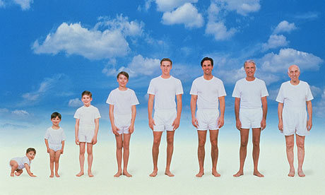
ما هي مراحل الحياة؟
Notes:
Are you a youth or not? That depends on how many stages of life exist. But in its most basic sense, I think life has essentially three stages…

Slide 4
ثلاث مراحل للنساء
1. إزعاج والدها
2. إزعاج زوجها
3. إزعاج صهرها
Notes:
One person says that the three stages for women include: (1) annoying her dad, (2) annoying her husband, and (3) annoying her son-in-law.
What a sad evaluation that is!

Slide 5
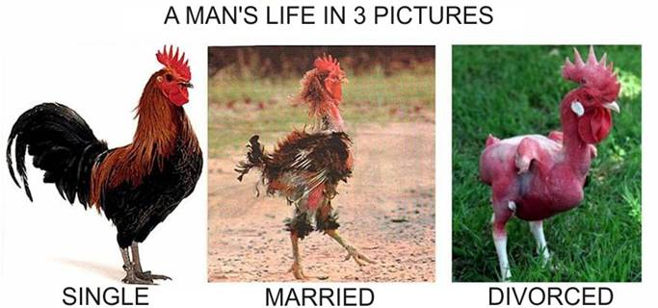
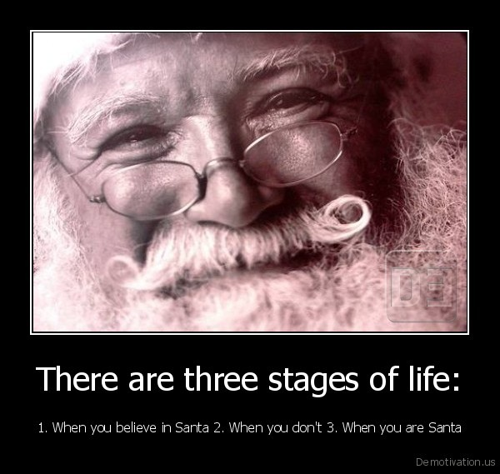
ثلاث مراحل للرجال
1. تؤمن بوجود سانتا 2. لا تؤمن 3. أنت سانتا
Notes:
For men the stages are: (1) You believe in Santa, (2) You don't believe, and (3) You are Santa!
Seriously speaking, though…

Slide 6
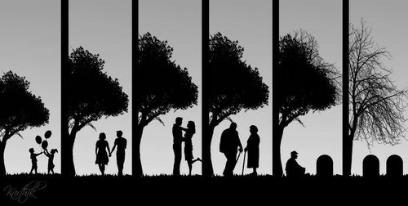
ثلاث مراحل في الحياة
ما الذي يجب أن يسعى إليه الشباب في الحياة؟
الشباب 0 - 30
الشباب 0 - 30
منتصف الحياة 30 - 60
الشيخوخة 60 - 90
Notes:
Youth includes birth up to about age 30, since by that time most of us get married and are on our own.
Mid-life starts quite early in this depiction at age 30 and goes to age 60.
Nowadays many people live into their 80s and even their 90s, so old age would refer to ages 60-90.
What happens in stage 1 will certainly influence stages 2 and 3, so youth is crucial. This raises the important question: What should youth pursue in life? How should they live>

Slide 7
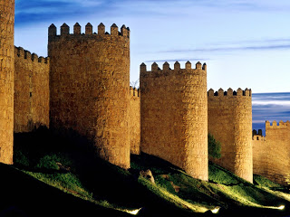
ماذا يستطيع سليمان أن يعلمنا؟
الجامعة
Notes:
What can Solomon teach us? Like us, Solomon had three stages of his life…

Slide 8
مراحل سليمان الثلاثة
الشباب نشيد
منتصف الحياة أمثال
الشيخوخة جامعة
Notes:
He lived godly in his youth—knew true love (Song of Songs), asked for wisdom (1 Kings 3), built the temple (1 Kings 6), etc.
He got sidetracked in middle age—with political links to 1000 women and other profitless pursuits we saw in Ecclesiastes 2—yet he likely wrote Proverbs then.
He now shares the wisdom he gained in his old age—work and wisdom don't last (Eccl.).

Slide 9
إنه وقت
الجامعة
Notes:
How does today’s passage fit into the book?

Slide 10
ماذا يعالج هذا السفر؟
Q
Q
Q
Q
Q
Q
Q
Q
Q
Q
Q
Q
Q
Q
Q

Slide 11
في رأيي .......

Slide 12
....... ألف شيء وواحد

Slide 13
لكن مع القراءة المتأنية سوف تجد 3 مناطق عابرة في الحياة

Slide 14
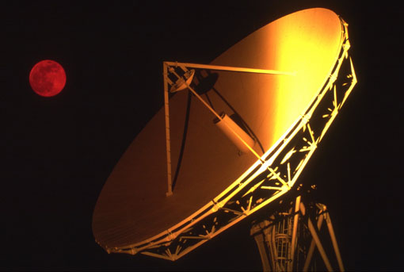
الطبيعة العابرة للإنجاز البشري
1

Slide 15
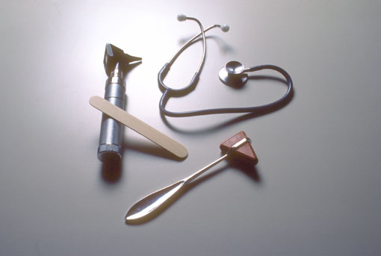
الطبيعة العابرة للحكمة البشرية
2

Slide 16
و

Slide 17
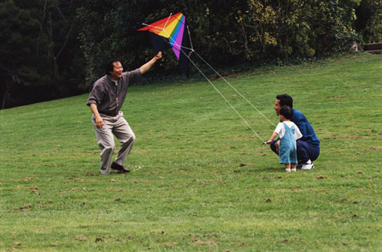
الطبيعة العابرة للشباب
3

Slide 18
ملخص الجامعة
403
Notes:
But now the subject shifts into the third fleeting area in the final section of the book.
This time it’s about youth (explain book chart).

Slide 19
تحتوي الحياة على ثلاث مراحل
ما الذي يجب أن يسعى إليه الشباب في الحياة؟
التركيز على مسعيين
الشباب
0 - 30
الشباب
0 - 30
جا 11: 7 – 12: 7
Notes:
This passage specifically shows two pursuits every youth should have. However, it actually relates to all of us, whether youth or not. Even if you are not a youth, you certainly relate to youth and can help them with this passage. This means that you are closer to aging, which this passage also addresses!
Solomon gives us God’s two key priorities for youth in Ecclesiastes 11:7–12:7. Let’s listen in!

Slide 20
1. استمتع بالحياة الآن قبل مجيء الدينونة والموت (11: 7-10)
Notes:
Live each day with joy because you’ll account for it and it might be your last.

Slide 21
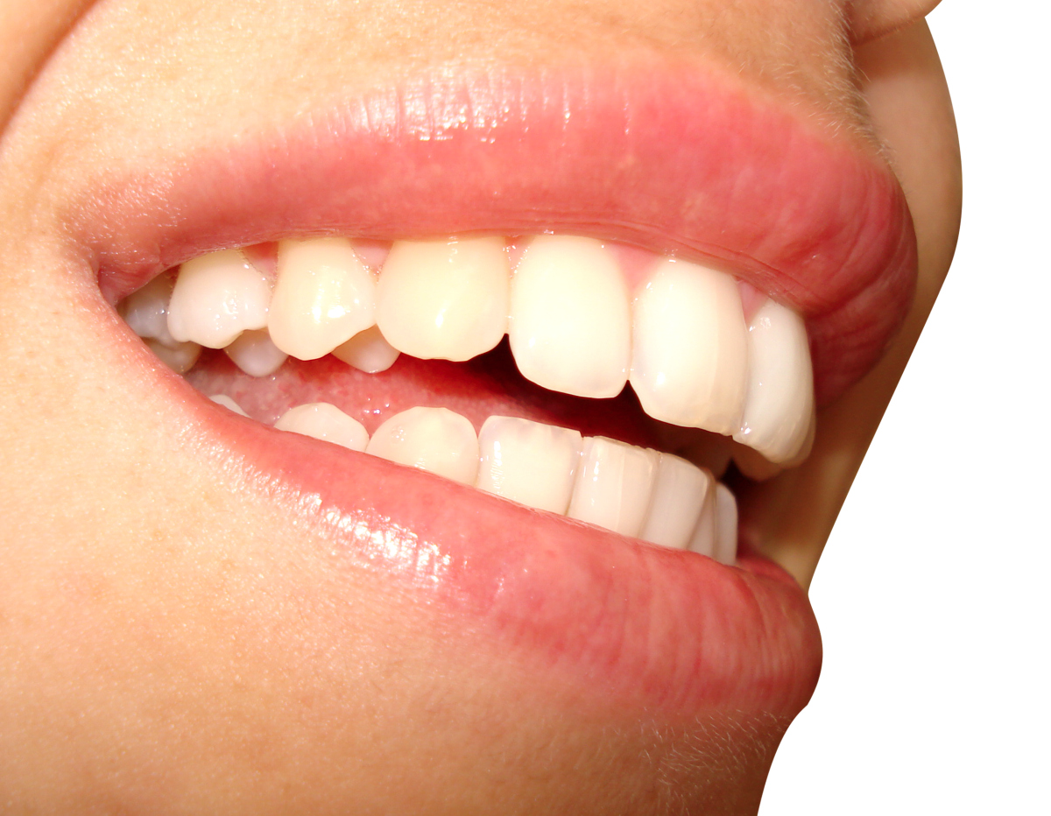
استمتع بكل حياتك الآن قبل مجيء الموت (11: 7-8)

Slide 22
النور حلو، وخير للعينين أن تنظرا الشمس. (11: 7)
Notes:
Living is pleasant and good (11:7).

Slide 23
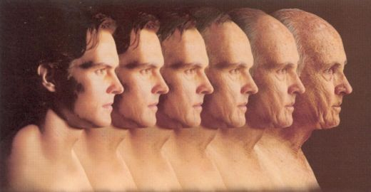
لأنه إن عاش الإنسان سنين كثيرة فليفرح فيها كلها، وليتذكر أيام الظلمة لأنها تكون كثيرة، كل ما يأتي باطل. (11: 8)
Notes:
Enjoy life into your old age (11:8a).
Live responsibly because after death is eternity (11:8b).
The future after death is obscure (11:8c).
(However, some of us are youth, so how can youth enjoy life?)

Slide 24
استمتع بشبابك في ضوء دينونة الله (11: 9-10)
Notes:
[Pursue life’s opportunities realizing that you’ll account to God for each.]

Slide 25
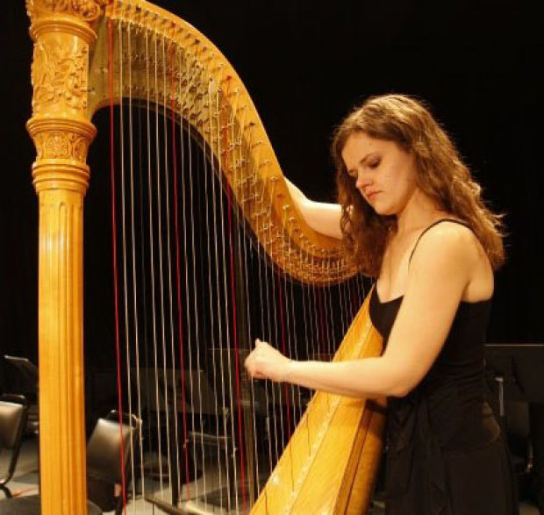
افرح أيها الشاب في حداثتك، وليسرك قلبك في أيام شبابك (11: 9أ)
Notes:
Enjoy your childhood and youth (11:9a).

Slide 26
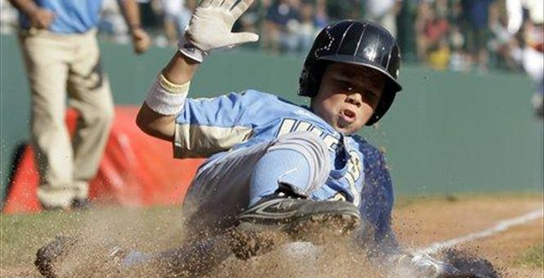
واسلك في طرق قلبك وبمرأى عينيك (11: 9ب)
Notes:
Do what you like and pursue what you see (11:9b).

Slide 27
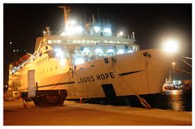
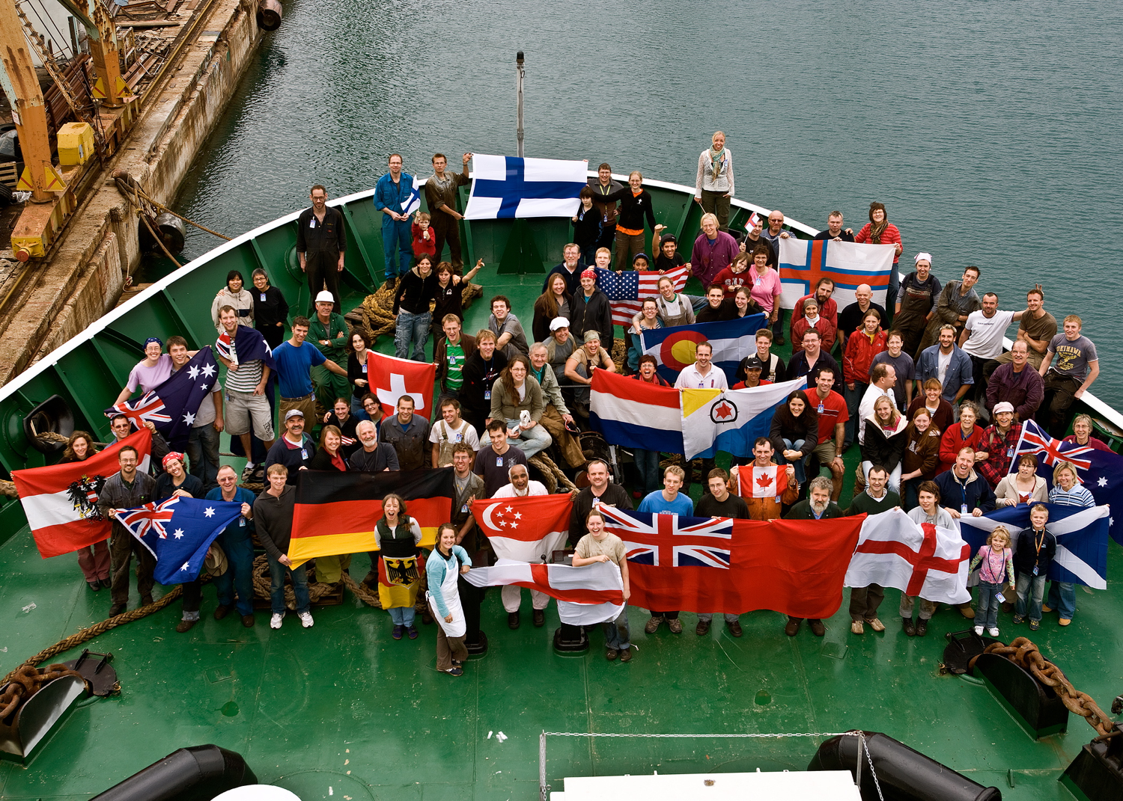
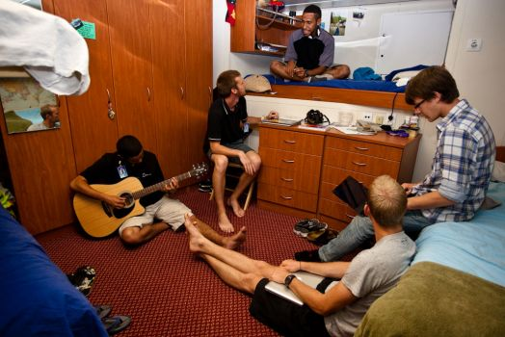
Logos Hope
Notes:
Travel to share the gospel as many places as you can—like on Logos Hope.

Slide 28
الطرق المتقاطعة (1981-83)
Notes:
After college it seemed the natural thing to do to join Campus Crusade staff in the Philippines on a seven-member music team.

Slide 29
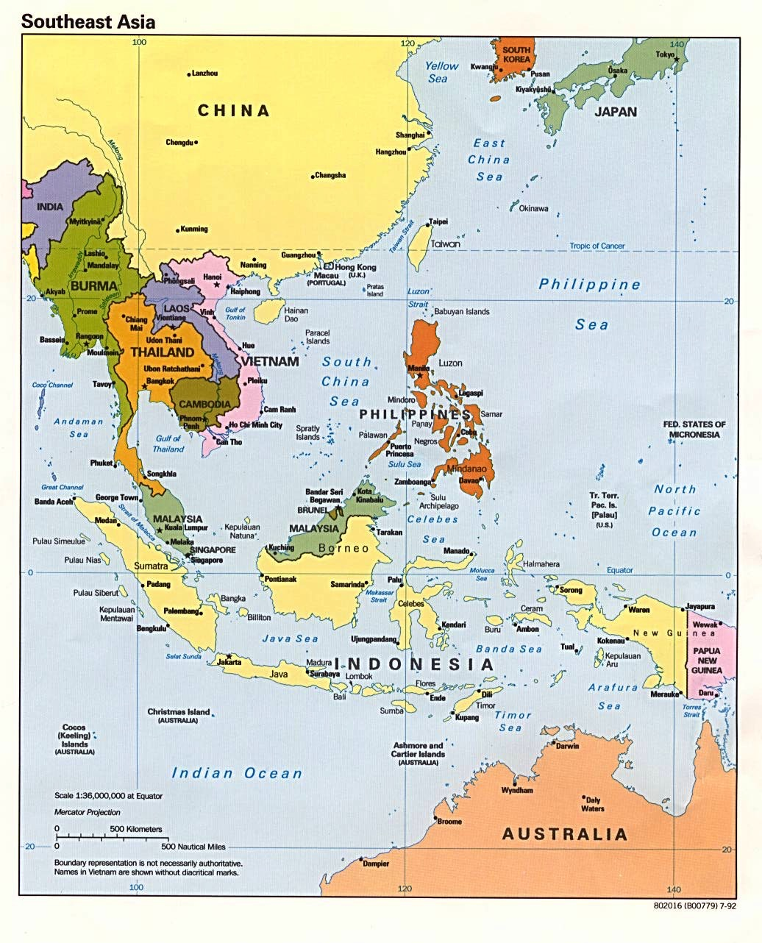
خدمة الطرق المتقاطعة
كوريا
الصين
اليابان
هونغ كونغ
تايوان
ماكاو
تايلاند
الفلبين
ماليزيا
سنغافورة
أندونيسيا
Notes:
The Crossroads team shared the gospel in 11 Asian nations. We sang 269 concerts and saw over 10,000 people indicate decisions to trust Christ!

Slide 30
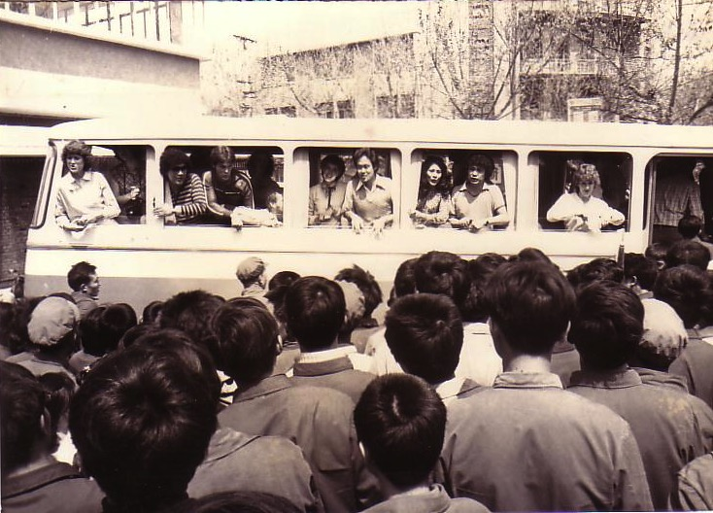
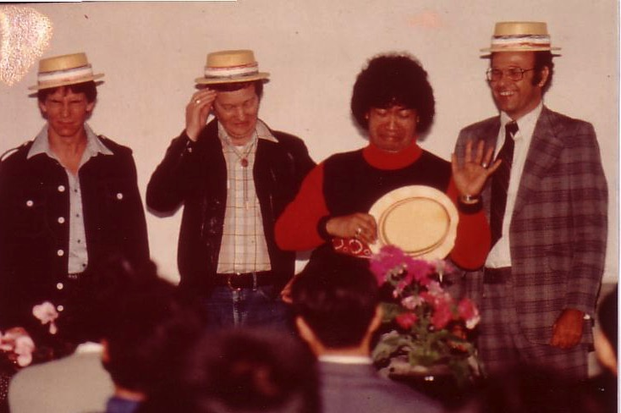
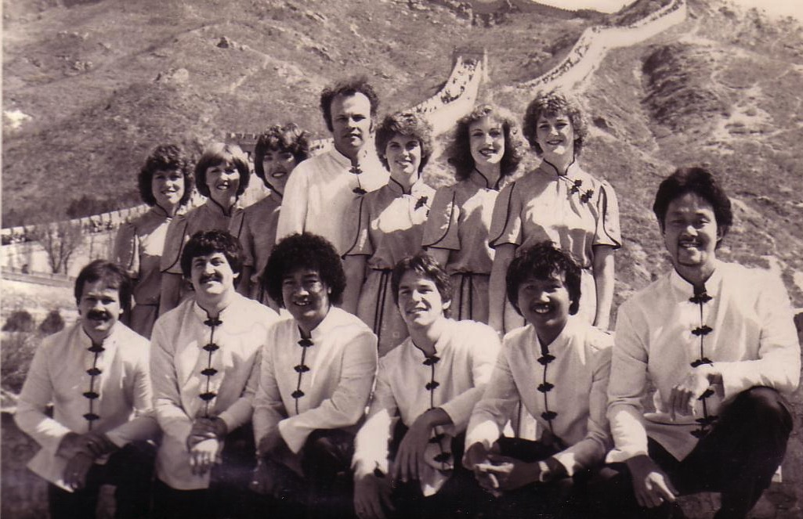
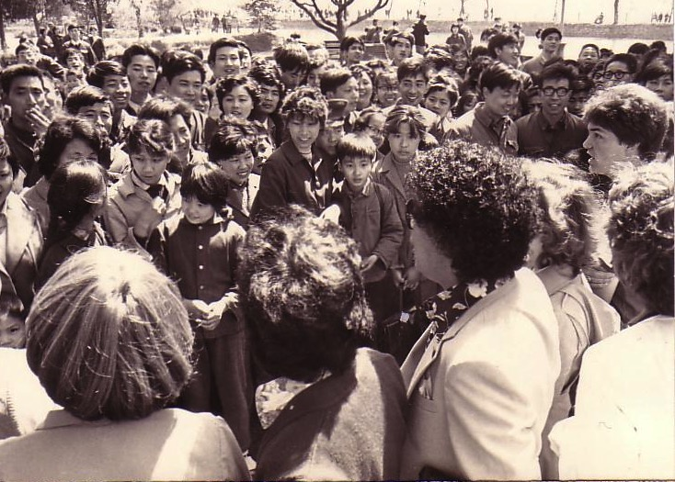
الصين، 1981
Notes:
On our first tour to China we were the first Christian musical team to visit the New China. We sang in music conservatories, parks, and even from the bus! God began to open my eyes to the needs of East Asia…

Slide 31
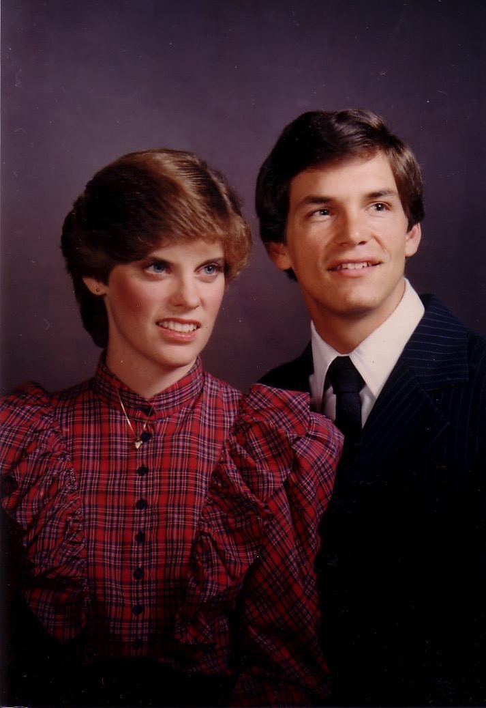
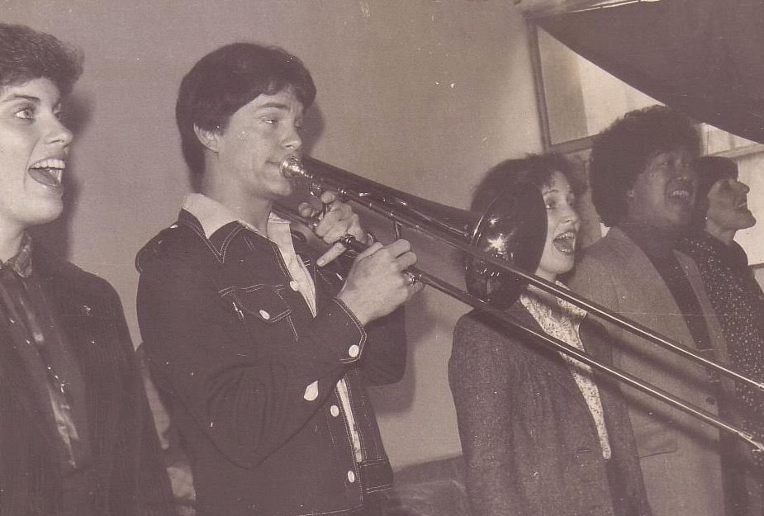
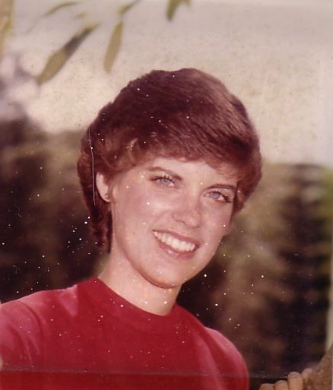
الرومانسية، 1982
Notes:
God also began to open my eyes to the woman singing next to me! She initially despised me but after a year or so she saw the light. That's our engagement picture. In 1983 we returned to the USA.
My advice? Don’t get married until your mid-20s. Marriage is great—but it can wait!

Slide 32
واعلم أنه على هذه الأمور كلها يأتي بك الله إلى الدينونة. (11: 9ت)
Notes:
Yet realize that God will judge your choices in life (11:9c).
God knows that the most important decisions in life we make when we are young—so he wants this passage to set the trajectory for our lives on the right course. God will hold you accountable for the decisions you make.

Slide 33
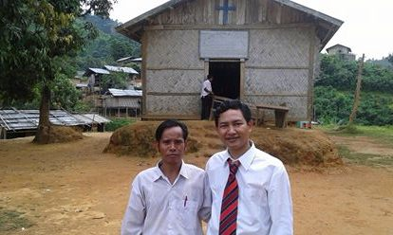
سينغ بو في ميانمار
Notes:
This week our Burmese member Singpu sent a report of a recent conference he conducted in Myanmar.

Slide 34
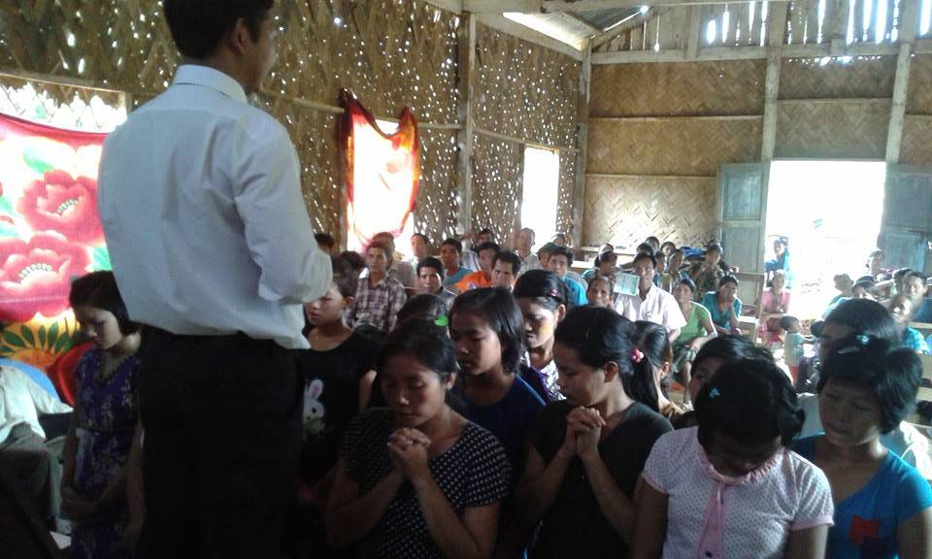
سينغ بو في ميانمار
Notes:
He saw 24 young people come to Christ!

Slide 35
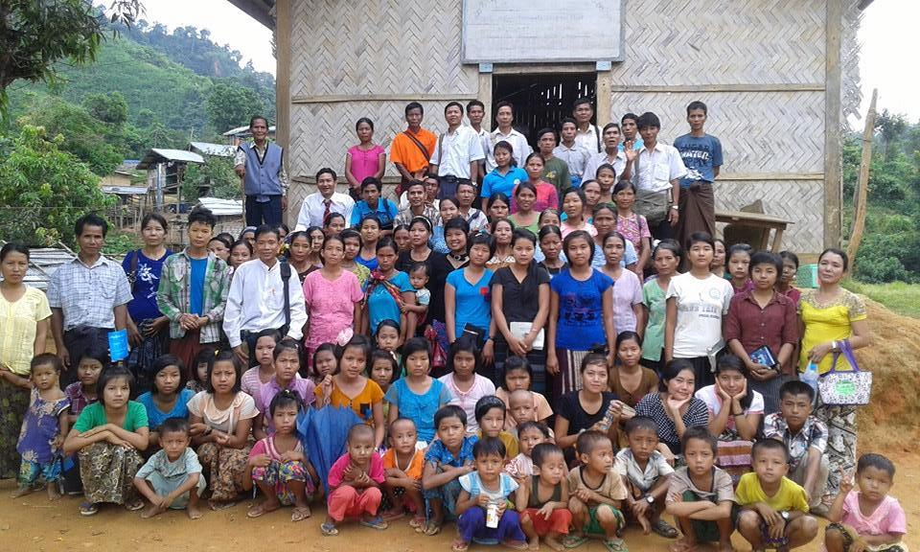
سينغ بو في ميانمار
Notes:
In fact, 80% of people who become Christians do so before age 18.

Slide 36
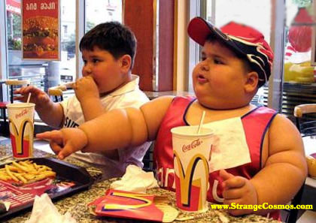
فانزع الغم من قلبك، وأبعد الشر عن لحمك. (11: 10أ)
Notes:
Refuse to worry and keep your body healthy (11:10a).

Slide 37
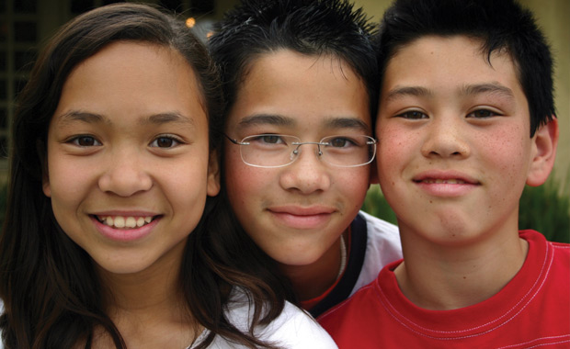
لأن الحداثة والشباب باطلان (عابران) (11: 10ب)
Notes:
Yet know that youthful energy won’t last (11:10b).

Slide 38
تحتوي الحياة على ثلاث مراحل
ما الذي يجب أن يسعى إليه الشباب في الحياة؟
التركيز على مسعيين
الشباب
0 - 30
الشباب
0 - 30
جا 11: 7 – 12: 7
Notes:
This passage specifically shows two pursuits every youth should have. However, it actually relates to all of us, whether youth or not. Even if you are not a youth, you certainly relate to youth and can help them with this passage. This means that you are closer to aging, which this passage also addresses!
Solomon gives us God’s two key priorities for youth in Ecclesiastes 11:7–12:7. Let’s listen in!

Slide 39
1. استمتع بالحياة الآن قبل مجيء الدينونة والموت (11: 7-10)
Notes:
We saw first that God wants youth—and all of us—to enjoy life. But what else should youth pursue besides fun? In other words, how are youth to enjoy life? The way to really enjoy your youth is to…

Slide 40
2. أكرم الله كخالق قبل أن تشيخ وتموت (12: 1-7)
Notes:
Respect the Lord as a young person because you soon will be elderly.

Slide 41
فاذكر خالقك في أيام شبابك قبل أن تداهمك سنوات الشيخوخة الصعبة، لأنك حينئذ ستقول: أين سعادتي؟ (12: 1 المبسطة)
أذكر خالقك في أيام شبابك ... (12: 1)
Notes:
Honor your Creator now.

Slide 42
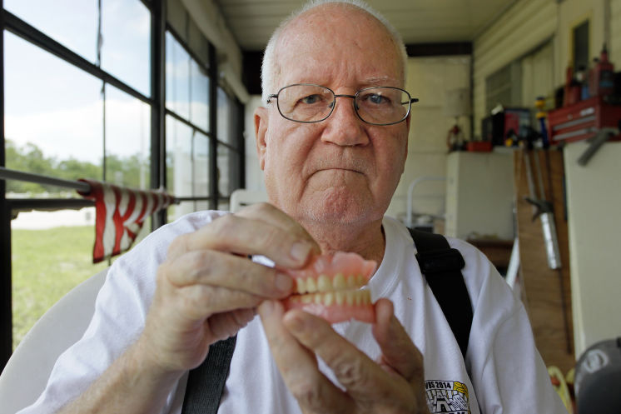
يوماً ما في عيادة الأسنان
Notes:
Have you ever been guilty of looking at others your own age and thinking, surely I can't look that old? One woman writes…
My name is Alice, and I was sitting in the waiting room for my first appointment with a new dentist.
I noticed his DDS diploma on the wall, which bore his full name. Suddenly, I remembered a tall, handsome, dark-haired boy with the same name had been in my high school class some 30-odd years ago.
Could he be the same guy that I had a secret crush on, way back then?
Upon seeing him, however, I quickly discarded any such thought.
This balding, gray-haired man with the deeply lined face was way too old to have been my classmate.
After he examined my teeth, I asked him if he had attended Morgan Park High School…
“Yes, yes, I did. I’m a mustang,” he gleamed with pride.
“When did you graduate?” I asked.
He answered, “In 1975. Why do you ask?”
“You were in my class!” I exclaimed.
He looked at me closely.
Then, that ugly, old, bald, wrinkled-faced, fat, gray-haired, decrepit, man asked,
“What did you teach???”

Slide 43
إن الوصية (أذكر خالقك) يعني توقير الله، وحفظ شرائعه بأمانة، وخدمته بمسؤولية، وتذكر أن كونه خلق البشر، فإن كل شخص مدين له بحياته. دونالد جلين، في التفسير المعرفي للكتاب المقدس —
أذكر خالقك في أيام شبابك ... (12: 1)
Notes:
What does it mean to “remember your creator” (12:1)?
BKC quote above
The opposite, of course, is to forget God—specifically to forget him as Creator…

Slide 44
Foster Letter 2002
كشف بحث (العائلة الأمريكية في الأزمات) الذي أجراه المجلس المعمداني الجنوبي للحياة الأسرية، عن بعض الحقائق المثيرة للقلق، فمن بين الأطفال الذين نشأوا في بيوت إنجيلية، 88% منهم يغادرون الكنيسة في سن 18 عاماً ولا يعودون أبداً.
نشرة القس الأسبوعية، التركيز على الأسرة، 26 تموز 2002، مقتبس في غاري فوستر، رسالة الحضانة، 10 آب 2002، ص. 1.
Notes:
Why does Solomon say for youth to “remember your Creator”? Because most don’t!
From Carl Kerby
Following is the entire quote that was in my newsletter. My source was the 7/26/02 issue of Pastor's Weekly Briefing published by the Pastoral Ministries department of Focus on the Family.
American Family In Crises Research by the Southern Baptist Council on Family Life has uncovered some disturbing facts that are leading the group to emphasize the need to rebuild the American family.
§ 88% of the children raised in evangelical homes leave church at the age of 18, never to return.
§ The divorce ratio among members of evangelical churches is virtually the same as non-church members.
§ One million children in the U.S. see their parents divorce.
§ Personal bankruptcies are at an all-time high in America.
The majority of children in America have less than 10 minutes of significant and meaningful conversation with their parents each week. If you remove the mother, you can measure this statistic in seconds. The council recommends that families set aside one evening a week as a family night, on which no local church activities would be scheduled to interfere. It also urged an increased emphasis on biblically based premarital counseling. (PWB 7/26)
Gary D. Foster
Gary D. Foster Consulting
334 Sutherland Place
Manitou Springs, CO 80829
Phone: 719-685-1138 E-mail: GFosterCns@rmi.net Website: http://www.garydfoster.com/
"Helping Christian ministries & product companies discover new revenue streams and to better leverage existing ones."

Slide 45
Already Gone 04802
ذهب فعلاً
كين هام وبريت بيمر
مع تود هيلارد
© Answers in Genesis-USA
Notes:
Ken Ham of Answers in Genesis reports that our kids are actually losing their faith much earlier—as young teenagers, in fact.

Slide 46
حضور المدارس الثانوية
مدرسة كاثوليكية
6ر0%
مدرسة مستقلة
2ر3%
مدرسة بيتية
4ر3%
مدرسة مسيحية
9ر6%
مدرسة عامة
9ر85%
Notes:
Survey done by American Research Group (similar to Barna and Gallup)—professional statistically valid study paid for by AiG supporters
Survey 20-29 year olds who grew up in church but don't go to church any more, to find out why.

Slide 47
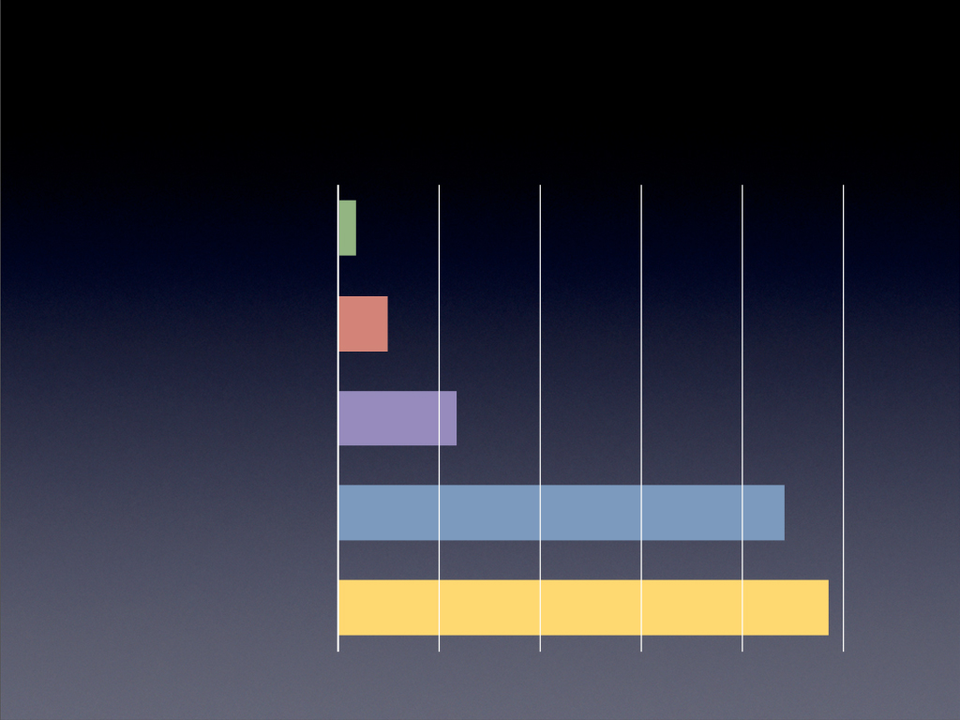
إذا كنت لا تؤمن، فمتى بدأت بالشك لأول مرة؟
لا أعرف
61ر1%
المدرسة الأساسية
37ر4%
الجامعة
57ر10%
المدرسة المتوسطة
77ر39%
المدرسة الثانوية
68ر43%

Slide 48
أي مما يلي يجعلك تشكك في الكتاب المقدس أكثر؟
2ر45%
المعجزات ليست حقيقية
3ر4%
الكتاب المقدس غير منطقي
7ر10%
قصة الخلق
2ر11%
الكثير من القوانين
4ر14%
عمر الأرض ليس 10 آلاف سنة
7ر29%
لا شيء مما ذكر
6ر25%
أولئك الذين غالباً ما حضروا مدرسة الأحد

Slide 49
أي مما يلي يجعلك تشكك في الكتاب المقدس أكثر؟
1ر32%
المعجزات ليست حقيقية
8ر0%
الكتاب المقدس غير منطقي
7ر11%
قصة الخلق
5ر13%
الكثير من القوانين
7ر10%
عمر الأرض ليس 10 آلاف سنة
8ر17%
لا شيء مما ذكر
4ر43%
أولئك الذين نادراً ما حضروا مدرسة الأحد
Notes:
We are not saying that we should get rid of Sunday school. But we are suggesting that we need to change the curriculum and the training.
Most Sunday school teachers, like most Christian adults don't know how to defend the faith against the skeptical challenges that are coming through the schools, media, science programs on TV, etc. We need apologetics training for the teachers and then they need to give it to the kids.

Slide 50
Psalm 11:3 NAS
مزمور 11: 3
إذا انقلبت الأعمدة، فالصديق ماذا يفعل؟

Slide 51
الشرف
الفرق بين الرجال الأخيار والرجال الأشرار، هو ما إذا كانوا يستخدمون دروعاً بشرية، أو يجعلون من أنفسهم دروعاً بشرية.

Slide 52
إكرام الله
الفرق بين الرجال الأخيار والرجال الأشرار، هو ما إذا كانوا يريدون الله أن يكرمهم، أو يريدون أن يكرموا الله.
Notes:
I agree, but I’d tweak it a bit, as the difference between the good guys and the bad guys is whether they want God to honor them or they want to honor God.

Slide 53
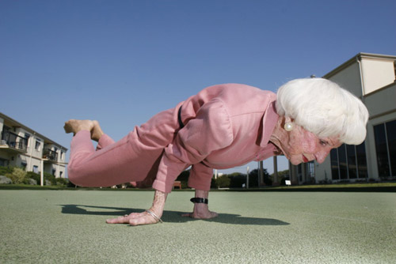
كشباب، نعتقد أننا سنكون دائماً غير قابلين للهزيمة
Notes:
(But why honor him now? As youth, we think we’ll always be invincible—but your life will pass faster than you can ever imagine! So chapter 12 begins by telling youth…)

Slide 54
أكرم خالقك الآن قبل أن تصل إلى حدود الشيخوخة (12: 1-5ج)

Slide 55
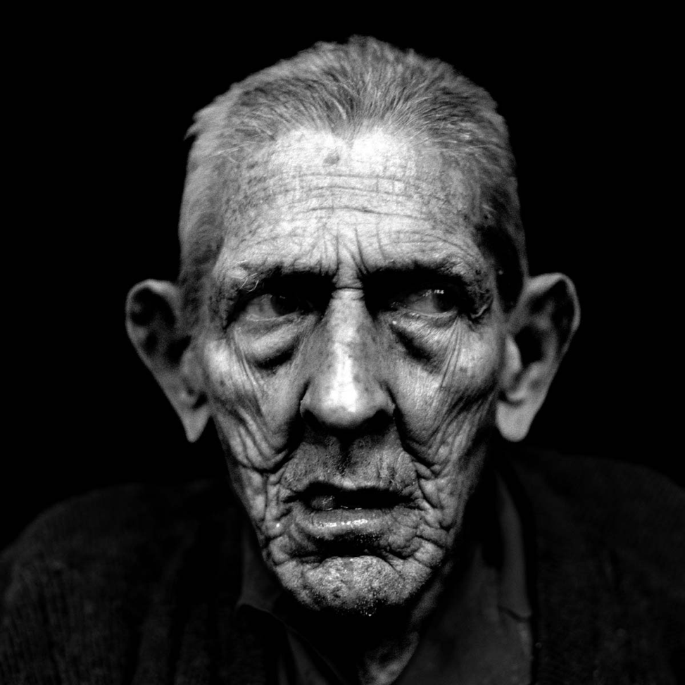
"before the sun and the light, the moon and the stars are darkened, and clouds return after the rain" (12:2 NAU).
قبل ما تظلم الشمس والنور والقمر والنجوم، وترجع السحب بعد المطر.
(12: 2)
Notes:
The elderly lose perspective (12:1-2):
• Honor God now before you can't see well or enjoy life (12:1-2a).
• The elderly are often gloomy (12:2b).

Slide 56
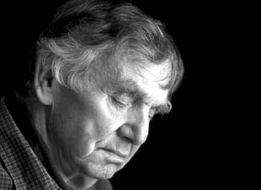
كآبة المسنين
Notes:
Research shows that elderly depression is a common, widespread problem. Adults over age 60 are five times more likely to be depressed or suicidal than younger people.
To fight gloom, it’s like me giving my wife the promise that…
http://www.beliefnet.com/Health/galleries/Old-and-Depressed-The-Not-So-Golden-Years.aspx#FjzGjWUit1iwiCM2.99

Slide 57
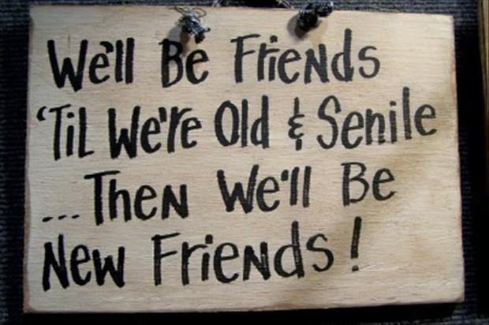
الخرف

Slide 58
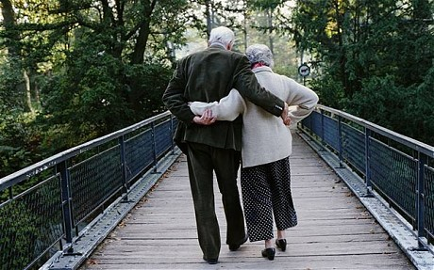
يتباطأ المسنون جسدياً حتى يموتوا (12: 3-4)

Slide 59
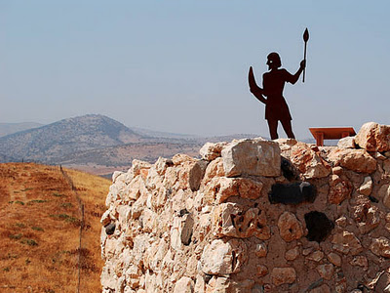
حينئذ ستفقد ذراعاك قوتهما (12: 3أ المبسطة)
في يوم يتزعزع فيه حفظة البيت (12: 3أ فاندايك)
Notes:
Their legs and arms tremble with age (12:3a)

Slide 60
وتضعف رجلاك وتنحيان (12: 3ب المبسطة)
وتتلوى رجال القوة (12: 3ب فاندايك)
Notes:
Their spine curves so they walk bent over (12:3b)

Slide 61
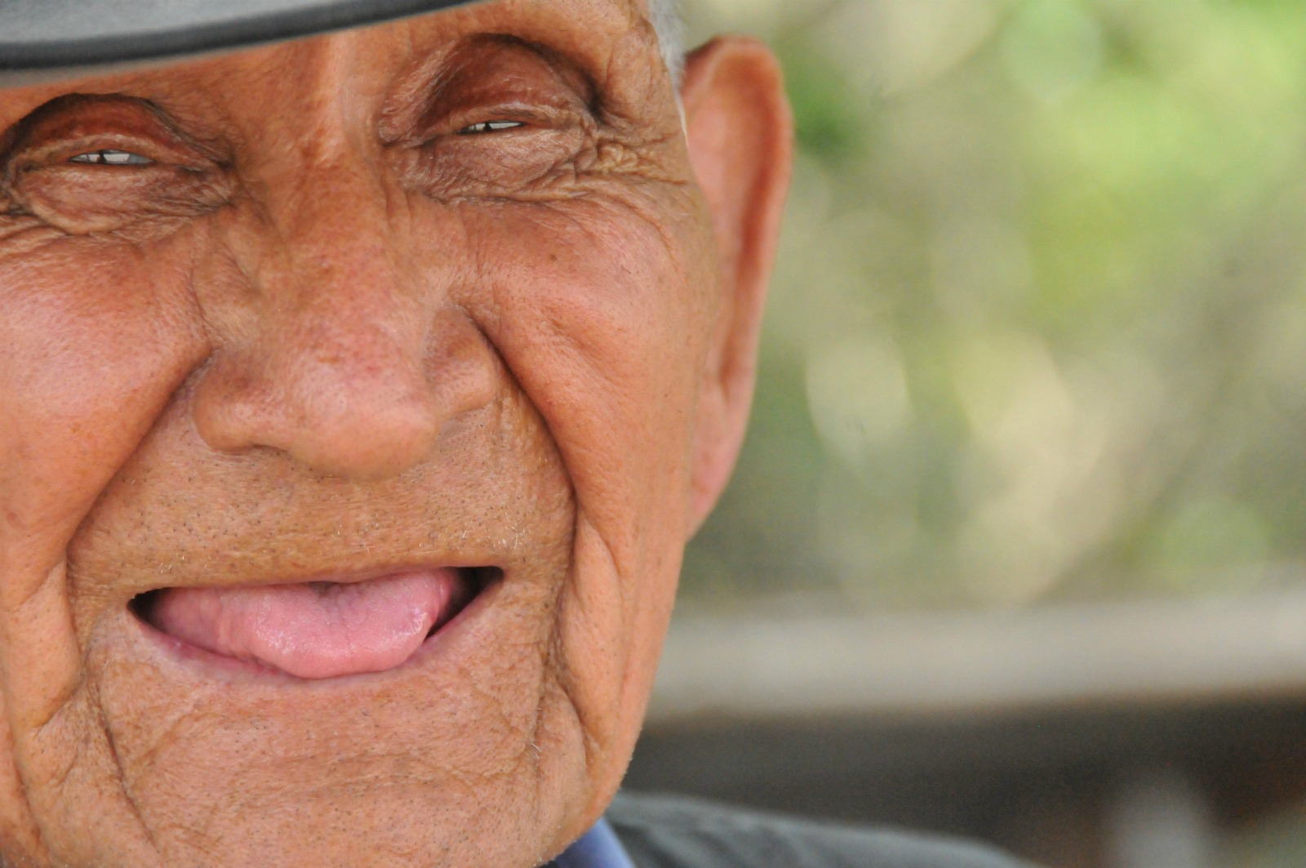
وتبطل الطواحن لأنها قلت (12: 3ت فاندايك)
تضعف أسنانك وتتساقط (12: 3ت المبسطة)
Notes:
Their teeth fall out with too few to chew properly (12:3c).

Slide 62
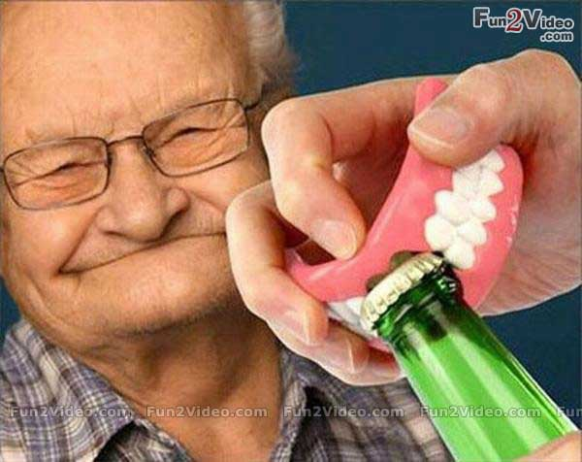
Black
Notes:
Chewing has always been a problem for the elderly.
Fortunately, someone has invented a bottle opener shaped like teeth that the elderly can use to get things done faster!

Slide 63
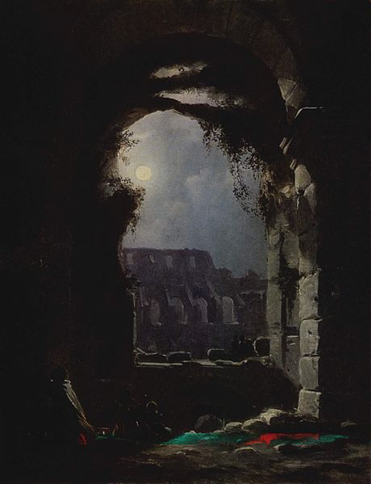
ويكل نظرك (12: 3ث المبسطة)
وتظلم النواظر من الشبابيك.
(12: 3ث فاندايك)
Notes:
Their eyes can hardly see (12:3d).

Slide 64
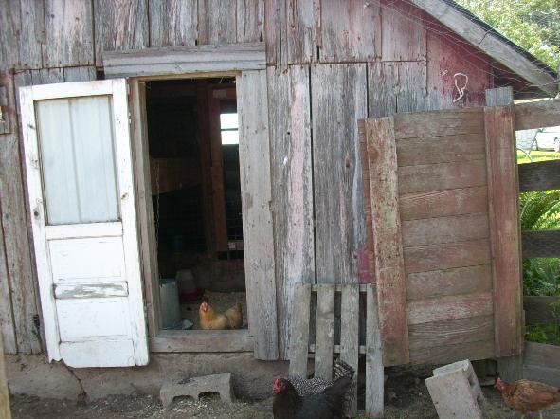
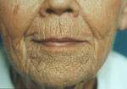
يضعف سمعك فلا تقدر أن تسمع صوت المطاحن (12: 4أ المبسطة)
وتغلق الأبواب في السوق، حين ينخفض صوت المطحنة.
(12: 4أ فاندايك)
Notes:
Their pursed lips enclose teeth that chew slowly (12:4a).

Slide 65
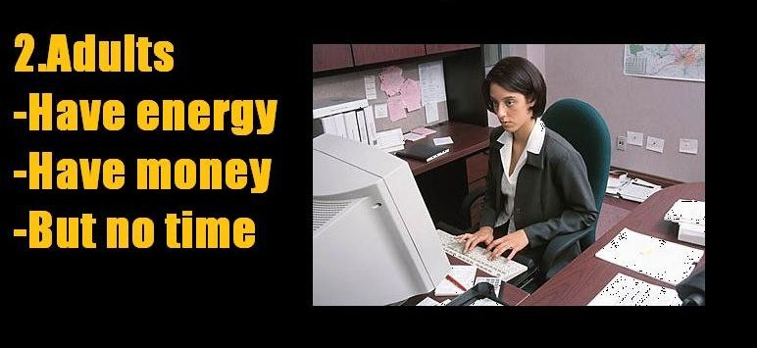
للحياة ثلاث مراحل
Notes:
Remember when I noted that life has three stages? Here’s another depiction…

Slide 66
لكنك ستصحو على صوت عصفور (12: 4ب المبسطة)
ويقوم لصوت العصفور (12: 4ب فاندايك)
Notes:
Their ability to sleep is disturbed by a tiny noise (12:4b).

Slide 67
أو غناء النساء (12: 4ت المبسطة)
وتحط كل بنات الغناء. (12: 4ت فاندايك)
Notes:
Ironically, their hearing is impaired (12:4c).

Slide 68
الشجاعة
معدية

Slide 69
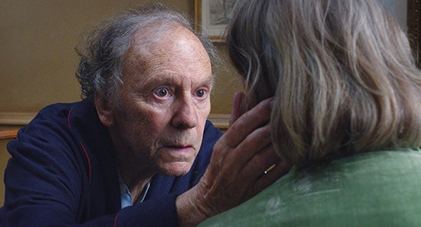
يفقد كبار السن الشجاعة والقدرة (12: 5أ-ج)

Slide 70
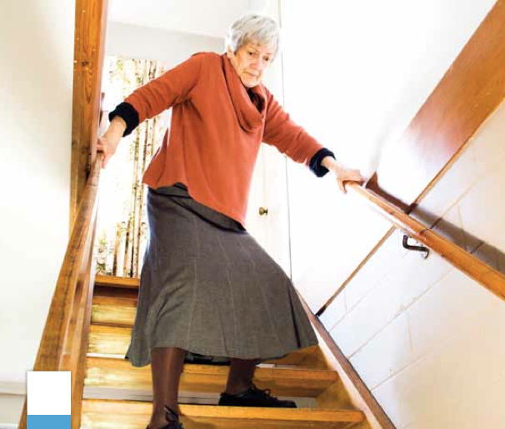
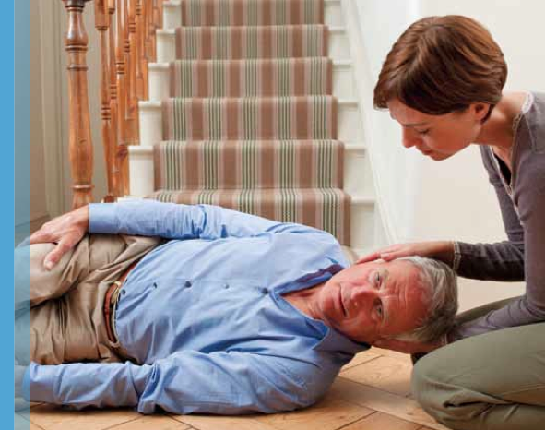
المرتفعات ستخيفك (12: 5أ المبسطة)
وأيضاً يخافون من العالي
(12: 5أ فاندايك)
Notes:
Their lack of balance causes a fear of high places (12:5a).

Slide 71
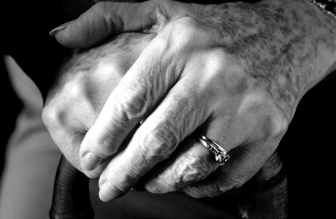
وكل حجر في الطريق (12: 5ب المبسطة)
وفي الطريق أهوال (12: 5ب فاندايك)
Notes:
Their sense of adventure turns into staying home (12:5b).

Slide 72
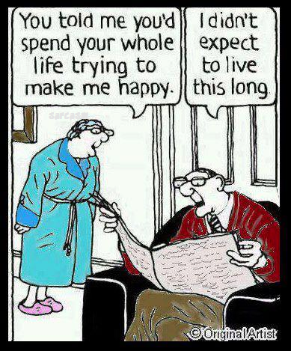
في بعض الأحيان يكون قلقنا هو أننا نعيش طويلاً
لقد أخبرتني أنك ستقضي حياتك كلها تحاول أن تجعلني سعيدة.
لم أكن أتوقع أن تعيشي كل هذه المدة.

Slide 73
نحن نعيش لفترة أطول مما نتوقع وقد تكون هذه أخباراً سيئة في فترة ما بعد التقاعد
Notes:
By Arden Dier, Newser Staff
http://www.newser.com/story/198626/we-live-way-longer-than-we-expect.html
In fact, a study came out this week that shows that most people are living longer than they expected! Half thought they’d die before 75 but they didn’t!
(Newser) – How long do you think you'll live? New research suggests you can tack a few more years on to whatever number you came up with. In 1992, University of Michigan researchers asked 26,000 Americans between the ages of 51 and 61 if they thought they would make it to 75. Some 22 years later, researchers with the Brookings Institution crunched the data and found people tend to underestimate how many years they have left. Of those born between 1931 and 1934, a full 49% who said they wouldn't see 75 were wrong. In fact, almost all that group's respondents, except those who gave themselves 90% or better odds of making it to 75, turned out to have been overly pessimistic, the Wall Street Journal reports.
It's more than just an interesting stat: With the dwindling state of Social Security, researchers worry people won't save enough money to cover the possibility that they'll live longer than they expect, Phys.org reports. "Individuals do not fully understand the longevity risk they face," the authors explain. A longevity annuity could be a solution: An individual hands over a chunk of cash and begins receiving payments after a set number of years. The researchers outline what $100,000 spent on an annuity by a 60-year-old male could result in: $1,052 monthly payments beginning at 70, or $2,539 payments if the purchaser waited until 80 to collect. (Your nose may offer a clue to your longevity.)

Slide 74
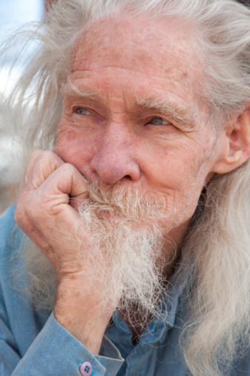
سيبيض شعرك (12: 5ت المبسطة)
واللوز يزهر (12: 5ت فاندايك)
Notes:
Their hair turns white or gray (12:5c).

Slide 75
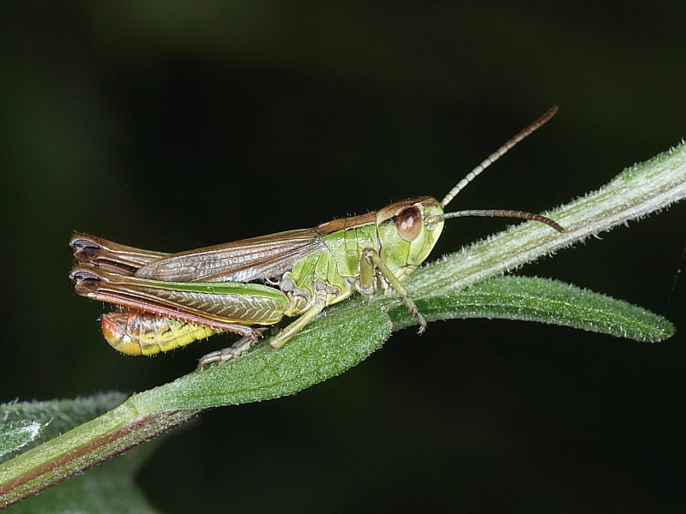
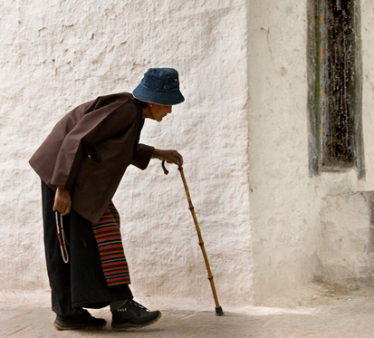
وتجر قدميك بتثناقل (12: 5ث المبسطة)
والجندب يستثقل (12: 5ث فاندايك)
Notes:
Their feeble legs make them move slowly (12:5d).

Slide 76
وتفقد شهيتك (12: 5ج المبسطة)
والشهوة تبطل. (12: 5ج فاندايك)
Notes:
Their desires to do things diminish (12:5e).

Slide 77
يتعب كبار السن بسهولة

Slide 78
أكرم خالقك الآن قبل أن يأتي الموت (12: 5ح-7)

Slide 79
لأن الإنسان ذاهب إلى بيته الأبدي، والنادبون يطوفون في السوق. (12: 5ح)
Notes:
At death people enter eternity but others mourn their loss (12:5f).

Slide 80
الموت دائم (12: 6)

Slide 81
قبل ما ينفصم حبل الفضة. (12: 6أ)
Notes:
Death is like a broken cord, never fixed again (12:6a).

Slide 82
.... أو ينسحق كوز الذهب (12: 6ب)
Notes:
Death is like a broken bowl, never fixed again (12:6b).

Slide 83
أو تنكسر الجرة على العين (12: 6ت)
Notes:
Death is like a broken pitcher, never fixed again (12:6c).

Slide 84
أو تنقصف البكرة عند البئر. (12: 6ث)
Notes:
Death is like a broken pulley, never fixed again (12:6d).

Slide 85
فيرجع التراب إلى الأرض كما كان، وترجع الروح إلى الله الذي أعطاها (12: 7)

Slide 86
جاء آدم من تراب (تك 2: 7)

Slide 87
فيرجع التراب إلى الأرض كما كان (12: 7أ)
Notes:
The body returns to the dust from where it came (12:7a).

Slide 88
وترجع الروح إلى الله الذي أعطاها. (12: 7ب)
Notes:
The spirit returns to God from whom it came (12:7b; cf. Gen. 2:7).

Slide 89
كيف تستمتع بشبابك؟
جامعة 11: 7-12: 7

Slide 90
طريقة الإستمتاع بشبابك هي إكرام الله
الفكرة الرئيسية

Slide 91
تحتوي الحياة على ثلاث مراحل
ما الذي يجب أن يسعى إليه الشباب في الحياة؟
التركيز على مسعيين
الشباب
0 - 30
الشباب
0 - 30
جا 11: 7 – 12: 7
Notes:
This passage specifically shows two pursuits every youth should have. However, it actually relates to all of us, whether youth or not. Even if you are not a youth, you certainly relate to youth and can help them with this passage. This means that you are closer to aging, which this passage also addresses!
Solomon gives us God’s two key priorities for youth in Ecclesiastes 11:7–12:7. Let’s listen in!

Slide 92
1. استمتع بالحياة الآن قبل مجيء الدينونة والموت (11: 7-10)
Notes:
However, the way to enjoy life is to…

Slide 93
2. أكرم الله كخالق قبل أن تشيخ وتموت (12: 1-7)
Notes:
Remember Him!

Slide 94
كلنا في محطة
دائماً ما ينكزني كبار السن في حفلات الزفاف ويقولون: أنت التالي، لذلك
بدأت أفعل نفس الشيء
معهم في الجنازات.

Slide 95
تلخص ممرضة الرعاية التلطيفية أهم خمسة أشياء يندم عليها الناس وهم على فراش الموت:
1. أتمنى لو كان لدي الشجاعة لأعيش حياة صحيحة لي، وليس الحياة التي يتوقعها مني الآخرون.
2. أتمنى لو لم أعمل بجد.
3. أتمنى لو كان لدي الشجاعة لأعبر عن مشاعري.
4. أتمنى لو بقيت على اتصال مع أصدقائي.
5. أتمنى لو جعلت نفسي أكثر سعادة.
Notes:
Imagine yourself on your deathbed. What regrets do you think you might have? How might you wish you had used your life differently?
A nurse named Bronnie Ware recently wrote an article entitled, “The Top Five Regrets People Make on Their Deathbed.” What are these 5 regrets?
________
For many years I worked in palliative care. My patients were those who had gone home to die. Some incredibly special times were shared. I was with them for the last three to twelve weeks of their lives. People grow a lot when they are faced with their own mortality.
I learnt never to underestimate someone’s capacity for growth. Some changes were phenomenal. Each experienced a variety of emotions, as expected, denial, fear, anger, remorse, more denial and eventually acceptance. Every single patient found their peace before they departed though, every one of them.
When questioned about any regrets they had or anything they would do differently, common themes surfaced again and again. Here are the most common five:
1. I wish I’d had the courage to live a life true to myself, not the life others expected of me.
This was the most common regret of all. When people realize that their life is almost over and look back clearly on it, it is easy to see how many dreams have gone unfulfilled. Most people had not honoured even a half of their dreams and had to die knowing that it was due to choices they had made, or not made.
It is very important to try and honour at least some of your dreams along the way. From the moment that you lose your health, it is too late. Health brings a freedom very few realise, until they no longer have it.
2. I wish I didn’t work so hard.
This came from every male patient that I nursed. They missed their children’s youth and their partner’s companionship. Women also spoke of this regret. But as most were from an older generation, many of the female patients had not been breadwinners. All of the men I nursed deeply regretted spending so much of their lives on the treadmill of a work existence.
By simplifying your lifestyle and making conscious choices along the way, it is possible to not need the income that you think you do. And by creating more space in your life, you become happier and more open to new opportunities, ones more suited to your new lifestyle.
3. I wish I’d had the courage to express my feelings.
Many people suppressed their feelings in order to keep peace with others. As a result, they settled for a mediocre existence and never became who they were truly capable of becoming. Many developed illnesses relating to the bitterness and resentment they carried as a result.
We cannot control the reactions of others. However, although people may initially react when you change the way you are by speaking honestly, in the end it raises the relationship to a whole new and healthier level. Either that or it releases the unhealthy relationship from your life. Either way, you win.
4. I wish I had stayed in touch with my friends.
Often they would not truly realise the full benefits of old friends until their dying weeks and it was not always possible to track them down. Many had become so caught up in their own lives that they had let golden friendships slip by over the years. There were many deep regrets about not giving friendships the time and effort that they deserved. Everyone misses their friends when they are dying.
It is common for anyone in a busy lifestyle to let friendships slip. But when you are faced with your approaching death, the physical details of life fall away. People do want to get their financial affairs in order if possible. But it is not money or status that holds the true importance for them. They want to get things in order more for the benefit of those they love. Usually though, they are too ill and weary to ever manage this task. It is all comes down to love and relationships in the end. That is all that remains in the final weeks, love and relationships.
5. I wish that I had let myself be happier.
This is a surprisingly common one. Many did not realise until the end that happiness is a choice. They had stayed stuck in old patterns and habits. The so-called ‘comfort’ of familiarity overflowed into their emotions, as well as their physical lives. Fear of change had them pretending to others, and to their selves, that they were content. When deep within, they longed to laugh properly and have silliness in their life again. When you are on your deathbed, what others think of you is a long way from your mind. How wonderful to be able to let go and smile again, long before you are dying.
Life is a choice. It is YOUR life. Choose consciously, choose wisely, choose honestly. Choose happiness.
_____________
Source: This article originated from blog of author Bronnie Ware at http://inspirationandchai.com/Regrets-of-the-Dying.html.
Based on this article, Bronnie has released a full-length book. It is a memoir of her own life and how it was transformed based on the regrets of the dying people she cared for. The book is available from her website http://www.bronnieware.com and major online bookstores and is called ‘The Top Five Regrets of the Dying – A Life Transformed by the Dearly Departing’.

Slide 96
إعادة صياغة نص سفر الجامعة
1. أتمنى لو طلبت خطة الله لحياتي.
2. أتمنى لو وضعت طاقتي في أولويات أبدية.
3. أتمنى لو كنت أميناً مع الله حول كيفية شعوري.
4. أتمنى لو اهتممت بالأشخاص أكثر من الأشياء.
5. أتمنى لو وجدت فرحي في الله.
Notes:
This nurse isn’t a Christian, so she gives a secular way of saying what Solomon says here in Ecclesiastes. I would paraphrase what this nurse is saying as [above compared to below]
I wish I had the courage to live a life true to myself, not the life others expected of me.
I wish I didn’t work so hard.
I wish I had the courage to express my feelings.
I wish I had stayed in touch with my friends.
I wish that I had let myself be happier.
Which of these would you most likely say on your deathbed, given your present state in life?
Put a mark by it in your notes and commit it to prayer.

Slide 97
Black

Slide 98
رابط وعظ العهد القديم على BibleStudyDownloads.org
أحصل على العرض التقديمي والنص مجاناً

