Slide 1
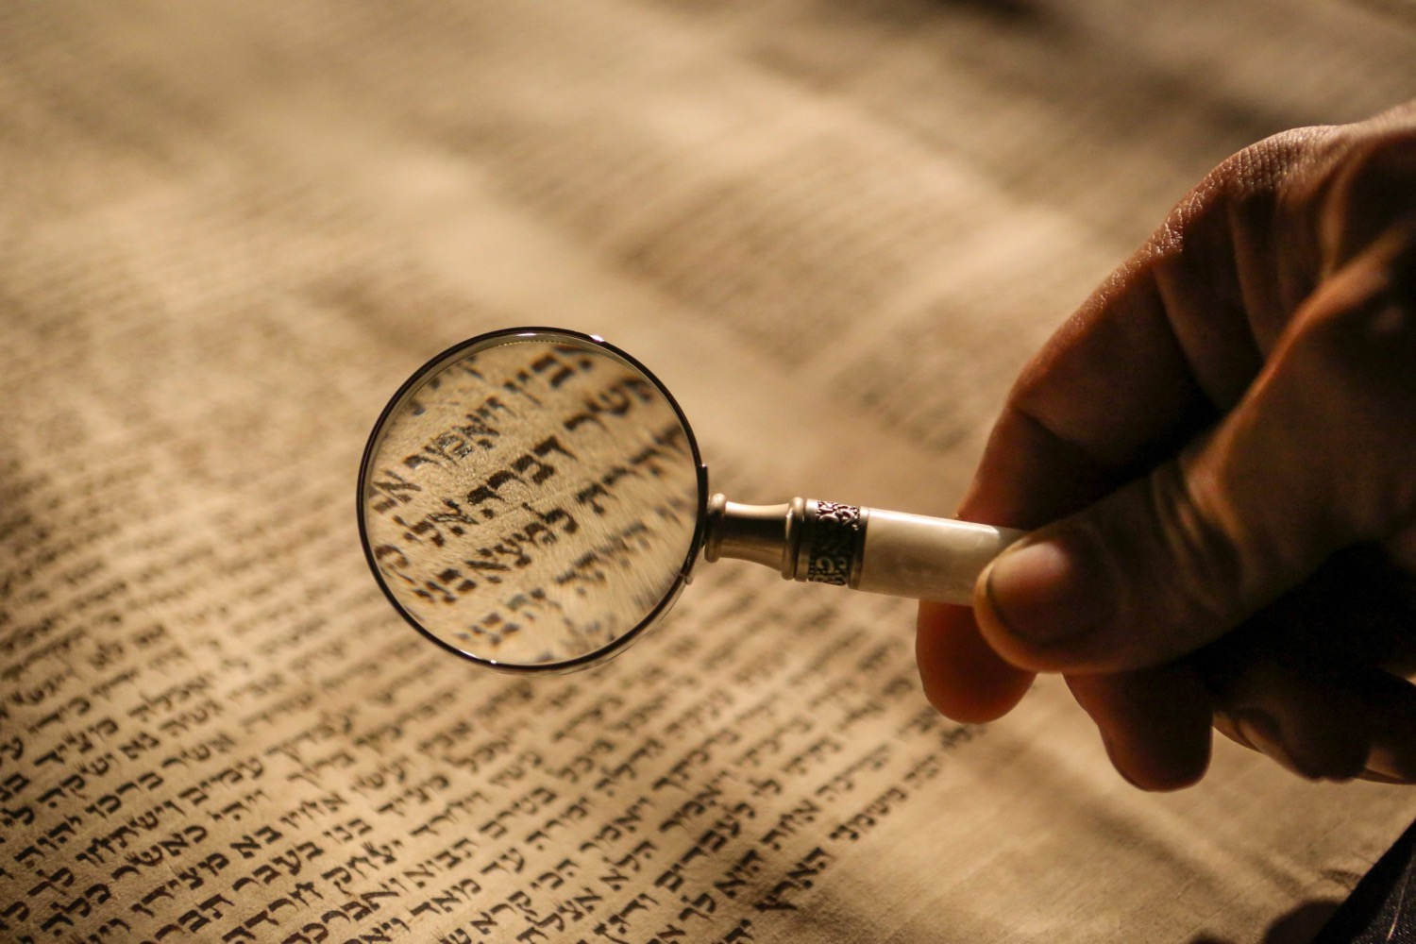
دحض نقاد العهد القديم
قم بواجبك لو سمحت
د. ريك جريفيث • مؤسسة الدراسات اللاهوتية الأردنية
BibleStudyDownloads.org

Slide 2
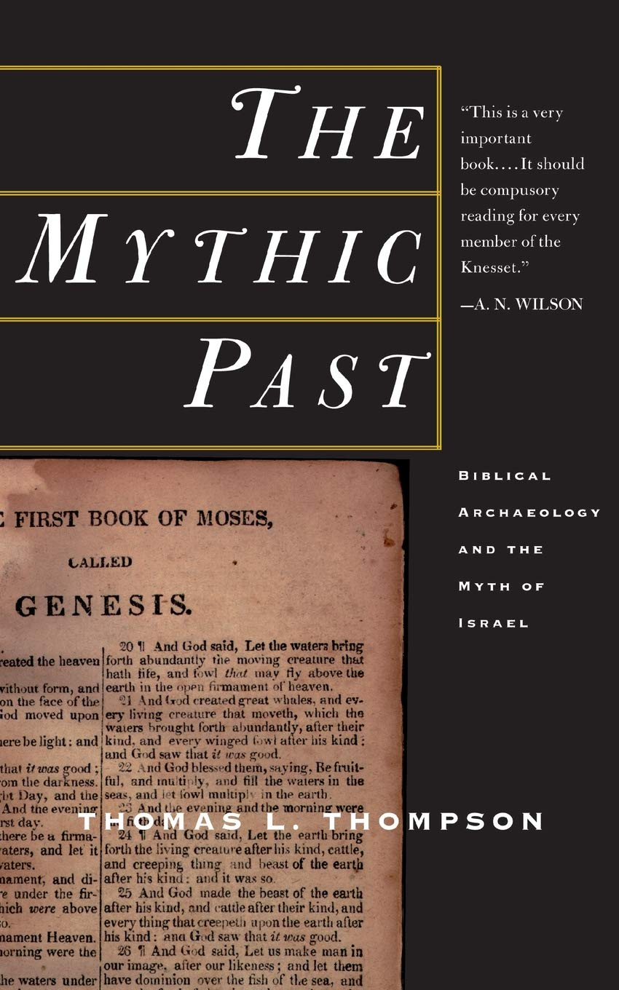

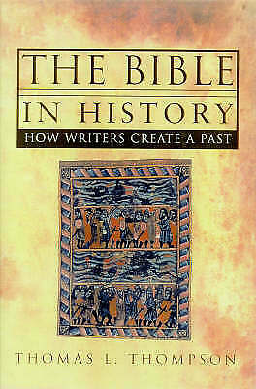
توماس ل. ثومبسون
Notes:
"The two T. L. Thompson books we are concerned with: Early History of the Israelite People from the Written and Archaeological Sources (Leiden: Brill, 1992) and The Bible in History (London: Cape, 1999) = The Mythic Past (New York: Basic Books, 1999).”
Cited by K. A. Kitchen, On the Reliability of the Old Testament (Grand Rapids: Eerdmans, 2003), Kindle Edition. Loc 9702 of 14432 (footnote 2)

Slide 3
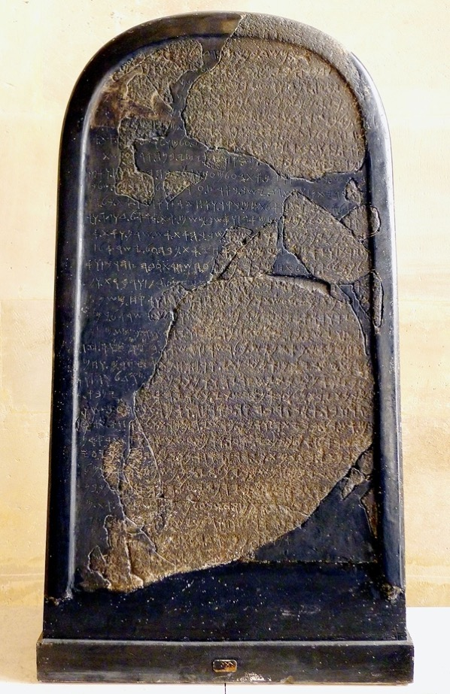
بدلاً من النص التاريخي فإن نقش عمري ملك إسرائيل كمضطهد لموآب (حوالي 830) في الواقع ينتمي إلى تقليد أدبي كبير لقصص ملوك الماضي. نجد قصة مشابهة (تُروى في شكل سيرة ذاتية، بضمير المتكلم) والتي يعود تاريخها إلى القرن الثالث عشر قبل الميلاد على الأقل. وتدور أحداثها حول ملك آلالاخ الإدريمي الذي كان في الواقع قد حكم هذه المدينة آلالاخ قبل قرنين من الزمان. بشكل مشابه لقصة الإدريمي نجد أن قصة ميشع مكتوبة بضمير المتكلم ومقدمة بصوت الملك نفسه (وهي) تقدم لنا خلاصة حكم الملك.... لقد تم عمله، كلا النقشين هما تحية لملك عظيم من ملوك المملكة السابقين مجسدًا عهده.
توماس ل. طومسون، الماضي الأسطوري/الكتاب المقدس في التاريخ (ليدن، 1993)، 11-13
الرد؟ هل قام أي من الملوك القدماء بالكتابة بضمير المتلكلم
Notes:
Cited by K. A. Kitchen, On the Reliability of the Old Testament (Grand Rapids: Eerdmans, 2003), Kindle Edition. Loc 9808 of 14432

Slide 4
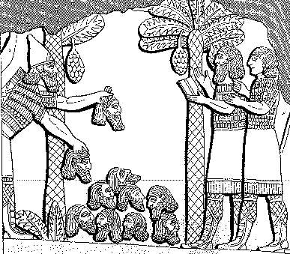
Assyrian Brutality
الوحشية
614
الاشورية
هرم من الرؤوس رفعته أمام مدينته. وأحرقت شبابهم وعذاريهم في النيران
شلمنصر 859 – 824 ق.م = قبل يونان بثمانين سنة
لوكنبيل، السجلات القديمة لآشور وبابل، 1: 213

Slide 5
غرور أسرحدون (660 ق.م)
614
أنا قوي، أنا كلي القدرة، أنا بطل، أنا عملاق، أنا هائل، أنا مكرم، أنا معظم، أنا هو من لا مثيل له بين جميع الملوك، المختار من آشور ونبو ومردوخ
لوكنبيل، السجلات القديمة لآشور وبابل، 2:226

Slide 6

رد كيتشن
من الواضح أن نطاق استخدام ضمير المتكلم في النصوص ضئيل ومضلل بشكل يائس، استخدام ضمير المتكلم من قبل الملك لا ينتمي حصرياً إلى النصوص التذكارية بعد الوفاة أو إلى الأساطير اللاحقة حول هؤلاء الملوك، وجيش ضخم من النصوص يبين كذب قرينته” (الموقع 9825 من 14432).
Notes:
“﻿(ii) TLT’s knowledge of the range of use of first person in texts is clearly minimal and hopelessly misleading. Use of the first person by a monarch does not belong exclusively to either postmortem memorial texts or to later legends about such kings. A huge army of texts shows up the falsity of his presumption. Here are a few. (1) In his Ten-Year Annals (CoS II, 83-91),9 Mursil II begins in the first person, describes his modest past (acceded young, and not the heir, asked the help of his deities), then proceeds through ten years of successful warfare exclusively in the first person, observes that he has now reigned ten years, and promises to record any further successes. We know that this is not a postmortem text, because he in fact lived and warred for many more years, as his detailed annals prove conclusively, running up to Years 21 and beyond (the end is broken). (2) In the “Hittite Hieroglyphic”/Phoenician bilingual inscription of Azitawatas, a local vassal king of the ruler of Adana, first millennium B.C., in Cilicia (125-26, 149-50), he begins (just like Mesha), “I am Azitawatas,” followed by epithets, and likewise goes on in a continuous first-person narrative. Near the end he clearly asks for health and (long) life/many years — this was not a postmortem legend, but a text contemporary with the king! (3) Exactly the same is true of Yehawmilk, king of Byblos (151-52) — “I am Yehawmilk …” — and he too asks for long years to come, being far from dead! (4) In the Mesopotamian world, as everywhere else, texts were also produced in either third- or first-person mode. For first person, not postmortem, see (e.g.) Lipit-Ishtar (247), Warad-Sin/Kudur-mabuk (251-52), Rim-Sin I (253, his third text), Hammurabi (256-57), Ammi-ditana (258-59), and Shamshi-Adad I (259), all early second millennium. In the first millennium every major Assyrian king did exactly likewise, in various editions of their annals that were anything but postmortem, from Tiglath-pileser I to Assurbanipal (cf. ANET, 274-301; CoS II, 261-306; RIMA, 1-3 passim). (5) And likewise their high officers in the eighth century (278-84), all strictly within their lifetimes. (6) We may add the Neo-Babylonians, Nabopolassar, Nebuchadrezzar II, and Nabonidus (306-14). (7) To round things out, so too in Egypt. Thus Tuthmosis III on his Gebel Barkal stela (14-18, its main account) speaks mostly in a first-person narrative after a conventional third-person date line and introduction; the monument dates to Year 47 — but the king survived its making, till his known Year 54, seven whole
Kitchen, K. A.. On the Reliability of the Old Testament . Wm. B. Eerdmans Publishing Co.. Kindle Edition.

Slide 7
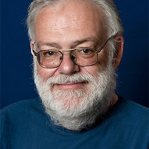
هجومات من قبل ن. ب. لمخي
الدراسات التاريخية النقدية (حول الكتاب المقدس العبري) مبنية على منهجية خاطئة وتؤدي إلى استنتاجات خاطئة.
2. والذي يعني ببساطة أنه يمكننا تجاهل 200 عام من الدراسات الكتابية وإلقائها في سلة المهملات. إنها لا تساوي الورق الذي طبعت عليه.
Notes:
"Well … who is the fantasizer? Biblical (and other) scholarship of the last two hundred years, or Dr. Lemche? Let us now look at these stirring (and stimulating) trumpet calls to junk both the Hebrew Bible and most scholarly study of it, in the light of NPL’s personal beliefs. Let us group these eight pronouncements in three lots: 1-2, 3-6, 7-8.
First, items 1-2. To junk some 200 years of “historical-critical scholarship.” Hurrah! Three cheers! Whoopee! Well … maybe? Or not quite? Or not quite entirely? Yes, an uncomfortably large proportion of old books, theses, and papers on (e.g.) endless variants of literary-critical theories of the composition of the books of the Old Testament could be profitably pulped and recycled. What about the extravagances a century ago of J1, J2, J3? Or (only half a century or so ago) of Pfeiffer’s L source? Or Eissfeldt’s pet S source? Or most of the books locked in battle long ago over supplementary and fragmentary theses of composition, etc.? Down to the present time, biblical studies journals still carry over much of these gossamer speculations (unsullied by objective data) that real professional scholars of Near Eastern texts and material cultures could easily dispense with.
But a quite separate issue is the properly philological side of things. The basics of standard (and “silver age”) Hebrew grammar and lexicon, and of our knowledge of other related languages and scripts, were first well laid down systematically by the end of the nineteenth century into the early twentieth — e.g., of Akkadian, and epigraphic West Semitic and Old South Arabian, as well as Egyptian. Naturally our knowledge of these languages has now progressed immensely beyond the 1890s/1900s, and others have been added (Ugaritic, Hittite, Hurrian, etc.), but it did start from those bases. Our factual knowledge of the biblical and related languages and associated bodies of texts cannot be dispensed with, now or ever. And all of it has to be taken into account. To junk everything in sight so that our Copenhagen (and related) “butterflies” may disport themselves indefinitely inside their own antibiblical, antifactual fantasy world is, alas, simply not on.”
In H. Shanks’s “Quote of the Month” from Lemche’s publication, see in BAR 26, no. 4 (July-August 2000): 16.
Response by K. A. Kitchen, On the Reliability of the Old Testament (Grand Rapids: Eerdmans, 2003), Kindle Edition. Loc 9866-9000 of 14432.

Slide 8
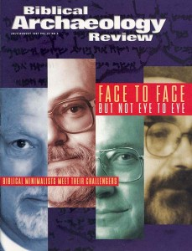
هجومات من قبل ن. ب. لمخي
3. إن الصورة الكتابية لإسرائيل القديمة لا تتناسب مع أي صورة للمجتمع الفلسطيني القديم التي يمكن تأسيسها على أساس المصادر القديمة من فلسطين أو الإشارة إلى فلسطين، ولكنها تتعارض معها.
4. لا يمكن التوفيق بين هذه الصورة الموجودة في الكتاب المقدس وبين الماضي التاريخي للمنطقة.
5. وإذا كان الأمر كذلك فيجب أن نتخلى عن الأمل في أننا نستطيع إعادة بناء تاريخ ما قبل الهلنستية على أساس العهد القديم.
6. هذا الأخير بالكاد يسبق الفترة اليونانية الرومانية (أي ليس قبل القرن الثالث قبل الميلاد إلى القرن الأول الميلادي).
Notes:
““﻿Second, items 3-6. Here the situation is far more clear cut. If the transmitted Hebrew history does not fit the external data for that place and period, and its image cannot be reconciled with such, but is a Greco-Roman-age invention having almost no contact with earlier epochs, and offers no data for those epochs, then on the basis of real, genuinely ancient, firsthand documentation from the third to late first millennia B.C. we must pose some very awkward questions. Such as:
WHY, then, is the literary profile of Gen. 1–11 basically identical with the profiles of comparable Mesopotamian literature relating to creation, flood-catastrophe, and long “linkup” human successions — and, as a search of the ancient literatures shows, as a topos in vogue creatively only in the early second millennium B.C. (and earlier?), not later? Not my fault!
WHY, then, do main features in the much-maligned patriarchal narratives fit so well (and often, exclusively) into the framework supplied by the independent, objective data of the early second millennium? (E.g., details in Gen. 14; Elamite activity in the west, uniquely then; basic slave price of twenty shekels for Joseph; etc.) This is not “conservative salvaging” (as Dever would claim); it comes straight from a huge matrix of field-produced data.11 Not my fault!
WHY, then, do the human and other phenomena at the exodus show clearly Egyptian traits (not Palestinian, not Neo-Babylonian …), and especially of the thirteenth century? Thus (Pi)-Ramesse was Delta capital just for the thirteenth and most of the twelfth century, AND NOT LATER. Then, from circa 1070, Tanis (Zoan) took over there — a historical fact not open to dispute. Tabernacle-type worship structures are known in the Semitic world (Mari, Ugarit, Timna) specifically for the nineteenth to twelfth centuries; the Sinai tabernacle is based directly on Egyptian technology of the thirtieth to thirteenth centuries (with the concept extending into the eleventh). The Sinai/plains of Moab covenant (much of Exodus-Leviticus, Deuteronomy, Josh. 24) is squarely tied in format and content exclusively to the massively documented format of the fourteenth-thirteenth centuries, before and after which the formats were wholly different; we have over ninety original exemplars that settle the matter decisively, whether any of us like it or not. Most definitely, not my fault!
WHY, then, does Merenptah (in his Year 5, 1209/1208) report a people Israel, a foreign tribal grouping by the very accurate determinative signs (in a very accurately written text) who are west of Ascalon and Gezer, and south of Yenoam, and hence in the central Canaanite hill country, if no such named people existed? How curious that we have, in Canaan for 200 years directly following this episode, a clear and massive rise in population that installed themselves in a rash of fresh, new villages the length of the land. It’s either due to a sex orgy or immigrants? No escape from those options. The hill culture develops away from the coastal cultures, it eschews any pronounced taste for pigs or image-based worship, with no stone/brick-built temples, but only scattered high places. Whose fault is this factual scenario? Of a definite entry (so Joshua, a raider, not all-conqueror) and slow settlement (cf. Judges-Samuel). Not my fault!
WHY, then, in the oncoming tenth century, are there suddenly clear material changes in Canaan, of demographic movement from hamlets into towns, and into use of a new red-burnished pottery, first by hand and later mechanically? And suddenly “government” compounds in strategic places (where late Canaanite occupation is blitzed out) such as Hazor, Megiddo, and Gezer, with new developments in the Negev? A centralized power is the clear answer, and the “united monarchy,” its practical expression. The described Jerusalem temple and its furnishings drew directly on long-standing temple planning (besides the tabernacle precedent) and on contemporary Early Iron usages independently attested in Phoenicia, Syria, and Cyprus. Within a few years of Solomon’s death and the Shishak raid on his son Rehoboam, we find a pharaoh suddenly spending absolutely unparalleled amounts of gold and silver on his country’s temples. Hardly a total coincidence. Honest, it was Osorkon I who did this, not me!
WHY, then, is pre-853 Hebrew history to be treated as fiction, when we know that Shishak was the Shoshenq I who did invade Palestine and left a huge triumph scene and long (and highly original!) topographical list for both Judah and Israel, plus other records (El-Hiba list, now destroyed; Karnak stela; retainer’s remark), that indicate the reality of his campaign? And his stela at Megiddo itself, which rams the message home to ancients and moderns alike?
WHY, then, is the divided monarchy to be belittled down to just a king list? Or even Mesha to be refused credence? After all, he was there! TLT and NPL were not. Not only do we have a king list, we also have a detailed chronology for the twin kingdoms built on contemporary ancient Near Eastern usage, which dovetails brilliantly well with two independent chronologies: that of Assyria and that of Egypt. And time and again the histories in Kings, Chronicles, and the Prophets do dovetail very well whenever there are data to compare, be it Assyrian annals, Babylonian chronicles, West Semitic inscriptions (Mesha; Tell Dan, no fake!; Siloam; Lachish Letters; personal seals; etc.). Again, not my fault! I didn’t fake any of it — it just came out of the ground when I wasn’t looking!
WHY, then, do we find Jehoiachin actually in exile in Babylon, with him and his family group having their meal tickets in 592; and most of Judah empty of occupation (except where — as in Benjamin at Mizpah — the imperial authorities wanted to exploit the land), during the main part of the sixth century? The Babylonian exile was not a fiction, and the young king is explicitly labeled “king of the land of Judah,” not of an anonymous south Syrian fringeland. Blame the Babylonians — it’s not my fault!
WHY, then, if the Dead Sea Scrolls (ca. 150 B.C. onward) are the formative fragments that went into a fuller (and later) Old Testament, do we have a Greek text (certainly for the Pentateuch, and doubtless more) of the third century (LXX) that is a translation of an as-yet-nonexistent Old Testament? And why are the latter’s constituent books written in a “classical” Hebrew that — curiously! — is typical of our externally discovered examples of Hebrew prose in the ninth-to-early-sixth centuries (Samaria, Mesad-Hashavyahu, Arad, Lachish ostraca; Kuntillet Ajrud, Siloam, Khirbet Qom, Beit-Lei, Ketef Hinnom inscriptions, etc.) — but NOT of the Hellenistic/early Roman period (“Qumranic Hebrew,” etc.)? And which contains various peculiar features (e.g., specialized psalm headings that are no longer understood, already!). How very odd!
And so one might go on and on, almost indefinitely. In short, there is absolutely nothing to support sweeping claims that “ancient Israel does not fit” its screamingly obvious context, or that the biblical image cannot be reconciled with Palestine’s older history, or that the Hebrew Bible’s writings are of Hellenistic date. Therefore, even as day follows night, it is (alas!) NPL whose wholly spurious claims should be binned. Sorry! Not my fault!”
__________
In H. Shanks’s “Quote of the Month” from Lemche’s publication, see in BAR 26, no. 4 (July-August 2000): 16.
Response by K. A. Kitchen, On the Reliability of the Old Testament (Grand Rapids: Eerdmans, 2003), Kindle Edition. Loc 9900-9951 of 14432.

Slide 9
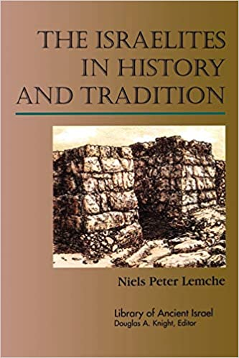
هجومات من قبل ن. ب. لمخي
7. العهد القديم هو ببساطة تاريخ مخترع مع عدد قليل من الإشارات (المراجع إلى أشياء حدثت بالفعل أو كانت موجودة.
8. من وجهة نظر مؤرخ فإن إسرائيل القديمة هي مخلوق وحشي. لقد انبثق هذا الكتاب من خيال مؤرخي الكتاب المقدس ومعيدي صياغتهم المعاصرين أي علماء النقد التاريخي في المائتي عام الماضية.
مقتبس من قبل ك. أ. كيتشن، حول مصداقية العهد القديم( غراند رابيدز: إردمانز، 2003) طبعة كيندل. لوك 9866 من 14432
Notes:
"With all this also fall NPL’s dicta 7-8. The content of the Hebrew Bible is not “invented history” and never was. This is merely crude antibiblical (almost anti-Semitic) propaganda, and ultimately nothing more. Ancient Israel was no more “monstrous” than any of its neighbors, its history is too closely tied to verifiable fact to be undiluted fantasy; and paraphrasing is an essential tool of all history writing, to be used as and when appropriate, but not as a substitute for independent assessments involving all available data when working out properly fact-based syntheses. Goodbye to Lemche’s claims.”
________
In H. Shanks’s “Quote of the Month” from Lemche’s publication, see in BAR 26, no. 4 (July-August 2000): 16.
Response by K. A. Kitchen, On the Reliability of the Old Testament (Grand Rapids: Eerdmans, 2003), Kindle Edition. Loc 9951-9960 of 14432.

Slide 10
Black

Slide 11


دراسات نقدية في العهد القديم at BibleStudyDownloads.org
أحصل على هذا العرض التقديمي والنص مجاناً

