Slide 1
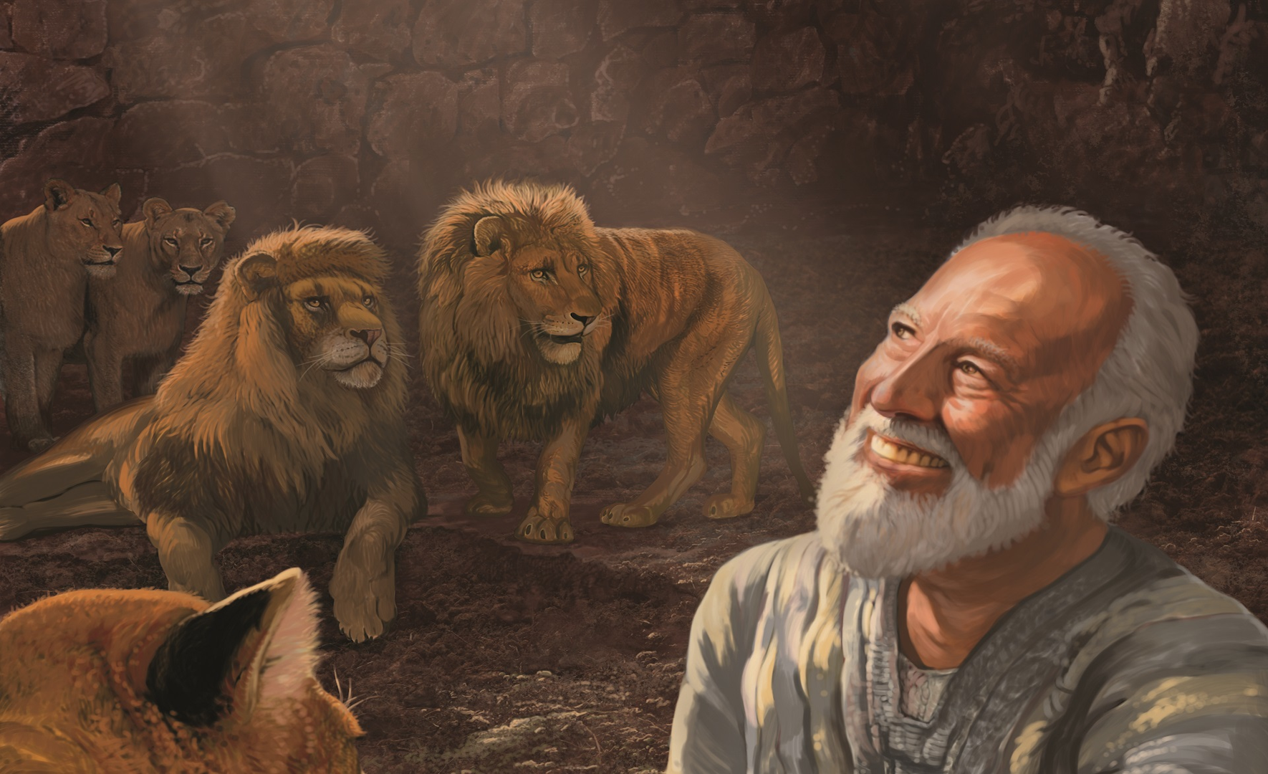
تأليف سفر دانيال
القرن السادس أم الثاني ق.م ؟
د. ريك جريفيث • مؤسسة الدراسات اللاهوتية الأردنية
BibleStudyDownloads.org

Slide 2
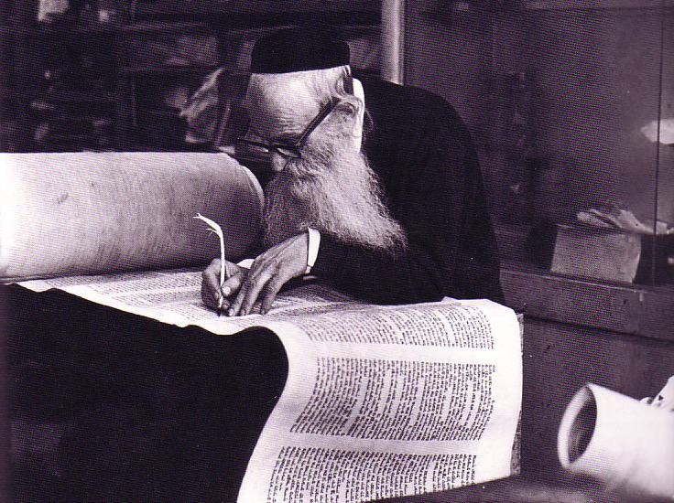
من كتب دانيال ؟
533
الدليل الداخلي :
7: 2-12: 13 (صيغة المتلكم)، 8: 1، 9: 2، 12: 5
الدليل الخارجي :
حز 14: 14و20، متى 24: 15

Slide 3
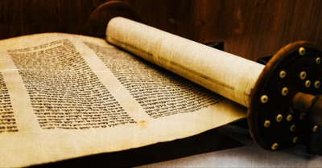
دعم التأليف دانيال
داخلي

Slide 4
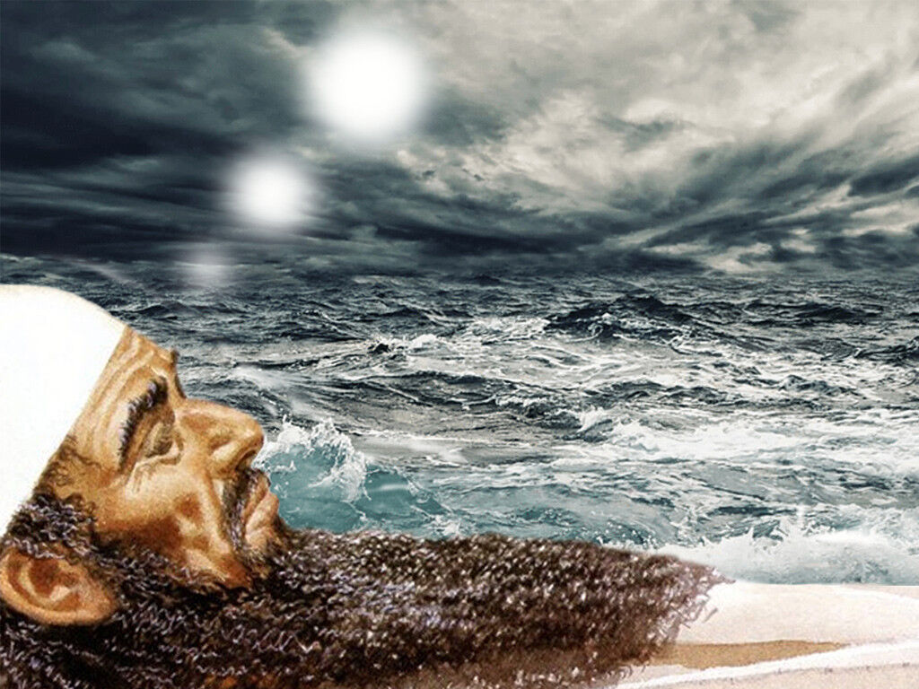
دانيال 7: 2 بصيغة المتكلم
1 في السنة الأولى لبيلشاصر ملك بابل رأى دانيال حلماً و رؤى رأسه على فراشه حينئذ كتب الحلم و أخبر برأس الكلام 2 أجاب دانيال و قال كنت أرى في رؤياي ليلاً و إذا بأربع رياح السماء هجمت على البحر الكبير

Slide 5
رحلة السبي و العودة
حلب
بابل
المملكة البابلية
أورشليم

Slide 6
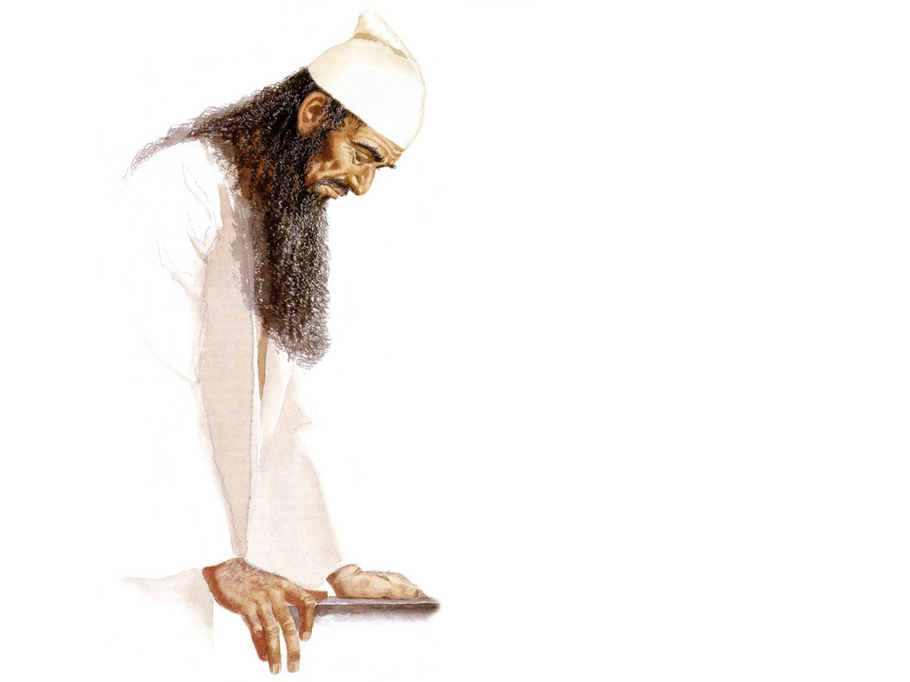
دانيال 8: 1 بصيغة المتكلم
في السنة الثالثة من ملك بيلشاصر الملك ظهرت لي أنا دانيال رؤيا بعد التي ظهرت لي في الإبتداء

Slide 7
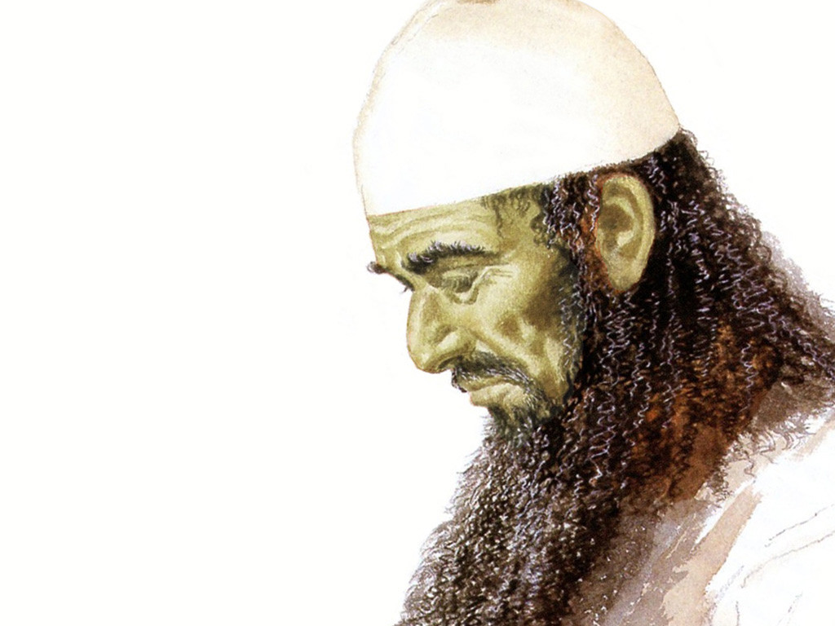
دانيال 9: 2 بصيغة المتكلم
في السنة الأولى من ملكه أنا دانيال فهمت من الكتب عدد السنين التي كانت عنها كلمة الرب إلى إرميا النبي لكمالة سبعين سنة على خراب أورشليم

Slide 8
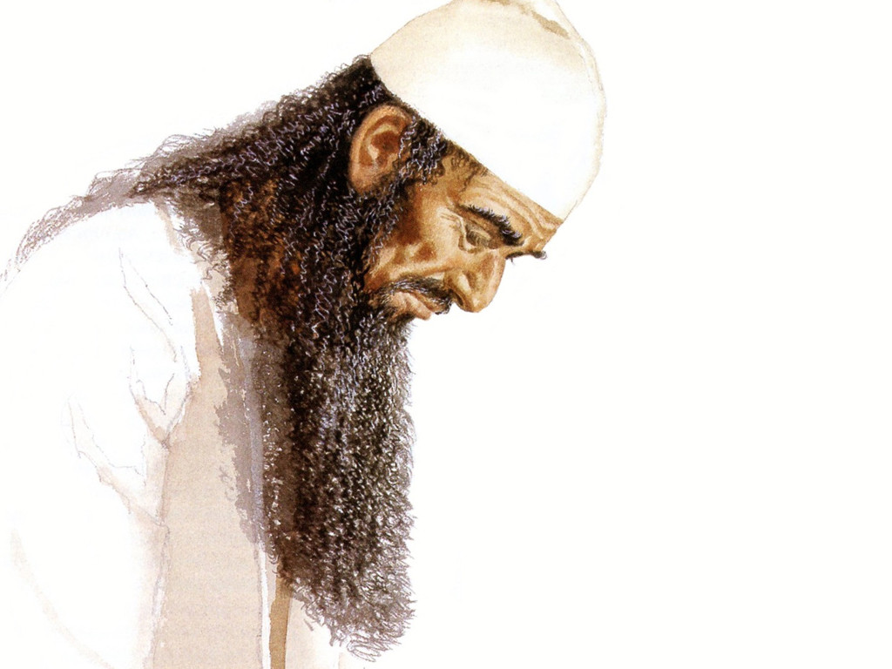
دانيال 12: 5 بصيغة المتكلم
فنظرت أنا دانيال و إذا باثنين آخرين قد وقفا واحد من هنا على شاطئ النهر و آخر من هناك على شاطئ النهر

Slide 9
تاريخ كتابة دانيال
خدمة دانيال
(1: 1،10: 1)
605-536
نبوات دانيال
(دا 2-11)
605-70م
أنطيوخس يدنس الهيكل
167-164
600
550
500
450
400
350
300
250
200
150
100
50
ق
م/م
50
يرى النقاد أن الأحداث التاريخية مسجلة كنبوات
يؤرخ النقاد دانيال بعد 164

Slide 10
الخط الزمني للسبي
605
70 سنة
536
حزقيال 592-572 (20)
دانيال 605-537 (68)
إرميا 626-586 (40)
بيلشاصر 550-539 (11)
الملوك البابليون
نبونايدس (555-539 (16)
الأنبياء
نيريغلايسر (559-555 (4)
إيل مردوخ 561-560 (1)
نبوخدنصر 605-561 (44)
نبوبولاسر 630-605 (25)
650
600
550
500 ق.م

Slide 11
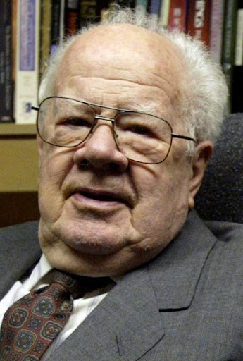
دوايت ج. بنتيكوست ” دانيال في تفسير الكتاب المقدس جون ف. والفورد و روي زوك: التوافق الإلكتروني الطبعة الثانية ويتون : كتب فكتور، 1985)، 1: 1324
إن معرفة دانيال بالأفراد الذين تحدث عنهم الكتاب وبالأحداث والعادات التاريخية المذكورة في الكتاب يستلزم تحديد تاريخ الكتاب في القرن السادس. لم يكن بالإمكان الاحتفاظ بالتفاصيل الدقيقة الواردة في الكتاب بدقة من خلال التقليد الشفوي لنحو 400 عام ، كما اقترح أولئك الذين يفترضون تاريخًا متأخرًا للكتاب
Notes:
Seminary professor J. Dwight Pentecost taught until age 98
Dr. J. Dwight Pentecost (MONA REEDER - 87389)By dallasnews Administrator https://www.dallasnews.com/news/obituaries/2014/05/06/seminary-professor-j-dwight-pentecost-taught-until-age-98/
11:11 PM on May 5, 2014 CDT
The Rev. J. Dwight Pentecost taught more than 10,000 students during his decades at the Dallas Theological Seminary. He taught like he preached, without notes and from the Bible.
The distinguished professor emeritus of Bible exposition taught his last class in December, when he was 98.
Featured on Dallas News
Texas Gov. Greg Abbott scolds Austin for overly ‘stringent’ COVID-19 rules that nix veterans’ parade Gov. Greg Abbott on Tuesday blasted Austin officials for imposing overly restrictive COVID-19…
Pentecost, 99, died April 28 of natural causes at the Forum at Park Lane in Dallas.
A celebration of his life will be at 3 p.m. Wednesday on the seminary campus. Private graveside services were at Restland Memorial Park.
“Dr. ‘P’ — as we affectionately called him — was an inspiration to so many and an institution in his own time,” said seminary president Mark L. Bailey.
“We who have had the privilege to sit under him or teach beside him have all come to know and appreciate the whole of the Bible that our beloved friend believed so thoroughly and taught so faithfully for so many years — all centered in the words and works of Jesus Christ,” Bailey said.
Born in Chester, Pa., Pentecost was 10 when he realized God intended for him to become a minister, he said. His ancestors changed the family name to Pentecost after fleeing the persecutions of French Protestants in 1573. The family arrived in England on Pentecost, the seventh Sunday after Easter, when Christians celebrate the descent of the Holy Spirit on the apostles.
Pentecost attended Hampden-Sydney College in Virginia. He came to Dallas after a summer youth conference where he met a man who had an impressive knowledge of the Bible.
“I wanted to be able to handle the Bible like he did,” Pentecost said in 2005. “So I asked him where he learned how to do that, and he told me he studied at the Dallas seminary.”
In the fall of 1937, Pentecost became the 100th student to enroll at Dallas Theological Seminary, which had been open 12 years then. He earned his master’s degree in 1941 and returned to Pennsylvania, where he was a pastor and taught for eight years at the Philadelphia Bible Institute.
The young pastor devoted two hours each morning to studying Greek, theology and the Bible. He decided he should become a professor.
“While I loved my involvement with people as their shepherd, I felt that I could multiply that effect through teaching,” he said.
Pentecost returned to Dallas and earned his doctorate at the seminary in 1956. While a student, he taught theology, Greek and Bible exposition.
In 1958, he joined the seminary faculty. He was also senior pastor at Grace Bible Church in Dallas from the mid-1950s to 1973.
In 2012, Pentecost missed class for the first time after he fell and broke his leg. Three months later, he was back in the classroom, seminary officials said.
Pentecost authored or co-authored more than 20 books.
His wife of 62 years, Dorothy Pentecost, died in 2000, and a daughter, Gwen Arnold, died in 2011.
Pentecost is survived by a daughter, Jane Fenby of Florida, and two grandchildren.
Memorials may be made to the Dallas Theological Seminary, 3909 Swiss Ave., Dallas, Texas 75204.

Slide 12
يرى بعض النقاد أنه بما أن دانيال لم يستخدم اسم الله يهوه ، ولأن الاسم كان شائعًا في أيام دانيال من قبل الآخرين ، فلا بد أن الكتاب قد كتب في وقت لاحق
ومع ذلك ، فقد فشل هذا الاعتراض في ملاحظة أنه في الفصل 9 تم استخدام هذا الاسم ثماني مرات (. 9: 2 ، 4 ، 8 ، 10 ، 13- 14 [ثلاث مرات] ، 20). اسم الله الذي استخدمه المؤلف في تم تحديد المقطع المحدد من خلال محتواه ، وليس حسب العادات الشعبية
بنتيكوست، ب ك س، 1: 1325
Notes:
Some have objected to Daniel’s sixth-century date on the grounds that the book is included in the Writings, the third section of the Hebrew Bible, rather than among the Prophets, the second division. The last prophetic book (Malachi) was written in the fifth century B.C. Those arguing for a late date for Daniel allege that if his book were written in the sixth century, it would have been included in the second division (the Prophets) rather than relegated to the third (the Writings). However, as previously noted, the prophets were set apart by God as His messengers with a special ministry to the nation Israel. Since Daniel was counted by his contemporaries as a governmental leader rather than a prophet, his writings were included in the third division rather than in the second. Thus the status of the author rather than the date of his book determined the division in which his book was included in the Hebrew Bible.
Some critics hold that since God’s name Yahweh is not used by Daniel and since the name was commonly used in Daniel’s day by others, the book must have been written at a later time. However, this objection fails to note that in chapter 9 this name is used eight times (Dan. 9:2, 4, 8, 10, 13-14 [thrice], 20). The name for God an author used in a given passage was determined by his content, not by popular custom.
Some have objected to Daniel’s authorship because of supposed historical errors found in the book. Some have asserted, for instance, that Nebuchadnezzar was not the father of Belshazzar, as indicated in Daniel 5:2, 11, 13, 18 (cf. v. 22). They argue that if Daniel had written the book, he would not have made such an error. However, it has been demonstrated that a royal successor to the throne was called a “son” (5:22) even if he had no blood relationship to an earlier king. (See the chart “Kings of the Neo-Babylonian Empire.”)
Again objection is made to Daniel’s authorship because the writer refers in 1:21 to the time of Daniel’s death. However, 1:21 does not state when Daniel died; it states that he “remained there” (in Babylon) till Cyrus’ first year. Cyrus’ decree liberated the Jews from their exile in Babylon, thus bringing the 70-year Captivity to a near end. Daniel 1:21 is simply pointing out that Daniel lived through the span of the Captivity. The verse does not specify the time of his death. In fact he lived on into at least Cyrus’ third year (10:1).

Slide 13
يظهر اعتراض آخر على تاليف دانيال للسفر لأن الكاتب يشير في 1: 21 إلى وقت موت دانيال
ومع ذلك ، فإن 1: 21 لا تذكر متى مات دانيال بل إنها تنص على أنه بقي هناك (في بابل) حتى السنة الأولى لكورش . وقد حرر مرسوم كورش اليهود من سبيهم في بابل مما أدى إلى السبي لمدة 70 عامًا إلى نهاية قريبة . يشير دانيال 1: 21 ببساطة إلى أن دانيال عاش خلال فترة السبي . ولا تحدد الآية وقت وفاته و في الواقع عاش في السنة الثالثة على الأقل لكورش (10: 1 )
بنتيكوست، ب ك س، 1: 1325
Notes:
Some have objected to Daniel’s sixth-century date on the grounds that the book is included in the Writings, the third section of the Hebrew Bible, rather than among the Prophets, the second division. The last prophetic book (Malachi) was written in the fifth century B.C. Those arguing for a late date for Daniel allege that if his book were written in the sixth century, it would have been included in the second division (the Prophets) rather than relegated to the third (the Writings). However, as previously noted, the prophets were set apart by God as His messengers with a special ministry to the nation Israel. Since Daniel was counted by his contemporaries as a governmental leader rather than a prophet, his writings were included in the third division rather than in the second. Thus the status of the author rather than the date of his book determined the division in which his book was included in the Hebrew Bible.
Some critics hold that since God’s name Yahweh is not used by Daniel and since the name was commonly used in Daniel’s day by others, the book must have been written at a later time. However, this objection fails to note that in chapter 9 this name is used eight times (Dan. 9:2, 4, 8, 10, 13-14 [thrice], 20). The name for God an author used in a given passage was determined by his content, not by popular custom.
Some have objected to Daniel’s authorship because of supposed historical errors found in the book. Some have asserted, for instance, that Nebuchadnezzar was not the father of Belshazzar, as indicated in Daniel 5:2, 11, 13, 18 (cf. v. 22). They argue that if Daniel had written the book, he would not have made such an error. However, it has been demonstrated that a royal successor to the throne was called a “son” (5:22) even if he had no blood relationship to an earlier king. (See the chart “Kings of the Neo-Babylonian Empire.”)
Again objection is made to Daniel’s authorship because the writer refers in 1:21 to the time of Daniel’s death. However, 1:21 does not state when Daniel died; it states that he “remained there” (in Babylon) till Cyrus’ first year. Cyrus’ decree liberated the Jews from their exile in Babylon, thus bringing the 70-year Captivity to a near end. Daniel 1:21 is simply pointing out that Daniel lived through the span of the Captivity. The verse does not specify the time of his death. In fact he lived on into at least Cyrus’ third year (10:1).

Slide 14
دعم التأليف دانيال
خارجي
خارجي
خارجي
خارجي
خارجي

Slide 15
الخط الزمني للسبي
605
70 سنة
536
حزقيال 592-572 (20)
دانيال 605-537 (68)
إرميا 626-586 (40)
يشير حزقيال إلى أن دانيال كان معاصرًا له على قدم المساواة مع أيوب في ثمانينيات القرن الخامس قبل الميلاد (أربعة قرون قبل 164 قبل الميلاد) ، لذلك كان دانيال معروفًا - وليس أسطورة
حز 14: 14 و كان فيهم هؤلاء الرجال الثلاثة نوح و دانيال و أيوب فإنهم إنما يخلصون أنفسهم ببرهم يقول السيد الرب
حز 14: 20 و في وسطها نوح و دانيال و أيوب فحي أنا يقول السيد الرب إنهم لا يخلصون ابناً و لا ابنة إنما يخلصون أنفسهم ببرهم
بيلشاصر 550-539 (11)
الملوك البابليون
نبونايدس (555-539 (16)
الأنبياء
نيريغلايسر (559-555 (4)
إيل مردوخ 561-560 (1)
نبوخدنصر 605-561 (44)
نبوبولاسر 630-605 (25)
650
600
550
500 ق.م

Slide 16
دانيال 9: 25-27
86 ب-د
25 فاعلم و افهم أنه من خروج الأمر لتجديد أورشليم و بنائها إلى المسيح الرئيس سبعة أسابيع و اثنان و ستون أسبوعاً يعود و يبنى سوق و خليج في ضيق الأزمنة و بعد اثنين و ستين اسبوعاً يقطع المسيح و ليس له و شعب رئيس آت يخرب المدينة و القدس و انتهاؤه بغمارة و إلى النهاية حرب و خرب قضي بها و يثبت عهداً مع كثيرين في أسبوع واحد و في وسط الأسبوع يبطل الذبيحة و التقدمة و على جناح الأرجاس مخرب حتى يتم و يصب المقضي على المخرب

Slide 17
1. النظرة النقدية
555
إر 25: 11-12
605-586 ق.م
مرسوم كورش
538 ق.م
مقتل أونياس
171 ق.م
تدنيس
أنطيوخس
167 ق.م
إعادة
تكريس
الهيكل
164 ق.م
الإنتقاد
7 أسابيع
62 أسبوع
أسبوع واحد
انتقاد النظرة النقدية :
تضيف الأسابيع ما يصل إلى 422 أو 441 عامًا (وليس 490)
لم يكن أنطيوخس شخصية مسيحية
لم يقطع أنطيوخس الرابع عهدا مع إسرائيل
يُنظر إلى النبوة فقط على أنها تنبؤ خيالي

Slide 18
أسابيع دانيال السبعون
551
المسيح
المرسوم
69 أسبوع = 483 سنة
7 اسابيع 62 أسبوع
1 أسبوع
= 7 سنوات
444 ق.م – 395 ق.م
395 ق.م – 33م

Slide 19
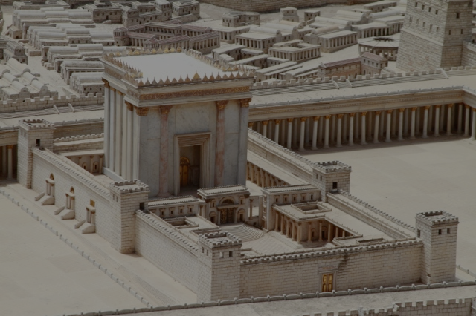
متى 24: 15
فمتى نظرتم رجسة الخراب التي قال عنها دانيال النبي قائمة في المكان المقدس (ليفهم القارئ)
يقول يسوع أن دانيال 9: 27 كتب من قبل دانيال
Notes:
Some critics say Antiochus IV fulfilled Dan 9:27 in 167 BC when he desecrated the temple by offering a pig on the altar. Yet Jesus noted that the fulfillment was still future. I will take the word of Jesus over the critics.

Slide 20
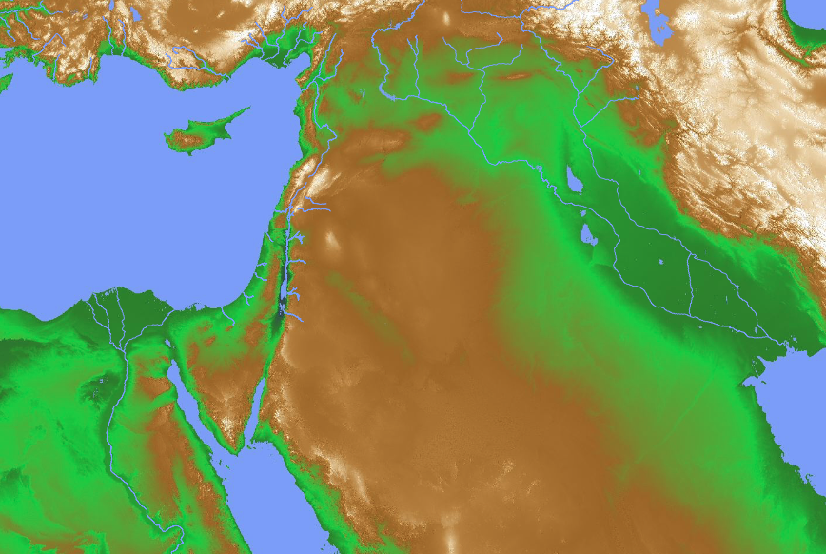
تم تأكيد ذلك في التسلسل الزمني للشرق الأدنى القديم
الكتاب العبريون في أسفار الملوك وما إلى ذلك لديهم ملوكهم الآشوريون والبابليون بالترتيب الصحيح بدقة ... (كيتشن ، 23)
بلاد ما بين النهرين : • بابل القديمة (1432-1180) • أشور (912-609) • بابل الحديثة (626-539)
إسرائيل (التواريخ مؤكدة)
حكم طهاركا من 690 إلى 664 ونشو الثاني من 610 إلى 595 وحفرا من 589 إلى 570 ، كل ذلك بالتسلسل إلى جانب معاصريهم العبريين (كيتشن ، 23)
مصر
(1550/1540-525)
Notes:
“﻿The framework of ancient Near Eastern history in this epoch is provided by the two major hearths of complex civilization of that day, namely, Mesopotamia (Assyria and Babylonia) on the east and Egypt to the southwest. Before Alexander the Great (336-323) we have the Persian Empire, which ended the independence of Babylon in 539 (by Cyrus) and (for a time) of Egypt in 525 (by Cambyses). All these dates are firm and universally accepted. In Mesopotamia the Neo-Babylonian kings ruled Babylonia from 626 to 539. Overlapping at the end and preceding them, the kings of Assyria are dated to the year from 912 down to 648 (eponym lists, 911/910ff., plus king lists), and to the final end of Assyria in 609. Before 912 Assyrian dates are closely correct back to 1180, before which a dispute over three or thirteen years for Ninurta-apil-ekur gives a maximum ten-year variation back to 1432/1422 for the accession of Enlil-nasir II. Thus from 1180 (and quite closely from the late fifteenth century) Assyrian dates provide a firm backbone of dating other, less securely fixed regions in the Near East.61
On the other side of the area, Egypt also makes a valuable contribution, essentially independent of Mesopotamia. Thus, before the Persian conquest in 525, the Twenty-Sixth (Saite) Dynasty reigned to the year during 664 to 525. The reign of Tanutamun was contemporary with the Twenty-Sixth Dynasty, and the Twenty-Third and Twenty-Fourth Dynasties were wholly contemporary with the Twenty-Second and with each other; so none of these affect the flow of successive dates. Before the Twenty-Sixth Dynasty, Taharqa of the Twenty-Fifth (Kushite/Nubian) Dynasty reigned from 690 to 664. Before this date, it is now clear that Shebitku reigned from at least 702 (and perhaps 706), and his predecessor Shabaka for fourteen years, thirteen over Egypt, maximally 719/minimally 715 to 702. Before him in Egypt, but not ending before 716 (Osorkon IV = Shilkanni of an Assyrian text in 716), the Twenty-Second (Libyan) Dynasty reigned an absolute minimum of close to 230 years, beginning with Shoshenq I (“Shishak”) from 945 (or extremely close to it). Note that this Egyptian chronology stands independently of both the Assyrian and Hebrew data.
Before 945, the Twenty-First Dynasty goes back to 1070 within a year or so. Earlier still, the Ramesside Nineteenth and Twentieth Dynasties (New Kingdom) go back to firm dates of 1279-1213 (not 1212!) for Ramesses II, and for the preceding Eighteenth Dynasty and start of the New Kingdom to either 1550 or 1540 (again, varying because of a king [Tuthmosis II] who reigned either three or thirteen years).62”
Kenneth A. Kitchen, On the Reliability of the Old Testament (Grand Rapids, MI: Eerdmans, 2003), 22-23 (Kindle Edition Loc 780-796 of 14432)
Loc 804 in the black boxes above

Slide 21
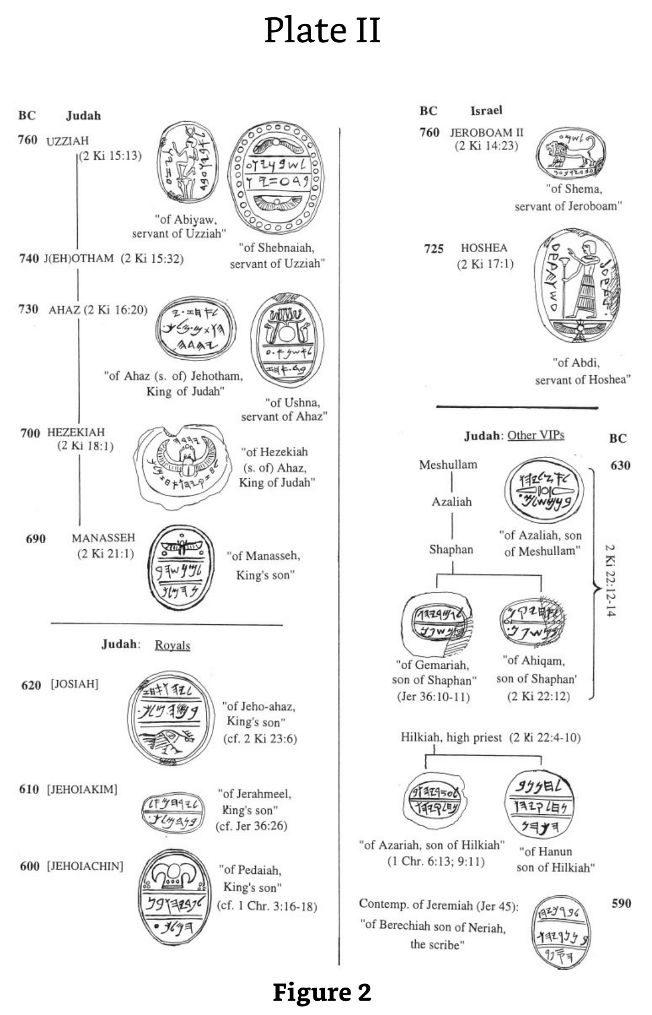
17 ختم شاهد على ملوك اليهود
تُظهر هذه الأختام التي تحتوي على العديد من اللقطات القريبة في الشرائح التالية دعمًا أثريًا وافرًا لممالك إسرائيل ويهوذا.
وينطبق الشيء نفسه على ملوك بابل المذكورة في نبوة دانيال.
كينيث أ. كيتشن، مصداقية العهد القديم (جراند رابيدز، إيردمانز، 2003)، 16-21، 604
Notes:
﻿”3. KINGS OF ISRAEL AND JUDAH IN LOCAL RECORDS (LR) A. KINGS OF ISRAEL The famous seal of “Shema servant [= minister of state] of Jeroboam” is almost universally recognized to belong to the reign of Jeroboam II of Israel (cf. fig. 2); attempts to date it to Jeroboam I are unconvincing. The Samaria ostraca (main lot) belong also to this period, and maybe to this particular reign.44 To Shallum (I) (or much less likely, his Judean namesake, Jehoahaz III/Shallum II) may just possibly be attributed an eighth-century cylindrical seal stone of royal style (kingly figure, winged discs, etc.).45 As for Hoshea, to his reign belongs the seal of one “Abdi, servant of Hoshea” (fig. 2).46 B. KINGS OF JUDAH (i) Azariah/Uzziah, Jotham, Ahaz To the reign of Azariah/Uzziah belong two seals, of the state ministers (“servants”) Shebaniah (Shebanyau) and Abiah (Abiyau).47 Jotham is attested as Jehotham and father of Ahaz on a recently discovered seal impression (“bulla”) that bears the text “Belonging to Ahaz (son of) Jehotham [= long form of Jotham], King of Judah.”48 A seal of this reign is known, of Ushna servant of Ahaz (for these, cf. fig. 2).49 For Ahaz as father of Hezekiah, see under Hezekiah. (ii) Hezekiah (Fig. 2) His name is mentioned on another recently discovered bulla, which reads: “Belonging to Hezekiah (son of) Ahaz, King of Judah,” and with it can now be matched a damaged bulla that bore the same text.50 To these royal stamps can be added no less than three bullae of “servants” of Hezekiah: of Jehozarah son of Hilkiah, of Azariah son of Jeho’abi, and of one on which the name has been lost.51 Among inscriptions without the royal name but belonging to this time should certainly belong the famous Siloam tunnel inscription (cf. 2 Kings 20:20; 2 Chron. 32:30), and likewise the tomb inscription of the royal steward (“he who is over the house”), […]iah, highly likely to have been [Shebna]iah — and the same as Shebna (abbreviated form of this name), the royal steward of Hezekiah’s day, condemned by the prophet Isaiah (Isa. 22:15-25).52 (iii) Manasseh As a young prince he may have had his own personal seal for official purposes. Such a seal may be seen in a known seal inscribed “belonging to Manasseh, son of the king” (fig. 2), the latter being Hezekiah.53 (iv) Josiah Several items may well belong to this reign, although they are without certainty and do not rank as firm evidence. But they can be conveniently set out here as a good example of items that (in almost every case) clearly belong to the later seventh (to early sixth) century in Judah. In this short period the choice of reigns is sometimes limited by year dates, too high to be anyone but either Manasseh or Josiah in practice. These are: (a) Ostracon Mousaieff 1, which required payment of three shekels of silver to “the House [= temple] of the LORD [YHWH]” in the name of ’Ashiah/’Oshiah the king, via a man [Z]echariah. The script is either eighth (so, Cross) or seventh century (so, Yardeni). In the former case, ’Ashiah/’Oshiah is a variant of Joash, king of Judah; in the latter case, of Josiah, which is the latest date possible. In Josiah’s time a Levite named Zechariah was concerned with repairs to the Jerusalem temple (cf. 2 Chron. 34:12), so the later dating might well allow of our two Zechariahs being the same man.54 (b) Seal stones and impressions. These include both fiscal and personal seals. One fiscal seal is dated to a royal “Year 26” in late seventh-/early sixth-century script. Therefore its editors date it to Josiah, the only king who reigned that long, then. (However, it should be said that as Manasseh supposedly reigned fifty-five years, he cannot be ruled out absolutely.) Exactly similar fiscal stamps include dates in Years 13, 14, and 20 (another in a Year 3 is different).55 The personal seals include (fig. 2): one of a king’s son Jeho-ahaz, probably Josiah’s eventual successor; one of Azaliah son of Meshullam (father of Shaphan) (cf. 2 Kings 22:3); one of Ahikam son of Shaphan, this reign or Jehoiakim’s (cf. 2 Kings 22:12-14; Jer. 26:24); a seal stone in ring, of Hanan son of Hilkiah, (high) priest in Jerusalem (cf. 2 Kings 22:8, 10).56 (v) Jehoiakim and Jehoiachin Attributable to Jehoiakim’s reign (fig. 2) may be the seal of the king’s son Jerahmeel and a bulla from a second seal of the same man. Such a man was son of King Jehoiakim and involved with the prophet Jeremiah (Jer. 36:26). An impression or bulla of “Gemariah son of Shaphan” recalls the man of this name and filiation under Jehoiakim in Jer. 36:10-11.57 For the seal of Gemariah’s brother Ahikam, see above under Josiah. For Baruch in this reign and the next two, see under Zedekiah, below. We have also the seal of the king’s son Pedaiah, readily identifiable as one of the sons of Jehoiachin, named in 1 Chron. 3:16-18.58 Cf. fig. 2. (vi) Zedekiah Here a series of personal seals belong to people who bear the names of characters active in this reign. Most famous are two bullae from seals of “Berechiah [= Baruch], son of Neriah the scribe,” well known as the prophet Jeremiah’s faithful secretary (Jer. 32:12; 36; 43:1-7; 45). Cf. Fig. 2. Malkijah the king’s son (Jer. 38:6) may be the same man as the owner of CWSS, 55, no. 15. Seraiah son of Neriah appears to be Baruch’s brother; Azariah son of Hilkiah would be brother of Hanan (cf. under Josiah); cf. 1 Chron. 6:13; 9:11. Gedaliah “who is over the house” may have been the Gedaliah who briefly governed Judah after the Babylonian conquest in 586 (cf. 2 Kings 25:22-25). One or another of four seal owners Jaazaniah, one being “servant of the king,” may again have been the army officer active in 586 (2 Kings 25:23). A king’s son, Elishama, had descendants active at the fall of Jerusalem (2 Kings 25:25; Jer. 41:1); his probable seal would then date anytime from Josiah onward.59 A major inscriptional source at this time is the collection of ostraca found in the ruins of Lachish, known as the “Lachish Letters.” Archaeologically they date from the last days of Lachish before it was destroyed by Nebuchadrezzar’s troops.60
Kenneth A. Kitchen, On the Reliability of the Old Testament (Grand Rapids, MI: Eerdmans, 2003), 16-21, 604 (Kindle Edition Loc 716-772 of 14432)

Slide 22
أختام عزيا و يوثام
“quote”
ق.م
يهوذا
760
عزيا (2 مل 15: 13)
من أبيا
خادم عزيا
من شبنيا
خادم عزيا
740
يوثام (2 مل 15: 32)
Notes:
﻿”3. KINGS OF ISRAEL AND JUDAH IN LOCAL RECORDS (LR) A. KINGS OF ISRAEL The famous seal of “Shema servant [= minister of state] of Jeroboam” is almost universally recognized to belong to the reign of Jeroboam II of Israel (cf. fig. 2); attempts to date it to Jeroboam I are unconvincing. The Samaria ostraca (main lot) belong also to this period, and maybe to this particular reign.44 To Shallum (I) (or much less likely, his Judean namesake, Jehoahaz III/Shallum II) may just possibly be attributed an eighth-century cylindrical seal stone of royal style (kingly figure, winged discs, etc.).45 As for Hoshea, to his reign belongs the seal of one “Abdi, servant of Hoshea” (fig. 2).46 B. KINGS OF JUDAH (i) Azariah/Uzziah, Jotham, Ahaz To the reign of Azariah/Uzziah belong two seals, of the state ministers (“servants”) Shebaniah (Shebanyau) and Abiah (Abiyau).47 Jotham is attested as Jehotham and father of Ahaz on a recently discovered seal impression (“bulla”) that bears the text “Belonging to Ahaz (son of) Jehotham [= long form of Jotham], King of Judah.”48 A seal of this reign is known, of Ushna servant of Ahaz (for these, cf. fig. 2).49 For Ahaz as father of Hezekiah, see under Hezekiah. (ii) Hezekiah (Fig. 2) His name is mentioned on another recently discovered bulla, which reads: “Belonging to Hezekiah (son of) Ahaz, King of Judah,” and with it can now be matched a damaged bulla that bore the same text.50 To these royal stamps can be added no less than three bullae of “servants” of Hezekiah: of Jehozarah son of Hilkiah, of Azariah son of Jeho’abi, and of one on which the name has been lost.51 Among inscriptions without the royal name but belonging to this time should certainly belong the famous Siloam tunnel inscription (cf. 2 Kings 20:20; 2 Chron. 32:30), and likewise the tomb inscription of the royal steward (“he who is over the house”), […]iah, highly likely to have been [Shebna]iah — and the same as Shebna (abbreviated form of this name), the royal steward of Hezekiah’s day, condemned by the prophet Isaiah (Isa. 22:15-25).52 (iii) Manasseh As a young prince he may have had his own personal seal for official purposes. Such a seal may be seen in a known seal inscribed “belonging to Manasseh, son of the king” (fig. 2), the latter being Hezekiah.53 (iv) Josiah Several items may well belong to this reign, although they are without certainty and do not rank as firm evidence. But they can be conveniently set out here as a good example of items that (in almost every case) clearly belong to the later seventh (to early sixth) century in Judah. In this short period the choice of reigns is sometimes limited by year dates, too high to be anyone but either Manasseh or Josiah in practice. These are: (a) Ostracon Mousaieff 1, which required payment of three shekels of silver to “the House [= temple] of the LORD [YHWH]” in the name of ’Ashiah/’Oshiah the king, via a man [Z]echariah. The script is either eighth (so, Cross) or seventh century (so, Yardeni). In the former case, ’Ashiah/’Oshiah is a variant of Joash, king of Judah; in the latter case, of Josiah, which is the latest date possible. In Josiah’s time a Levite named Zechariah was concerned with repairs to the Jerusalem temple (cf. 2 Chron. 34:12), so the later dating might well allow of our two Zechariahs being the same man.54 (b) Seal stones and impressions. These include both fiscal and personal seals. One fiscal seal is dated to a royal “Year 26” in late seventh-/early sixth-century script. Therefore its editors date it to Josiah, the only king who reigned that long, then. (However, it should be said that as Manasseh supposedly reigned fifty-five years, he cannot be ruled out absolutely.) Exactly similar fiscal stamps include dates in Years 13, 14, and 20 (another in a Year 3 is different).55 The personal seals include (fig. 2): one of a king’s son Jeho-ahaz, probably Josiah’s eventual successor; one of Azaliah son of Meshullam (father of Shaphan) (cf. 2 Kings 22:3); one of Ahikam son of Shaphan, this reign or Jehoiakim’s (cf. 2 Kings 22:12-14; Jer. 26:24); a seal stone in ring, of Hanan son of Hilkiah, (high) priest in Jerusalem (cf. 2 Kings 22:8, 10).56 (v) Jehoiakim and Jehoiachin Attributable to Jehoiakim’s reign (fig. 2) may be the seal of the king’s son Jerahmeel and a bulla from a second seal of the same man. Such a man was son of King Jehoiakim and involved with the prophet Jeremiah (Jer. 36:26). An impression or bulla of “Gemariah son of Shaphan” recalls the man of this name and filiation under Jehoiakim in Jer. 36:10-11.57 For the seal of Gemariah’s brother Ahikam, see above under Josiah. For Baruch in this reign and the next two, see under Zedekiah, below. We have also the seal of the king’s son Pedaiah, readily identifiable as one of the sons of Jehoiachin, named in 1 Chron. 3:16-18.58 Cf. fig. 2. (vi) Zedekiah Here a series of personal seals belong to people who bear the names of characters active in this reign. Most famous are two bullae from seals of “Berechiah [= Baruch], son of Neriah the scribe,” well known as the prophet Jeremiah’s faithful secretary (Jer. 32:12; 36; 43:1-7; 45). Cf. Fig. 2. Malkijah the king’s son (Jer. 38:6) may be the same man as the owner of CWSS, 55, no. 15. Seraiah son of Neriah appears to be Baruch’s brother; Azariah son of Hilkiah would be brother of Hanan (cf. under Josiah); cf. 1 Chron. 6:13; 9:11. Gedaliah “who is over the house” may have been the Gedaliah who briefly governed Judah after the Babylonian conquest in 586 (cf. 2 Kings 25:22-25). One or another of four seal owners Jaazaniah, one being “servant of the king,” may again have been the army officer active in 586 (2 Kings 25:23). A king’s son, Elishama, had descendants active at the fall of Jerusalem (2 Kings 25:25; Jer. 41:1); his probable seal would then date anytime from Josiah onward.59 A major inscriptional source at this time is the collection of ostraca found in the ruins of Lachish, known as the “Lachish Letters.” Archaeologically they date from the last days of Lachish before it was destroyed by Nebuchadrezzar’s troops.60
Kenneth A. Kitchen, On the Reliability of the Old Testament (Grand Rapids, MI: Eerdmans, 2003), 16-21, 604 (Kindle Edition Loc 716-772 of 14432)

Slide 23
أختام يربعام الثاني و هوشع
ق.م
إسرائيل
760
يربعام الثاني (2 مل 14: 23)
من شمع
خادم يربعام
725
هوشع (2 مل 17: 1)
من عبدي
خادم هوشع
Notes:
﻿”3. KINGS OF ISRAEL AND JUDAH IN LOCAL RECORDS (LR) A. KINGS OF ISRAEL The famous seal of “Shema servant [= minister of state] of Jeroboam” is almost universally recognized to belong to the reign of Jeroboam II of Israel (cf. fig. 2); attempts to date it to Jeroboam I are unconvincing. The Samaria ostraca (main lot) belong also to this period, and maybe to this particular reign.44 To Shallum (I) (or much less likely, his Judean namesake, Jehoahaz III/Shallum II) may just possibly be attributed an eighth-century cylindrical seal stone of royal style (kingly figure, winged discs, etc.).45 As for Hoshea, to his reign belongs the seal of one “Abdi, servant of Hoshea” (fig. 2).46 B. KINGS OF JUDAH (i) Azariah/Uzziah, Jotham, Ahaz To the reign of Azariah/Uzziah belong two seals, of the state ministers (“servants”) Shebaniah (Shebanyau) and Abiah (Abiyau).47 Jotham is attested as Jehotham and father of Ahaz on a recently discovered seal impression (“bulla”) that bears the text “Belonging to Ahaz (son of) Jehotham [= long form of Jotham], King of Judah.”48 A seal of this reign is known, of Ushna servant of Ahaz (for these, cf. fig. 2).49 For Ahaz as father of Hezekiah, see under Hezekiah. (ii) Hezekiah (Fig. 2) His name is mentioned on another recently discovered bulla, which reads: “Belonging to Hezekiah (son of) Ahaz, King of Judah,” and with it can now be matched a damaged bulla that bore the same text.50 To these royal stamps can be added no less than three bullae of “servants” of Hezekiah: of Jehozarah son of Hilkiah, of Azariah son of Jeho’abi, and of one on which the name has been lost.51 Among inscriptions without the royal name but belonging to this time should certainly belong the famous Siloam tunnel inscription (cf. 2 Kings 20:20; 2 Chron. 32:30), and likewise the tomb inscription of the royal steward (“he who is over the house”), […]iah, highly likely to have been [Shebna]iah — and the same as Shebna (abbreviated form of this name), the royal steward of Hezekiah’s day, condemned by the prophet Isaiah (Isa. 22:15-25).52 (iii) Manasseh As a young prince he may have had his own personal seal for official purposes. Such a seal may be seen in a known seal inscribed “belonging to Manasseh, son of the king” (fig. 2), the latter being Hezekiah.53 (iv) Josiah Several items may well belong to this reign, although they are without certainty and do not rank as firm evidence. But they can be conveniently set out here as a good example of items that (in almost every case) clearly belong to the later seventh (to early sixth) century in Judah. In this short period the choice of reigns is sometimes limited by year dates, too high to be anyone but either Manasseh or Josiah in practice. These are: (a) Ostracon Mousaieff 1, which required payment of three shekels of silver to “the House [= temple] of the LORD [YHWH]” in the name of ’Ashiah/’Oshiah the king, via a man [Z]echariah. The script is either eighth (so, Cross) or seventh century (so, Yardeni). In the former case, ’Ashiah/’Oshiah is a variant of Joash, king of Judah; in the latter case, of Josiah, which is the latest date possible. In Josiah’s time a Levite named Zechariah was concerned with repairs to the Jerusalem temple (cf. 2 Chron. 34:12), so the later dating might well allow of our two Zechariahs being the same man.54 (b) Seal stones and impressions. These include both fiscal and personal seals. One fiscal seal is dated to a royal “Year 26” in late seventh-/early sixth-century script. Therefore its editors date it to Josiah, the only king who reigned that long, then. (However, it should be said that as Manasseh supposedly reigned fifty-five years, he cannot be ruled out absolutely.) Exactly similar fiscal stamps include dates in Years 13, 14, and 20 (another in a Year 3 is different).55 The personal seals include (fig. 2): one of a king’s son Jeho-ahaz, probably Josiah’s eventual successor; one of Azaliah son of Meshullam (father of Shaphan) (cf. 2 Kings 22:3); one of Ahikam son of Shaphan, this reign or Jehoiakim’s (cf. 2 Kings 22:12-14; Jer. 26:24); a seal stone in ring, of Hanan son of Hilkiah, (high) priest in Jerusalem (cf. 2 Kings 22:8, 10).56 (v) Jehoiakim and Jehoiachin Attributable to Jehoiakim’s reign (fig. 2) may be the seal of the king’s son Jerahmeel and a bulla from a second seal of the same man. Such a man was son of King Jehoiakim and involved with the prophet Jeremiah (Jer. 36:26). An impression or bulla of “Gemariah son of Shaphan” recalls the man of this name and filiation under Jehoiakim in Jer. 36:10-11.57 For the seal of Gemariah’s brother Ahikam, see above under Josiah. For Baruch in this reign and the next two, see under Zedekiah, below. We have also the seal of the king’s son Pedaiah, readily identifiable as one of the sons of Jehoiachin, named in 1 Chron. 3:16-18.58 Cf. fig. 2. (vi) Zedekiah Here a series of personal seals belong to people who bear the names of characters active in this reign. Most famous are two bullae from seals of “Berechiah [= Baruch], son of Neriah the scribe,” well known as the prophet Jeremiah’s faithful secretary (Jer. 32:12; 36; 43:1-7; 45). Cf. Fig. 2. Malkijah the king’s son (Jer. 38:6) may be the same man as the owner of CWSS, 55, no. 15. Seraiah son of Neriah appears to be Baruch’s brother; Azariah son of Hilkiah would be brother of Hanan (cf. under Josiah); cf. 1 Chron. 6:13; 9:11. Gedaliah “who is over the house” may have been the Gedaliah who briefly governed Judah after the Babylonian conquest in 586 (cf. 2 Kings 25:22-25). One or another of four seal owners Jaazaniah, one being “servant of the king,” may again have been the army officer active in 586 (2 Kings 25:23). A king’s son, Elishama, had descendants active at the fall of Jerusalem (2 Kings 25:25; Jer. 41:1); his probable seal would then date anytime from Josiah onward.59 A major inscriptional source at this time is the collection of ostraca found in the ruins of Lachish, known as the “Lachish Letters.” Archaeologically they date from the last days of Lachish before it was destroyed by Nebuchadrezzar’s troops.60
Kenneth A. Kitchen, On the Reliability of the Old Testament (Grand Rapids, MI: Eerdmans, 2003), 16-21, 604 (Kindle Edition Loc 716-772 of 14432)

Slide 24
أختام آحاز و حزقيا
730
آحاز (2 مل 16: 20)
”
من آحاز
بن يوثام
ملك يهوذا
من عشنا
خادم آحاز
700
حزقيا (2 مل 18: 1)
من حزقيا
بن آحاز
ملك يهوذا
Notes:
﻿”3. KINGS OF ISRAEL AND JUDAH IN LOCAL RECORDS (LR) A. KINGS OF ISRAEL The famous seal of “Shema servant [= minister of state] of Jeroboam” is almost universally recognized to belong to the reign of Jeroboam II of Israel (cf. fig. 2); attempts to date it to Jeroboam I are unconvincing. The Samaria ostraca (main lot) belong also to this period, and maybe to this particular reign.44 To Shallum (I) (or much less likely, his Judean namesake, Jehoahaz III/Shallum II) may just possibly be attributed an eighth-century cylindrical seal stone of royal style (kingly figure, winged discs, etc.).45 As for Hoshea, to his reign belongs the seal of one “Abdi, servant of Hoshea” (fig. 2).46 B. KINGS OF JUDAH (i) Azariah/Uzziah, Jotham, Ahaz To the reign of Azariah/Uzziah belong two seals, of the state ministers (“servants”) Shebaniah (Shebanyau) and Abiah (Abiyau).47 Jotham is attested as Jehotham and father of Ahaz on a recently discovered seal impression (“bulla”) that bears the text “Belonging to Ahaz (son of) Jehotham [= long form of Jotham], King of Judah.”48 A seal of this reign is known, of Ushna servant of Ahaz (for these, cf. fig. 2).49 For Ahaz as father of Hezekiah, see under Hezekiah. (ii) Hezekiah (Fig. 2) His name is mentioned on another recently discovered bulla, which reads: “Belonging to Hezekiah (son of) Ahaz, King of Judah,” and with it can now be matched a damaged bulla that bore the same text.50 To these royal stamps can be added no less than three bullae of “servants” of Hezekiah: of Jehozarah son of Hilkiah, of Azariah son of Jeho’abi, and of one on which the name has been lost.51 Among inscriptions without the royal name but belonging to this time should certainly belong the famous Siloam tunnel inscription (cf. 2 Kings 20:20; 2 Chron. 32:30), and likewise the tomb inscription of the royal steward (“he who is over the house”), […]iah, highly likely to have been [Shebna]iah — and the same as Shebna (abbreviated form of this name), the royal steward of Hezekiah’s day, condemned by the prophet Isaiah (Isa. 22:15-25).52 (iii) Manasseh As a young prince he may have had his own personal seal for official purposes. Such a seal may be seen in a known seal inscribed “belonging to Manasseh, son of the king” (fig. 2), the latter being Hezekiah.53 (iv) Josiah Several items may well belong to this reign, although they are without certainty and do not rank as firm evidence. But they can be conveniently set out here as a good example of items that (in almost every case) clearly belong to the later seventh (to early sixth) century in Judah. In this short period the choice of reigns is sometimes limited by year dates, too high to be anyone but either Manasseh or Josiah in practice. These are: (a) Ostracon Mousaieff 1, which required payment of three shekels of silver to “the House [= temple] of the LORD [YHWH]” in the name of ’Ashiah/’Oshiah the king, via a man [Z]echariah. The script is either eighth (so, Cross) or seventh century (so, Yardeni). In the former case, ’Ashiah/’Oshiah is a variant of Joash, king of Judah; in the latter case, of Josiah, which is the latest date possible. In Josiah’s time a Levite named Zechariah was concerned with repairs to the Jerusalem temple (cf. 2 Chron. 34:12), so the later dating might well allow of our two Zechariahs being the same man.54 (b) Seal stones and impressions. These include both fiscal and personal seals. One fiscal seal is dated to a royal “Year 26” in late seventh-/early sixth-century script. Therefore its editors date it to Josiah, the only king who reigned that long, then. (However, it should be said that as Manasseh supposedly reigned fifty-five years, he cannot be ruled out absolutely.) Exactly similar fiscal stamps include dates in Years 13, 14, and 20 (another in a Year 3 is different).55 The personal seals include (fig. 2): one of a king’s son Jeho-ahaz, probably Josiah’s eventual successor; one of Azaliah son of Meshullam (father of Shaphan) (cf. 2 Kings 22:3); one of Ahikam son of Shaphan, this reign or Jehoiakim’s (cf. 2 Kings 22:12-14; Jer. 26:24); a seal stone in ring, of Hanan son of Hilkiah, (high) priest in Jerusalem (cf. 2 Kings 22:8, 10).56 (v) Jehoiakim and Jehoiachin Attributable to Jehoiakim’s reign (fig. 2) may be the seal of the king’s son Jerahmeel and a bulla from a second seal of the same man. Such a man was son of King Jehoiakim and involved with the prophet Jeremiah (Jer. 36:26). An impression or bulla of “Gemariah son of Shaphan” recalls the man of this name and filiation under Jehoiakim in Jer. 36:10-11.57 For the seal of Gemariah’s brother Ahikam, see above under Josiah. For Baruch in this reign and the next two, see under Zedekiah, below. We have also the seal of the king’s son Pedaiah, readily identifiable as one of the sons of Jehoiachin, named in 1 Chron. 3:16-18.58 Cf. fig. 2. (vi) Zedekiah Here a series of personal seals belong to people who bear the names of characters active in this reign. Most famous are two bullae from seals of “Berechiah [= Baruch], son of Neriah the scribe,” well known as the prophet Jeremiah’s faithful secretary (Jer. 32:12; 36; 43:1-7; 45). Cf. Fig. 2. Malkijah the king’s son (Jer. 38:6) may be the same man as the owner of CWSS, 55, no. 15. Seraiah son of Neriah appears to be Baruch’s brother; Azariah son of Hilkiah would be brother of Hanan (cf. under Josiah); cf. 1 Chron. 6:13; 9:11. Gedaliah “who is over the house” may have been the Gedaliah who briefly governed Judah after the Babylonian conquest in 586 (cf. 2 Kings 25:22-25). One or another of four seal owners Jaazaniah, one being “servant of the king,” may again have been the army officer active in 586 (2 Kings 25:23). A king’s son, Elishama, had descendants active at the fall of Jerusalem (2 Kings 25:25; Jer. 41:1); his probable seal would then date anytime from Josiah onward.59 A major inscriptional source at this time is the collection of ostraca found in the ruins of Lachish, known as the “Lachish Letters.” Archaeologically they date from the last days of Lachish before it was destroyed by Nebuchadrezzar’s troops.60
Kenneth A. Kitchen, On the Reliability of the Old Testament (Grand Rapids, MI: Eerdmans, 2003), 16-21, 604 (Kindle Edition Loc 716-772 of 14432)

Slide 25
أختام أشخاص مهمين من يهوذا
مشلام
630
عزليا
من عزليا
بن مشلام
شافان
2 مل 22: 12-14
من جمريا
بن شافان
(إر 36: 10-11)
من أحيقام بن شافان
(2 مل 22: 12)
Notes:
﻿”3. KINGS OF ISRAEL AND JUDAH IN LOCAL RECORDS (LR) A. KINGS OF ISRAEL The famous seal of “Shema servant [= minister of state] of Jeroboam” is almost universally recognized to belong to the reign of Jeroboam II of Israel (cf. fig. 2); attempts to date it to Jeroboam I are unconvincing. The Samaria ostraca (main lot) belong also to this period, and maybe to this particular reign.44 To Shallum (I) (or much less likely, his Judean namesake, Jehoahaz III/Shallum II) may just possibly be attributed an eighth-century cylindrical seal stone of royal style (kingly figure, winged discs, etc.).45 As for Hoshea, to his reign belongs the seal of one “Abdi, servant of Hoshea” (fig. 2).46 B. KINGS OF JUDAH (i) Azariah/Uzziah, Jotham, Ahaz To the reign of Azariah/Uzziah belong two seals, of the state ministers (“servants”) Shebaniah (Shebanyau) and Abiah (Abiyau).47 Jotham is attested as Jehotham and father of Ahaz on a recently discovered seal impression (“bulla”) that bears the text “Belonging to Ahaz (son of) Jehotham [= long form of Jotham], King of Judah.”48 A seal of this reign is known, of Ushna servant of Ahaz (for these, cf. fig. 2).49 For Ahaz as father of Hezekiah, see under Hezekiah. (ii) Hezekiah (Fig. 2) His name is mentioned on another recently discovered bulla, which reads: “Belonging to Hezekiah (son of) Ahaz, King of Judah,” and with it can now be matched a damaged bulla that bore the same text.50 To these royal stamps can be added no less than three bullae of “servants” of Hezekiah: of Jehozarah son of Hilkiah, of Azariah son of Jeho’abi, and of one on which the name has been lost.51 Among inscriptions without the royal name but belonging to this time should certainly belong the famous Siloam tunnel inscription (cf. 2 Kings 20:20; 2 Chron. 32:30), and likewise the tomb inscription of the royal steward (“he who is over the house”), […]iah, highly likely to have been [Shebna]iah — and the same as Shebna (abbreviated form of this name), the royal steward of Hezekiah’s day, condemned by the prophet Isaiah (Isa. 22:15-25).52 (iii) Manasseh As a young prince he may have had his own personal seal for official purposes. Such a seal may be seen in a known seal inscribed “belonging to Manasseh, son of the king” (fig. 2), the latter being Hezekiah.53 (iv) Josiah Several items may well belong to this reign, although they are without certainty and do not rank as firm evidence. But they can be conveniently set out here as a good example of items that (in almost every case) clearly belong to the later seventh (to early sixth) century in Judah. In this short period the choice of reigns is sometimes limited by year dates, too high to be anyone but either Manasseh or Josiah in practice. These are: (a) Ostracon Mousaieff 1, which required payment of three shekels of silver to “the House [= temple] of the LORD [YHWH]” in the name of ’Ashiah/’Oshiah the king, via a man [Z]echariah. The script is either eighth (so, Cross) or seventh century (so, Yardeni). In the former case, ’Ashiah/’Oshiah is a variant of Joash, king of Judah; in the latter case, of Josiah, which is the latest date possible. In Josiah’s time a Levite named Zechariah was concerned with repairs to the Jerusalem temple (cf. 2 Chron. 34:12), so the later dating might well allow of our two Zechariahs being the same man.54 (b) Seal stones and impressions. These include both fiscal and personal seals. One fiscal seal is dated to a royal “Year 26” in late seventh-/early sixth-century script. Therefore its editors date it to Josiah, the only king who reigned that long, then. (However, it should be said that as Manasseh supposedly reigned fifty-five years, he cannot be ruled out absolutely.) Exactly similar fiscal stamps include dates in Years 13, 14, and 20 (another in a Year 3 is different).55 The personal seals include (fig. 2): one of a king’s son Jeho-ahaz, probably Josiah’s eventual successor; one of Azaliah son of Meshullam (father of Shaphan) (cf. 2 Kings 22:3); one of Ahikam son of Shaphan, this reign or Jehoiakim’s (cf. 2 Kings 22:12-14; Jer. 26:24); a seal stone in ring, of Hanan son of Hilkiah, (high) priest in Jerusalem (cf. 2 Kings 22:8, 10).56 (v) Jehoiakim and Jehoiachin Attributable to Jehoiakim’s reign (fig. 2) may be the seal of the king’s son Jerahmeel and a bulla from a second seal of the same man. Such a man was son of King Jehoiakim and involved with the prophet Jeremiah (Jer. 36:26). An impression or bulla of “Gemariah son of Shaphan” recalls the man of this name and filiation under Jehoiakim in Jer. 36:10-11.57 For the seal of Gemariah’s brother Ahikam, see above under Josiah. For Baruch in this reign and the next two, see under Zedekiah, below. We have also the seal of the king’s son Pedaiah, readily identifiable as one of the sons of Jehoiachin, named in 1 Chron. 3:16-18.58 Cf. fig. 2. (vi) Zedekiah Here a series of personal seals belong to people who bear the names of characters active in this reign. Most famous are two bullae from seals of “Berechiah [= Baruch], son of Neriah the scribe,” well known as the prophet Jeremiah’s faithful secretary (Jer. 32:12; 36; 43:1-7; 45). Cf. Fig. 2. Malkijah the king’s son (Jer. 38:6) may be the same man as the owner of CWSS, 55, no. 15. Seraiah son of Neriah appears to be Baruch’s brother; Azariah son of Hilkiah would be brother of Hanan (cf. under Josiah); cf. 1 Chron. 6:13; 9:11. Gedaliah “who is over the house” may have been the Gedaliah who briefly governed Judah after the Babylonian conquest in 586 (cf. 2 Kings 25:22-25). One or another of four seal owners Jaazaniah, one being “servant of the king,” may again have been the army officer active in 586 (2 Kings 25:23). A king’s son, Elishama, had descendants active at the fall of Jerusalem (2 Kings 25:25; Jer. 41:1); his probable seal would then date anytime from Josiah onward.59 A major inscriptional source at this time is the collection of ostraca found in the ruins of Lachish, known as the “Lachish Letters.” Archaeologically they date from the last days of Lachish before it was destroyed by Nebuchadrezzar’s troops.60
Kenneth A. Kitchen, On the Reliability of the Old Testament (Grand Rapids, MI: Eerdmans, 2003), 16-21, 604 (Kindle Edition Loc 716-772 of 14432)

Slide 26
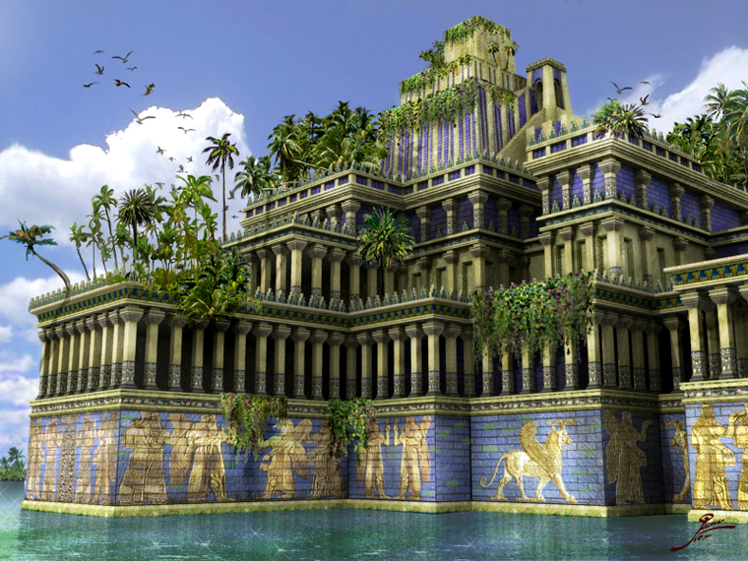
حدائق بابل المعلقة
Notes:
OC-19-Daniel Authorship-26
OS-12-2 Kings-232
OS-14-2 Chron-298

Slide 27
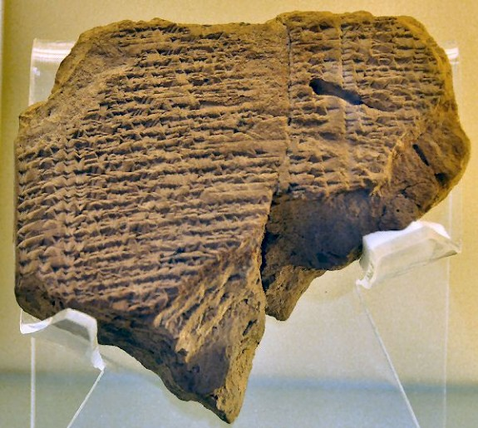
اللطف نحو يهوياكين في السبي
و في السنة السابعة و الثلاثين لسبي يهوياكين ملك يهوذا في الشهر الثاني عشر في السابع و العشرين من الشهر رفع أويل مردوخ ملك بابل في سنة تملكه رأس يهوياكين ملك يهوذا من السجن و كلمه بخير و جعل كرسيه فوق كراسي الملوك الذين معه في بابل و غير ثياب سجنه و كان يأكل دائماً الخبز أمامه كل أيام حياته ووظيفته وظيفة دائمة تعطى له من عند الملك أمر كل يوم بيومه كل أيام حياته
2 ملوك 25: 27-30
لوح المؤن متحف برلين
Chap. 21
Notes:
OC-19-Daniel Authorship-27
OS-12-2 Kings-233
OS-14-2 Chron-298

Slide 28
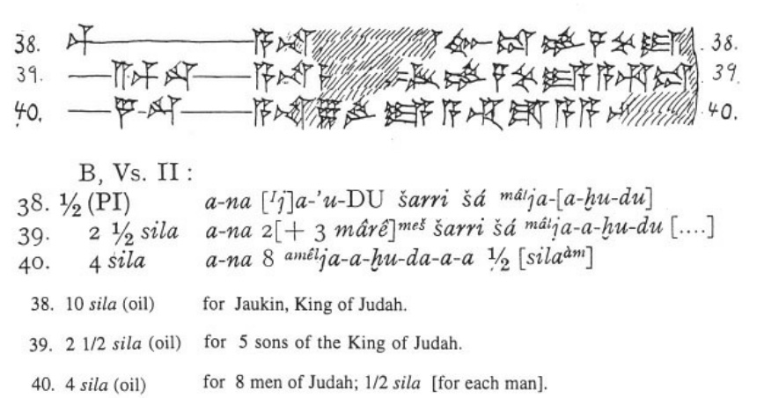
لوح مؤن يهوياكين في السبي
الحفريات
البابلية
1899-1917
38) 10سيلا (زيت) ليهوياكين ملك يهوذا
39) 2 و نصف سيلا (زيت) لخمسة من ابناء ملك يهوذا
40) 4 سيلا (زيت) لثمانية من رجال يهوذا، نص سيلا لكل رجل
Notes:
OC-19-Daniel Authorship-28
OS-12-2 Kings-234
OS-14-2 Chron-299
________
Tablet picture above from:
“Jehoiachin in Babylonia
One of the last kings of Judah, Jehoiachin (r.598-597) was taken captive by the Babylonians (2 Kings 24.15; ABC 5) and lived in exile in the country of the conquerors. However, he was released, and a couple of cuneiform tablets from Babylonia inform us about his fate.
Cuneiform tablet, mentioning Jehoiachin The story of Jehoiachin's release can be found at the end of the Biblical book 2 Kings:
And in the thirty-seventh year of the exile of Jehoiachin king of Judah, in the twelfth month, on the twenty-seventh day of the month, Evil-merodach king of Babylon, in the year that he began to reign, graciously freed Jehoiachin king of Judah from prison; and he spoke kindly to him, and gave him a seat above the seats of the kings who were with him in Babylon. So Jehoiachin put off his prison garments. And every day of his life he dined regularly at the king's table; and for his allowance, a regular allowance was given him by the king, every day a portion, as long as he lived.^{note}
There are several possible dating systems, but the accession year of Amel-Marduk (or Evil-merodach) was 562/561, and this is more or less identical to the thirty-seventh year of the exile of Jehoiachin, which began in 596 (ABC 5 with note); the twenty-seventh day of the thirty-seventh year must be somewhere in the spring of 560. There is a small error, but it is not disastrous. We can be sure that Jehoiachin was released when Amel-Marduk became king, after his father Nebuchadnezzar had died.
Why Amel-Marduk released the former king of Judah is not known, but a recent theory is that as a crown prince, the Babylonian had fallen victim to a court intrigue and had been sent to prison. There, he may have met Jehoiachin.
According to Talmudic traditions, Jehoiachin lived in Nehardea, not far from Sippar, in the north of Babylonia. In general terms, this is confirmed by about thirty-five cuneiform texts referring to a village called âl-Jahûda ("the Judaean town") near Sippar. The prophet Ezekhiel mentions a settlement called Tell Abib near Nippur.
There are several cuneiform texts that illustrate Jehoiachin's position after his release, which were discovered by Robert Koldewey in Babylon and are collectively known as ANET³ 308.^{note} These documents, now in Berlin, are lists of deliveries of food and oil to important people, and prove that the king of Judah (who is called Ia-'-u-kin, Ia-'-kin, and Ia-ku-ú-ki-nu) received substantial rations. Here are the relevant lines:
1
... to Ia-'-u-kin, king ... to the qîpûtu-house of ... ... for Shalamiamu, the ... ... for 126 men from Tyre ... ... for Zabiruam the Ly[dian] ...
2
10 sila of oil to ... [Ia]-'-kin, king of Ia-[a-hu-du] 2½ sila of oil to the [five so]ns of the king of Ia-a-hu-du 4 sila to eight men from Ia-a-hu-da-a-a ...
3
1½ sila for three carpenters from Arvad, ½ sila each 11½ sila for eight ditto from Byblos, 1 sila each ... 3½ sila sila for seven ditto, ½ sila each ½ sila for Nabû-êtir the carpenter 10 sila to Ia-ku-ú-ki-nu, the son of the king of Ia-ku-du 2½ sila for the five sons of the king of Ia-ku-du through Qana'a
Comment
The third list is the most interesting, because it suggests that Jehoiachin had five sons, whereas the Bible says that there were seven::^{note}
The sons of Jehoiachin, the captive: Shealtiel his son, Malchiram, Pedaiah, Shenazzar, Jekamiah, Hoshama, and Nedabiah.
Perhaps two had died, or had not yet come of age. It is also possible that a mistake was made by someone who copied this verse, because the wording is a bit odd and there is a variant reading. The text, as we now have it, suggests that only Shealtiel was Jehoiachin's son, and the other names are in fact without qualification. Perhaps they are descendants of Malchiram, son of Shealtiel, and perhaps we should read:
The sons of Jehoiachin, the captive: Shealtiel his son, Malchiram his son, and Pedaiah, Shenazzar, Jekamiah, Hoshama, Nedabiah, the sons of Malchiram.
Of course, this implies that the five sons of text three are in fact five descendants, which is certainly possible, because the word "son" was frequently used in a very loose sense. This creates another problem, however: why aren't Shealtiel and Malchiram mentioned in text three? Perhaps they had become courtiers of one of the Babylonian kings, but this is just a hypothesis.
A final remark: because Jehoiachin had been king for a mere three months, he could also be described as "the son of the king of Judah" in the third text.
Literature
ANET = James K. Pritchard, Ancient Near Eastern Texts relating to the Old Testament (1969 third edition)
Diana Edelman, The Origins of the 'Second' Temple. Persian Imperial Policy and the Rebuilding of Jerusalem (2005), pp.21-22
Irving Finkel, "The Lament of Nabû-šuma-ukîn" in J. Renger (ed.), Babylon. Focus mesopotamischer Geschichte, Wiege früher Gelehrtsamkeit, Mythos in der Moderne (1999 Saaerbrücken) 323-341
This page was created in 2007; last modified on 12 October 2020.”
https://www.livius.org/articles/person/jehoiachin-in-babylonia/
——————————
White cuneiform image above from K. A. Kitchen:
﻿"From a vaulted building closely adjoining the royal palace proper came a series of cuneiform tablets dated to the tenth to thirty-fifth years of Nebuchadrezzar II (595-570), being “ration tablets” for people kept or employed in Babylon and its palace. Among the beneficiaries in receipt of oil were “Jehoiachin king of Judah” (just once, “king’s son of Judah”) and “the 5 sons of the king of Judah in the care of (their guardian?) Qenaiah” (cf. fig. 10C). Thus the exiled young king and his infant children were already on a regular allowance in Nebuchadrezzar’s time (one tablet is of Year 13, 592), but under the palace equivalent of house arrest."
Kitchen, K. A.. On the Reliability of the Old Testament . Wm. B. Eerdmans Publishing Co.. Kindle Edition. Plate X, Fig 10C
____________

Slide 29
النعمة في السبي
256
يهوياكين (يكنيا/كنيا)
597 (حكم 3 شهور)
شألتئيل
فدايا
يقميا
ندبيا
ملكيرام
شنأصر
هوشاماع
زربابل
1 أخ 3 : 17-19
Notes:
1Chr. 3:16 The successors of Jehoiakim were his son Jehoiachin and his brother Zedekiah.ª
Descendants of Jehoiachin
1Chr. 3:17 The sons of Jehoiachin,ª who was taken prisoner by the Babylonians, were Shealtiel, 18 Malkiram, Pedaiah, Shenazzar, Jekamiah, Hoshama, and Nedabiah.
1Chr. 3:19 The sons of Pedaiah were Zerubbabel and Shimei.
The sons of Zerubbabel were Meshullam and Hananiah. (Their sister was Shelomith.) 20 His five other sons were Hashubah, Ohel, Berekiah, Hasadiah, and Jushab-hesed.
1Chr. 3:21 The sons of Hananiah were Pelatiah and Jeshaiah. Jeshaiah’s son was Rephaiah. Rephaiah’s son was Arnan. Arnan’s son was Obadiah. Obadiah’s son was Shecaniah.
1Chr. 3:22 The descendants of Shecaniah were Shemaiah and his sons, Hattush, Igal, Bariah, Neariah, and Shaphat—six in all.
1Chr. 3:23 The sons of Neariah were Elioenai, Hizkiah, and Azrikam—three in all.
1Chr. 3:24 The sons of Elioenai were Hodaviah, Eliashib, Pelaiah, Akkub, Johanan, Delaiah, and Anani—seven in all.
_____
OC-19-Daniel Authorship-29
OS-12-2 Kings-235
OS-14-2 Chron-299

Slide 30
دانيال في تاريخ العهد القديم
دانيال 605-536 ق.م
المملكة المتحدة
1050-930
المملكة المنقسمة
930-722
المملكة المنعزلة
722-586
ما بعد السبي
536-425
1100
1050
1000
950
900
850
800
750
700
650
600
550
500
450
السبي 586-536

Slide 31
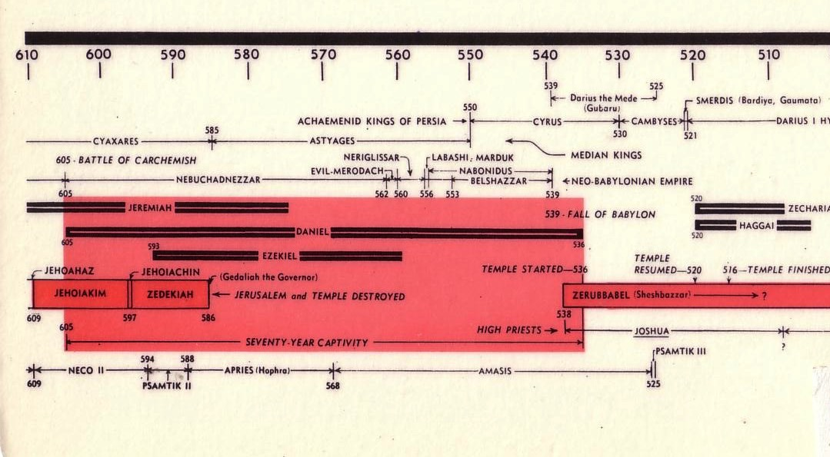
جدول السبي
232و342
السبي البابلي
John C. Whitcomb, 4th rev. ed., Winona Lake, IN: BMH Books, 1962, 1968

Slide 32
جدول السبي
2321و342
السبي البابلي
John C. Whitcomb, 4th rev. ed., Winona Lake, IN: BMH Books, 1962, 1968

Slide 33
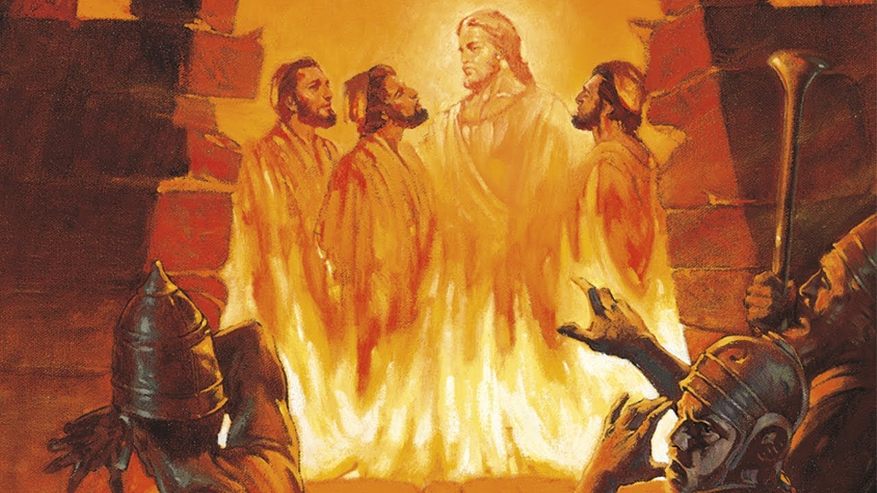
أتون النار

Slide 34
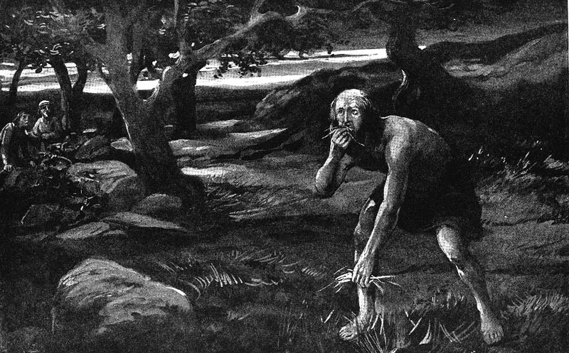
تناول النباتات الإجباري
Notes:
The result was involuntary vegetarianism. Daniel chose vegetarianism in chapter 1, but God gave the king no choice in the matter!

Slide 35
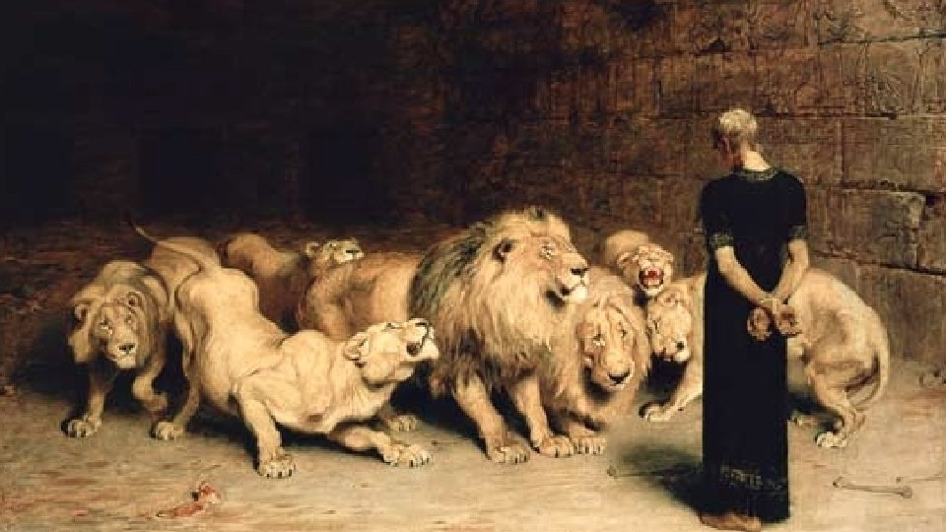
هل هذه مجرد حكايات ؟
إن ملاحظة أن الكتاب يحتوي على العديد من المغالطات التاريخية هي أهم دليل على حقيقة أن الكتاب نشأ في القرن الثاني .
ويتم شرح هذه الأخطاء بمجرد إدراك أن الكاتبة كتبت عن أحداث فترتها الخاصة القرن الثاني
نيل ، "تحليل تاريخي أدبي لدانيال 2: قوتان في المعارضة" ، أكتا ثيولوجيكا 22 (2002): 78 ؛ استشهد بها تانر ، دانيال ، 2

Slide 36
تاريخ دانيال
خدمة دانيال
(1: 1، 10: 1)
605-536
نبوات دانيال
(دا 2-11)
605-70م
أنطيوخس يدنس الهيكل
167-164
600
550
500
450
400
350
300
250
200
150
100
50
قم/بم
50
يرى النقاد أن الأحداث التاريخية سجلت على شكل نبوات
يؤوخ النقاد دانيال بعد عام 164

Slide 37
اعترض البعض على تأليف دانيال بسبب الأخطاء التاريخية المفترضة الموجودة في الكتاب. وقد أكد البعض ، على سبيل المثال ، أن نبوخذ نصر لم يكن والد بيلشاصر ، كما هو مبين في دانيال 5: 2 ، 11 ، 13 ، 18 (را. 22) يجادلون بأنه لو كان دانيال قد كتب السفر لما ارتكب مثل هذا الخطأ
ومع ذلك ، فقد ثبت أن خليفة الملك على العرش كان يُدعى" ابنًا "(5:22) حتى لو لم تكن له علاقة دم بملك سابق
—Pentecost, BKC, 1:1325
Notes:
Some have objected to Daniel’s sixth-century date on the grounds that the book is included in the Writings, the third section of the Hebrew Bible, rather than among the Prophets, the second division. The last prophetic book (Malachi) was written in the fifth century B.C. Those arguing for a late date for Daniel allege that if his book were written in the sixth century, it would have been included in the second division (the Prophets) rather than relegated to the third (the Writings). However, as previously noted, the prophets were set apart by God as His messengers with a special ministry to the nation Israel. Since Daniel was counted by his contemporaries as a governmental leader rather than a prophet, his writings were included in the third division rather than in the second. Thus the status of the author rather than the date of his book determined the division in which his book was included in the Hebrew Bible.
Some critics hold that since God’s name Yahweh is not used by Daniel and since the name was commonly used in Daniel’s day by others, the book must have been written at a later time. However, this objection fails to note that in chapter 9 this name is used eight times (Dan. 9:2, 4, 8, 10, 13-14 [thrice], 20). The name for God an author used in a given passage was determined by his content, not by popular custom.
Some have objected to Daniel’s authorship because of supposed historical errors found in the book. Some have asserted, for instance, that Nebuchadnezzar was not the father of Belshazzar, as indicated in Daniel 5:2, 11, 13, 18 (cf. v. 22). They argue that if Daniel had written the book, he would not have made such an error. However, it has been demonstrated that a royal successor to the throne was called a “son” (5:22) even if he had no blood relationship to an earlier king. (See the chart “Kings of the Neo-Babylonian Empire.”)
Again objection is made to Daniel’s authorship because the writer refers in 1:21 to the time of Daniel’s death. However, 1:21 does not state when Daniel died; it states that he “remained there” (in Babylon) till Cyrus’ first year. Cyrus’ decree liberated the Jews from their exile in Babylon, thus bringing the 70-year Captivity to a near end. Daniel 1:21 is simply pointing out that Daniel lived through the span of the Captivity. The verse does not specify the time of his death. In fact he lived on into at least Cyrus’ third year (10:1).

Slide 38
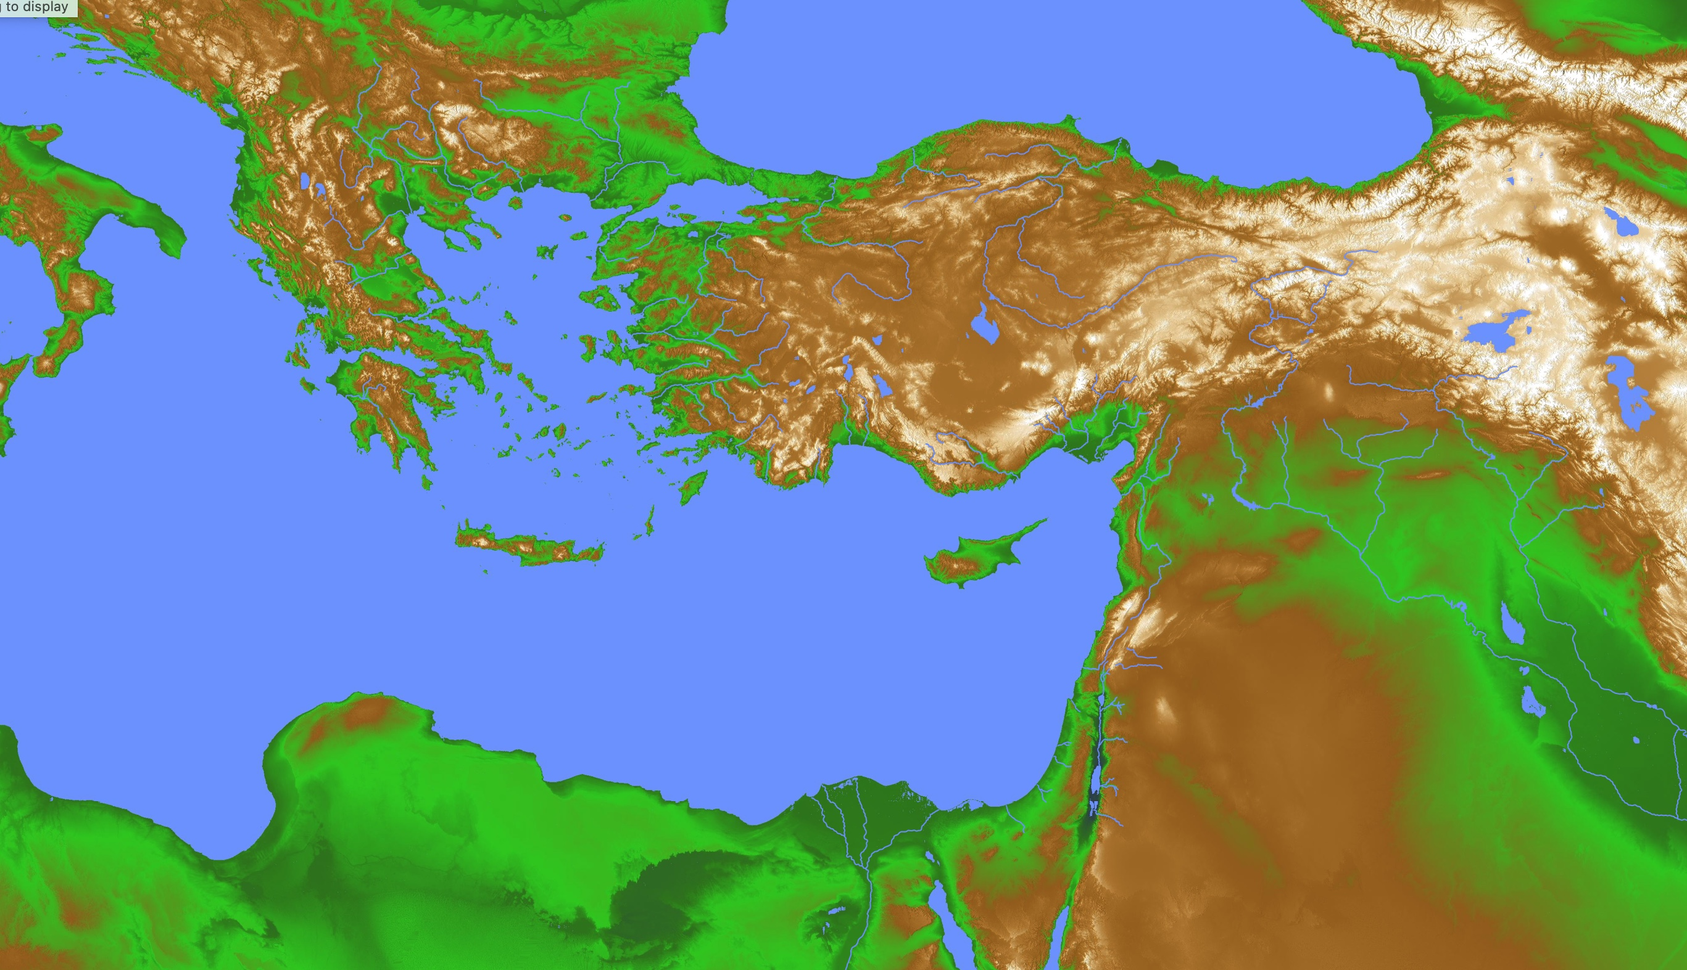
الكلمات اليونانية و الفارسية المستعارة في دانيال
28
اليونان
فارس
و نادى مناد بشدة قد أمرتم أيها الشعوب و الأمم و الألسنة عنتدما تسمعون صوت القرن و الناي و العود و الرباب و السنطير و المزمار و كل أنواع العزف أن تخروا و تسجدوا لتمثال الذهب الذي نصبه نبوخدنصر الملك و من لا يخر و يسجد ففي تلك الساعة يلقى في وسط أتون نار متقدة
(دا 3: 4-6)
كيف نفسر هذه الكلمات اليونانية والفارسية العديدة في عام 600 قبل الميلاد قبل إنشاء الإمبراطوريتين اليونانية والرومانية؟
بابل

Slide 39
الكلمات اليونانية و الفارسية المستعارة في دانيال
28
اليونان
فارس
أثير عدد من الاعتراضات الأخرى على التاريخ المبكر للكتاب. على سبيل المثال ، يجادل البعض بأن العديد من الكلمات الفارسية واليونانية في الكتاب تشير إلى أنه يجب أن يكون قد كتب في وقت متأخر عن القرن السادس قبل الميلاد. كشف النقاب عن وجود تجارة بين اليونان وبابل حتى قبل أيام دانيال ، وهذا يفسر وجود الكلمات اليونانية ، والكلمات الفارسية في الكتاب كانت من شكل رسمي أو أدبي للغة الفارسية التي كانت مستخدمة على نطاق واسع في جميع أنحاء الشرق الأدنى. (راجع دي جي وايزمان وآخرون ، ملاحظات حول بعض المشاكل في كتاب دانيال ، ص 23-7 ، 35-50.)
بابل
بنتيكوست،
ب ك س، 1: 1325
Notes:
Dwight J. Pentecost, "Daniel,” in The Bible Knowledge Commentary; ed. John F. Walvoord and Roy B. Zuck; Accordance electronic ed. 2 vols.; Wheaton: Victor Books, 1985), 1:1325.

Slide 40
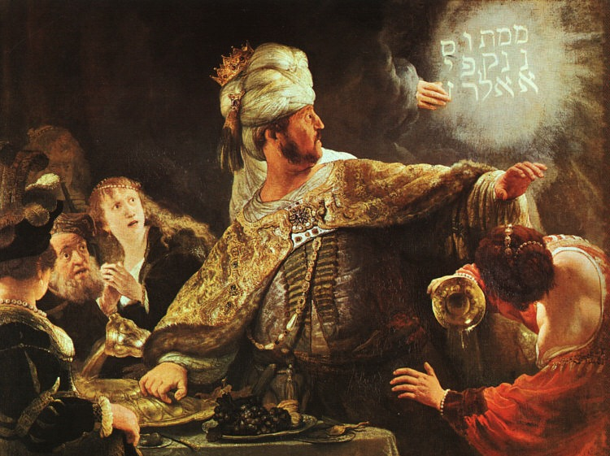
إذلال بيلشاصر
رامبرانت
Notes:
In 539 BC Belshazzar denied God's sovereignty at a huge party by praising false gods while drinking from the temple goblets (5:1-4).
God hid his judgment due to Belshazzar’s pride in an unreadable wall inscription that the wise men could not decipher (5:5-9).
God helped Daniel interpret the inscription as his judgment on Belshazzar’s pride and wisdom for the humble (5:10-28).

Slide 41
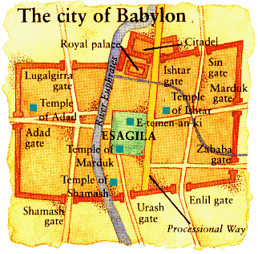
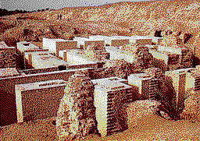
سقوط بابل 539 ق.م
510أ
دخل الفرس تحت بوابات الماء
مدينة بابل
دانيال 5
(احتفال بيلشاصر)
Notes:
"Babylon was being besieged by the Persian army, led by Ugbaru, governor of Gutium, while Belshazzar, inside the city, was giving a great banquet for 1,000 of his nobles. Belshazzar's name means "Bel (another name for the god Marduk) has protected the king." Perhaps the banquet was given to show Belshazzar's contempt for the Persians and to allay his people's fears. Archeologists have excavated a large hall in Babylon 55 feet wide and 165 feet long that had plastered walls. Such a room would have been sufficient to house a gathering of this size. Belshazzar considered his city secure from assault because of its massive walls. Within the city were supplies that would sustain it for 20 years. Therefore the king felt he had little cause for concern."
Dwight Pentecost, “Daniel,” eds. John F. Walvoord, Roy B. Zuck and Dallas Theological Seminary, The Bible Knowledge Commentary : An Exposition of the Scriptures (Wheaton, IL: Victor Books, 1983-1985), 1:1344.

Slide 42
سقوط بابل (هيرودوت)
544ب
تاريخ حروب الفرس 1.191 (430 ق.م)
وضع كورش جزءًا من جيشه عند النقطة التي يدخل فيها النهر إلى المدينة، وجزءًا آخر في الجزء الخلفي من المكان الذي ينبع منه، مع أوامر بالزحف إلى المدينة عند مجرى النهر، في أقرب وقت لأن المياه أصبحت ضحلة بدرجة كافية
ثم انطلق بنفسه مع الجزء غير الحربي من مضيفه ، وصنع المكان الذي حفرت فيه نيتوكريس حوض النهر ، حيث فعل بالضبط ما فعله سابقًا: حول نهر الفرات عبر قناة إلى الحوض ، والذي كان ثم مستنقع غرق فيه النهر لدرجة أن السرير الطبيعي للجدول أصبح قابلاً للبقاء
عندئذٍ ، دخل الفرس الذين تُركوا لهذا الغرض في بابل على ضفة النهر ، المجرى الذي غرق الآن حتى وصلوا في منتصف الطريق تقريبًا فوق فخذ الرجل ، وبالتالي دخلوا المدينة

Slide 43
سقوط بابل (هيرودوت)
544ب
لو كان البابليون على علم بما كان يدور لدى كورش ، أو لو لاحظوا خطرهم ، لما سمحوا للفرس بدخول المدينة ، لكنهم كانوا سيدمرونهم تمامًا ؛ لأنهم كانوا سيغلقون جميع بوابات الشوارع التي على النهر ، ويركبوا على الجدران على جانبي النهر ، مما كان من شأنه أن يوقع العدو في فخ. ولكن ، كما كان ، جاء الفرس عليهم على حين غرة وأخذوا المدينة . بسبب الحجم الهائل للمكان ، فإن سكان الأجزاء المركزية (كما أعلن سكان بابل) بعد فترة طويلة من أخذ الأجزاء الخارجية من المدينة ، لم يعرفوا شيئًا عما حدث ، لكنهم كانوا يشاركون في مهرجان ، استمروا في الرقص والاستمتاع حتى علموا بالقبض على بابل
تاريخ حروب الفرس 1.191 (430 ق.م)

Slide 44
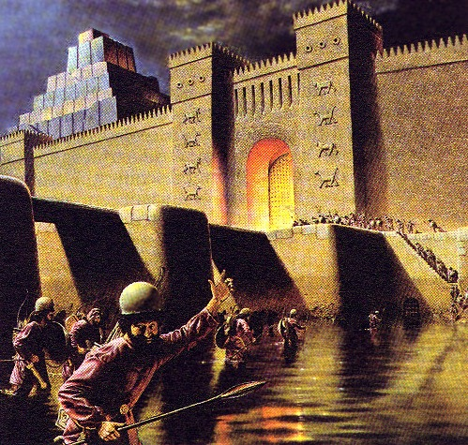
في تلك الليلة قتل بيلشاصر ملك الكلدانيين فأخذ المملكة داريوس المادي و هو ابن اثنتين و ستين سنة
(دا 5: 30-31)

Slide 45
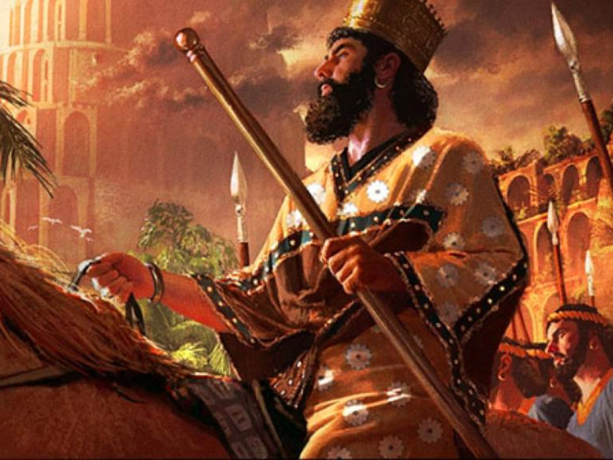
كورش يحتل بابل
539 ق.م
Notes:
Daniel was promoted to Babylon’s third position to show God's pleasure with those who accept his sovereignty (5:29).
Belshazzar lost his kingdom that night to Darius the Mede [in the reign of Cyrus the Persian, 6:28] for denying God's rule (5:30).

Slide 46
يشكك النقاد بشكل خاص في رؤى دانيال 7-12 (تم رفض نهاية العالم عام 600 ق.م)
ما هو ردك ؟

Slide 47
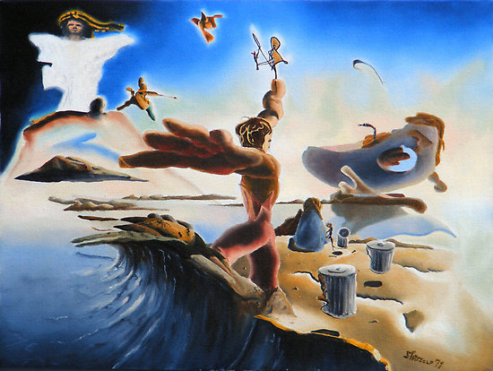
سفر الرؤيا هو السفر الوحيد الرؤيوي في العهد الجديد
ألا يعتبر سفر دانيال مبكراً بالنسبة للكتابة الرؤيوية ؟
الأوقات الأخيرة
ص 322 النقطة د
تحذيرات
(ليس توبة)
تشاؤم
انتصار الله
السرية
الحتمية

Slide 48
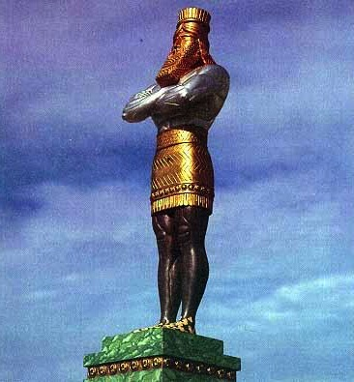
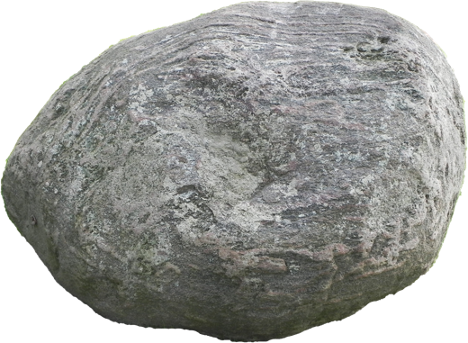
تمثال دانيال 2 هو أمر رؤيوي أيضاً
ذهب
بابل
فضة
فارس
نحاس
اليونان
حديد
روما
حديد و خوف
ضد المسيح
حجر
الملكوت
Notes:
\While Babylon was depicted by gold, even Babylon would fall to Christ’s kingdom!

Slide 49
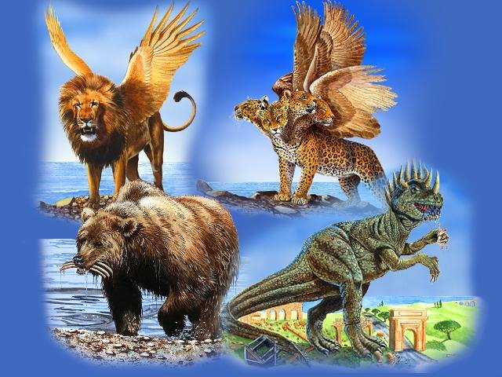
الأمم في دانيال 7
بابل
اليونان
روما
مادي و فارس

Slide 50
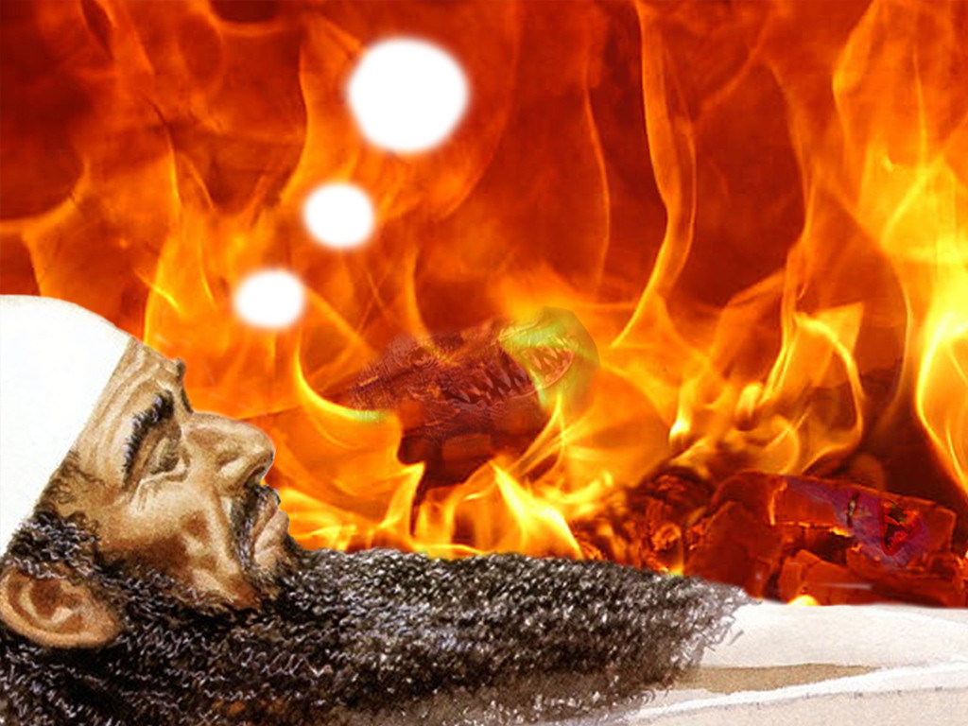
كيف يمكن قبول تنبؤات دانيال 2 للدول الأربع المستقبلية ولكن الشك في نفس الشيء في دانيال 7؟

Slide 51
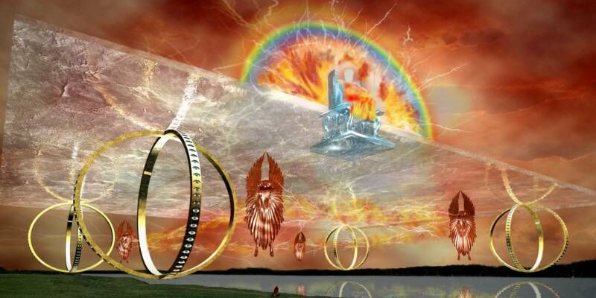
حزقيال 1
رؤيا نهاية العالم الأخرى في زمن دانيال
Notes:
Before Jerusalem’s fall, Ezekiel sees a vision of God’s glory to show his sovereignty and holiness as the basis for the book (Ezek 1).
“A further objection is based on the apocalyptic literature found in the book. Such literature appeared prolifically in Israel in the later time of the Maccabees (literature that is not part of the biblical canon); therefore many scholars infer that the book must have been written in that period (168-134 B.C.). However, as already noted (see “Literary Form”), apocalyptic literature is found in the Book of Ezekiel and he, like Daniel, was a sixth-century prophet.”
Dwight J. Pentecost, "Daniel,” in The Bible Knowledge Commentary; ed. John F. Walvoord and Roy B. Zuck; Accordance electronic ed. 2 vols.; Wheaton: Victor Books, 1985), 1:1325.
_____
Picture from http://ldsscriptureteachings.org/2012/05/02/ezekiels-vision-ezekiel-1-3/

Slide 52
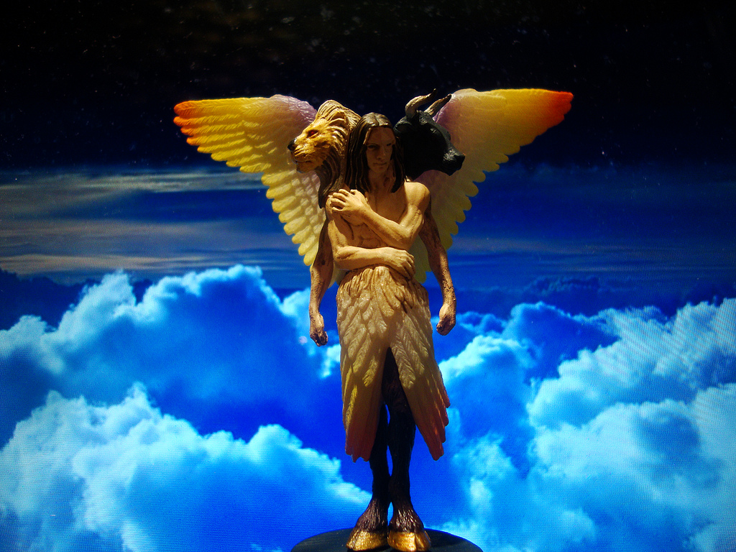
مخلوقات بأربع وجوه (حزقيال 1: 11)
367
فهذه أوجهها أما أجنحتها فمبسوطة من فوق لكل واحد اثنان متصلان أحدهما بأخيه و اثنان يغطيان أجسامها
Notes:
"I believe that these special creatures symbolize God's creation and are related to God's covenant with Noah (Gen. 9:8–17). The faces of the living creatures parallel God's statement in Genesis 9:10—His covenant is with Noah (the face of the man), the fowl (the face of the eagle), the cattle (the face of the calf), and the beasts of the earth (the face of the lion)" (Wiersbe on Revelation 4:7).

Slide 53
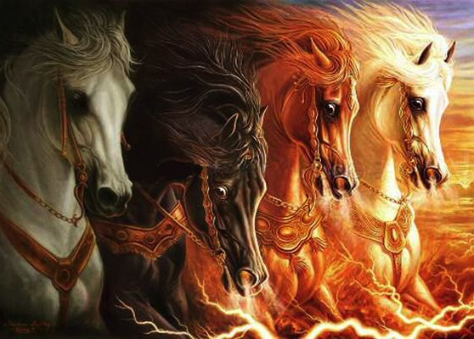
يتوسع زكريا 1: 8 في رؤيا 6: 1-4

Slide 54
اعترض البعض على تاريخ دانيال في القرن السادس على أساس أن الكتاب مدرج في الكتابات و هو القسم الثالث من الكتاب المقدس العبري وليس بين الأنبياء أي القسم الثاني . وكتب آخر سفر نبوي (ملاخي) في القرن الخامس قبل الميلاد يزعم أولئك الذين يجادلون حول تأريخ متأخر لدانيال أنه إذا كتب كتابه في القرن السادس ، لكان قد تم إدراجه في القسم الثاني (الأنبياء) بدلاً من أن ينزل إلى القسم الثالث (الكتابات)
ما هو ردك ؟
بنتيكوست، ب ك س، 1: 1325
Notes:
Some have objected to Daniel’s sixth-century date on the grounds that the book is included in the Writings, the third section of the Hebrew Bible, rather than among the Prophets, the second division. The last prophetic book (Malachi) was written in the fifth century B.C. Those arguing for a late date for Daniel allege that if his book were written in the sixth century, it would have been included in the second division (the Prophets) rather than relegated to the third (the Writings). However, as previously noted, the prophets were set apart by God as His messengers with a special ministry to the nation Israel. Since Daniel was counted by his contemporaries as a governmental leader rather than a prophet, his writings were included in the third division rather than in the second. Thus the status of the author rather than the date of his book determined the division in which his book was included in the Hebrew Bible.
Some critics hold that since God’s name Yahweh is not used by Daniel and since the name was commonly used in Daniel’s day by others, the book must have been written at a later time. However, this objection fails to note that in chapter 9 this name is used eight times (Dan. 9:2, 4, 8, 10, 13-14 [thrice], 20). The name for God an author used in a given passage was determined by his content, not by popular custom.
Some have objected to Daniel’s authorship because of supposed historical errors found in the book. Some have asserted, for instance, that Nebuchadnezzar was not the father of Belshazzar, as indicated in Daniel 5:2, 11, 13, 18 (cf. v. 22). They argue that if Daniel had written the book, he would not have made such an error. However, it has been demonstrated that a royal successor to the throne was called a “son” (5:22) even if he had no blood relationship to an earlier king. (See the chart “Kings of the Neo-Babylonian Empire.”)
Again objection is made to Daniel’s authorship because the writer refers in 1:21 to the time of Daniel’s death. However, 1:21 does not state when Daniel died; it states that he “remained there” (in Babylon) till Cyrus’ first year. Cyrus’ decree liberated the Jews from their exile in Babylon, thus bringing the 70-year Captivity to a near end. Daniel 1:21 is simply pointing out that Daniel lived through the span of the Captivity. The verse does not specify the time of his death. In fact he lived on into at least Cyrus’ third year (10:1).

Slide 55
ومع ذلك وكما لوحظ سابقًا فقد خصص الله الأنبياء كرسل له مع خدمة خاصة للأمة إسرائيل . نظرًا لأن دانيال كان يحسبه معاصروه كزعيم حكومي وليس نبيًا فقد تم تضمين كتاباته في القسم الثالث وليس في الثاني . وهكذا فإن مكانة المؤلف وليس تاريخ كتابه هي التي حددت التقسيم الذي أُدرج فيه كتابه في الكتاب المقدس العبري
بنتيكوست، ب ك س، 1: 1325
Notes:
Some have objected to Daniel’s sixth-century date on the grounds that the book is included in the Writings, the third section of the Hebrew Bible, rather than among the Prophets, the second division. The last prophetic book (Malachi) was written in the fifth century B.C. Those arguing for a late date for Daniel allege that if his book were written in the sixth century, it would have been included in the second division (the Prophets) rather than relegated to the third (the Writings). However, as previously noted, the prophets were set apart by God as His messengers with a special ministry to the nation Israel. Since Daniel was counted by his contemporaries as a governmental leader rather than a prophet, his writings were included in the third division rather than in the second. Thus the status of the author rather than the date of his book determined the division in which his book was included in the Hebrew Bible.
Some critics hold that since God’s name Yahweh is not used by Daniel and since the name was commonly used in Daniel’s day by others, the book must have been written at a later time. However, this objection fails to note that in chapter 9 this name is used eight times (Dan. 9:2, 4, 8, 10, 13-14 [thrice], 20). The name for God an author used in a given passage was determined by his content, not by popular custom.
Some have objected to Daniel’s authorship because of supposed historical errors found in the book. Some have asserted, for instance, that Nebuchadnezzar was not the father of Belshazzar, as indicated in Daniel 5:2, 11, 13, 18 (cf. v. 22). They argue that if Daniel had written the book, he would not have made such an error. However, it has been demonstrated that a royal successor to the throne was called a “son” (5:22) even if he had no blood relationship to an earlier king. (See the chart “Kings of the Neo-Babylonian Empire.”)
Again objection is made to Daniel’s authorship because the writer refers in 1:21 to the time of Daniel’s death. However, 1:21 does not state when Daniel died; it states that he “remained there” (in Babylon) till Cyrus’ first year. Cyrus’ decree liberated the Jews from their exile in Babylon, thus bringing the 70-year Captivity to a near end. Daniel 1:21 is simply pointing out that Daniel lived through the span of the Captivity. The verse does not specify the time of his death. In fact he lived on into at least Cyrus’ third year (10:1).

Slide 56
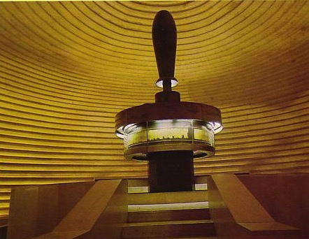
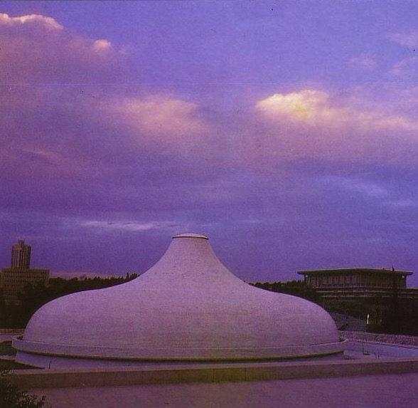
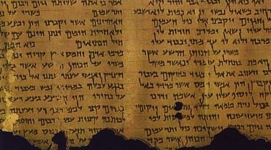
ضريح الكتاب
أهمية مخطوطات البحر الميت
534
نهطوطات البحر الميت تثبت صحة التأريخ المحافظ لأسفار العهد القديم
متى كتب دانيال ؟
المحافظون
560 ق.م
نسخة دانيال من مخطوطات البحر الميت
200-100 ق.م
المتحررون
164 ق.م
Notes:
“The fact that manuscript fragments from the Book of Daniel were found in Qumran, written perhaps in the second century B.C., preclude the notion that Daniel was written in 165 B.C., as many critics suggest. Not enough time would have been available for the book to have reached the Essene community in Qumran and for it to have been copied there.”
Dwight J. Pentecost, Daniel (The Bible Knowledge Commentary; ed. John F. Walvoord and Roy B. Zuck; Accordance electronic ed. 2 vols.; Wheaton: Victor Books, 1985), 1:1324.

Slide 57
لكن هل كان من الممكن أن يكون لدانيال لاهوت متقدم عن الملائكة والقيامة؟
حجة أخرى للناقدين
Notes:
Further objection is made to an early date because of the advanced theology in the book. Critics claim that frequent references to angels and a reference to the resurrection of the dead (12:2) necessitates a late postexilic date for the book. This, however, overlooks the fact that angels are frequently referred to throughout Israel’s long history and that resurrection is mentioned in passages such as Psalm 16:10 and Isaiah 26:19, which certainly predate the time of Daniel”
Dwight J. Pentecost, "Daniel,” in The Bible Knowledge Commentary; ed. John F. Walvoord and Roy B. Zuck; Accordance electronic ed. 2 vols.; Wheaton: Victor Books, 1985), 1:1325.

Slide 58
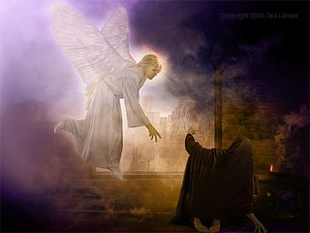
قيام ميخائيل (دا 12: 1)
Notes:
These prophecies will bless Israel in the Tribulation and reveal judgment for unbelievers to encourage Israel with God's rule (12:4-14).

Slide 59
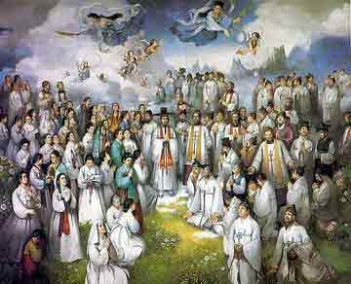
دينونة قديسي العهد القديم
ف ي 160
1 و في ذلك اليوم يقوم ميخائيل الرئيس العظيم القائم لبني شعبك و يكون زمان ضيق لم يكن منذ كانت أمة إلى ذلك الوقت و في ذلك الوقت ينجى شعبك كل من يوجد مكتوباً في السفر 2 و كثيرون من الراقدين في تراب الأرض يستيقظون هؤلاء غلى الحياة الأبدية و هؤلاء غلى العار للإزدراء الأبدي 3 و الفاهمون يضيئون كضياء الجلد و الذين ردوا كثيرين إلى البر كالكواكب إلى أبد الدهور
(دا 12: 1-3)
Notes:
____________
OS-Daniel
FU-Resurrections

Slide 60
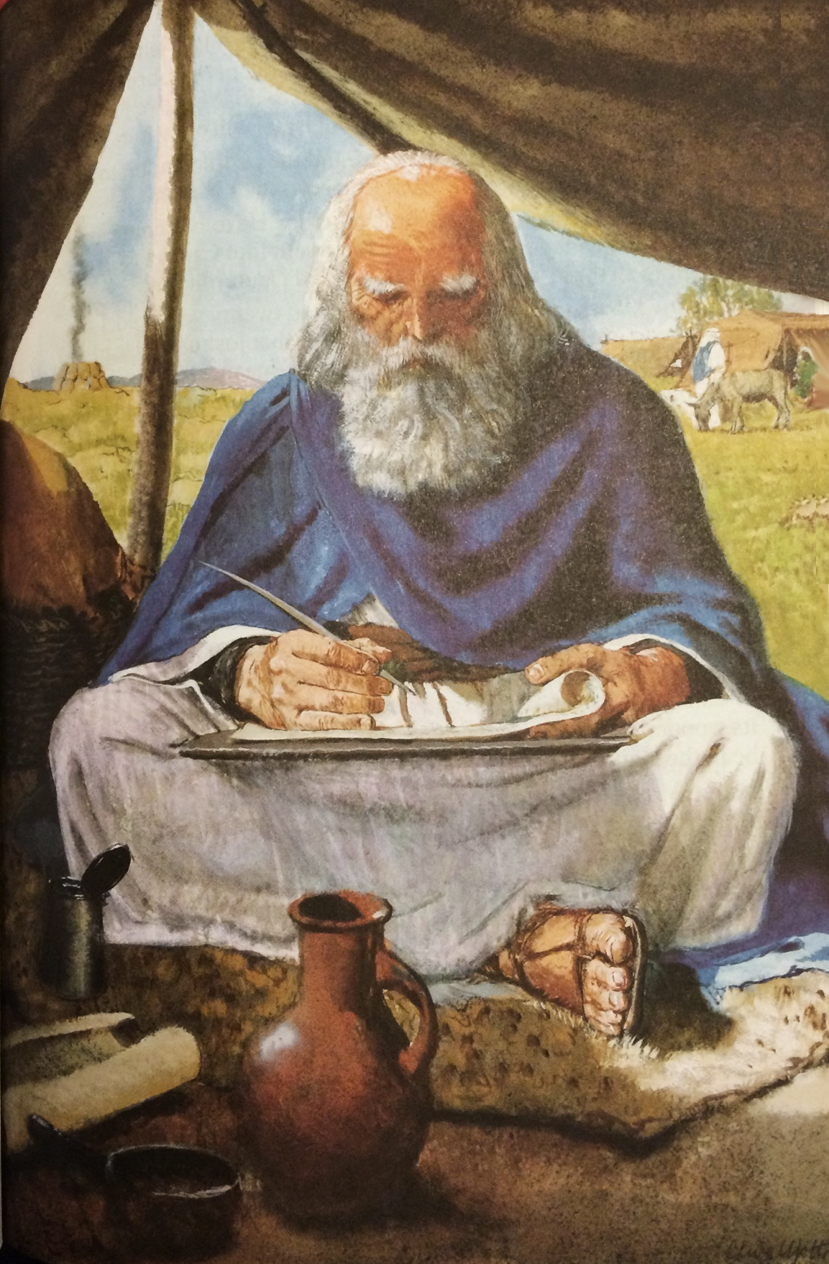
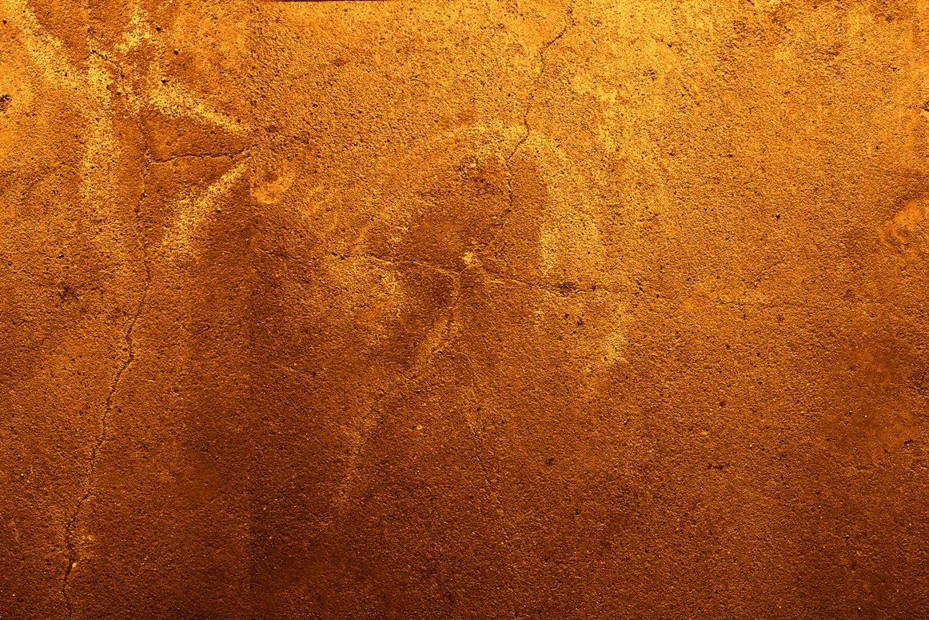
تحيا أمواتك تقوم الجثث استيقظوا ترنموا يا سكان التراب لأن طلك طل أعشاب و الأرض تسقط الأخيلة
اشعياء 26: 19

Slide 61
لأنك لن تترك نفسي في الهاوية لن تدع تقيك يرى فساداً (مز 16: 10)
لاحظ بطرس هذا كنبوة مستقبلية عن قيامة المسيح (أعمال الرسل 2)
Notes:
OC-19-Daniel Authorship-57
OS-19-Psalms-263

Slide 62
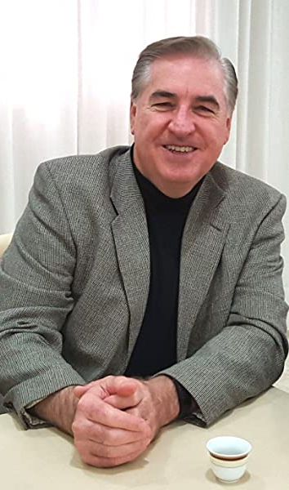
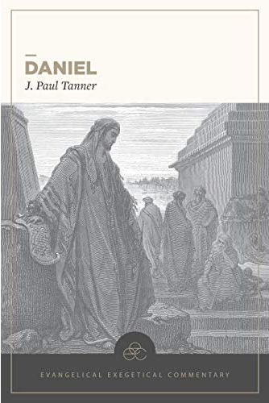
ج. بول تانر
و أخيراً
تفسير إنجيلي كبير عن سفر دانيال
دانيال ، التعليق التفسيري الإنجيلي (بيلينجهام ، واشنطن: مطبعة ليكشام ، 2020)

Slide 63
خلاصة
هل لديم أية شكوك أن دانيال كتب السفر الذي يحمل اسمه ؟

Slide 64
Black

Slide 65
دراسات نقدية في العهد القديم at BibleStudyDownloads.org
أحصل على العرض التقديمي و النص مجاناً

