Slide 1
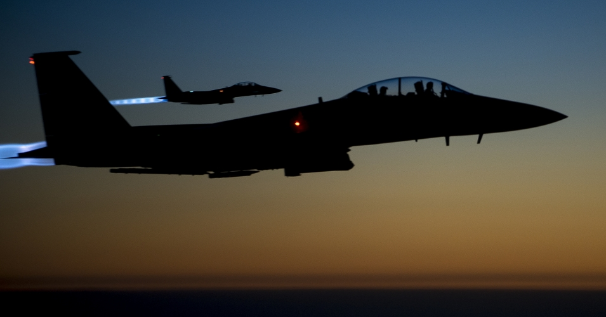
٢ تيموثاوس
صوت
عقيدة
ضد
مقاومة
د. ريك غريفيث. مؤسسة الدراسات اللاهوتية الأردنية • BibleStudyDownloads.org

Slide 2
الكلمة المفتاحية
237
العقيدة
٢ تيموثاوس

Slide 3
الموضوع
23
صوت العقيدة ضد المقاومة
٢ تيموثاوس

Slide 4
الآيات المفتاحية
237
16 كل الكتاب هو موحى به من الله، ونافع للتعليم والتوبيخ، للتقويم والتأديب الذي في البر 17 لكي يكون إنسان الله كاملاً متأهباً لكل عمل صالح ... اكرز بالكلمة
( 3: 16- 17؛ 4: 2)
٢ تيموثاوس

Slide 5
237
البيان الموجز
المثابرة ضد الإرتداد رغم المشقة، بالوعظ بالكلمة بكل أمانة.
٢ تيموثاوس

Slide 6

بيان الملكوت
237
27د
237
إن الإشارة بظهوره وملكوته (4: 1) تربط عودة المسيح بحكمه الألفي بينما يوصلني إلى ملكوته السماوي (4: 18) تظهر طبيعته الأبدية.
٢ تيموثاوس

Slide 7

العهد
27د
بولس رسول يسوع المسيح بمشيئة الله لأجل وعد الحياة التي في يسوع المسيح.
( 1: 1)
٢ تيموثاوس

Slide 8

الفداء
27د
الكتب المقدسة تجعلنا حكماء من أجل الخلاص من خلال الإيمان الذي بيسوع المسيح.
( 3: 15؛ 2: 10)
٢ تيموثاوس

Slide 9
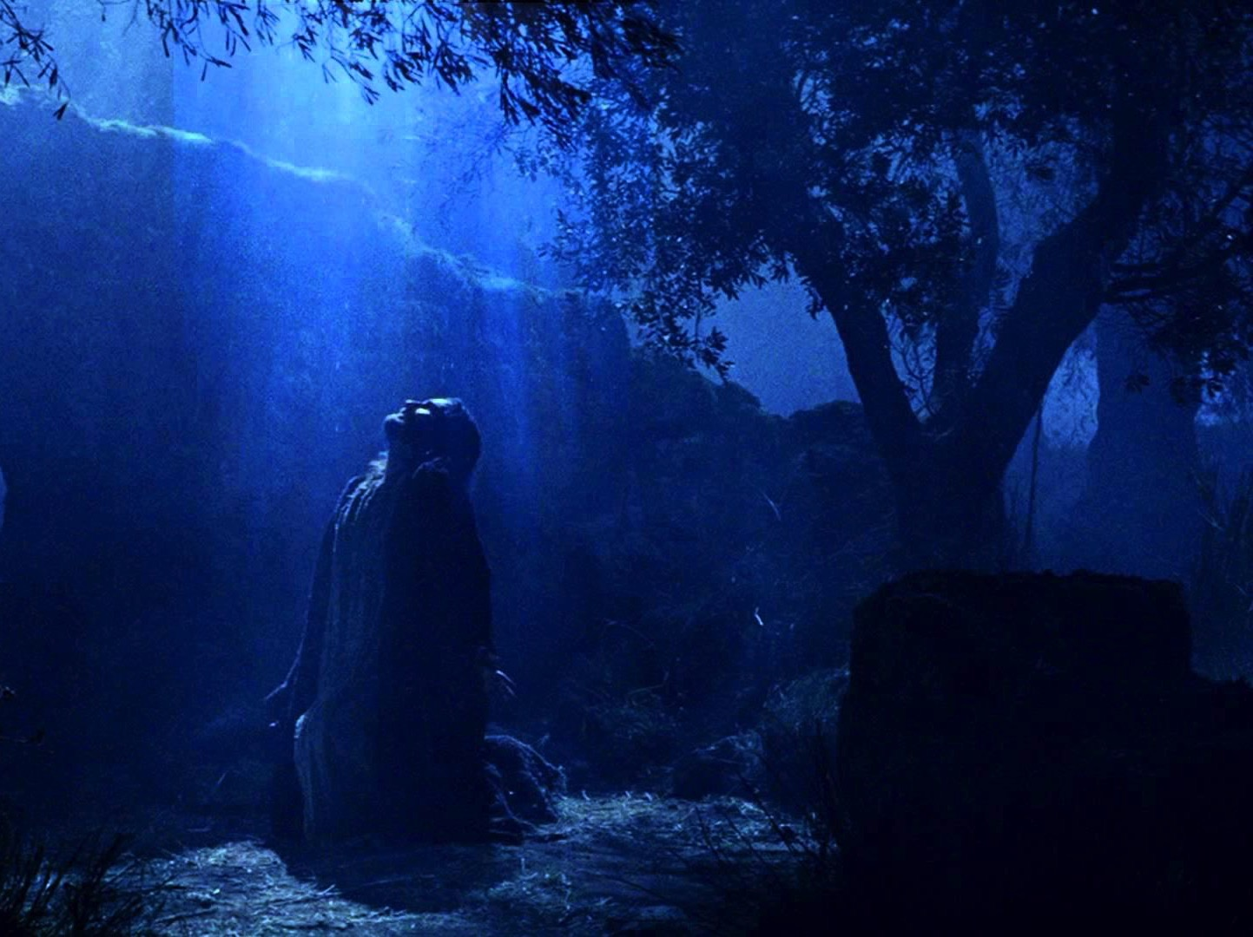
النبوة
(الرب ، الأله )
27 د
يسوع يدعى الرب 16 مرة فقط في أربعة اصحاحات قصيرة مثل ( 1: 8؛ 2: 19؛ 4: 8)، والتي تجعل هناك منطق عندما كان بولس على وشك الموت من أجل إعلان ألوهية يسوع.
٢ تيموثاوس

Slide 10
٢ تيموثاوس
الخطوط العريضة
237
صوت العقيدة ضد المقاومة
الثبات في التجارب الحاضرة |  | الثبات في التجارب المستقبلية
الإصحاحات 1 - 2 |  | الإصحاحات 3 - 4
أمثلة على الأمانة 1 | مميزات الأمانة 2 | المشكلة : الإرتداد 3: 1 - 9 | الحل : اكرز بالكلمة 3: 10- 4: 5 | أمل بولس 4: 6- 22
أفنيكي لوئيس بولس أونيسيفورس | التلمذة فكر واحد مطيع مجتهد كتابي مقدس وديع | عدم التقوى النفاق والرياء | الوعظ الثبات التوبيخ التشجيع الكرازة | استشهاد خيانات تحيات مباركة
روما إلى أفسس
خريف 67 ب. م ( السجن الروماني الثاني )

Slide 11
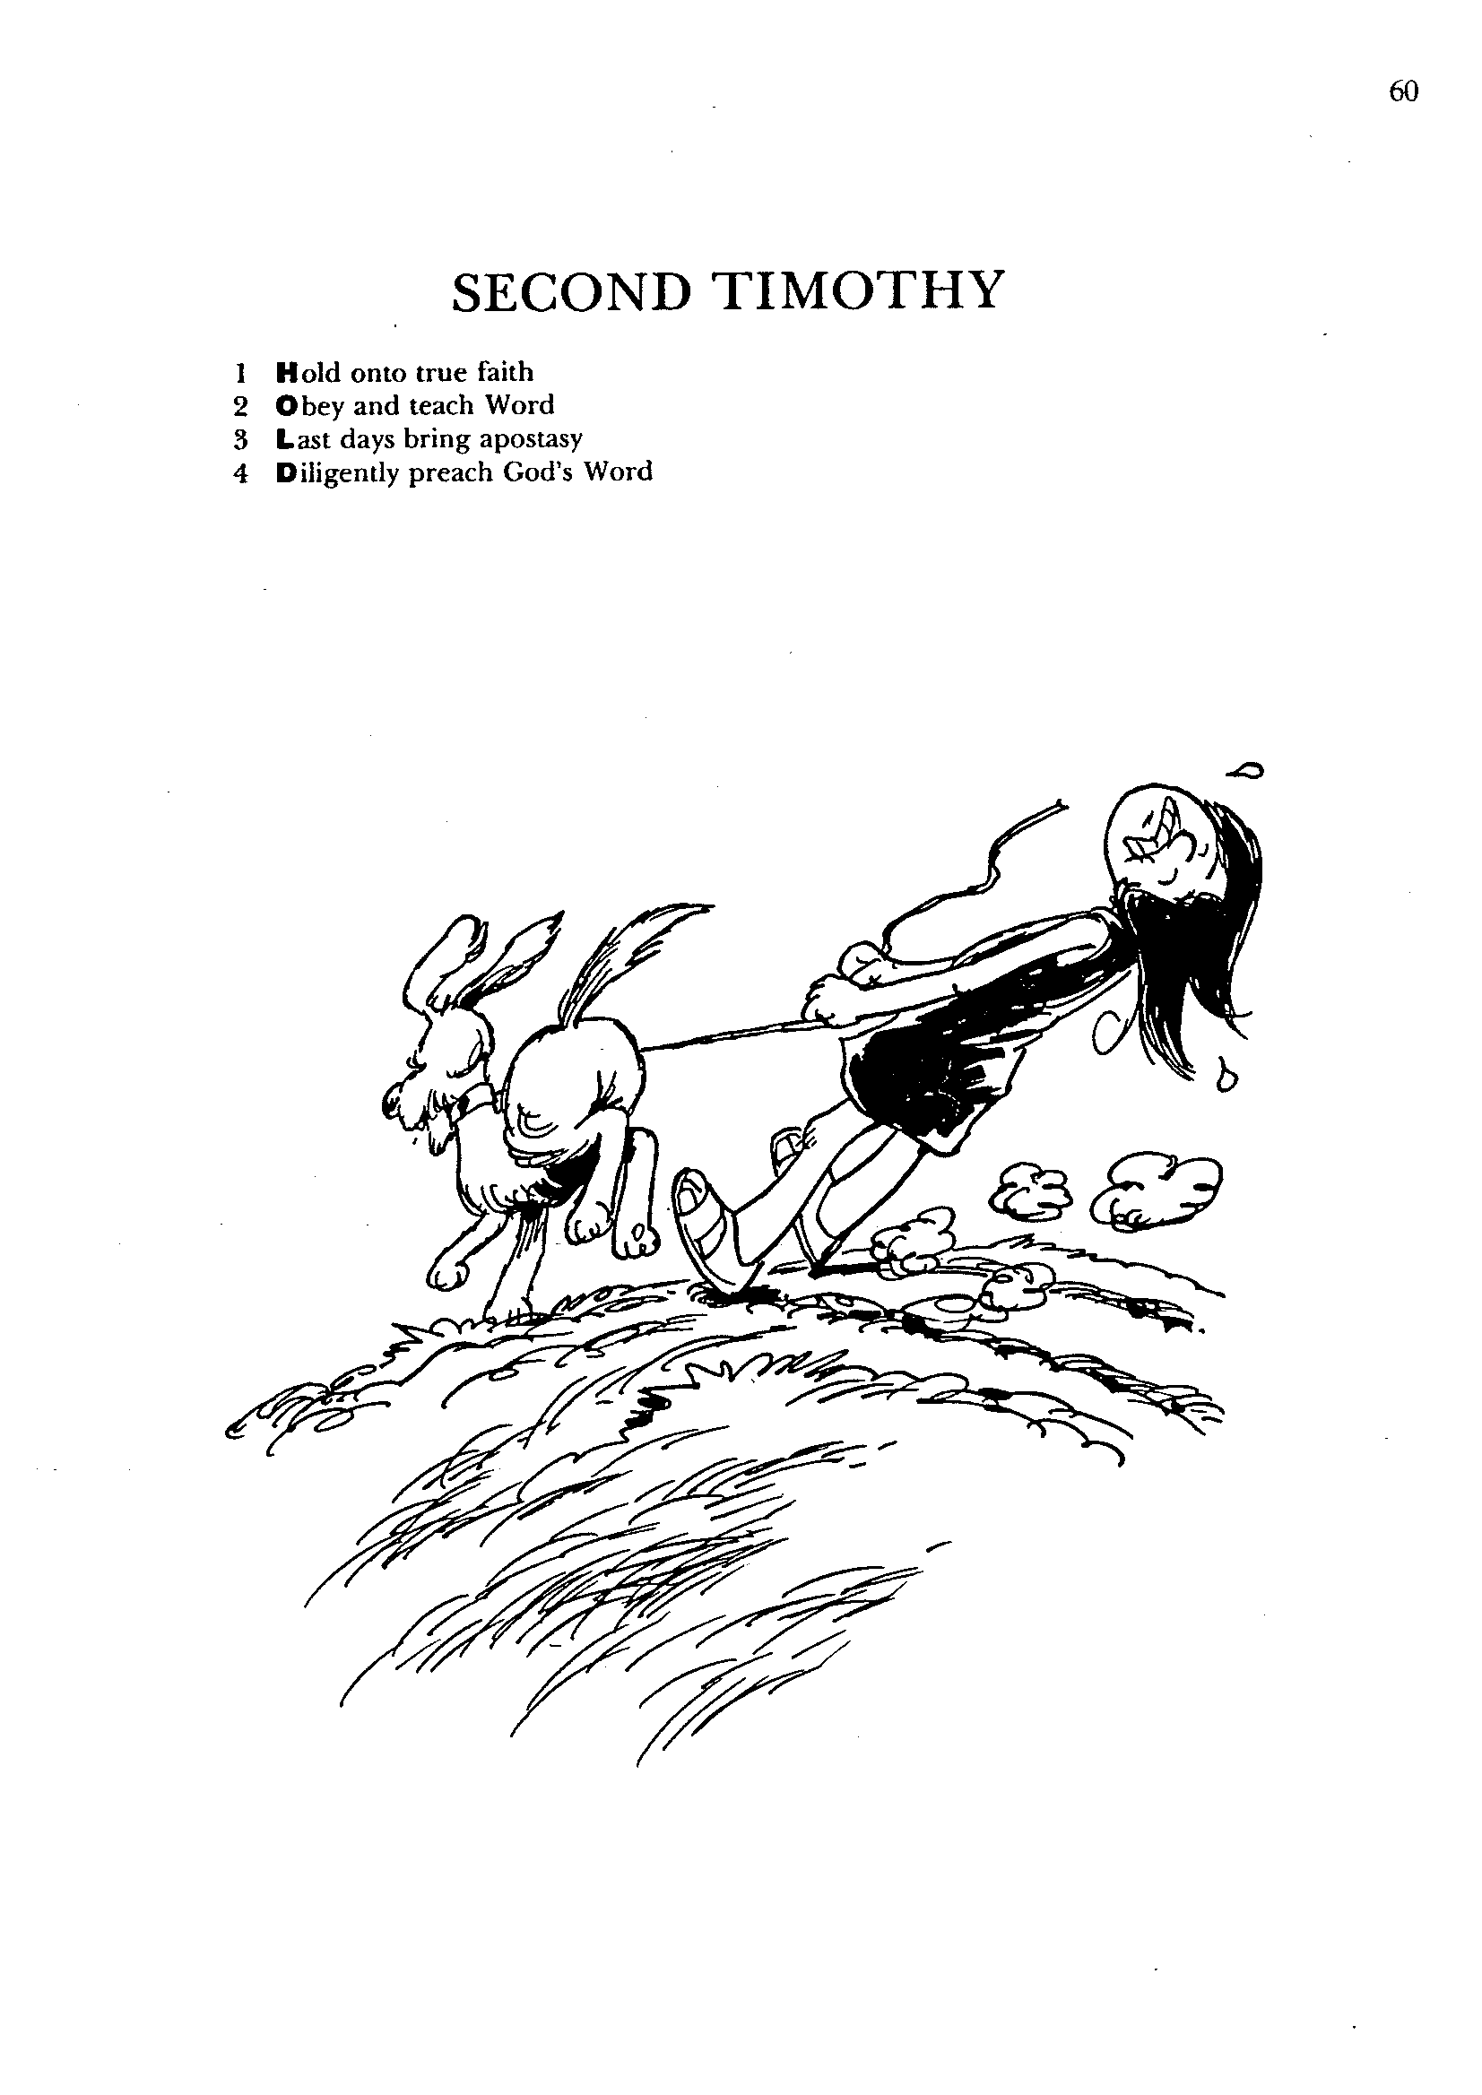
٢ تيموثاوس
1- تمسك بالإيمان الصحيح
2- أطع وعلِّم الكلمة
3- الأيام الأخيرة تجلب الإرتداد
4- عظ كلمة الله بجدية
باري هدلستون، الكتاب المقدس الأبجدي

Slide 12
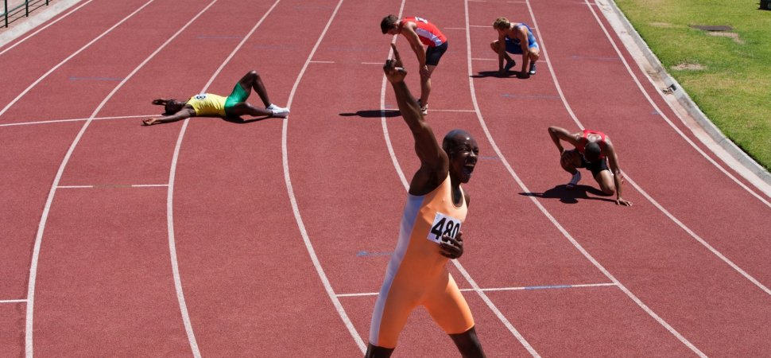
كن مثابراً
٢ تيموثاوس
د. ريك جريفيث • مؤسسة الدراسات اللاهوتية الأردنية
BibleStudyDownloads.org

Slide 13

الإرتداد
التراجع من خلال الرفض
٢ تيموثاوس
Notes:
This is called “apostasy.” It literally means a turning away by rejecting.
Sometimes this means that the person no longer claims to be a Christian—but in other cases, the person still claims the name of Jesus (professes Christ) but has turned away from a key doctrine of the faith.

Slide 14

كيف يمكنك أن تثابر وسط الإرتداد؟
٢ تيموثاوس
Notes:
Will you be walking with Jesus ten years from now?
What should you do now to make sure you are faithful then?
What can you do now to make sure you are following the Lord faithfully in the future?

Slide 15
نظرة عامة على العهد الجديد (رسائل بولس)
38
124
39-41
إلى أقصى الأرض (أع 1: 8)
أع 9 13 14 15 16 18 21 27 28
نيسان 48-
أيلول 49
1
غلاطية
نيسان 50-
أيلول 52
2
بحر إيجة
ربيع 53-
ايار 57
3
أسيا
شباط 60 –
آذار 62
1
روما
ربيع 62 -
خريف 67
4
إسبانيا
خريف 67 –
ربيع 68
2
روما
أيار 57
آب 59
المحاكمات
صيف 35-37
دمشق
أنطاكية
خريف 49
المجمع
ربيع 68
توسع
الكنيسة
35 48 49 50 52 53 57 60 62 67 68 95
مت
لو
أع
مر
يو
غل
1 تس
1 كو
أف
1 تي
2 تي
2 تس
2 كو
كو
تي
الإرسالية
رو
في
الرعوية
فيل
الأناجيل والأعمال
1 2 3 4
الرحلات
السجن
الرسائل البولسية
روما
السجون
التصنيفات البولسية
Notes:
_________
NS-00-NT Introduction-96
NS-03-Luke1-12-slide 65

Slide 16

كيف تبقى هناك
بأمانة؟
أطع
كلمة
الله
عظ
كلمة
الله
و
٢ تيموثاوس
1-2
٢ تيموثاوس
3-4
Notes:
Consistently follow what God says (1-2)
Consistently tell others what God says (3-4)

Slide 17
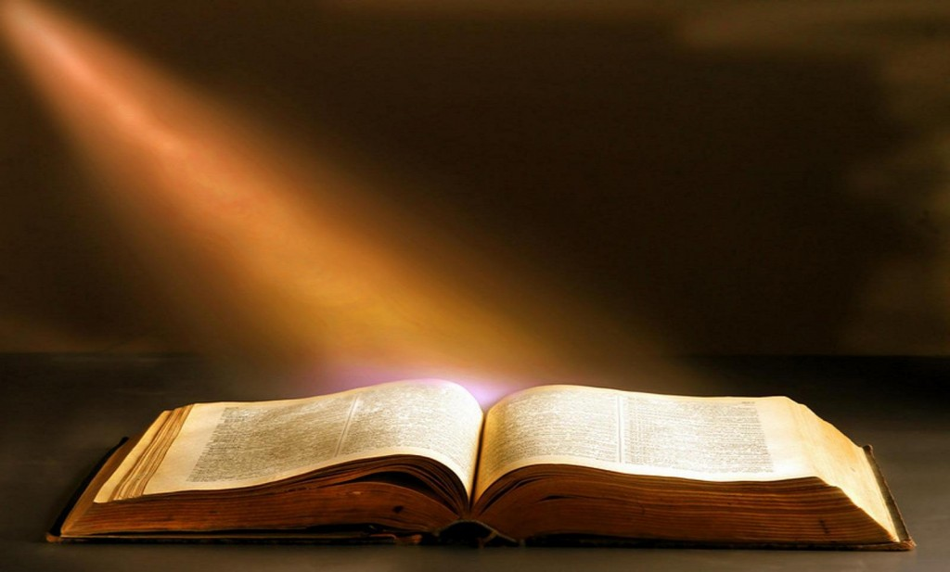
الفكرة الرئيسية
أطع وعظ كلمة الله بأمانة
٢ تيموثاوس

Slide 18
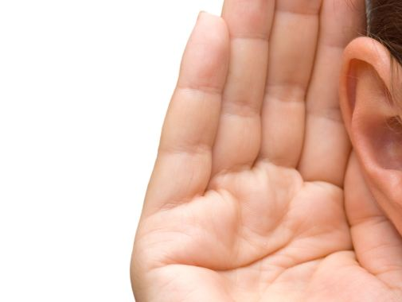
3 لأنه سيكون وقت لا يحتملون فيه
التعليم الصحيح،
بل حسب شهواتهم الخاصة يجمعون
لهم معلمين
مستحكة مسامعهم،
4 فيصرفون مسامعهم عن الحق، وينحرفون إلى الخرافات
( 4: 3 – 4)
يصرفون مسامعهم
(apostrepho)
عن الحق
(2 تيموثاوس 4: 4)

Slide 19
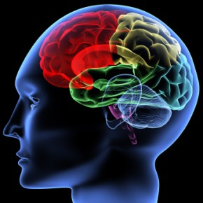
هل تبني القراءة، والأخبار، والأصدقاء، والأفلام، والتلفاز، والإنترنت خصوصاً إيمانك أم تهدمه؟

Slide 20
Black

Slide 21
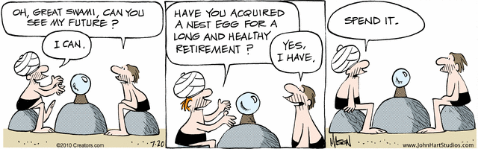
المستقبل
يا سوامي العظيم ، هل تستطيع أن تخبرني عن مستقبلي؟
هل حصلت على مبلغ من أجل تقاعد طويل وصحي؟
أصرفه
Nephew
أستطيع
نعم،
عندي
Notes:
A man in the cartoon strip "B.C." seeks crystal ball advice [read].
"B.C" gives a negative view of the future!

Slide 22

كمسيحي، هل يجب أن تكون متفائلاً بخصوص المستقبل؟

Slide 23
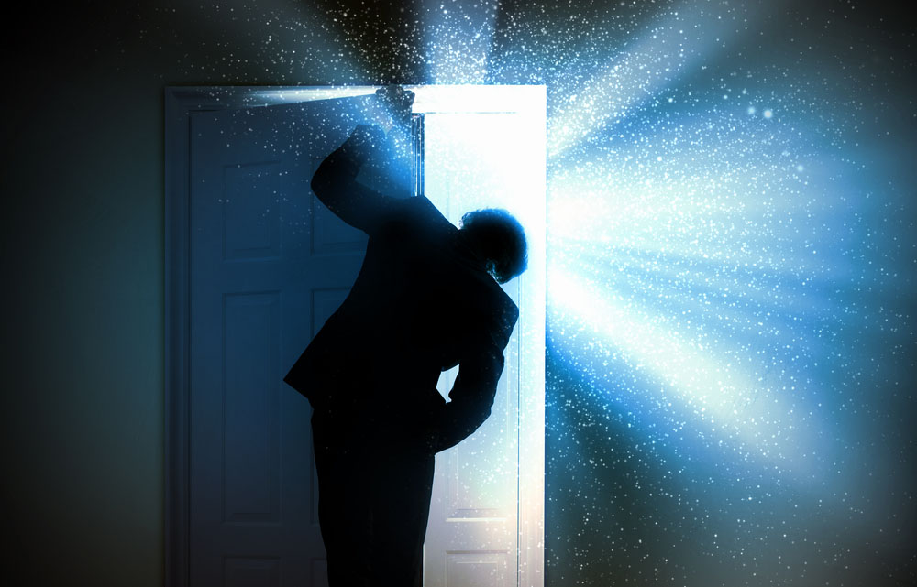
المستقبل
Notes:
One could say that Christians ought to be the most positive people on the planet

Slide 24

المستقبل
Notes:
After all, who else has the assurance of sins forgiven and a heavenly home? Who else has a Guide right now who knows everything, loves us unconditionally, and can do anything? Doesn't it seem that believers ought to be the most confident people about the future?

Slide 25

المستقبل ملك لنا
Notes:
What about you? Are you an optimist? Shouldn't you be?

Slide 26
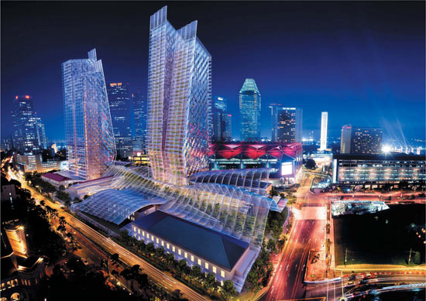
سنغافورة في المستقبل
Notes:
Singapore is now in its 50th year, having grown from a sleepy fishing village to a major player on the global scene.

Slide 27

سنغافورة في المستقبل
Notes:
The economy is looking up—employment is full, property prices are stable or rising.

Slide 28

مزارع سنغافورة العائمة
Notes:
Singapore marches forward toward floating farms…

Slide 29

مزارع سنغافورة العائمة
Notes:
…just outside Marina Bay.

Slide 30

ألا يجب أن نكون متشجعين؟
Notes:
Even looking at eternal things, the percentage of Christians in Singapore continues to rise, as does the number of churches—growing even faster than the general population increase. Shouldn't Christians be encouraged?

Slide 31

لا يجب أن تتفاءل
كمسيحي، هل لديك تفاؤل بخصوص المستقبل؟

Slide 32
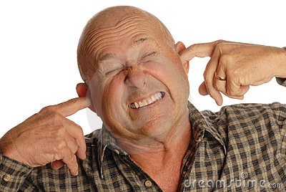
ستصبح الأمور أسوأ
Notes:
The Bible says that the worst days are ahead prior to Christ's return. It is going to get worse. In fact, it started getting worse in the first century. How's that?

Slide 33

الإرتداد
... تابعين أرواحاً مضلة وتعاليم شياطين
(1 تيموثاوس 4: 1)
Notes:
“During the last days there will be a great "Falling Away", a major apostasy, and a great abandoning of all obedience to God's word. Elements in the world that once promoted or greatly favored Christianity will now viciously turn against it. What is right will be called wrong, and what is wrong will be called right. This is apparent all over the planet as church after church is falling to homosexual sin, perversions, lies, the prosperity gospel and other heresies even worse than that, and embracing them with reckless abandon.”
__________________
The Great Apostasy
Posted On January 5th, 2015
AKA: The Great Falling Away
https://www.prophecyindex.org/prophecies/view/the_great_apostasy/

Slide 34
الإرتداد
الإثباتات والتتميمات (185)
أول أسقف مثلية الجنس تستبدل الصلبان برموز إسلامية ليشعر المسلمون بالإرتياح
رجال الدين المسيحيون واليهود يباركون عيادة الإجهاض، ويدعون أن الله موجود في هذا الفضاء
مدرسة أوهايو تزيل لوحة الوصايا العشر منذ ما يقرب من 100 عام لأجل المجموعة الملحدة
طائفة إنجيلية تطرد الجماعة بأكملها بسبب سياسة المثليين
أسقف مثلي الجنس مكرس حديثاً يعلن أن الله امرأة – المتصل اليومي
أكبر طائفة مشيخية أمريكية ترسم أول شخص غير ثنائي بينما يحتفل جول أوستين بأول زوجة مثلية في حفل الليدي غاغا
رجال الدين في كنيسة المسيح المتحدة يقيمون خدمة البركة في منظمة تنظيم الأسرة
تؤكد كنيسة هيلسونغ على موقفها المؤيد الكامل لمجتمع المثليين في مؤتمر ألفا للدين العالمي الواحد
الجامعة الميثودية تقدم دورة تدريبية للطلاب حول تأويل الكتاب المقدس المثلي
مؤسس كريسلام ريك وارن يتعاون مع المساجد للمساواة بين إله الكتاب المقدس والله
تعرض كنيسة دورهام تغطية الصلبان أثناء استضافة صلاة المسلمين - الأنجليكانية
يُظهر التحقيق أن الإنجيليين يعيشون أنماط حياة فخمة
تدعي مالكة مزرعة إنجيل الازدهار، بولا وايت، أن الله أخبرها بقبول لقب الرسول
إسبانيا: 10 ملايين يعيشون في مدن لا يوجد بها حضور إنجيلي
... تابعين أرواحاً مضلة وتعاليم شياطين (1 تيموثاوس 4: 1)
Notes:
Examples of this turning away from the truth are legion, so I will highlight only a few.
__________________
The Great Apostasy
Posted On January 5th, 2015
AKA: The Great Falling Away
https://www.prophecyindex.org/prophecies/view/the_great_apostasy/

Slide 35
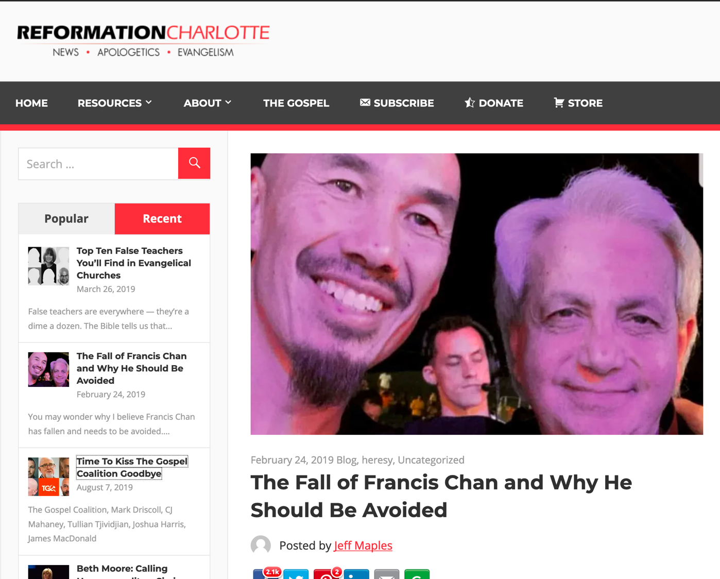
سقوط فرانسيس تشان ولماذا يجب تجنبه
Notes:
You may wonder why I believe Francis Chan has fallen and needs to be avoided. Isn’t he orthodox? Doesn’t he preach the true gospel? Isn’t he, well, doctrinally sound?
Well, Chan is a graduate of both John MacArthur’s Master’s University and Seminary, an unusually solid, seminary that teaches rightly on such important doctrines as the sovereignty of God, the inerrancy of Scripture, and the cessation of the apostolic sign gifts. He was the founder and former pastor of Cornerstone Community Church in Simi Valley, California. Chan is now a well-known conference speaker, regularly preaching alongside questionable, at best charismatics such as Mike Bickle of IHOPKC and many others.
Chan, despite his solid theological educational background, is highly compromised in many ways, and not just because he regularly shares the stage with heretics. While that, in and of itself, is problematic, Chan’s compromises are much deeper and stem from a serious lack of discernment.
Chan aims to be a people-pleaser. It’s understandable that a man in the flesh would desire the praise of other men, but God dislikes this attitude and the Apostle Paul warns against it (Galatians 1:10).
When Chan decided to leave his church several years ago to begin his charismatic crusade, he announced to his congregation “God was leading him elsewhere.” Then, two years ago, while speaking at a gathering, speaking of his former church, he told the audience that they were all a “bunch of losers” who didn’t exercise their spiritual gifts.
Francis Chan, for several years, has been on the speaker circuit for several heretical crusades. On of the most popular crusades he’s frequented has been IHOPKC’s annual One Thing conference alongside such heretics as Todd White, Michael Brown, Joyce Meyer, and Seventh Day Adventist, Ben Carson. This conference is not only heretical due to its theological grounding steeped in New Apostolic Reformation ideology, it’s also ecumenical, and holds a Catholic track.
But Chan is no stranger to ecumenism. In 2003, Mike Gendron, a Christian apologist best known for his polemics and evangelistic resources for Catholics, was invited to speak at Chan’s church. Gendron, a man who knows and loves Catholics enough to speak truthfully about the serious and damning theological errors they hold to, spoke to Chan’s audience truthfully about the errors of purgatory, Mary, the Eucharist, and the biblical way of salvation. This prompted Chan to rebuke Mike Gendron in front of the entire gathering, stating that it “was a mistake” to host Gendron.
Chan’s obvious discontent with biblical truth shows that he is not only theologically inept and lacks serious discernment, but that he also seeks to not offend man, effectively offending God much worse.
PICTURES:
Francis Chan with Heretic, Mike Bickle
Francis Chan with charlatan, Benny Hinn
Francis Chan with faux faith-healer, Todd White
In his never-ending crusade to please the world, Chan continues to praise well-known, well-liked heretics while throwing solid men of God under the bus. Chan knows that men like Gendron are less popular with the world and the culture because they see the truth of Scripture as black and white — without compromise.
This weekend, Chan, at Lou Engle’s 2019 Send Conference, Chan was noted praising arch-heretics, Todd White and Daniel Kolenda. Todd White is a fraudulent “faith-healer” who claims to have healed hundreds of people of various ailments without a shred of evidence. Todd White holds to the Word of Faith heresy, “little God” theology, and is largely into the heretical New Apostolic Reformation movement that teaches that the office of Apostle — like the original 12 — has been reinstated and Apostles and Prophets exist today. Besides the fact that every single “Apostle” and “Prophet” in this movement is morally compromised in some way, not a single one has ever prophesied the way the biblical prophets have done. You can see Chan praising these men in the video below, toward the end.
Francis Chan, though he may occasionally speak things that sound right and biblical, is a wolf in sheep’s clothing to be avoided at all costs. Because of his associations with heretics and false teachers — and his considerable lack of discernment — Chan leads his people astray. He is not a shepherd to be followed, as he feeds his sheep directly to the wolves.
____________
https://reformationcharlotte.org/2019/02/24/francis-chan-why-you-should-avoid-him/

Slide 36

حان الوقت لتقبيل وداع ائتلاف الإنجيل
Notes:
In the wake of Joshua Harris’ apostasy — the Purity Culture pastor who divorced his wife, denounced Christianity, and embraced homosexuality — many people are wondering just exactly what went wrong. The apostasy follows a string of The Gospel Coalition contributors who have either been disqualified or have completely turned from their faith altogether.
From Tullian Tjividjian and Mark Driscoll to James MacDonald and C.J. Mahaney, many men that had been warned about by those “pesky discernment blogs” ultimately showed their true colors and were caught up in scams ranging from sex abuse cover-ups to bullying their staff at church.
The entire paradigm exemplifying The Gospel Coalition gave rise to a new breed of professing Christian — New Calvinism. While some, like Kevin DeYoung, ponder the reasoning behind the rampant apostasy at The Gospel Coalition, speculating that it is because they are too quick to “elevate gifted men,” I suspect the problem is much deeper than that. DeYoung writes,
What is worth exploring in this instance [Harris’ apostasy]—and, we can tell you, has already for years generated a great deal of soul searching—is why a number of young men who were at one time closely associated with The Gospel Coalition have been forced to leave the ministry. Our primary takeaway is that in years past our tribe was too quick to elevate gifted men who may not have had enough time to prove themselves faithful for the long haul. But even here, we would note that the public crises always get more attention than scores of young men who have quietly continued to serve the Lord with growing maturity.
The problem, you see, isn’t being “too quick” to “elevate gifted men.” The problem is elevating men who have a primary cause that fits the theme and narrative of The Gospel Coalition. The problem is, The Gospel Coalition isn’t really about the gospel — it’s about other things, like social justice, egalitarianism, LGBTQ activism, open borders and mass illegal immigration, theological liberalism, self-advancement, etc. The Gospel Coalition merely cloaks these causes in Christian-themed language, slaps the phrase “gospel-centered” on it, and brings aboard anyone who is willing to advance their cause — or at least act as a cloak for the gospel while The Gospel Coalition advances their own cause.
And the problem isn’t that just a few men have been officially disqualified — The Gospel Coalition continues to be wrought with unqualified, disqualified, and outright dangerous men and women. At The Gospel Coalition, the bad far outweigh the good. The Gospel Coalition still employs a massive number of homosexuals and LGBTQ activists, social justice warriors, and egalitarians. The Gospel Coalition employs people who are funded by leftist billionaires like George Soros, James Riady, and Zack Exley. The problem is The Gospel Coalition isn’t guided by the gospel, the Scriptures, or even basic Christian principles. It is guided by a leftist agenda whose primary purpose is to turn the Evangelical Church to the left politically and theologically.
Mark Driscoll wasn’t the problem. Tullian Tjividjian wasn’t the problem. C.J. Mahaney wasn’t the problem. James MacDonald wasn’t the problem. And no, Joshua Harris wasn’t the problem. All of these fallen men are merely symptoms of the problem. The problem is that The Gospel Coalition — and the (very few) good men who may be left — continue to give a platform to leftists, use complicit men like these to disguise their agenda, and allow the leftists at the organization to promote their agenda unfettered.
It’s time to kiss The Gospel Coalition goodbye.
_______
https://reformationcharlotte.org/2019/08/07/time-to-kiss-the-gospel-coalition-goodbye/

Slide 37

Apostasy

Slide 38

العنوان
2 تيموثاوس
238
رسالة تيموثاوس الثانية
هي واحدة من ثلاثة أسفار يسمون عادة بالرسائل الرعوية والتي تعتبر فريدة في أن كل منها يتعامل مع أشخاص (ليس كنائس) كما تشكل كتابات بولس الأخيرة.

Slide 39
مقدمة
238
إحدى الرسائل الرعوية الثلاث (1 و2 تيموثاوس وتيطس)
يوجه بولس هذه الرسائل لأفراد (بالمقارنة مع رسائله الأخرى للكنائس)

Slide 40
التأليف
238
الرسول بولس
(ذكر بولس بوضوح في الأعداد 1و2 بولس رسول يسوع المسيح ... إلى تيموثاوس الإبن الحبيب)
Notes:
Need to not only talk about Paul authorship, other opinions about others view of authorship

Slide 41
Authorship
2 تيموثاوس
التأليف
238
الدليل الخارجي
الشهادة على التأليف البولسي جيد بمقدار أي رسالة بولسية أخرى ما عدا رومية و1 كورنثوس
الدليل الداخلي
تدعي الرسالة التأليف البولسي (2 تي 1: 1) وتحتوي على صفات بولسية نموذجية.

Slide 42
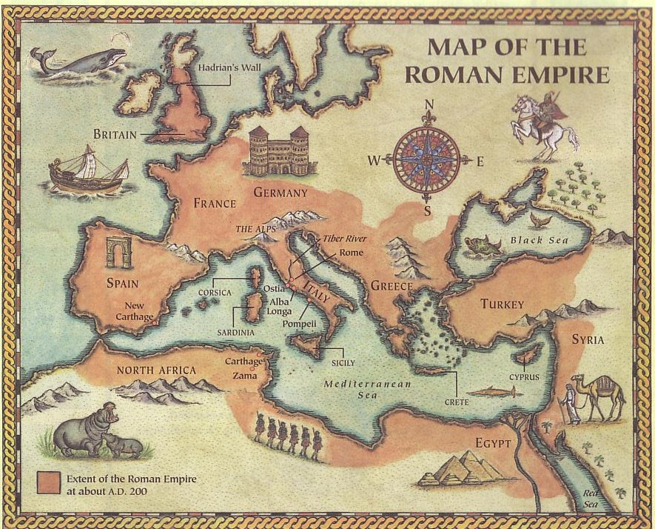
Origins / Recipients
2 تيموثاوس
الأصل / المستلمين
238
كتب بولس 2 تيموثاوس إلى رفيق سفره الطويل تيموثاوس (2 تي 1: 2) بعد 5 سنوات من رسالته الأولى.
على اعتبار أن تيموثاوس لا يزال في أفسس (1 تي 1: 3ب) فإن 2 تيموثاوس لها نفس الوجهة (2 تي 1: 16-18، 4: 19)
روما
أفسس
تم كتابة الرسالة من روما (1: 17، 2: 9) خلال سجن بولس الثاني في روما بعد دفاعه الأول أمام المحكمة الإمبراطورية (4: 16-17)

Slide 43
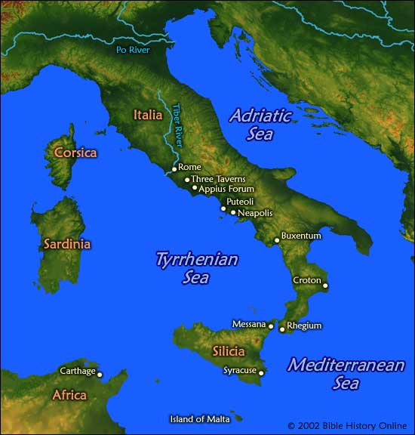
المكان
2 تيموثاوس
238
خلال سجن بولس الثاني
روما

Slide 44
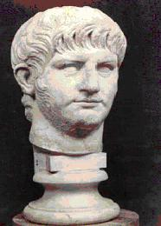
التاريخ
2 تيموثاوس
238
حكم الإمبراطور نيرون (67م)

Slide 45
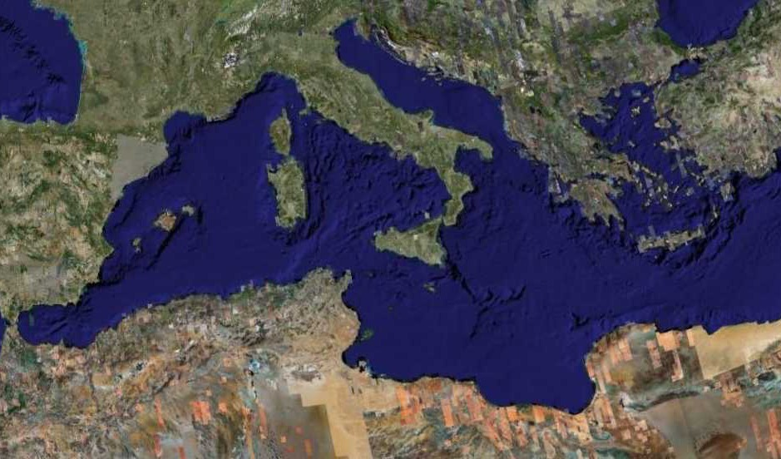
الرحلة التبشيرية الرابعة
1 و2تيموثاوس وتيطس بعد سفر الأعمال
ربيع 62– خريف 67
Notes:
Paul had finished reaching the Eastern Roman Empire by the time he wrote Titus—and even had just returned from Spain.
__________
NS-15-Pastorals-3
NS-16-2 Timothy-87
—————
Freedom from Imprisonment Spring 62–Fall 67
Paul in Ephesus and Colosse (Timothy left at Ephesus) Spring–Summer 62
Peter travels to Rome 62
Paul in Macedonia late summer 62-winter 62/63
1 Timothy written from Macedonia to Timothy in Ephesus Fall 62
Paul in Asia Minor Spring 63-Spring 64
Paul in Spain (anticipated in Rom. 15:24) Spring 64-Spring 66
Christians persecuted by Nero; Peter martyred Summer 64
Paul in Crete (Titus left there; Tit 1:5) early Summer 66
Paul in Asia Minor Summer- Fall 66
Titus written from Asia Minor to Titus in Crete Summer 66
Paul in Nicopolis (Tit 3:12) Winter 66/67
Paul in Troas (2 Tim 4:13), Macedonia and Greece Spring– Fall 67
Second Roman Imprisonment Fall 67–Spring 68
Paul arrested and brought to Rome Fall 67
2 Timothy written from Rome to Timothy in Ephesus Fall 67
Paul beheaded Spring 68

Slide 46
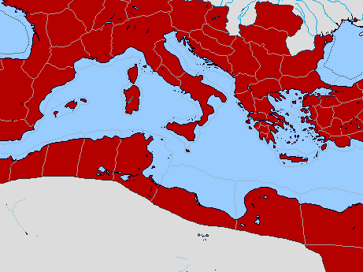
Bible Lands Blank Map
رسالة بولس في أعمال ٢٨: ٣٠ - ٣١
١٤٢
روما
مكدونية
إسبانيا
افسس
كولوسي
أفسس
فليمون
فيلبي
كريت
© https://www.deviantart.com/sharklord1/art/Alt-Roman-Empire-Provinces-701148110
Notes:
Paul wrote the Prison Epistles while under house arrest in Rome, recorded in the last two verses of Acts. These took two years (AD 60-62) and were likely written in this order above. We are unsure whether Ephesians and Colossians were written at the same time, but they have many similarities. But it is nearly certain that Tychicus and Onesimus brought back to Colosse both the letter to the entire church and also the personal letter to Philemon, who lived there and had the church meet in his house.
—————
Freedom from Imprisonment Spring 62–Fall 67
Paul in Ephesus and Colosse (Timothy left at Ephesus) Spring–Summer 62
Peter travels to Rome 62
_______________
NS-15-Pastorals-4
NS-15-1 Timothy-61
NS-16-2 Timothy-46

Slide 47


Date 1
تيطس
البيانات
٢٤٢
يعتبر التسلسل الزمني لسنوات الرسائل البولسية غامضاً بالنظر إلى التناغم أو التنسيق بين الدليل الداخلي والخارجي للبيانات التي تعود للحوار
السجن الروماني الأول شباط ٦٠–آذار ٦٢
(أع ٢٨: ٣٠-٣١(
كتابات بولس للأفسسين
خريف ٦٠– أوائل ربيع ٦٢
غلاطية وفليمون وفيلبي
استشهاد يعقوب
ربيع ٦٢
أخو الرب
Notes:
Paul wrote 1 Timothy shortly after being there himself—likely only months later. We benefit from him recording his instructions to Timothy rather than simply telling him verbally.
—————
Freedom from Imprisonment Spring 62–Fall 67
Paul in Ephesus and Colosse (Timothy left at Ephesus) Spring–Summer 62
Peter travels to Rome 62
Paul in Macedonia late summer 62-winter 62/63
1 Timothy written from Macedonia to Timothy in Ephesus Fall 62
Paul in Asia Minor Spring 63-Spring 64

Slide 48
Bible Lands Blank Map
بولس ما بعد رحلات سفر الأعمال
142
روما
مكدونية
إسبانيا
أفسس
١ تيموثاوس
كريت
© https://www.deviantart.com/sharklord1/art/Alt-Roman-Empire-Provinces-701148110
Notes:
Paul wrote 1 Timothy shortly after being there himself—likely only months later. We benefit from him recording his instructions to Timothy rather than simply telling him verbally.
—————
Freedom from Imprisonment Spring 62–Fall 67
Paul in Ephesus and Colosse (Timothy left at Ephesus) Spring–Summer 62
Peter travels to Rome 62
Paul in Macedonia late summer 62-winter 62/63
1 Timothy written from Macedonia to Timothy in Ephesus Fall 62
Paul in Asia Minor Spring 63-Spring 64
_______________
NS-15-Pastorals-6
NS-15-1 Timothy-6
NS-16-2 Timothy-48

Slide 49

Date 2
تيطس
البيانات
٢٤٢
الإطلاق من السجن والحصول على الحرية) ربيع 62– خريف 67)
وجود بولس في أفسس وكولوسي ربيع–صيف 62
)مغادرة تيموثاوس لأفسس(
رحلات بولس لرومية 62
بولس في مكدونية أواخر صيف 62 شتاء 62-63
كتبت تيموثاوس الأولى في مكدونية خريف 62
لتيموثاوس في أفسس
بولس في أسيا الصغرى ربيع 63 - ربيع 64
بولس في إسبانيا ربيع 64 ربيع 66
متوقع في رومية (15: 24)
الإضطهاد على المسيجين من نيرون صيف 64
استشهاد بطرس
Notes:
Paul wrote 1 Timothy shortly after being there himself—likely only months later. We benefit from him recording his instructions to Timothy rather than simply telling him verbally.

Slide 50
Bible Lands Blank Map
رحلة بولس بعد أعمال الرسل
١٤٢
روما
مكدونية
2 تيموثاوس
نيكوبوليس
ترواس
إسبانيا
أفسس
تيطس
كريت
© https://www.deviantart.com/sharklord1/art/Alt-Roman-Empire-Provinces-701148110
Notes:
Paul in Asia Minor Spring 63-Spring 64
Paul in Spain (anticipated in Rom. 15:24) Spring 64-Spring 66
Christians persecuted by Nero; Peter martyred Summer 64
Paul in Crete (Titus left there; Tit 1:5) early Summer 66
Paul in Asia Minor Summer- Fall 66
Titus written from Asia Minor to Titus in Crete Summer 66
Paul in Nicopolis (Tit 3:12) Winter 66/67
Paul in Troas (2 Tim 4:13), Macedonia and Greece Spring– Fall 67
Second Roman Imprisonment Fall 67–Spring 68
Paul arrested and brought to Rome Fall 67
2 Timothy written from Rome to Timothy in Ephesus Fall 67
Paul beheaded Spring 68
_______________
NS-15-Pastorals-8
NS-15-1 Timothy-8
NS-16-2 Timothy-50

Slide 51

Date 3
تيطس
البيانات
٢٣٨
بولس في كريت صيف ٦٦ مبكراً
(تيطس ترك هناك ; تيطس ١: ٥(
بولس في اسيا الصغرى صيف -خريف ٦٦
كتب تيطس من اسيا الصغرة صيف ٦٦
إلى تيطس في كريت
بولس في نيكوبوليس )تي 3: 12) شتاء ٦٧/٦٦
بولس في ترواس )٢تي ٤ :١٣)، ربيع - خريف ٦٧
مكدونيا و اليونان
رسالة تيطس كتبت من آسيا الصغرى صيف ٦٦
إلى تيطس من كريت
السجن الثاني في روما خريف ٦٧–ربيع ٦٨
اعتقال بولس وأخذه إلى روما. خريف ٦٧
رسالة يتموثاوس كتب من سجن روما الثاني خريف ٦٧
إلى تيموثاوس في أفسس
قطع رأس بولس ربيع ٦٨
كتب تيموثاوس من سجن روما الثاني خريف ٦٧
إلى تيموثاوس في أفسس
تدمير أورشليم ٢ سبتمبر ٧٠
Notes:
Titus is in green as Paul wrote it while he was free to GO around to share the gospel.
But 2 Timothy is purple to remind us that, while imprisoned again, he did this for royal purposes.
Paul spent at least 5 of his final 11 years in prison:
• AD 57-59 Caesarea for 2 years
• AD 60-62 Rome for 2 years
• AD 67-68 Rome for 1 year

Slide 52
المستلم
2 تيموثاوس
238
رفيق سفر بولس الطويل – تيموثاوس
النوع
رسالة شخصية وعاطفية بشكل كبير

Slide 53

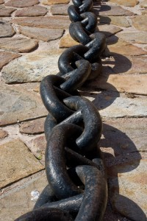
المناسبة
2 تيموثاوس
238
كتبت بعد 1 تيموثاوس بخمس سنوات
سجن بولس الروماني الثاني
(4: 6-8)
قبل إعدام بولس (4: 9، 21)
عندما ألقى نيرون اللوم على المسيحيين

Slide 54

Occasion
2 تيموثاوس
المناسبة
238
عندما كتب بولس رسالة تيموثاوس الثانية في عام 67 م، كان نزيلاً ذا خبرة في عدة مدن:
أورشليم: قبلها 10 سنوات (أيار 29 – حزيران 9، 57)
قيصرية: قبلها 8-10 سنوات (حزيران 57 – آب 59)
روما: قبلها 5-7 سنوات (شباط 60 – آذار 62)
بعد أن أمضى ما يقرب من خمس سنوات من السنوات العشر الماضية خلف القضبان، كان على علم بالسجون والإجراءات السياسية، وكان يعلم أن هذا السجن الروماني الثاني لا يمكن أن يؤدي إلا إلى الإعدام (٢تي ٤: ٦-٨).
بما أن بولس لم يكن يتوقع أن يعيش فترة أطول في السجن الروماني، فقد طلب من تيموثاوس أن يسرع إليه قبل الشتاء (٢ تيموثاوس ٤: ٩، ٢١).

Slide 55
Characteristics
2 تيموثاوس
الخصائص
239
هذه الرسالة إلى ابني الحبيب (1: 2) هي آخر رسالة نمتلكها من بولس.
تعطي أوضح تفسير في العهد الجديد عن الحاجة إلى التفسير (4: 2) وتخبرنا أن:
نحمي الإنجيل (1: 14)
نحفظ الكتاب المقدس مركزياً (2: 15)
نثابر في الإنجيل (3: 14)
نتألم لأجل الإنجيل (1: 8، 2: 3)
نعتبر الكتاب المقدس موحى به (3: 16-17)
Notes:
Most of us would write the person closest to us—perhaps a spouse, parent, or child. Paul had none of these, except Timothy, whom he called “my dear son” (1:2). So what did Paul write Timothy?

Slide 56
Key Word / Verse
2 تيموثاوس
238
الكلمة المفتاحية
العقيدة
الآيات المفتاحية
16 كل الكتاب هو موحى به من الله، ونافع للتعليم والتوبيخ، للتقويم والتأديب الذي في البر 17 لكي يكون إنسان الله كاملاً متأهباً لكل عمل صالح ... اكرز بالكلمة
( 3: 16- 17؛ 4: 2)

Slide 57
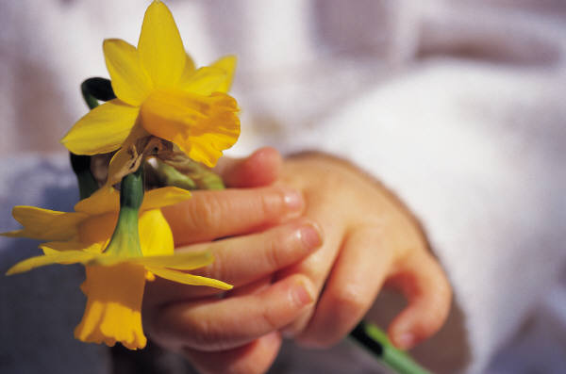
الحجة
2 تيموثاوس
238
أخبر بولس تيموثاوس ما هو بالحقيقة مهم.
ثابر في حياتك المسيحية وإيمانك كراعي.
اكرز بكلمة الله بأمانة وسط الصعوبات والمعلمين الكذبة

Slide 58
تيموثاوس الثانية
1- تمسك بالإيمان الصحيح
2- أطع وعلم الكلمة
3- الأيام الأخيرة تجلب الإرتداد
4- عظ كلمة الله بجدية
باري هدلستون، الكتاب المقدس الأبجدي

Slide 59
Argument
2 تيموثاوس
الحجة
239
تتعامل هذه الرسالة مع الرجل تيموثاوس أكثر مما تتعامل مع كنيسته
(مثل 1 تيموثاوس)
مع سقوط الكثيرين قبل موت بولس مباشرة، اختار بولس بعناية كلماته
في رسالته الأخيرة إلى تيموثاوس ليؤكد أن تيموثاوس سيبقى أميناً
للإيمان حتى الموت.
يحقق الرسول ذلك من خلال حثه على الثبات في الضيقات الحاضرة
بشخصية تقية (2 تي 1-2)، لأن المستقبل سيكون أكثر صعوبة
(2 تي 3-4).
سيكون عليه بشكل خاص أن يحارب الإرتداد من خلال الكرازة بأمانة
بكلمة الله (3: 10-4: 5).

Slide 60
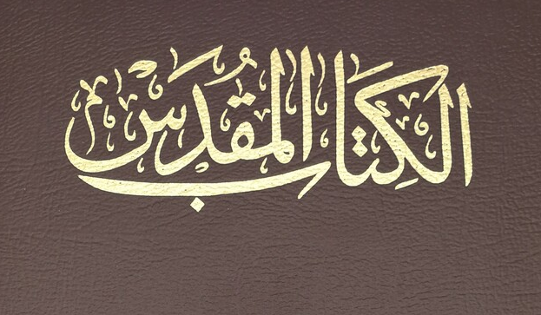
المخطط
2 تيموثاوس
239
صوت العقيدة ضد المقاومة
1-2 الثبات في التجارب الحاضرة
3-4 الثبات في التجارب المستقبلية

Slide 61
الخطوط العريضة
2 تيموثاوس
237
الإصحاحات 1 - 2
الإصحاحات 3 - 4
الثبات في التجارب الحاضرة
الثبات في التجارب المستقبلية
أمثلة على الأمانة
1
الحل :
اكرز بالكلمة
3: 10-
4: 5
رجاء بولس
4: 6- 22
مميزات الأمانة
2
المشكلة :
الإرتداد
3: 1 - 9

Slide 62

متى تعلق هناك؟
ثابر الآن
ثابر في المستقبل
و

Slide 63
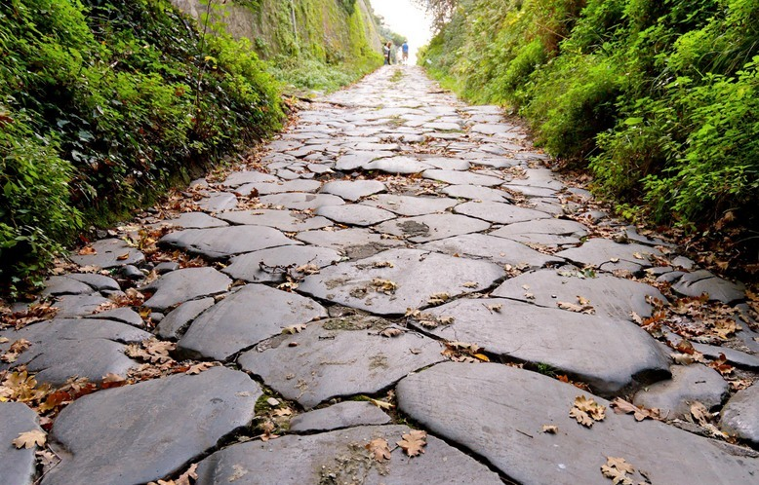
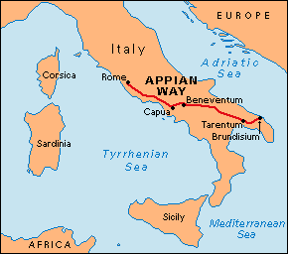
سجن روما الأول (60-62 م، أعمال الرسل 28: 15)
15 ومن هناك لما سمع الإخوة بخبرنا خرجوا لاستقبالنا إلى فورن أبيوس والثلاثة الحوانيت، فلما رآهم بولس شكر الله وتشجع.
Notes:
Paul was warmly welcomed by the believers in AD 60 when he first came to Rome…

Slide 64
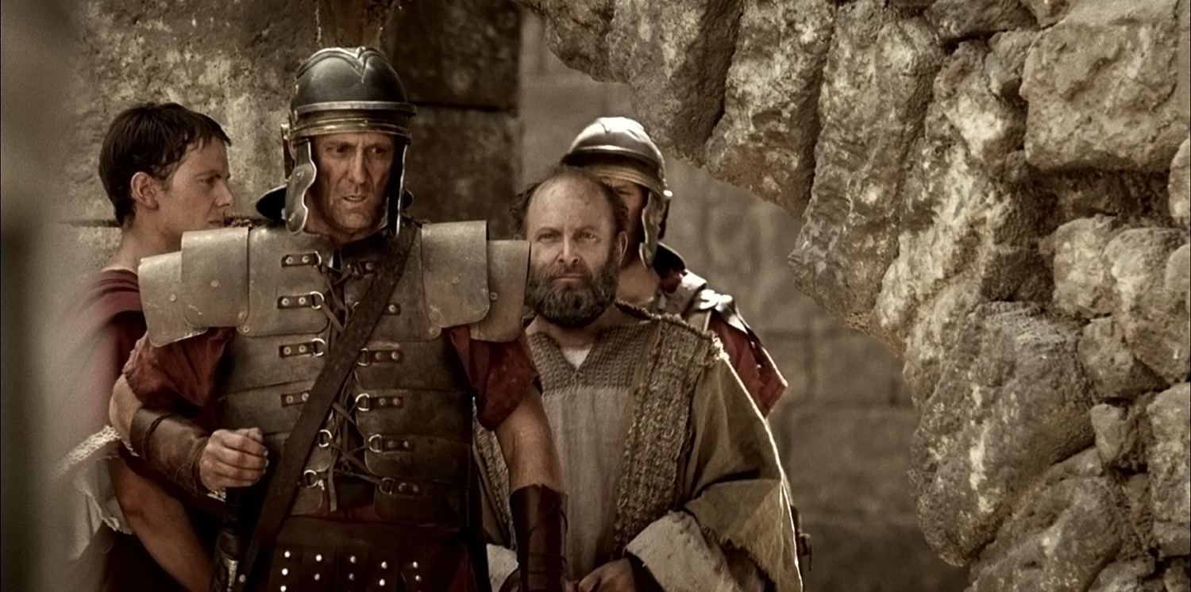
قيادة بولس إلى السجن

Slide 65
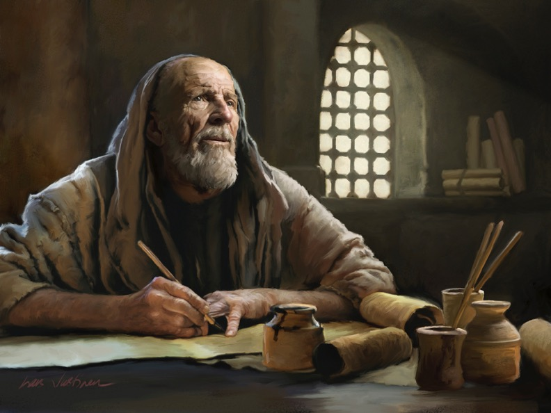
السجن الأول

Slide 66

الرسائل الرعوية
1 تيموثاوس
تيطس
2 تيموثاوس
1 تيموثاوس = شخصية، طارئة، تركيز عقائدي
تيطس = طارئة أقل، تركيز تطبيقي
2 تيموثاوس = شخصية، طارئة، تركيز على الكلمة
Notes:
These last three letters of Paul are called the Pastoral Epistles.
They show the most advanced theology of local church life and shepherding the flock—but this makes sense since Paul and the church had learned much in the previous 30 years since the church had begun.
Sadly, most NT scholars today do not believe that Paul wrote these letters and many date them in the second century. I guess they think that Paul was a slow learner!

Slide 67

خريف 67 ب. م ( السجن الروماني الثاني )
٢ تيموثاوس ٤ : ٦-٧
6 فإني أنا الآن أسكب سكيباً ووقت انحلالي قد حضر.
7 قد جاهدت الجهاد الحسن، أكملت السعي، حفظت الإيمان

Slide 68
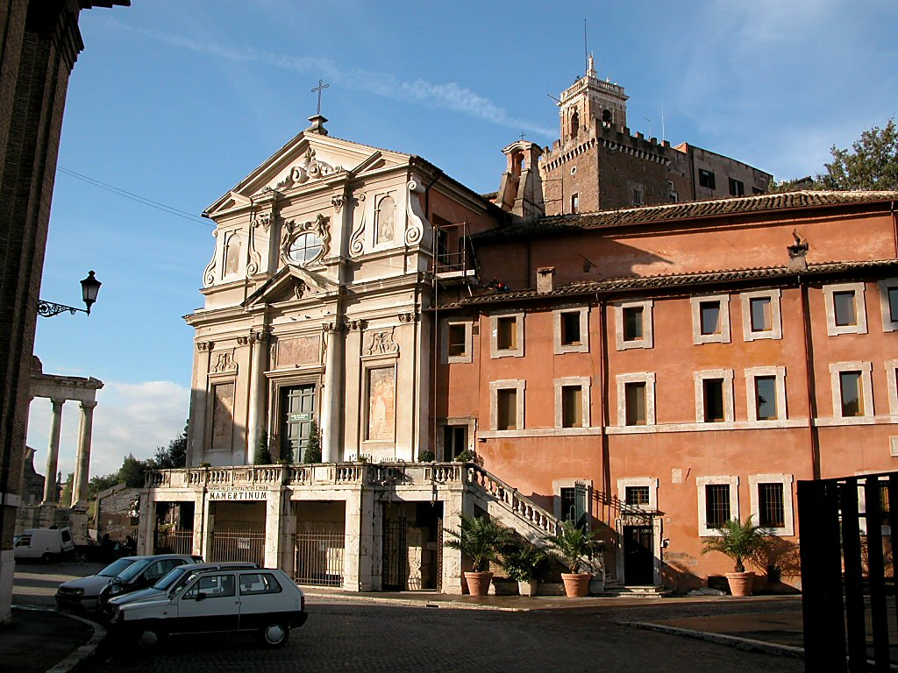
سجن مامرتين
Notes:
The traditional site of the Apostle Paul's and the Apostle Peter's imprisonment in Rome, this prison was simply known as "Carcer" ("prison") in Paul's day. "Mamertine" was attributed to the prison in the Medieval Period. —Todd Bolen, BiblePlaces.com

Slide 69
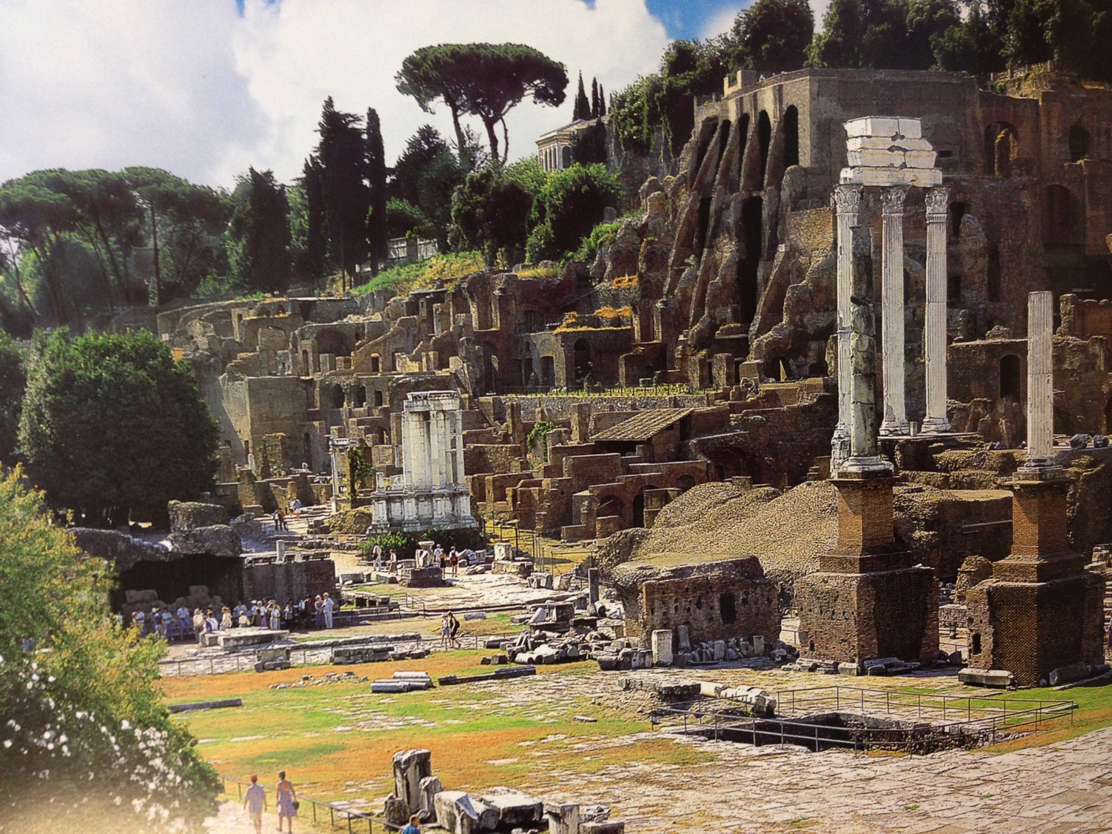
منتدى روما المركزي (الآثار الحديثة)
Notes:
Right across the street from the prison was the most famous location in all the Roman Empire—the Forum, or the seat of power for the Republic.

Slide 70
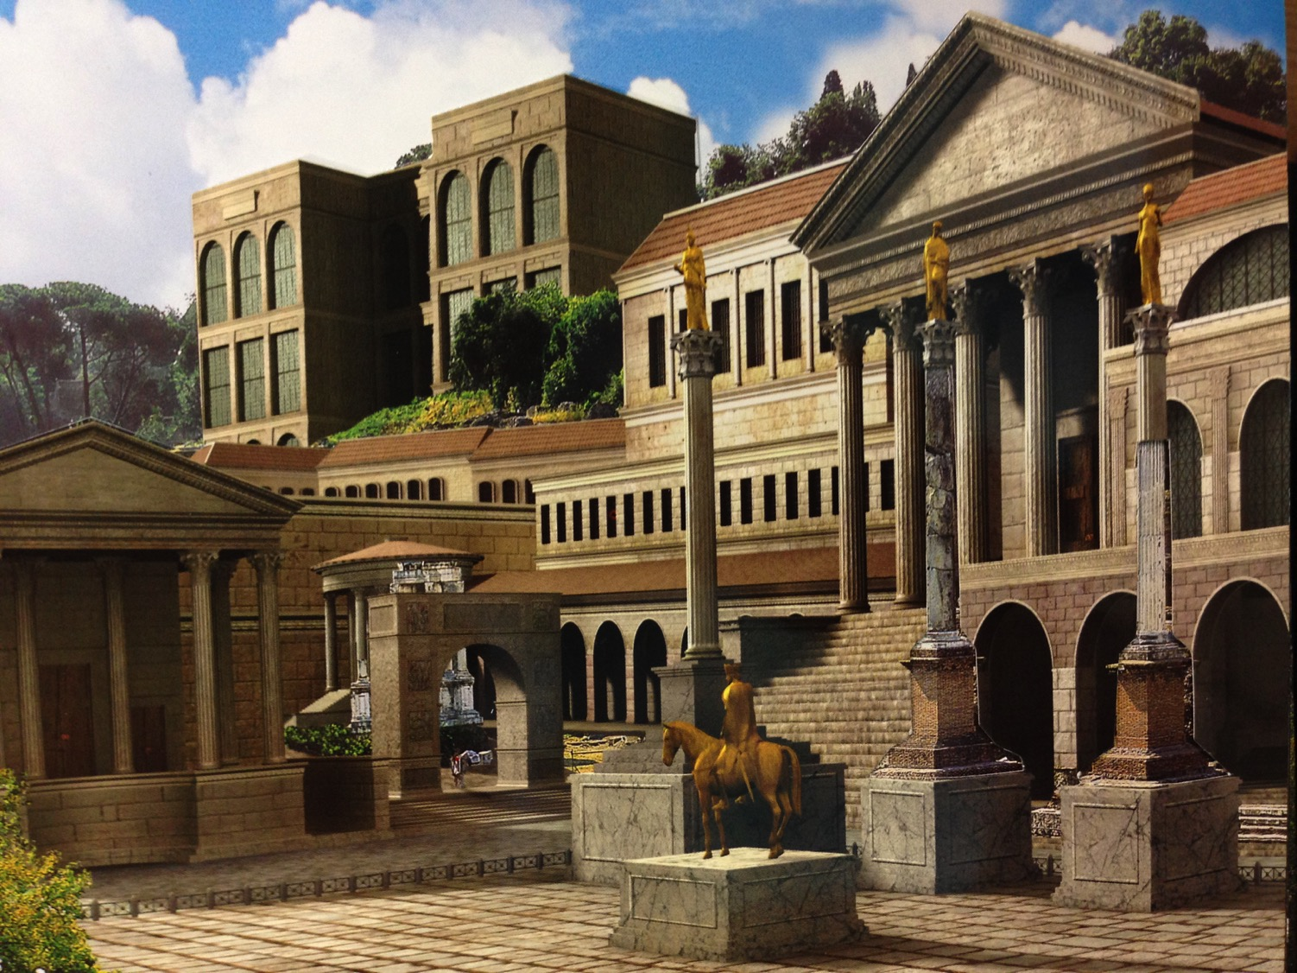
منتدى روما المركزي (القرن الرابع الميلادي)
Notes:
In Paul’s day, the Forum was spectacular. It continued to grow in magnificence until the fourth century AD, when Rome was destroyed.

Slide 71
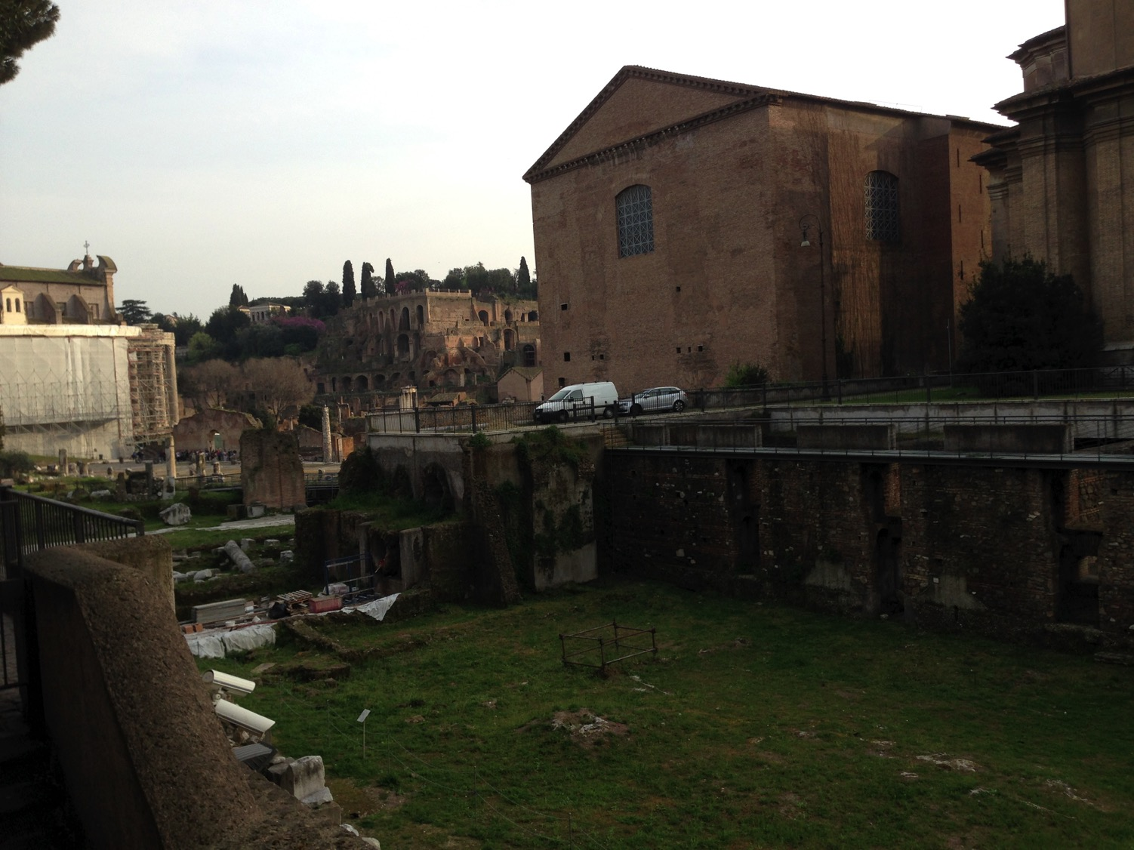
مواقع
قريبة
سجن مامرتين
كوريا
مجلس الشيوخ
Notes:
I wonder if Paul knew that Caesar was just across the street!

Slide 72
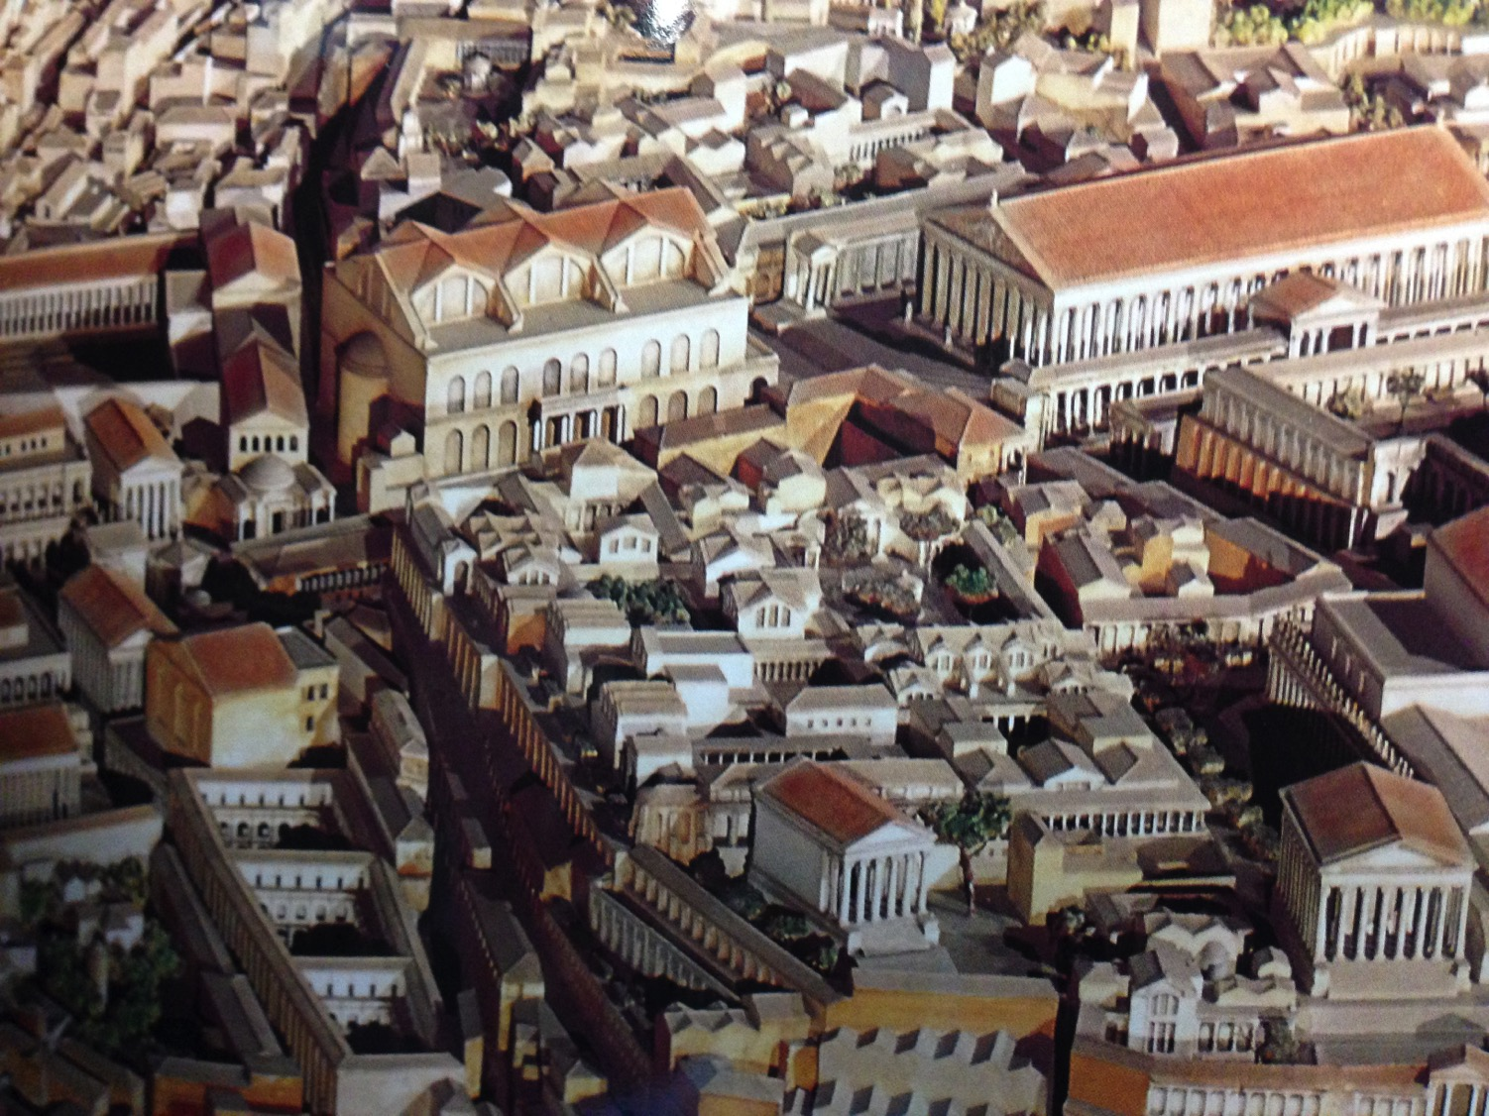
المنتدى المركزي من الأعلى
Notes:
Buildings then were tightly compacted together as they did not need large expressways for vehicles.

Slide 73
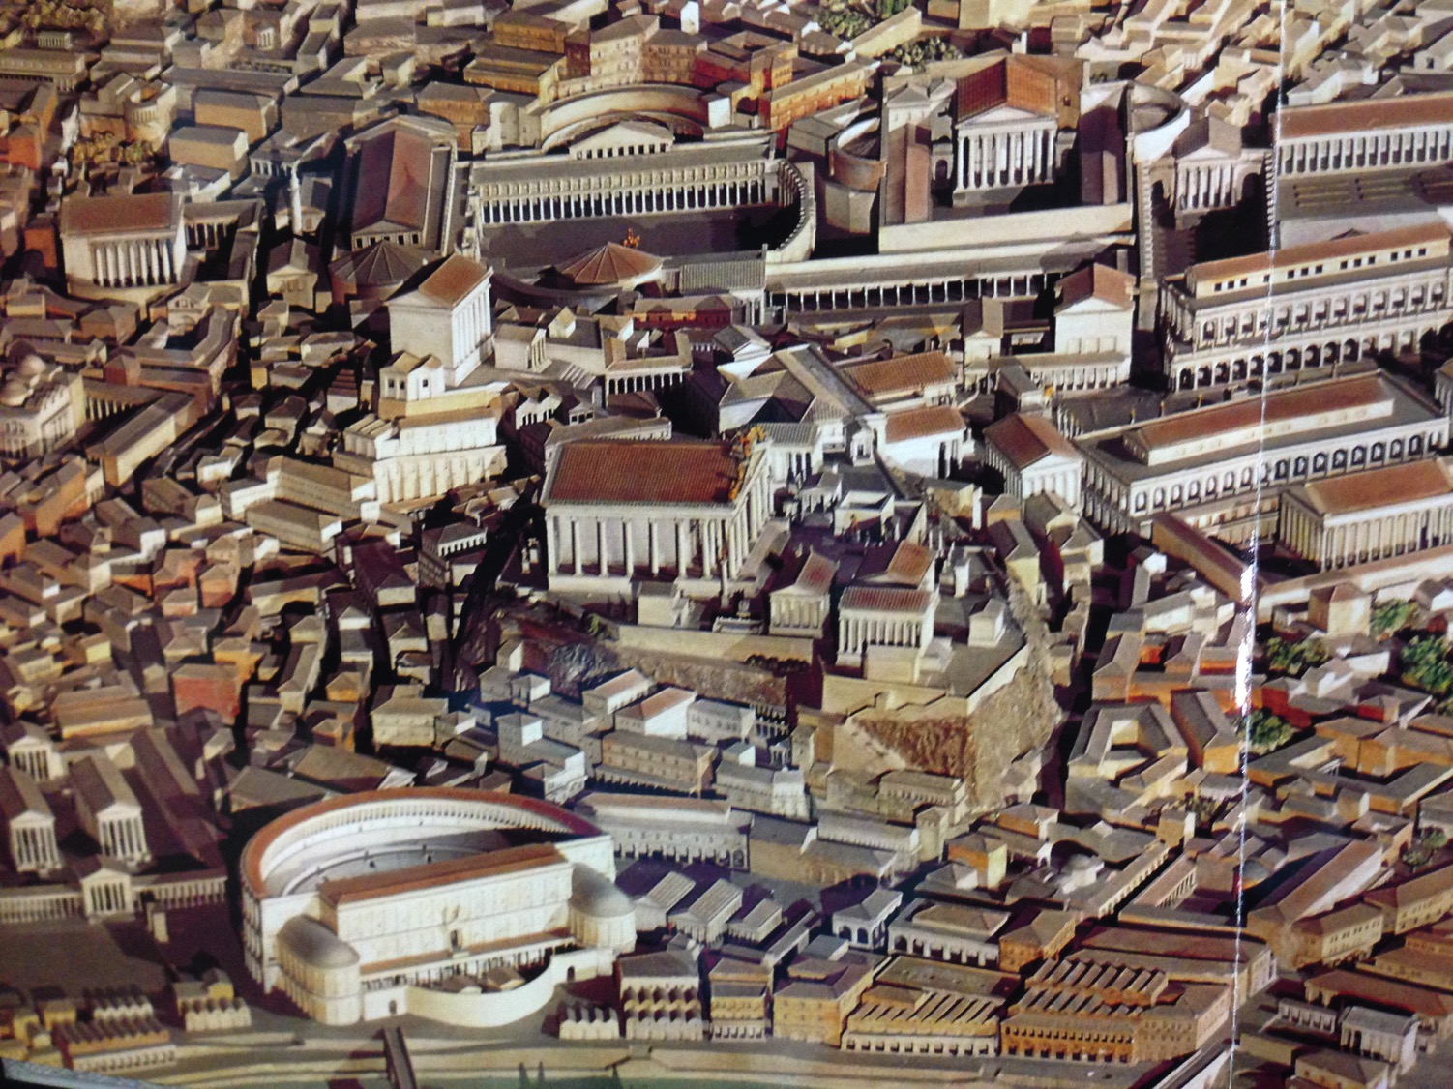
المنتدى الغربي من الأعلى
Notes:
Such buildings included theatres and municipal structures.

Slide 74
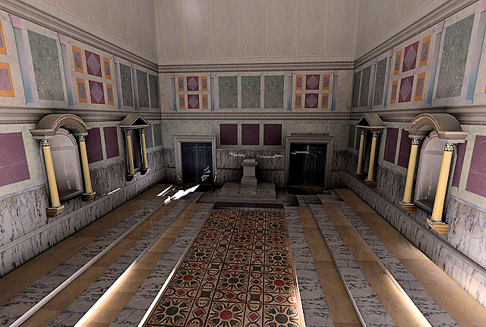
كوريا من الداخل
إعادة بناء الجزء الداخلي من كوريا جوليا، الذي أنشأه مركز التقنيات التجريبية بجامعة كاليفورنيا
Notes:
You can visit the Curia now where aristocratic senators sat in chairs on either side. Toa large extent, their influence had waned by Pauls’ time, as the days of the Republic had given way to the whims of the Emperor, whose power was unchecked.
http://www.vroma.org/~bmcmanus/curiainterior.html

Slide 75
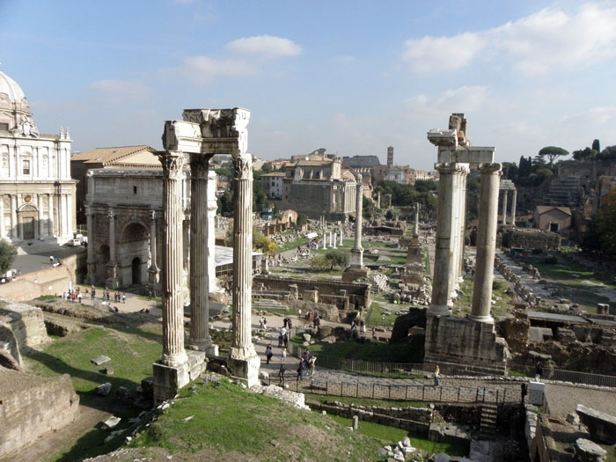
منظر للمنتدى من سجن مامرتين (2014 م)
Notes:
The Forum is in ruins today, but the ideas born here have overtaken the world in the past century, where we have seen that rise of republics like the United States, Singapore, and Taiwan. Similar to this would be the largest democracy in the world, India.

Slide 76
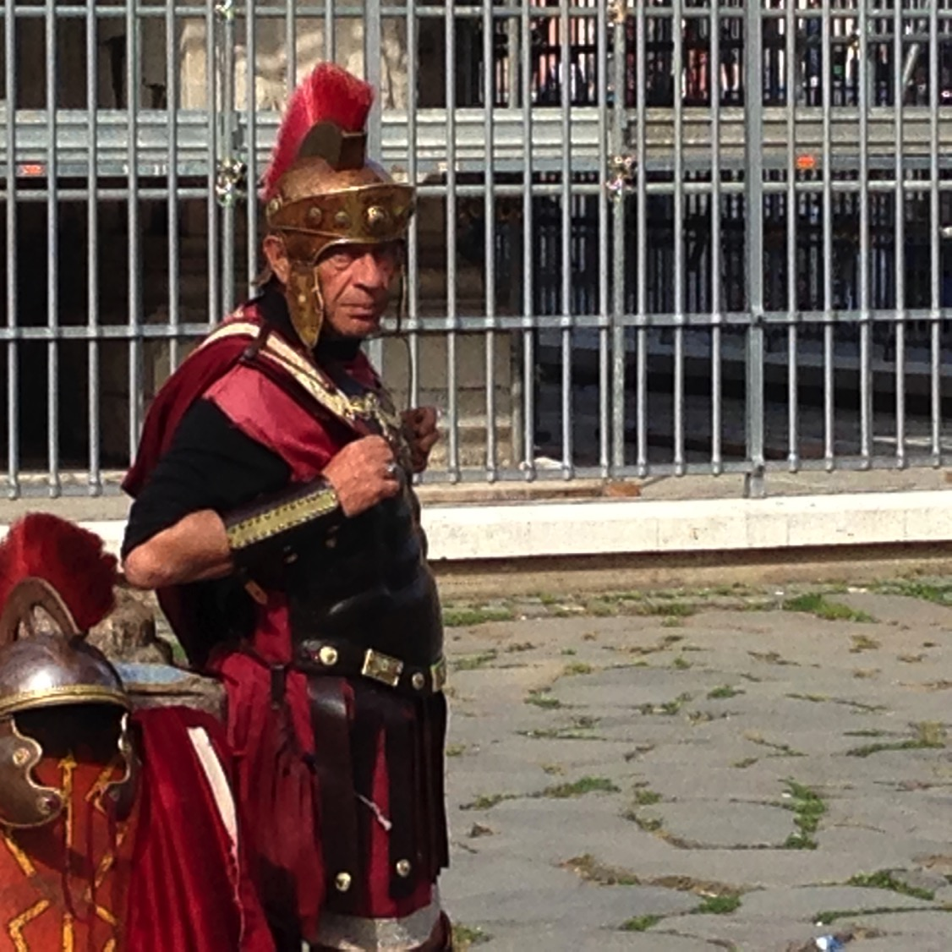
أخبر جارك
إن كان عليك أن تكتب رسالتك الأخيرة قبل الإعدام، من الشخص الذي ستكتب له وماذا ستقول؟
2 تيموثاوس
Notes:
So now we return to 2 تيموثاوس, Paul’s last letter. Imagine you were given time to write your final letter the morning of your execution. Who would you write? What would you say? Tell the person next to you.

Slide 77
2 تيموثاوس
الخطوط العريضة
237
صوت العقيدة ضد المقاومة
الثبات في التجارب الحاضرة |  | الثبات في التجارب المستقبلية
الإصحاحات 1 - 2 |  | الإصحاحات 3 - 4
أمثلة على الأمانة 1 | مميزات الأمانة 2 | المشكلة : الإرتداد 3: 1 - 9 | الحل : اكرز بالكلمة 3: 10- 4: 5 | أمل بولس 4: 6- 22
أفنيكي لوئيس بولس أونيسيفورس | التلمذة فكر واحد مطيع مجتهد كتابي مقدس وديع | عدم التقوى النفاق والرياء | الوعظ الثبات التوبيخ التشجيع الكرازة | استشهاد خيانات تحيات مباركة
روما إلى أفسس
خريف 67 ب. م ( السجن الروماني الثاني )

Slide 78
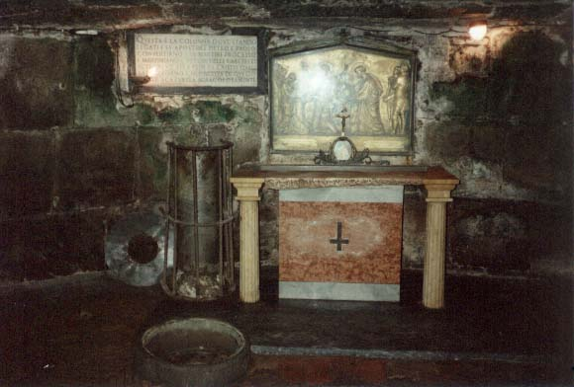
مواضيع رئيسية
2 تيموثاوس
1. الأمانة
2. الإرتداد
3. كلمة الله الموحى بها

Slide 79
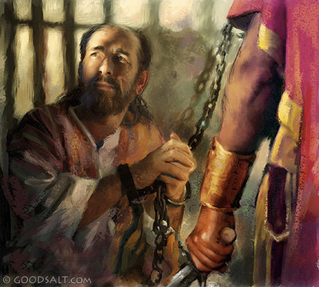
البيان الموجز
2 تيموثاوس
237
المثابرة ضد الإرتداد رغم المشقة، بالوعظ بالكلمة بكل أمانة.

Slide 80
كن مثابراً
٢ تيموثاوس
د. ريك جريفيث • مؤسسة الدراسات اللاهوتية الأردنية
BibleStudyDownloads.org

Slide 81

الكثيرين ممن تبعوا يسوع

Slide 82
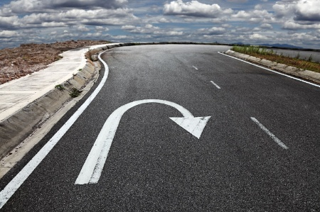
لا يتبعونه اليوم

Slide 83
الإرتداد
التراجع من خلال الرفض
2 تيموثاوس
Notes:
This is called “apostasy.” It literally means a turning away by rejecting.
Sometimes this means that the person no longer claims to be a Christian—but in other cases, the person still claims the name of Jesus (professes Christ) but has turned away from a key doctrine of the faith.

Slide 84
3 لأنه سيكون وقت لا يحتملون فيه التعليم الصحيح، بل حسب شهواتهم الخاصة يجمعون لهم معلمين مستحكة مسامعهم،
4 فيصرفون مسامعهم عن الحق، وينحرفون إلى الخرافات.
( 4: 3 – 4)
يصرفون مسامعهم
(apostrepho)
عن الحق
(2 تيموثاوس 4: 4)

Slide 85
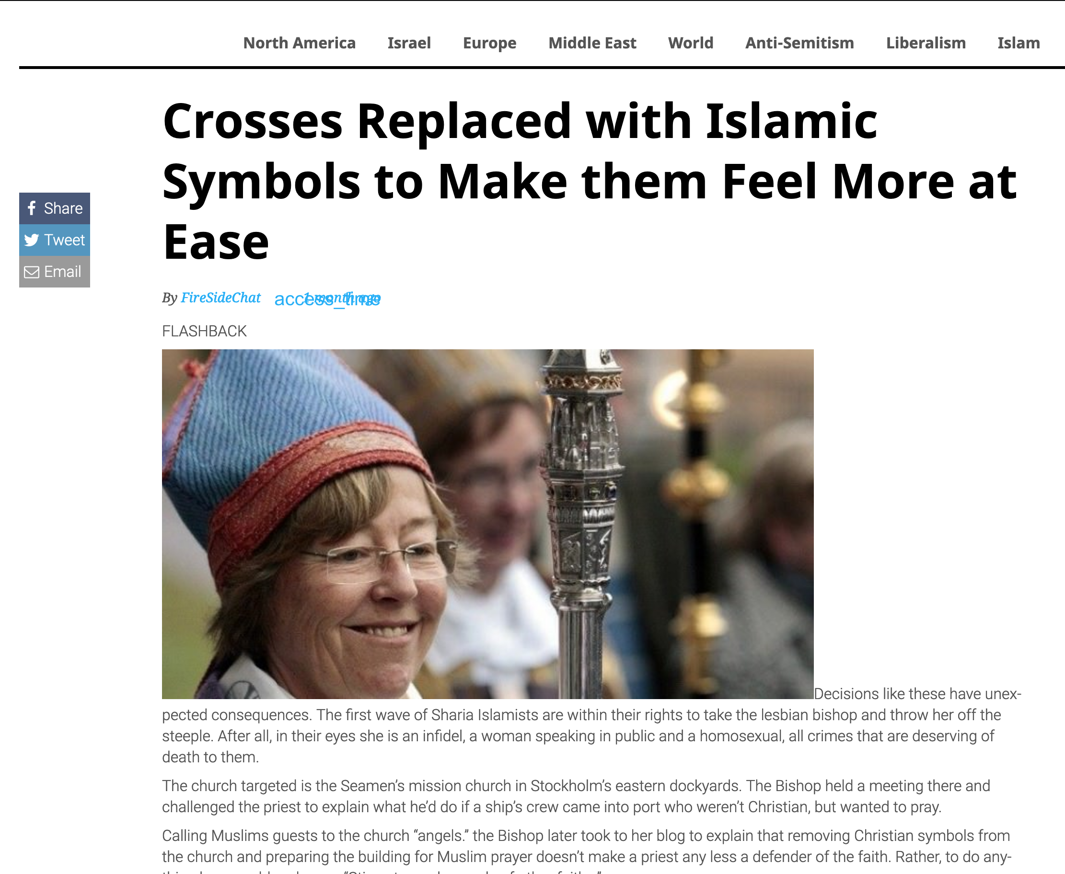
تم استبدال الصلبان بالرموز الإسلامية لتجعلهم يشعرون بمزيد من الراحة
22 آب 2019
Notes:
First Lesbian Bishop Orders Crosses Replaced with Islamic Symbols to Make them Feel More at Ease
________
https://www.firesidechat.news/2019/08/22/first-lesbian-bishop-orders-church-crosses-replaced-with-islamic-symbols-to-make-them-feel-more-at-ease.html
__________________
The Great Apostasy
Posted On January 5th, 2015
AKA: The Great Falling Away
https://www.prophecyindex.org/prophecies/view/the_great_apostasy/

Slide 86
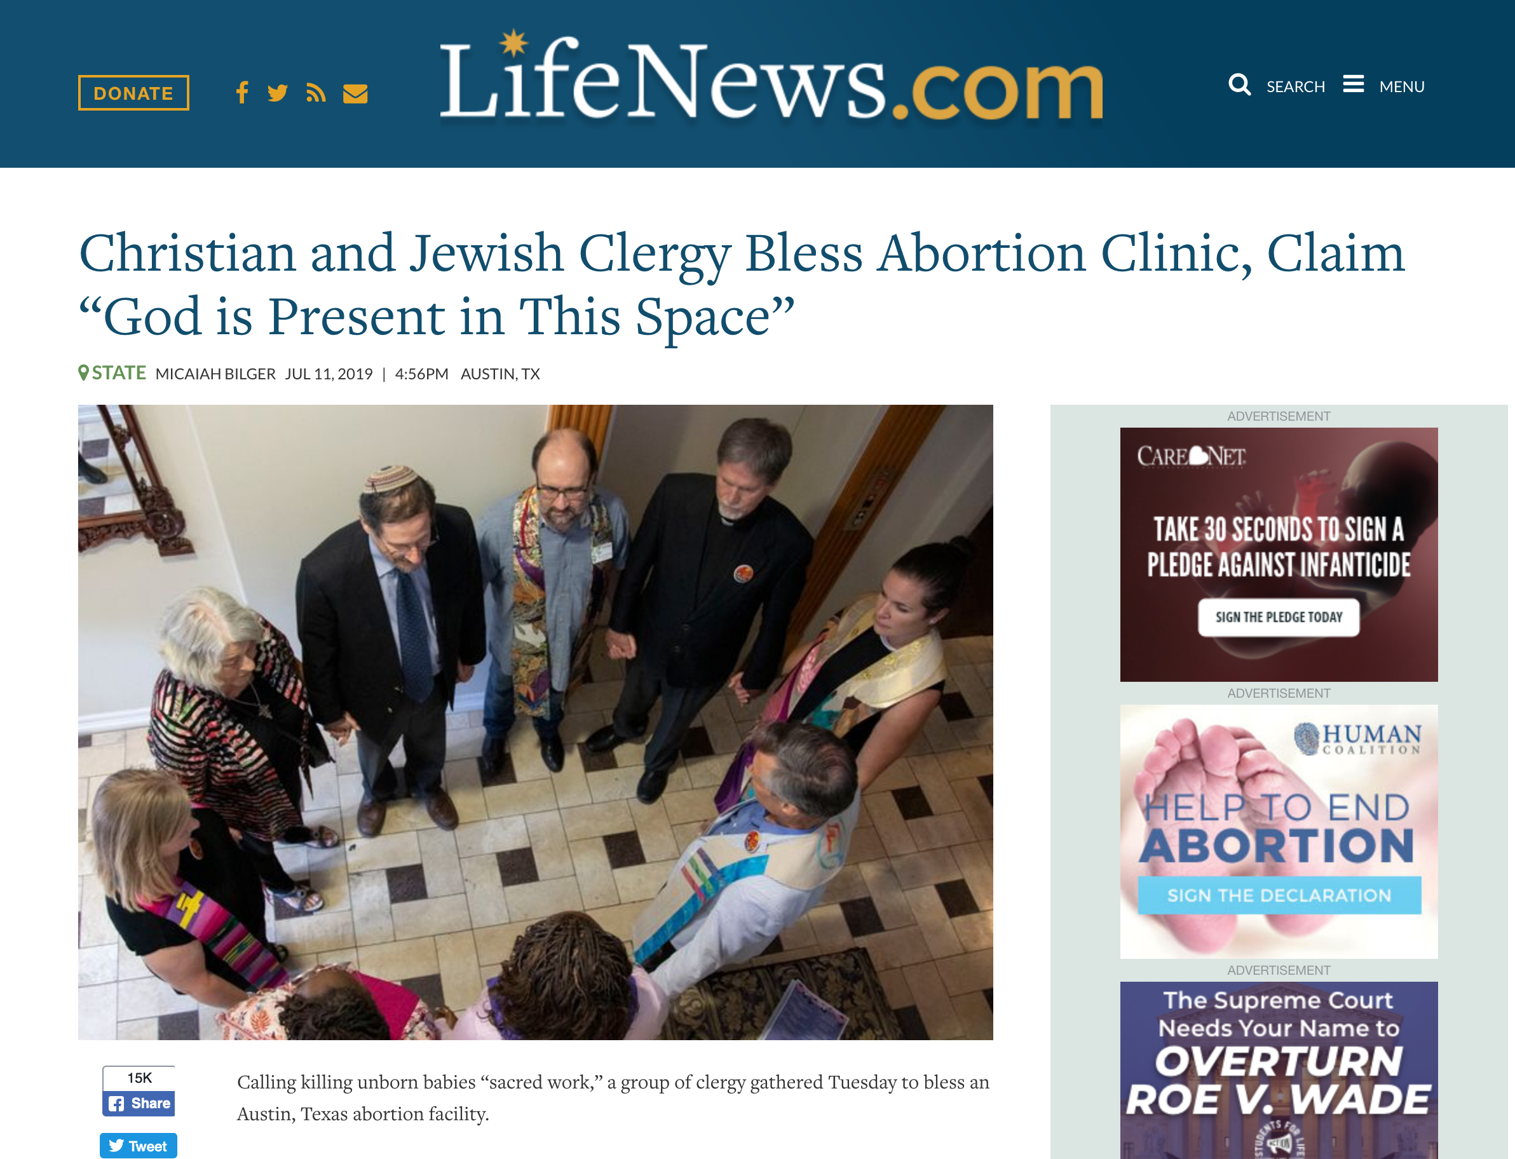
رجال الدين المسيحيون واليهود يباركوا عيادة الإجهاض ويزعمون أن الله موجود في هذا المكان
Notes:
https://www.lifenews.com/2019/07/11/christian-and-jewish-clergy-bless-abortion-clinic-claim-god-is-present-in-this-space/

Slide 87
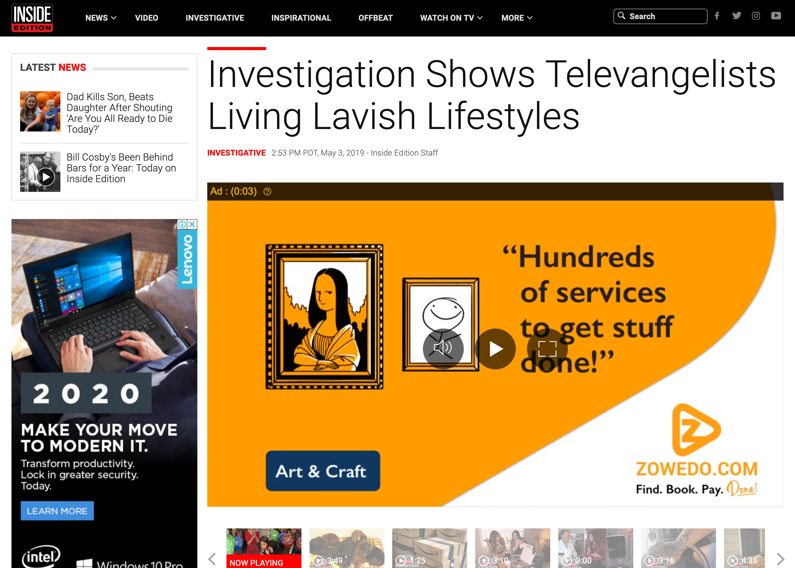

يظهر التحقيق أن القادة الإنجيليين يعيشون أسلوب حياة فخم
Notes:
Kenneth Copeland owns TWO private jets and has his own airport at his home in Texas!
Watch the 4-minute clip below
______
https://www.insideedition.com/investigation-shows-televangelists-living-lavish-lifestyles-52662

Slide 88
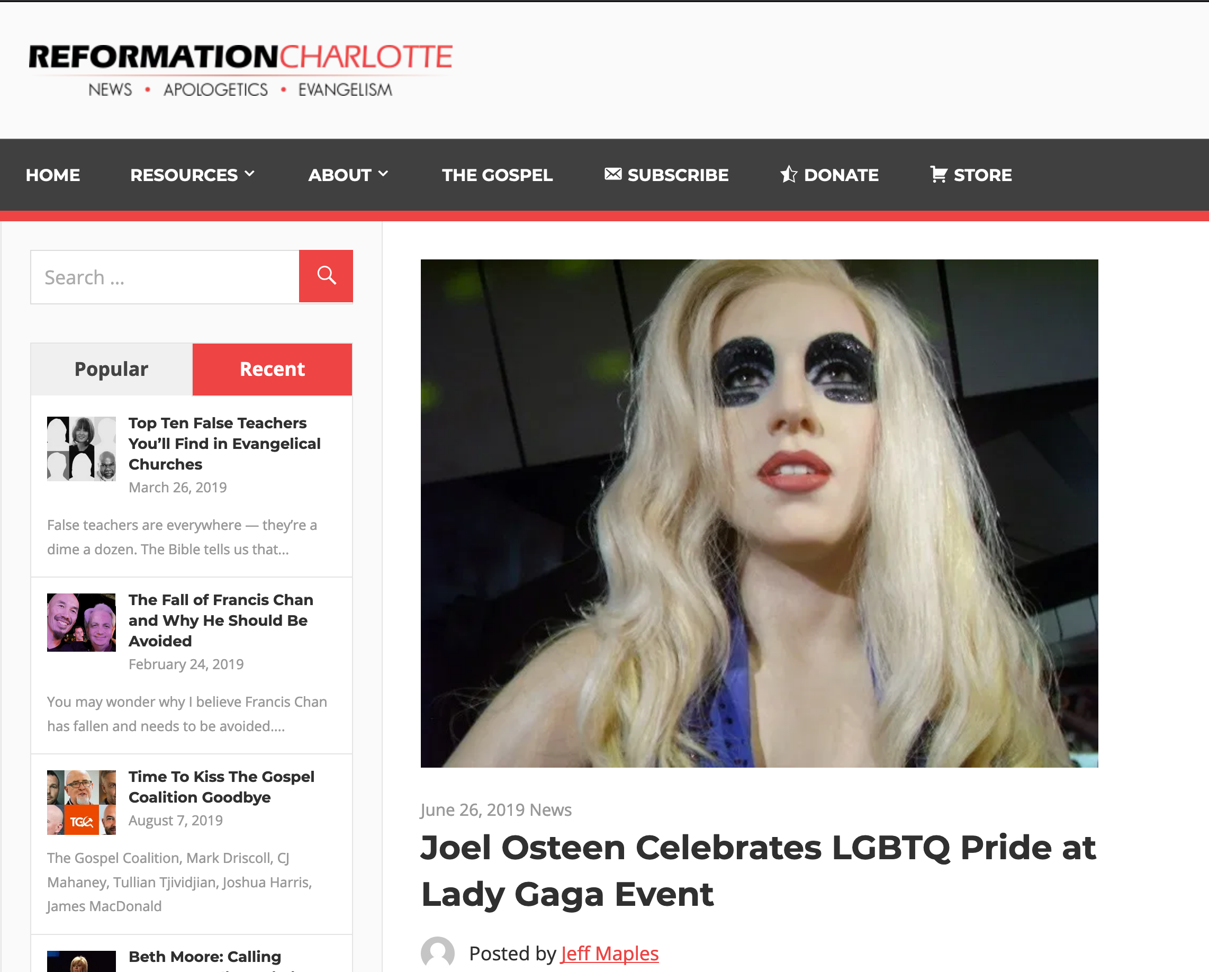
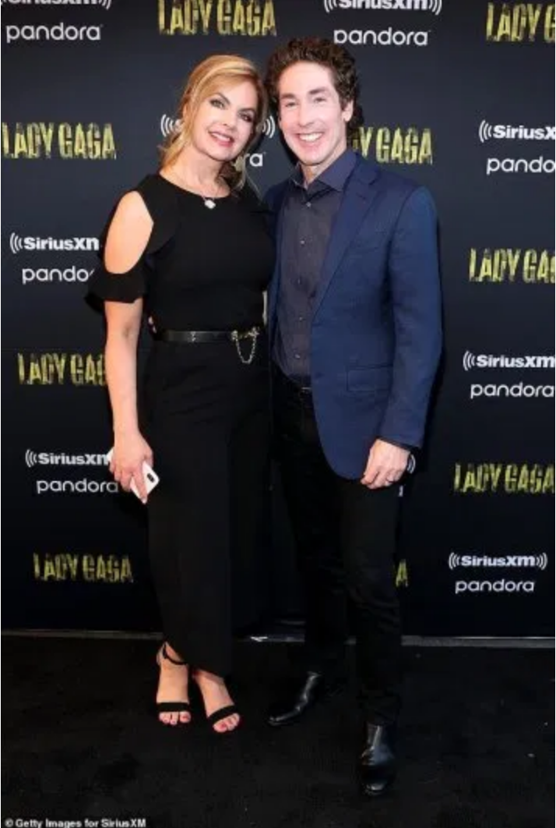
يحتفل جويل أوستين في احتفال المثليين مفتخراً في حدث اقامته الليدي غاغا
Notes:
Therefore go out from their midst, and be separate from them, says the Lord, and touch no unclean thing; then I will welcome you…
2 Corinthians 6:17
This is not satire, this really happened. Joel Osteen, one of the modern-day princes of the Word of Faith prosperity gospel movement, was seen at Lady Gaga’s pride celebration at Apollo Theater on Monday night. The New York Daily News reports,
Poehler wasn’t the only heavy hitter in the crowd. From Alaska Thunderf–k, a drag performer who won Season 2 of “RuPaul’s Drag Race All Stars” to the controversial televangelist and anti-LGBTQ pastor Joel Osteen, the event drew an eclectic mix of fans, industry insiders and celebrities, from the movies (Catherine Zeta-Jones, Michael Douglas), the music universe (Clive Davis, Adam Lambert), the fashion world (Alexander Wang), television (John Oliver, Camila Mendes) and the America’s gay Royal couple and Harlem residents Neil Patrick Harris and husband David Burtka.
Osteen’s presence was curious, because Gaga has championed LGBTQ causes.
Lady Gaga is known for her risque performances and lack of modest attire. Being that Osteen is a charlatan who has been given over to the lusts of this world and bilks millions of people for every dime they have, it comes as no surprise that he and his wife, Victoria, would immerse themselves in the culture of demonic influence, sex, and greed. It was reported that Osteen was wearing a blue blazer while his wife was wearing a long, black dress. A picture of the two can be seen here.
Interestingly, Osteen asserted a few years ago that he believes that the Scriptures are clear that homosexuality is a sin. Yet, he has continuously softened his tone and downplayed the significance toward homosexuality since then. In an effort to remain culturally relevant and inclusive, Osteen generally avoids the topic altogether.
Osteen’s ministry has produced a number of look-alike worldly money-hungry pastors, including his very own apprentice, John Gray, who was caught cheating on his wife and made amends to her by buying her a $200 thousand Lamborghini while living in a $1.8 million home paid for by his church.
________________
https://reformationcharlotte.org/2019/06/26/joel-osteen-celebrates-lgbtq-pride-at-lady-gaga-event/

Slide 89
كيف يمكنك أن تثابر وسط الإرتداد؟
2 تيموثاوس
Notes:
Will you be walking with Jesus ten years from now?
What should you do now to make sure you are faithful then?
What can you do now to make sure you are following the Lord faithfully in the future?

Slide 90
نظرةٌ عامَّةٌ إلى رسائل بولس
38
124
39-41
إلى أقصى الأرض (أعمال الرسل 1: 8)
أع 9 13 14 15 16 18 21 27 28
نيسان 48-
أيلول 49
1
غلاطيَّة
نيسان 50-
أيلول 52
2
بحر إيجة
ربيع 53-
أيَّار 57
3
أسيَّا
أيَّار 57
آب 59
محاكمات
شباط 60 –
آذار 62
1
روما
ربيع 62 -
خريف 67
4
إسبانيا
خريف 67 – ربيع 68
2
روما
ربيع 68
تَوَسُّع
الكنيسة
صيف 35-37 م
دمشق
أنطاكيَّة
خريف 49
المجْمَع
35 48 49 50 52 53 57 60 62 67 68 95
متَّى
لوقا
أعمال
مرقس
يوحنَّا
غلاطيَّة
1تسالونيكي
1 كورنثوس
أفسس
1تيموثاوس
2تيموثاوس
2تسالونيكي
2 كورنثوس
كولوسِّي
تيطس
الإرساليَّة
رومية
فليمون
الراعويَّة
فيلبِّي
الأناجيل وأعمال الرسل
1 2 3 4
السجن
الرحلات التبشيريَّة
الرسائل البولسيَّة
روما
أوقاتٌ في السجن
الفئات البولسيَّة
Notes:
في الوقت الذي كتب فيه بولس الرسول رسالته إلى أهل رومية، كان قد رأى حركة زرع الكنيسة تصل إلى الجزء الشرقي من الإمبراطوريَّة! وقد نوّه عن ذلك في رومية 15.
We may suppose that heresies take a long time to develop, but the New Testament teaches otherwise. Within a generation of Christ's life, many false systems developed. Paul writes in the AD 60s, just prior to his beheading, that many had fallen into the snare of deceptive teaching.
Yet nearly all of Paul's writings responded to a heresy. This means that he took false doctrine seriously, in contrast to the church of our day in many circumstances.
Paul wrote while traveling, imprisoned, or to key leaders.
Observations about chronology:
Gospels were not written first, but throughout the NT era
Evangelistic letters preceded pastoral
Rough letter (Galatians) preceded smoother ones
_______________
Common-493
NS-00-NT Introduction-101
NS-03-Luke1-12-slide 65
NS-06-MissionaryEpistles-2
NS-06-Rom1-2-slide 16
NS-07-1Cor1-9-slide 23
NS-08-2Cor-27
NS-10-Pauline Epistles-3
NS-10-Prison Epistles-2
NS-11-Philippians-15, 40
NS-12-Colossians-22, 24, 304
NS-15-Pastoral Epistles-2

Slide 91
الرحلة التبشيرية الرابعة
1-2 تيموثاوس وتيطس بعد سفر الأعمال
ربيع 62 – خريف 67
Notes:
Paul had finished reaching the Eastern Roman Empire by the time he wrote Titus—and even had just returned from Spain. Yet he soon was captured and brought to Rome a second time, where he wrote 2 Timothy.
—————
Freedom from Imprisonment Spring 62–Fall 67
Paul in Ephesus and Colosse (Timothy left at Ephesus) Spring–Summer 62
Peter travels to Rome 62
Paul in Macedonia late summer 62-winter 62/63
1 Timothy written from Macedonia to Timothy in Ephesus Fall 62
Paul in Asia Minor Spring 63-Spring 64
Paul in Spain (anticipated in Rom. 15:24) Spring 64-Spring 66
Christians persecuted by Nero; Peter martyred Summer 64
Paul in Crete (Titus left there; Tit 1:5) early Summer 66
Paul in Asia Minor Summer- Fall 66
Titus written from Asia Minor to Titus in Crete Summer 66
Paul in Nicopolis (Tit 3:12) Winter 66/67
Paul in Troas (2 Tim 4:13), Macedonia and Greece Spring– Fall 67
Second Roman Imprisonment Fall 67–Spring 68
Paul arrested and brought to Rome Fall 67
2 Timothy written from Rome to Timothy in Ephesus Fall 67
Paul beheaded Spring 68

Slide 92
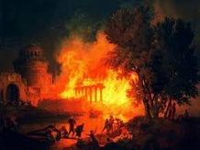
المقارنة بين مرات سجن بولس في روما
38
124
39-41
شباط 60-
آذار 62
1
روما
ربيع 62-خريف 67
4
إسبانيا
خريف 67-
ربيع 68
2
روما
60 62 67 68
أف
2 تي
كو
فيل
في
الرسائل البولسية
1 2 3 4
الرحلات
روما
السجون
Notes:
What had changed between Pauls’ two imprisonments in Rome? Much! One key event was the Great Fire at Rome in July AD 64.

Slide 93
المقارنة بين مرات سجن بولس في روما
38
124
39-41
شباط 60-
آذار 62
1
روما
ربيع 62-
خريف 67
4
إسبانيا
خريف 67-
ربيع 68
2
روما
60 62 67 68
صحة نيرون العقلية
متزن
مجنون
حريق روما 64 م
قبل
بعد
النظرة للمسيحيين
فرقة يهودية
أغلبية من الأمم
تسامح روما
محمية
لا قيود
اضطهاد روما
نادر
منتشر
النتيجة بالنسبة لشاول
أطلق سراحه
قطع رأسه
Notes:
You can see that all legal protections for Christians were removed by the time Paul returned to Rome’s prison system a second time.

Slide 94
السجن الثاني في روما (67-68 م)
أنت تعلم هذا أن جميع الذين في أسيا ارتدوا عني الذين منهم فيجلس وهرموجانس
(2 تي 1: 15)
وجميع الذين يريدون أن يعيشوا بالتقوى في المسيح يسوع يضطهدون ولكن الناس الأشرار المزورين سيتقدمون إلى أردأ مضِلين ومضَلين
(2 تي 3: 12-13)
Notes:
Seven years later the first imprisonment under house arrest, the situation was entirely different. Nero had initiated a persecution of believers and it was very unpopular to be a Christian. May had denied the faith and most had gone underground to the catacombs if they still continued in the faith.

Slide 95
أصدقاء بولس خلال السجن الثاني في روما (67-68 م)
9 يا تيموثاوس بادر أن تجيء إليَّ سريعاً 10 لأن ديماس قد تركني إذ أحب العالم الحاضر وذهب إلى تسالونيكي، وكريسكيس إلى غلاطية، وتيطس إلى دلماطية 11لوقا وحده معي خذ مرقس وأحضره معك لأنه نافع لي للخدمة 12 أما تيخيكس فقد أرسلته إلى أفسس 13 الرداء الذي تركته في ترواس عند كاربس، أحضره متى جئت، والكتب أيضاً ولا سيما الرقوق 14 إسكندر النحاس أظهر لي شروراً كثيرة. ليجازه الرب حسب أعماله 15 فاحتفظ منه أنت أيضاً لأنه قاوم أقوالنا جداً.
(2 تي 4: 9-15)
Notes:
Life was lonely for a very relational man like Paul at this point. Most of his friends had either escaped Rome or fallen away from the Faith.

Slide 96
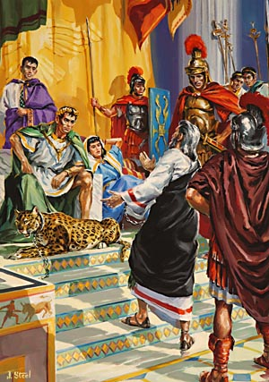
Paul's Second Imprisonment (AD 67-68)
في احتجاجي الأول لم يحضر أحد معي بل الجميع تركوني لا يحسب عليهم ولكن الرب وقف معي وقواني لكي تتم بي الكرازة ويسمع جميع الأمم فأنقذت من فم الأسد
(2 تي 4 : 16-17)
Notes:
Serving Jesus includes times when we feel like no one else is with us in terms of their presence and prayers. But Jesus remains, despite the failures of people.

Slide 97
مواقع
قريبة
سجن مامرتين
كوريا
مجلس الشيوخ
Notes:
I wonder if Paul knew that Caesar was just across the street!

Slide 98
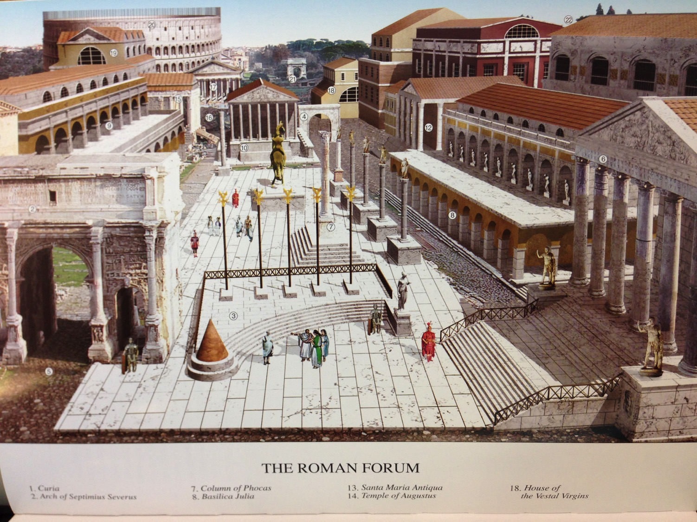
منظر للمنتدى من سجن مامرتين
(القرن الرابع الميلادي)
Notes:
The Forum was filled with buildings and monuments honoring the emperors and generals who expanded the Empire. In AD 80, the Coliseum was completed and can be seen in the rear left. It was funded by the gold seized from burning Herod’s temple in Jerusalem.

Slide 99
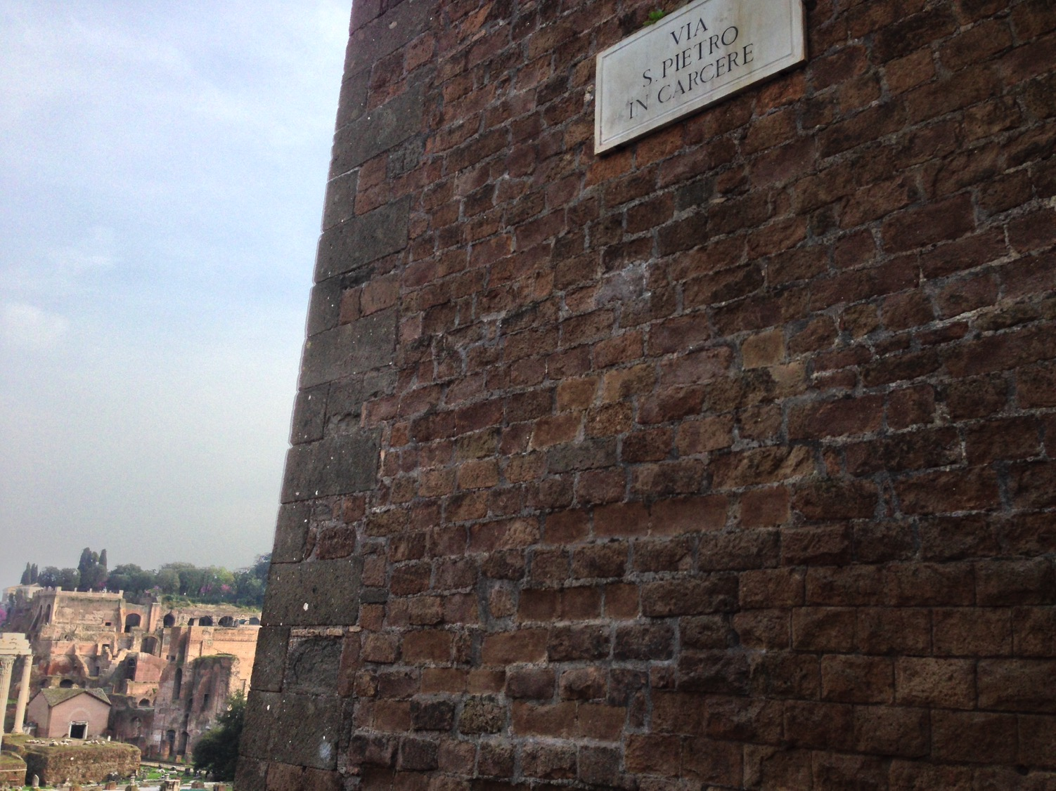
بطرس في شارع السجن
Notes:
Honestly, Susan and I had a very difficult time finding the prison where Paul was held. It wasn’t on any of the tourist maps! Yet, finally, we found it on “Peter in Prison Street”!

Slide 100
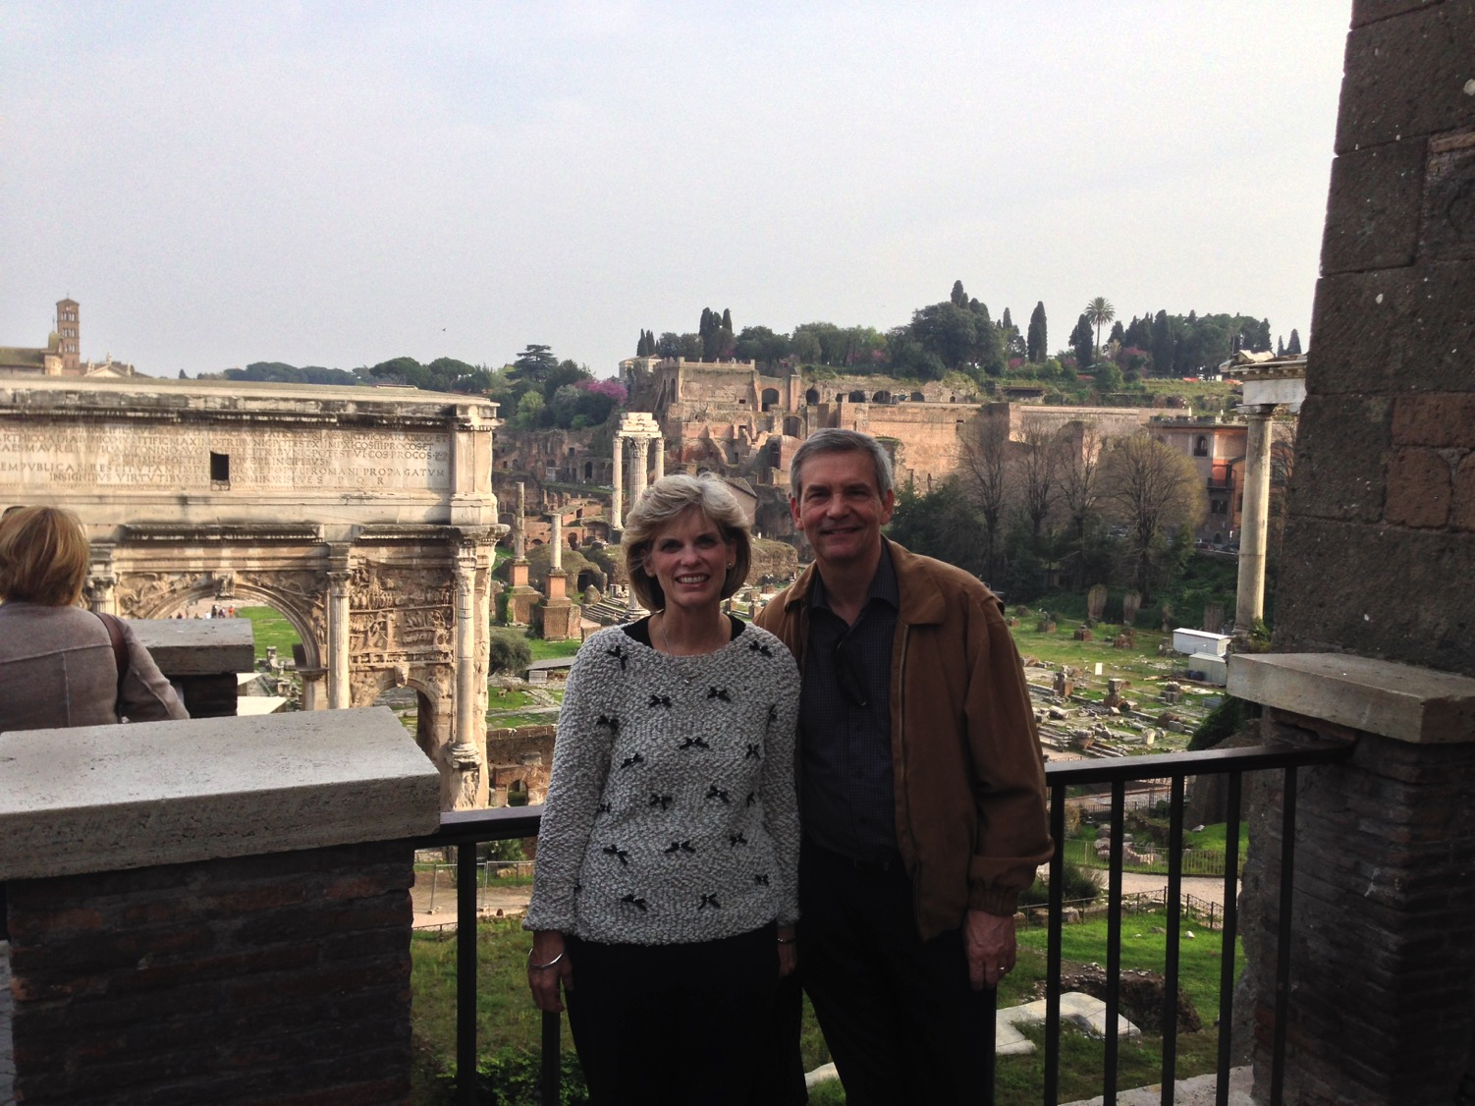
سوزان وريك أحرار بسبب
سجن بطرس وبولس
Notes:
The thought struck me that I could be free to visit the place 2000 years after Paul lost his freedom on this street. He even lost his life.

Slide 101
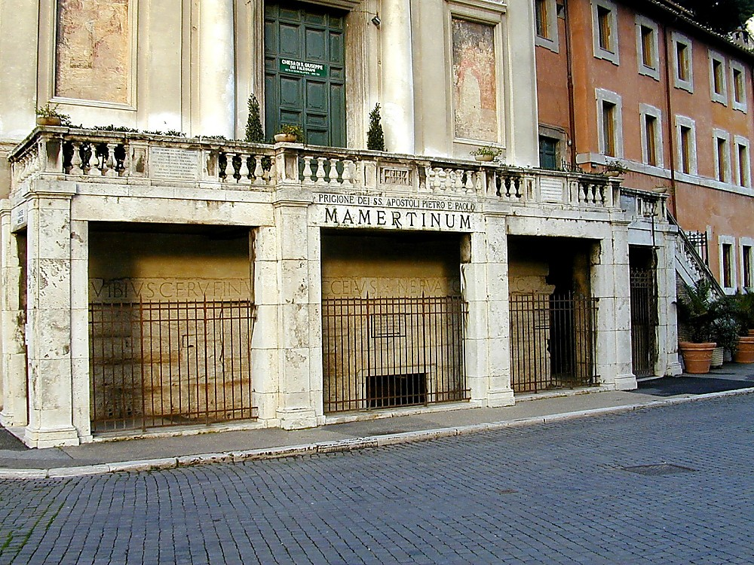
سجن الرسل بطرس و بولس في مامرتين
Notes:
Tourists can visit the prison for a small sum—if you can find it!
—Todd Bolen, BiblePlaces.com

Slide 102
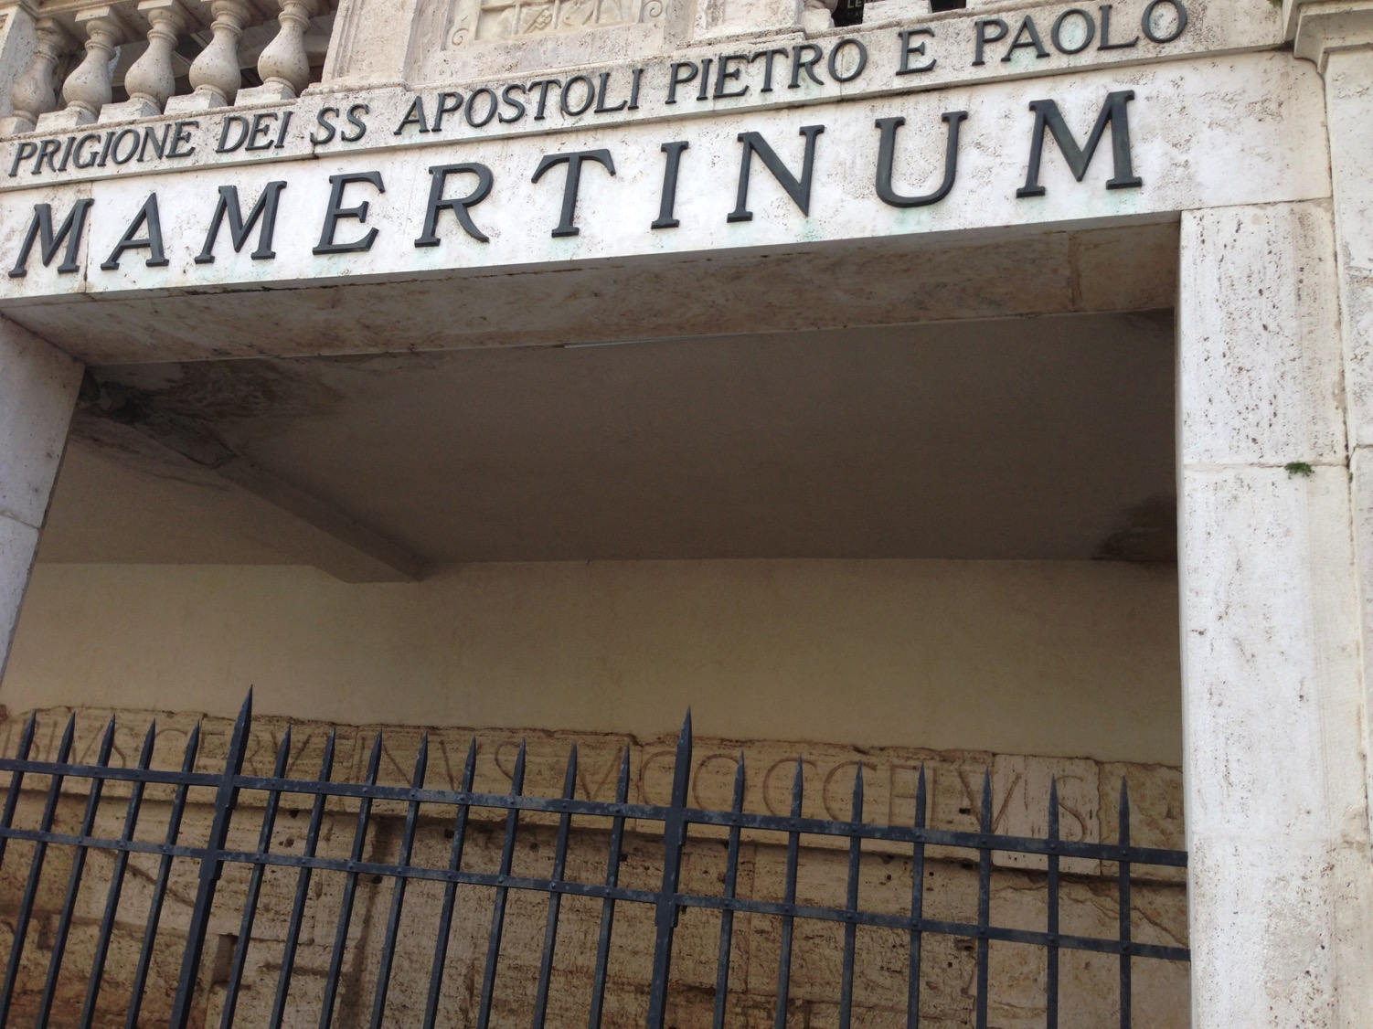
سجن الرسل بطرس وبولس في مامرتين
Notes:
These two most prominent apostles, interestingly, were imprisoned in the same cell but three years apart.

Slide 103
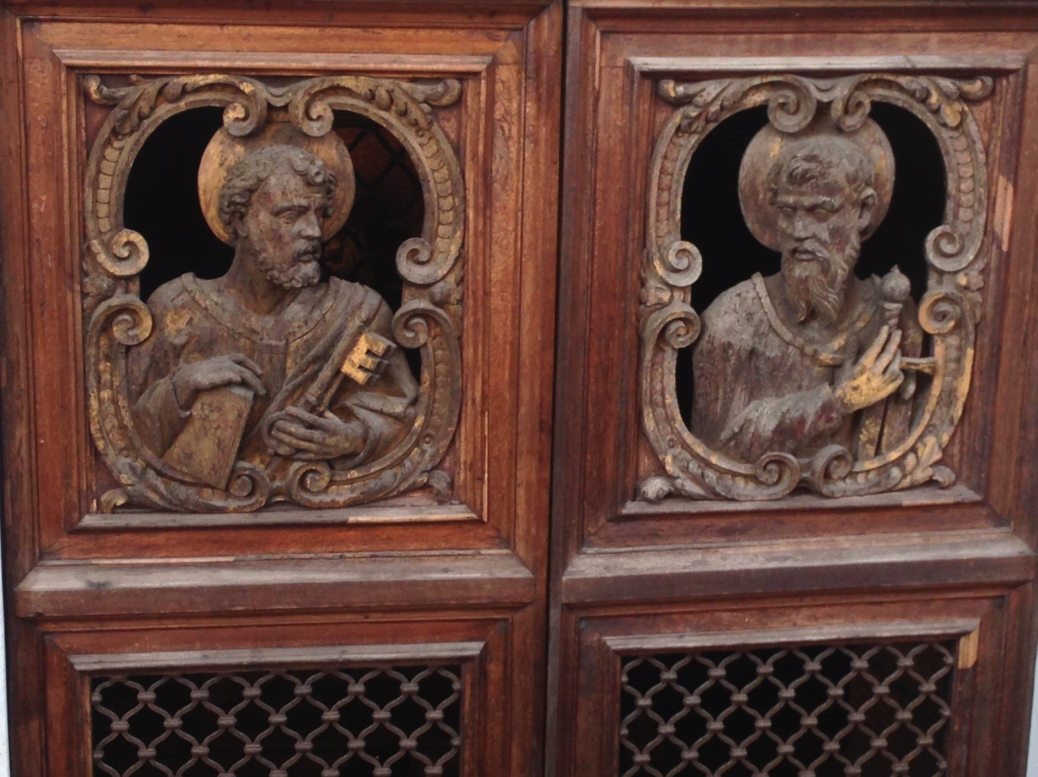
أبواب مامرتين تصور بطرس وبولس
Notes:
Both went through doors like this (AD 64 for Peter, AD 67 for Paul).

Slide 104
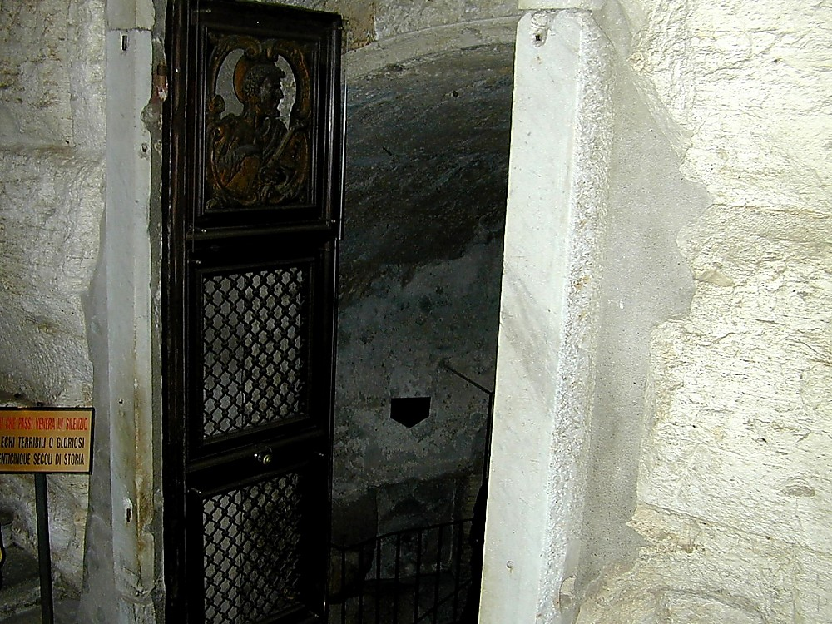
مدخل سجن مارمرتين
Notes:
It is a simple building of stone and iron.

Slide 105

جولة في مامرتين
Notes:
Given Peter’s stature as supposedly the first Pope there in Rome, he is given priority over Paul.

Slide 106

غرفة مامرتين العليا تماثيل نصفية لبطرس وبولس
Notes:
At the ground level is an altar to these great apostles. Yet they had little time at this level, for they were lowered into a hole in the floor and kep below.

Slide 107

تم إنزال السجناء من خلال فتحة التفتيش إلى الخزان السابق أدناه
Notes:
The Carcer was the only prison in ancient Rome. It had two sections, an upper and a lower; the upper was known as the "Carcer" proper, while the lower (originally thought to have been a cistern) was known as the "Tullianum." Those prisoners that entered the Tullianum from the Carcer were lowered through a hole in the Carcer's floor. The name "Tullianum" is probably derived from the Latin word for a spring of water, and incidentally, this section of the prison does, in fact, house a well. According to tradition, the Apostle Peter caused the well-water to spring up so that he might baptize his jailors, St. Processus and St. Martinianus. It is debated whether Peter was actually incarcerated here. —Todd Bolen, BiblePlaces.com

Slide 108

Mamertine Prison writing area and door
منطقة الكتابة وباب سجن مامرتين
Notes:
The state rarely incarcerated common criminals but kept the Mamertine Prison for political prisoners doomed for execution by being thrown off the Tarpeian Rock. Enemies of the State, such as Jugurtha and Vercingetorix, were often strangled in the Tullianum. Sallust, a Roman writer in 40 B.C., described the Tullianum as "about twelve feet deep, closed all round by strong walls and a stone vault. Its aspect is repugnant and fearsome from its neglect, darkness, and stench."
—Todd Bolen, BiblePlaces.com

Slide 109

أسفل الدرج
Notes:
Now steps have been added so people like me and you can descend into the lower level that Paul had to enter via the hole.

Slide 110

زنزانة بطرس (64 م) وبولس (67-68 م) أدناه
Notes:
When told that he would die by crucifixion, Peter felt he was not worthy to die by the same means as Jesus. He requested to be crucified upside down, and the Romans obliged. The altar recalls this with an upside down cross.

Slide 111
كيف يمكنك أن تكون مثابراً وسط الإرتداد؟
طريقتين
2 تيموثاوس
Notes:
What can you do now to make sure you are following the Lord faithfully in the future?

Slide 112
كيف تبقى هناك ....
بإخلاص
أطع
كلمة
الله
2 تيموثاوس
1-2
Notes:
Consistently follow what God says (1-2)

Slide 113
2 تيموثاوس 1

Slide 114
2 تيموثاوس
الخطوط العريضة
237
صوت العقيدة ضد المقاومة
الثبات في التجارب الحاضرة |  | الثبات في التجارب المستقبلية
الإصحاحات 1 - 2 |  | الإصحاحات 3 - 4
أمثلة على الأمانة 1 | مميزات الأمانة 2 | المشكلة : الإرتداد 3: 1 - 9 | الحل : اكرز بالكلمة 3: 10- 4: 5 | أمل بولس 4: 6- 22
أفنيكي لوئيس بولس أونيسيفورس | التلمذة فكر واحد مطيع مجتهد كتابي مقدس وديع | عدم التقوى النفاق والرياء | الوعظ الثبات التوبيخ التشجيع الكرازة | استشهاد خيانات تحيات مباركة
روما إلى أفسس
خريف 67 ب. م ( السجن الروماني الثاني )

Slide 115
استقبل بولس تيموثاوس بموقفه المثابر في وجه الموت (1: 1-2)

Slide 116

1 بولس رسول يسوع المسيح بمشيئة الله، لأجل وعد الحياة التي في يسوع المسيح.
(2 تيموثاوس 1: 1)

Slide 117
2 إلى تيموثاوس الإبن الحبيب: نعمة ورحمة وسلام من الله الآب والمسيح يسوع ربنا.
(2 تيموثاوس 1: 2)

Slide 118
يجب على تيموثاوس أن يقتدي بأمانة الآخرين رغم كثرة الذين سقطوا (١: ٣-١٨)

Slide 119
تعلم الأمانة من أمه وجدته في رسامته
(1: 3-7)

Slide 120

الموضوع الرئيسي 1 : الأمانة
2 تيموثاوس
أمثلة عن الأمانة
أ. تعلم من أمه أفنيكي وجدته لوئيس (1: 3-7)
تعلم تيموثاوس في ​​منزله المختلط الوالدين، حيث كانت النساء في حياته قدوة للإخلاص في التعاملات اليومية.

Slide 121

الموضوع الرئيسي 1 : الأمانة
2 تيموثاوس
ب. تعلم من بولس (1: 8-14)
بقي بولس أميناً في الأوقات الصعبة لأنه آمن ووثق بالله بأن يحفظه حتى النهاية
(1: 11-12)

Slide 122
يجب أن يعاني بشجاعة من عذاب نيرون مثل بولس من خلال قوة الإنجيل (1: 8-14)

Slide 123
8 فلا تخجل بشهادة ربنا ولا بي أنا أسيره، بل اشترك في احتمال المشقات لأجل الإنجيل بحسب قوة الله 9 الذي خلصنا ودعانا دعوة مقدسة، لا بمقتضى أعمالنا بل بمقتضى القصد والنعمة التي أعطيت لنا في المسيح يسوع قبل الأزمنة الأزلية
(2 تيموثاوس 1: 8-9)

Slide 124
٢ تيموثاوس ١ : ١٠-١١
10 وإنما أظهرت الآن بظهور مخلصنا يسوع المسيح، الذي أبطل الموت وأنار الحياة والخلود بواسطة الإنجيل 11 الذي جعلت أنا له كارزاً ورسولاً ومعلماً للأمم.

Slide 125

12 لهذا السبب أحتمل هذه الأمور أيضاً، لكنني لست أخجل لأنني عالم بمن آمنت، وموقن أنه قادر أن يحفظ وديعتي إلى ذلك اليوم.
(2 تيموثاوس 1: 12)

Slide 126

أنا عالم بمن آمنت
CCLI Song # 31762
© Words: Public Domain | Music: Public Domain
For use solely with the SongSelect®. Terms of Use. All rights reserved. www.ccli.com
CCLI License # 277507

Slide 127
لا أعرف لماذا نعمة الله العجيبة
التي جعلها معروفة لي
ولا لماذا فأنا لا أستحق محبة المسيح
افتداني من أجل خاصته.

Slide 128
ولكن أنا أعرف من آمنت،
ومقتنع أنه قادر
ليحافظ على ما التزمت به
له في ذلك اليوم.

Slide 129
لا أعرف ما هو الخير أو الشر
يمكن أن يكون محفوظاً بالنسبة لي،
من الطرق المرهقة أو الأيام الذهبية،
أمام وجهه أرى.

Slide 130
ولكن أنا أعرف من آمنت،
ومقتنع أنه قادر
ليحافظ على ما التزمت به
له في ذلك اليوم.

Slide 131
لا أعلم متى يأتي ربي،
في الليل أو في فترة الظهيرة،
ولا إن كنت سأسير في الوادي معه،
أو ألتقي به في الهواء.

Slide 132
ولكن أنا أعرف من آمنت،
ومقتنع أنه قادر
ليحافظ على ما التزمت به
له في ذلك اليوم.

Slide 133
لا أعرف ما هو الخير أو الشر
الذي يمكن أن يبقى لي
من الطرق المتعبة أو الأيام الذهبية
أمام وجهه الذي أرى.

Slide 134
ولكن أنا أعرف من آمنت،
ومقتنع أنه قادر
ليحافظ على ما التزمت به
له في ذلك اليوم.

Slide 135
لا أعلم متى يأتي ربي،
في الليل أو في فترة الظهيرة،
ولا إن كنت سأسير في الوادي معه،
أو ألتقي به في الهواء.

Slide 136
ولكن أنا أعرف من آمنت،
ومقتنع أنه قادر
ليحافظ على ما التزمت به
له في ذلك اليوم.

Slide 137
أنا عالم بمن آمنت
لا أعرف لماذا نعمة الله العجيبة
لقد أخبرني،
ولا لماذا لا يستحق المسيح في الحب
افتداني لخاصته
الجوقة:
لكني أعرف بمن آمنت
ومقتنع أنه قادر
لأحفظ ما عاهدته عليه في ذلك اليوم
لا أعرف ما هو الخير أو الشر
يمكن أن تكون محفوظة بالنسبة لي،
من الطرق المرهقة أو الأيام الذهبية
أمام وجهه أرى.
2 تيموثاوس 1: 12

Slide 138

٢ تيموثاوس ١ : ١٣-١٤
13 تمسك بصورة الكلام الصحيح الذي سمعته مني، في الإيمان والمحبة التي في المسيح يسوع 14 احفظ الوديعة الصالحة بالروح القدس الساكن فينا.

Slide 139
هجر المؤمنون الآسيويون بولس لكن أنيسيفورس وضع مثالاً أمينًا (١: ١٥-١٨)

Slide 140
السجن الثاني في روما (67-68 م)
15 أنت تعلم هذا أن جميع الذين في أسيا ارتدوا عني الذين منهم فيجلس وهرموجانس
(2 تي 1: 15)
Notes:
Seven years later the first imprisonment under house arrest, the situation was entirely different. Nero had initiated a persecution of believers and it was very unpopular to be a Christian. May had denied the faith and most had gone underground to the catacombs if they still continued in the faith.

Slide 141

الموضوع الرئيسي 1 : الأمانة
2 تيموثاوس
  ت. تعلم من أنيسيفورس (1: 15-18)
  كان أنيسيفورس غير خجل ليعرف بأنه صديق بولس عندما كان سجيناً ، لقد بحث عن بولس بإخلاص ووجده

Slide 142
2 تيموثاوس 2

Slide 143
إن معرفة شكل الأمانة يساعدنا على المثابرة
تحت التجربة (2 تي 2)

Slide 144
كمعلم متلمذ استثمر في الآخرين التعليم الذي تلقيته (2: 1-2)

Slide 145

٢ تيموثاوس ٢ : ١
1 فتقو أنت يا ابني بالنعمة التي في المسيح يسوع.

Slide 146

التلمذة
.... تلمذوا جميع الأمم .... (مت 28: 19)
لكن كيف؟
Notes:
We all know that our basic calling is to make disciples among the nations.

Slide 147



ضاعف نفسك في أشخاص أمناء
2 وما سمعته مني بشهود كثيرين، أودعه أناساً أمناء، يكونون أكفاء أن يعلموا آخرين أيضاً.
(2 تي 2: 2)
التلمذة
بولس
تيموثاوس
رجال أكفاء
آخرين
Notes:
Get mentored by godly people (2 Tim. 2:2).

Slide 148

مستويات
التلمذة
مشجع (بولس)
نظير
نظير
(نيموثاوس)
متشجع (آخرين)
Notes:
Each of us should be like Timothy to learn from someone more mature than us, and also be a "Paul" to someone less mature to help that person grow in Christ.

Slide 149

مجموعات
الحياة
المتغيرة
التعهد : تقابل لمدة ساعة أسبوعياً مع شخص أو شخصين آخرين من نفس الجنس لتقديم المحاسبية في ثلاث نقاط :
1. اعترف بخطية في حوالي 10 أسئلة
2. اقرأ 3 اصحاحات من الكتاب المقدس يومياً
3. صلِّ من أجل الأصدقاء الضالين
شركاء التضاعف في الكنيسة ––www.CMAResources.org
Notes:
How can you mentor and get mentored? Life Transformation Groups are 2-3 people meeting weekly for accountability.
An LTG has 2-3 persons committed to growing spiritually. They meet in a home, restaurant, church, business, or wherever they can have a 60-minute accountability session each week.

Slide 150


مجموعات
الحياة
المتغيرة
شركاء تضاعف الكنيسة––www.CMAResources.org
Notes:
No LTG should be larger than 3 people. Once a member invites a 4th person and it is shown that this 4th person will be committed to the LTG concept, the group of 4 multiplies into 2 groups of 2 persons. The additional members can be believers or unbelievers, as long as they are committed to confession, Bible reading, and prayer.

Slide 151




مجموعات
الحياة
المتغيرة
شركاء تضاعف الكنيسة ––www.CMAResources.org
Notes:
Ideally, the church is then composed of many LTG groups at different stages, growing to multiply more groups so that accountability remains intact in a small group for each person.

Slide 152


طلاب كلية سنغافورة للكتاب المقدس
أمريكا
منغوليا
اليابان
كوريا
الصين
هونغ كونغ
ميانمار
الهند
تايلاند
فيتنام
الفلبين
ماليزيا
سنغافورة
سريلانكا
أندونيسيا
SBC
Notes:
These faithful leaders are from about 25 countries who come to us in Singapore for masters and doctoral-level training. We train them to build into others back in their home countries.

Slide 153
كجندي صالح أظهر التزاماً لا يتزعزع لإرضاء رئيسك يسوع (2: 3-4)

Slide 154
خصائص الأمانة
2 تيموثاوس
  الجندي (2: 3-4) على الجندي أن يعاني الصعوبات وأن ينفصل عن كل الأعمال الدنيوية الأخرى ليكون مخلصاً لقائده.

Slide 155

3 فاشترك أنت في احتمال المشقات كجندي صالح ليسوع المسيح 4 ليس أحد وهو يتجند يرتبك بأعمال الحياة لكي يرضي من جنده.
(2 تيموثاوس 2: 3-4)

Slide 156

وحدة في المعركة
Notes:
When we all wear the armor, we can both attack enemy strongholds and also defend from Satan’s attacks.

Slide 157

السلحفاة
= التقدم معاً
Notes:
Believers who are united in direction can advance the gospel where they otherwise would be unprotected.

Slide 158

حماية بعضنا بعضاً
Notes:
When we all wear the armor, we defend not only ourselves from attack—we defend one another.

Slide 159


Slide 160

Roman Soldiers

Slide 161

Roman Soldiers

Slide 162
خبر عاجل

Slide 163


نأسف لإبلاغكم بأن رئيس الوزراء لي هسين لونج قد تم اختطافه للتو من إستانا...

Slide 164

مع ذلك تم إرسال مجموعة النخبة من الكوماندوز لإنقاذ رئيس الوزراء.

Slide 165

سيكون العمل شاقاً، هل تستطيع تحمله؟

Slide 166
للأسف، أحد هؤلاء الكوماندوز لم يستطيع التغلب على رغبات الشباب الشريرة ...

Slide 167

Bailing out…
لم يستطع شخص آخر تحمل الحرارة (التجارب)

Slide 168
مثل رياضي ناجح أطِع قواعد كلمة الله
(2: 5)

Slide 169

صفات الأمانة
2 تيموثاوس
  2. الرياضي (2: 5) – الرياضي يجب أن يتبع القوانين للفوز بالسباق
Notes:
Like a successful athlete, obey the rules in God's Word (2:5).
One of those rules historically has been that men cannot compete in women's sports—even if they claim to be a woman. But no longer…

Slide 170
مثل مزارع مجتهد تمتع بفرح الثمر الروحي
مثل يسوع بعد أن قام (2: 6-13)

Slide 171
صفات الأمانة
2 تيموثاوس
  3. المزارع (2: 6-13) – المزارع يجب أن يعمل بجد ليحصل على حصاد جيد
الأمانة = الولاء للمسيح قائدنا لنتبع قانون الله ونعمل بجد

Slide 172
٢ تيموثاوس ٢ : ٨-١٠
8 أذكر يسوع المسيح المقام من الأموات، من نسل داود بحسب إنجيلي 9 الذي فيه أحتمل المشقات حتى القيود كمذنب، لكن كلمة الله لا تقيد 10 لأجل ذلك أنا أصبر على كل شيء لأجل المختارين، لكي يحصلوا هم أيضاً على الخلاص الذي في المسيح يسوع مع مجد أبدي.

Slide 173

2 تيموثاوس 2 : 11-13
11 صادقة هي الكلمة: أنه إن كنا قد متنا معه فسنحيا أيضاً معه.
12 إن كنا نصبر فسنملك أيضاً معه، إن كنا ننكره فهو أيضاً سينكرنا.
13 إن كنا غير أمناء فهو يبقى أميناً، لن يقدر أن ينكر نفسه.

Slide 174

٢ تيموثاوس ٢ : ١٢
إن كنا نصبر
فسنملك أيضاً معه

Slide 175

2 تيموثاوس 2: 15
اجتهد أن تقيم نفسك
لله
مزكى
عاملاً
لا
يُخزى
مفصلاً كلمة
الحق
بالإستقامة

Slide 176
مثل عامل بلا خجل، حارب البدع بالكتاب المقدس - وليس بالكلمات البشرية (2: 14-19)

Slide 177

٢ تيموثاوس ٢ : ١٥
اجتهد أن تقيم نفسك لله
مُزَكّىً
عاملاً لا يُخزى
مفصلاً كلمة الحق بالإستقامة

Slide 178
حماية من المعلمين الكذبة
(2 تي 2: 14-26)
احمي القطيع
(14-19)
احمي الراعي
(20-26)

Slide 179

٢ تيموثاوس ٢ : ١٦-١٨
16 وأما الأقوال الباطلة الدنسة فاجتنبها، لأنهم يتقدمون إلى أكثر فجور 17 وكلمتهم ترعى كآكلة الذين منهم هيمينايس وفيليتس.
18 اللذان زاغا عن الحق قائلين: إن القيامة قد صارت فيقلبان إيمان قوم.

Slide 180

٢ تيموثاوس ٢ : ١٩
19 ولكن أساس الله الراسخ قد ثبت، إذ له هذا الختم: يعلم الرب الذين هم له. وليتجنب الإثم كل من يسمي اسم المسيح.

Slide 181

الثقة في يوم الدينونة
19 ولكن أساس الله الراسخ قد ثبت، إذ له هذا الختم: يعلم الرب الذين هم له.
2 تيموثاوس 2: 19

Slide 182
مثل إناء للكرامة بدلاً من إناء للهوان، كن نقياً لتجنب المعلمين الكذبة (2: 20-22).

Slide 183
مثل إناء لطيف علم المعلمين الكذبة بلطف بدلاً من الجدال معهم (2: 23-26)

Slide 184

التوزيع الديني في سنغافورة
4%
7ر0%
5ر8%
5ر42%
البوذيون
البوذيون
المسلمون
6ر14%
المسيحيون
اللادينيون
المسيحيون
اللادينيون
الطاويون
الهندوس
8ر14%
أخرى
المسلمون
9ر14%
ستريتس تايمز 14 يناير 2013
Notes:
Singapore may have seen church growth, but it is only a microcosm of the world as a whole. Even here, the increase of so-called "free thinkers" who claim no religion continues to increase. Christians are afraid to share their faith in the marketplace and are going underground in many ways, fearing they might lose their job.
http://therealsingapore.com/content/op-ed-straits-times-different-under-god

Slide 185
كيف تستطيع أن تكون مثابراً وسط الإرتداد؟
2 تيموثاوس
Notes:
What can you do now to make sure you are following the Lord faithfully in the future?

Slide 186
كيف تبقى هناك
بأمانة؟
أطع
كلمة
الله
عظ
كلمة
الله
و
2 تيموثاوس
1-2
2 تيموثاوس
3-4
Notes:
Consistently follow what God says (1-2)
Consistently tell others what God says (3-4)

Slide 187
2 تيموثاوس 3

Slide 188
قبل عودة المسيح تجنب المعلمين الكذبة الذين يتكلمون بسلاسة لكنهم غير مؤمنين (3: 1-9)

Slide 189

كيف نتعامل مع العلمانية
2 تيموثاوس 3
د. ريك جريفيث• مؤسسة الدراسات اللاهوتية الأردنية• BibleStudyDownloads.org

Slide 190

لا يوجد إله
كيف يجب أن تتعامل مع العلمانية؟
2 تيموثاوس 3
يعطينا طريقتين
Notes:
How should you deal with secularism? How should believers respond to the increasing godlessness of our age?

Slide 191

تجنب
المعلمين
الكذبة
(3: 1-9)
Notes:
How else can we deal with heretics besides avoiding them? What are those efforts that will last? Paul says, "But you…" in verse 10 to give us what to do instead of following godless teachers. We can deal with secularism when we…

Slide 192

1 ولكن اعلم هذا أنه في الأيام الأخيرة ستأتي أزمنة صعبة
(3: 1)
Notes:
We are promised difficulty (3:1).
Paul was experiencing great trials when he wrote this.

Slide 193
الموضوع الرئيسي الثاني: الإرتداد
2 تيموثاوس
- سجل بولس 19 صفة للايام الأخيرة والتي
ترينا علامات العقيدة الخاطئة (3: 1-5)
- تكلم بولس عن وقت عندما يرفض الناس
العقيدة السليمة (4: 3-4)
- نصح بولس تيموثاوس أن يبقى بعيداً عن
هؤلاء الناس (3: 5-8)
Notes:
Many were falling away just before Paul's death, he carefully chose his words in perhaps his last statements to Timothy in order to assure that Timothy himself would remain true to the faith until death. Paul did this end by exhorting him to persevere in present hardships with godly character (2 Tim. 1–2). This included several examples of faithfulness (1:3-18) as well as what perseverance looks like in his list of the characteristics of a faithful minister (2:1-26).

Slide 194
٢ تيموثاوس ٣ : ١
ولكن اعلم هذا أنه في الأيام الأخيرة ستأتي أزمنة صعبة
Notes:
When did the "last days" begin and are we in the "last days" today?
This period began in the first century. Paul noted in 1 Timothy 4:1 that apostasy would characterize the "last days," and Jude 18 applies this his own time in the first century.
These "last days" then continue up to the present time and until Christ's return.

Slide 195

ستكون الحياة صعبة لأن الأشرار يخدعون الآخرين (3: 2-5أ)

Slide 196

19 صفة للمرتدين (3: 1-5)
2 تيموثاوس
محبين لأنفسهم
محبين للمال
متعظمين
مستكبرين
مجدفين
غير طائعين لوالديهم
غير شاكرين
دنسين
بلا حنو
بلا رضى
ثالبين
عديمي النزاهة
شرسين
غير محبين للصلاح
خائنين
مقتحمين
متصلفين
محبين للذات دون محبة الله
لهم صورة التّقوى ولكنهم منكرون قوتها
Notes:
Paul lists 19 characteristics of secular people who actually do not appear so secular, as they have a religious nature about them. It is a very sobering list.
Verses 2-5 give 19 sad traits of people in general.
This is followed by the characteristics of religious leaders in verses 6-9.
Beginning in verses 6-7, "Paul focused on the specific situation in Ephesus. It was from the increasingly large group in society who displayed the preceding characteristics that the false teachers had emerged to plague the church" (BKC).

Slide 197

ماذا يجب أن نفعل؟
خطر
Notes:
What should we do with such people? Should we confront them? Should we debate them? No. Paul says to…

Slide 198

تجنب القادة الكذبة
فأعرض عن هؤلاء
(2 تي 3: 5ب فاندايك)
فابتعد عن هؤلاء
(2 تي 3: 5ب المبسطة)
Notes:
The advice to us today is often to engage with false teachers. However, Paul's meaning here is to "purposely to avoid associating with someone, turn away from, avoid" (BDAG).

Slide 199

تجنب القادة الملحدين
Notes:
But how could Timothy avoid godless people when they were all around him (5b)? "No doubt Paul had in mind here Timothy's official associations, since he had already instructed Timothy to be kind to everyone (cf. 2 Tim. 2:24)" (BKC)
(But why should we avoid associations with such heretical leaders? It is because…)

Slide 200

6 فإنه من هؤلاء هم الذين يدخلون البيوت، ويسبون نسيات محملات خطايا، منساقات بشهوات مختلفة.
7 يتعلمن في كل حين، ولا يستطعن أن يقبلن إلى معرفة الحق أبداً.
(2 تي 3: 6-7)
Notes:
Heretics are doomed despite their popularity (3:6-9).
Gullible women loved the latest heresy (3:6-7).
(Why is it a waste of time listening to heretics?)

Slide 201

الوعط المسر للناس

Slide 202

8 وكما قاوم ينيس ويمبريس موسى، كذلك هؤلاء أيضا يقاومون الحق. أناس فاسدة أذهانهم ومن جهة الإيمان مرفوضون 9 لكنهم لا يتقدمون أكثر، لأن حمقهم سيكون واضحاً للجميع، كما كان حمق ذينك أيضاً.
(3: 8-9)
Notes:
Godless teachers are doomed due to their depraved minds that reject truth (3:8-9).
"The reference to Jannes and Jambres and their opposition to Moses draws not on the Old Testament but on a widespread Jewish legend about two of Pharaoh's magicians who competed against Moses and lost (cf. Ex. 7:11; 9:11). The comparison between the false teachers and the Egyptians, and implicitly therefore Timothy and Moses, must have encouraged the young minister" (BKC).
————————
Common Core State Standards in Mathematics, Grades 3–8
In this timely and practical course, Dr. Kanold and Dr. Briars explain both the whys and the how-tos for implementing the CCSS
http://www.solution-tree.com/authors/tim-kanold/ccss-math-3-8-online-course.html

Slide 203

شكراً لك على عدم تشويش عقلك
يتم الكشف عن قيمنا من خلال ما نعتبره قمامة. يريد الله منا اليوم أن نستثمر طاقاتنا في جهود تدوم.

Slide 204
تجنب
المعلمين
الكذبة
(3: 1-9)
Notes:
How else can we deal with heretics besides avoiding them? What are those efforts that will last? Paul says, "But you…" in verse 10 to give us what to do instead of following godless teachers. We can deal with secularism when we…

Slide 205
اقبل وعظ كلمة الله كما يجب أن تتمم كل مسؤوليات الخدمة (3: 10-4: 5)

Slide 206

اقبل الحق (3: 10-17)
Notes:
Feed yourself reality from God's servants and God's Word.

Slide 207
٢ تيموثاوس ٣ : ١٠-١٧
10 وأما أنت فقد تبعت تعليمي، وسيرتي، وقصدي، وإيماني، وأناتي، ومحبتي، وصبري،
11 واضطهاداتي، وآلامي، مثل ما أصابني في أنطاكية وإيقونية ولسترة، أية اضطهادات احتملت ومن الجميع أنقذني الرب.

Slide 208
٢ تيموثاوس ٣ : ١٠-١٧
12 وجميع الذين يريدون أن يعيشوا بالتقوى في المسيح يسوع يضطهدون 13 ولكن الناس الأشرار المزورين سيتقدمون إلى أردأ، مضلين ومضلين.

Slide 209
٢ تيموثاوس ٣ : ١٠-١٧
14 وأما أنت فاثبت على ما تعلمت وأيقنت، عارفاً ممن تعلمت 15 وأنك منذ الطفولية تعرف الكتب المقدسة، القادرة أن تحكمك للخلاص، بالإيمان الذي في المسيح يسوع.

Slide 210
٢ تيموثاوس ٣ : ١٠-١٧
16 كل الكتاب هو موحى به من الله، ونافع للتعليم والتوبيخ، للتقويم والتأديب الذي في البر 17 لكي يكون إنسان الله كاملاً، متأهباً لكل عمل صالح.

Slide 211

أ. اتبع خدام الله (3: 10-13)

Slide 212

10 وأما أنت فقد تبعت تعليمي، وسيرتي، وقصدي، وإيماني، وأناتي، ومحبتي، وصبري 11 واضطهاداتي، وآلامي، مثل ما أصابني في أنطاكية وإيقونية ولسترة، أية اضطهادات احتملت ومن الجميع أنقذني الرب.
(3 : 10-11)
Notes:
Follow Paul's example in suffering (3:10-11).
We often say, "Don't follow me. Follow Christ." That sounds humble, but people need to see contemporary examples of Jesus.
Paul said to follow Christ, but he also encouraged his readers to follow him. "Follow me, as I follow Christ" (Eph. 5:1)

Slide 213

توقع أن تتألم بسبب التقوى كما حدث مع بولس (2 تيموثاوس 3: 12)

Slide 214

12 وجميع الذين يريدون أن يعيشوا بالتقوى في المسيح يسوع يضطهدون 13 ولكن الناس الأشرار المزورين سيتقدمون إلى أردأ مضلين ومضلين.
14 وأما أنت فاثبت على ما تعلمت وأيقنت، عارفاً ممن تعلمت 15 وأنك منذ الطفولية تعرف الكتب المقدسة، القادرة أن تحكمك للخلاص، بالإيمان الذي في المسيح يسوع.
٢ تيموثاوس ٣ : ١٢-١٧

Slide 215
16 كل الكتاب هو موحى به من الله، ونافع للتعليم والتوبيخ، للتقويم والتأديب الذي في البر 17 لكي يكون إنسان الله كاملاً متأهباً لكل عمل صالح.
٢ تيموثاوس ٣ : ١٢-١٧

Slide 216

12 وجميع الذين يريدون أن يعيشوا بالتقوى في المسيح يسوع يضطهدون 13 ولكن الناس الأشرار المزورين سيتقدمون إلى أردأ مضلين ومضلين.
(2 تي 3: 12-13)

Slide 217

وجميع الذين يريدون أن يعيشوا بالتقوى في المسيح يسوع يضطهدون
(2 تي 3: 12)
Notes:
This verse seems so incredible to us that we strain at a gnat to explain it away. "Surely that look they gave me is a form of persecution!" we rationalize.
More likely, we are fooling ourselves into thinking that we are really living a godly life.

Slide 218

اضطهاد الأطفال
Notes:
We need not look too far to find examples of the godly facing persecution. In fact, in 2014 we heard of examples of even Christian children in Iraq who refused to deny Christ and were literally crucified and beheaded as a result.
Perhaps it is time to realize that this verse really isn't as perplexing as it seems. More perplexing is our ability to explain it away.

Slide 219

٢ تيموثاوس ٣ : ١٣
ولكن الناس الأشرار المزورين سيتقدمون إلى أردأ، مضِلين ومضَلين.
Notes:
Here is why we need godly examples: the ungodly ones are sure to increase.
The very deceptive part is that when a person is deceived, he doesn't even know it. That is why he is deceived! Are you?

Slide 220
كيف نقبل الحق بدلاً من الكذب؟
الحق
الأكاذيب
Notes:
How can we accept truth instead of lies?

Slide 221
أ. اتبع خدام الله (3: 10-13)
Notes:
Godly examples can help, but there must be an absolute standard, so Paul also says to…

Slide 222

ب. اتبع كلمة الله (3: 14-17)

Slide 223

٢ تيموثاوس ٣ : ١٤-١٥
14 وأما أنت فاثبت على ما تعلمت وأيقنت، عارفاً ممن تعلمت 15 وأنك منذ الطفولية تعرف الكتب المقدسة، القادرة أن تحكمك للخلاص ...
Notes:
Stay true to God's truth that you learned (3:14-15a).
We must remain, abide, or stay (BDAG) faithful to the truth (3:14a).
Paul gives two reasons we must keep the truth (3:14b-15a).
(1) Our teachers are trustworthy (3:14a).
Timothy first learned from his believing mother and grandmother (cf. 2 Tim. 1:5; Acts 16:1).
Paul later referred to him as his "son" in the faith (1 Tim. 1:2; 2 Tim. 1:2).
(But how can teachers be trustworthy?)
(2) They are trustworthy because they taught us the Bible (3:15a).
Survey any Christian gathering and you will find that most trusted Christ before age 18.
We cannot overemphasize how vital it is to train children in God's Word.
(But why is teaching the Bible so important?)

Slide 224

بركات كلمة الله (3: 15ب – 17)
Notes:
Why is teaching the Bible so important?
Because when you continue in God's Word it blesses you in many ways (3:15b-17)

Slide 225

٢ تيموثاوس ٣ : ١٥
الكتب المقدسة القادرة أن تحكمك للخلاص بالإيمان الذي في المسيح يسوع.
Notes:
Scripture gives us wisdom to accept Christ (3:15b).
True wisdom focuses on what's most important.
Since the Scripture is genuine wisdom, it helps us trust in the only source of salvation—Christ Jesus.

Slide 226

٢ تيموثاوس ٣ : ١٦
كل الكتاب هو موحى به من الله
Notes:
Scripture comes from God's own "mouth" (3:16a).

Slide 227

كل الكتاب هو موحى به
(2 تيموثاوس 3: 16أ)
Notes:
The Greek word for "inspiration" literally means "God-breathed."

Slide 228

كل الكتاب هو موحى به
(2 تيموثاوس 3: 16أ)
Notes:
True, God used people, but his Spirit spoke through them so the Scriptures are without error.

Slide 229

لماذا كلمة الله مفعمة بالحيوية جداً؟
16 كل الكتاب هو موحى به من الله، ونافع للتعليم والتوبيخ، للتقويم والتأديب الذي في البر 17 لكي يكون إنسان الله كاملاً متأهباً لكل عمل صالح.
٢ تيموثاوس ٣ : ١٦-١٧

Slide 230

أربع نتائج لكلمة الله
التقويم
التوبيخ
التأديب
(في البر)
التعليم
2 تيموثاوس 3: 16-17
Notes:
If you read sequentially through the Bible, you will have the divine balance in these four areas:
Teaching tells people how to walk God's road
Rebuking tells them when they get off the path
Correcting shows how to get back to the right way
Training in righteousness is the result of the cycle of teaching, rebuking and correcting over and over.

Slide 231
الموضوع الرئيسي الثالث: الكتاب المقدس
2 تيموثاوس
نظرة بولس للكتاب المقدس
  أ. وحي / أنفاس الله (3: 16، 2 بط 1: 21)
  ب. نافعة (3: 17)
  - التعليم
  التوبيخ
  التقويم
  التأديب الذي في البر
الغرض من ذلك هو تجهيزنا لنكون كاملين وقادرين وأكفاء... لتلبية جميع المطالب ضد التعاليم الكاذبة والقيام بالأعمال الصالحة.
Notes:
Scripture equips us to do every good work (3:17).
To do a job well, we need the right tools. The Bible doesn't just make us "adequate" in a limited sense. The Greek word here is "fully qualified" or "complete, capable, proficient in the sense of being able to meet all demands" (BDAG).
The result of all these benefits is that we have the tools to do any good deed.

Slide 232

كيف تكون
علمانياً؟
Notes:
So we live in a world that is increasingly secular.

Slide 233

كل الديانات متساوية
Notes:
We are told lies like all the world's religions are the same.

Slide 234

كل الديانات متساوية
Notes:
Many seek to combine them all as if there is no real truth.

Slide 235
ليس هناك إله
كيف يجب أن تتعامل مع العلمانية؟
Notes:
So how should you deal with this kind of secularism—a kind that often portrays itself as having a form of godliness without God?

Slide 236

الفكرة الرئيسية
استبدل الأكاذيب بالحق
Notes:
Don't get sucked into secular thinking—but instead rely upon godly values, truth.
But how can you learn truth instead of lies?

Slide 237
تجنب
المعلمين
الكذبة
(3: 1-9)
Notes:
How else can we deal with heretics besides avoiding them? What are those efforts that will last? Paul says, "But you…" in verse 10 to give us what to do instead of following godless teachers. We can deal with secularism when we…

Slide 238
اقبل الحق (3: 10-17)
Notes:
Feed yourself reality from God's servants and God's Word.

Slide 239

Garbage in, Garbage out
Notes:
但是’垃圾进垃圾出’也是针对成年人的忠告

Slide 240
الموضوع الرئيسي الثاني: الإرتداد
2 تيموثاوس
هل لديك أشخاص كهؤلاء في كنيستك؟
تشتهي الأذنان ما يرضي ذوق القلب الجسدي العنيد. القلب الجسدي يفضل الأساطير التي لا معنى لها على الحقيقة الصلبة.

Slide 241
الملخص
2 تيموثاوس
239-240
1. يشجع بولس تيموثاوس أن يثابر خلال الصعوبات الحالية ويوضح الصفات التي ينبغي له أن يجسدها لمحاربة التعليم الكاذب والإرتداد (2 تي 1-2)
2. يحث بولس تيموثاوس أن يثابر في الضيقة المستقبلية وينثر فكره الإيجابي تجاه الموت لتشجيع تيموثاوس على الوعظ بالكلمة بكل أمانة بغض النظر عن الإرتداد المتزايد في التعليم والتطبيق (2 تي 3-4)

Slide 242
المفتاحية
2 تيموثاوس
237
العقيدة
الكلمة المفتاحية:
الآيات المفتاحية:
كل الكتاب هو موحى به من الله، ونافع للتعليم والتوبيخ، للتقويم والتأديب الذي في البر لكي يكون إنسان الله كاملاً متأهباً لكل عمل صالح ...
اكرز بالكلمة
( 3: 16- 17؛ 4: 2)

Slide 243
البيان الموجز
2 تيموثاوس
237
اكرز بالكلمة
HARDSHIP
HARDSHIP
طبِّق بأمانة

Slide 244
تطبيقات
2 تيموثاوس
1. هل أنت أنيسيفورس، تتمسك بالإعتراف المسيحي في وقت التجربة
والإضطهاد؟ ما هي خصائص الأمانة التي تمتلكها: ولاء الجندي،
وطاعة الرياضي، والعمل الجاد الذي يقوم به المزارع؟
2. هل يوجد مرتدين في خدمتك؟ ماذا يمكنك أن تفعل من أجل البقاء؟
3. فكر في نوع الشهادة التي ستكتبها في نهاية حياتك، ما هي كلمات
التشجيع والتحدي للجيل القادم؟

Slide 245
2 تيموثاوس 4

Slide 246
عظ وعش الحق في الضيق والتوبيخ والتشجيع والتبشير (4: 1-5)

Slide 247

1 أنا أناشدك إذاً أمام الله والرب يسوع المسيح، العتيد أن يدين الأحياء والأموات، عند ظهوره وملكوته: 2 اكرز بالكلمة، اعكف على ذلك في وقت مناسب وغير مناسب، وبخ انتهر عظ بكل أناة وتعليم.
(2 تيموثاوس 4: 1-2)

Slide 248
3 لأنه سيكون وقت لا يحتملون فيه التعليم الصحيح، بل حسب شهواتهم الخاصة يجمعون لهم معلمين مستحكة مسامعهم 4 فيصرفون مسامعهم عن الحق، وينحرفون إلى الخرافات.
(2 تيموثاوس 4: 3-4)
يصرفون مسامعهم
(apostrepho)
عن الحق
(2 تيموثاوس 4: 4)

Slide 249

5 وأما أنت فاصح في كل شيء، احتمل المشقات، اعمل عمل المبشر، تمم خدمتك.
(2 تيموثاوس 4: 5)

Slide 250
ضع رجائك في الله حتى الموت على الرغم من خيانة الأصدقاء (4: 6-18)

Slide 251
خريف 67 ب. م ( السجن الروماني الثاني )
٢ تيموثاوس ٤ : ٦-٧
6 فإني أنا الآن أسكب سكيباً ووقت انحلالي قد حضر.
7 قد جاهدت الجهاد الحسن، أكملت السعي، حفظت الإيمان

Slide 252

8 وأخيراً قد وضع لي إكليل البر، الذي يهبه لي في ذلك اليوم، الرب الديان العادل، وليس لي فقط، بل لجميع الذين يحبون ظهوره أيضاً.
(2 تيموثاوس 4: 8)

Slide 253
أصدقاء بولس خلال السجن الثاني في روما (67-68 م)
9 يا تيموثاوس بادر أن تجيء إليَّ سريعاً 10 لأن ديماس قد تركني إذ أحب العالم الحاضر وذهب إلى تسالونيكي، وكريسكيس إلى غلاطية، وتيطس إلى دلماطية 11لوقا وحده معي خذ مرقس وأحضره معك لأنه نافع لي للخدمة 12 أما تيخيكس فقد أرسلته إلى أفسس 13 الرداء الذي تركته في ترواس عند كاربس، أحضره متى جئت، والكتب أيضاً ولا سيما الرقوق 14 إسكندر النحاس أظهر لي شروراً كثيرة. ليجازه الرب حسب أعماله 15 فاحتفظ منه أنت أيضاً لأنه قاوم أقوالنا جداً.
(2 تي 4: 9-15)
Notes:
Life was lonely for a very relational man like Paul at this point. Most of his friends had either escaped Rome or fallen away from the Faith.

Slide 254
Paul's Second Imprisonment (AD 67-68)
في احتجاجي الأول لم يحضر أحد معي بل الجميع تركوني لا يحسب عليهم ولكن الرب وقف معي وقواني لكي تتم بي الكرازة ويسمع جميع الأمم فأنقذت من فم الأسد
(2 تي 4 : 16-17)
Notes:
Serving Jesus includes times when we feel like no one else is with us in terms of their presence and prayers. But Jesus remains, despite the failures of people.

Slide 255
٢ تيموثاوس ٤ : ١٨
18 وسينقذني الرب من كل عمل رديء ويخلصني لملكوته السماوي، الذي له المجد إلى دهر الدهور. آمين.

Slide 256
لا تهزم بالموت بل انتصر فيه وكن علائقياً من خلال كل تجربة (٤: ١٩-٢٢)

Slide 257

٢ تيموثاوس ٤ : ١٩-٢٠
19 سلم على فرسكا وأكيلا وبيت أنيسيفورس 20 أراستس بقي في كورنثوس، وأما تروفيمس فتركته في ميليتس مريضاً.

Slide 258

٢ تيموثاوس ٤ : ٢١-٢٢
21 بادر أن تجيء قبل الشتاء، يسلم عليك أفبولس وبوديس ولينس وكلافدية والإخوة جميعاً 22 الرب يسوع المسيح مع روحك، النعمة معكم. آمين.
Notes:
Due to double accents on theفَ , verse 21 shows وَكَلاَفَِدِيَّةُ incorrectly.

Slide 259
يستحق الأمر كل هذا العناء
في كثير من الأحيان يبدو اليوم طويلاً، وتجاربنا صعبة التحمل،
نحن نميل إلى الشكوى والتذمر واليأس.
ولكن المسيح سيظهر قريباً ليخطف عروسه بعيداً،
كل الدموع ستنتهي إلى الأبد في يوم الله الأبدي.
الجوقة:
سيكون الأمر يستحق كل هذا العناء عندما نرى يسوع،
سوف تبدو تجارب الحياة صغيرة جداً عندما نرى المسيح؛
لمحة واحدة من وجهه العزيز ستمحو كل الأحزان،
لذلك اركضوا بشجاعة في السباق حتى نرى المسيح.

Slide 260

يستحق الأمر كل هذا العناء
في بعض الأحيان تبدو السماء مظلمة مع عدم وجود شعاع من الضوء،
لقد تم إلقاؤنا ودفعنا للأمام، ولا توجد مساعدة بشرية في الأفق؛
ولكن هناك من في السماء يعرف مدى اهتمامنا العميق،
دع يسوع يحل مشكلتك، فقط اذهب إليه بالصلاة
الجوقة:
سيكون الأمر يستحق كل هذا العناء عندما نرى يسوع،
سوف تبدو تجارب الحياة صغيرة جداً عندما نرى المسيح؛
لمحة واحدة من وجهه العزيز ستمحو كل الأحزان،
لذلك اركضوا بشجاعة في السباق حتى نرى المسيح.

Slide 261
يستحق الأمر كل هذا العناء
سينتهي يوم الحياة قريباً، كل العواصف قد مضت إلى الأبد،
سوف نعبر الفجوة الكبيرة إلى المجد آمنين أخيراً؛
سوف نشارك أفراح السماء: قيثارة، بيت، تاج،
سيتم سبي المجرب، وسنضع أثقالنا.
الجوقة:
سيكون الأمر يستحق كل هذا العناء عندما نرى يسوع،
سوف تبدو تجارب الحياة صغيرة جداً عندما نرى المسيح؛
لمحة واحدة من وجهه العزيز ستمحو كل الأحزان،
لذلك اركضوا بشجاعة في السباق حتى نرى المسيح.

Slide 262
كيف تستطيع أن تكون مثابراً وسط الإرتداد؟
2 تيموثاوس
Notes:
What can you do now to make sure you are following the Lord faithfully in the future?

Slide 263
الفكرة الرئيسية
أطع وعظ كلمة الله بأمانة
2 تيموثاوس

Slide 264
كيف تبقى هناك
بأمانة؟
أطع
كلمة
الله
عظ
كلمة
الله
و
2 تيموثاوس
1-2
2 تيموثاوس
3-4
Notes:
Consistently follow what God says (1-2)
Consistently tell others what God says (3-4)

Slide 265

هل أنت متعب روحياً

Slide 266

— ماكس لوكادو —
لم يقل الله مطلقأ أن
الرحلة
ستكون سهلة
لكنه قال أن
الوصول
جدير بالإهتمام

Slide 267

المثابرة

Slide 268
3 لأنه سيكون وقت لا يحتملون فيه التعليم الصحيح، بل حسب شهواتهم الخاصة يجمعون لهم معلمين مستحكة مسامعهم 4 فيصرفون مسامعهم عن الحق، وينحرفون إلى الخرافات.
(2 تيموثاوس 4: 3-4)
يصرفون مسامعهم
(apostrepho)
عن الحق
(2 تيموثاوس 4: 4)

Slide 269

هل ستسير
مع يسوع
عشر سنوات
من الآن؟
ماذا يجب
أن تفعل الآن
لتتأكد أنك
ستكون أميناً حينها؟

Slide 270


Garbage in, Garbage out
قمامة
داخلة
قمامة
خارجة
كل شيء يدخل الذهن يؤثر على كيفية تفكيرنا وسلوكنا
لا تدع القمامة تدخل ذهنك
Notes:
Watch your input—your reading, news, friends, movies, TV, and especially the Internet.
We often teach this to children—and rightly so.

Slide 271
هل تبني القراءة والأخبار والأصدقاء والأفلام والتلفاز والإنترنت خصوصاً إيمانك أم تهدمه؟

Slide 272



DTS Online
Notes:
Dallas Theological Seminary sees learning as a lifelong process, so the seminary offers free online courses. Sign up for one of them this week!

Slide 273

التطبيق
2 تيموثاوس
237
هل هناك شيء أقوى ضد الهرطقة من كلمة الله – الأساليب، والمنطق، وتجاهل التعاليم الكاذبة، وما إلى ذلك؟
مع أن التعليم المناسب ليس هو الشيء الوحيد الذي نحتاجه، لكنه الشيء الأكثر أهمية.

Slide 274
Black

Slide 275


وعظ العهد الجديد • BibleStudyDownloads.org
أحصل على هذا العرض التقديمي مجاناً
Notes:
NP NT Preaching (np) Arabic

Slide 276
خصائص 2 تيموثاوس
238
الشرح الأكثر أهمية للكتاب المقدس (3: 16-17)
أوضح سفر في العهد الجديد عن التفسير (4: 2)
الحاجة لحماية الإنجيل (1: 14)
مركزية الكتاب المقدس (2: 15)
المثابرة في الإنجيل (3: 14)
المعاناة لأجل الإنجيل (1: 8، 2: 3)

Slide 277

أعضاء فريق العرض التقديمي الأصلي للمجموعة
2 تيموثاوس
لي سيو بون، فنسنت
مريم المجدلية
تونغ هانغ فونغ، كوني
أكشاي راج كومار
آنغ جينغ تشاي
لاو جيفري
لي ماي سزي، آستريد
لو إنغ هون، كاسورين

Slide 278
Black

Slide 279
مسح العهد الجديد • BibleStudyDownloads.org
أحصل على هذا العرض التقديمي مجاناً
Notes:
NT Survey (ns) Arabic

