Slide 1
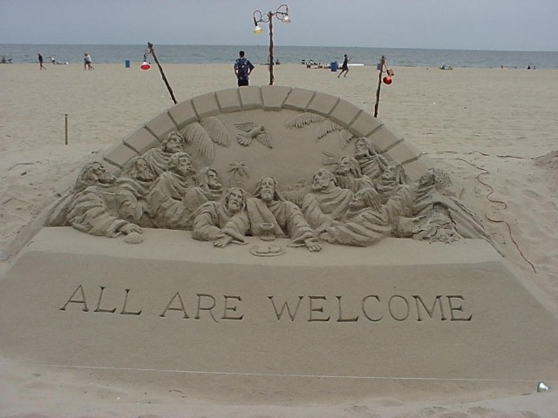
مرقس ٩-١٦
د. ريك جريفيث• مؤسسة الدراسات اللاهوتية الأردنية• BibleStudyDownloads.org

Slide 2
Slides on مرقس 9

Slide 3
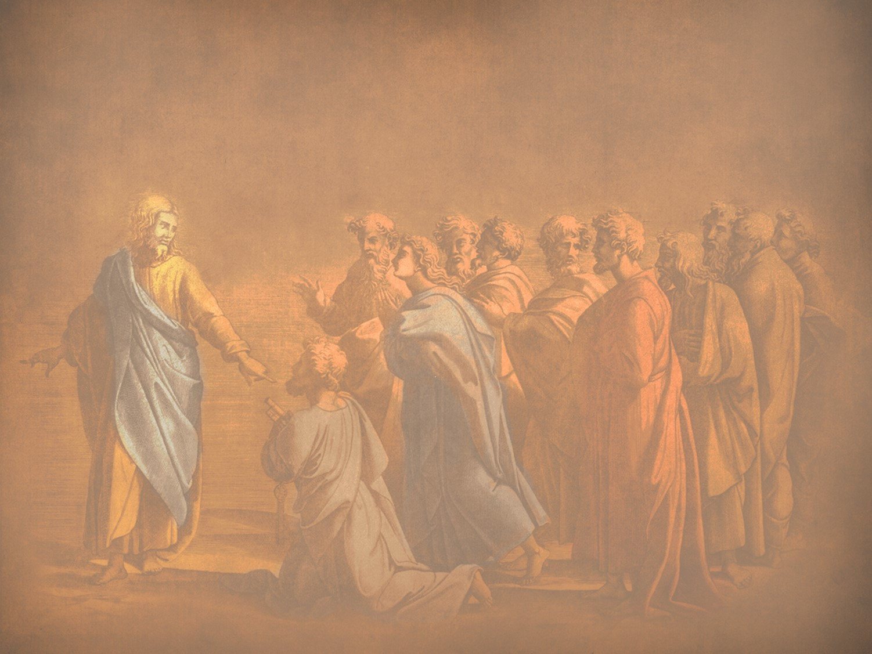
ص. إعلان الملكوت
87
متى 17: 1-8، مرقس 9: 2-8، لوقا 9: 28-36
تحقيقاً لنبوة المسيح عن رؤية مجده قبل أسبوع واحد تجلى يسوع أمام بطرس ويعقوب ويوحنا ليكشف في صورة مصغرة عن المجد الجوهري الذي سيعلنه للعالم عندما يبدأ ملكه عند المجيء الثاني ويثبت ان المسيح هو الوحيد المستحق الطاعة
Notes:
The three Synoptic Gospels all record the Transfiguration of Jesus. Here is the only glimpse of the true nature of Christ that we find in the gospels as no one sees him in his full glory during his earthly life—and the Transfiguration was only for a few moments. God, in his mercy, did not let people view the glorified Christ lest they die in doing so! But this experience on the mountain (probably Mount Tabor) lifted the veil, as it were, so that at least Peter, James, and John could imagine the glory of Jesus when he reigns in the millennial kingdom.
_____________
LC-04-Instruction of the Twelve-106
NS-01-Matt15-18—slide 12
NS-02-Mark9-16—slide 3
NS-03-Luke1-12—slide 386

Slide 4
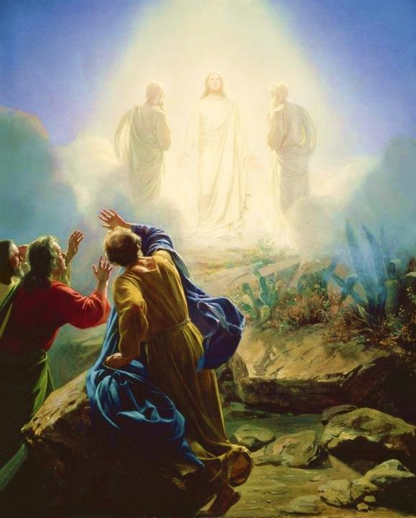
كارل بلوش، 1865
تجلي يسوع
مرقس 9: 2-13
Notes:
Today’s scripture, found in Mark chapter 9, vs 2-13 is also about a transformation. This transformation is known as the Transfiguration of Jesus.
Transformation is an important theme in the Bible. The passage we read together earlier was from Paul’s letter to the Romans, ch 8 vs 19-30 was about transformation. As we saw in Romans 8:30, reading now from the ESV, Paul writes that “and those whom he predestined he also called, and those whom he called he also justified, and those whom he justified he also glorified.”
To go from sin and suffering to being called, justified, and glorified is an extreme transformation. So how do we get to that transformation? We look to Jesus. That is what we are going to do today. We will look at Jesus and his “transfiguration” or “transformation.”
We will see how it affected the disciples and how it should affect us.

Slide 5
لماذا بطرس
ويعقوب ويوحنا فقط؟
مر 9: 2-13 التجلي
مر 14: 33 جثسيماني
مع أندراوس
مر 1: 29-30 حماة بطرس
مر 13: 3 خطاب جبل الزيتون

Slide 6
2 وبعد ستة أيام أخذ يسوع بطرس ويعقوب ويوحنا وصعد بهم إلى جبل عالٍ منفردين وحدهم
مرقس 9: 2-13
Notes:
Now we pick in in Mark ch 9 vs 2

Slide 7

كيف تقوم بإعادة الشحن؟
مرقس 6: 30-32
30 واجتمع الرسل إلى يسوع وأخبروه بكل شيء كل ما فعلوا وكل ما علموا 31 فقال لهم تعالوا أنتم منفردين إلى موضع خلاء واستريحوا قليلاً لأن القادمين والذاهبين كانوا كثيرين ولم تتيسر لهم فرصة للأكل 32 فمضوا في السفينة إلى موضع خلاء منفردين

Slide 8
2 وبعد ستة أيام أخذ يسوع بطرس ويعقوب ويوحنا وصعد بهم إلى جبل عالٍ منفردين وحدهم وتغيرت هيئته قدامهم 3 وصارت ثيابه تلمع بيضاء جداً كالثلج لا يقدر قصار على الأرض أن يبيض مثل ذلك 4 وظهر لهم إيليا مع موسى وكانا يتكلمان مع يسوع
مرقس 9: 2-13
Notes:
Now we pick in in Mark ch 9 vs 2

Slide 9
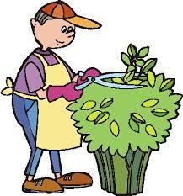
ماذا
رأوا؟
يوحنا 20: 15 .... ظنوا أنه البستاني

Slide 10
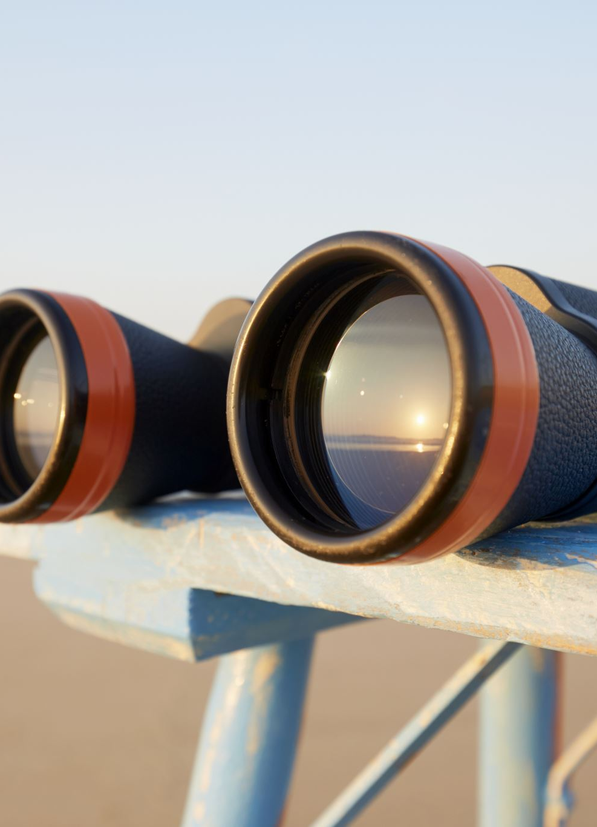
رؤيا 1
12 فالتفت لأنظر الصوت الذي تكلم
معي ولما التفت رأيت سبع مناير من
ذهب 13 وفي وسط السبع المناير
شبه ابن إنسان متسربلاً بثوب إلى
الرجلين ومتمنطقاً عند ثدييه بمنطقة
من ذهب 14 وأما رأسه وشعره
فأبيضان كالصوف الأبيض كالثلج
وعيناه كلهيب نار 15 ورجلاه شبه
النحاس النقي كأنهما محميتان في أتون وصوته كصوت مياه كثيرة
16 ومعه في يده اليمنى سبعة كواكب وسيف ماضٍ ذو حدين يخرج من فمه ووجهه كالشمس وهي تضيء في قوتها

Slide 11
2 وبعد ستة أيام أخذ يسوع بطرس ويعقوب ويوحنا وصعد بهم إلى جبل عالٍ منفردين وحدهم وتغيرت هيئته قدامهم 3 وصارت ثيابه تلمع بيضاء جداً كالثلج لا يقدر قصار على الأرض أن يبيض مثل ذلك 4 وظهر لهم إيليا مع موسى وكانا يتكلمان مع يسوع
مرقس 9: 2-13
Notes:
Now we pick in in Mark ch 9 vs 2

Slide 12
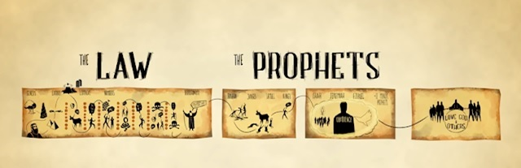
يسوع
موسى
إيليا

Slide 13
2 وبعد ستة أيام أخذ يسوع بطرس ويعقوب ويوحنا وصعد بهم إلى جبل عالٍ منفردين وحدهم وتغيرت هيئته قدامهم 3 وصارت ثيابه تلمع بيضاء جداً كالثلج لا يقدر قصار على الأرض أن يبيض مثل ذلك 4 وظهر لهم إيليا مع موسى وكانا يتكلمان مع يسوع 5 فجعل بطرس يقول ليسوع يا سيدي جيد أن نكون ههنا فلنصنع ثلاث مظال لك واحدة ولموسى واحدة ولإيليا واحدة 6 لأنه لم يكن يعلم ما يتكلم به إذ كانوا مرتعبين
مرقس 9: 2-13
Notes:
How do the disciples respond?

Slide 14
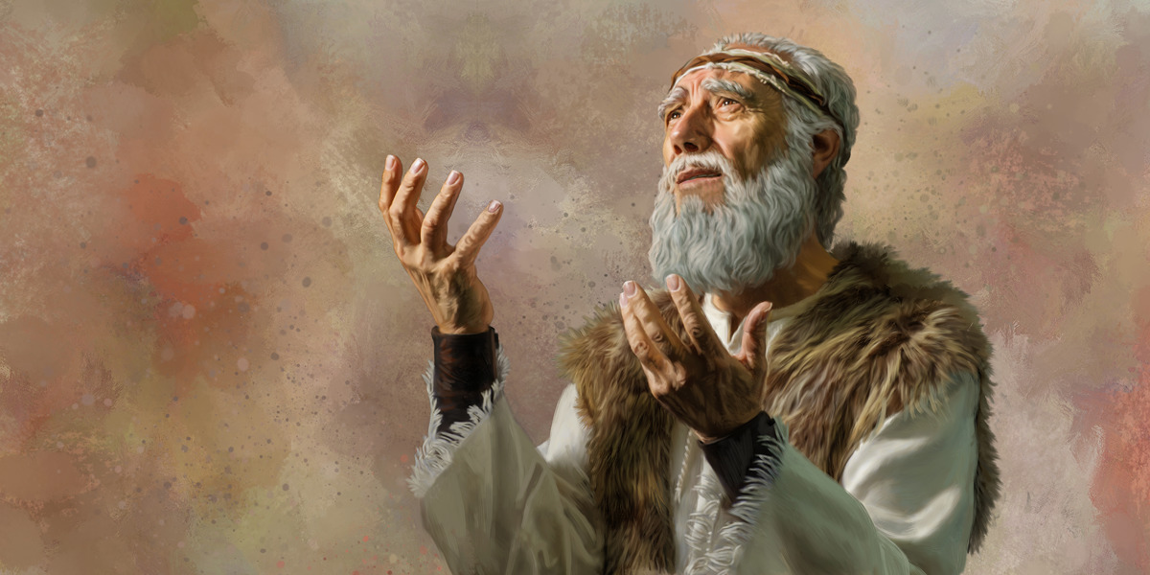
The Second Coming
ملاخي ٤ : ٥-٦
5 هأنذا أرسل إليكم إيليا النبي قبل مجيء يوم الرب اليوم العظيم والمخوف 6 فيرد قلب الآباء على الأبناء وقلب الأبناء على آبائهم. لئلا آتي وأضرب الأرض بلعن.
Notes:
Here are the final two verse of the Old Testament that include both blessing and a curse.
__________
LC-04-Instruction of the Twelve-118
OS-39-Malachi-135
NS-01-Matt 15-28-slide 23

Slide 15
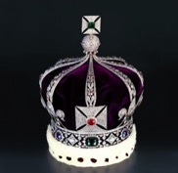
التوقعات: إيليا، المسيح، المملكة
76
المسيا
هذا العصر
العصر القادم
نبوة
ملكوت
أسرار المملكة متى 13
إيليا
المسيا
المملكة
إيليا
المسيا
مملكة
الرفض
استقبال
مجيء المسيح الاول
مجيء الثاني
الحكم على إسرائيل البركة للأمم
الحكم على الأمم استعادة إسرائيل
مقتبس من مارك ل. بيلي، كلية دالاس اللاهوتية ملاحظات صفية، 1986
Notes:
كان العنصر الرئيسي بين العصر الحالي والعصر القادم (عصر الملكوت) في اللاهوت اليهودي هو مجيء المسيح. لكنه سيسبقه شخصية إيليا. كان يمكن ليوحنا المعمدان أن يكون "إيليا" لو أن إسرائيل آمنت بالمسيح، لأن المملكة الألفية كانت ستتبع بعد ذلك بأمة صالحة. ولكن بما أن إسرائيل رفضت ملكها، سيأتي "إيليا" آخر – ربما يكون أحد شاهدي رؤيا 11. في هذه الأثناء، فإن عصر المجيء الدولي هذا له الملكوت في شكل سري مع فوائد روحية تعطى للأمم حتى يحدث العدد الكامل من الأمم (روم 11: 25-27). ثم، بدلا من الدينونة على إسرائيل والبركة على الأمم، سوف ينعكس. ستكون الدينونة على الأمم المعارضة لإسرائيل (حزقيق 38-39) تليها البركة على إسرائيل (حزقيق 40-48). __________
__________
LC-04-Instruction of the Twelve-119
OS-39-Malachi-136
NS-01-Matt 15-28-slide 24

Slide 16
11 فسألوه قائلين لماذا يقول الكتبة إن إيليا ينبغي أن يأتي أولاً 12 فأجاب وقال لهم إن إيليا يأتي أولاً ويرد كل شيء وكيف هو مكتوب عن ابن الإنسان أن يتألم كثيراً ويرذل 13 لكن أقول لكم إن إيليا أيضاً قد أتى وعملوا به كل ما أرادوا كما هو مكتوب عنه
مرقس 9: 2-1

Slide 17
سؤال جيد
س: لماذا يجب أن يأتي إيليا أولاً ؟
ج: هكذا يقول الكتاب
ملا 3: 1 هأنذا أرسل ملاكي فيهيء الطريق أمامي
ملا 4: 5 هأنذا أرسل إليكم إيليا النبي قبل مجيء يوم الرب

Slide 18
اثبات سلطة الكتاب المقدس
س: لماذا يجب أن يعاني المسيح؟
ج: هكذا يقول الكتاب
مز 69: 20-21 العار قد كسر قلبي فمرضت انتظرت رقة فلم تكن ومعزين فلم أجد ويجعلون في طعامي علقماً وفي عطشي يسقونني خلاً
أشعياء 53: 5 وهو مجروح لأجل معاصينا مسحوق لأجل آثامنا تأديب سلامنا عليه وبحبره شفينا

Slide 19
11 فسألوه قائلين لماذا يقول الكتبة إن إيليا ينبغي أن يأتي أولاً 12 فأجاب وقال لهم إن إيليا يأتي أولاً ويرد كل شيء وكيف هو مكتوب عن ابن الإنسان أن يتألم كثيراً ويرذل 13 لكن أقول لكم إن إيليا أيضاً قد أتى وعملوا به كل ما أرادوا كما هو مكتوب عنه
مرقس 9: 2-1

Slide 20

بأي سلطان
يستطيع يسوع
أن يصرح بأن
يوحنا المعمدان تمم النبوات عن إيليا؟

Slide 21
# | العنوان | مت | مر | لو | يو
1 | يسوع يشفي الكثيرين | مت 4: 23-24 | مر 1: 32-34
2 | يسوع يطرد الشياطين | مت 4: 24 | مر 1: 39 | لو 7: 18-23
3 | يسوع يطهر الأبرص | مت 8: 1-4 | مر 1: 40-45 | لو 5: 12-16
4 | يسوع يشفي عبد قائد المئة | مت 8: 5-13 |  | لو 7: 1-10
-----------------------------------------
59 | يسوع يظهر في غرفة مغلقة |  |  |  | يو 20: 19-23
60 | يسوع يظهر في غرفة مغلقة لتوما |  |  |  | يو 20: 26-29
61 | يسوع يصنع صيد سمك معجزي (يوحنا) |  |  |  | يو 21: 4-6
61 معجزة
Notes:
But most of the miracles mentioned in the gospels are performed by Jesus. Some 61 out of 76 miracles were Jesus making the blind see, the lame walk, the deaf hear, and the dead rise from the grave. These miracles were announcing Jesus as the Messiah, the Christ, the son of the Living God.
A list of all the miracles in the gospels is available in an excel file that has been uploaded into this zoom chat, our Church WhatsApp group, and will be placed on our website, along with the slides, notes, and audio for this and the other sermons.

Slide 22
مرتعبين في محضر الرب
استمع للرب
استمع التلاميذ للرب
أسئلة التلاميذ أجيبت من الرب

Slide 23
كن متحولاً
لا مرتعباً

Slide 24
Slides on مرقس 10

Slide 25
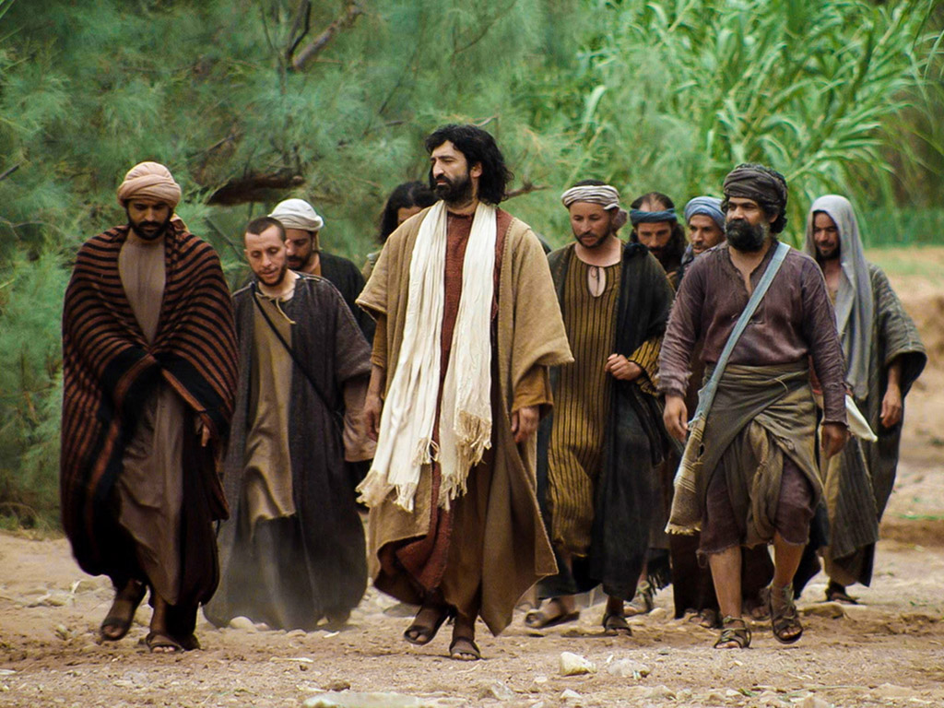
ض. تعليمات بخصوص الحياة الأبدية
134
متى 19: 16 :20-16، مرقس 31-17 :10، لوقا 18: 30-18
يظهر المسيح استحالة دخول الملكوت من خلال الغنى ليدحض الإيمان الفريسي أن الغنى المادي يشير إلى الرضا الإلهي والحياة الأبدية
Notes:
The Rich Man
Matt. 19:16 Someone came to Jesus with this question: “Teacher, what good deed must I do to have eternal life?”
Matt. 19:17 “Why ask me about what is good?” Jesus replied. “There is only One who is good. But to answer your question—if you want to receive eternal life, keep the commandments.”
Matt. 19:18 “Which ones?” the man asked.
And Jesus replied: “‘You must not murder. You must not commit adultery. You must not steal. You must not testify falsely. ¹⁹ Honor your father and mother. Love your neighbor as yourself.’”
Matt. 19:20 “I’ve obeyed all these commandments,” the young man replied. “What else must I do?”
Matt. 19:21 Jesus told him, “If you want to be perfect, go and sell all your possessions and give the money to the poor, and you will have treasure in heaven. Then come, follow me.”
Matt. 19:22 But when the young man heard this, he went away sad, for he had many possessions.
Matt. 19:23 Then Jesus said to his disciples, “I tell you the truth, it is very hard for a rich person to enter the Kingdom of Heaven. ²⁴ I’ll say it again—it is easier for a camel to go through the eye of a needle than for a rich person to enter the Kingdom of God!”
Matt. 19:25 The disciples were astounded. “Then who in the world can be saved?” they asked.
Matt. 19:26 Jesus looked at them intently and said, “Humanly speaking, it is impossible. But with God everything is possible.”
Matt. 19:27 Then Peter said to him, “We’ve given up everything to follow you. What will we get?”
Matt. 19:28 Jesus replied, “I assure you that when the world is made new and the Son of Man sits upon his glorious throne, you who have been my followers will also sit on twelve thrones, judging the twelve tribes of Israel. ²⁹ And everyone who has given up houses or brothers or sisters or father or mother or children or property, for my sake, will receive a hundred times as much in return and will inherit eternal life. ³⁰ But many who are the greatest now will be least important then, and those who seem least important now will be the greatest then.
Parable of the Vineyard Workers
Matt. 20:1 “For the Kingdom of Heaven is like the landowner who went out early one morning to hire workers for his vineyard. ² He agreed to pay the normal daily wage and sent them out to work.
Matt. 20:3 “At nine o’clock in the morning he was passing through the marketplace and saw somepeople standing around doing nothing. ⁴ So he hired them, telling them he would pay them whatever was right at the end of the day. ⁵ So they went to work in the vineyard. At noon and again at three o’clock he did the same thing.
Matt. 20:6 “At five o’clock that afternoon he was in town again and saw some more people standing around. He asked them, ‘Why haven’t you been working today?’
Matt. 20:7 “They replied, ‘Because no one hired us.’
“The landowner told them, ‘Then go out and join the others in my vineyard.’
Matt. 20:8 “That evening he told the foreman to call the workers in and pay them, beginning with the last workers first. ⁹ When those hired at five o’clock were paid, each received a full day’s wage. ¹⁰ When those hired first came to get their pay, they assumed they would receive more. But they, too, were paid a day’s wage. ¹¹ When they received their pay, they protested to the owner, ¹² ‘Those people worked only one hour, and yet you’ve paid them just as much as you paid us who worked all day in the scorching heat.’
Matt. 20:13 “He answered one of them, ‘Friend, I haven’t been unfair! Didn’t you agree to work all day for the usual wage? ¹⁴ Take your money and go. I wanted to pay this last worker the same as you. ¹⁵ Is it against the law for me to do what I want with my money? Should you be jealous because I am kind to others?’
Matt. 20:16 “So those who are last now will be first then, and those who are first will be last.”
The Rich Man
Mark 10:17 As Jesus was starting out on his way to Jerusalem, a man came running up to him, knelt down, and asked, “Good Teacher, what must I do to inherit eternal life?”
Mark 10:18 “Why do you call me good?” Jesus asked. “Only God is truly good. ¹⁹ But to answer your question, you know the commandments: ‘You must not murder. You must not commit adultery. You must not steal. You must not testify falsely. You must not cheat anyone. Honor your father and mother.’”
Mark 10:20 “Teacher,” the man replied, “I’ve obeyed all these commandments since I was young.”
Mark 10:21 Looking at the man, Jesus felt genuine love for him. “There is still one thing you haven’t done,” he told him. “Go and sell all your possessions and give the money to the poor, and you will have treasure in heaven. Then come, follow me.”
Mark 10:22 At this the man’s face fell, and he went away sad, for he had many possessions.
Mark 10:23 Jesus looked around and said to his disciples, “How hard it is for the rich to enter the Kingdom of God!” ²⁴ This amazed them. But Jesus said again, “Dear children, it is very hard to enter the Kingdom of God. ²⁵ In fact, it is easier for a camel to go through the eye of a needle than for a rich person to enter the Kingdom of God!”
Mark 10:26 The disciples were astounded. “Then who in the world can be saved?” they asked.
Mark 10:27 Jesus looked at them intently and said, “Humanly speaking, it is impossible. But not with God. Everything is possible with God.”
Mark 10:28 Then Peter began to speak up. “We’ve given up everything to follow you,” he said.
Mark 10:29 “Yes,” Jesus replied, “and I assure you that everyone who has given up house or brothers or sisters or mother or father or children or property, for my sake and for the Good News, ³⁰ will receive now in return a hundred times as many houses, brothers, sisters, mothers, children, and property—along with persecution. And in the world to come that person will have eternal life. ³¹ But many who are the greatest now will be least important then, and those who seem least important now will be the greatest then.”
The Rich Man
Luke 18:18 Once a religious leader asked Jesus this question: “Good Teacher, what should I do to inherit eternal life?”
Luke 18:19 “Why do you call me good?” Jesus asked him. “Only God is truly good. ²⁰ But to answer your question, you know the commandments: ‘You must not commit adultery. You must not murder. You must not steal. You must not testify falsely. Honor your father and mother.’”
Luke 18:21 The man replied, “I’ve obeyed all these commandments since I was young.”
Luke 18:22 When Jesus heard his answer, he said, “There is still one thing you haven’t done. Sell all your possessions and give the money to the poor, and you will have treasure in heaven. Then come, follow me.”
Luke 18:23 But when the man heard this he became very sad, for he was very rich.
Luke 18:24 When Jesus saw this, he said, “How hard it is for the rich to enter the Kingdom of God! ²⁵ In fact, it is easier for a camel to go through the eye of a needle than for a rich person to enter the Kingdom of God!”
Luke 18:26 Those who heard this said, “Then who in the world can be saved?”
Luke 18:27 He replied, “What is impossible for people is possible with God.”
Luke 18:28 Peter said, “We’ve left our homes to follow you.”
Luke 18:29 “Yes,” Jesus replied, “and I assure you that everyone who has given up house or wife or brothers or parents or children, for the sake of the Kingdom of God, ³⁰ will be repaid many times over in this life, and will have eternal life in the world to come.”

Slide 26
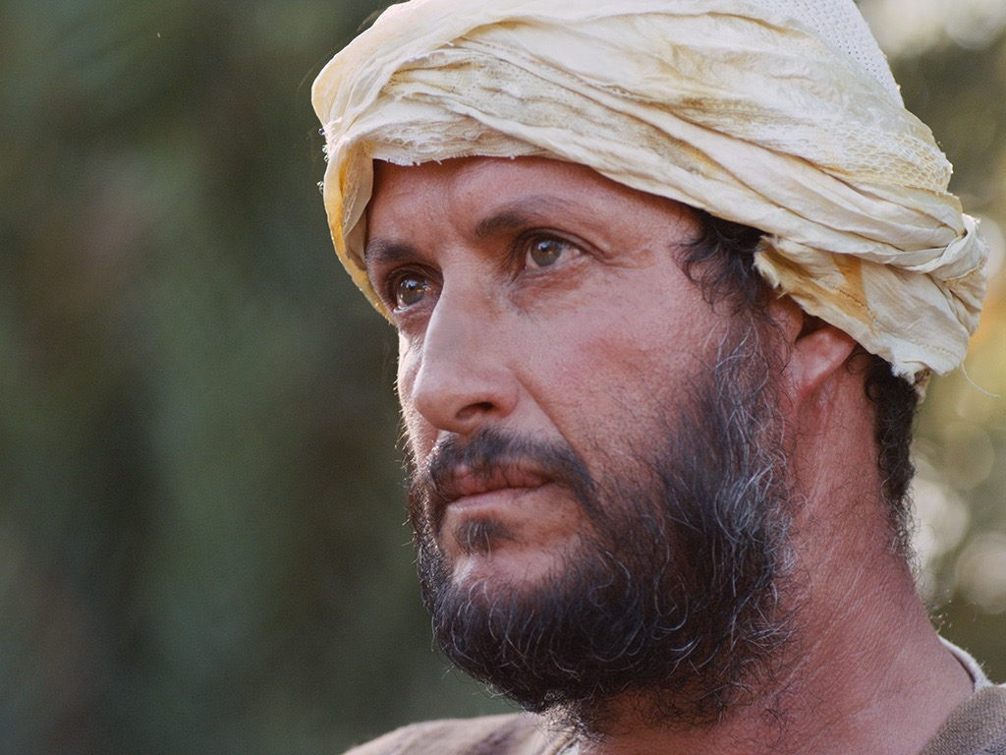

شاب غني
يسأل يسوع
متى 19: 16-30، مرقس 10: 17-31، لوقا 18: 18-30
Notes:
"This man’s question indicated that he viewed eternal life as something to be achieved by doing good (in contrast with Mark 10:15; cf. Matt. 19:16) and also that he felt insecure about his future destiny. References to eternal life (mentioned in Mark only in 10:17, 30), “entering God’s kingdom” (vv. 23-25), and being “saved” (v. 26) all focus on the future possession of life with God, though a person enters it now by accepting God’s rule in his earthly life. John’s Gospel emphasizes the present possession of eternal life."
John D. Grassmick, Mark *(The Bible Knowledge Commentary; eds. John F. Walvoord and Roy B. Zuck; Accordance electronic ed. 2 vols.; Wheaton: Victor Books, 1983), 2:150.

Slide 27
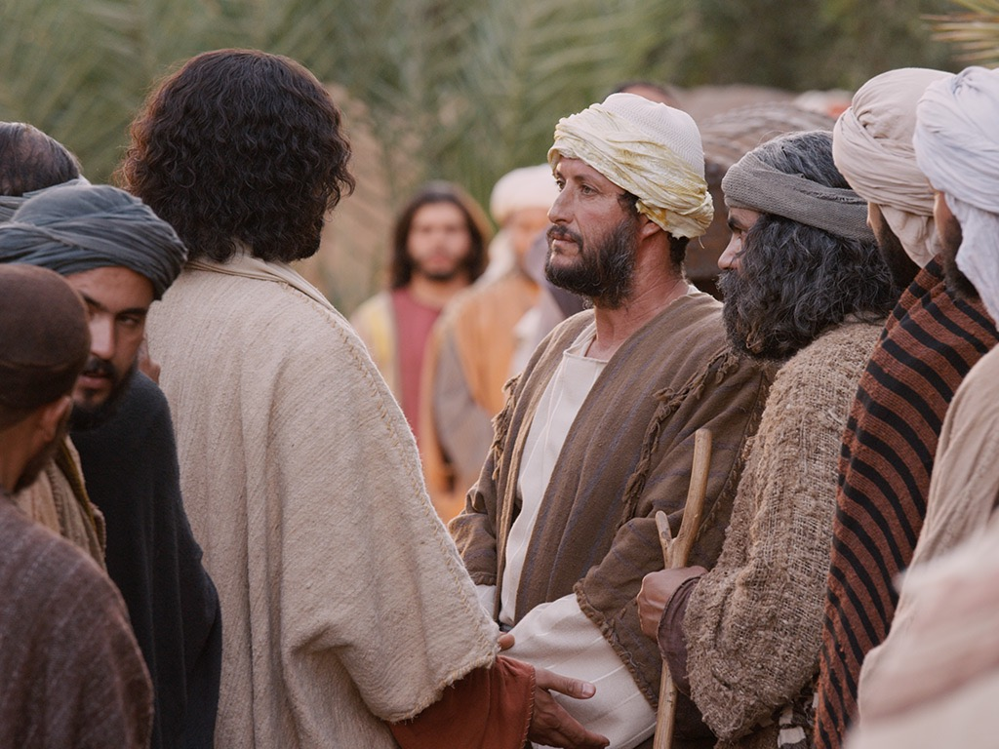
Notes:
Mark 10:17 As Jesus was starting out on his way to Jerusalem, a man came running up to him, knelt down, and asked, “Good Teacher, what must I do to inherit eternal life?”
———————
"His question was specifically, “What must I do to inherit eternal life?” In Jewish understanding, to “inherit eternal life” was to be resurrected and accepted for entrance into the messianic kingdom of the future (cf. Dan 12:2; 2 Macc 7:9).
5 Notice Mark 10:30 in which Jesus spoke of “eternal life” in the “age to come.” So “to inherit eternal life” was an equivalent expression for entering the kingdom of God, referred to elsewhere as “inheriting the kingdom” (cf. Mt 25:34; 1 Cor 6:9, 10; 15:50; Gal 5:21). The NT is very clear that one can only do this by humbly coming to Jesus with a child-like faith in order to be born again (Mk 10:15; John 3:3; Col 1:13-14). The young man’s question in Mark 10:17, however, gives him away that he does not understand the right approach, for he asks, “What must I do?” The NT is clear that there is not anything we can “do” to merit eternal life. Receiving God’s forgiveness and eternal life do not come because of what we “do,” but only as a free gift of God’s grace."
—Paul Tanner, Following the Master (BEE World), 144

Slide 28
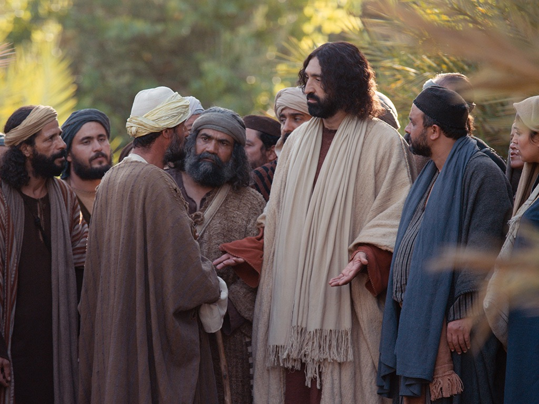
Notes:
Mark 10:18 “Why do you call me good?” Jesus asked. “Only God is truly good.

Slide 29
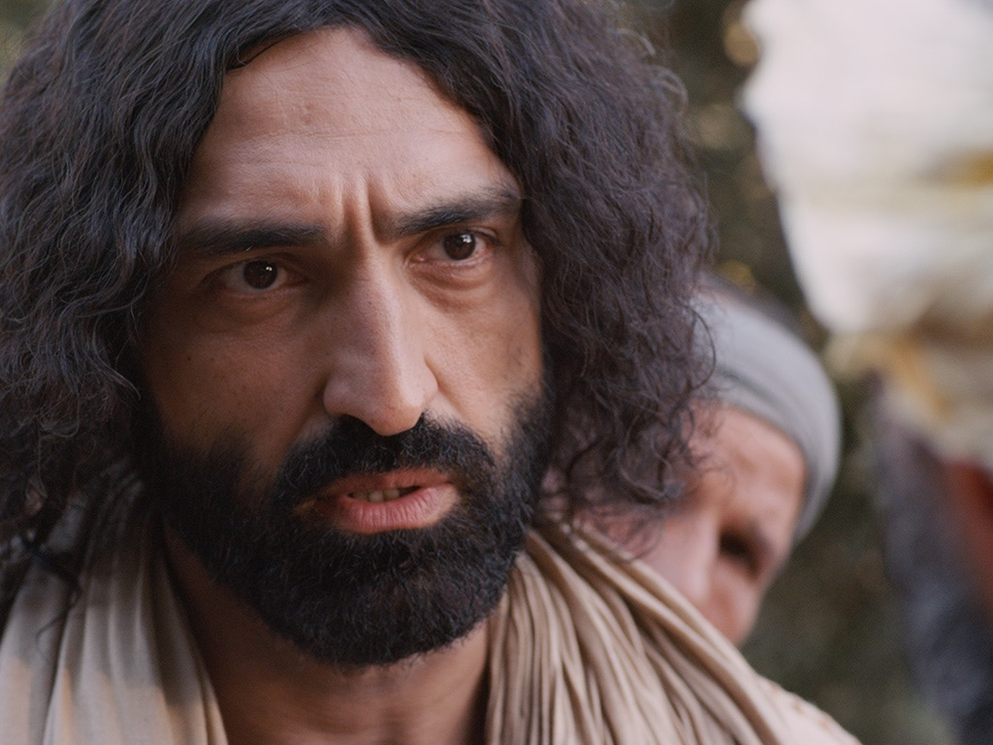
Notes:
Mark 10:19 But to answer your question, you know the commandments: ‘You must not murder. You must not commit adultery. You must not steal. You must not testify falsely. You must not cheat anyone. Honor your father and mother.’"
————————
Jesus sought to show him that he was not good after all by having him evaluate himself by the Ten Commandments.

Slide 30
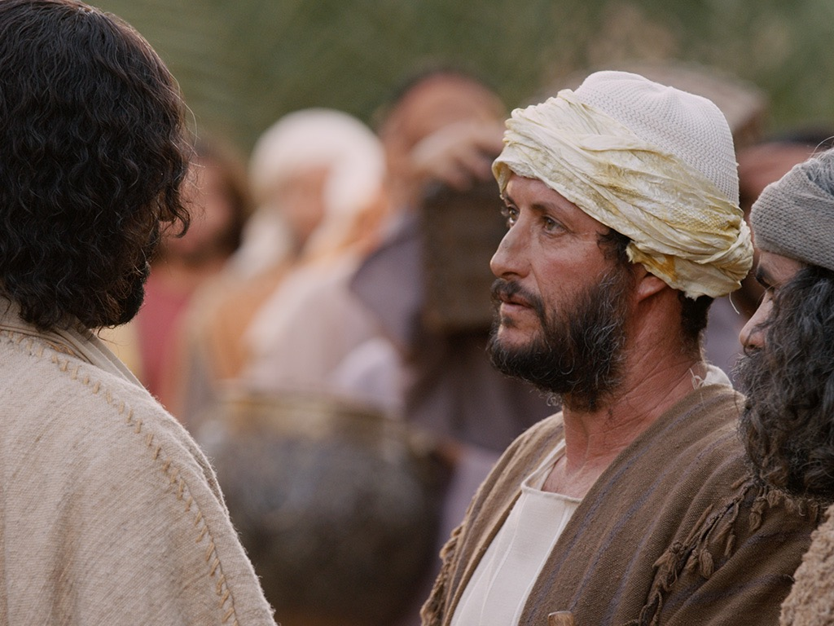
Notes:
Mark 10:20 “Teacher,” the man replied, “I’ve obeyed all these commandments since I was young.”
——————————
This shows that the man was self-deluded that he was the only person in the world who was good! He should have known Isa 64:6, “all our so-called righteous acts are like a menstrual rag in your sight.”

Slide 31
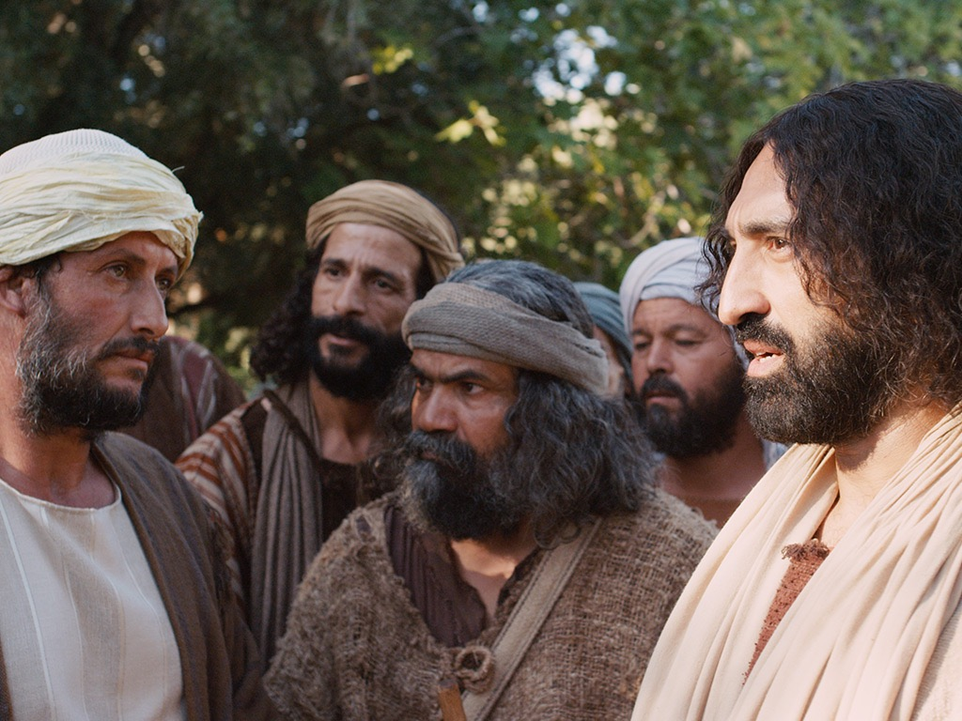
Notes:
Mark 10:21 Looking at the man, Jesus felt genuine love for him.

Slide 32
Notes:
Mark 10:21 “There is still one thing you haven’t done,” he told him.

Slide 33
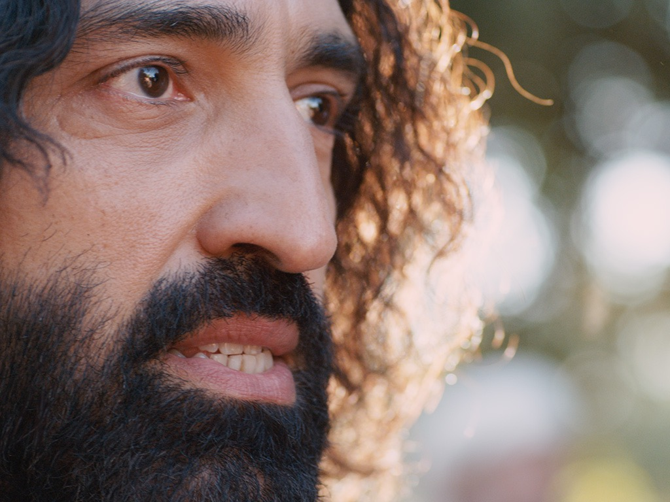
Notes:
Mark 10:21 “Go and sell all your possessions and give the money to the poor, and you will have treasure in heaven. Then come, follow me.”

Slide 34
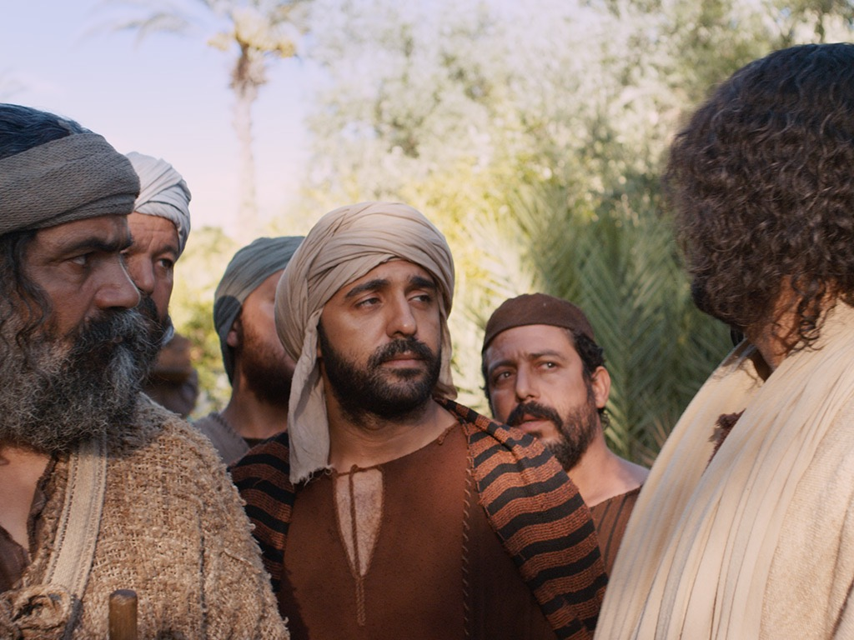
Notes:
Mark 10:22 At this the man’s face fell, and he went away sad, for he had many possessions.

Slide 35
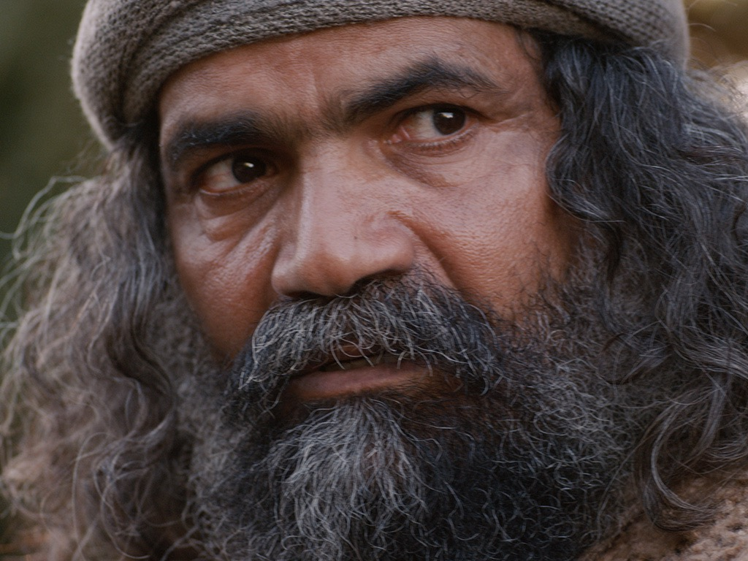
Notes:
Mark 10:23 Jesus looked around and said to his disciples, “How hard it is for the rich to enter the Kingdom of God!”

Slide 36
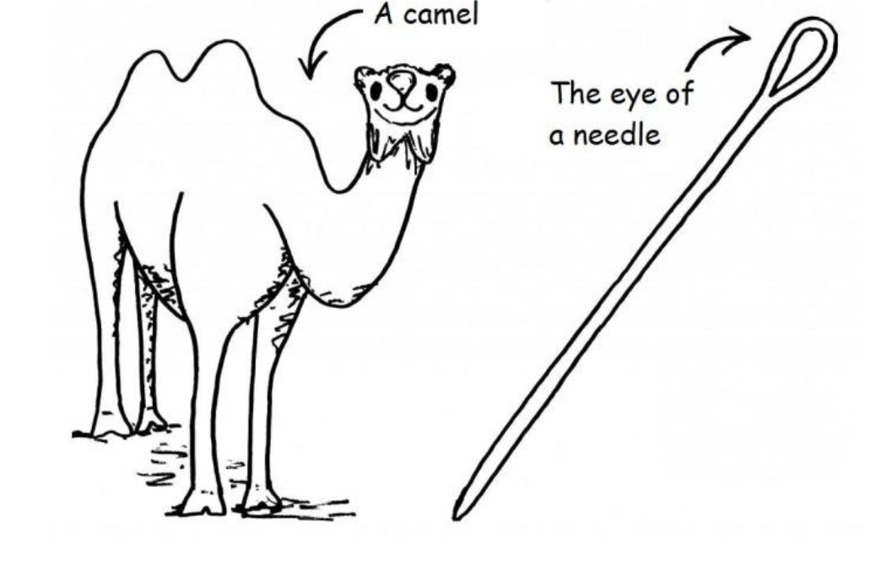
A camel
The eye of a needle
Notes:
Mark 10:24 This amazed them. But Jesus said again, “Dear children, it is very hard to enter the Kingdom of God. ²⁵ In fact, it is easier for a camel to go through the eye of a needle than for a rich person to enter the Kingdom of God!”
Mark 10:26 The disciples were astounded. “Then who in the world can be saved?” they asked.
—————————
LC-06-Preparation-184
NS-01-Matt15-28—slide 102

Slide 37
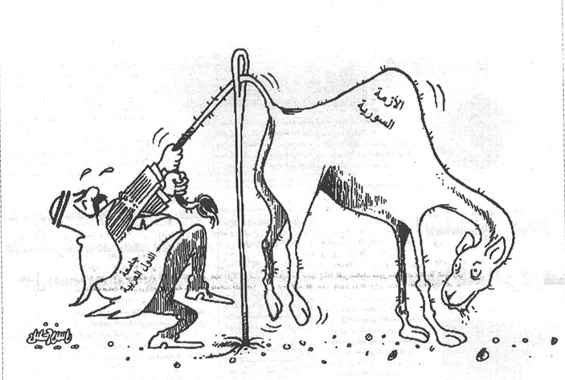
Notes:
Q: Is Jesus explaining something difficult or impossible?
A: Humanly speaking, a camel cannot fit through a normal-sized needle, so it is impossible. Some understand this to mean that a wealthy person cannot enter heaven through their wealth (an impossibility).
Others say that riches often prevent the wealthy from seeing their need for Jesus (a difficulty).
Which is correct? Both are theologically sound, but which view best fits the context?
—————————
LC-06-Preparation-185
NS-01-Matt15-28—slide 103

Slide 38
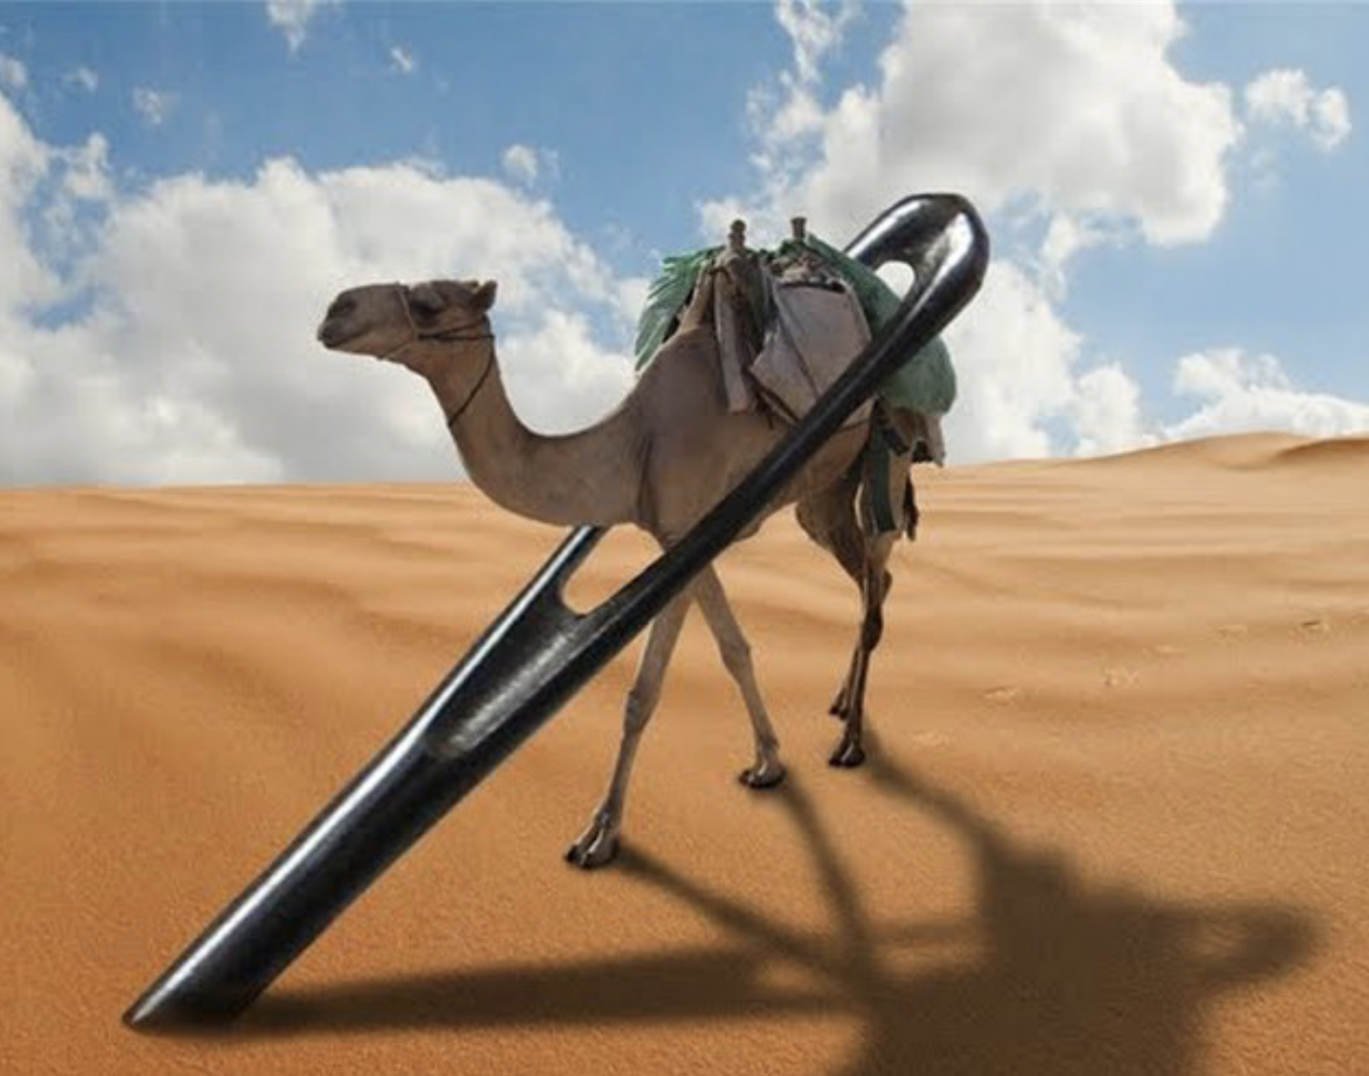
Notes:
Joseph Dillow presents an alternate view:
"Are Works a Condition for Entering the Kingdom?
The New Testament includes 23 references to entering the kingdom, entering into “life,” seeking “life,” or seeking the kingdom.⁷³¹ These passages, commonly called the “entry sayings,” are usually understood to refer to entrance into personal salvation either now or in the eschatological future. However, in many of these passages, entry into the kingdom or into “life” appears to be predicated on works.⁷³² If the traditional idea that “the kingdom” always refers to individual salvation and that “entrance into the kingdom” always refers to “getting saved” or going to heaven when one dies is accepted, as Bill did, then there emerges an apparent conflict with the faith-alone gospel of the New Testament.
For example, to “enter the kingdom”⁷³³ requires a righteousness that is greater than that of the scribes and Pharisees (Matthew 5:20).⁷³⁴ Those who enter the kingdom must do so through the path of discipleship, the narrow gate (Matthew 7:13, 14). In order to enter the kingdom, one must do the “will of the Father,” that is, obey the precepts taught in the Sermon on the Mount (Matthew 7:21).⁷³⁵ To “enter into life,” which is an equivalent phrase, one must deal radically with sin, reject it, and remove it from one’s lifestyle (Matthew 18:3, 9).⁷³⁶ To enter the kingdom, one must be “converted” (Matthew 18:3, 9). Jesus tells the rich young ruler that to “enter into life” (which he equates with entering the kingdom, v. 23) one must “keep the commandments” (Matthew 19:17).⁷³⁷ Strenuous moral effort is required if one is to enter the kingdom (Mark 10:24, “how hard”).
It should be obvious to any unbiased reader that the calls to enter the kingdom are conditioned upon works. Neonomian writers, believing that entering the kingdom means “going to heaven,” simply call a spade a spade and in agreement with the Catholics boldly assert that salvation is secured by non-meritorious, God-produced works in the believer. It is disappointing that the Evangelical Theological Society, is now publishing books and articles advocating this viewpoint. A recent example from the pen of Edmund Neufeld says, “Each [beatitude] is an aspect of the condition by which the follower of Christ receives salvation from God.”⁷³⁸
In the following discussion I will argue that the calls to enter the kingdom in the Gospel of Matthew are all addressed to those who are already born again. They are challenges to live out one’s faith, not always invitations to personal salvation, entrance into heaven, or entrance into the Millennial Kingdom. The next three chapters will be devoted to establishing this understanding of the “entry” sayings."
731 The “entry sayings” refer to these phrases: (1) “enter the kingdom of heaven” (Matthew 5:20; 7:21; 18:3; 19:23, 24; 23:13; Mark 9:47; 10:15, 25; Luke 18:17, 24, 25; John 3:5; Acts 14:22); (2) “entering into life” (Matthew 18:8, 9; 19:17; Mark 9:43; (3) “seeking life” (Luke 17:33; Romans 2:7); (4)
“seeking the kingdom” (Matthew 6:33; 13:45; Luke 12:31). These seem to be parallel and explain one another.
732 See G. Todd Wilson, "Conditions for Entering the Kingdom," Perspectives in Religious Studies 5 (Spring 1978): 40.
733 Equivalent expressions to “enter the kingdom” are “enter into life” and “enter into joy” and in some cases “inherit the kingdom” (see Schneider, “eiserchomai,” TDNT, 2.677).
734 Some understand this “greater righteousness” to refer to either forensic justification or a characteristic of all who are saved. However, as will be demonstrated later, both these options are inconsistent with the context. See pp. 233 ff.
735 To obey the will of the Father seems to refer to good works in Matthew 12:50. And it is highly unlikely that the “will of the Father” in the context of the Sermon on the Mount is to believe on Christ of
salvation as it is in John 6:40. For discussion of this phrase, see pp. 306 ff.
736 “This unconditional orientation to the coming kingdom demands sacrifice, namely, a clean break with everything that would hinder or prejudice the newly established existence of man before God (cf. the sayings about offences in Matthew 18:8 ff.),”ibid., 2.677
737 True, the disciples ask, “Who then can be saved?” As already demonstrated, “saved” does not have to refer to soteriological entrance into heaven. As has been shown earlier, the salvation in view is the deliverance of the soul by self-denying discipleship to Christ, leading to high honor and reward in the kingdom, see pp. 202 ff.
738 Edmund K. Neufeld, "The Gospel in the Gospels: Answering the Question 'What must I do to be saved?' From the Synoptics," JETS 51, no. 2 (June 2008): 273.
—Joseph Dillow, Final Destiny, 230-31
—————————
LC-06-Preparation-186
NS-01-Matt15-28—slide 104

Slide 39
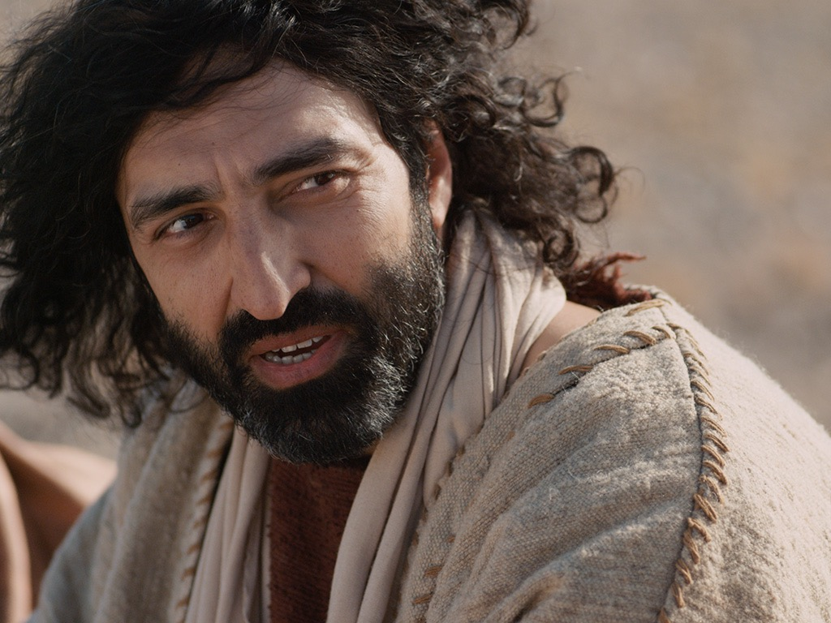
Notes:
Mark 10:27 Jesus looked at them intently and said, “Humanly speaking, it is impossible. But not with God. Everything is possible with God.”
Mark 10:28 Then Peter began to speak up. “We’ve given up everything to follow you,” he said.
Mark 10:29 “Yes,” Jesus replied, “and I assure you that everyone who has given up house or brothers or sisters or mother or father or children or property, for my sake and for the Good News, ³⁰ will receive now in return a hundred times as many houses, brothers, sisters, mothers, children, and property—along with persecution. And in the world to come that person will have eternal life. ³¹ But many who are the greatest now will be least important then, and those who seem least important now will be the greatest then.”

Slide 40
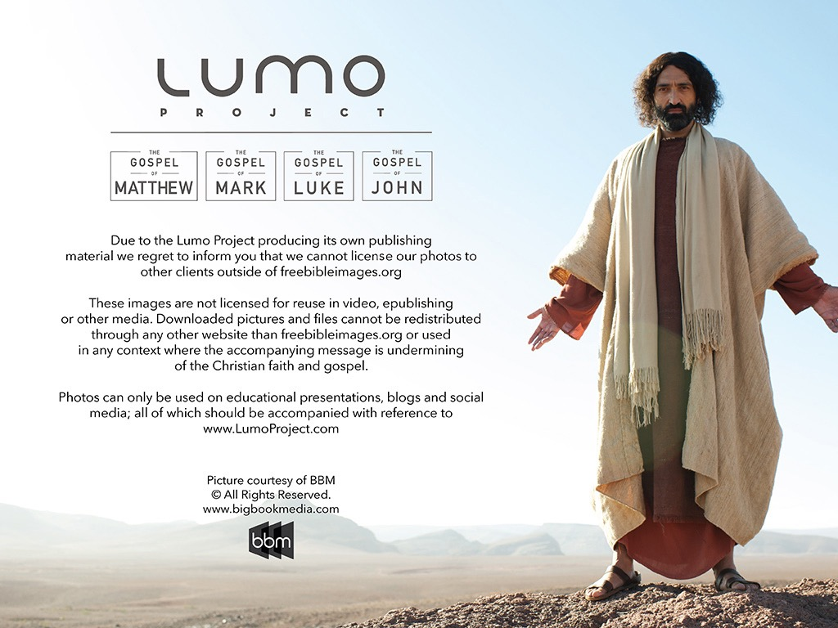
Used with Permission
THE GOSPEL ——OF—— MATTHEW
THE GOSPEL ——OF—— MARK
THE GOSPEL ——OF—— LUKE
THE GOSPEL ——OF—— JOHN
Due to the Lumo Project producing its own publishing material we regret to inform you that we cannot license our photos to other clients outside of freebibleimages.org.
These images are not licensed for reuse in video, epublishing or other media. Downloaded pictures and files cannot be redistributed through any other website than freebibleimages.org or used in any context where the accompanying message is undermining of the Christian faith and gospel.
Photos can only be used on educational presentations, blogs and social media, all of which should be accompanied with reference to www.LumoProject.com.
Picture courtesy of BBM © All Rights Reserved.
www.bigbookmedia.com

Slide 41
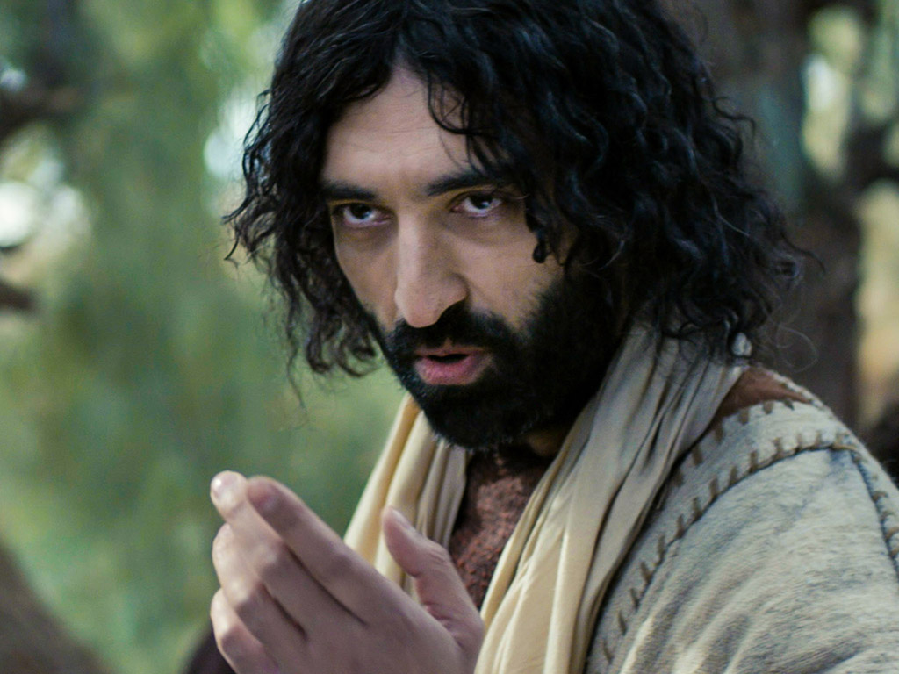
علَّمَ يسوعُ في أثناء ذهابه إلى أورشليم بأنَّ تلاميذَه سيُجابَهون بالمقاومة
(مرقس 8: 27- 10: 52)

Slide 42


مرقس ١٠ : ٣٥-٣٧
٣٥ وَتَقَدَّمَ إِلَيْهِ يَعْقُوبُ وَيُوحَنَّا ابْنَا زَبْدِي قَائِلَيْنِ: «يَا مُعَلِّمُ نُرِيدُ أَنْ تَفْعَلَ لَنَا كُلَّ مَا طَلَبْنَا». ٣٦ فَسَأَلَهُمَا: «مَاذَا تُرِيدَانِ أَنْ أَفْعَلَ لَكُمَا؟» ٣٧ فَقَالاَ لَهُ: «أَعْطِنَا أَنْ نَجْلِسَ وَاحِدٌ عَنْ يَمِينِكَ وَالآخَرُ عَنْ يَسَارِكَ فِي مَجْدِكَ».

Slide 43
مرقس ١٠ : ٣٨-٤٠
٣٨ فَقَالَ لَهُمَا يَسُوعُ: «لَسْتُمَا تَعْلَمَانِ مَا تَطْلُبَانِ. أَتَسْتَطِيعَانِ أَنْ تَشْرَبَا الْكَأْسَ الَّتِي أَشْرَبُهَا أَنَا وَأَنْ تَصْطَبِغَا بِالصِّبْغَةِ الَّتِي أَصْطَبِغُ بِهَا أَنَا؟» ٣٩ فَقَالاَ لَهُ: «نَسْتَطِيعُ». فَقَالَ لَهُمَا يَسُوعُ: «أَمَّا الْكَأْسُ الَّتِي أَشْرَبُهَا أَنَا فَتَشْرَبَانِهَا وَبَالصِّبْغَةِ الَّتِي أَصْطَبِغُ بِهَا أَنَا تَصْطَبِغَانِ. ٤٠ وَأَمَّا الْجُلُوسُ عَنْ يَمِينِي وَعَنْ يَسَارِي فَلَيْسَ لِي أَنْ أُعْطِيَهُ إلاَّ لِلَّذِينَ أُعِدَّ لَهُمْ».

Slide 44
مرقس ١٠ : ٤١-٤٢
٤١ وَلَمَّا سَمِعَ الْعَشَرَةُ ابْتَدَأُوا يَغْتَاظُونَ مِنْ أَجْلِ يَعْقُوبَ وَيُوحَنَّا. ٤٢ فَدَعَاهُمْ يَسُوعُ وَقَالَ لَهُمْ: «أَنْتُمْ تَعْلَمُونَ أَنَّ الَّذِينَ يُحْسَبُونَ رُؤَسَاءَ الأُمَمِ يَسُودُونَهُمْ وَأَنَّ عُظَمَاءَهُمْ يَتَسَلَّطُونَ عَلَيْهِمْ.

Slide 45
مرقس ١٠ : ٤٣-٤٥
٤٣ فَلاَ يَكُونُ هَكَذَا فِيكُمْ. بَلْ مَنْ أَرَادَ أَنْ يَصِيرَ فِيكُمْ عَظِيماً يَكُونُ لَكُمْ خَادِماً ٤٤ وَمَنْ أَرَادَ أَنْ يَصِيرَ فِيكُمْ أَوَّلاً يَكُونُ لِلْجَمِيعِ عَبْداً. ٤٥ لأَنَّ ابْنَ الإِنْسَانِ أَيْضاً لَمْ يَأْتِ لِيُخْدَمَ بَلْ لِيَخْدِمَ وَلِيَبْذِلَ نَفْسَهُ فِدْيَةً عَنْ كَثِيرِينَ».

Slide 46
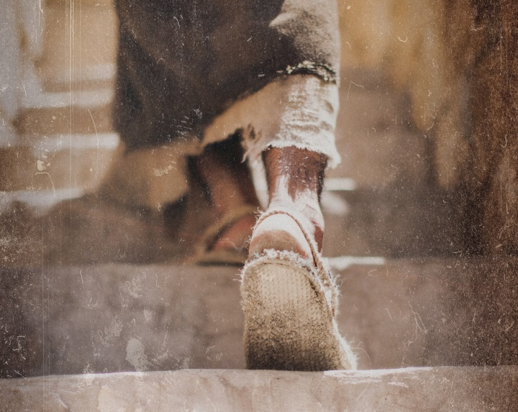
هل تقاوم التيَّار من أجل أن تخدم يسوع أكثر من خدمة أيِّ شخصٍ آخَر؟

Slide 47

كيف يمكنك أن تكون تلميذاً حقيقيَّاً ليسوع في عالَم عِدائيّ؟
مرقس
Notes:
ما الذي يتطلَّبه الأمر منك لكي تتبع المسيح حقَّاً عندما يكون معظم الناس حولك يُعارِضون يسوع؟

Slide 48
الكيفيَّة التي يمكنك بها أن تكون تلميذاً في عالم عِدائيّ
اخدِمْ
مثْلَ
يسوع
تألَّـمْ
مثْلَ يسوع
لا تتشبَّثْ بسُلْطتك
16 | 11-15 | 1: 14- 10: 52 | 1: 1-13
مرقس
Notes:
اعملْ على التشبُّه بالتضحية بالنفس التي قام بها يسوع بصفته خادماً في أثناء أحداث رفْضِه وموته (مرقس، الأصحاحات 11-15).

Slide 49
Slides on مرقس 11

Slide 50
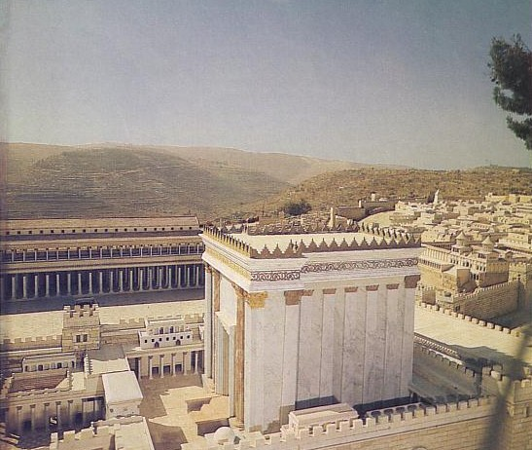
الملخص
85
(1:14–10:52) تتلقى خدمة المسيح كخادم معارضة، وهو ما يسجله مرقس مع استجابة المسيح للتعليم عن التلمذة من أجل تشجيع قراءه على توقع الإضطهاد من أجل البر.
(الفصل 11-15) إن تضحية المسيح بنفسه كخادم والتي أظهرت في رفضه وموته تم تسجيلها كمثال نهائي لخدمة الآخرين على الرغم من الاضطهاد.
(الفصل 16) تؤكد رواية القيامة أن يسوع هو المسيح والله، بحيث يمكن لأولئك الذين يخدمون هذا العبد أن يكون لديهم أيضًا أمل في الانتصار على الموت.

Slide 51
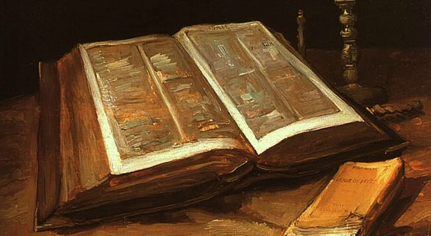
مرقس ١١ : ١-٢
١ وَلَمَّا قَرُبُوا مِنْ أُورُشَلِيمَ إِلَى بَيْتِ فَاجِي وَبَيْتِ عَنْيَا عِنْدَ جَبَلِ الزَّيْتُونِ أَرْسَلَ اثْنَيْنِ مِنْ تَلاَمِيذِهِ ٢ وَقَالَ لَهُمَا: «اذْهَبَا إِلَى الْقَرْيَةِ الَّتِي أَمَامَكُمَا فَلِلْوَقْتِ وَأَنْتُمَا دَاخِلاَنِ إِلَيْهَا تَجِدَانِ جَحْشاً مَرْبُوطاً لَمْ يَجْلِسْ عَلَيْهِ أَحَدٌ مِنَ النَّاسِ. فَحُلاَّهُ وَأْتِيَا بِهِ.

Slide 52
مرقس ١١ : ٣-٤
٣ وَإِنْ قَالَ لَكُمَا أَحَدٌ: لِمَاذَا تَفْعَلاَنِ هَذَا؟ فَقُولاَ: الرَّبُّ مُحْتَاجٌ إِلَيْهِ. فَلِلْوَقْتِ يُرْسِلُهُ إِلَى هُنَا». ٤ فَمَضَيَا وَوَجَدَا الْجَحْشَ مَرْبُوطاً عِنْدَ الْبَابِ خَارِجاً عَلَى الطَّرِيقِ فَحَلاَّهُ.

Slide 53
مرقس ١١ : ٥-٦
٥ فَقَالَ لَهُمَا قَوْمٌ مِنَ الْقِيَامِ هُنَاكَ: «مَاذَا تَفْعَلاَنِ تَحُلاَّنِ الْجَحْشَ؟» ٦ فَقَالاَ لَهُمْ كَمَا أَوْصَى يَسُوعُ. فَتَرَكُوهُمَا.

Slide 54
مرقس ١١ : ٧-٨
٧ فَأَتَيَا بِالْجَحْشِ إِلَى يَسُوعَ وَأَلْقَيَا عَلَيْهِ ثِيَابَهُمَا فَجَلَسَ عَلَيْهِ. ٨ وَكَثِيرُونَ فَرَشُوا ثِيَابَهُمْ فِي الطَّرِيقِ وَآخَرُونَ قَطَعُوا أَغْصَاناً مِنَ الشَّجَرِ وَفَرَشُوهَا فِي الطَّرِيقِ.

Slide 55
مرقس ١١ : ٩-١٠
٩ وَالَّذِينَ تَقَدَّمُوا وَالَّذِينَ تَبِعُوا كَانُوا يَصْرُخُونَ قَائِلِينَ: «أُوصَنَّا! مُبَارَكٌ الآتِي بِاسْمِ الرَّبِّ! ١٠ مُبَارَكَةٌ مَمْلَكَةُ أَبِينَا دَاوُدَ الآتِيَةُ بِاسْمِ الرَّبِّ! أُوصَنَّا فِي الأَعَالِي!».

Slide 56
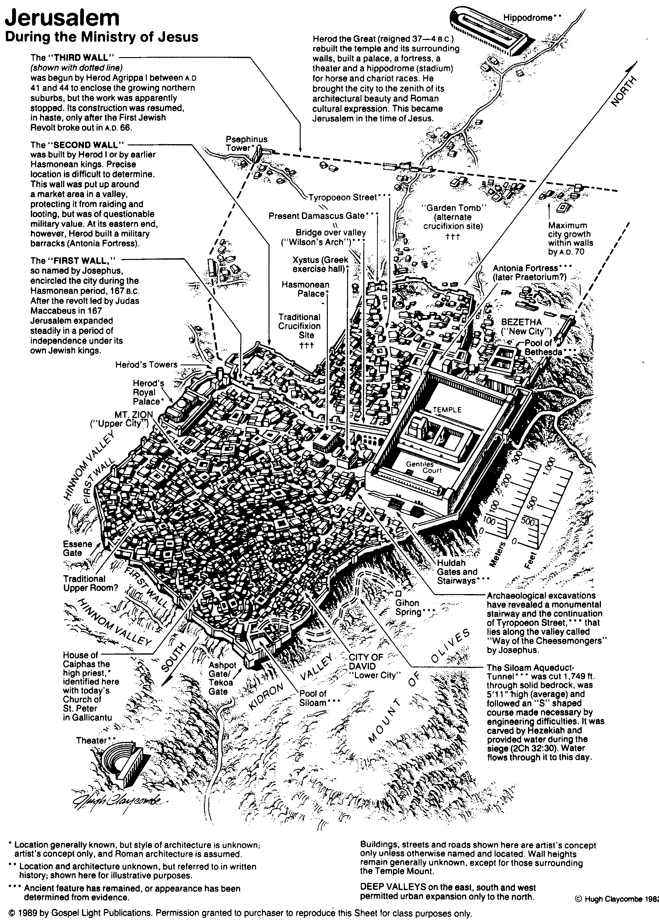
أورشليم خلال خدمة يسوع
80

Slide 57
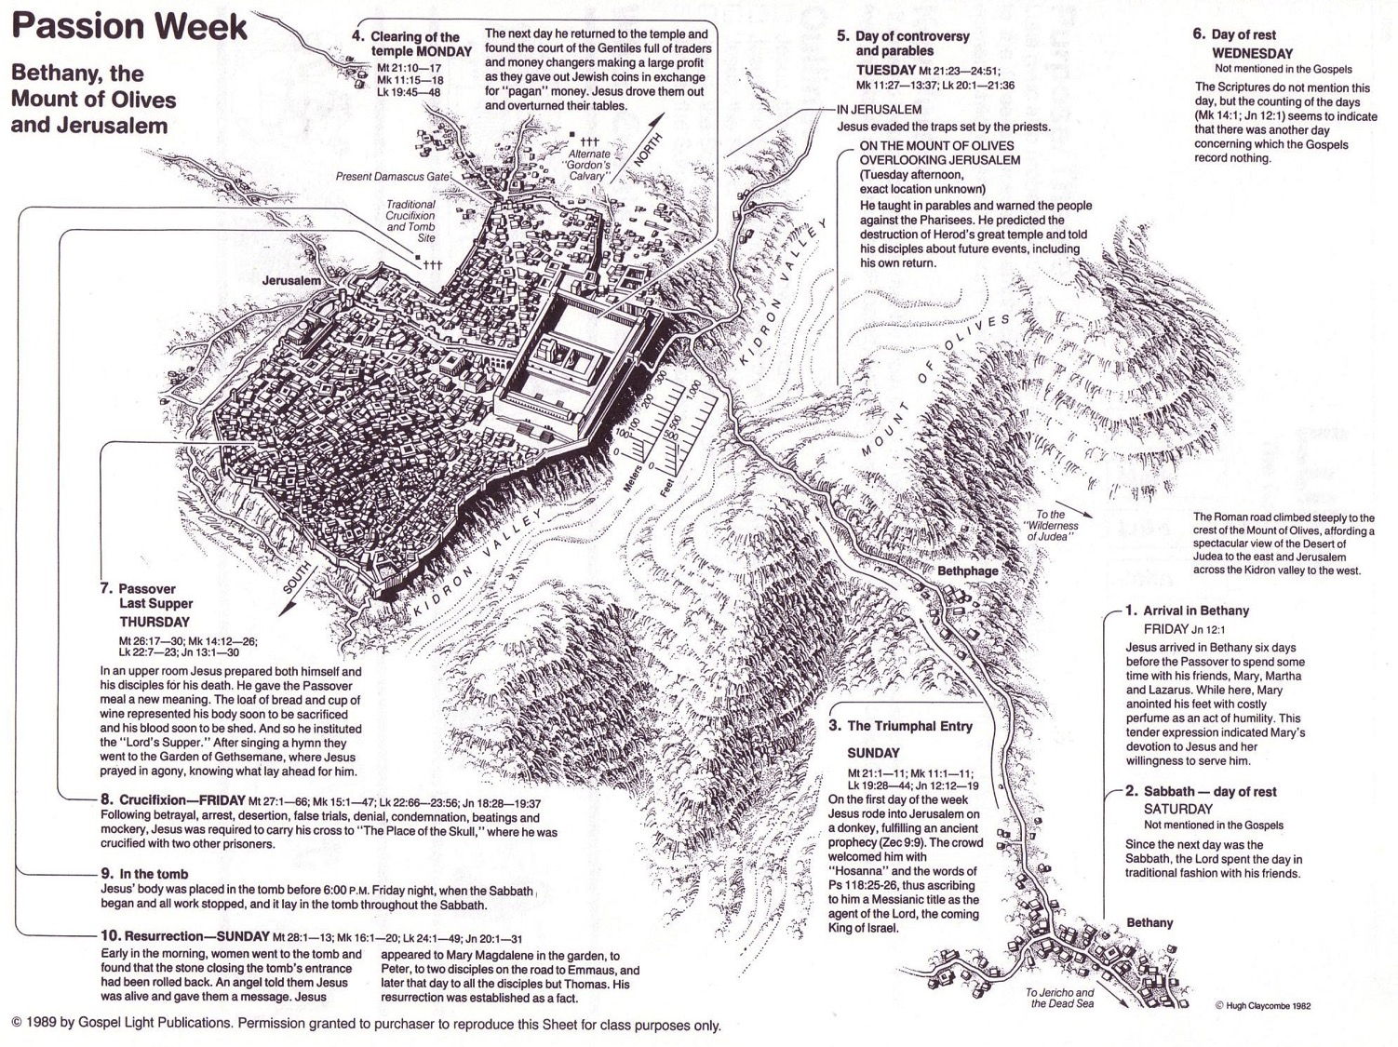
أسبوع الآلام
64
الإثنين
الأربعاء
الثلاثاء
الجمعة
الخميس
الجمعة
الأحد
السبت
السبت
الأحد
Notes:
Jesus invested his final week in Jerusalem and Bethany east of it, going back and forth from Bethany to the city in a purposeful series of events designed to end in his crucifixion and resurrection.
__________
Common-437
LC-00-NT Chronology-43
LC-08-Official Presentation-22, 60, 92
LC-09-Rejection-9
NS-01-Matt15-28-slide 141
NS-02-Mark9-16-slide 105
NS-03-Luke13-24-slide 224
NS-04-John12-21-slide 295

Slide 58
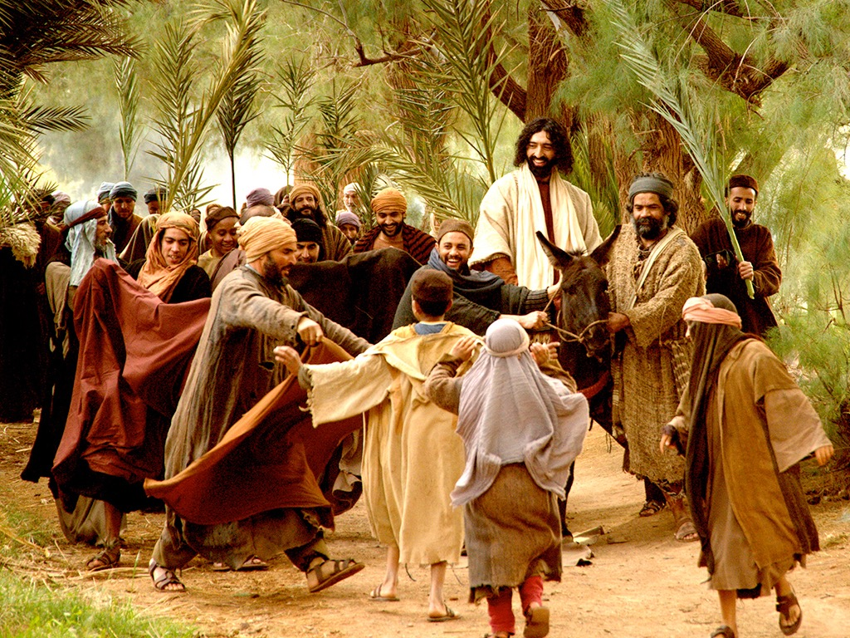
متى 21: 1-11
مرقس 11: 1-11
لوقا 19: 28-44
يوحنا 12: 12-19
قصة الفصح
الدخول الإنتصاري
(أحد الشعانين)

Slide 59
مرقس 11: 1-11
وَلَمَّا قَرُبُوا مِنْ أُورُشَلِيمَ إِلَى بَيْتِ فَاجِي وَبَيْتِ عَنْيَا عِنْدَ جَبَلِ الزَّيْتُونِ

Slide 60
أَرْسَلَ اثْنَيْنِ مِنْ تَلاَمِيذِهِ ٢ وَقَالَ لَهُمَا: «اذْهَبَا إِلَى الْقَرْيَةِ الَّتِي أَمَامَكُمَا

Slide 61
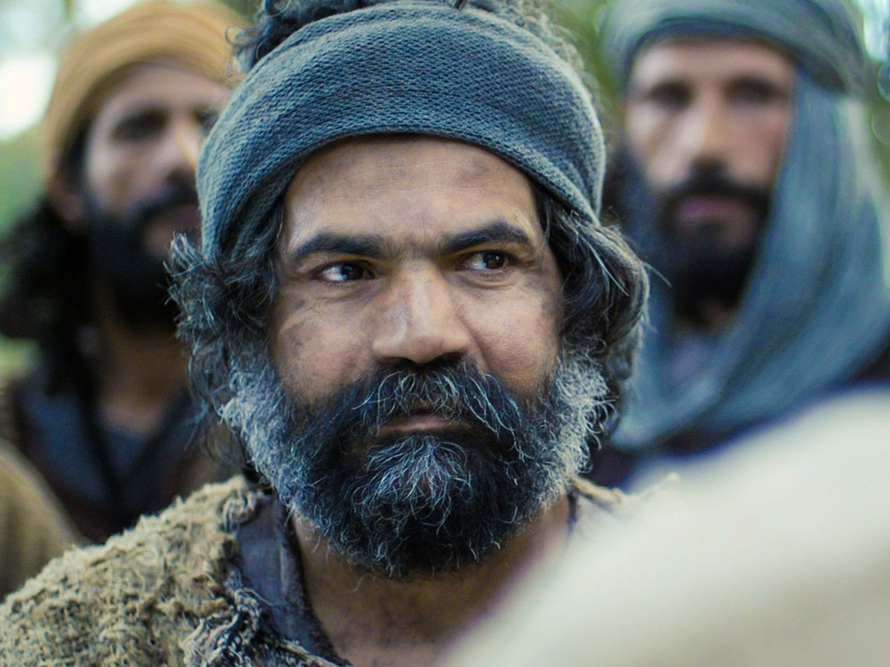
فَلِلْوَقْتِ وَأَنْتُمَا دَاخِلاَنِ إِلَيْهَا تَجِدَانِ جَحْشاً مَرْبُوطاً لَمْ يَجْلِسْ عَلَيْهِ أَحَدٌ مِنَ النَّاسِ. فَحُلاَّهُ وَأْتِيَا بِهِ.
٣ وَإِنْ قَالَ لَكُمَا أَحَدٌ: لِمَاذَا تَفْعَلاَنِ هَذَا؟ فَقُولاَ: الرَّبُّ مُحْتَاجٌ إِلَيْهِ. فَلِلْوَقْتِ يُرْسِلُهُ إِلَى هُنَا».

Slide 62
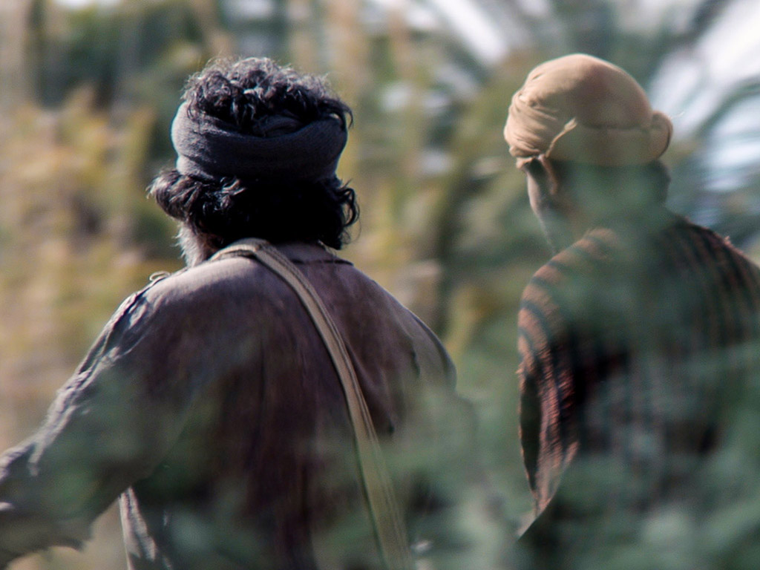
فَمَضَيَا وَوَجَدَا الْجَحْشَ مَرْبُوطاً عِنْدَ الْبَابِ خَارِجاً عَلَى الطَّرِيقِ فَحَلاَّهُ.

Slide 63
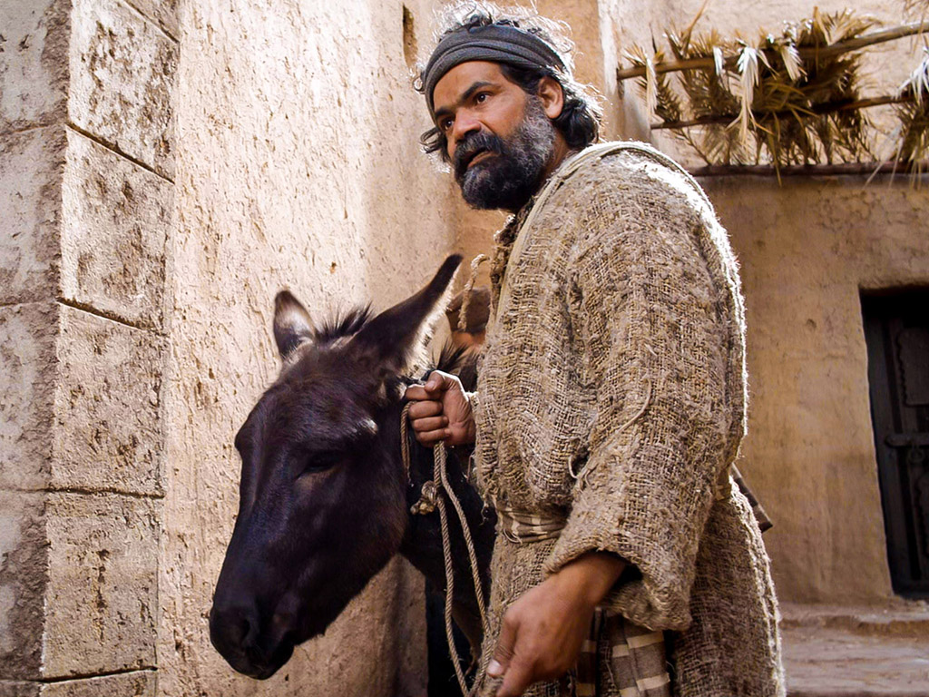
٥ فَقَالَ لَهُمَا قَوْمٌ مِنَ الْقِيَامِ هُنَاكَ:

Slide 64
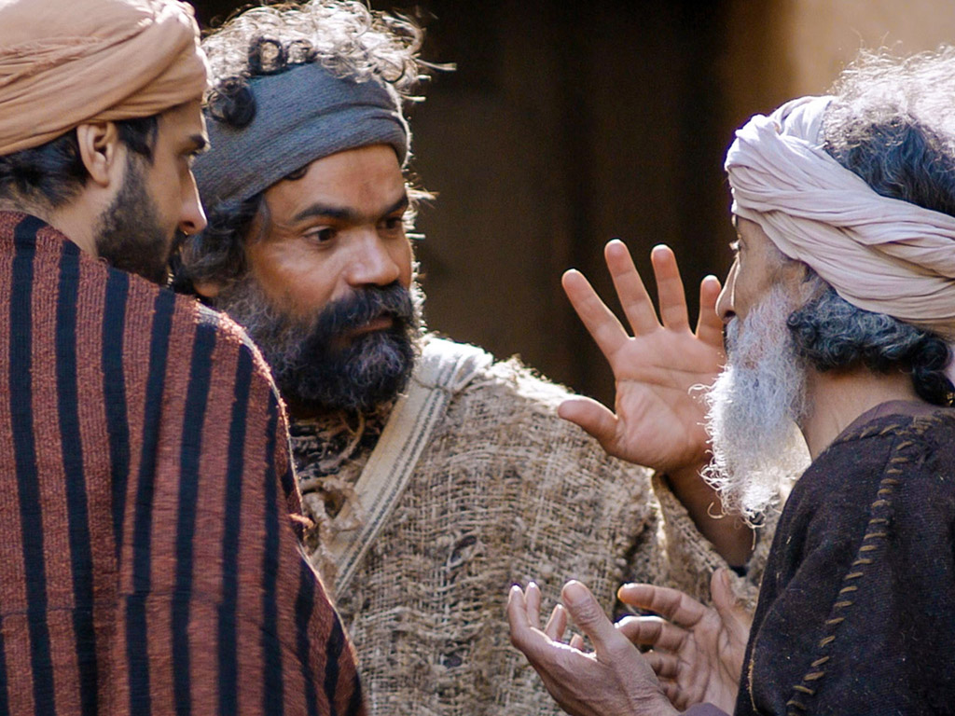
« مَاذَا تَفْعَلاَنِ تَحُلاَّنِ الْجَحْشَ؟ » ٦ فَقَالاَ لَهُمْ كَمَا أَوْصَى يَسُوعُ. فَتَرَكُوهُمَا.

Slide 65
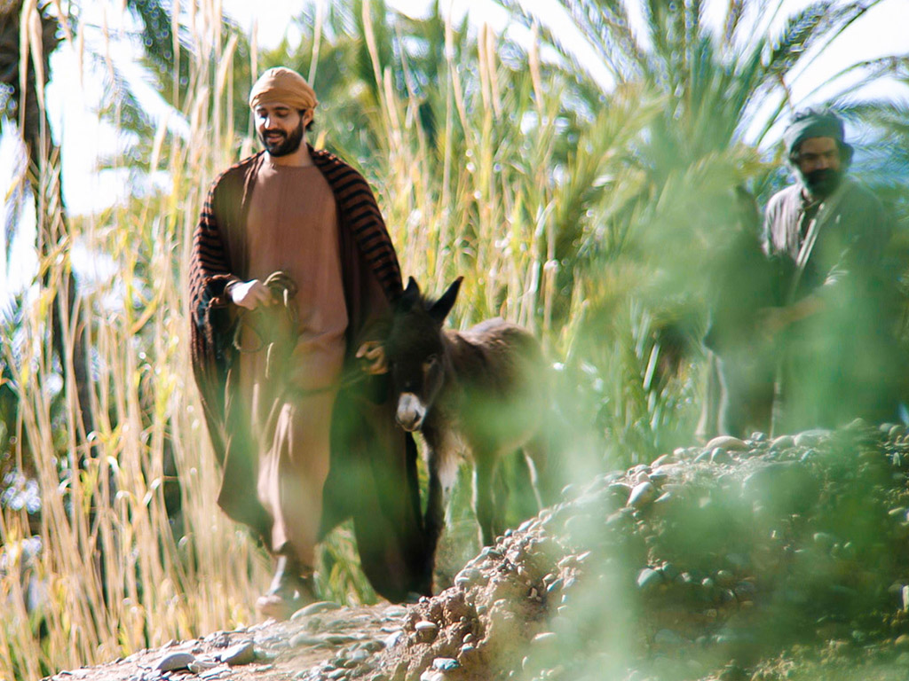
٧ فَأَتَيَا بِالْجَحْشِ إِلَى يَسُوعَ

Slide 66
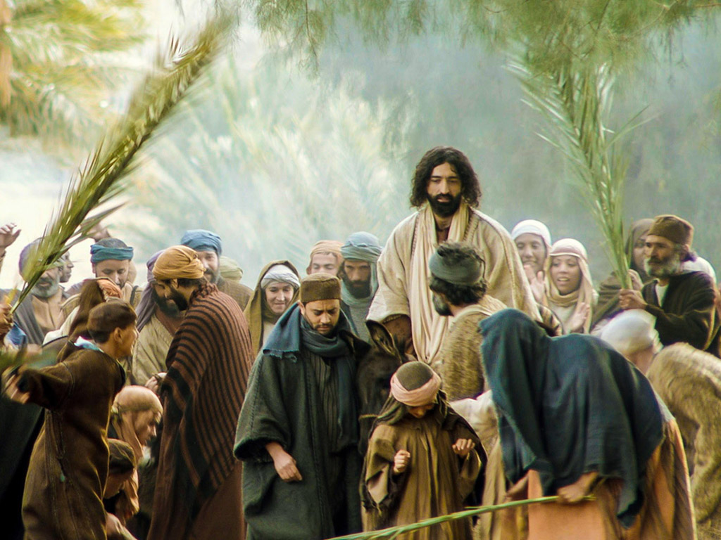
وَأَلْقَيَا عَلَيْهِ ثِيَابَهُمَا فَجَلَسَ عَلَيْهِ.

Slide 67
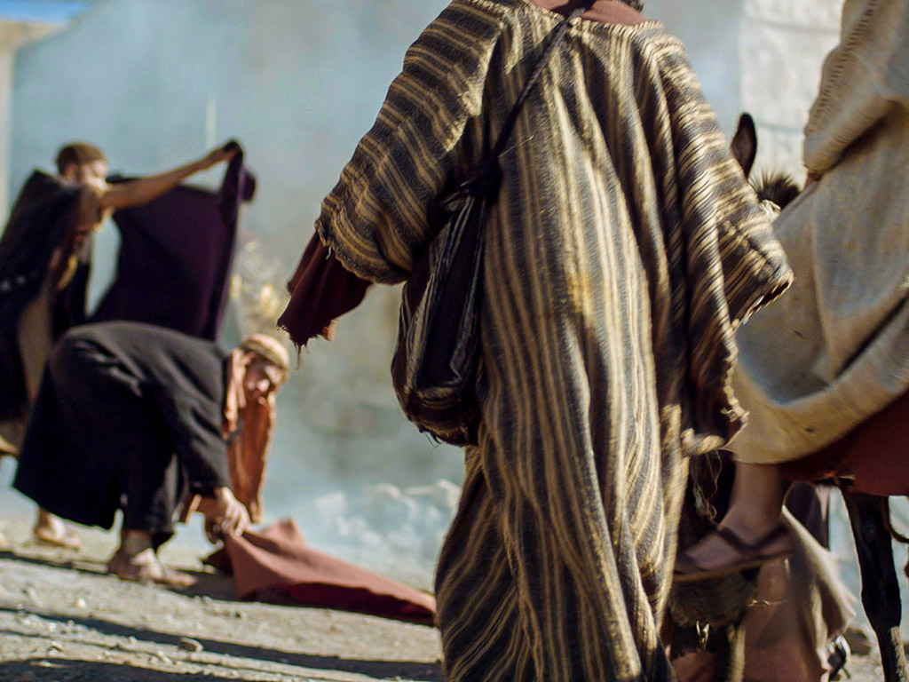
٨ وَكَثِيرُونَ فَرَشُوا ثِيَابَهُمْ فِي الطَّرِيقِ وَآخَرُونَ قَطَعُوا أَغْصَاناً مِنَ الشَّجَرِ وَفَرَشُوهَا فِي الطَّرِيقِ.

Slide 68
٩ وَالَّذِينَ تَقَدَّمُوا وَالَّذِينَ تَبِعُوا كَانُوا يَصْرُخُونَ قَائِلِينَ:

Slide 69
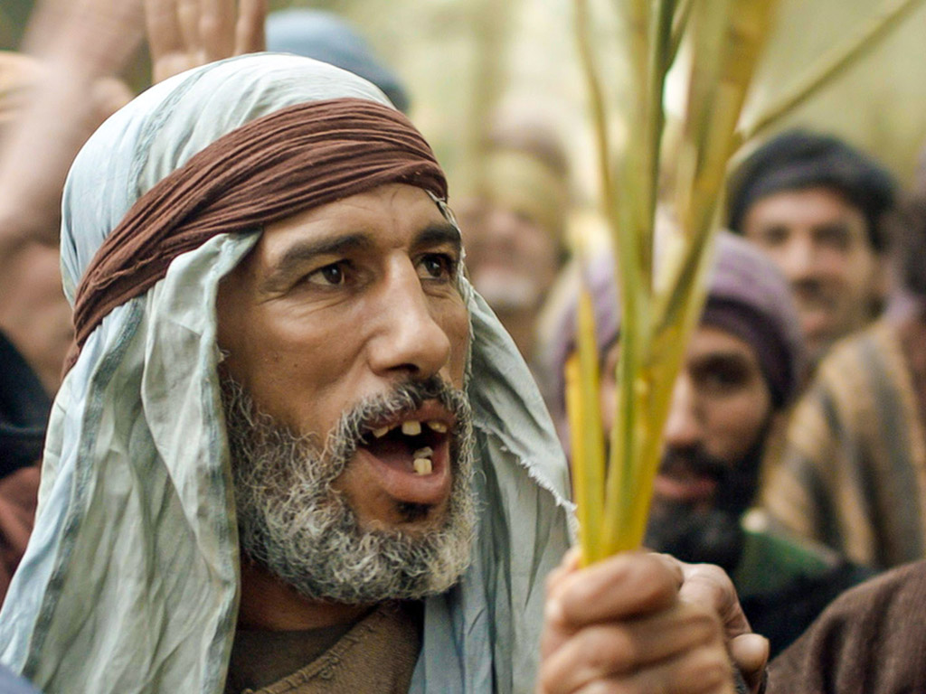
أُوصَنَّا! مُبَارَكٌ الآتِي بِاسْمِ الرَّبِّ!

Slide 70
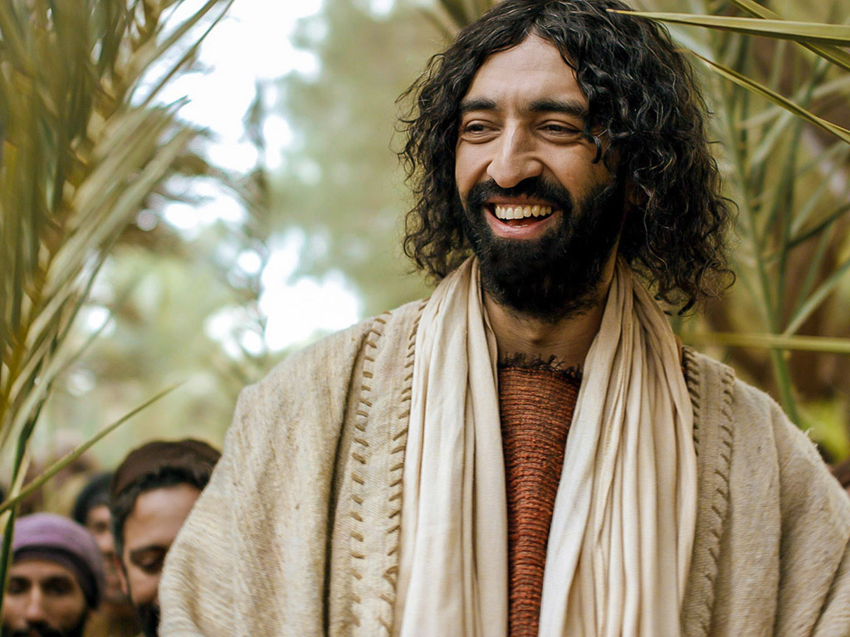
١٠ مُبَارَكَةٌ مَمْلَكَةُ أَبِينَا دَاوُدَ الآتِيَةُ بِاسْمِ الرَّبِّ!

Slide 71
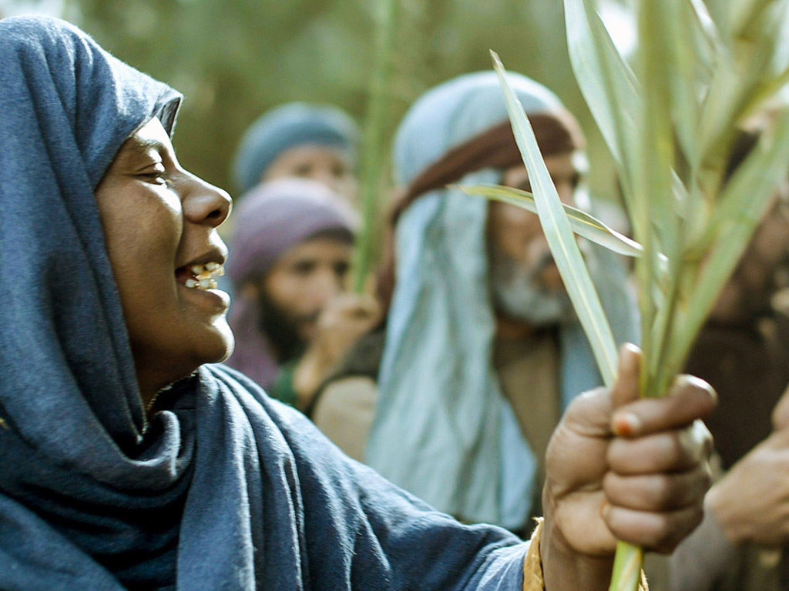
أُوصَنَّا فِي الأَعَالِي!

Slide 72
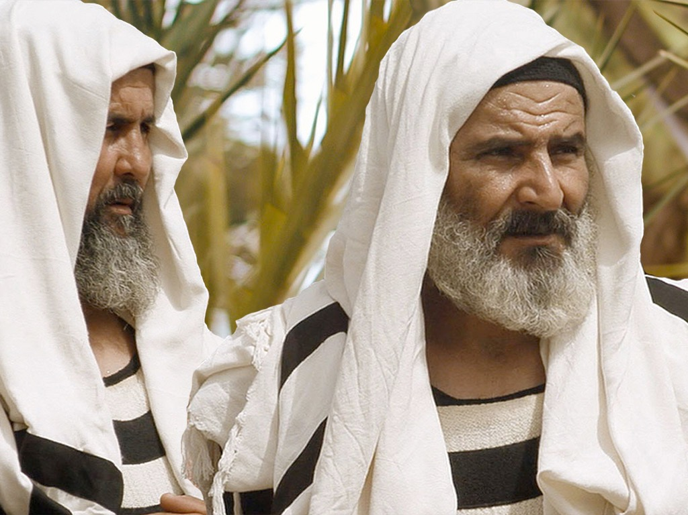
لوقا ١٩ : ٣٩
٣٩ وَأَمَّا بَعْضُ الْفَرِّيسِيِّينَ مِنَ الْجَمْعِ فَقَالُوا لَهُ: «يَا مُعَلِّمُ انْتَهِرْ تَلاَمِيذَكَ «.

Slide 73
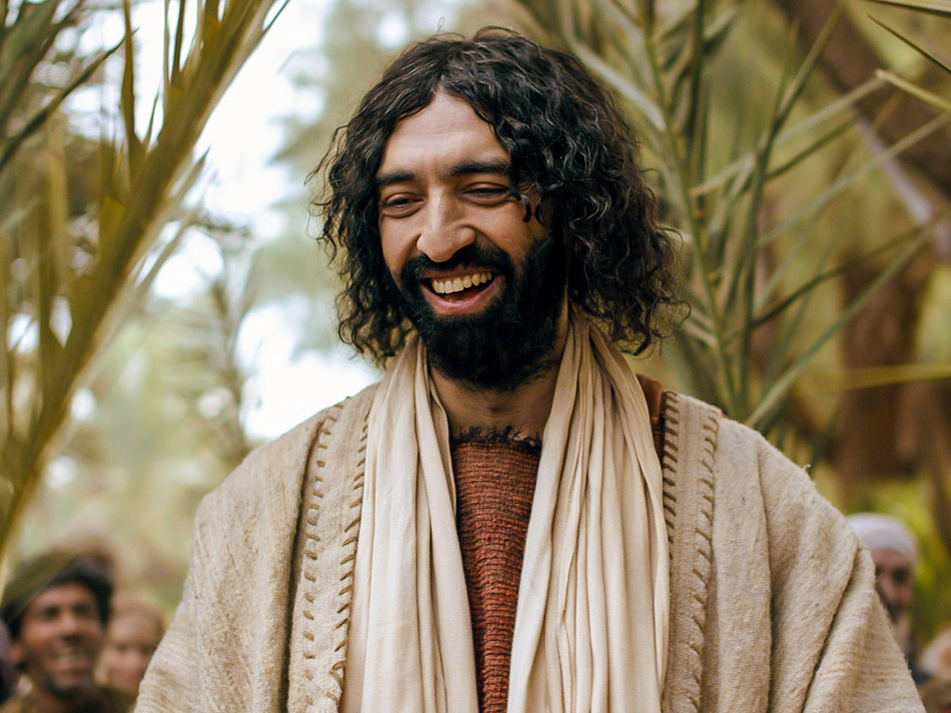
لوقا ١٩ : ٤٠
٤٠ فَأَجَابَ: «أَقُولُ لَكُمْ: إِنَّهُ إِنْ سَكَتَ هَؤُلاَءِ فَالْحِجَارَةُ تَصْرُخُ! «.

Slide 74
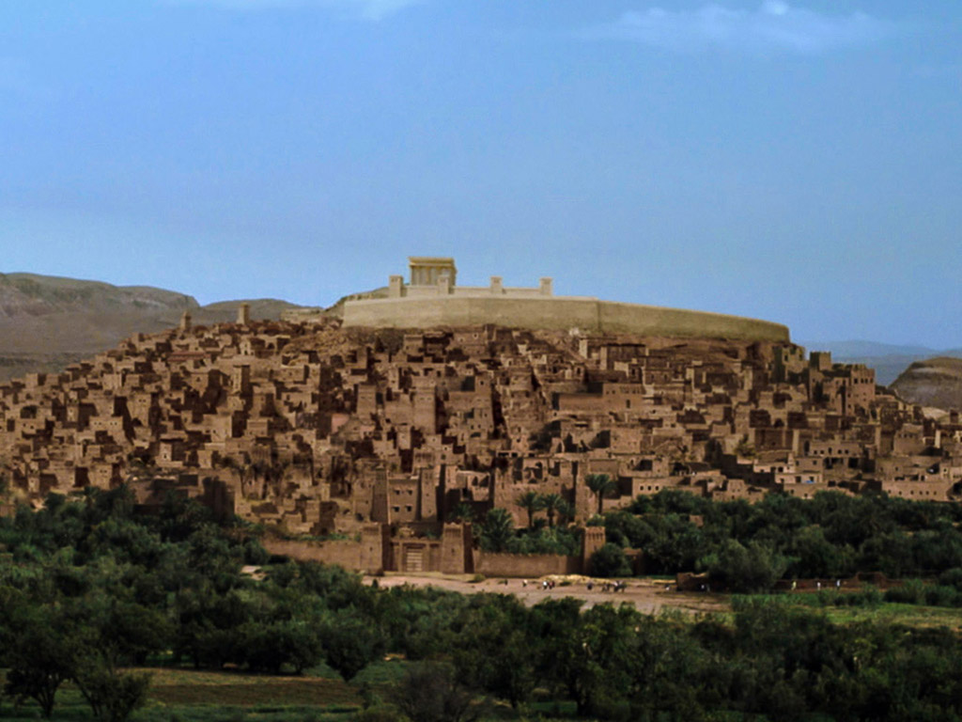
لوقا ١٩ : ٤١
٤١ وَفِيمَا هُوَ يَقْتَرِبُ نَظَرَ إِلَى الْمَدِينَةِ وَبَكَى عَلَيْهَا

Slide 75
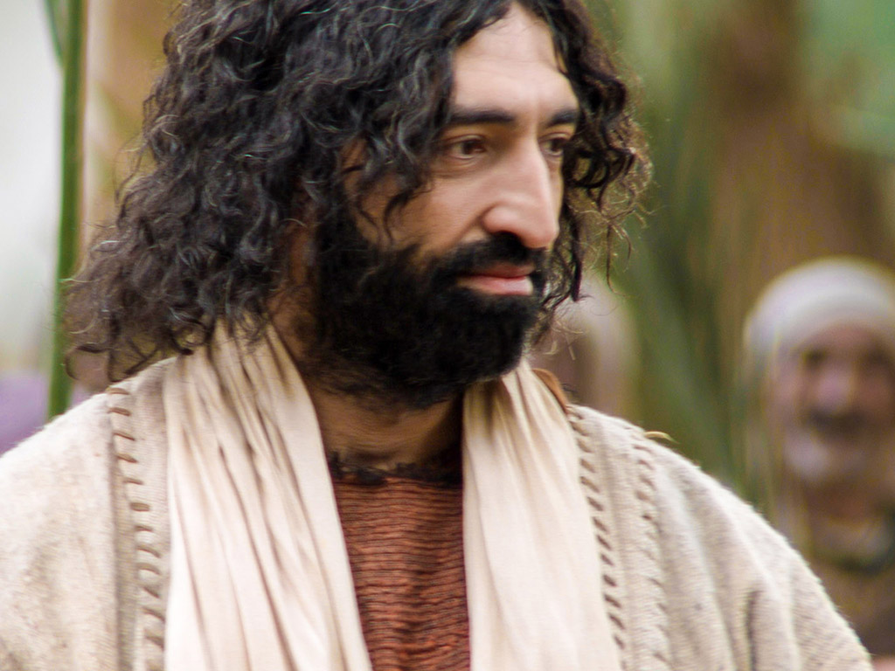
لوقا ١٩ : ٤٢
٤٢ قَائِلاً: «إِنَّكِ لَوْ عَلِمْتِ أَنْتِ أَيْضاً حَتَّى فِي يَوْمِكِ هَذَا مَا هُوَ لِسَلاَمِكِ. وَلَكِنِ الآنَ قَدْ أُخْفِيَ عَنْ عَيْنَيْكِ.

Slide 76
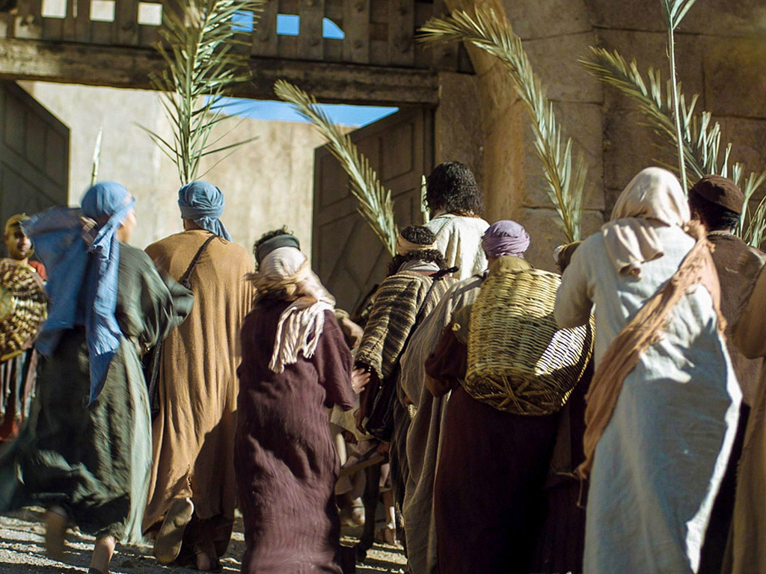
لوقا ١٩ : ٤٣
٤٣ فَإِنَّهُ سَتَأْتِي أَيَّامٌ وَيُحِيطُ بِكِ أَعْدَاؤُكِ بِمِتْرَسَةٍ وَيُحْدِقُونَ بِكِ وَيُحَاصِرُونَكِ مِنْ كُلِّ جِهَةٍ

Slide 77
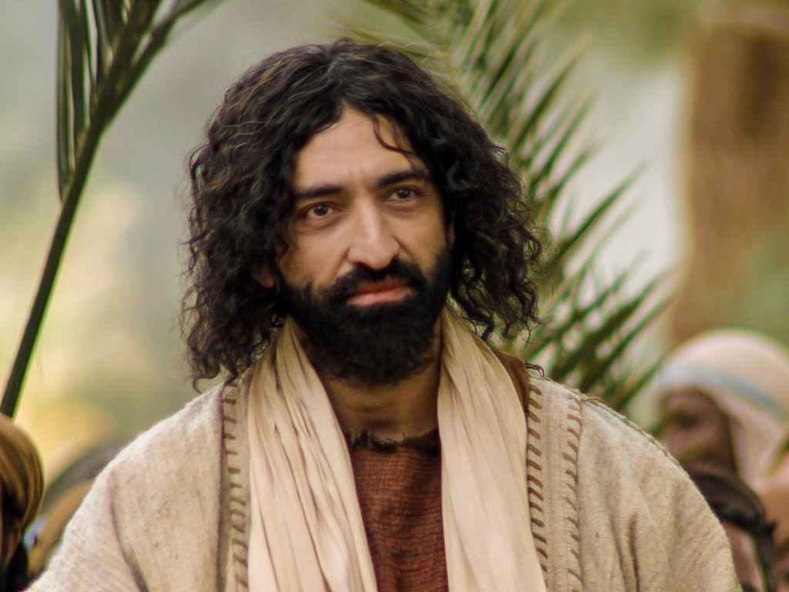
لوقا ١٩ : ٤٤
٤٤ وَيَهْدِمُونَكِ وَبَنِيكِ فِيكِ وَلاَ يَتْرُكُونَ فِيكِ حَجَراً عَلَى حَجَرٍ لأَنَّكِ لَمْ تَعْرِفِي زَمَانَ افْتِقَادِكِ.

Slide 78

الكلمة في صور

Slide 79
استخدمت بإذن رسمي
إنجيل
متى
إنجيل
مرقس
إنجيل
لوقا
إنجيل
يوحنا
نظرًا لإنتاج Lumo لمواد النشر الخاصة به ، نأسف لإبلاغك بأنه لا يمكننا ترخيص صورنا لعملاء آخرين خارج
freebibleimages.org
هذه الصور غير مرخصة لإعادة استخدامها في الفيديو أو النشر أو الوسائط الأخرى. لا يمكن إعادة توزيع الصور والملفات التي تم تنزيلها من خلال أي موقع ويب آخر غير freebibleimages.org أو استخدامها في أي سياق تؤدي فيه الرسالة المصاحبة إلى تقويض الإيمان المسيحي والإنجيل.
لا يمكن استخدام الصور إلا في العروض التقديمية التعليمية والمدونات ووسائل التواصل الاجتماعي ، وكلها يجب أن تكون مصحوبة بالإشارة إلى
www.LumoProject.com.
Picture courtesy of BBM © All Rights Reserved.
www.bigbookmedia.com

Slide 80

ت. سلطة الملك
140
متى 21: 12-13، 18-19، مرقس 11: 12-18، لوقا 19: 45-48
يلعن المسيح شجرة التين ليرمز إلى مراءاة الأمة باعتباره اعترافاً خاطئاً لحمل الثمار لله ويطهر الهيكل مرة ثانية ليُعلِن حقه في الدينونة باعتباره المسيا

Slide 81
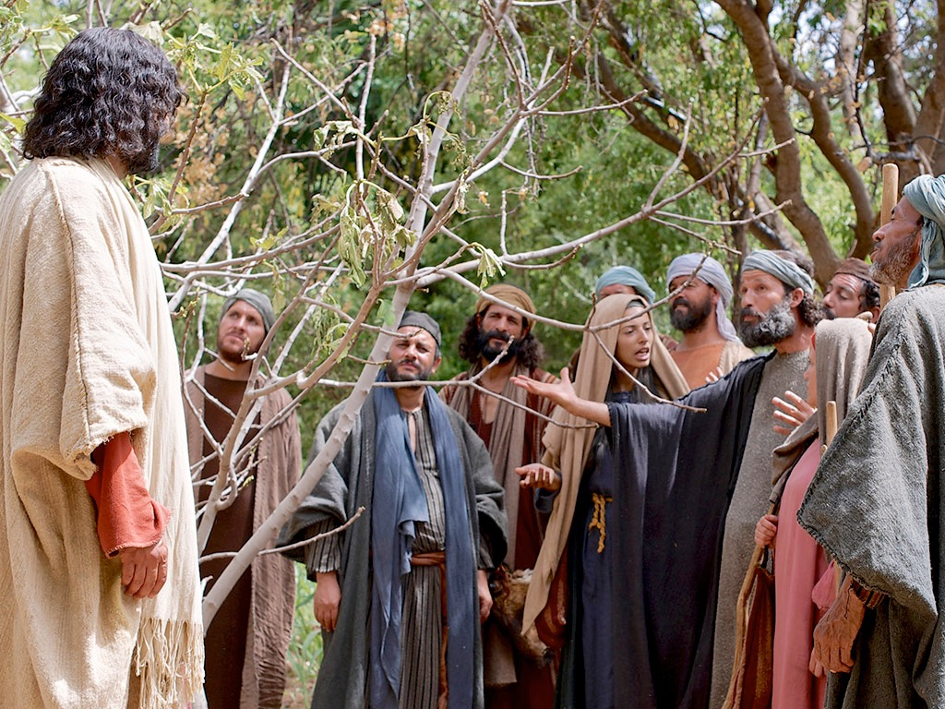
يسوع يلعن شجرة التين
مرقس ١١ : ١٢-١٤

Slide 82
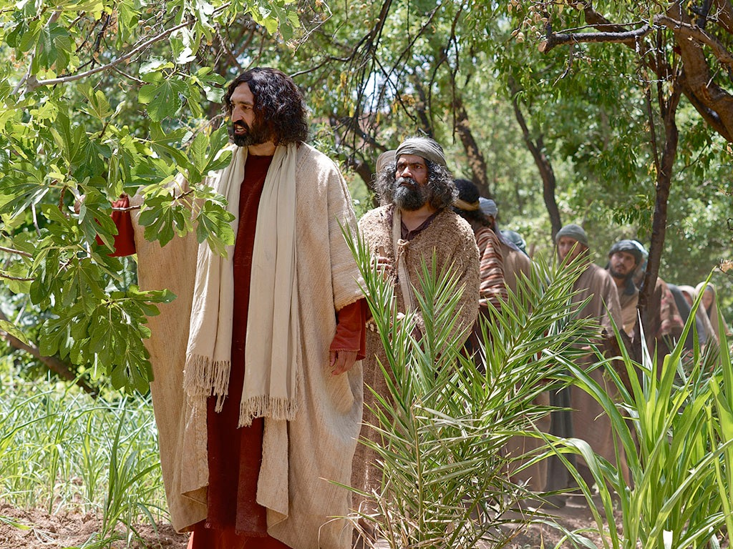
Notes:
Mark 11:12 The next morning as they were leaving Bethany, Jesus was hungry. ¹³ He noticed a fig tree in full leaf a little way off, so he went over to see if he could find any figs.

Slide 83
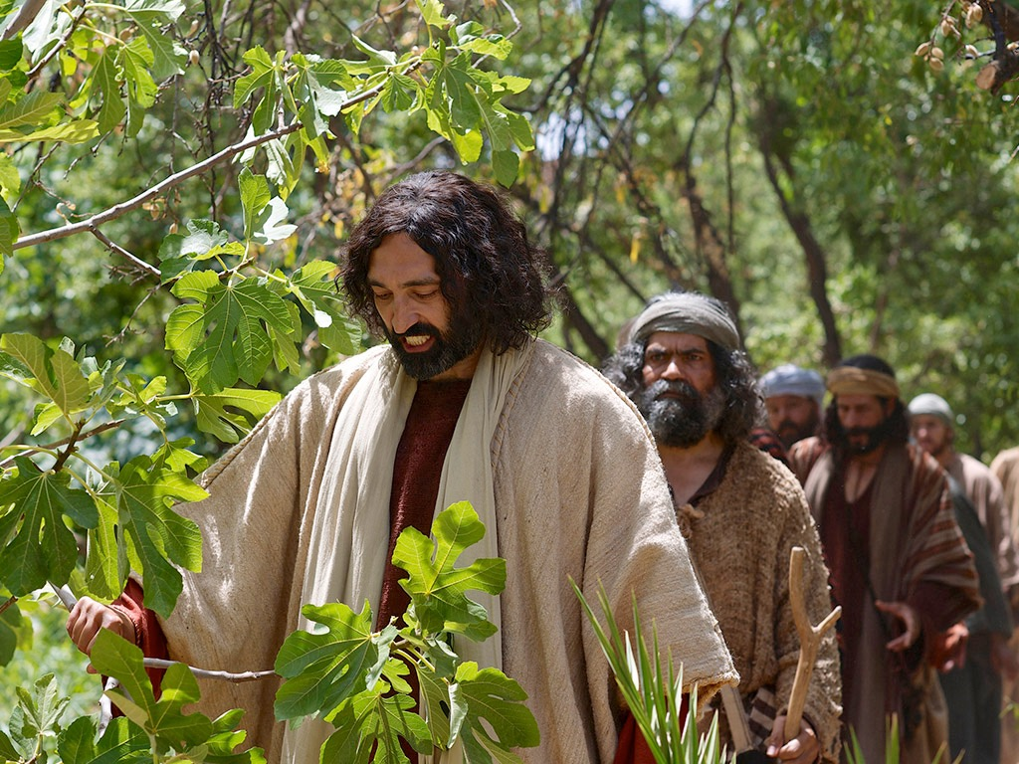
Notes:
Mark 11:13b But there were only leaves because it was too early in the season for fruit.

Slide 84
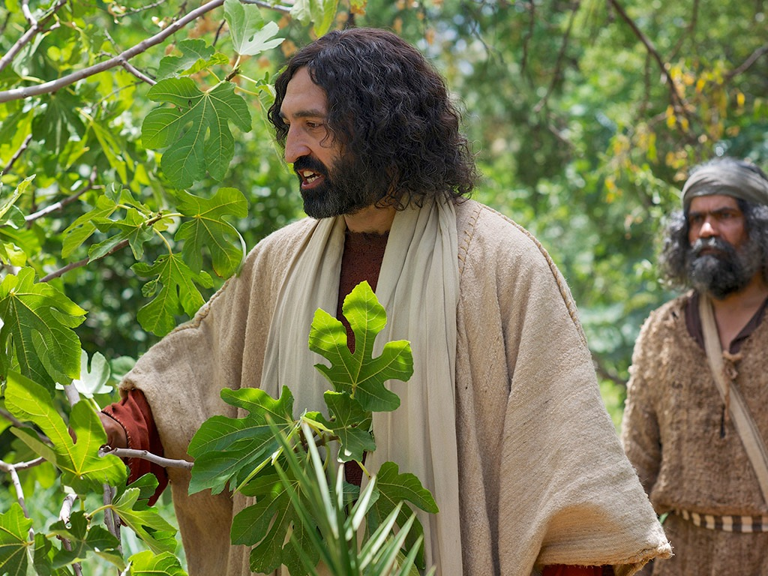
Notes:
Mark 11:14 Then Jesus said to the tree, “May no one ever eat your fruit again!” And the disciples heard him say it.

Slide 85
أسبوع الآلام
64
الإثنين
الأربعاء
الثلاثاء
الجمعة
الخميس
الجمعة
الأحد
السبت
السبت
الأحد
Notes:
Jesus invested his final week in Jerusalem and Bethany east of it, going back and forth from Bethany to the city in a purposeful series of events designed to end in his crucifixion and resurrection.
__________
Common-437
LC-00-NT Chronology-43
LC-08-Official Presentation-22, 60, 92
LC-09-Rejection-9
NS-01-Matt15-28-slide 141
NS-02-Mark9-16-slide 105
NS-03-Luke13-24-slide 224
NS-04-John12-21-slide 295

Slide 86

متى 21: 12-17
مرقس 11: 15-19
لوقا 19: 45-48
يوحنا 2: 13-24
قصة الفصح
تطهير الهيكل

Slide 87

وَكَانَ فِصْحُ الْيَهُودِ قَرِيباً فَصَعِدَ يَسُوعُ إِلَى أُورُشَلِيمَ
يوحنا ٢ : ١٣

Slide 88

وَوَجَدَ فِي الْهَيْكَلِ الَّذِينَ كَانُوا يَبِيعُونَ بَقَراً وَغَنَماً وَحَمَاماً
يوحنا ٢ : ١٤ا

Slide 89

وَالصَّيَارِفَ جُلُوساً.
يوحنا ٢ : ١٤ب

Slide 90


Slide 91

فَصَنَعَ سَوْطاً مِنْ حِبَالٍ وَطَرَدَ الْجَمِيعَ مِنَ الْهَيْكَلِ اَلْغَنَمَ
يوحنا ٢ : ١٥ا

Slide 92
وَالْبَقَرَ وَكَبَّ دَرَاهِمَ الصَّيَارِفِ
يوحنا ٢ : ١٥ت

Slide 93

ف وَقَلَّبَ مَوَائِدَهُمْ.
يوحنا ٢ : ١٥

Slide 94

وَقَالَ لِبَاعَةِ الْحَمَامِ:
يوحنا ٢ : ١٦ا

Slide 95

«ارْفَعُوا هَذِهِ مِنْ هَهُنَا. لاَ تَجْعَلُوا بَيْتَ أَبِي بَيْتَ تِجَارَةٍ».
يوحنا ٢ : ١٦ت

Slide 96

يوحنا ٢ : ١٧
فَتَذَكَّرَ تلاَمِيذُهُ أَنَّهُ مَكْتُوبٌ: «غَيْرَةُ بَيْتِكَ أَكَلَتْنِي».

Slide 97


Slide 98

فَسَأَلَهُ الْيَهُودُ: «أَيَّةَ آيَةٍ تُرِينَا حَتَّى تَفْعَلَ هَذَا؟»
يوحنا ٢ : ١٨

Slide 99

أَجَابَ يَسُوعُ: «انْقُضُوا هَذَا الْهَيْكَلَ وَفِي ثلاَثَةِ أَيَّامٍ أُقِيمُهُ».
يوحنا ٢ : ١٩

Slide 100

فَقَالَ الْيَهُودُ: «فِي سِتٍّ وَأَرْبَعِينَ سَنَةً بُنِيَ هَذَا الْهَيْكَلُ أَفَأَنْتَ فِي ثلاَثَةِ أَيَّامٍ تُقِيمُهُ؟»
يوحنا ٢ : ٢٠

Slide 101

وَأَمَّا هُوَ فَكَانَ يَقُولُ عَنْ هَيْكَلِ جَسَدِهِ.
يوحنا ٢ : ٢١

Slide 102

يوحنا ٢ : ٢٢
فَلَمَّا قَامَ مِنَ الأَمْوَاتِ تَذَكَّرَ تلاَمِيذُهُ أَنَّهُ قَالَ هَذَا فَآمَنُوا بِالْكِتَابِ وَالْكلاَمِ الَّذِي قَالَهُ يَسُوعُ.

Slide 103
الكلمة في صور

Slide 104

المفارقة ما بين السُلْطة والخدمة في إنجيل مرقس
الخدمة | السُلطة
التلمذة | قيادة المسيح | المواضيع
التلاميذ يخدمون (10: 43) | رؤساء الأمم يسودونهم (10: 42) | الاستراتيجية
"يُهلِك نفسه" (8: 35ب) | "يُخلِّص نفسه" (8: 35أ) | الدافع
"الآخِر (الأخير)" (9: 35ب؛ 10: 31ب) | "الأول" (9: 35أ؛ 10: 31أ) | الأولوية
"خادمًا" (10: 43ب) | "عظيمًا" (10: 43أ) | السمعة
"للجميع عبداً" (10: 44ب) | "أوَّلاً" (10: 44أ) | المركز
سُلْطةٌ وأرفقها بالخدمة: يوحنا المعمدان يوسف الذي من الرامة | سُلْطةٌ دون أن يخدموا: القادة الدينيون الرجل الغني يهوذا | أمثلة على السُلطة
لم تكنْ لديهم السُلْطة ولكنَّهم خدموا الآخَرين رغم ذلك: بارتيماوس المرأة التي سكبَتِ الدهن على المسيح | كانت لديهم السُلْطة ولكن واجهوا صعوبة في أن يخدموا الآخَرين: التلاميذ | أمثلة على الخدمة
 | سُلْطة المسيح | القسم الأول (1: 1- 8: 26)
 | الشدُّ (التوتُّر) ما بين السُلْطة والخدمة | القسم الثاني (8: 27- 10: 52)
الخدمة في حياة المسيح |  | القسم الثالث (الأصحاحات 11-16)
89أ
مُلخَّص ناري إف. سانتوس (Narry F. Santos)، Bibliotheca Sacra 154 (تشرين الأول-كانون الأول، 1997): ص.ص 452-60

Slide 105

القيادة العالمية
مرقس
89أ
التابعون يخدمون القائد، والذي يجلس بدوره في أعلى الهرم
القائد
التابعون

Slide 106
القيادة الكتابية
مرقس
89أ
القائد يخدم التابعين
التابعون
القائد

Slide 107
ج. اثبات سلطة الملك
142
متى 21: 20-22، مرقس 11: 19-25، لوقا 21: 37-38
شجرة التين التي لعنها المسيح ذبلت لتشير أن الدينونةالمعلنة على الأمة سوف تأتي سريعاً لتقدم الدعوة للإيمان في شخصه

Slide 108
يسوع يلعن شجرة التين
مرقس ١١ : ٢٠-٢٥

Slide 109
Notes:
Mark 11:20 The next morning as they passed by the fig tree he had cursed, the disciples noticed it had withered from the roots up.

Slide 110

Notes:
Mark 11:21 Peter remembered what Jesus had said to the tree on the previous day and exclaimed, “Look, Rabbi! The fig tree you cursed has withered and died!”

Slide 111

Notes:
Mark 11:22-23 Then Jesus said to the disciples, “Have faith in God. ²³ I tell you the truth, you can say to this mountain, ‘May you be lifted up and thrown into the sea,’ and it will happen. But you must really believe it will happen and have no doubt in your heart."

Slide 112

Notes:
Mark 11:24-25 I tell you, you can pray for anything, and if you believe that you’ve received it, it will be yours. ²⁵ But when you are praying, first forgive anyone you are holding a grudge against, so that your Father in heaven will forgive your sins, too.”

Slide 113
الكلمة في صور

Slide 114
استخدمت بإذن رسمي
إنجيل
متى
إنجيل
مرقس
إنجيل
لوقا
إنجيل
يوحنا
نظرًا لإنتاج Lumo لمواد النشر الخاصة به ، نأسف لإبلاغك بأنه لا يمكننا ترخيص صورنا لعملاء آخرين خارج
freebibleimages.org
هذه الصور غير مرخصة لإعادة استخدامها في الفيديو أو النشر أو الوسائط الأخرى. لا يمكن إعادة توزيع الصور والملفات التي تم تنزيلها من خلال أي موقع ويب آخر غير freebibleimages.org أو استخدامها في أي سياق تؤدي فيه الرسالة المصاحبة إلى تقويض الإيمان المسيحي والإنجيل.
لا يمكن استخدام الصور إلا في العروض التقديمية التعليمية والمدونات ووسائل التواصل الاجتماعي ، وكلها يجب أن تكون مصحوبة بالإشارة إلى
www.LumoProject.com.
Picture courtesy of BBM © All Rights Reserved.
www.bigbookmedia.com

Slide 115


Palm Sunday
مزمور
الأحد
Notes:
棕榈星期天是一个有趣的名字，不是吗？

Slide 116


Palm Sunday
Notes:
We know that today recalls the palm branches waved at Jesus as he entered Jerusalem at the beginning of his last week of his life. Yet the focus really isn't the tree palms, but the hand palms of Jesus that would stretch out on a cross but a few days later.

Slide 117

أشجار النخيل للعبور
Notes:
Tree palms were but a prelude to the cross.

Slide 118


انتصار الدخول
متى ٢١ : ٩
Notes:
Even the alternate name—Triumphant Entry—is also perplexing.

Slide 119

انتصار الدخول
Notes:
True, Jesus rode into Jesus and the crowds cheered his arrival.

Slide 120

انتصار الدخول
٩ وَالْجُمُوعُ الَّذِينَ تَقَدَّمُوا وَالَّذِينَ تَبِعُوا كَانُوا يَصْرَخُونَ: «أُوصَنَّا لاِبْنِ دَاوُدَ! مُبَارَكٌ الآتِي بِاسْمِ الرَّبِّ! أُوصَنَّا فِي الأَعَالِي!».
متى ٢١ : ٩
Notes:
Matthew 21:9 says the crowds that went ahead of him and those that followed shouted, "Hosanna to the Song of David!" "Blessed is he who comes in the name of the Lord!" "Hosanna in the highest!"

Slide 121

الشعانين إلى الصليب
Notes:
Normally a king rode into the city as the victor over his enemies, while that very week would culminate in Jesus' death on Friday, which we call Good Friday.

Slide 122

ما هو الأمر الجيد بخصوص الجمعة العظيمة ؟
Notes:
But that name is equally puzzling. Why is Good Friday called "good"?
Our leader died on that day, so it seems strange to call the day "good." No other religion refers to the death of their leader as "good."
We believe that his death was good. How was that?

Slide 123

كيف يكون موت المسيح أفضل من أي ذبيحة ؟

Slide 124
أسبوع الآلام
64
الإثنين
الأربعاء
الثلاثاء
الجمعة
الخميس
الجمعة
الأحد
السبت
السبت
الأحد
Notes:
LC-00-NT Chronology-43
NS-01-Matt15-28-slide 139
NS-02-Mark9-16-slide 105
NS-03-Luke13-24-slide 211
NS-04-John12-21-slide 294

Slide 125
Slides on مرقس 12

Slide 126
ذ. تعليمات عند الخزانة
149
مرقس 12: 41-44، لوقا 21: 1-4
يباين المسيح ما بين الممارسات المنافقة غير الأمينة للفريسيين مع الإلتزام الضحي لأرملة فقيرة ليظهر أنها كانت تلميذة حقيقية ستدخل الملكوت
Notes:
The Widow’s Mites
Mark 12:41 And He sat down opposite the treasury, and began observing how the people were putting money into the treasury; and many rich people were putting in large sums. ⁴² A poor widow came and put in two ¹small copper coins, which amount to a cent. ⁴³ Calling His disciples to Him, He said to them, “Truly I say to you, this poor widow put in more than all ¹the contributors to the treasury; ⁴⁴ for they all put in out of their ¹surplus, but she, out of her poverty, put in all she owned, ²all she had to live on.”
The Widow’s Gift
Luke 21:1 And He looked up and saw the rich putting their gifts into the treasury. ² And He saw a poor widow putting in two small copper coins. ³ And He said, “Truly I say to you, this poor widow put in more than all of them; ⁴ for they all out of their ¹surplus put into the ²offering; but she out of her poverty put in all ³that she had to live on.”
____________
LC-07-Presentation-81
NS-02-Mark9-16—slide 116

Slide 127

فلسن الأرملة
مرقس ١٢: ٤١-٤٤؛ لوقا ٢١: ١-٤
Notes:
____________
LC-07-Presentation-82
NS-02-Mark9-16—slide 117

Slide 128

فلسن الأرملة
مرقس ١٢: ٤١-٤٤؛ لوقا ٢١: ١-٤
Notes:
____________
LC-07-Presentation-83
NS-02-Mark9-16—slide 118

Slide 129

فلسن الأرملة
مرقس ١٢: ٤١-٤٤؛ لوقا ٢١: ١-٤
Notes:
____________
LC-07-Presentation-84
NS-02-Mark9-16—slide 119

Slide 130

فلسن الأرملة
مرقس ١٢: ٤١-٤٤؛ لوقا ٢١: ١-٤
Notes:
____________
LC-07-Presentation-85
NS-02-Mark9-16—slide 120

Slide 131

ماذا في يدك؟
Mark 12:41-44; Luke 21:1-4
Notes:
____________
LC-07-Presentation-86
NS-02-Mark9-16—slide 121

Slide 132

ما هو الأكثر أهمية؟
Notes:
What do you think is the most important thing we do as a church? Worship? Evangelism? Fellowship? Bible study? Prayer? When I was a pastor, a man inquiring about our church asked me, “So what is most important to your church? What is unique?” If he had asked you, what would you have said? I told him one word: LOVE!
One of the teachers of religious law was standing there listening to Jesus debate. He realized that Jesus had answered well, so he asked, “Of all the commandments, which is the most important?”
________
LC-06-Presentation-113
NS-01-Matt15-28-slide 143
NS-02-Mark9-16-slide 107
132

Slide 133

الأمر الأكثر أهمية هو أن تستمتع بحياتك هذا كل ما يهم — أودري هيبورن —

Slide 134

"Happiness is most important"
السعادة هي الأمر الأكثر أهمية في العالم وبدونها تعيش حياة الإكتئاب
— مارلين مونرو —

Slide 135

ما هو الأكثر أهمية ؟
مرقس 12: 29-31 ... فأجابه يسوع إن أول كل الوصايا هي اسمع يا إسرائيل الرب إلهنا رب واحد 30 وتحب الرب إلهك من كل قلبك ومن كل نفسك ومن كل فكرك ومن كل قدرتك هذه هي الوصية الأولى
31 وثانية مثلها هي تحب قريبك كنفسك ليس وصية أخرى أعظم من هاتين
Notes:
One of the teachers of religious law was standing there listening to the debate. He realized that Jesus had answered well, so he asked, “Of all the commandments, which is the most important?” Jesus answered…
——————————
Common-263
OS-05-Deut-154
NS-02-Mark9-16-slide 110
135

Slide 136
رؤيتنا
حب الأمم
حب الكنيسة
حب
الله
Notes:
Repentance will bring restoration in a church: God wants our church to really trust him.
We still don’t see our need for him as we don’t see our need to pray.
We also need to be involved in his work: missions, teaching, accountability groups, finances, etc.
——————————
Common-263
BE-05-Deut-82
OP-05-Deut-71
OS-05-Deut-155, 237
OS-29-Joel-128
NS-02-Mark1-8-slide 111

Slide 137
Slides on مرقس 13

Slide 138
Slides on مرقس 14

Slide 139


مكسور ومنسكب
متى 26:6-13
مرقس 14:1-11
يوحنا 12:1-11
متى 13-6:23
مرقس 11-1:14
يوحنا11-1:12
يؤديها ستيف جرين
تم إهمال يسوع

Slide 140

Notes:
Music background 1 of 2

Slide 141

Notes:
Music background 1 of 2

Slide 142

في يوم من الأيام كانت امرأة قروية عادية مدفوعة بالحب لربها

Slide 143

سكب بتهور من جوهر قيم ، متجاهلاً الإزدراء

Slide 144
وبمجرد أن تم كسرها وانسكابها ، ملأ العطر كل الغرفة.

Slide 145
كسجين خرج من أغلاله كروح تحررت من القبر

Slide 146

محطمة ومترددة ، فقط من أجل حبك يا يسوع

Slide 147
أغلى كنز في الحياة سدد عليك

Slide 148

كسرت وخرجت وانسكبت عند قدميك

Slide 149
في التخلي الحلو ، اسمحوا لي أن أتسرب من أجلك

Slide 150

يا رب ، لقد كنت كنز الله الثمين ، ومحبوبًا له وابنه الكامل

Slide 151
أُرسِلَتْ هنا لتظهر لي محبة الآب ، فقط من أجل المحبة التي تمت

Slide 152

وعلى الرغم من أنك كنت كاملاً ومقدسًا ، فقد تخلت عن نفسك طواعية

Slide 153
أنت لم تدخر أي نفقات في عفوتي استهلكت وضيعت من أجلي

Slide 154

مكسورة وتحدثت فقط من أجل محبتي ، يا يسوع

Slide 155
أغلى كنز الله أغدق علي

Slide 156

كسرت وانسكبت على قدمي.

Slide 157
في هجر جميل ، يا رب ، لقد تم إراحتك واستهلكت من أجلي

Slide 158

في التخلي الحلو ، اسمحوا لي أن ينسكب من أجل اليك

Slide 159

الصور مقدمة من Big Book Media © جميع الحقوق محفوظة
استخدمت بإذن
BIG BOOK MEDIA

Slide 160
الكلمة في صور

Slide 161


هل كانت مريم المجدليَّة هي المرأة حاملة قارورة الطيب؟
المرأة
و
قارورة الطيب
مريم
المجدليَّة
والكأس
المقدَّسة
لا . في لوقا غير مذكور اسمها
ولكن في الأناجيل الأُخرى
هي مريم من بيت عنيا
بكل وضوح
كما ورد
في كتاب
شيفرة دافنشي
Notes:
Over 1000 years ago, Pope Gregory preached a sermon that confused the two anointings of Jesus so that Mary Magdalene ended up being the illicit woman of Luke 7. This mixed her up with Mary of Bethany and also implied that she was a prostitute when, in fact, she had seven demons.
Mark 16:9 After Jesus rose from the dead early on Sunday morning, the first person who saw him was Mary Magdalene, the woman from whom he had cast out seven demons.
Luke 8:2 along with some women who had been cured of evil spirits and diseases. Among them were Mary Magdalene, from whom he had cast out seven demons.
__________
Common-427
LC-03-Controversy-17
NS-01-Matt15-28-slide 212
NS-02-Mark9-16-slide 145
NS-03-Luke13-24-slide 304
NS-04-John12-21-slide 19

Slide 162

يوحنا ١٢ حدث
64
656
ملخص عدم الإيمان ١٢: ٣٧-٥٠
التنبؤ بالموت
١٢:٢١-٣٦
النصر١٢:١٢ - ٢٠
الدهن في بيت عنيا ١٢: ١-١١

Slide 163

لم يكن هذا مثل لوقا ٧: ٣٦-٥٠ مع يسوع والمرأة الخاطئة
Notes:
Luke 7 stands alone in the anointings of Jesus as it was much earlier.
__________
Common-428
LC-03-Controversy-18
NS-01-Matt15-28-slide 214
NS-02-Mark9-16-slide 147
NS-03-Luke13-24-slide 305
NS-04-John12-21-slide 20

Slide 164

مسح يسوع
أمور مشتركة في قصص الأناجيل الأربعة
1. زيارة غير معلنة من امرأة
2. مسح رأس و قدمي يسوع
3. تنشيف قدميه بشعرها
4. اعتراض التلاميذ/يهوذا على الإسراف
5. توبيخ التلاميذ من قبل يسوع
6. في بيت
7. قارورة الطيب (باستثناء يوحنَّا)
8. مالك المنزل هو رجل يدعى سمعان
Notes:
Luke 7 has in common with the Passion Week anointing many traits.
__________
Common-429
LC-03-Controversy-17
NS-01-Matt15-28-slide 215
NS-02-Mark9-16-slide 148
NS-03-Luke13-24-slide 306
NS-04-John12-21-slide 21

Slide 165

مسحتي يسوع
لوقا ٧: ٣٦ - ٥٠
في وقت مبكر في الخدمة
البكاء
للعبادة، مغفورة خطايا المرأة (لوقا ٧: ٤٨)
بواسطة زانية
لم يذكر اسمها في منزل سمعان الفريسي
(لوقا ٧: ٤٠) في بلدة غير معروفة
متى ٢٦: ٦ – ١٣
مرقس ١٤: ۳ – ٩
يوحنَّا ١٢: ١ – ١١
خلال أسبوع الآلام
لم يلاحظ بكاء
للدفن، لا تحتاج المرأة إلى الصفح
من قبل مريم أخت لعازر في منزل سمعان الأبرص(متى ٢٦: ٦؛ مرقس ١٤: ٣) في بيت عنيا مسقط رأس لعازر (يوحنَّا ١٢: ١)
Notes:
Significant differences between these two anointings show them to be two separate but similar events.
__________
Common-430
LC-03-Controversy-18
NS-01-Matt15-28-slide 216
NS-02-Mark9-16-slide 149
NS-03-Luke13-24-slide 307
NS-04-John12-21-slide 22

Slide 166

متَّى 26: 17-35
مرقس 14: 12-31
لوقا 22: 7-38
يوحنا 13: 18-38
قصة عيد الفصح
العشاء
الأخير

Slide 167


Slide 168


Slide 169


Slide 170


Slide 171


Slide 172


Slide 173


Slide 174


Slide 176


Slide 177


Slide 178


Slide 179


Slide 180


Slide 181


Slide 182
الكلمة في صور

Slide 183

متَّى 26: 36-56
مرقس 41: 32-52
لوقا 22: 39-53
يوحنَّا 18: 1-12
قصَّة الفصح
يسوع يُصلِّي في
جثسيماني

Slide 184


Slide 185


Slide 186


Slide 187


Slide 188


Slide 190


Slide 191


Slide 192


Slide 193


Slide 194


Slide 195


Slide 196


Slide 197


Slide 198


Slide 199


Slide 200


Slide 201


Slide 202


Slide 203


Slide 204
الكلمة في صور

Slide 205
استخدمت بإذن رسمي
إنجيل
متى
إنجيل
مرقس
إنجيل
لوقا
إنجيل
يوحنا
نظرًا لإنتاج Lumo لمواد النشر الخاصة به ، نأسف لإبلاغك بأنه لا يمكننا ترخيص صورنا لعملاء آخرين خارج
freebibleimages.org
هذه الصور غير مرخصة لإعادة استخدامها في الفيديو أو النشر أو الوسائط الأخرى. لا يمكن إعادة توزيع الصور والملفات التي تم تنزيلها من خلال أي موقع ويب آخر غير freebibleimages.org أو استخدامها في أي سياق تؤدي فيه الرسالة المصاحبة إلى تقويض الإيمان المسيحي والإنجيل.
لا يمكن استخدام الصور إلا في العروض التقديمية التعليمية والمدونات ووسائل التواصل الاجتماعي ، وكلها يجب أن تكون مصحوبة بالإشارة إلى
www.LumoProject.com.
Picture courtesy of BBM © All Rights Reserved.
www.bigbookmedia.com

Slide 206

دعوة بطرس
(مصدر مرقس في كتابة إنجيله)

Slide 207

إنكارات بطرس

Slide 208


متَّى 26: 69-75
مرقس 41: 66-72
لوقا 22: 54-62
يوحنَّا 18: 15-27
قصَّة الفصح
بطرس ينكر يسوع

Slide 209


Slide 210


Slide 211


Slide 212


Slide 213


Slide 214


Slide 215


Slide 216


Slide 217


Slide 219
الصور مقدمة من Big Book Media © All Rights Reserved.
مستخدمة بإذن
بيك بوك ميديا
وسائط الكتب الكبيرة
Notes:
_________
Common-486
NS-01-Matt1-14-slide 477

Slide 220
الكلمة في صور

Slide 221

متَّى 26: 57-67
مرقس 41: 53-65
لوقا 22: 66-71
يوحنَّا 18: 15-27
قصَّة الفصح
يسوع يقف أمام مجلس السنهدريم
Notes:
يُظهِر اعتقالُ يسوع ومحاكماتُه بصورة متكرِّرة براءتَه من جميع التهم الموجَّهة إليه ليؤكِّد ذلك كونه ذبيحةً عن خطايا العالَم- وليس عن خطايا موجودة فيه (لوقا 22: 47- 23: 25).

Slide 222


Slide 223


Slide 224


Slide 226


Slide 227


Slide 228


Slide 229


Slide 230
الكلمة في صور

Slide 231
استخدمت بإذن رسمي
إنجيل
متى
إنجيل
مرقس
إنجيل
لوقا
إنجيل
يوحنا
نظرًا لإنتاج Lumo لمواد النشر الخاصة به ، نأسف لإبلاغك بأنه لا يمكننا ترخيص صورنا لعملاء آخرين خارج
freebibleimages.org
هذه الصور غير مرخصة لإعادة استخدامها في الفيديو أو النشر أو الوسائط الأخرى. لا يمكن إعادة توزيع الصور والملفات التي تم تنزيلها من خلال أي موقع ويب آخر غير freebibleimages.org أو استخدامها في أي سياق تؤدي فيه الرسالة المصاحبة إلى تقويض الإيمان المسيحي والإنجيل.
لا يمكن استخدام الصور إلا في العروض التقديمية التعليمية والمدونات ووسائل التواصل الاجتماعي ، وكلها يجب أن تكون مصحوبة بالإشارة إلى
www.LumoProject.com.
Picture courtesy of BBM © All Rights Reserved.
www.bigbookmedia.com

Slide 232
Slides on مرقس 15

Slide 233

متَّى 27: 27-37
مرقس 15: 16-25
لوقا 23: 26-34
يوحنَّا 19: 16-27
قصَّة الفصح
يسوع مصلوبًا

Slide 234


Slide 235


Slide 236


Slide 237


Slide 238


Slide 239


Slide 240


Slide 241


Slide 242


Slide 243


Slide 244


Slide 245


Slide 246


Slide 247


Slide 248


Slide 249


Slide 250
الكلمة في صور

Slide 251
استخدمت بإذن رسمي
إنجيل
متى
إنجيل
مرقس
إنجيل
لوقا
إنجيل
يوحنا
نظرًا لإنتاج Lumo لمواد النشر الخاصة به ، نأسف لإبلاغك بأنه لا يمكننا ترخيص صورنا لعملاء آخرين خارج
freebibleimages.org
هذه الصور غير مرخصة لإعادة استخدامها في الفيديو أو النشر أو الوسائط الأخرى. لا يمكن إعادة توزيع الصور والملفات التي تم تنزيلها من خلال أي موقع ويب آخر غير freebibleimages.org أو استخدامها في أي سياق تؤدي فيه الرسالة المصاحبة إلى تقويض الإيمان المسيحي والإنجيل.
لا يمكن استخدام الصور إلا في العروض التقديمية التعليمية والمدونات ووسائل التواصل الاجتماعي ، وكلها يجب أن تكون مصحوبة بالإشارة إلى
www.LumoProject.com.
Picture courtesy of BBM © All Rights Reserved.
www.bigbookmedia.com

Slide 252

متى 27: 38-66
مرقس 15: 25-47
لوقا 23: 35-56
يوحنا 19: 28-42
قصة الفصح
يسوع يموت على الصليب

Slide 253


Slide 254


Slide 255


Slide 256


Slide 257


Slide 258


Slide 259


Slide 261


Slide 262


Slide 264


Slide 265


Slide 266


Slide 267


Slide 268


Slide 269


Slide 270


Slide 271
الكلمة في صور

Slide 272
استخدمت بإذن رسمي
إنجيل
متى
إنجيل
مرقس
إنجيل
لوقا
إنجيل
يوحنا
نظرًا لإنتاج Lumo لمواد النشر الخاصة به ، نأسف لإبلاغك بأنه لا يمكننا ترخيص صورنا لعملاء آخرين خارج
freebibleimages.org
هذه الصور غير مرخصة لإعادة استخدامها في الفيديو أو النشر أو الوسائط الأخرى. لا يمكن إعادة توزيع الصور والملفات التي تم تنزيلها من خلال أي موقع ويب آخر غير freebibleimages.org أو استخدامها في أي سياق تؤدي فيه الرسالة المصاحبة إلى تقويض الإيمان المسيحي والإنجيل.
لا يمكن استخدام الصور إلا في العروض التقديمية التعليمية والمدونات ووسائل التواصل الاجتماعي ، وكلها يجب أن تكون مصحوبة بالإشارة إلى
www.LumoProject.com.
Picture courtesy of BBM © All Rights Reserved.
www.bigbookmedia.com

Slide 273
كيف يمكنك أن تكون أميناً رغم عدم الراحة واختبارك للألم والمعاناة؟

Slide 274
كيف يمكنك أن تكون تلميذاً حقيقيَّاً ليسوع في عالَم عِدائيّ؟
مرقس
Notes:
ما الذي يتطلَّبه الأمر منك لكي تتبع المسيح حقَّاً عندما يكون معظم الناس حولك يُعارِضون يسوع؟

Slide 275
الكيفيَّة التي يمكنك بها أن تكون تلميذاً في عالم عِدائيّ
سوف
تقوم (من الموت)
اخدِمْ
مثْلَ
يسوع
تألَّـمْ
مثْلَ يسوع
لا تتشبَّثْ بسُلْطتك
16 | 11-15 | 1: 14- 10: 52 | 1: 1-13
مرقس
Notes:
سوف نختبر الانتصار على الموت تماماً كما قام المسيح من بين الأموات بوصفه المسيَّا والله (مرقس، الأصحاح ١٦)

Slide 276
Slides on مرقس 16

Slide 277

متَّى 28: 1-15
مرقس 16: 1-20
لوقا 24: 1-47
يوحنَّا 20: 1-29
قصَّة الفصح
يسوع حيٌّ

Slide 278


Slide 280


Slide 281


Slide 282


Slide 283


Slide 284


Slide 285


Slide 286


Slide 287


Slide 288


Slide 289


Slide 290


Slide 291


Slide 292


Slide 293


Slide 294


Slide 295


Slide 296
الكلمة في صور

Slide 297
استخدمت بإذن رسمي
إنجيل
متى
إنجيل
مرقس
إنجيل
لوقا
إنجيل
يوحنا
نظرًا لإنتاج Lumo لمواد النشر الخاصة به ، نأسف لإبلاغك بأنه لا يمكننا ترخيص صورنا لعملاء آخرين خارج
freebibleimages.org
هذه الصور غير مرخصة لإعادة استخدامها في الفيديو أو النشر أو الوسائط الأخرى. لا يمكن إعادة توزيع الصور والملفات التي تم تنزيلها من خلال أي موقع ويب آخر غير freebibleimages.org أو استخدامها في أي سياق تؤدي فيه الرسالة المصاحبة إلى تقويض الإيمان المسيحي والإنجيل.
لا يمكن استخدام الصور إلا في العروض التقديمية التعليمية والمدونات ووسائل التواصل الاجتماعي ، وكلها يجب أن تكون مصحوبة بالإشارة إلى
www.LumoProject.com.
Picture courtesy of BBM © All Rights Reserved.
www.bigbookmedia.com

Slide 298

بطرس في يوم الخمسين

Slide 299

عطلة نهاية أسبوع نبوية
م ع ج 39
يوم الخميس
جمعة
السبت
الأحد
الجليل
الفداء
الانفصال
القيامة
يهودا
الفداء
الانفصال
القيامة
العشاء الأخير
صلب
القيامة
2 أبريل 33
3 أبريل 33
5 أبريل 33
١ كورنثوس ١٥ : ٢٠
وَلَكِنِ الآنَ قَدْ قَامَ الْمَسِيحُ مِنَ الأَمْوَاتِ وَصَارَ بَاكُورَةَ الرَّاقِدِينَ.
Notes:
Leviticus 23 gives the order of three key feasts of Israel: • Passover, • Unleavened Bread, and • Firstfruits.
• But how could Jesus have Passover Thursday night but then die at 3 PM the next day on Friday when the Passover lambs were being slaughtered? And why did the Jewish leaders want the bodies off the cross quickly as Passover was approaching when Jesus had already celebrated Passover the night before?
• The answer is that Galilean Jews celebrated Passover the day before • Judean Jews. Since his disciples were Galileans, Jesus naturally celebrated on their timetable.
• The Feast of Unleavened Bread always began the day after Passover (Lev 23:5-6).
• Then Firstfruits followed sometime later on the first Sabbath after the first crops began to ripen (Lev 23:11). It indicated that millions of additional sheaves would follow until the entire harvest came in at Pentecost. In AD 33, these three celebrations occurred one after another on three consecutive days!
The significance is astonishing. • Christ predicted his death at the Last Supper Thursday night. • Then Jesus died on the Judean Passover • so that believers can live a life without yeast (Unleavened Bread), • which immediately followed with his resurrection on Firstfruits as he is the first and only human ever to obtain a glorified body as an installment for millions more to follow (1 Cor 15:20)!
We know these dates to be • 2 April 33 for the Thursday night Passover, • 3 April 33 was the day of his crucifixion, and • Jesus rose from the dead on the Feast of Firstfruits on 5 April 33.
————————————
OB-25-Feasts-35
OS-03-Leviticus-303
OS-26-Ezek40-43-Slide105
LC-00-Chronology of Christ-8
NB-11-Feasts-35
NS-00-NTS Chronology-slide 40
NS-00-Chronology of Christ-8
NS-01-Matt15-28-slide 315
NS-02-Mark9-16-slide 262
NS-03-Luke13-24-slide 290
NS-04-John12-21-slide 294

Slide 300

مرقس 16: 9-20
أحد أصعب المشاكل النصية في العهد الجديد
88
90-92

Slide 301

3 أنواع من نصوص المخطوطات
غربية
90
بيزنطية
اسكندرية
Notes:
The NT manuscripts of the early centuries of the church were copied in three main regions:
Rome gave us the Western text type which has many manuscripts from the 8th-10th centuries, supported by the Roman Catholic church.
The city of Constantinople became the capital of the Eastern Orthodox church with its Byzantine manuscripts (or majority text, since they copied so many of them). While considerably varying, it also underlies the Textus Receptus Greek text used for most Reformation-era translations of the New Testament into vernacular languages, and
A large community of Christians gathered in Alexandria, Egypt. This Alexandrian texts were the earliest, going back to about AD 200. Modern translations mainly use Eclectic editions that conform more often to the Alexandrian text-type.

Slide 302
ماذا عن مرقس 16: 9-20 ؟
غربية
90
بيزنطية
الكل يحتوي على مر 16: 9-20
مخطوطات كثيرة
ما عدا القرن 7-5
الكل يحتوي على مر 16: 9-20
مخطوطات كثيرة
ما عدا القرن 9-15
البعض ألغى 16: 9-20
فقط 5 مخطوطات
القرن الرابع احتواها
القرن 5-9 استثناها
اسكندرية
Notes:
The NT manuscripts of the early centuries of the church were copied in three main regions:
Rome gave us the Western text type which has many manuscripts from the 8th-10th centuries, supported by the Roman Catholic church.
The city of Constantinople became the capital of the Eastern Orthodox church with its Byzantine manuscripts (or majority text, since they copied so many of them). While considerably varying, it also underlies the Textus Receptus Greek text used for most Reformation-era translations of the New Testament into vernacular languages, and
A large community of Christians gathered in Alexandria, Egypt. This Alexandrian texts were the earliest, going back to about AD 200. Modern translations mainly use Eclectic editions that conform more often to the Alexandrian text-type.

Slide 303

عِشْ حياتك في ضوء مستقبلك الأبدي!

Slide 304
كيف يمكنك أن تكون تلميذاً حقيقيَّاً ليسوع في عالَم عِدائيّ؟
مرقس
Notes:
ما الذي يتطلَّبه الأمر منك لكي تتبع المسيح حقَّاً عندما يكون معظم الناس حولك يُعارِضون يسوع؟

Slide 305

الفكرة الرئيسية
اخدمْ وتألَّـمْ مثْلَ يسوع
مرقس

Slide 306
التطبيق
مرقس
82
هل أنت تلميذ يتألم طوعًا
على مثال يسوع؟

Slide 307

كيف يمكنك أن تكون تلميذاً يتألَّـم على غرار يسوع؟
مرقس

Slide 308

تلميذ صنع الإختناقات
Notes:
We are making disciples too slowly with too few opportunities to grow and serve. Instead of waiting until people grow enough on their own to become a deacon or elder or ministry leader, we need to get back to how Jesus made disciples by investing himself into a small group that multiplies.

Slide 309

تلميذٌ ضمن مجتمع

Slide 310
Black

Slide 311


وعظ العهد الجديد • BibleStudyDownloads.org
أحصل على هذا العرض التقديمي مجاناً
Notes:
NP NT Preaching (np) Arabic

Slide 312

الملك الخادم
جراهام كندريك
Notes:
LC-01-Introduction-221
NS-02-Mark9-16-beginning on slide 275

Slide 313

أتيت من السماء أيها الطفل العاجز
دخلت عالمنا مجدك محجوب
لا لتُخدم بل لتخدم
و تعطي حياتك حتى نعيشها

Slide 314
هذا هو إلهنا الملك الخادم
يدعونا الآن لاتباعه
لجلب حياتنا كتقدمة يومية
من عبادة الملك الخادم

Slide 315
هناك في حديقة الدموع
حملي الثقيل اختار أن يتحمله
تمزق قلبه بالحزن
قال ولكن ليست إرادتي بل إرادتك.

Slide 316
هذا هو إلهنا الملك الخادم
يدعونا الآن لاتباعه
لجلب حياتنا كتقدمة يومية
من عبادة الملك الخادم

Slide 317
تعال وانظر يديه ورجليه
الندوب التي تتحدث عن الذبيحة
الأيدي التي رمت النجوم في الفضاء
إلى المسامير القاسية استسلمت

Slide 318
هذا هو إلهنا الملك الخادم
يدعونا الآن لاتباعه
لجلب حياتنا كتقدمة يومية
من عبادة الملك الخادم

Slide 319
لذا دعونا نتعلم كيف نخدم
وفي حياتنا نتوجه
يحتاج كل منا إلى الأفضل
لاننا نخدم المسيح

Slide 320
هذا هو إلهنا الملك الخادم
يدعونا الآن لاتباعه
لجلب حياتنا كتقدمة يومية
من عبادة الملك الخادم
من عبادة الملك الخادم.

Slide 321
Black

Slide 322
مسح العهد الجديد • BibleStudyDownloads.org
أحصل على هذا العرض التقديمي مجاناً
Notes:
NT Survey (ns) Arabic

