Slide 1
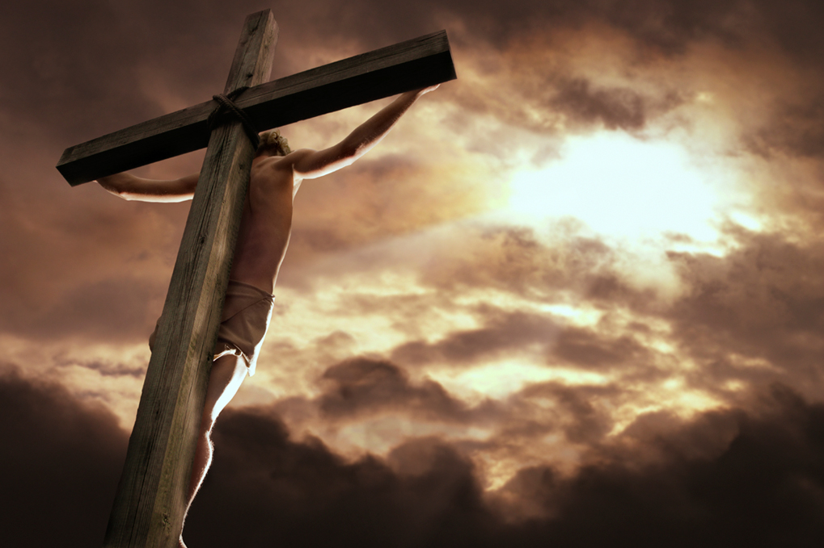
أفضل من الذبائح
عبرانيين 9: 1-10: 18
د. ريك جريفيث • كنيسة الطرق المتقاطعة الدولية سنغافورة
BibleStudyDownloads.org

Slide 2
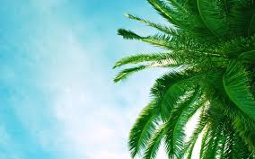
Palm Sunday
مزمور
الأحد
Notes:
Palm Sunday is an interesting name for the day, isn't it?
________
Common-432
NS-01-Matt15-28-slide 131
NS-02-Mark9-16-slide 96
NS-03-Luke13-24-slide 94
NS-04-John12-21-slide 23

Slide 3
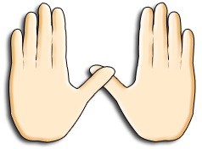
Palm Sunday
Notes:
We know that today recalls the palm branches waved at Jesus as he entered Jerusalem at the beginning of his last week of his life. Yet the focus really isn't the tree palms, but the hand palms of Jesus that would stretch out on a cross but a few days later.

Slide 4
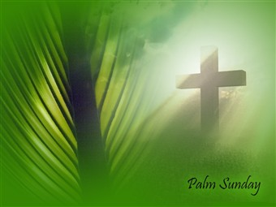
الشعانين إلى الصليب
Notes:
Tree palms were but a prelude to the cross.

Slide 5
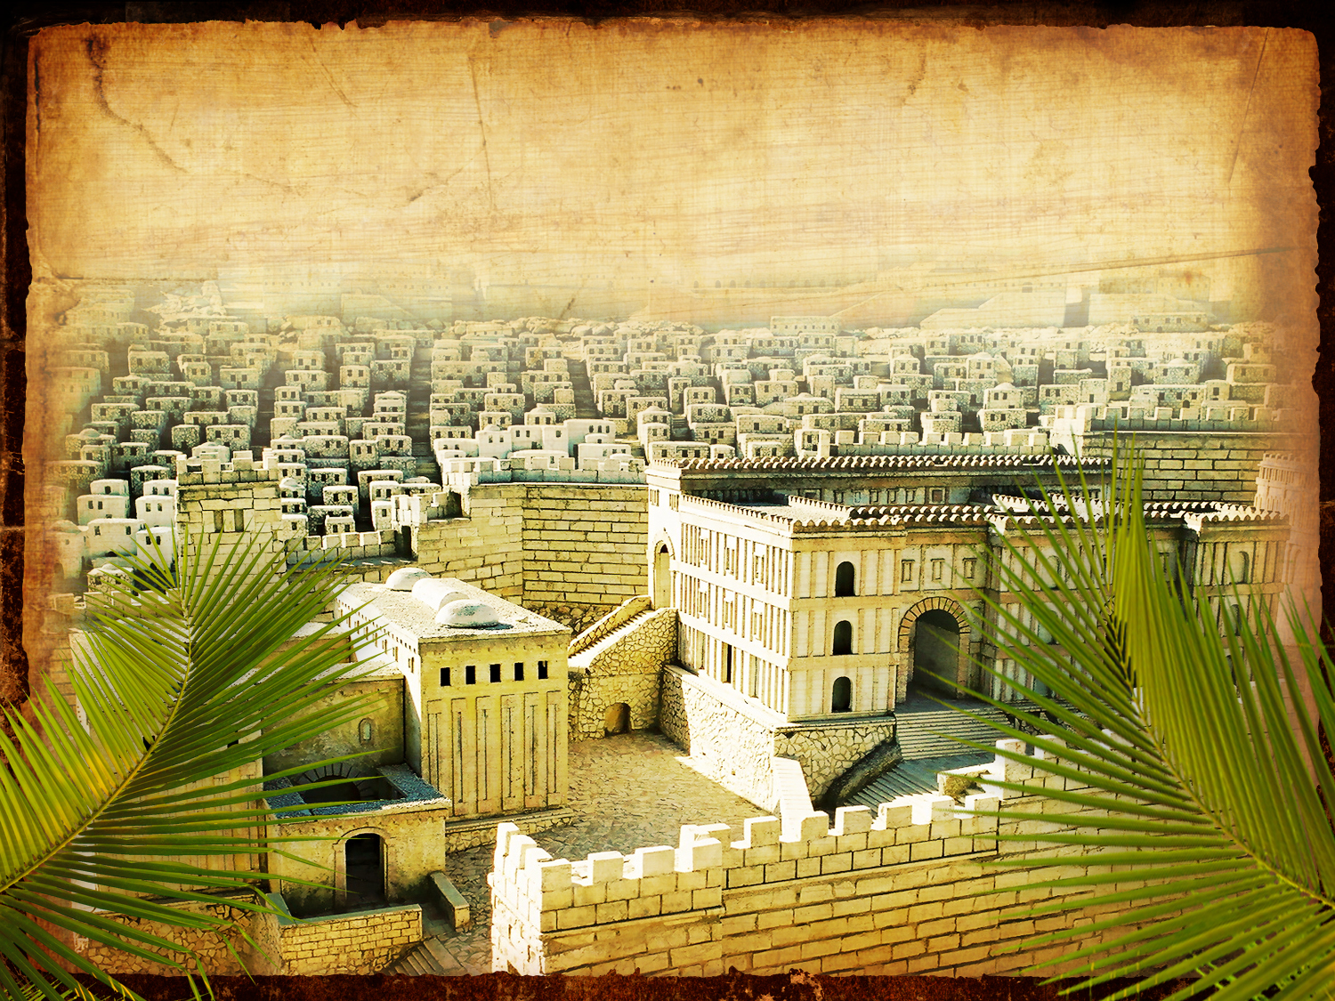
انتصار الدخول
متى ٢١ : ٩
Notes:
Even the alternate name—Triumphant Entry—is also perplexing.

Slide 6
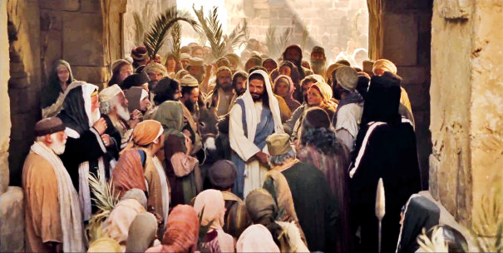
الدخول الإنتصاري
Notes:
True, Jesus rode into Jerusalem and the crowds cheered his arrival.

Slide 7
الدخول الإنتصاريّ
٩ وَالْجُمُوعُ الَّذِينَ تَقَدَّمُوا وَالَّذِينَ تَبِعُوا كَانُوا يَصْرَخُونَ: «أُوصَنَّا لاِبْنِ دَاوُدَ! مُبَارَكٌ الآتِي بِاسْمِ الرَّبِّ! أُوصَنَّا فِي الأَعَالِي!».
متَّى ٢١ : ٩
Notes:
نقرأ في متَّى 21: 9 الكلمات الآتية: "وَالْجُمُوعُ الَّذِينَ تَقَدَّمُوا وَالَّذِينَ تَبِعُوا كَانُوا يَصْرَخُونَ: «أُوصَنَّا لاِبْنِ دَاوُدَ! مُبَارَكٌ الآتِي بِاسْمِ الرَّبِّ! أُوصَنَّا فِي الأَعَالِي!»".

Slide 8
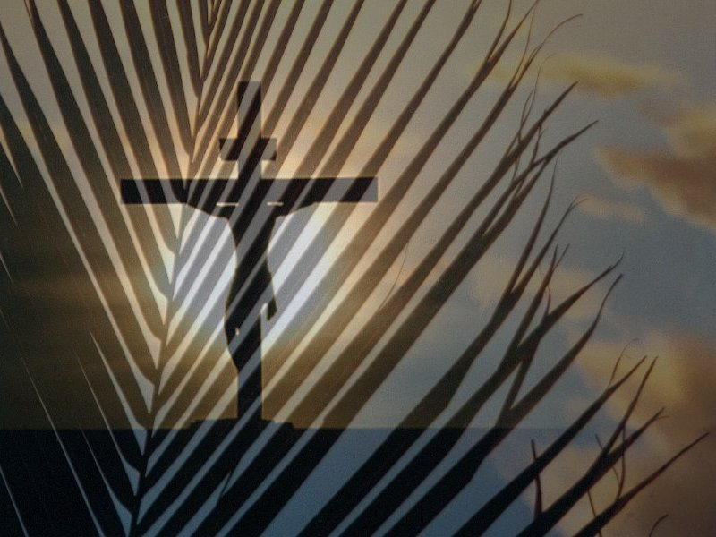
من الشعانين إلى الشعانين
Notes:
Normally a king rode into the city as the victor over his enemies, while that very week would culminate in Jesus' death on Friday, which we call Good Friday.

Slide 9
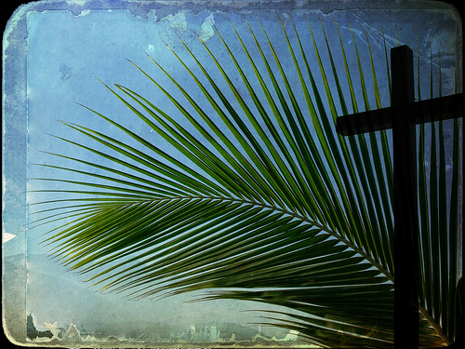
ما هو الأمر الجيد بخصوص الجمعة العظيمة؟
Notes:
But that name is equally puzzling. Why is Good Friday called "good"?
Our leader died on that day, so it seems strange to call the day "good." No other religion refers to the death of their leader as "good."
We believe that his death was good. How was that?

Slide 10
كيف يكون موت المسيح أفضل من أي ذبيحة؟

Slide 11
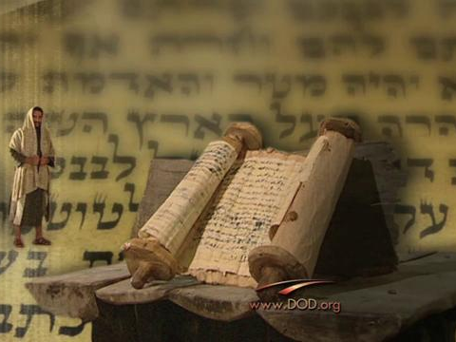
خلفية الرسالة إلى العبرانيين
Notes:
Today we continue in our study of the book of Hebrews. The first readers were confused about the significance of the death of Jesus, so they were tempted to return to the old sacrificial system.

Slide 12
ثابر
دراسة في العبرانيين
Notes:
Instead, the author exhorted them to "Press on!"

Slide 13
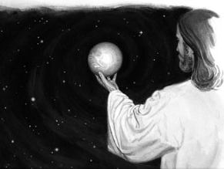
ولا يعلمون كل واحد قريبه، وكل واحد أخاه قائلا: اعرف الرب، لأن الجميع سيعرفونني من صغيرهم إلى كبيرهم. (عب 8: 11)
Notes:
They had experienced persecution for becoming Christians, but in 8:11 he had encouraged them with the realization that, after the return of Christ, the whole world know the Lord.

Slide 14
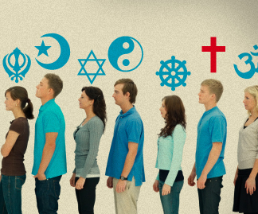
لا عالمية
Notes:
This is not universalism—a false teaching that everyone who ever lived will be saved, whatever they believed.

Slide 15
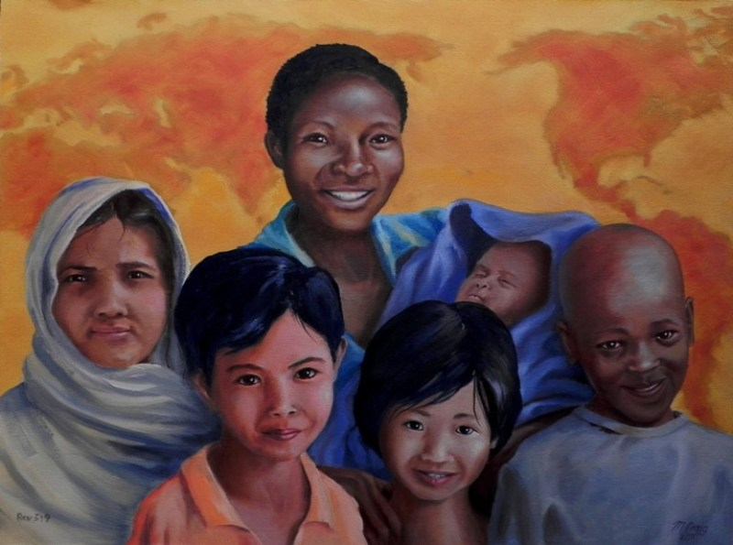
من كل قبيلة ولسان وشعب وأمة (رؤ 5: 9)
369
Notes:
Rather, Revelation 5:9 says that, of the many unreached peoples of the world today, at least one person will be saved "from every tribe, nation, language and people."

Slide 16
اختطاف ما قبل الضيقة يوضح كيف يمكن أن يكون هناك أطفال وموت في الألفية
435
المجيء الثاني
المؤمنون
الإختطاف
الباقون
الضيقة
الألفية
عصر الكنيسة
المملكة الأبدية
7 سنوات
1000 سنة
في الإختطاف سيذهب المؤمنون إلى السماء بينما يبقى غير المؤمنون على الأرض – ستبدأ الضيقة بوجود 0% من المؤمنين
بعد الضيقة سيدخل المؤمنون على الأرض إلى الألفية في أجسادهم الفانية – ستبدأ الألفية بوجود 100% مؤمنين
الدينونة

Slide 17
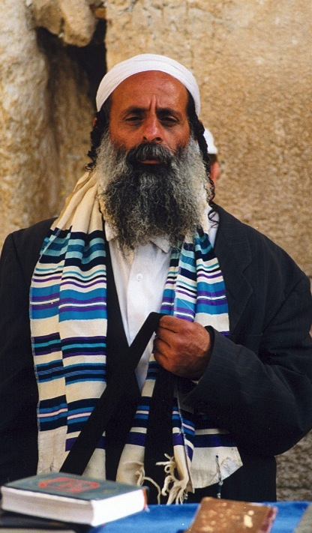
وَهَكَذَا سَيَخْلُصُ جَمِيعُ إِسْرَائِيلَ (رومية ١١ : ٢٥-٢٧)
155w
فإني لست أريد أيها الإخوة أن تجهلوا هذا السر، لئلا تكونوا عند أنفسكم حكماء: أن القساوة قد حصلت جزئياً لإسرائيل إلى أن يدخل ملؤ الأمم،
26 وهكذا سيخلص جميع إسرائيل. كما هو مكتوب:
سيخرج من صهيون المنقذ ويرد الفجور عن يعقوب.
27 وهذا هو العهد من قبلي لهم متى نزعت خطاياهم.
Notes:
NS-06-Rom9-13-slide 50
NS-22-Rev13-19-slide 53

Slide 18
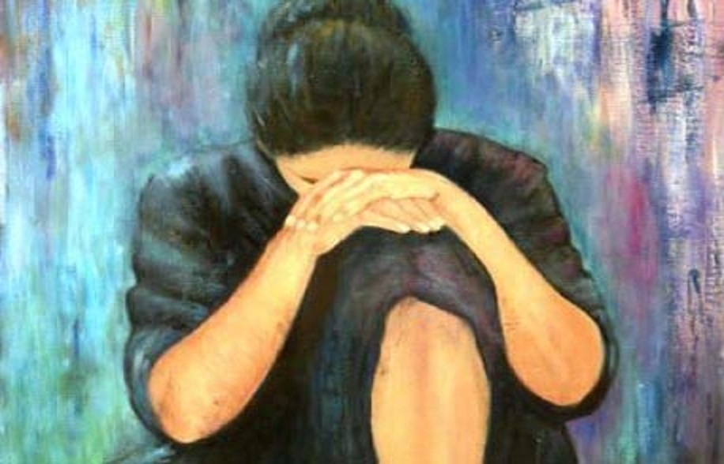
إيمان عالمي بالله
Notes:
Since only believers will enter the millennial kingdom, we can say with 8:11 that there will finally be worldwide belief in God.
In light of the worldwide triumph of Christianity, do you see why the author was eager to show how Christ is superior to the tabernacle sacrifices?

Slide 19
عبرانيين: ثابر
254
تفوق المسيح على اليهودية كرئئس كهنة
متفوق في شخصه على ... |  |  | متفوق في عمله الكهنوتي على ... |  |  |  |  | الثبات من خلال الإيمان
1: 1-4: 13 |  |  | 4: 14-10: 18 |  |  |  |  | 10: 19-13: 25
الأنبياء | الملائكة | موسى | هارون | ملكي صادق | العهد القديم | خيمة الإجتماع | الذبائح | الخطية الإرادية | النماذج | الثبات كأبناء | الأخلاق | رفض الله | التشجيع
1: 1-3 | 1: 4- 2: 18 | 3: 1- 4: 13 | 4: 14- 6: 20 | 7 | 8 | 9: 1-10 | 9: 11- 10: 18 | 10: 19-39 | 11: 1- 12: 3 | 12: 4-13 | 12: 14-17 | 12: 18-29 | 13
جلال المسيح |  |  | خدمة المسيح |  |  |  |  | إظهار المسيحية
اللاهوت |  |  |  |  |  |  |  | الممارسة
المؤلف والمستلمون والأصل والوجهة غير معروفين
67-68 م
9: 1-10: 18

Slide 20
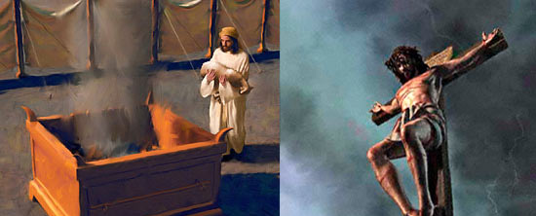
سؤالين مهمين
ما هي المشكلة في ذبائح العهد القديم؟
كيف كان موت المسيح أفضل؟

Slide 21
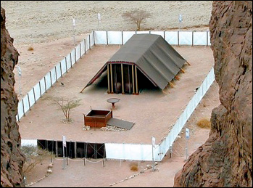
1. كانت ذبائح خيمة الإجتماع مؤقتة (9: 1-10)

Slide 22
ثم العهد الأول كان له أيضاً فرائض خدمة والقدس العالمي (9: 1)

Slide 23
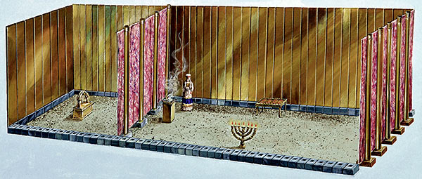
لأنه نصب المسكن الأول الذي يقال له القدس الذي كان فيه المنارة، والمائدة، وخبز التقدمة. (9: 2)
قدس الأقداس
القدس

Slide 24
ووراء الحجاب الثاني المسكن الذي يقال له قدس الأقداس (9: 3)
قدس الأقداس
القدس

Slide 25
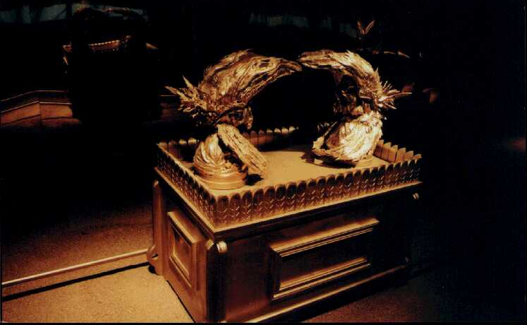
فيه مبخرة من ذهب، وتابوت العهد مغشى من كل جهة بالذهب (9: 4أ)

Slide 26
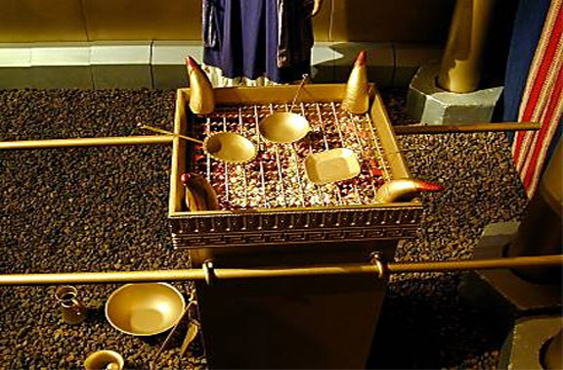
أين كان مذبح البخور؟
Notes:
This verse seems to imply that it was inside the Holy of Holies—yet the OT says it was in the other room. Possibly by the time of this letter it had been moved into the inner room, though. Why?

Slide 27
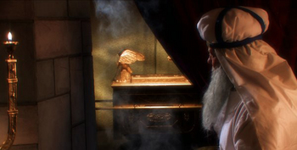
أين كان تابوت العهد؟
Notes:
By AD 67 the ark had been missing for ages, so maybe it was replaced by the incense altar?

Slide 28
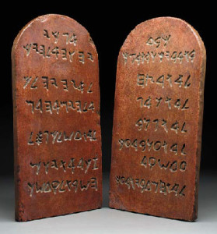
أين كان لوحا الوصايا؟

Slide 29
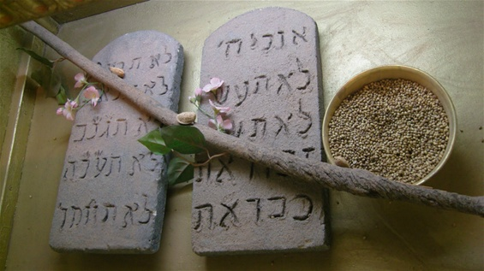
الذي فيه قسط من ذهب فيه المن، وعصا هارون التي أفرخت، ولوحا العهد. (9: 4ب)

Slide 30
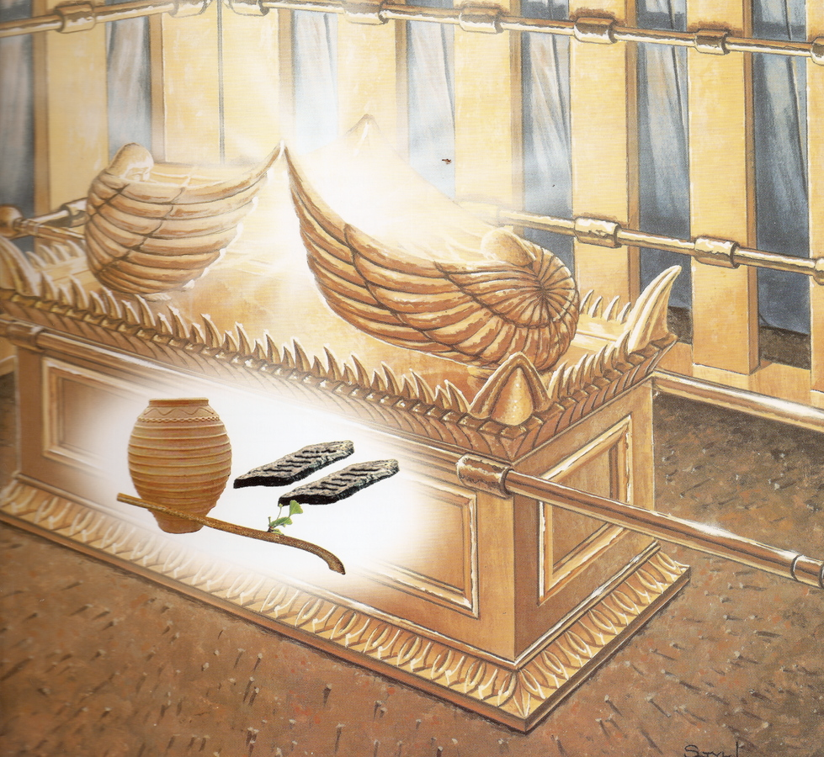
وفوقه كروبا المجد مظللين الغطاء. (9: 5أ)

Slide 31
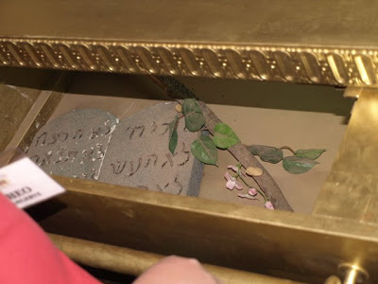
أشياء ليس لنا الآن أن نتكلم عنها بالتفصيل. (9: 5ب)

Slide 32
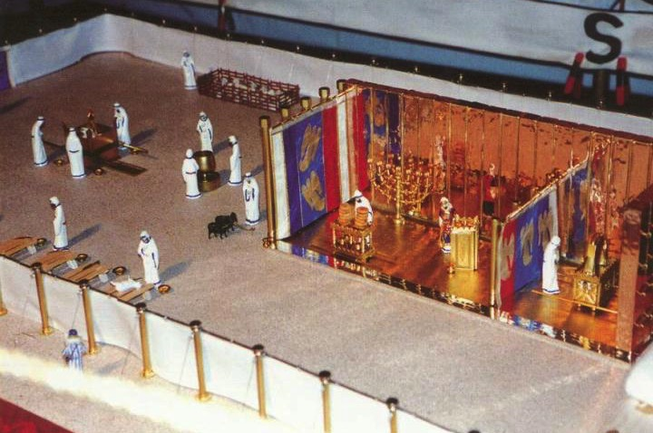
ثم إذ صارت هذه مهيأة هكذا، يدخل الكهنة إلى المسكن الأول كل حين، صانعين الخدمة (9: 6)
الساحة
القدس
قدس الأقداس
يوم الكفارة (لا 16: 29-34)

Slide 33
يوم الكفارة (لا 16: 29-34)
الساحة
القدس
قدس الأقداس
وأما إلى الثاني فرئيس الكهنة فقط مرة في السنة، ليس بلا دم يقدمه عن نفسه وعن جهالات الشعب
(9: 7)

Slide 34
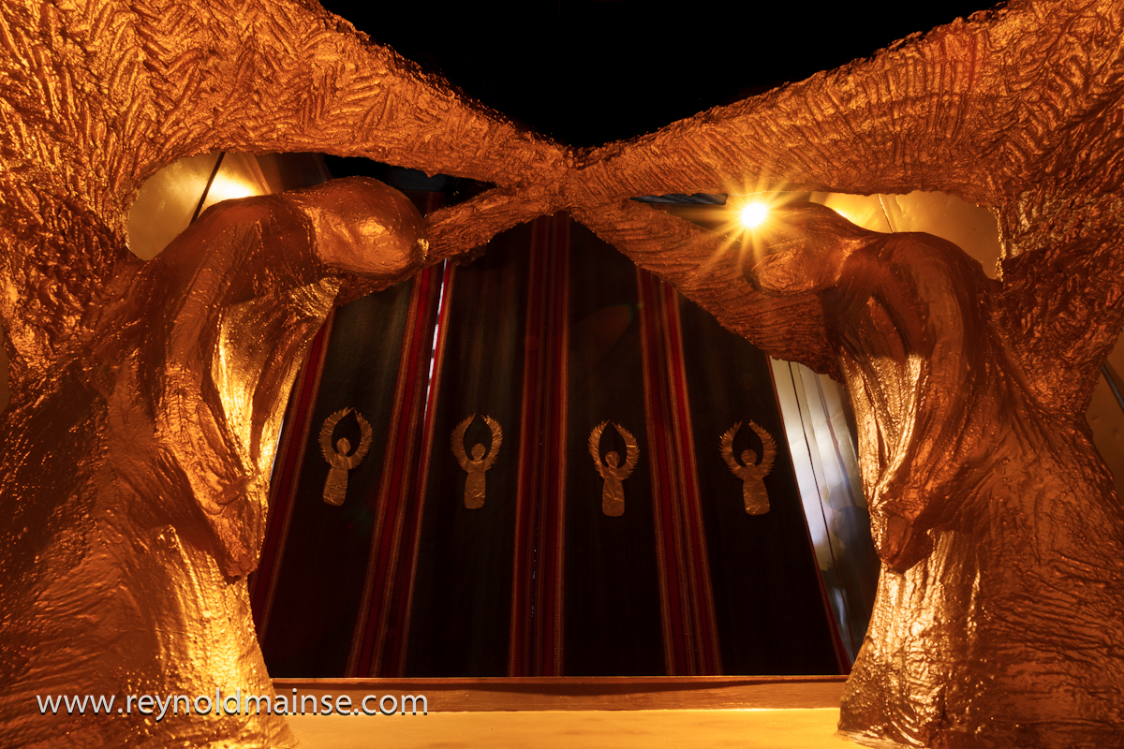
معلناً الروح القدس بهذا أن طريق الأقداس لم يظهر بعد، ما دام المسكن الأول له إقامة (9: 8)
Notes:
Two Cherubim kneel on top of a replica of the Ark of the Covenant in the Holy of Holies at Timna National Park located in the Jordan Rift Valley.

Slide 35
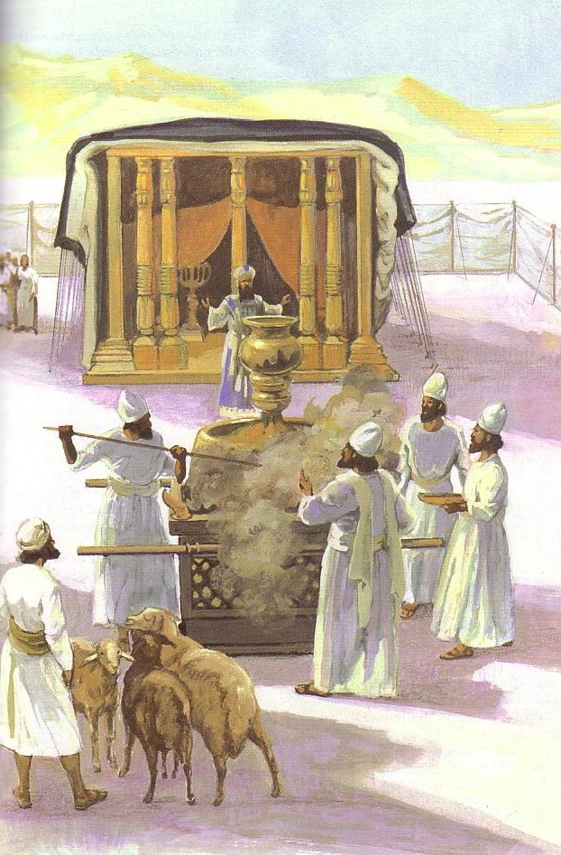
الذي هو رمز للوقت الحاضر، الذي فيه تقدم قرابين وذبائح، لا يمكن من جهة الضمير أن تكمل الذي يخدم (9: 9)

Slide 36
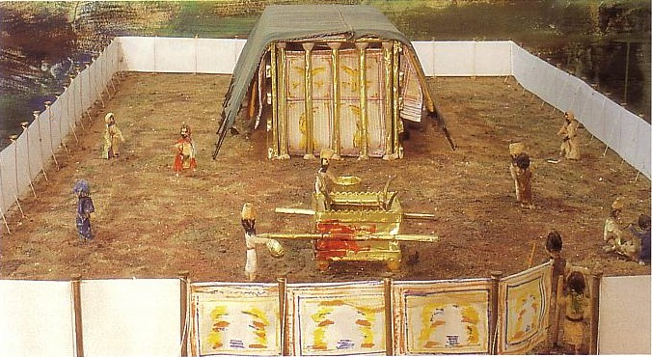
وهي قائمة بأطعمة وأشربة وغسلات مختلفة وفرائض جسدية فقط، موضوعة إلى وقت الإصلاح. (9: 10)

Slide 37
كيف يكون موت المسيح أفضل من أي ذبيحة؟

Slide 38
1. كانت ذبائح خيمة الإجتماع مؤقتة (9: 1-10)

Slide 39
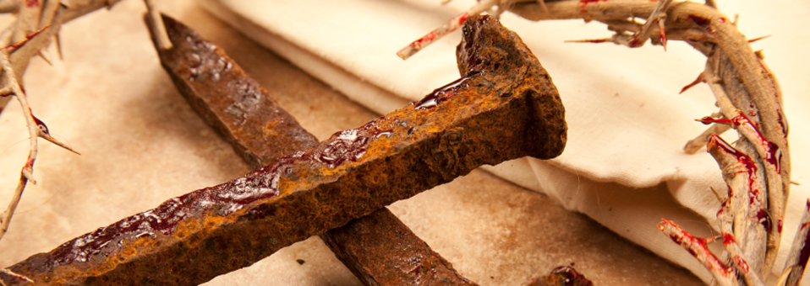
2. يخلصنا موت المسيح بشكل دائم (9: 11-10: 18)
Notes:
His sacrifice gives us eternal life.

Slide 40
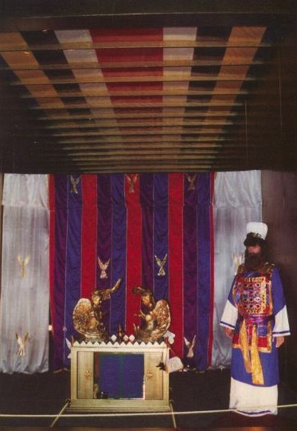
رمزية يوم الكفارة
وأما المسيح، وهو قد جاء رئيس كهنة للخيرات العتيدة، فبالمسكن الأعظم والأكمل غير المصنوع بيد، أي الذي ليس من هذه الخليقة
عبرانيين 9: 11

Slide 41
مرة بدم نفسه لأجل الجميع
وليس بدم تيوس وعجول، بل بدم نفسه، دخل مرة واحدة إلى الأقداس، فوجد فداء أبدياً.
عبرانيين 9: 12

Slide 42
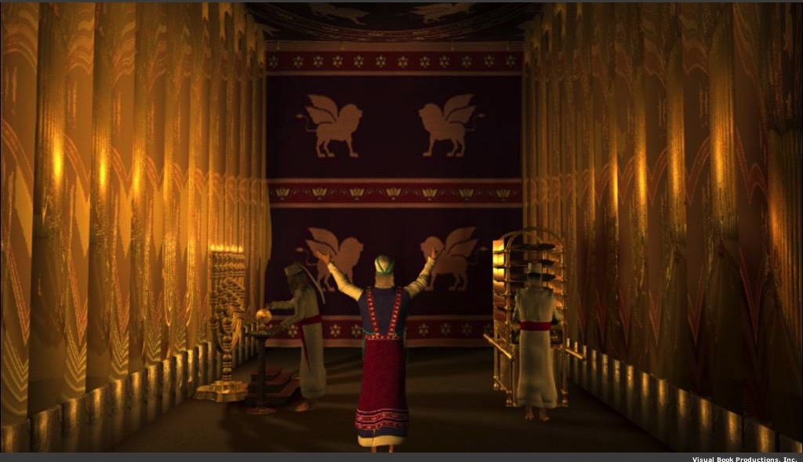
لأنه إن كان دم ثيران وتيوس ورماد عجلة مرشوش على المنجسين، يقدس إلى طهارة الجسد (9: 13)

Slide 43
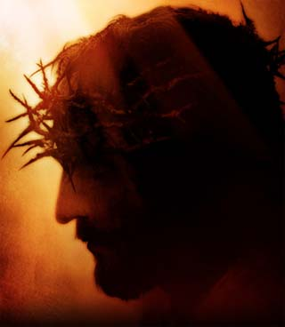
فكم بالحري يكون دم المسيح، الذي بروح أزلي قدم نفسه لله بلا عيب، يطهر ضمائركم من أعمال ميتة لتخدموا الله الحي (9: 14)

Slide 44
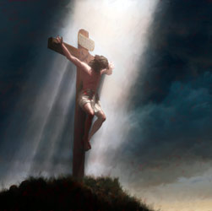
ولأجل هذا هو وسيط عهد جديد، لكي يكون المدعوون­ إذ صار موت لفداء التعديات التي في العهد الأول ينالون وعد الميراث الأبدي (9: 15)

Slide 45
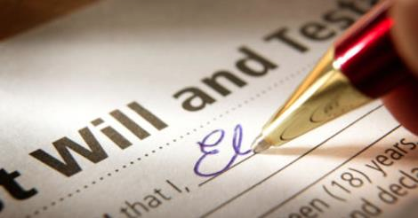
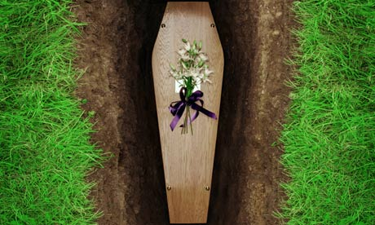
لأنه حيث توجد وصية، يلزم بيان موت الموصي، لأن الوصية ثابتة على الموتى، إذ لا قوة لها البتة ما دام الموصي حياً. (9: 16-17)

Slide 46
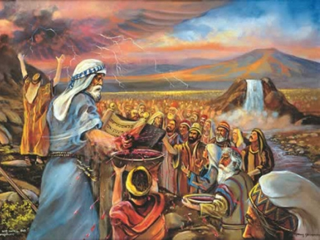
فمن ثم الأول أيضا لم يكرس بلا دم (9: 18)

Slide 47
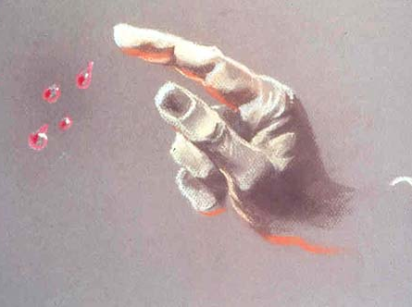
لأن موسى بعدما كلم جميع الشعب بكل وصية بحسب الناموس، أخذ دم العجول والتيوس، مع ماء
وصوفا قرمزيا وزوفا، ورش الكتاب نفسه وجميع الشعب
(9: 19)

Slide 48
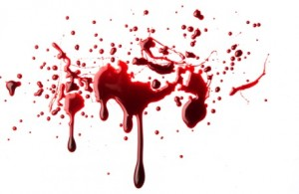
قائلاً: هذا هو دم العهد الذي أوصاكم الله به، والمسكن أيضاً وجميع آنية الخدمة رشها كذلك بالدم، وكل شيء تقريباً يتطهر حسب الناموس بالدم (9: 20-22أ)

Slide 49
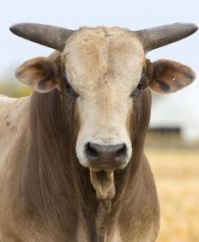
وبدون سفك دم لا تحصل مغفرة (9: 22ب)

Slide 50
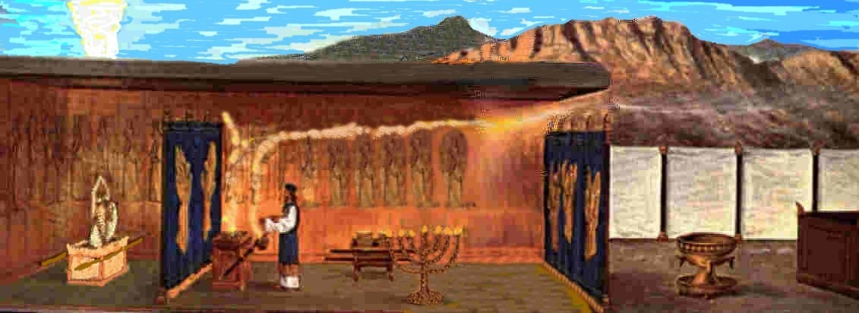
فكان يلزم أن أمثلة الأشياء التي في السماوات تطهر بهذه، وأما السماويات عينها، فبذبائح أفضل من هذه. (9: 23)

Slide 51
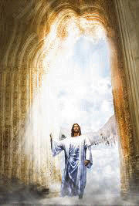
لأن المسيح لم يدخل إلى أقداس مصنوعة بيد أشباه الحقيقية، بل إلى السماء عينها، ليظهر الآن أمام وجه الله لأجلنا. (9: 24)

Slide 52
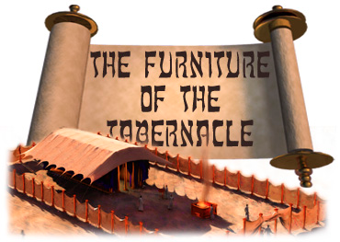
أثاث خيمة الإجتماع
Notes:
"Light from the Old Testament"
Copyright © 1998-2015 UB David & I'll B Jonathan, Inc. Mailbox Club lessons © The Mailbox Club International; used by permission with adaptation for the Internet. All rights reserved.
http://ubdavid.org/bibleexploration/light-old-testament/light-old-testament_8-1.html

Slide 53
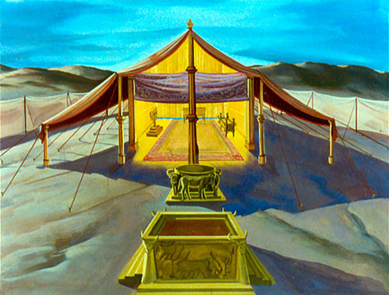
Tabernacle prefiguring the Cross
Notes:
"What is a "tabernacle"? It is a temporary dwelling place. God told Moses and the children of Israel to build the Tabernacle that He might dwell among His people. God said, "Let them make Me a sanctuary; that I may dwell among them." (Exodus 25:8)
The Tabernacle was always in the midst of the camp. The 12 tribes were arranged around it, three tribes on each side. The Tabernacle always faced east, toward the sunrise.
The Tabernacle was designed to picture or illustrate how sinful man could approach a holy God and be accepted by Him. There were six main vessels of furniture.
The Brazen Altar.
This is where the animals were sacrificed. This points to Christ's death on the cross.
The Laver.
This is where the priests washed before entering the Tabernacle. This speaks of daily cleansing from sins, which we need if we are to have fellowship with a holy God."
Copyright © 1998-2015 UB David & I'll B Jonathan, Inc. Mailbox Club lessons © The Mailbox Club International; used by permission with adaptation for the Internet. All rights reserved.
http://ubdavid.org/bibleexploration/light-old-testament/light-old-testament_8-1.html

Slide 54
Tabernacle prefiguring the Cross
Notes:
"The Table of Showbread.
This reminds us of Christ who is "the Bread of life." We must feed on Him daily.
The Golden Candlestick.
This speaks of Christ as "the Light of the world."
The Golden Altar.
This points to Christ as the One by whom we have access to God in prayer.
The Ark.
This speaks of Christ's Person and His work. The lid of "Mercy Seat" of the ark was where the blood of the sin offering was sprinkled. God said, "There will I meet with you, and I will commune with you from above the mercy seat...." (Exodus 25:22)."
Copyright © 1998-2015 UB David & I'll B Jonathan, Inc. Mailbox Club lessons © The Mailbox Club International; used by permission with adaptation for the Internet. All rights reserved.
http://ubdavid.org/bibleexploration/light-old-testament/light-old-testament_8-1.html

Slide 55
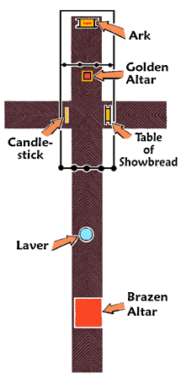
خيمة الاجتماع صورة مسبقة عن الصليب
التابوت
المذبح
الذهبي
المنارة
مائدة خبز
الوجوه
المرحضة
المذبح
النحاسي
Notes:
"الآن أنظر بالضبط إلى الشكل التخطيطي. نرى أن موضع الأثاث في الفناء وفي خيمة الاجتماع على شكل صليب. هل كان هذا مصادفة؟ كلا! الله قال لموسى أين يجب أن تكون كل قطعة من الأثاث بالضبط."
Copyright © 1998-2015 UB David & I'll B Jonathan, Inc. Mailbox Club lessons © The Mailbox Club International; used by permission with adaptation for the Internet. All rights reserved.
http://ubdavid.org/bibleexploration/light-old-testament/light-old-testament_8-1.html

Slide 56
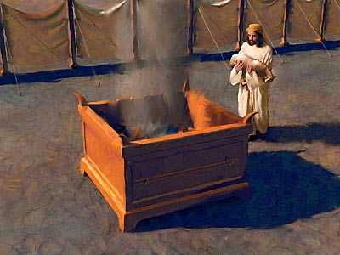
المذبح النحاسي
Notes:
"The moment a person stepped inside the one gate, he stood before the Brazen Altar, which burned continuously with its animal sacrifices.
The Brazen Altar was a large frame of acacia wood, covered with brass. It was about 7½ feet square and 4½ feet high, and it was made to bear the heaviest burdens.
There was nothing beautiful or ornamental about the Brazen Altar. In fact, it was ghastly looking. The altar had but one purpose—upon it the sacrificial animals were killed, their blood poured out, and the sacrifices themselves consumed by fire."
Copyright © 1998-2015 UB David & I'll B Jonathan, Inc. Mailbox Club lessons © The Mailbox Club International; used by permission with adaptation for the Internet. All rights reserved.
http://ubdavid.org/bibleexploration/light-old-testament/light-old-testament_8-1.html

Slide 57
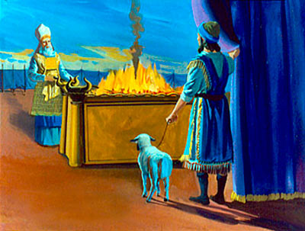
المذبح النحاسي
Notes:
"The Brazen Altar is a type of Christ and His death on the cross. The acacia wood points to His sinless humanity. The wood was covered with brass so that it could endure the fire. Brass is a type of the wrath of God against sin. On the cross, and on our behalf, Christ endured the "fire" of God's righteous wrath against sin. Christ is not only the Altar, but He is the Sacrifice as well.
The Brazen Altar stood on the desert sands, not on some high, inaccessible place. It could be approached without effort. It was equally accessible for a child or a full-grown man. There were no steps to the Brazen Altar! The sinner needs no "steps" to come to Christ; he can come to Christ just as he is.
The Brazen Altar was called "the altar" because there was no other. Christ and Christ alone is "the Altar." He is also "the Lamb of God," the perfect sacrifice. No other sacrifice is accepted by God.
The Brazen Altar was called "the altar at the door," because there was no way of approach to God except by passing that altar. The only access to God was on the ground of the sacrifices on that altar.
We need to let this truth burn itself into our hearts and minds. There is no way to God except through Christ and His blood which was shed for our sins. The Bible says,
"Forasmuch as you know that you were not redeemed with corruptible things, as silver and gold... But with the precious blood of Christ, as of a lamb without blemish and without spot." 1 Peter 1:18-19
"In Whom we have redemption through His blood, the forgiveness of sins, according to the riches of His grace." Ephesians 1:7
When the children of Israel came to the gate of the court, they had to bring an animal sacrifice for their sins, usually a lamb.
Slowly and reverently, a man approaches the gate with his lamb. At the gate he is met by the priest. The lamb is placed on the Brazen Altar and bound there with cords. The man lays his hand upon the head of the lamb, saying in effect, "God, I thank You for allowing this lamb to die in my place for my sins."
The man then kills the lamb. Its blood is poured out. The priest catches the blood in a basin. Some of the blood is sprinkled on the altar, and the remainder is poured out at the base of the altar. The lamb's body is then burned on the altar."
Copyright © 1998-2015 UB David & I'll B Jonathan, Inc. Mailbox Club lessons © The Mailbox Club International; used by permission with adaptation for the Internet. All rights reserved.
http://ubdavid.org/bibleexploration/light-old-testament/light-old-testament_8-1.html

Slide 58
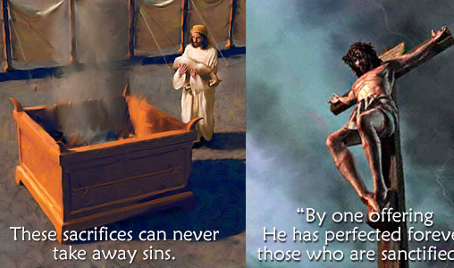
المذبح النحاسي
و كل كاهن يقوم كل يوم يخدم و يقدم مراراً كثيرة تلك الذبائح عينها التي لا تستطيع البتة أن تنزع الخطية (عب 10: 11)
لأنه بقربان واحد أكمل إلى الأبد المقدسين (عب 10: 14)
Notes:
What was God teaching His people in all of this? He was teaching them that sin is a very serious matter. It must be punished by death, either in person, or in a substitute.
Animal sacrifices were offered daily on the Brazen Altar for many hundreds of years. Then one day Jesus, the Lamb of God, was nailed to a Roman cross. It was not just the nails that held Him to the cross; He was bound there by "cords of love." He went to the cross because He loved us.
Our sins were laid on Him. He bore the "fire" of God's righteous wrath against sin. When He died, He said, "It is finished!"
After Christ's death, no further animal sacrifices were needed. There never need be another lamb offered on a "brazen altar." The perfect sacrifice for sin has been offered and accepted by God. He will never accept any other. The Bible says,
"Every priest stands daily ministering and offering oftentimes the same sacrifices, which can never take away sins: But this Man, after He had offered one sacrifice for sins for ever, sat down on the right hand of God... For by one offering He has perfected for ever them that are sanctified [set apart]." Hebrews 10:11-12, 14
Copyright © 1998-2015 UB David & I'll B Jonathan, Inc. Mailbox Club lessons © The Mailbox Club International; used by permission with adaptation for the Internet. All rights reserved.
http://ubdavid.org/bibleexploration/light-old-testament/light-old-testament_8-1.html

Slide 59
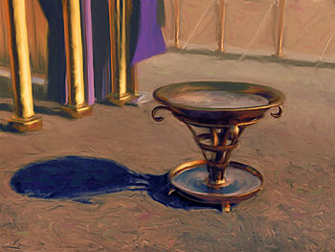
المرحضة
Notes:
"Only the priests could enter the Tabernacle itself, but they could not enter without washing at the Laver. The Laver of brass was a large, shallow bowl in which clean water was kept continually.
The Laver was made from the brass "mirrors" called "looking-glasses," which were melted down and made into the Laver. These highly-polished, brass looking-glasses were prized by the women of Israel, but they gave them freely for the service of the Lord."
Copyright © 1998-2015 UB David & I'll B Jonathan, Inc. Mailbox Club lessons © The Mailbox Club International; used by permission with adaptation for the Internet. All rights reserved.
http://ubdavid.org/bibleexploration/light-old-testament/light-old-testament_8-1.html

Slide 60
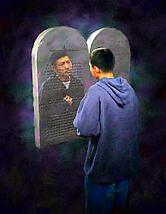
المرحضة
Notes:
"What is the Laver a type of? It is a type of the Word of God. The Word of God is our "looking-glass." As we read God's Word and meditate, with an obedient heart, God shows us the things in our life that are not pleasing to Him. As we see our need of cleansing, we confess our sins and turn from them, and we are "washed."
Though the priests had the right to enter the Holy Place of the Tabernacle, they dared not do so without washing. God said, "When they go into the tabernacle of the congregation, they shall wash with water, that they die not...." (Exodus 30:20)
Actually there were two distinct washings of the priests. On the day of their consecration, the priests were brought to the door of the Tabernacle and washed all over with water by Moses. No holy garments were put on them until they were washed all over. This washing was performed for them by another; they had no hand in it. This act was never repeated throughout their lives.
What does this speak of? This speaks of our new birth—"the washing of regeneration." When we trust Christ as our Savior, we are "washed" from all our sins, we are born again spiritually into the family of God. This is all done for us by God, and it need never be repeated.
The priests, now cleansed and consecrated, could enter the Tabernacle and have sweet communion with God. The Holy Place was now their "home." But, as they went forth to serve God's people, their hands and feet got dirty. They had to go to the Laver daily for cleansing. And we must go daily to the "laver" of God's Word for cleansing. The Bible says,
"Wherewithal [how] shall a young man cleanse his way? by taking heed thereto according to Your Word." Psalm 119:9
Copyright © 1998-2015 UB David & I'll B Jonathan, Inc. Mailbox Club lessons © The Mailbox Club International; used by permission with adaptation for the Internet. All rights reserved.
http://ubdavid.org/bibleexploration/light-old-testament/light-old-testament_8-1.html

Slide 61
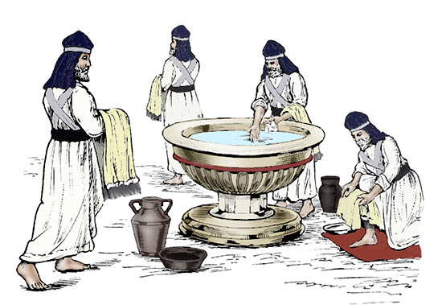
المرحضة
Notes:
"Dear child of God, do you know that you are a "priest"? Did you realize that, the moment you trusted Christ as your Savior, you were consecrated as a priest of God? Yes, this is true! The Bible says, "You are a chosen generation, a royal priesthood" (1 Peter 2:9).
As priests of God we have the right to enter the Tabernacle. Indeed, it is now our "home." But remember, no unclean priest could enter the Holy Place. Aaron and his sons were told to wash before entering the Holy Place "lest they die." They had to wash at the Laver daily. Unless we "wash at the Laver daily," we die also. To what? We die to fellowship with God."
Copyright © 1998-2015 UB David & I'll B Jonathan, Inc. Mailbox Club lessons © The Mailbox Club International; used by permission with adaptation for the Internet. All rights reserved.
http://ubdavid.org/bibleexploration/light-old-testament/light-old-testament_8-1.html

Slide 62
The Laver
Notes:
"John chapter 13 describes the last supper Jesus had with His beloved disciples before He went to the cross. After the supper, Jesus, knowing that the Father had given all things into His hands, laid aside His outer garments, took a towel and girded Himself.
Jesus, who was "God manifest in the flesh," took the place of a servant, poured water into a basin, and began to wash the feet of His disciples. What was He doing? He was teaching them that they must be cleansed daily from the defilement of sin in order to have fellowship with Him. He was fulfilling the type of the Brazen Laver—cleansing His disciples.
When He came to Simon Peter, Peter said, "You shall never wash my feet!" Jesus answered him, "If I wash you not, you have no part with Me."
Consider this: Peter was a disciple—forgiven, saved. For Him the sin question was settled. But what about his daily walk? We are defiled daily as we walk in this sinful world. Regarding daily cleansing, Jesus said to Peter, "If I wash you not, you have no part with Me"—in fellowship."
Copyright © 1998-2015 UB David & I'll B Jonathan, Inc. Mailbox Club lessons © The Mailbox Club International; used by permission with adaptation for the Internet. All rights reserved.
http://ubdavid.org/bibleexploration/light-old-testament/light-old-testament_8-1.html

Slide 63
ترمز خيمة الإجتماع للصليب
Notes:
"The Brazen Altar takes care of the sin question. We are God's forgiven-forever children. But we must have daily cleansing if we are to have fellowship with a Holy God.
If you are not spending time alone with God each day, in prayer and the study of His Word, do you wonder why you have so little power, why your testimony is weak, and why your prayers are not answered? The reason is that you are not coming to God for cleansing and turning away from your sins.
Precious believer, beloved of God, do not stay at the Brazen Altar. Go to the Laver for daily cleansing! If you are not having a daily Quiet time with God, start doing so immediately. Set aside time to be alone with God for the reading of His Word and for prayer."
Copyright © 1998-2015 UB David & I'll B Jonathan, Inc. Mailbox Club lessons © The Mailbox Club International; used by permission with adaptation for the Internet. All rights reserved.
http://ubdavid.org/bibleexploration/light-old-testament/light-old-testament_8-1.html

Slide 64
Tabernacle prefiguring the Cross
المشابك الفضية
Notes:
Copyright © 1998-2015 UB David & I'll B Jonathan, Inc. Mailbox Club lessons © The Mailbox Club International; used by permission with adaptation for the Internet. All rights reserved.
http://ubdavid.org/bibleexploration/light-old-testament/light-old-testament_8-1.html

Slide 65
خيمة الإجتماع تصور الصليب
المشابك الفضية
Notes:
"We come now to the Tabernacle itself. The walls of the Tabernacle were composed of 48 boards, each about 15 feet high and 2½ feet wide.
Each board had two "tenons," or knobs, which fit into two sockets of silver buried in the sand. The boards rested on 96 sockets of silver. Each socket of silver weighed over 90 pounds. Thus the Tabernacle stood upon a solid foundation of silver, weighing over four and a half tons!
Where did they get all this silver? Remember, when the children of Israel left Egypt, the Egyptians gave them much silver and gold, whatever they wanted.
Silver in the Bible stands for redemption. God had instructed His people that, when men of twenty years and older were numbered for the army, they should each pay a half shekel of silver as an offering to the Lord. This was "a ransom for their souls." (See Exodus 30:11-16— bottom of the left sidebar.)
This money was called "atonement money." The word "atonement" means "to cover sins." This is what the Old Testament offerings did. They "covered" the sins of the people until Christ died on the cross and took them away.
Half a shekel was what each man paid. God said, "The rich shall not give more, and the poor shall not give less." Each man had to pay for himself. No one could pay for another person. God laid down the conditions for the atonement money.
God has laid down the condition for our redemption—faith in Jesus Christ and His blood. This is true for every person, whether rich or poor, learned or ignorant, young or old. The condition is simple. Every person can have faith in Jesus Christ and His blood which was shed for their sins.
When the men were numbered for the army of Israel, there were 605,550 men. Each paying a half shekel meant 302,775 shekels of silver—over five tons of silver. With this they made the sockets of silver as the foundation of the boards. Thus the Tabernacle rested upon a foundation of silver, a type of redemption by Jesus Christ and His blood which was shed for our sins.
Redemption by the blood of Jesus Christ is the foundation on which the believer rests. As the tenons (knobs) on the boards took hold of the silver sockets, so does the believer's faith lay hold on Christ as his redemption.
Our foundation is not the shifting sands of men's ideas and opinions, but Christ and His redemption. The Bible says, "For other foundation can no man lay than that is laid, which is Jesus Christ." (1 Corinthians 3:11)"
Copyright © 1998-2015 UB David & I'll B Jonathan, Inc. Mailbox Club lessons © The Mailbox Club International; used by permission with adaptation for the Internet. All rights reserved.
http://ubdavid.org/bibleexploration/light-old-testament/light-old-testament_8-1.html

Slide 66
Tabernacle prefiguring the Cross
الألواح
Notes:
Copyright © 1998-2015 UB David & I'll B Jonathan, Inc. Mailbox Club lessons © The Mailbox Club International; used by permission with adaptation for the Internet. All rights reserved.
http://ubdavid.org/bibleexploration/light-old-testament/light-old-testament_8-1.html

Slide 67
Tabernacle prefiguring the Cross
Notes:
"The framework of the Tabernacle consisted of 48 boards of acacia wood overlaid with gold. There were 20 boards on the north side, 20 on the south side, and eight on the western end. The eastern end of the Tabernacle was enclosed by a curtain.
Each board was about 15 feet in length and about 2½ feet wide. The boards were overlaid with gold. Each board had two knobs by which it was connected with the two sockets of silver buried in the sand.
Each of these boards represents a sinner, saved by the grace of God. I was once a member of Adam's sinful family, but I trusted Christ as my Savior. I died to my old life in the old creation, and I was raised with Christ as a new person in God's new creation. I now stand before God in Christ.
Let us see how this was all brought about. These boards were once stately acacia trees planted in the earth. The earth sustained them. Their roots were in the earth and of the earth.
But God had need of them for the building of His dwelling place. They were cut down; they died to the earth; their connection with it was forever cut off."
Copyright © 1998-2015 UB David & I'll B Jonathan, Inc. Mailbox Club lessons © The Mailbox Club International; used by permission with adaptation for the Internet. All rights reserved.
http://ubdavid.org/bibleexploration/light-old-testament/light-old-testament_8-1.html

Slide 68
ترمز خيمة الإجتماع للصليب
Notes:
"Such is the case with everyone who is in God's called-out assembly, His holy dwelling place now. We were once in the world and of it, part of the old creation. Our life was taken up with the things of the world. But the sharp and mighty "axe" of God's Word fell upon our heart and conscience. We were "cut down" before God. We trusted in Christ and we were converted.
The tree not only had to be cut down, but it had to be stripped of its limbs and shaped into boards of the proper size. The boards were then given a new beauty and glory. They were overlaid with gold.
So it is with the child of God. We have to be "stripped" of the things pertaining to our old life. But we are given a new beauty and glory. God places us in Christ. We may not seem beautiful in the eyes of men, but in the eyes of God, we are beautiful indeed—"accepted in the Beloved."
Copyright © 1998-2015 UB David & I'll B Jonathan, Inc. Mailbox Club lessons © The Mailbox Club International; used by permission with adaptation for the Internet. All rights reserved.
http://ubdavid.org/bibleexploration/light-old-testament/light-old-testament_8-1.html

Slide 69
ترمز خيمة الإجتماع للصليب
Notes:
"Finally, the boards were placed in the sockets and then bound together by five horizontal bars, making them into one structure, the dwelling place of God on earth.
So it is with us. We are not simply individual "boards," but we are bound together into one Body. All believers are members of the one Body of Christ called "the Church." We are built together as the dwelling place of God. The Bible says,
"In whom [in Christ] you also are builded together for an habitation of God through the Spirit." Ephesians 2:22"
Copyright © 1998-2015 UB David & I'll B Jonathan, Inc. Mailbox Club lessons © The Mailbox Club International; used by permission with adaptation for the Internet. All rights reserved.
http://ubdavid.org/bibleexploration/light-old-testament/light-old-testament_8-1.html

Slide 70
ولا ليقدم نفسه مراراً كثيرة، كما يدخل رئيس الكهنة إلى الأقداس كل سنة بدم آخر. (9: 25)

Slide 71
تم التخلص من الخطيئة (وليس فقط تغطيتها)
فإذ ذاك كان يجب أن يتألم مراراً كثيرة منذ تأسيس العالم، ولكنه الآن قد أظهر مرة عند انقضاء الدهور ليبطل الخطية بذبيحة نفسه.
عبرانيين 9: 26

Slide 72
وكما وضع للناس أن يموتوا مرة ثم بعد ذلك الدينونة،

Slide 73
ماذا عن ... ؟
17أ
التقمص
يعتقد أنه بعد الموت يعود الناس إلى الأرض مرة أخرى في جسد بشري آخر (راجع اللاتينية carne، جسد)

Slide 74
التقمص في أمريكا
17أ
1 من كل 5 أمريكيين
استطلاع غالوب 2005
Notes:
http://home.sandiego.edu/~baber/logic/gallup.html
In 1994 it was 27% and 2001 at 25%, so the belief is going down but still strong.

Slide 75
ما قبل التقمص
في بعض الأحيان تبدأ الروح في الإنتقال إلى المكان الجديد، حتى قبل انتهاء عقد إيجار المكان القديم.

Slide 76
وكما وضع للناس أن يموتوا مرة ثم بعد ذلك الدينونة،
هكذا المسيح أيضاً، بعدما قدم مرة لكي يحمل خطايا كثيرين، سيظهر ثانية بلا خطية للخلاص للذين ينتظرونه.
(9: 27-28)

Slide 77
لأن الناموس، إذ له ظل الخيرات العتيدة لا نفس صورة الأشياء، لا يقدر أبداً بنفس الذبائح كل سنة، التي يقدمونها على الدوام، أن يكمل الذين يتقدمون. (عب 10: 1)

Slide 78
وإلا أفما زالت تقدم؟ من أجل أن الخادمين، وهم مطهرون مرة، لا يكون لهم أيضا ضمير خطايا. (عب 10: 2)

Slide 79
لكن فيها كل سنة ذكر خطايا، لأنه لا يمكن أن دم ثيران وتيوس يرفع خطايا. (عب 10: 3-4)

Slide 80
لذلك عند دخوله إلى العالم يقول: ذبيحة وقرباناً لم ترد، ولكن هيأت لي جسداً. بمحرقات وذبائح للخطية لم تسر. (عب 10: 5-6)

Slide 81
ثم قلت: هنذا أجيء، في درج الكتاب مكتوب عني، لأفعل مشيئتك يا الله، إذ يقول آنفاً: «إنك ذبيحة وقرباناً ومحرقات وذبائح للخطية لم ترد ولا سررت بها، التي تقدم حسب الناموس، ثم قال: هنذا أجيء لأفعل مشيئتك يا الله، ينزع الأول لكي يثبت الثاني. (عب 10: 7-9)

Slide 82
فبهذه المشيئة نحن مقدسون بتقديم جسد يسوع المسيح مرة واحدة (عب 10: 10)

Slide 83
وكل كاهن يقوم كل يوم يخدم ويقدم مرارا كثيرة تلك الذبائح عينها، التي لا تستطيع البتة أن تنزع الخطية. (عب 10: 11)

Slide 84
جلس يسوع

Slide 85
وأما هذا فبعدما قدم عن الخطايا ذبيحة واحدة، جلس إلى الأبد عن يمين الله
عبرانيين 10: 12

Slide 86
منتظراً بعد ذلك حتى توضع أعداؤه موطئاً لقدميه، لأنه بقربان واحد قد أكمل إلى الأبد المقدسين. (عب 10: 13-14)

Slide 87
ويشهد لنا الروح القدس أيضاً، لأنه بعدما قال سابقاً:
هذا هو العهد الذي أعهده معهم بعد تلك الأيام، يقول الرب، أجعل نواميسي في قلوبهم وأكتبها في أذهانهم
ولن أذكر خطاياهم وتعدياتهم فيما بعد (عب 10: 15-17)

Slide 88
وإنما حيث تكون مغفرة لهذه لا يكون بعد قربان عن الخطية. (عب 10: 18)

Slide 89
كيف يكون موت المسيح أفضل من أية ذبيحة؟

Slide 90
يخلصنا يسوع بشكل دائم
الفكرة الرئيسية

Slide 91
1. كانت ذبائح خيمة الإجتماع مؤقتة (عب 9: 1-10)

Slide 92
2. يخلصنا موت المسيح بشكل دائم (عب 9: 11-10: 18)

Slide 93
نحن نعيش مرة واحدة، نموت مرة واحدة، وبعد ذلك ندخل حالتنا الأبدية
17ب
ولكنه (المسيح) الآن قد أظهر مرة عند انقضاء الدهور ليبطل الخطية بذبيحة نفسه، وكما وضع للناس أن يموتوا مرة ثم بعد ذلك الدينونة، هكذا المسيح أيضاً، بعدما قدم مرة ....
(عب 9: 26ب-28أ)

Slide 94
هل تؤمن أن يسوع قد خلصك من الخطية بشكل دائم؟

Slide 95
دائم

Slide 96
Black

Slide 97
على رابط وعظ العهد الجديد BibleStudyDownloads.org
أحصل على هذا العرض التقديمي والنص مجاناً

