Slide 1
جسده أجسادنا
جسده_أجسادنا
١ كورنثوس ١٥
د. ريك جريفيث• مركز الدراسات اللاهوتية الأردني• BibleStudyDownloads.org

Slide 2
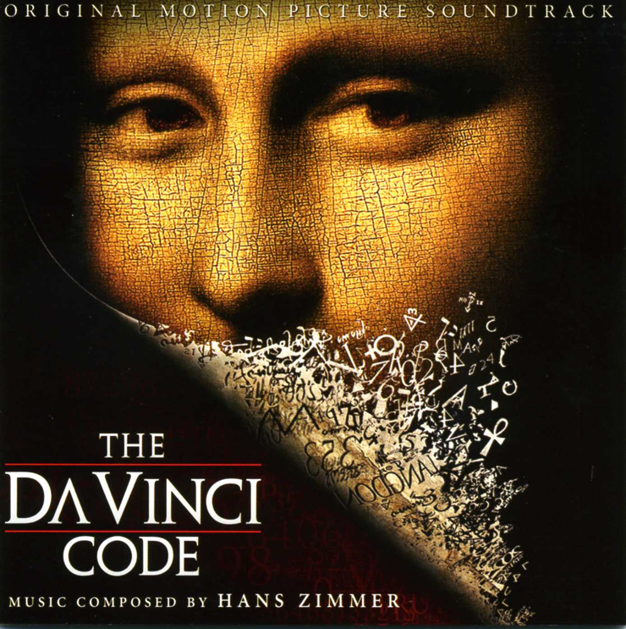
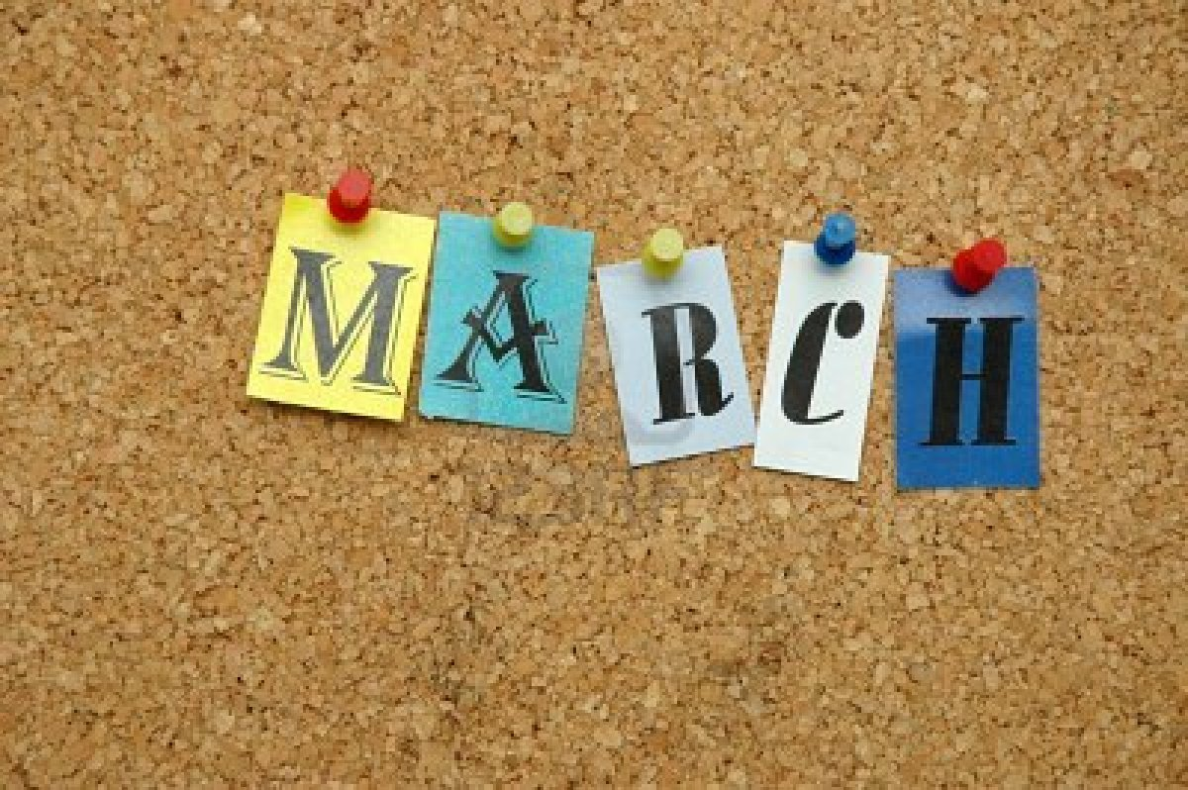
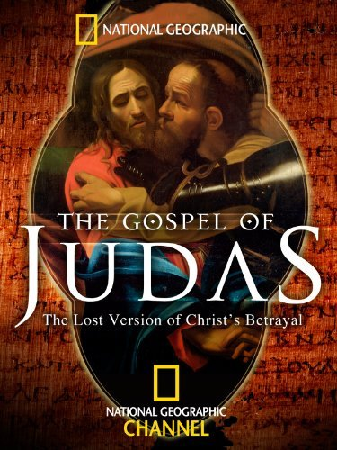
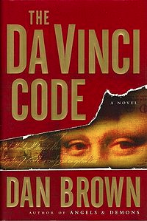
The month of March…
Notes:
Have you noticed that nearly every year there is an attack on Jesus in March? The Da Vinci Code rolled off the presses in March, then years later the film came out in March. The Gospel of Judas attacked Jesus in March too. All of these are attacks on the death and resurrection of Jesus Christ.

Slide 3
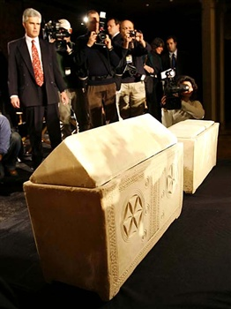
عظام يسوع
جيمس كاميرون 26 شباط 2007 رويترز / مايك سيجار
Notes:
In 2007 the media at a news conference in New York photographed two ossuaries—these are chests made for human bones. Why? Filmmaker James Cameron claimed that these ossuaries were found in a 2,000-year-old tomb in Jerusalem in 1980 and they may have held the bones of Jesus and “his wife,” Mary Magdalene. He claims that Jesus and Mary Magdalene may have even had a son named Judah.
26 Feb 2007 REUTERS/Mike Segar

Slide 4
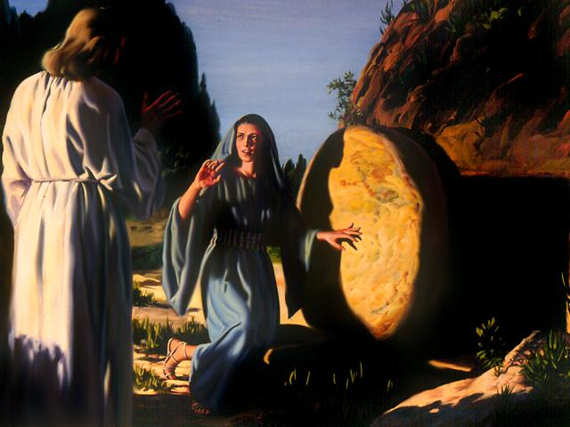
ما الفرق الذي تعنيه بالنسبة لك ؟
Notes:
I wonder if this concerns you. Would it really matter to you personally if they did find Jesus’ body? What would change in your life if this report was true?
Would a dead Jesus change how you spend your time?
Does the resurrection of Christ affect how you spend your money?
Would it affect your marriage?
What would change—for you—if anything?

Slide 5
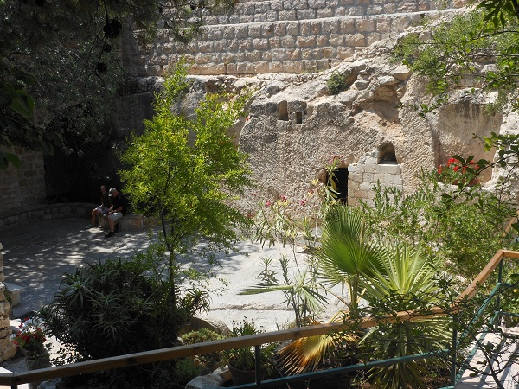
بستان القبر
Notes:
Of course, we know that Jesus did rise from the dead—like He said He would!
Did you hear that someone asked the owner of the tomb, Joseph of Arimathea, “That was a great tomb. Why did you give it to someone else to be buried in?”
“Oh,” Joseph said, “He only needed it for the weekend.”
The resurrection is a fact! But…

Slide 6
He is not here – for he is risen
ما هو الأمر المهم بخصوص قيامة المسيح؟
Notes:
What’s so important about Christ’s resurrection? Why should it matter to you and me that Jesus arose?

Slide 7
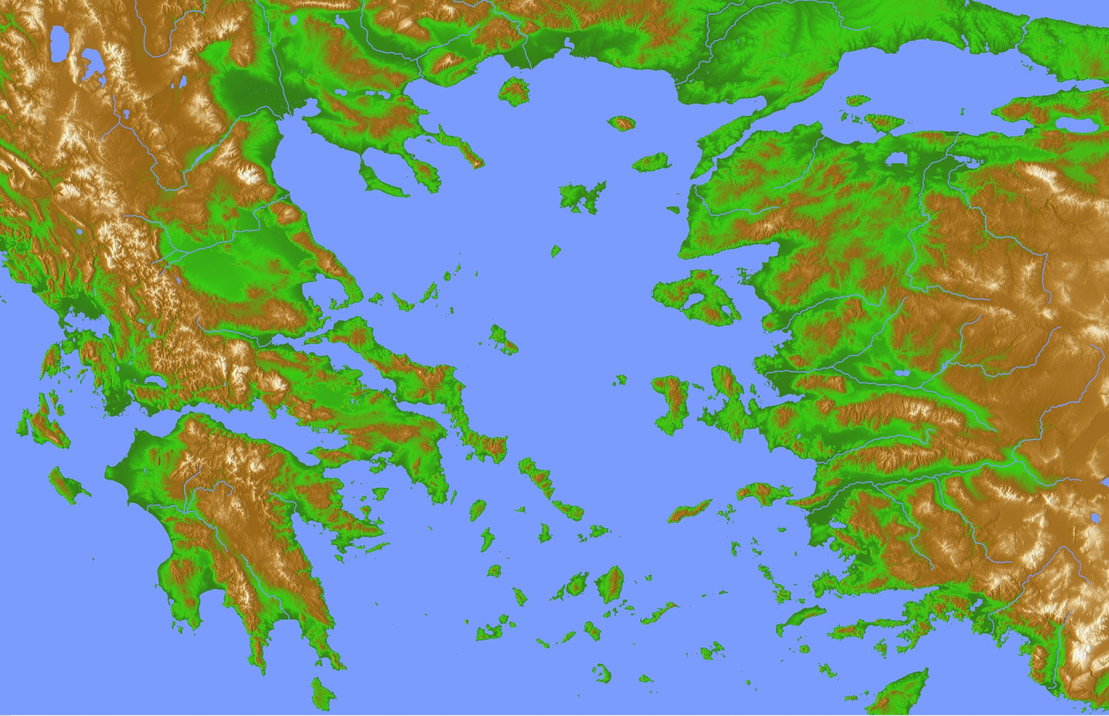
فلسفات أثينا
أثينا
كورنثوس
Notes:
Paul addressed this issue to some people who doubted the resurrection.
They lived in ancient Corinth—a seaport city where a lot of ideas floated around.

Slide 8
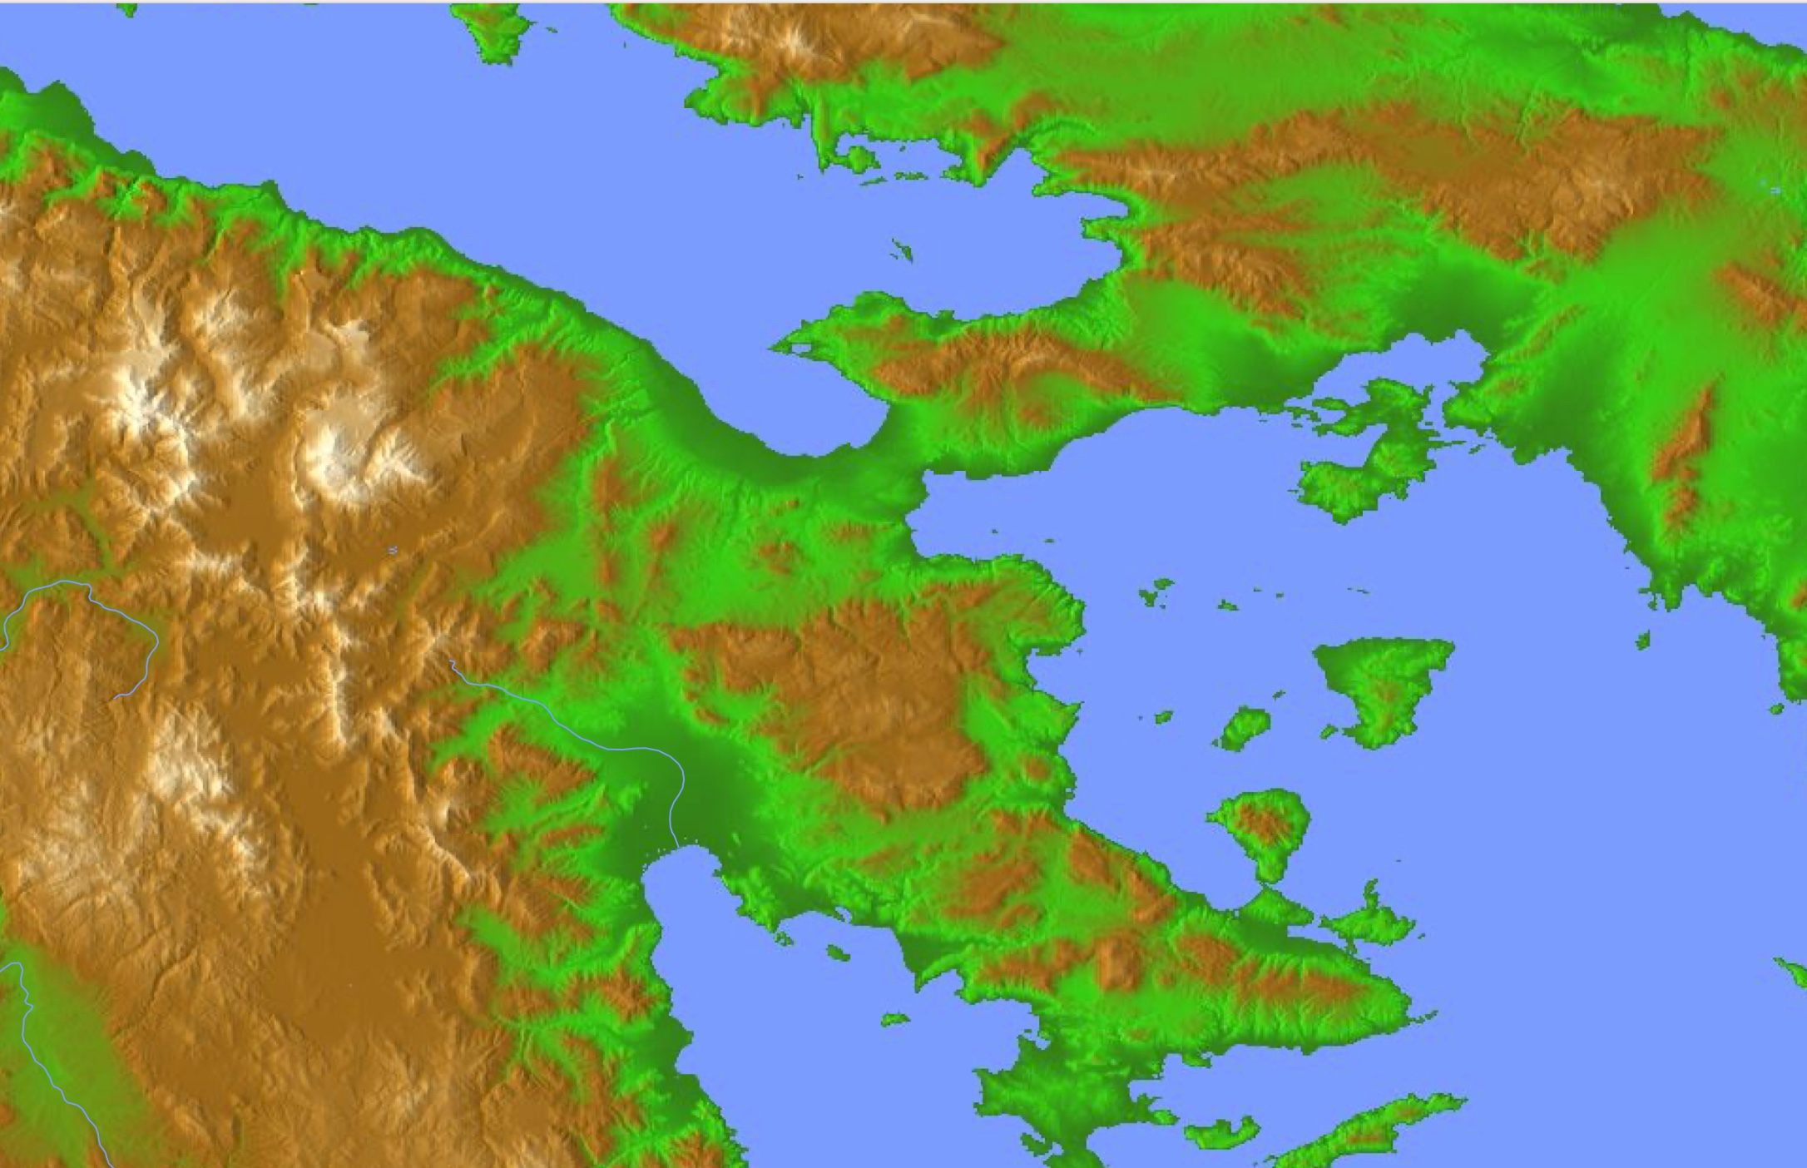
فلسفات أثينا
أثينا
كورنثوس
Notes:
Paul addressed this issue to some people who doubted the resurrection.
They lived in ancient Corinth—a seaport city where a lot of ideas floated around.

Slide 9
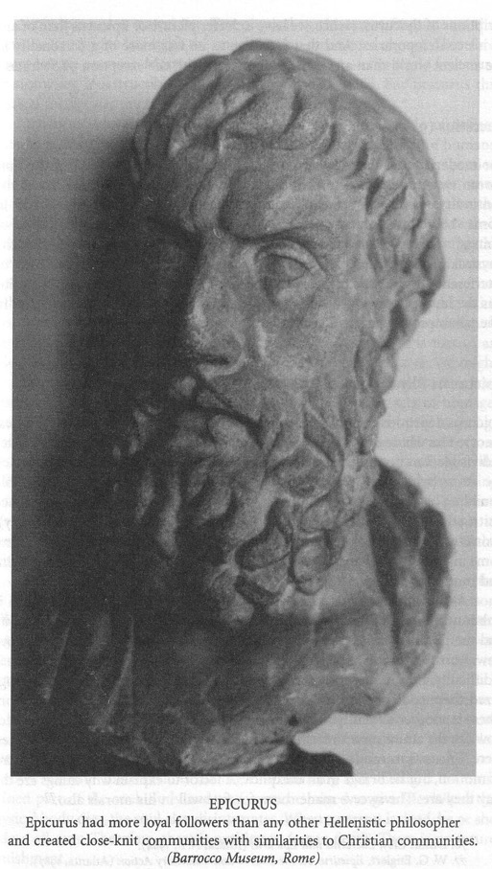
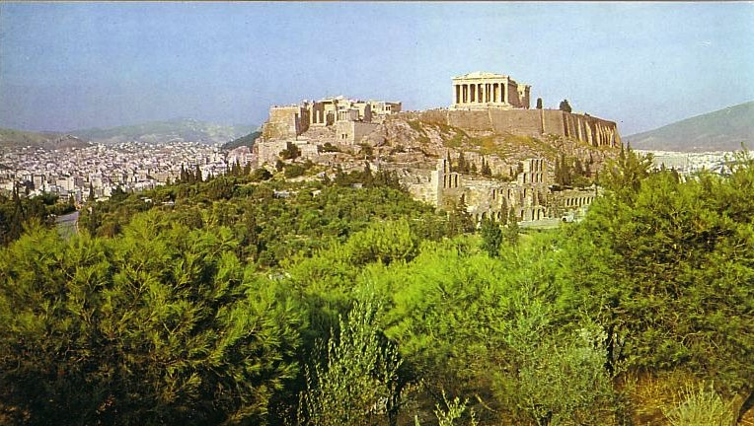
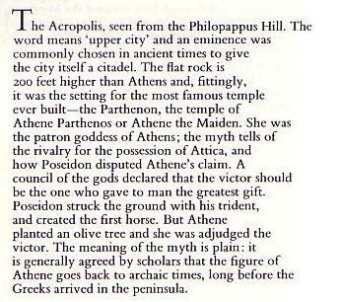
الأبيقوريون و الرواقيون في
Notes:
Nearby philosophies like Epicureanism and Stoicism influenced many people in Corinth to scoff at the idea of bodily existence after death, so some of the Corinthian Christians had even followed this line of doubt.

Slide 10
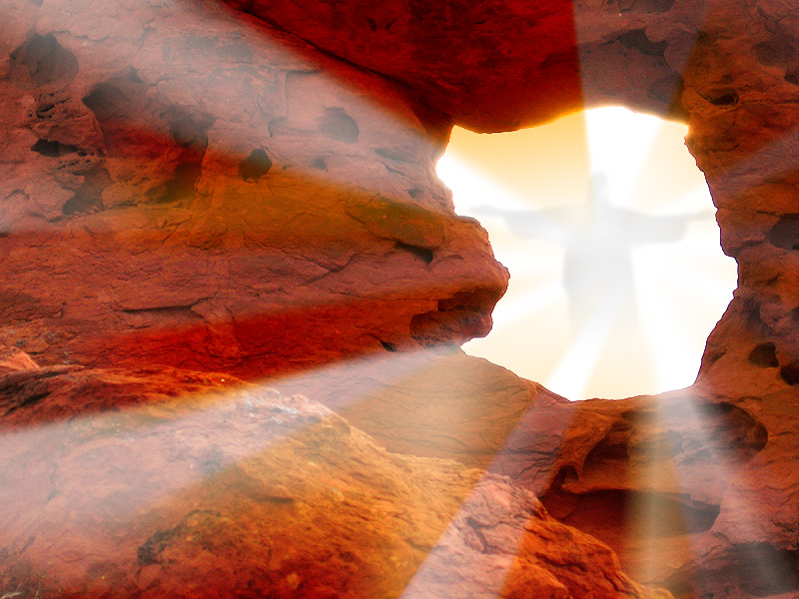
المسيح المُقام
3
أسباب
لماذا هذا الأمر مهم ؟
Notes:
But Paul took this denial of the resurrection very seriously! So let’s see
• three reasons Paul says Christ’s resurrection is important in 1 Corinthians 15. First…

Slide 11
1. قيامة المسيح جزء أساسي من الإنجيل (1 كو 15: 1-11)
Notes:
[You don’t have the true message of salvation without a living Jesus!]

Slide 12
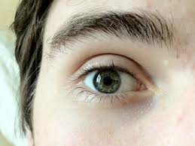
و أعرفكم أيها الإخوة بالإنجيل الذي بشرتكم به فإنني سلمت إليكم في الأول ما قبلته أنا أيضاً 1 كو 15: 1أ، 3أ))
Notes:
The gospel is so vital that our faith is founded on it (1-3a).
The Corinthians, like us, received the gospel for salvation (1-2).
The gospel was the most vital doctrine they knew (3a; NLT “I passed on to you what was most important”).

Slide 13
ما هو الإنجيل ؟
Notes:
Is "gospel" a type of music?

Slide 14
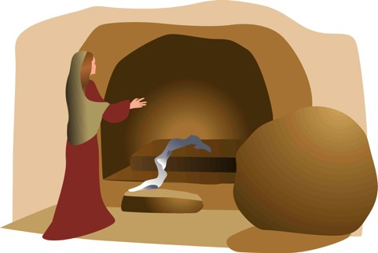
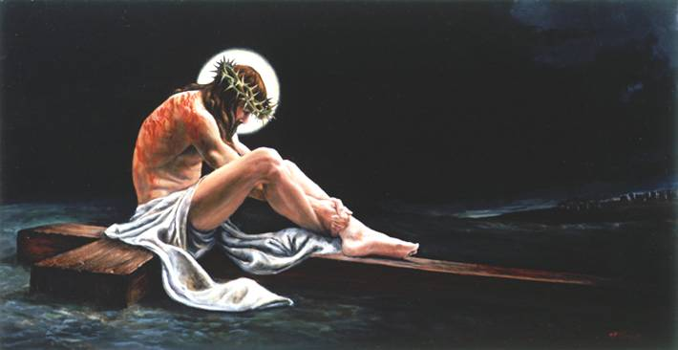
الإنجيل الكامل
فإنني سلمت إليكم ... الأخبار السارة (الإنجيل)
ما قبلته أنا أيضاً
الدفن
القيامة
الموت
المسيح مات من أجل خطايانا
و أنه قام في اليوم الثالث
و أنه دفن
1 كو 15: 3-4
Notes:
The gospel has three key elements (3b-8):
Christ’s death fulfilled Isaiah 53 to show He bore our sins rather than His own (3b).
Christ’s burial proved He really died (4a).
Christ’s resurrection and appearances proved Him to be the Messiah prophesied by the OT (4b-8).

Slide 15
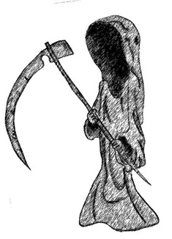
ما الفرق ؟
ميت
حي
Notes:
The resurrection makes Jesus unique among the world’s religious leaders—not even ONE of them died and rose again! Abraham, Buddha, and Mohammed all are still dead.

Slide 16
ما الفرق
^{5 و أنه ظهر لصفا ثم للإثني عشر}
6 و بعد ذلك ظهر دفعة واحدة لأكثر من خمسمئة أخ أكثرهم باق إلى الآن و لكن بعضهم قد رقدوا
7 و بعد ذلك ظهر ليعقوب ثم للرسل أجمعين
ميت
يسوع
حي
Notes:
Paul confesses, "Last of all, as though I had been born at the wrong time, I also saw him" (15:8). In fact, Jesus proved his resurrection with at least 11 appearances.
OPTIONAL: Also, the gospel of Christ being alive today brings salvation to all who believe (9-11).
1Cor. 15:9-11 NLT ⁹ For I am the least of all the apostles. In fact, I’m not even worthy to be called an apostle after the way I persecuted God’s church. ¹⁰ But whatever I am now, it is all because God poured out his special favor on me—and not without results. For I have worked harder than any of the other apostles; yet it was not I but God who was working through me by his grace. ¹¹ So it makes no difference whether I preach or they preach, for we all preach the same message you have already believed.

Slide 17
He is not here – for he is risen
ما هو الأمر المهم بخصوص قيامة المسيح؟
Notes:
What’s so important about Christ’s resurrection? Why should it matter to you and me that Jesus arose?

Slide 18
1. قيامة المسيح جزء أساسي من الإنجيل (1 كو 15: 1-11)
Notes:
[You don’t have the true message of salvation without a living Jesus!]

Slide 19
2. قيامة المسيح ستقيمنا في أجساد جديدة مستقبلاً (12-57)
Notes:
[Since Christ rose, you will too!]

Slide 20
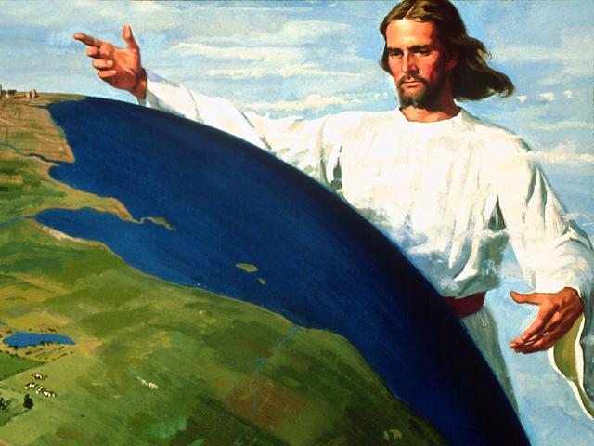
3. مستقبلنا القيامة يجب أن تحفزنا لنخدمه الآن بثقة (58)
• تمسك بالقيامة
• لا تسمح لأحد أن يهز إيمانك
• اخدم المسيح بكل إخلاص
• سوف تُكافئ
Notes:
[Since we know we’ll rise then, we should rise to service now!]
NIV 1Cor. 15:58 Therefore, my dear brothers, stand firm. Stand firm in what? In the resurrection!
• Let nothing move you. Does this mean to be stubborn about everything? No. Don't let anyone shake your belief in the risen Jesus.
• Always give yourselves fully to the work of the Lord—don't be half-hearted in serving Jesus.
• because you know that your labor in the Lord is not in vain. You support a truth—the resurrection of Jesus and your future resurrection—so you are not wasting your life to serve Christ. You will be rewarded.

Slide 21
He is not here – for he is risen
ما هو الأمر المهم بخصوص قيامة المسيح؟
Notes:
What’s so important about Christ’s resurrection? Why should it matter to you and me that Jesus arose?

Slide 22
بما أن المسيح قد قام فأنت كذلك ستقوم لهذا عش هكذا
الفكرة الرئيسية في 1 كورنثوس 15
Notes:
Jesus is alive today—since he also will make us alive again after death, serve him now until death.

Slide 23
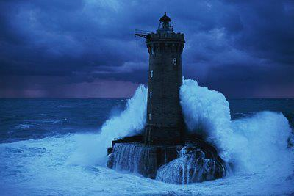
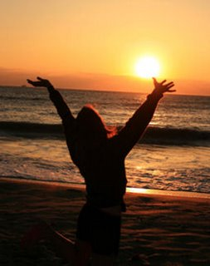
حياة القيامة
إذاً يا إخوتي الأحباء كونوا راسخين غير متزعزعين مكثرين في عمل الرب كل حين عالمين أن تعبكم ليس باطلاً في الرب (1 كو 15: 58)
Notes:
But what does a “resurrection life” look like?
Verse 58 says to “give yourself fully to the work of the Lord”! Do you serve Him with all of your might?
“Resurrection life” has hope too. Don’t be like these Corinthians who lost hope (Gospel presentation).

Slide 24
Black

Slide 25
وعظ العهد الجديد • BibleStudyDownloads.org
أحصل علي هذا العرض مجانا!
Notes:
NP NT Preaching (np) Arabic

