Slide 1
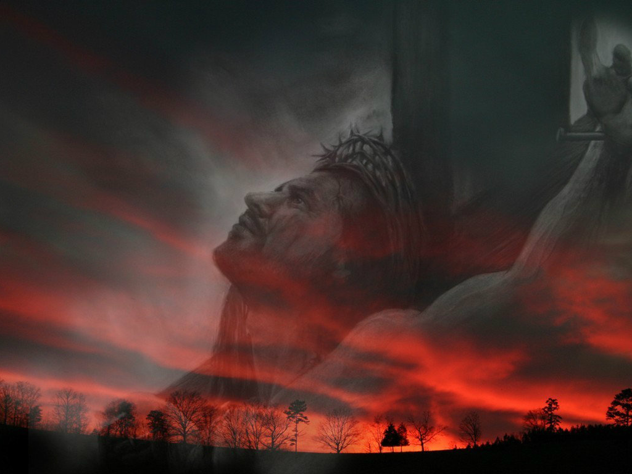
رئيس كهنتنا
عبرانيين 9
د. ريك جريفيث • كنيسة الطرق المتقاطعة الدولية سنغافورة
BibleStudyDownloads.org

Slide 2
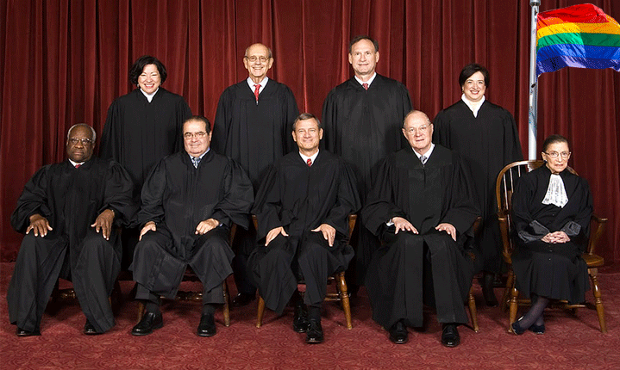
إعادة تعريف المحكمة العليا للزواج
26 حزيران 2015

Slide 3
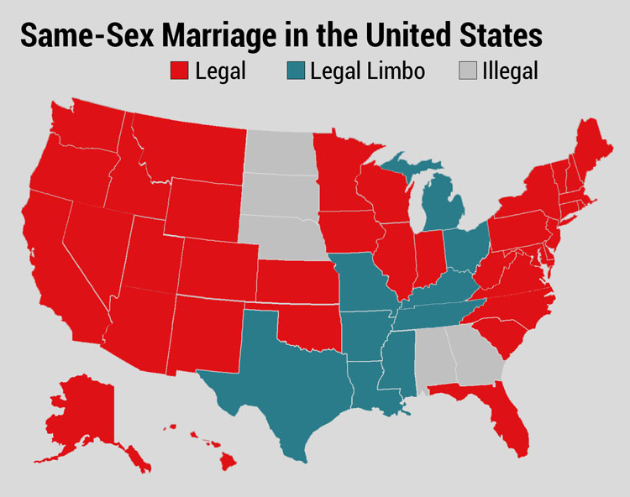
Supreme Court Redefinition of Marriage 26 June 2015

Slide 4
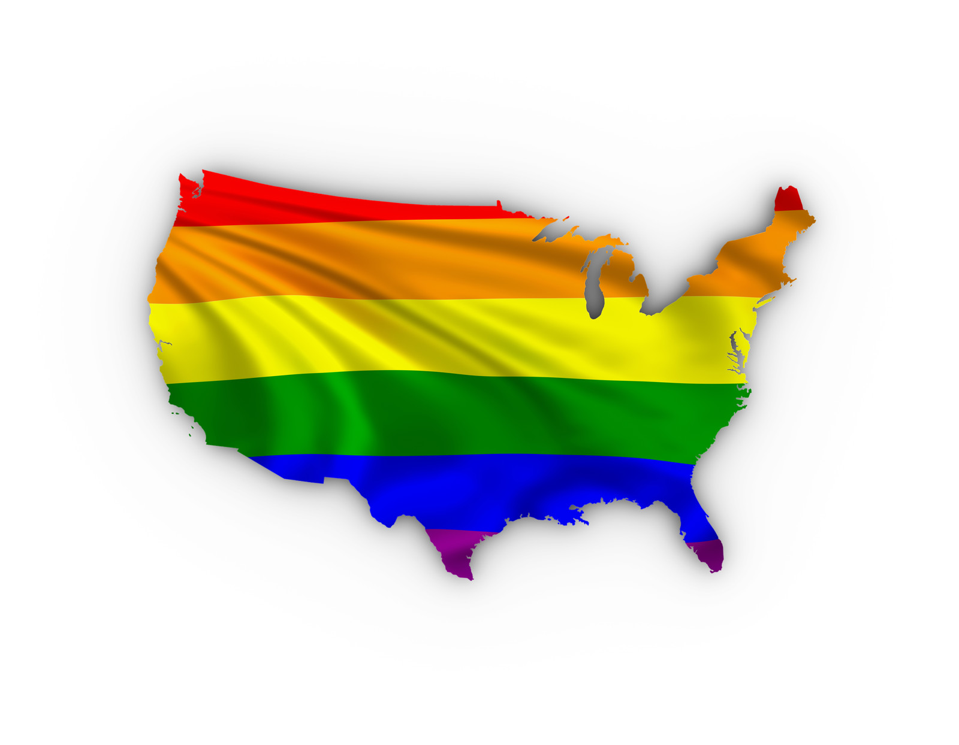
Supreme Court Redefinition of Marriage 26 June 2015

Slide 5
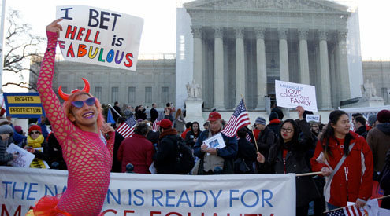
إعادة تعريف المحكمة العليا للزواج
26 حزيران 2015

Slide 6
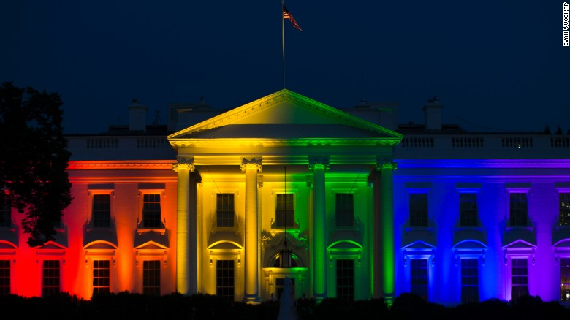
إعادة تعريف المحكمة العليا للزواج
26 حزيران 2015

Slide 7
الآثار المترتبة

Slide 8
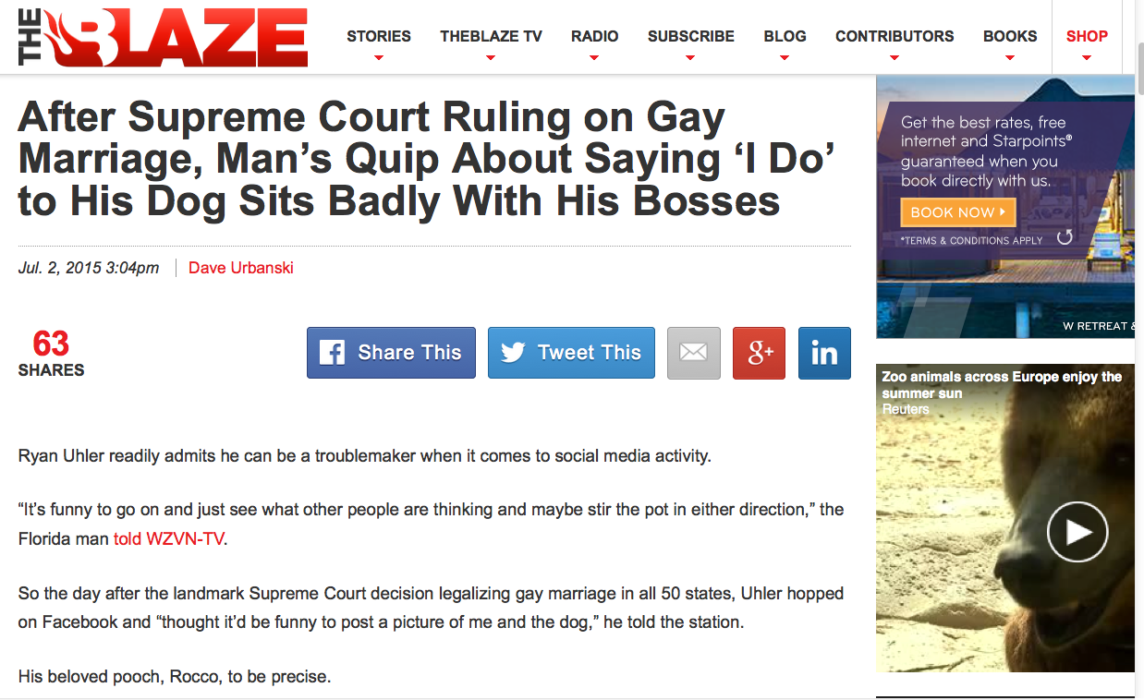
إلى أي مدى ستصل عملية إعادة التعريف؟
Notes:
Dave Urbanski, "After Supreme Court Ruling on Gay Marriage, Man's Quip About Saying 'I Do' to His Dog Sits Badly With His Bosses"
His tech computer fired him for this facebook quote.
"Uhler said the company where he'd worked as a digital marketing specialist for the last two years — Grace Tax Advisory Group in Fort Myers — fired him because of his post.
"What happened was, they took it out of context," he told WZVN.
Trial lawyer Scot Goldberg told the station that while the company's actions are "a little bit over the line," Uhler's former bosses have legal recourse since Florida is an "at will" state — meaning no reason is needed for firing without notice.
Now relegated to hoofing it for a new job — you might call it "Ryan Uhler's Day Off" and then some — his affection for Rocco remains steadfast.
"God, I love my dog," he told the station, "just as much as I love my wife and my kid."
No word yet on how that's going over with the family."
July 2, 2015 (accessed 3 July 2015) at http://www.theblaze.com/stories/2015/07/02/after-supreme-court-ruling-on-gay-marriage-mans-quip-about-saying-i-do-to-his-dog-sits-badly-with-his-bosses/

Slide 9
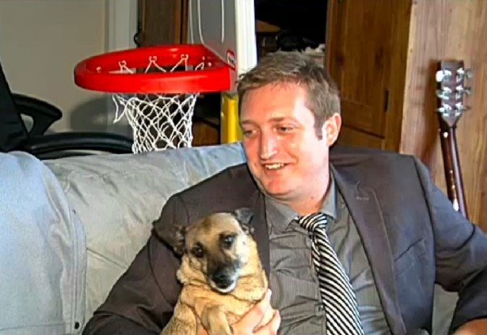
كيف يختلف الزواج من كلب إذا كنت تحبه؟ أتمنى اليوم أن نتمكن من التركيز على الحب بأسلوب هزلي، أنا أحب كلبي روكو، وهو يحبني. نأمل أن نتمكن من الزواج في يوم من الأيام.
Notes:
Dave Urbanski, "After Supreme Court Ruling on Gay Marriage, Man's Quip About Saying 'I Do' to His Dog Sits Badly With His Bosses"
His tech computer fired him for this facebook quote.
"[Ryan] Uhler said the company where he'd worked as a digital marketing specialist for the last two years — Grace Tax Advisory Group in Fort Myers — fired him because of his post.
"What happened was, they took it out of context," he told WZVN.
Trial lawyer Scot Goldberg told the station that while the company's actions are "a little bit over the line," Uhler's former bosses have legal recourse since Florida is an "at will" state — meaning no reason is needed for firing without notice.
Now relegated to hoofing it for a new job — you might call it "Ryan Uhler's Day Off" and then some — his affection for Rocco remains steadfast.
"God, I love my dog," he told the station, "just as much as I love my wife and my kid."
No word yet on how that's going over with the family."
July 2, 2015 (accessed 3 July 2015) at http://www.theblaze.com/stories/2015/07/02/after-supreme-court-ruling-on-gay-marriage-mans-quip-about-saying-i-do-to-his-dog-sits-badly-with-his-bosses/

Slide 10
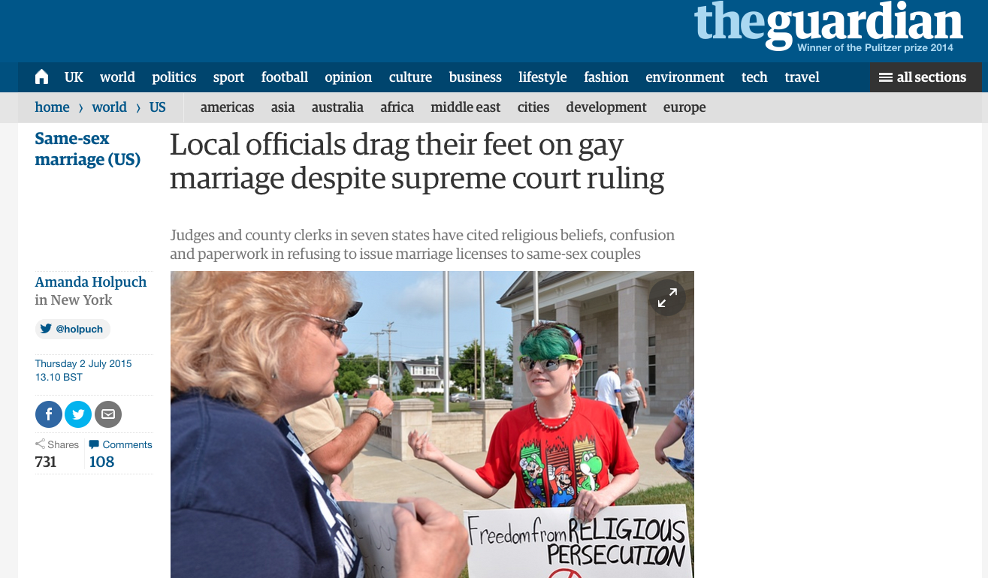
إعادة تعريف المحكمة العليا للزواج
26 حزيران 2015
Notes:
Tony Perkins (President of Family Research Council) wrote on 1 July 2015 at http://www.frc.org/updatearticle/20150701/keep-calm-clerk-on
The five justices of the Supreme Court weren't the only ones with a strong opinion on marriage. And dozens of county clerks are risking everything to prove it. Five days after five justices bulldozed the votes of 50 million people, the Left was wrong to assume everyone would just fall in line. They didn't count on an army of local officials standing in the wreckage of judicial activism, refusing to budge.
For most of them, it wasn't a question of if their beliefs would come under attack, but when. Like Jennifer Schoenrock, the wife of a disabled veteran and family breadwinner, they knew the day was coming when they'd have to choose between their convictions and their career. "I want to do the right thing," Jennifer explained. And that means obeying God's law -- not man's. After last week, these clerks take seriously the reality that their offices are the new front lines in the battle for religious liberty -- and many of them have no intention of going quietly. As far as they're concerned, a lot of things have changed since Friday, but their First Amendment rights weren't one of them.
From small counties in Arkansas to busy towns in Texas, there are hundreds of people ready to defend the ground five unelected justices took from voters. The Court may have changed their definition of marriage, Kentucky clerk Chris Cockrell explained, but he isn't prepared to change his. If that means going to jail, so be it. And according to the state's ACLU, that's no empty threat. "Two things can happen if a Kentucky clerk won't issue a marriage license to a same-sex couple," warned one law professor. "They can resign or go to jail."
And don't think the Left won't send them. This week, the Kentucky County Clerks Association says it's been swamped with cries for help from local officials after Governor Steve Beshear (D) ordered government workers to abide by the ruling. Resistance comes with a heavy price: a year in prison for "first-degree official misconduct." That doesn't scare Rowan County clerk (and Democrat) Kim Davis. Like a lot of offices, hers shut down the marriage license window altogether -- in part because so many of her co-workers object. "What has happened is that five lawyers have imposed their personal view of what the definition of marriage should be on the rest of us. And I, as a Christian, have strong views too. And I know I don't stand alone."
Gay activists have started picketing Davis's office, but she refuses to resign. If the government won't force her, the ACLU vows to. Which may be why the only people busier than state officials are U.S. attorneys. On both sides, offices have been inundated with requests for legal help. In Texas, Attorney General Ken Paxton has promised to find legal representation for any government official whose beliefs are under attack.
That could be several. Of the 254 counties in Texas, less than half (114) told the AP they were "ready and willing" to issue same-sex marriage licenses. Nationally, nonprofit groups like Alliance Defending Freedom and Liberty Institute are already responding to the marriage whirlwind, flying to the aid of clerks and other officials everywhere.
In some states, the turmoil is even splitting the executive and legislative branches. After Governor Asa Hutchinson (R) insisted that Arkansas comply with the Court, state representatives swore to stand by clerks who refuse. "We affirm our support for Amendment 83 of the Arkansas Constitution as overwhelmingly passed by the people in 2004. We refuse to simply shrug our shoulders and abandon basic principles that have guided our country successfully the past 239 years. We will work with other conservative leaders in our state and across the nation... [to] explore all available options."
Down in Mississippi, the handful of clerks handing in their resignation letters includes Linda Barnette. After 24 years, the Grenada County Baptist said that when it came to her job or her faith, there was never any real debate. "My final authority is the Bible," she told Fox News's Todd Starnes. In her mind, the battle is finally at the church's door. "Christians are being put to the test," she said. 'We're going to see the true Christians who stand. It's going to be time to stop talking the talk. It's going to come down to that."
One man who knows about walking the walk is Governor Bobby Jindal (R-La.). Fortunately, the Louisiana governor was as prepared for this as he would be for any local disaster and had the foresight to protect religious liberty in law. People in Indiana and Arizona weren't so lucky. Their governors either watered down their legislation -- or refused to pass it altogether -- leaving officials without the legal firewall they need to keep the Left at bay. If the ACLU wants to sue Governor Jindal, let them. "The Left likes to pick and choose which liberties they support at any given time," he jabbed.
The reality is, the First Amendment has been around a lot longer than whatever "rights" the Court invented June 26. And with a growing chorus of conservative leaders, Bobby Jindal is willing to go to the mat to defend them. Your state officials should too. Contact your leaders and ask them to follow in the footsteps of courageous conservatives like Governor Jindal and Ken Paxton. Also, don't miss the Governor in his own words from yesterday's radio interview on "Washington Watch."

Slide 11
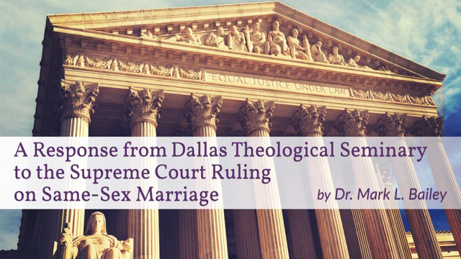
كيف يجب أن نرد على هذا الحكم 5-4؟
Notes:
Tony Perkins (President of Family Research Council) wrote on his Action Alert on 30 June 2015:
"Last week, the Supreme Court ruled in Obergefell v. Hodges that all states must license and recognize marriages between same-sex couples. This decision could have devastating implications for institutions and individuals that hold the belief that marriage is between one man and one woman. We have seen state discrimination, and we need you to urge Congress to prevent federal discrimination against those who support natural marriage!"

Slide 12
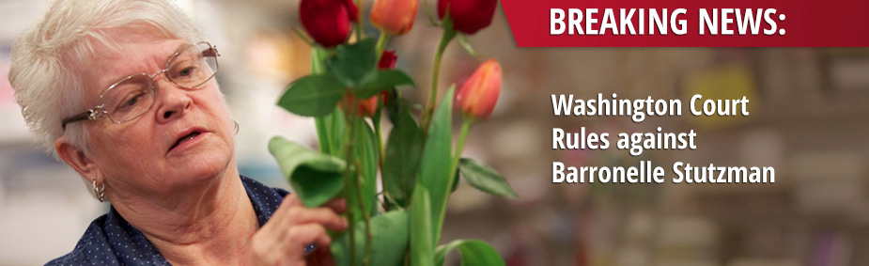
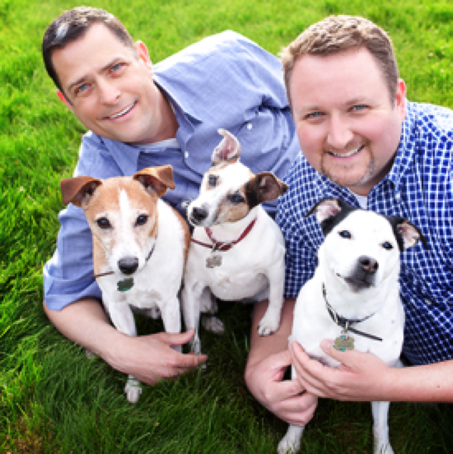
هل يمكننا الإكتفاء بقول لا؟
غرامة قدرها 135 ألف دولار أمريكي
Notes:
Tony Perkins (President of Family Research Council) wrote on his Action Alert on 30 June 2015:
"Businesses and organizations continue to be threatened because of their owners' faith. An Oregon bakery owned by Aaron and Melissa Klein was fined $135,000 simply for declining to make a wedding cake for a same-sex wedding. Barronelle Stutzman, a grandmother in Washington state, had to close her floral business because of the crippling fees imposed on her for not providing flower arrangements for a same-sex wedding.
Child welfare organizations, such as Lutheran Community Services and Catholic Charities, are being threatened by this decision to recognize same-sex marriage or face losing their ability to participate in federal programs or apply for federal grants.
Our Founders envisioned a nation where the moral and religious beliefs of individuals, faith-based organizations, and business owners would be protected, not a nation where one's convictions about marriage could be used as a disqualifying factor for interaction with the federal government.
To stop the federal government from discriminating against people because of their beliefs in marriage, Senator Mike Lee (R-UT) has introduced the First Amendment Defense Act, S.1598, in the Senate, and Representative Raúl Labrador (R-UT) has introduced the companion bill, H.R. 2802, in the House. Simply put, FADA would prohibit the federal government from penalizing persons for their personal moral or religious beliefs in natural marriage in areas such as federal employment, grants, contracts, tax treatment, and other programs.

Slide 13
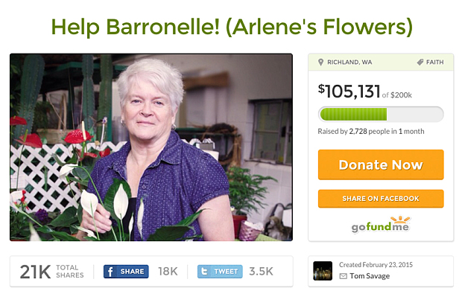
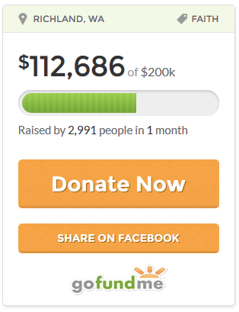
هل يمكننا المساعدة؟

Slide 14
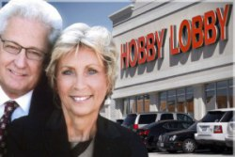
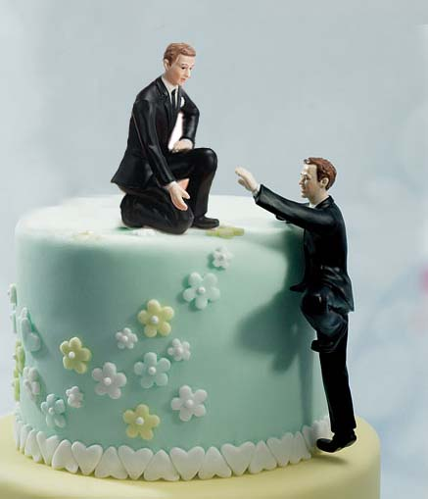
حالات أخرى

Slide 15
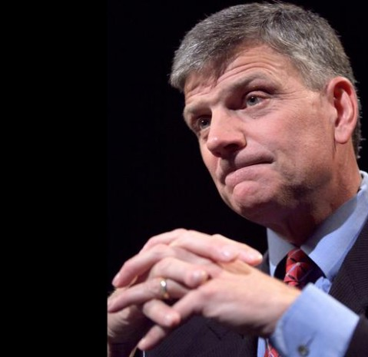
من الأفضل أن تكون جاهزاً ومن الأفضل أن تكون مستعداً لأنه قادم، سيكون هناك اضطهاد للمسيحيين بسبب موقفنا.
القس فرانكلين غراهام

Slide 16
أشعياء 5: 20
ويل للقائلين للشر خيراً وللخير شراً،
الجاعلين الظلام نوراً والنور ظلاماً،
الجاعلين المر حلواً والحلو مراً.

Slide 17
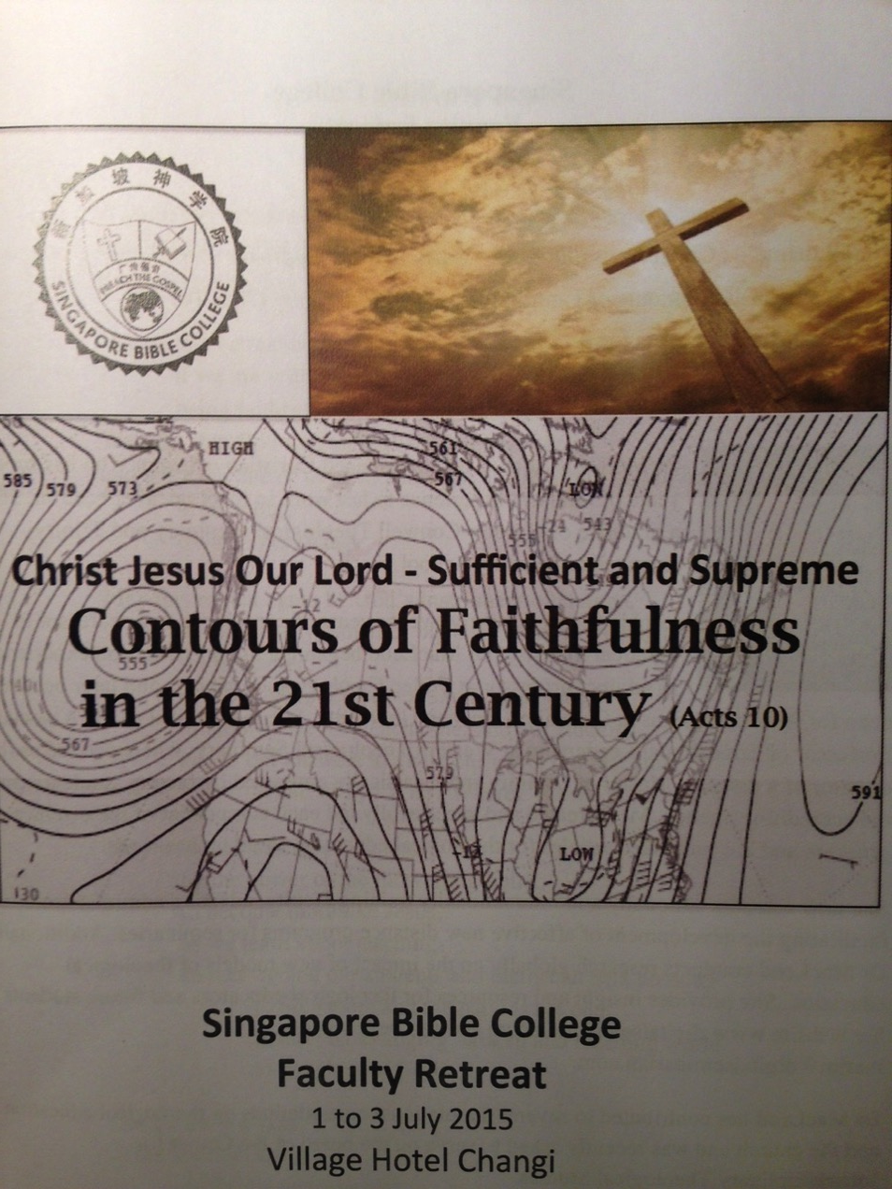
يتم سحبها معاً
تجنب
انحدار الغرب
التعلم من المخرجات

Slide 18
التعلم من المخرجات بالنسبة لخرجي كلية الكتاب المقدس سنغافورة
    المهارات
      ترجمة وتطبيق الحق الكتابي لإشراك مجموعة متنوعة من السياقات الثقافية والخدمة (متواصلون فعالون)
      تحليل ومعالجة احتياجات الثقافات المتجانسة والمختلطة في الكنيسة (القادة الخادمين)
      إظهار التمييز للانخراط بشكل خلاق في بيئة تعددية
    الشخصية
      إظهار الأمانة في خدمة دعوة الله
      امتلاك الحيوية الروحية لخدمة الله وشعبه

Slide 19
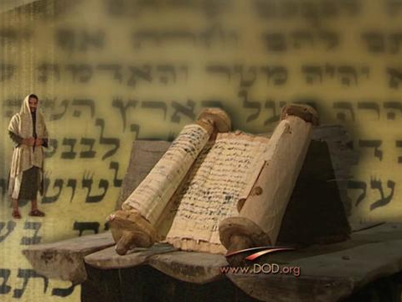
خلفية
الرسالة إلى العبرانيين
Notes:
Today we continue in our study of the book of Hebrews. The first readers were confused about the significance of the death of Jesus, so they were tempted to return to the old sacrificial system.

Slide 20
العبرانيين
256-257
المولف
المستلمون
الأصل
الوجهة
غير معروفون
Notes:
Little is known about the author, recipients, origin and destination

Slide 21
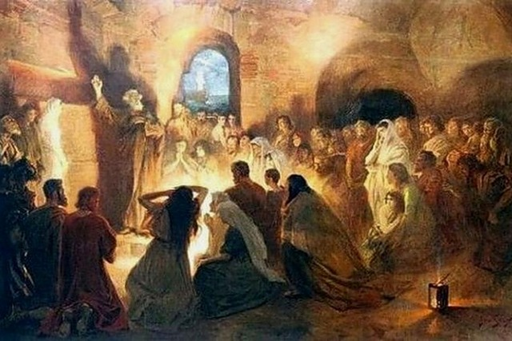
مجتمع يهودي محدد
ولكن أطلب أكثر أن تفعلوا هذا لكي أرد إليكم بأكثر سرعة.
(13: 19)
Notes:
The author already visited them once and wanted to revisit them (13:19, 23).
The readers apparently had a concern for Timothy as well (13:18).

Slide 22
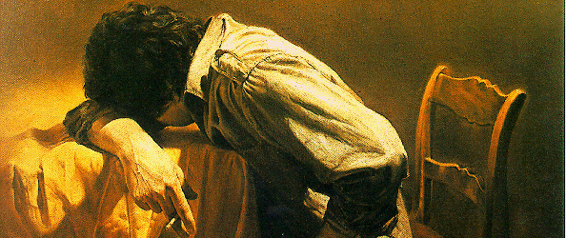
مجتمع يهودي تحت الضغط
لأنكم رثيتم لقيودي أيضاً، وقبلتم سلب أموالكم بفرح، عالمين في أنفسكم أن لكم مالاً أفضل في السماوات وباقياً.
(10: 34)
Notes:
They have a definite history to which the author is acquainted, including their conversion (2:3), ministry to other Christians (6:10), sufferings for the gospel (10:32-34), and present state of spiritual maturity (5:11ff.).
The readers may have been the leaders of a larger community since it is unlikely that the writer would expect the entire church to be teachers (5:12).

Slide 23
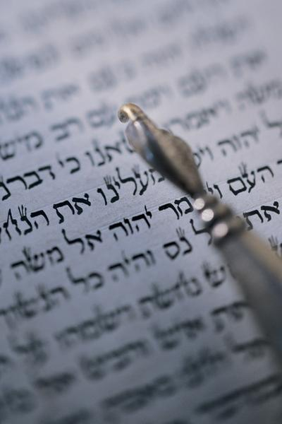
هل يجب أن أرجع؟
لذلك يجب أن نتنبه أكثر إلى ما سمعنا لئلا نفوته
(2: 1)

Slide 24

Christ is Better

Slide 25

عبرانيين: ثابر
254
تفوق المسيح على اليهودية كرئئس كهنة
متفوق في شخصه على ... |  |  | متفوق في عمله الكهنوتي على ... |  |  |  |  | الثبات من خلال الإيمان
1: 1-4: 13 |  |  | 4: 14-10: 18 |  |  |  |  | 10: 19-13: 25
الأنبياء | الملائكة | موسى | هارون | ملكي صادق | العهد القديم | خيمة الإجتماع | الذبائح | الخطية الإرادية | النماذج | الثبات كأبناء | الأخلاق | رفض الله | التشجيع
1: 1-3 | 1: 4- 2: 18 | 3: 1- 4: 13 | 4: 14- 6: 20 | 7 | 8 | 9: 1-10 | 9: 11- 10: 18 | 10: 19-39 | 11: 1- 12: 3 | 12: 4-13 | 12: 14-17 | 12: 18-29 | 13
جلال المسيح |  |  | خدمة المسيح |  |  |  |  | إظهار المسيحية
اللاهوت |  |  |  |  |  |  |  | الممارسة
المؤلف والمستلمون والأصل والوجهة غير معروفين
67-68 م
9: 1-10: 18

Slide 26
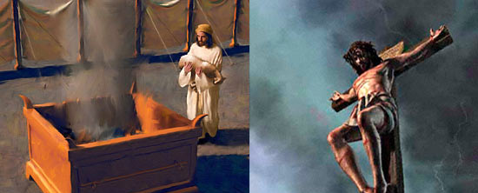
سؤالين مهمين
ما هي المشكلة في ذبائح العهد القديم؟
كيف كان موت المسيح أفضل؟

Slide 27
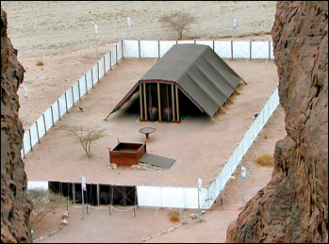
ما هي المشكلة في ذبائح العهد القديم؟
Notes:
God approved the old covenant system but only for a time.

Slide 28

ثم العهد الأول كان له أيضاً فرائض خدمة والقدس العالمي
(9: 1)

Slide 29
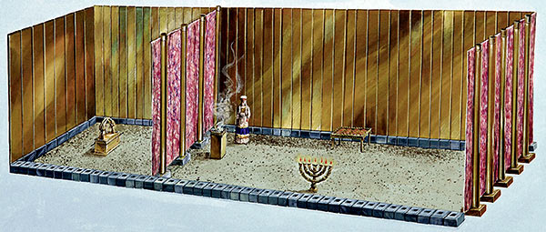
لأنه نصب المسكن الأول الذي يقال له القدس الذي كان فيه المنارة، والمائدة، وخبز التقدمة.
(9: 2)
القدس

Slide 30
ووراء الحجاب الثاني المسكن الذي يقال له قدس الأقداس
(9: 3)
قدس الأقداس
القدس

Slide 31
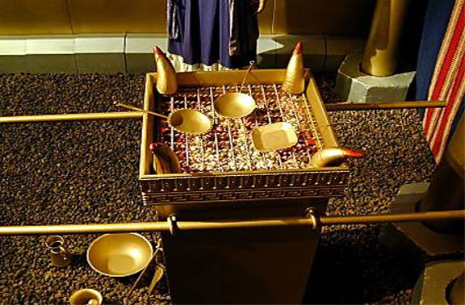
فيه مبخرة من ذهب ... (9: 4أ)

Slide 32
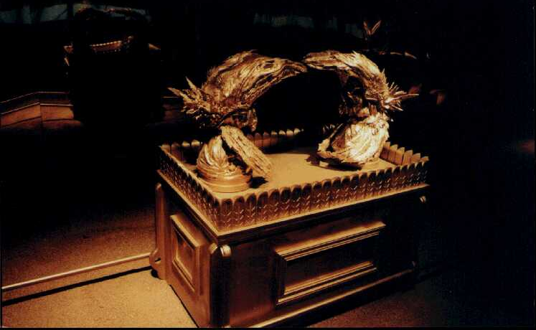
فيه مبخرة من ذهب، وتابوت العهد مغشى من كل جهة بالذهب (9: 4أ)

Slide 33
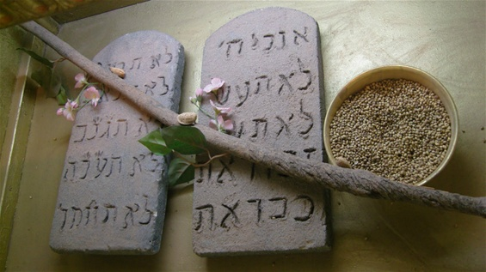
الذي فيه قسط من ذهب فيه المن، وعصا هارون التي أفرخت، ولوحا العهد.
(9: 4ب)

Slide 34
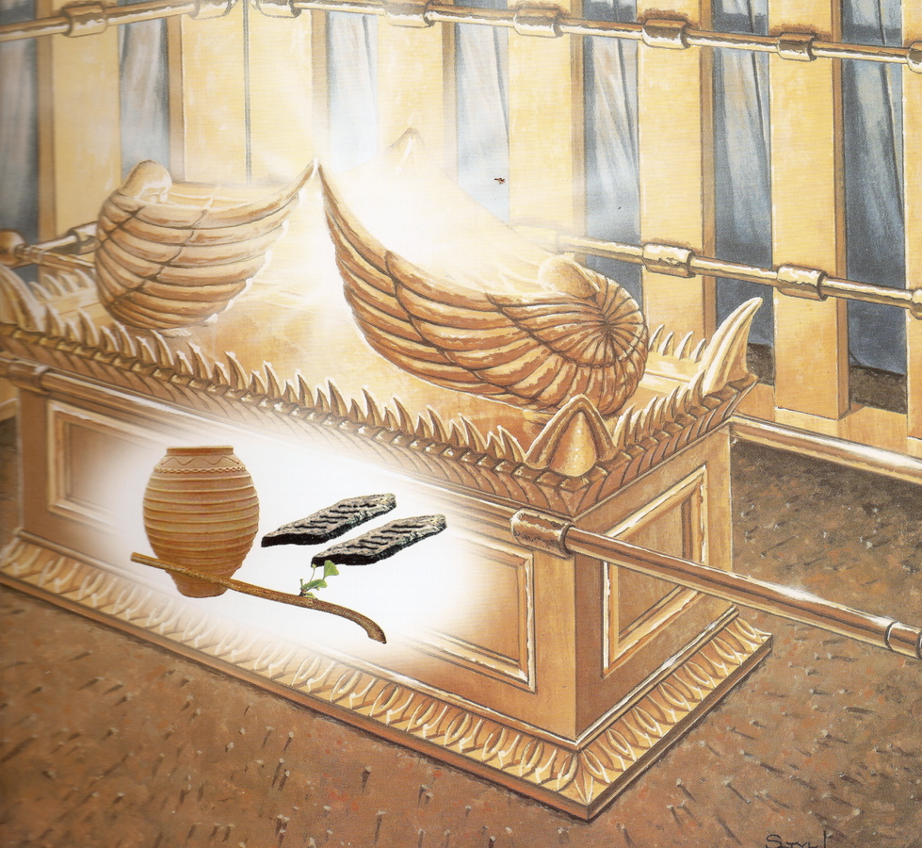
وفوقه كروبا المجد مظللين الغطاء.
(9: 5أ)

Slide 35
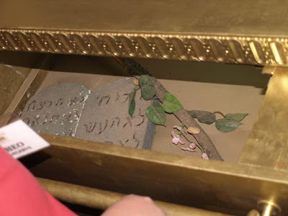
أشياء ليس لنا الآن أن نتكلم عنها بالتفصيل.
(9: 5ب)

Slide 36
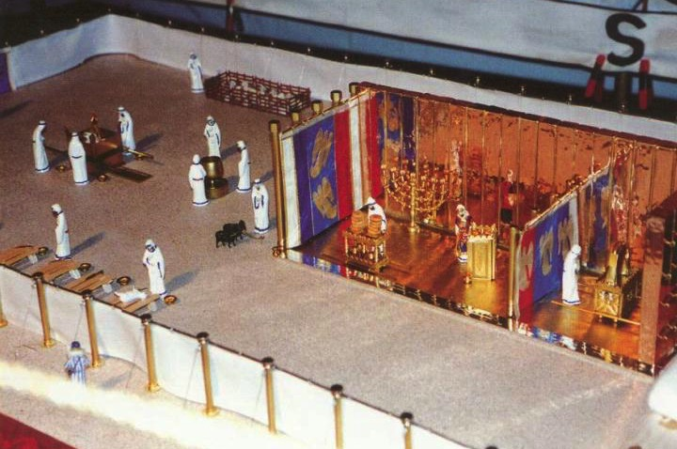
ثم إذ صارت هذه مهيأة هكذا، يدخل الكهنة إلى المسكن الأول كل حين، صانعين الخدمة (9: 6)
الساحة
القدس
قدس الأقداس
يوم الكفارة (لا 16: 29-34)

Slide 37
يوم الكفارة (لا 16: 29-34)
الساحة
القدس
قدس الأقداس
وأما إلى الثاني فرئيس الكهنة فقط مرة في السنة، ليس بلا دم يقدمه عن نفسه وعن جهالات الشعب
(9: 7)

Slide 38
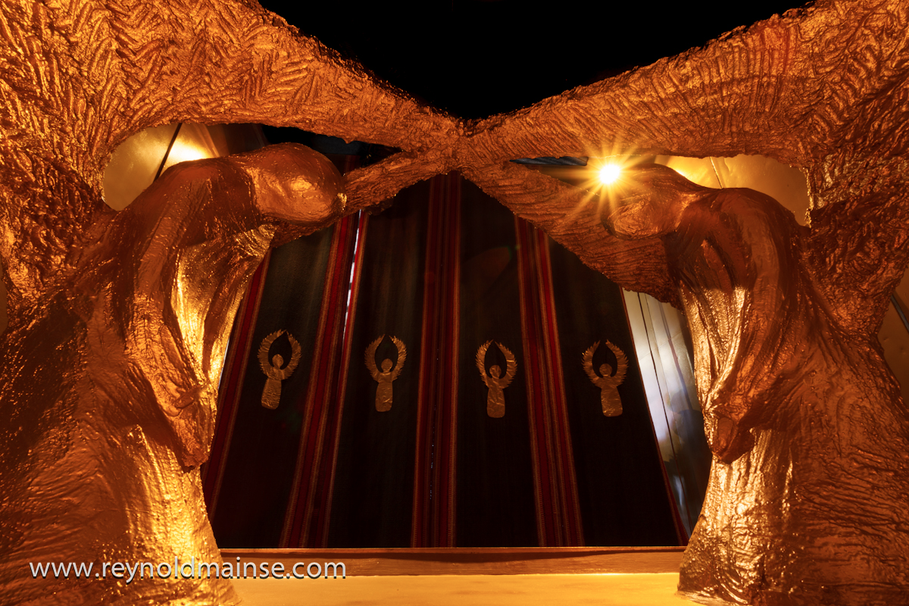
معلناً الروح القدس بهذا أن طريق الأقداس لم يظهر بعد، ما دام المسكن الأول له إقامة
(9: 8)
Notes:
Two Cherubim kneel on top of a replica of the Ark of the Covenant in the Holy of Holies at Timna National Park located in the Jordan Rift Valley.

Slide 39
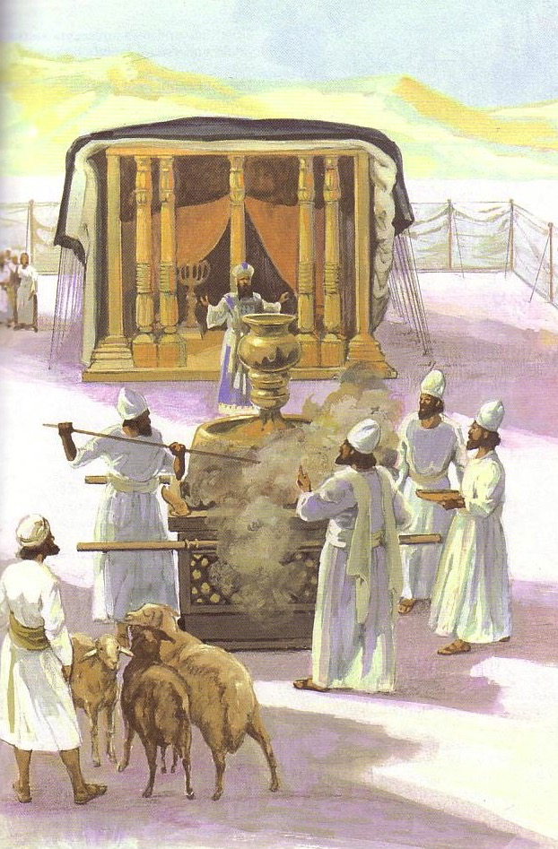
الذي هو رمز للوقت الحاضر، الذي فيه تقدم قرابين وذبائح، لا يمكن من جهة الضمير أن تكمل الذي يخدم
(9: 9)

Slide 40
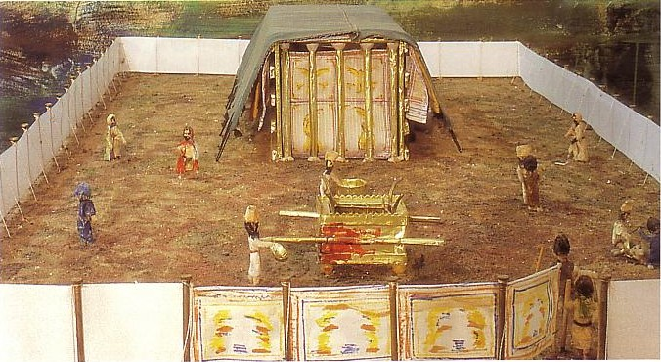
وهي قائمة بأطعمة وأشربة وغسلات مختلفة وفرائض جسدية فقط، موضوعة إلى وقت الإصلاح.
(9: 10)

Slide 41

كيف يكون موت المسيح أفضل من أي ذبيحة؟

Slide 42
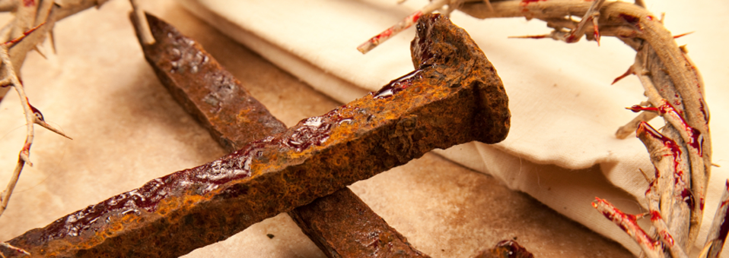
كيف يكون موت المسيح
أفضل؟
Notes:
His sacrifice gives us eternal life.

Slide 43
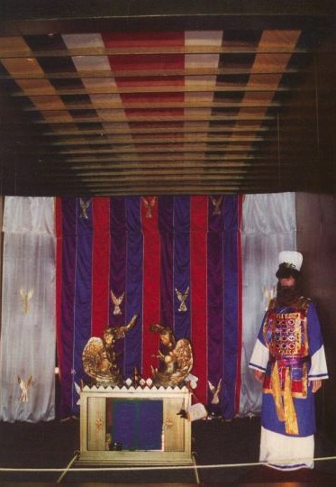
رمزية يوم الكفارة
وأما المسيح، وهو قد جاء رئيس كهنة للخيرات العتيدة، فبالمسكن الأعظم والأكمل غير المصنوع بيد، أي الذي ليس من هذه الخليقة
عبرانيين 9: 11

Slide 44
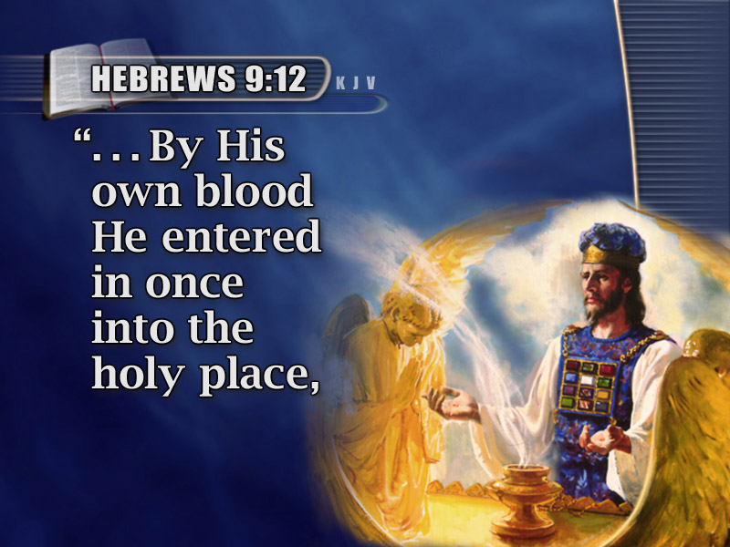
مرة بدم نفسه لأجل الجميع
وليس بدم تيوس وعجول، بل بدم نفسه، دخل مرة واحدة إلى الأقداس، فوجد فداء أبدياً.
عبرانيين 9: 12

Slide 45
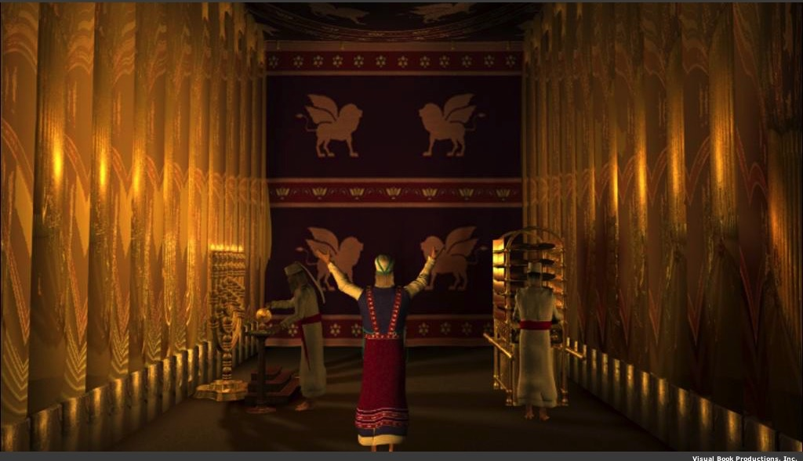
لأنه إن كان دم ثيران وتيوس ورماد عجلة مرشوش على المنجسين، يقدس إلى طهارة الجسد
(9: 13)

Slide 46
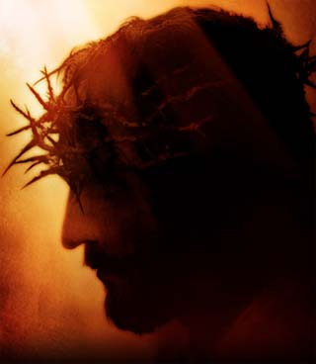
فكم بالحري يكون دم المسيح، الذي بروح أزلي قدم نفسه لله بلا عيب، يطهر ضمائركم من أعمال ميتة لتخدموا الله الحي (9: 14)

Slide 47
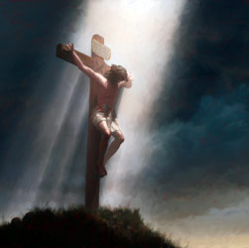
ولأجل هذا هو وسيط عهد جديد، لكي يكون المدعوون­ إذ صار موت لفداء التعديات التي في العهد الأول ينالون وعد الميراث الأبدي (9: 15)

Slide 48
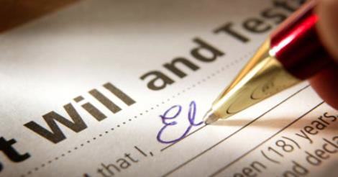
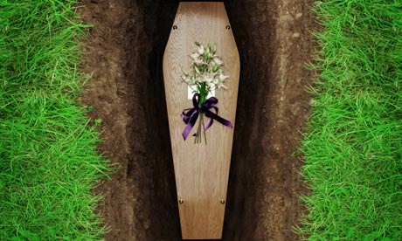
لأنه حيث توجد وصية، يلزم بيان موت الموصي، لأن الوصية ثابتة على الموتى، إذ لا قوة لها البتة ما دام الموصي حياً.
(9: 16-17)

Slide 49
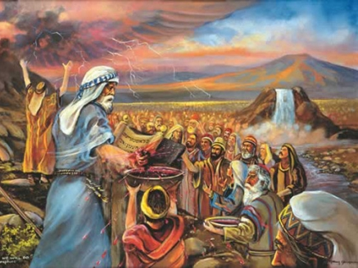
فمن ثم الأول أيضا لم يكرس بلا دم
(9: 18)

Slide 50
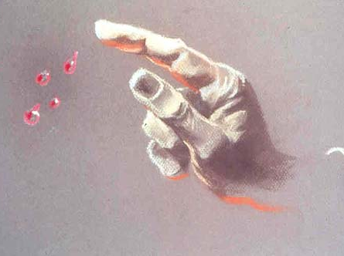
لأن موسى بعدما كلم جميع الشعب بكل وصية بحسب الناموس، أخذ دم العجول والتيوس، مع ماء
وصوفا قرمزيا وزوفا، ورش الكتاب نفسه وجميع الشعب
(9: 19)

Slide 51

قائلاً: هذا هو دم العهد الذي أوصاكم الله به، والمسكن أيضاً وجميع آنية الخدمة رشها كذلك بالدم، وكل شيء تقريباً يتطهر حسب الناموس بالدم (9: 20-22أ)

Slide 52
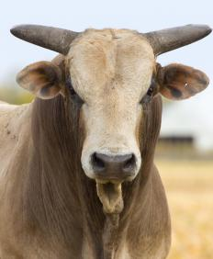
وبدون سفك دم لا تحصل مغفرة
(9: 22ب)

Slide 53
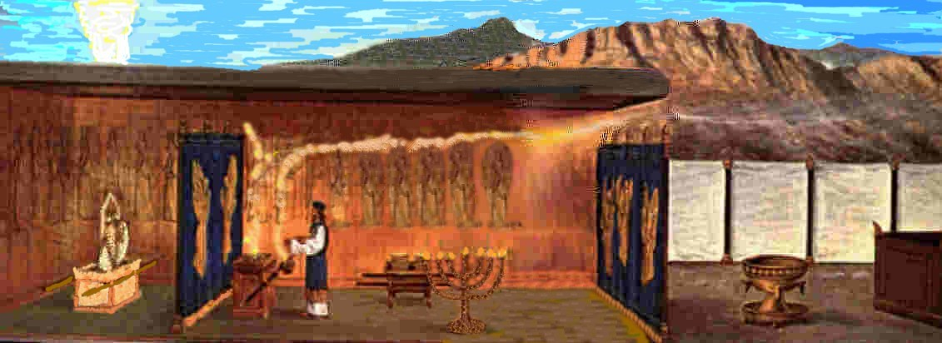
فكان يلزم أن أمثلة الأشياء التي في السماوات تطهر بهذه، وأما السماويات عينها، فبذبائح أفضل من هذه.
(9: 23)

Slide 54
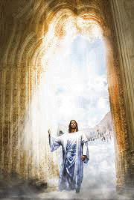
لأن المسيح لم يدخل إلى أقداس مصنوعة بيد أشباه الحقيقية، بل إلى السماء عينها، ليظهر الآن أمام وجه الله لأجلنا.
(9: 24)

Slide 55
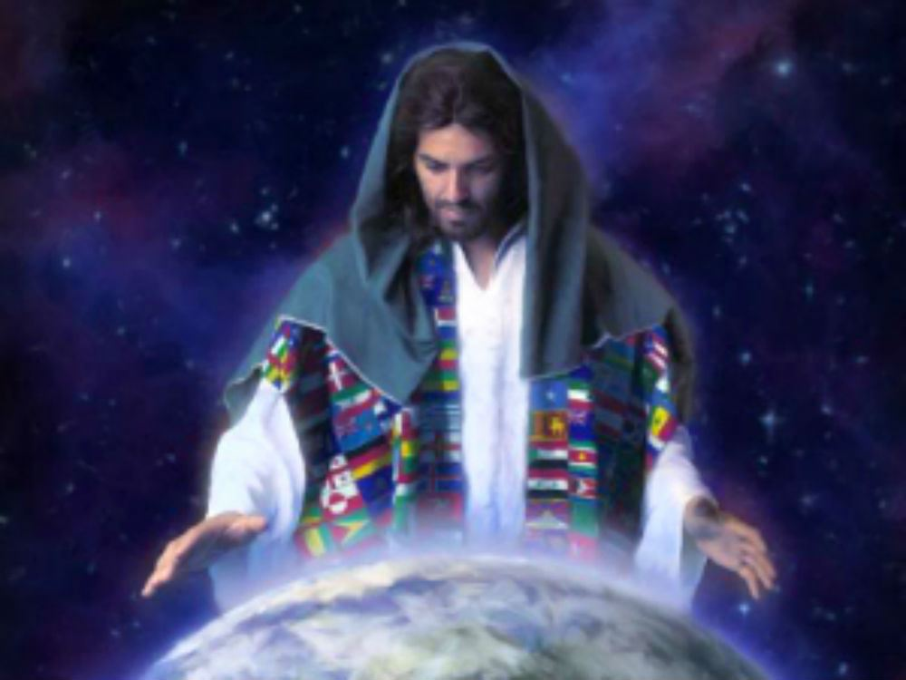
ولا ليقدم نفسه مراراً كثيرة، كما يدخل رئيس الكهنة إلى الأقداس كل سنة بدم آخر.
(9: 25)

Slide 56
تم التخلص من الخطيئة (وليس فقط تغطيتها)
فإذ ذاك كان يجب أن يتألم مراراً كثيرة منذ تأسيس العالم، ولكنه الآن قد أظهر مرة عند انقضاء الدهور ليبطل الخطية بذبيحة نفسه.
عبرانيين 9: 26

Slide 57
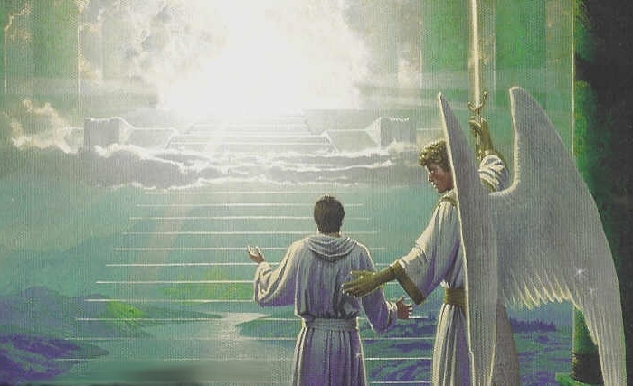
وكما وضع للناس أن يموتوا مرة ثم بعد ذلك الدينونة،
هكذا المسيح أيضاً، بعدما قدم مرة لكي يحمل خطايا كثيرين، سيظهر ثانية بلا خطية للخلاص للذين ينتظرونه.
(9: 27-28)

Slide 58
كيف يكون موت المسيح أفضل من أي ذبيحة؟

Slide 59

يخلصنا المسيح بشكل دائم
الفكرة الرئيسية

Slide 60
1. كانت ذبائح خيمة الإجتماع مؤقتة (9: 1-10)

Slide 61
2. يخلصنا موت المسيح بشكل دائم (9: 11-10: 18)

Slide 62
سؤالين مهمين في 9: 35
ما هي المشكلة في ذبائح العهد القديم؟
كيف كان موت المسيح أفضل؟

Slide 63
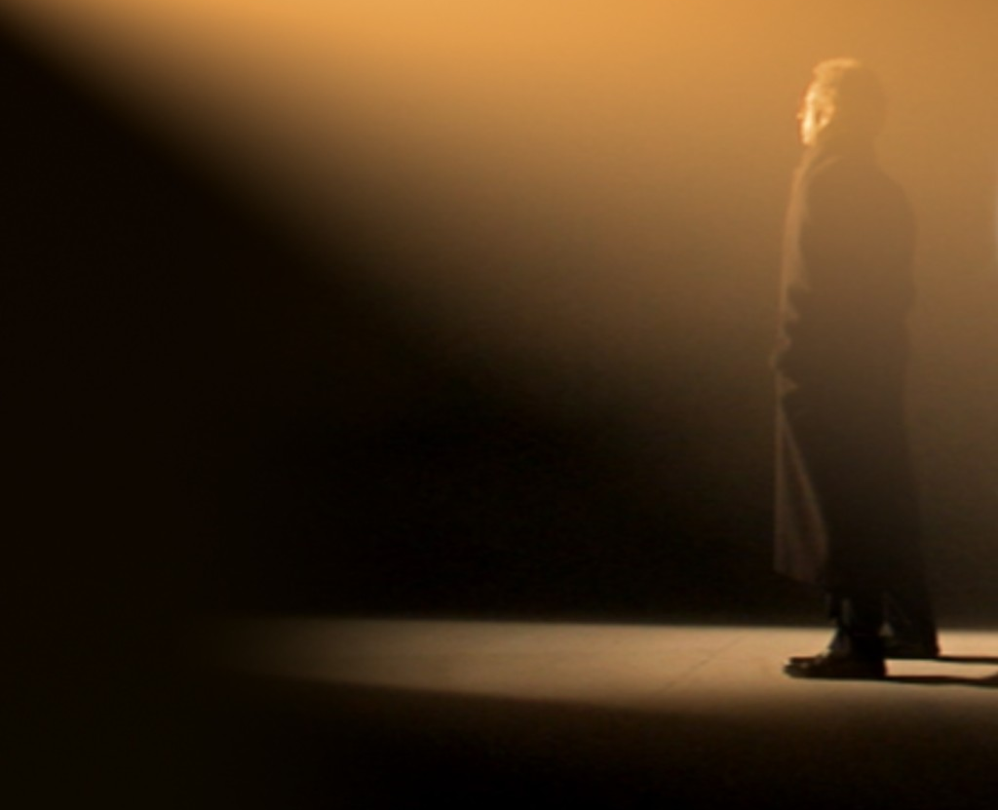
أشكر الله في مجموعتك الصغيرة على أن يسوع هو رئيس كهنتك الدائم حتى الساعة 9:45

Slide 64
Black

Slide 65


الرابط للعرض التقديميِّ "وعْظُ العهد الجديد" متاحٌ على الموقع الإلكترونيّ:
BibleStudyDownloads.org
أحصل على هذا العرض التقديمي مجاناً
Notes:
NP NT Preaching (np) Arabic
_____________
Common-33

