Slide 1
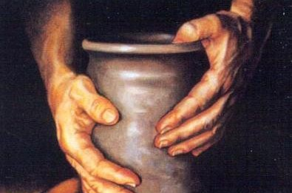
لا تحتقر التأديب
عبرانيين 12: 4-17
د. ريك جريفيث • كنيسة الطرق المتقاطعة الدولية سنغافورة
BibleStudyDownloads.org

Slide 2
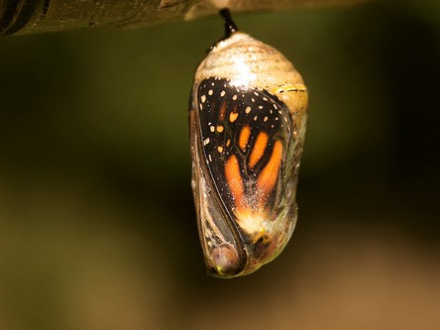
Cocoon
Notes:
An old grain farmer looked out his kitchen door one morning and saw a butterfly cocoon. The man watched as the creature struggled. Finally the struggle became so intense that the man thought the butterfly would die. He thought that, without help, the butterfly wouldn't escape from the cocoon.
So the man took his pocketknife and carefully cut a slit in the side of the cocoon. Almost immediately, one wing appeared and then the other. The butterfly was free! It took a few steps, fell over on its side, and died.
You see, its body was large, but its wings were small and weak. It needed to struggle to become strong enough to be able to fly. The struggle was part of the plan for its development.

Slide 3
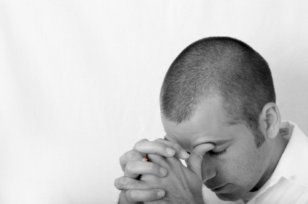
نحتاج أحياناً أن نتألم
Notes:
Too often we think God should make life easy for us. But sometimes the struggle is exactly what we need. What do you need? Do you view struggles and hurts as a good thing?

Slide 4
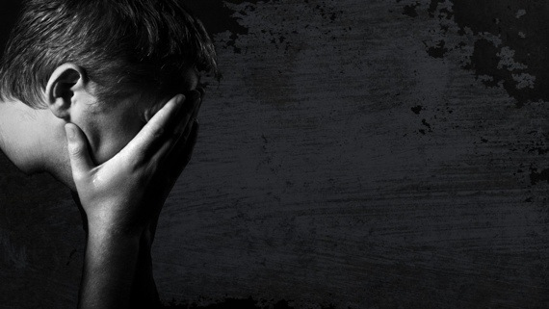
هل الحياة سهلة أم صعبة بالنسبة لك الآن؟ كيف؟
Notes:
If life is easy, then thank God for a respite.
But most of us will admit that life has many challenges. If you know God, then you will realize that he is all-powerful and could give you a smooth road, but he doesn't do that very often. He is disciplining us for better things.

Slide 5
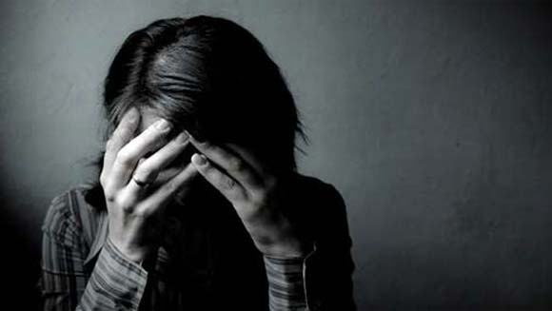
لماذا يجب أن نرحب بتأديب الله؟
Notes:
Why should we respond positively to God's discipline?
Why should you even welcome God allowing things to get difficult in your life?

Slide 6
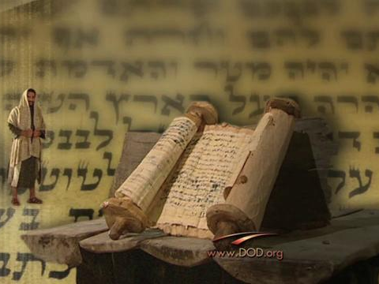
خلفية الرسالة
Notes:
The letter of the Hebrews teaches about divine discipline. But what is God's discipline?

Slide 7
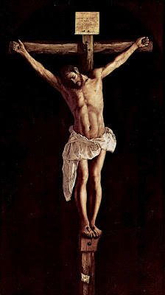
ولكن تذكروا الأيام السالفة التي فيها بعدما أنرتم صبرتم على مجاهدة آلام كثيرة. (10: 32)
Notes:
Remember the courage you had for Christ in the past (10:32-34).

Slide 8
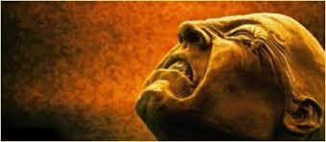
من جهة مشهورين بتعييرات وضيقات، ومن جهة صائرين شركاء الذين تصرف فيهم هكذا. (10: 33)

Slide 9
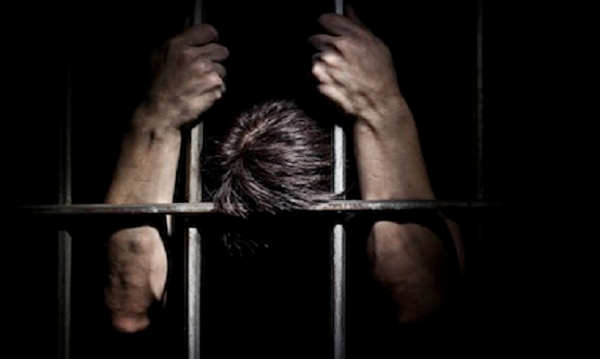
لأنكم رثيتم لقيودي أيضاً، وقبلتم سلب أموالكم بفرح، عالمين في أنفسكم أن لكم مالاً أفضل في السماوات وباقياً. (10: 34)

Slide 10
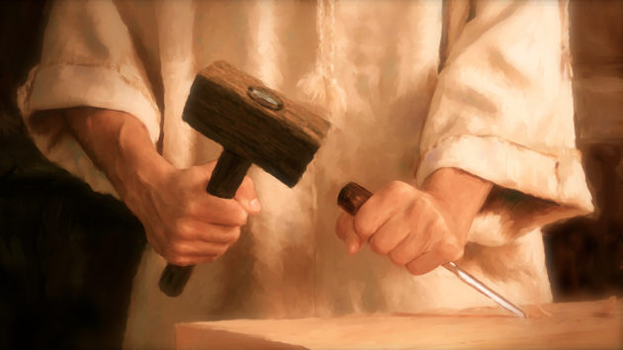
تم تأديب القراء لإرجاعهم.
Notes:
They were believers tempted to live like unbelievers to avoid difficulty—so God disciplined them to bring them back

Slide 11
HALL OF FAITH
Notes:
The author has just sought to encourage his readers with many examples of faithful endurance in the Bible's "Hall of Faith" (Hebrews 11). This included young and old people to imitate—as well as a variety of occupations.

Slide 12
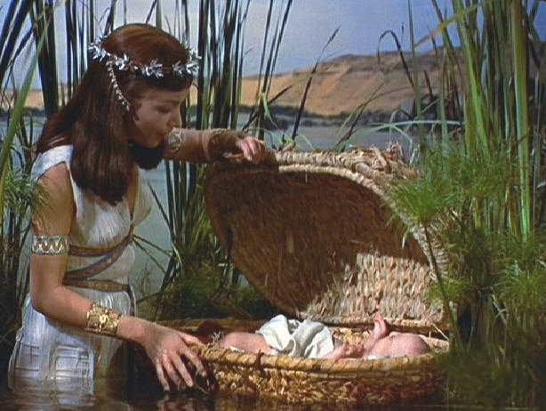
بالإيمان موسى بعدما ولد، أخفاه أبواه ثلاثة أشهر، لأنهما رأيا الصبي جميلاً، ولم يخشيا أمر الملك. (11: 23)
Notes:
Some were parents, farmers, others shepherds, judges, politicians and prophets

Slide 13
ثابر
دراسة في عبرانيين
Notes:
The best of these great models was Jesus himself, so the author has just told the readers to fix their eyes on Christ, who also endured to the point of death on the cross (12:1-3). Our theme is to "Press On!" towards Christ.

Slide 14
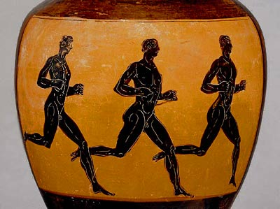
لنطرح كل ثقل (12: 1)
Notes:
He has just told them to lay aside every encumbrance—like Greek runners who ran naked!

Slide 15
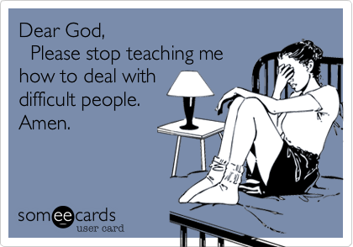
Bad Leadership
عزيزي الله
أرجو أن تتوقف عن تعليمي كيف أتعامل مع الأشخاص الصعبين.
آمين
Notes:
To motivate them not to turn back to Judaism, God disciplined them—not punished them. He does the same for us in our day, too. So hang with me if you are like the lady I noted last week who prayed, "Dear God, Please stop teaching me how to deal with difficult people"!

Slide 16
لماذا يجب أن نرحب بتأديب الله؟
ثلاثة أسباب (عب 12: 4-17)
Notes:
What is the first reason we should welcome God's discipline? Why have a positive perspective when God allows things to get difficult in our lives? First…

Slide 17
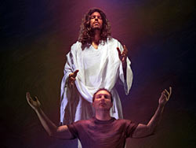
1. يؤكد التأديب أننا أولاد الله القديسون (12: 4-11)
Notes:
The Lord corrects those he calls sons and daughters so they will grow in righteousness

Slide 18
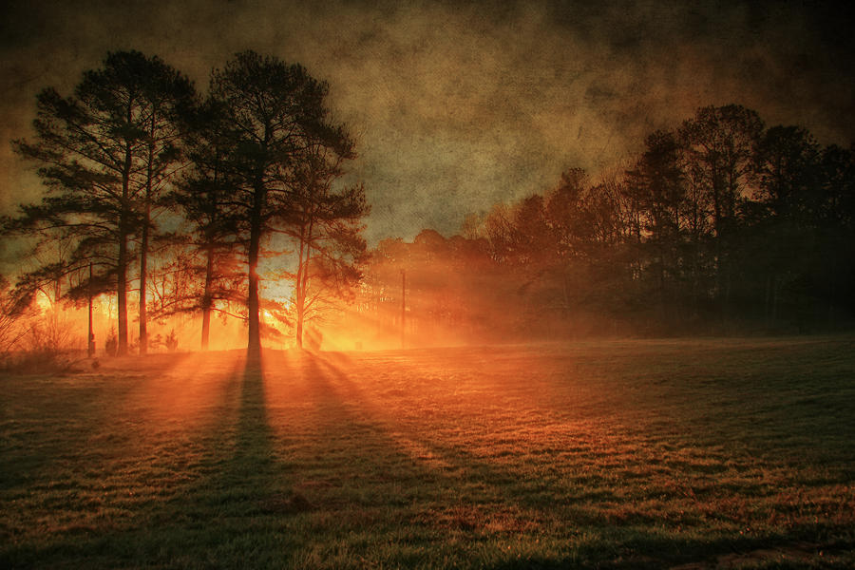
لم تقاوموا بعد حتى الدم مجاهدين ضد الخطية (12: 4)

Slide 19
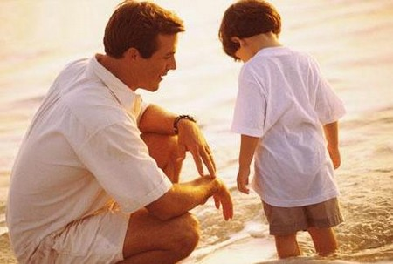
التأديب المحب (عب 12: 5-6)
5 وقد نسيتم الوعظ الذي يخاطبكم كبنين: يا ابني لا تحتقر تأديب الرب، ولا تخر إذا وبخك 6 لأن الذي يحبه الرب يؤدبه، ويجلد كل ابن يقبله.

Slide 20
التأديب المحب (عب 12: 7)
إن كنتم تحتملون التأديب يعاملكم الله كالبنين، فأي ابن لا يؤدبه أبوه؟

Slide 21
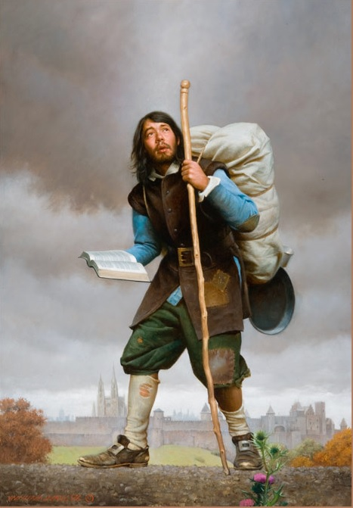
ولكن إن كنتم بلا تأديب، قد صار الجميع شركاء فيه، فأنتم نغول لا بنون. (12: 8)

Slide 22
ثم قد كان لنا آباء أجسادنا مؤدبين، وكنا نهابهم....
أفلا نخضع بالأولى جدا لأبي الأرواح، فنحيا؟
(12: 9)

Slide 23
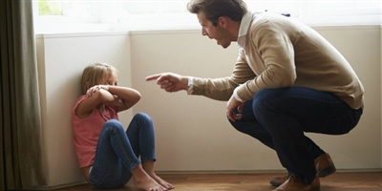
هل تأديب الله قاسٍ مثل تأديب أبي؟

Slide 24
ما الفرق؟
العقاب
التأديب
دفع ثمن الخطية
الإسترداد
الماضي
المستقبل
إدانة
توجيه
الأعداء
الأولاد
Notes:
Punishment is difficulty in our lives from past sin. We punish people by withholding privileges due to their failures: being on probation, making them work at tasks less than their abilities, etc. It's a judgment for doing wrong.
Discipline refers to difficulty with the positive goal of giving them future blessings: expecting responsibility so they can handle more responsible positions in the days to come, toughening us up for future challenges, etc. It instructs us and trains us.
Is the purpose vengeance or virtue? God as Judge or God as Father?

Slide 25
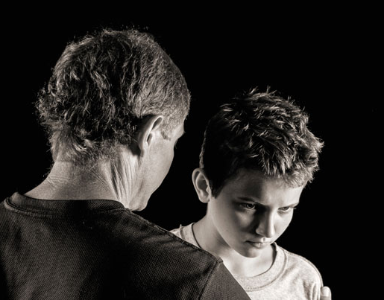
التأديب (paideia) في 12: 7 هو عمل تقديم الإرشاد للحياة المسؤولة، والتربية، والتدريب، والتعليم... والتأديب، والتقويم ((BDAG 748.

Slide 26
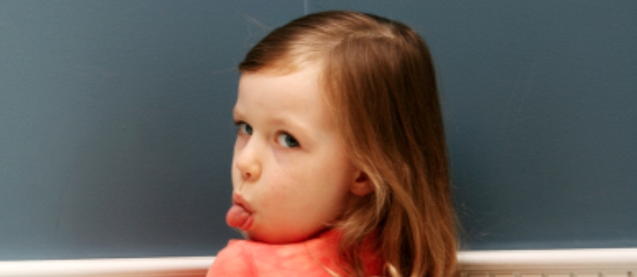
من نؤدب؟
Notes:
We don't discipline other people's kids because discipline confirms that we are true children

Slide 27
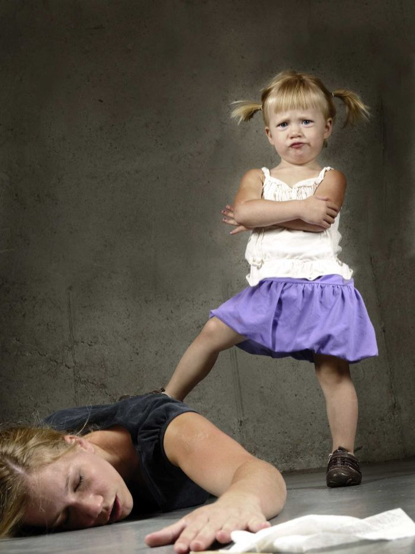
Discipline
Notes:
You probably have seen, as I have, mothers with their children in public who were showing them who was boss. At times I have wanted to intervene—but I never have—why not? They weren't my children!

Slide 28
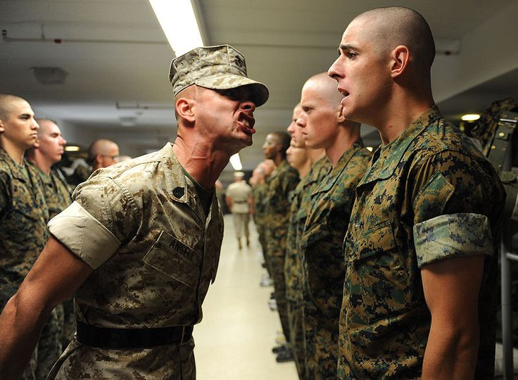
Discipline
Notes:
Other times I have felt that other parents were too harsh—like a drill sergeant—but since they were not my kids, I didn't intervene.

Slide 29
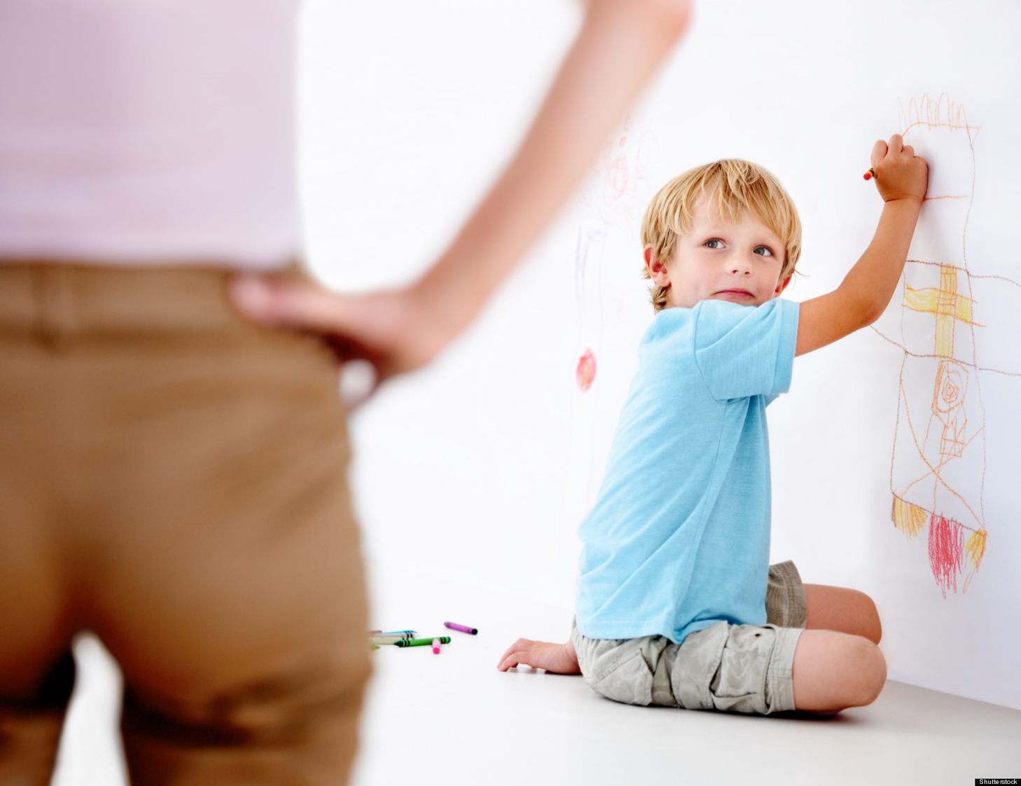
Discipline
Notes:
But I intervened for my own sons.

Slide 30
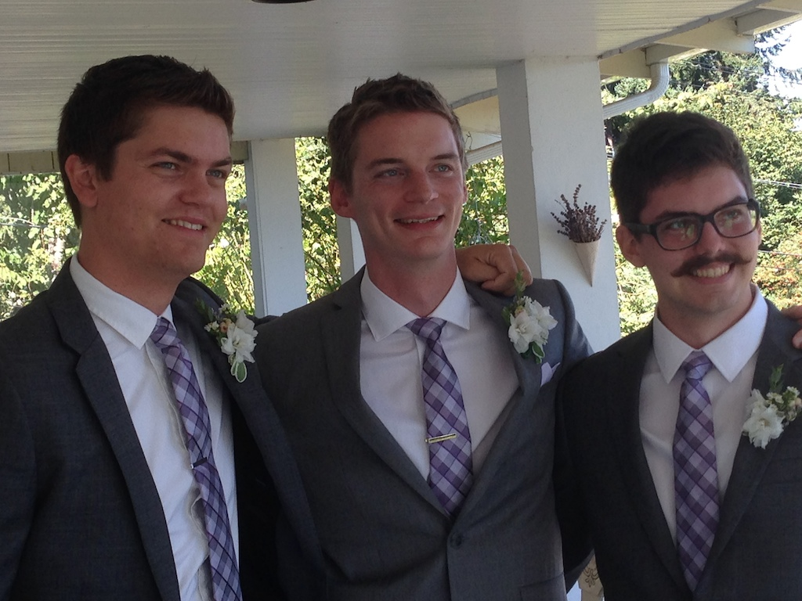
أولادنا الثلاثة
Notes:
The past week two of our three sons thanked us for disciplining them

Slide 31
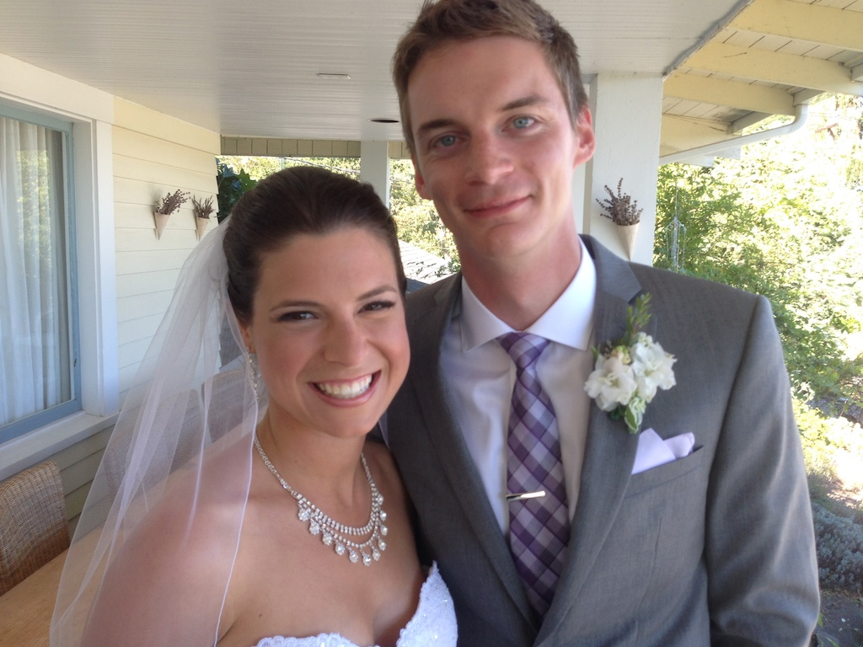
كارا وكيرت (28)
Notes:
Our oldest, Kurt, got married last September and shows a lot of discipline, actually

Slide 32
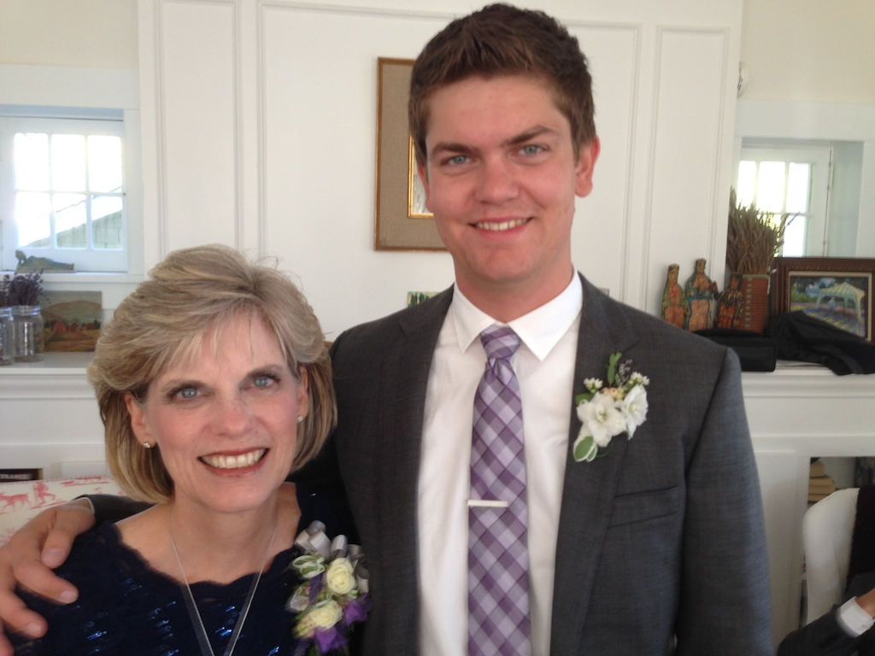
سوزان وستيفن (25)
Notes:
But this past week, our 25-year-old son Stephen is first officer who had to fly with a drunken 59-year-old pilot whom he had to wake up upon approach. When Susan commended him for counseling this man whose marriage was ending, he wrote, "That's how I was raised."

Slide 33
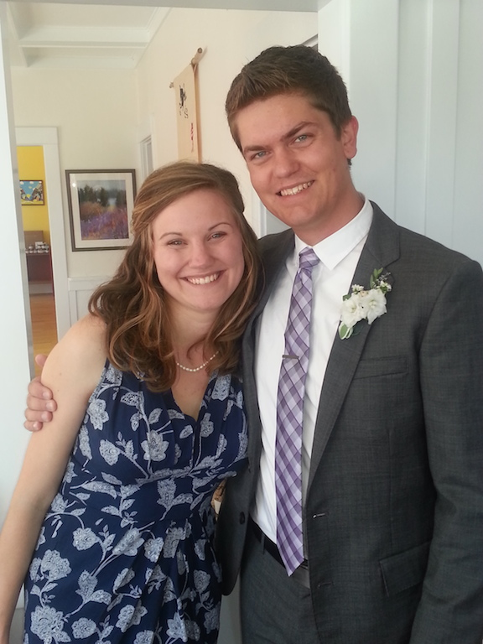
ستيفن وكيتي
Notes:
He will get married next month and we pray that he will respond well to God's discipline in his own life

Slide 34
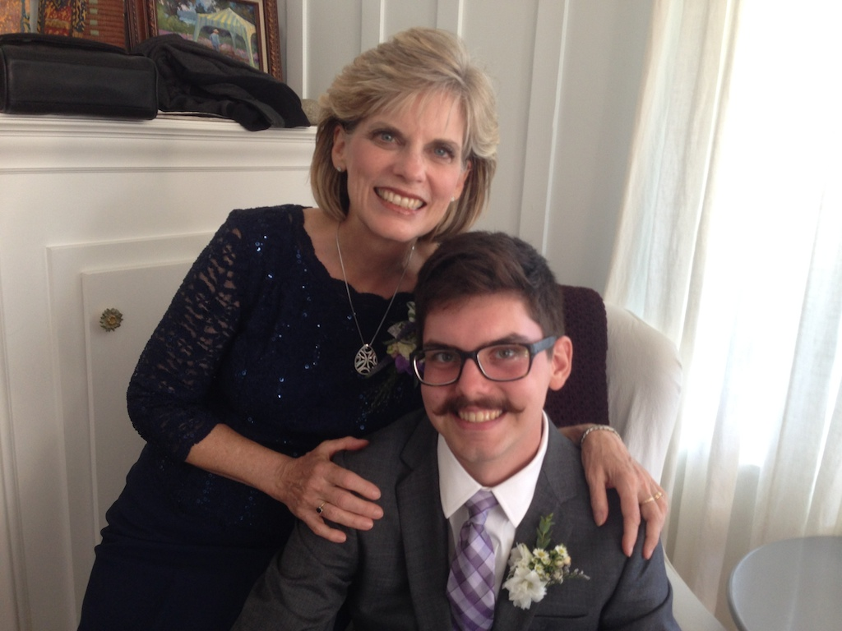
سوزان وجون (22)
Notes:
Our 22-year-old son John told me, "Dad, you weren't a perfect Dad" and then informed me of one of my major blunders when he was in fifth grade. But then he said, "But thank you for being a great Dad."

Slide 35
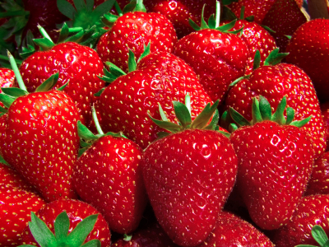
التأديب يعلمنا البر (12: 10-11)

Slide 36
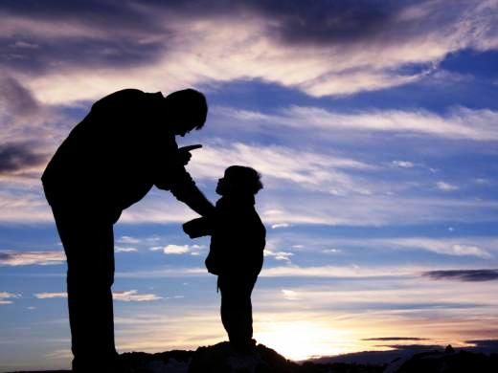
لأن أولئك أدبونا أياماً قليلة حسب استحسانهم، وأما هذا فلأجل المنفعة، لكي نشترك في قداسته. (12: 10)

Slide 37
ولكن كل تأديب في الحاضر لا يرى أنه للفرح بل للحزن، وأما أخيرا فيعطي الذين يتدربون به ثمر بر للسلام. (12: 11)

Slide 38
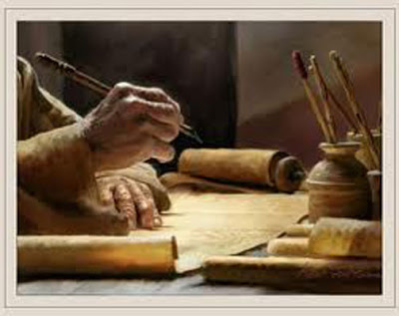
تحمل التأديب بشكل مناسب
Notes:
The Hebrews needed to endure difficulty without falling away. Perhaps they saw the very existence of trials as indicating that God wasn't with them.
However, the opposite was the case. They needed to see that God was trying to accomplish holiness in their lives through difficulty.

Slide 39
لماذا يجب أن نرحب بتأديب الله؟
Notes:
So why should we welcome God's discipline? We need to see that God wants to build in us his righteousness through discipline and difficulty. This will help us not say, "Thanks a lot for making my life difficult, God!" But besides holiness built in us, why else should we welcome discipline?

Slide 40
1. يؤكد التأديب أننا أولاد الله القديسون (12: 4-11)

Slide 41
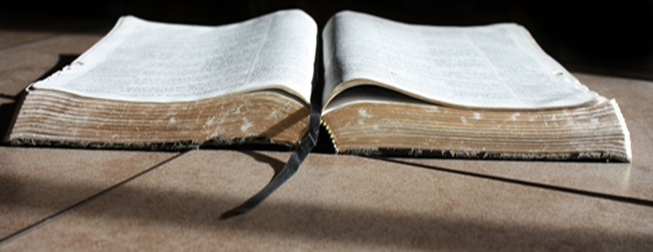
2. يقوي التأديب تصميمنا على طاعة الله. (12: 12-13)
Notes:
God's correction helps us better relate to him

Slide 42
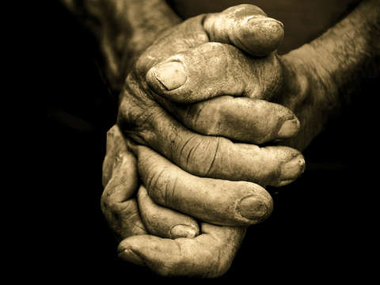
لذلك قوموا الأيادي المسترخية والركب المخلعة (12: 12)

Slide 43
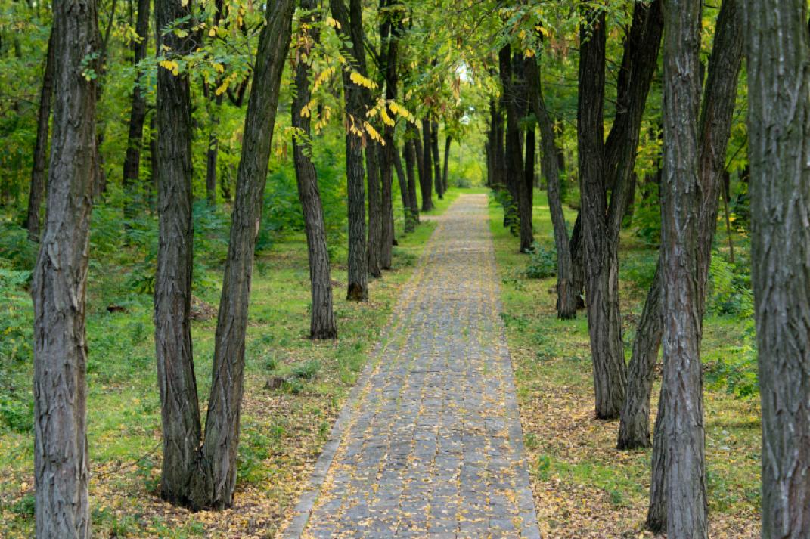
واصنعوا لأرجلكم مسالك مستقيمة ... (12: 13أ)

Slide 44
لكي لا يعتسف الأعرج، بل بالحري يشفى. (12: 13ب)

Slide 45
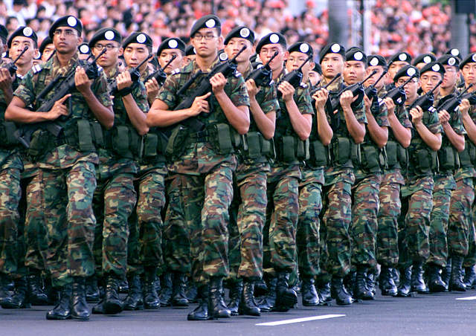
NS

Slide 46
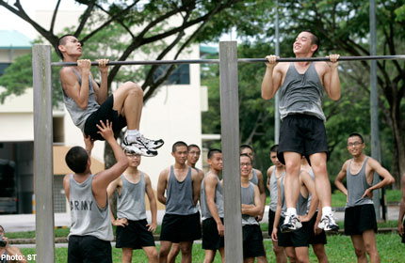
NS

Slide 47
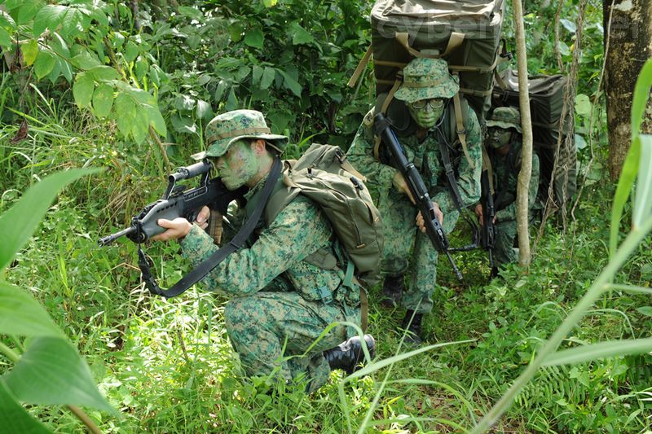
NS

Slide 48
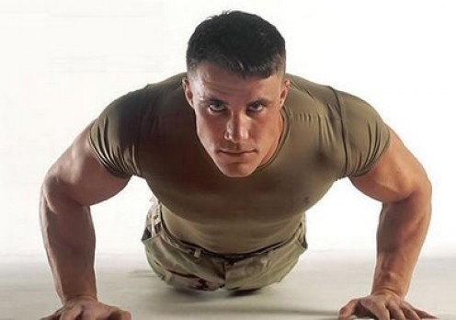
بناء الأجسام مع ريك. كوم

Slide 49
لماذا يجب أن نرحب بتأديب الله؟
Notes:
So why should we welcome God's discipline? We need to see that God wants to build in us his righteousness through discipline and difficulty. This will help us not say, "Thanks a lot for making my life difficult, God!" But besides holiness built in us, why else should we welcome discipline?

Slide 50
1. يؤكد التأديب أننا أولاد الله القديسون (12: 4-11)

Slide 51
2. يقوي التأديب تصميمنا على طاعة الله. (12: 12-13)

Slide 52
3. يقوي التأديب علاقاتنا (12: 14-17)
Notes:
God's correction helps us better relate to others

Slide 53
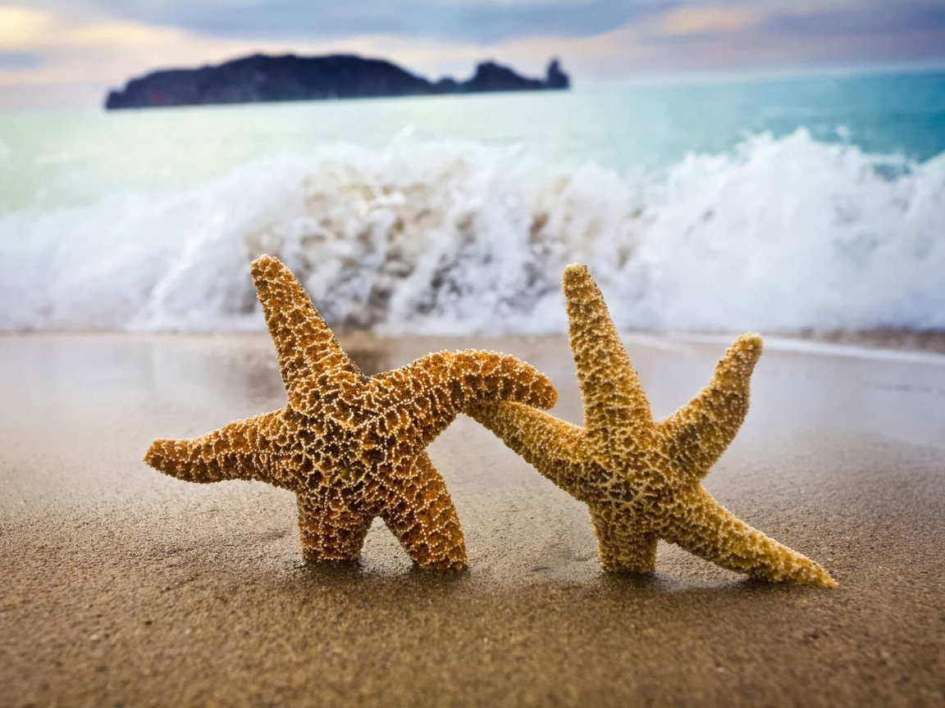
اتبعوا السلام مع الجميع، والقداسة التي بدونها لن يرى أحد الرب (12: 14)
Notes:
Peace with others is needed to be truly holy (12:14).

Slide 54
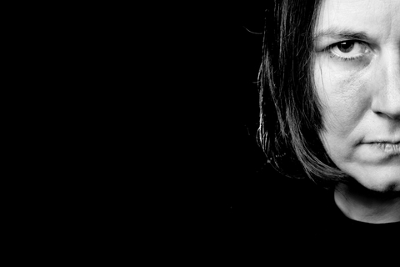
ملاحظين لئلا يخيب أحد من نعمة الله، لئلا يطلع أصل مرارة ويصنع انزعاجاً، فيتنجس به كثيرون. (12: 15)
Notes:
Holy relationships stop the spread of bitterness (12:15).

Slide 55
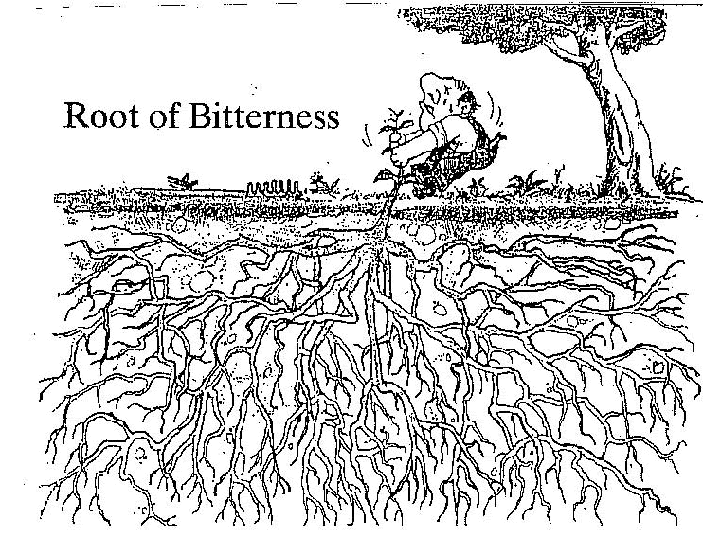
تنتشر المرارة من خلال جذور عميقة

Slide 56
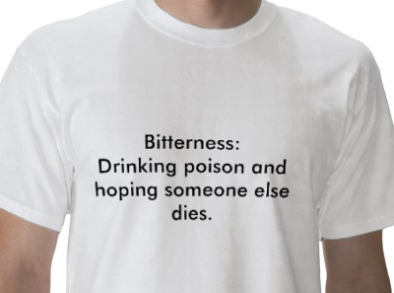
Definitin of Bitterness
Notes:
Holy relationships stop the spread of bitterness (12:15).

Slide 57
تدريب أغابي الدولي (1980)
Notes:
AIT (Agape International Training) was the three-month missionary training course that I endured at age 22. The thing I remember most was when they told us that the chief reason for missionaries returning from overseas was their inability to get along with other missionaries.
The goal was to train the 72 of us Campus Crusade staff members how to minister effectively cross-culturally in community. Since nearly all of us where middle-class, white Americans, the leaders reasoned that they should train us in a missionary-like environment within the USA.
So we were all shipped into the black community of downtown LA. We were, as far as I know, the only Caucasians that lived there. We attended African American churches, lived in run-down apartments or with black families, and stayed within this environment for three months.
Susan was paired with another white girls to do door-to-door evangelism. Most were shocked to find a young, white woman at their door to share the gospel! One older lady even told her and her friend, "Please come in! Last week four people were killed out on the sidewalk in a drive-by shooting."
I lived with three other men in an apartment. One night we went shopping and were driving back to our apartment and could see a helicopter circling overhead with its lights shining on a building below. As we got closer, we saw the road blocked off in front of our apartment. Pulling over, the police officer told us, "Sorry, you cannot pass through due to a shooting in the complex." But I told him, "But we aren't passing through. We live here!" I'll never forget the shock on his face!

Slide 58
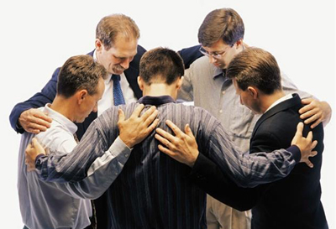
توقف العلاقات المقدسة انتشار المرارة (12: 15)
• مرارة
• زبدة
• أفضل
Notes:
Verse 15 reminds of us the “bitter, butter or better” principle.
When relational problems surface, we often get bitter towards others.
Some think the solution is just to be like butter—“Cut into me if you wish!”
Instead, we should be better! Become a better listener, better at compassion, or learn how to be a better friend.

Slide 59
16 لئلا يكون أحد زانياً أو مستبيحاً كعيسو، الذي لأجل أكلة واحدة باع بكوريته 17 فإنكم تعلمون أنه أيضاً بعد ذلك، لما أراد أن يرث البركة رفض، إذ لم يجد للتوبة مكاناً، مع أنه طلبها بدموع (12: 16-17)
Notes:
Immorality destroys relationships.
Godlessness destroys relationships.

Slide 60
لماذا يجب أن نرحب بتأديب الله؟
Notes:
So why should we welcome God's discipline? We need to see that God wants to build in us his righteousness through discipline and difficulty. This will help us not say, "Thanks a lot for making my life difficult, God!" But besides holiness built in us, why else should we welcome discipline?

Slide 61
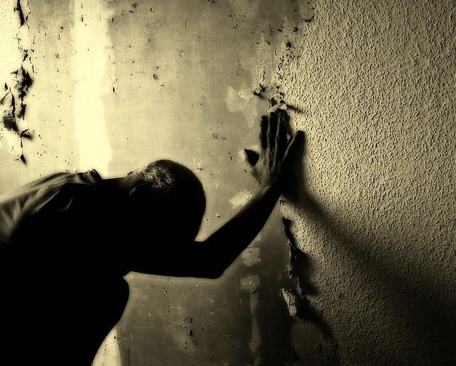
لا تحتقر تأديب الله لأجل فوائده الكثيرة
الفكرة الرئيسية في عبرانيين 12: 4-17

Slide 62
لماذا يجب أن نرحب بتأديب الله؟
Notes:
So why should we welcome God's discipline? We need to see that God wants to build in us his righteousness through discipline and difficulty. This will help us not say, "Thanks a lot for making my life difficult, God!" But besides holiness built in us, why else should we welcome discipline?

Slide 63
1. يؤكد التأديب أننا أولاد الله القديسون (12: 4-11)

Slide 64
2. يقوي التأديب تصميمنا على طاعة الله. (12: 12-13)

Slide 65
3. يقوي التأديب علاقاتنا (12: 14-17)

Slide 66
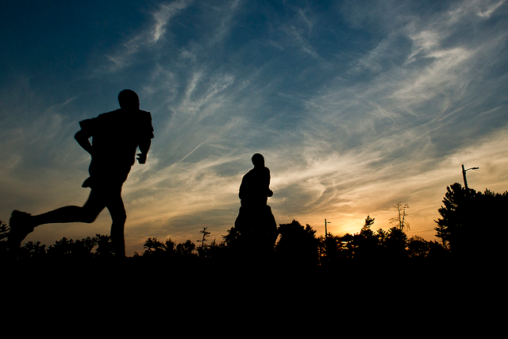
• كيف يؤكد الله هويتك كإبن له من خلال تأديبك الآن؟
تأديب الله
• كيف يمكنك تقوية قداستك وتصميمك وعلاقاتك؟
Notes:
How is God confirming your identity as his child by disciplining you right now?
• Have you thought that God has withdrawn his hand from you because things have gotten difficult?
• Or do you see that the Lord has been with you all along—correcting you because you are his precious son or daughter?
How can you strengthen your holiness, resolve and relationships?
• What area of holiness is the Lord speaking to you about right now?
• Have you asked God to give you that inner resolve that you need?
• Is your struggle leading to isolation and loneliness—or does it draw you into the circle of Christian friends? Let it do the latter. This will help you to become a channel of God's peace to others.

Slide 67
Black

Slide 68
على رابط وعظ العهد الجديد BibleStudyDownloads.org
أحصل على هذا العرض التقديمي والنص مجاناً

