Slide 1
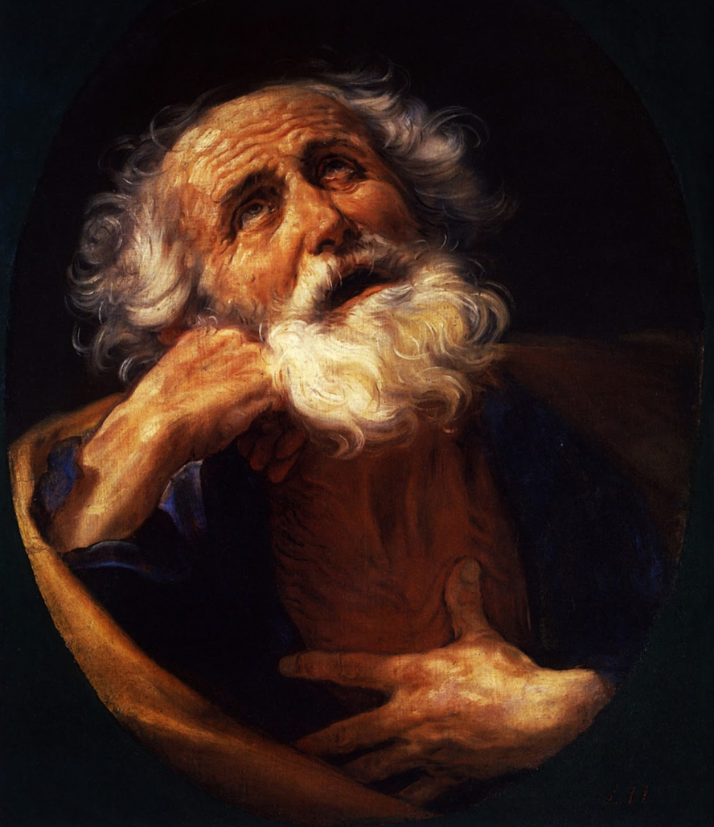
ما نعرفه هو ما يجب أن نفعله
٢بطرس ١: ١-١١
د. ريك جريفيث• مؤسسة الدراسات اللاهوتية الأردنية• BibleStudyDownloads.org

Slide 2

هل تريد
معرفة أكثر ؟
Notes:
Who here wants more knowledge? Raise your hand.

Slide 3

المعرفة 知识
Notes:
Students, what do you think of your education so far? Some students are just getting going, while for others, May (or graduation) can't come soon enough.

Slide 4
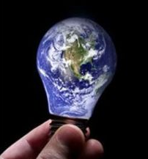
المعرفة لا نهائية
Notes:
We all know that knowledge is infinite.
This was made clear to me by one of my teachers. He told me, "We are giving you your PhD because we've educated you beyond your intelligence!"
In any case, people have various opinions about education.

Slide 5

كبرياء المعرفة
Notes:
Some love learning so they can hold their knowledge over others. If you're thinking about coming to seminary to show off your knowledge, you will be disappointed.

Slide 6
مناهض للتفكير
Notes:
Others are at the other end of the spectrum and are anti-intellectual, thinking that education is a waste of time. Well, I wouldn't encourage such people to come either!

Slide 7
287
بطرس 2
المشكلة
التعليم الكاذب
(البدع)
مصدر المشكلة
داخلي
الكلمة المفتاحية
“المعرفة"
(16 مرة)
التاريخ
بداية ربيع
64 م
Notes:
Peter avoids both of these extremes in 2 Peter. He wrote to his readers facing an internal problem of heresy, so he uses the words for "knowledge" 16 times in this short letter of three brief chapters—and he presents knowledge in a positive sense.

Slide 8
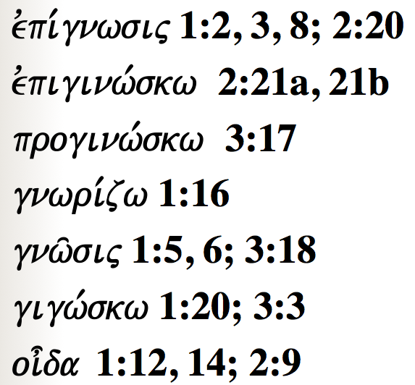
يستخدم بطرس العديد من الكلمات ليبين مدى أهمية المعرفة للمؤمنين ...
287
evpi,gnwsij 1:2, 3, 8; 2:20
evpiginw,skw 2:21a, 21b
proginw,skw 3:17
gnwri,zw 1:16
gnw/sij 1:5, 6; 3:18
gigw,skw 1:20; 3:3
oi=da 1:12, 14; 2:9
Notes:
Today we will see words for "knowledge" five times in the first 11 verses!

Slide 9
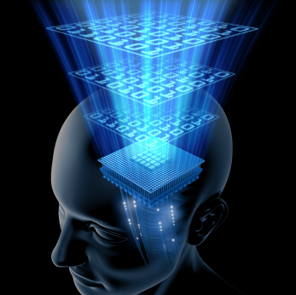
ما الذي
تحتاج أن
تعرفه بالحقيقة ؟
Notes:
However, while knowledge is important, we can't learn everything—so what do you really need to know? What'll be on the test?

Slide 10

ما الذي
تحتاج أن
تعرفه بالحقيقة ؟
Notes:
When you consider how many things there are to know, it can be daunting. You probably came to seminary to get answers to your questions, but now your list of questions has grown! So what are the essentials that we really need to know?
You've come to the right place because Peter has an answer for you in today's text.

Slide 11
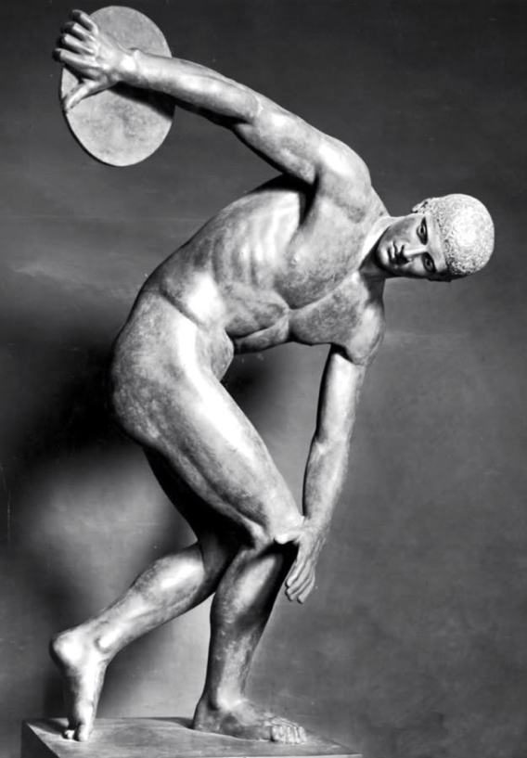
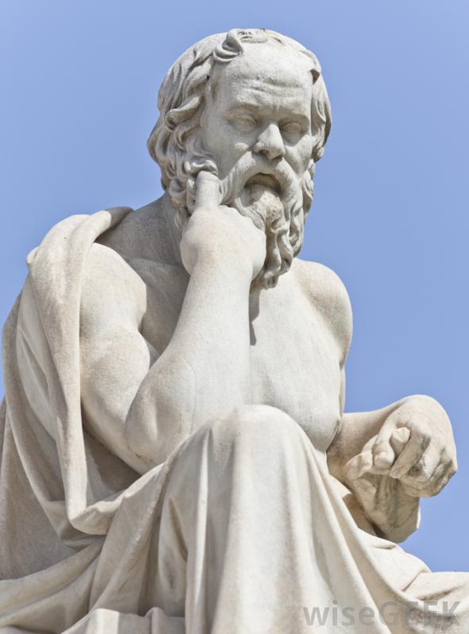
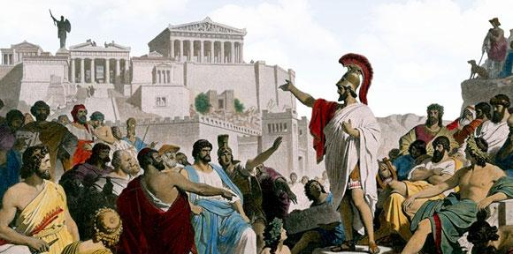
الأفكار اليونانية
Notes:
Greeks sought ideals perhaps more than any society at that time—looking for the perfect society (deemed to be Greek democracy), the perfect mind (thought to be Greek philosophy), and the perfect body (thus the Greek Olympics).

Slide 12

المعرفة الكاملة
Notes:
In this context, Peter gives the divinely inspired version of perfect knowledge based on Jesus Christ.

Slide 13

ما الذي
نحتاج
أن نعرفه ؟
ما الذي
نحتاج
أن نفعله ؟
٢بطرس ١: ١-١١
Notes:
Today we'll see the knowledge that God gives you, and then what we should do with that knowledge. The title of this message is "What to Know, What to Do." These are our two main points. What we need to know—and then do—are in the first eleven verses of 2 Peter.

Slide 14
ما الذي
نحتاج
أن نعرفه ؟
Notes:
So, first, know that…

Slide 15
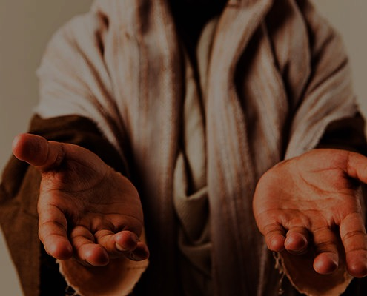
1. أنت كامل
في المسيح
الذي هو الله
(1: 1-4)
Notes:
God gives you all you need in your knowledge and faith in Jesus as deity.

Slide 16
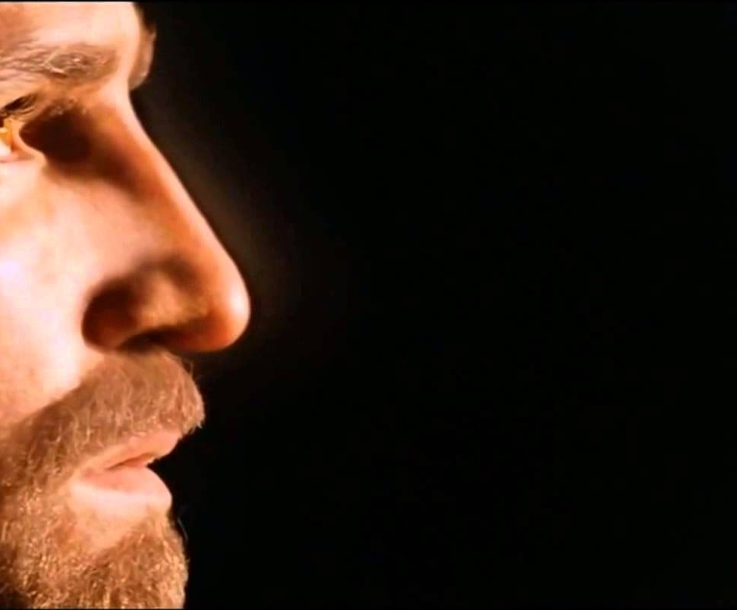
1. أعطاك الله نفس الإيمان كما أعطى الرسل بسبب ألوهية المسيح
أنت كامل في المسيح كالله (1: 1-4)

Slide 17

٢بطرس ١ : ١
سِمْعَانُ بُطْرُسُ عَبْدُ يَسُوعَ الْمَسِيحِ وَرَسُولُهُ، إِلَى الَّذِينَ نَالُوا مَعَنَا إِيمَاناً ثَمِيناً مُسَاوِياً لَنَا، بِبِرِّ إِلَهِنَا وَالْمُخَلِّصِ يَسُوعَ الْمَسِيحِ.
Notes:
Peter notes that his readers had the same faith as "ours" (1a).
There is a great sense of humility here where the great apostle puts himself on the same level as his meek readers.
In this pre-Gnostic world, teachers prided themselves with their privileged, so-called "secret knowledge."
Yet Peter says the righteousness provided by Jesus Christ gives us all the "same faith"! Wow!
The phrase "our God and Savior" also teaches Christ's deity (1b).
"The grammar here clearly indicates that 'God and Savior' are one Person, not two (i.e., there is one Gr. article with two substantives). This passage ranks with the great Christological passages of the New Testament which plainly teach that Jesus Christ is coequal in nature with God the Father" (Gangel, BKC, 2:863-64).
We need to understand that our faith is in Jesus as God, not just some teacher of knowledge.

Slide 18
1. أعطاك الله نفس الإيمان كما أعطى الرسل بسبب ألوهية المسيح
أنت كامل في المسيح كالله (1: 1-4)
2. أظهر لنا الله شخص المسيح للنعمة و السلام

Slide 19
٢بطرس ١ : ٢
لِتَكْثُرْ لَكُمُ النِّعْمَةُ وَالسَّلاَمُ بِمَعْرِفَةِ اللَّهِ وَيَسُوعَ رَبِّنَا.
Notes:
God shows us Christ's person for grace and peace (2).
The word for "knowledge" here implies an intimate, personal relationship.
We need to know that grace is in Christ (2a).
We need to know that Christ alone gives us peace (2b).

Slide 20
1. أعطاك الله نفس الإيمان كما أعطى الرسل بسبب ألوهية المسيح
أنت كامل في المسيح كالله (1: 1-4)
2. أظهر لنا الله شخص المسيح للنعمة و السلام
3. يعطيك الله قوة المسيح لعيش حياة تقية

Slide 21
٢بطرس ١ : ٣
كَمَا أَنَّ قُدْرَتَهُ الإِلَهِيَّةَ قَدْ وَهَبَتْ لَنَا كُلَّ مَا هُوَ لِلْحَيَاةِ وَالتَّقْوَى، بِمَعْرِفَةِ الَّذِي دَعَانَا بِالْمَجْدِ وَالْفَضِيلَةِ،
Notes:
God gives you Christ's power to live a godly life (3).
Too often we think that we're missing some great secret to godliness.
Peter says that we already have all we need!
If we already have everything we need for a godly life (3), then why does Peter wish his readers more grace and peace (2)?
Evidently we don't apply or access all that God has in store for us!

Slide 22
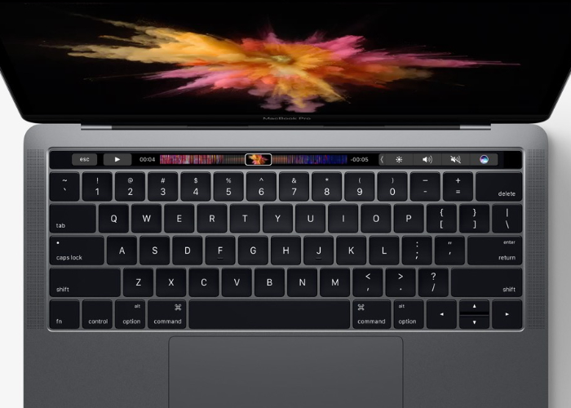
الحاسوب
Notes:
We are like a computer that has immense capabilities, but the user doesn't know how to use them.

Slide 23
1. أعطاك الله نفس الإيمان كما أعطى الرسل بسبب ألوهية المسيح
أنت كامل في المسيح كالله (1: 1-4)
2. أظهر لنا الله شخص المسيح للنعمة و السلام
3. يعطيك الله قوة المسيح لعيش حياة تقية
4. يعطيك الله وعود المسيح لعيش حياة تقية

Slide 24
٢بطرس ١ : ٤
اللَّذَيْنِ بِهِمَا قَدْ وَهَبَ لَنَا الْمَوَاعِيدَ الْعُظْمَى وَالثَّمِينَةَ لِكَيْ تَصِيرُوا بِهَا شُرَكَاءَ الطَّبِيعَةِ الإِلَهِيَّةِ، هَارِبِينَ مِنَ الْفَسَادِ الَّذِي فِي الْعَالَمِ بِالشَّهْوَةِ.
Notes:
God gives you Christ's promises to live a godly life (4).
What specific promises does God give to help us be like Christ (4)?

Slide 25

خمسة وعود
      1. لدينا كل ما نحتاج إليه لعيش حياة تقية (3)
      2. نشارك في طبيعته الإلهية حتى نصير في النهاية شبه المسيح (4ب)
      3. يمكننا أن نهرب من أي خطية (4ت)
      4. نحن مختارون و موعودون بالخلاص (10)
      5. إذا كنا ثابتين في شخصياتنا فسوف نكافأ بسخاء (10-11)

Slide 26
1. أنت كامل
في المسيح
الذي هو الله
(1: 1-4)
Notes:
So what do you really need to know about Christ? Verses 1-4 tell us what God has done—We need to know that Christ’s deity makes us complete in Him. Our faith in his person gives us power and promises. But what do we do with this knowledge? We need to…

Slide 27
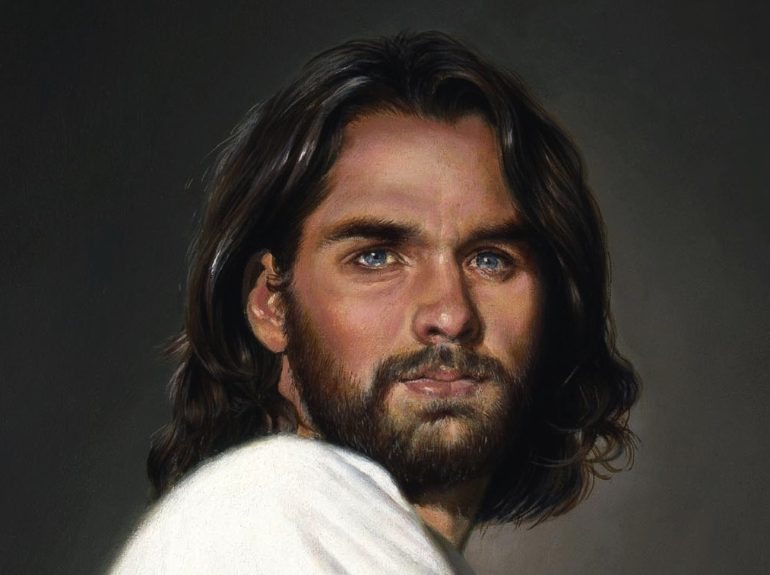
2. كن شبه المسيح بشكل متزايد
(1: 5-11)
Notes:
Use your knowledge to grow in Christ-likeness.

Slide 28


إنمو في
التشبه بالمسيح
خطوة تلو الأخرى
(1: 5-7)

Slide 29
٢بطرس ١ : ٥
وَلِهَذَا عَيْنِهِ وَأَنْتُمْ بَاذِلُونَ كُلَّ اجْتِهَادٍ قَدِّمُوا فِي إِيمَانِكُمْ فَضِيلَةً، وَفِي الْفَضِيلَةِ مَعْرِفَةً،

Slide 30
٢بطرس ١ : ٦
وَفِي الْمَعْرِفَةِ تَعَفُّفاً، وَفِي التَّعَفُّفِ صَبْراً، وَفِي الصَّبْرِ تَقْوَى،

Slide 31
٢بطرس ١ : ٧
وَفِي التَّقْوَى مَوَدَّةً أَخَوِيَّةً، وَفِي الْمَوَدَّةِ الأَخَوِيَّةِ مَحَبَّةً.

Slide 32
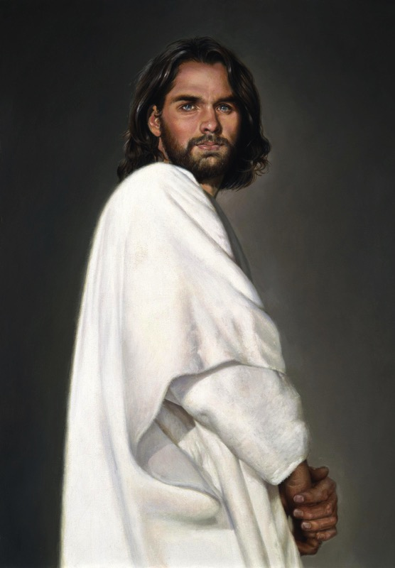
بطرس 2 1
حياة مسيحية فعالة و مثمرة
(1: 5-7)
289
نقاء و تشبه بالمسيح
(شركاء الطبيعة الإلهية)
عدد 4
محبة
مودة أخوية
تقوى
صبر
تعفف
معرفة
فضيلة
إيمان
Notes:
Faith in Christ justifies us and starts our growth in character (5a).
Goodness (moral excellence) results from sins forgiven (5b).
Knowledge helps our goodness expand (5c).
Self-control comes from knowing Christ's own self-control (6a).
Perseverance is self-control over the long haul (6b).
Godliness results from persevering over the long haul (6c).
Brotherly kindness results since godliness is relational (7a).
Love is the climax as the highest character trait (7b).
These traits explain how we should show the divine nature in verse 4.

Slide 33
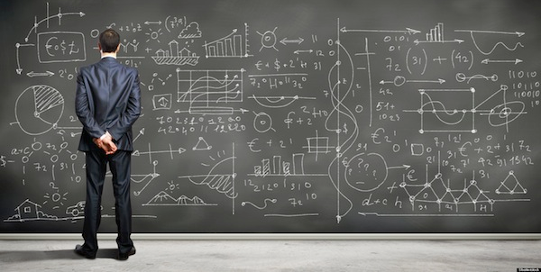
لا ننمو دائماً في التشبه بالمسيح (1: 8-9)

Slide 34
٢بطرس ١ : ٨
لأَنَّ هَذِهِ إِذَا كَانَتْ فِيكُمْ وَكَثُرَتْ، تُصَيِّرُكُمْ لاَ مُتَكَاسِلِينَ وَلاَ غَيْرَ مُثْمِرِينَ لِمَعْرِفَةِ رَبِّنَا يَسُوعَ الْمَسِيحِ.
Notes:
Some believers continue to grow and become more effective (8).

Slide 35
٢بطرس ١ : ٩
لأَنَّ الَّذِي لَيْسَ عِنْدَهُ هَذِهِ هُوَ أَعْمَى قَصِيرُ الْبَصَرِ، قَدْ نَسِيَ تَطْهِيرَ خَطَايَاهُ السَّالِفَةِ.
Notes:
Others stop character growth by forgetting they're forgiven (9).
In fact, most of the NT addresses believers who are not living up to God's standards. This is why God moved authors like Peter and Paul and James and others to write!

Slide 36
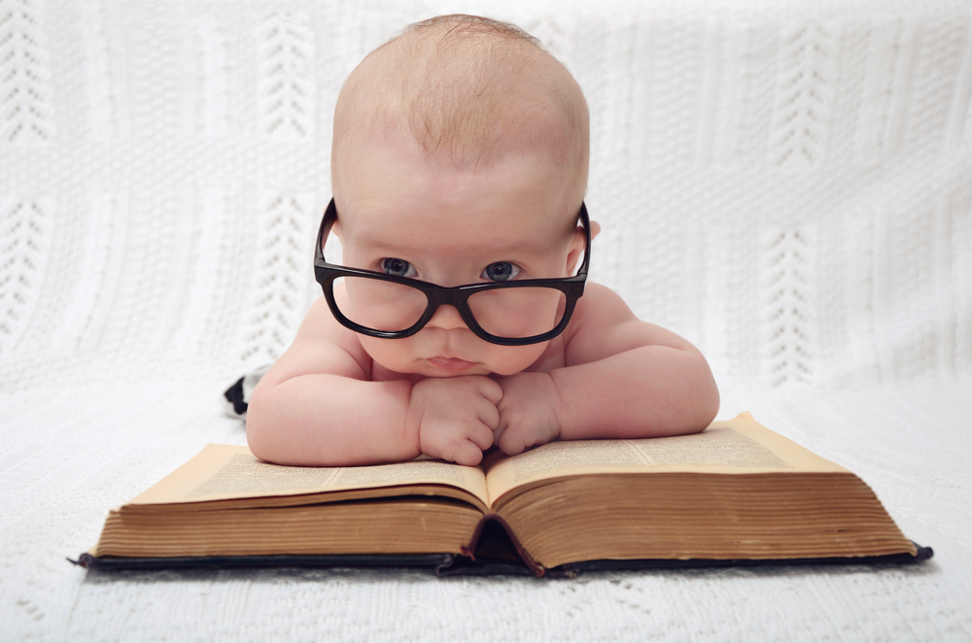
المعرفة 知识
Notes:
At chapel in my first year of seminary one student saw another student sitting by himself and exclaimed, "Wow! Look at that! A guy reading his Bible! Must be a first-year student!" Everyone laughed—sadly.

Slide 37

طالب
السنة الأولى
طالب
السنة الأخيرة
معرفة كاملة
دون حماس
حماس كامل
دون معرفة
Notes:
That same year, a friend asked me, "Do you know how to tell the difference between a first-year student and a final-year student?" I didn't know. So he said, "The first-year student is all zeal, no knowledge. The final-year student is all knowledge, no zeal."

Slide 38
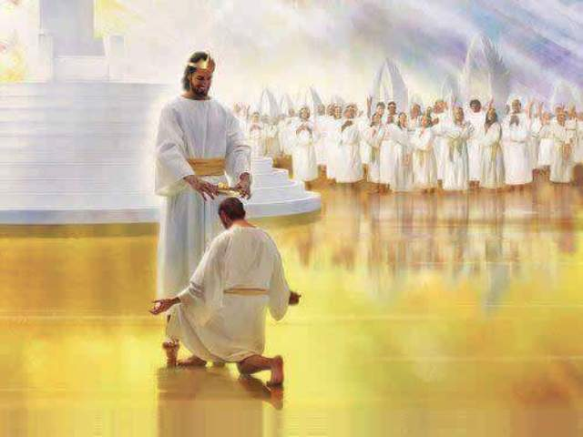
عندما نعمل بجد
سوف نكافأ
بدلاً من أن نسقط
(1: 10-11)

Slide 39
٢بطرس ١ : ١٠
لِذَلِكَ بِالأَكْثَرِ اجْتَهِدُوا أَيُّهَا الإِخْوَةُ أَنْ تَجْعَلُوا دَعْوَتَكُمْ وَاخْتِيَارَكُمْ ثَابِتَيْنِ. لأَنَّكُمْ إِذَا فَعَلْتُمْ ذَلِكَ لَنْ تَزِلُّوا أَبَداً.
Notes:
When we work hard to show we're saved, we won't fall away (10).
Does "make your calling and election sure" (10) mean that we can add anything to Christ's work to be saved? No. It means we should live consistent with that salvation.
The NLT captures the idea well: "Work hard to prove that you really are among those God has called and chosen." When you seek to be more like Christ, you won't fall back. Instead…

Slide 40
٢بطرس ١ : ١١
لأَنَّهُ هَكَذَا يُقَدَّمُ لَكُمْ بِسِعَةٍ دُخُولٌ إِلَى مَلَكُوتِ رَبِّنَا وَمُخَلِّصِنَا يَسُوعَ الْمَسِيحِ الأَبَدِيِّ.
Notes:
God will reward us when we live consistent to our calling (11).
Does receiving "a rich welcome into the eternal kingdom…" refer to a person as being saved (11)?
No, this refers to being fully rewarded like the person in verse 8 who keeps growing in character.
It means you do not "fall" (10b) like the person in verse 9 who has forgotten about his forgiveness.

Slide 41
ما الذي
نحتاج
أن نعرفه ؟
ما الذي
نحتاج
أن نفعله ؟
Notes:
So what do you really need to know? And, more importantly, what do you do with this knowledge?

Slide 42
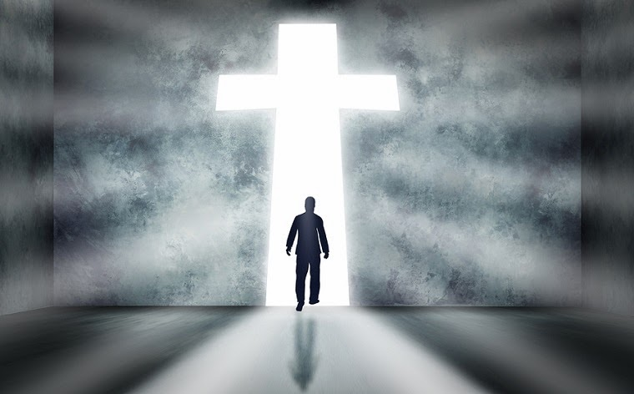
الفكرة الرئيسية في 2 بطرس 1: 1-11
اعلم أنك
كامل في المسيح لتصير أكثر شبهاً بالمسيح
Notes:
Have your knowledge of Christ lead you to be Christ-like (restated MI).

Slide 43
1. أنت كامل
في المسيح
الذي هو الله
(1: 1-4)
Notes:
God gives you all you need in your knowledge and faith in Jesus as deity.

Slide 44
2. كن شبه المسيح بشكل متزايد
(1: 5-11)
Notes:
Use your knowledge to grow in Christ-likeness.

Slide 45
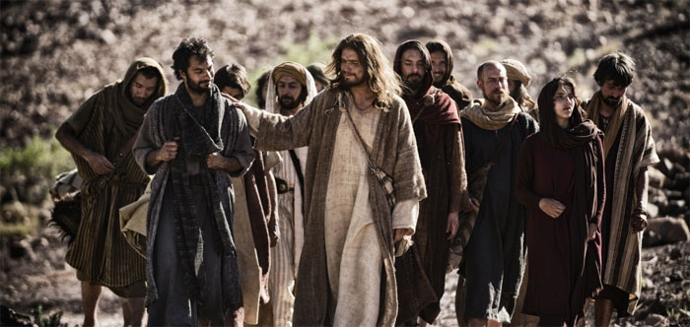
ما الذي تحتاج أن تعرفه أو تفعله ؟
افعل ؟
اعرف ؟
Notes:
Now what do you need to know or do?
How can you better know Christ?
• Do you need to grasp Christ's person, power or promises most (2-4)?
How can you do this?
• How can you better imitate Christ?
Are you more like Jesus this year than last year?
How will you be more like Christ next year?
Which quality in verses 5-7 do you need to imitate? How?

Slide 46
Black

Slide 47


عظات العهد الجديد at BibleStudyDownloads.org
أحصل على العرض التقديمي و النص مجاناً

