Slide 1
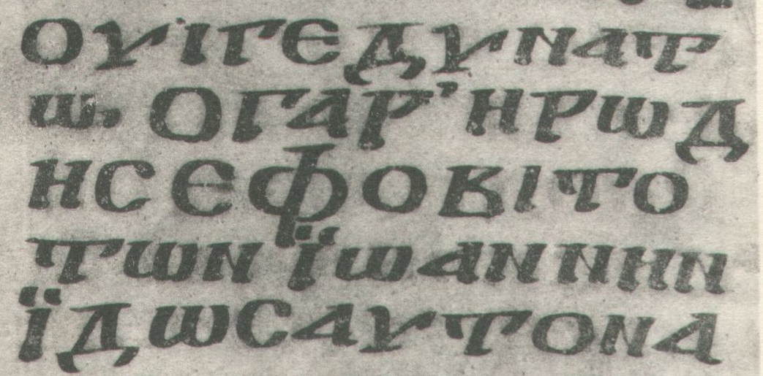
أنواع نصوص العهد الجديد
د. ريك جريفيث • مؤسسة الدراسات اللاهوتية الأردنية • BibleStudyDownloads.org

Slide 2

3 أنواع من نصوص المخطوطات
الغربية
90
البيزنطية
الإسكندرية
Notes:
The NT manuscripts of the early centuries of the church were copied in three main regions:
Rome gave us the Western text type which has many manuscripts from the 8th-10th centuries, supported by the Roman Catholic church.
The city of Constantinople became the capital of the Eastern Orthodox church with its Byzantine manuscripts (or majority text, since they copied so many of them). While considerably varying, it also underlies the Textus Receptus Greek text used for most Reformation-era translations of the New Testament into vernacular languages, and
A large community of Christians gathered in Alexandria, Egypt. This Alexandrian texts were the earliest, going back to about AD 200. Modern translations mainly use Eclectic editions that conform more often to the Alexandrian text-type.

Slide 3
الغربية
90
البيزنطية
روما
الروم الكاثوليك
600-800 م
مئات المخطوطات
القسطنطينية
الأرثوذكس الشرقيون
800-1400 م
النص الماسوري سنة 1000 (نص الأغلبية
النص المستقبل
الإسكندرية، مصر
طبعات انتقائية
200-800 م
عشرات النسخ الماسورية
^{ب66}
الإسكندرية
Notes:
The NT manuscripts of the early centuries of the church were copied in three main regions:
Rome gave us the Western text type which has many manuscripts from the 8th-10th centuries, supported by the Roman Catholic church.
The city of Constantinople became the capital of the Eastern Orthodox church with its Byzantine manuscripts (or majority text, since they copied so many of them). While considerably varying, it also underlies the Textus Receptus Greek text used for most Reformation-era translations of the New Testament into vernacular languages, and
A large community of Christians gathered in Alexandria, Egypt. This Alexandrian texts were the earliest, going back to about AD 200. Modern translations mainly use Eclectic editions that conform more often to the Alexandrian text-type.

Slide 4
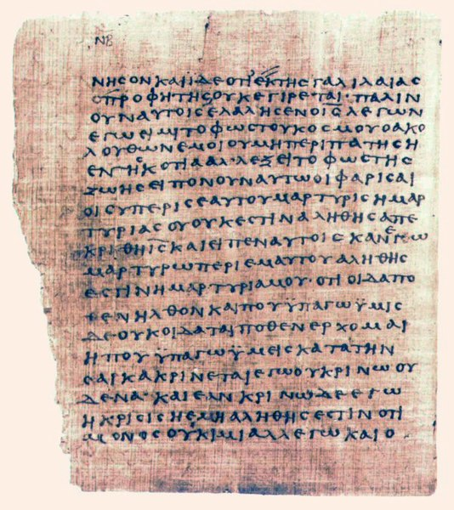
البردي 66
البردية 66 (يشار إليها أيضًا بـ 𝔓66) هي مخطوطة شبه كاملة لإنجيل يوحنا وجزء من المجموعة المعروفة باسم برديات بودمر.
Notes:
Papyrus 66 (also referred to as 𝔓⁶⁶) is a near complete codex of the Gospel of John, and part of the collection known as the Bodmer Papyri.
Description
The first page of the papyrus, showing John 1:1-13 and the opening words of v.14
The manuscript contains John 1:1–6:11, 6:35b–14:26, 29–30; 15:2–26; 16:2–4, 6–7; 16:10–20:20, 22–23; 20:25–21:9, 12, 17. It is one of the oldest well-preserved New Testament manuscripts known to exist. Its original editor assigned the codex to the early third century, or around AD 200, on the basis of its style of handwriting.^{[1]} Herbert Hunger later claimed that the handwriting should be dated to an earlier period in the middle or early part of the second century.^{[2]} More recently, Brent Nongbri has produced a broader study of the codex and argued that when one takes into consideration the format, construction techniques, and provenance of the codex along with the handwriting, it is more reasonable to conclude that the codex was produced "in the early or middle part of the fourth century."^{[3]} In common with both the other surviving early papyri of John's Gospel – P⁴⁵ (apparently), P⁷⁵, and most New Testament uncials – Papyrus 66 does not include the pericope of the adulteress (7:53-8:11),^{[4]} demonstrating the absence of this passage in all the surviving early witnesses of the Gospel of John. The manuscript also contains, consistently, the use of Nomina Sacra.

Slide 5
ماذا عن مرقس 16: 9-20 ؟
غربية
90
بيزنطية
الكل يحتوي على مر 16: 9-20
مخطوطات كثيرة
ما عدا القرن 5-7
الكل يحتوي على مر 16: 9-20
مخطوطات كثيرة
ما عدا القرن 9-15
البعض ألغى 16: 9-20
فقط 5 مخطوطات
القرن الرابع احتواها
القرن 5-9 استثناها
اسكندرية
Notes:
The NT manuscripts of the early centuries of the church were copied in three main regions:
Rome gave us the Western text type which has many manuscripts from the 8th-10th centuries, supported by the Roman Catholic church.
The city of Constantinople became the capital of the Eastern Orthodox church with its Byzantine manuscripts (or majority text, since they copied so many of them). While considerably varying, it also underlies the Textus Receptus Greek text used for most Reformation-era translations of the New Testament into vernacular languages, and
A large community of Christians gathered in Alexandria, Egypt. This Alexandrian texts were the earliest, going back to about AD 200. Modern translations mainly use Eclectic editions that conform more often to the Alexandrian text-type.

Slide 6
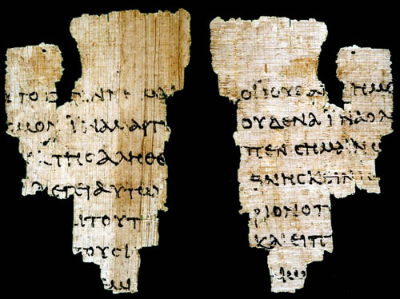
المخطوطات مقابل الأجزاء
Notes:
Manuscripts are full or nearly-full hand-written copies.
Fragments typically have enough text to know what document comprised the original.

Slide 7
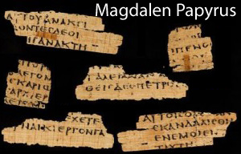
برديات مجدل
(من المحتمل أن تكون من القرن الثاني الميلادي)
متى 26: 23 و31
Notes:
Wikipedia:
The "Magdalen" papyrus was purchased in Luxor, Egypt in 1901 by Reverend Charles Bousfield Huleatt (1863–1908), who identified the Greek fragments as portions of the Gospel of Matthew (Chapter 26:23 and 31) and presented them to Magdalen College, Oxford, where they are catalogued as P. Magdalen Greek 17 (Gregory-Aland 𝔓⁶⁴) and whence they have their name. When the fragments were finally published by Colin Henderson Roberts in 1953, illustrated with a photograph, the hand was characterized as "an early predecessor of the so-called 'Biblical Uncial'" which began to emerge towards the end of the 2nd century. The uncial style is epitomised by the later biblical Codex Vaticanus and Codex Sinaiticus. Comparative paleographical analysis has remained the methodological key for dating the manuscript, but there is no consensus on the dating of the papyrus. Estimates have ranged from the 1st century to the 4th century AD.
The fragments are written on both sides, indicating they came from a codex rather than a scroll. More fragments, published in 1956 by Ramon Roca-Puig, cataloged as P. Barc. Inv. 1 (Gregory-Aland 𝔓⁶⁷), were determined by Roca-Puig and Roberts to come from the same codex as the Magdalen fragments, a view which has remained the scholarly consensus.
Date
𝔓⁶⁴ was originally given a 3rd-century date by Charles Huleatt, who donated the Manuscript to Magdalen College. Papyrologist A. S. Hunt then studied the manuscript and dated it to the early 4th century. After initially preferring a 3rd or possibly 4th century dating for the papyrus, Colin Roberts published the manuscript and gave it a dating of c. 200, which was confirmed by three other leading papyrologists: Harold Bell, T. C. Skeat and E. G. Turner.^{[1]} In late 1994, Carsten Peter Thiede proposed redating the Magdalen papyrus to the middle of the 1st century (AD 37 to 70). This attracted considerable publicity, as journalists interpreted the claim optimistically. Thiede's official article appeared in Zeitschrift für Papyrologie und Epigraphik in 1995. A version edited for the layman was co-written with Matthew d'Ancona and presented as The Jesus Papyrus, Weidenfeld & Nicolson, London, 1996. (also published as: Eyewitness to Jesus, 1996, New York: Doubleday). Thiede's redating of the papyrus was based on comparative analysis of the script with selected samples from Egypt and Palestine. He claimed to see similarities between the script of the Magdalen papyrus and that of dated documents from the 1st century CE, such as P.Oxy. II 246 (66 CE). Thiede's hypothesis has been viewed with scepticism by nearly all established papyrologists and biblical scholars.^{[2]}
Philip Comfort and David Barret in their book Text of the Earliest NT Greek Manuscripts argue for a more general date of 150–175 for the manuscript, and also for 𝔓⁴ and 𝔓⁶⁷, which they argue came from the same codex. 𝔓⁴ was used as stuffing for the binding of “a codex of Philo, written in the later 3rd century and found in a jar which had been walled up in a house at Coptos [in 250].”^{[3]} If 𝔓⁴ was part of this codex, then the codex may have been written roughly 100 years prior or earlier.^{[4]} Comfort and Barret also show that this 𝔓^{4/64/67} has affinities with a number of the late 2nd-century papyri.^{[5]}
Magdalen Papyrus
Comfort and Barret "tend to claim an earlier date for many manuscripts included in their volume than might be allowed by other palaeographers."^{[6]} The Novum Testamentum Graece, a standard reference for the Greek witnesses, lists 𝔓⁴ and 𝔓^{64/67} separately, giving the former a date of the 3rd century, while the latter is assigned c. 200.^{[7]} Charlesworth has concluded 'that 𝔓⁶⁴⁺⁶⁷ and 𝔓⁴, though written by the same scribe, are not from the same ... codex.'^{[8]} The most recent and thorough palaeographic assessment of the papyrus concluded that "until further evidence is forthcoming perhaps a date from mid-II to mid-IV should be assigned to the codex."^{[9]}

Slide 8
مؤشرات أن متى هو كاتب الإنجيل الأول
78أ
Notes:
NS-01-Gospels-37
NS-01-Matt1-14-slide 118
NS-04-John1-12-slide 29

Slide 9
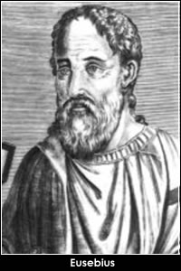
المؤشر الخارجي رقم 1
شهادة يوسابيوس (القرن الرابع)
78أ
من بين الأناجيل الأربعة وهي الأناجيل الوحيدة التي لا جدال فيها في كنيسة الله تحت السماء، تعلمت بالتقليد (من القرن الثاني، أوريجانوس) أن أول الأناجيل كتبه متى الذي كان يوماً ما عشاراً ولكن بعد ذلك رسول ليسوع المسيح، وقد تم إعداده للمتحولين عن اليهودية ونشر باللغة العبرية.
(يقتبس يوسابيوس
من أوريجانوس
في القرن الثاني)

Slide 10
المؤشر الخارجي رقم 1
شهادة يوسابيوس (القرن الرابع)
78أ
الثاني هو مرقس الذي ألفه وفقاً لتعليمات بطرس الذي في رسالته الكاثوليكية (أي العامة) يعترف به باعتباره ابناً قائلاً: الكنيسة التي في بابل المنتخبة معكم تسلم عليكم، وكذلك مرقس ابني . والثالث من لوقا حيث مدح هذا الإنجيل من قبل بولس وقد ألَّفه للمتحولين من الأمم وآخر ذلك كله بواسطة يوحنا.
(يقتبس يوسابيوس
من أوريجانوس
في القرن الثاني)

Slide 11
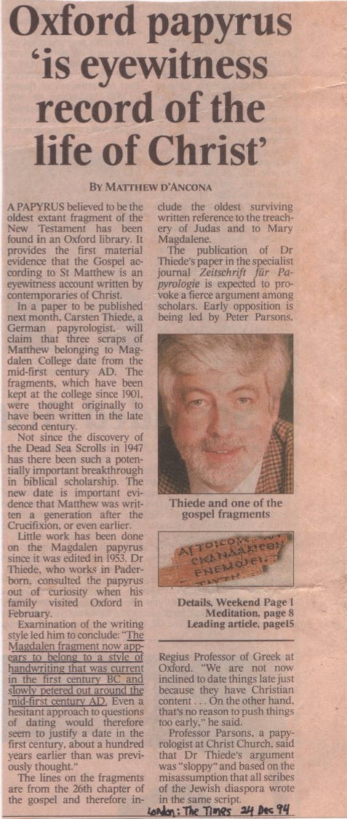
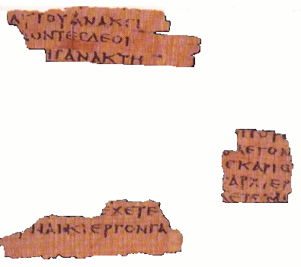
المؤشر الخارجي رقم 2
ورقة بردي من حوالي 50م
78أ
يبدو أن الجزء المجدلي الآن ينتمي إلى أسلوب الكتابة اليدوية الذي كان سائداً في القرن الأول قبل الميلاد وتلاشى ببطء في منتصف القرن الأول الميلادي
(د. كارستن ثيد)

Slide 12
Black

Slide 13


الرابط للعرض التقديميِّ "دراساتٌ نقديَّةٌ في العهد الجديد" متاحٌ على الموقع الإلكترونيّ:
BibleStudyDownloads.org
أحصل على هذا العرض التقديمي مجاناً
Notes:
NC NT Criticism (nc) Arabic
_____________
Common-32

